Slide 1






PSD14, 31 August - 3 September, 2026, Queen Mary University of London, UK
Self-quenching of 3D trench detectors: Geometry driven gain & fast timing
CERN-DRD3 WP2 project:
Novel silicon 3D-trench pixel detectors based on 8-inch CMOS process (IME)
G. Laštovička-Medin,ª G. Kramberger,^{b} , I. Mandić, ^{b} H. Ji,^{c} M. Liu,^{c} Z. Li,^{c} J. Lu,^{c} Z.Li,^{d} and M. Rebarz^{e}
ªFaculty of Natural Sciences and Mathematics, University of Montenegro, Dzordza Vashingtona bb,, 81000, Podgorica, Montenegro,
^{b}Jozef Stefan Institute, Jamova cesta 39, 10 000 Ljubljana, Slovenia
^{c}Institute of Microelectronics of the Chinese Academy of Sciences ,3 Beitucheng West Road, Chaoyang District, Beijing, China
^{d}The School of Integrated Circuits, Ludong University, Yantai 264025, China
^{e}ELI Beamlines Facility, The Extreme Light Infrastructure ERIC, Za Radnicí 835, 25241 Dolní Břežany, Czech Republic
.

Slide 2
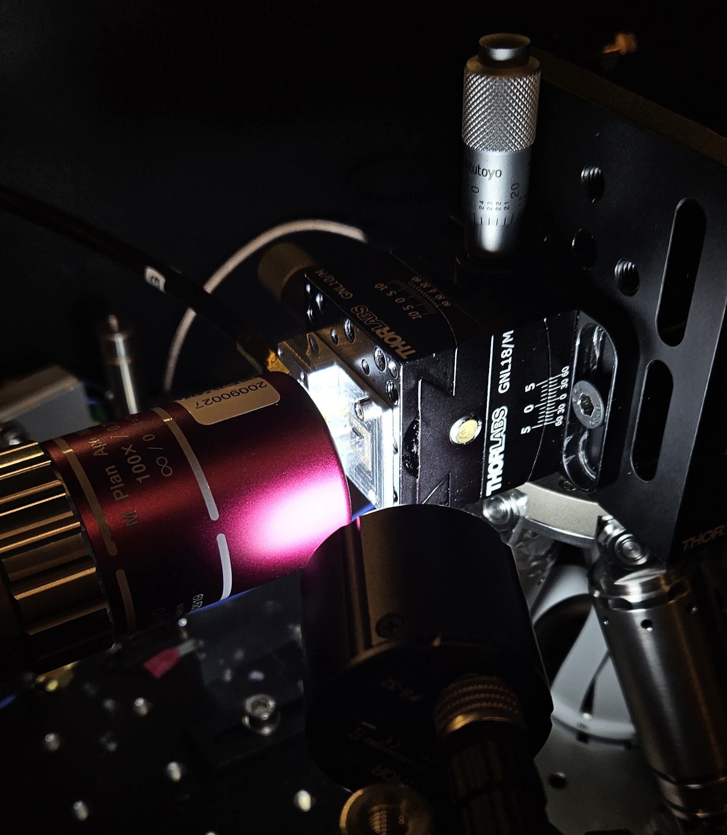
Outline
Gain in silicon and motivation
Overview of 3D IME-CAS devices produced in 8 INCH CMOS compatible technology
Two Photon Absorption - Transient Current Technique studies
Improvements of the design – future work
Measurements of impact ionization in silicon using Straw (cylindrical) 3D IME-CAS
Future work & Conclusions

Slide 3
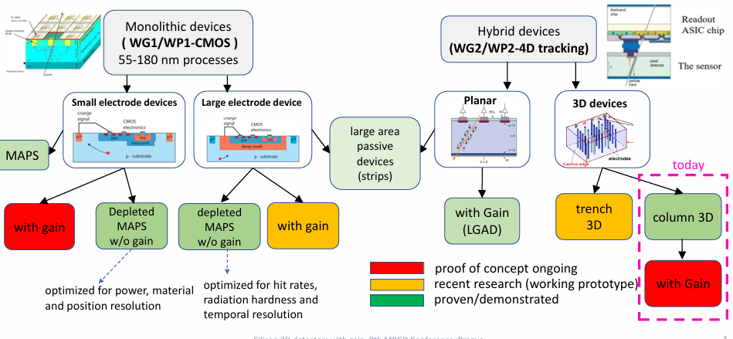
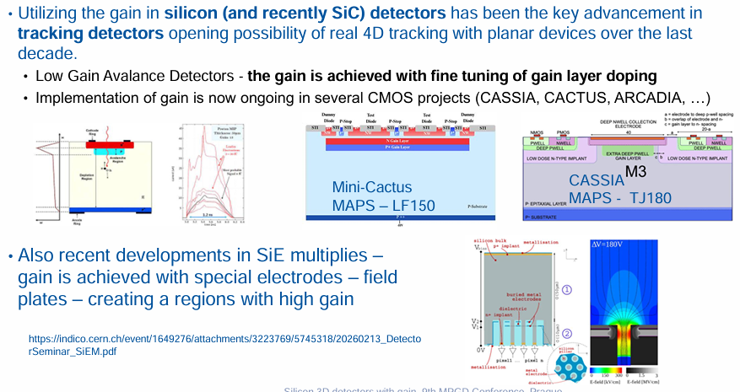
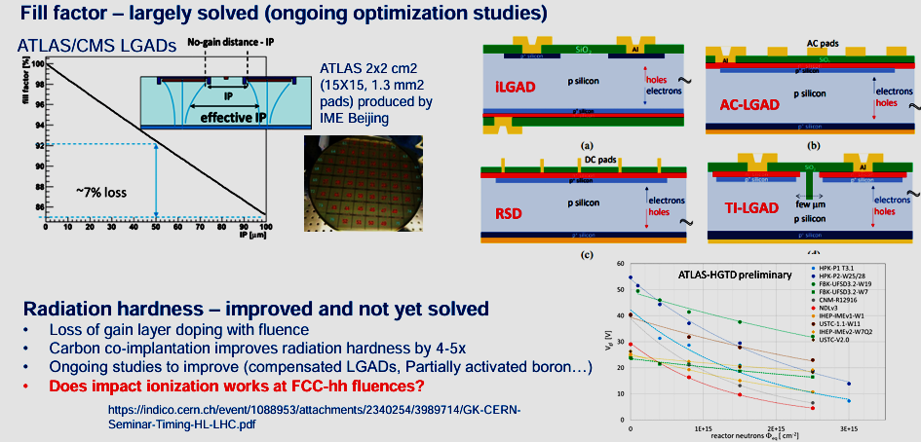
Motivation: radiation hard, fast device with the intrinsic gain

Slide 4
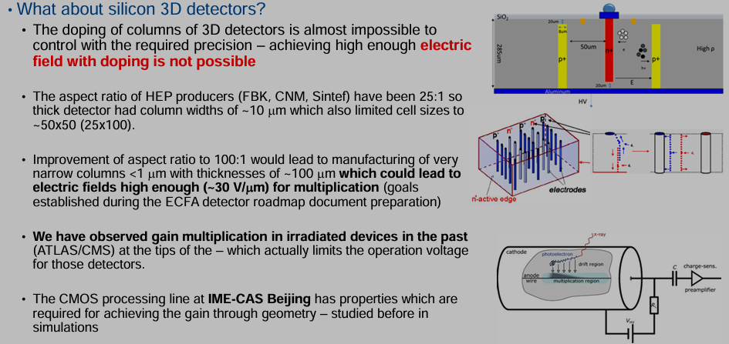
Motivation: radiation hard device with gain

Slide 5
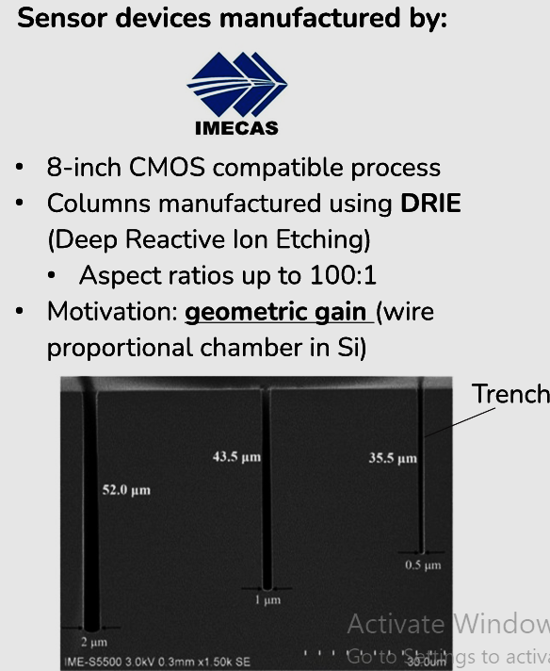
IME-CAS devices overview
Columns as narrow as 0.5 µm with aspect ratios of close to 100:1.
The devices as thin as 30 µm
Pixel detectors with cell sizes down to 15x15 µm².
Unlike in LGADs the gain is achieved simply by geometry and is much less affected by precise doping levels of columns.
As the gain is achieved by geometry and doesn’t critically depend on doping levels they are much more radiation hard than LGAD detectors.

Slide 6
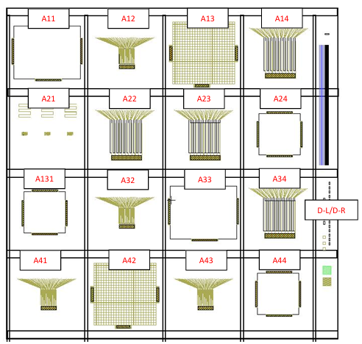
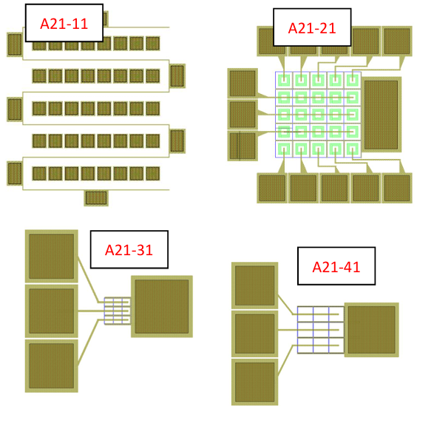
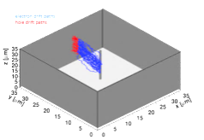
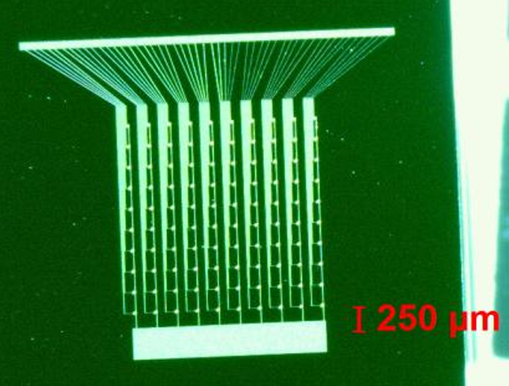
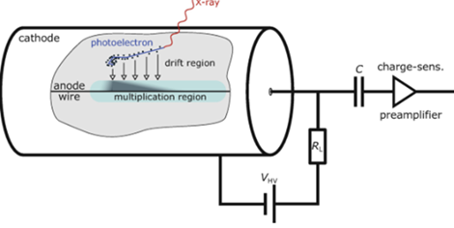
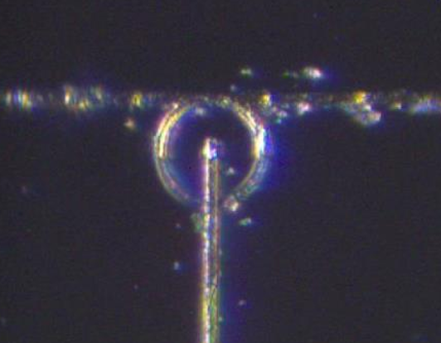
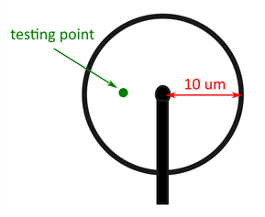
Different IME-CAS structures
HEP structure – pixel detector
Non- HEP structures – array if tiny columns (straws
Same as gaseous detector tube

Slide 7
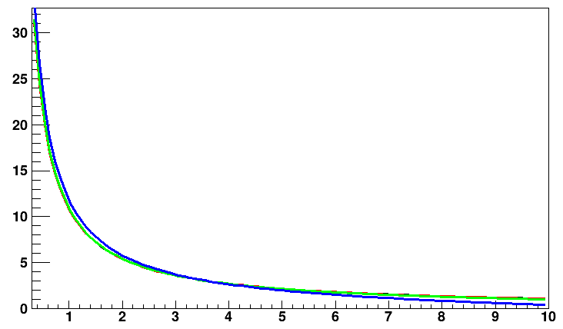

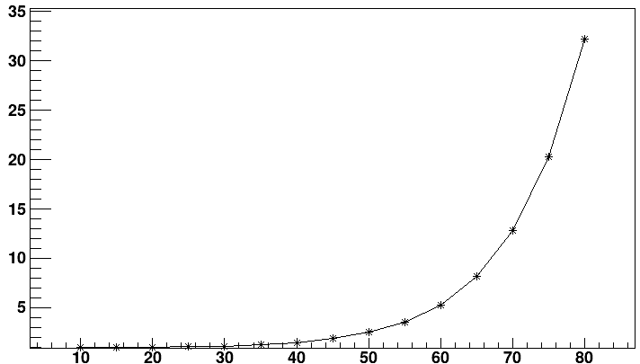

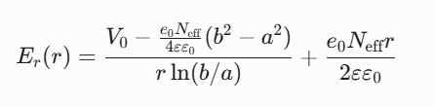

3D STRAW TUBES Impact ionization studies
E [V/μm]
Ideal structures to study impact ionization – especially after irradiation – as the field can be solved analytically
Experimentally this is very complicated, but we managed to do it.
Therefore, we will be able to study impact ionization at severe fluences.
From N_{eff}=1e12-1e14 cm⁻³
Gain
a=0.5 μm and b=10 μm
no gain up to some 30-40 V and then rapid increase
At the z=15 μm one can calculate analytically the gain – so fitting and extraction of impact ionization is straightforward
V_{bias} [V]

Slide 8
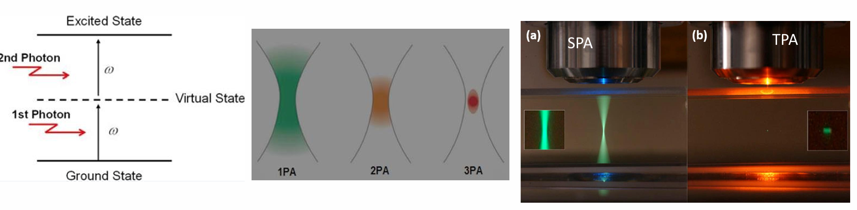
Characterization technique: Two Photon Absorption - TCT
Generation of free carriers by light and observing their drift – Transient Current Technique – has been a workhorse in many semiconductor detectors (lots of advantages):
➢ Two photon absorption is a step forward as it allows a very localized deposition in a voxel (~ 1-2 mm x 10 mm) . The key is to have very fast ~100 fs laser pulse focused to 1 mm with high enough energy
➢ 3D detectors are actually one of the best (if not the best) case studies for these techinque
➢ Large Laser facilities (such as ELI beams in Prague) allow even more photon absorption 3PA (longer wavelengths and more power) reaching very small voxel sizes

Slide 9
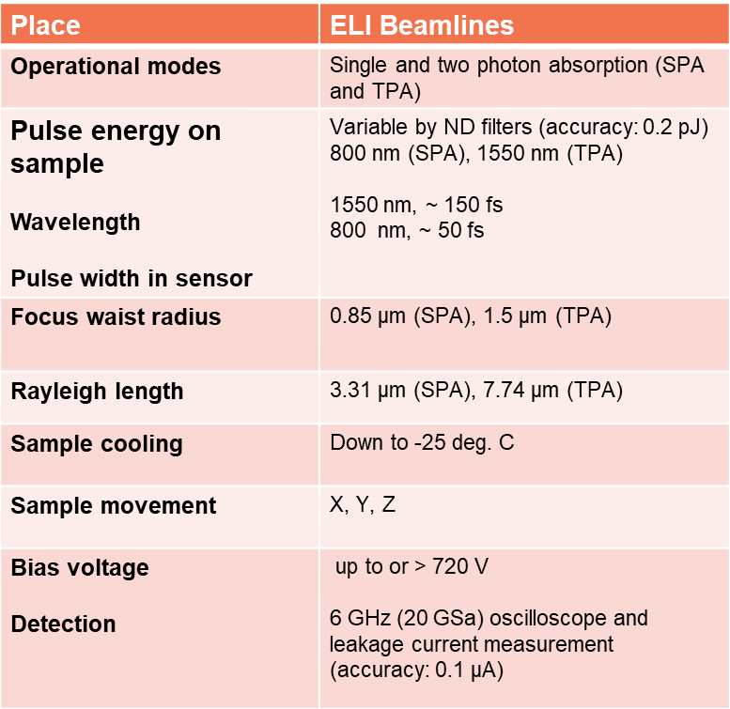
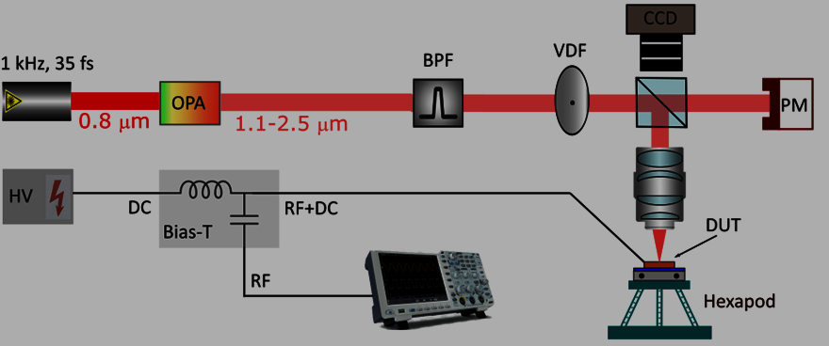
TCT set at at ELI
The sample is electrically connected by wire
bonds: the junction electrode is connected to high voltage (HV) via the Bias T circuit (Particulars BT-01), while the trench electrodes are grounded. The transient (RF) signals, decoupled from the HV by the Bias-T, are amplified by a wideband amplifier (Particulars AM-02 A, 3GHz, 53dB) and digitized by a 2.5GHz, 20 GS/s oscilloscope.

Slide 10
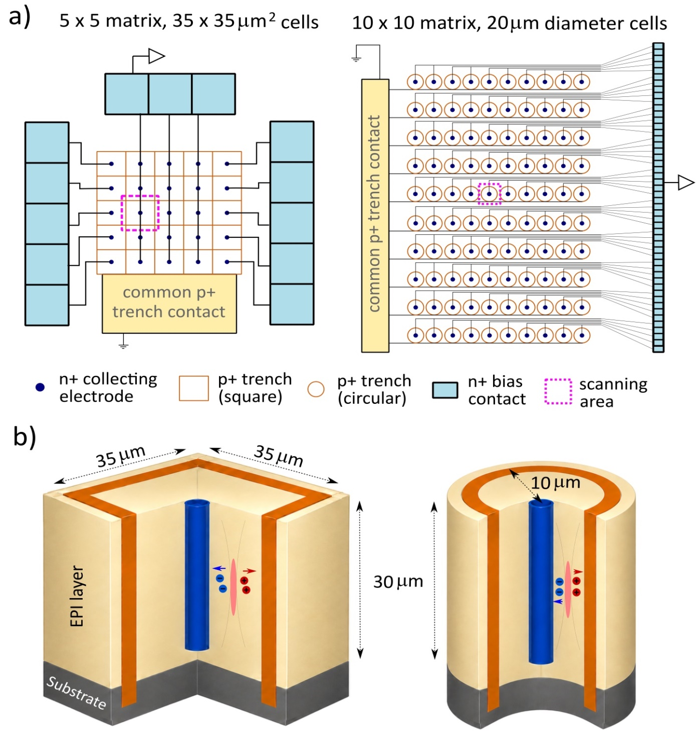
1
Investigated Devices
2

Slide 11
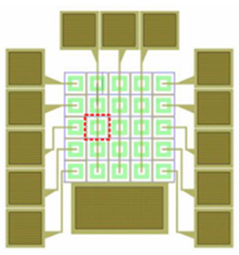
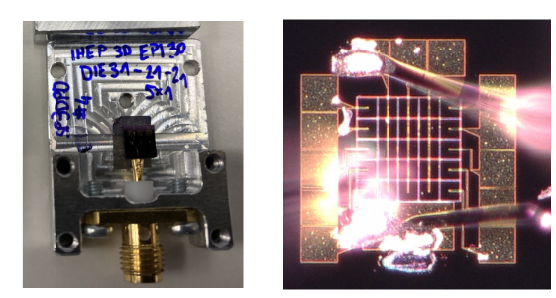
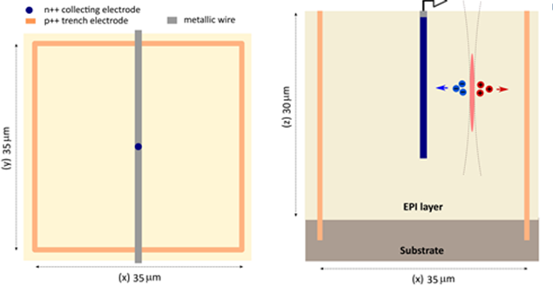
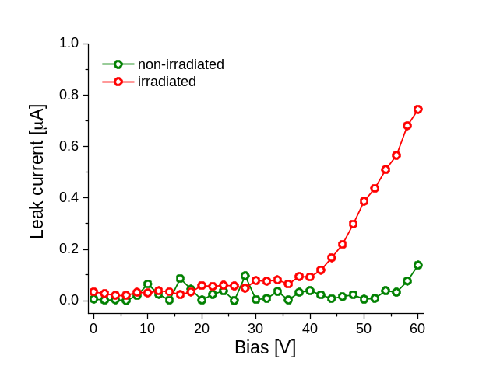
3D trench with square shape
1
Column readout
Trench electrode (V bias)

Slide 12
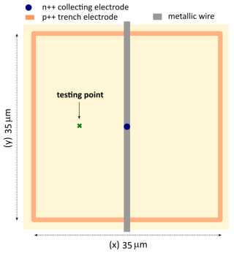
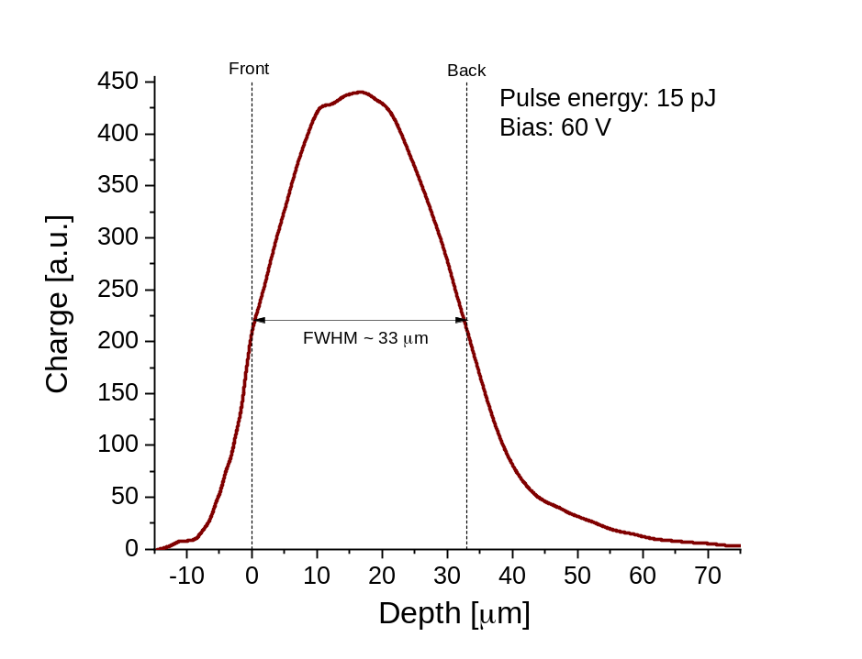
Z- Scan
FWHM of the profile is close to the nominal thickness which is 30 um.
We checked profiles in a few different points with very similar results.

Slide 13
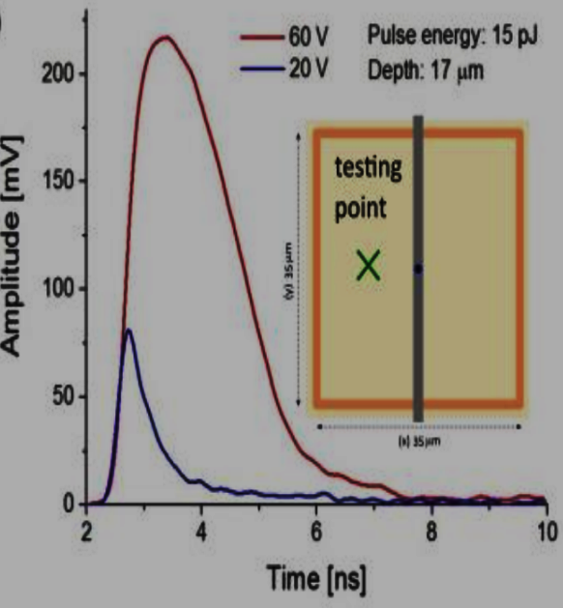
Waveforms at two biases:
20 V and 60 V
Another indicator of charge multiplication is the extended duration of the induced signals which results from the drift of the secondary holes to the ohmic contacts after the primary electrons undergo multiplication. Obviously enlarged amplitude can be seen.

Slide 14
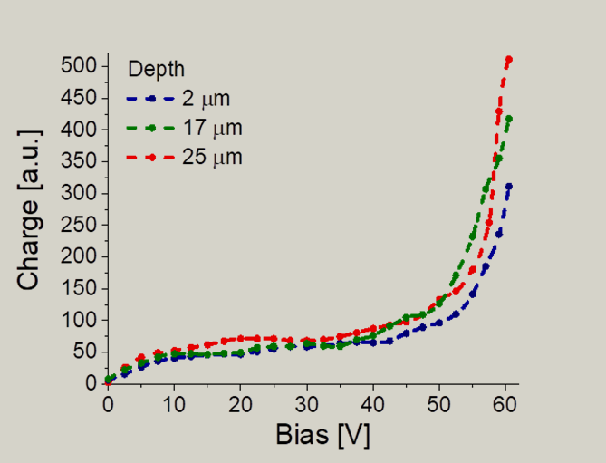
Charge collection and gain confirmation
After the initial depletion
phase the device becomes fully depleted at around 25V, where the collected charge reaches a plateau.
Steep increase of the collected charge that coincides with the rise in the leakage current clearly shows the avalanche breakdown

Slide 15
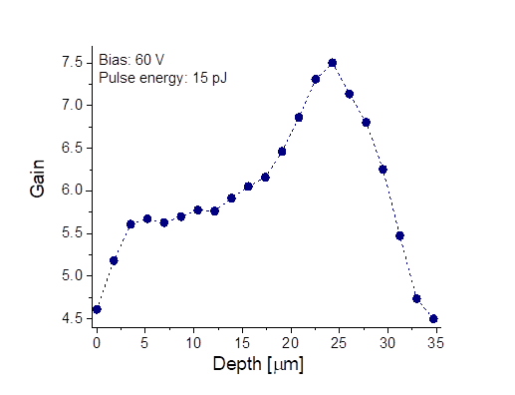
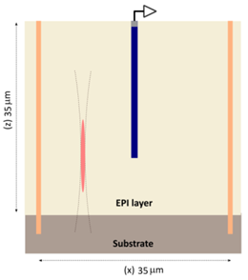
Gain Depth Dependence
At 60 V and at the depth of 25 µm
the gain is around G=Q(V)/Q(Vfd)∼7.5
TPA “cigar” leaving active area.
“cigar”
leaving
active area
Tip of n+ electrode
Illustration of focal point at the tip positon and TPA ellipsoidal voxel

Slide 16
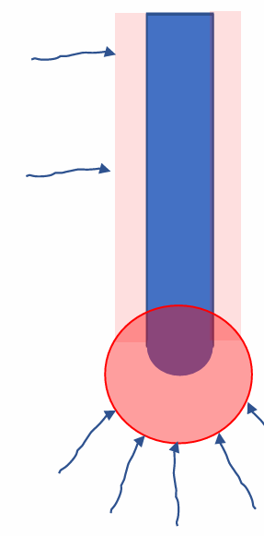
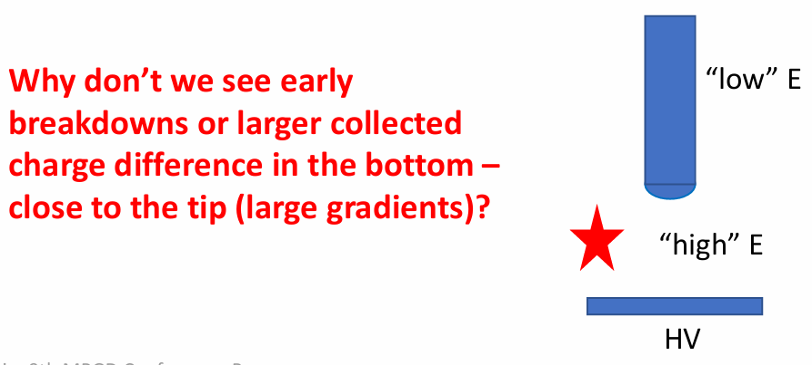
Why don’t we see early breakdown?
Smaller density, smaller screening
Tentative explanation:
For vey narrow column the gain in a small volume creates enough charge even for mip to screen the field – self quenching
➢ For conventional 3D this is not the case – 10 µm column is too large
➢ Along the electrode the difference is very small – small density no large screening
Higher density, higher screening

Slide 17
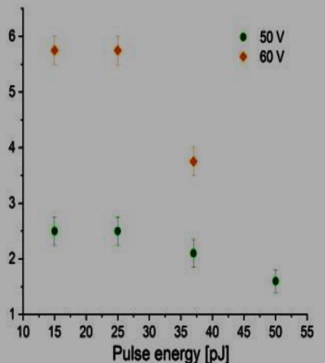
Gain self-quenching demonstrated
Screening observed- gain depends on carrier density
Gain suprression is observed
The small column diameter – gain stabilizer

Slide 18
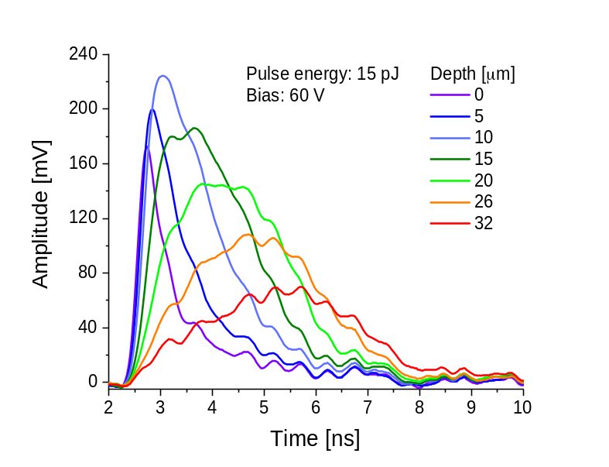
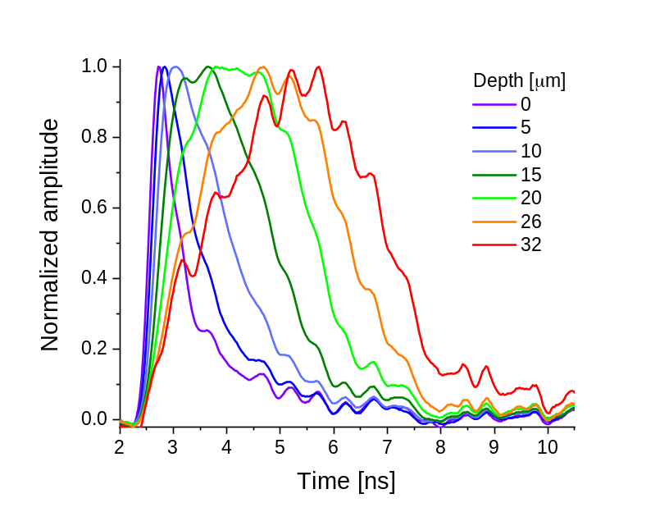
Slew Rate Depth profiling
  Signal becomes slower and arrives later with increasing depth.
Position (x,y) where z-scan was performed.
When the “cigar” enters substrate the carriers need to diffuse to the active zone – longer signals
Large slew rate difference across the sensor results in hit position dependent jitter for MIPS:
  ➢ Timing distributions will be skewed – different to LGADs

Slide 19
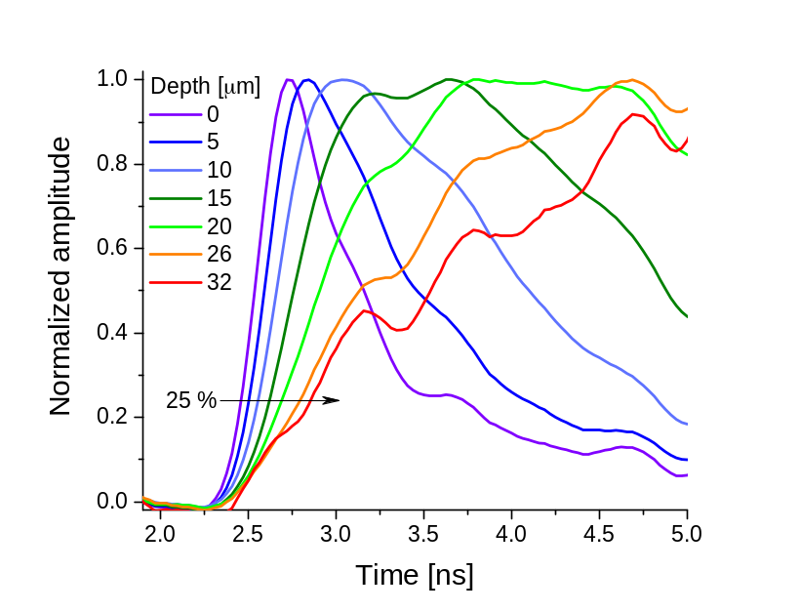
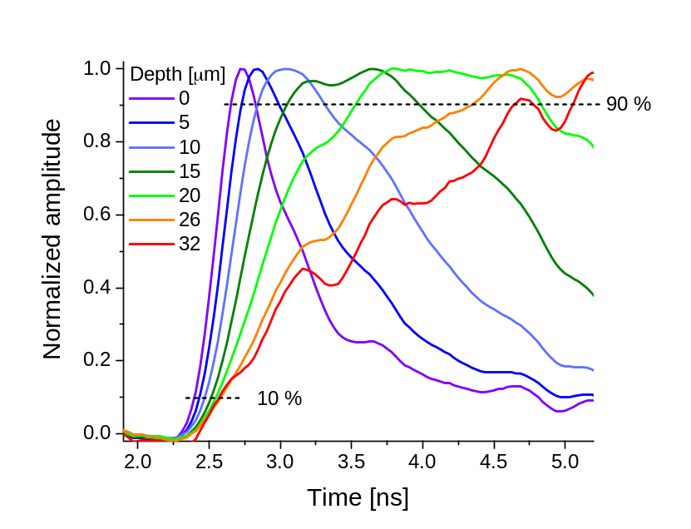
Already shown in previous slide but here magnified ( selected time window reagion ).

Slide 20
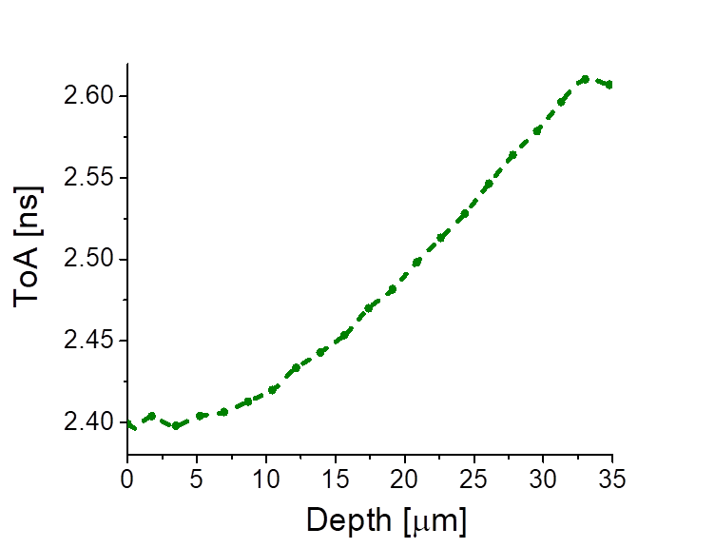
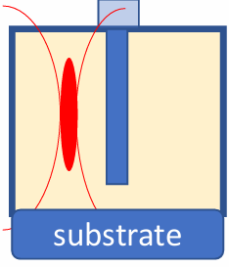
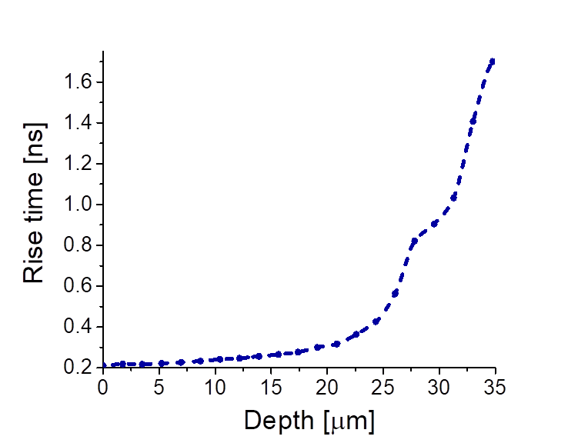
Rise Time & Time of Arrival Depth Profiling
Position (x,y) where z-scan was performed and the RT and ToA are extracted (from corresponding waveforms)
ToA and RT is increasing with increasing depth;
gain increases but also screening effect (slower movement of clouds of holes).
When the “cigar” enters substrate the carriers need to diffuse to the active zone – longer signals

Slide 21
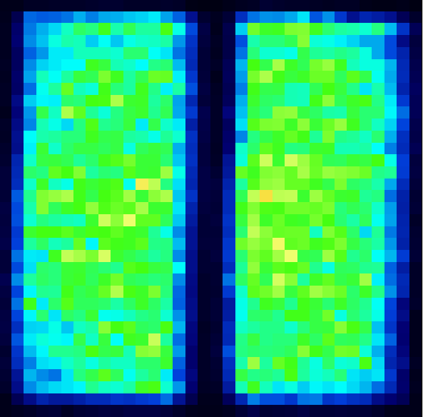
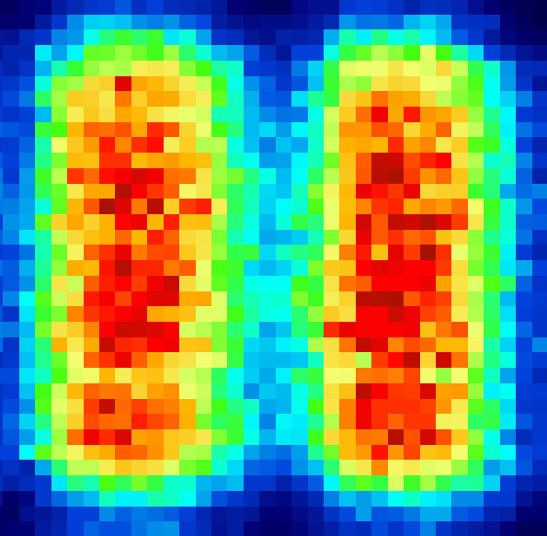
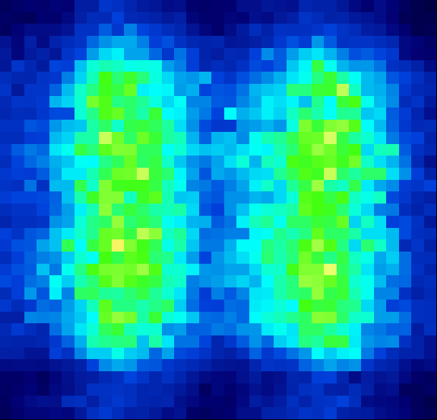

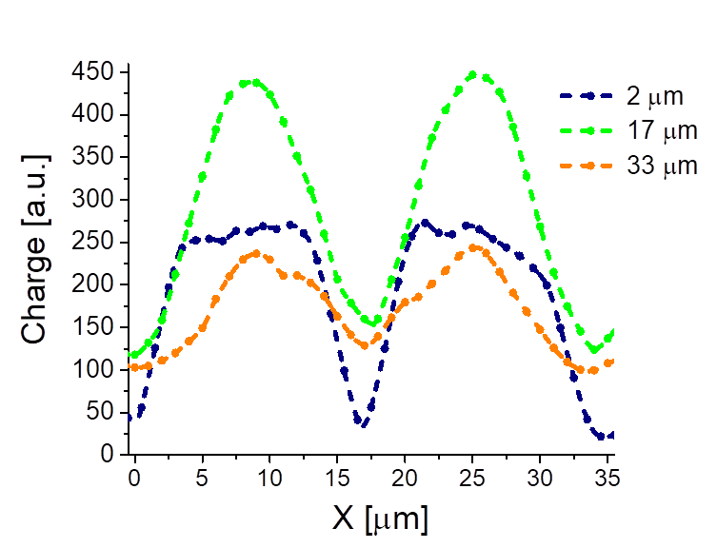
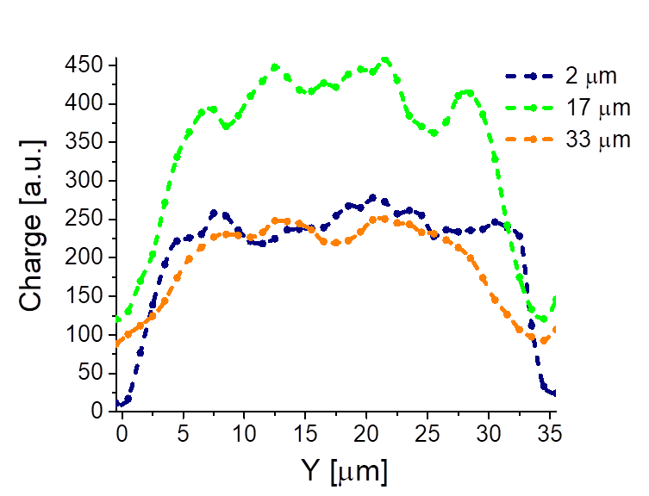
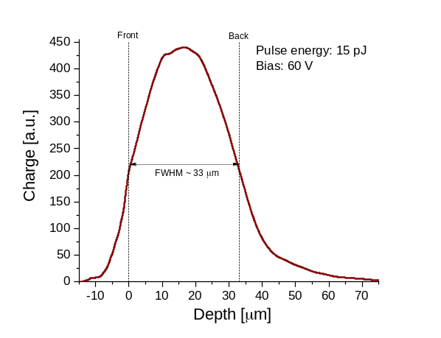
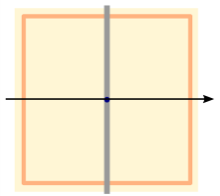
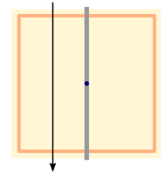
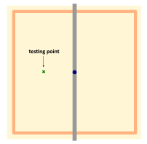
Charge vs. X
Charge vs. Y
2 μm
17 μm
33 μm
Charge [a.u.]
35 um
35 um

Slide 22
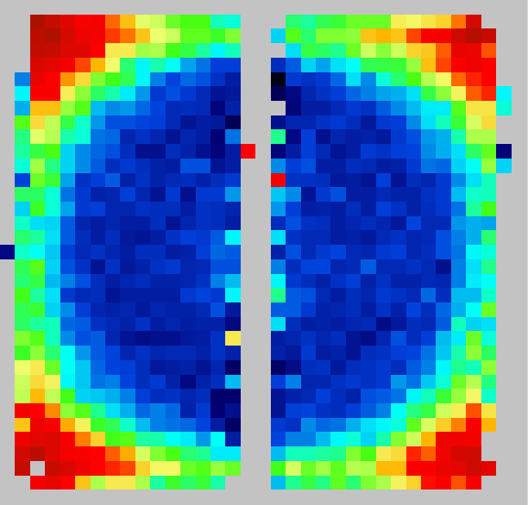





Lateral variation of Rise Time (RT):
In X direction
RT [ns]
2 μm
17 μm
33 μm

Slide 23





Lateral variation of ToA:
In X direction
ToA
2 μm
17 μm
33 μm

Slide 24



Rise Time spread
2 μm
17 μm
33 μm
RT [ns]
RT [ns]
RT [ns]
35 um
Depth: 2 µm
Depth: 17 µm
Depth: 18 µm
TPA vortex covers different el field regions

Slide 25




ToA spread
2 μm
17 μm
33 μm
ToA [ns]
35 um
35 um
RMS:59.3 ns
RMS:77.2ns
RMS:83.9 ns
Distribution of ToA at different depths is much more homogenous than rise time. However shifts towards bigger values with depth is clear. Also RMS increases vs depth from 59.3 ps close to top surface to 83.9 ps close to the bottom.
Simulated ToA spread of 80 ps at 62 V is in excellent agreement with TPA-TCT measurements (77.2 ps). (S9mulation performed by G. Kramberger (TREDI2026)

Slide 26

2D Gain Map
Pulse energy: 15 pJ
Depth: 17 um

Slide 27
Irradiated 3D Trench device
5x10¹⁵ n_{eq}/cm²

Slide 28





Gain after irradiation and other control plots plots
at +20⁰C (RT)
We see changes in performance:
➢ no plateau at full depletion but continuous increase of charge (trapping – geometry related);
➢ onset of gain at about the same voltage;
➢ slightly less gain and larger depth dependence;
Before irradiation
After irradiation
(trapping – geometry related
+20⁰C
-20⁰C

Slide 29





ToA after irradiation
ToA [ns]
2D image of ToA
at RT (left)
at -25⁰C (right)
RMS, MAD (ToA)
at RT (red)
-25⁰C (blue)

Slide 30




RT after irradiation
RT [ns]
at Room Temp
-25⁰C
2D image of Rise Time
RMS, MAD (Rise Time)
at RT (red)
-25⁰C (blue)

Slide 31

ToA, RT at low and room temperature
Significant reduction at low temperature

Slide 32

ToA, RT at low and room temperature

Slide 33










ToA vs. depth before and after irradiation
2 μm
17 μm
33 μm
ToA [ns]
35 um
After irradiation
35 um
Depth: 2 µm
Depth: 17 µm
Depth: 35 µm
RMS:37.8ns
RMS:47.5 ns
RMS:22.7 ns
Quite significant improvement
(not yet fully understood) in ToA
(CFD@0.5 from ~80 ps to 50 ps:
➢ trapping reduces longer tails
➢ larger space charge leads to
gradients in field – faster
collection
Before
irradiation
RMS: 59.3 ps
RMS:83.9 ps
RMS:77.2 ps

Slide 34


Straw Tube IME-CAS Detectors

Slide 35

2D of Charge, Rise time and ToA distribution before and after irradiation

Slide 36

RMS of RT and ToA before and after irradiation

Slide 37

Other control plots

Slide 38


Impact Ionization Study
In the first approximation field can be calculated analytically and also the gain:
➢ up to 10¹⁶ cm⁻² the changes to Neffcan be ignored
➢ short distances render trapping of the drifting charge negligible
➢ TPA allow injection away from the tip where analytical calculation is more reliable
➢ TPA allows also studies of charge screening effects
Extending the studies to very high fluences – above 10¹⁷ cm⁻² will reveal the answer if silicon gain devices can be operated - this is the key question for Silicon in FCC-hh. Without gain we know silicon will fail.
  ➢ a clear underestimation of the charge by the literature models
  ➢ no impact of radiation up to 5e15 cm⁻²
  ➢ extraction of parameters depends critically on “wire dimensions” (column width + doping layer) - we are now expanding the studies to more columns widths for more reliable extraction.

Slide 39


IDEAL 4D Tracking Device
REF: M. Puklavec, Small cell 3D detectors with intrinsic gain, TREDI2026; https://indico.cern.ch/event/1586892/contributions/6846212
Optimization of geometry to achieve better timing performance is underway
Trench-column 2E/nE devices Timing resolution of 20 ps Improvement of simulation tools
Optimization parameters:
PP – pixel pitch
PW – pixel width
ED – electrode distance PT - Thickness

Slide 40
Conclusion
Silicon/Semiconductor gain devices are in the focus of R&D activities. LGADs still dominate – to be used for the first time in ATLAS/CMS, but others, SiEM and 3D detectors are also gaining momentum.
➢ Very small pitch and thickness 3D devices were produced with controllable gain (35x35x30 µm³ cells) owing to 8” CMOS and DRIE processing at IME.
➢ Gains of up to around 10 were measured with devices fully functional at moderate voltages 62 V with only up to 20-30% gain variation across the cell was observed. Being thin these devices would have much better noise performance than standard 3D sensors.
➢ Devices were not optimized for timing and their timing performance is not excellent:
➢ Weighting field (distortion) contribution dominates the timing resolution
➢ rise time variation across the cell can lead to jitter variations - mapping for ToA and dV/dt of the device shows this
Extremely small single cell cylindrical devices are ideal for impact ionization measurements at extreme fluences.
Future PLAN:
2 more runs with timing optimized devices will following until the end of 2027
devices optimized for timing applications will be included
➢ impact ionization measurements over the large fluence range

Slide 41
Thank you for your attention!
Funding:
Research was partially funded through the project “TAIDA: Technological Advancement and Innovation for Detectors at Accelerators”, Contract No. 0402- 082/23-1740/5 (funding agency: Ministry of Education, Science and Innovation in Montenegro).
For device fabrication, the authors acknowledge fundings from National Natural Science Foundation of China under Grant 12375188 and in part by the National Key Research and Development Program of China under Grant 2023YFF0719600.
This project has received funding also from the European Union’s Horizon Europe Research and Innovation programme under Grant Agreement No 101057511 (EURO-LABS).

Slide 42







RT vs depth after irradiation
RT [ns]
2 μm
17 μm
33 μm
35 um
35 um
RMS:36ns
RMS:48.3ns
RMS:52.6ns

