Slide 1

4H-SiC LGADs: fabrication-stability optimization using TCAD simulations
Tobiáš Vasiljev

Slide 2
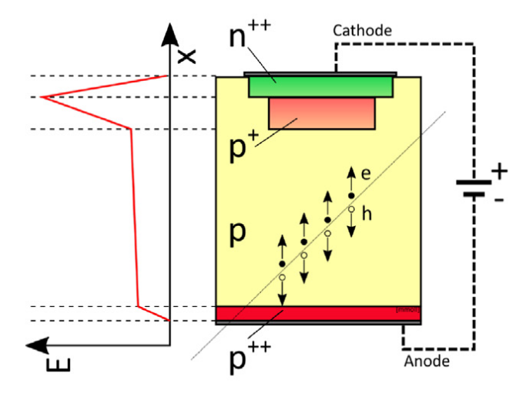
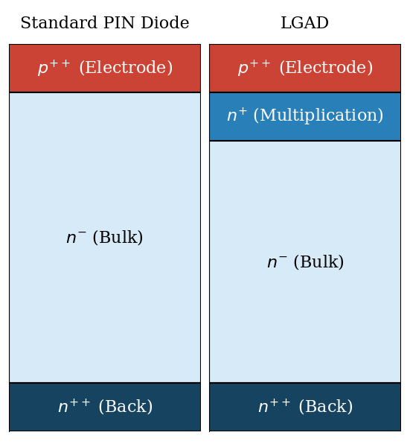
Low-Gain Avalanche Diode (LGAD)
~ PiN diode + internal charge multiplication
already in use on Silicon in the LHC
+ Superior timing resolution, SNR, low energy detection
- Performance degradation with radiation damage, needs cooling
Applications in HEP, Medical devices, Space
Notes:
klasická PN diode s širokou bulk vrstvou pro generování eh párů -> špatné časové rozlišení
LGAD: multiplikativní vrstva -> koncentrace E pole do špičky -> vysoký koeficient nárazové ionizace -> užší bulk, lepší časové rozlišení

Slide 3
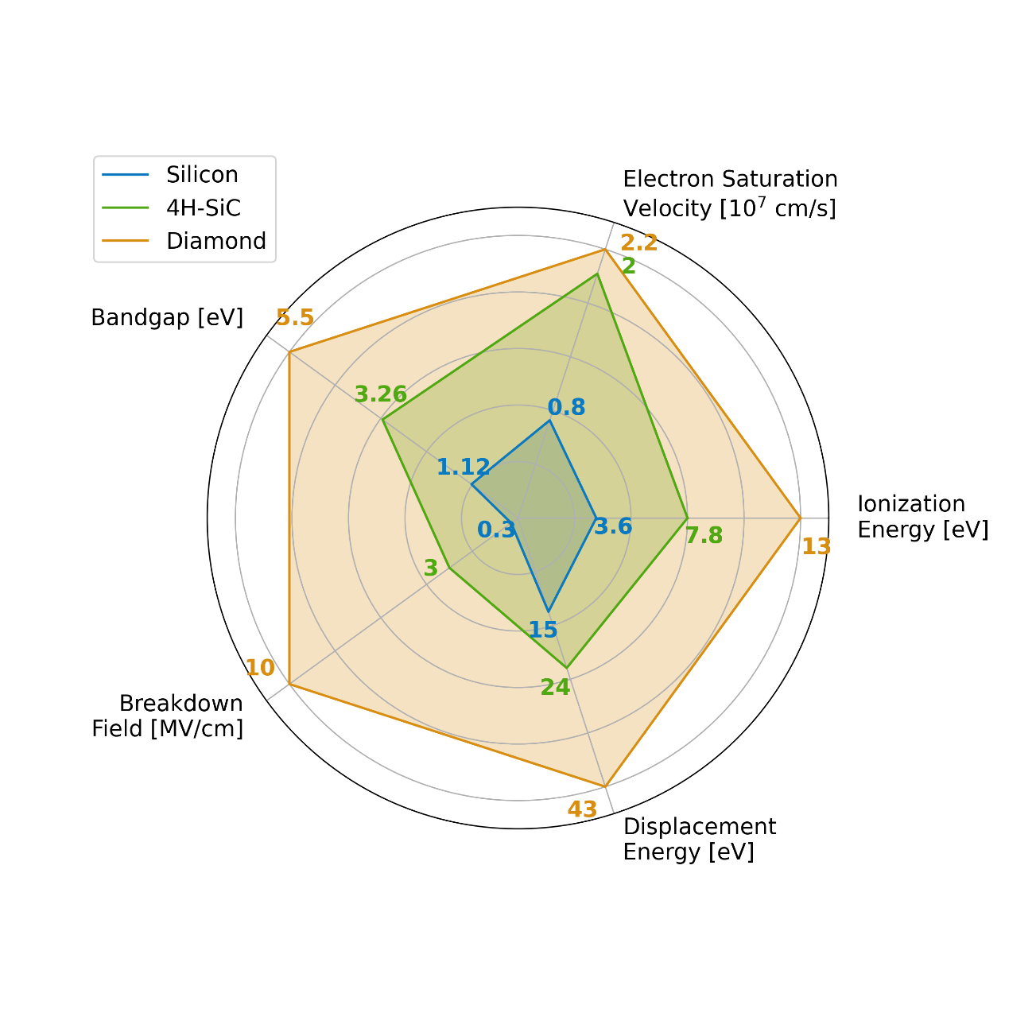
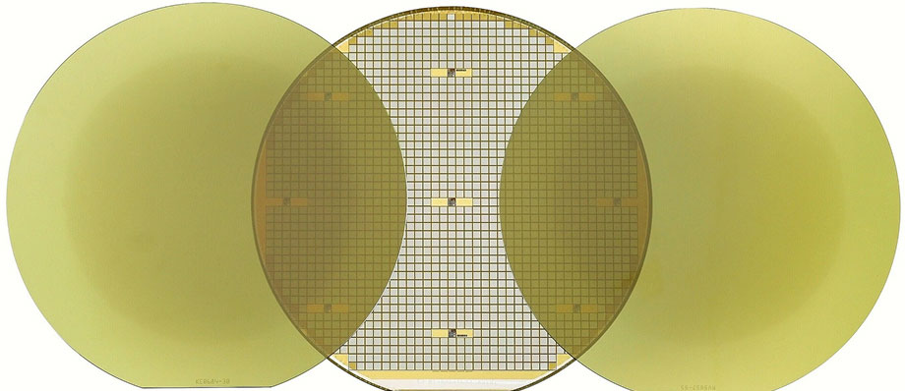
Why wide-bandgap (SiC)
Higher electric field before breakdown (10x),
faster charge collection (2x), higher thermal conductivity (3x),
very low intrinsic carrier concentration (~0), high radiation hardness,
temperature stability
Difficult fabrication without defects, difficult simulation in TCAD
Notes:
vysoká radiační odolnost
nízká intrinzická koncentrace nosičů náboje -> nízký unikající proud, fungování při pokojových teplotách
vyšší driftová rychlost nosičů -> rychlá odezva, vysokofrekvenční aplikace
Hojně využíváno ve výkonové elektronice, v autoprůmyslu
Náročný na výrobu (bez defektů)
Obtížné numerické simulace, nepřesné parametry

Slide 4
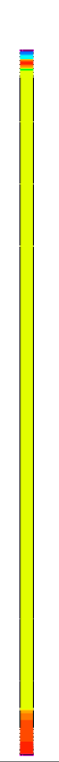
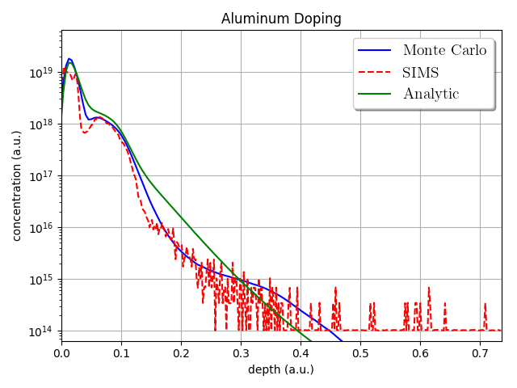
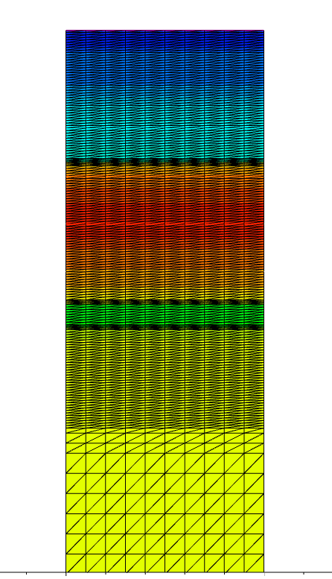
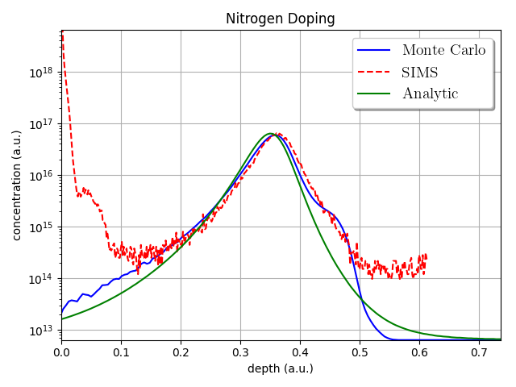
Simulation Model – fabrication process simulation
Arbitrary units used (a.u.)
(Synopsys Sentaurus TCAD)
SIMS measurements of doping
inaccurate in low concentrations
Doping structure was simulated
with Monte Carlo simulations
and from analytic tables
Monte Carlo model was determined to be the most accurate,
especially in lower concentrations
1x50 µm 2D cutout
vortex count ~ 9000
electrical simulation time ~ 1-6 hours

Slide 5
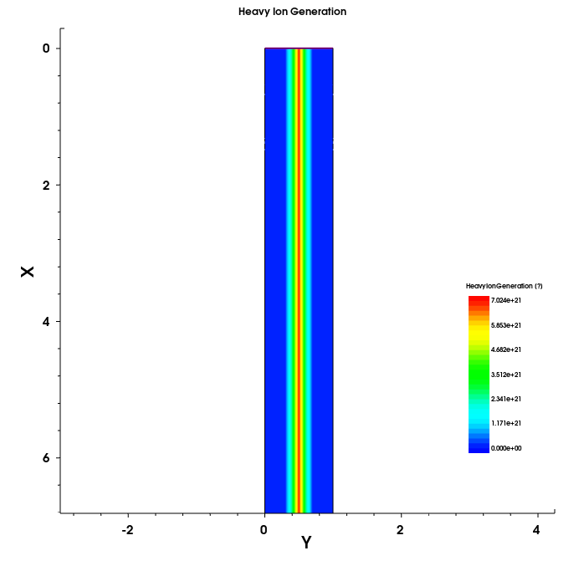
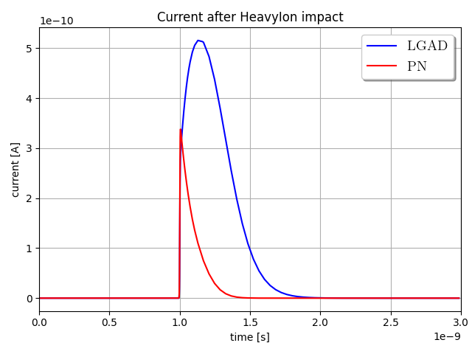
Simulation Model – particle strike
Arbitrary units used (a.u.)
Minimum ionizing particle flown through the whole length
~55 e-h pairs/µm
(Both operating at 300 V reverse bias,
same geometry)

Slide 6
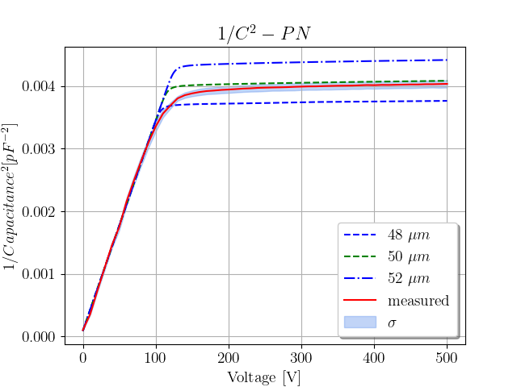
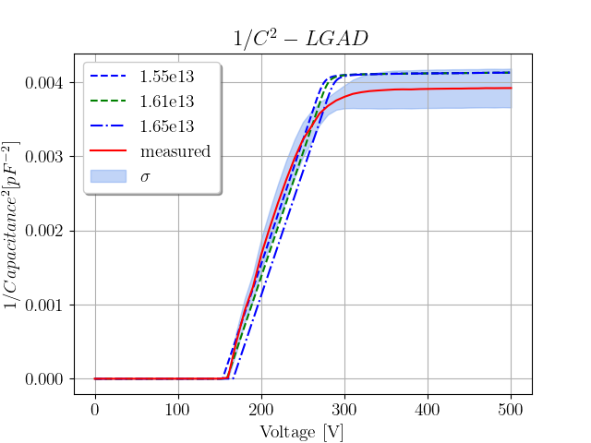
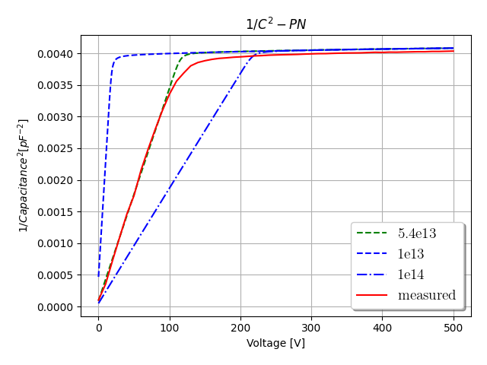
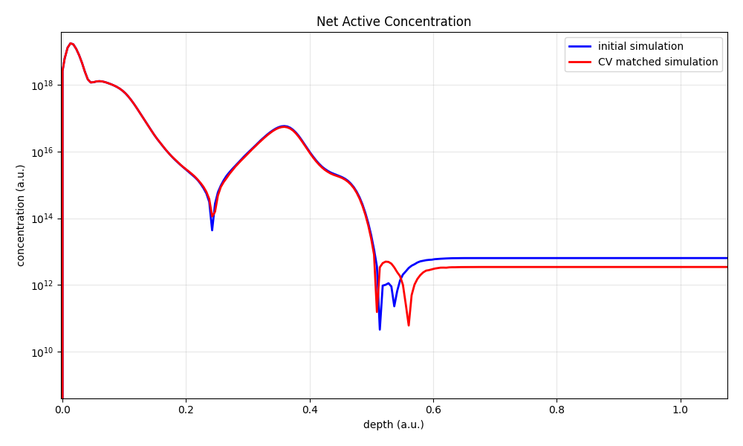
Model Calibration With Matching CV Curves
Arbitrary units used (a.u.)
bulk concentration
epitaxy layer length
Nitrogen gain layer dose
using nominal values from production results
in an inaccurate simulation model
“large” discrepancy in Nitrogen dose (5%)
!
resulting matched structure

Slide 7
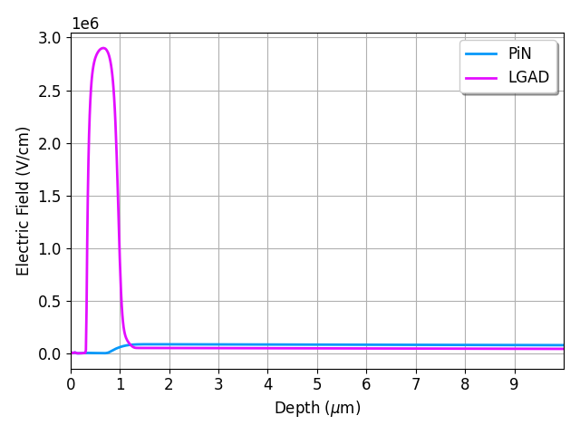
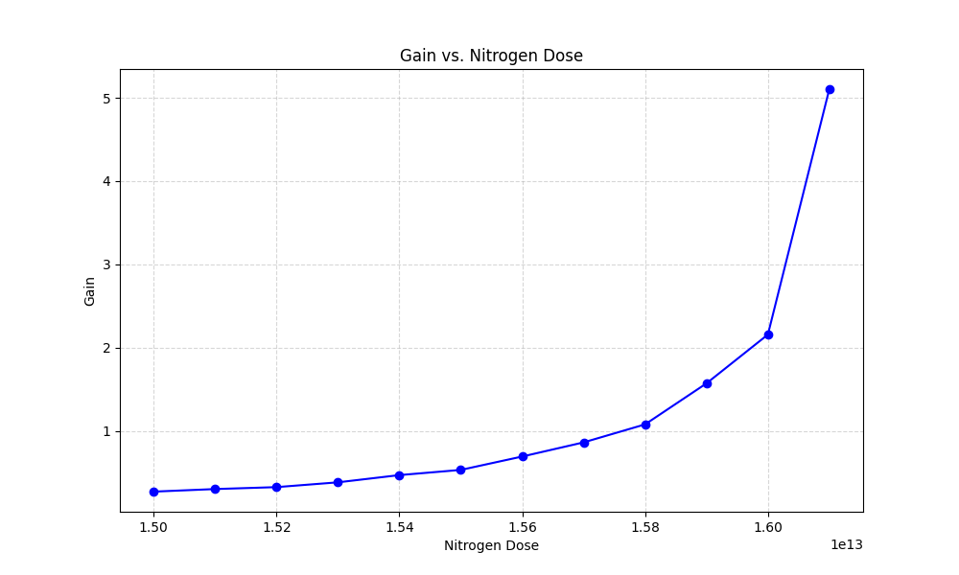

Sensitivity to Nitrogen Dose (Gain layer size/shape)
$$α\left(E\right)=A\exp\left(−\frac{B}{E}\right)$$
TCAD Avalanche multiplication models may not be accurate

Slide 8
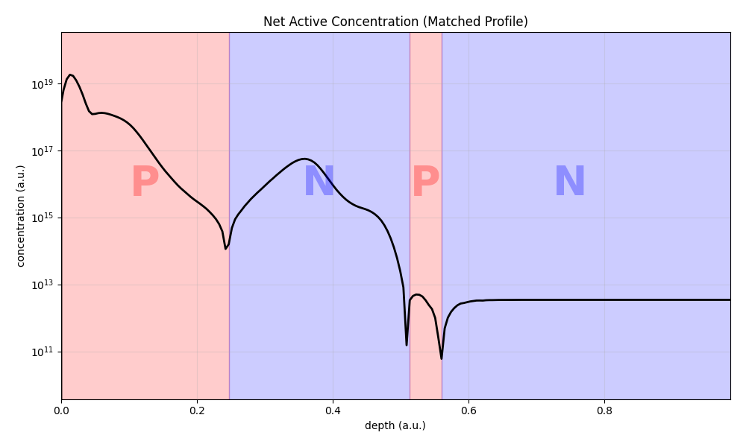
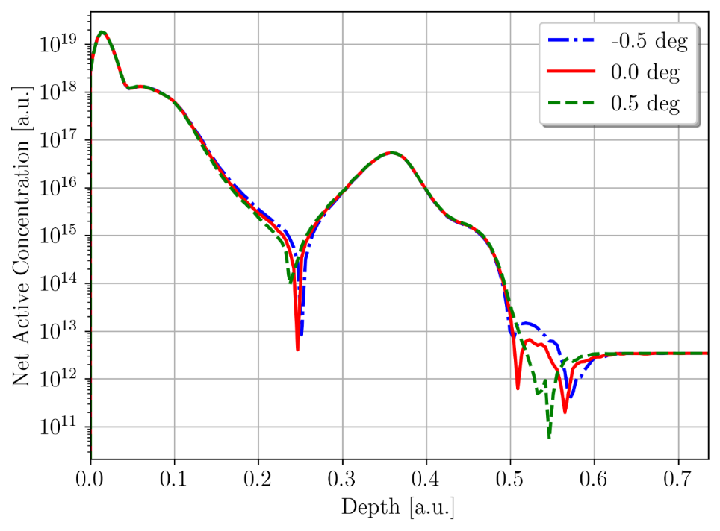
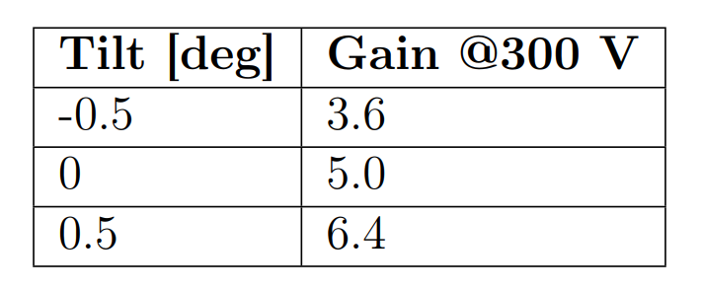
Sensitivity to Angle of Ion Implantation
Arbitrary units used (a.u.)
matched model shows a secondary “parasitic” junction

Slide 9
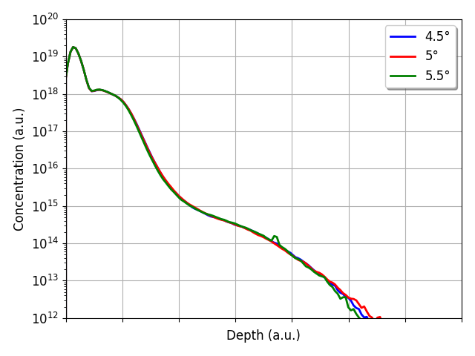
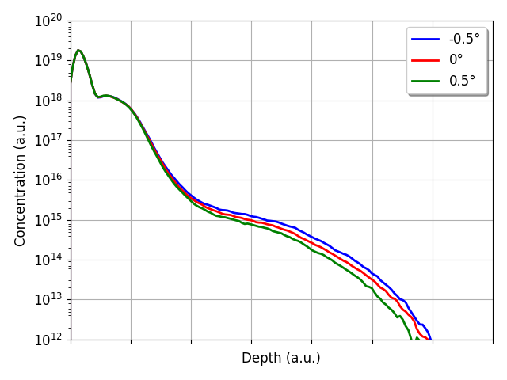
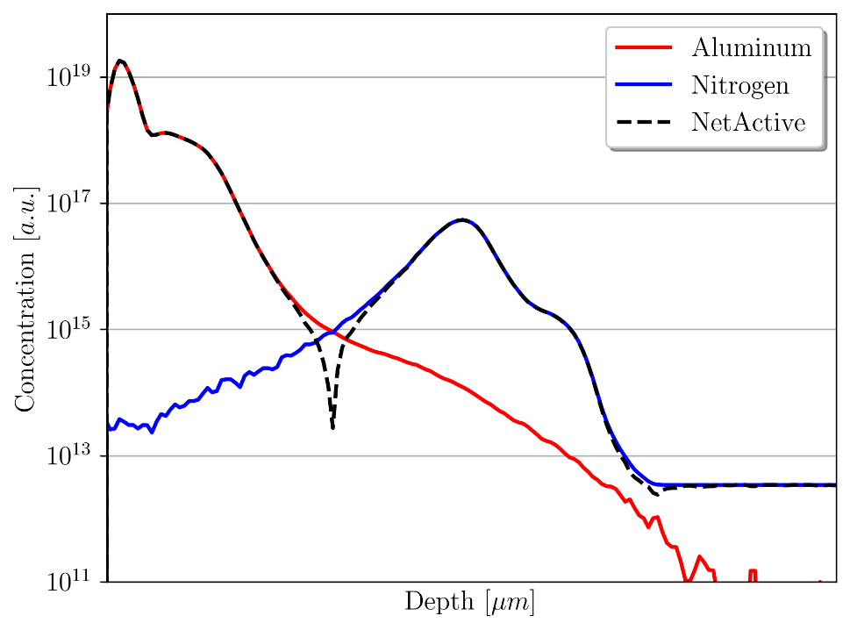
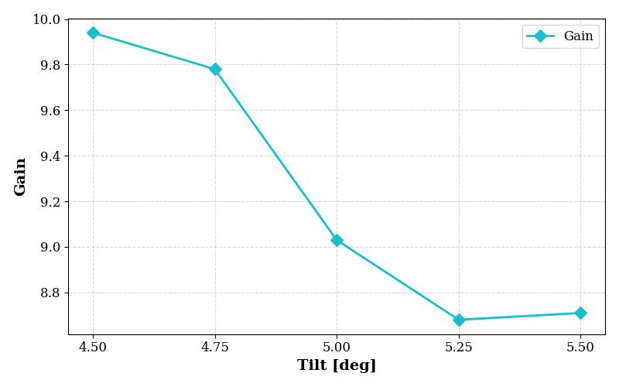
Channelling mitigation
Arbitrary units used (a.u.)
Ion implantation angle
set to 5 deg
varying low concentration values
due to channelling at 0 deg implant

Slide 10
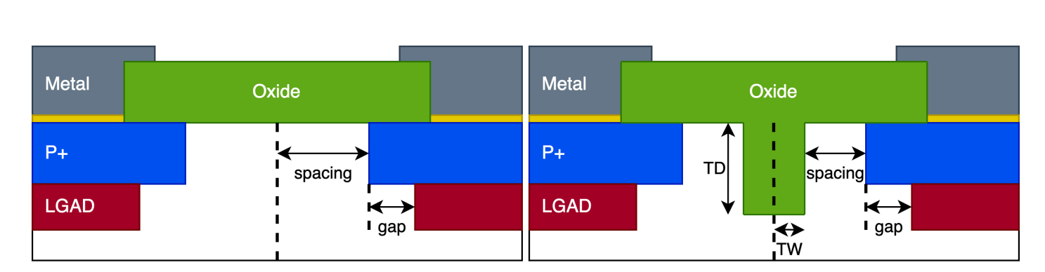
Segmentation strategies

Slide 11
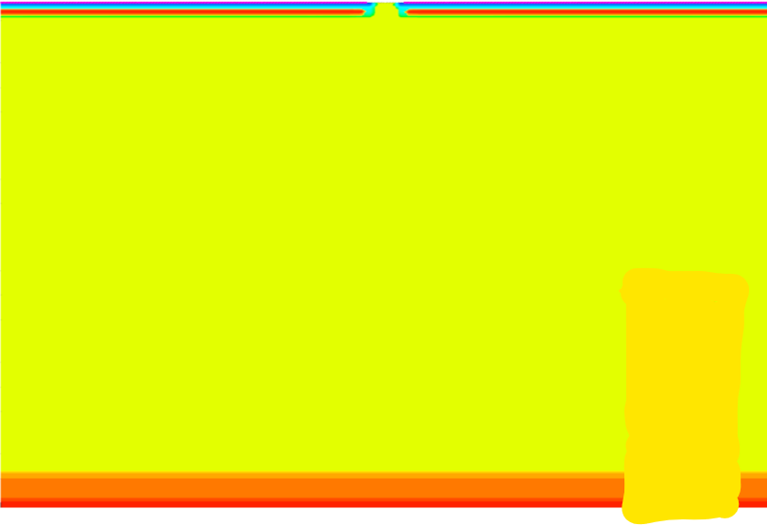
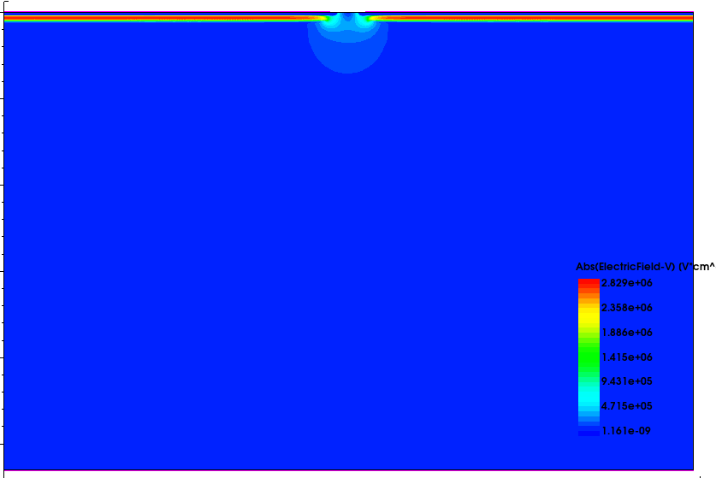
Larger 2D simulations - segmentation
24 simulations per design – point charge generation
vortex count ~ 120 000
simulation time ~ 15 – 60 hours (for 1 point generation)
Electric Field
Doping Concentration

Slide 12
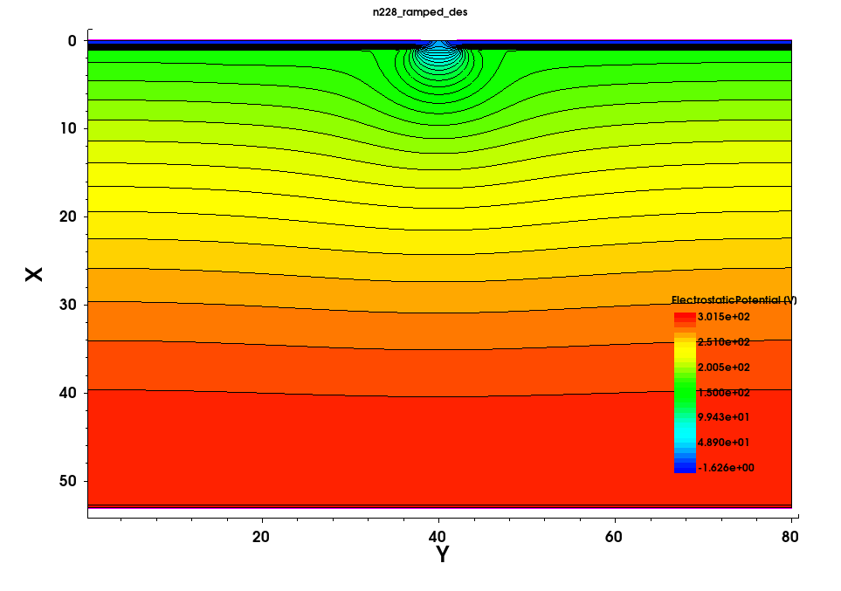
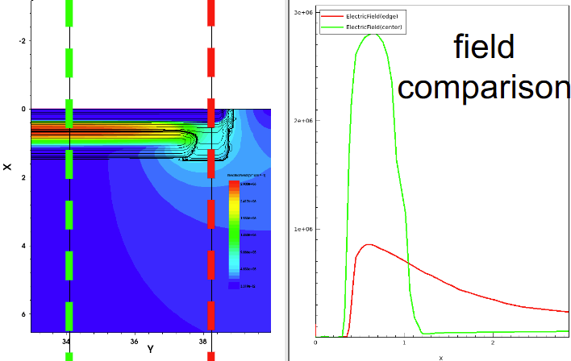
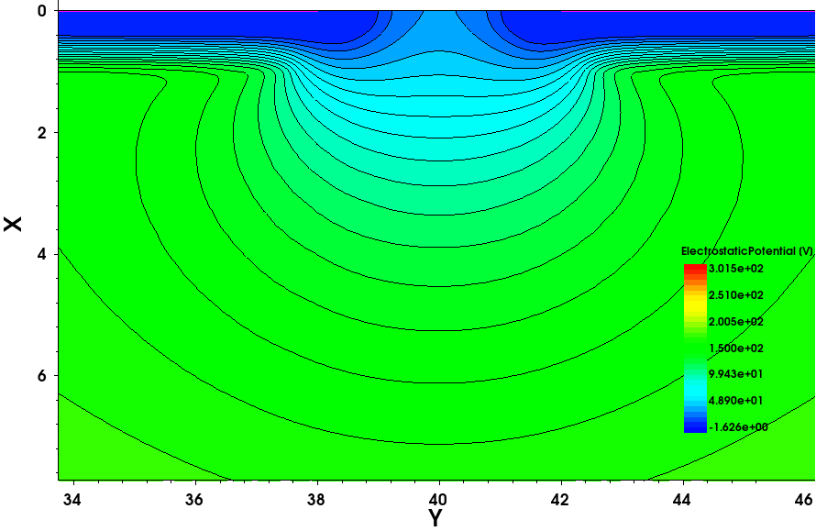
Generated charge is pulled through a low field region, doesn’t get multiplied
potential lines

Slide 13
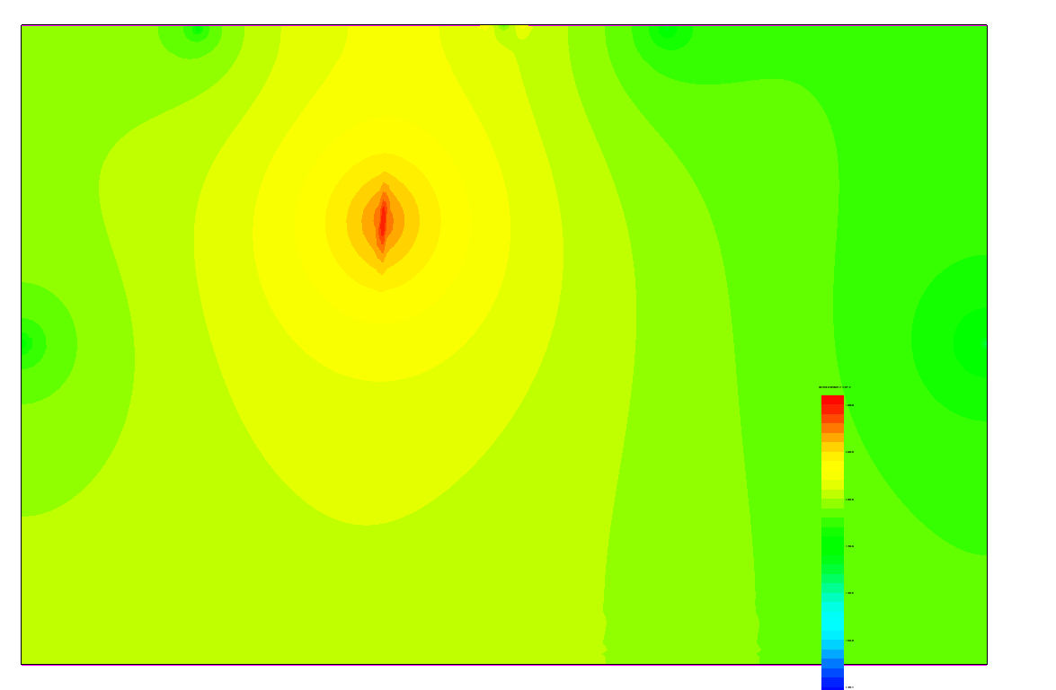

Slide 14
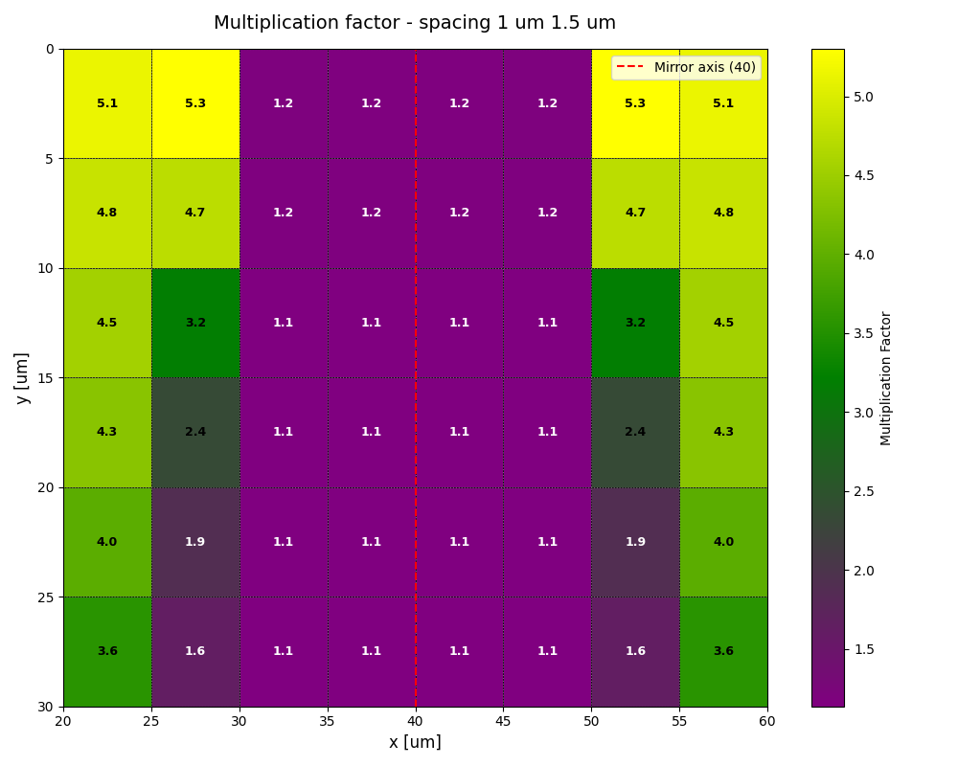
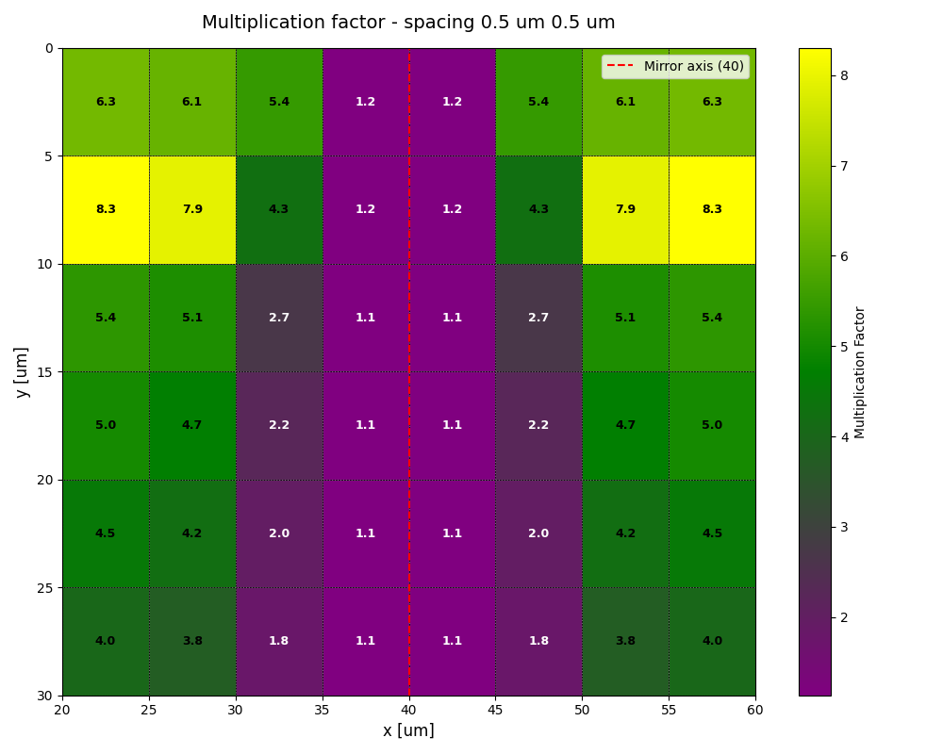
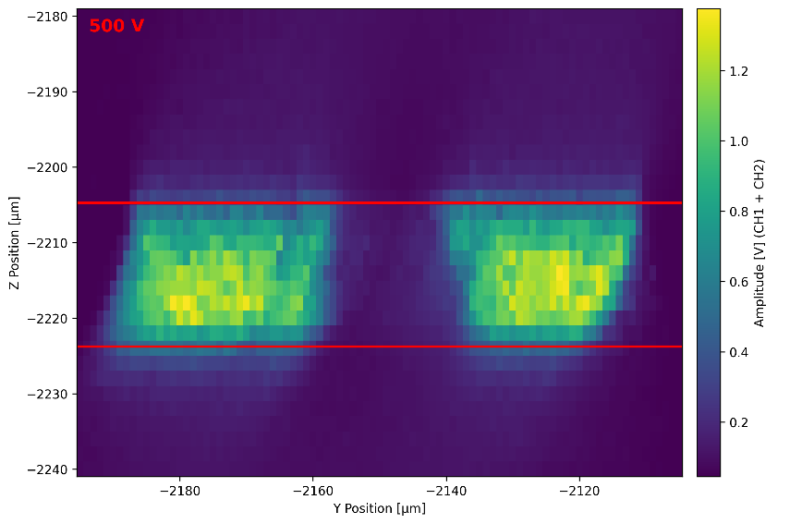
Zero gain region between pixels/strips
TPA-TCT measurements

Slide 15
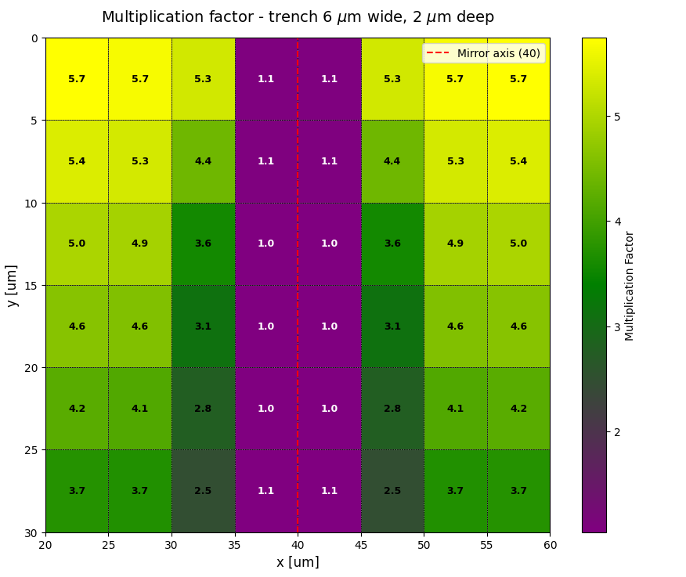
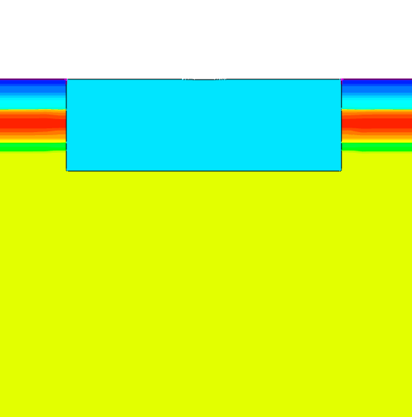
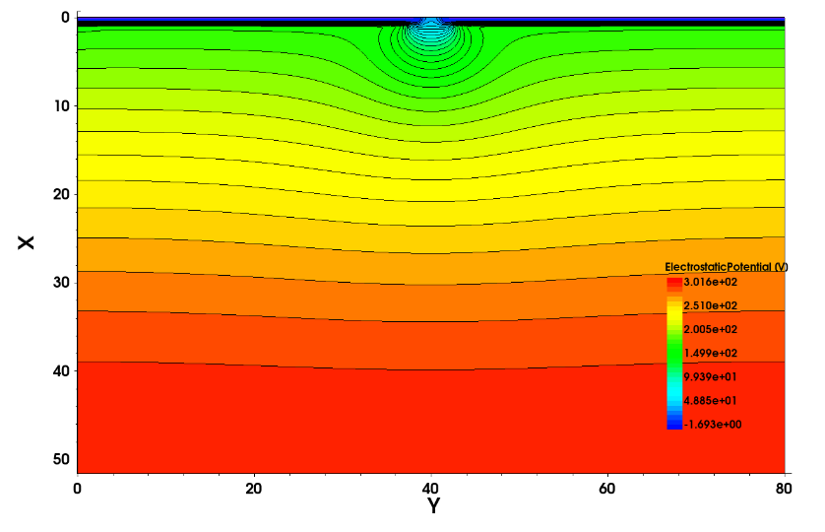
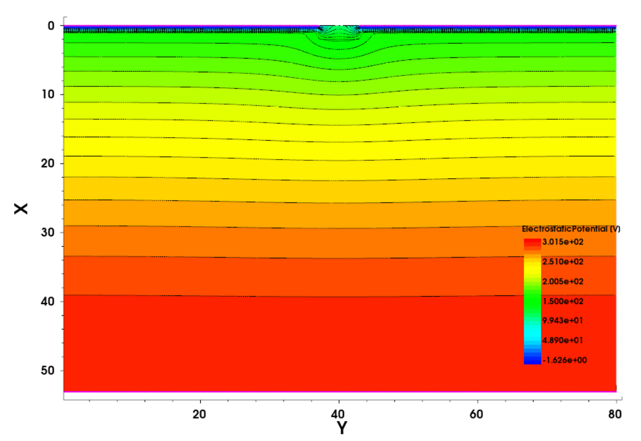
Trench isolation

Slide 16
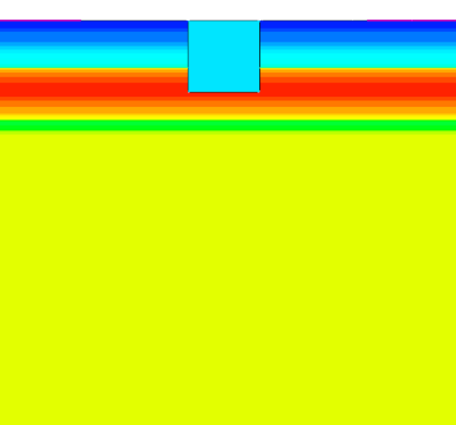
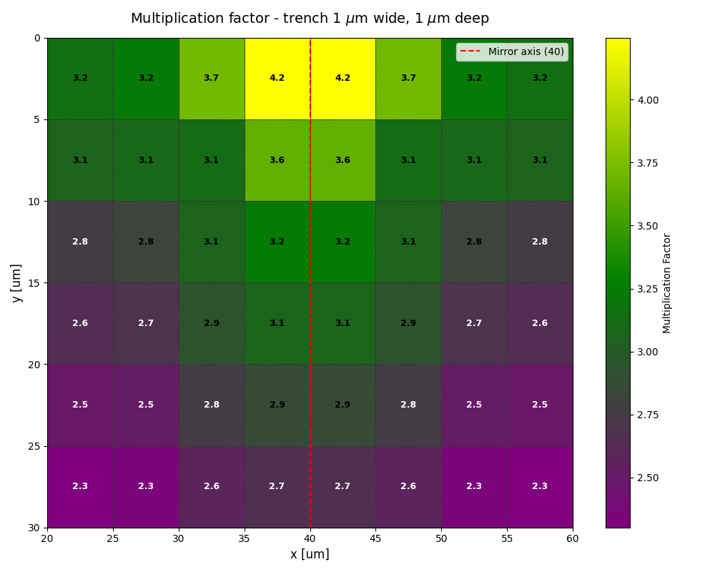
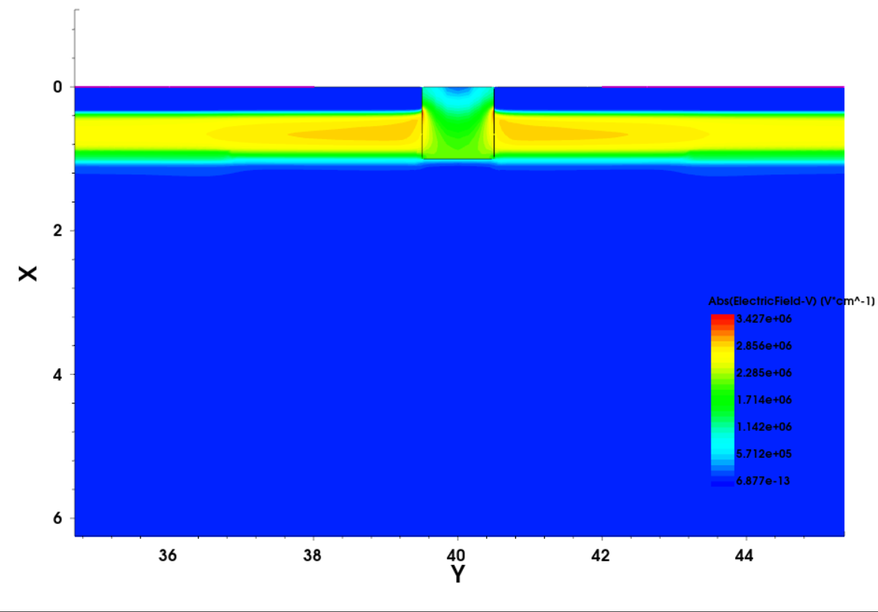
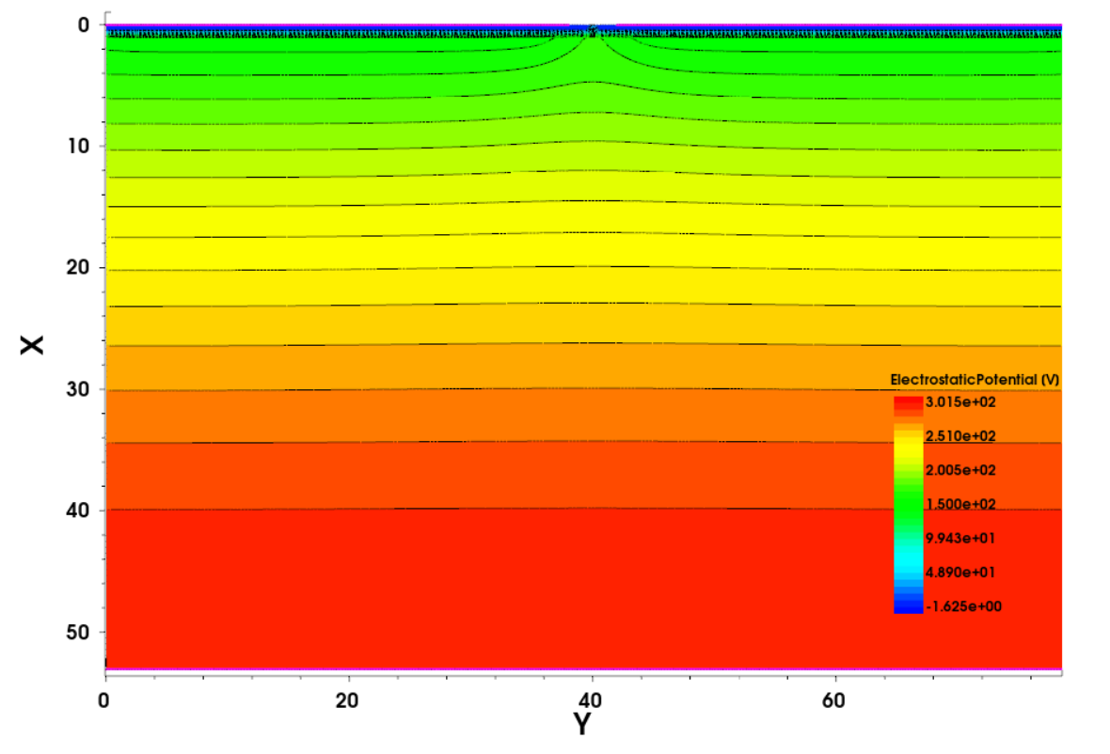
Trench isolation – no zero-gain region
Electric field gets concentrated
around the trench, affecting the
detector performance
perfectly shaped potential lines

Slide 17
Summary
We established a 4H-SiC LGAD simulation model and used it to improve the reproducibility our first-generations prototypes
We extended the simulation model to study different segmentation strategies
Future work:
Further optimize the doping structure for maximum reproducibility and lifespan
Simulate more segmentation strategies, compare with measurements
Investigate the zero-gain region further

Slide 19
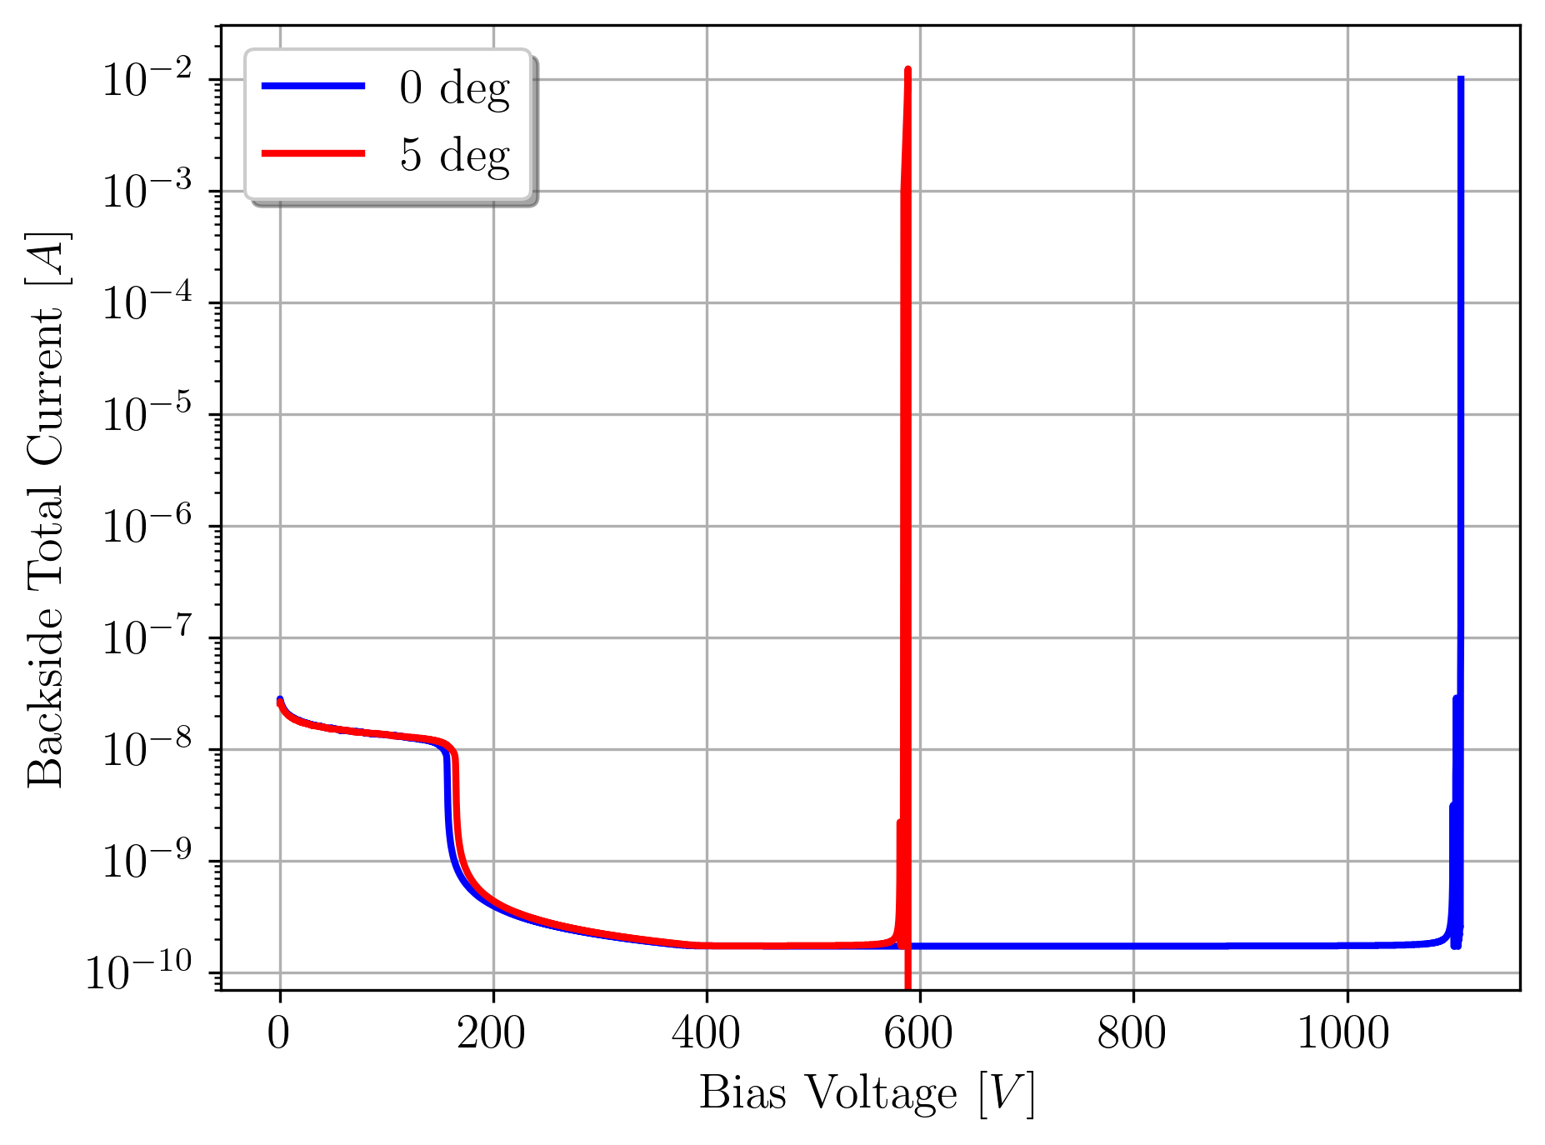
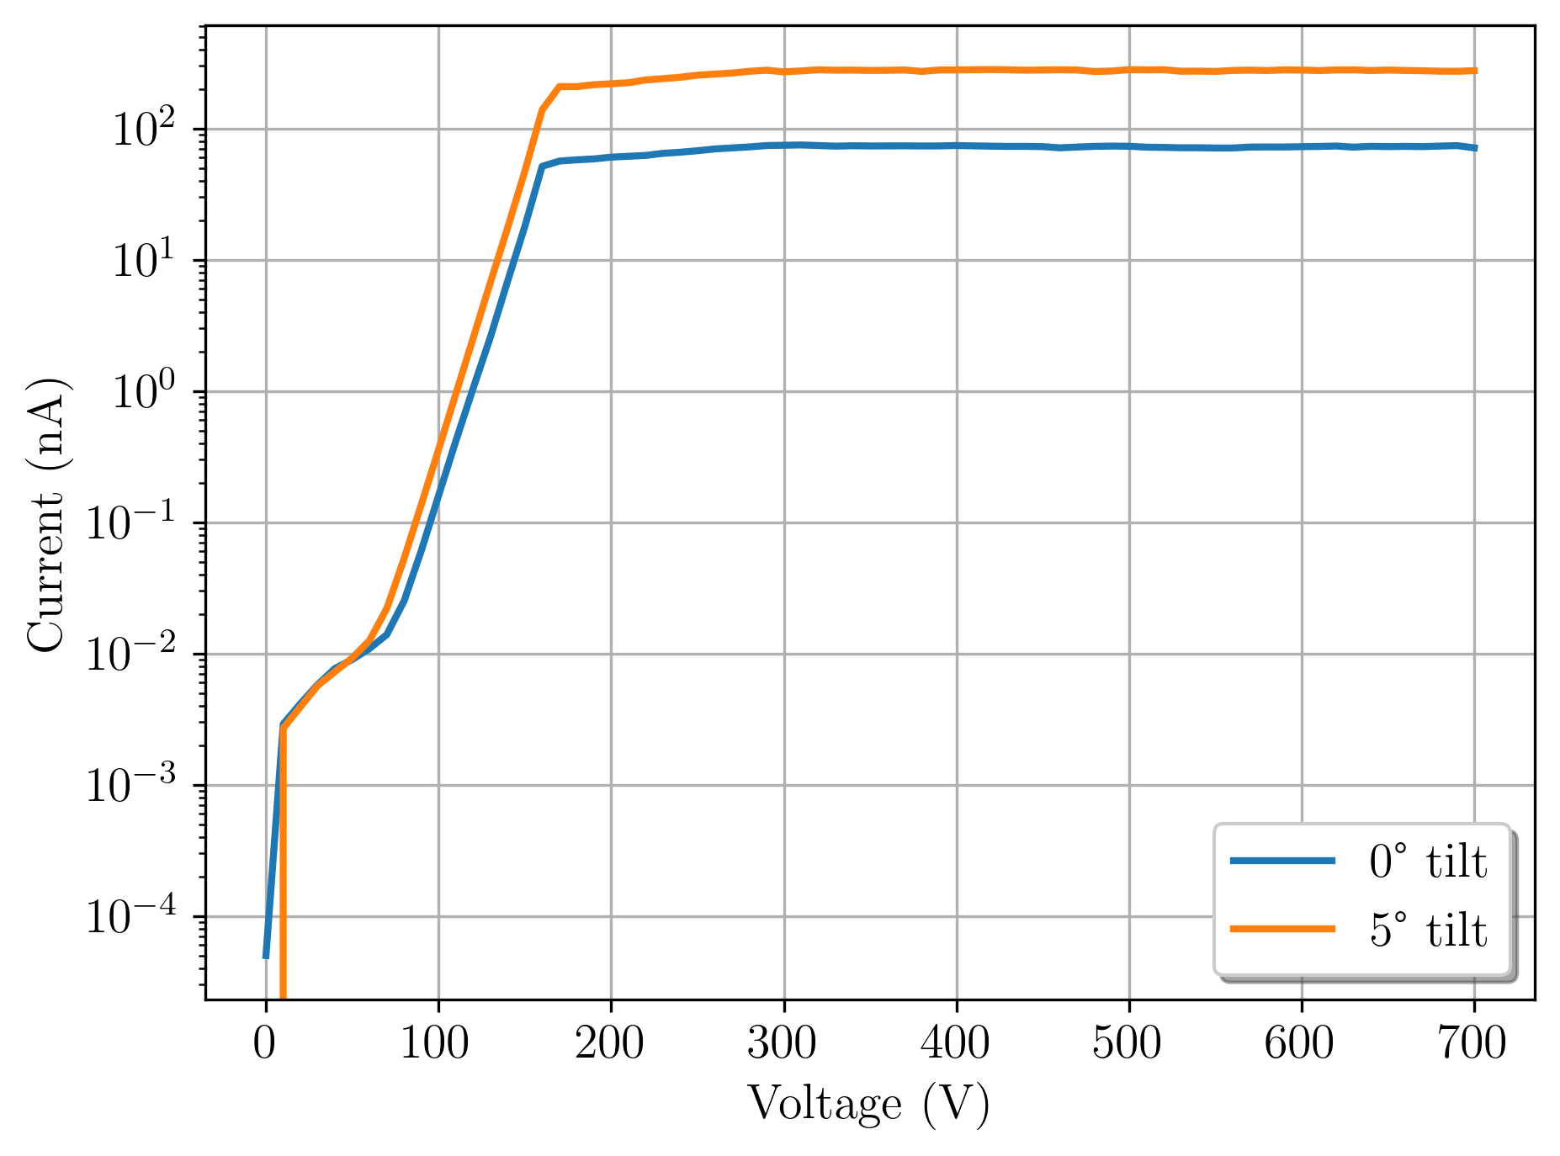
IV characteristics

