Slide 1
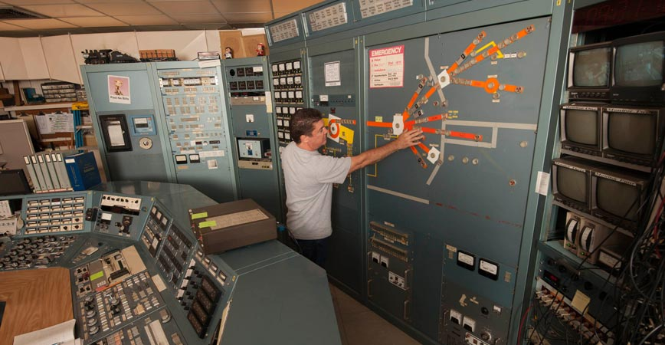
Radiation Facilities at UC Davis
Eric Prebys
Professor of Physics, UC Davis
Director, Crocker Nuclear Laboratory

Slide 2
Outline
Brief history of the Crocker Nuclear Laboratory Cyclotron
Beam services provided for users
  Protons
  Deuterons
  Alphas
  neutrons
New capabilities
Opportunities for collaboration
McClellan Nuclear Research Center (TRIGA reactor)
  Neutron radiography (largest scanning bays in the world!)
  High flux neutron exposures

Slide 3
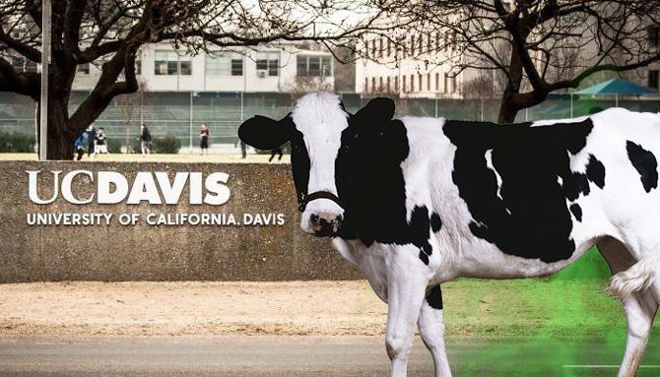
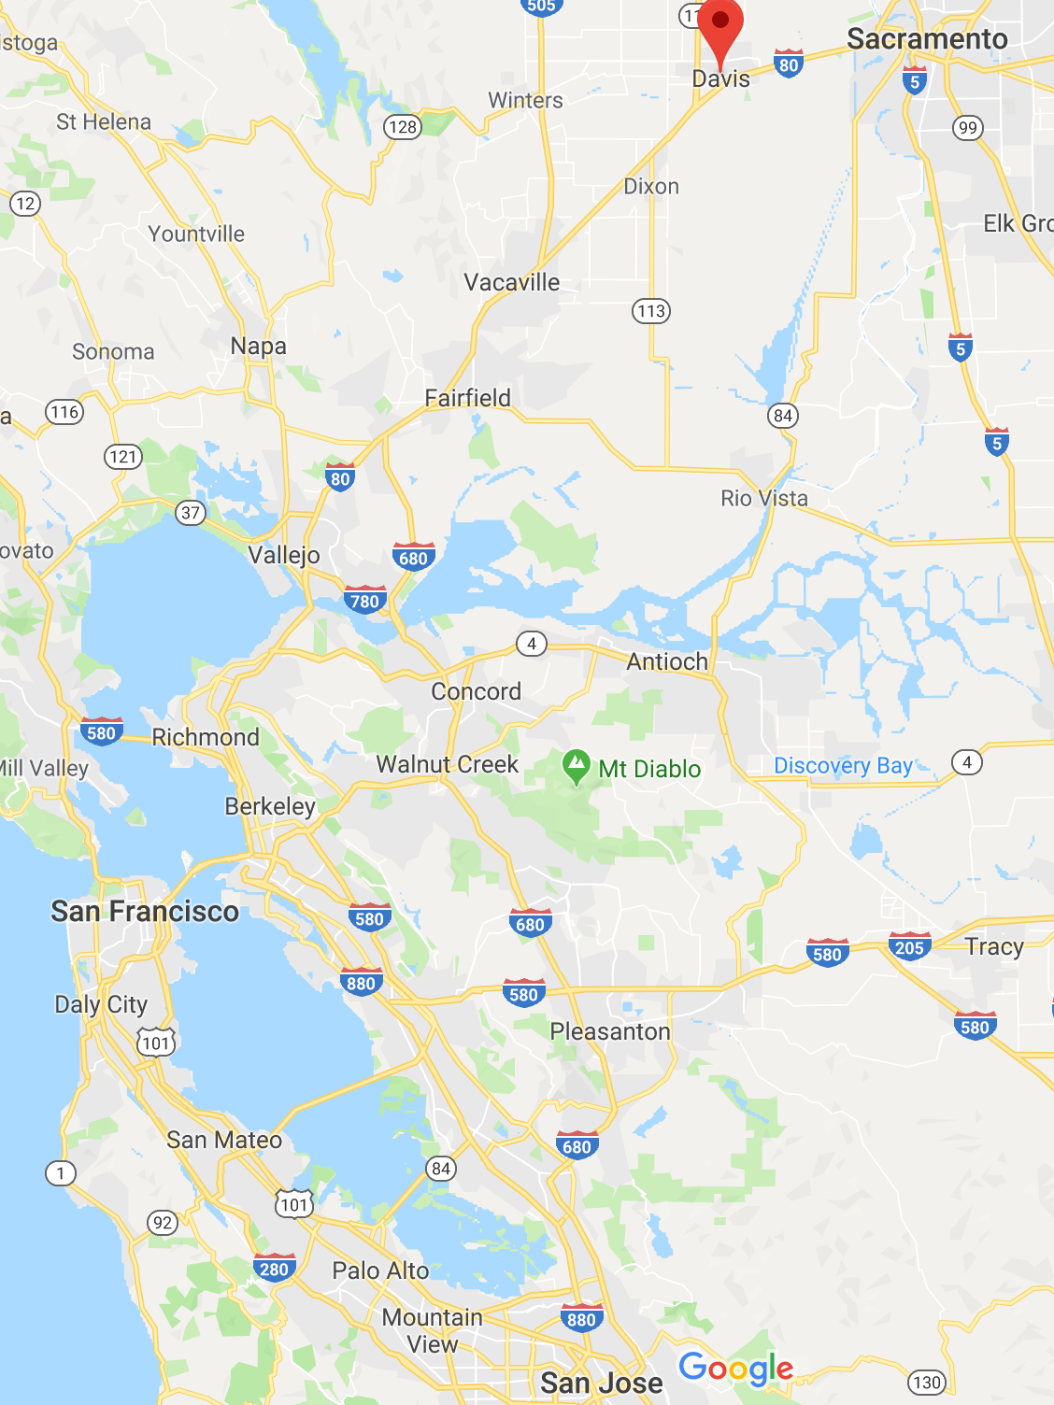
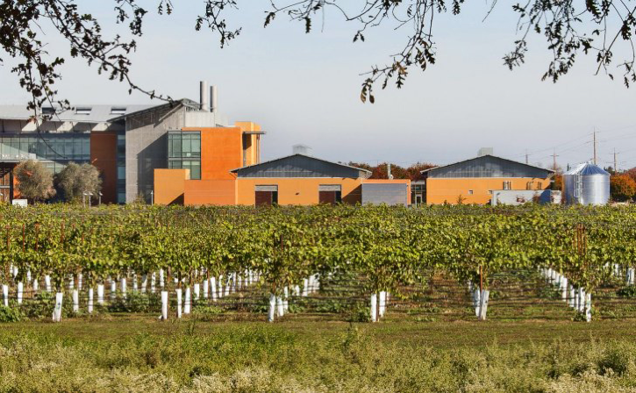
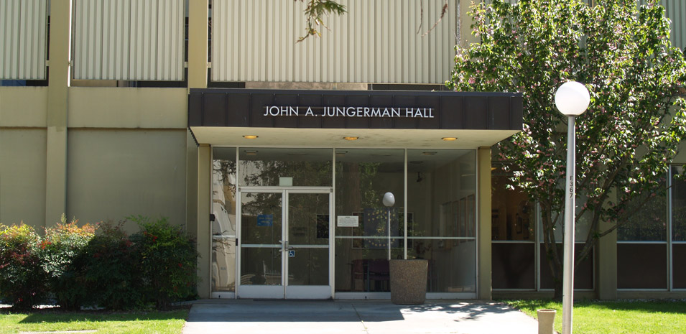
Orientation
CNL is “centrally isolated” at UC Davis, near Sacramento
Crocker Nuclear Laboratory

Slide 4
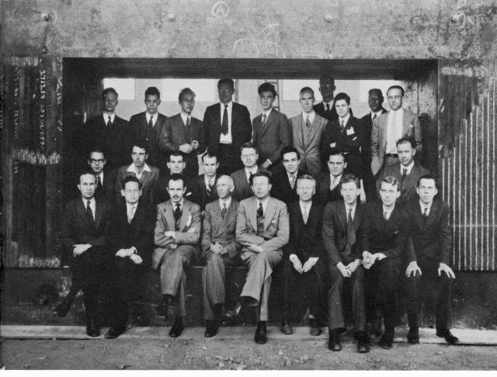
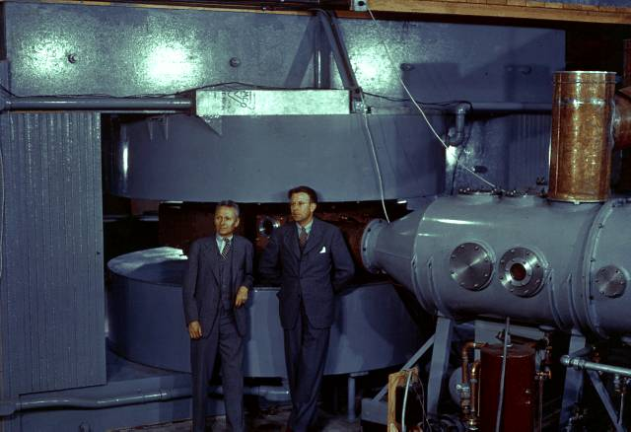
Crocker Origin: The 60” Cyclotron at LBNL (1939)
A few of the people in this picture:
  (a) Ernest Lawrence*, inventor of the cyclotron, pioneer
  in particle-based cancer therapy.
  (b) Louis Alvarez*, inventor of the linear accelerator
  figured out (with his son) why dinosaurs died
  (c) Edwin McMillan*, inventor of the synchrotron,
  discovered Plutonium with Glenn Seaborg
  (d) J. Robert Oppenheimer, father of the A-bomb
  (e) Robert Wilson, founder and first director of Fermilab
d
e
c
a
b
Up to19 MeV Deuterons
Discovered Plutonium and other transuranic elements
Prototype for many across the country
*Nobel laureate

Slide 5
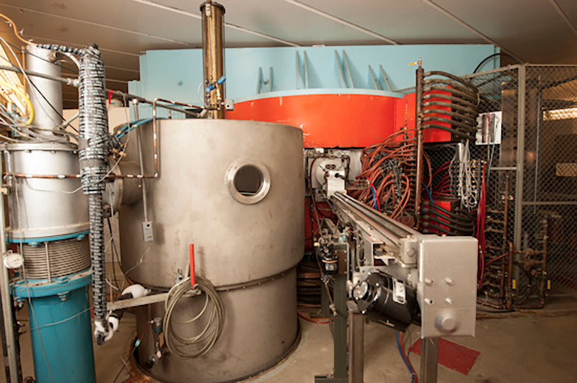
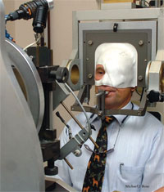
The Cyclotron at UC Davis
In the mid-1960s, the magnetic yoke and pole pieces were moved from Berkeley to UC Davis, and significantly upgraded
  Converted to AVF isochronous (copy of ORIC)
  Energy increased to 67 MeV
  for protons
  Can also accelerate Deuterons
  and Alpha Particles
The cyclotron was an important step
in establishing the Davis physics program
Did significant work in environmental
studies
Currently used for:
  Proton Therapy for uveal cancer in the eye
  (1 week/month)
  Radiation effects (this group!)
  Recently funded scientific programs
    Production of ²¹¹At as a potential cancer treatment
    isotope (requires alpha beam)
    ”Gamma camera” for localization of energy deposition
    during proton therapy
    Effects of radiation on synthetic human bone marrow
    High speed instrumentation for XFELs and proton
    accelerators

Slide 6
Crocker Layout
Cyclotron
Eye Therapy Facility (line 3)
High radiation line (line 0, former isotope production area)
Standard radiation effects line (line 2)
Secondary neutron line (line 5)/experimental counting area
Charged beam experimental lines:
(1a, 1b, 1c)

Slide 7
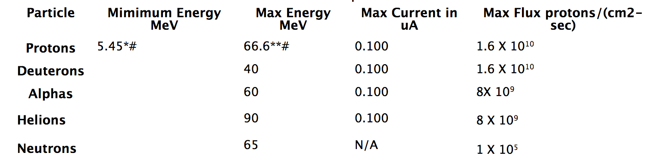
Available Beams
The CNL cyclotron can deliver the following variable energy beams, up to the following currents.
Beam time billed hourly, with an 8-hour minimum
  Final day of a multi-day run can be four hours
These fluxes assume the beam is passing through a diffuser, for uniformity. Much higher intensities can be achieved by removing the diffuser and focusing the beam

Slide 8
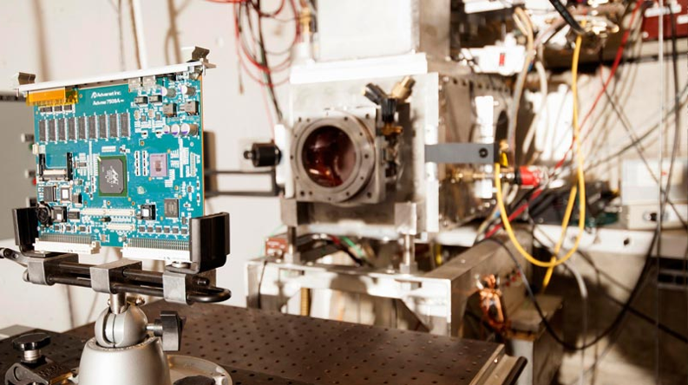
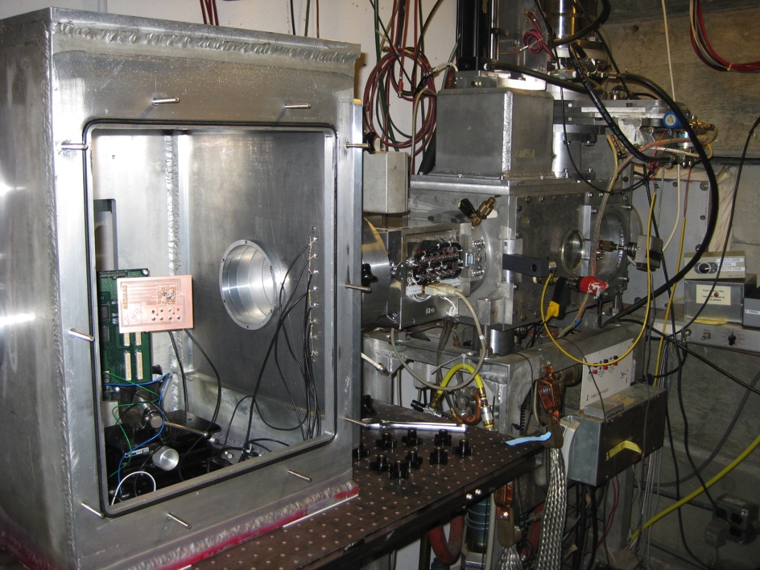
Radiation Effects Line (Line 2)
Patch panels, including
BNC connectors
SHV connectors
DB-9 and DB-20 cables
Ethernet
USB
Beam aperture: 6cm diameter full size
Numerous collimators available
Vacuum box with rotating stage also available
Moveable stage
Remotely or locally controlled
Vertical and lateral motion
Standard ¼-20 tapped holes on 1” grid

Slide 9
Dosimetry
Prior to exposure, a faraday cup is used to calibrate a SEM foil.
The Faraday cup is lowered, and the SEM foil is used to measure beam delivered.
Once beam is established, experimenters are given control
  Can set exposure by time or delivered dose
Transverse profile based on detailed measurements
  Uniform to within a few percent of 6 cm diameter

Slide 10
New: High Intensity Line (> 100 MRad Exposures)
Most of our users are interested in exposures of 100 kRad-1MRad
  100 nA limit in North Cave is well suited to them.
Some users (e.g. LHC) are interested in exposures of 100 Mrad (1 MGy) or more.
  Very long exposures in North Cave
  Causes unwanted activation
Resurrected an old isotope line
inside the vault
  1 μA over 1.5” diameter aperture
  → 100 MRad in 30 minutes!
Also adding post exposure ”hot
lab”
  Electrical tests
  Stress strain
  Thermal conductivity
Line 0

Slide 11
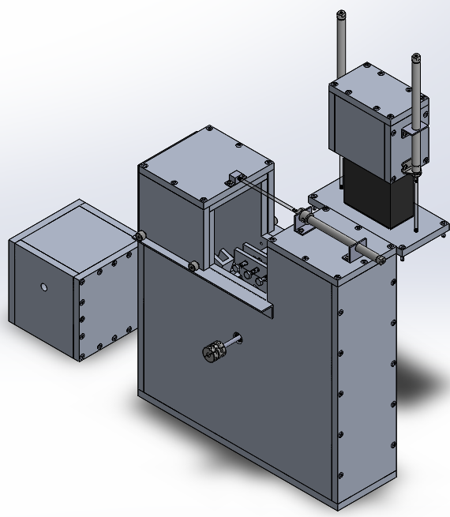
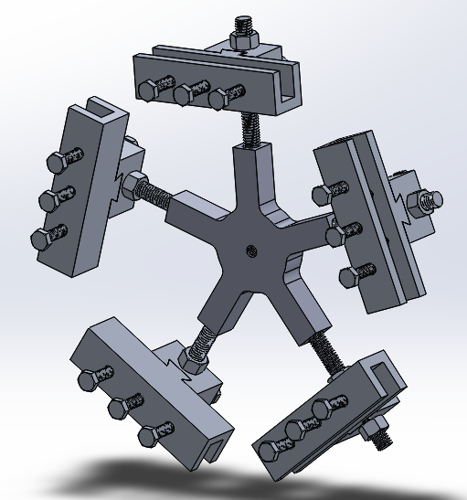
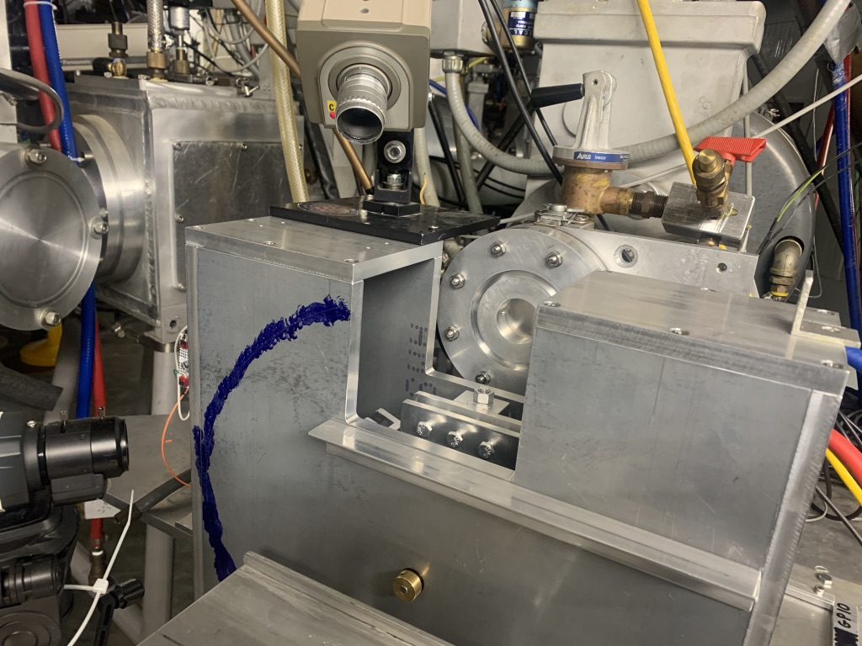
Target Changer
Both the sample and the area are highly activated after a 100 MRad exposure
  Generally need to wait overnight before accessing the area.
We have constructed a target changer that will allow us to irradiate up to five targets in a row, before accessing.

Slide 12
Comparison to other facilities
For particles through alphas, CNL is comparable to the LBNL 88” and the TAMU K150.
  We do not (yet?) have heavy ion capabilities, BUT
  We can now go to much higher fluxes
Some advantages of our facility
  Access to the North Cave is very fast
    Typically, about 1-2 minutes of overhead beam to beam
  We’re much cheaper than LBNL
  You don’t have to arrange your schedule work around our “Aggie” games
  Generally easier to get beam time.
  Because we only run day shifts (for now), we only charge for beam time
    Can arrange for users to do setup in the early morning or previous evenings.

Slide 13
New: X-ray Irradiation Facility
Soon, Crocker will add a commercial X-ray irradiation device.
  Spellman XRB150PN600 or eq.
  Capable of delivering 100 MRad in a few days
  Purchase funded by HEP Instrumentation grant
  Infrastructure and maintenance will be funded by user fees
    Working out rate, but much cheaper than cyclotron.
Stay tuned!

Slide 14
Scheduling, etc
Beam is reserved on a (mostly) first come, first served basis.
  Typically book 3-4 months in advance.
Currently, the facility only runs M-F, 8-4
  Users not charged for setup/teardown time outside of beam hours.
We have a blanket RUA for exposing anything with Z=82 (Pb) or lighter
  No individual SOW required
Can get approval for heavier elements in about 1 month
  Recently got approved to run radium
Training consists of reading the lab radiation safety handbook and agreeing to abide by it.
Proof of Covid-19 vaccination required for all users.

Slide 15
Opportunities for Collaboration
I was brought to UC Davis four years ago to increase the scientific output of CNL, while maintaining our commitment to the Eye Therapy Facility and our Radiation Effects users.
We are very open to projects with potential scientific impact:
  i.e. journal publications
Potential benefits to users include…
  Running priority
  Reduced beam rates
  Subsidized physics and mechanical support
  Dedicated or semi-dedicated beam delivery areas

Slide 16
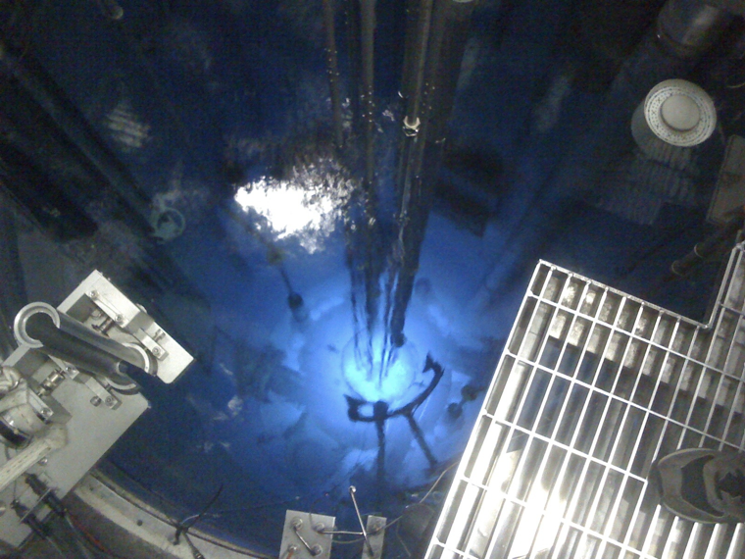
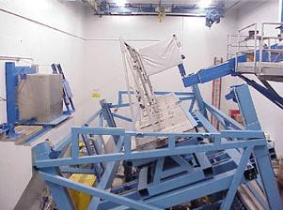
Other UCD Facility: McClellan Nuclear Research Center
MNRC is a 1MW TRIGA reactor at the former McClellan Air Force Base
  Belongs to UCD, but located in Sacramento
Those interested in high flux neutron exposures
or neutron radiography should consider this
facility
  Unique features
    World’s largest scanning bays.
    Multiple exposure options for samples

Slide 17
To Learn More…
Visit us online:
  Crocker: http://crocker.ucdavis.edu
  MNRC: https://mnrc.ucdavis.edu/
Or contact me: eprebys@ucdavis.edu

