Slide 1
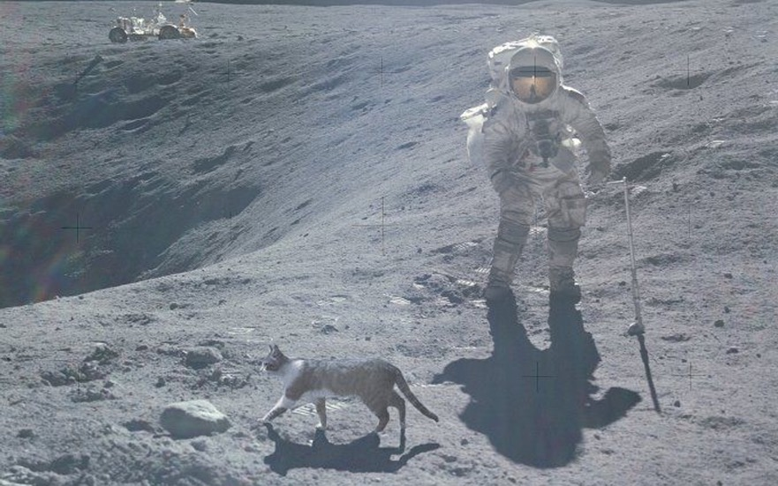
Using NSRL as a Test Beam
Snowmass Workshop on Calibration and Test Beams
and Irradiation Facilities Needs and Capabilities
1 December 2021
Michael Sivertz

Slide 2
Philosophy
The NASA Space Radiation Laboratory (NSRL) was designed by NASA with radiobiology in mind.
It is a NASA-owned Facility, that rents out beam time to non-NASA users when the schedule allows.
Users have a great deal of control over the operation of their experiments, along with a dedicated support staff.
Changing beam conditions (shape, flux, target) takes seconds.
Changing ion species or beam energy can be done in 2 – 3 minutes.
Beam flux is tailored for radiobiology: ~1 Gray/minute (100 Rads/minute).
This corresponds to ~3x10⁹ protons per cm² per minute,
or 4x10⁶ Fe ions per cm² per minute.
Beam spot is shaped magnetically to produce a large (20x20cm²) flat field.
Exposures take ~1 minute, target changes take ~5 minutes. Access is quick and easy, compared to RHIC/AGS experience.

Slide 3
Philosophy (continued)
NSRL operates for the NASA Radiobiology program for 6 months a year. During those months, there is little to no chance for non-NASA users to gain access to the facility.
It could be possible to fit in a short beam test of a few hours up to a day after hours or on weekends during the NASA program, but longer experiments would need extensive coordination.
Dedicated projects can purchase beam time between the NASA runs.

Slide 4
NSRL Beamline Design
NSRL Beamline designed to be achromatic with a series of 9 quads, 10 steering/pitching dipoles, and a pair of octupoles to produce a large bowl-shaped intensity distribution suitable for radiobiology experiments.

Slide 5
What NSRL can do!
Projectile Options:
  Protons
  Heavy Ions (Helium through Bismuth so far…)
Beam Energy
  50 – 2500 MeV for protons.
  50 – 1000 MeV/n for heavy ions up to Z=26 (Iron).
  Reduced peak energy for ions heavier than Iron, to 385 MeV/n for Bismuth.
  Stopping beam
Flux
  From 10 protons per spill to 2x10¹¹ protons per spill.
  From 10 to 2x10⁹ Fe-ions per spill.
Shape
  Large uniform square beam spot, up to 60 x 60 cm²
  As small as 1 cm spot size, uncollimated.

Slide 6
What NSRL cannot do!
Projectile Options:
  Neutrons
  Electrons (positron, muons, neutrinos…).
  Secondary particle beams (π, K, …).
Beam Energy
  No high energy beams possible.
Flux
  No “death ray” beams, limited by radiation safety envelop.
Shape
  No microbeams. It is hard to collimate 1 GeV protons, or even Fe beams.
Momentum analyzed final states
  No magnets in the target room.
  No tracking chambers.
No Vacuum chamber

Slide 7
Ions,
Energies, and
Flux
Momentum dispersion is
given approximately by
δp/p ≈ 0.005

Slide 8
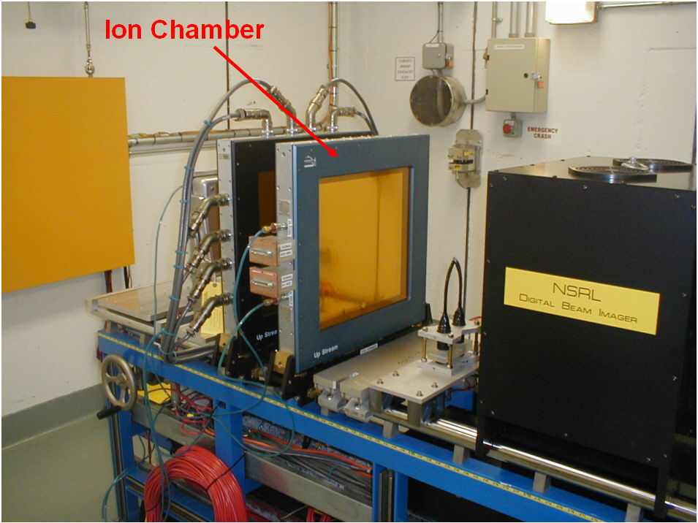
Beam Monitoring
High flux exposures make use of a large planar ion chamber to measure and cut-off the beam delivery.
Low flux exposures use a 1 cm² plastic scintillator (or scintillator pair in coincidence for proton beam running) to measure and cut-off beam.
Beam Camera gives real time information on beam status.

Slide 9
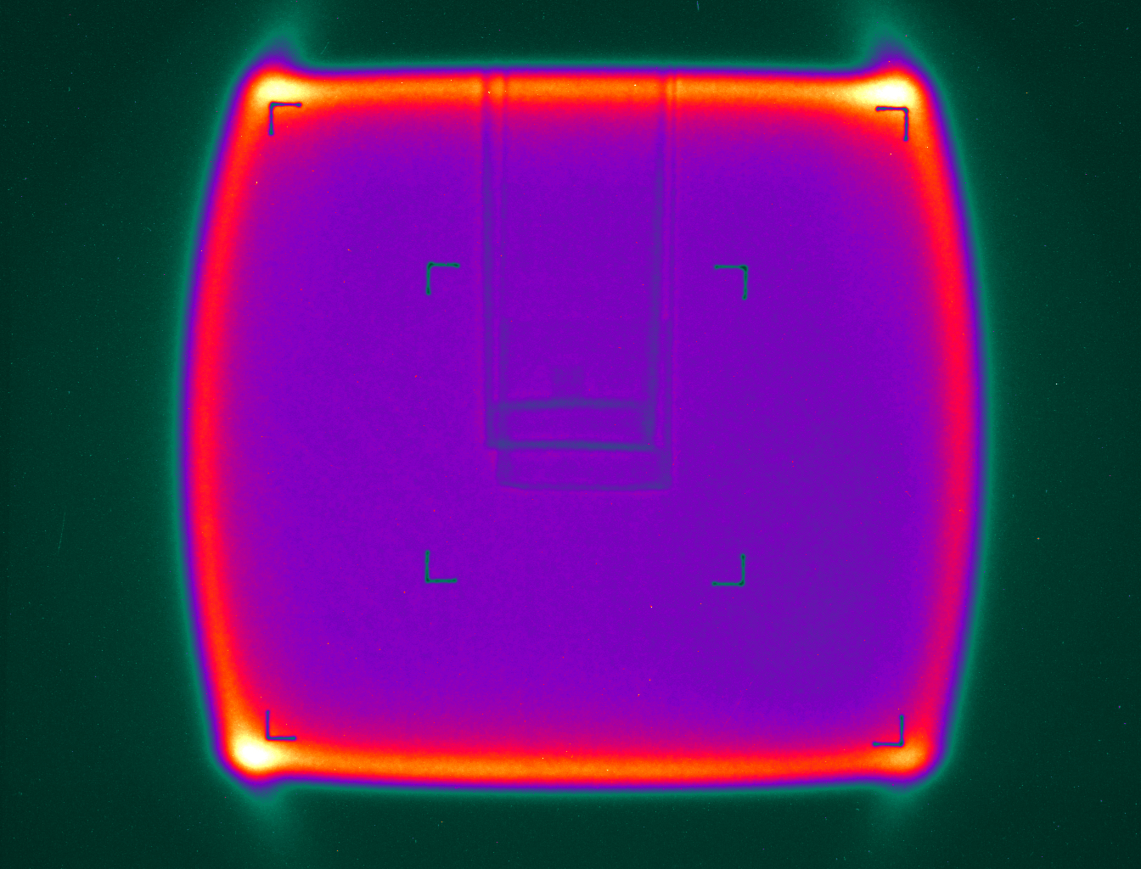
Beam Shape
Digital beam imager provides real-time information about beam intensity and shape.
Typical beam profiles are the square 20x20 cm² “biology beam”.
“Physics beam” is often a round Gaussian pencil beam, with FWHM of ~1cm.
Collimation down to ~1mm is also possible.

Slide 10
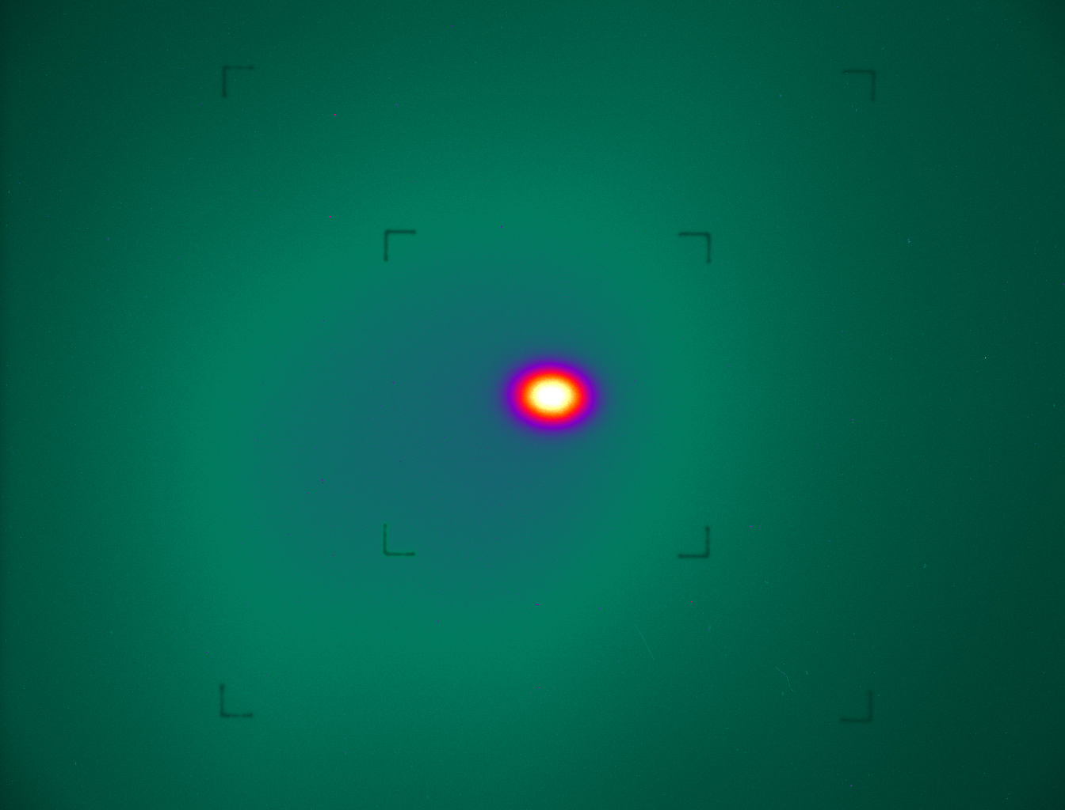
Beam Shape
Digital beam imager provides real-time information about beam intensity and shape.
Typical beam profiles are the square 20x20 cm² “biology beam”.
“Physics beam” is often a round Gaussian pencil beam, with FWHM of ~1cm.
Collimation down to ~1mm is also possible.

Slide 11
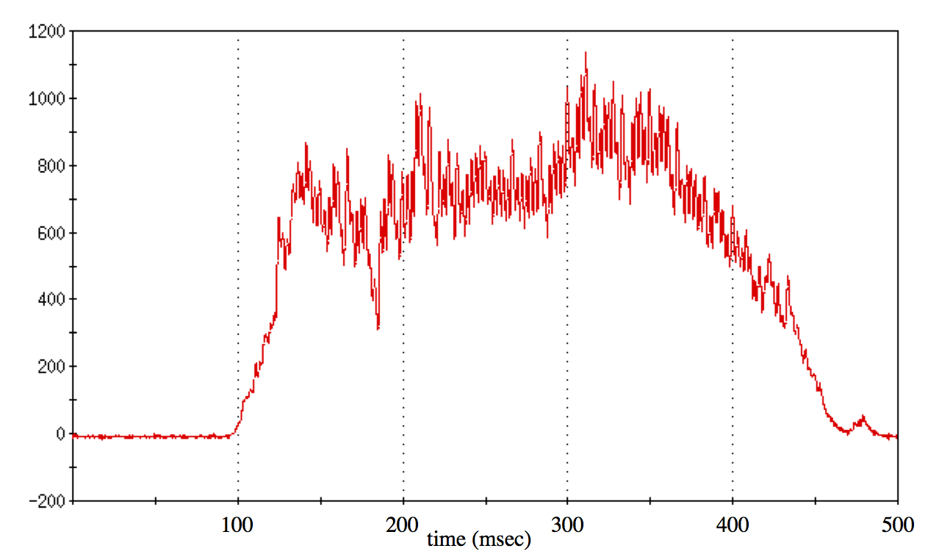
Time Structure
Beam comes from the Booster in “spills” every ~4 seconds (it was 6 seconds this year) in slow extraction.
Beam delivered to the target room during a ~300 ms spill.
There is some 60 Hz structure that survives filtering of the power
supplies, and additional
microstructure at ~2 MHz
that affects the duty cycle
of the data acquisition and
beam diagnostics.
The time structure changes
from spill to spill, and varies
with beam energy.
NSRL spill structure

Slide 12
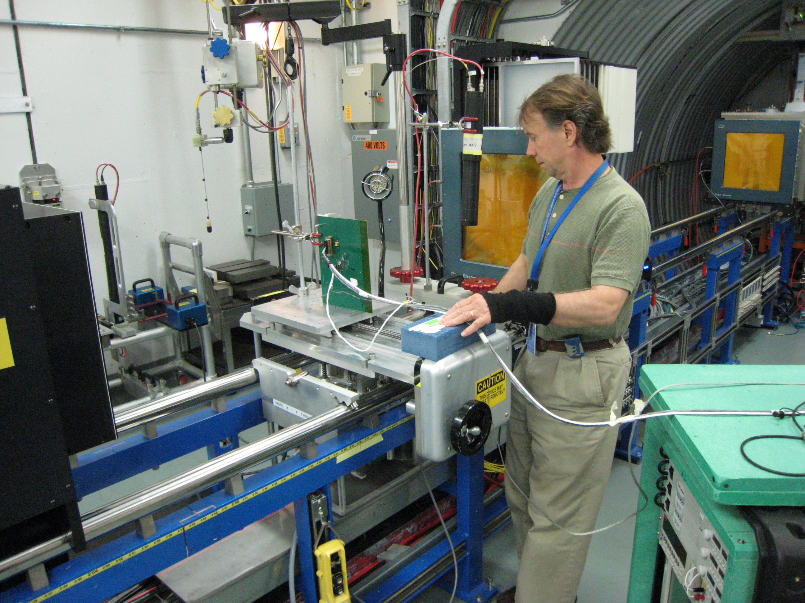
Infrastructure: Target Room
Target Room: 20’ x 20’ x 10’
Crane coverage – ½ ton capacity.
Laser alignment tools make finding beam center easy.
Rails to mount targets on standard mounting plates.
Remote target control:
Target table with X-Y stage.
Rotational table.
4-ft Translation table.
Energy degrader

Slide 13
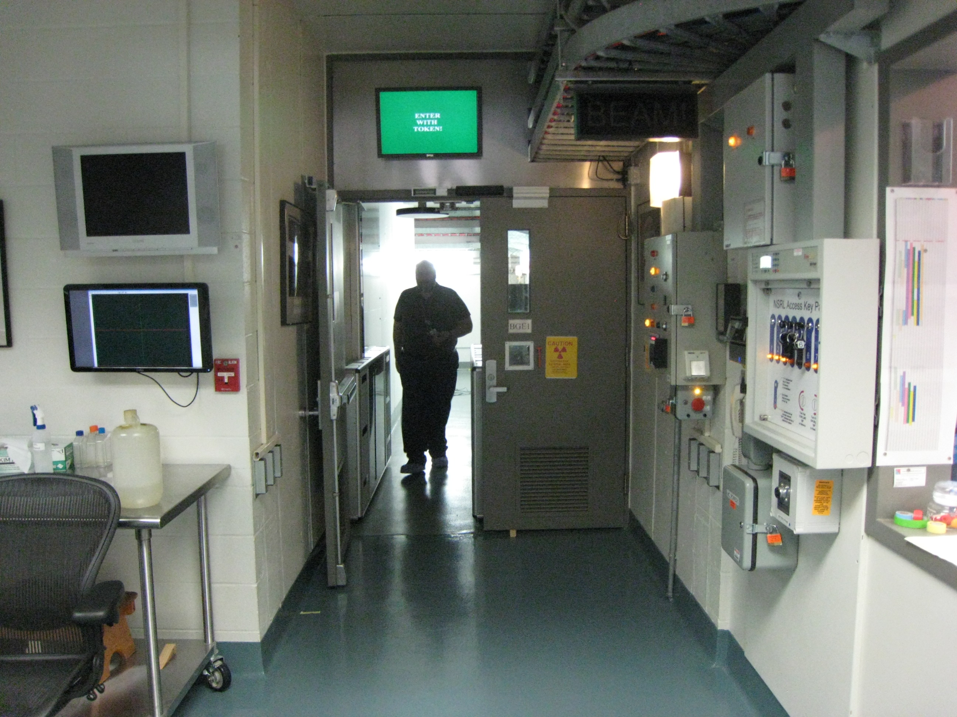
Infrastructure: Access
Entry doorway is 28” wide.
It can be made 72” with some work.
Labyrinth to Target Room has 4 corners and 59” width.
Access during running requires iris scan, magnetic key, and RFID tag to get past “people-reader”.

Slide 14
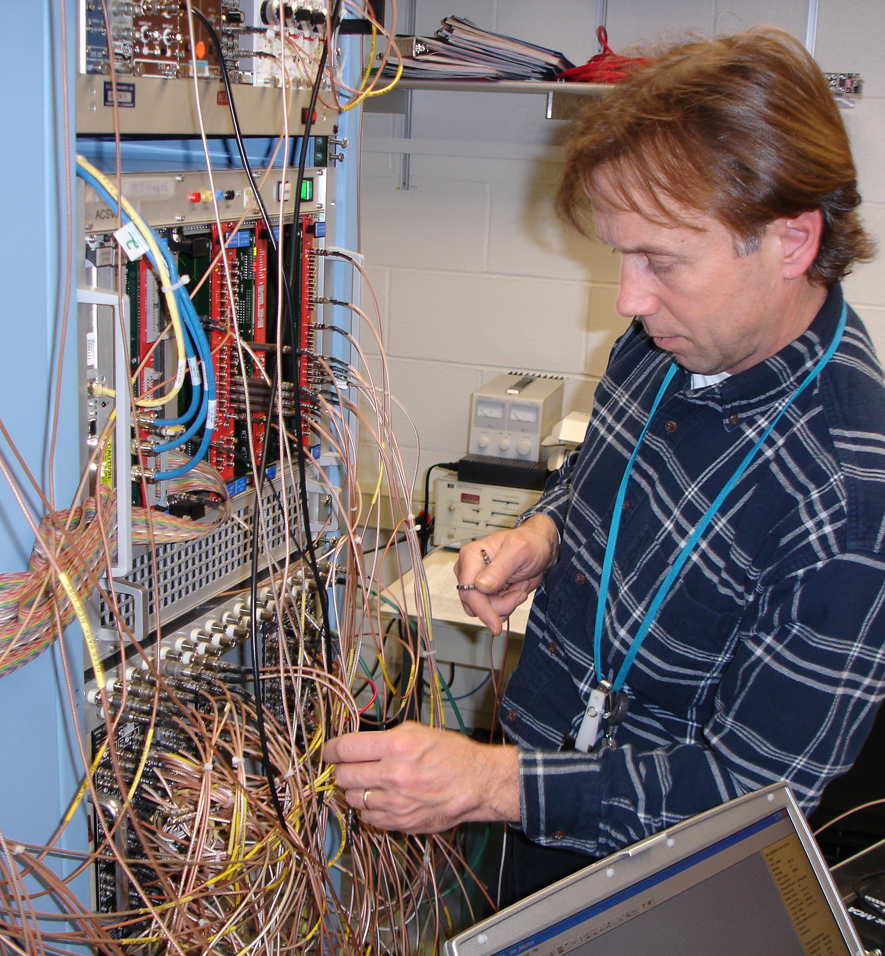
Infrastructure: DAQ
VME-based data acquisition system
Flexible, user configurable
2 kHz event rate
12- and 16-bit ADC and QDC
35-ps TDC
300 MHz scalers
Optical Bridge
32-channel HV
64 RG-58 signal cable patch panel
32 RG-59 HV cable patch panel
3 Tri-ax high-speed low-loss cables
3 Ethernet cables

Slide 15
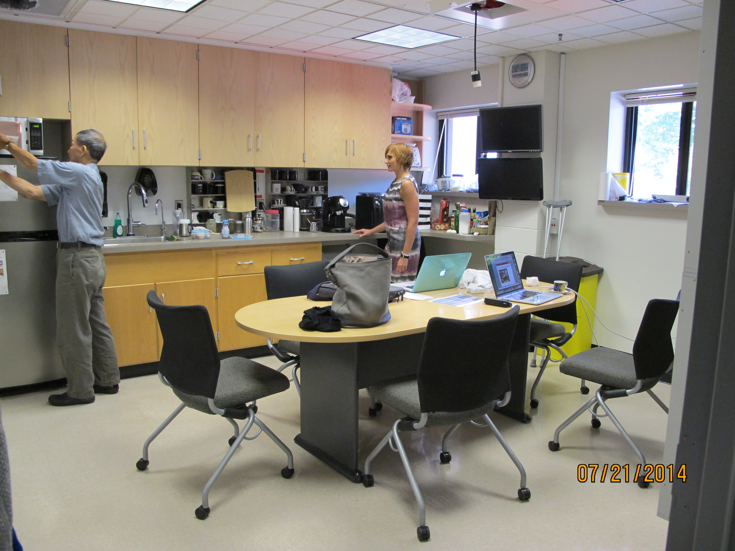
This is where the science happens!

Slide 16
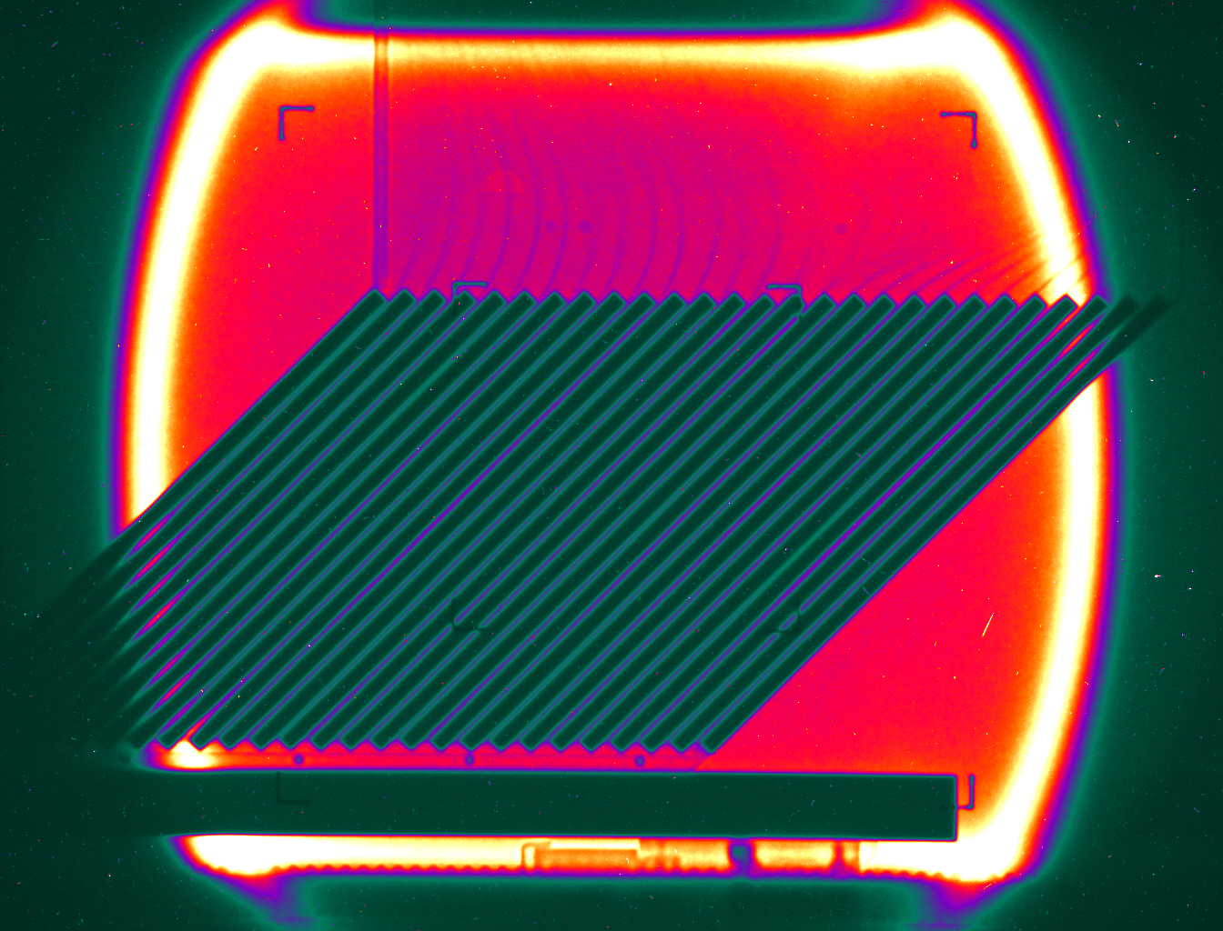
Examples: PHENIX ZDC
“Ferrograph” of the PHENIX ZDC module being calibrated with a 56 GeV Fe-beam (1000 MeV/n).
Data taken using the NSRL DAQ.
Entire process took less than an afternoon.

Slide 17
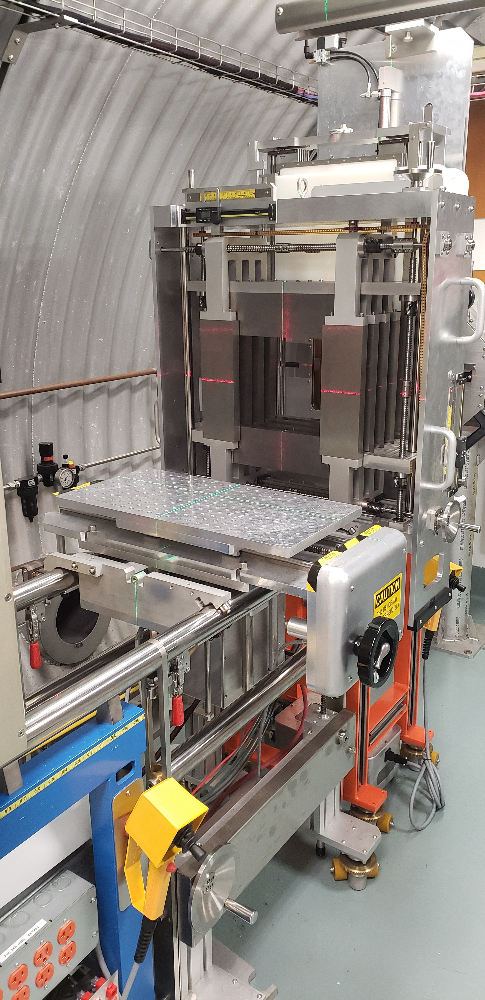
Summary
NSRL can be a valuable tool for users interested in detector development, response testing and calibration of experimental equipment.
The most valuable tool is the
skilled and enthusiastic engineering
and support staff who are dedicated
to making every experiment at
NSRL a success.

