Slide 1
Accelerator Test-Beam Capabilities at BNL
Accelerator Science & Technology Office
Mark Palmer
Snowmass Instrumentation Frontier Topical Group 9 Meeting
12/1/2021

Slide 2
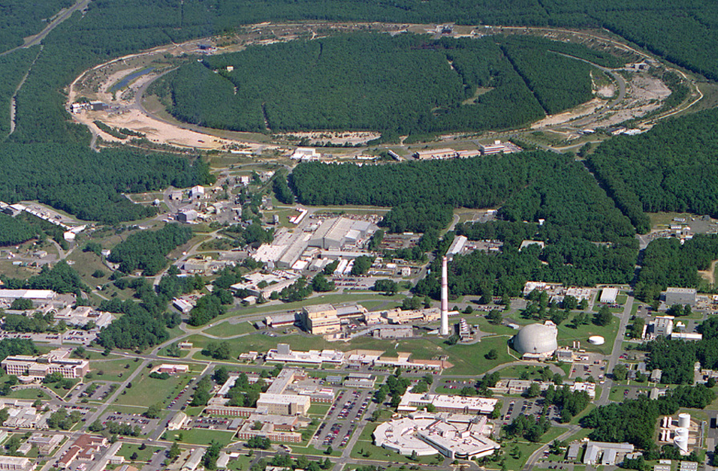
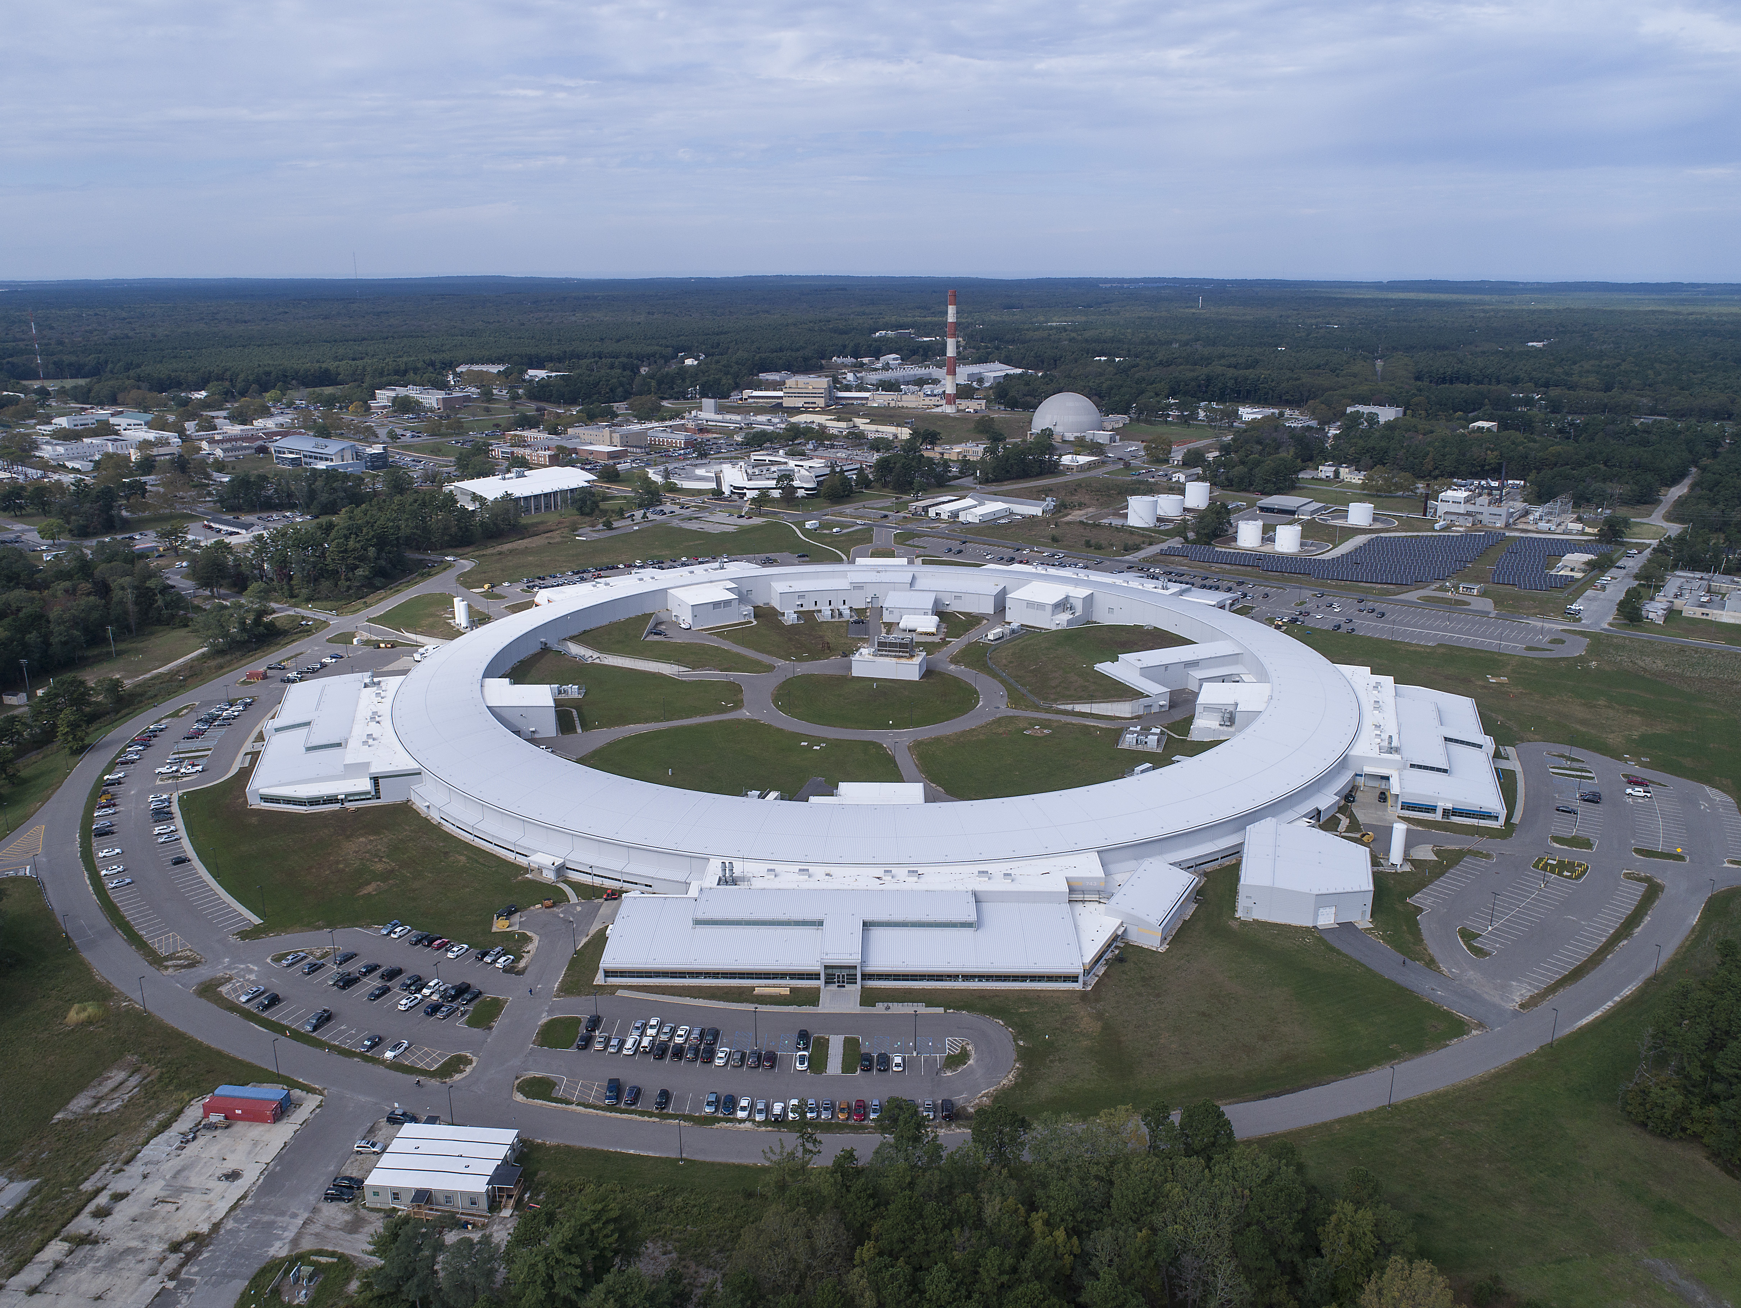
The Brookhaven Accelerator Complex
Polarized Jet Target
Complex supports a broad range of beam test options
Electron lenses
RHIC
Electron cooling
(s)PHENIX
RF
STAR
LINAC
NSRL
EBIS
Booster
SRF
BLIP
AGS
TPL
Tandems
ATF
Diverse Accelerator Complex: e⁻ a ions
Accelerator-based SC User Facilities: RHIC (NP), NSLS-II (BES), ATF (ARDAP)
Laboratory-operated User Facilities: Tandem Van de Graaff,
NASA Space Radiation Laboratory (NSRL)
Brookhaven Linac Isotope Producer (BLIP)
Future Capabilities Being Developed: Electron-Ion Collider (NP)
High Energy Effects Test (HEET) Facility @AGS
NSLS-II

Slide 3
Overview of Beam Test Capabilities
Will provide a brief overview of BNL beam test capabilities:
Proton/Ion Facilities
  Tandem Van de Graaff
  BLIP a NSLS-II Materials Analysis
  NSRL (see Mike Sivertz’ talk for more details)
  Emerging AGS options (HEET)
Electron Facilities
  ATF
  NSLS-II
How to connect to BNL beam test resources

Slide 4
Tandem Van de Graaff

Slide 5
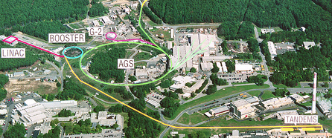
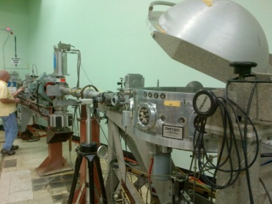
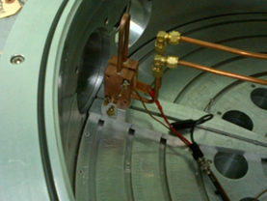
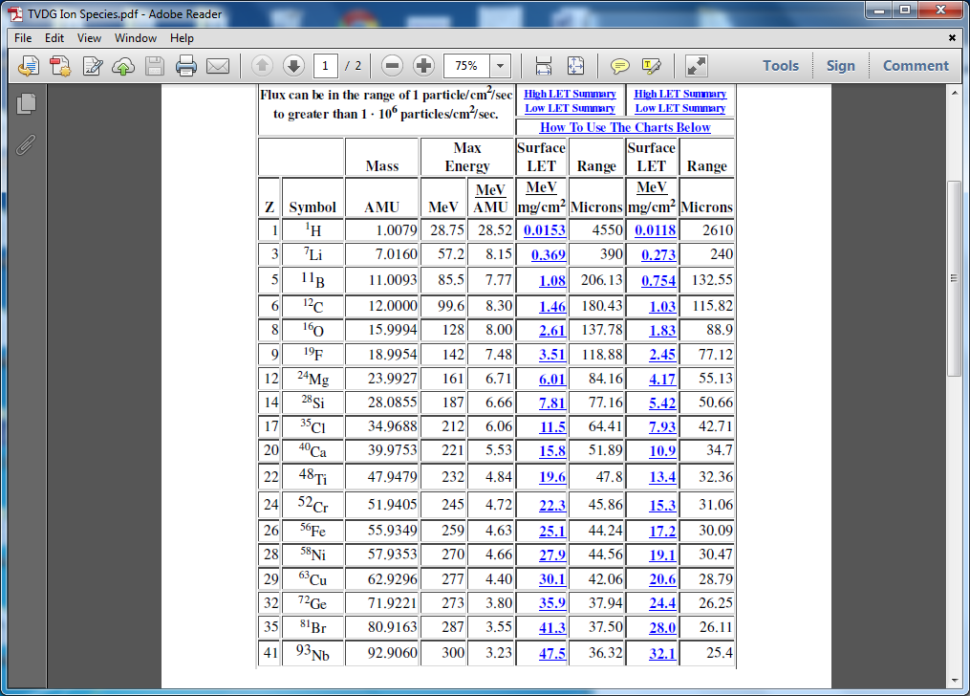
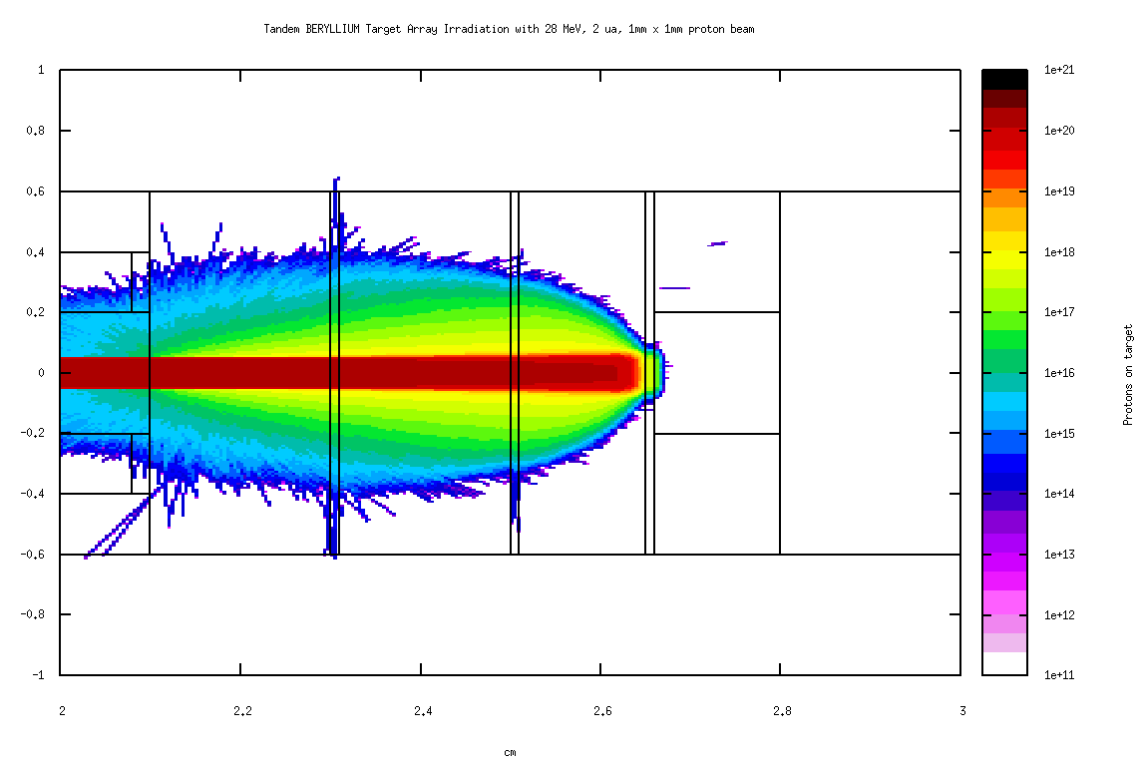
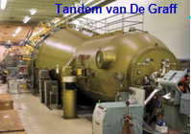
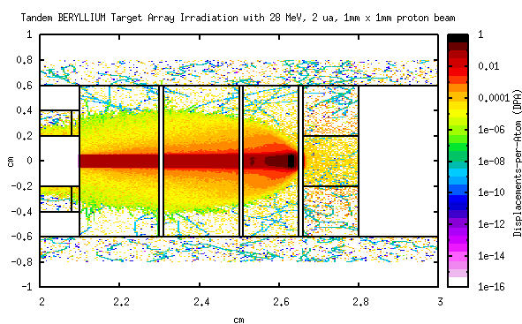
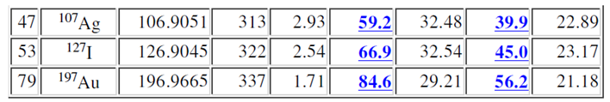
Tandem van de Graaff Capabilities
Target Irradiation Beamline
Ions Available at Tandem

Slide 6
Brookhaven LINAC Isotope Producer - BLIP

Slide 7
Targetry Studies: BLIP
& NSLS-II
Courtesy Nick Simos

Slide 8
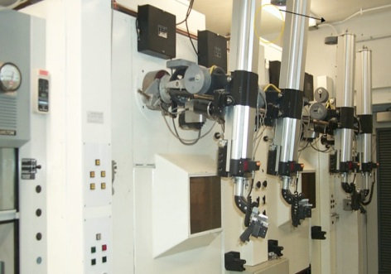
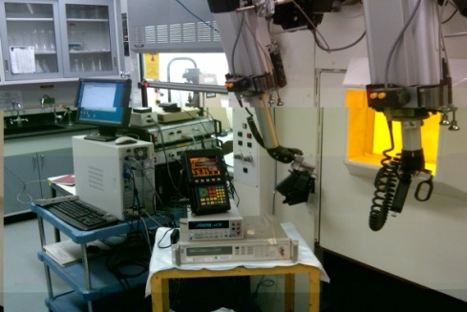
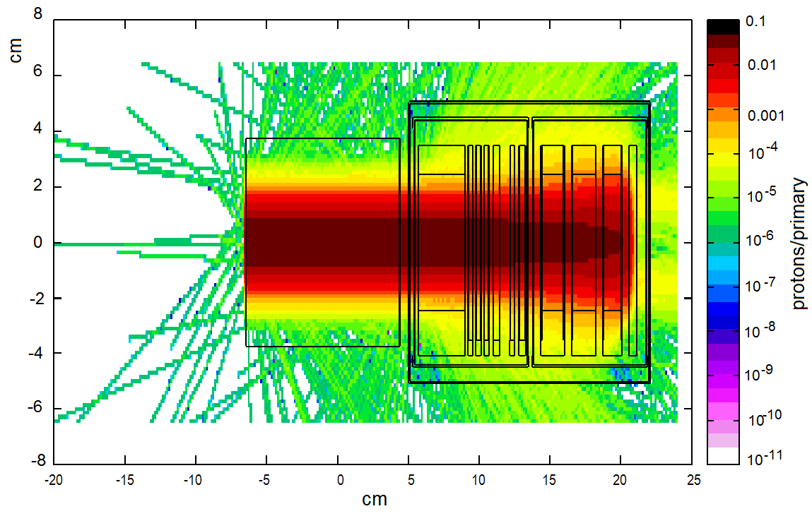
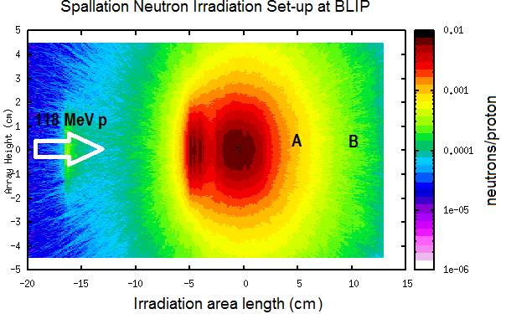
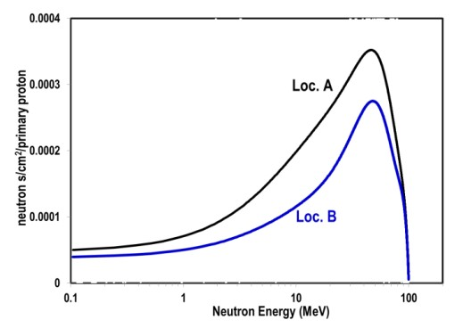
BLIP Irradiation Capabilities
Multiple proton energies 66-200 MeV
Beam current (165µA +)
Beam rastering
Typical RUN cycle (December – July)
Operates in tandem with Isotope production and RHIC
(no dedicated beam time needed)
Fully operational hot cell laboratory & infrastructure Availability of nuclear instruments/technical expertise Can operate as neutron spallation source
Mode I: Irradiation with BNL Linac protons (up to 200 MeV)
Mode II: Target endstation as a Neutron Source
Fusion spectrum similarities
Position A
Position B
Beam

Slide 9
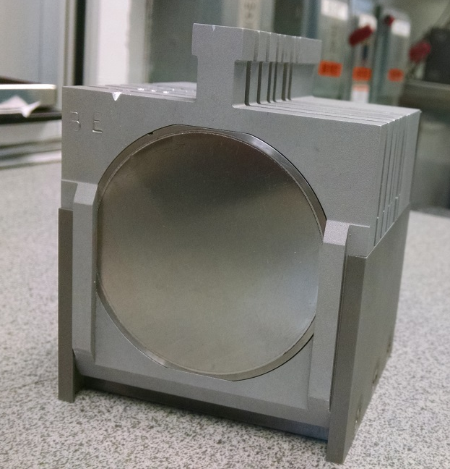
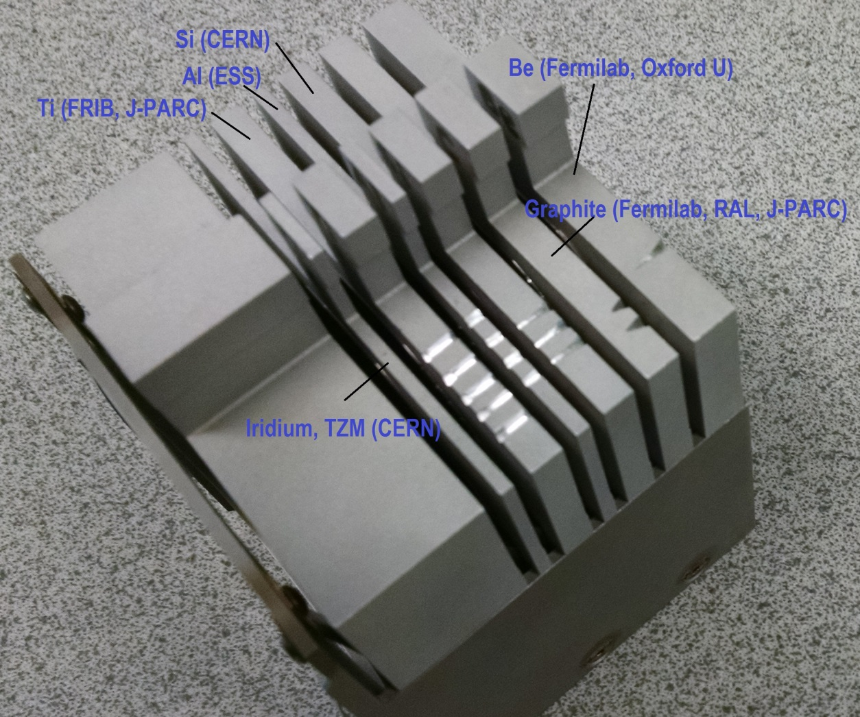
Irradiation Damage Experiments
Aim: reach proton fluence levels that approach threshold or operational goal
Target Array in Beam

Slide 10
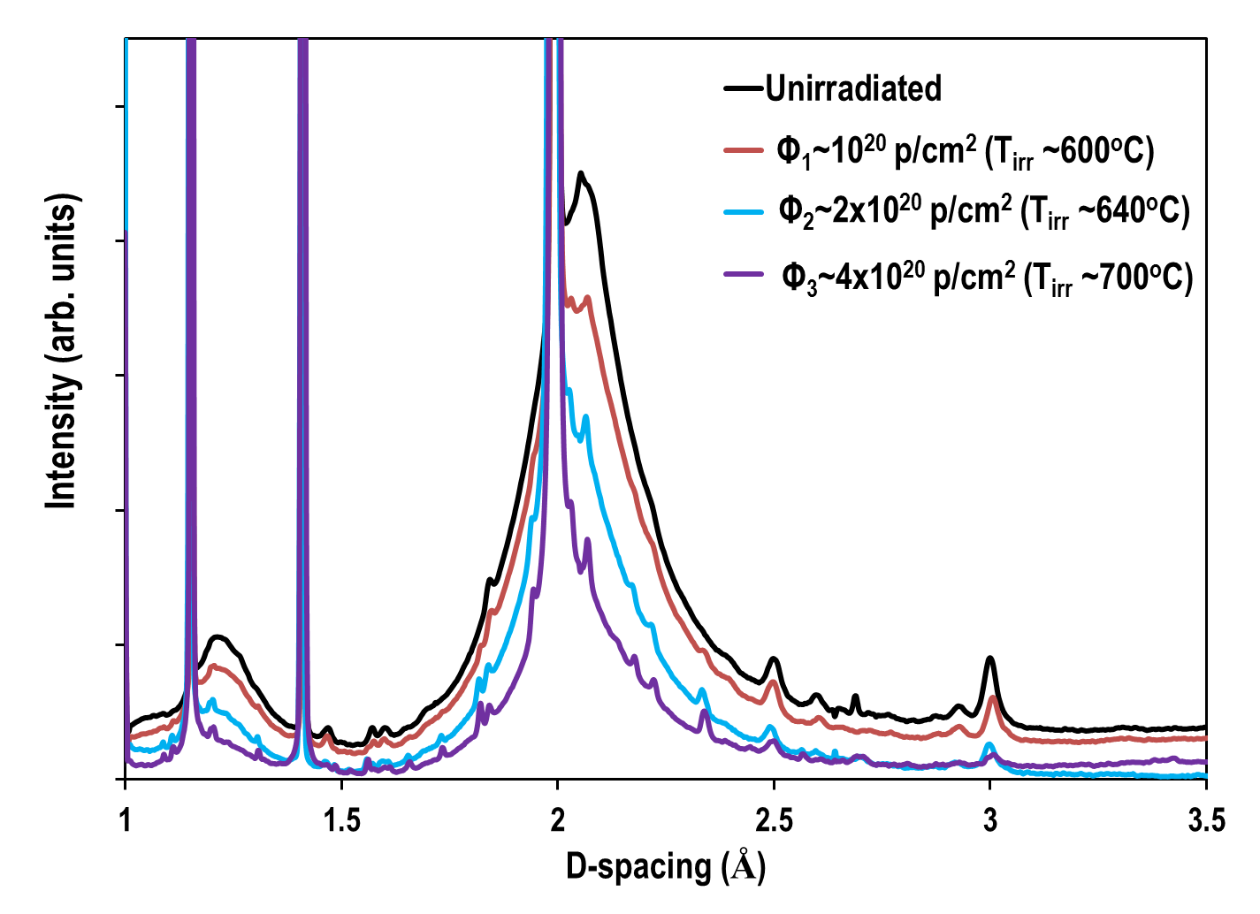
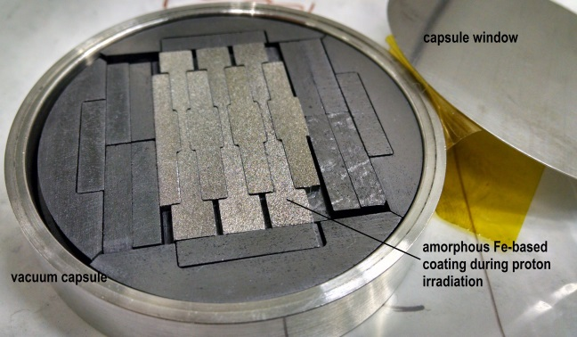
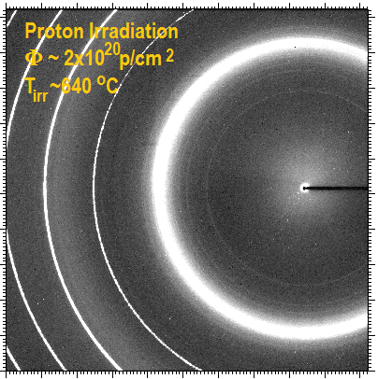
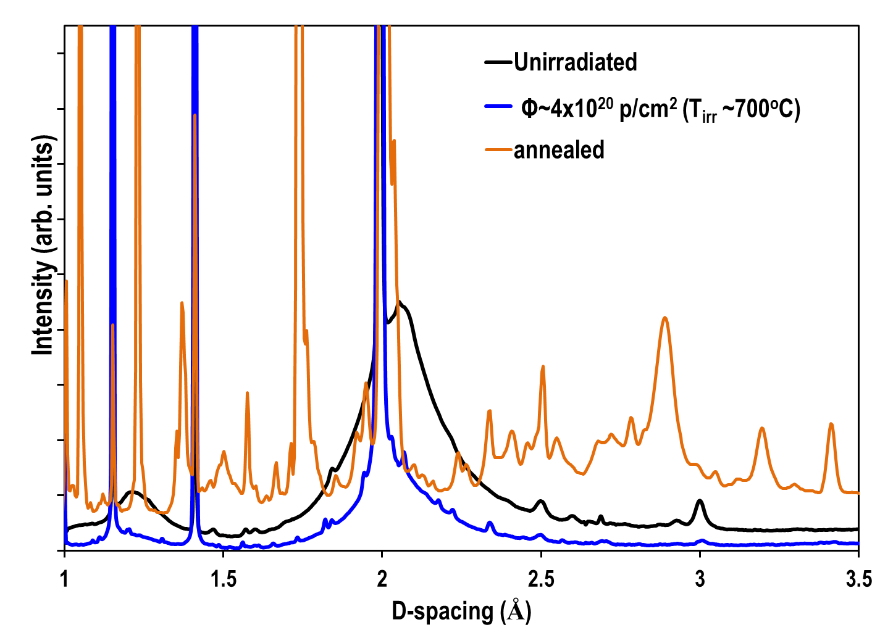
Nano-structured Fe-based Coatings on Steel
BNL studies demonstrated the remarkable ability of nano-structured coatings to remain amorphous under intense proton irradiation.

Slide 11
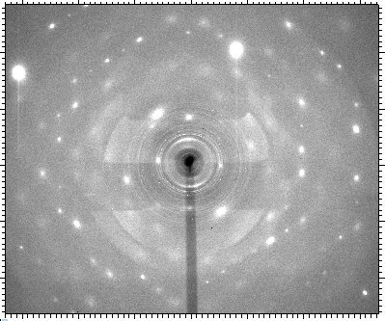
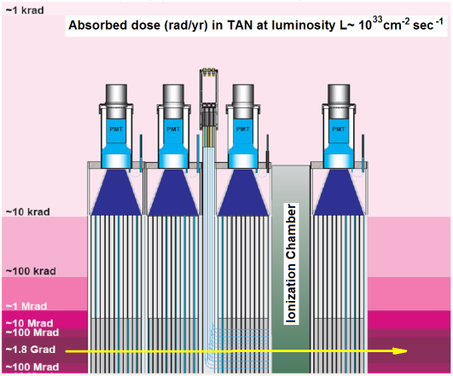
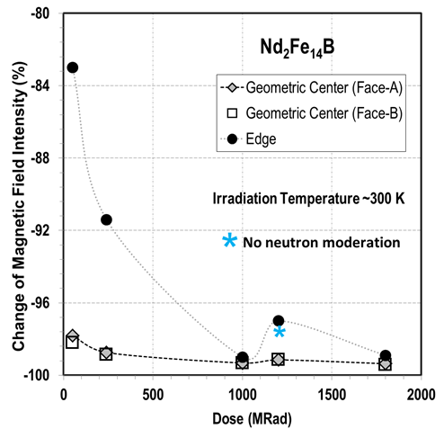
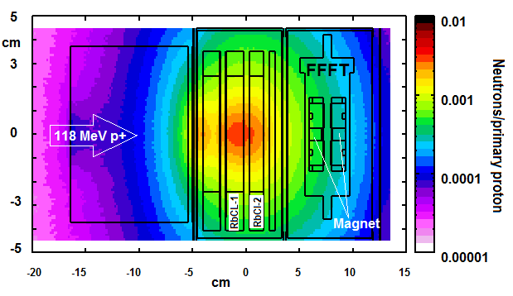
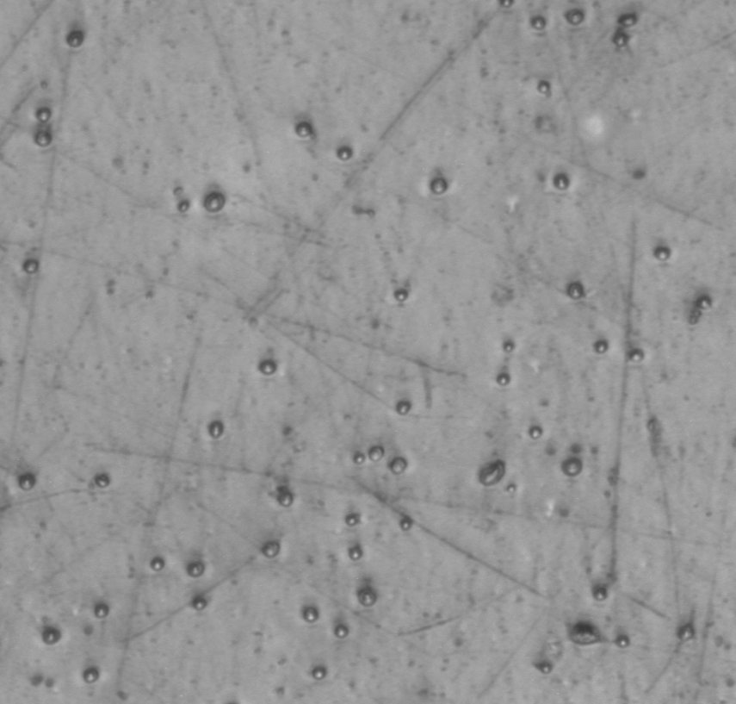
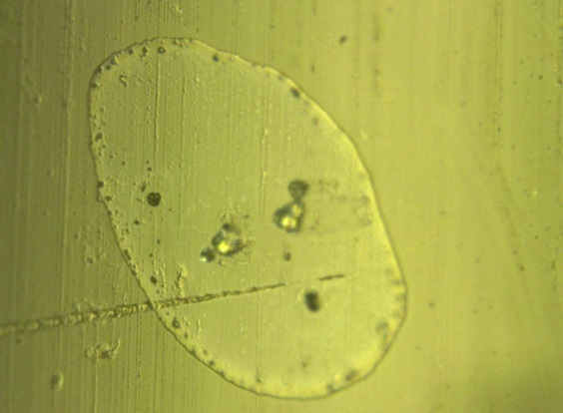
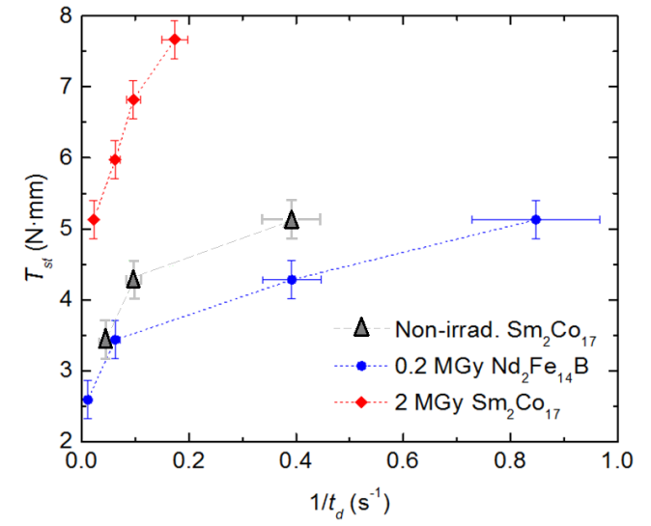
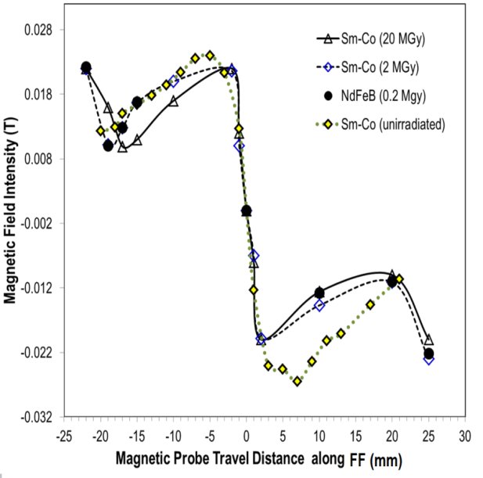
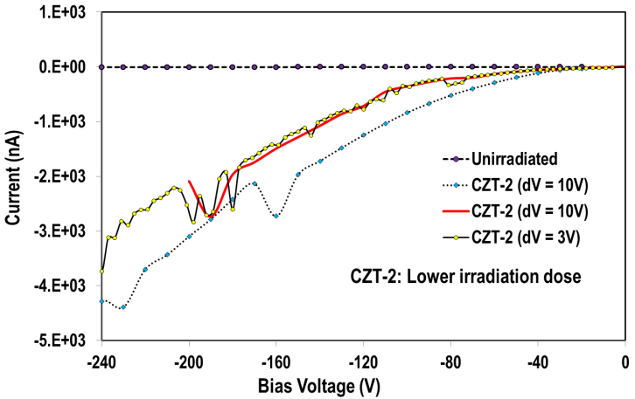
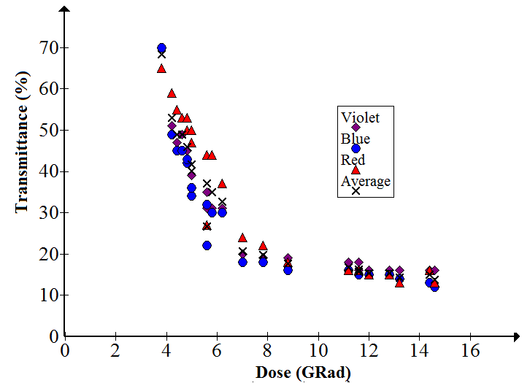
  CZT crystals
SiO₂: LHC
0-degree calorimeter
  Rare-earth magnets
  Ferrofluidics
  Performance Degradation of Ferrofluidic Feedthroughs in a Mixed Irradiation Field
FF static torque vs. the inverse of displacement time
(1/t_{d}) following rotational speed cycles up to 5,000 rpm

Slide 12
NASA Space Radiation Laboratory (NSRL)
See also next talk by Mike Sivertz

Slide 13
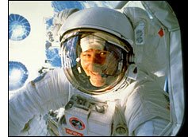
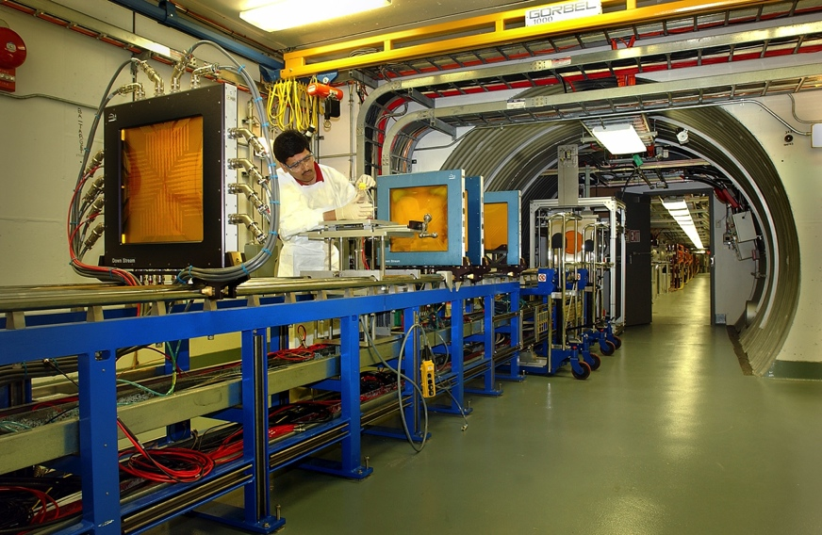
NASA Space Radiation Laboratory (NSRL)
Started in 2003, simulates galactic radiation for human space flight
  Heavy ion beams from AGS Booster
  Electron Beam Ion Source (EBIS)
  provides all necessary ion beams
  New laser ion source for EBIS allows
  for rapid species switching to simulate
  energy and species spectrum of deep space radiation field
Additional uses of NSRL
  Radiation effects studies (rapidly growing demand for satellite electronics testing)
  R&D of ion beam cancer treatment
  Agreement with NASA in place for non-NASA users (“non-designated user facility”)

Slide 14
AGS Future Possibilities: HEET

Slide 15
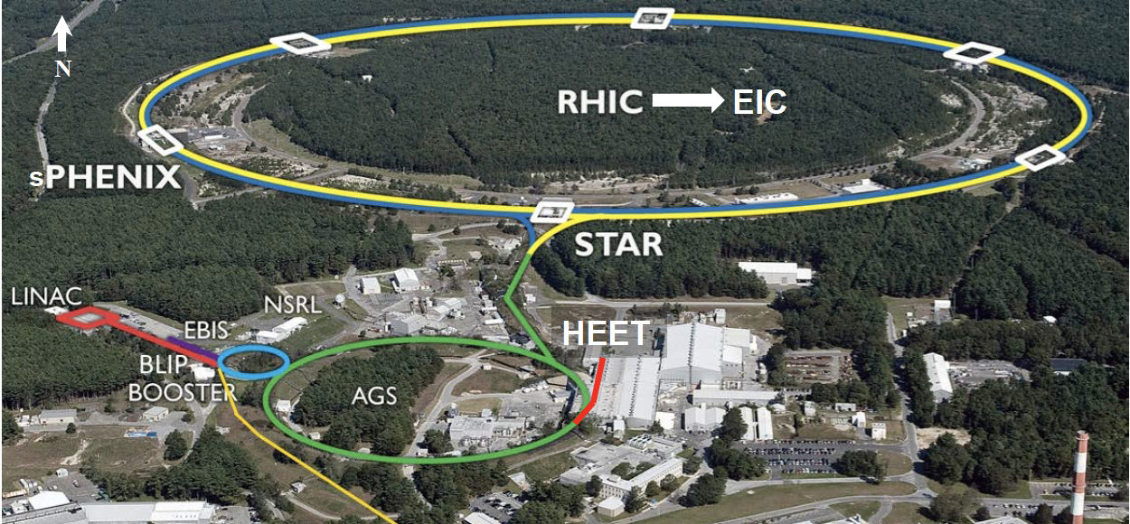
Proposed High Energy Effects Testing Beamline - HEET

Slide 16
HEET Overview
Large range of beam energies (e.g., 40 -2000 MeV/n Fe21+ions)
Large number of available ion species (e.g., H to U [Z = 1 to 92] and more)
Fast energy change (minutes)
Fast switching of ions (minutes)
3D Uniform Beams
  Square uniform beam sizes from 1 cm2 to 400 cm²
Pencil beams on the scale of 1 cm rms (Smaller also possible)
Many operational similarities to NSRL (next talk by M. Sivertz)
If approved, could be online in 3-4 years

Slide 17
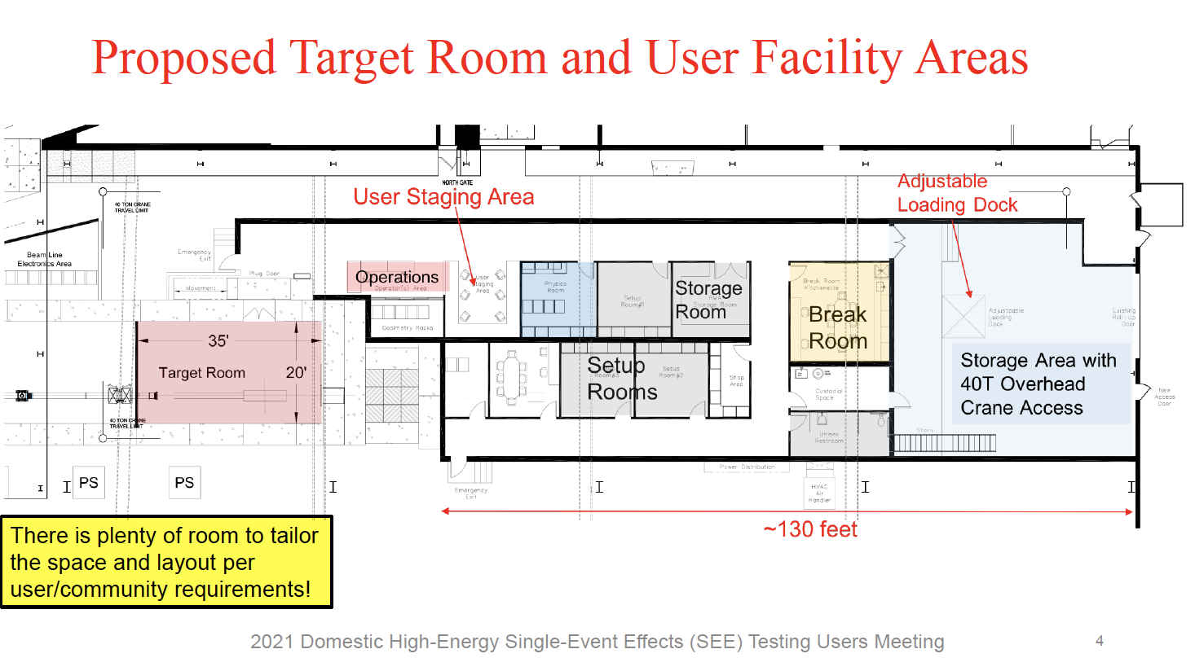
Courtesy: K. Brown

Slide 18
Electron Capabilities:
ATF & NSLS-II

Slide 19
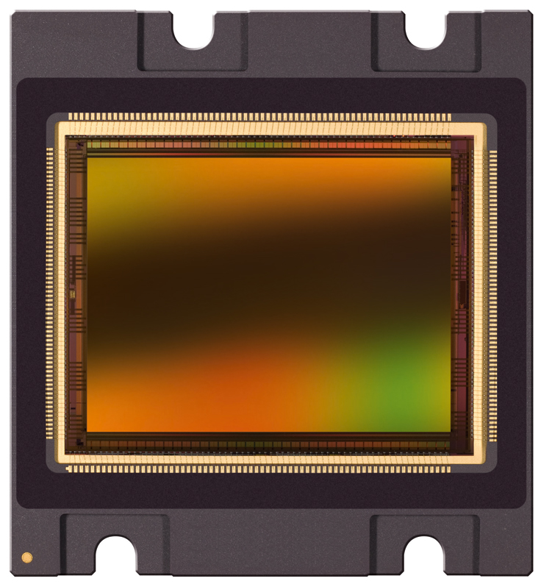
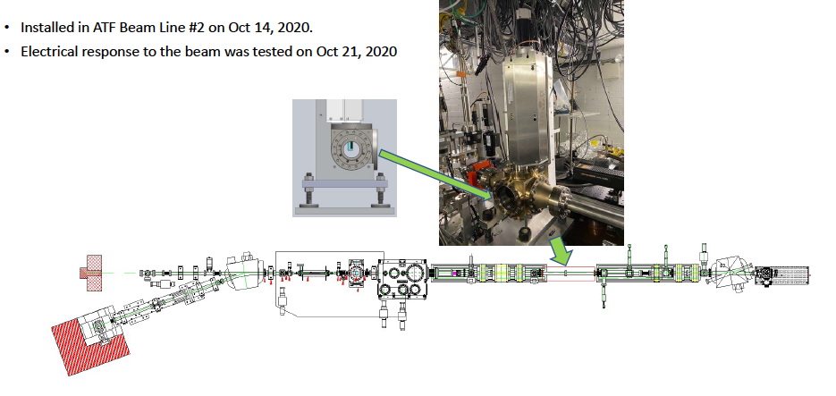
Accelerator Test Facility
Periscope body
Primary mission is development of advanced accelerator and laser concepts
High brightness electron beam available for a range of
18-75 MeV electrons, 1 μm emittance
~10 pC - 3 nC bunch currents
Azimuth Motor
Narrow angle camera, camera optics, rad- protected 20M Pixel CMOS detector
Tilt mirror
Star camera assembly
NASA’s New Frontier’s Homesteader Program, APIC concept component testing
CMOS CMV20000 detector
Adjustable Aperture Diamond Detector
Applied Diamond, Inc.

Slide 20
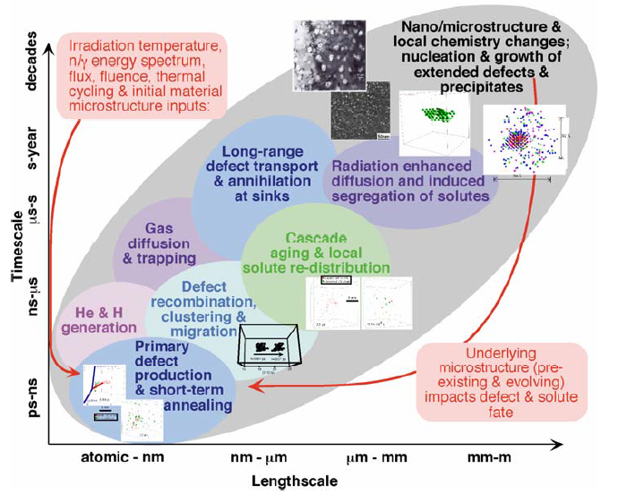
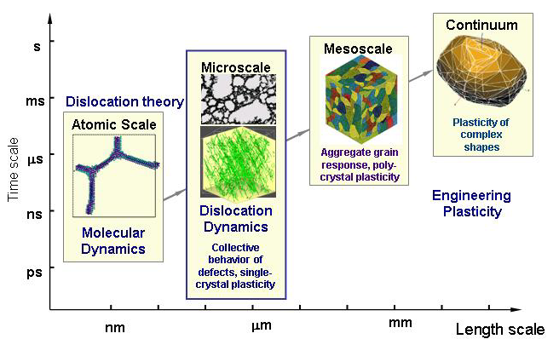
Challenges of Connecting Scales: Materials in Extreme Conditions
How do we connect irradiation outcomes with
the material properties?

Slide 21
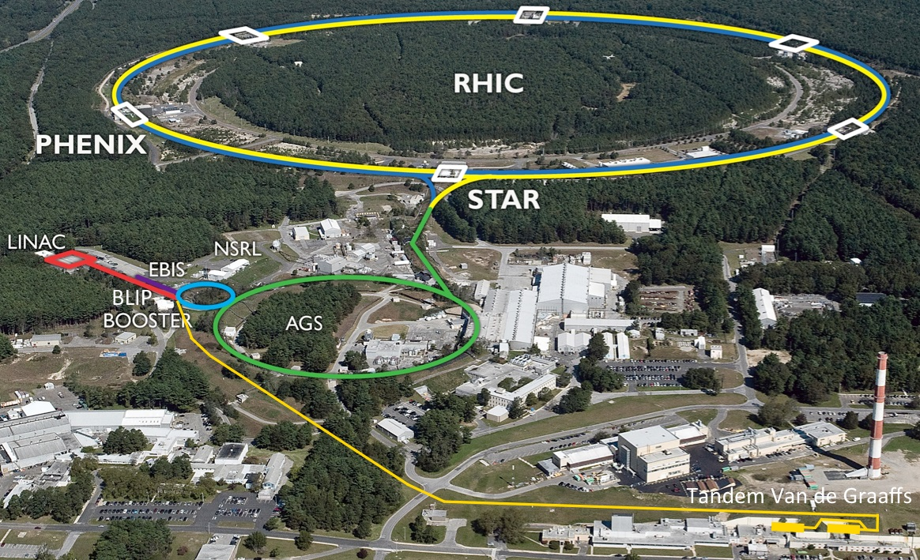

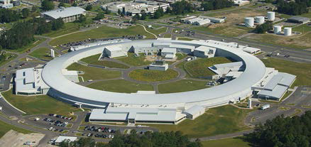
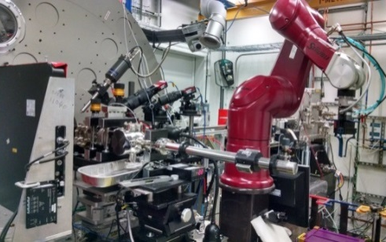
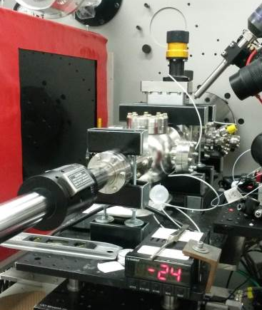
Synergies with the BNL Accelerator Complex
Collider Complex
NSLS II Synergy
ID 28 (XPD) Beamline

Slide 22
How to Connect to BNL Beam Capabilities

Slide 23
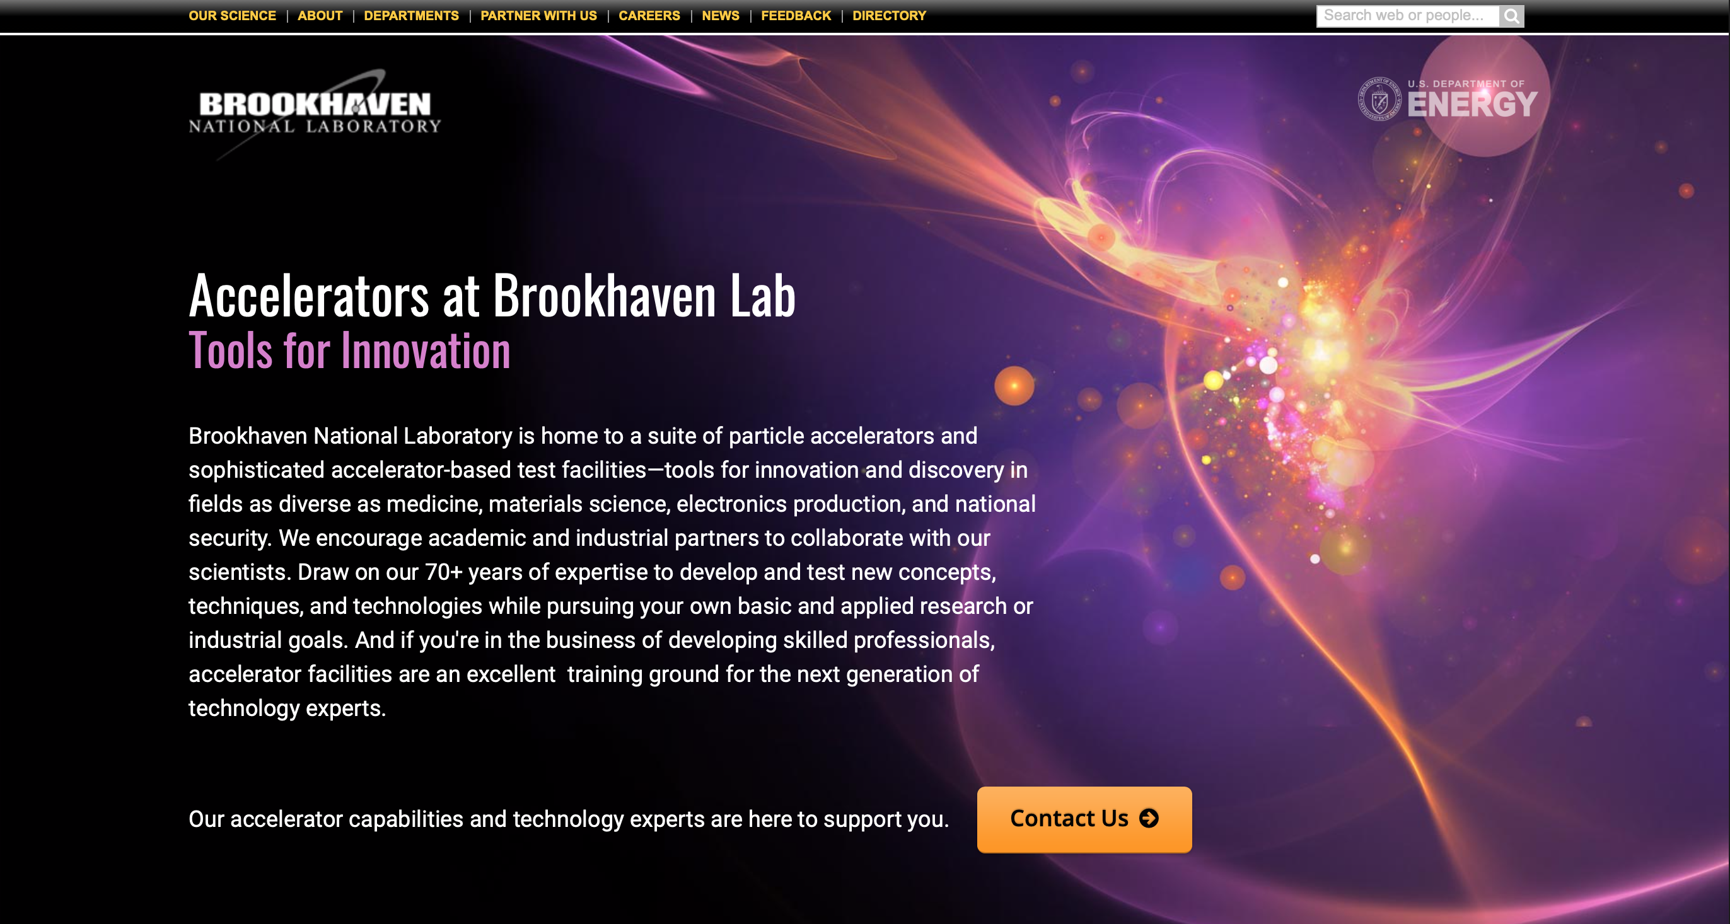
https://www.bnl.gov/accelerators/

Slide 24
Thank you for your attention!

