Slide 1
Linac to End Station A (LESA) at SLAC as Electron Test Beam
A Snowmass LOI
Natalia Toro
on behalf of LESA team
Dec 1, 2021

Slide 2
Outline
Overview of S30XL-LESA: Goals, Concept, and Status
  ESTB (SLAC End Station Test Beam) ➔LESA (Linac to End Station A)
Features of LESA as a Test Beam Facility
Example Use Cases
Snowmass Plans

Slide 3
From ESTB to S30XL, LESA
PAST: After many successful years of Test Beam in End Station A, the ESTB kickers were removed for LCLS-II superconducting beam line ➔ End of 2-15GeV normal conducting beams to End Station A
Goal: Provide a low current CW GeV-scale beam of electrons for test beams and dedicated experiments
Solution: Connect the 4 GeV LCLS-II SRF linac to End Station A and extract ‘dark current’ from between the primary FEL bunches in a parasitic manner
Compatible with LCLS-II-HE the 8 GeV Linac upgrade (ready later in the decade)
Side note: has gone by many names over the last 5 years of planning – DASEL, S30XL, LESA…
In current usage, S30XL is a part and precursor to LESA.

Slide 4
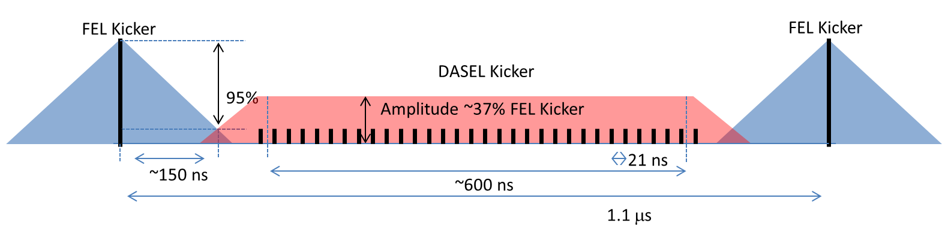
Backbone: LCLS-II
4 GeV SRF linac delivering ~1 MHz electron bunches for photon science
Short pulsed kickers divert individual bunches to FEL lines
Unclaimed bunches and “empty” (dark current) RF buckets between them
to dump line in BSY
LCLS-II RF gun
FEL bunches (1 MHz) and dark current (186 MHz) from RF gun
Beam Kickers
BSY dump
LCLS-II SCRF Linac
Soft X-Ray FEL
LCLS-II beamlines
Hard X-Ray FEL
S30XL Kicker

Slide 5
LESA Concept with Dark Current
Experimental Facilities
Small upgrades to ESA systems
LESA Beamline connecting to ESA line
2 dipoles & 14 quads (all refurbished)
LESA
FEL and dark current from RF gun
ESA
Beam Kickers
BSY dump
LCLS-II SCRF Linac
Soft X-Ray FEL
LCLS-II beamlines
Hard X-Ray FEL
S30XL kicker/septum system downstream of FEL kickers to eliminate interference
S30XL Kicker

Slide 6
LESA+Laser Concept
Experimental Facilities
Small upgrades to ESA systems
Laser system to fill “unused” buckets with electrons at 46 MHz
LESA Beamline connecting to ESA line
2 dipoles & 14 quads (all refurbished)
LESA
FEL and S30XL bunches from RF gun
ESA
Beam Kickers
BSY dump
LCLS-II SCRF Linac
Soft X-Ray FEL
LCLS-II beamlines
Hard X-Ray FEL
S30XL kicker/septum system downstream of FEL kickers to eliminate interference
S30XL Kicker

Slide 7
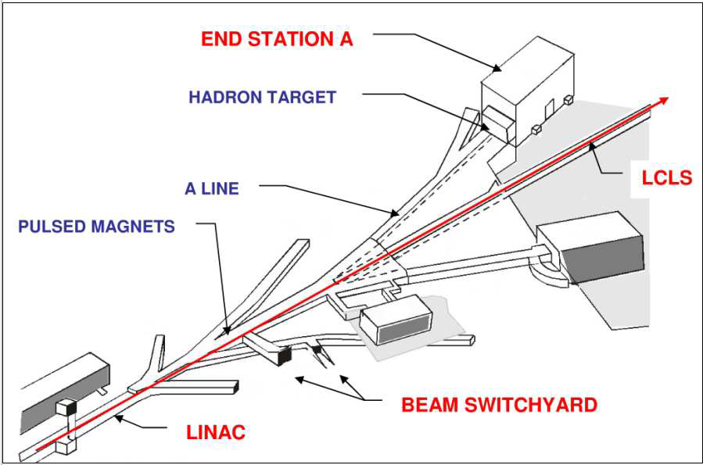
LESA Opportunity: LCLS-II & End Station A (ESA)
End Station A
Removed
ESTB Kickers
Existing A-Line
LCLS
LESA
Beamline
S30XL Kicker
— existing LCLS
— existing ESA
— S30XL/LESA proposal
SLAC Linac

Slide 8
Staging and Status
LESA will be constructed in three stages
S30XL (kicker/septum + 80m beamline): extract dark current from LCLS-II dumpline for initial science measurements and performance characterization – Funded and under construction
LESA (beamline connecting S30XL to ESA) – Funding requested, final design ongoing
Laser Upgrade adds source laser for better control of current – Planned for 2024

Slide 9
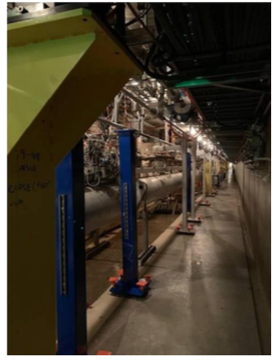
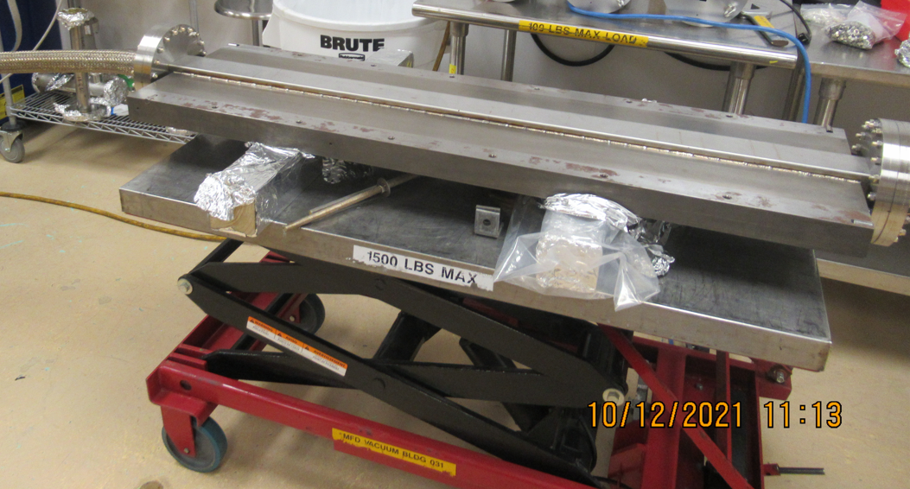
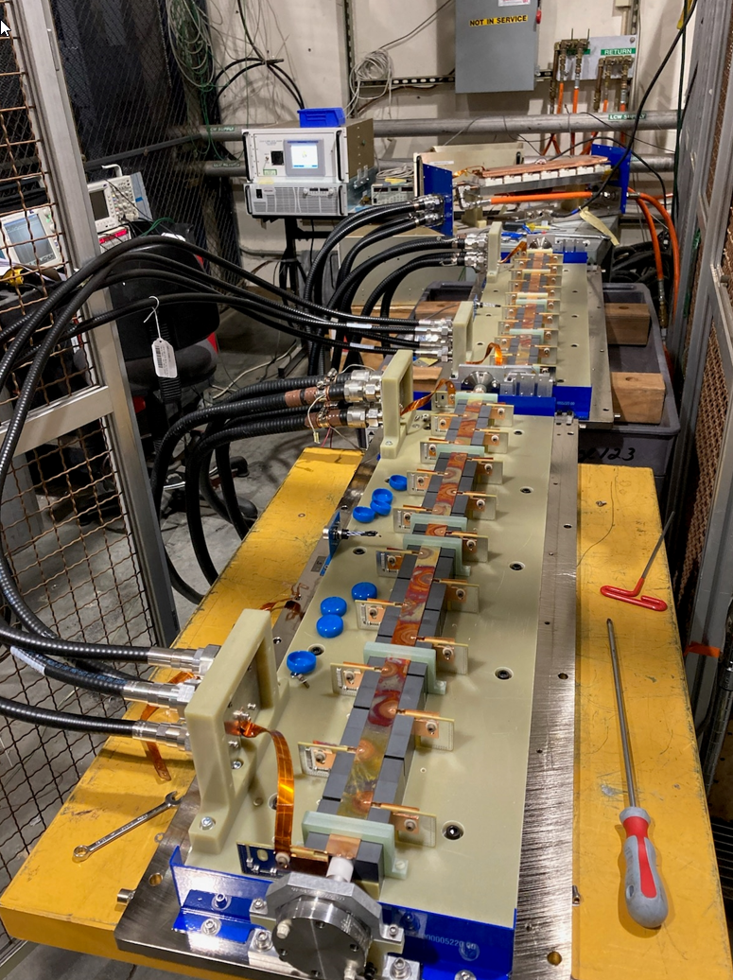
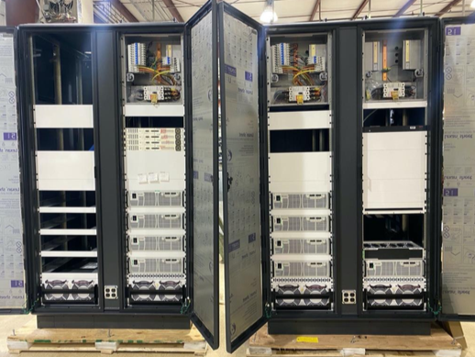
Examples of Hardware Progress
Septum leak-check 10-12-21 ⬆
⬇ DCPS racks partially loaded
Stands in S30 installed
Kicker magnets testing

Slide 10
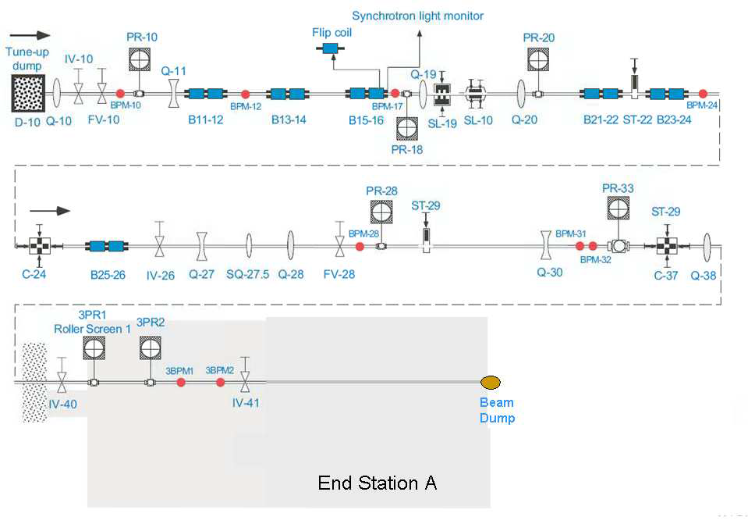
Leverage Existing A-Line Infrastructure for Attenuating & Beam Shaping
PR-10 Spoiler
SL-10 defines momentum
Attenuate ~25 nA LESA beam to pA-scale currents (1/few electrons per bunch w/ 21 ns bunch spacing)
Spoil beam at PR-10
SL10 selects momentum (1% to <1/1000)
24º bend w/ 6 dipoles
Beam spot defined by downstream collimators C-24 and C-37 and focusing quads
Collimators C-24 and C-37 define beam spot
3 kW beam dump
ESA
10

Slide 11
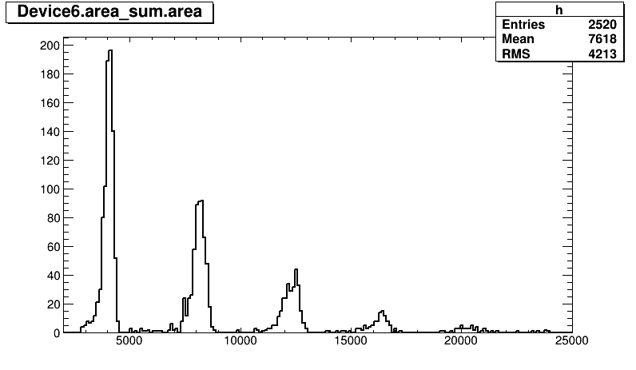
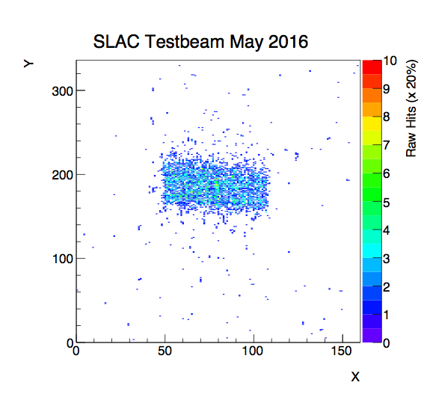
Attenuating & Shaping Beam in A-Line – ESTB Experience
2016 ATLAS Si upgrade tests
1 e⁻
2016 g-2 tests
2 e⁻
3 e⁻
3 mm
4 e⁻
5 e⁻
12 mm
Capability to reduce LESA beam to single/few electrons with control over beam spot, demonstrated in ESTB program
2 x 2 mm² spot size
2016 g-2 test
Material from Carsten Hast, 2016 DASEL Review

Slide 12
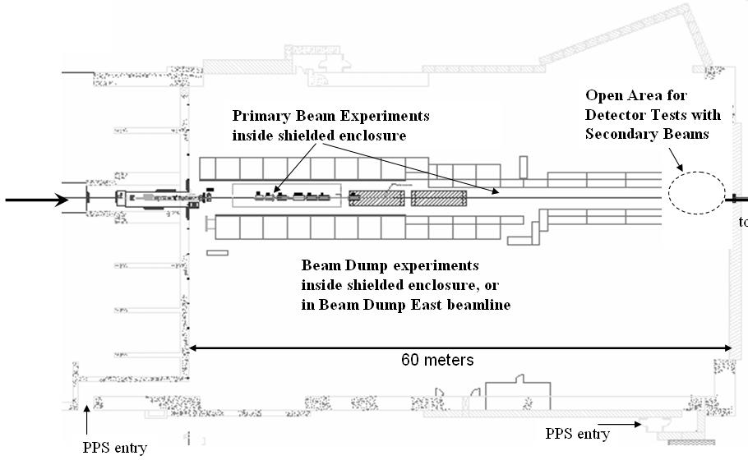
Layout and Overall Program
Beam from BSY
LESA designed for parasitic
operation concurrent with
LCLS-II running
  LCLS-II plans >5000 hours/yr
Multi-Use Program
  Test Beam
  Longer-running low-current experiments
    LDMX dark matter search
    e–Nuc scattering for neutrino program systematics
    and others
LDMX
12

Slide 13
LESA Features as Test Beam Facility
Variable current:
  Up to 25 nA [3000 e–/bunch] with 50% duty cycle (useful for irradiation tests,
  testing integrating detectors)
  Down to Poisson average < 1 e– per pulse
High repetition rate:
  Up to 1 pulse every 21 ns (46 MHz)
  with 50% macro-pulse duty cycle
  Allows direct study, in test beam, of high-rate performance and OOT pile-up
  Allows rapid integration of statistics – up to 10⁷ 1e– bunches per second
  Can reduce rate, while maintaining well defined time structure, by filling specific buckets in each macro-pulse and/or decreasing kicker repetition rate
  (macro-pulse repetition rate)
21 ns
~500 ns macro-pulse
S30XL Kicker

Slide 14
LESA Features as Test Beam Facility
Short Pulses:
    LESA delivers bunches of ps or sub-ps length, advantageous for calibrating precision timing detectors
Fixed Primary Energy:
    Pegged to LCLS-II beam energy – 4 GeV initially, then 8 GeV with
    upgrade to linac (attenuated beam would have slightly lower energy)
    Can tune A-line to lower energy (<<1 e per pulse)
Beam Availability
  Because LESA beam delivery is concurrent with normal LCLS-II operations, the core activity at SLAC, a high beam availability ∼250 days/year is anticipated. This will be shared between test beam and other HEP applications.

Slide 15
Example Use Cases
Detector studies for LHC upgrade detectors and related experiments
    Characterizing position and timing resolution of ATLAS silicon detector prototypes
    Mapping material distribution in tracking detectors, e.g. for ATLAS
    Studying EM shower response and pileup effects in the CMS HGCAL
    Tests of Silicon Pixel Tracking and Fast Timing Detectors for ATLAS upgrades and future colliders
Basic detector R&D efforts
    Testing the Timing Vertex Detector technology
    Characterizing low-gain avalanche detectors under development for 4D tracking
    R&D towards using fast scintillation component of BaF2 for high resolution, high rate crystal calorimeter
    Studies of EM-induced radiation damage for high-luminosity electron colliders, EIC
Detector development for other experimental programs in HEP and NP
    Detector tests for ATLAS HGTD and projects in the CERN Physics Beyond Colliders umbrella
    Response of MOLLER fused silica integrating detectors, in both single-electron and integrating regimes

Slide 16
Test Beam Programs Enabled or Enriched by LESA Time Structure
Detector studies for LHC upgrade detectors and related experiments
    Characterizing position and timing resolution of ATLAS silicon detector prototypes
    Mapping material distribution in tracking detectors, e.g. for ATLAS
    Studying EM shower response and pileup effects in the CMS HGCAL
    Tests of Silicon Pixel Tracking and Fast Timing Detectors for ATLAS upgrades and future colliders
Basic detector R&D efforts
    Testing the Timing Vertex Detector technology
    Characterizing low-gain avalanche detectors under development for 4D tracking
    R&D towards using fast scintillation component of BaF2 for high resolution, high rate crystal calorimeter
    Studies of EM-induced radiation damage for high-luminosity electron colliders, EIC
Detector development for other experimental programs in HEP and NP
    Detector tests for ATLAS HGTD and projects in the CERN Physics Beyond Colliders umbrella
    Response of MOLLER fused silica integrating detectors, in both single-electron and integrating regimes
Highlighted projects exploit short pulses and/or high repetition rate

Slide 17

Moving Forward in Snowmass
Snowmass LOI signed by LESA team members + interested potential users
We’re planning a short Snowmass whitepaper on LESA test beam capabilities and applications, as well as surveying community interest to better plan for use of the facility. Please let us know if you have ideas or questions about capabilities!

Slide 18

Questions

