Slide 1

The Cross-Cut Group
Marcel Demarteau (ORNL)
Jim Fast (PNNL)
Young-Kee Kim (Chicago)
Sunil Golwala (Caltech)
Abe Seiden (UCSC)
BRN Meeting
December 13, 2019

Slide 2
Report Structure
Exec Summary
Science Impact
Panel Report
  Audience: policy makers
  Length: ~1 page
  Describes the Key Challenges
  Audience: Office of Science
  Length: ~5-10 pages
  Describes the new horizons that the technology development will open for science
  Describes the science impact “without numbers” in “catchy” phrases
  Emphasizes:
    Need for facilities
    Workforce development
    Connection to other science disciplines
    Connection to high priority topics: AI/ML, QIS
  Audience: OHEP and HEP community
  Length: ~100 pages
  In-depth discussion – with specificity – of all the PRDs
  The PRDs have to be actionable

Slide 3
The Flow
Science Driver
Physics Objective
Requirement
Priority Research Direction
Key Challenge
25 PRDs 5 Key Challenges

Slide 4
Key Challenges
Breaking the picosecond time barrier
Advancing detectors to new regimes of sensitivity, integration and scalability
Building with novel materials and advanced techniques
Mastering the challenges of extreme environments
Converting exabytes to physical quantities in real time at the sensor
Notes:
Stock Image: Abstract Data Visualization Grid

Slide 5
Breaking the picosecond time barrier
The particle physics program of the future will require the capability to resolve phenomena separated by mere picoseconds of time, as well as to synchronize large numbers of sensors with picosecond precision, to handle unprecedented particle collision rates and energies. This picosecond synchronization capability, now translated to km and larger scales makes it possible to create coherent detection systems to study the cosmos.

Slide 6
Advancing detectors to new regimes of sensitivity, integration and scalability
The particle physics program of the future will require en masse use of sensors based on emerging and future technologies. Research and development will be needed to establish and enhance their sensitivity and demonstrate scalability to real detection systems. A key enabler of scalability is integration of many functions on, and extraction of multidimensional information from the sensor.

Slide 7
Building with novel materials and advanced techniques
To do the physics described earlier will take us beyond what is possible with the detection and construction materials and techniques with which we are familiar. Meeting these challenges will require identifying novel materials that provide new properties or capabilities and adapting them to our needs as well as taking advantage of advanced techniques for design and manufacturing.

Slide 8
Mastering the challenges of extreme environments
The physics program planned will take us into a number of extreme environments, including very high radiation doses, extraordinarily low temperatures, and incredible purity. These environments pose enormous challenges that require engagement with allied fields such as material science, chemistry, and engineering.

Slide 9
Converting exabytes to physical quantities in real time at the sensor
Future particle physics experiments will generate exabytes of information to explore elusive phenomena. Rather than a brute-force approach to the problem, real-time analysis at the sensor converts raw bits to physical quantities to reduce the data volume by many orders of magnitude. To do so requires intimate integration of intelligent computing with sensor technology.

Slide 10
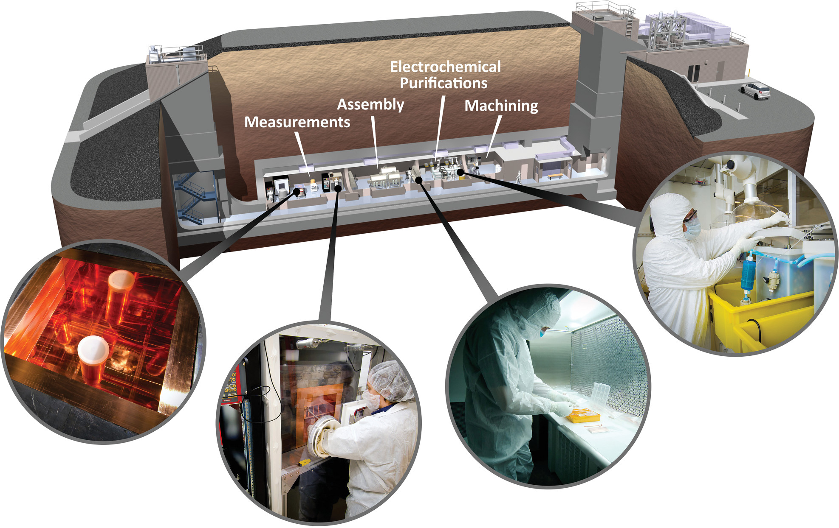
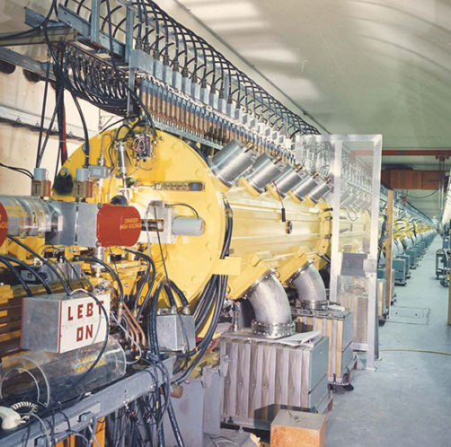
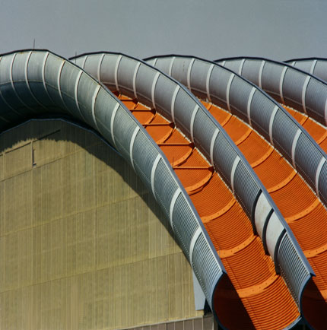
Facilities Support: Part of 10 pager.
To deliver on the priority research directions, a key element is the availability of test facilities to support the instrumentation development, which will not be listed as a PRD
Low Background Facility
Test Beams
Irradiation Facilities
Characterization Platforms
  Provides support for low-background experiments in the areas of materials and assay
Critical need for low-background experiments
  Provides high-quality beams and data taking infrastructure to develop and characterize new detector technologies
  Critical need to explore new technologies
Provides facilities to validate radiation resistance to extremely high fluences
Essential for Energy and Intensity Frontier experiments
Provides platforms for determining fundamental physics of materials
Vital for determining proof of principle and long-term viability of proposed materials and environments

