Slide 1
Basic Research Needs Study
High Energy Physics
Detector R&D
BRN Workshop Rockville, MD
December 11-14, 2019
Helmut Marsiske
Program Manager for Instrumentation
Office of High Energy Physics

Slide 2
HEP Mission
Understand how the universe works at its most fundamental level:
  Discover the elementary constituents of matter and energy
  Probe the interactions between them
  Explore the basic nature of space and time
HEP pursues its mission by:
  Building Projects that enable discovery science
  Operating Facilities that provide the capability to perform discovery science
  Conducting a Research program that yields discoveries

Slide 3
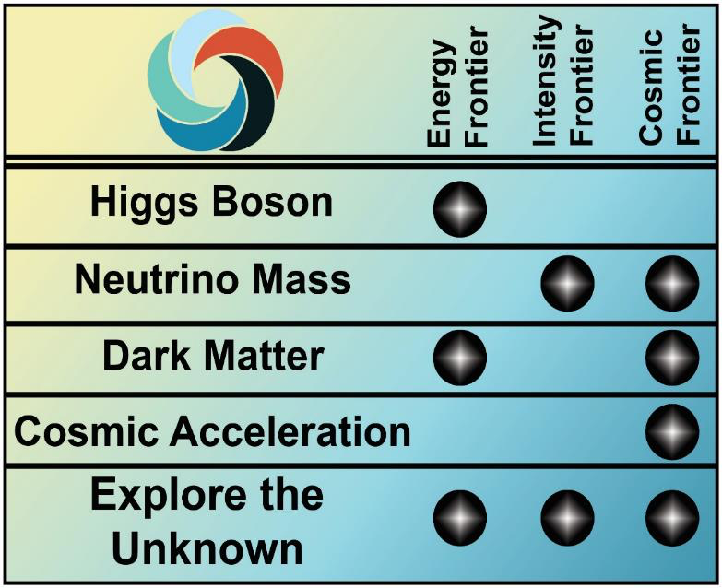
HEP Program
P5 Science Drivers identify the scientific motivation
Research Frontiers are useful categorization of experimental techniques and serve as the basis of the budget process
Research Frontiers are complementary
  No one Frontier addresses
  all science drivers
  Each Frontier provides a
  different approach to
  address a science driver
  Enables cross-checking
  scientific results
Detector R&D Program undergirds/overarches Research in all three Frontiers
R
e
s
e
a
r
c
h
F
r
o
n
e
r
s
s
r
e
v
i
r
D
e
c
n
e
i
c
S
s
c
i
s
y
h
P
e
l
c
r
a
P

Slide 4
Detector R&D Program Goals
Support research leading to fundamental advances in the science of particle detection, and develop the next generation of instrumentation for HEP
  Properly balanced between…
    …incremental, near-term, low-risk and transformative, long-term, high-risk R&D; i.e. Project-oriented vs. Generic R&D
    …universities and labs
  Focus on strategic areas
    Future promise and U.S. leadership
  Engage researchers from other fields and from industry

Slide 5
Detector R&D Program, continued
Provide graduate and post-doctoral research training in instrumentation
  Next generation of detector experts
Support “infrastructure”—technical personnel, equipment, “facilities”, and test beams—required for experimental detector R&D and fabrication

Slide 6
Program Funding/Effort/Process
Funding in FY 2019 is ~$24M, down from ~$30M earlier in the decade
  Research funding is ~2/3 of total, most of it at labs
  Facilities/test beam operations is ~1/3
Efforts at labs and universities:
  50-60 FTEs at 7 labs: ANL, BNL, FNAL, LBNL, LLNL, PNNL, SLAC
  20-30 FTEs at ~15 universities
Process to determine funding/effort:
  Labs: annual budget briefings, field work proposals (FWPs), and lab comparative review (last in 2016, next in FY 2021)
  Universities: annual funding opportunity announcement (FOA) and university comparative review (since 2012)

Slide 7
HEP Program Guidance
FACA panels & subpanels provide official advice
  High Energy Physics Advisory Panel (HEPAP)
    Jointly chartered by DOE and NSF to advise both agencies
    Provides the primary advice for the program
    Subpanels for detailed studies (e.g. Particle Physics Project Prioritization Panel (“P5”) in 2008, 2014
  Astronomy and Astrophysics Advisory Committee (AAAC)
    Advises DOE, NASA, and NSF on selected issues in astronomy & astrophysics of overlap, mutual interest and concern
Formal Advice Also Provided by National Academy of Sciences (NAS)
    Decadal Surveys in Astronomy & Astrophysics, Elementary Particle Physics

Slide 8
HEP Program Guidance, cont.
Other:
  Community-organized science studies and input
    Snowmass, CPAD, DPF input
  DOE-organized science studies and exercises
    Portfolio reviews
    Lab optimization
    Accelerator Technology Roadmap
    Computing Infrastructure Working Group
    Basic Research Needs (BRN) Studies
Taken together these processes aim to
  Improve the effectiveness and efficiency of HEP research programs and supporting technology R&D/infrastructure
  Identify currently operating experiments that have the highest impact on P5 science drivers
  Identify research and technology R&D areas that are ripe for additional investments, informing future experiments

Slide 9

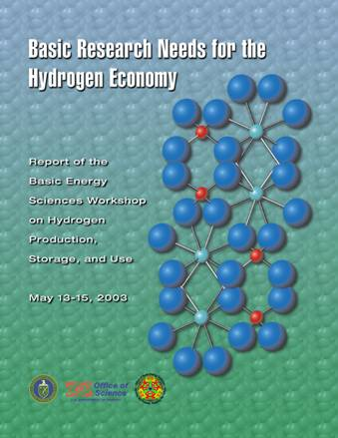

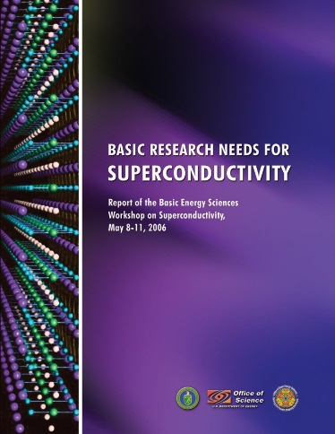

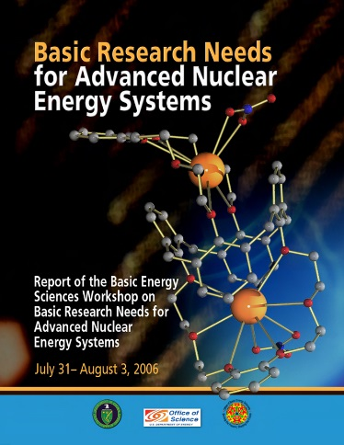
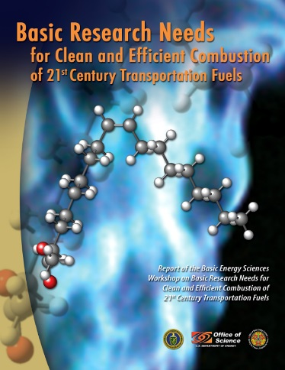
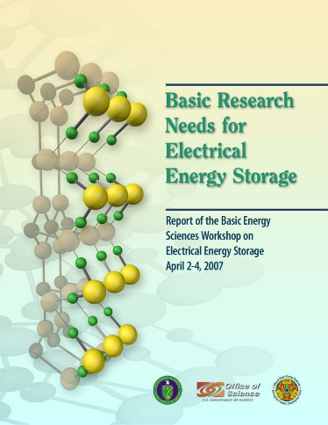
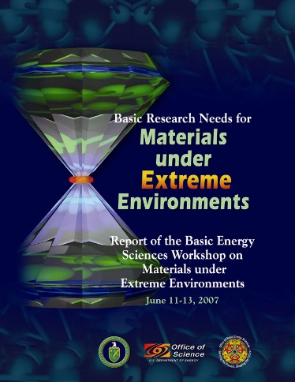
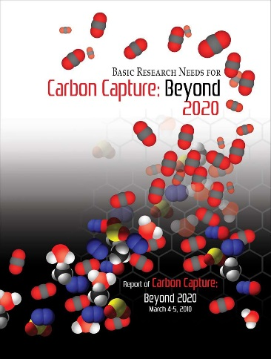
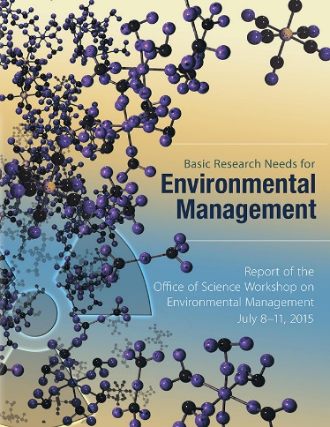
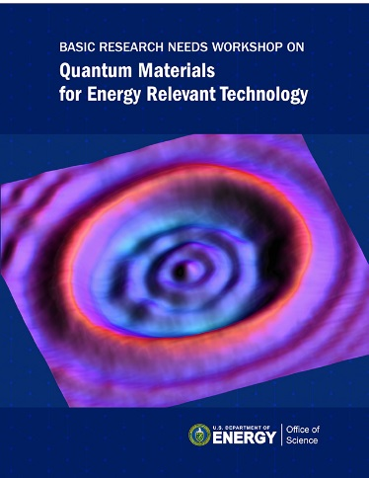

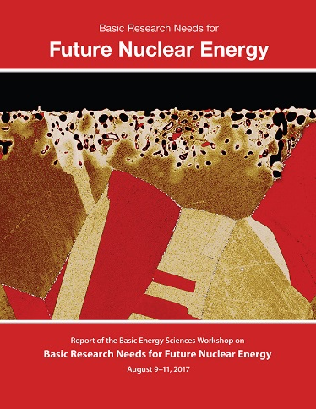
Basic Research Needs Studies (BRNs)
SC’s Office of Basic Energy Sciences initiated this approach with the Basic Research Needs to Assure a Secure Energy Future workshop in October 2002. This resulted in a comprehensive, 420-page report that identified 37 Proposed Research Directions.
Numerous (~20) subsequent topically-focused BRNs have helped to define directions and make the case for major new efforts such as Energy Frontier Research Centers and Innovation Hubs
While there are some variations and there has been some evolution, many BRNs have involved:
  Production of a Technology Perspectives Factual Document prior to the workshop
  Definition of a set of Science Grand Challenges that, if solved, might result in transformational changes
  Definition of a set of Priority Research Directions that address the technology R&D challenges

Slide 10
BRN Process and Structure
Targeted topics defined, and workshop charge issued, by SC program office
Attendance is limited and by invitation only
Participants will have considerable work to do before, during, and after the meeting
Workshop co-chairs develop agenda and select panel leads (with program office input); panel co-leads develop agenda and select panel members
Typical structure: Opening plenary sessions, panel breakout sessions that develop Priority Research Directions, closing plenary session, and extended writing session – draft report completed before departure!
Prompt output: final report released typically 60-90 days after the workshop

Slide 11
BRN Impacts
BRN reports are expected to serve as reference documents with a long shelf life, and to be readily accessible
Post-workshop outreach activities often include communication of the results to the broader community by co-chairs and the SC program, and briefings by federal staff to other interested federal parties (within and beyond DOE)
BRNs may, individually or collectively, serve as the basis for subsequent funding opportunities
  Many examples from BES
  HEP: Dark Matter New Initiatives BRN Study in 2018/2019; Dark Matter New Initiatives Funding Opportunity Announcement DE-FOA-0002112

Slide 12
HEP Detector R&D BRN Study
DOE/HEP commissioned Study to engage the community in identifying Detector R&D priorities
Assess the present status of the HEP technology landscape
Identify key enabling capabilities and associated performance requirements in pursuit of the P5 Science Drivers
Identify strategic technology areas, aligned with the strengths of the US community, that future long-term R&D efforts should focus on. Formulate Priority Research Directions in each area
Formulate a small set of broad, high-impact instrumentation “Key Challenges” where technological breakthroughs could lead to game-changing experimental capabilities for HEP
Study results will be described in a report delivered within two months following the completion of a workshop. DOE will use the study results to inform HEP Detector R&D program planning, which may include a call for proposals to support new technology developments and capabilities that address the study priorities

Slide 13
BRN Study, continued
Study co-chairs: Bonnie Fleming (Yale) and Ian Shipsey (Oxford)
Physics Working Groups reflecting the P5 Science Drivers
  Elucidate capabilities and performance requirements to achieve physics goals
Technology Working Groups
  Identify specific technologies capable of achieving performance requirements and elucidate R&D efforts to get there

Slide 14
BRN Study WGs and Co-Conveners
The BRN website is: http://doe-brn-hep-detectorrandd.physics.ox.ac.uk
Physics-focused WGs
  Higgs: Jim Hirschauer (FNAL), Gabriella Sciolla (Brandeis)
  Neutrinos: Ornella Palamara (FNAL), Kate Scholberg (Duke)
  Dark Matter: Jodi Cooley (SMU), Dan McKinsey (Berkeley)
  Dark Energy and Inflation: Clarence Chang (ANL), Brenna Flaugher (FNAL)
  Explore the Unknown: Monica Pepe Altarelli (CERN), Sarah Demers (Yale)
Technology-focused WGs
  Quantum Sensors: Andy Geraci (Northwestern), Kent Irwin (SLAC)
  Noble Liquids: Roxanne Guenette (Harvard), Jocelyn Monroe (RHUL)
  Photodetectors: Peter Krizan (IJS), Lindley Winslow (MIT)
  Solid State and Tracking: Marina Artuso (Syracuse), Carl Haber (LBNL)
  Calorimetry: Francesco Lanni (BNL), Roger Rusack (Minnesota)
  T/DAQ: Darin Acosta (UFlorida), Tulika Bose (Wisonsin)
  Readout and ASICs: Gabriella Carini (BNL), Mitch Newcomer (UPenn)
Cross-cut WG Marcel Demarteau (ORNL), Jim Fast (PNNL), Sunil Golwala (Caltech), Young-Kee Kim (Chicago), Abe Seiden (UCSC)

Slide 15
BRN Study, continued
WGs have been working on
  Engaging the broader community to gather input
  Drafts of WG reports encapsulating Priority Research Directions (PRDs)
Planning for workshop in the DC area December 11-14, 2019
  60-70 participants, by invitation
Complete final report by middle of February 2020

Slide 16
Summary
Thank You for contributing to this (second) HEP BRN
We look forward to the workshop discussions later this week and to the BRN final report
DOE will use the study results to inform HEP Detector R&D program planning, which may include a call for proposals to support new technology developments and capabilities that address the study priorities

Slide 17



Slide 18
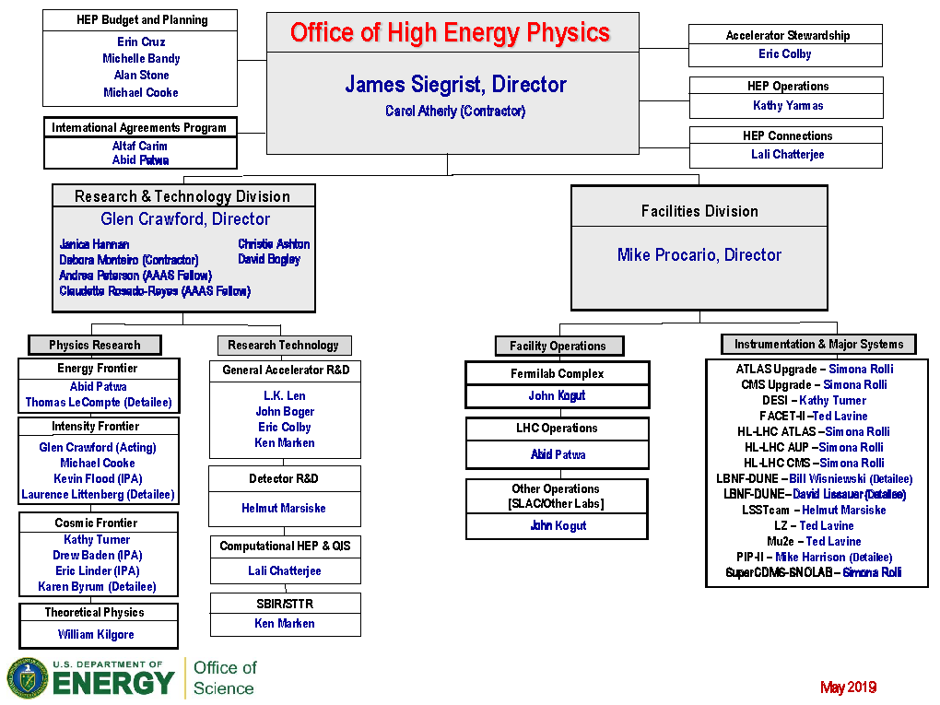
DOE Office of High Energy Physics

Slide 19
DOE HEP Research Priorities: Snapshot
Energy Frontier
  Analysis of LHC Run 2 data
  Contribute to operational responsibilities and complete “Phase I” upgrades
  Scientific support for HL-LHC program
Intensity Frontier
  Neutrino Program
    Support ProtoDUNE, LBNF/DUNE, and PIP-II
    Implement Fermilab Short-Baseline Neutrino Program and Intermediate Neutrino Program
    NOvA, T2K/SK, Minerva, MicroBooNE data analysis
  Muon Program: Complete Mu2e, take data with Muon g-2
  Heavy Flavor Program: take and analyze data with Belle-II
Cosmic Frontier
  Dark Matter: Scientific support for G2 experiments (in fabrication)
  Dark Energy: DES analysis; scientific support for LSST and DESI (in fabrication)
  Continue science and technology planning for CMB-S4
Accelerator R&D
  Focus on outcomes and capabilities that will dramatically improve cost effectiveness for mid-term and far-term accelerators
  Hosting workshops to develop and implement R&D plan following P5 and GARD panels
Detector R&D
  Developing process to identify highest priority R&D activities for current phase of implementing P5
  Aim to increase long-term “high-risk” R&D with potential for wide applicability and/or high-impact
    “Blue-Sky” scientific research on innovative technologies not already in contention for implementation in future DOE HEP projects
HEP Theory
  Maintain an overall “thriving” program as per P5

Slide 20
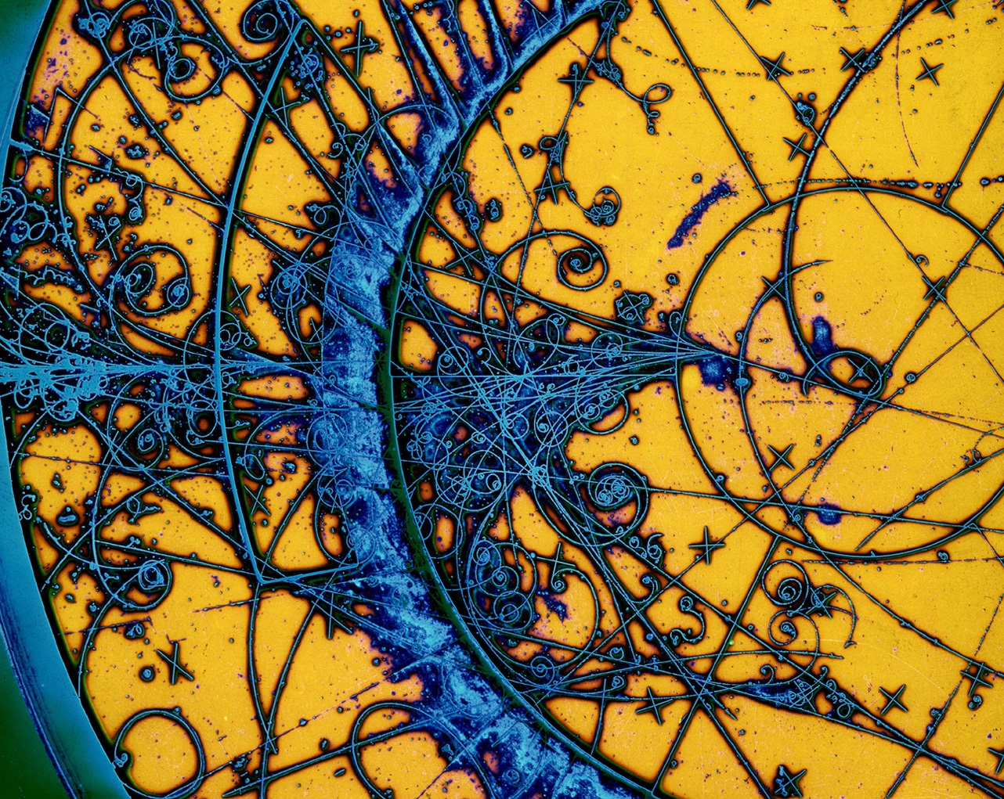
HEP Detector R&D Program

Slide 21
Detector R&D Program Goals
Support research leading to fundamental advances in the science of particle detection, and develop the next generation of instrumentation for HEP
  Properly balanced between…
    …incremental, near-term, low-risk and transformative, long-term, high-risk R&D; i.e. Project-oriented vs. Generic R&D
    …universities and labs
  Focus on strategic areas
    Future promise and U.S. leadership
  Engage researchers from other fields and from industry

Slide 22
Detector R&D Program, continued
Provide graduate and post-doctoral research training in instrumentation
  Next generation of detector experts
Support “infrastructure”—technical personnel, equipment, “facilities”, and test beams—required for experimental detector R&D and fabrication

Slide 23
Program Funding/Effort/Process
Funding in FY 2019 is ~$24M, down from ~$30M earlier in the decade
  Research funding is ~$17M, ~80% at labs
  Facilities/test beam operations is ~$7M
Efforts at labs and universities:
  50-60 FTEs at 7 labs: ANL, BNL, FNAL, LBNL, LLNL, PNNL, SLAC
  20-30 FTEs at ~15 universities
Process to determine funding/effort:
  Labs: annual budget briefings, field work proposals (FWPs), and lab comparative review (last in 2016)
  Universities: annual funding opportunity announcement (FOA) and university comparative review (since 2012)

Slide 24
Interim Summary
Innovation in Instrumentation (historical) strength of HEP
  Need to strengthen/reinvigorate this core competency
Near-term focus has been on high-priority P5 projects
  LHC phase-II upgrades
  Short- and long-baseline neutrino program
  Dark Matter, Dark Energy (and CMB)
Need to strengthen long-term efforts: more Blue-Sky R&D
Stewardship of instrumentation efforts has historically rested with national labs and a small number of university groups
  Need to establish new, effective and efficient collaborative models, and better engage universities in the R&D enterprise
  Continue to examine raison d’etre of existing detector facilities within the (changing) national HEP program
Community plays key role in identifying scientific and technological opportunities and in making them happen
  E.g., engaging CPAD for general- and special-purpose Detector R&D workshops

