Slide 1
Calorimeter BRN
Roger Rusack – The University of Minnesota

Slide 2
WHO
Conveners – Francesco Lanni (BNL) and Roger Rusack (Minnesota)
Sub-conveners –
Nural Akchurin (Texas Tech)
Sarah Eno (Maryland)
Paolo Rumerio (Alabama)
Renyuan Zhu (Caltech)
With input from: Marty Bradenbach, Vitaliy Fadeyev, Jim Brau, Marcello Mannelli, Paul Lecoq, Jim Hirschauer, Craig Woody, Stephen E. Derenzo David Hitlin, Sasha Ledovskoy, Charles L. Melcher,, Adam Para, Gaudio Gabriella, Lorenzo Pezotti, Franco Bedeschi, Roberto Ferrari,Paolo Giacomelli, Artur Apreysian, Maria Spiropolou, Alessandro Tricolli, Martin Aleska, Hong Ma.
Not a complete representation of the field, but broad input from multiple sub-disciplines of the field.

Slide 3
Timeline:
Our focus was on calorimeters for future collider experiments as they set the most stringent requirements.
And we don’t know what the future holds for us:
But we can guess.

Slide 4
Recent detector paradigm shifts
Particle Flow:
Calorimeters and tracker information combined to understand the event.
5D Calorimetery:
Measure position, energy and time of shower as it develops.
Precision Timing
Precision measurement of the time of arrival of a shower to better than 30 ps
UV sensitive photodetectors
Developments in neutrino and dark matter detectors.
MAPS Technology
Development of integrated sensor and readout technology.

Slide 5
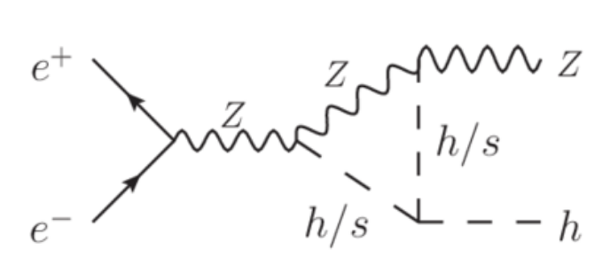
Priority Research Direction - 1
PRD #1 High precision 5D calorimetry with a resolutions of ~15%/√E EM and ~35%/√E hadronic and shower ∆T < 30 ps for linear and circular e⁺e⁻ machines. Timescale ready in 10 years.
2025
Relevant for e⁺e⁻ machines.

Slide 6
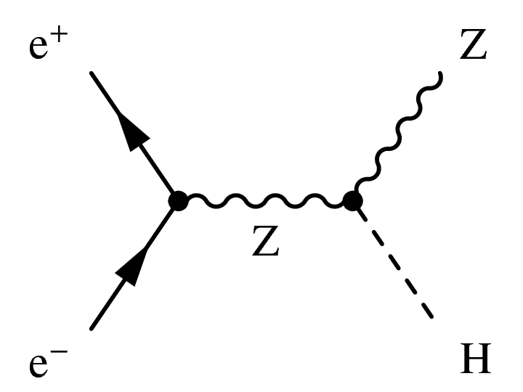
PRD #1 Motivation
Electron Positron machines are low energy, zero pile-up machines.
We can hope for 2 – 4 different detectors
Energy scale is set by Z-boson and Higgs decay (50 – 60 GeV) at rest at start top-quark later (~150 GeV).
Key physics goal: Z + H production, tag H with Z-hadronic decay.
Technology needs:
  Simple low-cost construction designed for particle flow
  High bandwidth intelligent readout for complex events
  Low power electronics or pulsed power.
  Timing precision ~ 25 ps to identify long-lived particles.

Slide 7
Priority Research Direction - 2
PRD #2 High precision 5D calorimetry for hh machines with an EM resolution of < 10%/√E and <30%/√E hadronic ∆T < 5 ps in an irradiation environment of > 10¹⁷ n/cm². Timescale ready in 20 years.
Ready by 2035
2035

Slide 8
PRD #2 Motivation
Detectors at 100 TeV hh machines will have to cope with high-energy jets, pile-up ~1000, irradiation levels, ~ 1 GigaGy and > 10¹⁷ neutrons/cm².
Energy scale is from <1 GeV to >20 TeV → Dynamic range of 10⁶
Key physics goal:
H-self-coupling, new physics searches, Higgs invisible, Precision Higgs coupling.
Technology needs:
  Construction designed for high radiation tolerance.
  High bandwidth readout for complex events
  Radiation hard low-power intelligent electronics
  Timing precision ~ 1 ps for pile-up suppression and particle id.

Slide 9
Priority Research Directions - 3
PRD #3 Ultrafast calorimetry media with order 1 ps precision for low-energy electrons and photons.
Physics motivation:
Cope with ultra-high rate CLFV experiments.
Special detectors at colliders.

Slide 10
Summary
We have identified three major detector research areas where the US can contribute to future high energy physics program needs.
PRD #1 High precision 5D calorimetry with a resolutions of ~15%/√E EM and ~35%/√E hadronic and shower ∆T < 30 ps for linear and circular e⁺e⁻ machines.
Timescale ready in 10 years.
PRD #2 High precision 5D calorimetry for hh machines with an EM resolution of < 10%/√E and <30%/√E hadronic ∆T < 5 ps in an irradiation environment of > 10¹⁷ n/cm². Timescale ready in 20 years.
PRD #3 Ultrafast calorimetry media with order 1 ps precision for low-energy electrons and photons.

Slide 11
Backup

Slide 12
Noble Liquids at FCC hh
Radiation levels will be ten times larger than HL-LHC and pileup ~ 1,000!
Inspired by ATLAS and HGCAL

Slide 13
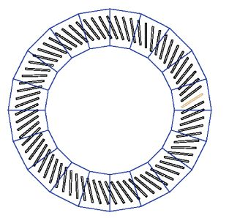
FCC –hh Calorimeter
EM Barrel
EM and Hadronic EndCap

Slide 14
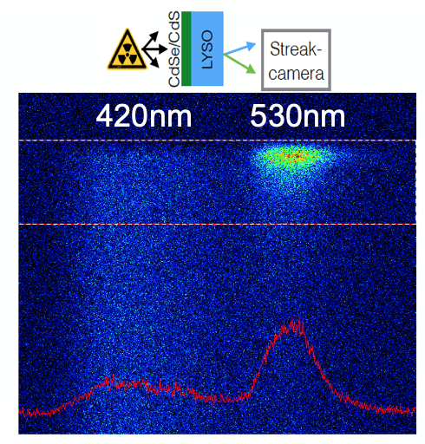
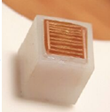
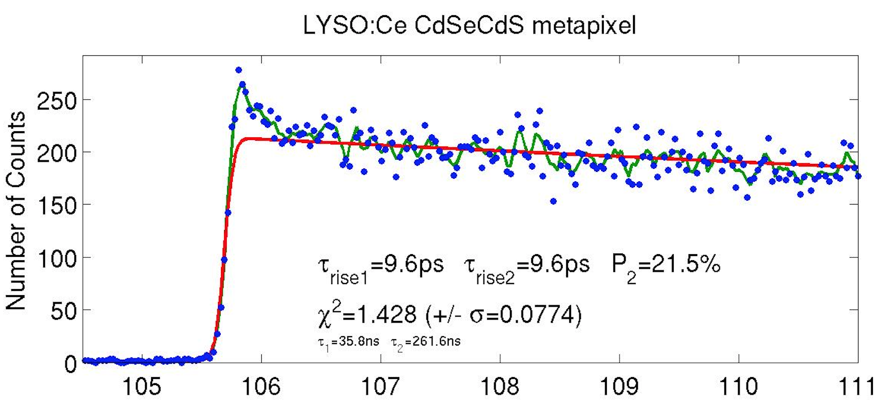

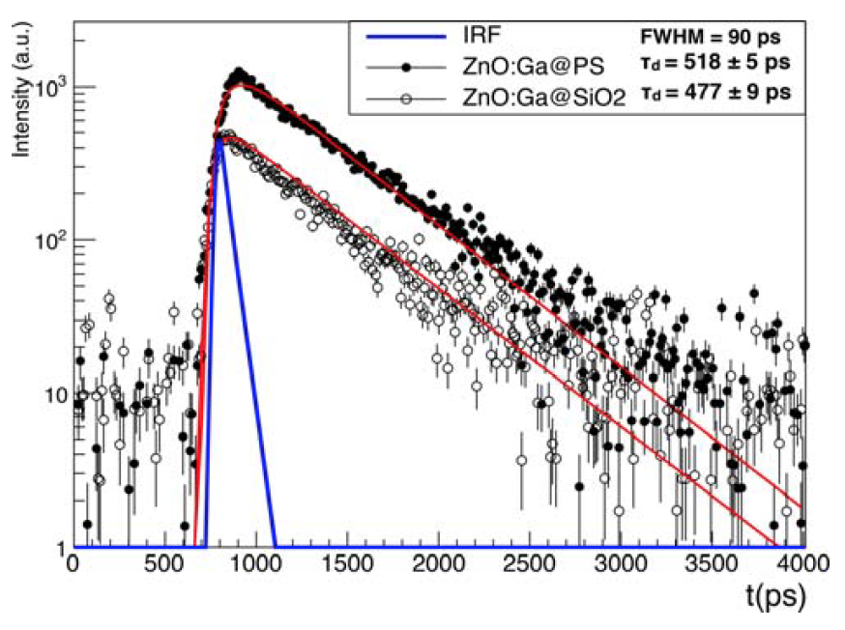
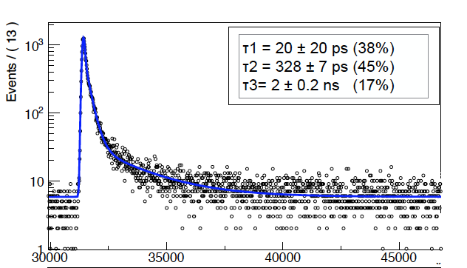
Fast Timing: Metascintillators
High stoping power
L(Y,G)SO, (La,Ce)Br3,
BGO, CsI
Prompt emission
Quantum confined (bi)-excitons
in nanocrystals
CdSe/CdS
nanoplatelets
ZnO:Ga powder
ZnO:Ga in PS
Light transport to SiPM
Photonic crystals, photonic fibers

