Slide 1
ASICs and Readout
Basic Research Needs for Future Experimental HEP Detectors
Conveners: Gabriella Carini →Julia Thom-Levy & Mitch Newcomer
Members
Tony Affolder (UCSC)
Grzegorz Deptuch (BNL)
Angelo Dragone (SLAC)
Gary Drake (FNAL)
Maurice Garcia-Sciveres (LBL)
Carl Grace (LBL)
Julia Thom-Levy (Cornell)

Slide 2
ASICs and Readout input
Nine members
Invited Specialist Input
Aritoki Suzuki – techniques & Possibilities for CMB & similar..
John Cressler – Georga Tech. Silicon Germanium & CMOS
Wes Hansford - IMEC US representative previously MOSIS
Paul O’connor – (BNL) ASIC & sensor development BRN Photosensors
Petra Merkel - Detector R&D FNAL BRN Solid State Detectors

Slide 3
Long Term Needs to Maintain IC Development and Implementation
The most crucial aspect of maintaining US competitive edge in ASIC design for Instrumentation of HEP Detector systems is the support for and constituency of the future design teams.
These priorities Include:
Long term support for Design Engineers & Instrumentation Physicists
Access to design and verification tools relevant to the complexity of designs
Improvement of the eroding possibility for Multi-Institutional Collaboration

Slide 4
Long Term Needs
Sustaining IC design workforce and IC design literacy among Physicists
Complex multi-functional ASICs will certainly be the common enabling experimental workhorse that drives the breakthrough potential of future High Energy Physics detector systems.
Physicists and Engineers need to work together with a common understanding of the state of the art of IC design and how it relates to our future detector systems. This affects all stages of ASIC design from the signal processing and readout architecture design to the evaluation and meaningful review of designs as they progress to the final review of functionality and the understanding of how to exploit the ASIC provided data.
Means to sustain a work force and provide broad community understanding:
Entry Level ASIC training for grad students, post docs and interested University faculty could be provided by Labs hosting visitor positions offering ASIC design courses online with support from lab personnel and “hands on” experience. Encouragement might be offered in the form of ~10% expert salary coverage…
DOE funded FOA’s with a range of ASIC projects targeting next generation detector systems could community interest (and discretion) could be used to define which projects are funded.

Slide 5
Long Term Needs
Access to future tools and processes:
Since inception In 1981 MOSIS supported by UC Southern Ca. provided foundry access to technology files and offered a wafer brokeraging service to many research groups including HEP.
In May 2019 MOSIS dropped support for research institutions leaving US HEP foundry support in limbo as MOSIS turned their attention to very expensive 22nm and smaller technology nodes.
An Important positive result was that within a few months IMEC, a Belgium based microelectronics R&D group that also supports ASIC fabrication brokeraging services approached many US HEP groups to offer support for access to TSMC technology nodes at 180 through to 65nm.
It appears that there are currently NO US commercial based ASIC fab companies that participate in supporting US HEP research initiatives.
It would be quite helpful to have funding and logistical support from DOE and other government Agencies to encourage US IC foundries to help with US research work in areas where custom IC’s can lead to breakthrough discoveries.

Slide 6
Long Term Needs
Multi-Institution Agreements
HEP ASICs have evolved to require high channel counts and broad functionality approaching Systems on a Chip SoC complexity.
  Require coordinated effort of a broad range of Experts. Resulting in the need for a large multi-institutional team. This worked for RD53b BUT
  There is currently NO similar model for this kind of design team in the US.
  Collaboration on designs is a non starter if our NDA agreements don’t allow sharing as with the CERN “frame contract”
IMEC was chosen by CERN to negotiate the successful TSMC 65nm multi-institutional contract and we learned recently IMEC would consider pursuing a similar agreement with US institutions.
→ We need to Prioritize finding and supporting a third party intermediary ( like IMEC) to negotiate a multi-institutional contract between US institutions and and one or more diverse foundries like TSMC.

Slide 7
Important Technical Development to Enable Breakthrough Innovation
Enabling NEW ASIC Functionalities of Common Interest
Areas of Interest for Priority Support for potential Breakthrough

Slide 8
Important Technical Developments
Reduced Radiation Sensitivity Techniques and Technology
Extreme Track Density and high collision rates for inner detector trackers already lead to total dose radiation level requirements above 500MRad. Radiation requirements will grow as higher energy high luminosity machines are developed for future colliders.
A near term PRD- explore total ionizing dose, bulk damage, SEE and SEU sensitivities in 28nm technology. This could be helpful in finding a suitable technology to replace the 65nm technology presently used in the ATLAS and CMS pixel trackers and eliminate a need for further replacement of these trackers for the duration of the HL-LHC runs.
A future PRD- develop a better understanding and improved predictability of the radiation tolerance of HEP accessible ASIC technologies.

Slide 9
Important Technical Developments
“Off & On” Detector synergistic planning will result in orders of magnitude
performance improvement: Lower Power/data transfer rates
On-Detector Processing for Low-Power, High-Performance Sensor Readout
Significant gains in data reduction are possible utilizing reconfigurable logic as witnessed by the high growth of FPGA processing.
Implementing open source RISC-V processors in next Generation ASICs
  Allows reconfigurable processing using C code instead of Verilog code. More familiar to the physics community.
  Likely result is more abstracted information from the front end
  Large savings per channel in power and off detector bandwidth.
PRD - Develop & share a RISC–V instruction set to enable to reach down into the detector. This can Leading to a huge reduction of power and bandwidth per channel.

Slide 10


RISC-V
RISC-V is an open-source instruction set architecture (ISA) developed at UCB
The ISA is the logical definition of a microprocessor that allows software development (interface between hardware and software)
Prior to RISC-V, a license to ARM or similar ($$) would be needed for System-on-Chip (SoC) development
  Since ARM is proprietary, no custom instructions allowed (unless you paid ARM)
Since RISC-V is open-source it is royalty- and license-free and it is possible to extend it
  RISC-V makes it practical to take advantage of custom computing

Slide 11
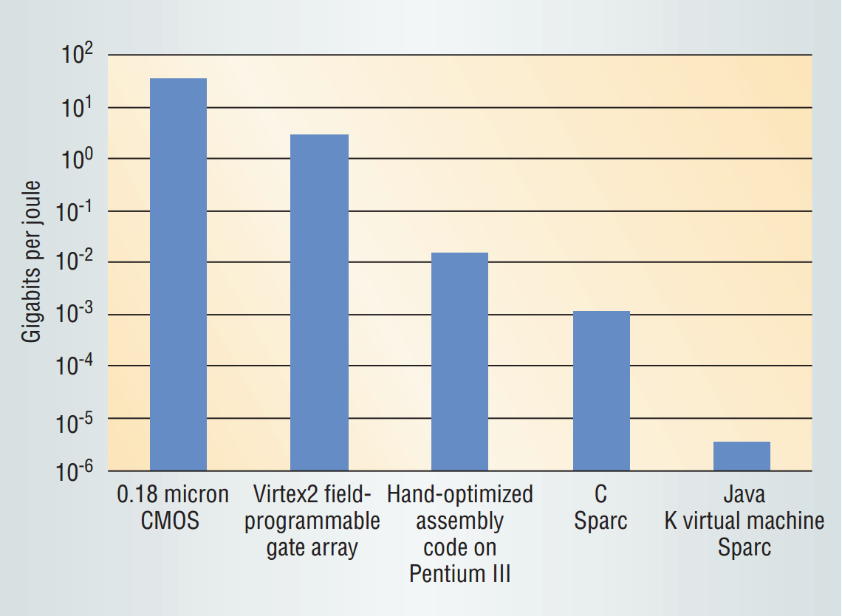
Matching Machine to Algorithm
Application-Specific Computing
One powerful method in matching machine to algorithm is to convert the core code for an algorithm into custom hardware
3.9 Gb/s
640 Mb/s
450 b/s
Over 6 orders-of-magnitude difference in performance (or equivalently, efficiency at fixed performance) by moving towards increasingly specific hardware
Custom instructions can provide good balance between flexibility and efficiency
128-bit key AES encryption algorithm
Schaumont et al., IEEE Computer, 3/2003

Slide 12
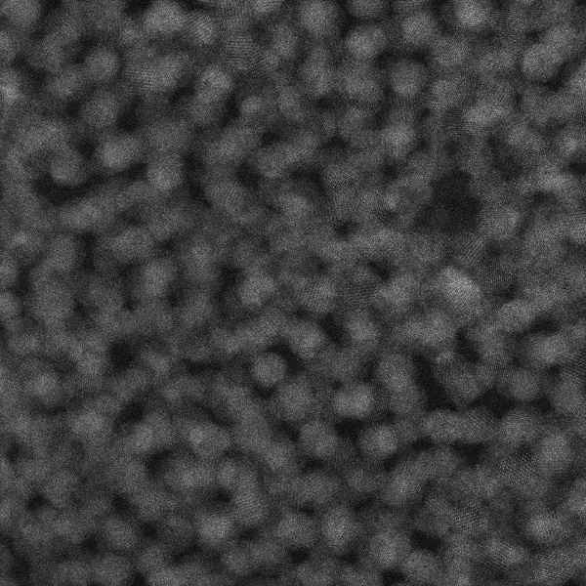

Custom Instruction : FFTAccel
Analyzing the FFT Accelerator with a 2-D FFT (using powder diffraction experimental data)
FFT Accelerator runs around 100x faster than single-threaded CPU
  SciPy FFT on Intel Core i7-5930K @ 3.50GHz: ~265ms
  FFTAccel (Floating): ~2.10ms
FPGA.. an ASIC implementation could be 10X faster…
Original Image
FFT

Slide 13
Important Technical Development
AI and Neuromorphic and Asynchronous Readout Techniques:
Machine Learning (ML) and Artificial Intelligence (AI) systems are changing the way large data sets are interpreted increasing the potential for discovery of current experiments.
Expect these techniques to have more powerful impact when implemented in-situ or on hardware optimally designed to implement neural networks.
Implementations
  Study Machine Learning architectures for HEP problems
  Improve ability to pull abstracted data from HEP detectors
  Study potential for on detector multi-channel synthesis of event parameters.

Slide 14
Important Technical Development
Power Management and Conditioning:
CMOS Technology advances have towards very high gate count and lower supply voltage operation. Resulting in growing complexity that needs to be supplied by higher current and Lower voltage devices.
  Traditional cabling treatments result in larger diameter (therefore more inert mass) supply cabling and higher sensitivity to resistance between the supply & load.
  Low Voltage results in circuits with higher sensitivity to supply noise
Recently ASICs have included Low Drop Out Linear Regulators on chip.
Next generation ASICs will want to follow the commercial industry examples and add DCDC converters on chip.
PRD - Develop commonly applicable SOC blocks for use in complex ASICs An FOA topic with example blocks could be helpful to find development interest.

Slide 15
Important Technical Development
Wireless Communications:
  Near term benefit: Free up high speed physics data channels from detector status and control information:
  First implementations:
    Slow Control operational modes, power sequencing, set and readback control registers, code revision and checking of future detector systems
    Environmental Monitoring Voltages, Currents, Temperatures
  Future:
    Triggering
    Regional Data
    ???

Slide 16
Important Technical Developments
High speed Data transmission interfaces:
PRD Improvent of Copper links and encoding techniques
  Phase II Pixel track detectors will last only a few years at HL-LHC before requiring replacement due to the extreme radiation environment.
  In the intervening time we can likely improve the bandwidth of data by a factor of 5 or 10X utilizing commercial techniques such as PAM4.
PRD Maximize Link speed for Optical Transmission-
  There is a large transfer BW gap between our HEP specialized 10Gb links and industrial capabilities now reaching 400Gbps.
  Environmental constraints limit our ability to just upgrade our links
    Radiation Sensitivity, Mass and Power for TX/RX, cold temperatures
    We need to look to industry for improved techniques and implement these in our communities.

Slide 17
Important Technical Development
Cold Electronics for Liquid Noble detector systems:
Technology Choices for operation at (-100 to 250C)
Commercial foundries cover models/reliability down to -40C
PRD –
Characterize target CMOS technologies & lifetime for Cold Temperature use in Liquid Noble gas environments.
Develop & Characterize “cold” digital library cells for reliable decadal operation.

Slide 18
Important Technical Development
Cryogenic Applications 4K and below:
Investigate CMOS Technologies, Develop Model parameters
Develop schemes for multiplexing & data reduction as the number of detectors races towards a million.
  TES CMOS Amplifiers have been shown to work at 4K they could replace SQUIDs if impedence matching issues could be solved muti-input Mux
  MKIDs
  Bolometers for Cosmic Microwave Backgrounds..
  Applications in QIS Quantum Interference Science
Technical PRD → Investigate CMOS amplifiers for TES at 4K

Slide 19
Important Technical Development
Picosecond High precision timing:
Front End Specialization dependent on Sensor Technology & Envoronment
  Low power High Speed Demands → High Speed Technologies
    High Intensity Hadron Machines with 100 MRAD & higher lifetime requirements
      CMOS 65, 28nm and possibly smaller.
    Electron Machines, Cold Detector Noble Liquid Detectors with Photon readout
      CMOS for back end processing &
      Silicon Germanium front ends. Transistors now approaching 1THz speed
      Silicon Germanium also works well at cold temperatures.
Technical PRD Investigate Silicon Germanium transistors for precision timing.

Slide 20
Important Technical Development
Standalone and 3D-integrated MAPS:
MAPs are an enabling technology for tracking systems at future colliders.
  Economical utilizing Commercial ASIC processes for sensor & readout.
  Eliminates sensor – readout electronics interconnect issues.
  Makes consideration of 500m² trackers plausible.
Technical PRD Develop a coherent US program to combine & process data on MAPS sensor chips

Slide 21
Summary
The highest HEP ASIC Instrumentation priority is to support a healthy mix of Physicists and Engineers in the readout design teams
  Maintain Expertise in the field by having interim projects to train others and develop readout techniques suitable for future HEP detectors
Pursue multi-institutional design agreements with ASIC manufacturers
Provide training opportunities that encourage young people to join ASIC design teams.
We need to support work in future detector related technologies
  Funding efforts to explore techniques and prepare blocks that we will need for our next generation detector systems.
  Develop detector specific understanding of unusual environmental issues created by extreme conditions related to temperature and radiation damage.

