Slide 1

The Cross-Cut Group
Preliminary Assessment
Marcel Demarteau (ORNL)
Jim Fast (PNNL)
Peter Fisher (MIT)
Young-Kee Kim (Chicago)
Sunil Golwala (Caltech)
Abe Seiden (UCSC)
CPAD Meeting
Madison, WI
December 9, 2019

Slide 2
Audience for the Report
A primary audience for the BRN report is policy makers, which frames the front-end language and ambition of the report, the OHEP program managers and the community.
The goal is to make a compelling argument to increase the funding for detector development for particle physics articulated in a way that appeals to policy makers and is aligned with current policy of OSTP
The P5 report provided a 10-year program with a 20-year vision and has been very successful with policy makers; we expect the P5 update to be equally successful. The P5 science drivers provide the long-term scientific motivation and the PRDs should build on these science drivers.
The PRD should be ambitious and forward looking. The current set of projects that are at CD-1 or beyond should not be part of the PRDs. If there still is important R&D to be carried out, that simply has to be successfully completed to deliver the approved projects.

Slide 3
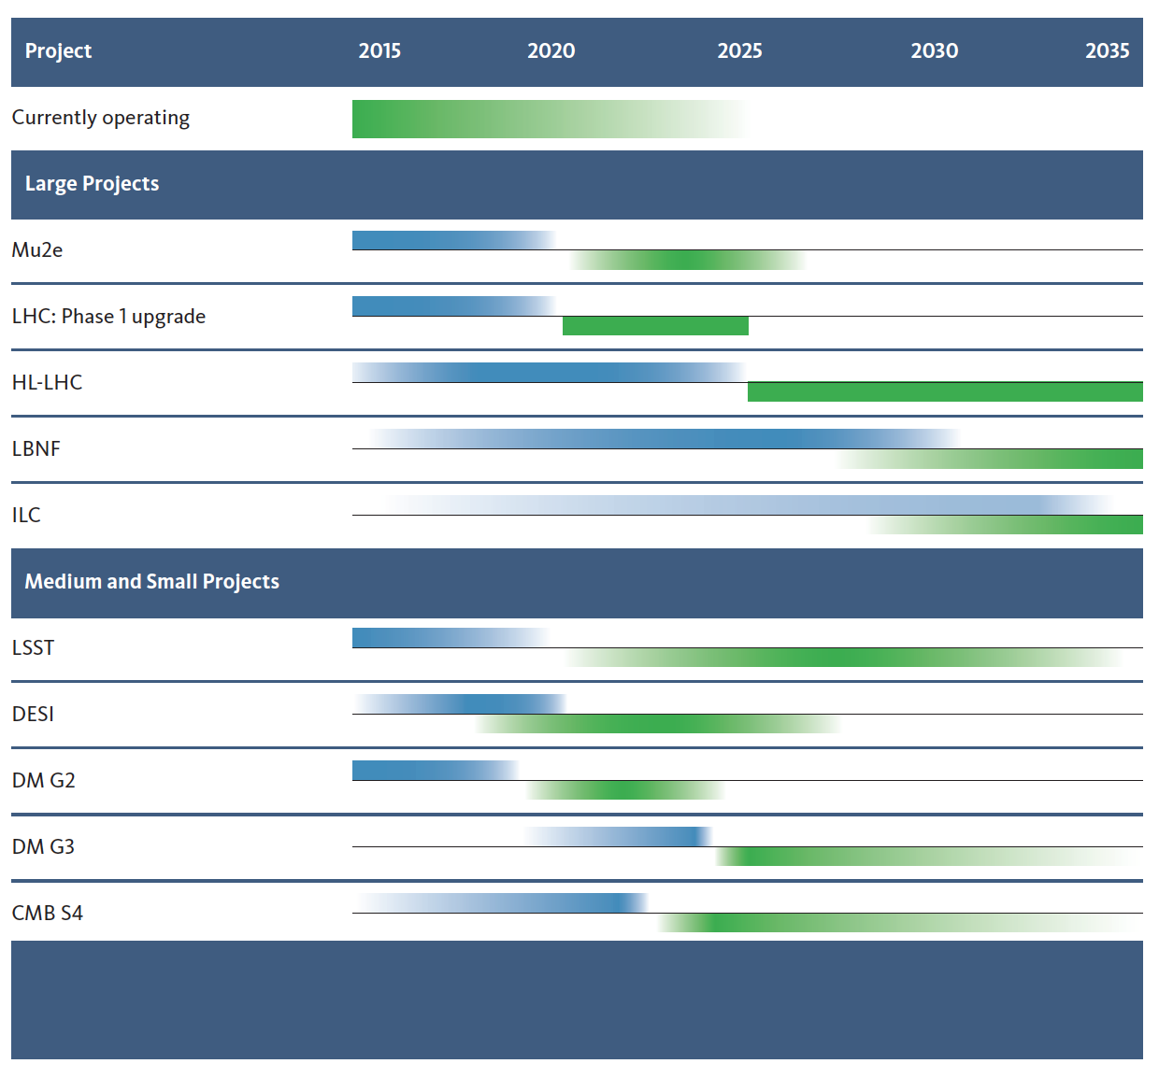
High-Priority Projects
P5 supported directed R&D for the near future.
Directed R&D has targeted current set of approved experiments:
  The Phase-II upgrades of the LHC,
  DUNE, module 1
  G2 dark matter experiments,
  CMB-S4
Continued investments in these projects are expected, but the goal of the BRN is to expand the program with more forward leaning efforts.
A long-term view should be taken for the PRDs
Today

Slide 4
The Priority Research Directions
The cross-cut group has distilled from the 3- and 6-pagers a total of about 120 PRDs

Slide 5
Key Challenges
It is suggested to have 3 to 5 key instrumentation challenges that can be captured in catchy statements.
The key challenges are the ambitions of the field that cross-cut technologies
Template key challenges:
  Breaking the picosecond time barrier
  Quantum-enhanced photoproduction and photodetection over the full frequency spectrum
  Sub-eV and below the standard quantum limit detectors
  5D Calorimetry over five orders of dynamic range
  Functionally integrated detectors
  The ultimate transparent charged particle tracker
  Advanced semi-conductor detectors and devices
  Single-quantum sensitive non-demolition probes

Slide 6
The Flow
Science Driver
Physics Objective
Requirement
Priority Research Direction
Key Challenge
Many areas are very thin on requirements, or are absent all together. We need help!
The “flow” that we believe will be helpful to frame the discussions:

Slide 7
The Flow
Science Driver
Physics Objective
Requirement
Priority Research Direction
Key Challenge
Many areas are very thin on requirements, or are absent all together. We need help!
The “flow” that we believe will be helpful to frame the discussions:
Key Challenge
Priority Research Direction
Requirement
Physics Objective
Science Impact

Slide 8
The Process
Science Impact
Physics Objective
Requirement
Priority Research Direction
Key Challenge
A possible natural way for the science groups to articulate their thinking follows the process:

Slide 9
The Process
Science Impact
Physics Objective
Requirement
Priority Research Direction
Key Challenge
A possible natural way for the science groups to articulate their thinking follows the process:
The Technology groups could follow the process:
Key Challenge
Priority Research Direction
Requirement
Physics Objective
Science Impact

Slide 10
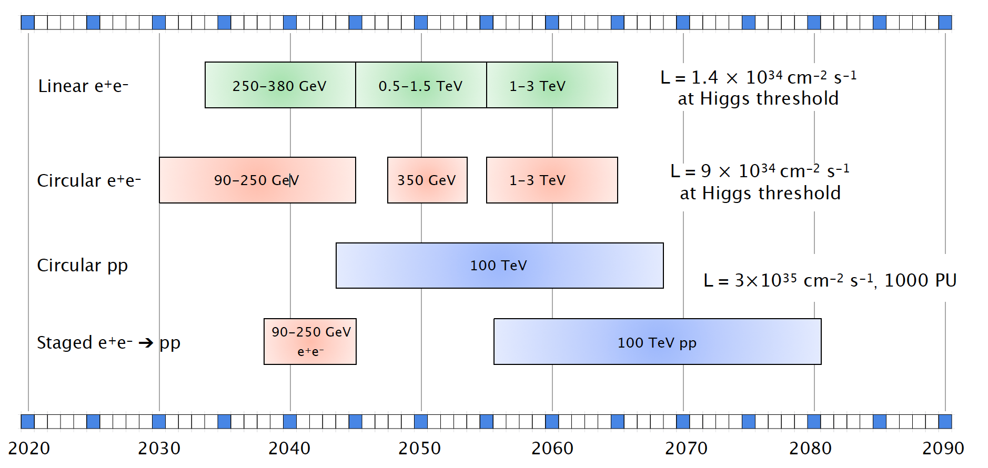
The Priority Research Directions
Each technology group is asked to identify 3 to 5 Priority Research Directions with a quantified physics motivation for each PRD.
We believe that the timelines identifying the technology challenges will be very helpful to identify the PRDs and help identify the cross-cut PRDs
Higgs timeline is a great start, but technology challenges should be added.

Slide 11
Example from Exploring the Unknown: Flavour Physics
ATLAS, CMS Phase II+ Upgrade (new inner tracking layers))
LHCb Upgrade Phase II
LHCb Upgrade Phase Ib
Belle II
LHCb accumulates 300fb-1
LHCb Upgrade Phase Ia
2020
2025
2030
2035
2040
Tracking with high granularity and good time resolution
Calorimetry with high granularity and timing
Real Time Processing of large amount of data
Readout
PhotoDetectors
Quantum Sensors
Noble Liquids
Calorimetry
SS and Tracking
TDAQ

Slide 12
Sample Priority Research Directions for Discussion and Framing
Enhanced photo-production and photo-detection.
PRDs
    Higher QE VUV sensitive detectors --- Neutrinos, Dark Matter,
    Water-based Liquid Scintillators --- Neutrinos
    Novel scintillator materials --- Neutrinos, Energy Frontier, Dark Matter
    Superconducting single-photon nanowires --- Dark Matter, QIS, ….
    ….
    PRDs could be quantitative and indicate what science regime is made accessible.

Slide 13
Sample Priority Research Directions for Discussion and Framing
Advanced semi-conductor devices and detectors
PRDs
    IR sensitive Ge CCD development -- Cosmic frontier
    Double the size of the observable universe
    12” rad hard Si technology for 5D imaging calorimetry -- Energy frontier
    Thinned MAPS technology with 5micron pixel size, 1μW/pixel -- Energy frontier
    28nm ASIC technology with integrated wireless transmission -- Intensity, Energy frontier
    Cryogenic pixelated LAr readout with aA sensitivity, …. -- neutrinos,
    …
    The development of the ASIC technology is becoming more and more expensive. Careful thought needs to be given to university-lab balance and workforce development.
    Need to develop contacts with foundries. Link to the Micro-electronics BRN needs to be established.

Slide 14
Sample Priority Research Directions for Discussion and Framing
The PRDs should be a balance between transformative and incremental R&D, but in either case be ambitious
Many other areas to be considered
  AI and ML: receives a lot of support within the Office of Science. Including this as a PRD is expected to be well received. However, there are other venues for support.
  Advanced manufacturing: additive and subtractive manufacturing techniques that work at the nanoscale level for functionalized materials.
  A critically important issue is also the workforce development, which will have to be addressed in the report.
We should keep a stage-approach in mind for our PRDs. Disruption is not the norm.

Slide 15
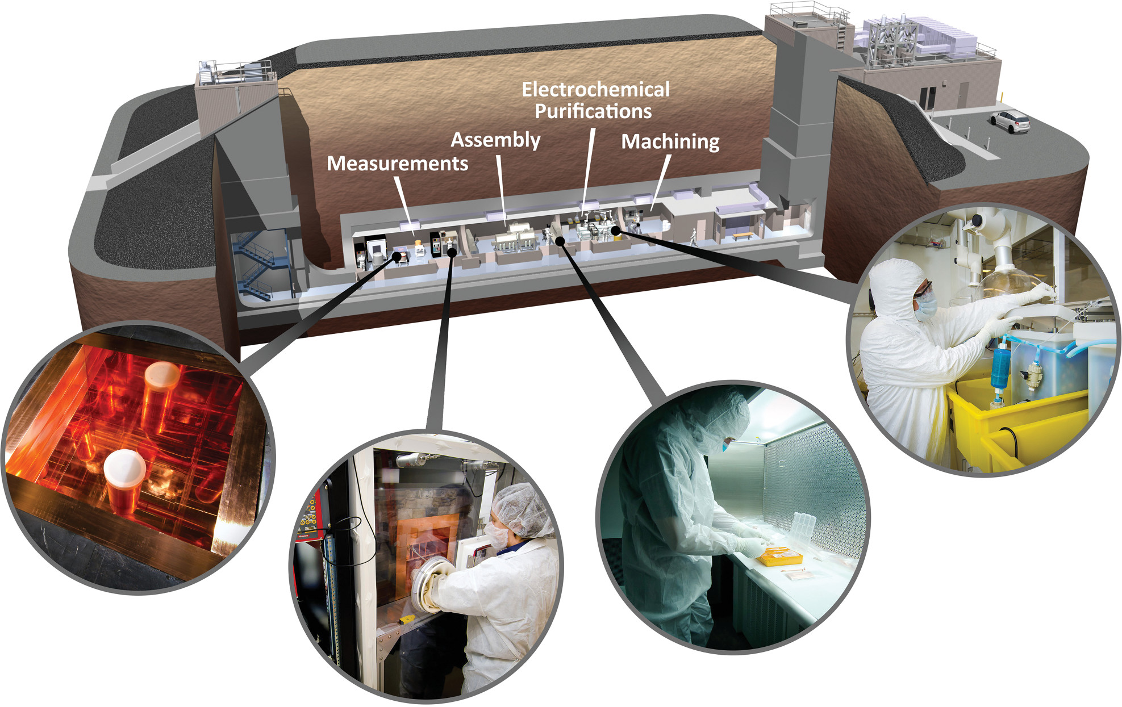
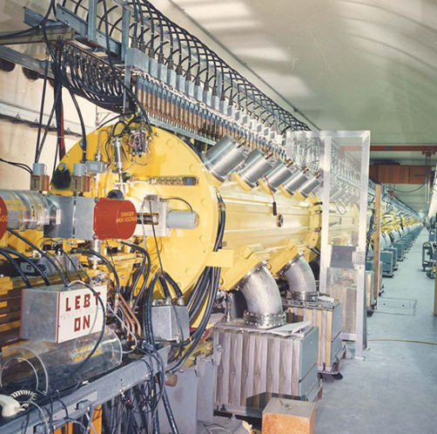
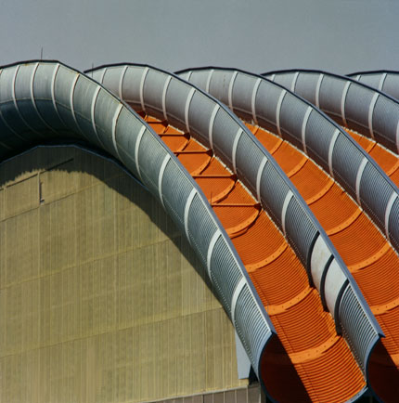
Facilities Support
To deliver on the priority research directions, a key element is the availability of test facilities to support the instrumentation development, which will not be listed as a PRD
Low Background Facility
Test Beams
Irradiation Facilities
Characterization Platforms
  Provides support for low-background experiments in the areas of materials and assay
Critical need for low-background experiments
  Provides high-quality beams and data taking infrastructure to develop and characterize new detector technologies
  Critical need to explore new technologies
Provides facilities to validate radiation resistance to extremely high fluences
Essential for Energy and Intensity Frontier experiments
Provides platforms for determining fundamental physics of materials
Vital for determining proof of principle and long-term viability of proposed materials and environments

Slide 16
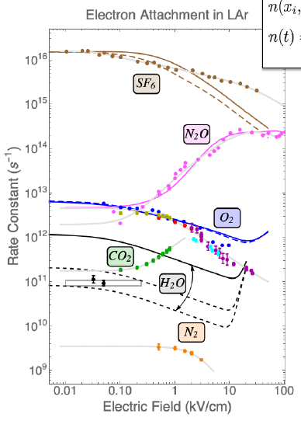
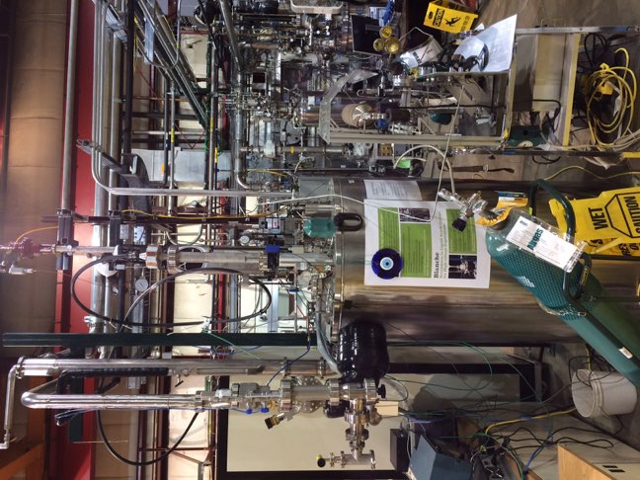
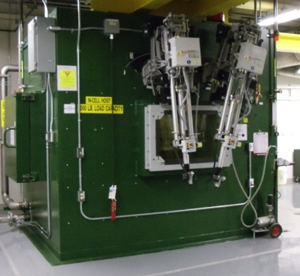

Facilities Support: Characterization Platforms
Noble Liquid
Platform
Calibration
Platform
Irradiation Evaluation Platform
Fundamental Properties
Platform
  System test of components of noble liquid detectors under operating conditions
  Calibration platform for various systems, such as liquid Argon field cage system to measure TPC field response
Evaluate radiation resistance of materials exposed to extremely high fluences for targetry
Platform for measurement of fundamental physics properties

Slide 17
Possible Process Train
Science Driver
Physics Objective
Priority Research Direction
Key Challenge
Technical Requirement
Science Driver
Physics Objective
Technical Requirement
Priority Research Direction
Key Challenge
Science Driver
Physics Objective
Technical Requirement
Priority Research Direction
Key Challenge
Science Driver
Physics Objective
Technical Requirement
Priority Research Direction
Key Challenge
Science Driver
Physics Objective
Technical Requirement
Priority Research Direction
Key Challenge
Science Driver
Physics Objective
Technical Requirement
Priority Research Direction
Key Challenge
Science Driver
Physics Objective
Technical Requirement
Priority Research Direction
Key Challenge

Slide 18
Anticipated Process Train
Science Driver
Physics Objective
Priority Research Direction
Key Challenge
Technical Requirement
Science Driver
Physics Objective
Technical Requirement
Priority Research Direction
Key Challenge
Science Driver
Physics Objective
Technical Requirement
Priority Research Direction
Key Challenge
Science Driver
Physics Objective
Technical Requirement
Priority Research Direction
Key Challenge
Science Driver
Physics Objective
Technical Requirement
Priority Research Direction
Key Challenge
Science Driver
Physics Objective
Technical Requirement
Priority Research Direction
Key Challenge
Science Driver
Physics Objective
Technical Requirement
Priority Research Direction
Key Challenge
Key Challenge
Several Priority Research Directions
are candidate ‘Key Challenges’

Slide 19
Anticipated Process Train
Science Driver
Priority Research Direction
Key Challenge
Technical Requirement
Physics Objective
Science Driver
Physics Objective
Technical Requirement
Priority Research Direction
Key Challenge
Science Driver
Physics Objective
Technical Requirement
Priority Research Direction
Key Challenge
Science Driver
Physics Objective
Technical Requirement
Priority Research Direction
Key Challenge
Science Driver
Physics Objective
Technical Requirement
Priority Research Direction
Key Challenge
Science Driver
Physics Objective
Technical Requirement
Priority Research Direction
Key Challenge
Science Driver
Physics Objective
Technical Requirement
Priority Research Direction
Key Challenge
The same physics objective can have multiple
technical requirements with other ‘Key Challenges’

Slide 20
Anticipated Process Train
Science Driver
Priority Research Direction
Key Challenge
Technical Requirement
Physics Objective
Science Driver
Physics Objective
Technical Requirement
Priority Research Direction
Key Challenge
Science Driver
Physics Objective
Technical Requirement
Priority Research Direction
Key Challenge
Science Driver
Physics Objective
Technical Requirement
Priority Research Direction
Key Challenge
Science Driver
Physics Objective
Technical Requirement
Priority Research Direction
Key Challenge
Science Driver
Physics Objective
Technical Requirement
Priority Research Direction
Key Challenge
Science Driver
Physics Objective
Technical Requirement
Priority Research Direction
Key Challenge
Key Challenge
Several Priority Research Directions
are candidate ‘Key Challenges’

Slide 21
Anticipated Process Train
Science Driver
Physics Objective
Priority Research Direction
Key Challenge
Technical Requirement
Science Driver
Physics Objective
Technical Requirement
Priority Research Direction
Key Challenge
Science Driver
Physics Objective
Technical Requirement
Priority Research Direction
Key Challenge
Science Driver
Physics Objective
Technical Requirement
Priority Research Direction
Key Challenge
Science Driver
Physics Objective
Technical Requirement
Priority Research Direction
Key Challenge
Science Driver
Physics Objective
Technical Requirement
Priority Research Direction
Key Challenge
Science Driver
Physics Objective
Technical Requirement
Priority Research Direction
Key Challenge
Key Challenge

Slide 22
Anticipated Process Train
Science Driver
Physics Objective
Technical Requirement
Priority Research Direction
Key Challenge
Science Driver
Physics Objective
Technical Requirement
Priority Research Direction
Key Challenge
Science Driver
Physics Objective
Technical Requirement
Priority Research Direction
Key Challenge
Science Driver
Physics Objective
Technical Requirement
Priority Research Direction
Key Challenge
Science Driver
Physics Objective
Technical Requirement
Priority Research Direction
Key Challenge
X
Key Challenge
There may be PRDs that do NOT map onto a
Key Challenge. That does not mean they cannot
rise to a key priority for the future program.

Slide 23
Process gets carried out by all groups

Slide 24
Process gets carried out by all groups
Cross-Cut group tries to look for
commonality between the PRDs

Slide 25
The Flow
Higgs (self)-Couplings
(5%) 1%
Event disambiguation
5ps per hit timing resolution
Trackorimeter
Breaking the picosecond Time Barrier
Many areas are very thin on requirements, or are absent all together. We need help!
Example “flow”:

Slide 26
The Flow
Higgs (self)-Couplings
(5%) 1%
Event disambiguation
5ps per hit timing resolution
Trackorimeter
Breaking the picosecond Time Barrier
The Unknown
Particle Identification
5ps per hit timing resolution
Transparent Tracker
Breaking the picosecond Time Barrier
Many areas are very thin on requirements, or are absent all together. We need help!
Example “flow”:

Slide 27
The Flow
Neutrino Physics
CP-violation
MO
High QE, large-area
VUV-sensitive Detectors
Ehanced Photodetection
Dark Energy
Spectroscopy
Ge-CCDs
Alternative Photodetector Materials
Enhanced Photodetection
Many areas are very thin on requirements, or are absent all together. We need help!
Example “flow”:

Slide 28
Report Structure
Exec Summary
  Audience: policy makers
  Length: ~1 page
  Describes the Key Challenges

Slide 29
Report Structure
Exec Summary
Science Impact
  Audience: policy makers
  Length: ~1 page
  Describes the Key Challenges
  Audience: Office of Science
  Length: ~5-10 pages
  Describes the new horizons that the technology development will open for science
  Describes the science impact “without numbers” in “catchy” phrases
  Emphasizes:
    Need for facilities
    Workforce development
    Connection to other science disciplines
    Connection to high priority topics: AI/ML, QIS

Slide 30
Possible Graphic
Cosmic Acceleration
Neutrino Mass
Explore the
Unknown
Higgs Boson
Dark Matter
KC 1
KC 2
KC 3
Impact beyond HEP
KC 4
KC 5

Slide 31
Report Structure
Exec Summary
Science Impact
Panel Report
  Audience: policy makers
  Length: ~1 page
  Describes the Key Challenges
  Audience: Office of Science
  Length: ~5-10 pages
  Describes the new horizons that the technology development will open for science
  Describes the science impact “without numbers” in “catchy” phrases
  Emphasizes:
    Need for facilities
    Workforce development
    Connection to other science disciplines
    Connection to high priority topics: AI/ML, QIS
  Audience: OHEP and HEP community
  Length: ~100 pages
  In-depth discussion – with specificity – of all the PRDs
  The PRDs have to be actionable

Slide 32

Comments?

