Slide 1

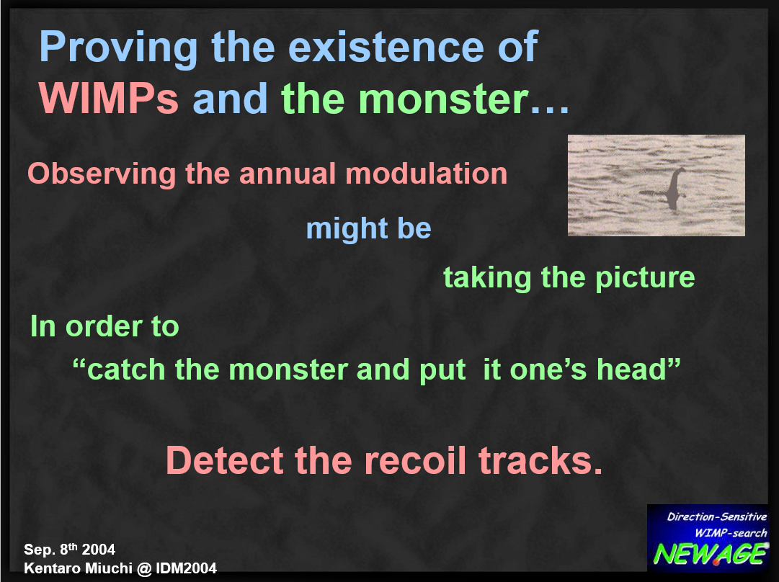

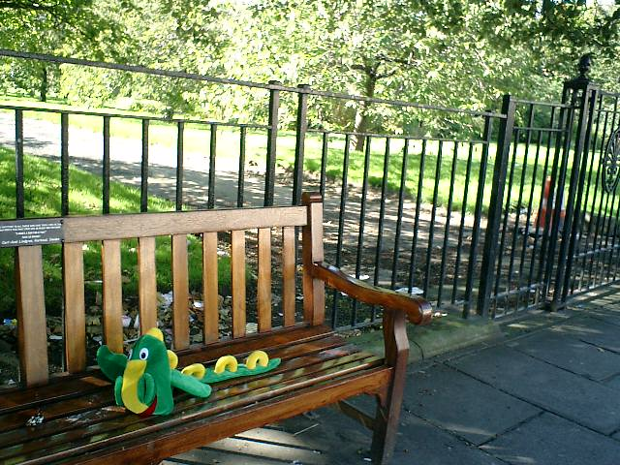
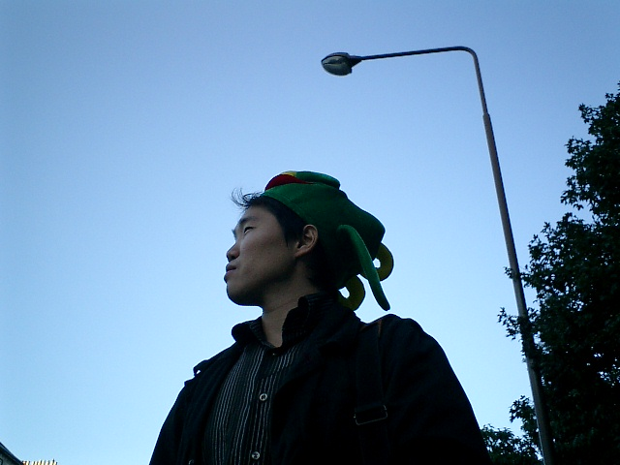

Possible collaboration
Kentaro Miuchi Kobe Univ.
CYGNOz 2026 26 Feb 2026

Slide 2
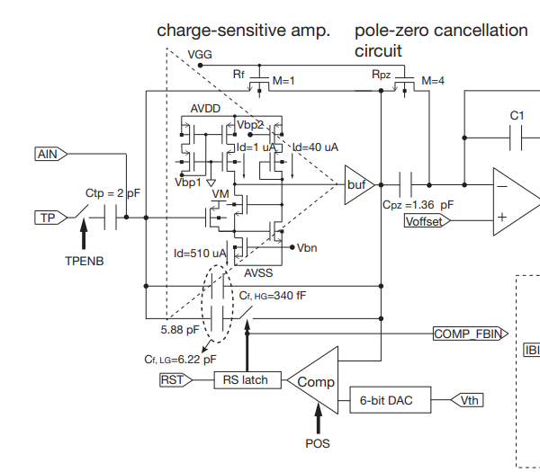
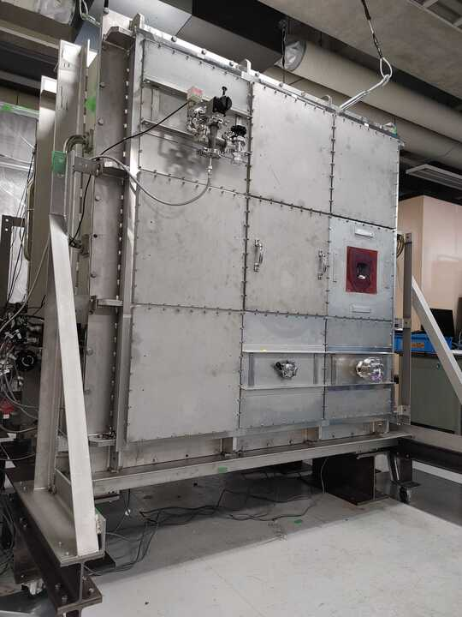
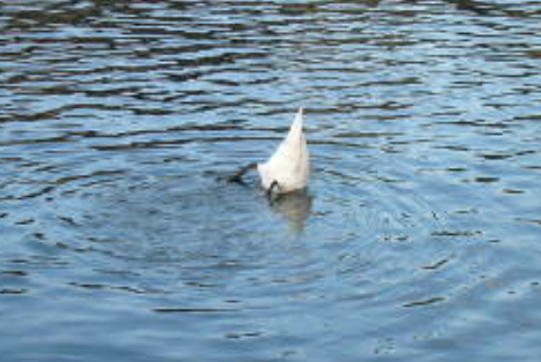
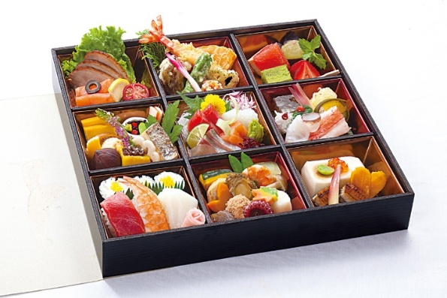
I have some funding to send/invite.
Low BG readout board: μ-PIC ⇒ R. Namai’s talk
Electronics for NI readout: dynamic gain change
https://iopscience.iop.org/article/10.1088/1748-0221/15/09/T09009
Radon emanation protection
Satoshi & Shuki
Gas circulation with water/radon removal
Charge yield measurement ⇒ W. Toyama’s poster
“BENTO” chamber ⇒ K. Miuchi’s poster
Liaison to a huge water tank: CYGNUSK

Slide 3
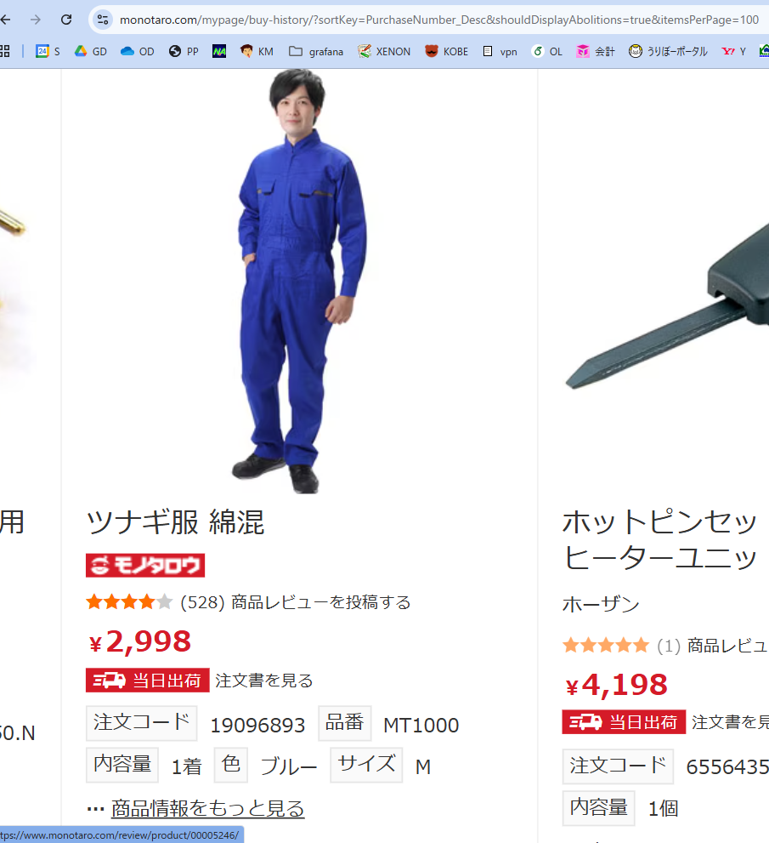
In-kind contribution
through “MONOTARO”

