Slide 1
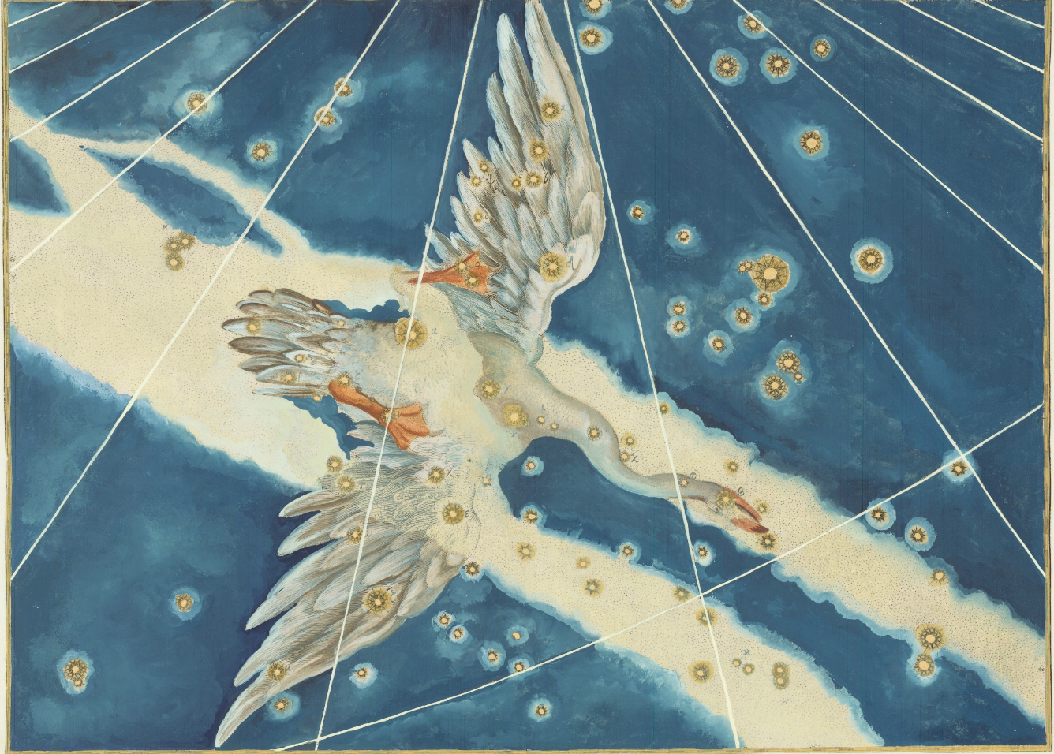


CYGnuOz:
What next?
Chiara Lisotti, supervised by Dr. Ciaran O’Hare

Slide 2
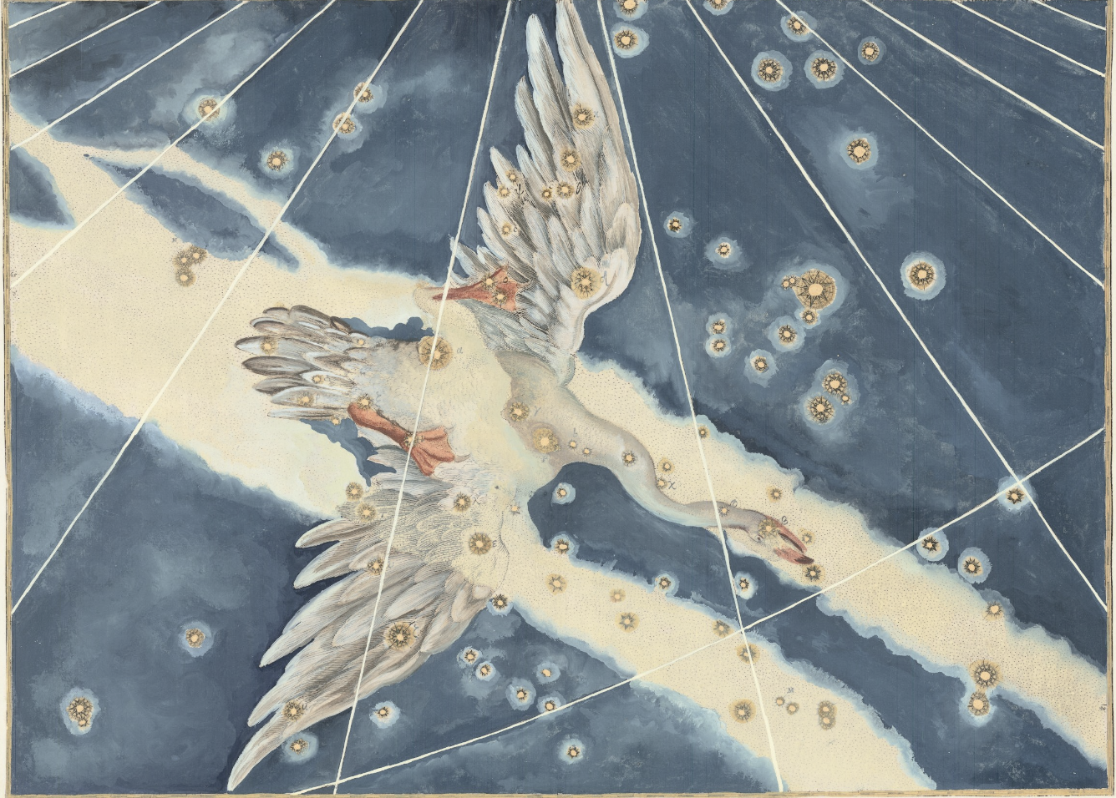
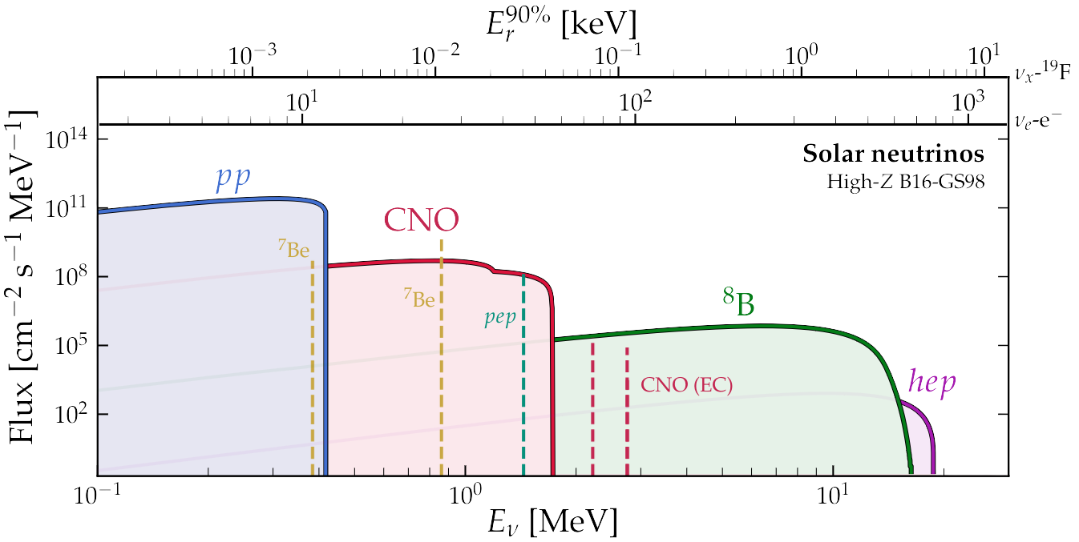
I
Solar Neutrinos

Slide 3
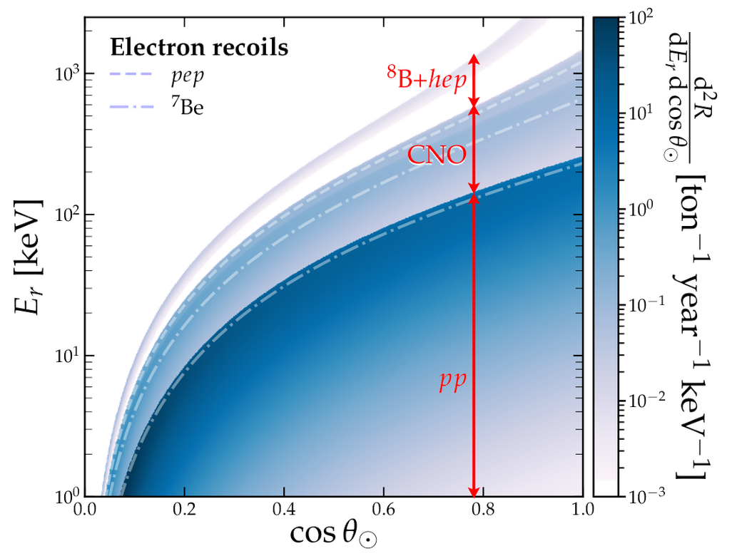
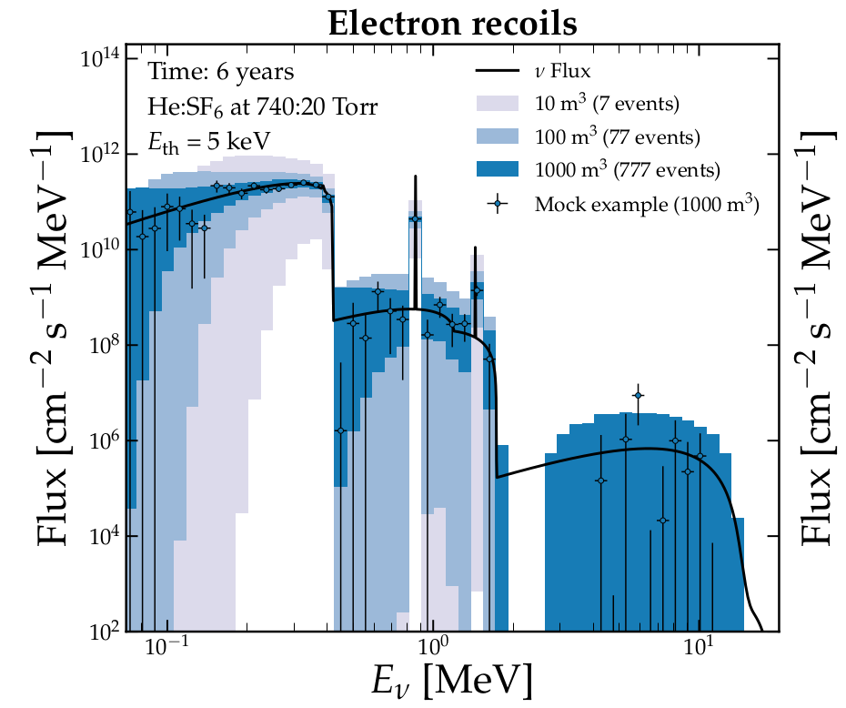


Slide 4
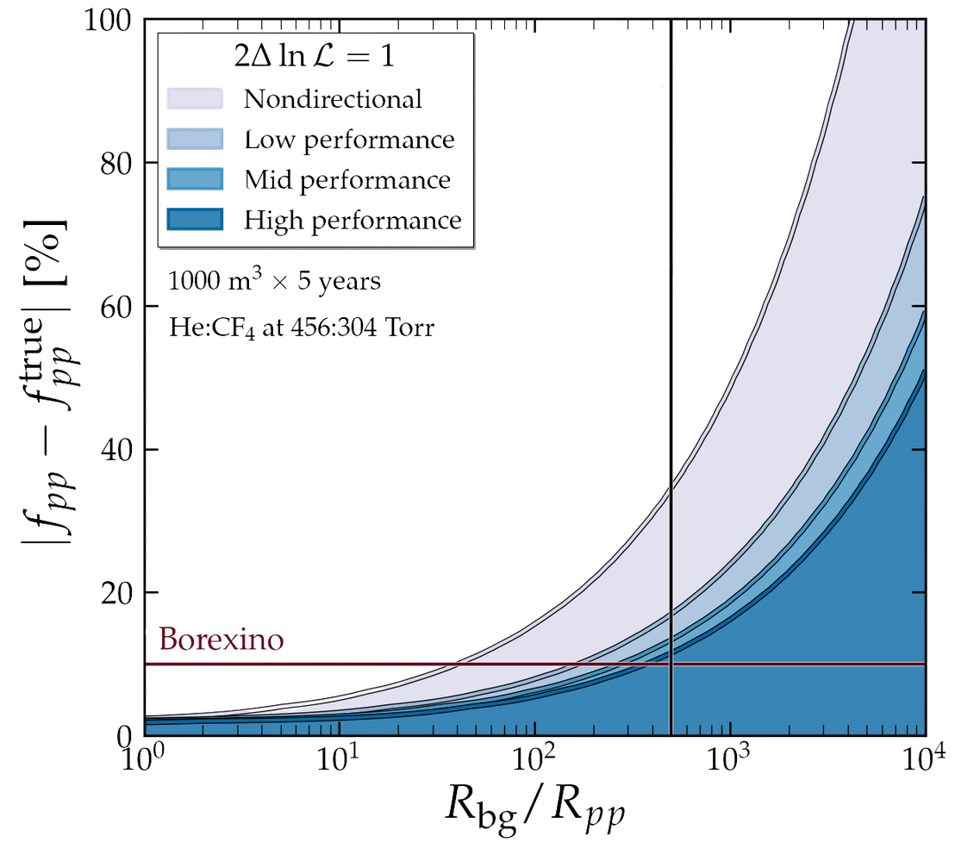
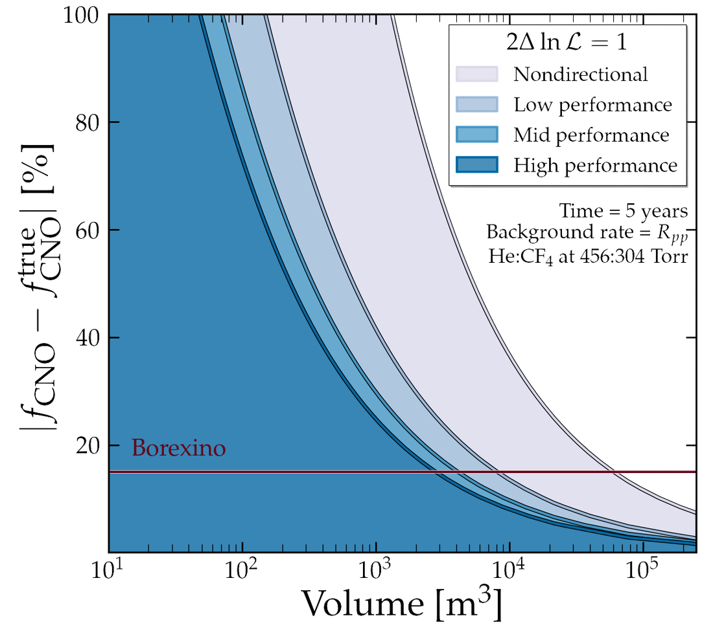
CYGNO (factor of 3 BG reduction)
CL, O’Hare, et al., [2404.03690]
+ see Samuele Torelli’s thesis for benchamrk performances and simulations

Slide 5
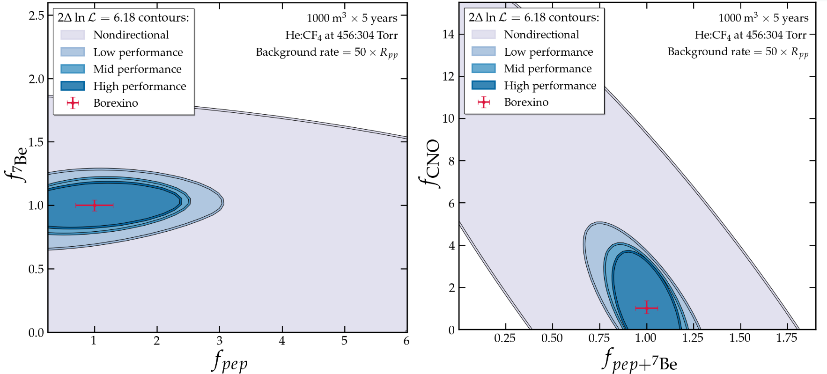
CL, O’Hare, et al., [2404.03690]
+ see Samuele Torelli’s thesis for benchamrk performances and simulations

Slide 6
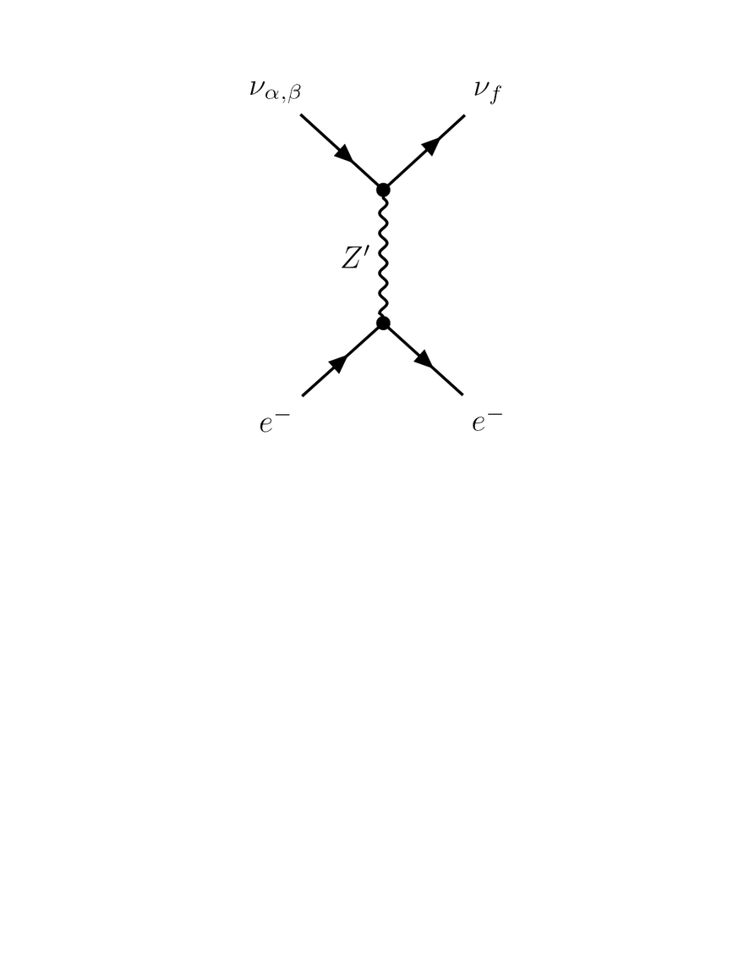
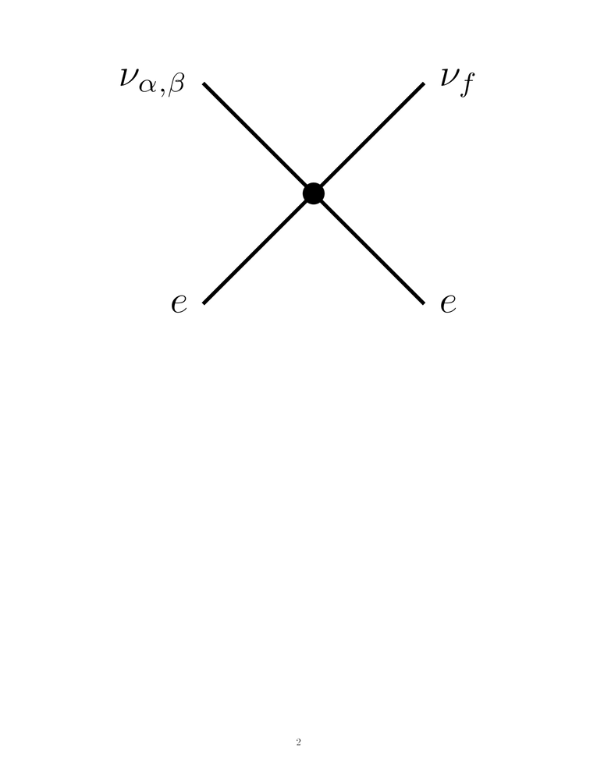
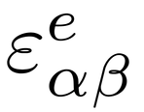

II
Solar Neutrinos bSM
Non-Standard Interactions
Let us add a new vector mediator
Light
if mass ≲ q
Heavy
if mass >> q
≈ effective 4-fermion
interaction
with free parameters

Slide 7
Non-Standard Interactions
Let us add a new vector mediator
Light
if mass ≲ q
Heavy
if mass >> q
≈ effective 4-fermion
interaction
with free parameters

Slide 8
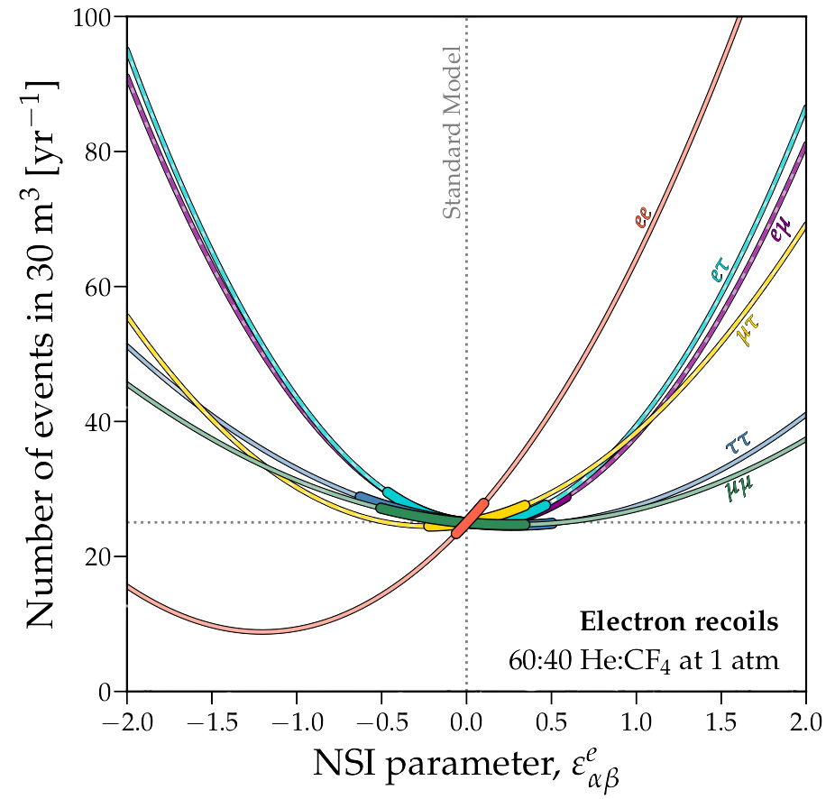
Suppression or enhancement of number of events!
Hard to discriminate from SM in the region [-0.5, 0.5]...
Chandra Shekar, CL, et al., [2506.09322]

Slide 9
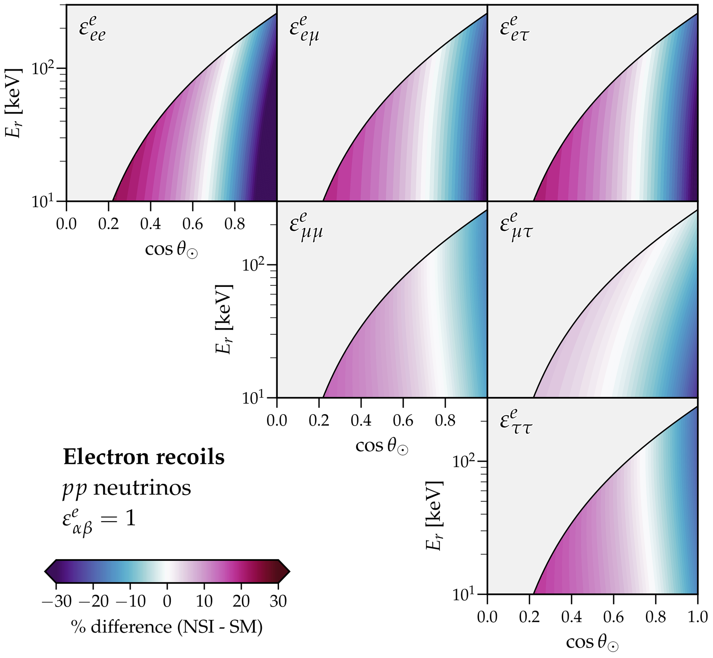
Differences in shape here; these are not present for the total event rate...
Direction can help us disentangle
SM and NSI effects!
Chandra Shekar, CL, et al., [2506.09322]

Slide 10
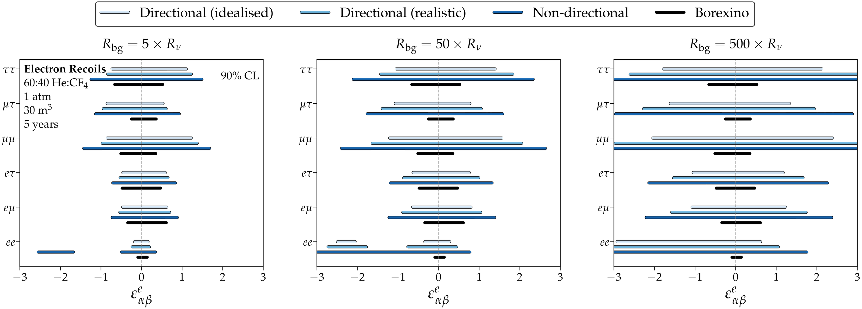
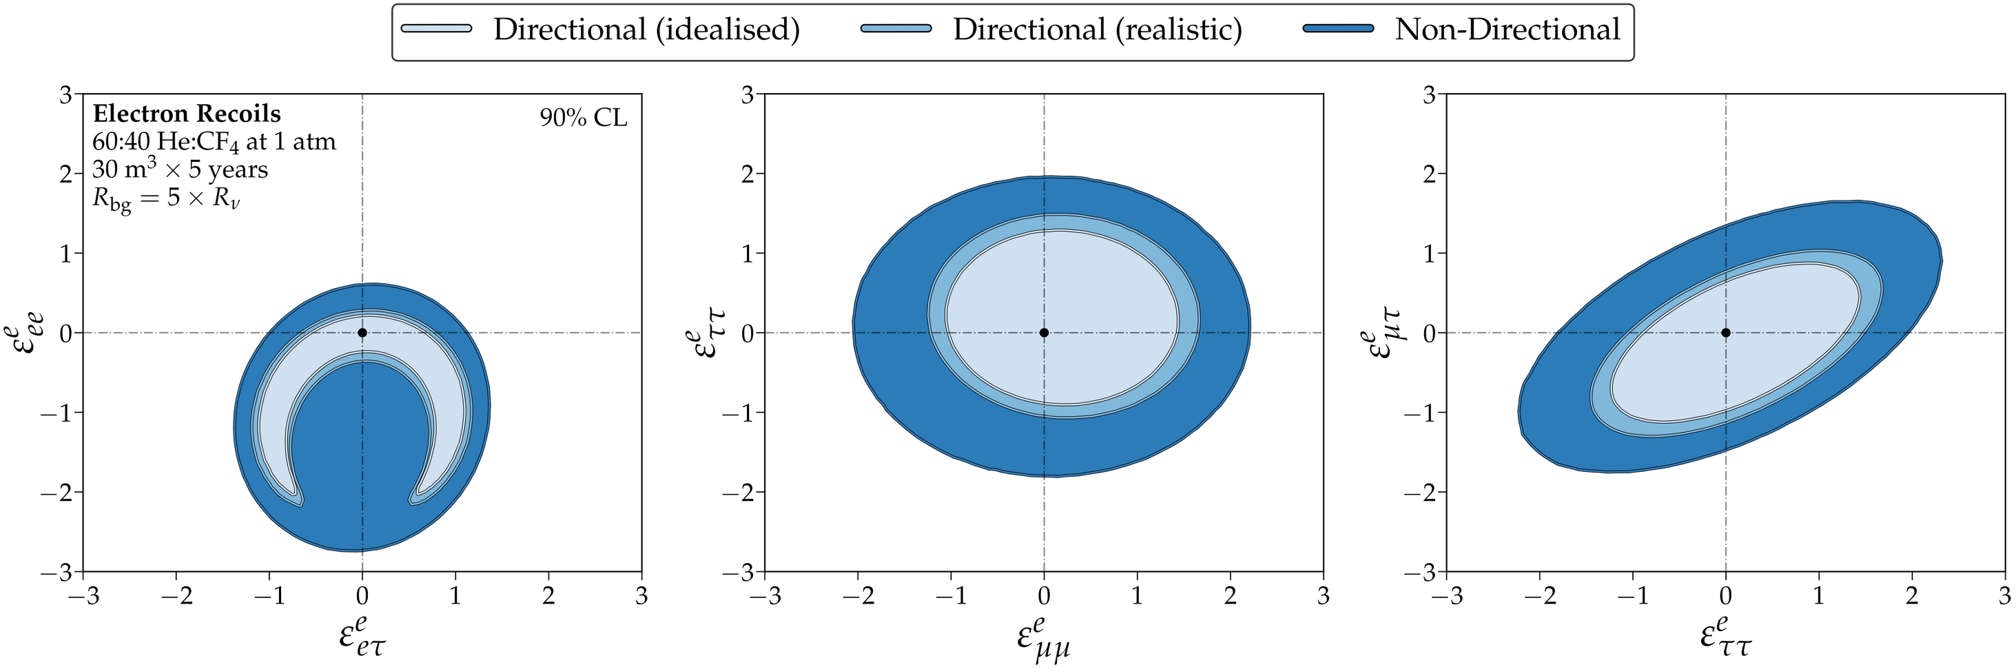
Chandra Shekar, CL, et al., [2506.09322]

Slide 11
Non-Standard Interactions
Let us add a new vector mediator
Light
if mass ≲ q
Heavy
if mass >> q
≈ effective 4-fermion
interaction
with free parameters

Slide 12
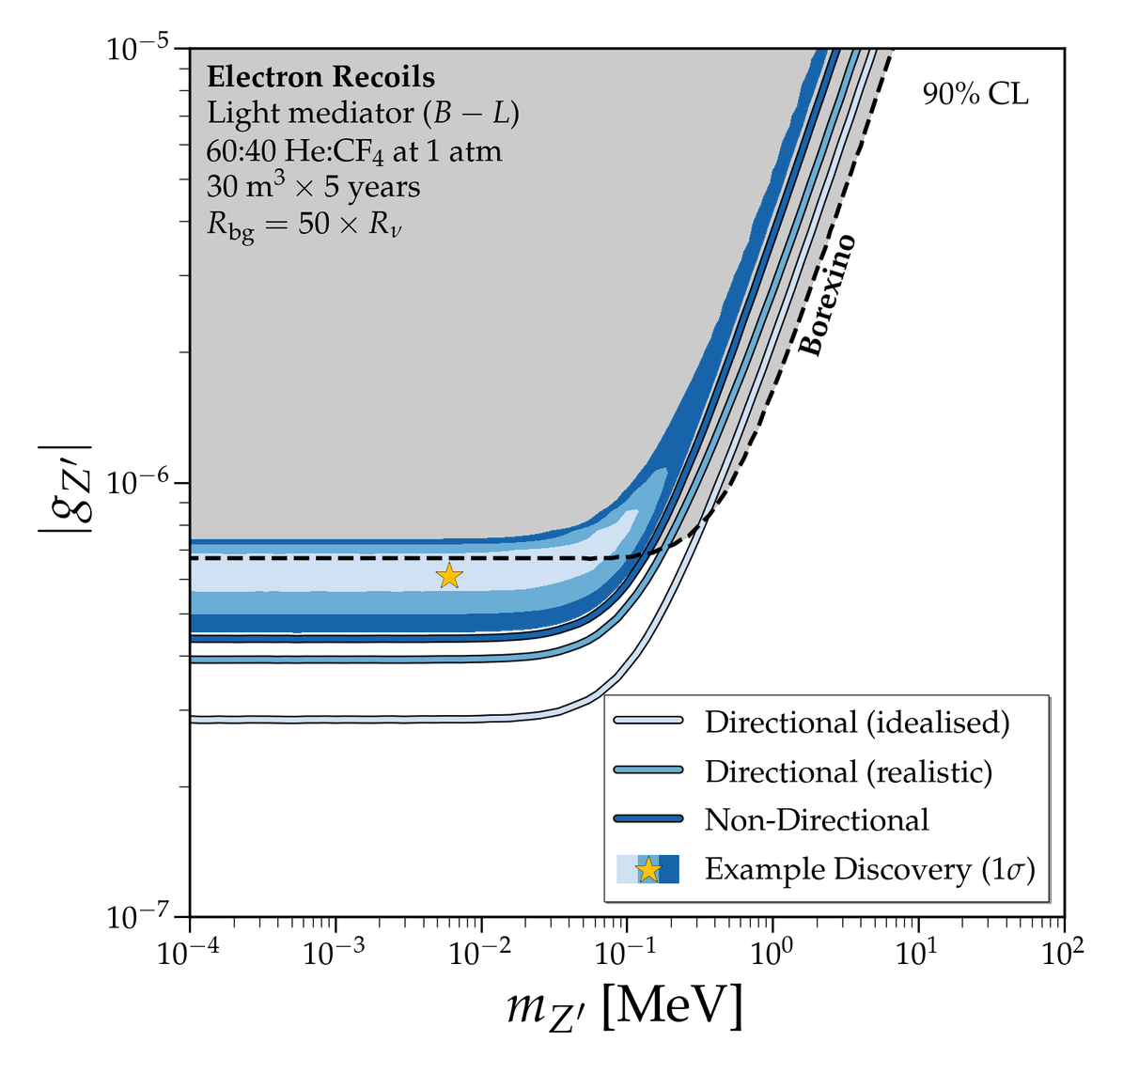
Lower threshold means we can probe smaller masses!
Other DM detectors could reach these exclusion limits
But it’s the background rejection that comes with directionality that would make a positive discovery possible!
Chandra Shekar, CL, et al., [2506.09322]

Slide 13



III
SNS
proton beam
liquid mercury target

Slide 14

III
SNS
neutrons
liquid mercury target

Slide 15
The majority of pions stop in the target, where they decay

Slide 16
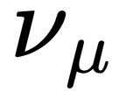
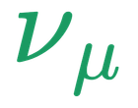

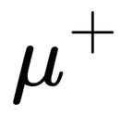
The majority of pions stop in the target, where they decay

Slide 17
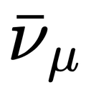
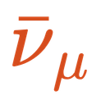


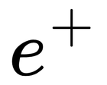
The majority of pions stop in the target, where they decay

Slide 18
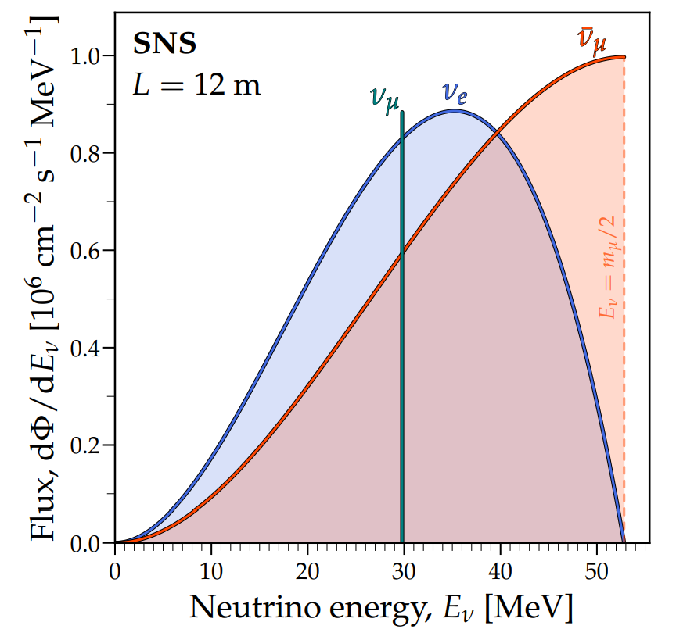
O’Hare, Chandra Shekar, CL, et al., [2602.19618]

Slide 19
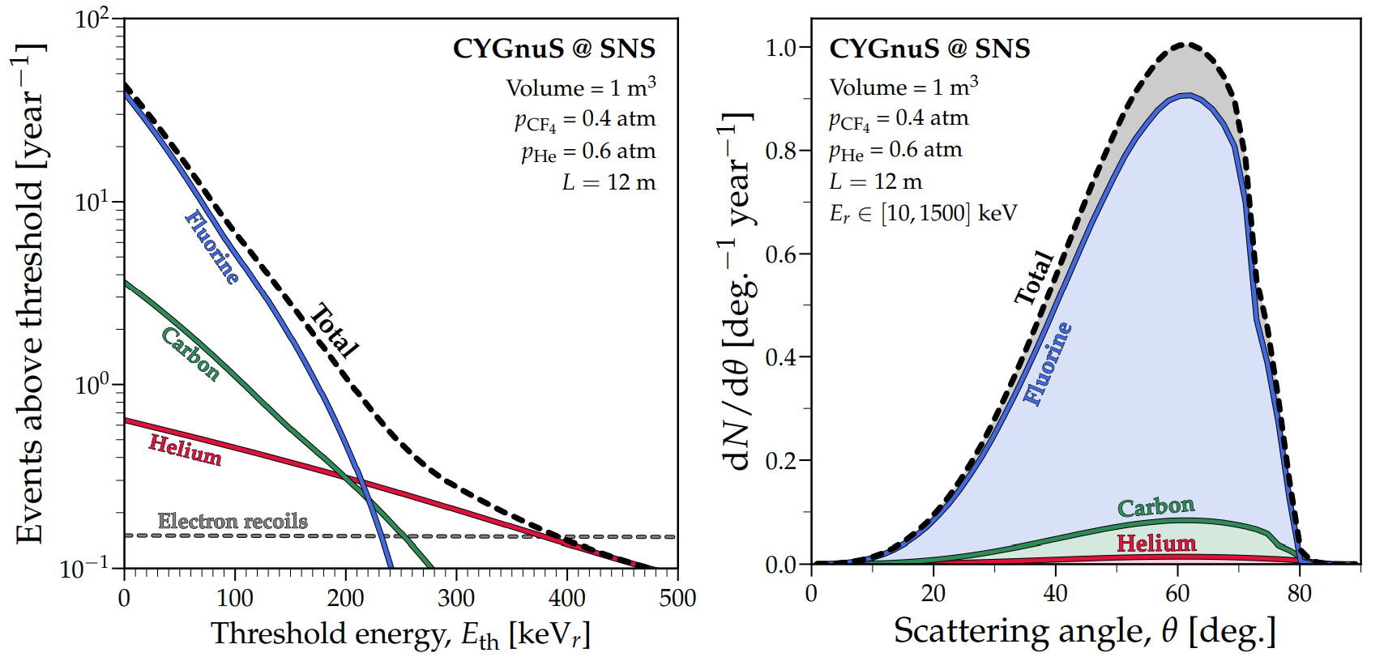
O’Hare, Chandra Shekar, CL, et al., [2602.19618]

Slide 20
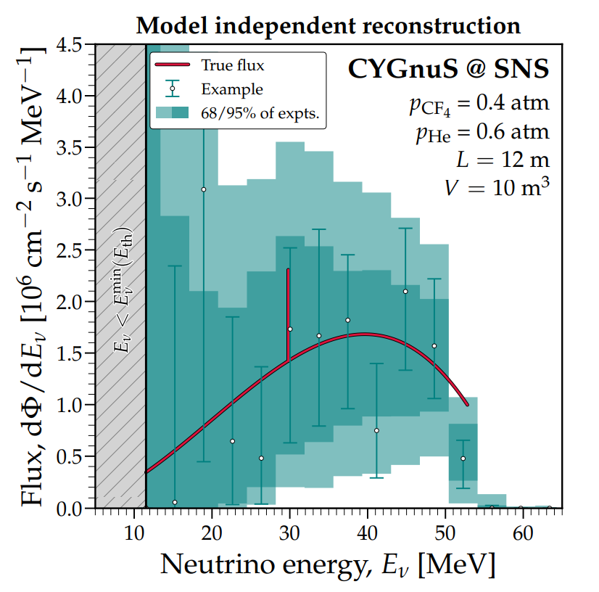
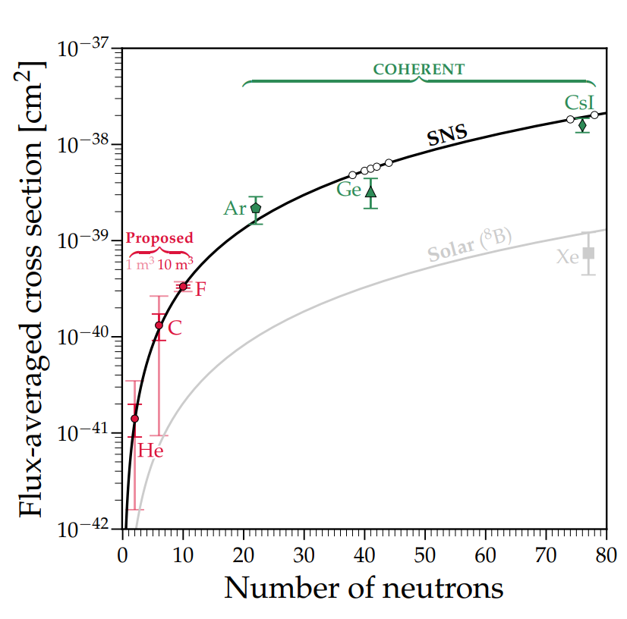
O’Hare, Chandra Shekar, CL, et al., [2602.19618]

Slide 21
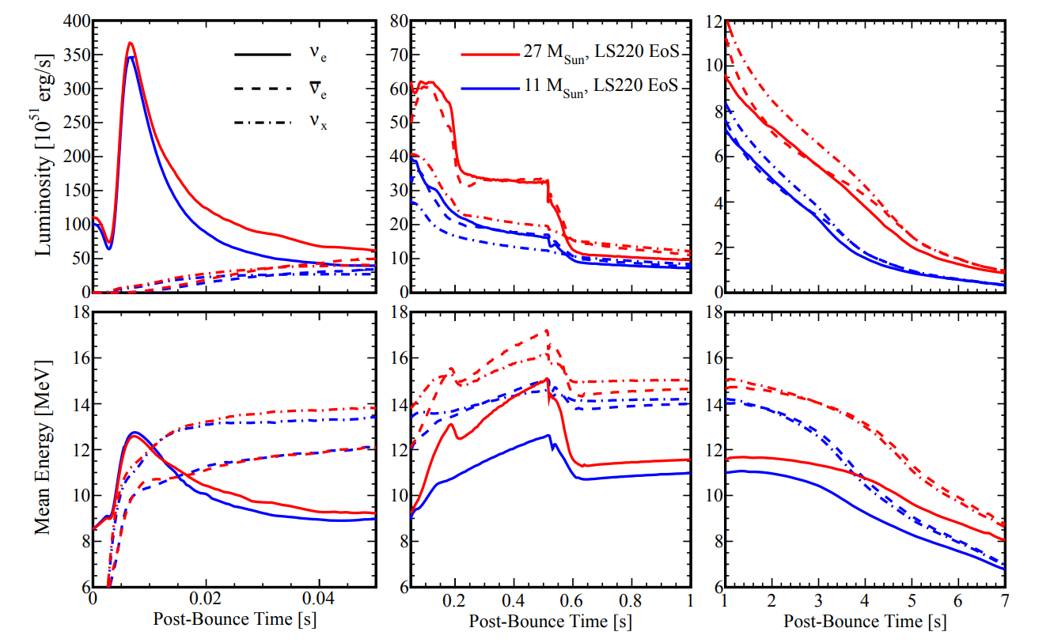
IV
CCSNs
Lang et al., [2506.09322]

Slide 22
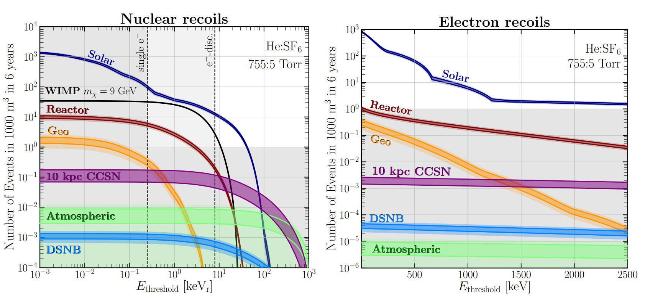
IV
CCSNs
Vahsen, O’Hare, et al. [2008.12587]

Slide 23
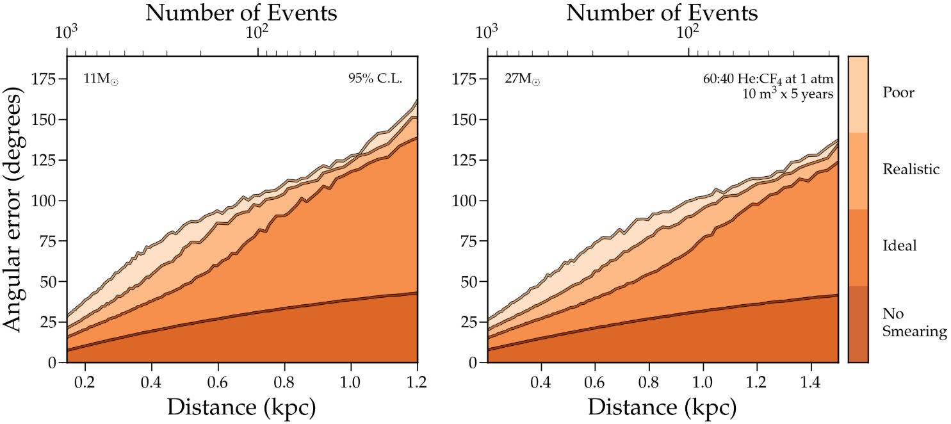
Through CE$ν$NS, we could reconstruct this neutrino flux
!!! THIS IS EXTREMELY PRELIMINARY !!!
and triangulate its source, aiding multimessenger astronomy

Slide 24
Possible next steps for this project:
- Working on constructing a full likelihood for this now
- It would be good to repeat this for electron recoils as well, as suggested by Elisabetta

Slide 25
Looking back at this...
Lang et al., [2506.09322]

Slide 26
Looking back at this...
Lang et al., [2506.09322]
What could we learn from ER, NR signals simultaneously?

Slide 27
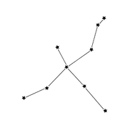

V
Relativistic DM
Halo DM

Slide 28
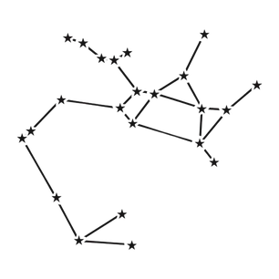
Halo DM
DM produced in
supernovae

Slide 29
Halo DM
DM produced in
supernovae

Slide 30
Halo DM
DM produced in
supernovae
Cosmic Rays

Slide 31

Halo DM
DM produced in
supernovae
Cosmic Rays

Slide 32
Halo DM
DM produced in
supernovae
Cosmic Ray
upscattered DM
Baracchini, DeRocco, Dho, [2009.08836]
Bringmann and Pospelov, PRL 2019

Slide 33
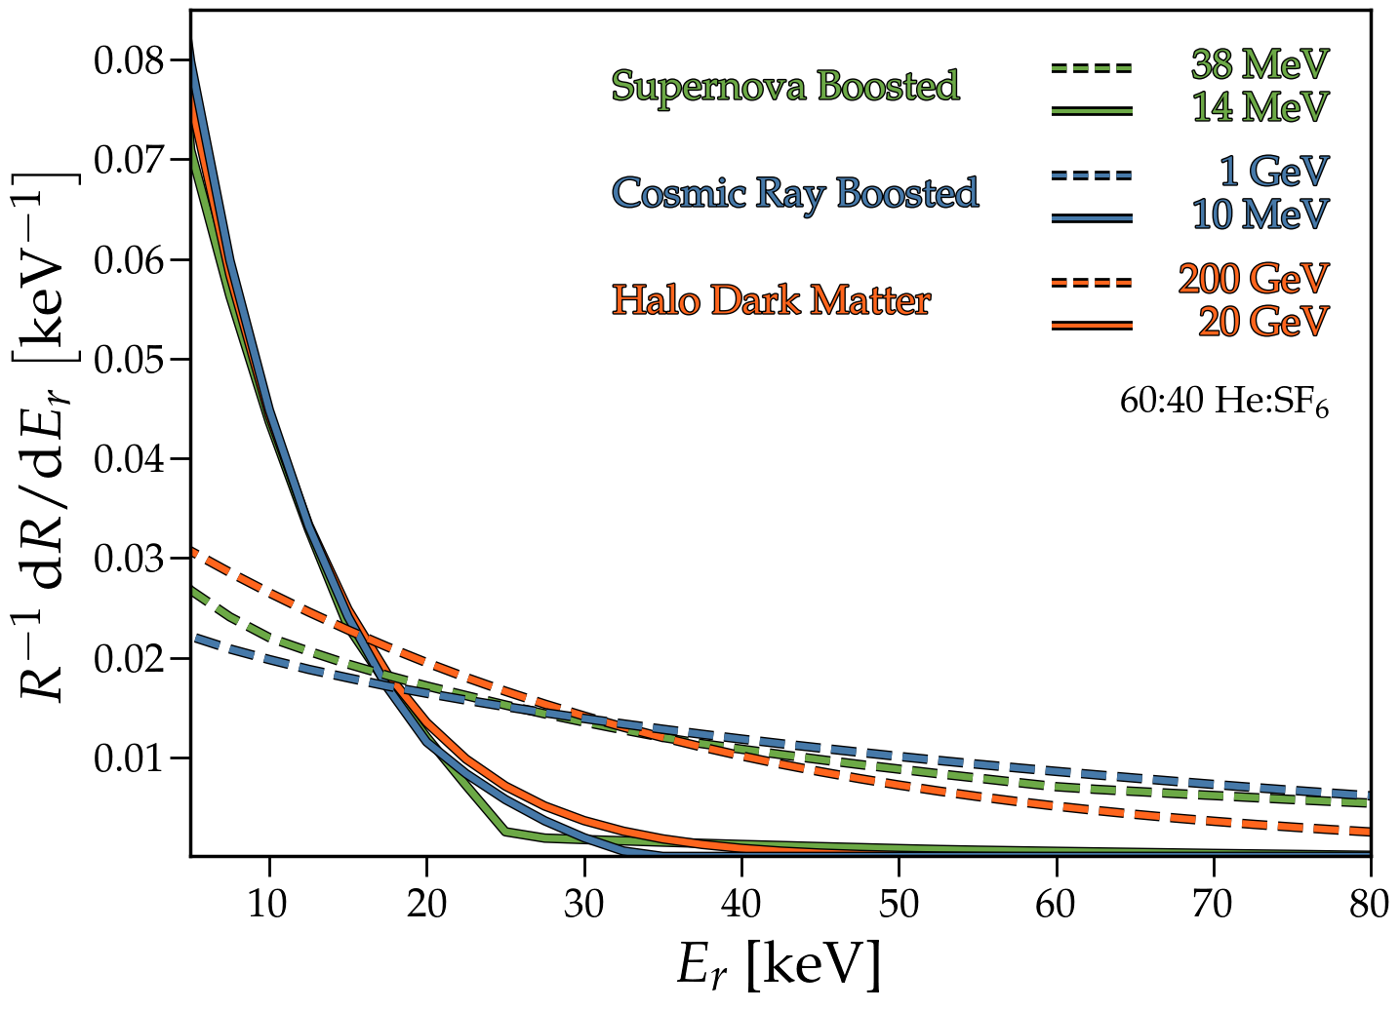
How to discern semi-relativistic sub-GeV DM and WIMPs,
assuming an identical number of events?

Slide 34
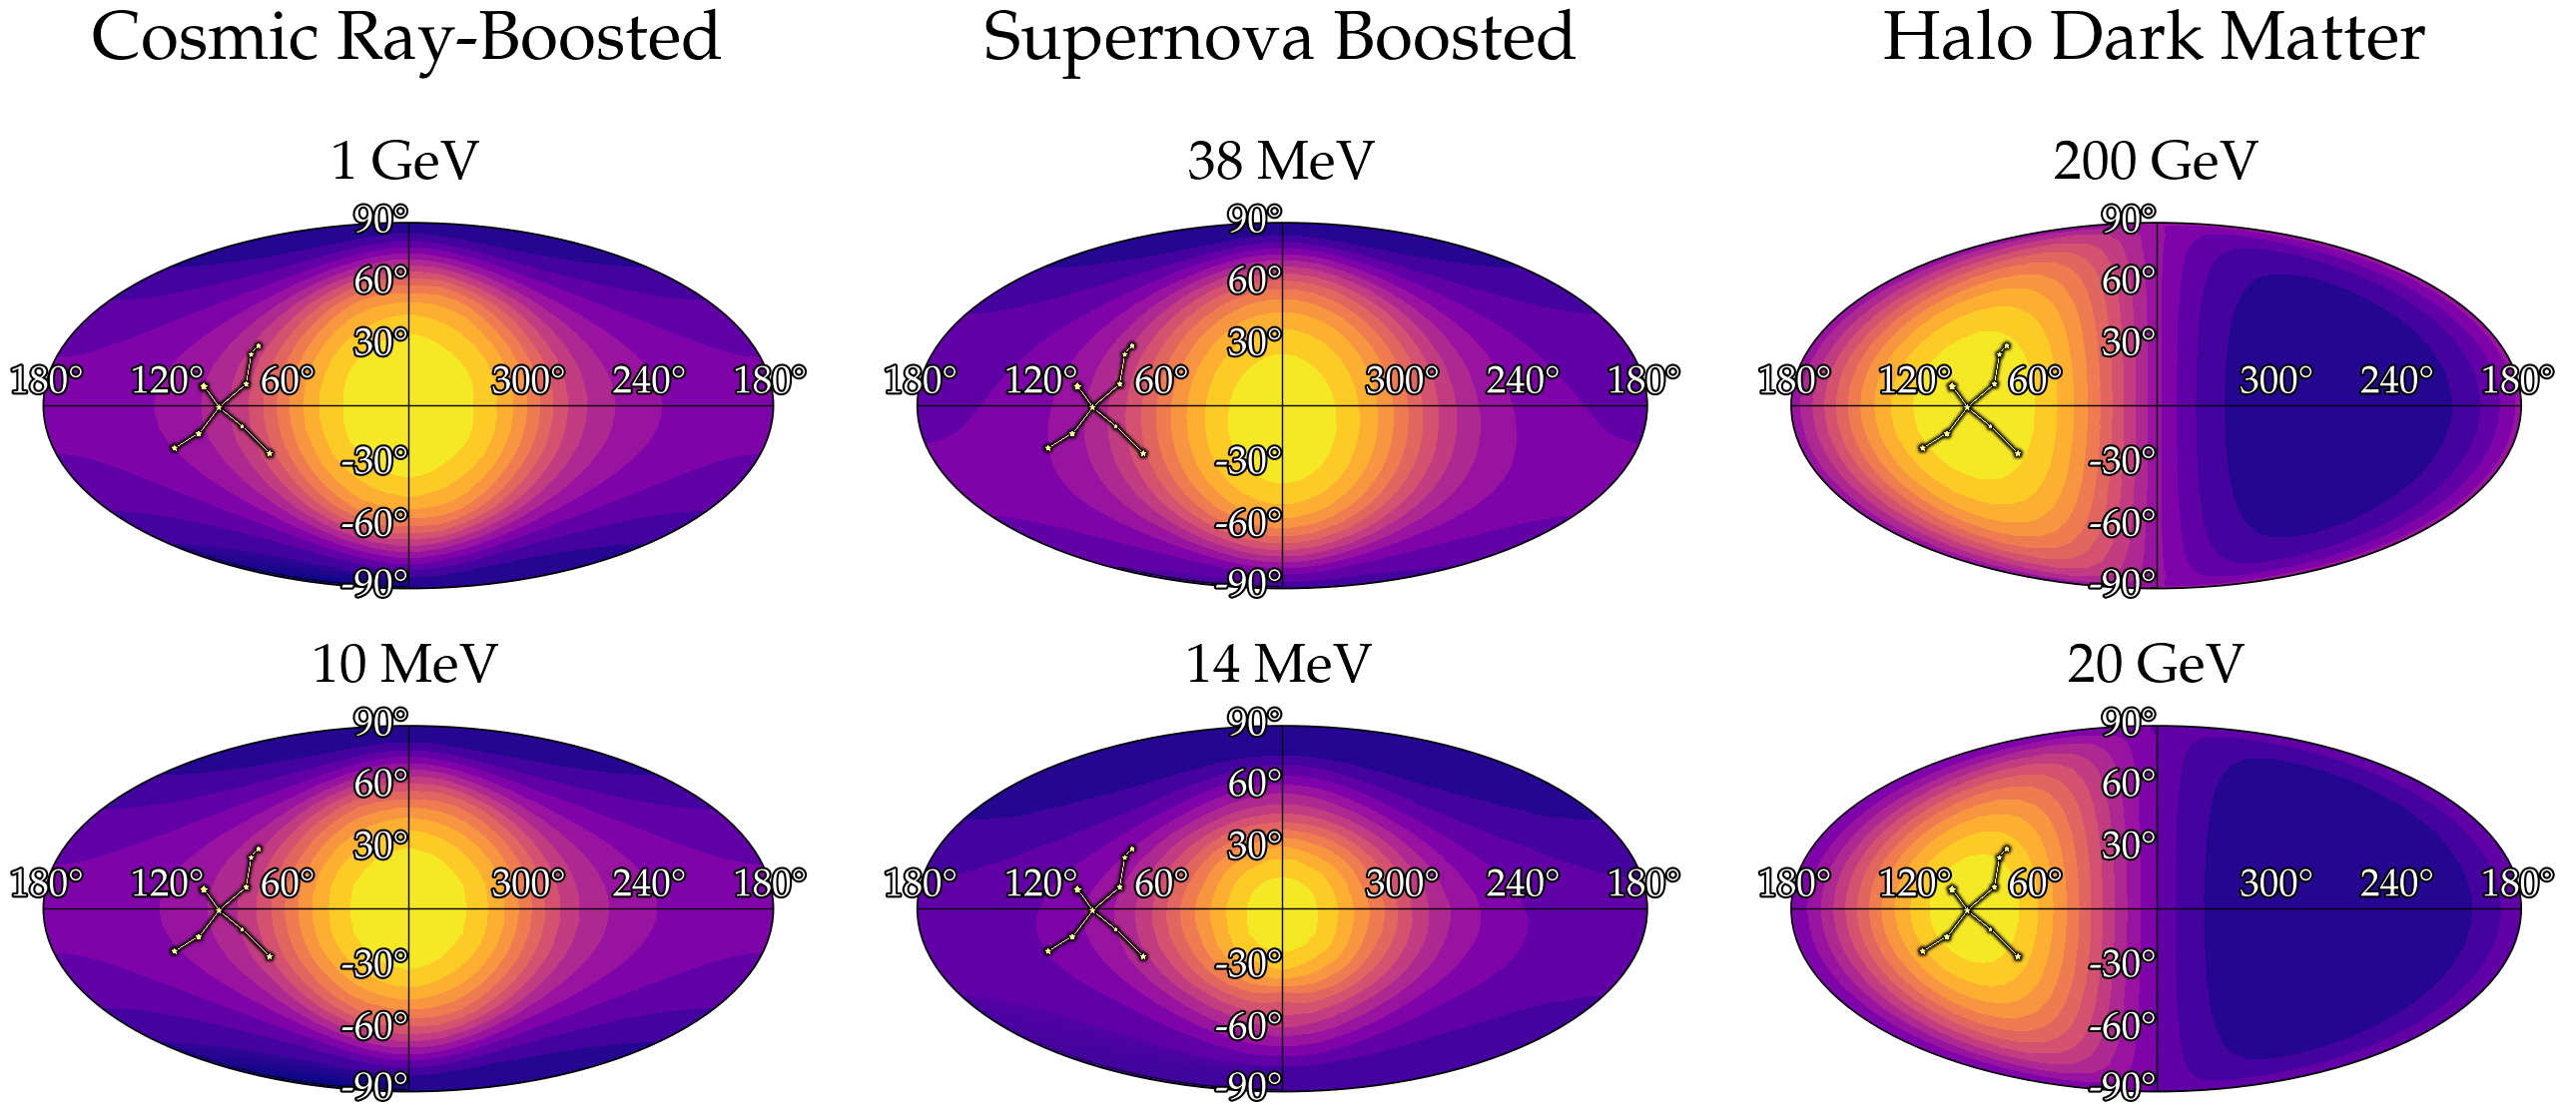

Slide 35
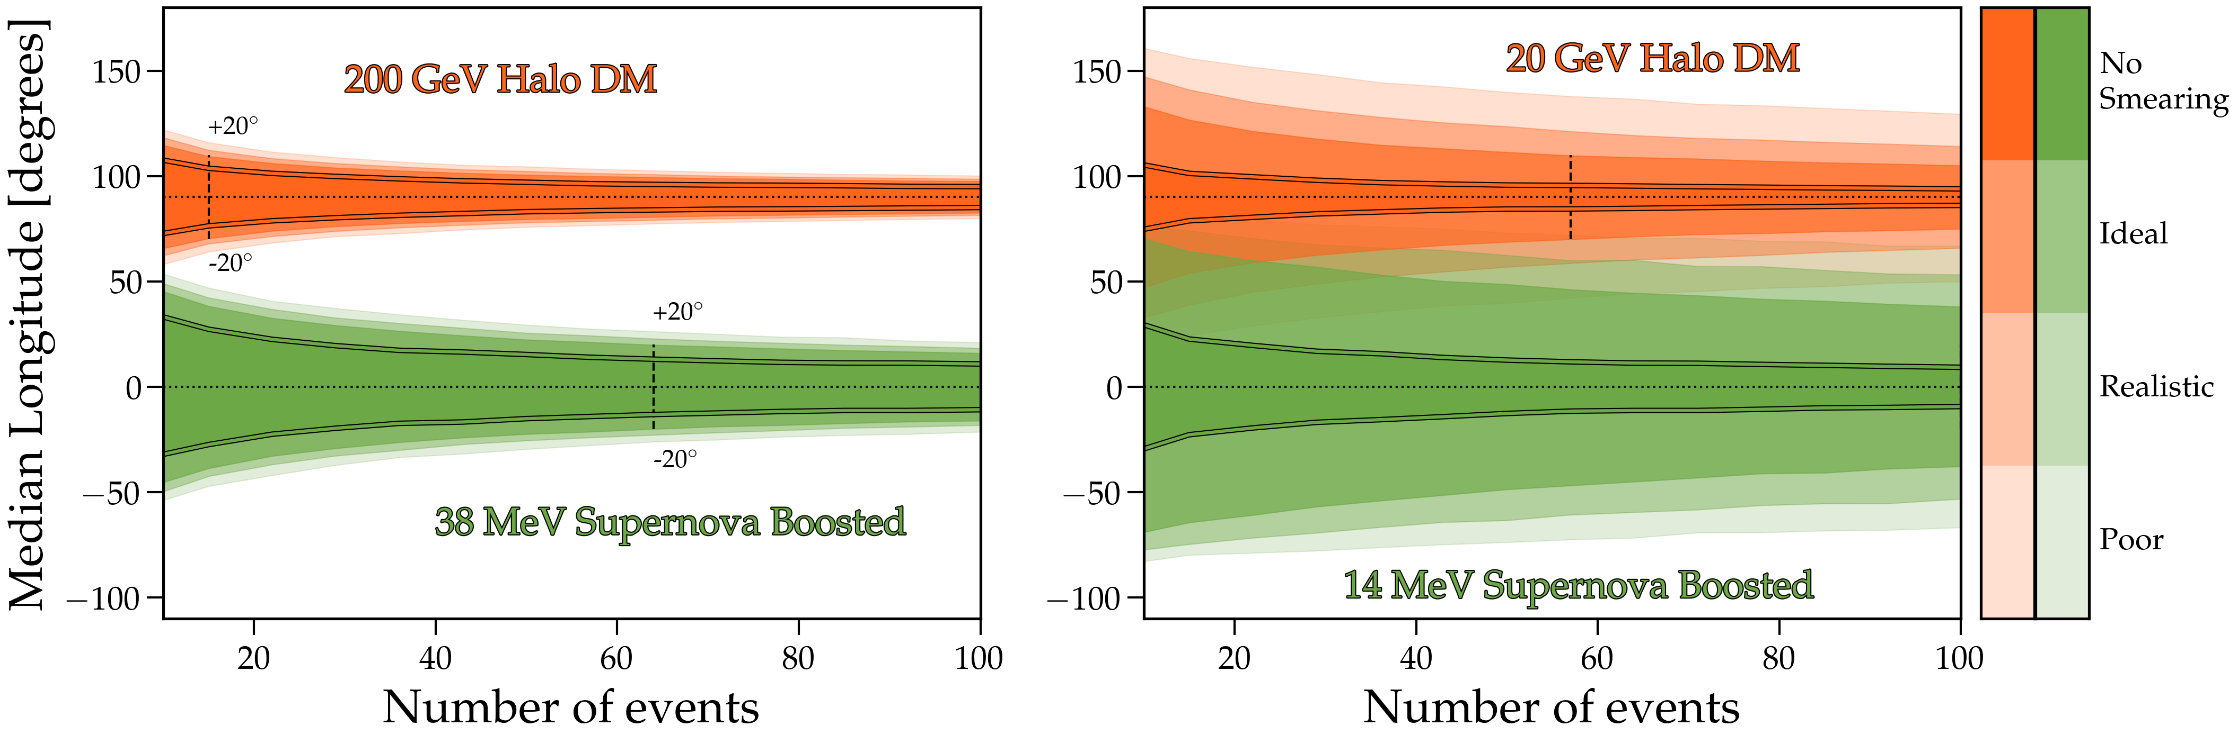

Slide 36
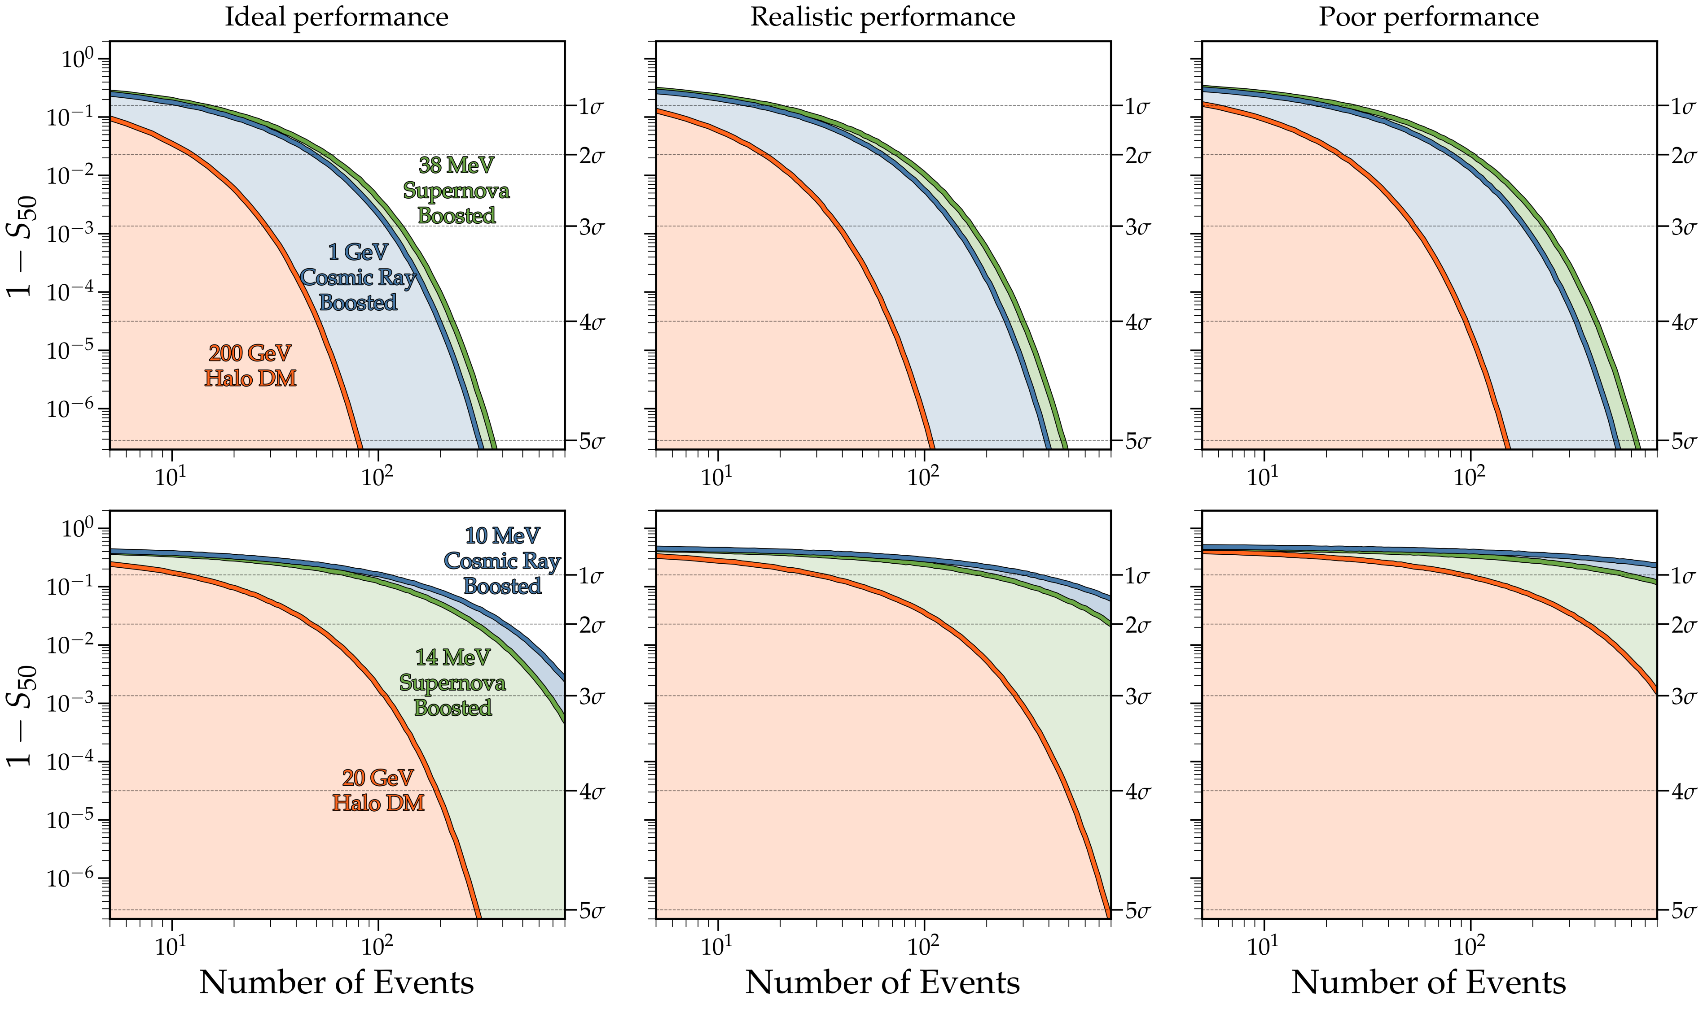

Slide 37
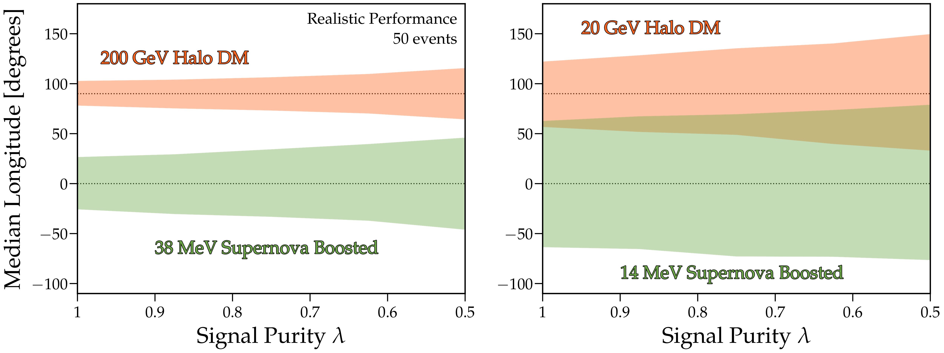

Slide 38
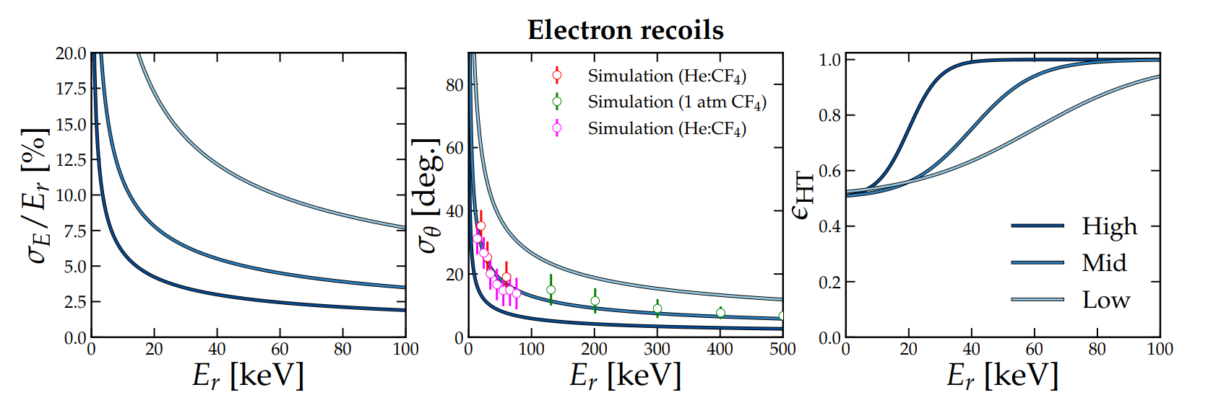
VI
A few questions from me to you
- Are the performance parameters realistic?
Real data from CYGNO for ERs, used for both solar neutrino papers

Slide 39
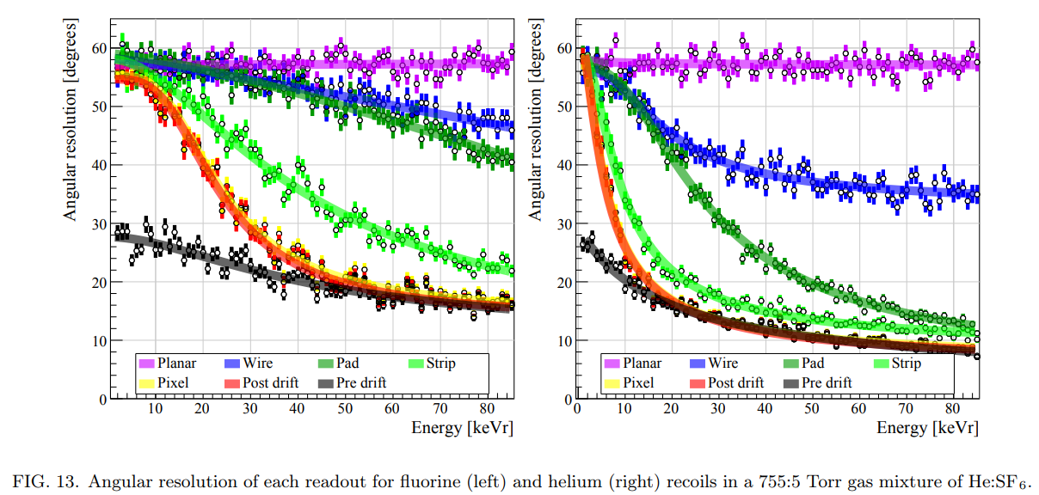
VI
A few questions from me to you
- Are the performance parameters realistic?
For CEvNS, I have been informing my choices based on this:
Vahsen, O’Hare, et al. [2008.12587]

Slide 40
And most importantly:
where to go from here?

Slide 41
Conclusions
Solar neutrinos remain an interesting physics case, both within and beyond the standard model
CCSN will be studied further: ER+NR channels?
Boosted DM searches are also a good avenue, mainly because of directional distinction of signals + further information about DM properties
Possibly should converge to a more realistic “realistic” detector performance, to achieve best theoretical predictions, especially in CEvNS case

Slide 42
Thank you!

Slide 43
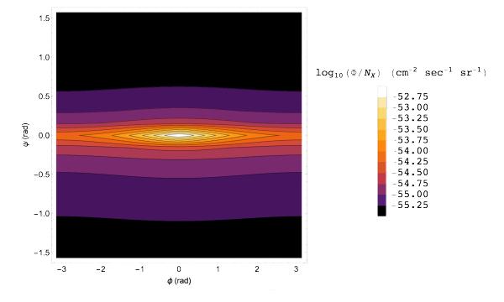
[2009.08836]

Slide 44
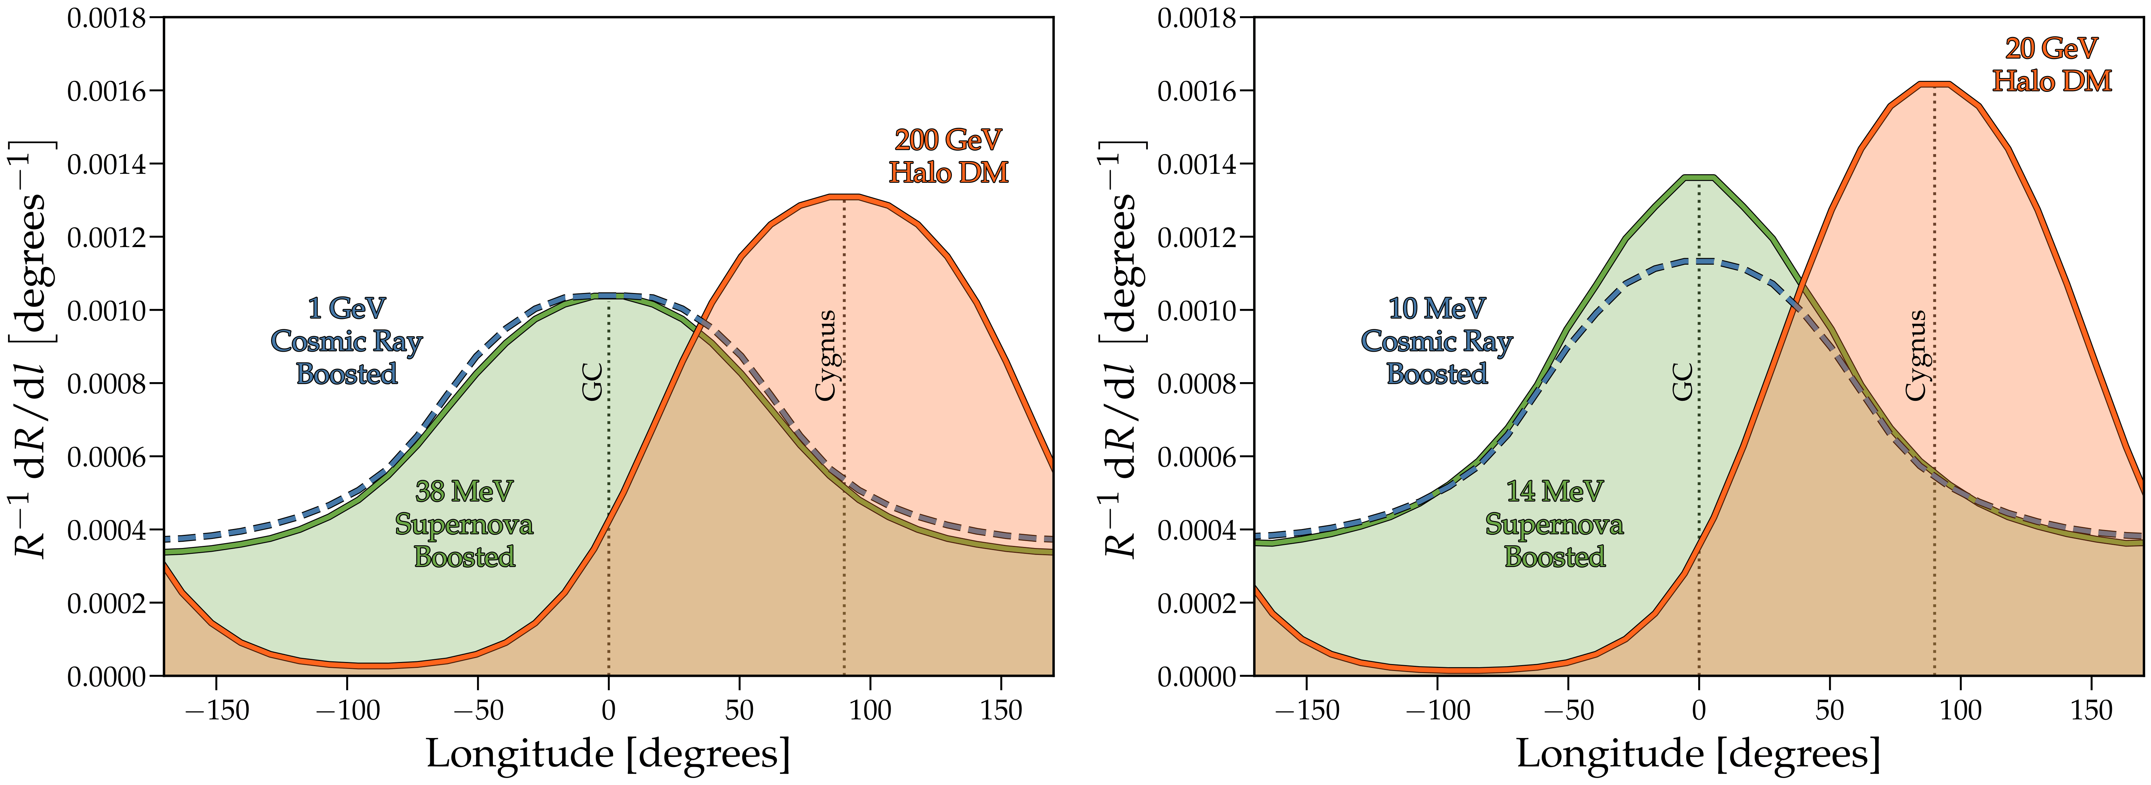

Slide 45
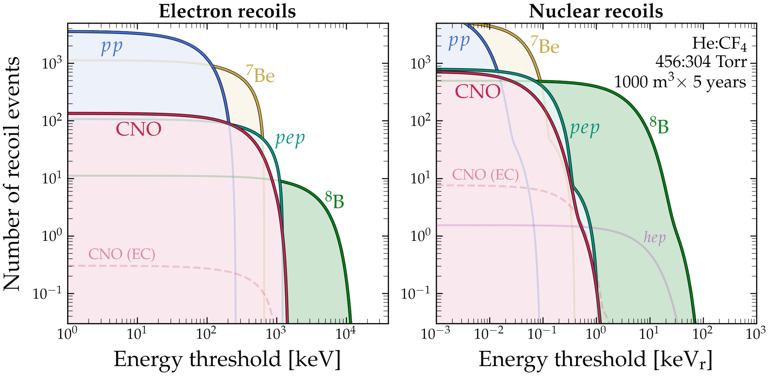

Slide 46
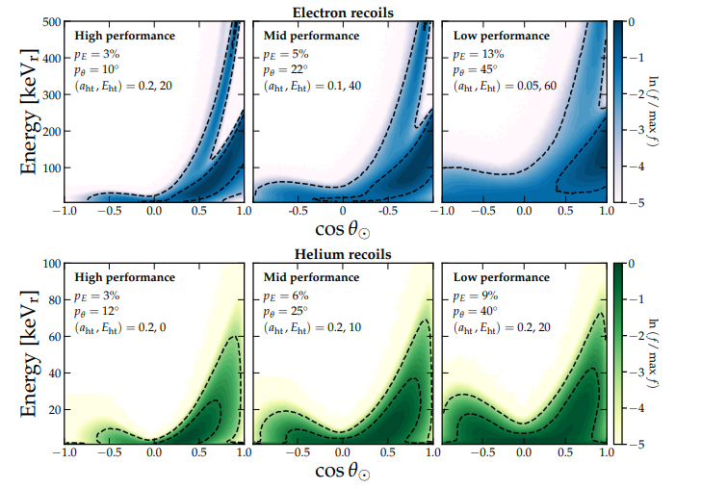
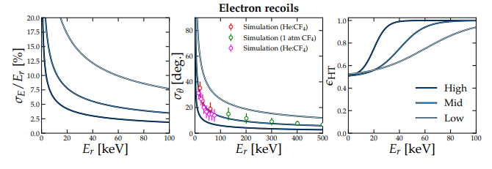

Slide 47
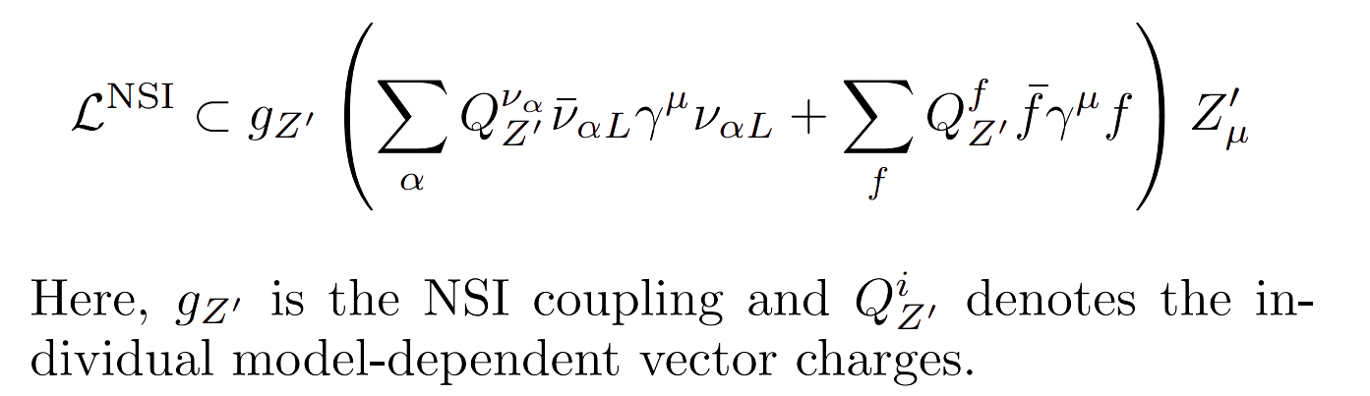

Slide 48
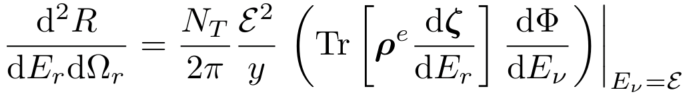
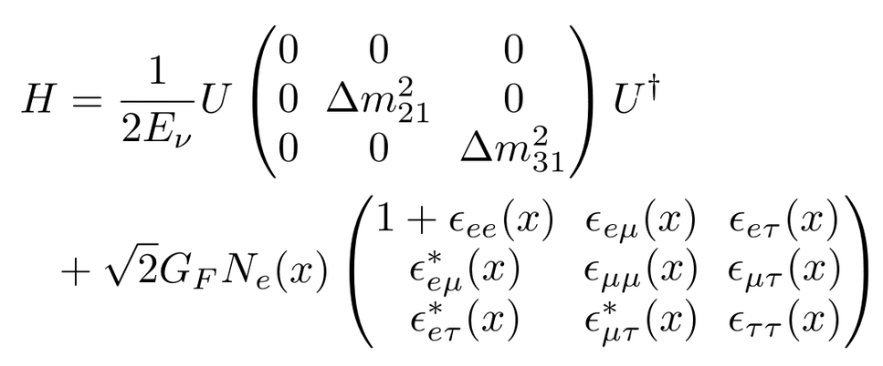
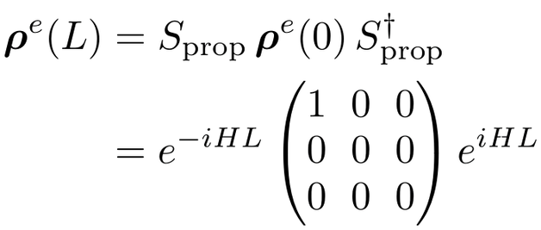
neutrino density matrix at detector:
where

Slide 49
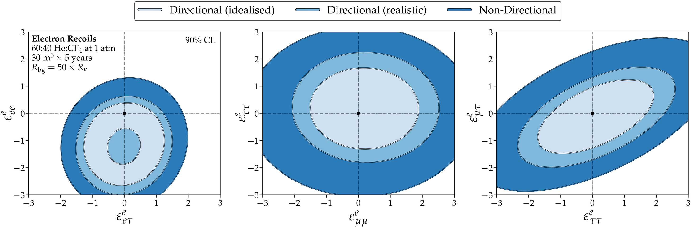

Slide 50
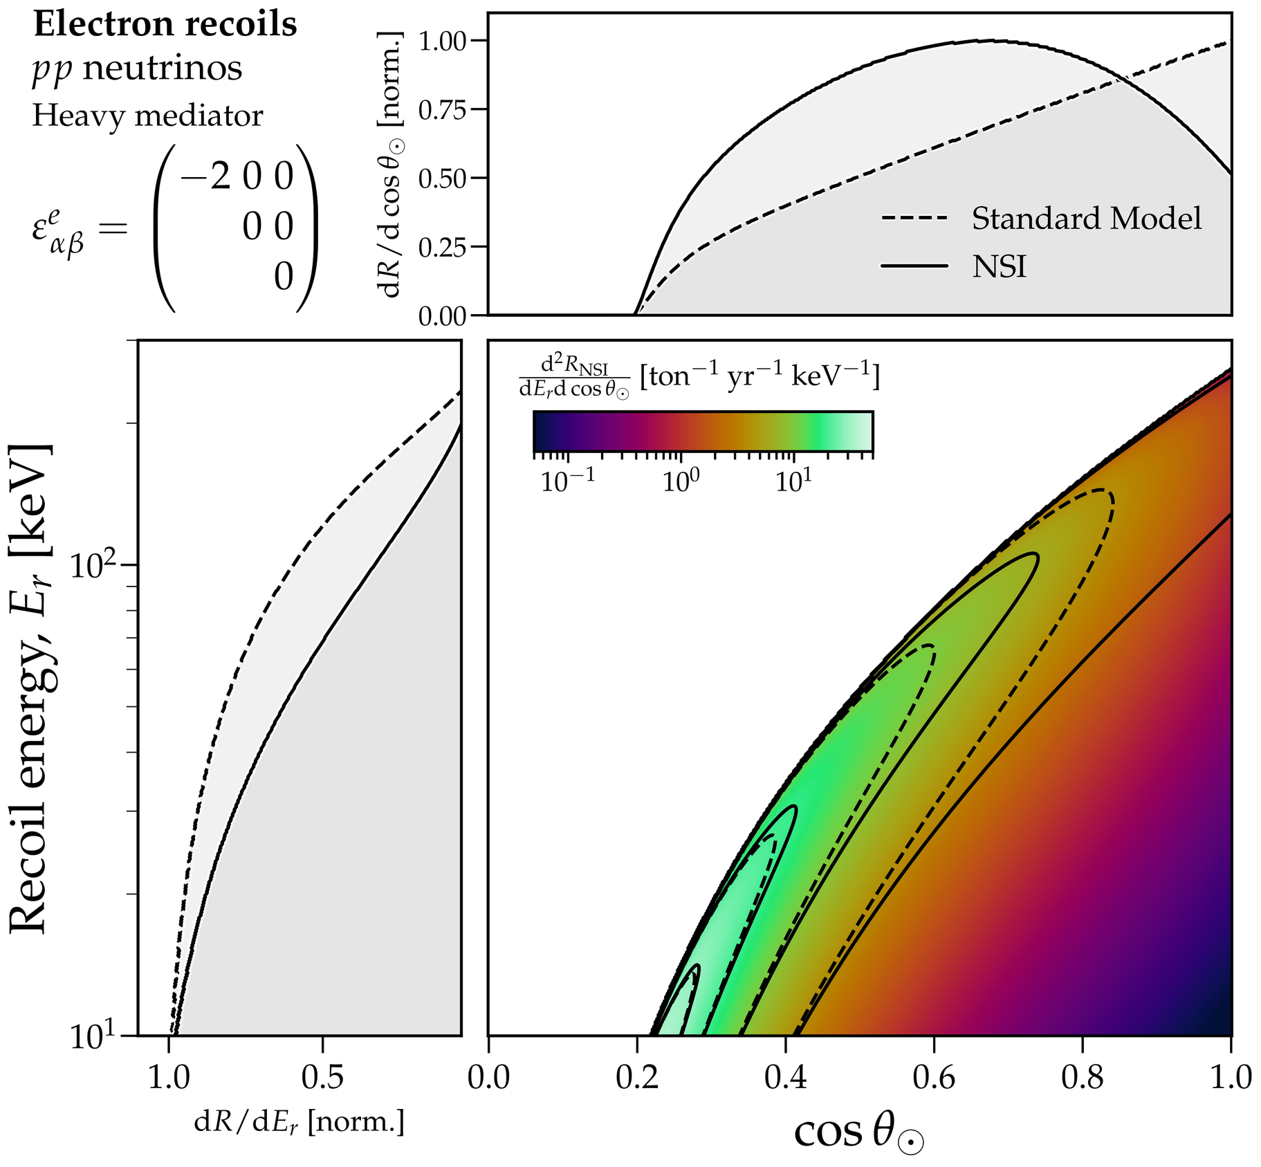

Slide 51
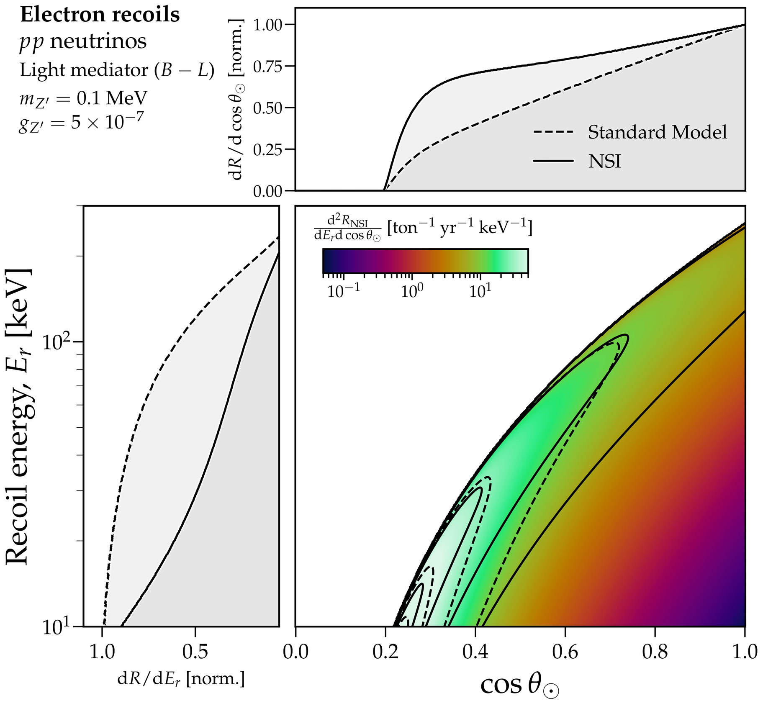

Slide 52


Slide 53



Slide 54


This is the same neutrino flux that made the first ever
measurement possible with the COHERENT experiment at Oak Ridge labs!

