Slide 1
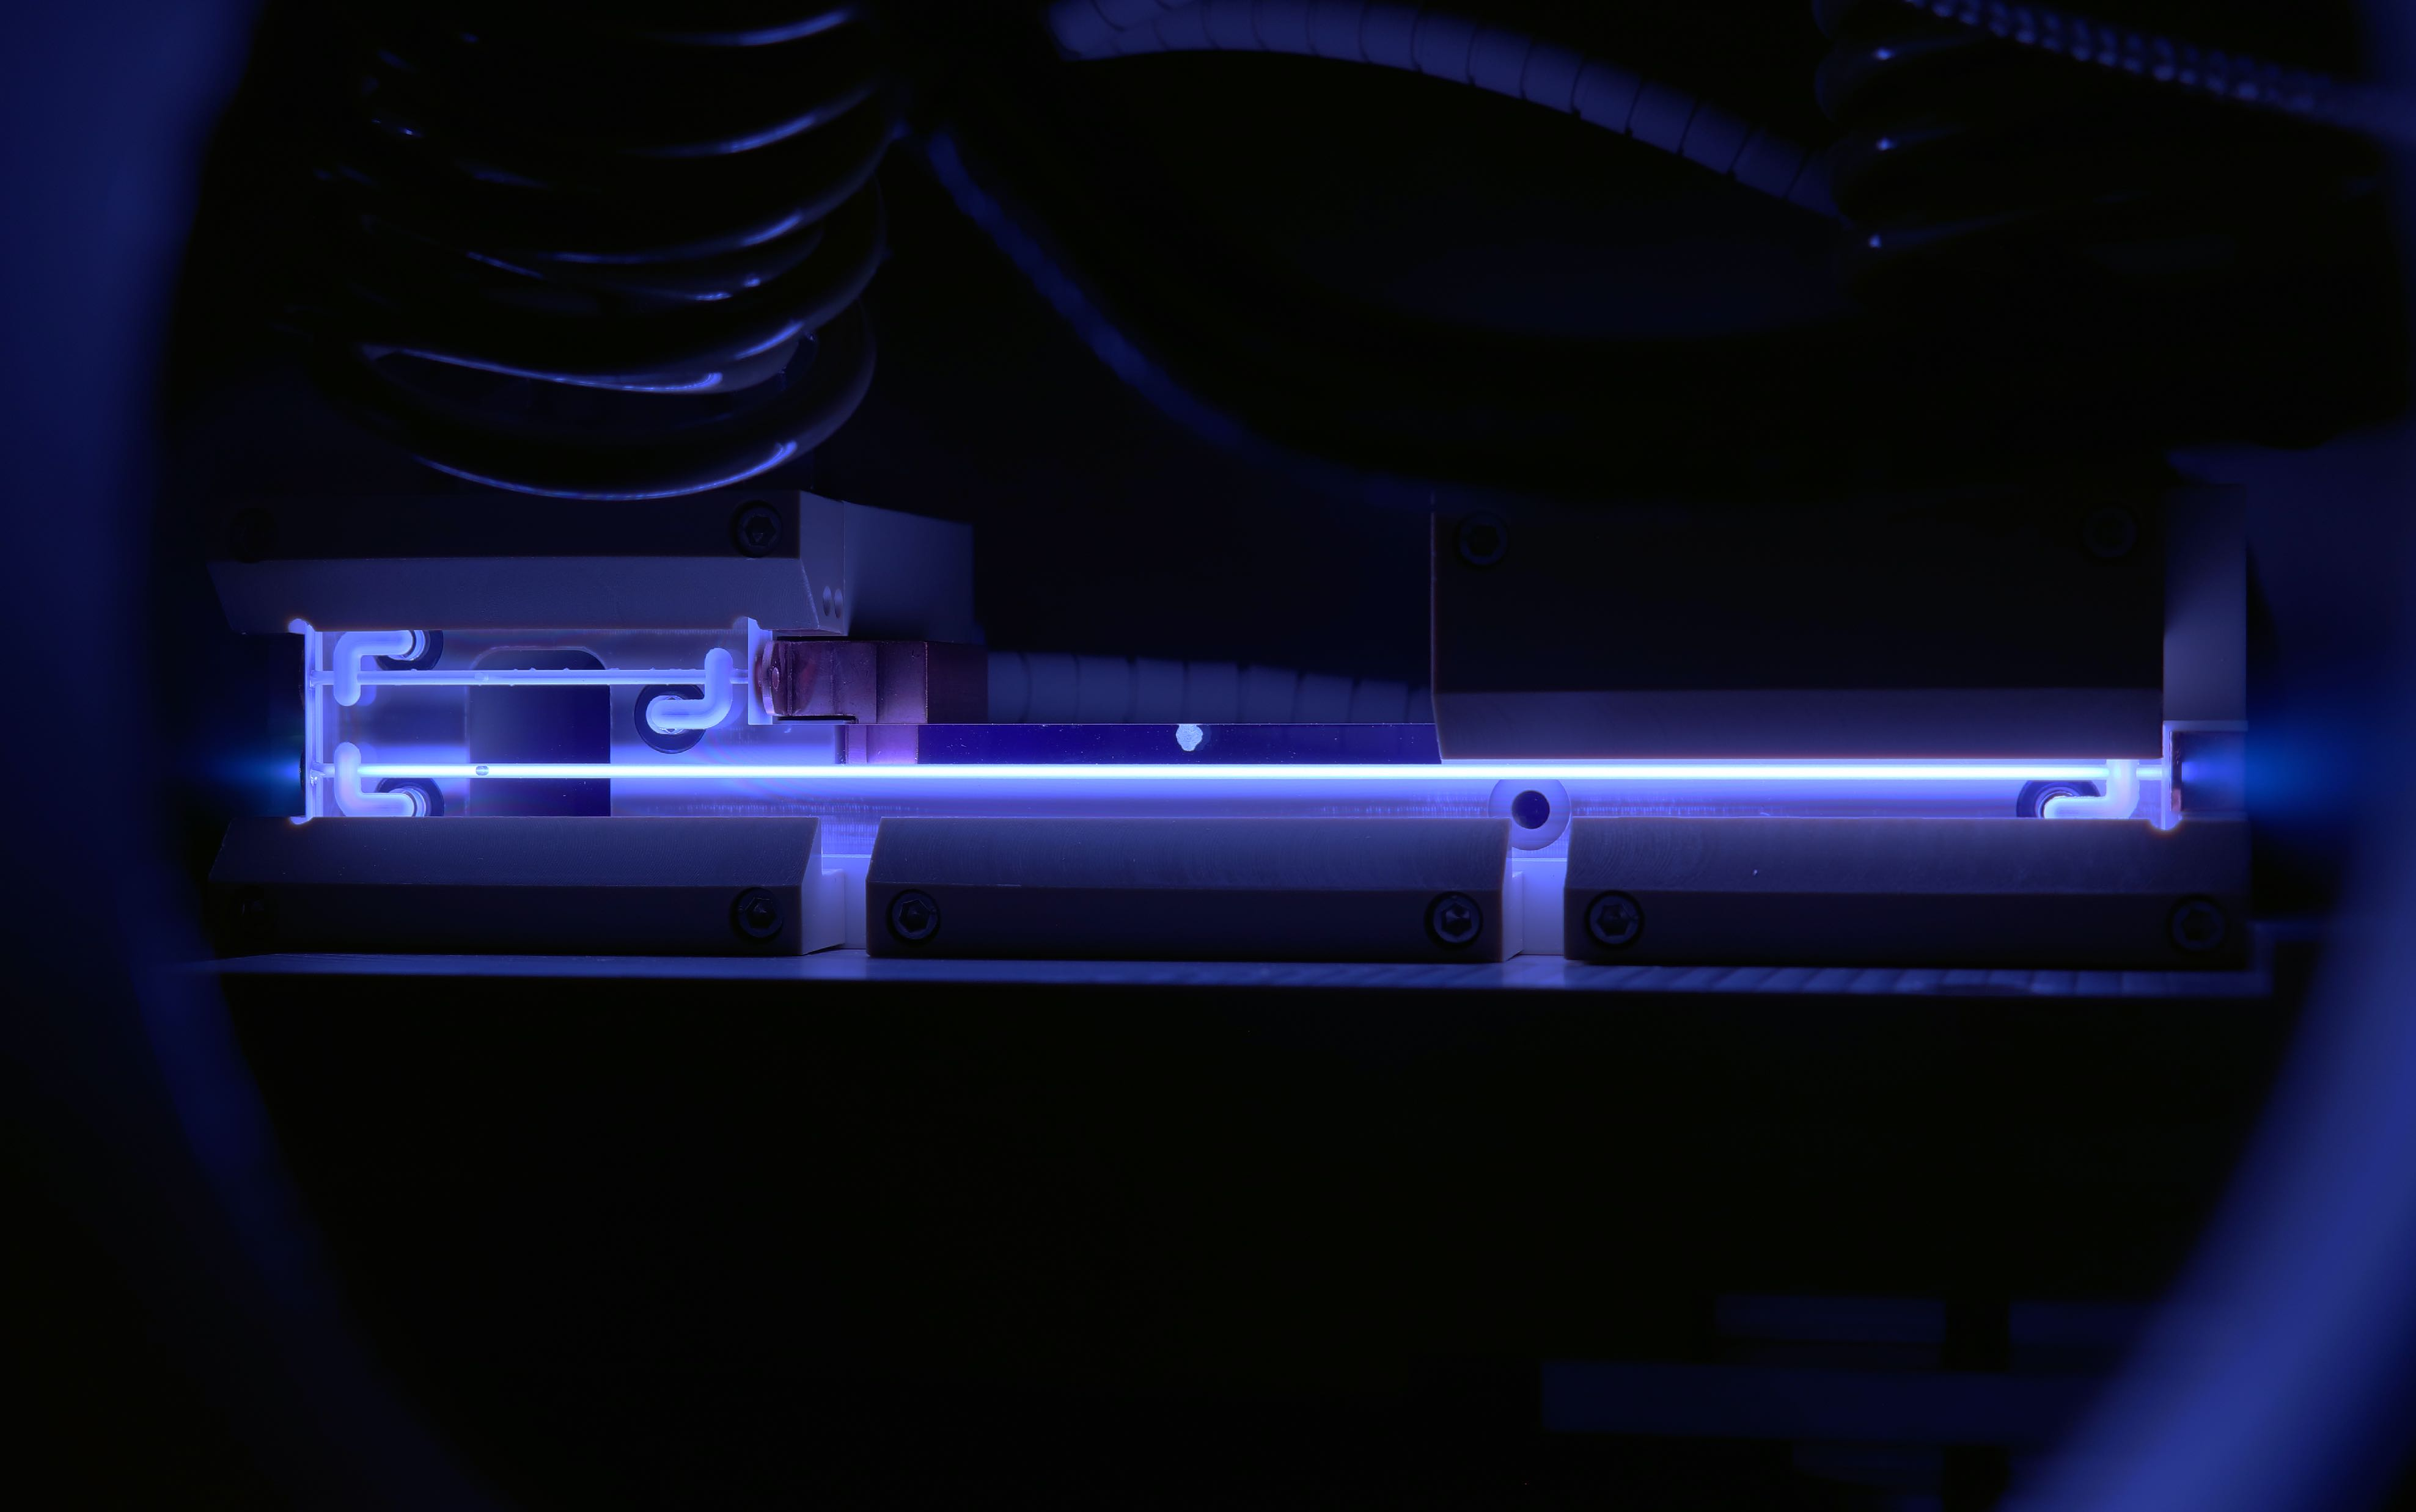

Temperature Effects in Plasma-Wakefield Accelerators
Meg Savage
John Adams Institute, University of Oxford
18/6/26 | Transfer of Status Symposium

Slide 2
What is plasma wakefield acceleration?
Why do we care about temperature?
The FACET-II facility and experiment feasibility
Outlook

Slide 3
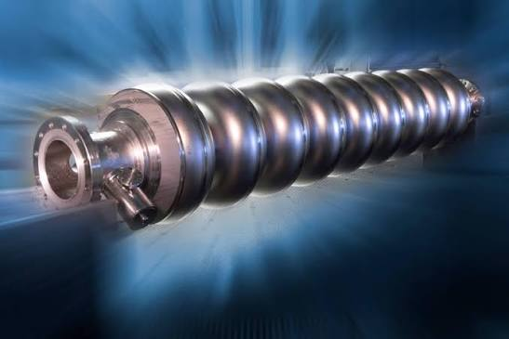
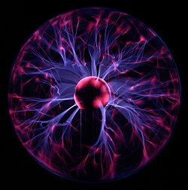
Why Plasma Wakefield Acceleration (PWFA)?
    Future collider designs are huge and expensive
    RF cavities can only sustain ~100 MV/m before breakdown
    How to get around this?
    Use a medium which is already broken down…
    PLASMA!

Slide 4
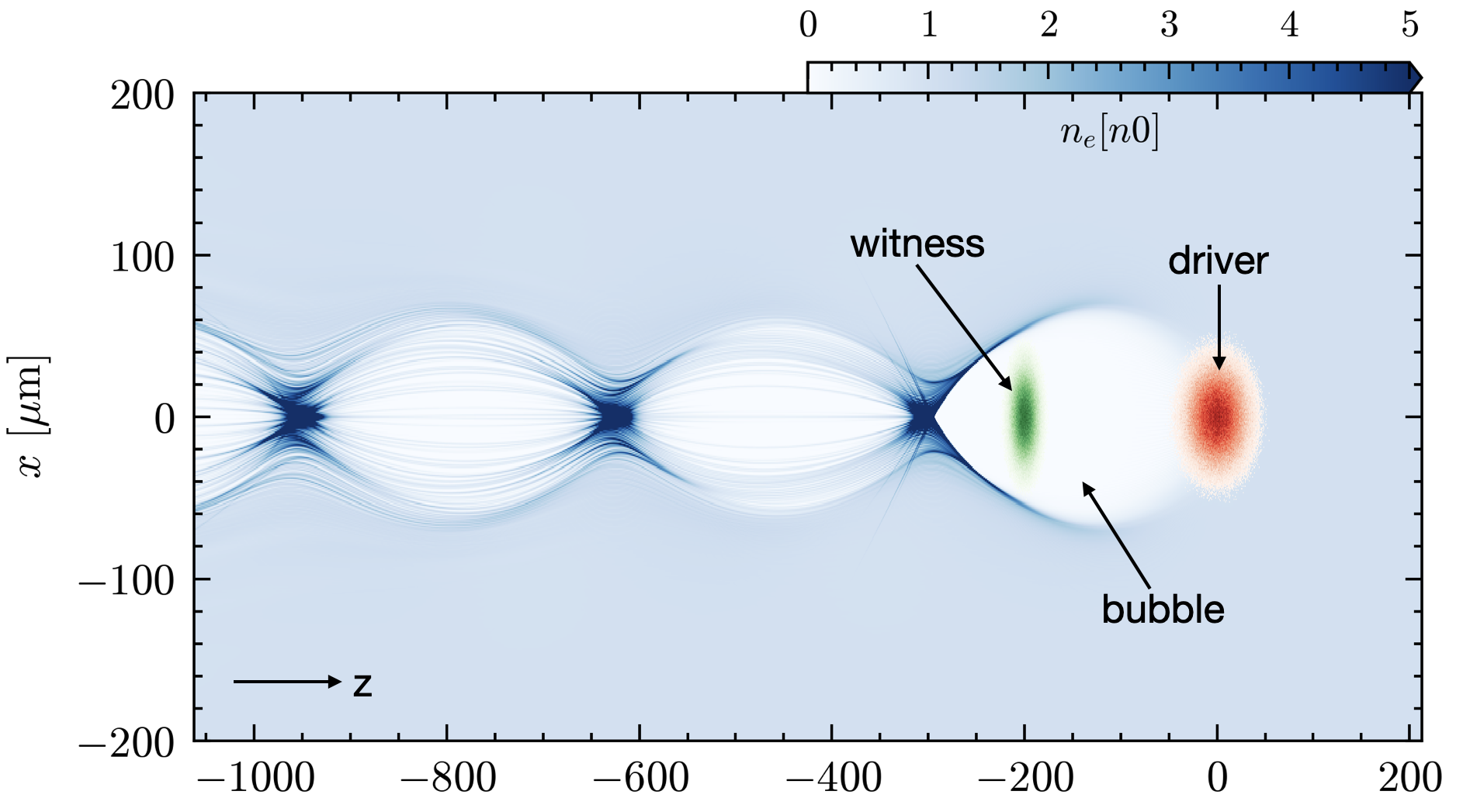
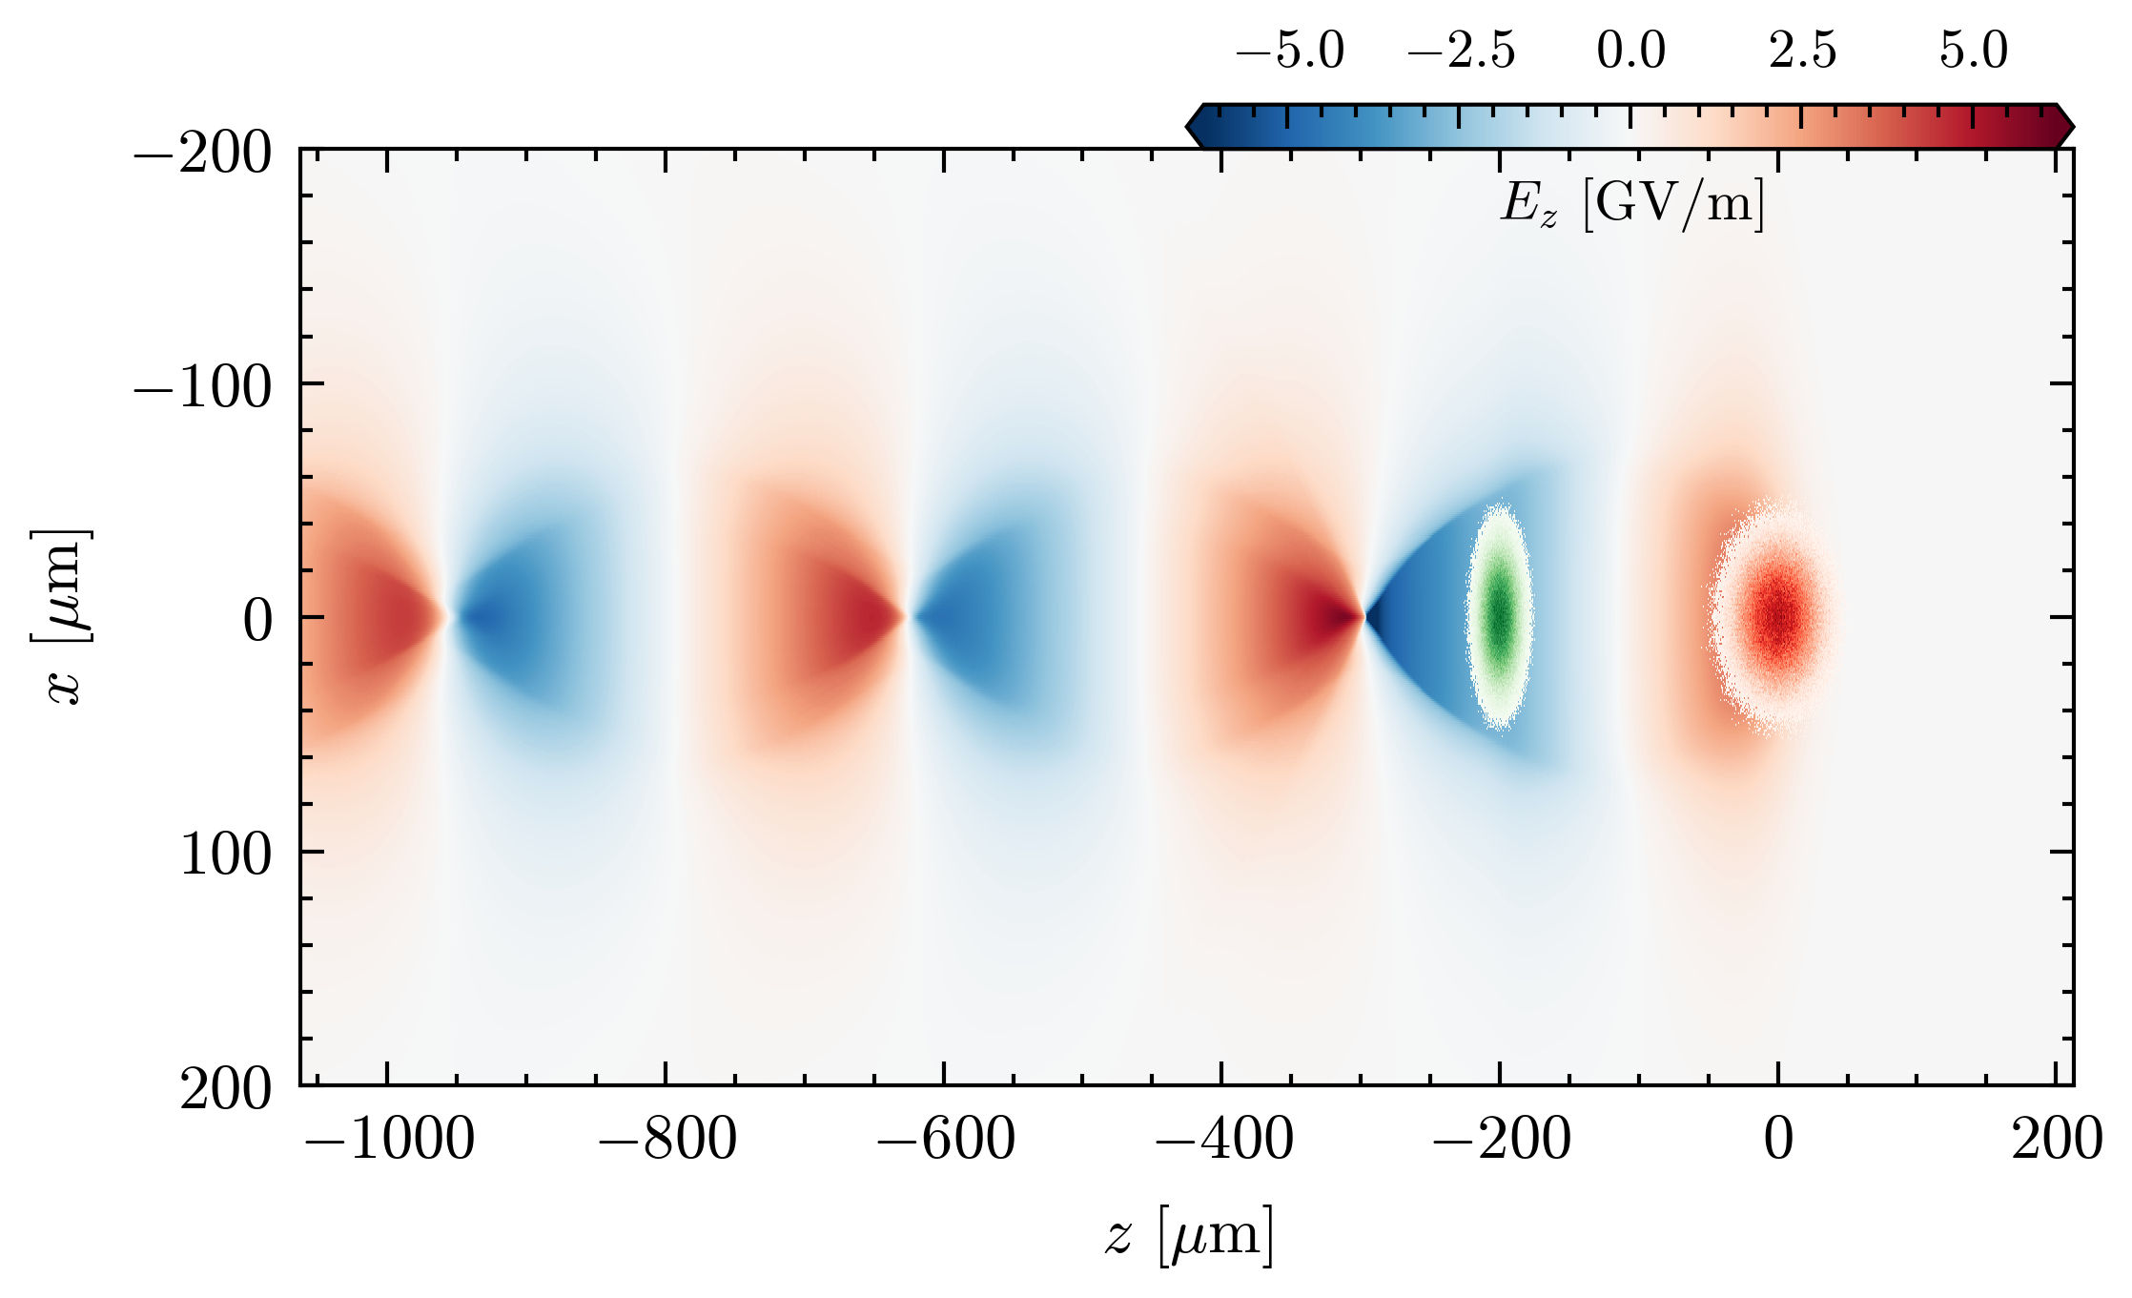
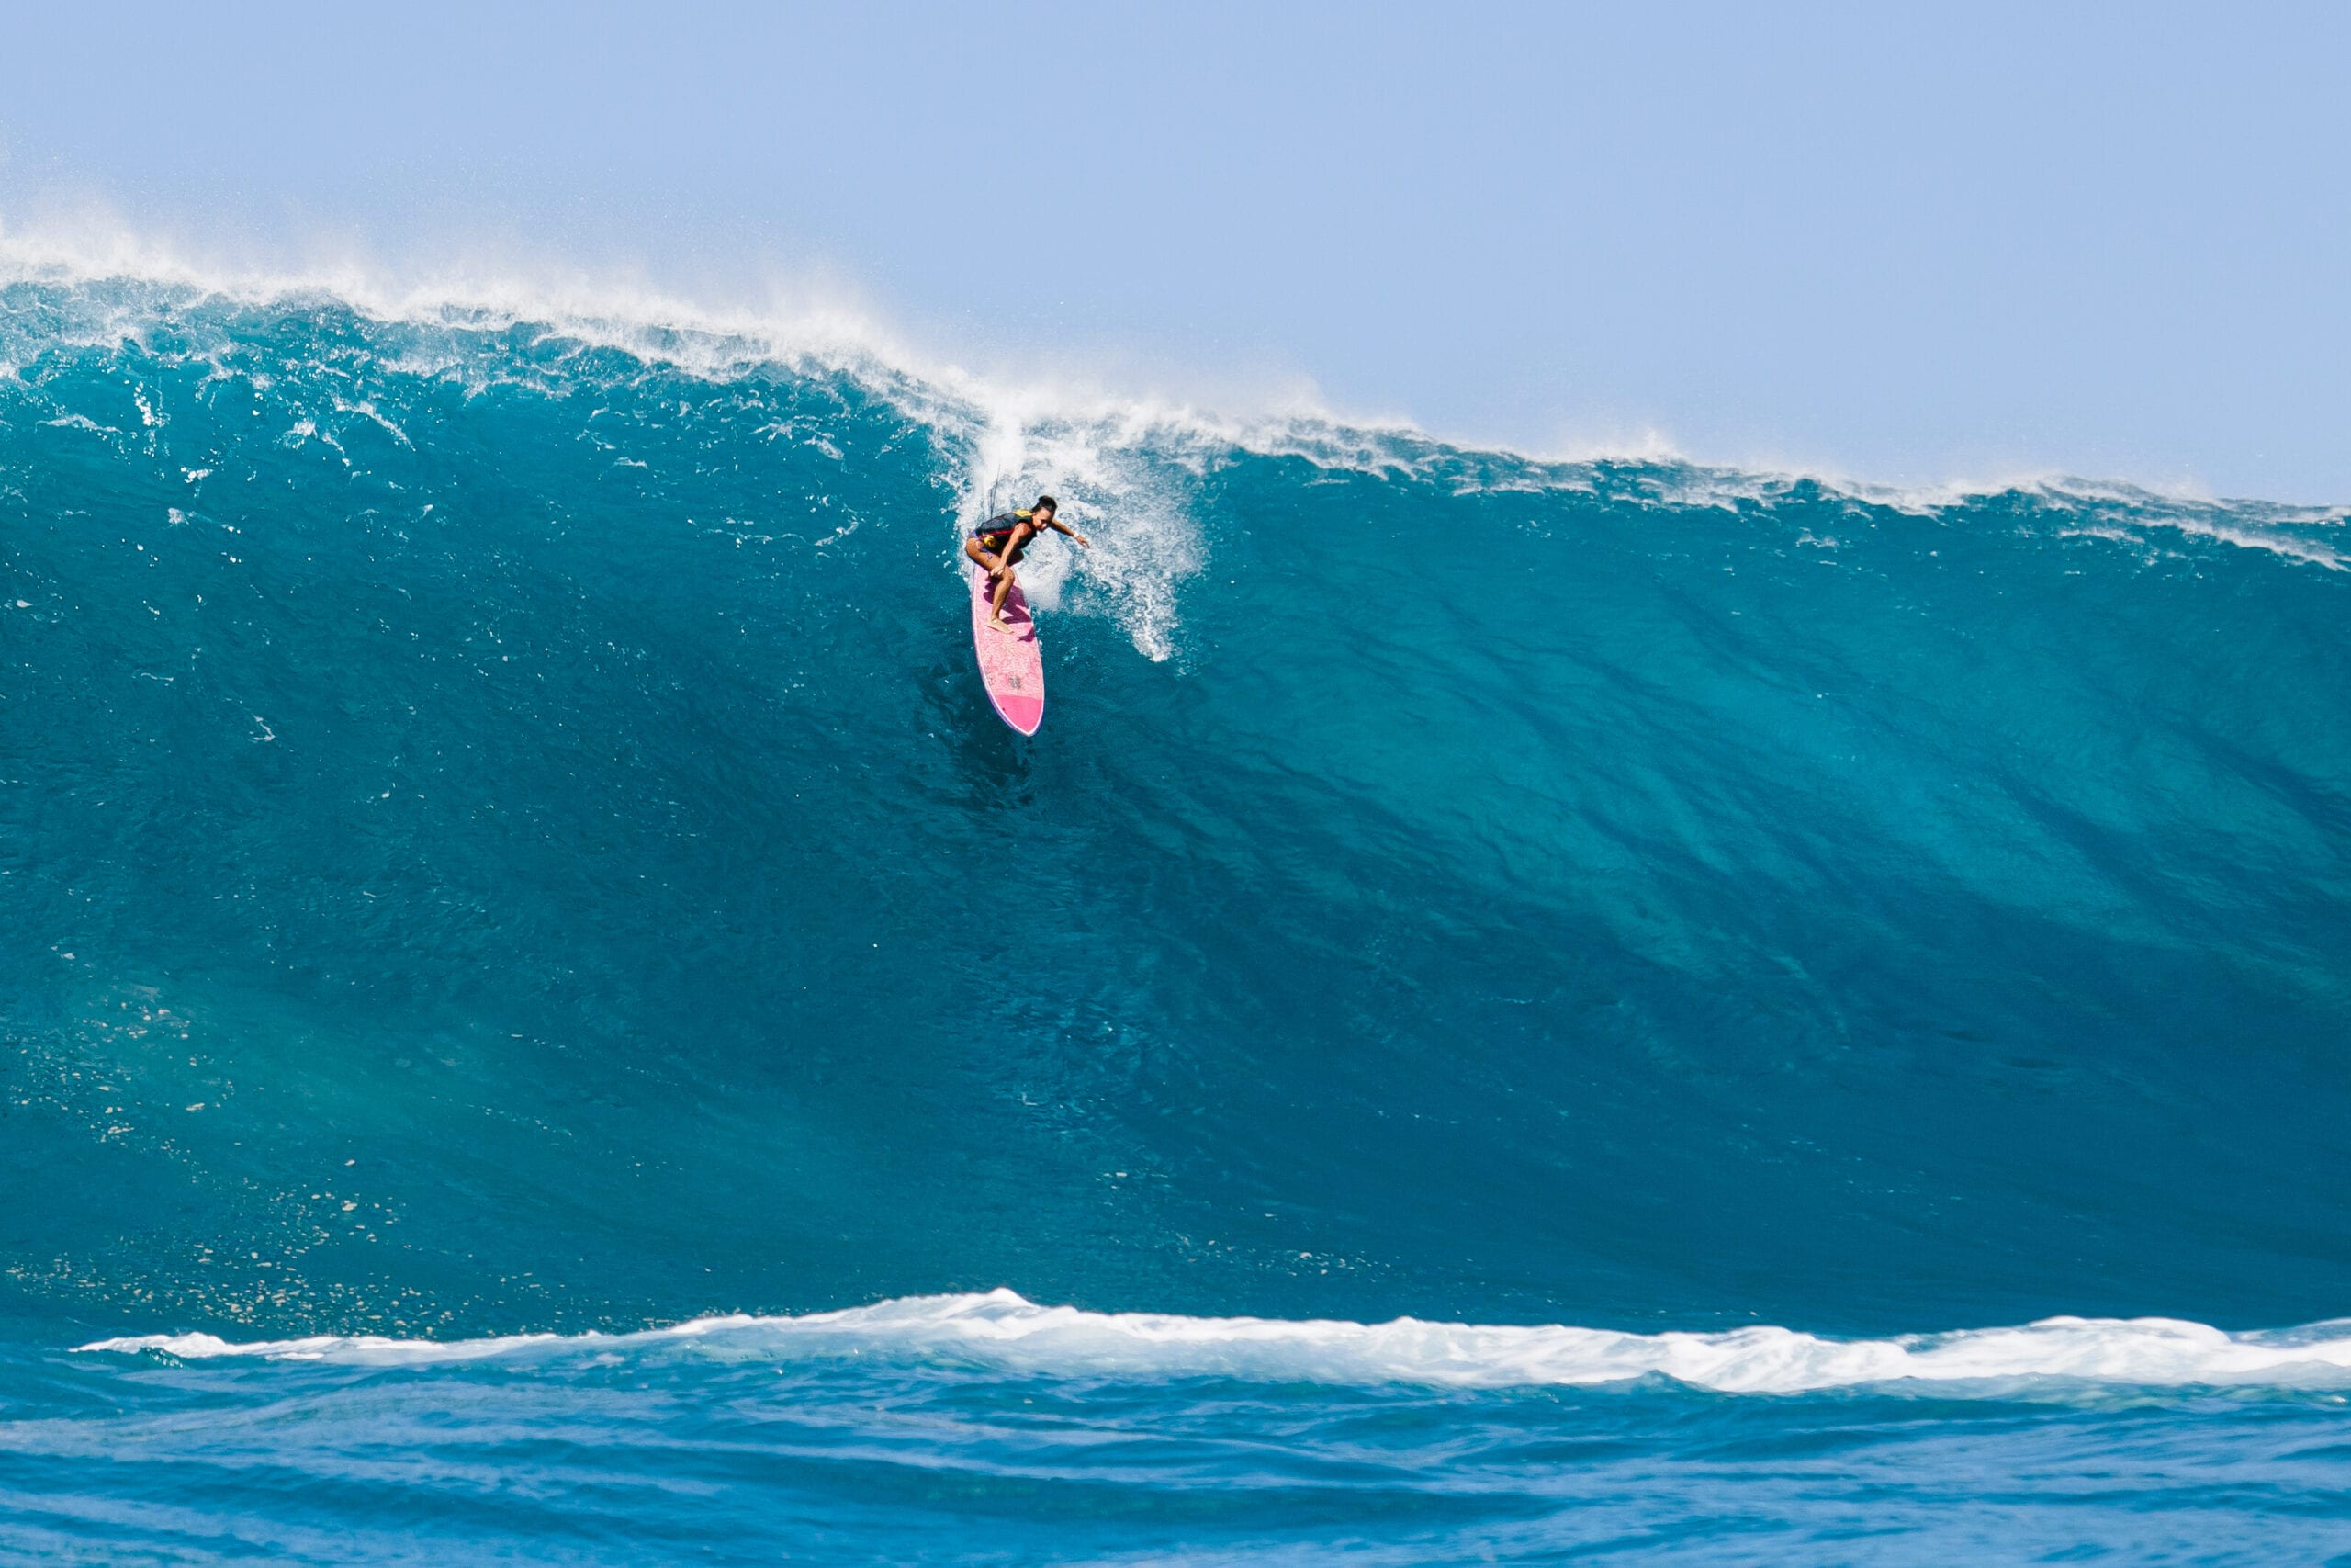
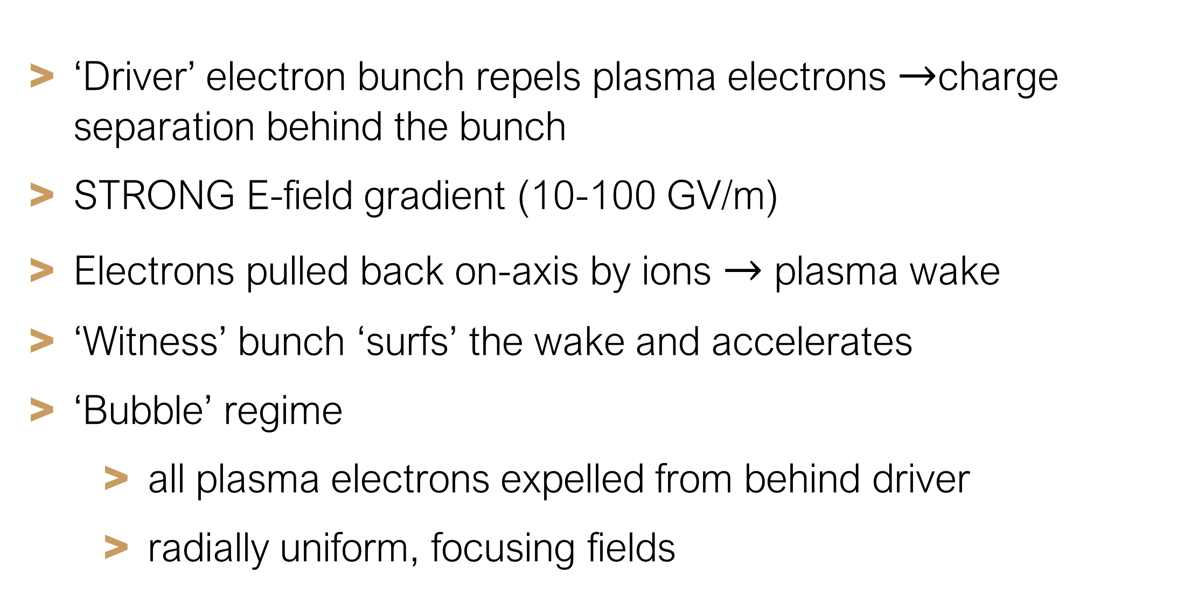
What is Plasma Wakefield Acceleration?
    ‘Driver’ electron bunch repels plasma electrons $→$charge separation behind the bunch
    STRONG E-field gradient (10-100 GV/m)
    Electrons pulled back on-axis by ions $→$ plasma wake
    ‘Witness’ bunch ‘surfs’ the wake and accelerates
    ‘Bubble’ regime
      all plasma electrons expelled from behind driver
      radially uniform, focusing fields

Slide 5
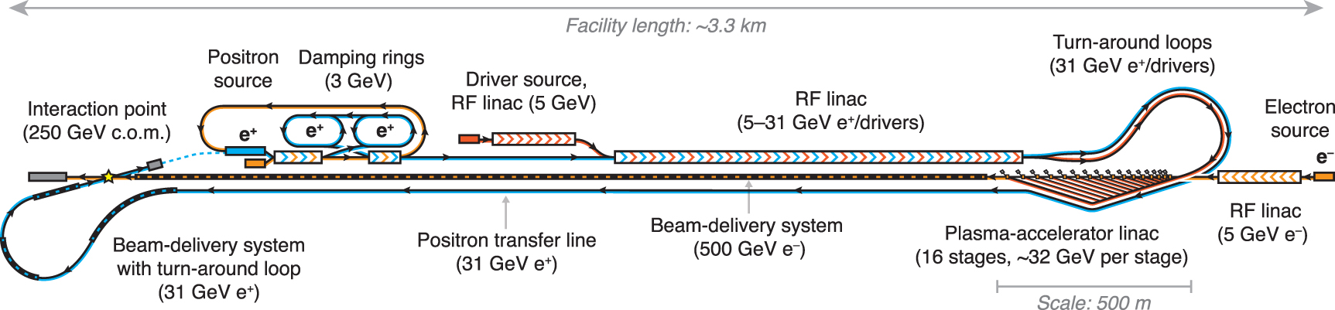
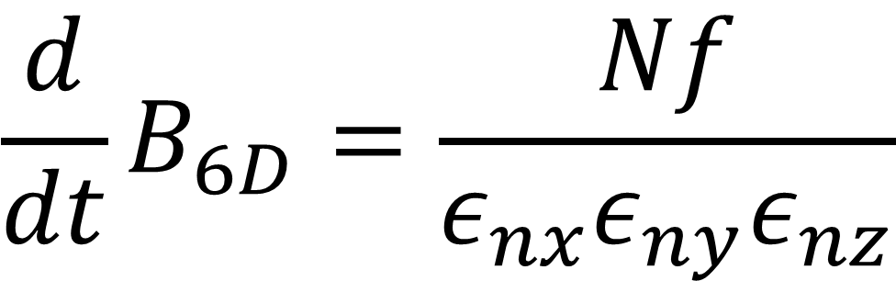
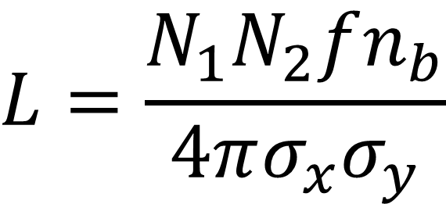
The Case For High Repetition Rate
$$\frac{d}{dt}B_{6D}=\frac{Nf}{ε_{nx}ε_{ny}ε_{nz}}$$
$$L=\frac{N_{1}N_{2}fn_{b}}{4πσ_{x}σ_{y}}$$
Luminosity: HEP (e.g. HALHF)
Integrated brightness: photon science (e.g. EuXFEL)
    Future collider designs e.g. Hybrid Asymmetric Linear Higgs Factory (HALHF)
    Require MHz repetition rates to be competitive with FCC, ILC
    Need to increase repetition rate

Slide 6
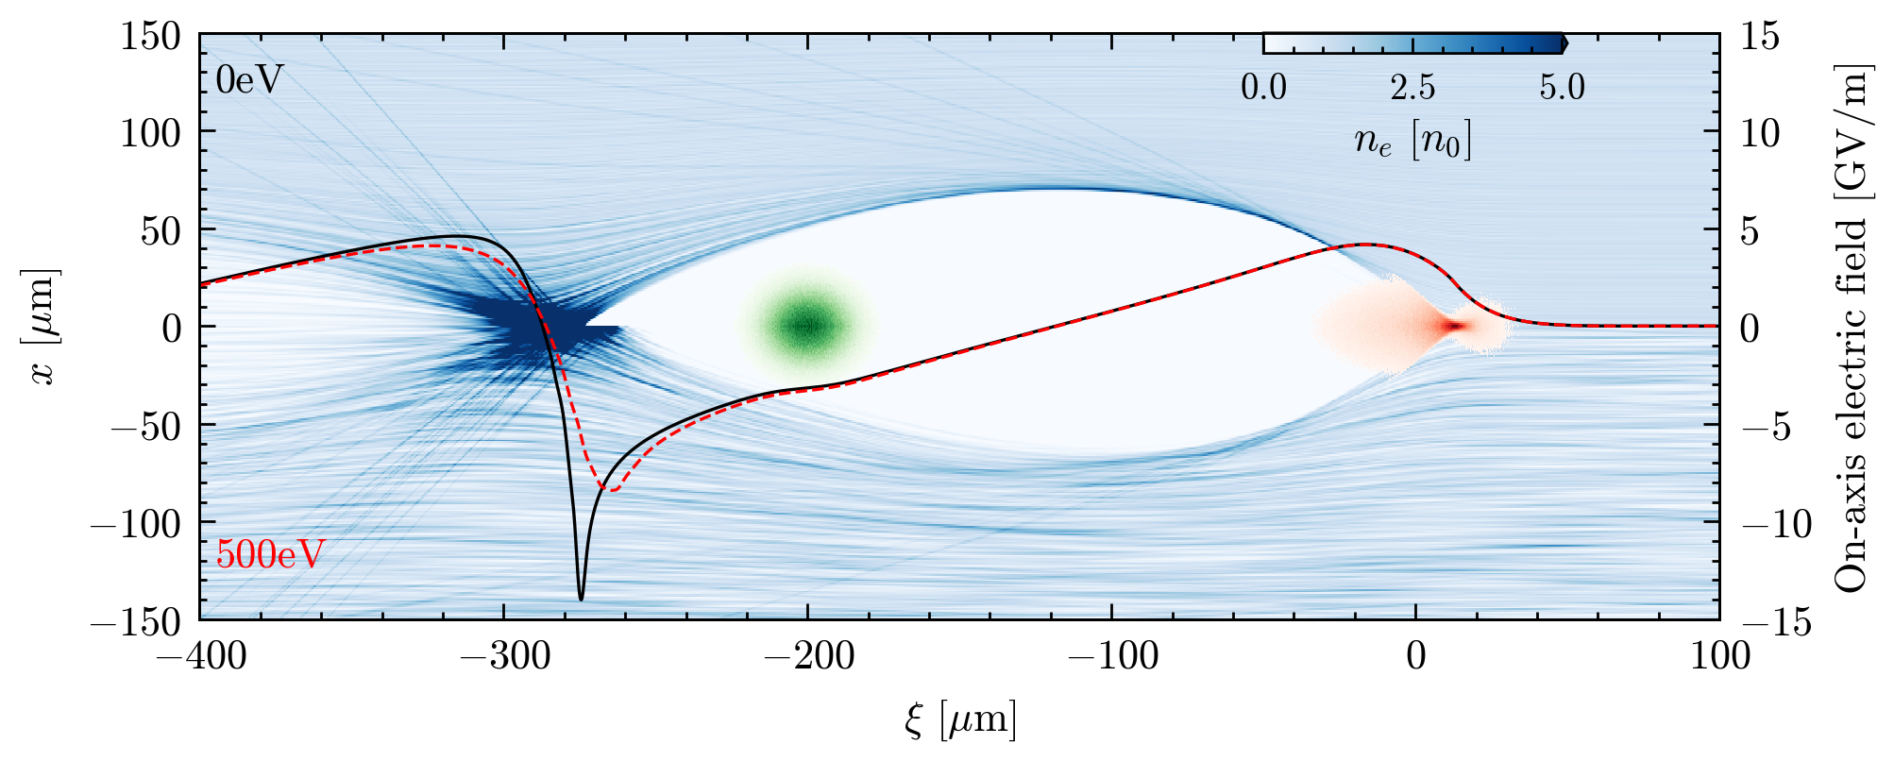
Plasma Temperature
    Energy transfer from the driver to the witness is not 100% efficient
    Significant energy remains in the plasma
    Increases KE (temperature) of plasma electrons
    Plasma heating (~20 eV per shot expected) modifies wakefield
    Significant at high repetition rate
    Bad for stable, repeatable acceleration
    Experimental studies of this have not yet been undertaken!

Slide 7
How does the drive beam affect plasma temperature?
How does an increase in plasma temperature affect subsequent plasma wake formation?

Slide 8
How does the drive beam affect plasma temperature?
How does an increase in plasma temperature affect subsequent plasma wake formation?

Slide 9

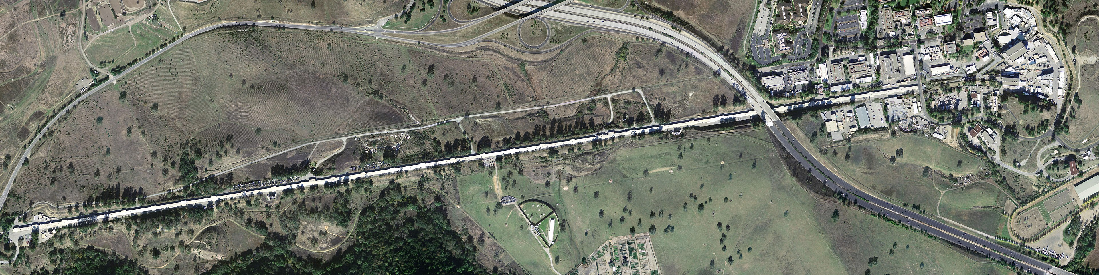
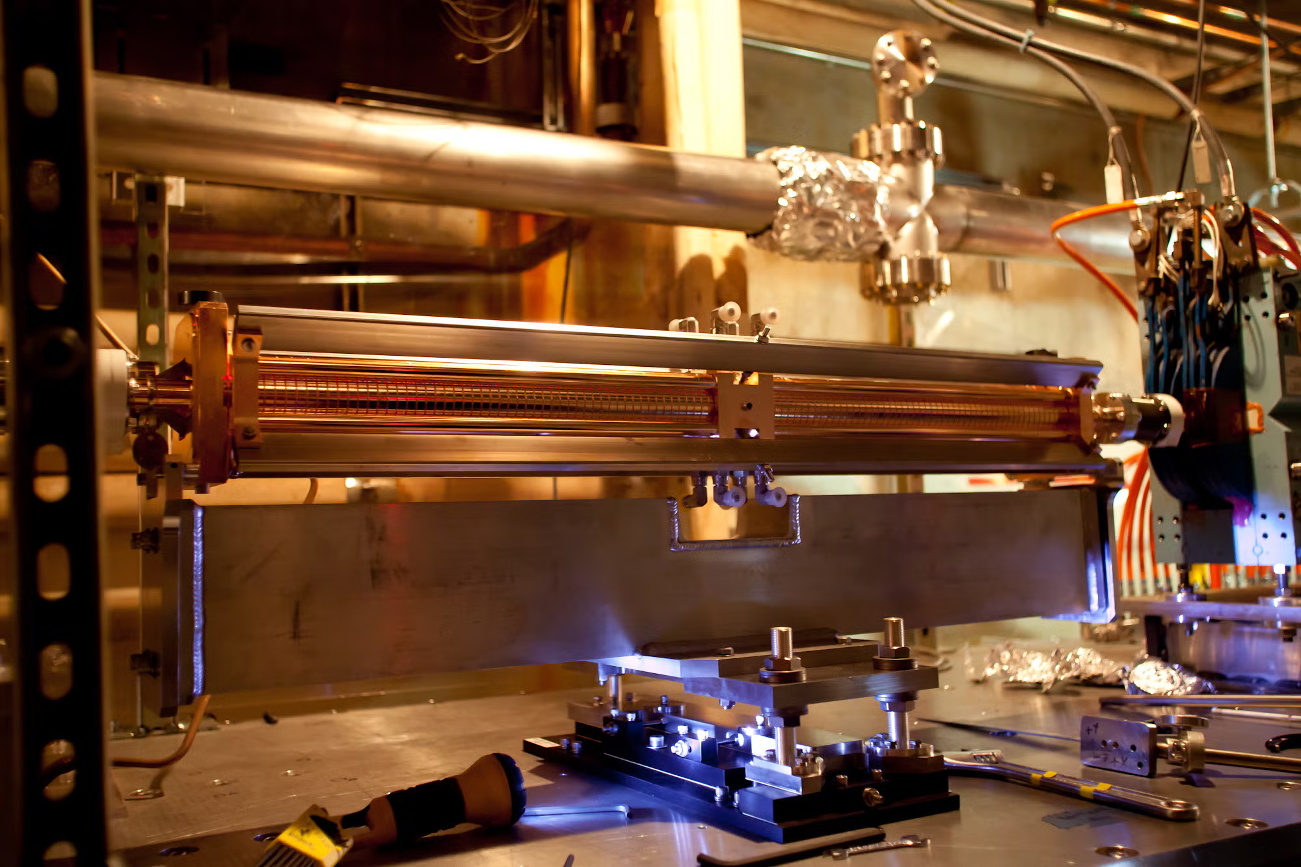
The FACET-II Facility
    SLAC linac
      Delivers 10 GeV, 1.6 nC beams at 10Hz (can be split into driver and witness beams)
    Laser-ionised plasma source
      85 cm capillary
      Adjusting polarisation of ionising laser from linear to circular should allow control over plasma temperature

Slide 10
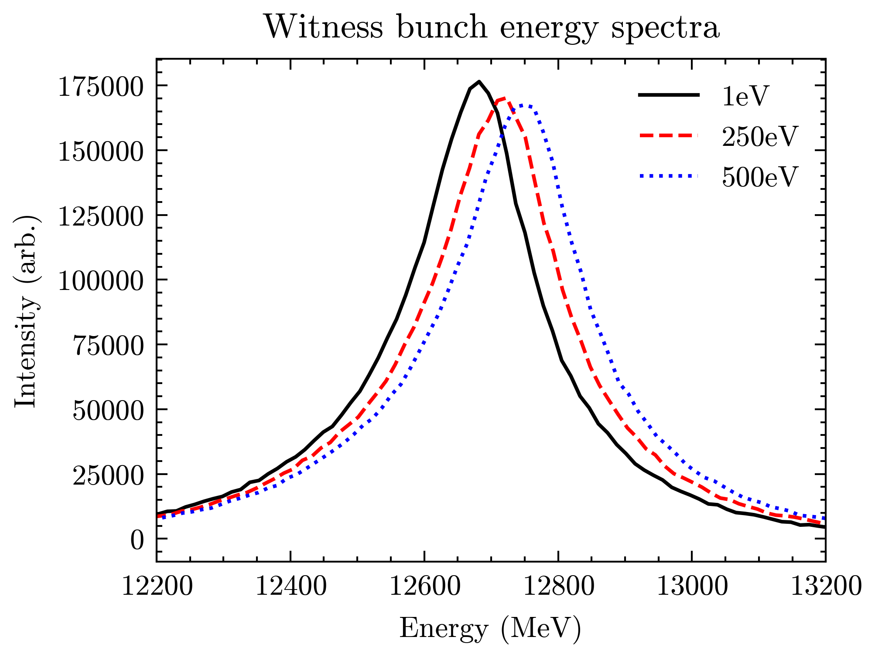
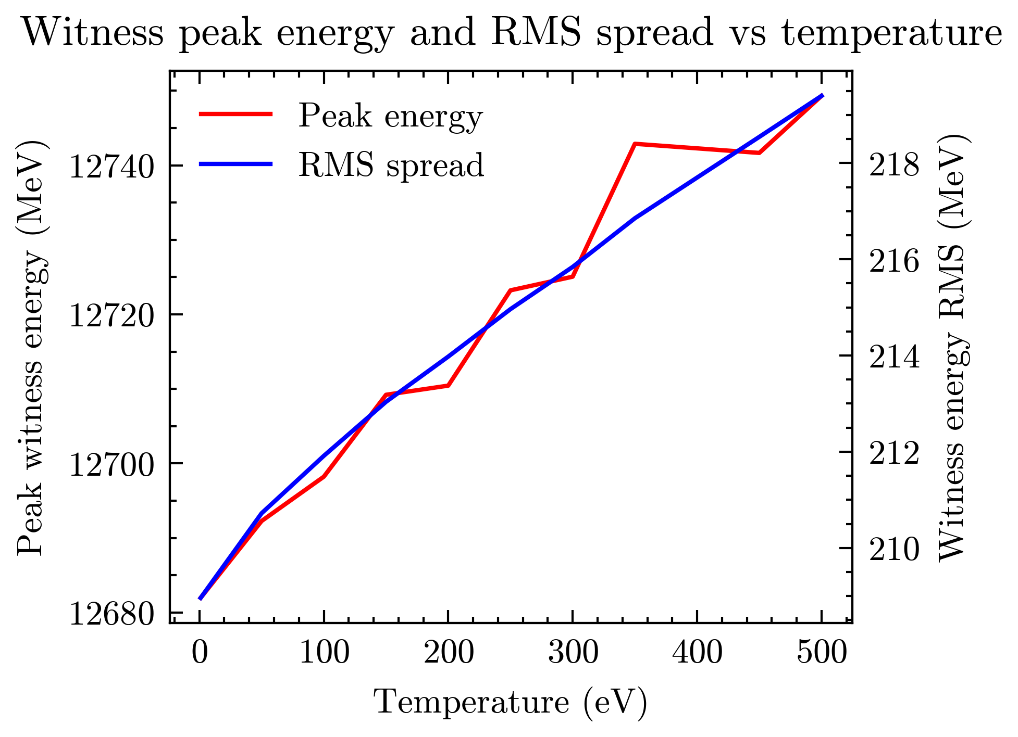
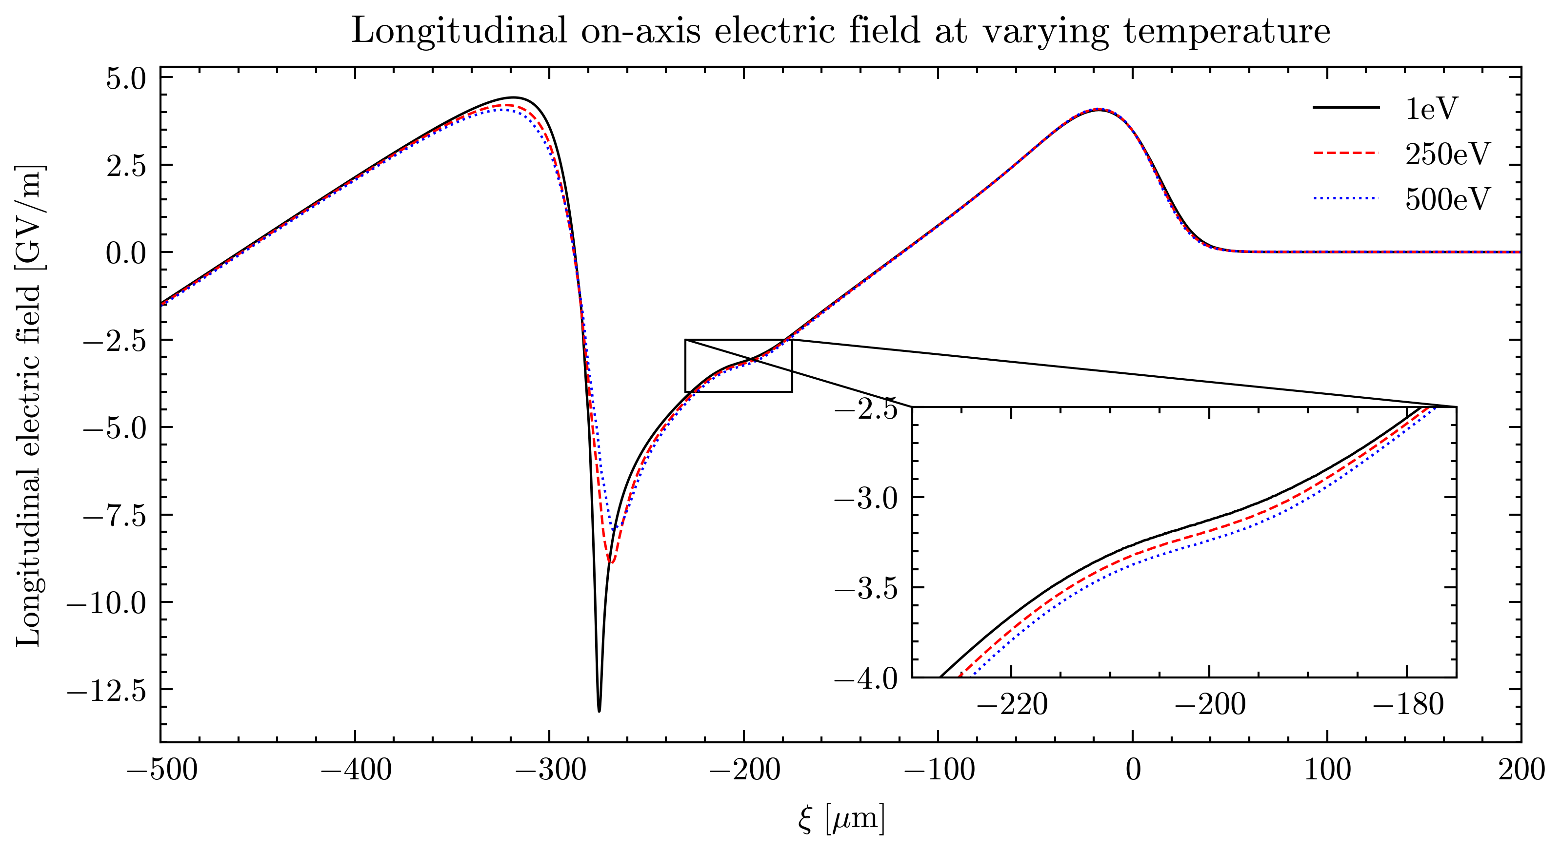
Plasma Temperature Experiment Feasibility
    Simulated witness bunch energy spectrum after plasma source at varying temperatures
    Increasing temperature increases witness bunch energy and energy spread
    Use witness bunch spectrum to diagnose differences in longitudinal E-field with temperature

Slide 11
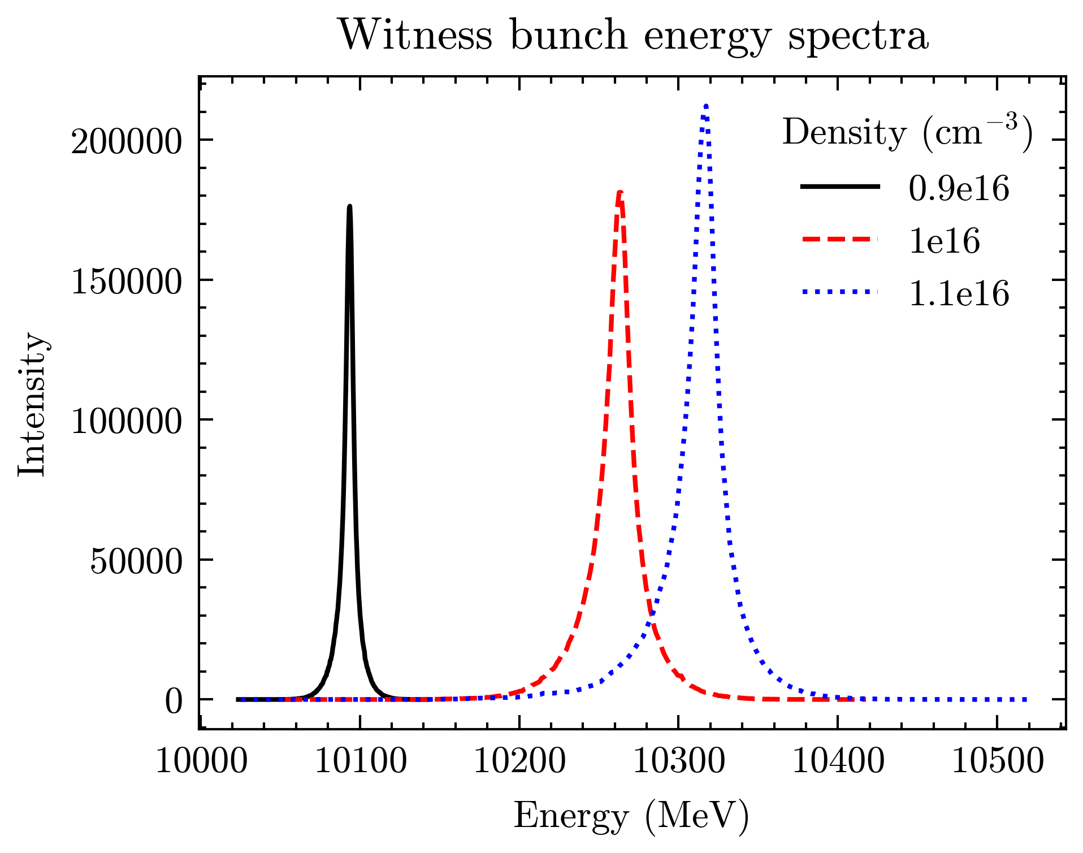
Remaining Challenges
    Density Effects
      Simulate effect of changing polarisation of ionising laser on both plasma density and temperature
    Numerical Effects
      Need convergence scans for number of particles per grid cell at higher temperatures
      Likely underestimating witness peak energy at higher temperatures
      Simulation time scales with particles per cell

Slide 12
Conclusions and Outlook
    More work needed to ensure feasibility of this experiment at FACET-II
    Plasma temperature and density diagnostics are being developed in the lab
      Directly measure temperature and density of FACET-II laser-ionised plasma source
      Plan to measure increase in plasma temperature from high repetition rate acceleration (other facilities)
    Answer both questions to develop more complete understanding of temperature effects in plasma accelerators
    Understanding and control of plasma heating will be essential for application of plasma accelerators to future colliders and light sources

