Slide 1
Coasting beams simulations with space charge
F. Straniero
Transfer of status symposium
18/6/2026

Slide 2
What will I talk about?
Coasting beams
Transverse instabilities
Collective effects
How to simulate all of this
Results

Slide 3
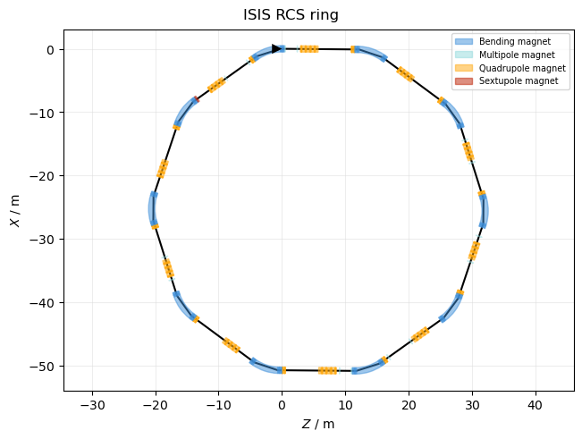
What are coasting beams? Why do we care about them?
Particle beam configuration with:
No acceleration
No bunching
No longitudinal focusing
Fills up the whole ring
Interesting for:
Impedance measurements
Transition state between different bunching structures

Slide 4
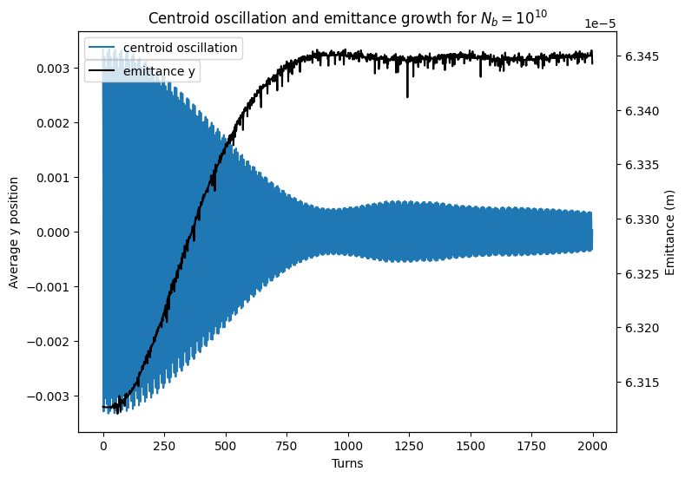
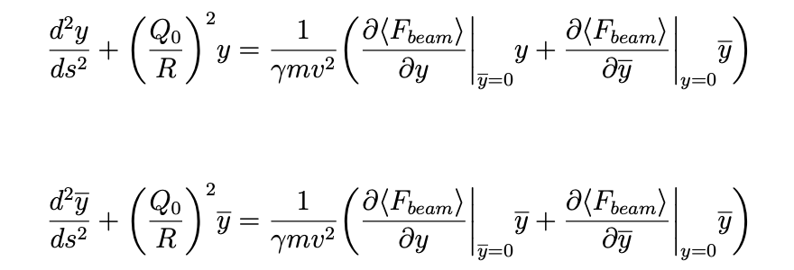
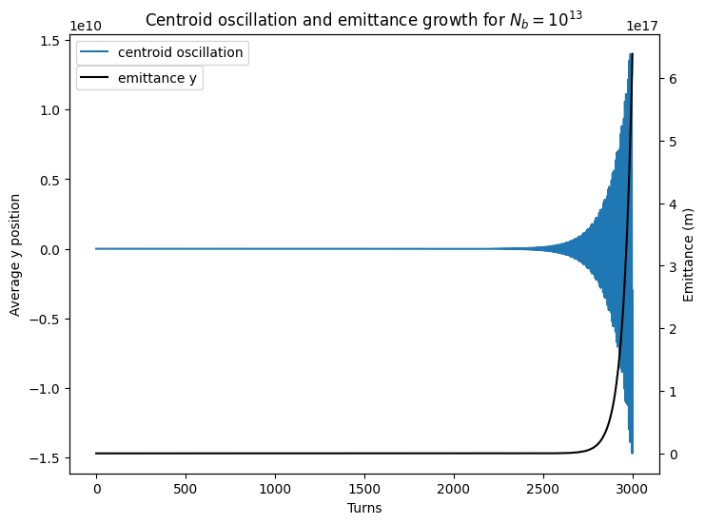
What are transverse instabilities?
Wakefields drive instabilities:

Slide 5
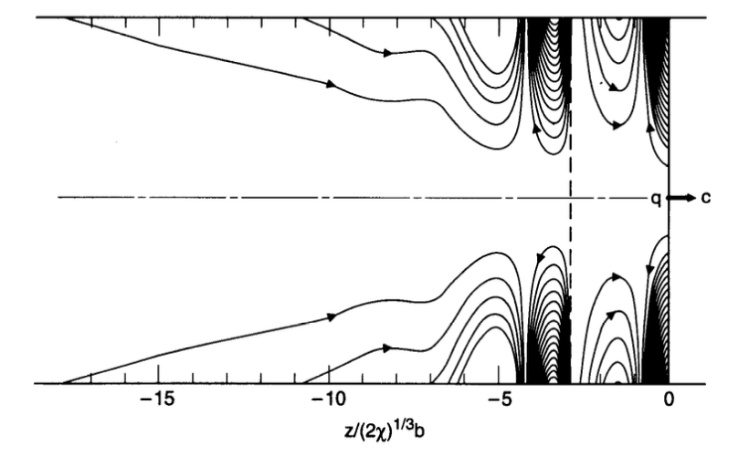
Key players in collective effects
Wakefields
Electromagnetic wake created by the resistive and non-smooth elements along the accelerator.
Resonators and Resistive walls.
[1]
A. Chao, Physics of Collective Beam instabilities in High Energy Accelerators, 1993
B. Wang et al, (2023) Structural and Multidisciplinary Optimization. 66. 10.1007/s00158-023-03669-8.
https://en.wikipedia.org/wiki/Landau_damping

Slide 6
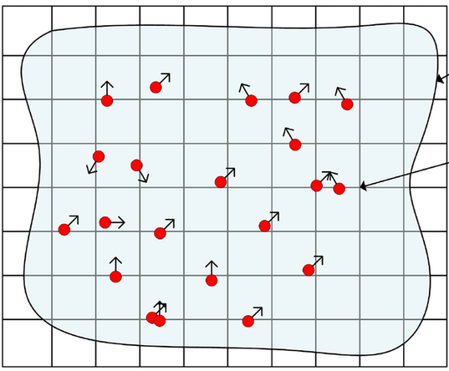
Key players in collective effects
Wakefields
Electromagnetic wake created by the resistive and non-smooth elements along the accelerator.
Resonators and Resistive walls.
Space Charge
Mean field theory of Coulomb interactions.
Incoherent effect (different from every particle, averages to zero for collective motion).
[1]
[2]
A. Chao, Physics of Collective Beam instabilities in High Energy Accelerators, 1993
B. Wang et al, (2023) Structural and Multidisciplinary Optimization. 66. 10.1007/s00158-023-03669-8.
https://en.wikipedia.org/wiki/Landau_damping

Slide 7
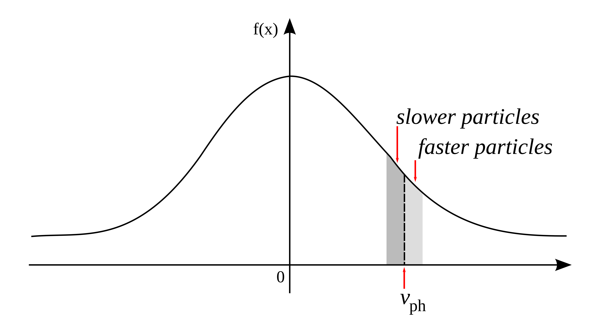
Key players in collective effects
Wakefields
Electromagnetic wake created by the resistive and non-smooth elements along the accelerator.
Resonators and Resistive walls.
Space Charge
Mean field theory of Coulomb interactions.
Incoherent effect (different from every particle, averages to zero for collective motion).
Landau Damping
Particles that oscillate at frequencies different from the collective mode, draw energy from it, damping it.
Damping of collective modes.
[1]
[2]
[3]
A. Chao, Physics of Collective Beam instabilities in High Energy Accelerators, 1993
B. Wang et al, (2023) Structural and Multidisciplinary Optimization. 66. 10.1007/s00158-023-03669-8.
https://en.wikipedia.org/wiki/Landau_damping

Slide 8
How can we simulate this?
* This line is just for comedic purposes. The views reported do not represent my views, my supervisors’ or anyone’s in the accelerator community.

Slide 9
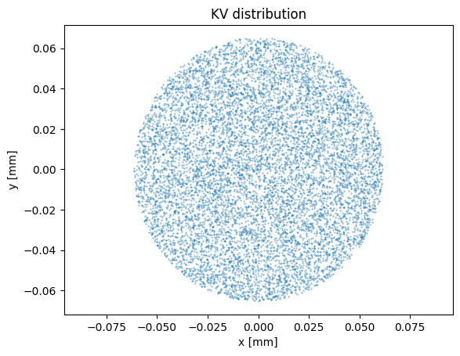
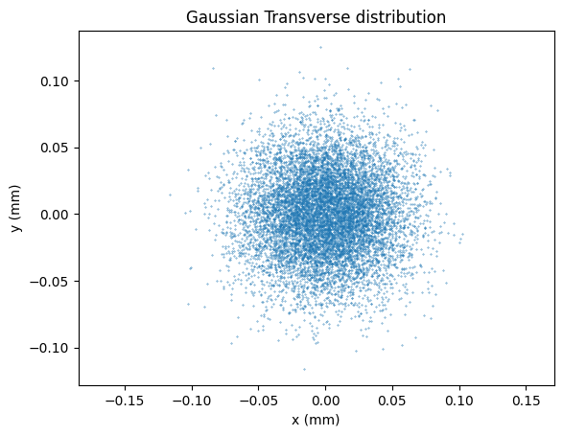
How can we simulate this?
LineMaps
Tracking particles through lattice elements is often slow and not flexible.
Instead we can use Twiss parameters applied as matrices.
Particle distributions
Particle in Cell (PIC)
Numerical method for self-field force.
Compute fields 100 times per turn.
N log(N) computation time.

Slide 10
How can we simulate this?
LineMaps
Tracking particles through lattice elements is often slow and not flexible.
Instead we can use Twiss parameters applied as matrices.
Particle distributions
Self field at any point is linear with x/y.
Quadrupole-like effect
Particle in Cell (PIC)
Numerical method for self-field force.
Compute fields 100 times per turn.
N log(N) computation time.
More realistic distribution

Slide 11
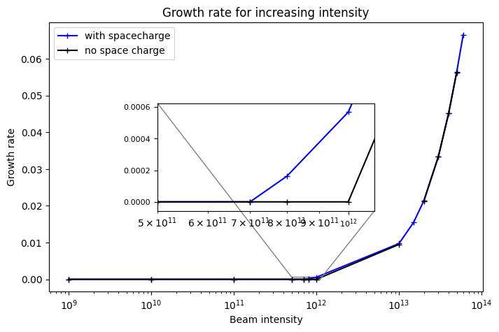
So, what happens with coasting beams?
Actually space charge reduces Landau damping in coasting beams, and pushes back the instability threshold!

Slide 12
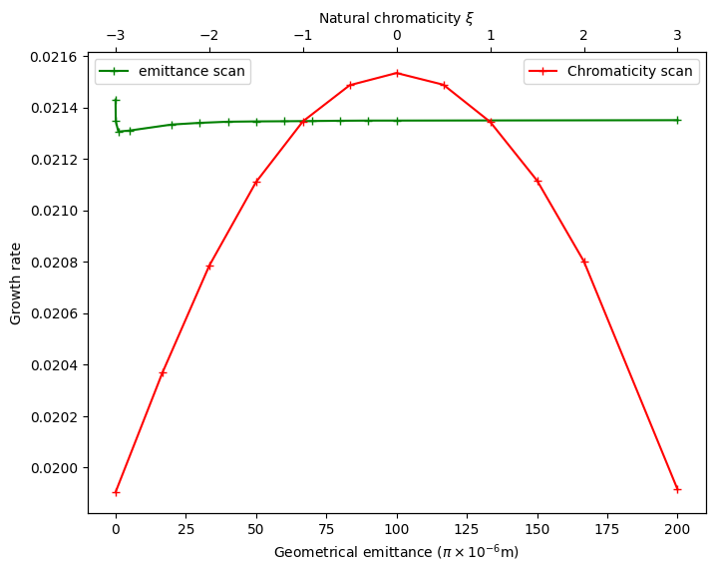
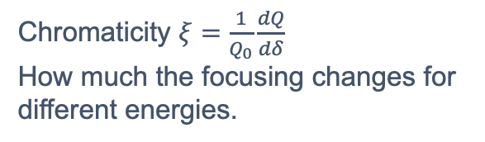
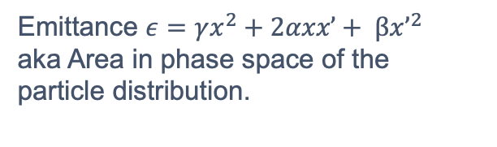
Chromaticity and emittance influence the instability as well
It is also interesting to study how growing rate varies with chromaticity and emittance.
Chromaticity $ξ=\frac{1}{Q_{0}}\frac{dQ}{dδ}$
How much the focusing changes for different energies.
Emittance $ε=γx^{2}+2αxx’+ βx’^{2}$
aka Area in phase space of the particle distribution.

Slide 13
Questions?

Slide 14
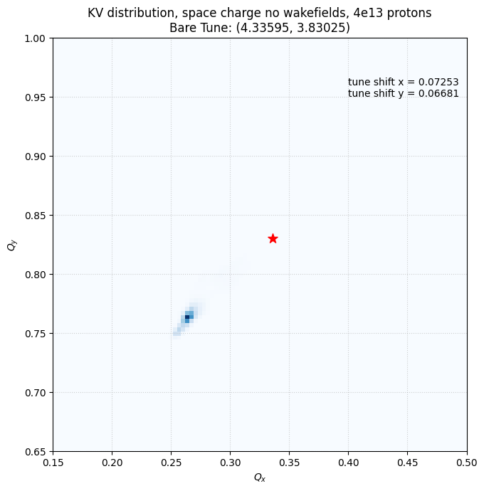
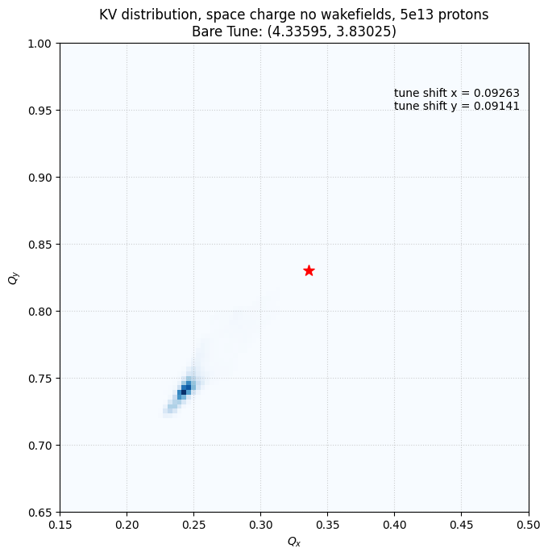
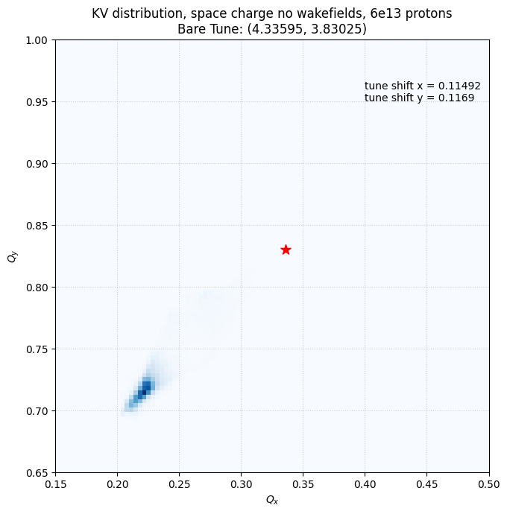
Tune shifts

