Slide 1
Measurement of the LHCb VELO length scale using material interaction vertices
Maoze Bai³, Malcolm John³,
Victor Coco¹, Wouter Hulsbergen², NIKHEF Metrology Team², CERN Tomography Team¹
1. CERN
2. NIKHEF
3. University of Oxford
18th. June. 2026
Transfer Symposium

Slide 2
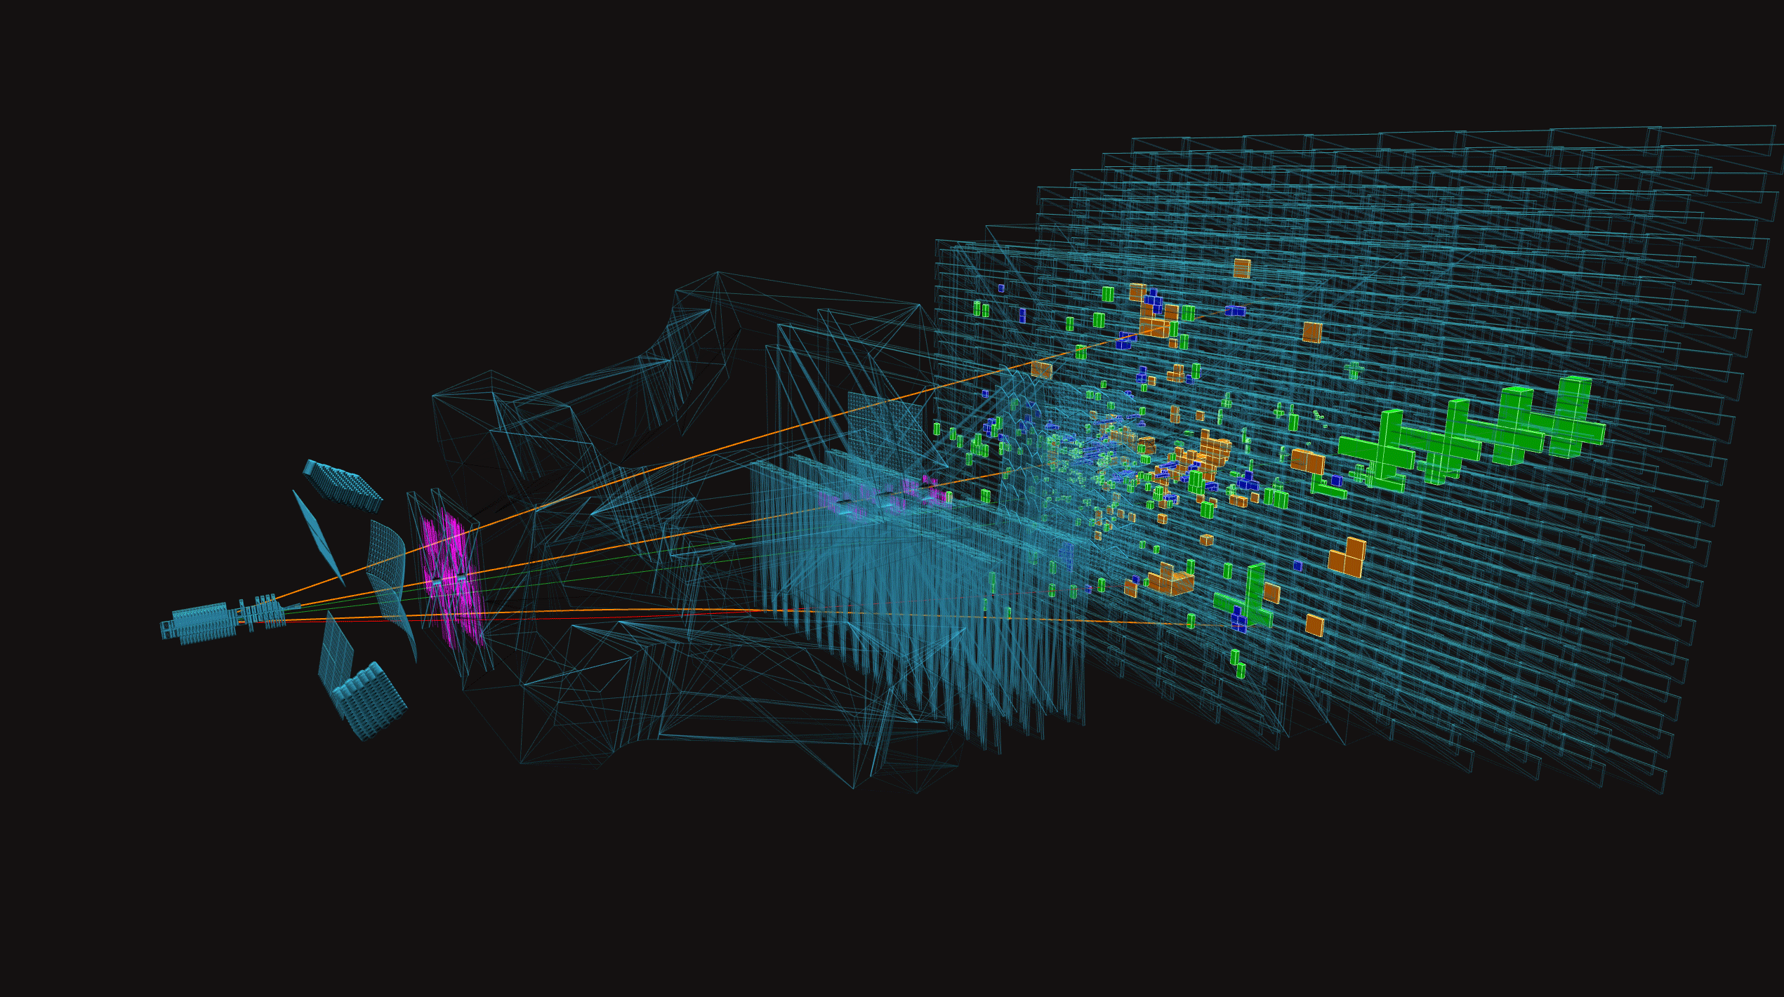
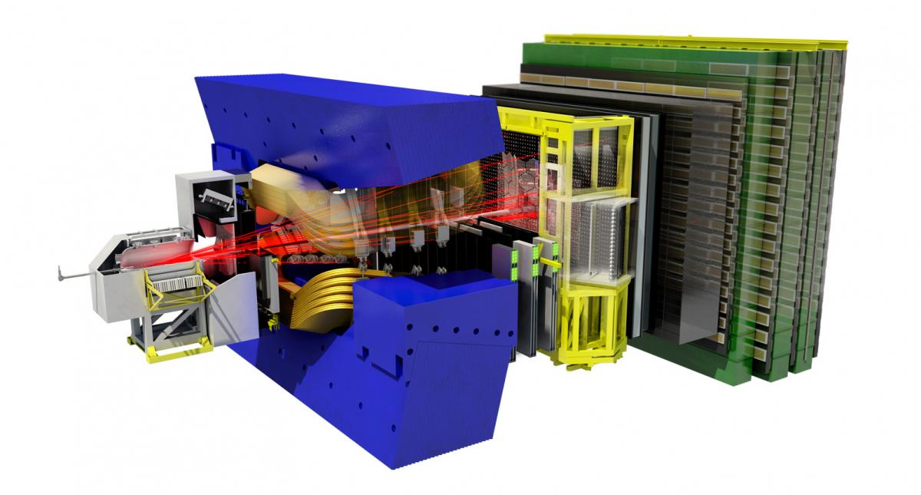
LHCb:
LHCb is one of the major experiments at the Large Hadron Collider (LHC).
A forward detector for heavy-flavour physics, designed to study beauty and charm hadrons.
These particles often decay a measurable distance away from the collision point.
Therefore, LHCb needs extremely precise vertex reconstruction.
https://hepsoftwarefoundation.org/phoenix/

Slide 3
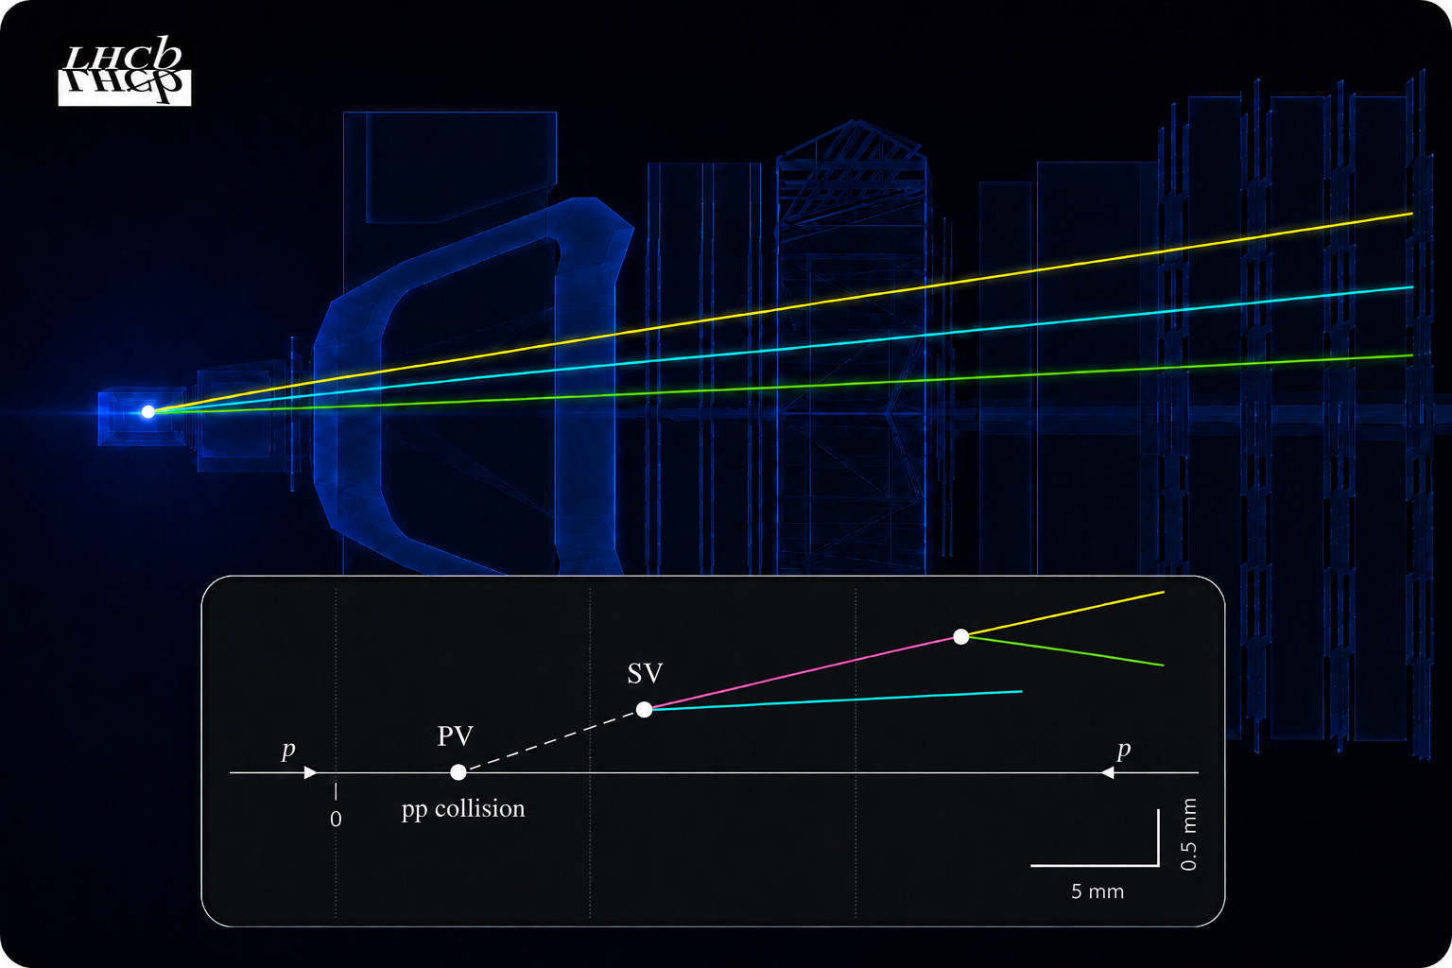
Vertex Locator (VELO) in LHCb:
Sits closest to the proton-proton collision point.
Measures charged-particle tracks very precisely near the interaction region.
Provide precise reconstruction of primary and secondary vertices, which are essential for heavy-flavour physics.
Generated By GPT

Slide 4
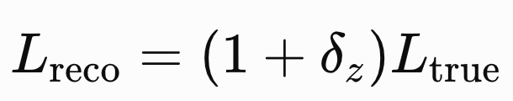
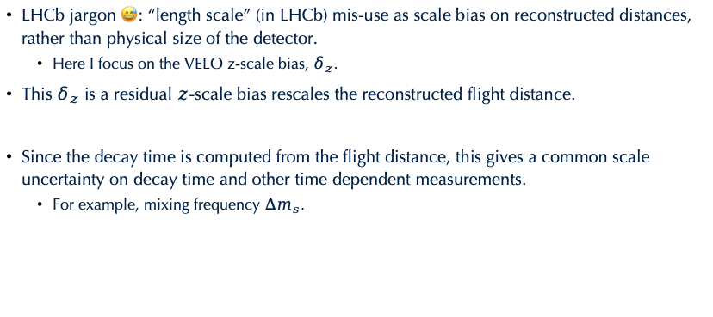
What is a Velo length scale (bias), $δ_{z}$?
LHCb jargon 😅: “length scale” (in LHCb) mis-use as scale bias on reconstructed distances, rather than physical size of the detector.
  Here I focus on the VELO z-scale bias, $δ_{z}$.
This $δ_{z}$ is a residual $z$-scale bias rescales the reconstructed flight distance.
Since the decay time is computed from the flight distance, this gives a common scale uncertainty on decay time and other time dependent measurements.
  For example, mixing frequency $∆m_{s}$.

Slide 5
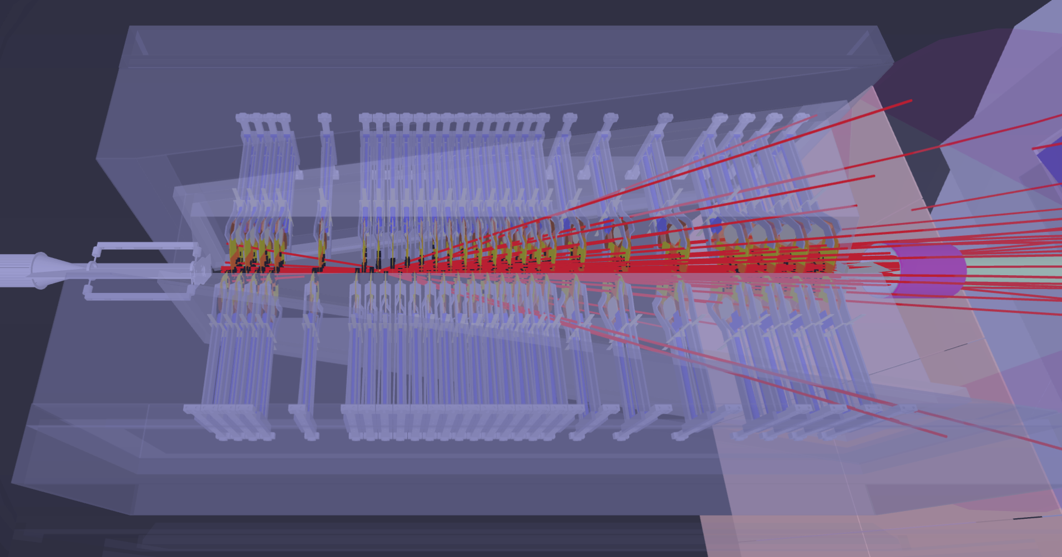
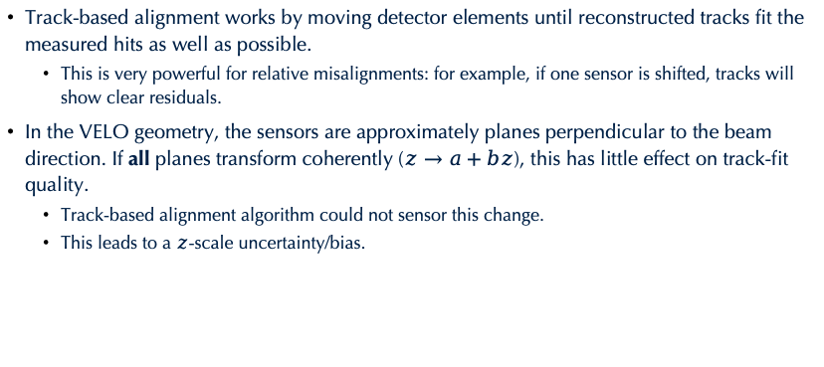
Where does the z-scale bias come from?
Track-based alignment works by moving detector elements until reconstructed tracks fit the measured hits as well as possible.
  This is very powerful for relative misalignments: for example, if one sensor is shifted, tracks will show clear residuals.
In the VELO geometry, the sensors are approximately planes perpendicular to the beam direction. If all planes transform coherently ($z→a+bz$), this has little effect on track-fit quality.
  Track-based alignment algorithm could not sensor this change.
  This leads to a $z$-scale uncertainty/bias.

Slide 6
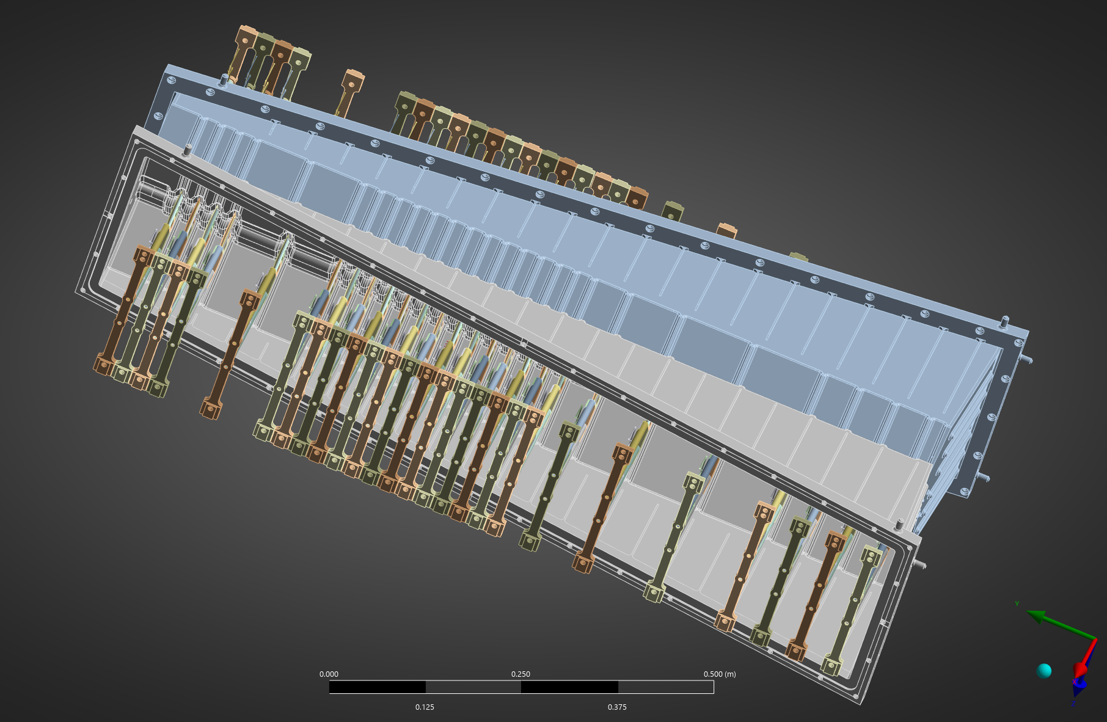
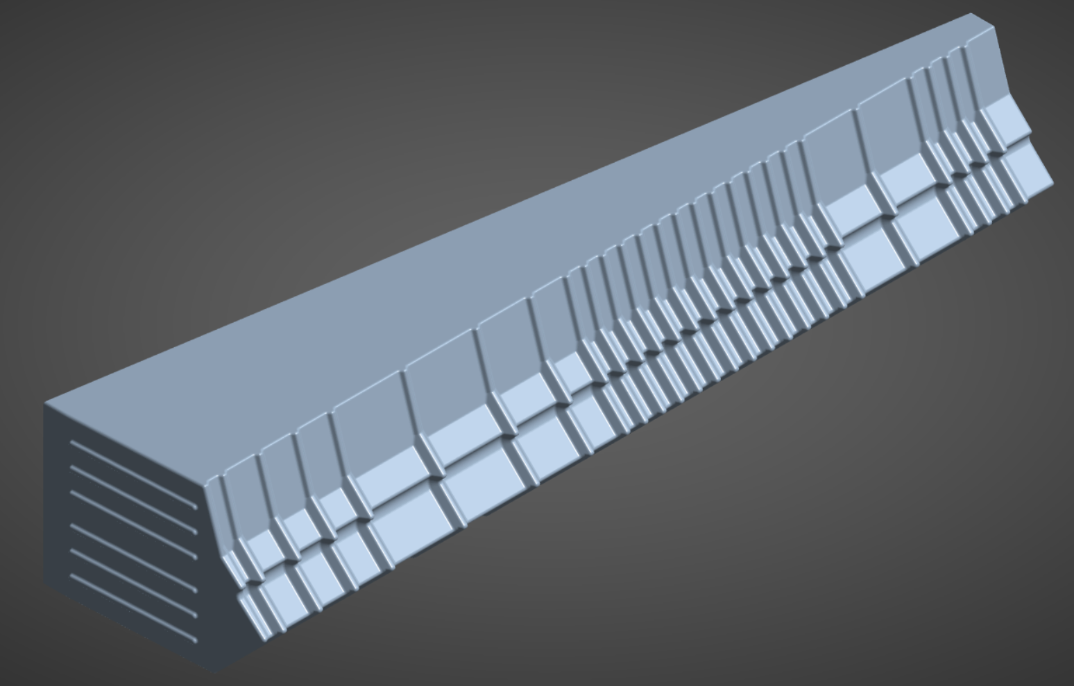
The RF Box provides built-in tick marks:
Luckily, the VELO sensors are surrounded by thin aluminium RF boxes. The box has repeated corrugations along z.
  These corrugations act like reference marks inside the detector.
Corrugations
VELO Sensor

Slide 7
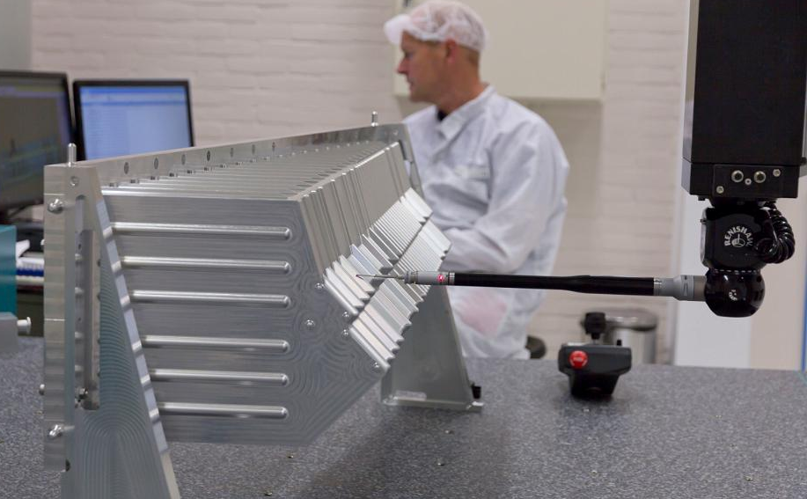
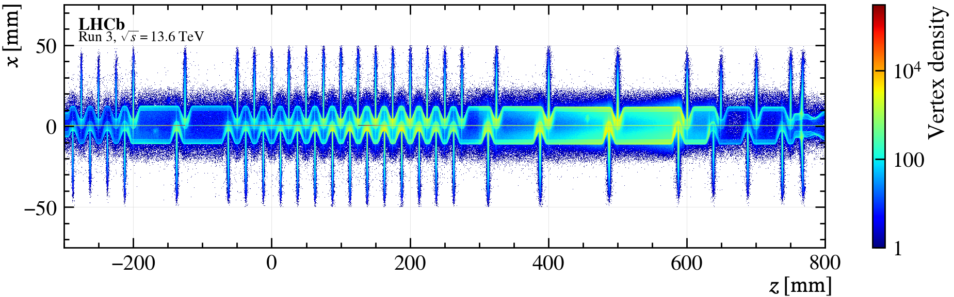
How RF-Box could be used in VELO Z-bias:
Tomography data (reconstructed vertices):
  As particles pass through detector, they undergo hadronic interactions with the material of the RF box and VELO modules
  Treat as 'effective' geometry as seen by the LHCb reconstruction algorithms.
  This heavily relies on the VELO internal alignment.
Metrology data (high precision scan) of RF-Box.
  Treat as the ‘physical reference’.
Tomography
Metrology

Slide 8

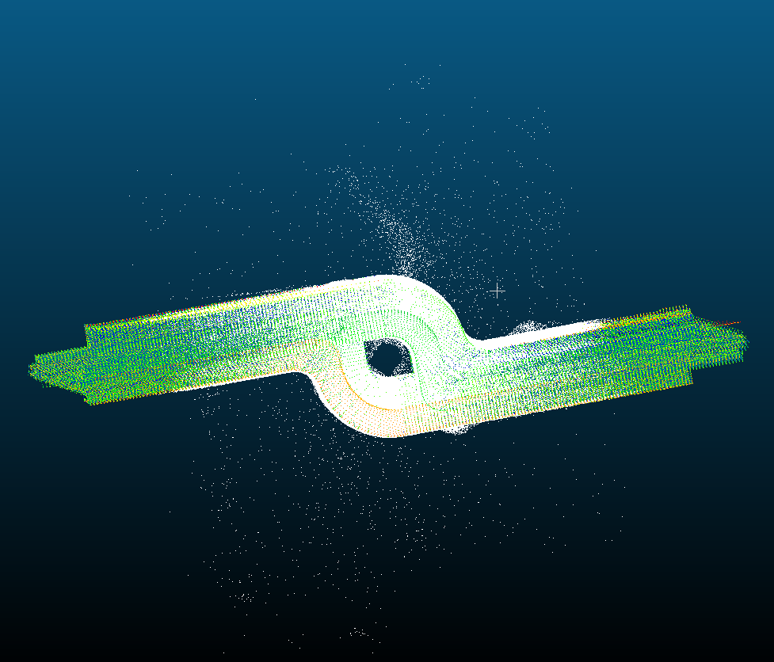
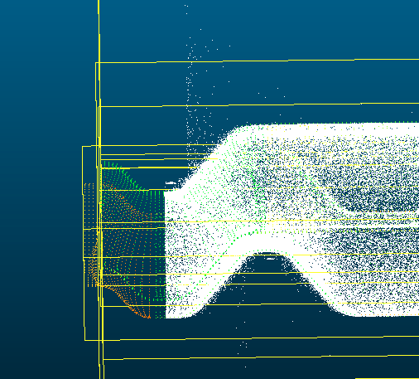
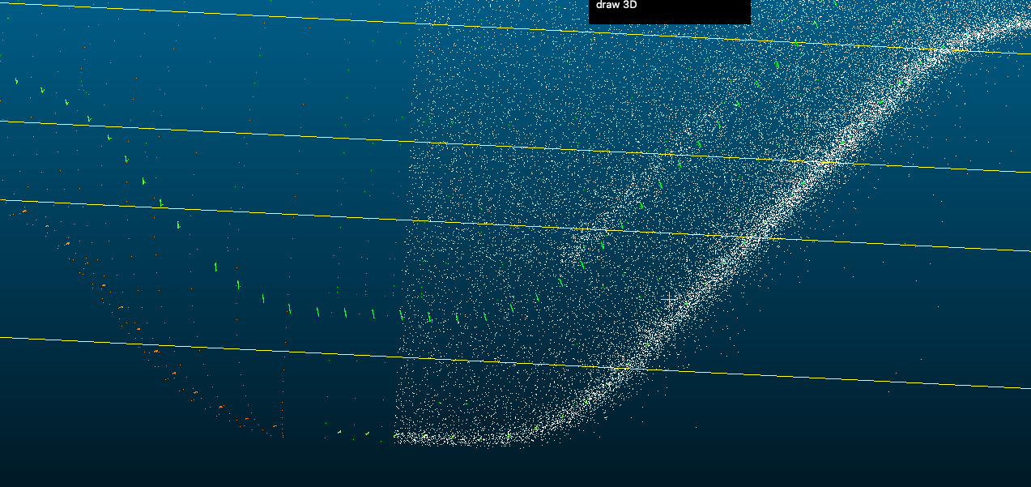
Alignment
The Metrology data is not aligned in LHCb Reference system.
We use software “CloudCompare” and python to do the alignment iteratively.
White points - Tomography
Green points - Metrology
Notes:
We did not use whole rf box, but only the foil

Slide 9
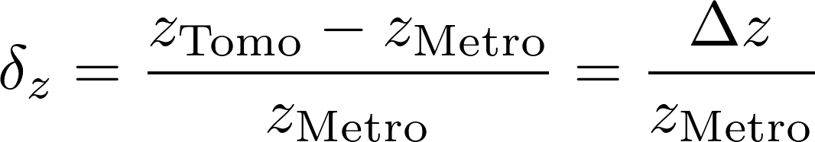
How RF-Box could be used in VELO Z-bias:
We have tomography data (reconstructed vertices) and metrology (high precision scan) of RF-Foil.
We will use differences between metrology and tomography to estimate the z-scale bias.
Physical reference

Slide 10
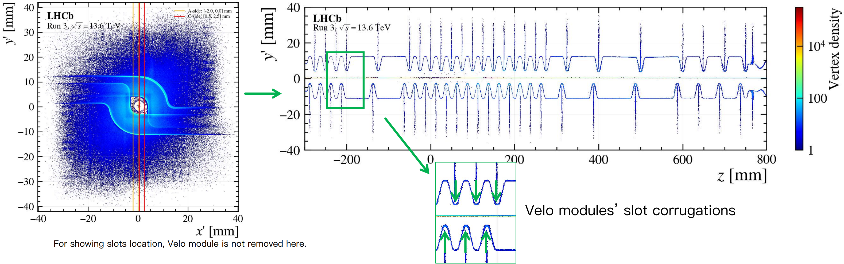
How RF-Box could be used in VELO Z-bias:
  We obtain these differences by precise determination of the center of corrugations.
  We first cut both data into a y'-z slice, and then fit the slot corrugation.
y’: rotate y axis 45 degree.

Slide 11
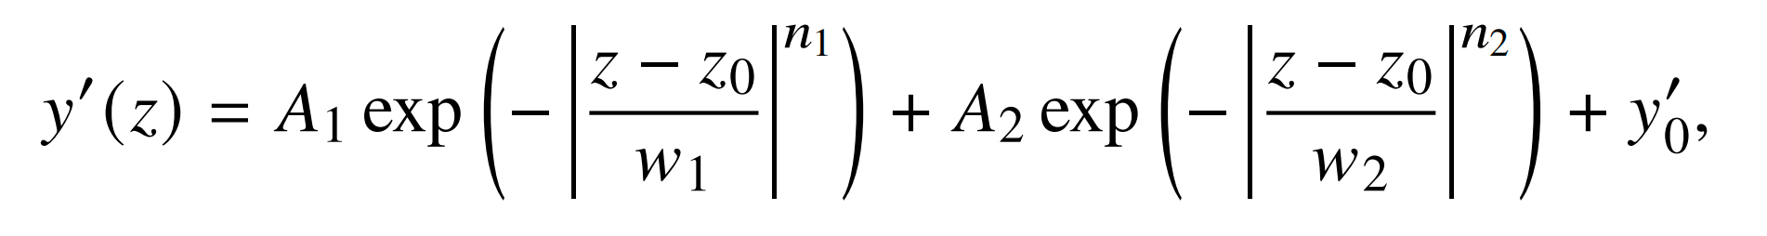
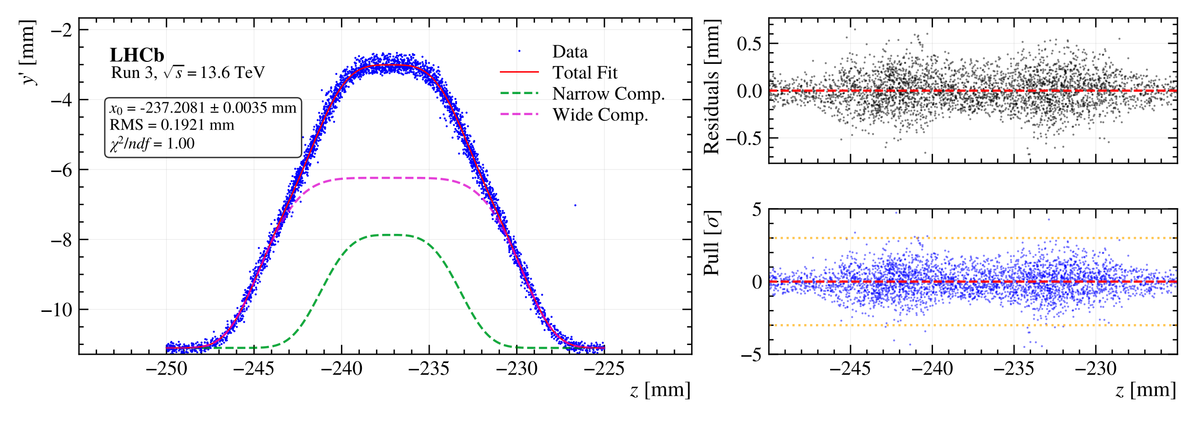
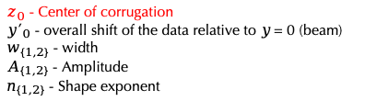
How RF-Box could be used in VELO Z-bias:
  We first cut both data into a y'(rotate 45 degree)-z slice, and then fit the slot corrugation.
  We create a function called Double Super-Gauss to describe corrugation
$z_{0}$ - Center of corrugation
${y′}_{0}$ - overall shift of the data relative to 𝑦 = 0 (beam)
$w_{\{1,2\}}$ - width
$A_{\{1,2\}}$ - Amplitude
$n_{\{1,2\}}$ - Shape exponent

Slide 12
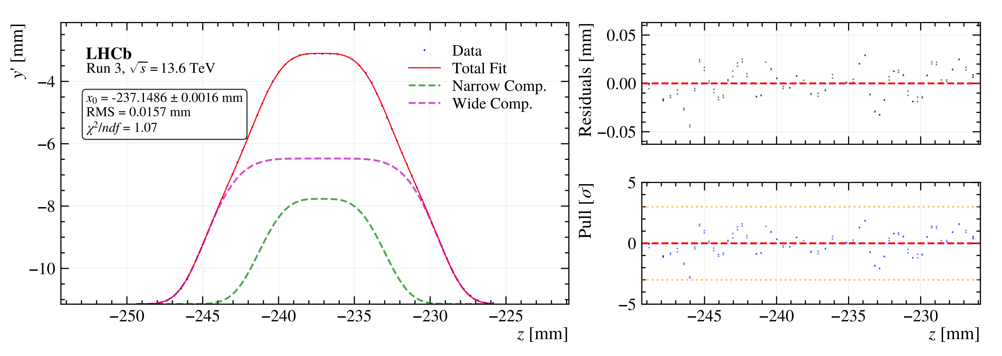
How RF-Box could be used in VELO Z-bias:
  We first cut both data into a y'(rotate 45 degree)-z slice, and then fit the slot corrugation.
  We create a function called Double Super-Gauss to describe corrugation
$z_{0}$ - Center of corrugation
${y′}_{0}$ - overall shift of the data relative to 𝑦 = 0 (beam)
$w_{\{1,2\}}$ - width
$A_{\{1,2\}}$ - Amplitude
$n_{\{1,2\}}$ - Shape exponent

Slide 13
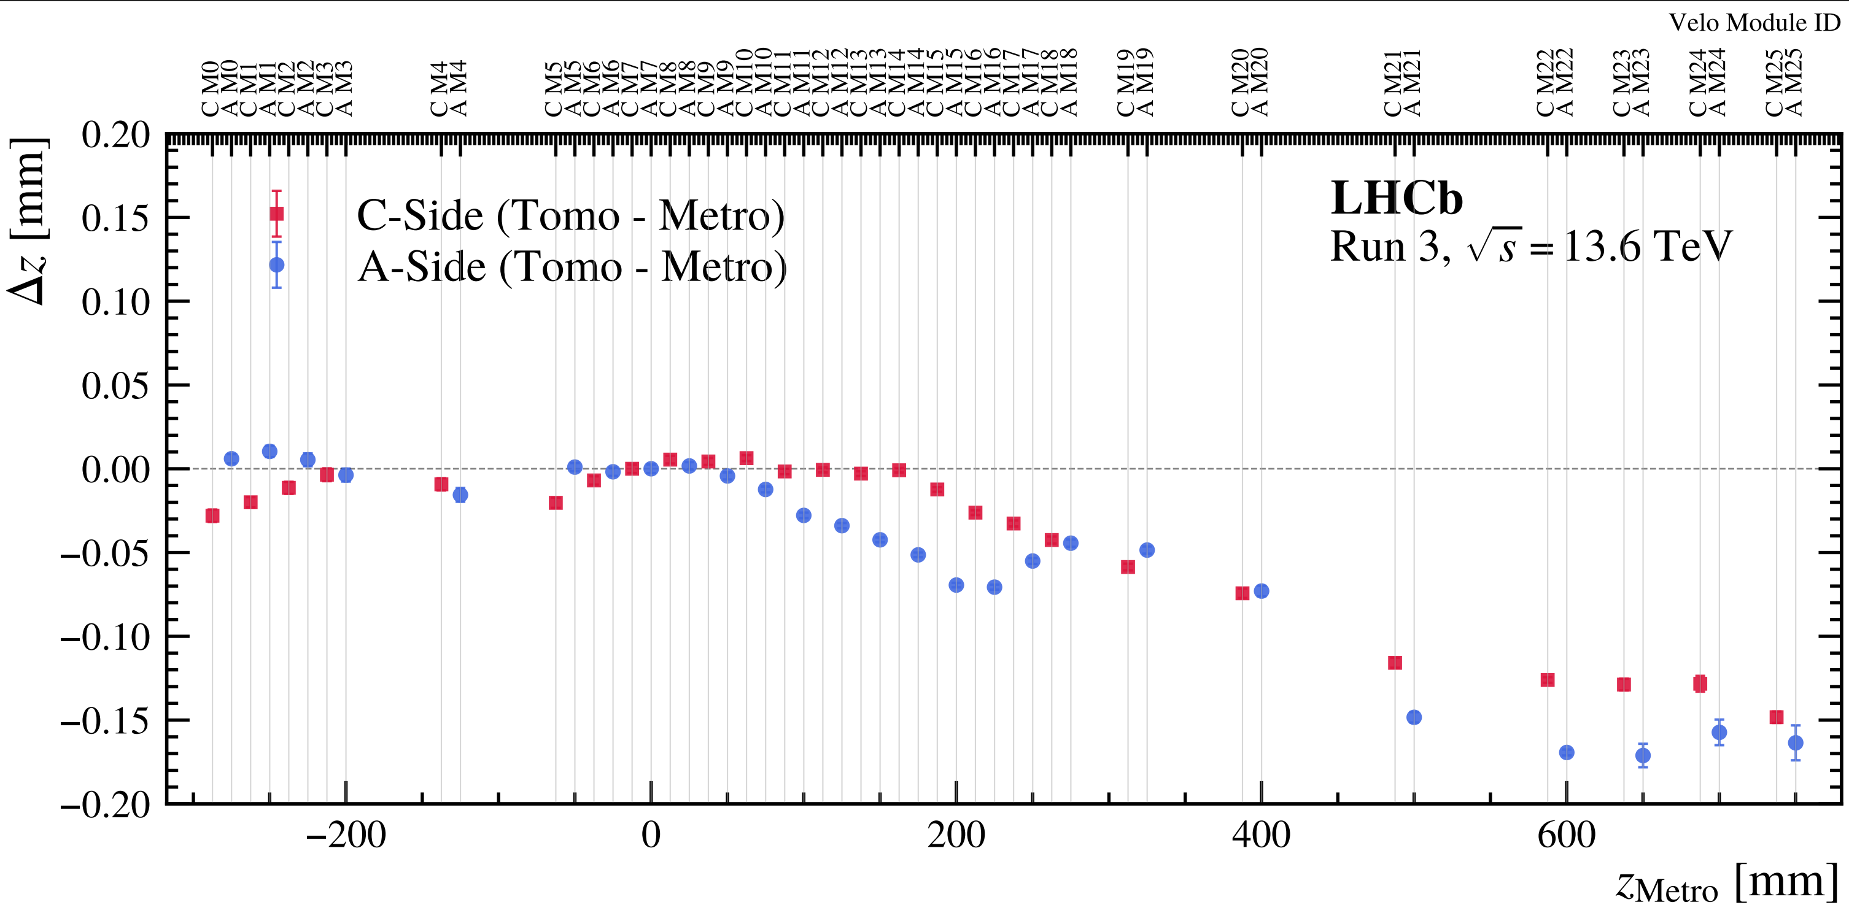
$∆z$(Tomo. - Metro.) vs $z_{Metro}$ :
  We could precise determine the center of corrugations (CoC) of RF-foil.
  Cut them into a y'(rotate 45 degree)-z slice, and fit the slot corrugation.
Approximately, tomography differs from metrology by a slope of ∼180micron/1m before applying the any correction.
See more details in paper draft.
Notes:
before considering any thermal contraction.

Slide 14
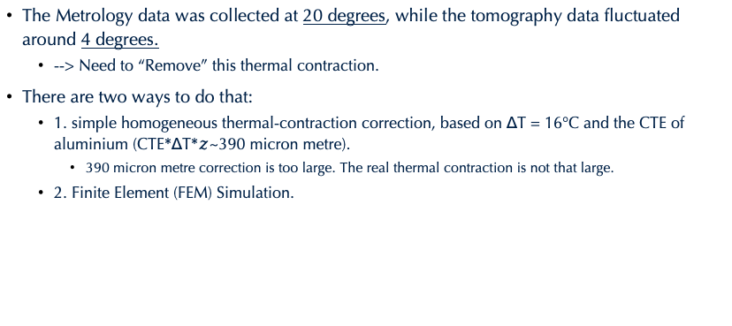
Thermal contraction
The Metrology data was collected at 20 degrees, while the tomography data fluctuated around 4 degrees.
  --> Need to “Remove” this thermal contraction.
There are two ways to do that:
  1. simple homogeneous thermal-contraction correction, based on ΔT = 16°C and the CTE of aluminium (CTE*ΔT*$z$~390 micron metre).
    390 micron metre correction is too large. The real thermal contraction is not that large.
  2. Finite Element (FEM) Simulation.
Notes:
it is just a constant thermal contraction. Therefore, we did FEM simulation to simulate this thermal contraction.

Slide 15

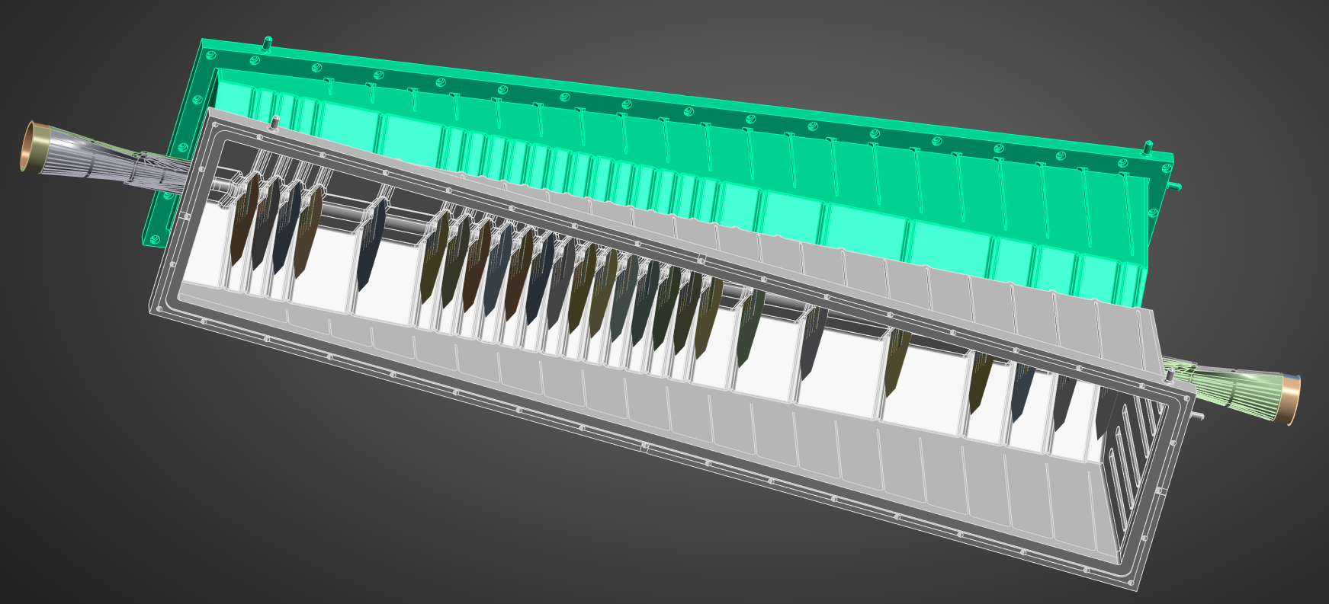
Thermal contraction
We then perform our own FEM simulation using Ansys.
  We only include VELO substrates in simulation.
  The screws of flange is fixed (no deformation will occur).
  The base is constantly heat at 20 degree.
  VELO substrates is set to -30 degree and cooling RF box via radiation (RF box --> cold VELO)
Notes:
In this model, the base is kept at 20◦C and the RF-foil, starting at 20◦C, is cooled radiatively by the nearby VELO modules.

Slide 16
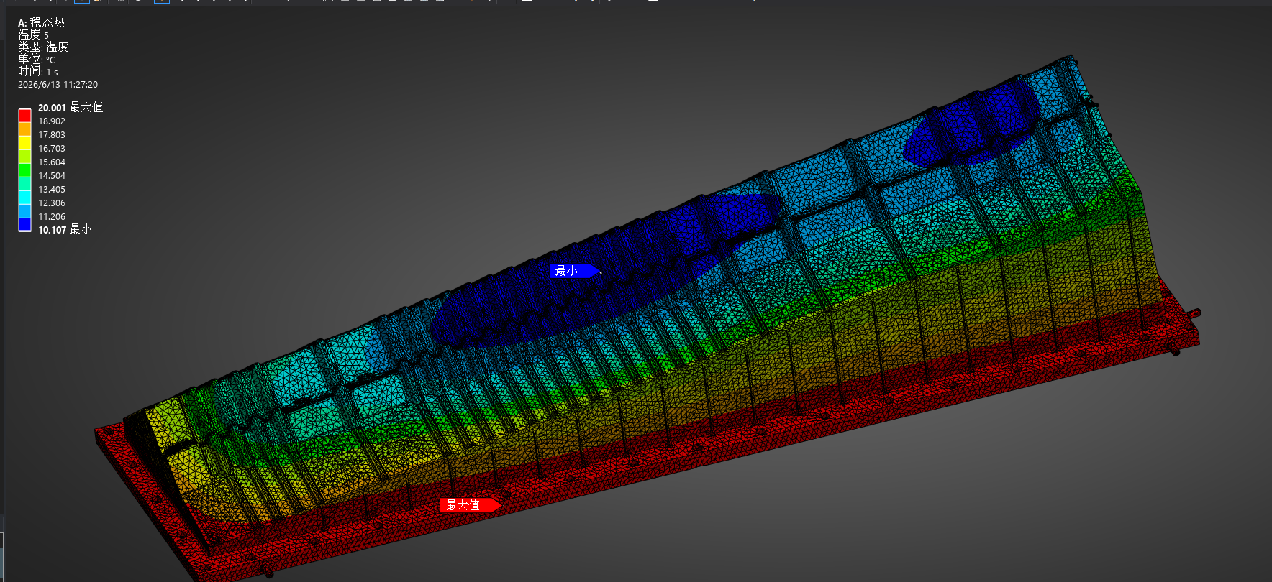
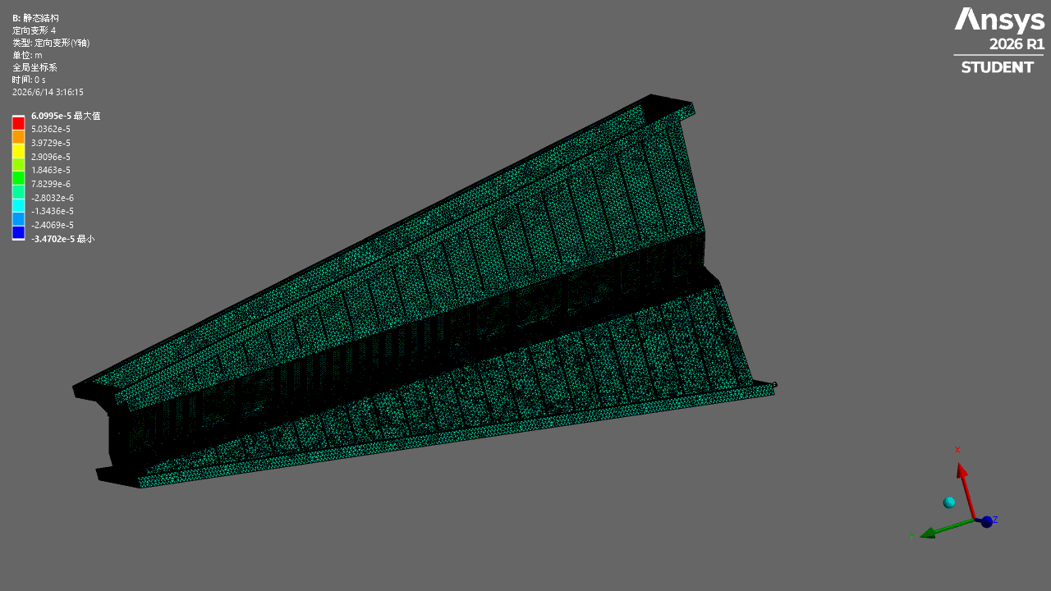
Thermal contraction
We perform then perform our own FEM simulation using Ansys.
Notice: the deformation in animation is exaggerated for visual purposes..
y-axis in FEM = z-axis in LHCb
Temperature in ˚C
Contraction in mm
Temperature distribution
Displacement along FEM y (= LHCb z)
Notes:
In this model, the base is kept at 20◦C and the RF-foil, starting at 20◦C, is cooled radiatively by the nearby VELO modules.

Slide 17
Thermal contraction
We perform then perform our own FEM simulation using Ansys.
  The thermal deformation in the z-direction is small compare with 390 micron.
This FEM simulation is not finalised, Because our FEM readings for temperature don't match the actual temperature.
  Perhaps we have overlooked certain part of materials.
  Perhaps we have entered incorrect material parameters.
Notes:
In this model, the base is kept at 20◦C and the RF-foil, starting at 20◦C, is cooled radiatively by the nearby VELO modules.

Slide 18
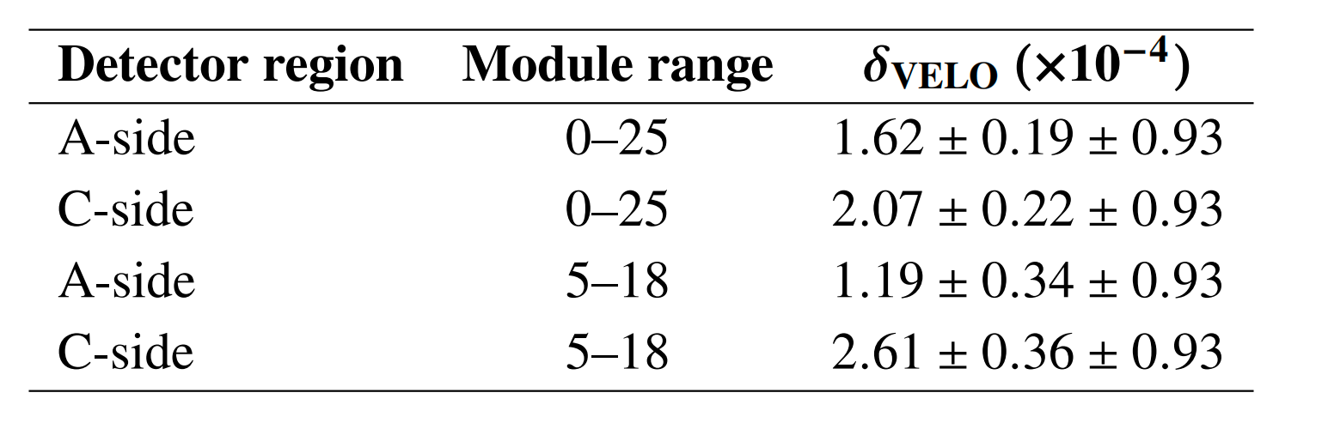
Conclusion:
Currently, since we are still trying to work out the "corrected" thermal contribution.
At this stage, we could only provide results based on homogeneous thermal contraction, which is too simplistic.
Notes:
we use extreme conservative value to envolope and include the subdominant effect.

Slide 19
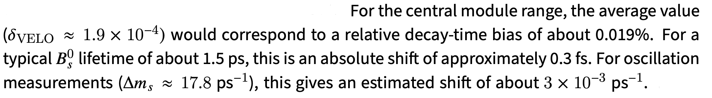
Conclusion:
Notes:
we use extreme conservative value to envolope and include the subdominant effect.

Slide 20
Backup

Slide 21
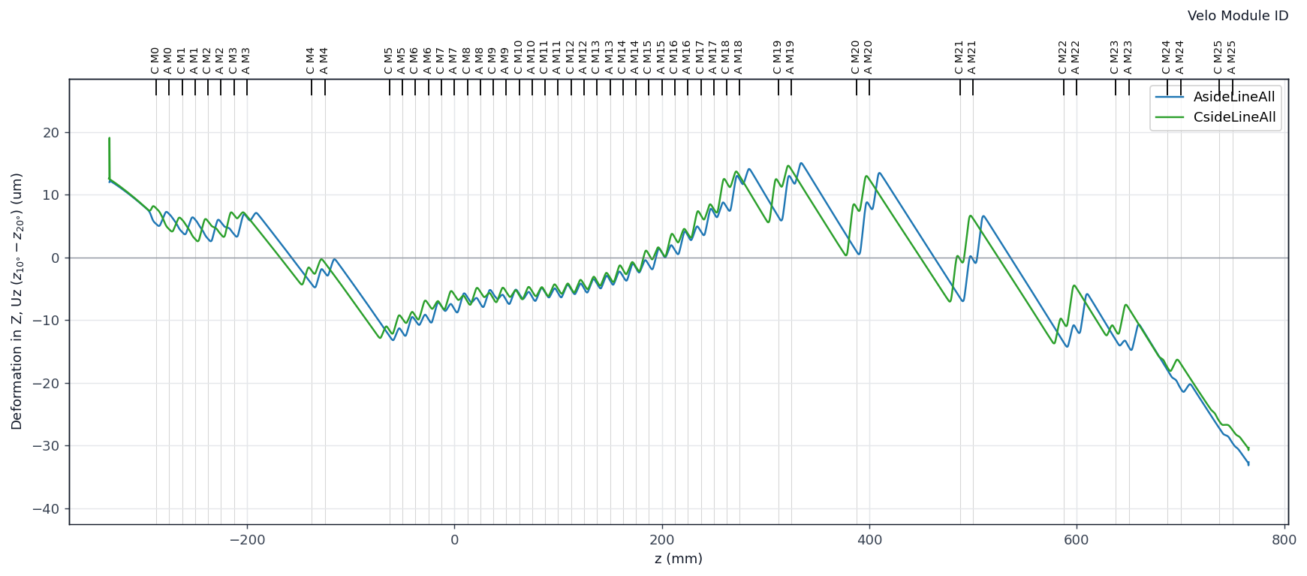
Themal contraction
We then perform our own FEM simulation using Ansys.
  The change in the z-direction is small compare with 390 micron.
Notes:
In this model, the base is kept at 20◦C and the RF-foil, starting at 20◦C, is cooled radiatively by the nearby VELO modules.

Slide 22
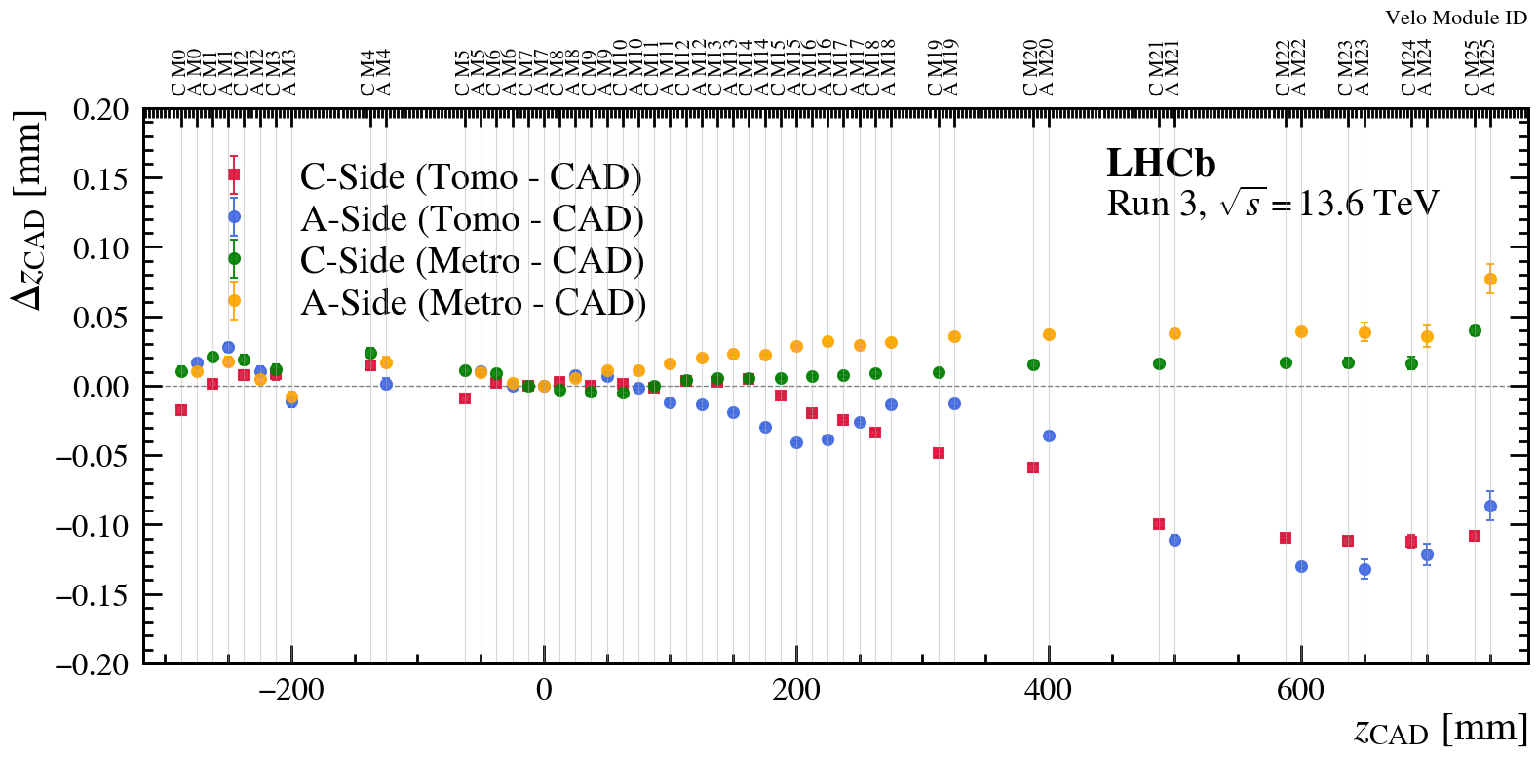
Compare with CAD design.
  [Metro - CAD] The built RF boxes deviates from the design by about 40 micron/1m.
  [Tomo - CAD] devaiate 150 micron/1m, which accounts for bias from trackbased alignment, deformation of RF-foil, thermal contraction.
Notes:
介绍一下图表: green and yellow dot......

Slide 23
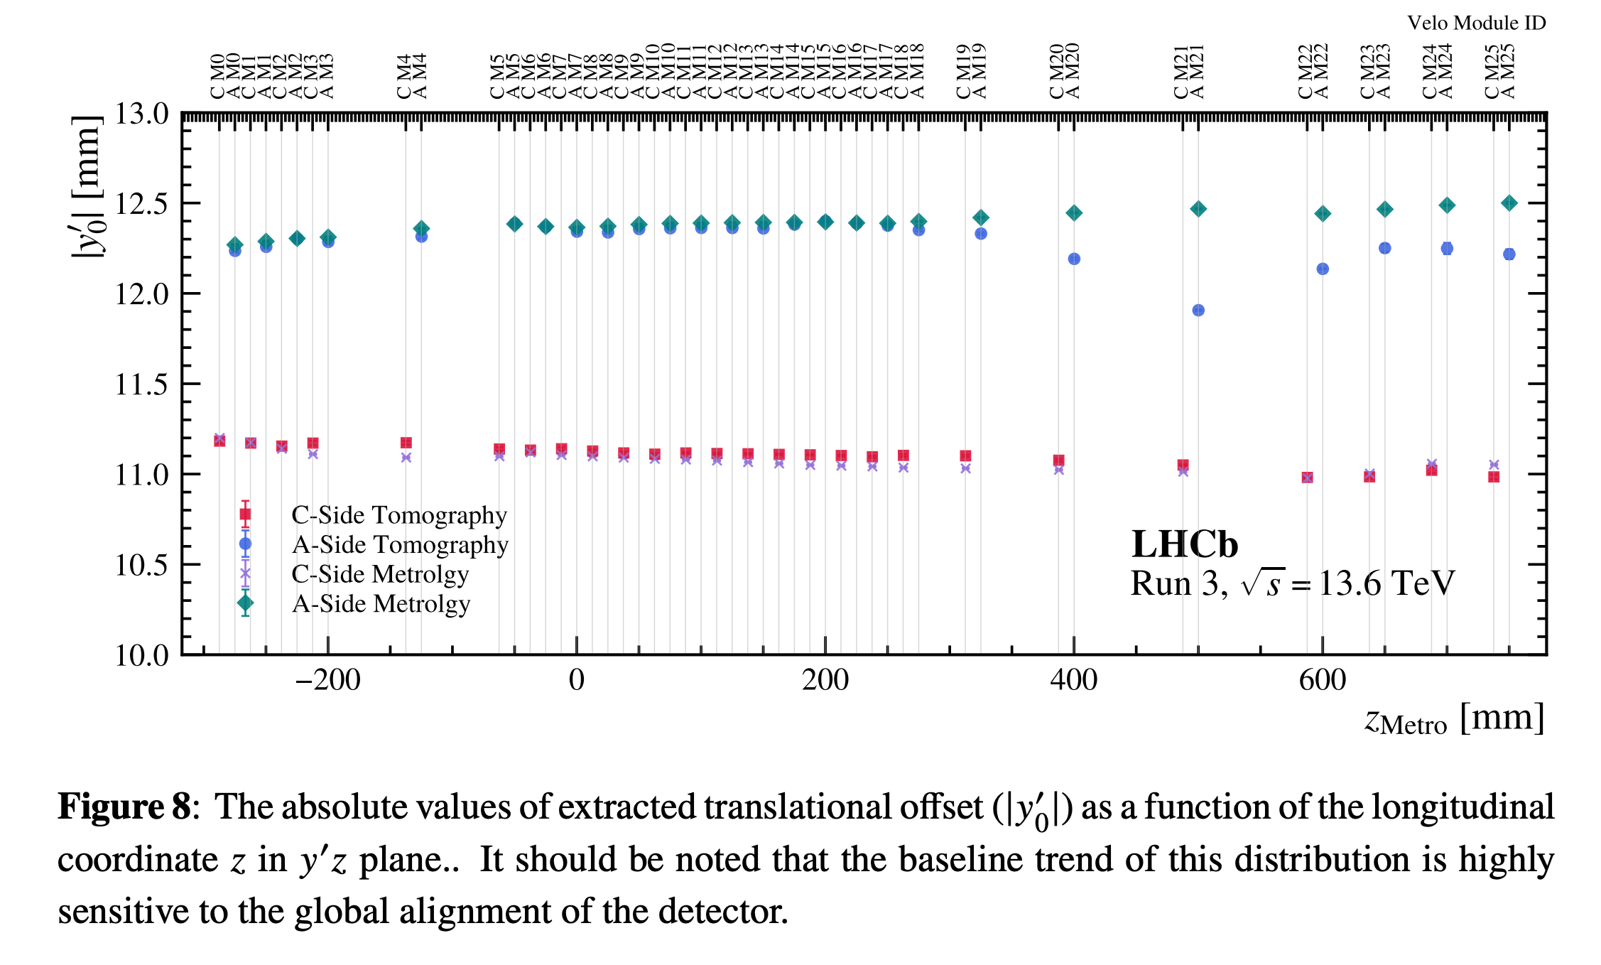
Deformation in Aside.
Notes:
介绍一下图表: green and yellow dot......

Slide 24
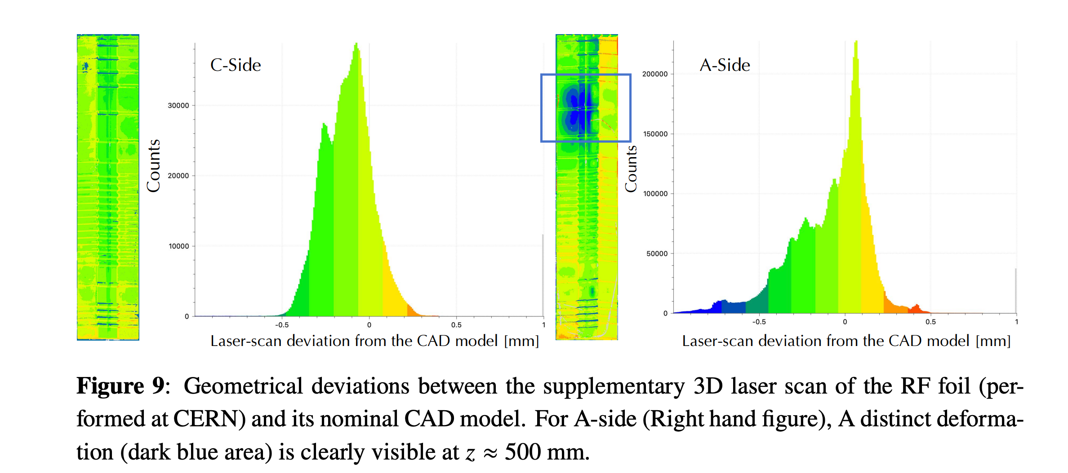
Deformation in Aside.
Notes:
介绍一下图表: green and yellow dot......

Slide 25
How are material-interaction vertices reconstructed?
Online trigger selection
  HLT1 looks for material-interaction candidates.
  Uses triplets of tracks displaced from the beamline.
  Tracks are required to have distance to beamline >3.5 mm and mutual distance <0.5 mm.
Offline vertex reconstruction
  Events are processed with an unbiased primary-vertex finder.
  Vertices are reconstructed without requiring them to be near the beamline.
  Requires at least 4 tracks per vertex.
RF-shield vertex selection
  Keep vertices displaced from the beamline: 2mm away in x and y.
  This removes most ordinary pp primary vertices.
Quality selection
  Require at least 7 tracks per vertex.
  Require estimated z-position uncertainty < 0.2 mm.

Slide 26
Some caveats:
This analysis only applies to data taken in March - August 2025.
  The period between the internal alignment of the velo was updated.
  There is a known z-scale bias in the 2024 alignment.
  So, this result (due to tomography) is track-based alignment dependent.
It is possible that aging affects the hit z-position due to changes in depletion depth, especially if we don't run at sufficient HV.
This analysis may be repeated for different points in time.

Slide 27
Some Remarks:
The following effects are not included explicitly:
  The beam-induced temperature effects.
    It is expected to be small and can be checked by comparing the pt-100 temperatures under different beam conditions.
    The larger issue is not that the beam makes the foil warmer, but that the measured foil temperature appears colder than expected when compared with the simulation. This is still under investigation.
      Average temperature from pt-100 sensor is ~4 degree, but the simulation shows we only cooling to 10 degree.
  Deformation from Stress effects:
    For Metrology, the deformations from stress effect are not be very large, because:
      During machining the box was fixed to a flat surface (hence constrained)
      During metrology it was free.
      However, the metrology is very close to the CAD design [40 micron/1m].
  Deformation from Air Pressure effect:
    In the detector (tomography), the pressure is approximately balanced on the two sides, the pressure force itself may not be the dominant issue of deformation.
Notes:
Those effects should be included in our very conservative uncertainty.

Slide 28
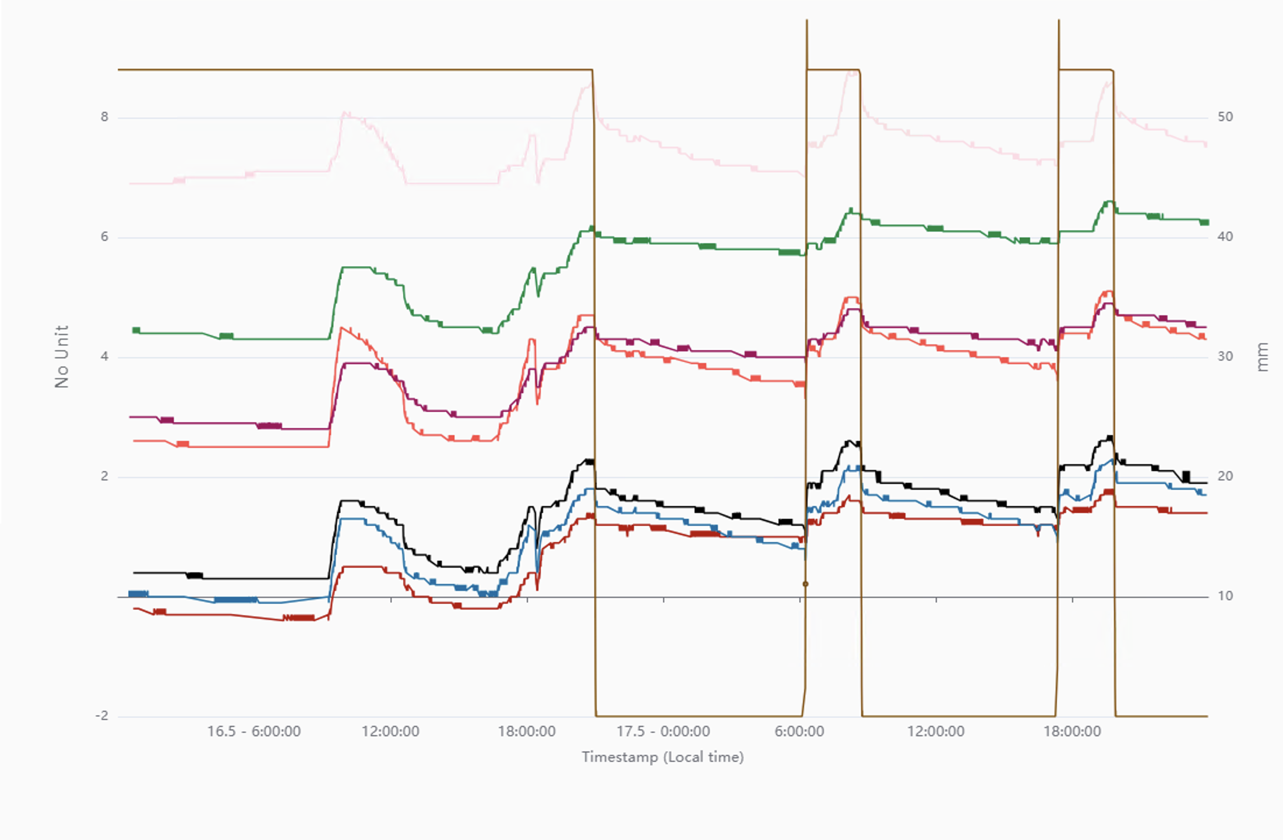
C M42 -> Cside Module 21 (~)
A M43 -> Aside Module 22 (~)
C M40 -> Cside Module 19 (~)
Temperature (deg)
A M41 -> Aside Module 20 (~)
A M07-> Aside Module 3 (~)
C M06 -> Cside Module 3 (~)
A M03 -> Cside Module 11 (~)

Slide 29
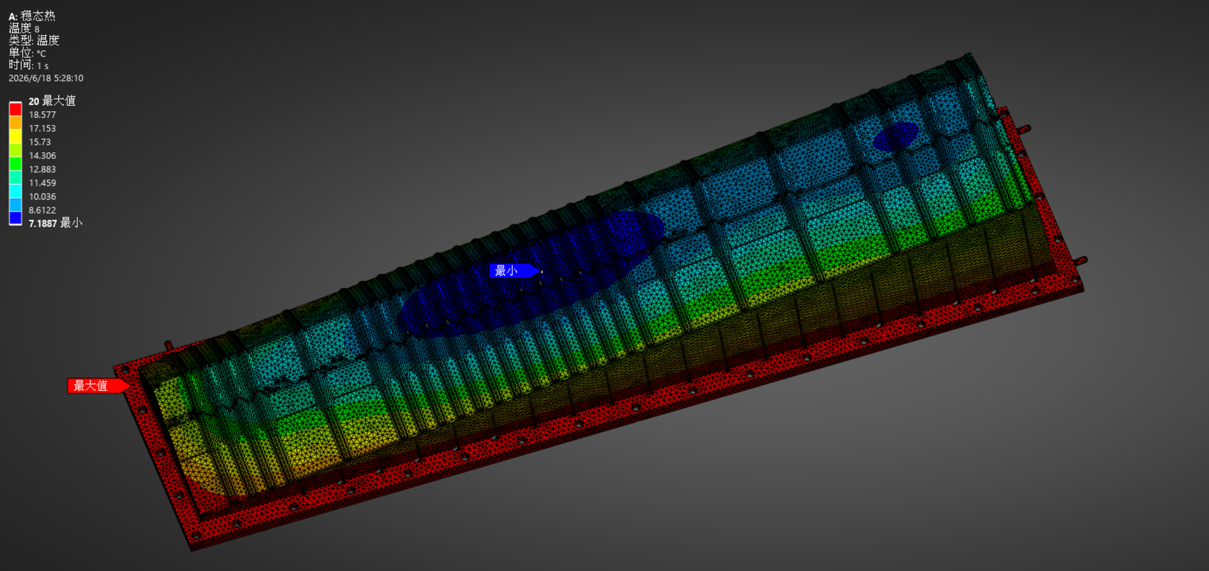
Conductivity reduced by 1.5

