Slide 1
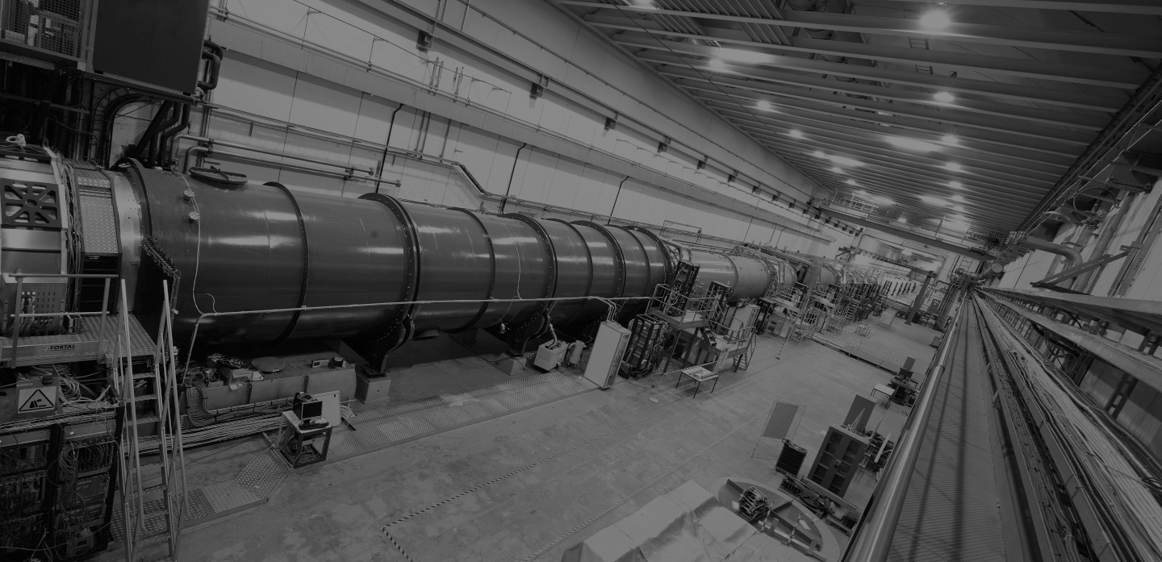
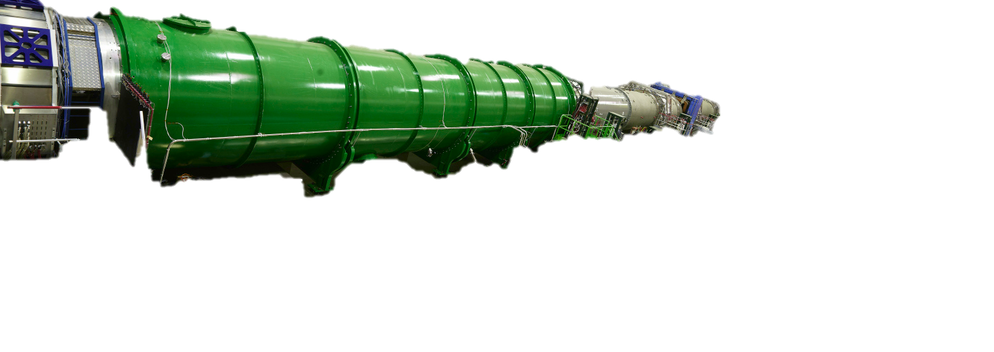

Kaon You Believe It?
NA62 Unveils the Rare $K^{+}→π^{+}ν\overline{ν}$ Decay!
NA62
CERN’s
Kaon factory
Benjamin Gladwyn | February 2025
Graduate Symposium based on arXiv:2412.12015
Notes:
Old data
Signal regions in red boxes and data events are black points = 20 events, so 10 expected SM and 10 expected background. ~3 sigma
How do we improve?
Tight cuts reject backgrounds but also reduce signal efficiency
Technique works but need new tools to control background.
Largest background is upstream = decays up stream of the fiducial volume. Second is pi^+ and pi^0
Upstream background – K->pi which gets through after KTAG and is scattered by STRAW, this gives a fake vertex. New scintillator tiles after the selection detect the photons from the pi^0 decay and veto that K^+ so 3x better rejection. (Veto counter)
Upgrades
Add a 4th station to GTK station improves efficiency and reduce pileup.
K+->pi^+ pi^0 .pi^0->gamma gamma. The gamma hits the RICH flange and creates a shower. HASC2 detector introduced to measure the shower and veto the electrons.
Intensity increases from 400-600MHz to improve statistics. Dead times reduced signal efficiency from this.
Analysis of new data
3 triggers in analysis. Minimum bias, normalization and signal.
You have to detect a single downstream particle.
Signal sensitivity – find effective number of K+ decays & use it as an input to the single event sensitivity. This allows us to calculate the expected SM events using the SM branching ratio. (but objective is to measure the BR so this is for comparison with the past data)
Random veto – 1-RV = prob of rejecting signal event due to additional activity (at high intensity you are more likely to reject due to other efficiencies in the detector, not related to track momentum)
Backgrounds
Backgrounds from kinematic misconstruction of the missing mass parameter. Need a control sample to evaluate how likely this is (use K+ to pi+pi0 to find this)
Radiative decays can start to look like a pion if the muon and the photon overlap.
^ All data driven estimates so far
A few other backgrounds that we don’t have data for. We use simulated decays and get about 0.9 simulated background events.
Upstream background & validation
Fully data driven. Calculation strategy uses upstream reference sample. We get 7.4+-2.1,1.8
You need to validate this because it is such a large background.
Use 10 samples, and change the mutually independent selection criteria to see how the upstream sample acceptance changes as we change these criteria.
Signal sensiticty results
10^-12 in single event sensitivity. 3.5% error.

Slide 2

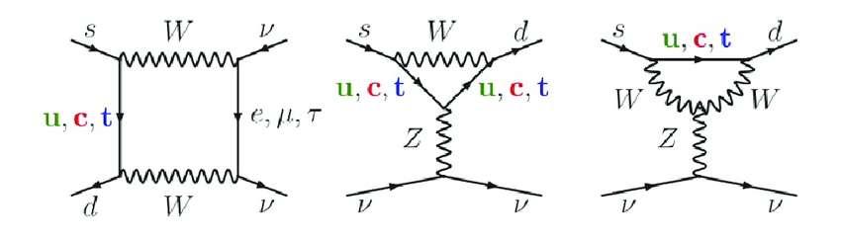



The “golden mode” $K^{+}→π^{+}ν\overline{ν}$
$K^{+}\left(u\overline{s}\right)→π^{+}\left(u\overline{d}\right)+ν+\overline{ν}$
Highly suppressed: GIM mechanism & CKM suppression of $t→d$
NA62’s goal $→$ Measure $𝔅\left(K^{+}→π^{+}ν\overline{ν}\right)$
Notes:
You will find these diagrams. You need to turn them around (draw)
The keen eyed will notice the penguin diagram! – this is where the collaboration gets its logo!
Highly suppressed
GIM – sign difference = interference of u & c
CKM – top to down very small
Why 10%???

Slide 3
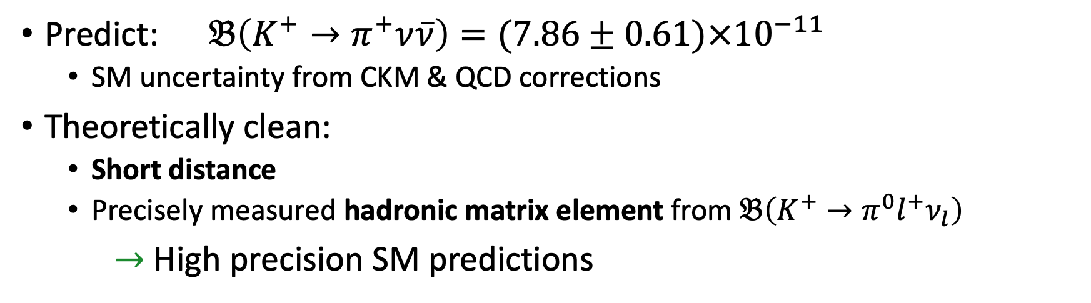
The “golden mode” $K^{+}→π^{+}ν\overline{ν}$
Predict: $𝔅\left(K^{+}→π^{+}ν\overline{ν}\right)=(7.86±0.61)×{10}^{−11}$
  SM uncertainty from CKM & QCD corrections
Theoretically clean:
  Short distance
  Precisely measured hadronic matrix element from $𝔅\left(K^{+}→π^{0}l^{+}ν_{l}\right)$
$→$ High precision SM predictions
Notes:
Very rare!
Clean theoretical = precisely predicted as dominated by short distance contributions so the theoretical scales factories nicely (not sensitice to virtual non-PT QCD effects ☺)
- The hadronic matrix element comes from well measured kaon decays via isospin rotation
Charged mode and neutral mode (both 10^-11)– flavour changing neutral current. GIM & CKM suppression.
Good theoretical prediction to better than 10%.

Slide 4
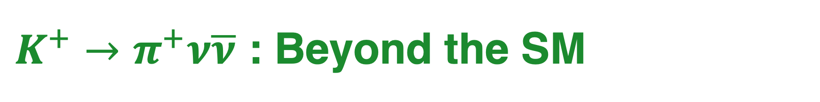
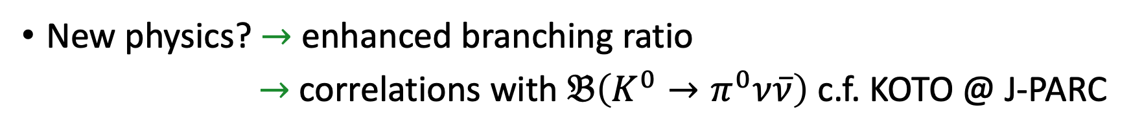
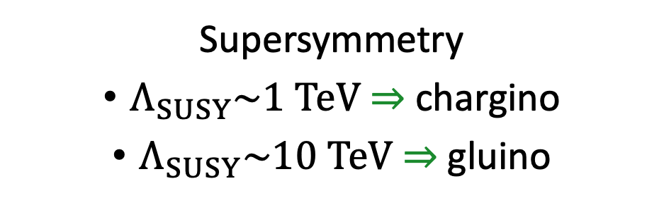
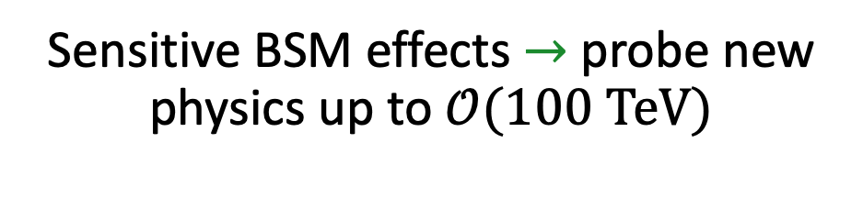
$K^{+}→π^{+}ν\overline{ν}$ : Beyond the SM
Z’ Bosons
Leptoquarks
Sensitive BSM effects $→$ probe new physics up to $𝒪(100 TeV)$
Supersymmetry
$Λ_{SUSY}\sim 1 TeV$ $⇒$ chargino
$Λ_{SUSY}\sim 10 TeV$ $⇒$ gluino
[Insert favourite BSM model here…]
New physics? $→$ enhanced branching ratio
$→$ correlations with $𝔅\left(K^{0}→π^{0}ν\overline{ν}\right)$ c.f. KOTO @ J-PARC
Leptoquarks
Notes:
Test for BSM testing. Very significant enhancement of these branching ratios (40-50%) OR correlation between the branching ratios of K_L and neutral mode.
Blue = Z’ gives very strong correlation.
Grossman-Nir bound = model independent relation, if this is broken the SM must be wrong.

Slide 5
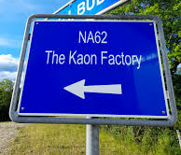
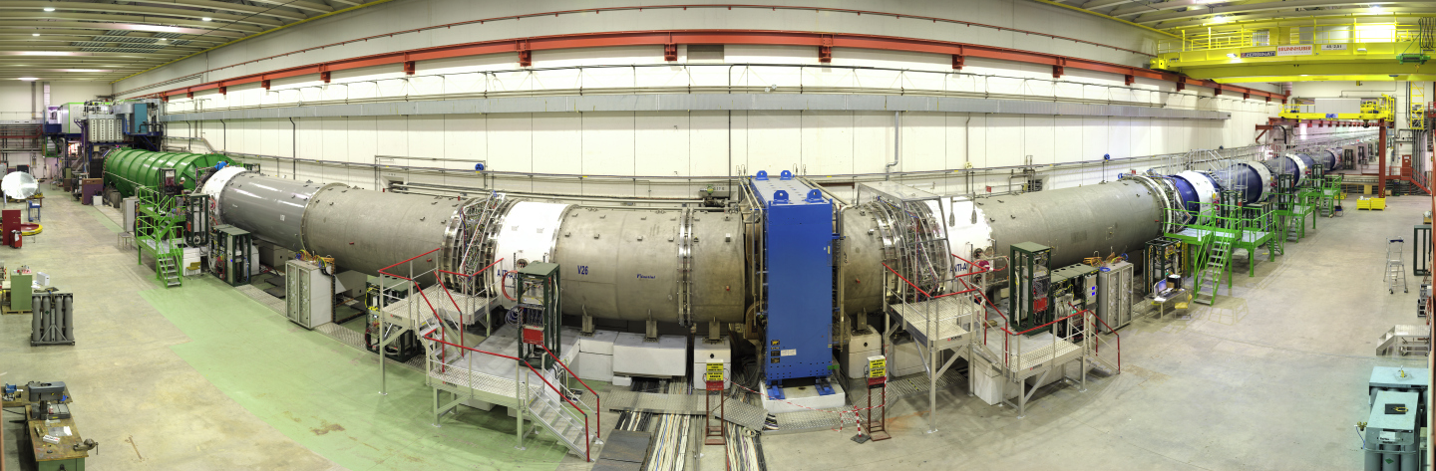
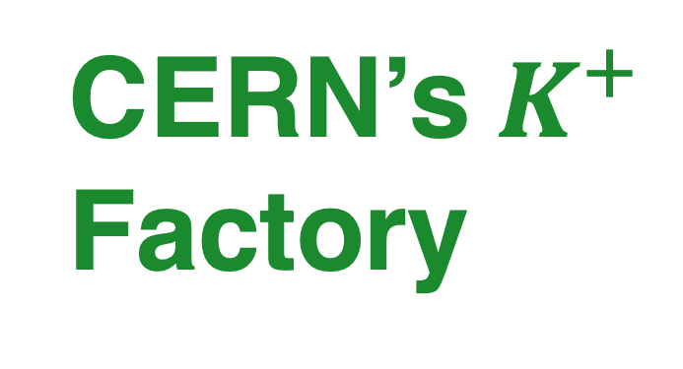
NA62
CERN’s $K^{+}$ Factory

Slide 6
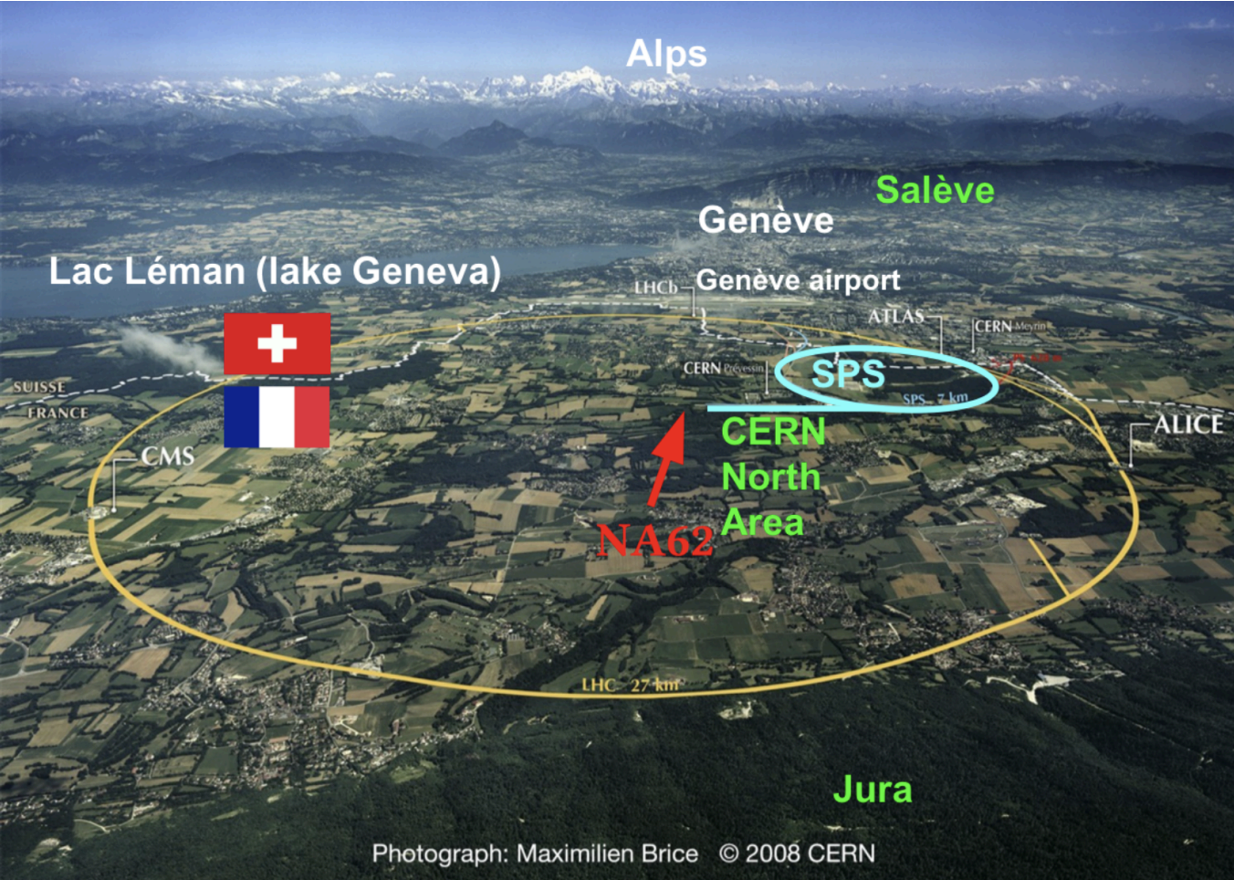
The NA62 Experiment
Fixed target experiment
  Produce & measure kaons!
2016-2018 & 2021-2022 data taking
Designed to study:
  Lepton Number Violating decays
  Lepton Flavour Violating decays
  Exotics
  Rare decays
Notes:
Based at centre of CERN ring (CERN NORTH AREA), takes 400GeV beam of an extraction line from CERN SPS onto Beryllium target = 6% kaons! (secondary beam?)
Other physics:
Lepton Number Violation (LNV) and Lepton Flavor Violation (LFV) Decays
Exotics dark photon
Rare decays, not just k to pi nunu but also K+ → π+γγ
Other physics includes rare K+ decays & exotics
Main data taking in 2016-2018
This paper is the 2021-2022 data

Slide 7
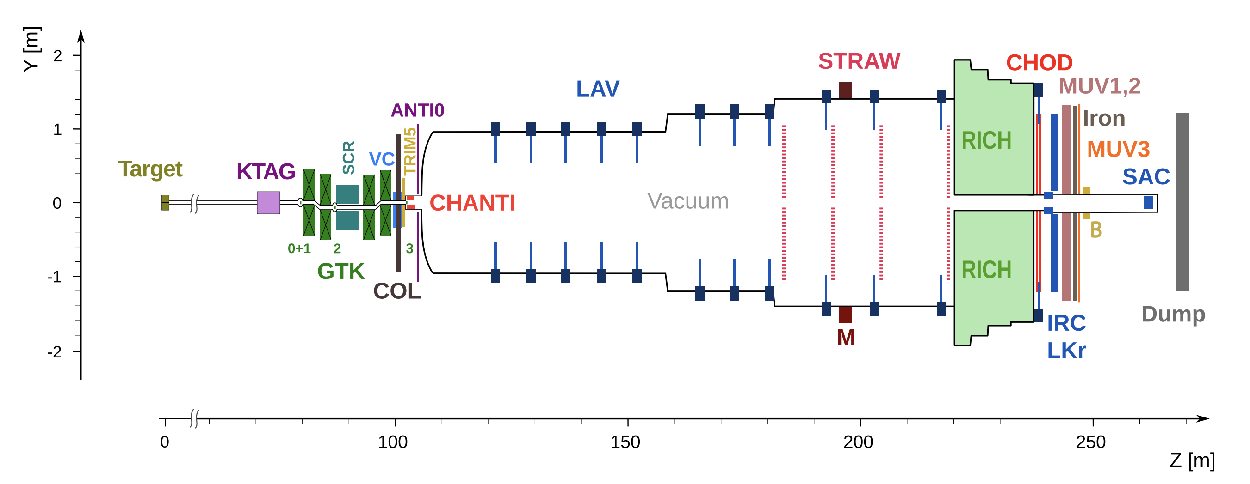
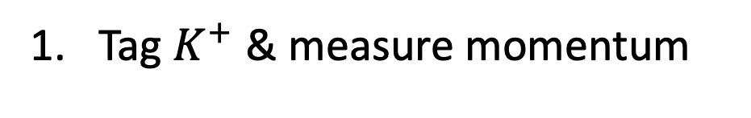
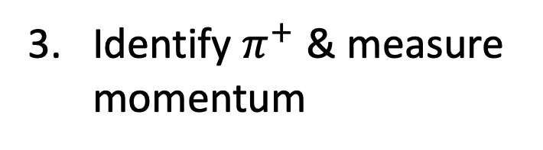
Experimental Strategy
Use kinematics & particle ID to filter out backgrounds
Tag $K^{+}$ & measure momentum
Identify $π^{+}$ & measure momentum
Kaons decay
Match $K^{+}$ and $π^{+}$ in time & reconstruct vertex
Notes:
Detect kaon + pion & match them together. You need 100ps time resolution to match them in time.
Need to suppress backgrounds to mu nu, pi+pi0, etc. by ~10 orders of magnitude (since they have such large branching ratios) = KINEMATICS
Kinemtaics alone suppresses these 4 orders of magnitude. You then need particle ID to get the last few orders of magnitude (RICH detector)

Slide 8

Experimental Design
Further particle ID & photon detection
Magnetic spectrometer
Collimator & Veto Counter
$400GeV$ $p$ beam
Ring Imaging Cherenkov detector
Kaon tagger
(Cherenkov)
Measure kaon momentum
Vacuum tank
Notes:
These kaons are tagged w/ Threshold Cherenkov kaon tagger
Measure the momentum and direction of the beam particles with BEAM SPECTROMETER = hybrid silicon detector
Collimator - absorbs hadrons which are produced in upstream K+ decays and not contained in the beam pipe.
Veto Counter = scintillator – installed in 2021 for the second run to detect particles produced in upstream K+ decays
Vacuum tank – 65m long. 11% of K+ decay in this length. -> long and thin experiment because kaons have a long lifetime.
LAV – photon vetos
AFTER THE DECAYS:
Magnetic spectrometer – 4 straw chambers and 0.9Tm dipole magnet
RICH – measures charge particle times and allows PID
Then LKr – liquid krypton electromagnetic calorimter for photon detection also PID
MUV – to help distinguish pions and muons.
KEY: Lots of vitos e.g. large angle vito (photons), and a calorimeter at the end.
- Photon vetos important for detecting pi0 decay to two photons and also K+-> mu nu gamma

Slide 9
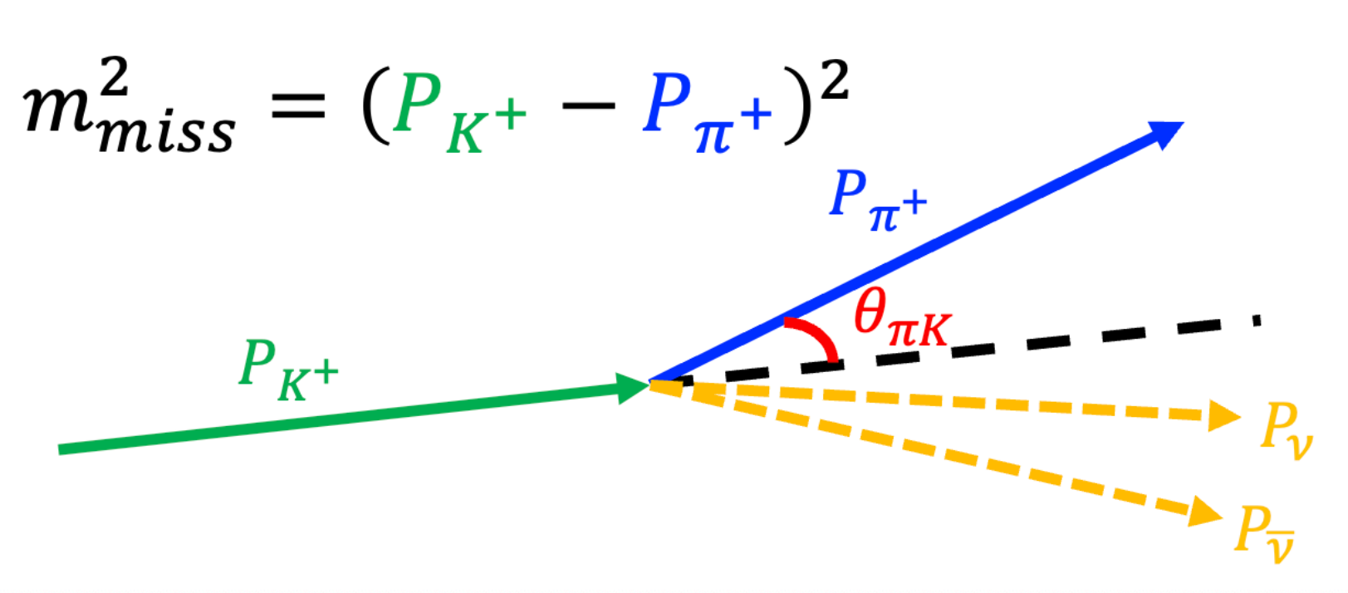


Control & Signal Regions
Construct $m_{miss}^{2}={\left(P_{K^{+}}−P_{π^{+}}\right)}^{2}$
Background regions $→$ reference for estimates
Control Regions $→$ validate estimates
Region 1 & 2 $→$ signal
Notes:
Use the squared missing mass (squared difference of kaon and pion momenta)
Data-driven estimation of backgrounds!
Background regions: Used as “reference samples” for some background NA62 estimates.
Control regions: Used to validate background predictions.
Signal regions – simply need to count the events in these regions
Control regions next to the background region – we estimate the fraction of events that spill out of the background region and into the neighbouring control & signal regions.= MC simulations
-> Non-gaussian tails makes this a complicated task, hence the need for validation.
Curvature since mis identify muon as a pion.
PID gets us the extra 6 orders of magnitude of suppression of backgrounds!

Slide 10

2021-2022 Data
Signal regions
Expected SM signal
  $N_{πν\overline{ν}}^{SM}≈10$
Expected background
  $N_{bg}={11.0}_{−1.9}^{+2.1}$
Observed
  $N_{obs}=31$
Measured branching ratio
  $𝔅_{2021−2022}\left(K^{+}→π^{+}ν\overline{ν}\right)=\left({16.0}_{−4.5}^{+5.0}\right)×{10}^{−11}$
Notes:
We need to check the control regions -> we see nice agreements across the board.
About 10 expected events.
31 events slightly more than the 20 bg+SM expected.
Goal = measure the branching ratio => profile likelihood ratio test statstic. => The uncertainty is about 35%

Slide 11
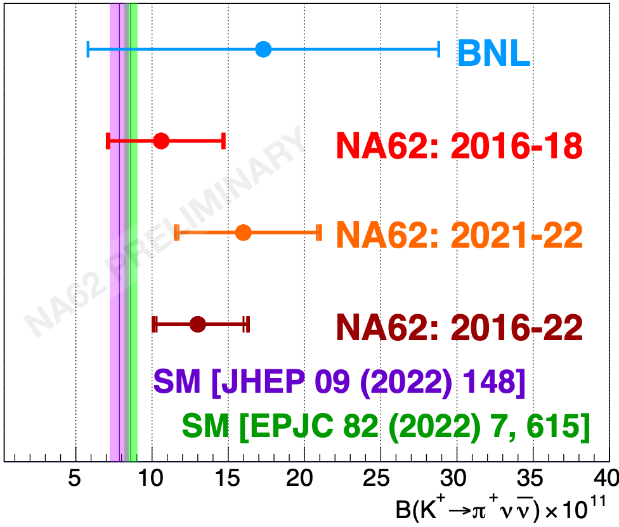

Conclusions & Future
Combination with 2016-2018 data:
The smallest branching ratio measured with a significance $>5σ$
BR consistent with SM within $1.7σ$
An exciting time for kaon physics c.f. KOTO, LHCb
  $𝔅_{2016−2022}\left(K^{+}→π^{+}ν\overline{ν}\right)=\left({13.0}_{−2.9}^{+3.3}\right)×{10}^{−11}$
2023—Long Shutdown 3 data-set collection & analysis in progress…
Notes:
Data also taken in 2016-2018 = uncertainty reducs from 35% to 25%!
THE SMALLEST BRANCHING RATIO that has been Observation
Furthur data taking = aim to get down to 10% to match the theory predictions!
Data taking ends 2026. NA62 will be the last dedicated K experiment for the forseeable future – need to exploit the data.
They are building the Beam Dump Facility/SHiP
KOTO @JPARC, and LHCb - It is certainly an exciting time for kaon physics!
Explain plot in a few more seconds.

