Slide 1
Predicting the death of stars
Speaker: Titanilla Braun
11 March 2025, Graduate Symposium
L. N. Machado et al 2022 ApJ 935 40
Notes:
Hi everyone, my name is Titanilla Braun and
this short talk is about how we can predict the death of stars.
Or more clearly,
I will be talking about a paper from 2022,
that describes a pre-supernova alert system for the Super-Kamiokande experiment.

Slide 2
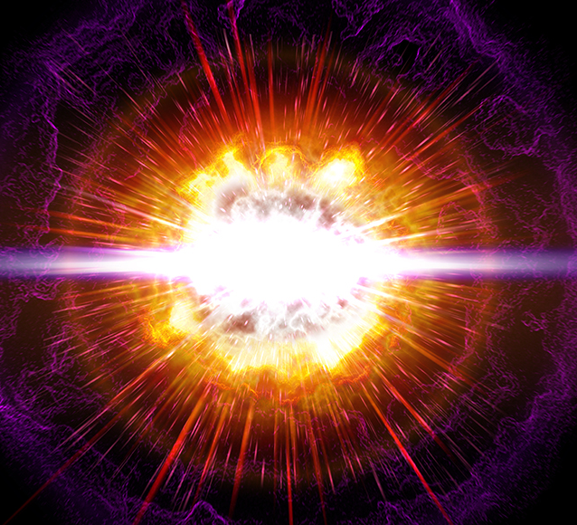
Can we know before it happens?
How rare are supernovae?
→ 2-3 /century in the Galaxy
Observed via sudden increase in brightness
How can we know ahead of time?
https://i0.wp.com/www.sciencenews.org/wp-content/uploads/2020/04/041520_mt_supernova_feat.jpg?w=1030&ssl=1
Notes:
I think we all have an idea about what a supernova is.
When a massive star that has at least 8 times the mass of our Sun reaches the end of its life, it explodes after running out of fuel.
But do we know how rare these events are?
Actually, quite rare in human terms, only a couple happens in a galaxy like ours every century.
They are observed by a sudden significant change in the brightness of the star.
But if we knew ahead of time, then we could monitor these stars in their final hours, learning more about this part of their evolution.
So how can we know when it will happen?
→ The answer is of course neutrinos

Slide 3

Can we know before it happens?
How rare are supernovae?
→ 2-3 /century in the Galaxy
Observed via sudden increase in brightness
How can we know ahead of time?
https://i0.wp.com/www.sciencenews.org/wp-content/uploads/2020/04/041520_mt_supernova_feat.jpg?w=1030&ssl=1
Notes:
I think we all have an idea about what a supernova is.
When a massive star that has at least 8 times the mass of our Sun reaches the end of its life, it explodes after running out of fuel.
But do we know how rare these events are?
Actually, quite rare in human terms, only a couple happens in a galaxy like ours every century.
They are observed by a sudden significant change in the brightness of the star.
But if we knew ahead of time, then we could monitor these stars in their final moments, learning more about this part of their evolution.
So how can we know when it will happen?
→ The answer is of course neutrinos

Slide 4
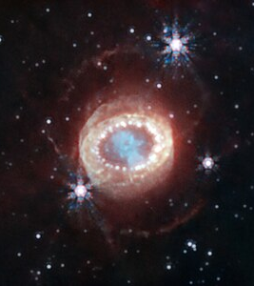
SN 1987A
1987 February 23
In the Large Magellanic Cloud
Detected via visible light
Recorded data → neutrinos arrived hours earlier! (25 in 13 seconds)
1st observation of supernova neutrinos
https://en.wikipedia.org/wiki/File:SN_1987A_(NIRCam_image)_(SN1987a-1).jpg (ESA/Webb)
Notes:
I would like to talk about a specific supernova that happened in 1987 in the Large Magellanic Cloud.
It was detected by the sudden change in its brightness,
However, it turns out that about 2-3 hours before the visible light reached us,
a burst of neutrinos were detected at 3 different neutrino observatories around the world.
Kamiokande II in Japan detected 12,
IMB in the US saw 8,
and Baksan in the USSR 5.
In total 25 neutrinos were detected within a burst lasting less than 13 seconds.
These numbers were significantly above the background level of these experiments.
This neutrino emission happened simultaneously with core collapse, but before visible light was emitted.
Hence, it became the first observation of supernova neutrinos and marks the beginning of neutrino astronomy.
Observatories:
12 detected by Kamiokande II (Japan)
8 by IMB (Irvine-Michigan-Brookhaven (USA))
5 by Baksan (Baksan Neutrino Observatory (USSR))
Image (Just for interest)
The NASA/ESA/CSA James Webb Space Telescope has begun the study of one of the most renowned supernovae, SN 1987A (Supernova 1987A). Located 168,000 light-years away in the Large Magellanic Cloud, SN 1987A has been a target of intense observations at wavelengths ranging from gamma rays to radio for nearly 40 years, since its discovery in February of 1987. New observations by Webb’s NIRCam (Near-Infrared Camera) provide a crucial clue to our understanding of how a supernova develops over time to shape its remnant. This image reveals a central structure like a keyhole. This centre is packed with clumpy gas and dust ejected by the supernova explosion. The dust is so dense that even near-infrared light that Webb detects can’t penetrate it, shaping the dark “hole” in the keyhole .A bright, equatorial ring surrounds the inner keyhole, forming a band around the waist that connects two faint arms of hourglass-shaped outer rings. The equatorial ring, formed from material ejected tens of thousands of years before the supernova explosion, contains bright hot spots, which appeared as the supernova’s shock wave hit the ring. Now spots are found even exterior to the ring, with diffuse emission surrounding it. These are the locations of supernova shocks hitting more exterior material. In this image blue represents light at 1.5 microns (F150W), cyan 1.64 and 2.0 microns (F164N, F200W), yellow 3.23 microns (F323N), orange 4.05 microns (F405N), and red 4.44 microns (F444W).

Slide 5
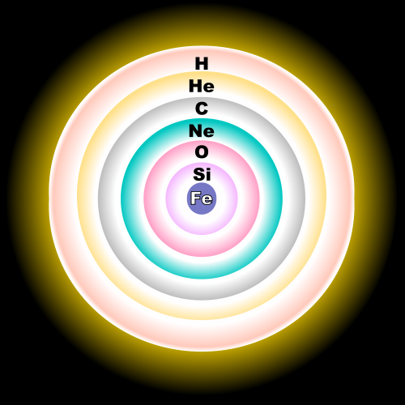
Pre-supernova stars
Very massive stars
Close to core-collapse
Nuclear fusion of heavy nuclei
Cooling mechanism: neutrino emission
Notes:
USE THE POINTER OR A STICK!!
So, let’s talk about pre-supernova stars.
We have this very massive star that is getting closer and closer to core collapse,
And it is supported by the fusion of heavier and heavier elements.
After Hydrogen → we have Helium → Carbon → Oxygen → Neon → Silicon → Iron
From the ignition of Carbon, the star’s main cooling mechanism is neutrino emission.
A neutrino cooled star will last hundreds of years until it reaches the last phase, the silicon burning phase.
NEXT SLIDE!!

Slide 6
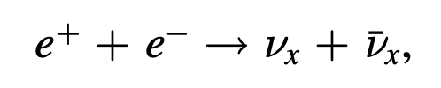
Pre-supernova stars
Last phase: silicon burning
Pre-supernova star (few days!)
Electron-positron annihilation
→ thermal neutrinos
Some exceed (IBD) threshold energy → can be detected by SK
Notes:
In this phase, an iron core is forming which will trigger the collapse.
It is now called a PRE-SUPERNOVA STAR, and it now only has a few days to live.
The dominant form of cooling is through electron-positron annihilation which produces thermal neutrinos.
Pairs of neutrinos and anti-neutrinos of all flavours are produced during this phase.
Some of these can exceed the threshold energy for an inverse beta decay interaction inside the Super-Kamiokande detector,
and therefore, they can be observed.

Slide 7
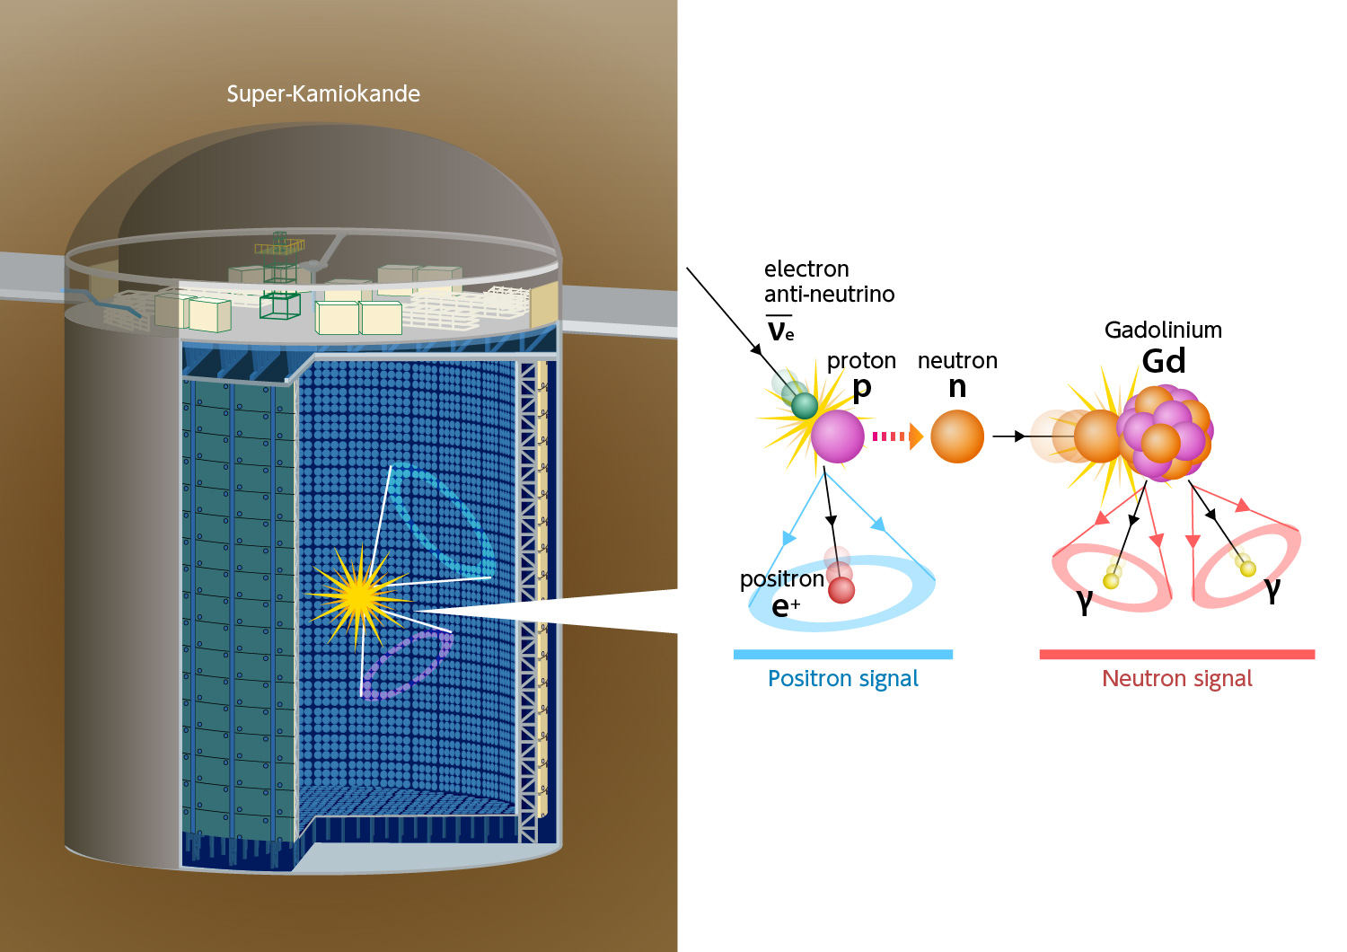
Super-Kamiokande experiment
Cherenkov neutrino detector (Japan)
SK-Gd phase: Gadolinium sulfate octahydrate (2020)
→ Increased identification of IBD neutrinos
https://www-sk.icrr.u-tokyo.ac.jp/en/wp-content/uploads/sites/2/2022/06/sk-gd-03-en.jpg
Notes:
Now we should talk about the detector itself.
The Super-Kamiokande Experiment is a 50 kiloton water Cherenkov detector located in the Kamioka mine in Japan
It was built to study neutrinos with energies from a few MeVs to a few 100s of GeVs.
In 2020, Gadolinium was added to the water to increase the sensitivity to low energy electron anti-neutrinos which interact with the detector through inverse beta decay.
On this figure we can see the detector and the interaction we are interested in.
INVERSE BETA DECAY (IBD)
Is the main interaction channel for low energy electron anti-neutrinos
An incoming electron anti-neutrino interacts with a proton (to produce a positron and a neutron)
In its final state
Prompt positron → directly detected through Cherenkov radiation
Delayed neutron
→ travels a short distance before being thermalized in water
→ captured by Gadolinium,
(Gadolinium) which has the largest thermal neutron capture cross section among the naturally occurring elements
(Gadolinium) and easily dissolved in water while staying transparent to Cherenkov radiation
→ these nuclei de-excite by emitting y-rays
→ (these photons create Compton scattered electrons which produce Cherenkov light)
Search for IBD events is characterized by the coincidence between the two signals: these prompt positrons and the delayed neutrons
Reconstruction is possible since it is unlikely that uncorrelated events produce the same pattern

Slide 8


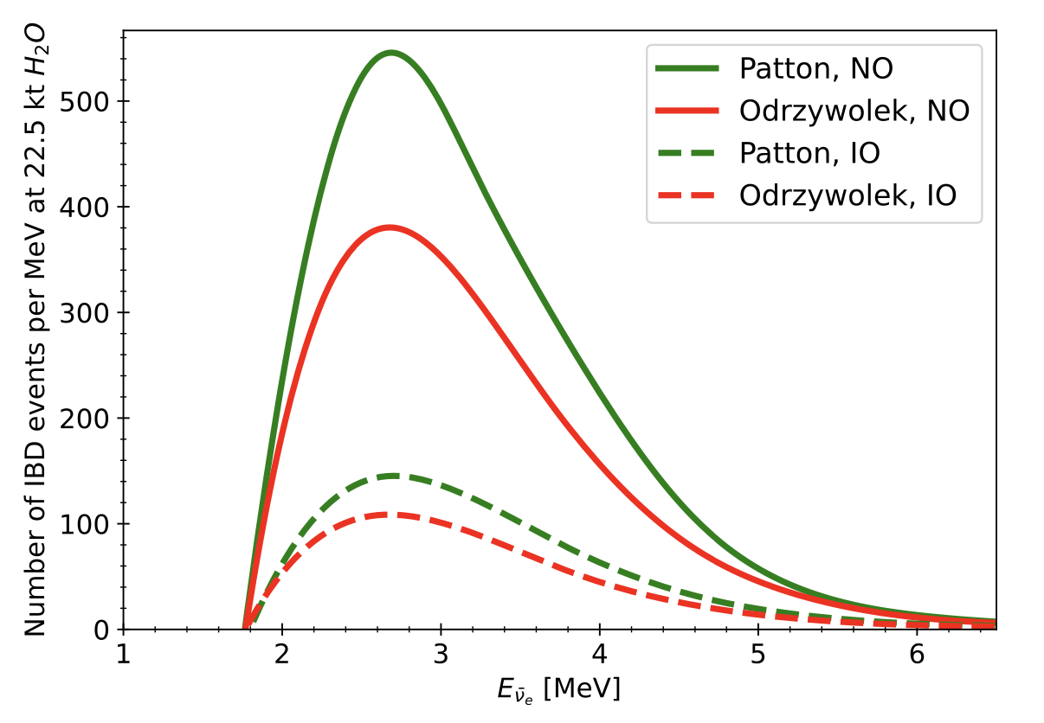
Expected number of IBD events
10 hr prior to the CCSN
Betelgeuse-like star (15 solar masses, 150 pc away)
Normal and inverted mass ordering
Notes:
This plot shows the expected number of IBD events happening in the analysis volume
integrated over a 10 hr period before the CCSN
wrt. the energy of the incoming electron anti-neutrino.
These are correct for a Betelgeuse-like star. (CLICK!! “in case anyone has seen the film ☺ ”)
Since currently Betelgeuse is the best candidate for detecting pre-supernova neutrinos.
Two models were used to describe the thermodynamics of stellar evolution:
Odrzywolek’s [ODDZIVOLEK], which assumes that the entire neutrino flux comes from pair annihilation
Patton: includes other thermal and nuclear processes
We have them both for normal and inverted mass ordering
The energy threshold is a few MeVs, so the events we observe are actually
On the right side of this distribution, mostly in the tail.

Slide 9
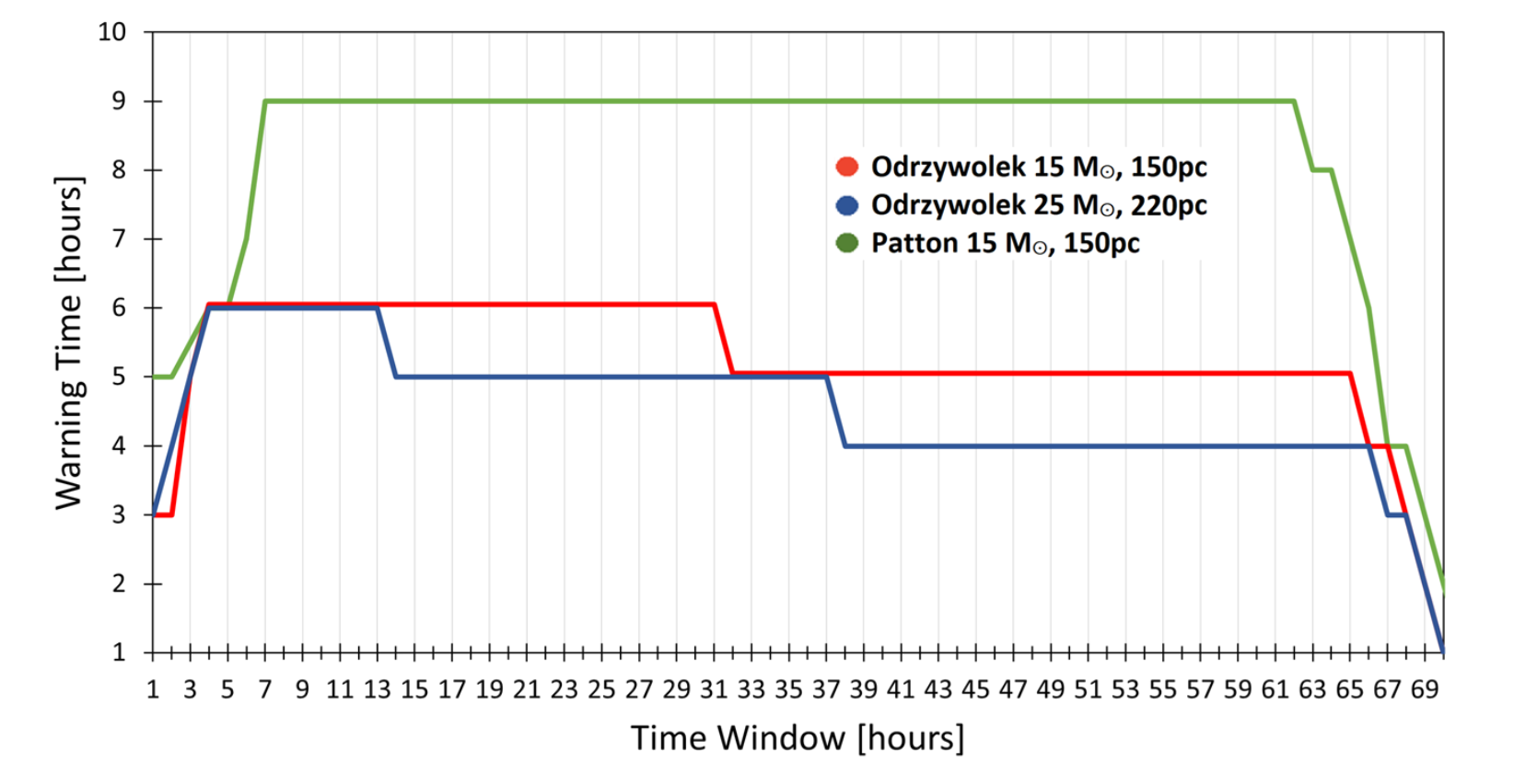
signal window for statistical analysis
→ choosing signal window for statistical analysis (8hr)
Notes:
Considering backgrounds and expected events a statistics analysis window needed to be chosen.
On this plot you can see how this analysis signal window (on x axis) affects the possible warning times (on y axis) for the models.
So, we have Ordzywolek model with two sets of parameters for Betelgeuse (distance, mass), and the Patton model for one set of parameters.
This analysis window is the time period during which the data was collected to then be analyzed in hourly steps.
And the warning time is how many hours before core collapse the alert-system can give out an alert about the supernova.
This choice was made based on which signal window would maximize the warning time for a Betelggeuse-like star according to the different models.
→ At the end 8hrs were chosen

Slide 10
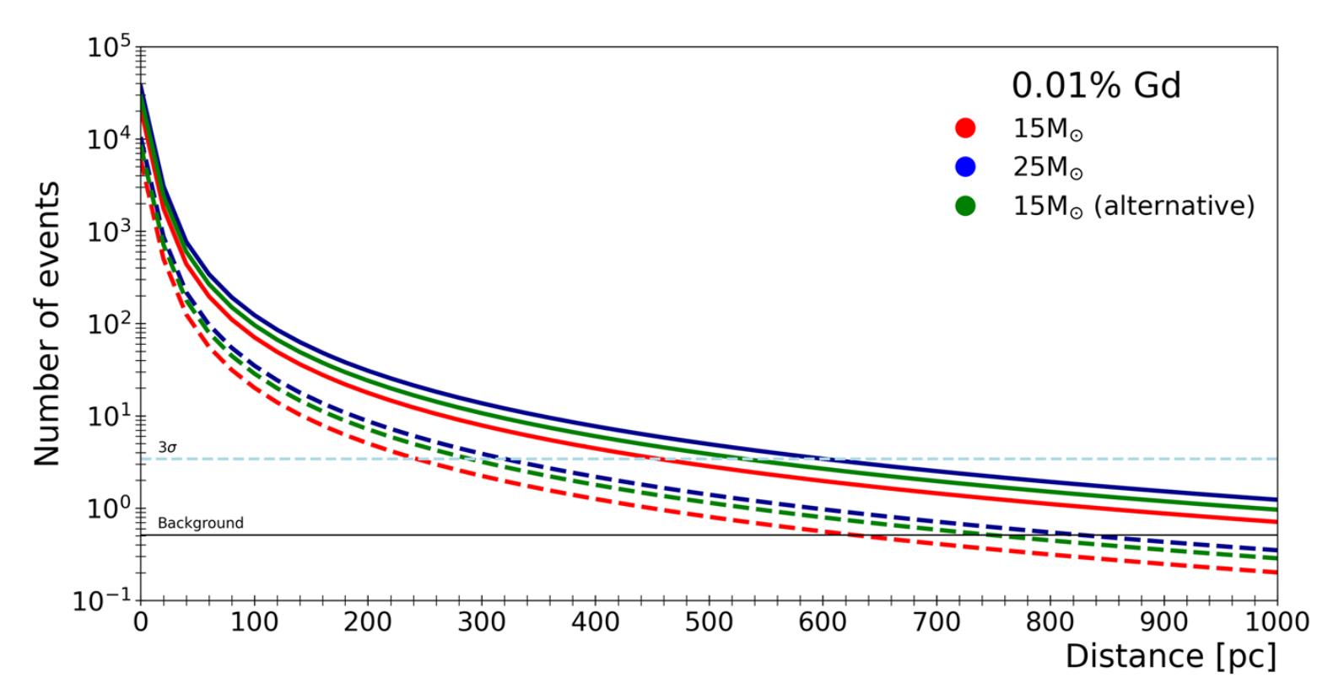
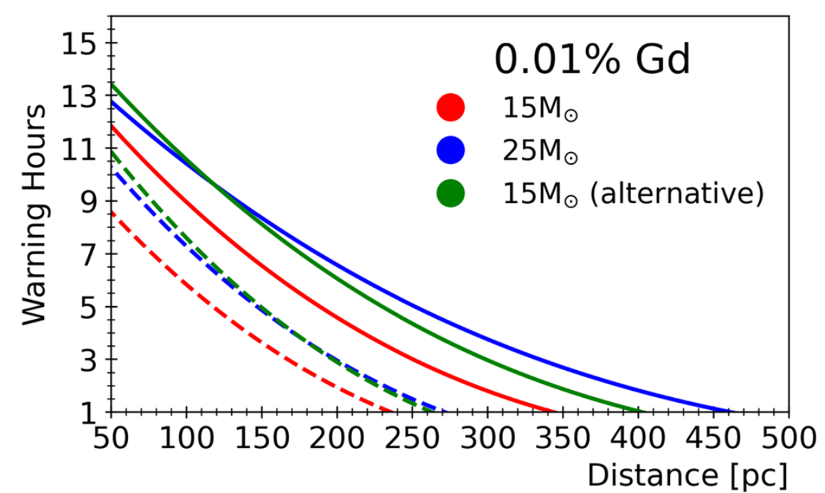
Results (1st phase)
600 pc neutrino detection radius
Betelgeuse alert: 9 hr
First phase
First phase
Flux integrated over 8 hrs before the core collapse
Notes:
Here you can see the results for the first gadolinium phase,
where the gadolinium content is 0.01% inside the detector.
On the left plot, the number of events (so the flux) is shown
integrated over 8hrs before the collapse
And wrt. the distance to the star
→This shows that the neutrino detection radius can reach a distance of about 600 pcs
(CLICK!!)
On the right plot you can see the possible warning hours
wrt. the distance to the star.
→In the optimistic scenario this can reach about 9 hrs for Betelgeuse (CLICK!!)
The 1st phase started in 2020,
in the current phase the gadolinium content is 0.03%
And in the final phase, the content will be 0.1%

Slide 11
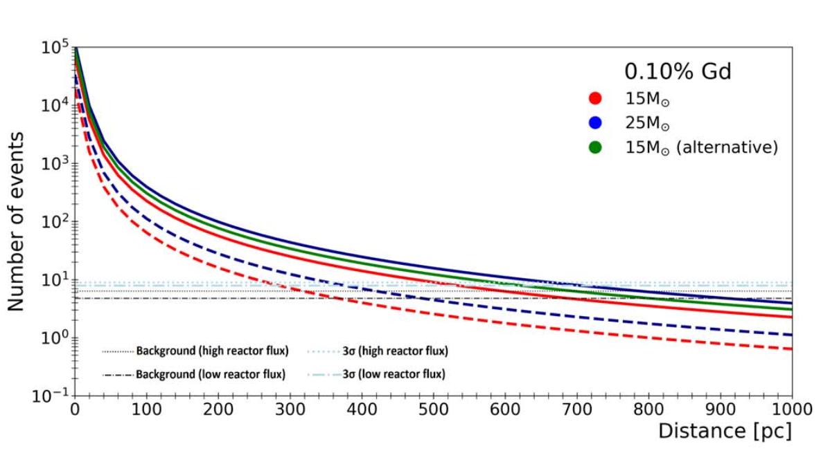
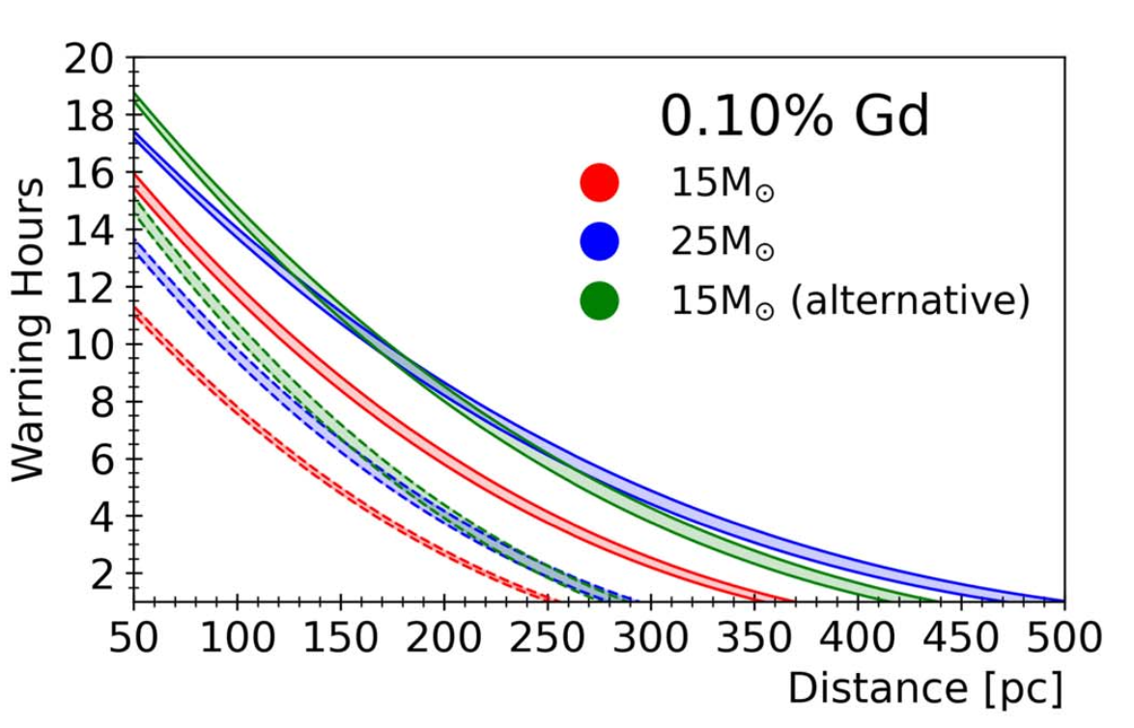
Results (Final phase)
700 pc neutrino detection radius
Betelgeuse alert: 11 hr
Final phase
Final phase
Flux integrated over 8 hrs before the core collapse
Notes:
You can see these final phase results here.
The neutrino detection radius can go up to 700 pcs
And the warning time for a Betelgeuse-like star could be about 11 hrs.
→Which I believe is quite powerful!! (CLICK!!)
And just something worth mentioning:
These results are from a 2022,
Recently a paper came out in 2024
Which describes this alert system combined between Super-K and KamLand
(which is another experiment in the Kamioka mine in Japan)
This combined system has even better results,
the possible warning time reaching 12-13 hours.

Slide 12
What can we achieve?
Pre-supernova alert system (active since 2021 October)
Potential 1st detection of pre-supernova neutrinos
Solve the issue of neutrino mass hierarchy
Notes:
So, all in all, what can we achieve?
A pre-supernova alert system
Which is actually already active since 2021
We could achieve a potential 1st detection of
Pre-supernova neutrinos
And with the data, we could decide which neutrino mass ordering is correct.

Slide 13
Thank you for your attention!

Slide 14
BACKUP Slides

Slide 15
Backgrounds
Reactor & geo electron anti-neutrinos → irreducible
Radioactive contamination
Accidental coincidences (intrinsic detector backgrounds)
Spallation, due to cosmic ray muons → most can be eliminated
Notes:
Reactor & geo electron anti-neutrinos → irreducible
Mainly from Japanese nuclear power reactor
Geoneutrinos: come from the decay of natural radioisotopes inside the earth
Radioactive contamination
Traces of radioactive isotopes mixed in with the Gadolinium
Accidental coincidences
Radioactive decay from detector materials
PMT dak noise
Uncorrelated events that randomly occure close in time and distance
Spallation
High energy cosmic ray muons interact with the detector
causing nuclear reactions,
produce radioactive isotopes which decay
And mimic the signal from neutrinos
Most of this can be eliminated
Since these events are correlated in time and space with energetic muons
→ So based on all these backgrounds and expected events a statistics analysis window needed to be chosen
Signal window chosen to perform statistical evaluations
Chosen based on which choise would maximize the warning time for a Betelggeuse-like star according to different models

Slide 16
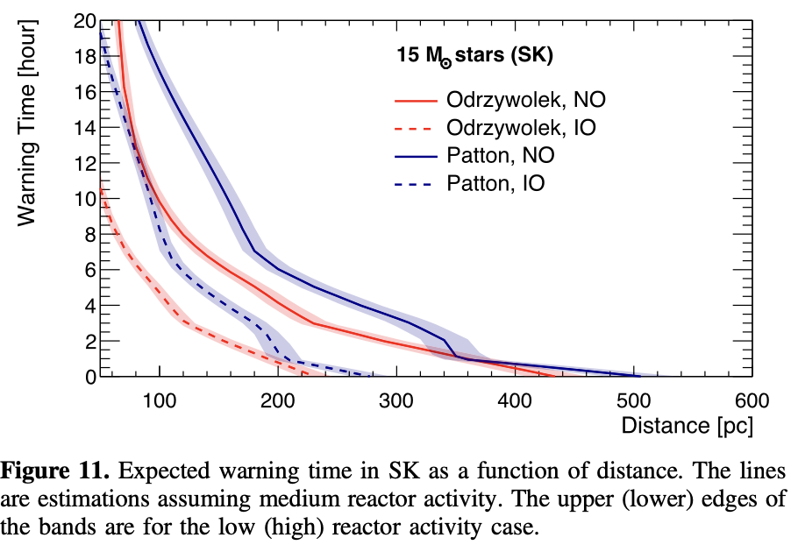
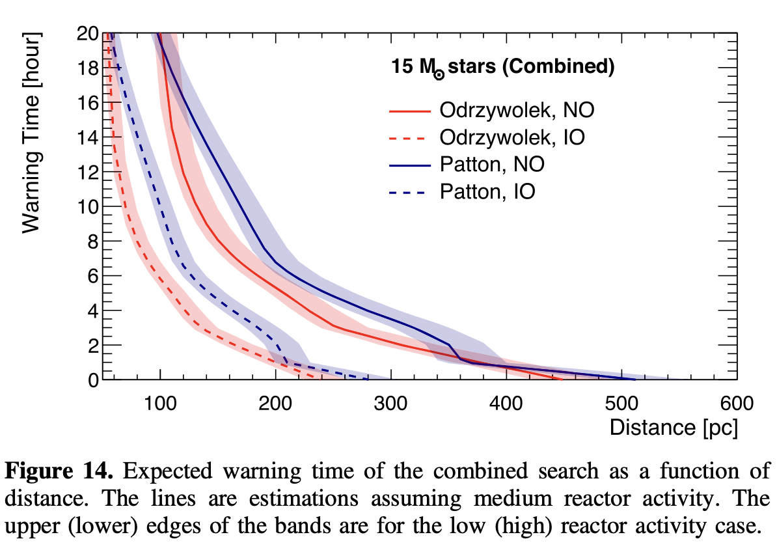
Joint SK and KamLand (2024 paper)

