Slide 1
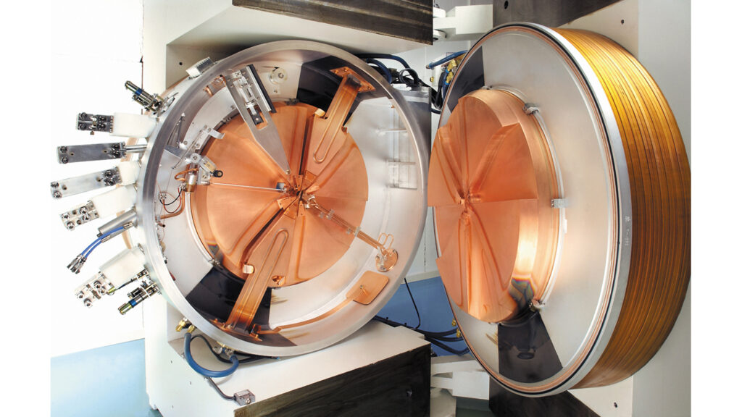
The Hot Box- Radioisotope production
Graduate Symposium
Sabrina Wang
Notes:
cite papers here

Slide 2
Overview
Radioisotope applications:
  Diagnostics
  Radiopharmaceuticals
Reactor-produced radioisotopes
Accelerator-produced radioisotopes

Slide 3
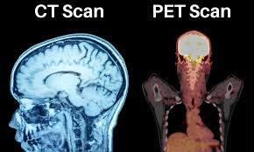
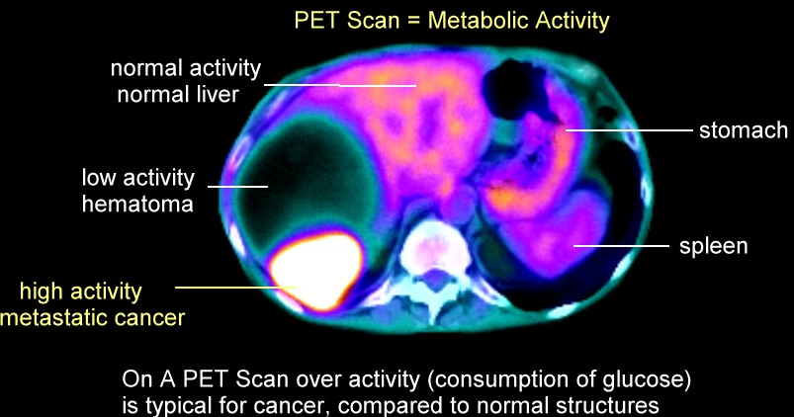
Radioisotopes- Diagnostics
Radiopharmaceutical agents taken orally or by inhalation
Radioisotope taken to site of high metabolism
Reveal metabolic abnormalities (tumours) not detected by CTs etc
Detected using scintillation cameras
Processed into 2d or 3d images
Notes:
medical adnoramlities-- more metabolism picture

Slide 4
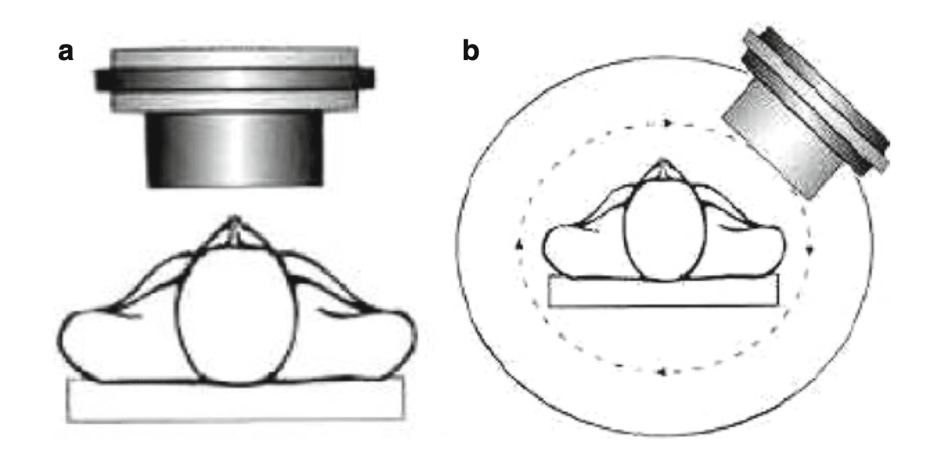
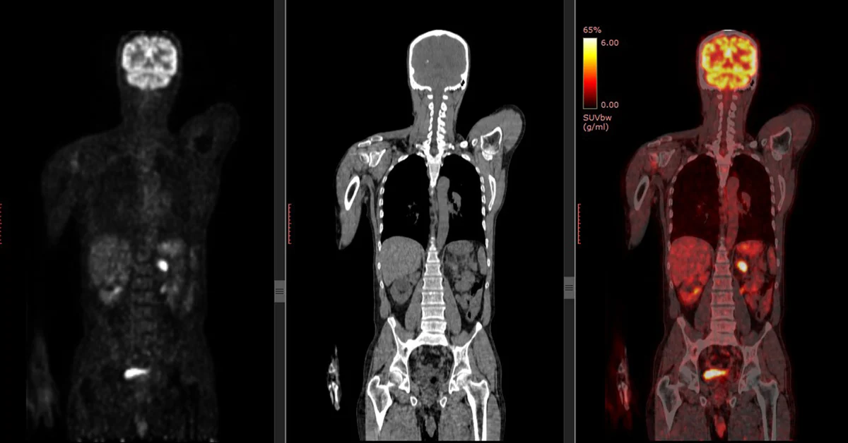
Diagnostics
PET: Detects photons after positron annihilates electron. ¹¹C or ¹⁸F
SPECT (single-photon emission computed tomography) ¹²³I, ^{99m}Tc
Planar scanning rotated in 3d
Hybrid systems such as PET-CT, PET-MRI, and SPECT-CT
Notes:
Iodine-123, technetium-99m, and thallium-201.

Slide 5
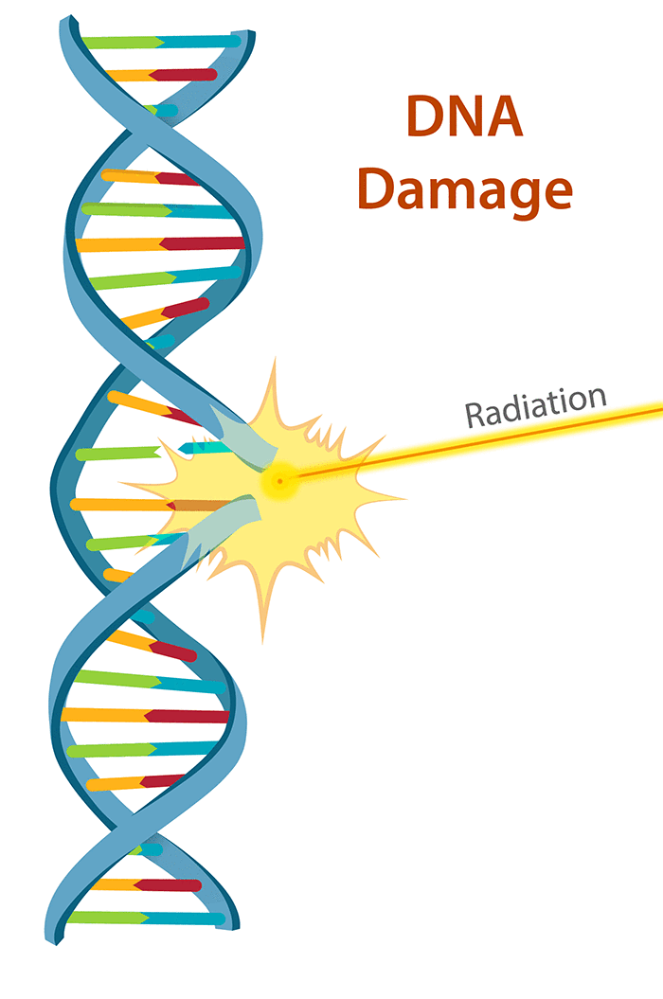
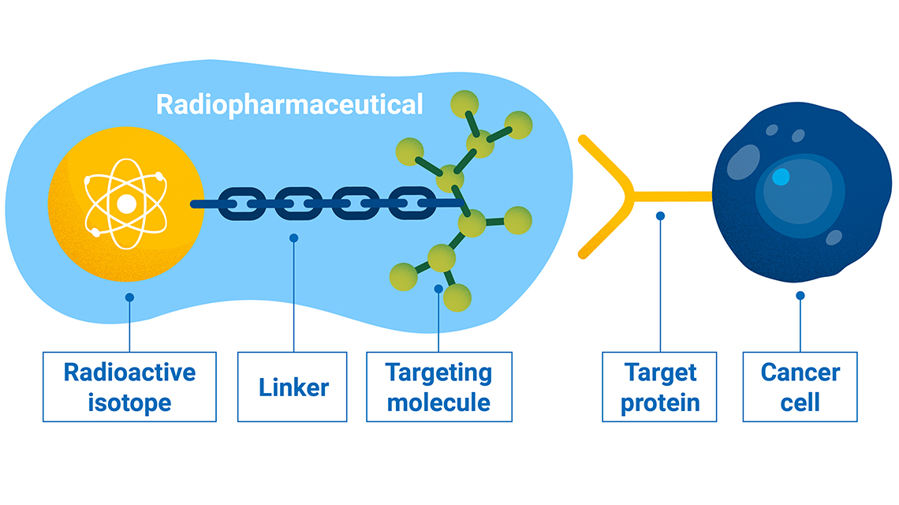
Therapeutic Nuclear Medicine
Treatment of thyroid cancer or bone pain palliation
Radionuclide in ionic form linked to molecule
Deliver high radiation doses to targeted tissues
Other Types
  Alpha radionuclide therapy
  Auger electron-based radionuclide therapy
Notes:
captalisation
cite properly
flip image order
3rd bullet- types
chemicals format properly

Slide 6
Criteria of Medical Radioisotopes
High radioactivity
Half-lives of minutes to hours
Locally produced
Notes:
fill space, font size
large radioactivity

Slide 7
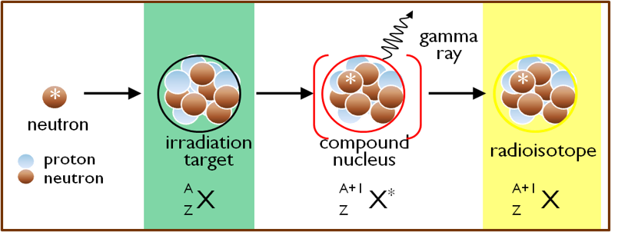
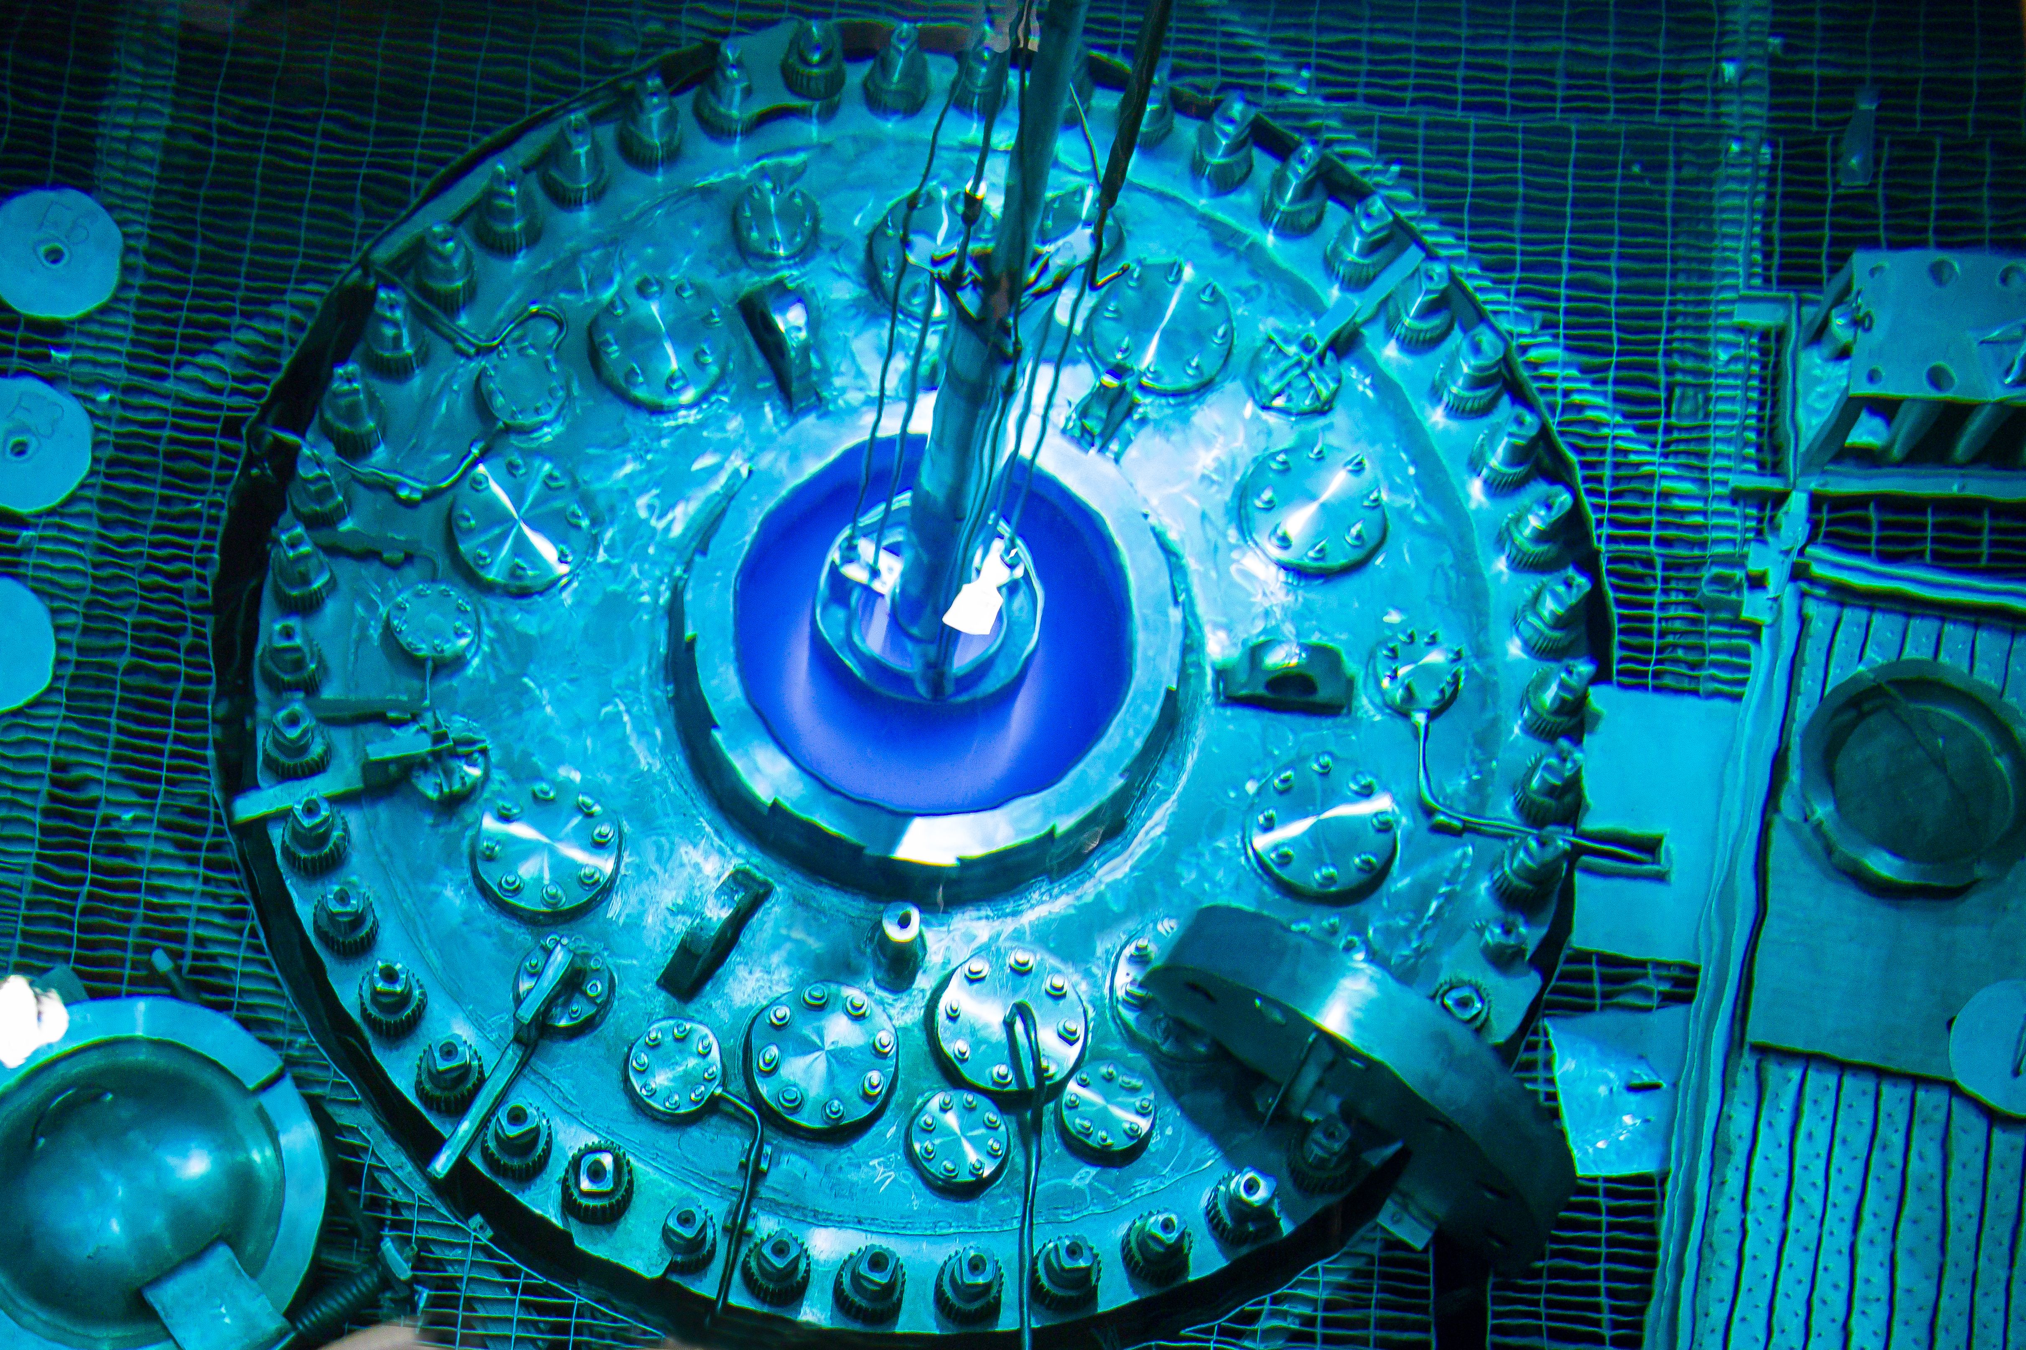
Reactor-Produced Radionuclides
Thermal neutrons from nuclear fuel
  Neutron capture- activation
  Fission reaction
Neutron-rich radioisotopes e.g. ⁹⁹ ^{m}Tc, ⁶⁰Co, ¹⁹²Ir, ¹³¹I, ¹⁶⁶Ho, ¹⁷⁷Lu
Relatively longer half-lives
Notes:
Font
sort bullets

Slide 8
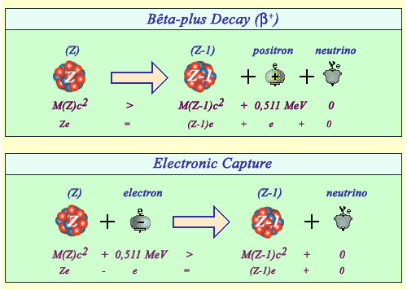
Accelerator-Produced Radionuclides
Proton/deuteron beam
Decay mostly by beta+ emission or electron capture
Proton-rich radioisotopes e.g. ¹¹C ¹⁸F, ¹⁵O, ¹³N
Relatively shorter half-lives, ideal for PET and SPECT
Notes:
condense first 2 bullets
image of how cyclotron works

Slide 9
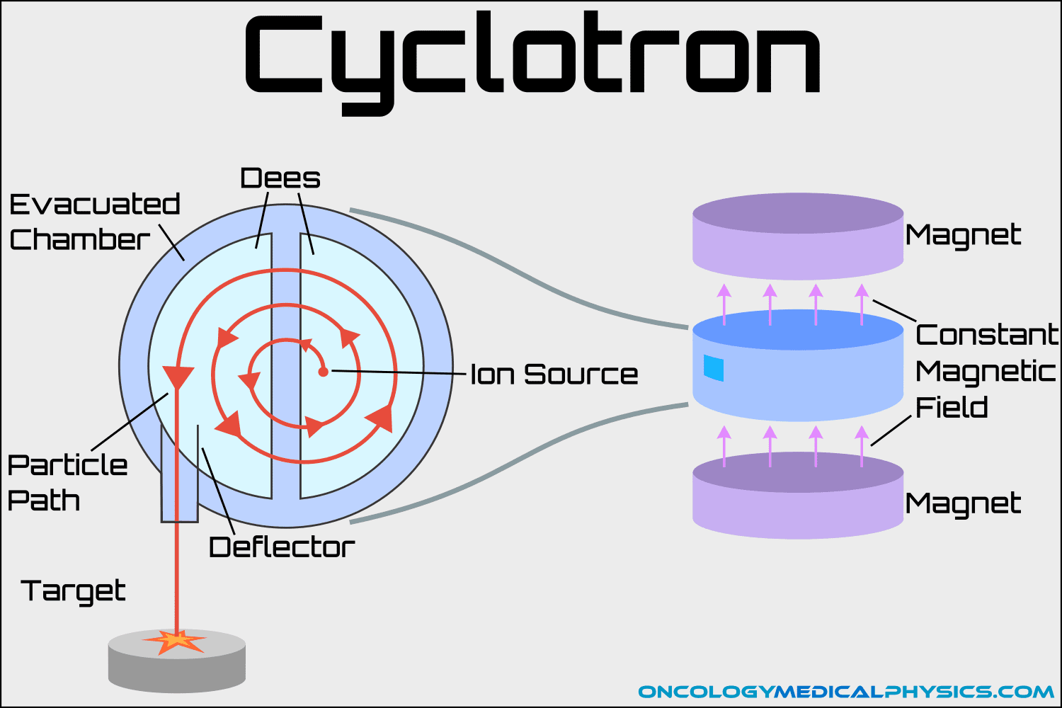

Slide 10
Advantages Comparison
Accelerator Produced | Nuclear Reactor Produced
On-demand, on-site production Ability to produce short-lived isotopes Safer Cheaper operating and decommissioning cost Less radioactive waste Easier separation from reactants | High production yield for certain isotopes More varied isotopes Established technology
Notes:
powered by electricity rather than fission reactions, they generate far less than 10% of the waste of research reactors. Furthermore, accelerator-produced waste is less hazardous than waste produced by a research reactor. Finally, accelerators do not pose a nuclear weapon proliferation risk.

Slide 11
Conclusion
Radioisotopes used in diagnostics and in cancer treatment
Can be reactor-produced (longer lifetime)
Accelerator –produced (local production, shorter lifetime, safer)

Slide 12
References
[1] Commission, C.N.S. (2019) Government of Canada, Canadian Nuclear Safety Commission. Available at: https://www.cnsc-ccsn.gc.ca/eng/resources/radiation/radiation-health-effects/
[2] Knapp, F.F. and Dash, A. (2016) Radiopharmaceuticals for therapy. New Delhi: Springer.
Wang, Y. et al. (2022) ‘Production Review of Accelerator-based medical isotopes’, Molecules, 27(16), p. 5294. doi:10.3390/molecules27165294.
[3] What is an isotope? (2023) Nuclear @ McMaster. Available at: https://nuclear.mcmaster.ca/resources/make-a-radioisotope/
[4] Worldwide medical cyclotron industry is projected to achieve a valuation exceeding US$ 562.4 million (no date) PharmiWeb.com. Available at: https://www.pharmiweb.com/press-release/2023-11-20/worldwide-medical-cyclotron-industry-is-projected-to-achieve-a-valuation-exceeding-us-5624-million

Slide 13
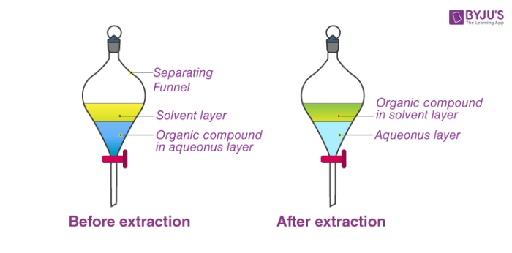
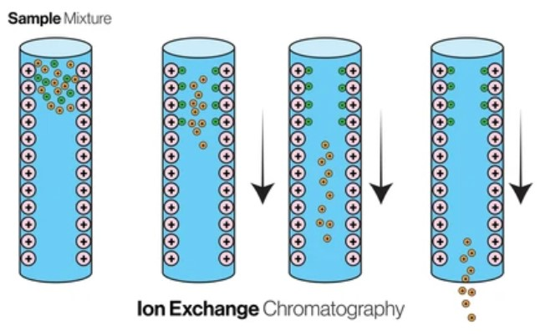
Radioisotope separation
Neutral Carrier Adsorption (NCA)
  Carriers bind to target radioisotopes
  Driven by weak interactions, e.g. Van de Waals
  filtration, centrifugation, or chromatography separation of carrier
  Recovery of radioisotopes
Ion Exchange Column Chromatography
Capture dissolved ions by insoluble support media, uses difference in charge density
Solvent extraction
  Based on difference in solubility
Distillation/Sublimation
  Based on difference in vapor pressure/boiling point
Solid-phase extraction
target radionuclide is adsorbed onto a solid sorbent material
Notes:
Addition of proton changes atomic number (reactors only change neutron number)
cut down slide
other examples... 4 at the right
Solvent extraction
Based on difference in solubility
Distillation/Sublimation
Based on difference in vapor pressure/boiling point
Solid-phase extraction
target radionuclide is adsorbed onto a solid sorbent material
highlight physics
pictures align

