Slide 1
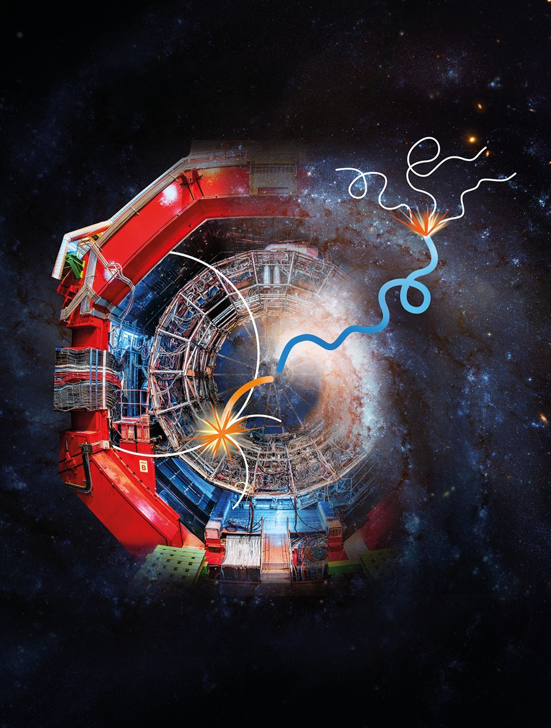
Anti-Nuclei and the speed of darkness
Graduate Symposium 2025
Charlie Wild
11 March 2025
[1]

Slide 2
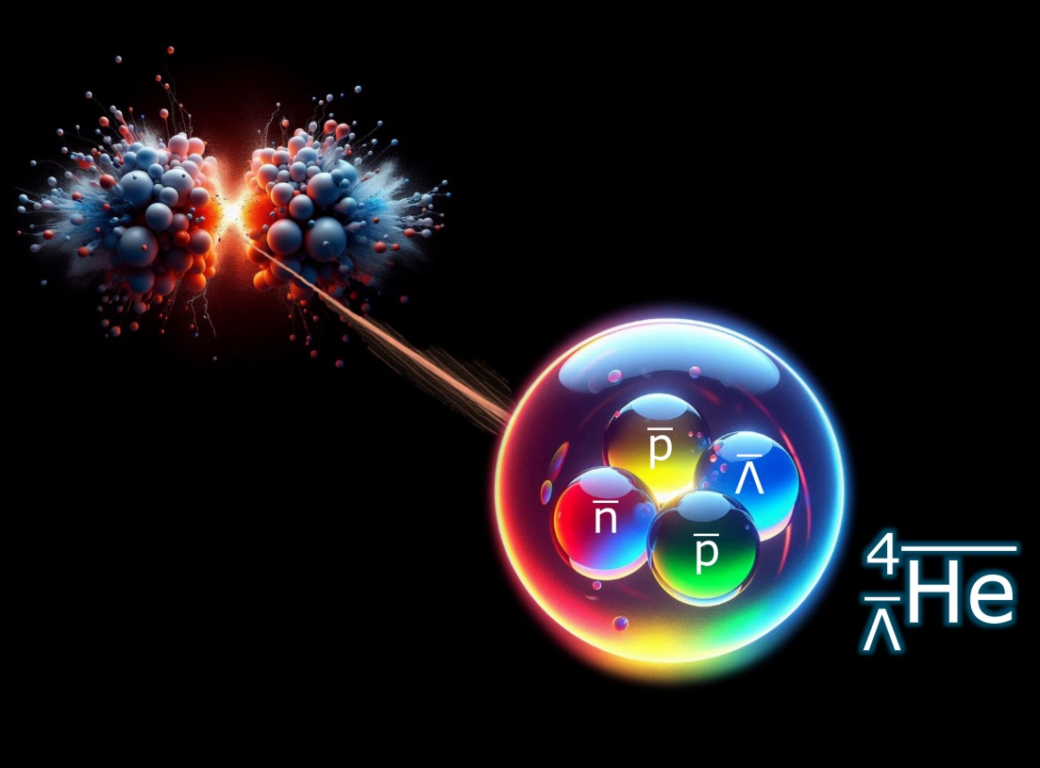

Introduction
What are antinuclei?
Physics Motivations.
Indirect Dark Matter searches.
The ALICE detector.
[2]
ALICE${}_{ }^{3}{\overline{He}}$ flux prediction.

Slide 3

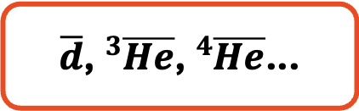
Anti-Nuclei
Anti-matter counterparts of atomic nuclei.
Anti-deuteron first produced in 1965 at CERN using proton-beryllium collisions [3].
Produced in cosmic ray interactions and at collider experiments.
Important for understanding of nuclear formation models, CP violation and baryogenesis, and Indirect Dark Matter searches.
$\overline{p}$, $\overline{n}$, ($\overline{Λ}$)
Nuclear formation
$\overline{d}$, ${}_{ }^{3}{\overline{He}}$, ${}_{ }^{4}{\overline{He}}$...

Slide 4
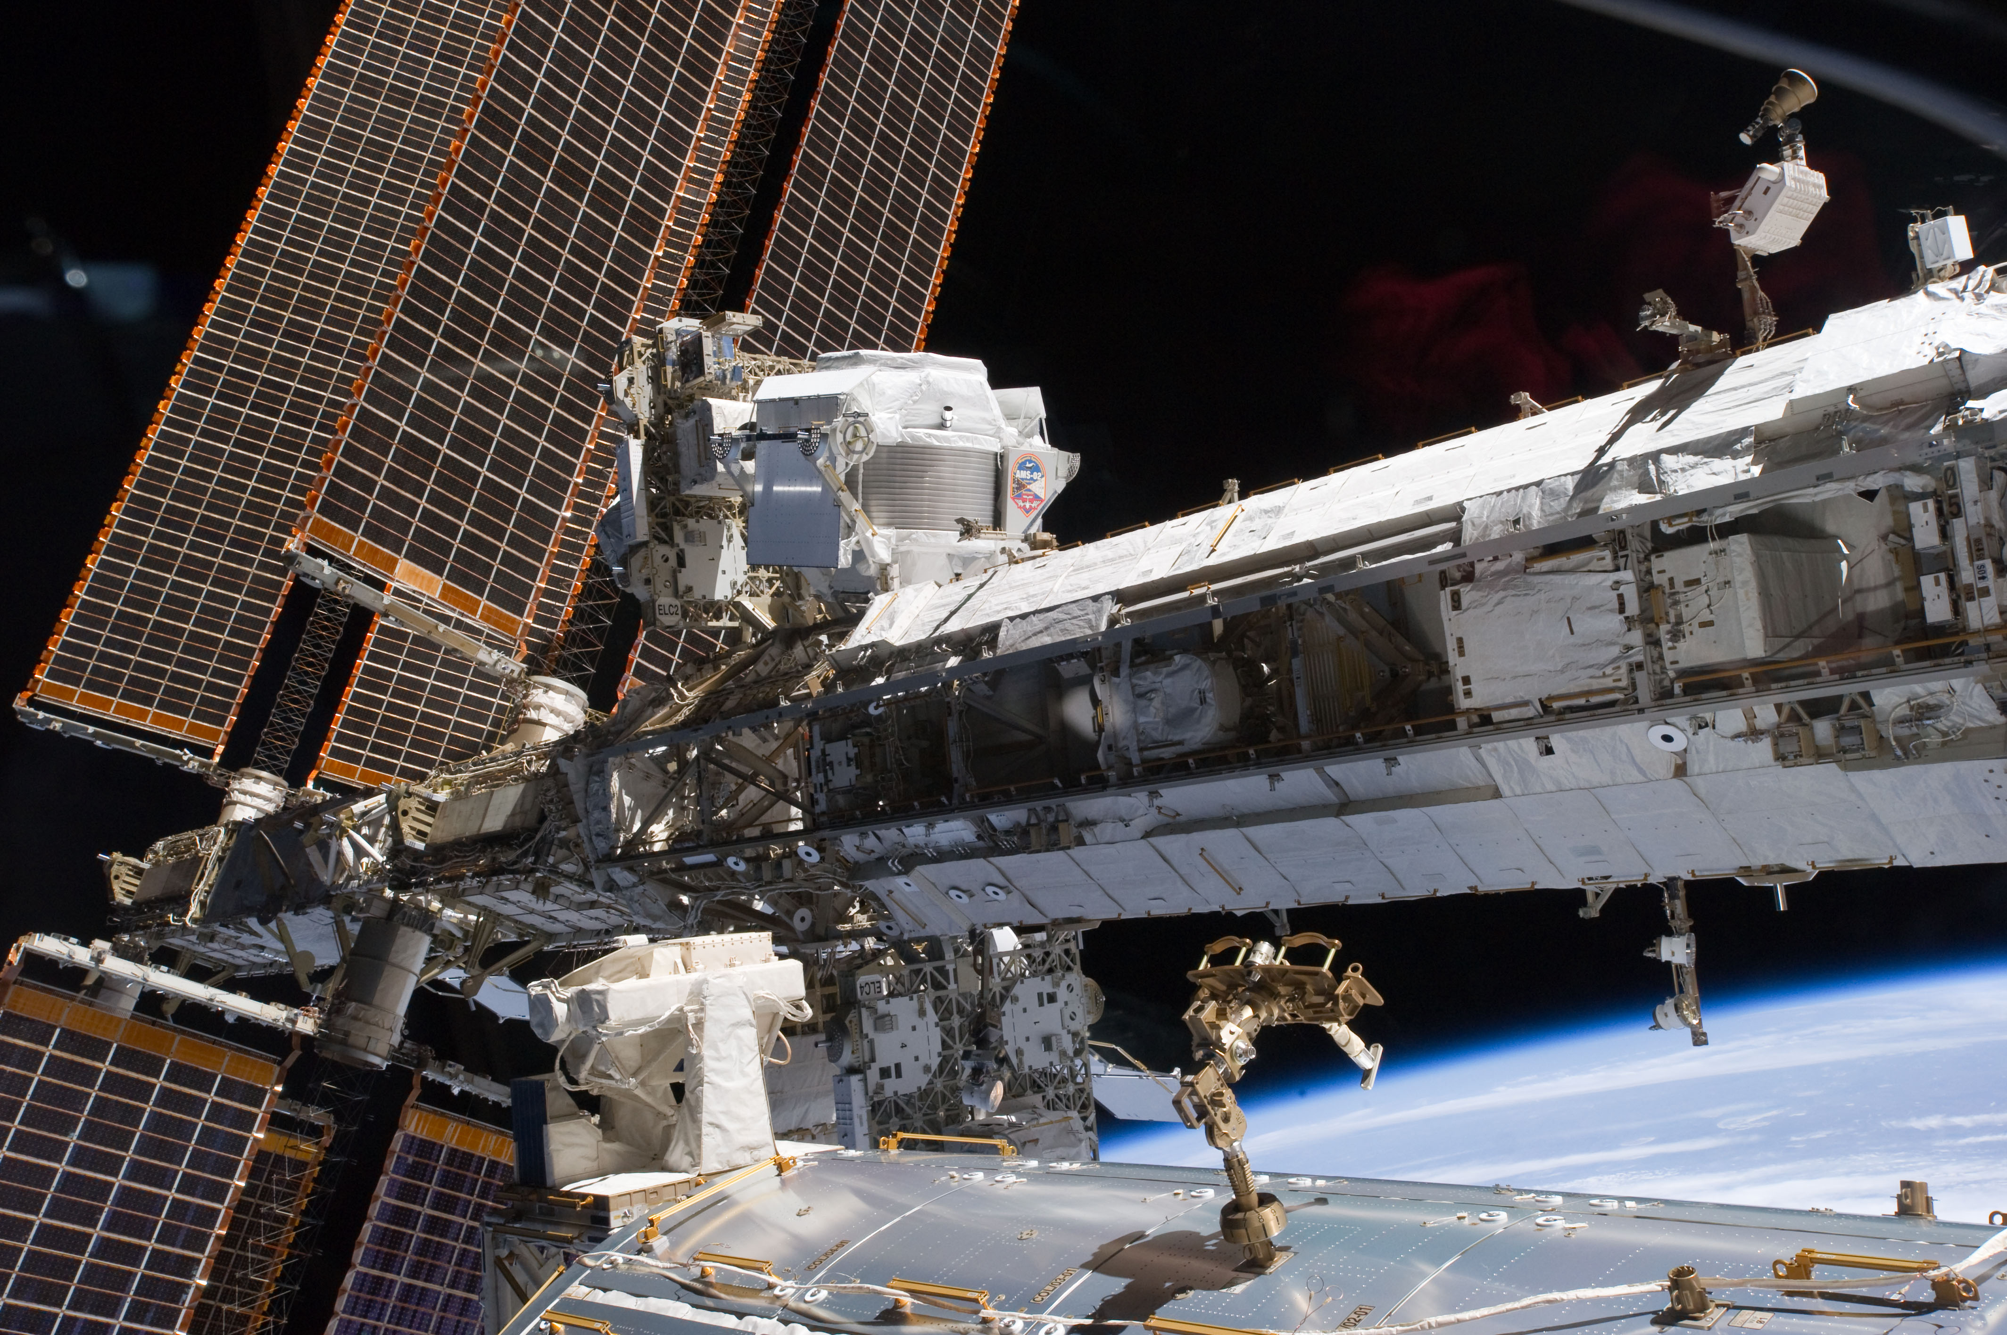
Indirect Dark Matter Searches
Look for excess flux of SM particles in cosmic rays.
AMS experiment on the ISS.
Search for antinuclei as DM signature.
  Rarely produced in hadronic interactions.
Need to understand background from astrophysical and hadronic processes.
Indirect
DM
SM
Direct
DM
SM
Collider
[4]

Slide 5
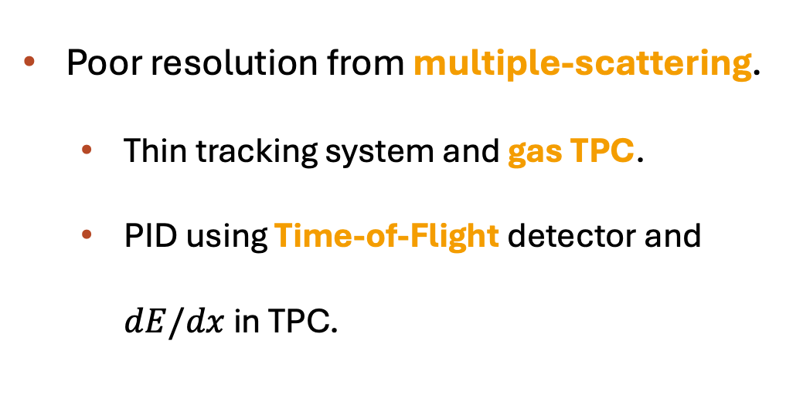
Anti-nuclei at the LHC
ALICE suited for tracking and Particle ID of low momenta particles.
Poor resolution from multiple-scattering.
  Thin tracking system and gas TPC.
  PID using Time-of-Flight detector and $dE/dx$ in TPC.
[5]
Notes:
Mid rapidity |y| < 0.5
HIC at LHCb first research in hypertriton at LHCb in 2023!

Slide 6
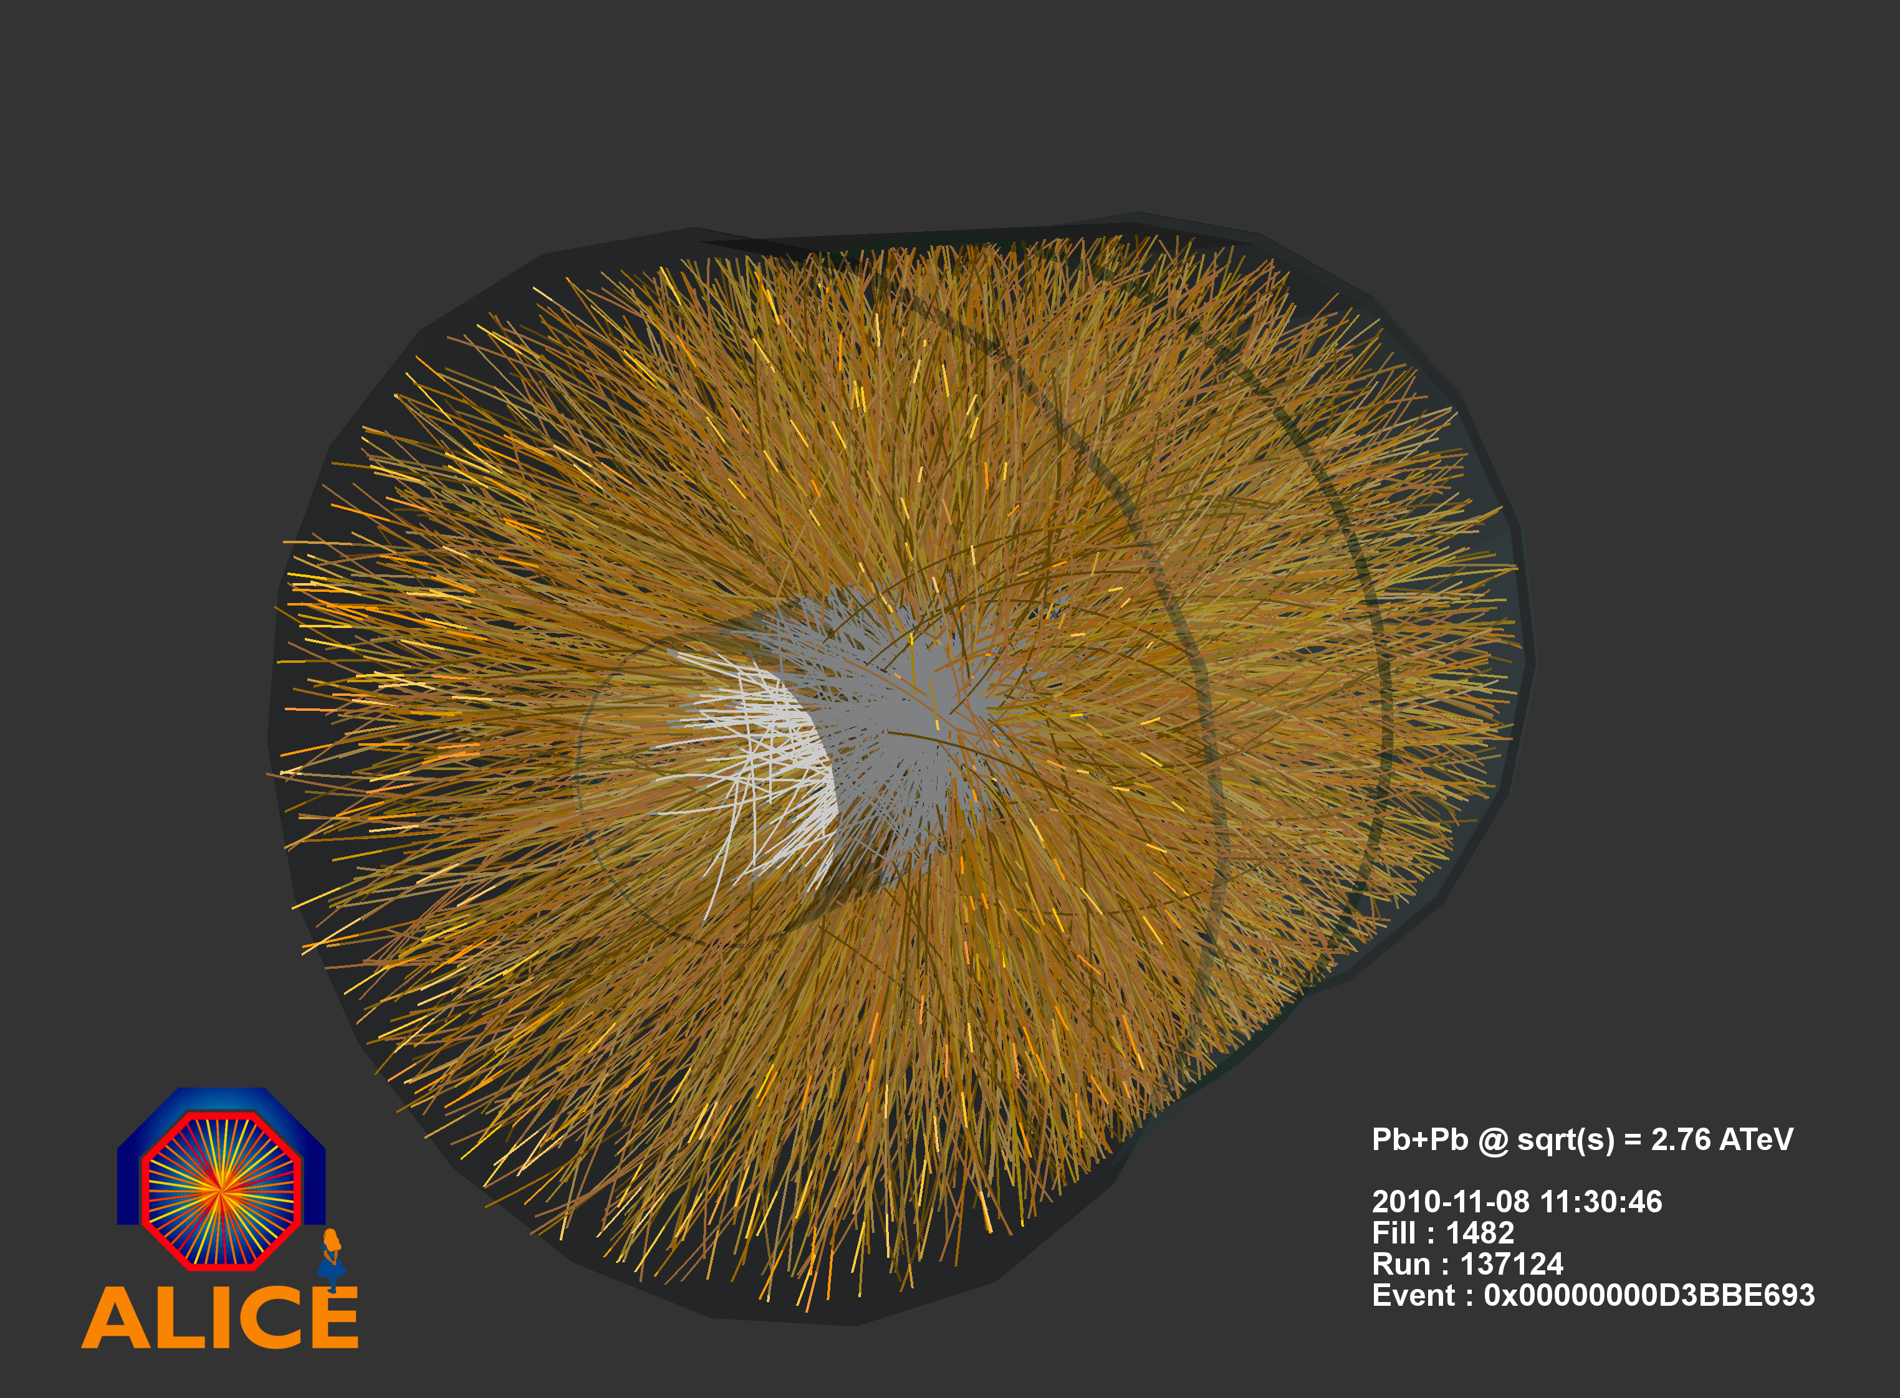
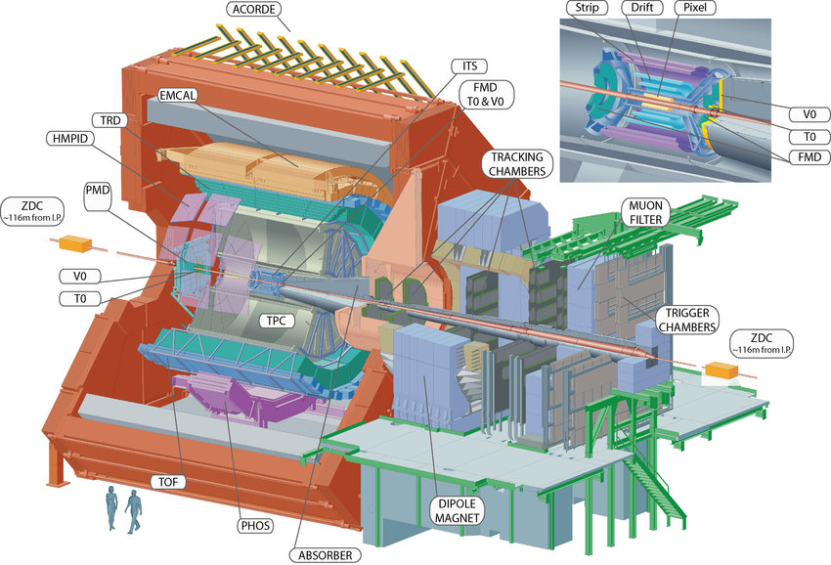
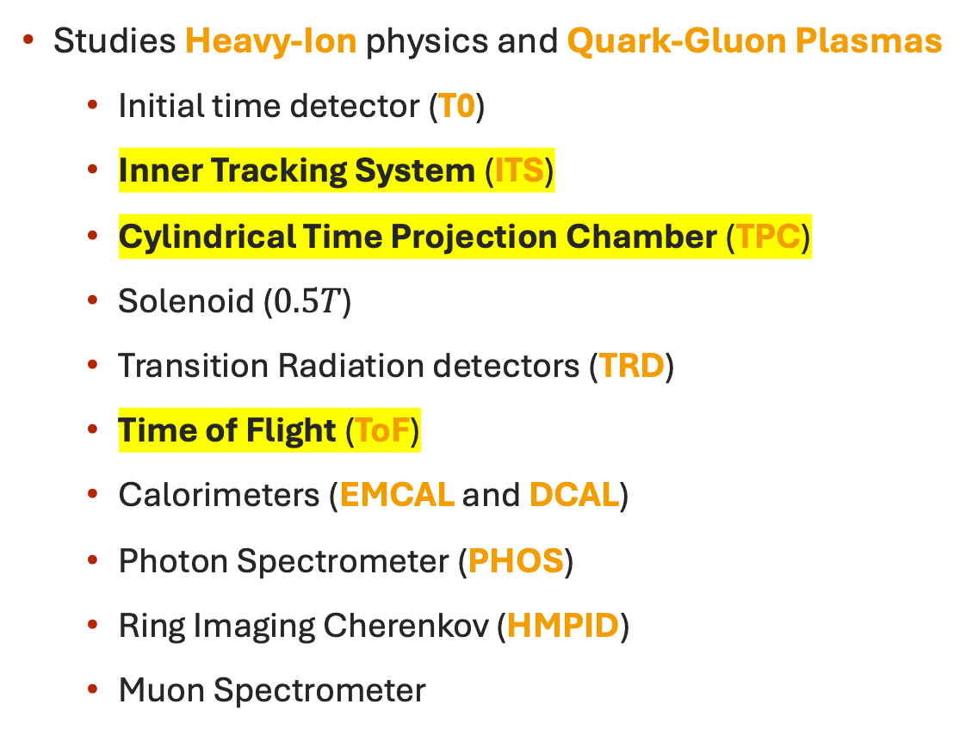
ALICE experiment
Studies Heavy-Ion physics and Quark-Gluon Plasmas
  Initial time detector (T0)
  Inner Tracking System (ITS)
  Cylindrical Time Projection Chamber (TPC)
  Solenoid ($0.5T$)
  Transition Radiation detectors (TRD)
  Time of Flight (ToF)
  Calorimeters (EMCAL and DCAL)
  Photon Spectrometer (PHOS)
  Ring Imaging Cherenkov (HMPID)
  Muon Spectrometer
[6]
[7]

Slide 7
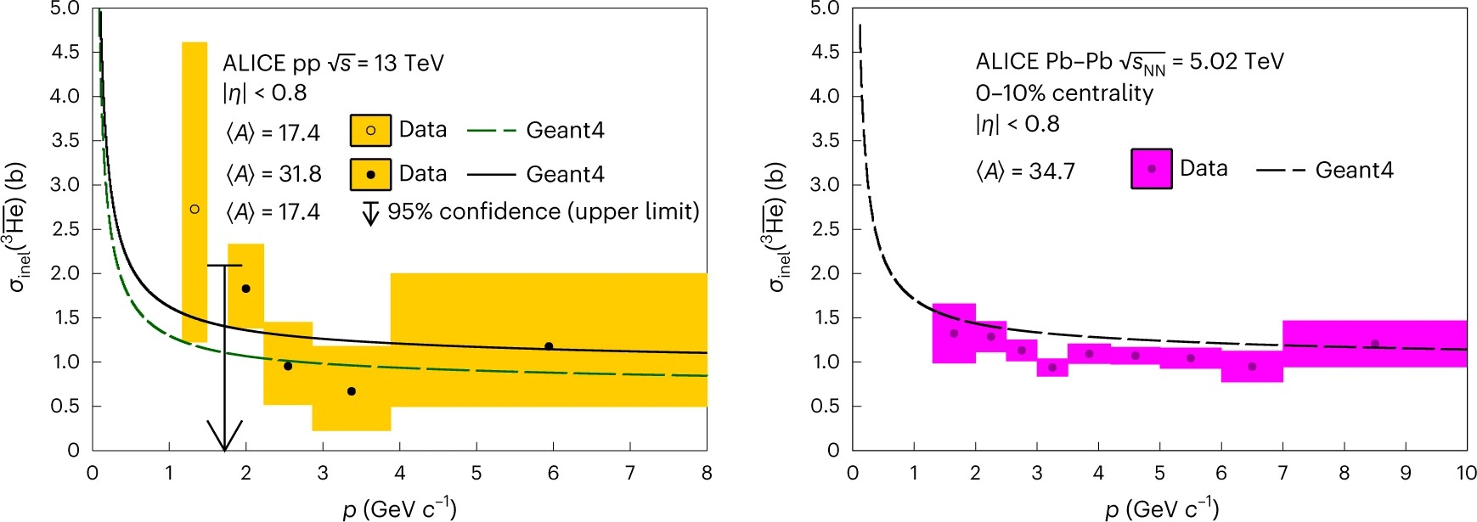


$$σ_{inel}({}_{ }^{3}{\overline{He}})$$
Fit ratio X as function of particle rigidity ($p/q)$ reconstructed at PV, using Geant4 with varying $σ_{inel}({}_{ }^{3}{\overline{He}})$.
X is ratio $\overline{{}_{ }^{3}{He}}/{}_{ }^{3}{He}$
X is ratio $\overline{{}_{ }^{3}{He}}$ that reach ToF detector to all $\overline{{}_{ }^{3}{He}}$
[8]
Notes:
Make X clear.

Slide 8
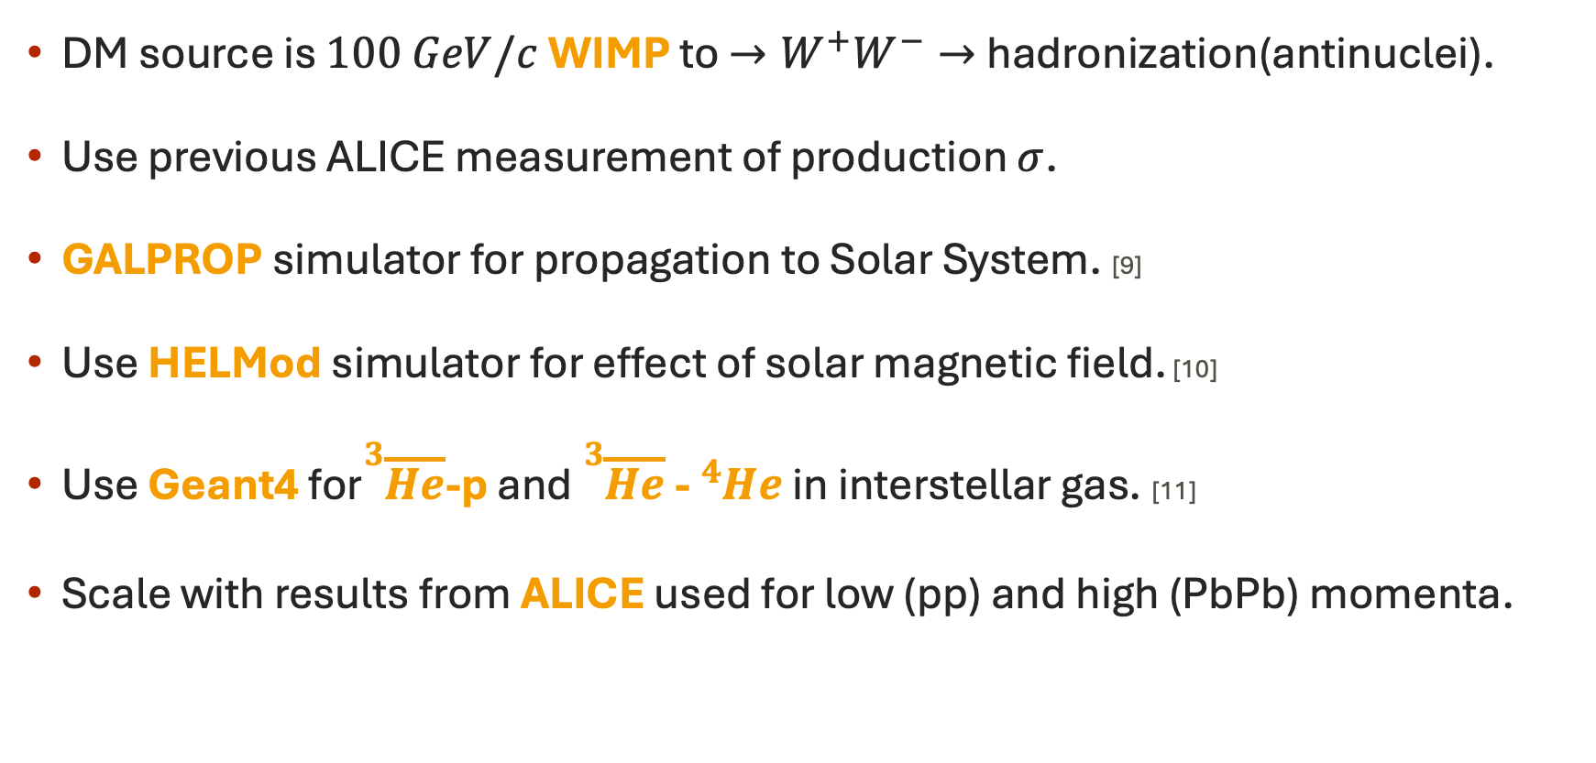
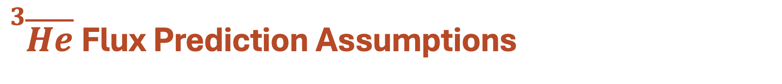
${}_{ }^{3}{\overline{He}}$Flux Prediction Assumptions
DM source is $100 GeV/c$WIMP to $→W^{+}W^{−}→$hadronization(antinuclei).
Use previous ALICE measurement of production $σ$.
GALPROP simulator for propagation to Solar System. [9]
Use HELMod simulator for effect of solar magnetic field. [10]
Use Geant4 for${}_{ }^{3}{\overline{He}}$-p and ${}_{ }^{3}{\overline{He}}$- ${}_{ }^{4}{He}$ in interstellar gas. [11]
Scale with results from ALICE used for low (pp) and high (PbPb) momenta.

Slide 9
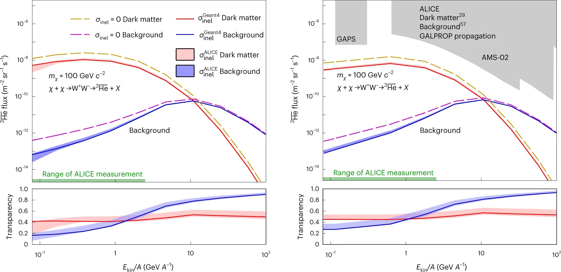
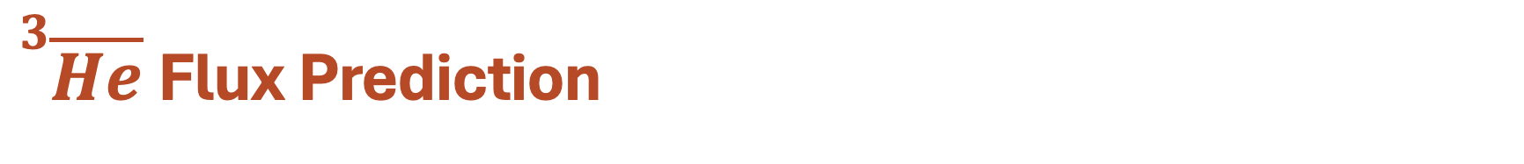
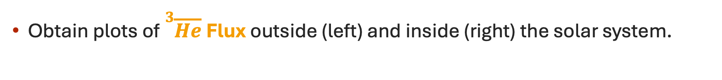
${}_{ }^{3}{\overline{He}}$Flux Prediction
Obtain plots of ${}_{ }^{3}{\overline{He}}$Flux outside (left) and inside (right) the solar system.
[8]

Slide 10
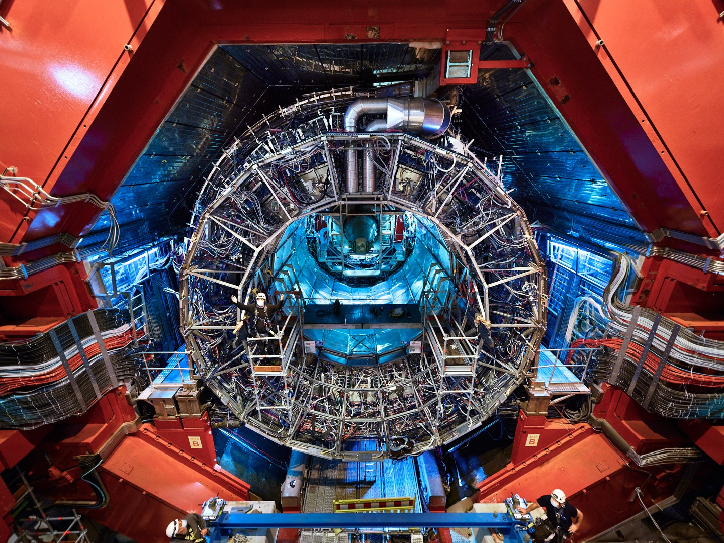

Conclusions
Physics motivation
Background on antinuclei
The ALICE detector.
Indirect Dark Matter searches
ALICE${}_{ }^{3}{\overline{He}}$ flux prediction.

Slide 11
Thank You
for listening
Graduate Symposium 2025
Charlie Wild
11 March 2025

Slide 12
References
[1] Image: Konigstorfer, Stephan Alexander, https://cds.cern.ch/record/2843519?ln=en
[2] Image: J. Ditzel with AI-assistance https://home.cern/news/news/physics/alice-finds-first-ever-evidence-antimatter-partner-hyperhelium-4
[3] Massam, T., Muller, T., Righini, B. et al. Experimental observation of antideuteron production. Nuovo Cim39, 10–14 (1965). https://doi.org/10.1007/BF02814251
[4] Image: NASA, https://www.nasa.gov/alpha-magnetic-spectrometer/
[5] Image: J. Orden, CERN https://cds.cern.ch/images/CERN-PHOTO-201903-053-2/file?size=original
[6] Image: ALICE team, https://cds.cern.ch/record/1305398/files/1011251_01.jpg?version=1
[7] Image: Pcharito, https://commons.wikimedia.org/wiki/File:2012-Aug-02-ALICE_3D_v0_with_Text_(1)_2.jpg
[8] The ALICE Collaboration. Measurement of anti-³He nuclei absorption in matter and impact on their propagation in the Galaxy. Nat. Phys. 19, 61–71 (2023). https://doi.org/10.1038/s41567-022-01804-8
[9] T. A. Porter et al The GALPROP Cosmic-ray Propagation and Nonthermal Emissions Framework: Release v57. ApJS 262 30(2022) https://doi.org/10.3847/1538-4365/ac80f6
[10] M.J. Boschini, S. Della Torre, M. Gervasi, G. La Vacca, P.G. Rancoita, Propagation of cosmic rays in heliosphere: The HelMod model, Advances in Space Research, 62 10 2859-2879 (2018) , https://doi.org/10.1016/j.asr.2017.04.017.
[11] Agostinelli, S., et al. (2003). Geant4—a simulation toolkit. Nuclear Instruments and Methods in Physics Research Section A: Accelerators, Spectrometers, Detectors and Associated Equipment, 506(3), 250-303. https://doi.org/10.1016/S0168-9002(03)01368-8

