Slide 1
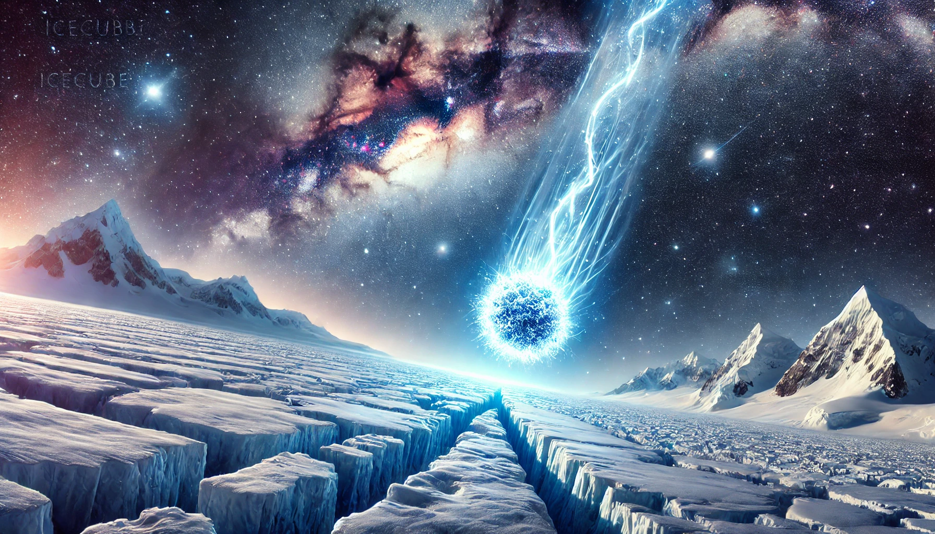
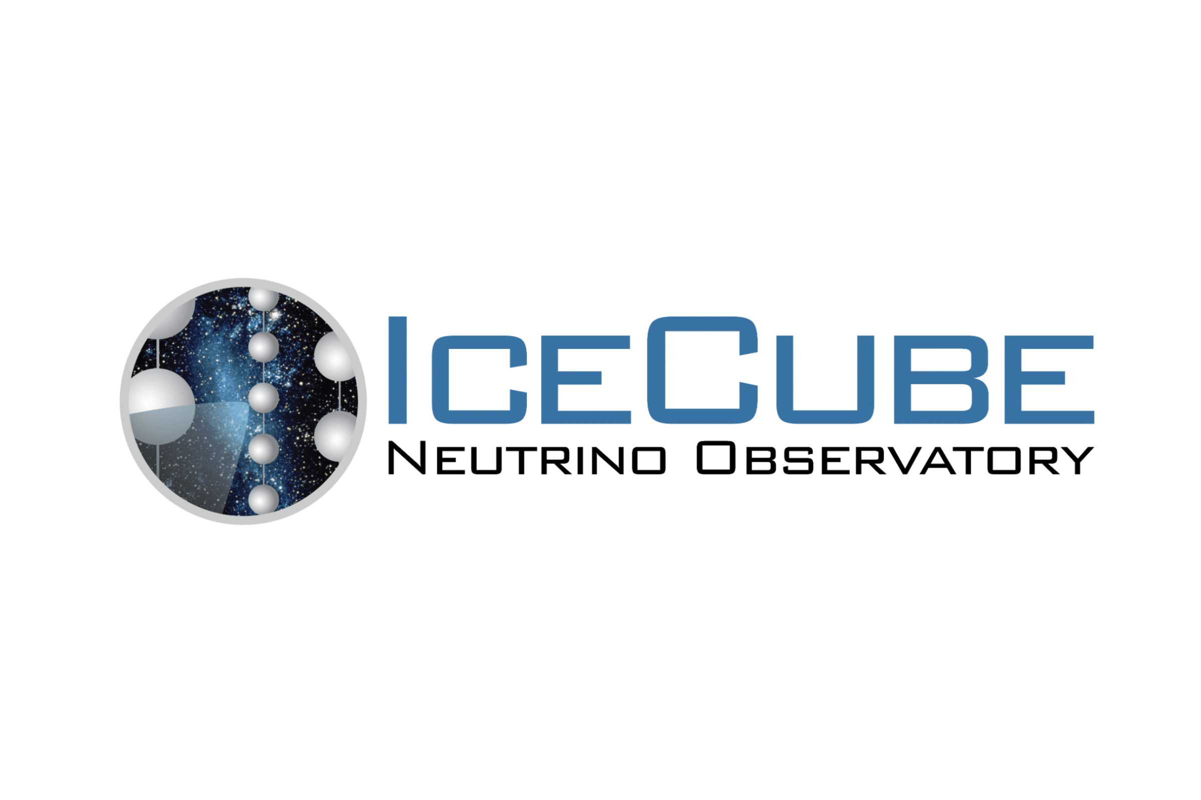

ICE-olating Neutrinos from the Galactic Plane
Observation of High-Energy Neutrinos from the Galactic Plane – IceCube Collaboration (2023), Science 380, 1338-1343
Ruben Hönscheid
11/03/2025

Slide 2
Contents
Neutrino Detection
IceCube Experiment
Astrophysical Neutrinos
Galactic Plane Neutrino Signal
Implications
Prospects
Ruben Hönscheid
11/03/2025
2

Slide 3
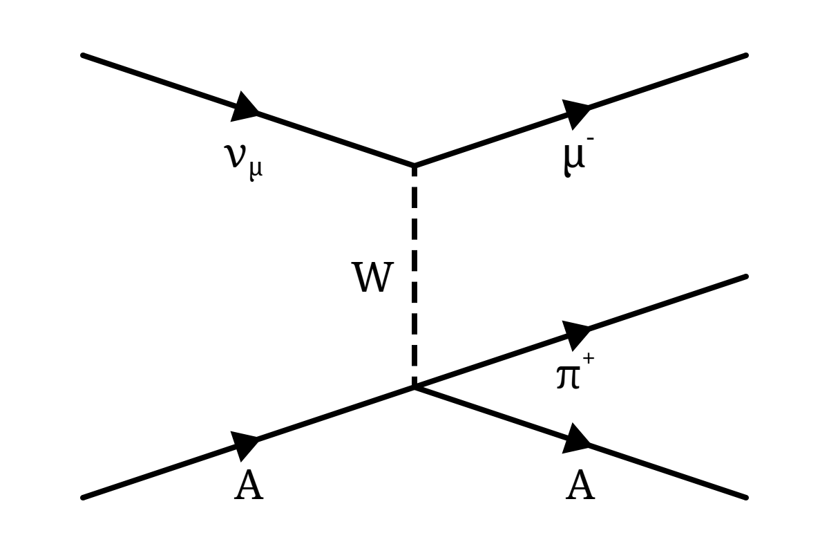
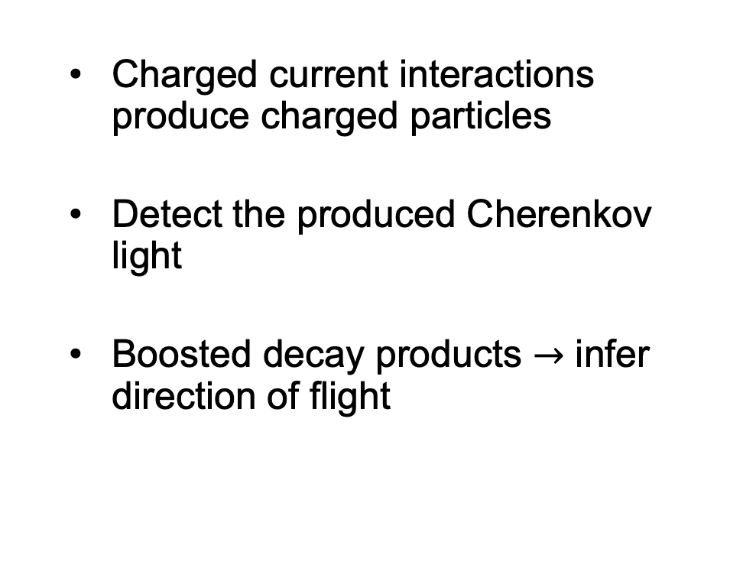
Neutrino Detection
  Charged current interactions produce charged particles
  Detect the produced Cherenkov light
  Boosted decay products $→$ infer direction of flight
Ruben Hönscheid
11/03/2025
3

Slide 4
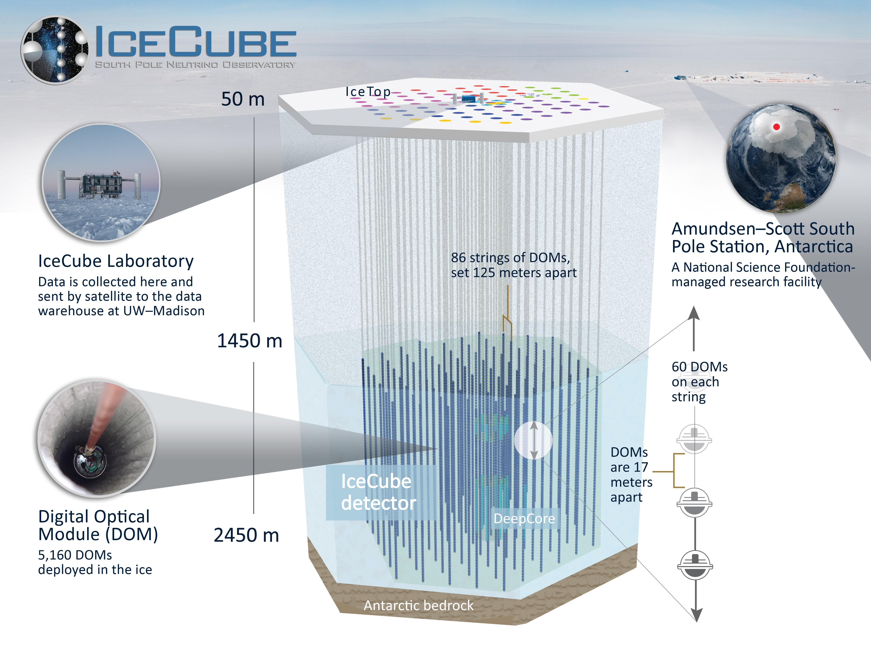
IceCube Experiment
Cubic-kilometer detector in Antarctic ice
5000+ PMTs buried in ice to collect Cherenkov light
IceTop for coincidence tests and rejection of cosmic rays
Ruben Hönscheid
11/03/2025
4

Slide 5
IceCube Experiment
Physics Goals
  Identify sources of high-energy astrophysical neutrinos
  Does the Milky Way produce high-energy neutrinos? What mechanism is behind this?
Ruben Hönscheid
11/03/2025
5

Slide 6
IceCube Experiment
Neutrino detection
  Antarctic ice is very pure.
  Submerge PMTs to convert large volumes of ice into Cherenkov detector
Physics Goals
  Identify sources of high-energy astrophysical neutrinos
  Does the Milky Way produce high-energy neutrinos? What mechanism is behind this?
Ruben Hönscheid
11/03/2025
6

Slide 7
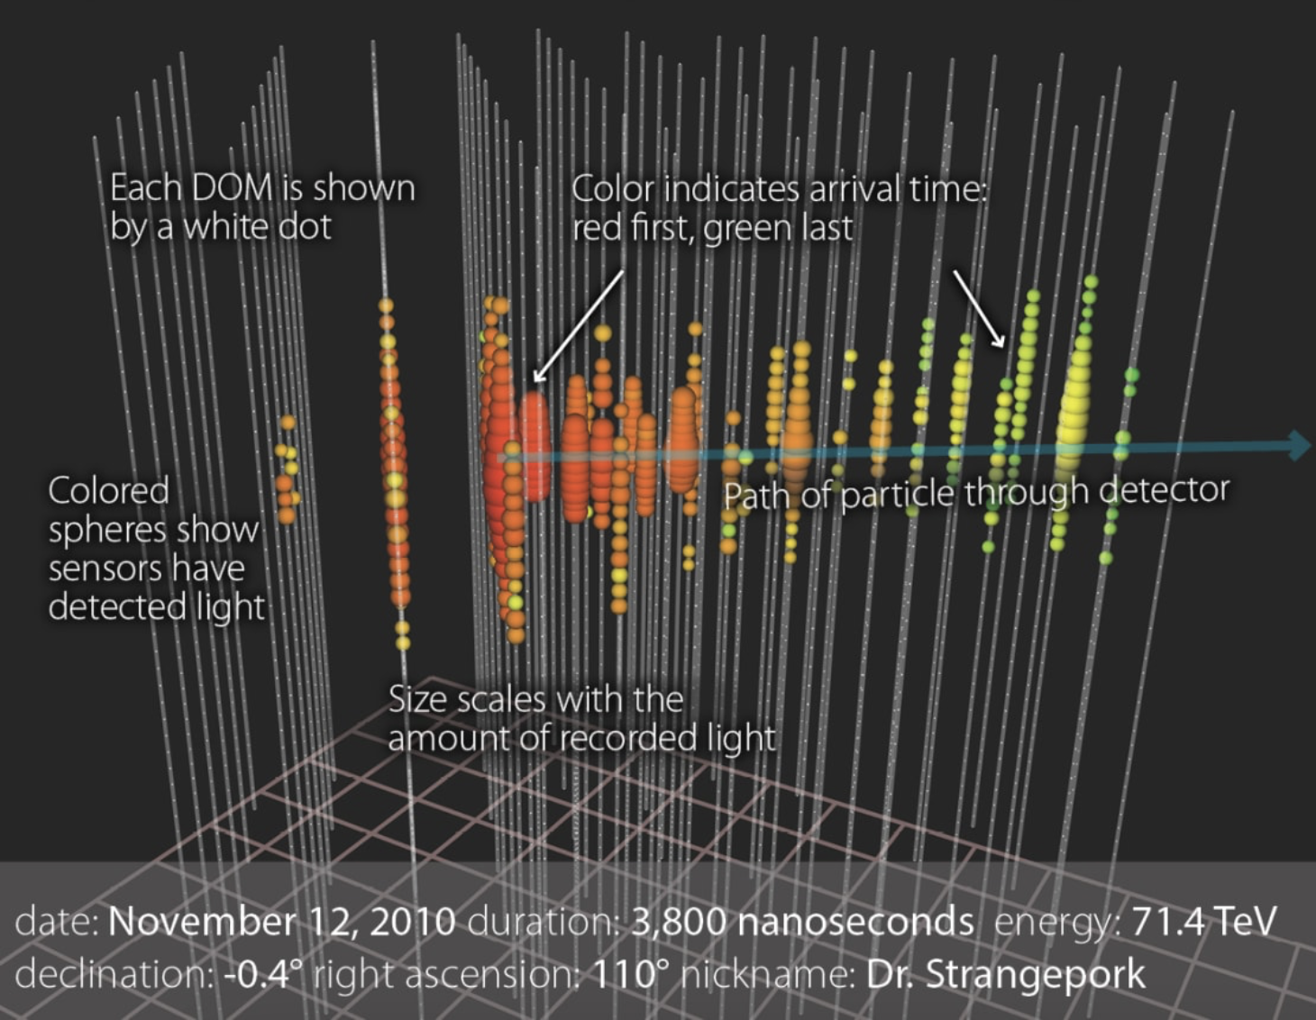
IceCube Simulated Event
Boosted decay products help infer the direction of flight.
Ruben Hönscheid
11/03/2025
7

Slide 8
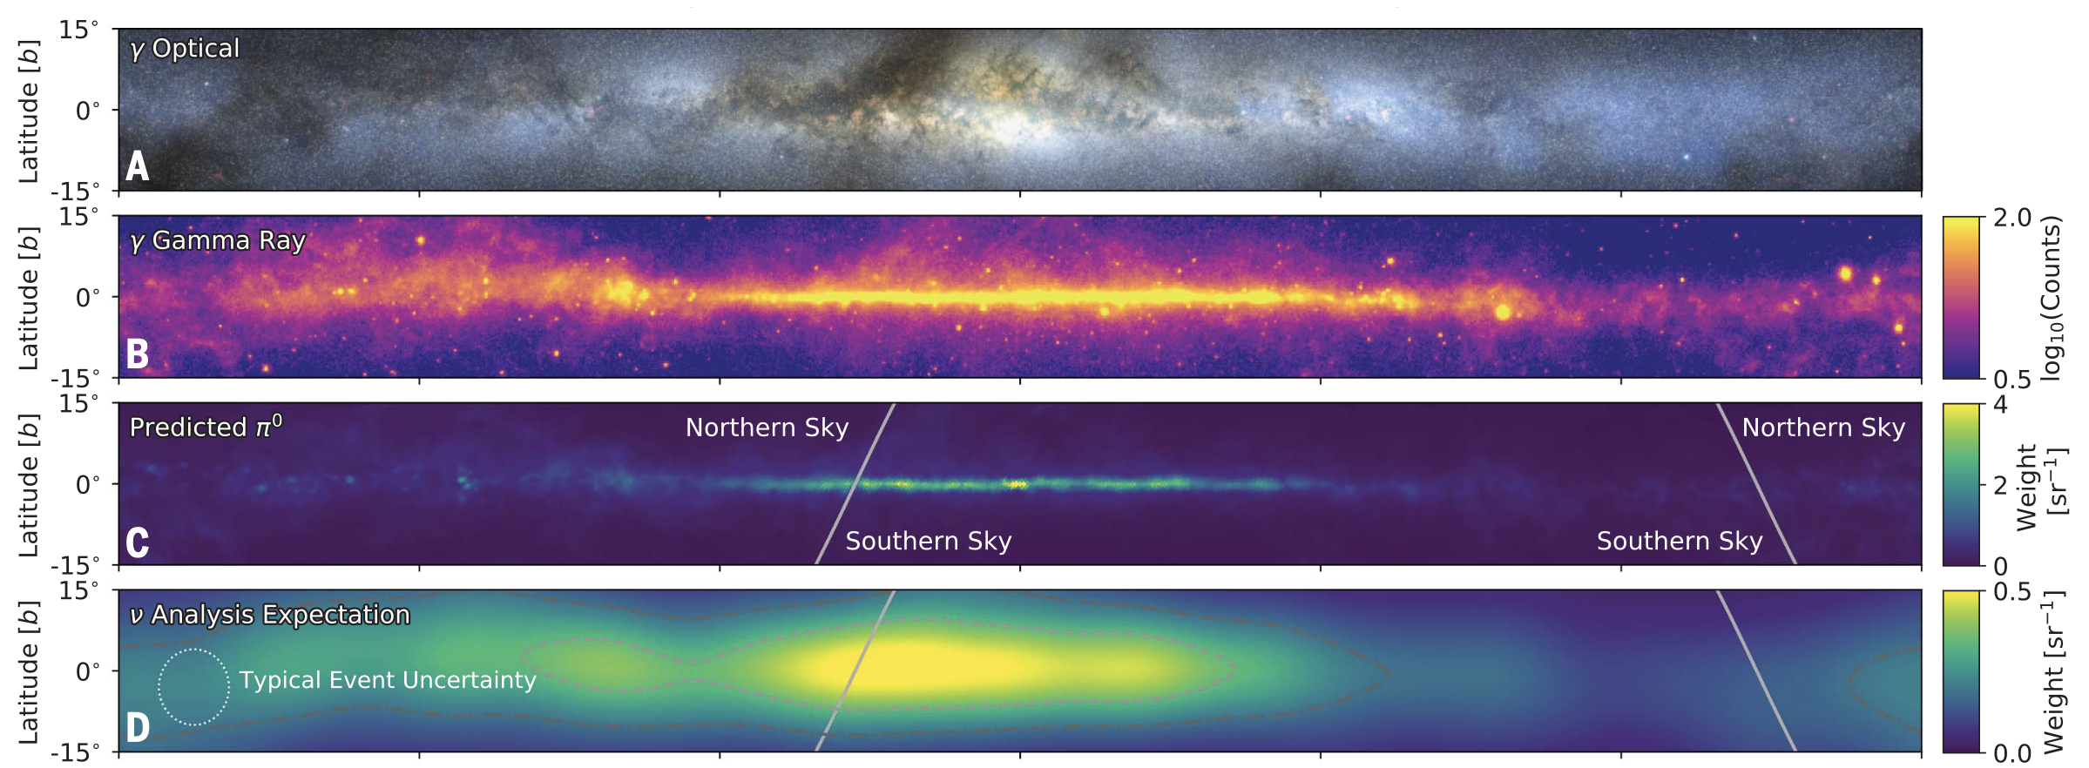
Astrophysical Neutrinos
Contours in D: 20% and 50% of expected diffuse neutrino signal.
Ruben Hönscheid
11/03/2025
8

Slide 9
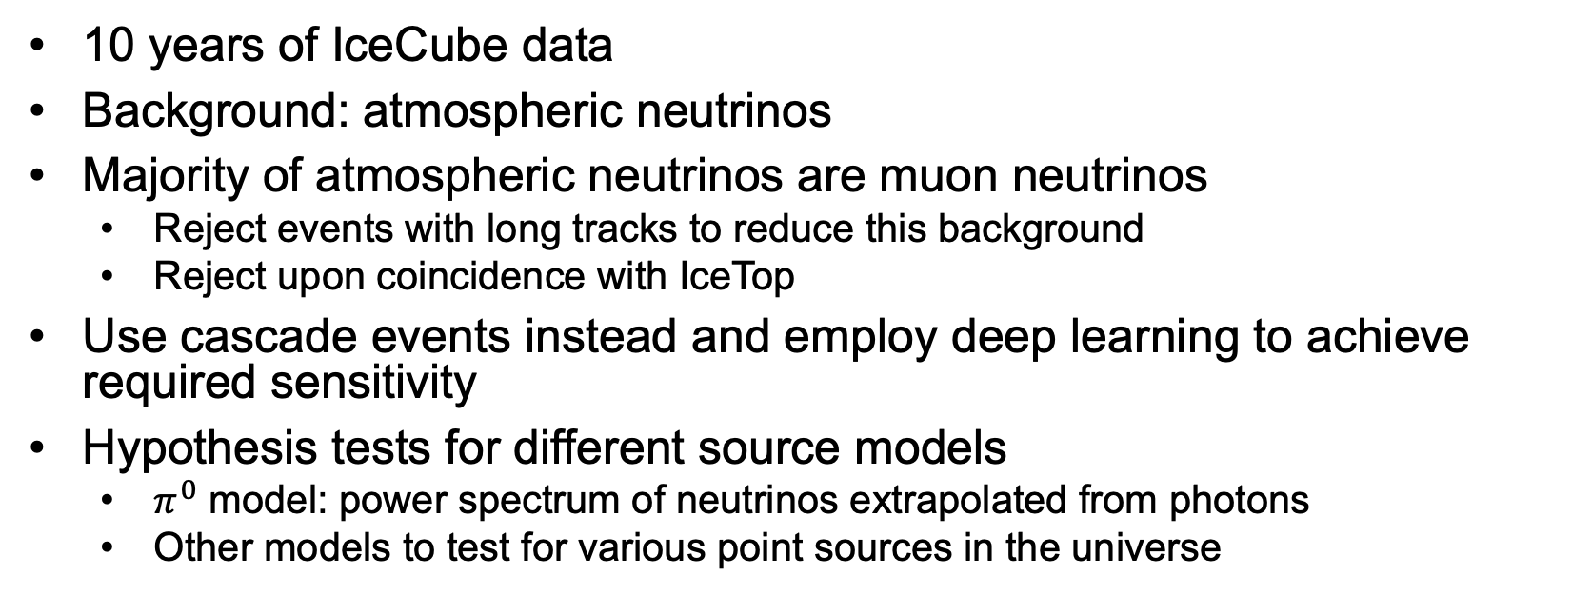
Analysis Strategy
10 years of IceCube data
Background: atmospheric neutrinos
Majority of atmospheric neutrinos are muon neutrinos
  Reject events with long tracks to reduce this background
  Reject upon coincidence with IceTop
Use cascade events instead and employ deep learning to achieve required sensitivity
Hypothesis tests for different source models
  $π^{0}$ model: power spectrum of neutrinos extrapolated from photons
  Other models to test for various point sources in the universe
Ruben Hönscheid
11/03/2025
9

Slide 10
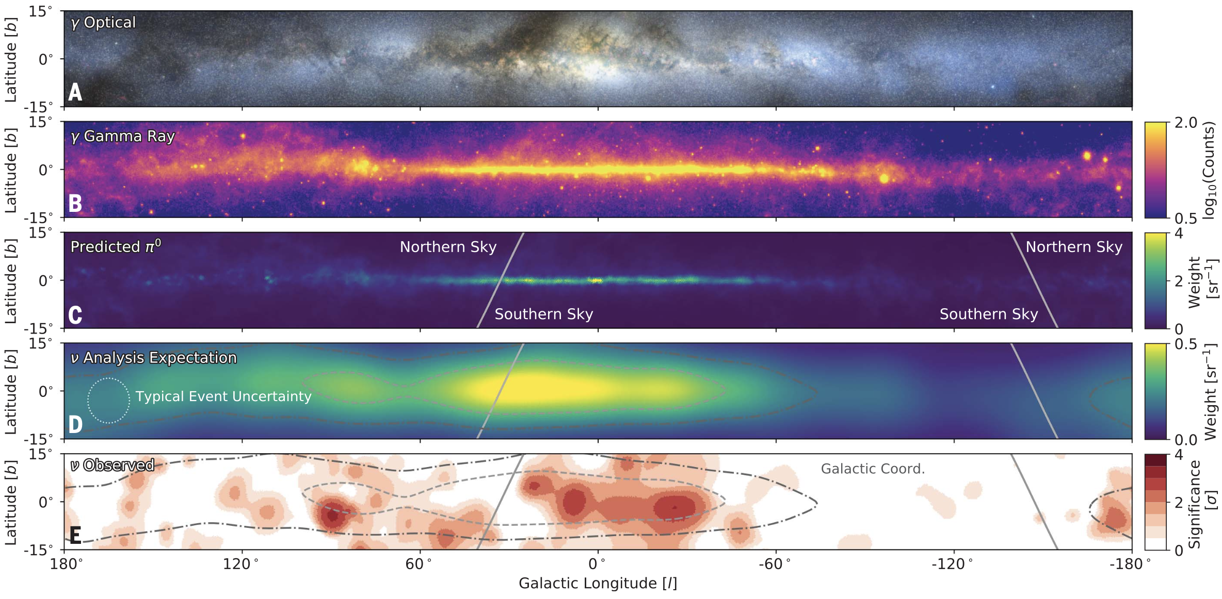
Results
Contours in D, E: 20% and 50% of expected diffuse neutrino signal.
Ruben Hönscheid
11/03/2025
10

Slide 11
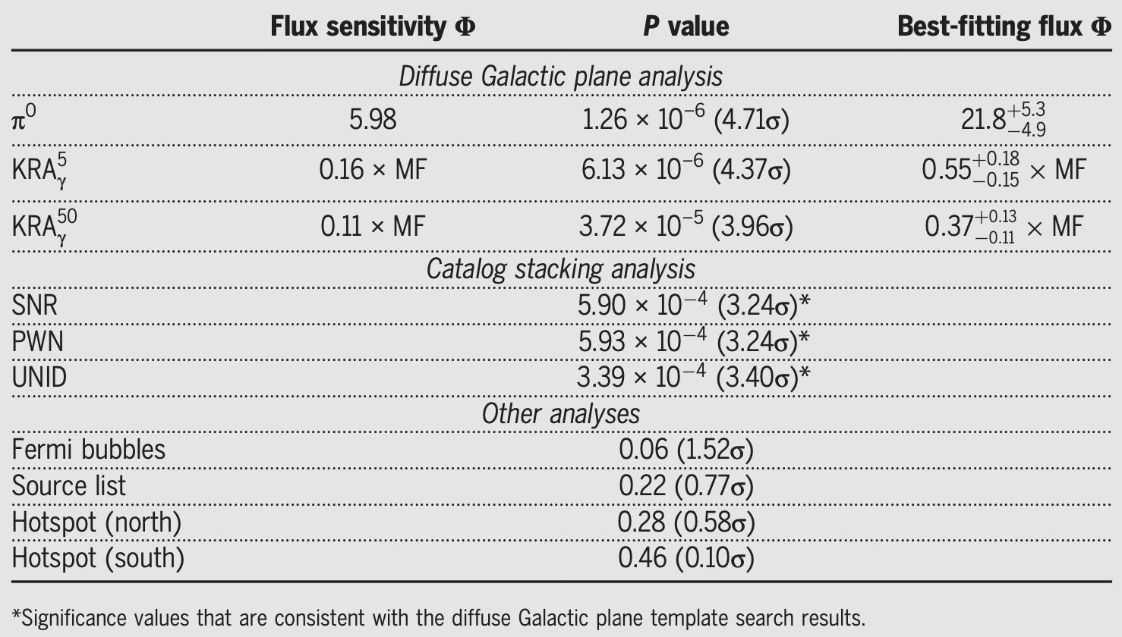
Results
Ruben Hönscheid
11/03/2025
11

Slide 12
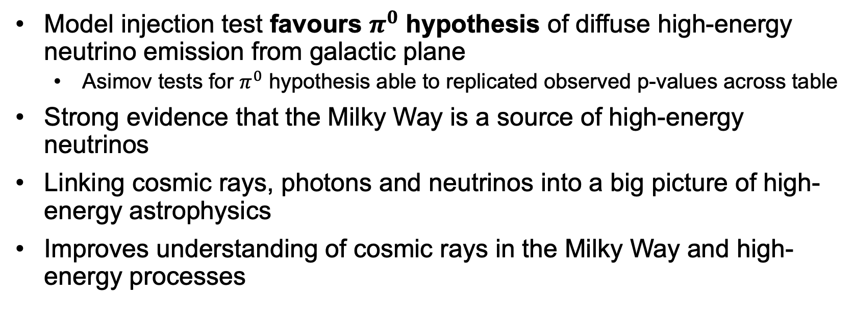
Implications
Model injection test favours $π^{0}$ hypothesis of diffuse high-energy neutrino emission from galactic plane
  Asimov tests for $π^{0}$ hypothesis able to replicated observed p-values across table
Strong evidence that the Milky Way is a source of high-energy neutrinos
Linking cosmic rays, photons and neutrinos into a big picture of high-energy astrophysics
Improves understanding of cosmic rays in the Milky Way and high-energy processes
Ruben Hönscheid
11/03/2025
12

Slide 13
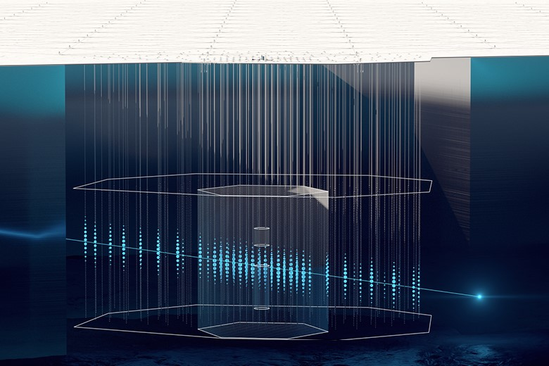
Prospects
IceCube
IceCube continues to collect data
IceCubeGen2
KM3NeT in the Mediterranean to study neutrinos on northern hemisphere
IceCubeGen2
Ruben Hönscheid
11/03/2025
13

Slide 14
Thank you!!
Ruben Hönscheid
11/03/2025
14

