Slide 1
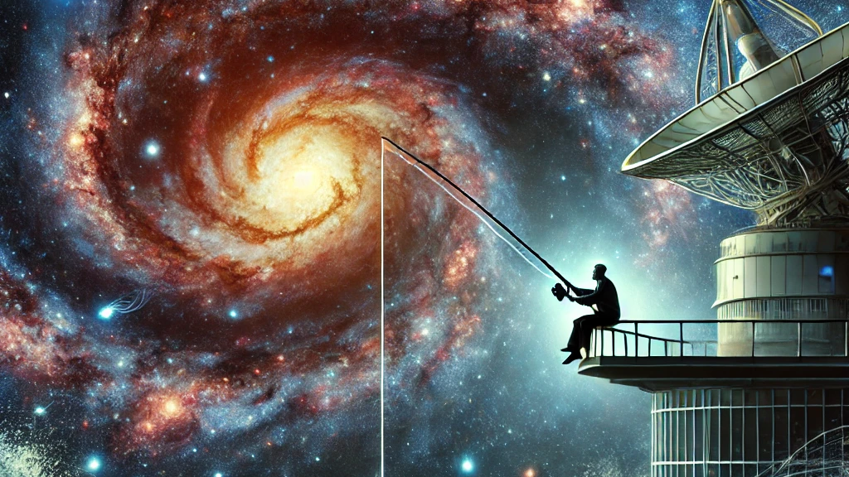
KM3NeT –
Fishing for Neutrinos in the Mediterranean
Aliki Sofia Rotelli
Graduate Symposium, 11th March 2025

Slide 2
Why Neutrino Astronomy?
Detector Technology
Where is the Detector?
Preliminary Results
2

Slide 3
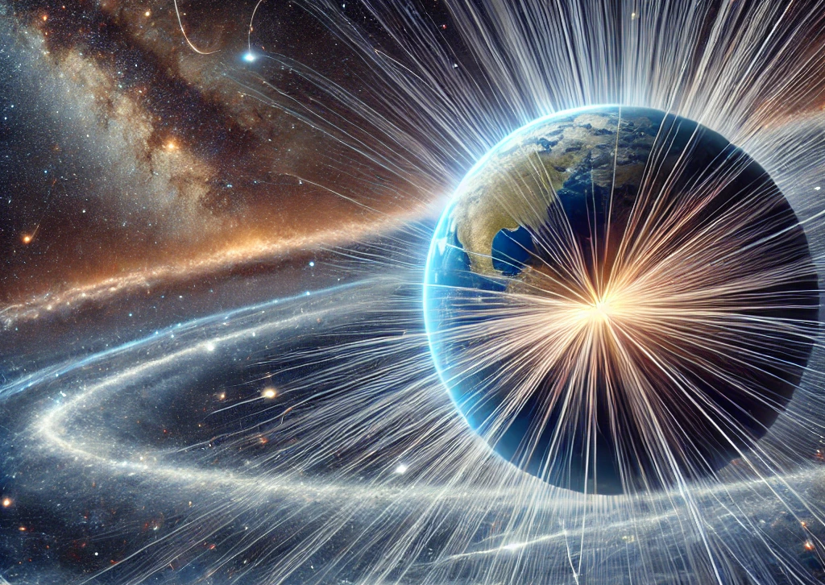
Why Neutrino Astronomy?
Existence of high-energy cosmic neutrinos → confirmed by IceCube (2013)
Elusive particle:
  Travel long distances undisturbed
  Difficult to detect
Notes:
small cross section for interacting matter

Slide 4
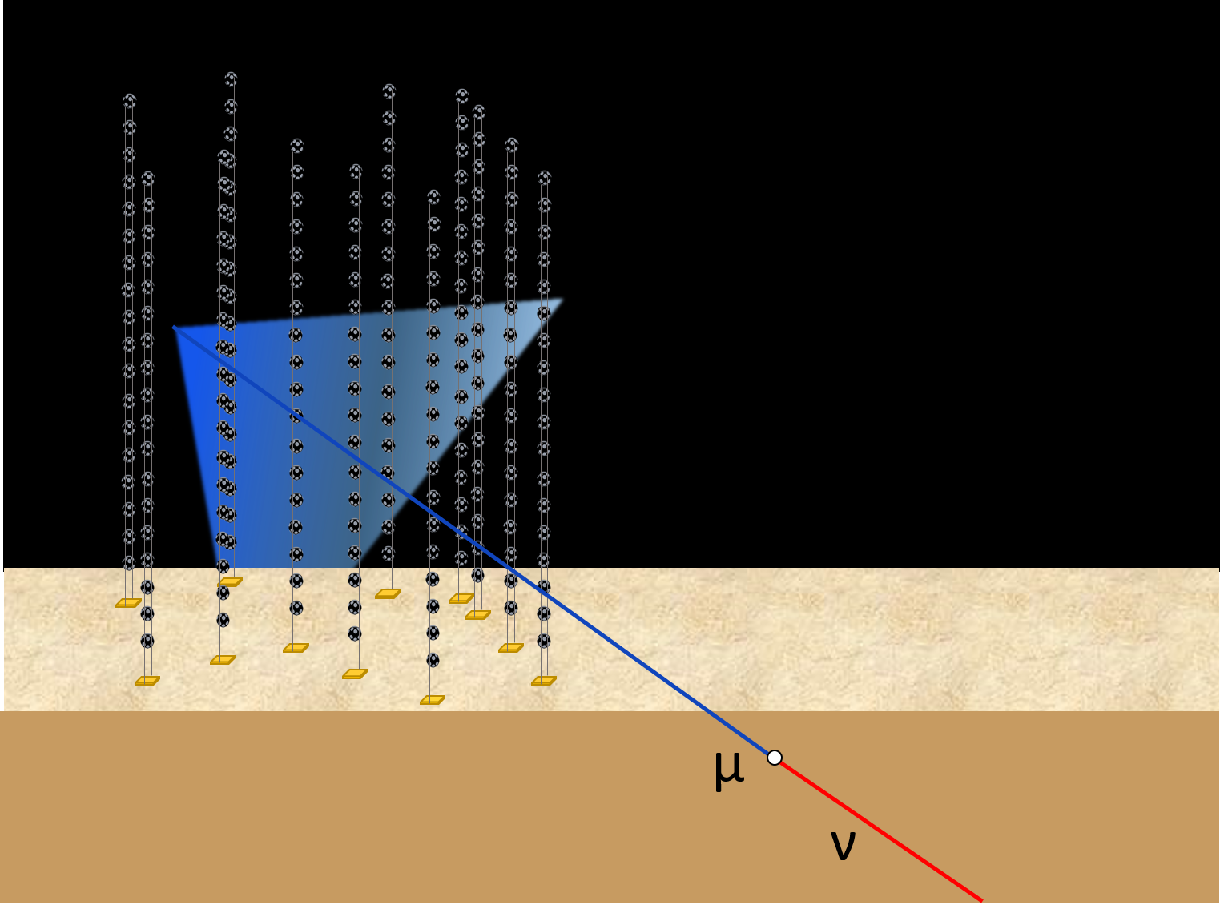
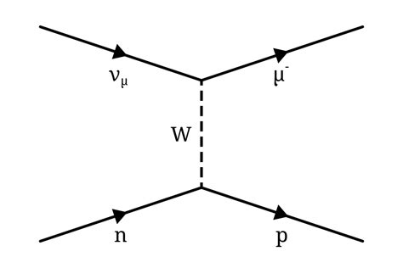
KM3NeT - Kilometre cube Neutrino Telescope
European collaboration
Under construction, will be of the largest astronomical telescopes ever built
Complementary field of view & higher sensitivity than IceCube
Neutrino interactions produce secondary charged particles, whose Cherenkov light yield is detected
Grids of optical sensors
Cherenkov cone
4
Copyright: KM3NeT
Notes:
Artist’s impression of a Cherenkov neutrino Telecscope. Courtesy KM3NeT. It is difficult to grasp the size of the volume of the KM3NeT detectors. The instrumented sea volume is in the range of cubic kilometres, while the dimensions of the optical modules is only about 30 cm.

Slide 5
Why Neutrino Astronomy?
Detector Technology
Where is the Detector?
Preliminary Results
5

Slide 6
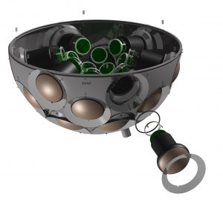
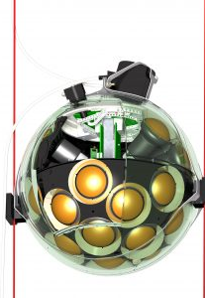
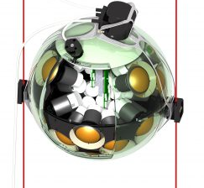
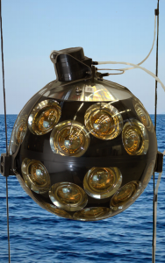
Digital Optical Module (DOM)
Pressure resistant 17-inch glass sphere
31 PMTs & readout electronics
  3-inch photocathode diameter
  HV and thresholds set from shore
Multi-PMT vs. IceCube Single PMT… why?
  Larger photocathode area
  Breakage isn’t fatal
  Noise reduction
  Directional resolution
6
Copyright: KM3NeT
Notes:
For illustration purposes some PMTs are removed

Slide 7
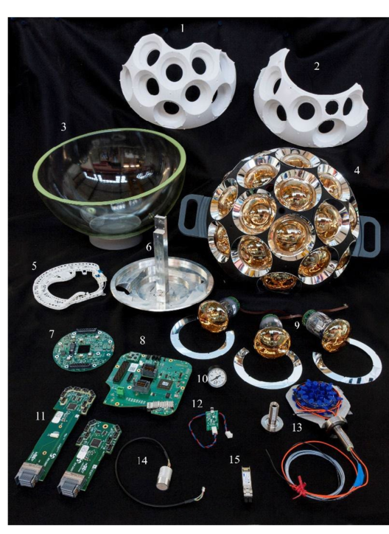
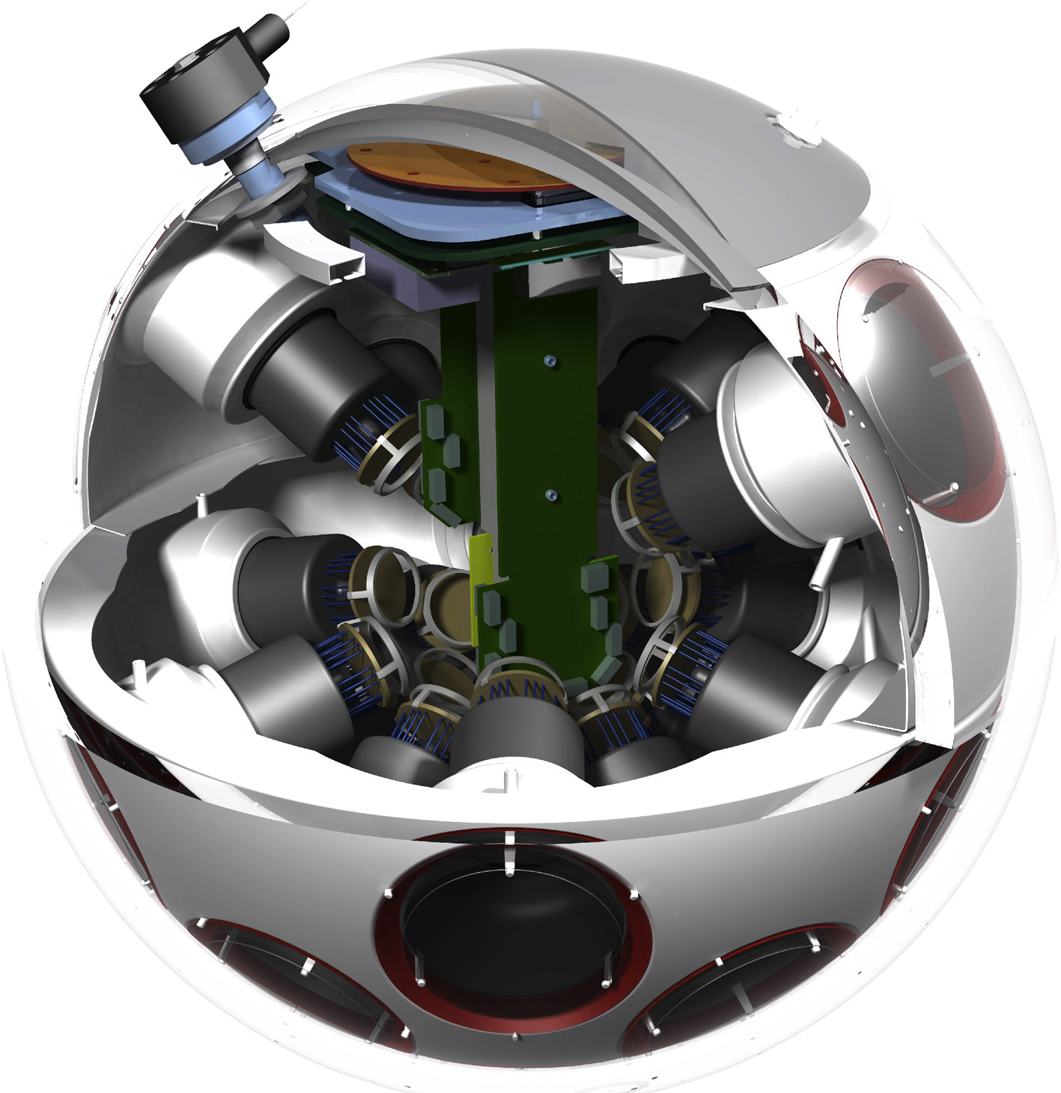
DOMs
PMTs & light collection rings
Piezo hydrophone – position calibration
7
Nanobeacon (led flasher) – timing calibration
Copyright: KM3NeT

Slide 8
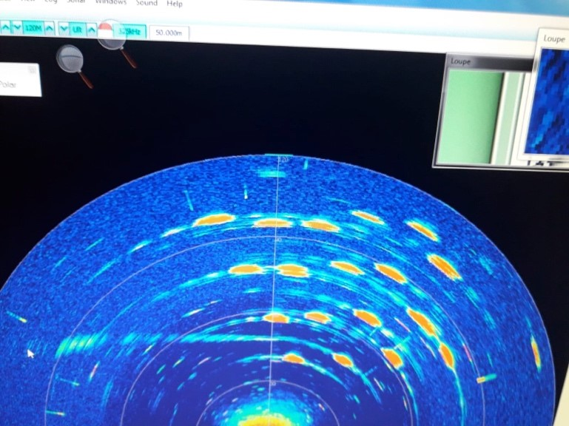
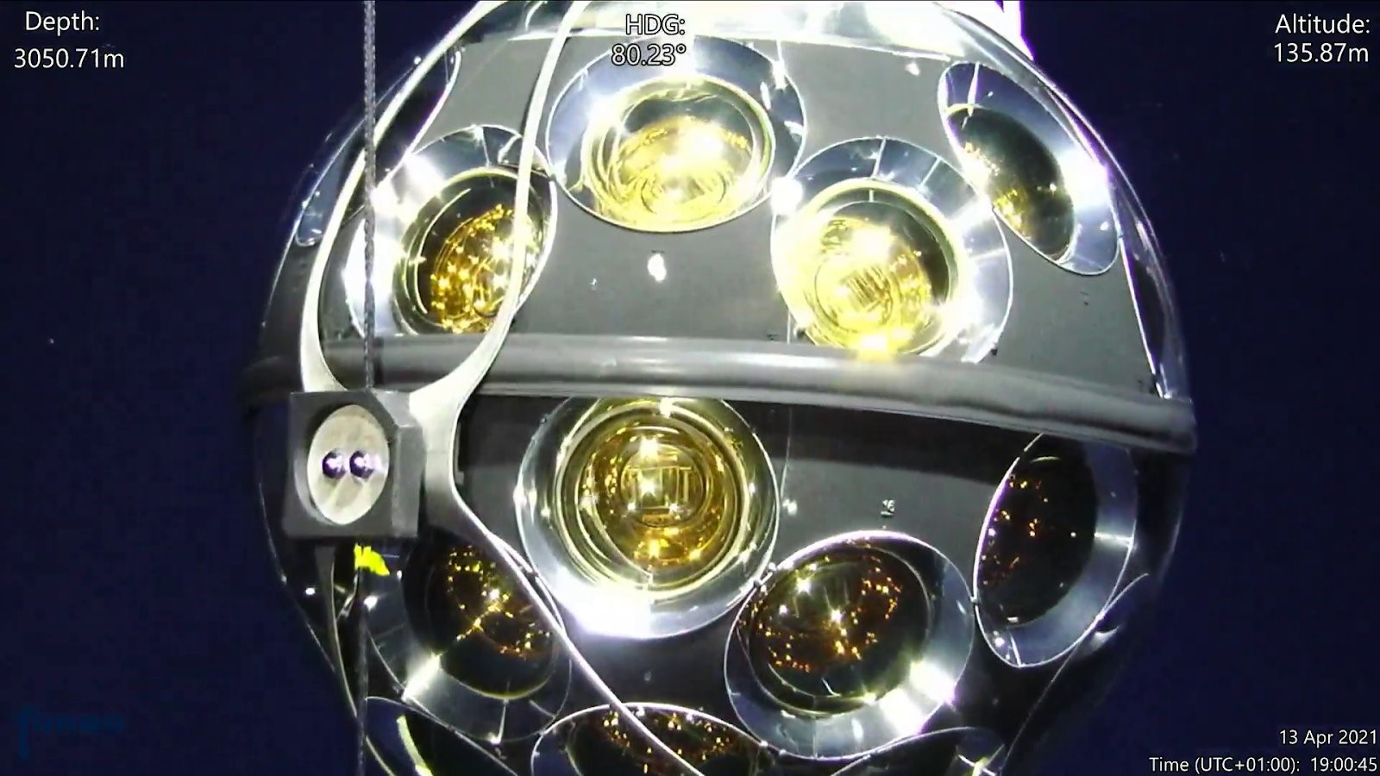
Some Underwater Photos…
DOM in action!
Sonar scan
of DOMs installed in KM3NeT ORCA
Copyright: KM3NeT
Notes:
Optical module photograph by submarine at a depth of 3050 m in the deep sea.
Sonar scan of string anchors in ORCA.

Slide 9
Why Neutrino Astronomy?
Detector Technology
Where is the Detector?
Preliminary Results
9
Notes:
The detector is placed at the bottom of the sea. Surely, if we put something at the bottom of the sea, it will be pitch black and there will be no background…right?
We need somewhere dark and spacious… the ociean!

Slide 10
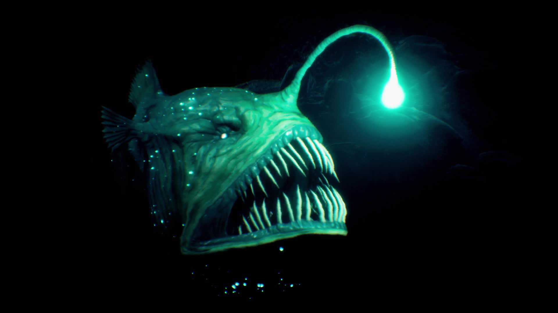
10
Notes:
What are you gonna find at the bottom of the ocean?

Slide 11
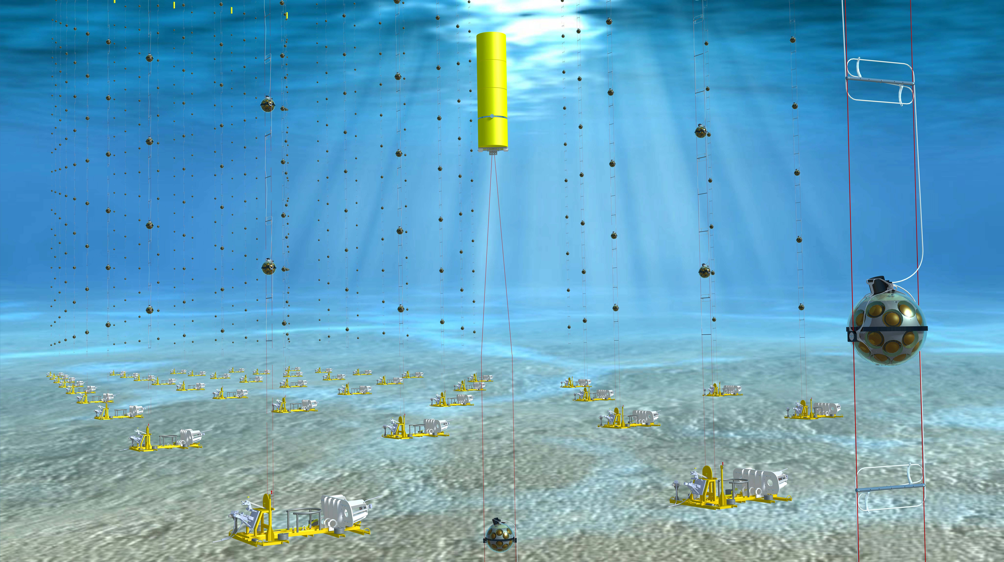
Why in the Mediterranean?
Water = target material & Cherenkov radiator
Interaction ℙ is higher in water compared to air
Mediterranean:
  Large volume of water target
  Deep waters
  Transparent
Major challenges:
  High pressure
  ⁴⁰K decays & bioluminescent organisms
11
Copyright: Edward Berbee/Nikhef
Notes:
View from inside a detector building block of detection units. Clearly visible the yellow buoy of a near by detection unit. (Copyright Edward Berbee/Nikhef)

Slide 12


Astroparticle Research with Cosmics in the Abyss
Goal: Astrophysical neutrino detection → TeV-PeV cosmic neutrinos
Layout: 1km³ sparsely instrumented (1 gigatonne)
Location: 90km south of Sicily, 3500m depth
ARCA
vs.
ORCA
Oscillation Research with Cosmics in the Abyss
Goal: Detect the oscillation of muon neutrinos into tau neutrinos, measure mass hierarchy → GeV scale atmospheric neutrinos
Layout: 7Mton densely instrumented
Location: 40km offshore of Toulon, 2450m depth
12

Slide 13
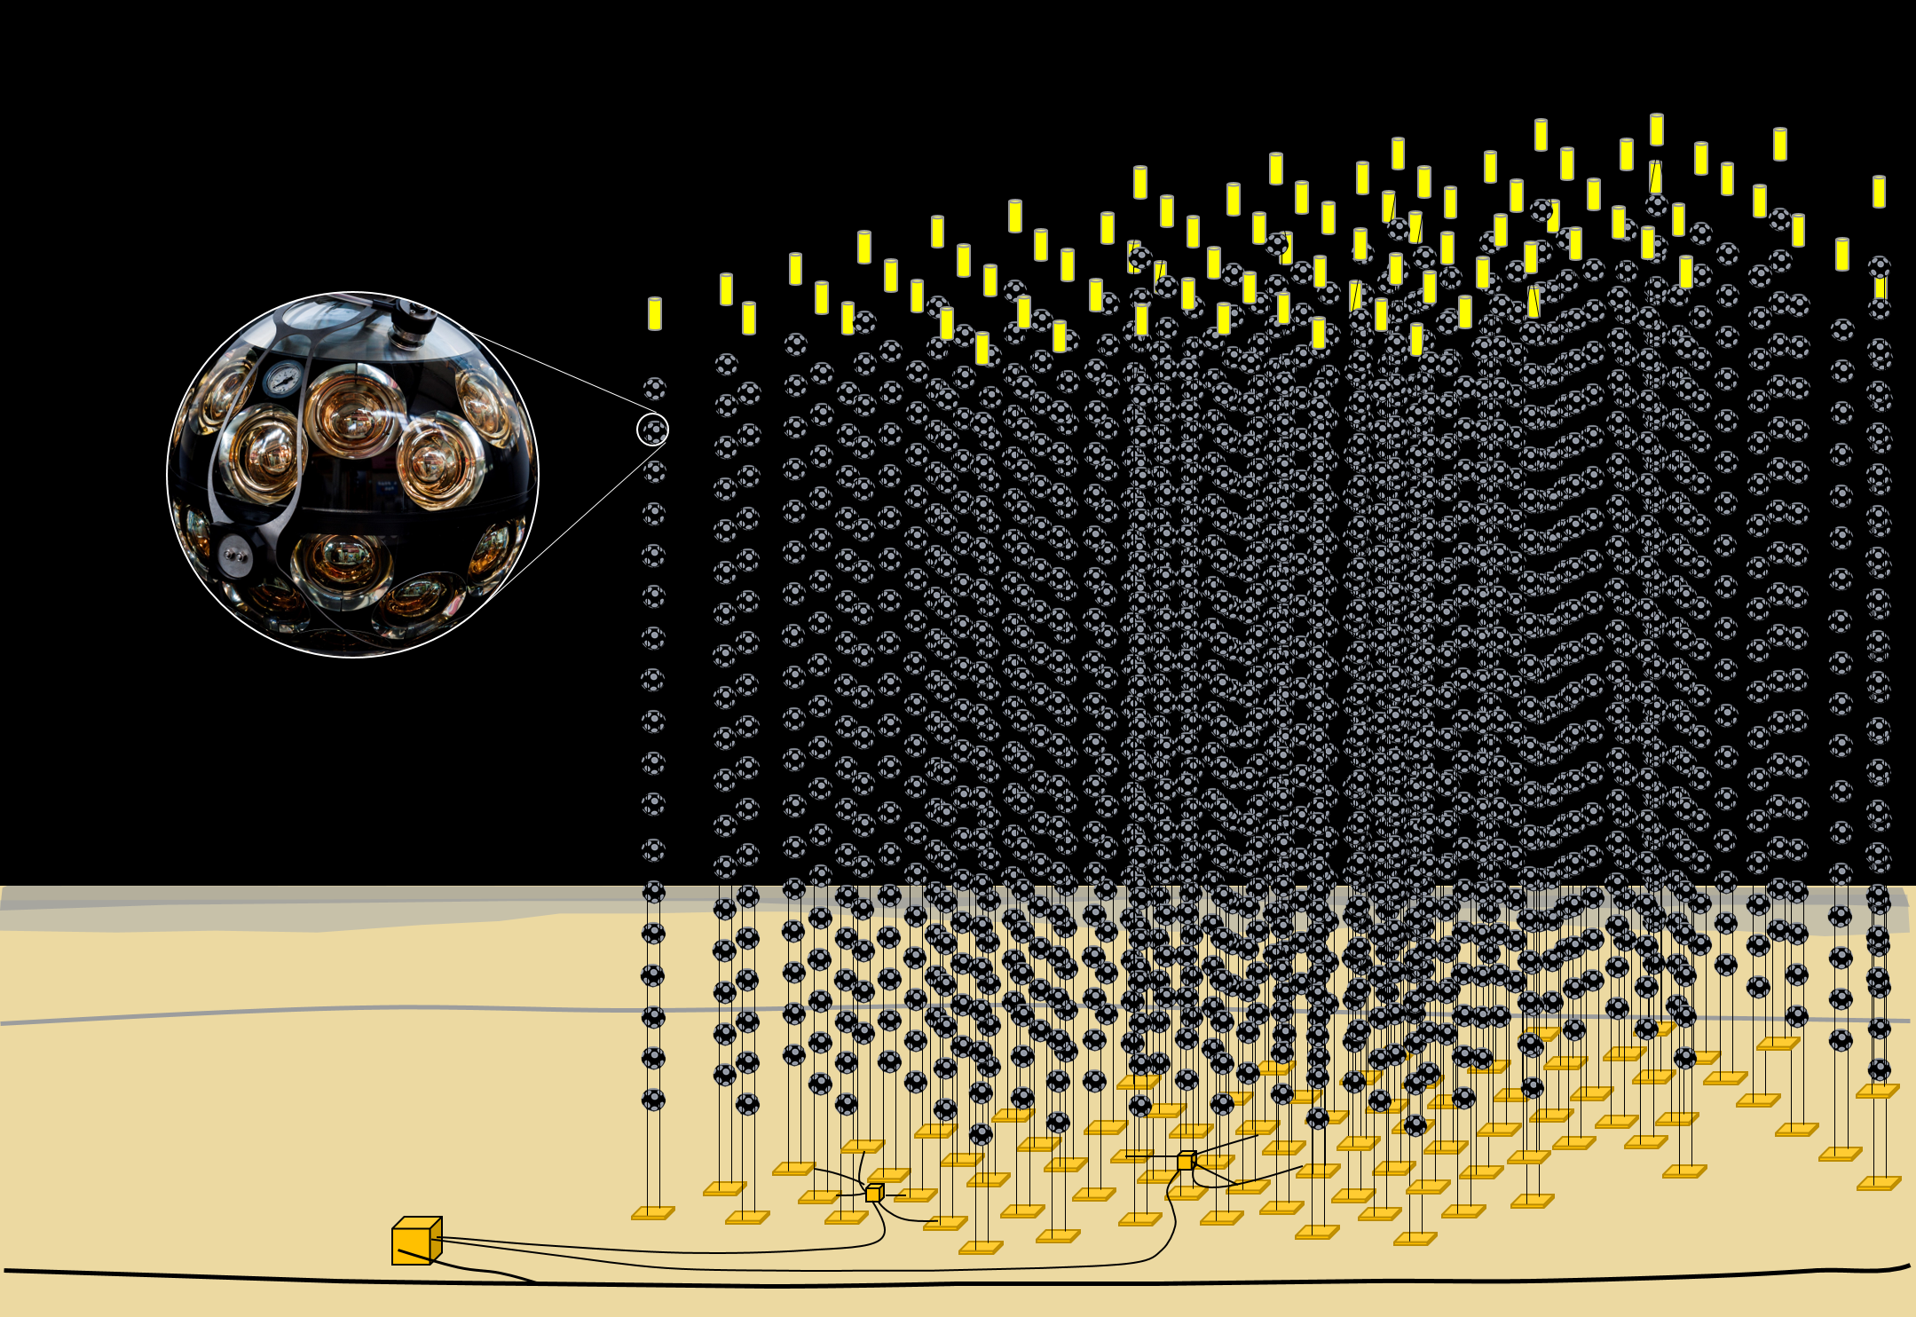
Experimental Layout
DOM – Digital Optical Module
3D grid of DOMs
DU = string-like structures, 18 DOMs + buoy, anchored to the seabed
DU – Detection Unit
 | ARCA | ORCA
DOM vertical spacing | 36m | 9m
DU horizontal spacing | 90m | 20m
Total number of DU | 230 | 115
Service Box
13
Copyright: KM3NeT
Notes:
Artist’s impression of the KM3NeT detector with the mulit-PMT optical module

Slide 14
Why Neutrino Astronomy?
Detector Technology
Where is the detector?
Preliminary Results
14

Slide 15
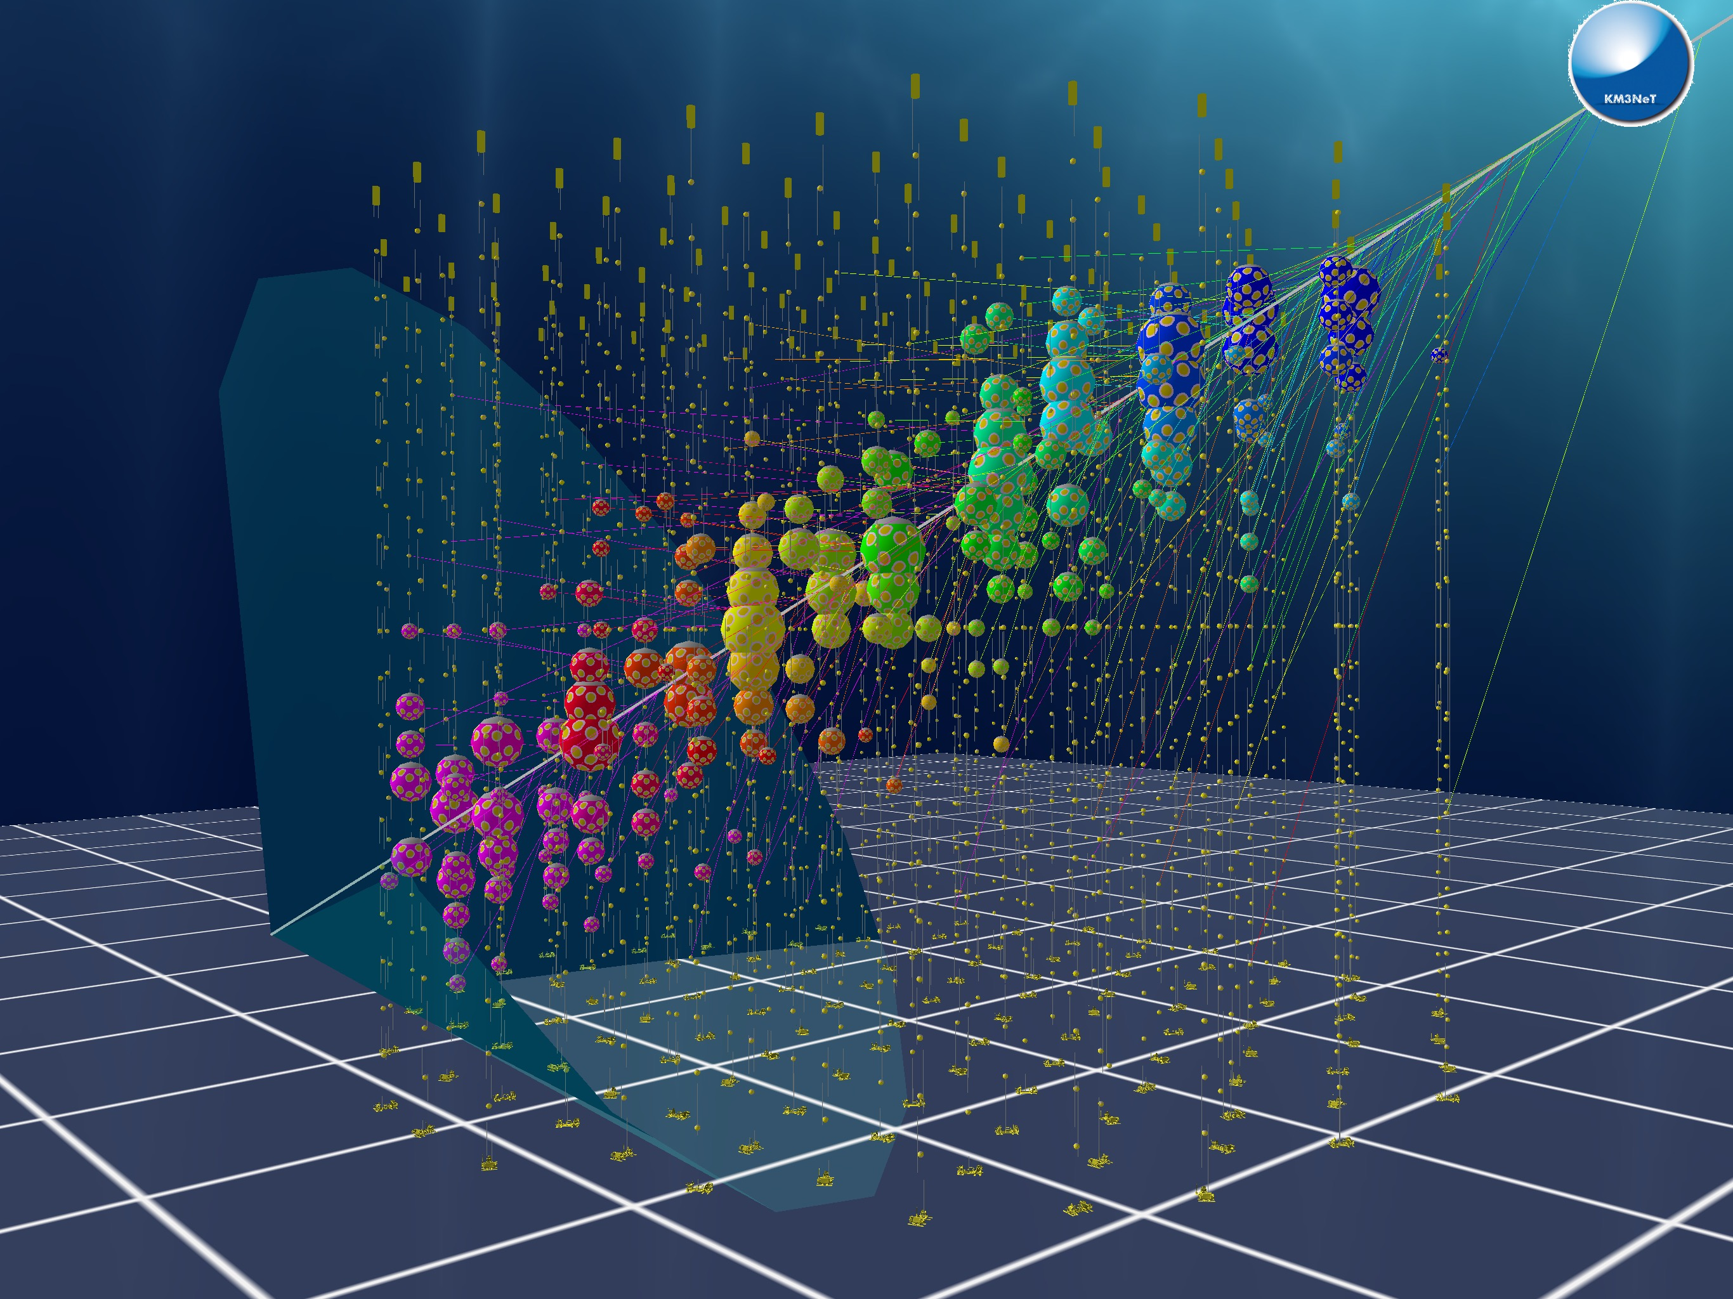
Data
All data is transmitted → triggered at shore stations
PMT hits → reconstruct energy & direction of incoming particles
Using machine learning to detect all possible configurations of neutrino-induced events
Construction ends 2028, currently data taking with reduced number of DU
15
Copyright: KM3NeT
Notes:
The visualisation of a simulated event in the KM3NeT/ORCA detector.

Slide 16
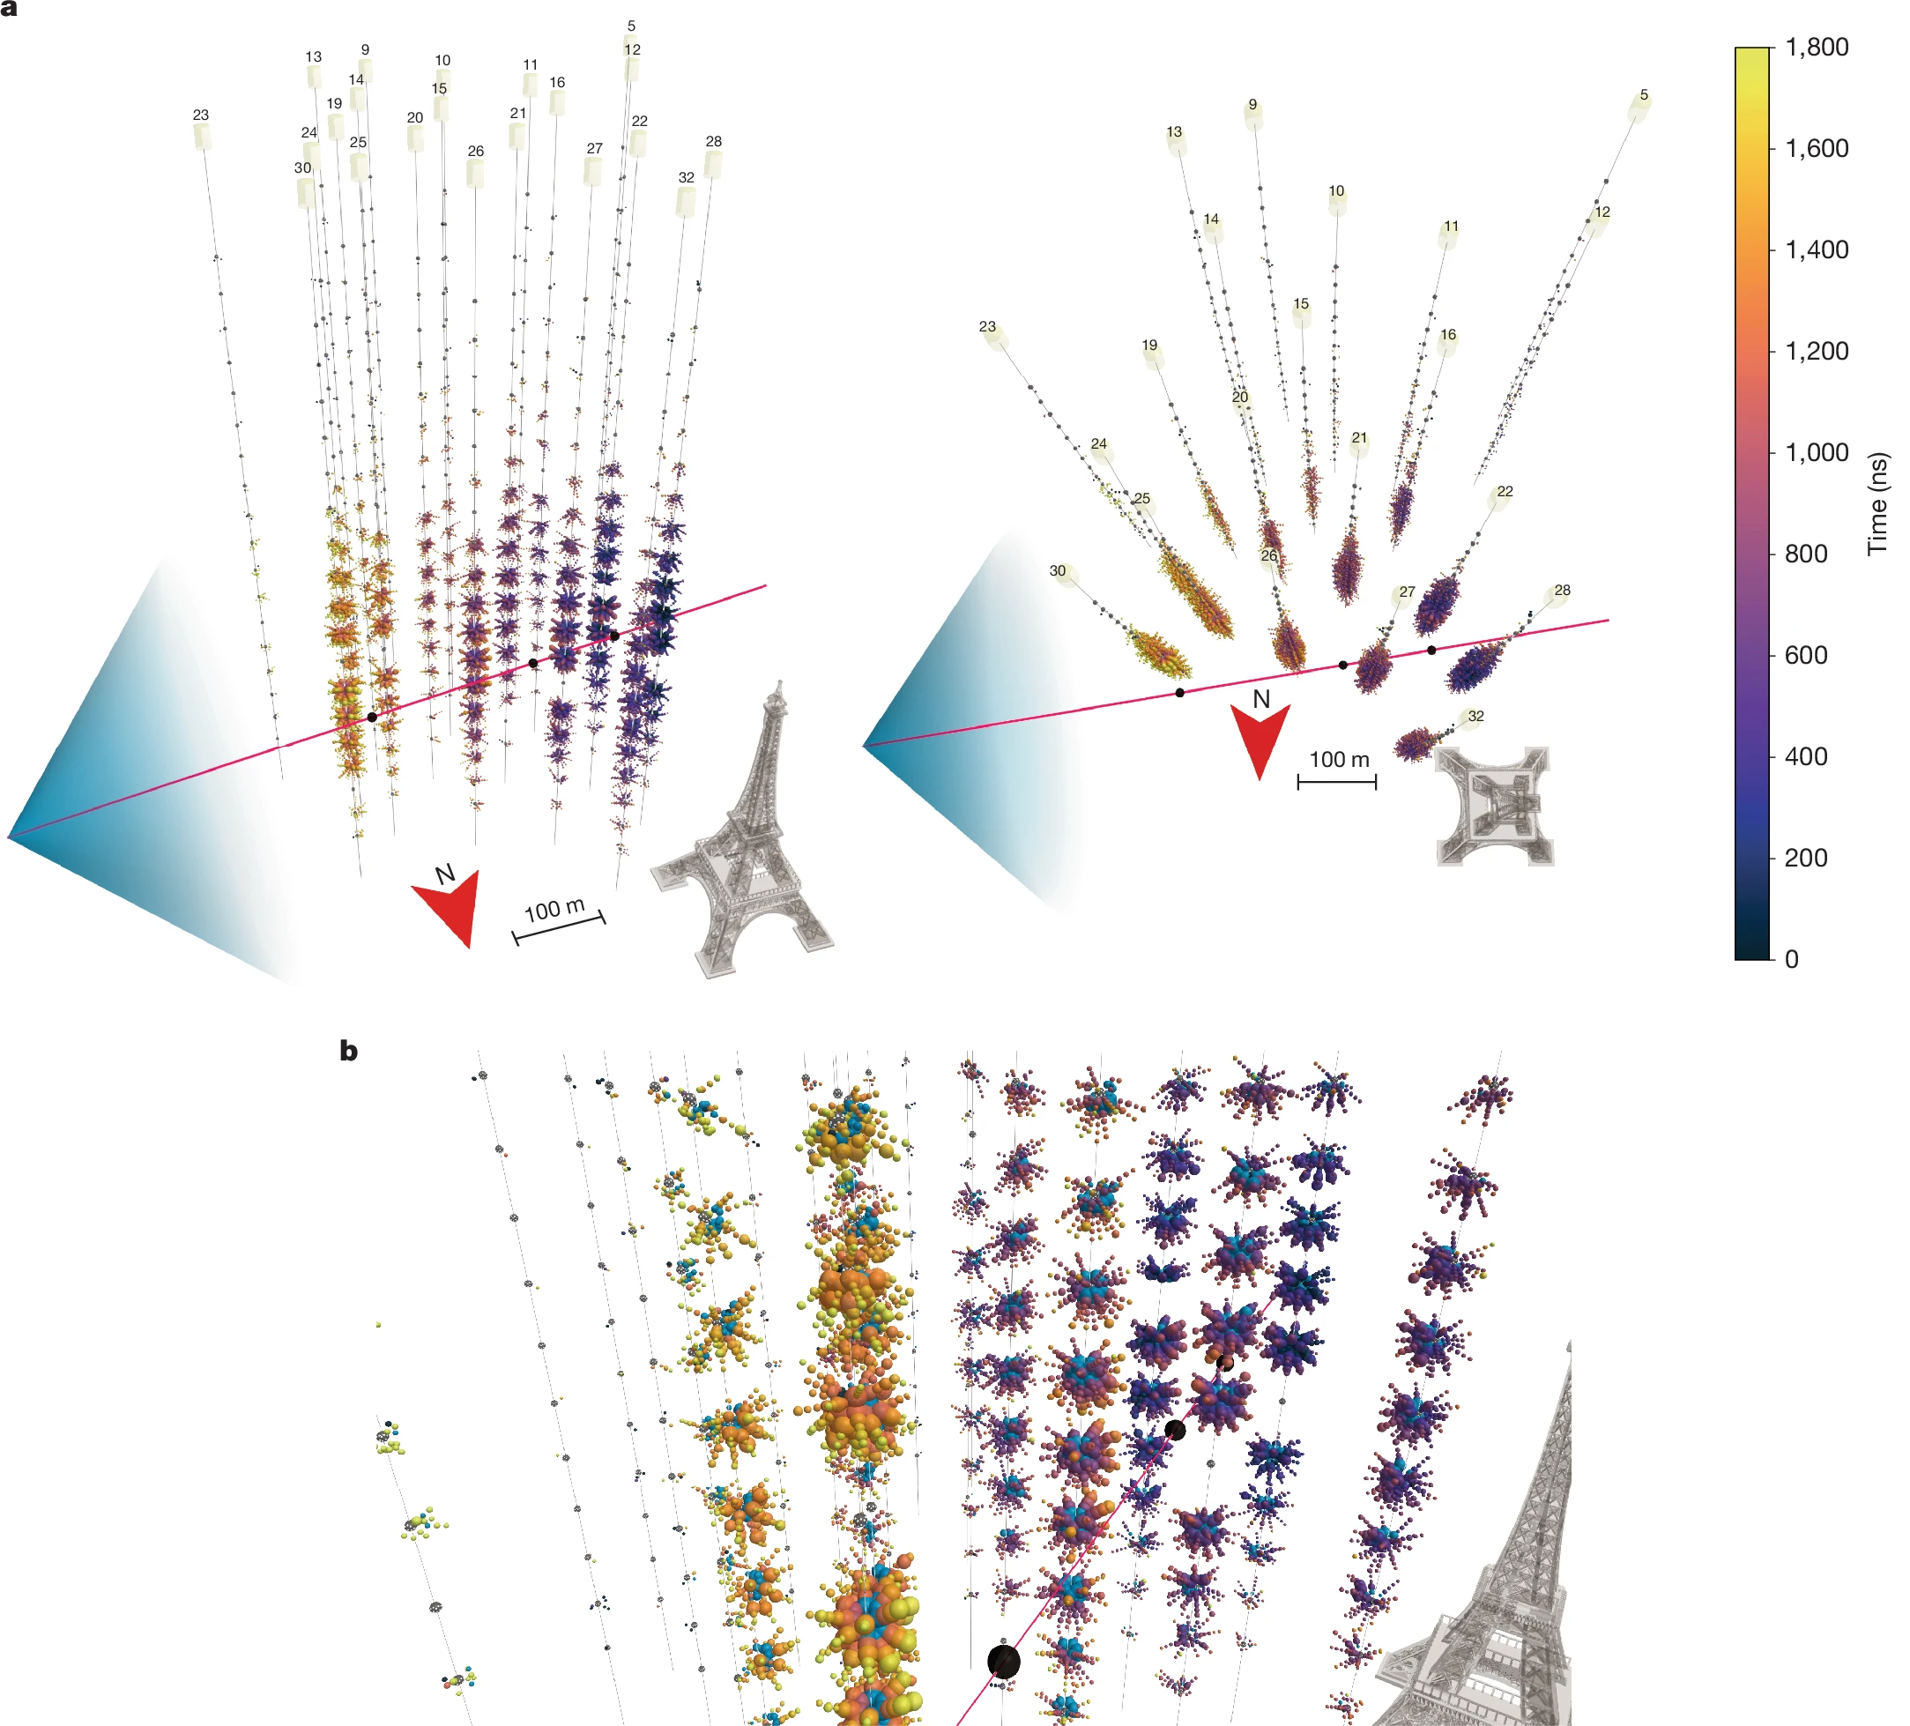
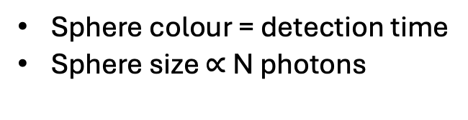
The neutrino event
KM3-230213A
ARCA, 21-line configuration
~220PeV neutrino, near horizontal
Detected Feb 2023, published Feb 2025
Sphere colour = detection time
Sphere size $∝$ N photons
16
KM3NeT Collaboration, Nature, 2025 https://doi.org/10.1038/s41586-024-08543-1
Notes:
Red line = reconstructed trajectory
Blue is the Cherenkov cone
Black spheres = location of secondary cascades
HP1: Upward fluctuation HP2: cosmogenic neutrino

Slide 17
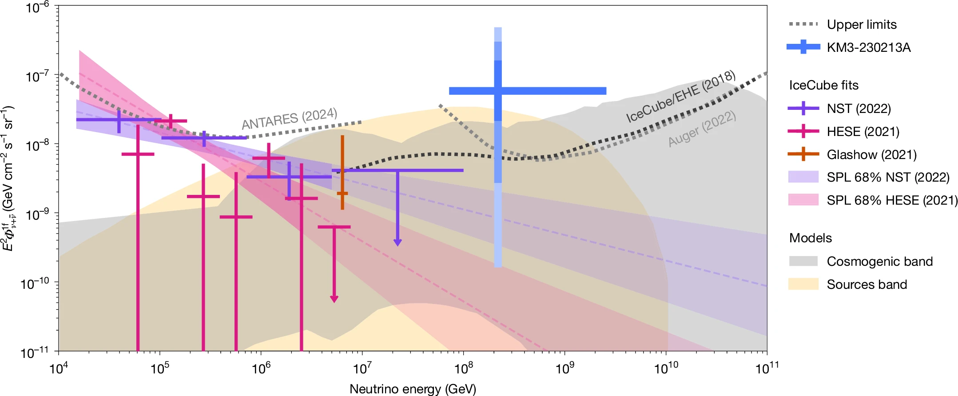
Comparison with Models & Earlier Measurements
17
Notes:
The flux measurement of this event is compared with measured and predicted neutrino fluxes and limits.
This event exceeds present limits from IceCube and Auger
1sigma 2 sigma 3 sigma confidence intervals

Slide 18
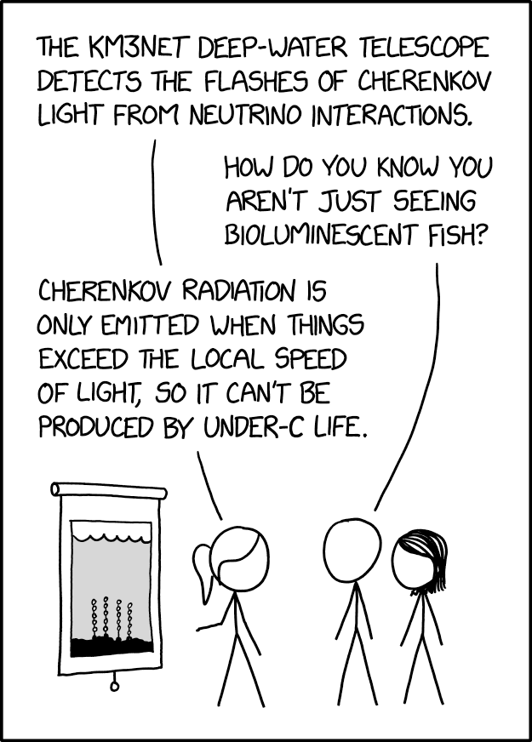
The End.
Thank you for listening!

Slide 19
BACKUP

Slide 20
Why Neutrino Astronomy?
ARCA vs ORCA
Detector Technology
Detector Installation
Preliminary Results

Slide 21
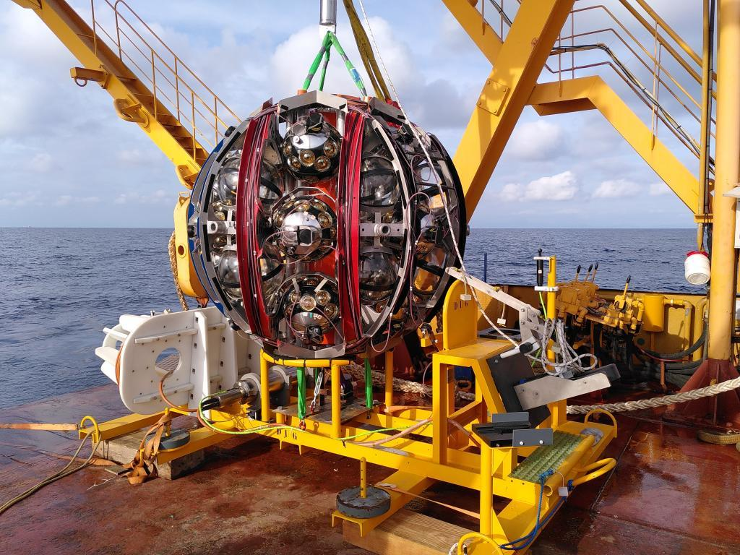
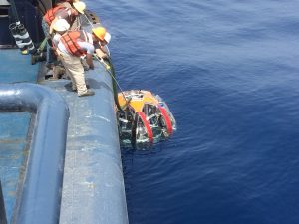
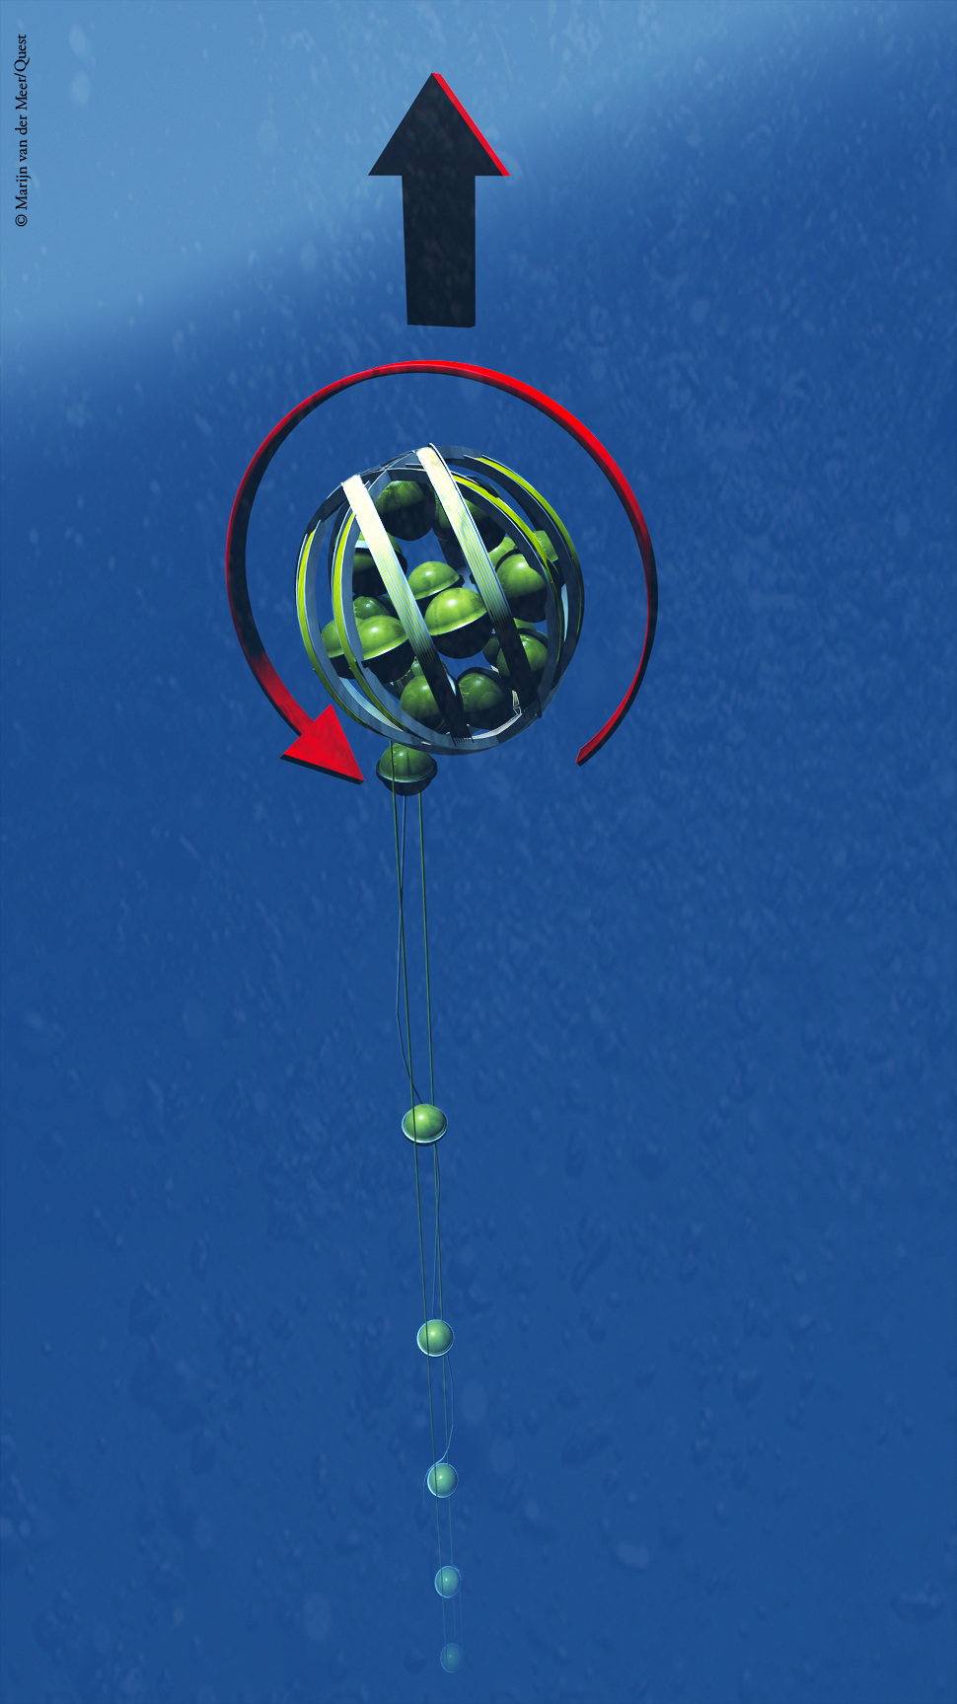
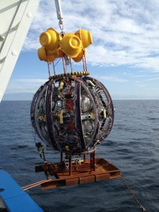
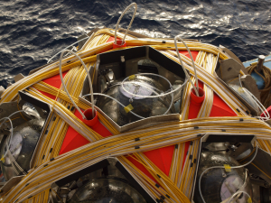



The Launcher Vehicle
Copyright: KM3NeT

Slide 22
Timeline
2012- Construction of seabed infrastructure at both sites
2013 -2014 – Prototype DOM took data
2014-2015 – Prototype string took data
Present: data taking is already taking place using a total of 21 DU ARCA (10 DU ORCA)
Second phase of construction has begun
2028-2043+ Data taking with complete detectors

Slide 23
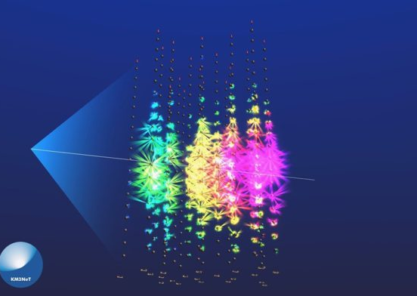
Preliminary Results
An ultra-high-energy event detected by KM3NeT/ARCA in its 21-line configuration.
Near horizontal muon neutrino
1/3 of detector illuminated,
~10PeV
Copyright: KM3NeT
Notes:
Fig. 4: An ultra-high-energy event detected by KM3NeT/ARCA in its 21-line configuration
recently KM3NeT has reported the detection of a remarkable muon neutrino of exceptionally high energy (see Fig. 4). The neutrino was near horizontal and illuminated one third of the detector, with the energy of the neutrino likely many tens of PeV; significantly higher than any neutrino previously observed.

Slide 24
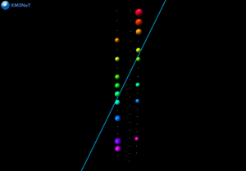
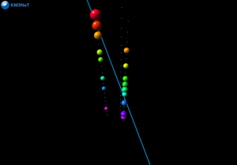
Hit Reconstruction
Copyright: KM3NeT
Sphere size = number of photons collected
Colour = arrival time (red →blue)
Notes:
Visualisation of a muon particle travelling close to two detection units of the KM3NeT/ARCA detector and generating light in the optical modules. The light recorded by the optical modules in the detection units is made visible as spheres with a size that reflects the amount of light collected and a colour that represents the arrival time of the light on the module: red is earlier than blue. The path of the muon particle that travels from above is reconstructed from this information and is made visible as the blue line.

