Slide 1
Cu-rious Alloys
Copper Alloy Designs for High-Gradient Accelerating Structures
1
Appl. Phys. Lett. 120, 134101 (2022)
Joshua Appleby

Slide 2
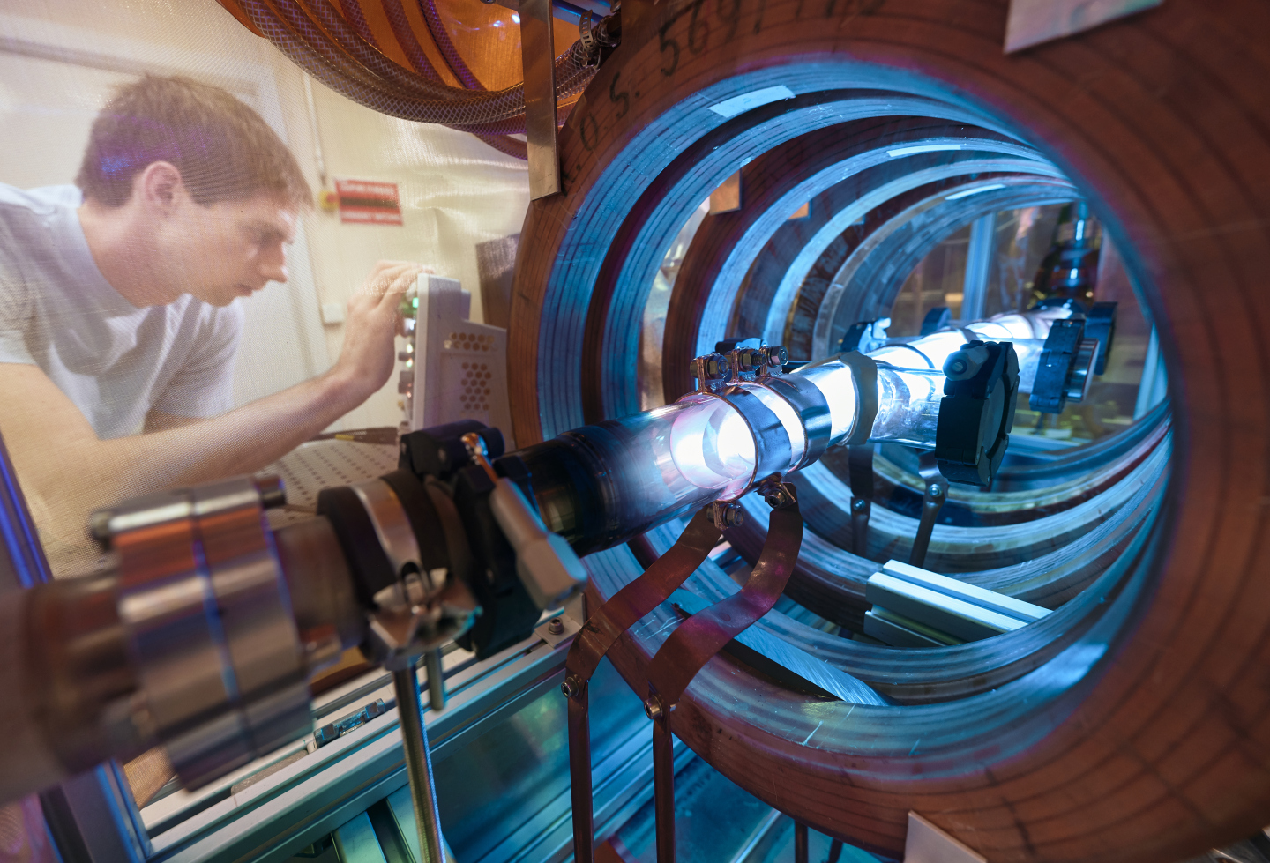
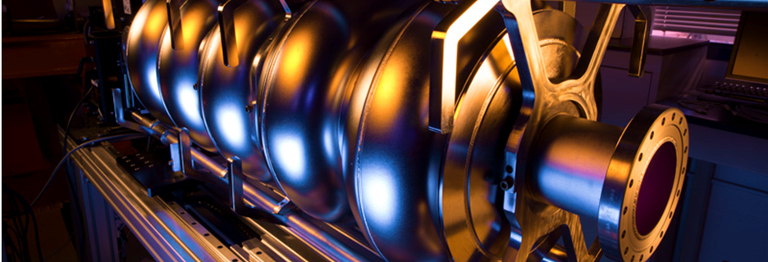
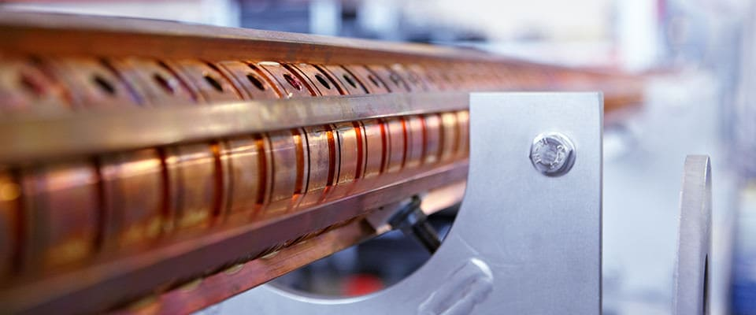
The Acceleration Gap
2
Superconducting RF [1, 2]
>= 55 MV/m
Up to 1 GHz
Low Breakdown Rates
High Efficiency
Requires Cryo-plant
Normal Conducting RF [1]
5 MV/m -> 100 MV/m
Up to a few GHz
High Breakdown Rates
Low Efficiency
No extra equipment
Plasma Wakefield (Laser/Beam) [3]
0.2 GV/m -> 300 GV/m
Experimental
Requires auxiliary equipment
Normal Conducting RF Copper Alloys?
Nb
Al
Mo
Cu
MV/m
10
100
1000
[1] H. Podlech, 2013
[2] D. Proch, 1998
[3] A. Cakir, O. Guzel, 2019
Images: Fermilab, Research Instruments, CERN
Notes:
To build Multi-TeV machines for Higgs factories (L inv propto gradient), we need:
High accelerator gradients
-> so we can reduce footprint
-> so its cheaper
Issue is breakdown in NC RF occurring above 100 MV/m.

Slide 3
Finding Suitable Materials
3
Experiment
Experiment
Experiment
Results
Trial & Error
Trial & Error
Trial & Error
Old
One Potential Material Identified
Time Consuming
Time Consuming
Time Consuming
Expensive
Expensive
Expensive
Simulations and Models
Experiment
Results
Computationally Light
Check Predictions
New
Should rank expected performance, relative to other materials
Limited Number of Trials Needed
Many Potential Material Identified
Must handle a wide range of hypothetical materials
Expensive
Notes:
Historically, new alloys have been found via trial and error which is time consuming and expensive
Use a Model that evaluates the proposed alloy, reducing the number of potential options to try.
But for the model to be useful, must be able to handle a wide range of theoretical materials, and be computationally light; thus must cannot include quantum, macroscopic or microstructural simulations

Slide 4
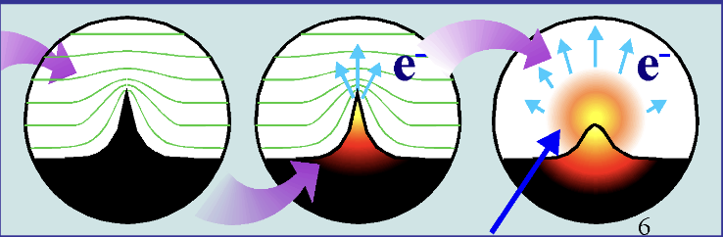
RF Breakdown: How?
4
[1] M. Tsventoukh, G. Mesyats, S. Barengolts, 2013
[2] J. W. Kovermann, 2010
Notes:
Emphasize the High E fields due to high gradients is proportional to the breakdown rates.
Defects in cavity surface due to manufacturing issues, contamination etc
Ohmic heating by emission current
Explosive electron emission
These electrons collide with the cavity walls and generate secondary electrons while chipping ions off the walls
Repeat
These collisions suddenly impart LOTS of energy into the walls, heating and deforming the surface
When the newly formed electron and ion plasma gets dense enough, conductivity is high, will short the cavity and cause a power drop. Can also melt, vaporize or mechanically stress the cavity walls.

Slide 5
Pure Material Structure
5
Due to regular arrangement:
Layers can slide
If they do slide, the structure is unchanged
The material is soft, and susceptible to breakdown
Minimal electron scattering, therefore high electrical conductivity and minimal thermal stress

Slide 6
Impure Material Structure
6
Due to irregular arrangement:
Layers cannot slide easily
If they do slide, the structure is significantly changed
The material is hard, and resistant to breakdown
Significant electron scattering, therefore low electrical conductivity and increased thermal stress
Notes:
Increased thermal stress -> Increased deformation -> increased electron avalanches -> increased breakdowns

Slide 7
RF Breakdown: Dependencies
7
Material Properties
Beam Properties
Peak RF Pulse Heating
Electromagnetic Properties
Physical Properties
Peak Surface Electric Fields
Hardness
RF Pulse Duration
Thermal Expansion Coefficient
Peak Surface Magnetic Fields
Thermal Conductivity
Beam Energy
Electrical Conductivity
Lattice Properties
Thermal Stress
Beam Charge
Magnetic Permeability
Surface Roughness
Shear Stress
Beam Current
Electrical Resistivity
Specific Heat Capacity
Frequency
Vacuum Quality
Density
Notes:
E conductivity, E resistivity
Hardness, Thermal exp coeff, thermal conductivity, lattice properties, shear stress, specific heat capacity, density
The model only factors in material properties, not properties of the beam or particles.

Slide 8
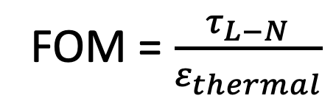
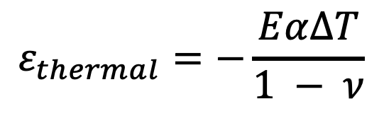
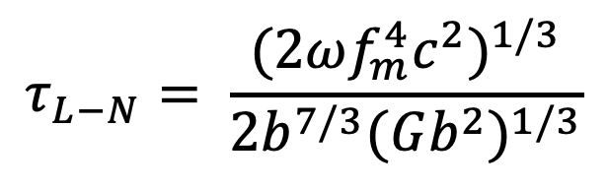
Figure-Of-Merit Model
8
Critical Resolved Shear Stress
Shear Modulus
Burgers Vector
$$τ_{L−N}= \frac{{(2ωf_{m}^{4}c^{2})}^{1/3}}{2b^{7/3}{(Gb^{2})}^{1/3}}$$
Maximum Interaction Force
Solute Concentration
Interaction Distance
Thermal Expansion Coefficient
FOM = $\frac{τ_{L−N}}{ε_{thermal}}$
Young’s Modulus
Poisson's Ratio
Thermal Stress due to RF Pulse Heating
Temperature Rise due to RF Pulse Heating
$$ε_{thermal}=−\frac{Eα∆T}{1 − ν}$$
Density
Specific Heat
Impedance
Electrical Conductivity
Thermal Conductivity
Notes:
See which values are used from previous slides.
The FOM model must balance the increased breakdown resistance (hardness) and the increased likelihood of breakdown (electrical conductivity).
The critical resolved shear stress (tau) (Labusch Nebarro model), shows the stress required to get the lattice to slip; defined by:
+ Shear Modulus – how a material deforms in response to a force parallel to a surface
+ the Burgers vector (b) which defines the magnitude and direction of the lattice distortion in the case of a lattice slip.
+ the maximum interaction force (f), between the solute and any dislocations
+ The solute concentration
+ the interaction distance between the solute and the dislocation
The thermal stress induced on the surface by RF pulse heating is approx by:
+ The thermal expansion coefficient
+ Youngs modulus, eg. Pulling on a wire and how much the wire stretches by
+ Poissons ratio, eg. Pulling on a wire and seeing how much thinner the wire gets.
+ temperature rise dependent on the surface resistivity (dependent on density, specific heat, impedence, thermal and electrical conductivity)
This FOM model can take into account additional RF params for optimization (required RF wavelength and accelerating gradient).
It however doesn’t take into account: machinability, surface roughness, solute solubility etc, so is used as a guide to initiate design of new allots, not as an engineering/performance tool

Slide 9
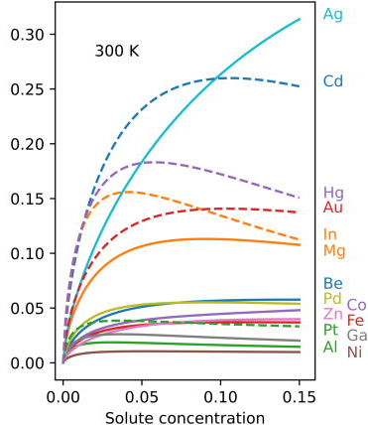
FOM Results
9
This FOM model has been used to:
Screen the periodic table for potential Cu alloys
Assess the relative performance of those alloys for RF breakdown under high gradients (> 100 MV/m)
Identify some promising alloys
Suggest optimal solute concentrations
But how does this compare to experimental results?

Slide 10
Experimental Agreement
10
The results here agree with experimental results:
Ag, Cd, Hg, Au, In and Mg all known for good electrical conductivity
CuAg experimentally shown to have lower breakdown rates compared to pure Cu [1].
CuMg experimentally shown to have excellent strength and electrical properties [2].
CuIn also mathematically modelled to have enhanced tensile strength and electrical conductivity [3].
[1] V. Dolgashev, EAAC, 2015
[2] S. Gorsse, et al, 2015
[3] H. Zhang, et al, 2020

Slide 11
Conclusion
11
This FOM model has successfully:
  Found potential Cu alloys designed for > 100 MV/m gradients while minimising breakdown rates
  Suggested alloys in agreement with experimental results
  Proof-of-concept methodology successfully demonstrated
The FOM model can be used in future to:
  Significantly increase the throughput of testing potential RF cavity alloys
  Model potential alloys using a different “base” eg Niobium
  Model tertiary or quaternary alloys
Notes:
Niobium base instead of copper? For example as niobium is exceptionally expensive.

Slide 12
Thank You For Listening
12
Any Questions?

