Slide 1

Space Hurricanes
Ion-Neutral Coupling in the Polar Ionosphere
Zhang et al, 2021, Nature Communications & Xiu et al, 2023, GRL
  Contents:
  Ion-Neutral coupling in space hurricanes
  Analysis of 2014 event
Speaker: Lizzie Bloomfield 11th March 2025
Notes:
Good [morning/afternoon], everyone. Today, I’ll be discussing space hurricanes and their impact on the polar ionosphere with a focus on ion-neutral coupling within these systems.
This discussion is centred around the findings of two papers; A space hurricane over the Earth’s polar ionosphere and Direct Observation of the Space Hurricane Disturbed Polar Thermosphere

Slide 2
Outline
1. Why research space hurricanes?
2. What are they?
3. What mechanisms drive them?
4. How do we define them?
Speaker: Lizzie Bloomfield 11th March 2025
Notes:
Good [morning/afternoon], everyone. Today, I’ll be discussing space hurricanes and their impact on the polar ionosphere with a focus on ion-neutral coupling within these systems.
This discussion is centred around the findings of two papers; A space hurricane over the Earth’s polar ionosphere and Direct Observation of the Space Hurricane Disturbed Polar Thermosphere

Slide 3
Impacts of Space Hurricanes
Ionosphere/Thermosphere Disruptions:
  Weaken the intensity of/reverse the direction of the neutral wind.
  Effective source of polar cap atmospheric gravity waves.
Impact on GPS & Communications:
  Radio signal propagation affected.
  GPS errors increase.
Impact on Satellites:
  Thermospheric expansion increases drag on low-Earth orbit (LEO) satellites.
Additional Implications
  Potential occurrence of similar phenomena on other planets with magnetic fields.
Speaker: Lizzie Bloomfield 11th March 2025
Notes:
"Space hurricanes have significant implications for space weather and human technology:
Navigation errors: GPS signals refract in disturbed ionospheric regions, causing positioning errors.*
Satellite drag: Thermospheric expansion increases drag on low-Earth orbit (LEO) satellites, altering trajectories.*
Communication disruptions: HF radio signals are absorbed or scattered by turbulent plasma.*
Understanding these effects helps improve space weather forecasting and satellite operations."*

Slide 4
What is a Space Hurricane?
Large-scale plasma storm.
Features:
          Rotating plasma currents
          Electron precipitation
          Auroral emissions
Forms due to solar wind interactions with Earth’s magnetic field.
https://doi.org/10.1038/s41467-021-21459-y | www.nature.com/naturecommunications
Speaker: Lizzie Bloomfield 11th March 2025
Notes:
We are all familiar with atmospheric hurricanes—large cyclonic storms driven by heat and pressure differences in the lower atmosphere. But space hurricanes occur in the polar ionosphere (50-1000km), made entirely of plasma instead of water vapor. These plasma cyclones have:
A rotating structure similar to a hurricane, with an 'eye' of low plasma density at the center.*
Plasma flow speeds exceeding 2000 m/s, driven by solar wind interactions.*
Enhanced electron precipitation, which produces intense auroral emissions.*
Space hurricanes differ from geomagnetic storms due to cyclonic pattern and low geomagnetic activity

Slide 5
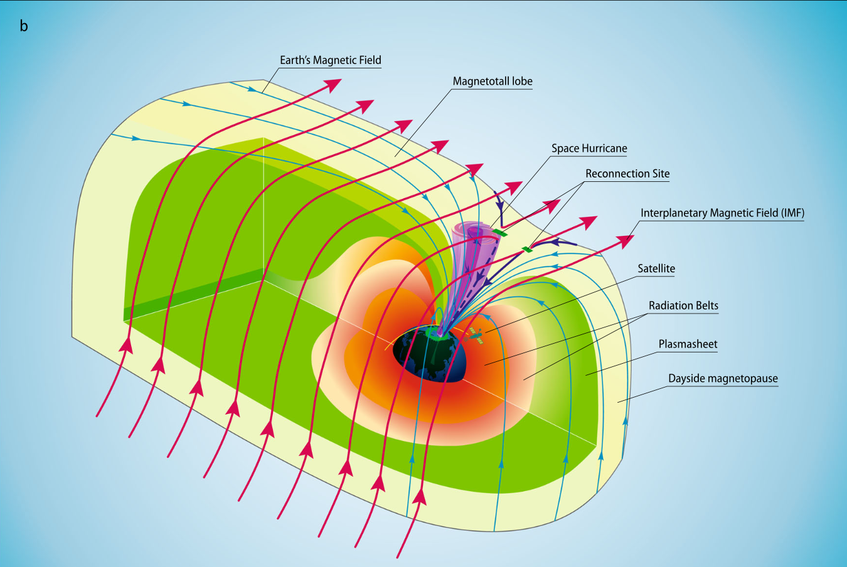
How do they form?
https://doi.org/10.1038/s41467-021-21459-y | www.nature.com/naturecommunications
Speaker: Lizzie Bloomfield 11th March 2025
Notes:
"Unlike atmospheric hurricanes, space hurricanes don’t require warm ocean waters—they form due to magnetospheric reconnection.
The solar wind is a continuous stream of charged particles (mostly electrons and protons) emitted by the Sun
When the IMF is northward, energy from the solar wind still enters the magnetosphere through dayside reconnection. Even in periods of low geomagnetic activity, dayside reconnection (where the solar wind and magnetosphere directly connect) allows energy transfer into the magnetosphere.
This energy is then channeled into the polar ionosphere, creating strong plasma flows
under the right conditions, these plasma flows can form a cyclonic pattern over the pole, creating the hurricane.*
Accelerated electrons in the plasma flows enhance the aurora, ionizing the upper atmosphere and sustaining the vortex for hours.*
These processes cause a stable, hurricane-like plasma structure even during low geomagnetic activity."*

Slide 6
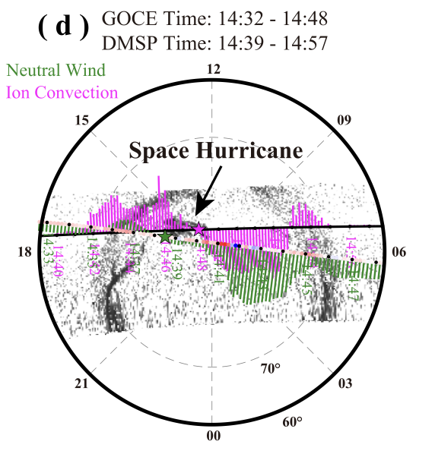
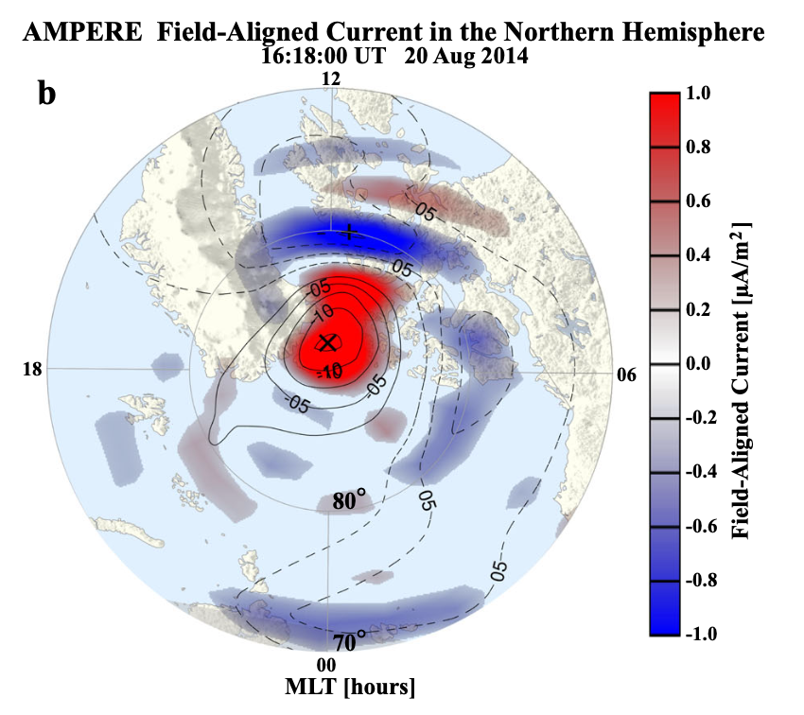
Detected Space Hurricane Event
2010
2014
Geophysical Research Letters, 51, e2023GL106735. https://doi. org/10.1029/2023GL106735
https://doi.org/10.1038/s41467-021-21459-y | www.nature.com/naturecommunications
Speaker: Lizzie Bloomfield 11th March 2025
Notes:
Historically, space hurricanes in our upper atmosphere has been purely theoretical but in the last two years, Shandong University in China has confirmed the existence of two space hurricanes, one on the 15th July 2010 and one on the 20th August 2014. Their two recent papers discuss their findings in studying these two storms, looking at the mechanisms involved and impacts they have.

Slide 7
Ion-Neutral Coupling
What is ion-neutral coupling?
Exchange of momentum and energy
Causes ion drag and heating within neutrals
Key processes:
Collisional interactions
Joule heating
Atmospheric/ion drag
$$a_{drag}=v_{ni}(u-v)$$
Speaker: Lizzie Bloomfield 11th March 2025
Notes:
"Now, let’s discuss ion-neutral coupling, a fundamental process in ionospheric physics. The ionosphere consists of charged particles such as electrons and ions, while the thermosphere is mostly neutral, as it is mainly composed of nitrogen and oxygen molecules. These two regions interact through:
Collisional momentum transfer: Ionized and neutral particles collide, causing energy and momentum exchange.*
Joule heating: Strong ionospheric currents heat the neutral atmosphere through electron-neutral and ion-neutral collisions.*
Atmospheric drag: which can be defined by the following equation, in which u and v are the neutral and plasma velocities, respectively and v_ni is the neutral-ion collision frequency. Typically in higher altitudes, the thermosphere is weakly ionized and so v_ni is small but this can be modified by particle precipitation.

Slide 8
Ion-Neutral Coupling in Space Hurricanes
How do space hurricanes affect the neutral atmosphere?
  Enhanced ionospheric currents → increased Joule heating.
  Localized thermospheric expansion → increases ion drag.
Geophysical Research Letters, 51, e2023GL106735. https://doi. org/10.1029/2023GL106735
Speaker: Lizzie Bloomfield 11th March 2025
Notes:
"During a space hurricane, ion-neutral coupling is significantly enhanced due to:
Rapid plasma rotation, which increases ion-neutral friction and momentum transfer.*
Localized Joule heating, which creates strong thermospheric upwelling.*
The figure shows satellite observations of vertical neutral wind speed (shown in red) and fractional neutral density fluctuation (shown in blue) as it travels over the north pole from dusk to dawn. As can be seen, in the hours after the space hurricane, both the vertical wind and the fraction neutral density begin to fluctuate dramatically. The vertical wind (red line) shows a reversal in this region, indicating strong ion-neutral coupling effects.
The fractional density fluctuations (blue line) are also enhanced, suggesting strong disturbances in atmospheric density.

Slide 9

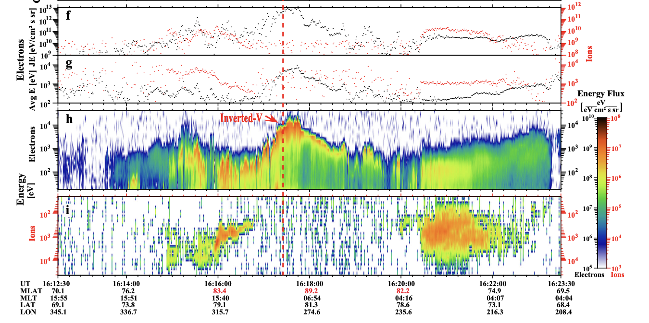
Analysis of 2014 Hurricane
https://doi.org/10.1038/s41467-021-21459-y | www.nature.com/naturecommunications
Speaker: Lizzie Bloomfield 11th March 2025
Notes:
These plots show hurricane characteristics such as the precipitating electron and ion total energy flux, g the electron and ion average energy, h the precipitating electron energy flux, and i the precipitating ion energy flux.. Fig. 3f, g show a significant increase in the total energy flux (shown in black, top) and the average energy of the precipitating electrons (shown in black, bottom), indicating the characteristic electron precipitation that occurs during space hurricanes.
Clear electron inverted-V acceleration appeared within the space hurricane. Note that there is almost no ion precipitation in the space hurricane area (Fig. 3i). These observations indicate that the space hurricane contains accelerated electron precipitation but has little effect on the convection of local ions.

Slide 10
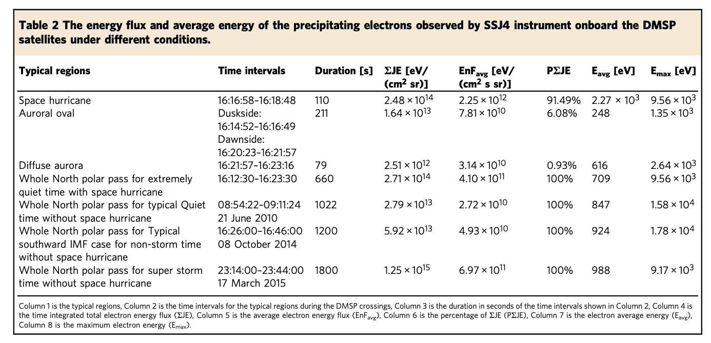
Analysis of 2014 Hurricane
https://doi.org/10.1038/s41467-021-21459-y | www.nature.com/naturecommunications
Speaker: Lizzie Bloomfield 11th March 2025
Notes:
The sum of the total energy flux is about 10 times higher than that for a polar pass without a space hurricane also under a geomagnetic quiet condition (see Tables 1 and 2 for the DMSP pass from 08:54:22 to 09:11:24 UT on 21 June 2010).
The space hurricane has an average energy flux about 15.1 times higher than the pass for the typical quiet case and even 3.2 times higher than the super storm case (see Table 2). These means that the average electron energy flux in the space hurricane (2.2 × 1012 eV/(cm2·s·sr)) is much higher than that during substorm expansion, but is comparable to that during super storms.

Slide 11
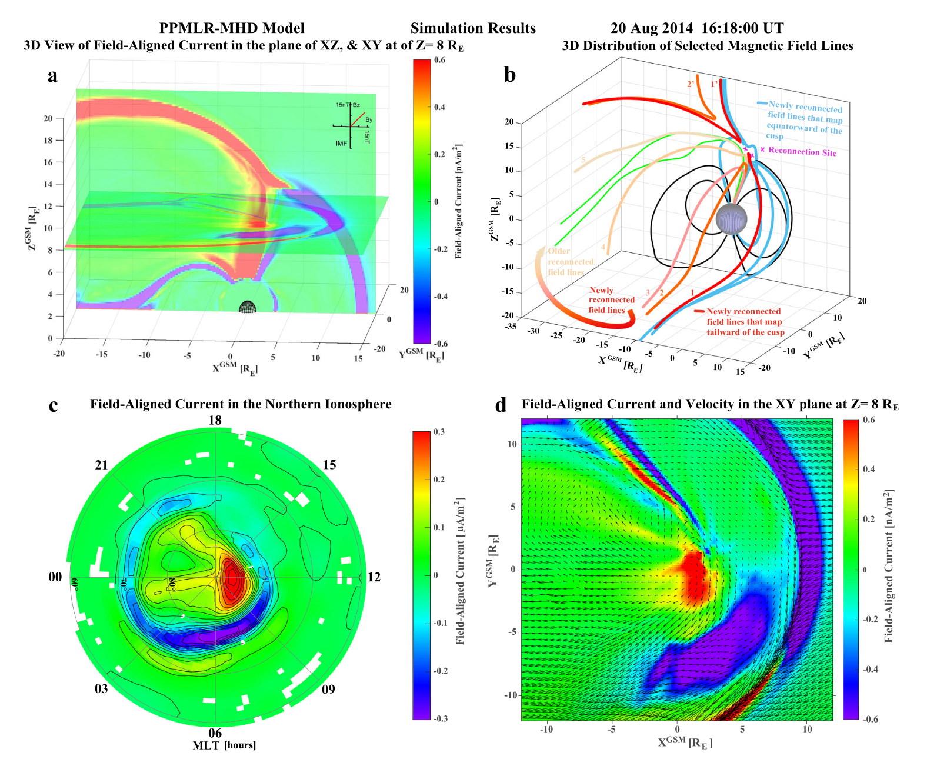
Analysis of 2014 Hurricane
  Further Observations:
  Upward displacement of neutral particles
  Thermospheric density increased by 15%.
  GPS signal disruptions due to ionospheric turbulence.
https://doi.org/10.1038/s41467-021-21459-y | www.nature.com/naturecommunications
Speaker: Lizzie Bloomfield 11th March 2025
Notes:
Panel c shows the polar view of the Northern Hemisphere ionosphere, with FAC intensity mapped using color contours. The strongest currents (red regions) align with the auroral oval, suggesting intense electron precipitation in the polar ionosphere, a hallmark of space hurricanes.
This zoomed-in panel shows FACs (color-coded) and plasma velocity vectors (black arrows). The central red region corresponds to a strong upward FAC, meaning electron precipitation is concentrated there.
The plasma velocity vectors reveal a rotational pattern, consistent with the vortex-like motion of a space hurricane.
This simulation confirms that magnetic reconnection at high latitudes can generate large-scale FACs, contributing to space hurricane formation.
The rotational plasma flow pattern in panel (d) suggests that ionospheric and magnetospheric currents are strongly coupled.
The FAC distributions in panel (c) align with auroral precipitation patterns, reinforcing the role of ion-neutral coupling in shaping thermospheric disturbances.

Slide 12
Conclusions
  Concluded features of space hurricanes:
    Dominated by electron precipitation.
    Can increase thermospheric density by 15%.
    Disrupt GPS and radio signals
    Distinctly different from geomagnetic storms
    Potential for future research comparing space hurricanes and super storms.
Speaker: Lizzie Bloomfield 11th March 2025
Notes:
In their 2023 paper, Xiu has created a simulation of the 2014 hurricane, as seen here.
This panel shows the distribution of FACs and the curved structure of the currents suggests an active region of plasma interaction, likely driven by solar wind-magnetosphere interaction, that is indicative of the hurricane.
On the bottom line, the strongest currents (red regions) align with the auroral oval, suggesting intense electron precipitation in the polar ionosphere, a hallmark of space hurricanes.
Analyzing the 2014 space hurricane further, the group came to the conclusion that:
Thermospheric density increased by 15% in the affected region.*
GPS signal disruptions were detected due to ionospheric turbulence.*
AGWs propagated toward mid-latitudes, affecting atmospheric circulation beyond the polar cap.*
These findings highlight the importance of space hurricanes in global atmospheric dynamics."*

Slide 13
Thank You for Listening
Speaker: Lizzie Bloomfield 11th March 2025

Slide 14
Supplementary Slides

Slide 15
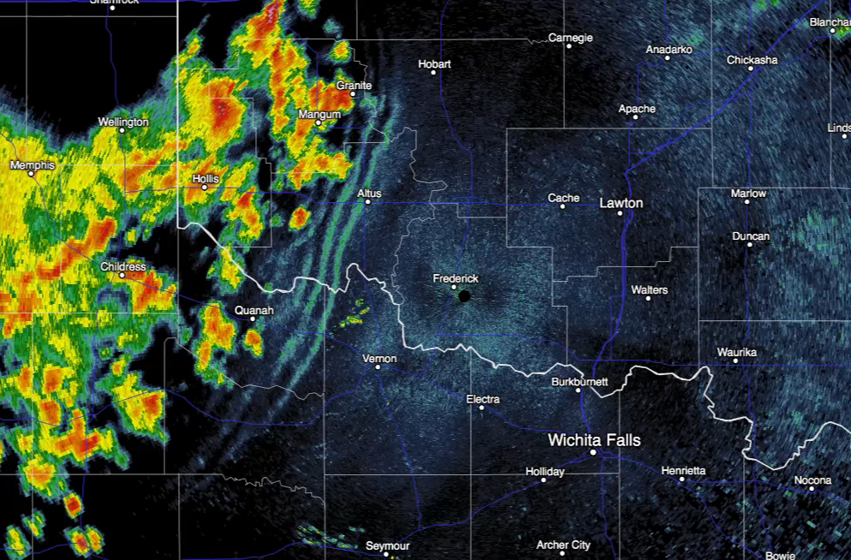
Atmospheric Gravity Waves
AGWs are oscillations in the atmosphere caused by the restoring force of gravity acting on displaced air parcels.
Generated when an external force disturbs the balance between buoyancy and gravity.
Observed effects:
  Thermospheric perturbations
  Enhanced traveling ionospheric disturbances (TIDs).
  Wave signatures spreading radially from the space hurricane centre.
Notes:
One of the most notable effects of ion-neutral interactions in space hurricanes is the generation of atmospheric gravity waves. Atmospheric gravity waves are oscillations in the atmosphere caused by a restoring force—gravity—acting on displaced air parcels. These waves are generated when an external force, such as ion-neutral interactions, disrupts the balance between buoyancy and gravity.
Observations show that AGWs manifest as:
Thermospheric perturbations
Traveling ionospheric disturbances (TIDs)
Wave signatures spreading radially from the space hurricane center

Slide 16
Atmospheric Gravity Waves
How Do Space Hurricanes Generate AGWs?
Ion-neutral coupling drives thermosphere disturbances, disrupting natural winds
Disruption lead to localised wind shears/pressure variations
Shears generate localized density perturbations and pressure gradients (sources of AGWs).
The strongest AGWs are observed on the dawn side of the space hurricane, where ion-neutral interactions are most dynamic.
Notes:
These waves occur when:
Strong ionospheric heating displaces neutral air parcels, creating oscillations.*
Buoyancy forces act as a restoring mechanism, causing wave-like propagations.*
AGWs transport energy downward from the ionosphere into the mesosphere and lower atmosphere. Satellite observations confirmed:*
Density fluctuations at ~350 km altitude.*
Wave periods of 20–40 minutes, propagating radially outward from the hurricane center.*
This suggests that space hurricanes may influence lower atmospheric weather over long distances.”*
The following radar loop is from the Fort Worth Spinks TX Doppler Radar (KFWS)

Slide 17
Ionosphere
Ionosphere
The ionosphere is the ionized part of the upper atmosphere of Earth, from about 48 km (30 mi) to 965 km
A region that includes the thermosphere and parts of the mesosphere and exosphere.
The ionosphere is ionized by solar radiation. It plays an important role in atmospheric electricity and forms the inner edge of the magnetosphere.
It has practical importance because, among other functions, it influences radio propagation to distant places on Earth.
Travel through this layer also impacts GPS signals, resulting in effects such as deflection in their path and delay in the arrival of the signal

Slide 18
Joule Heating
High-latitude Joule heating is an important energy source for thermospheric dynamics and composition.
Joule heating is a possible mechanism to generate AGWs
Express the Joule heating rate as: $\begin{aligned}J⋅E^{′}=σ_{p}{\left(E^{′}\right)}^{2} \\ E^{′}=(U−V)×B\end{aligned}$

