Slide 1
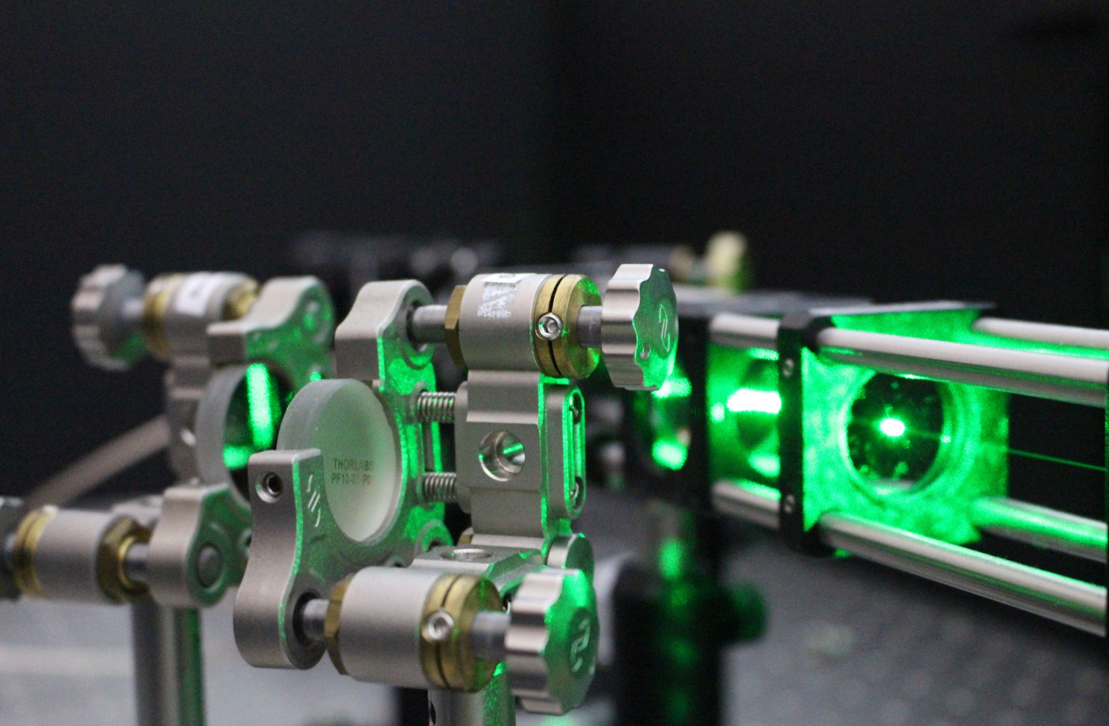
WP2: Macroscopic quantum superpositions for physics beyond the standard model (MaQS)
Gavin W Morley, University of Warwick

Slide 2
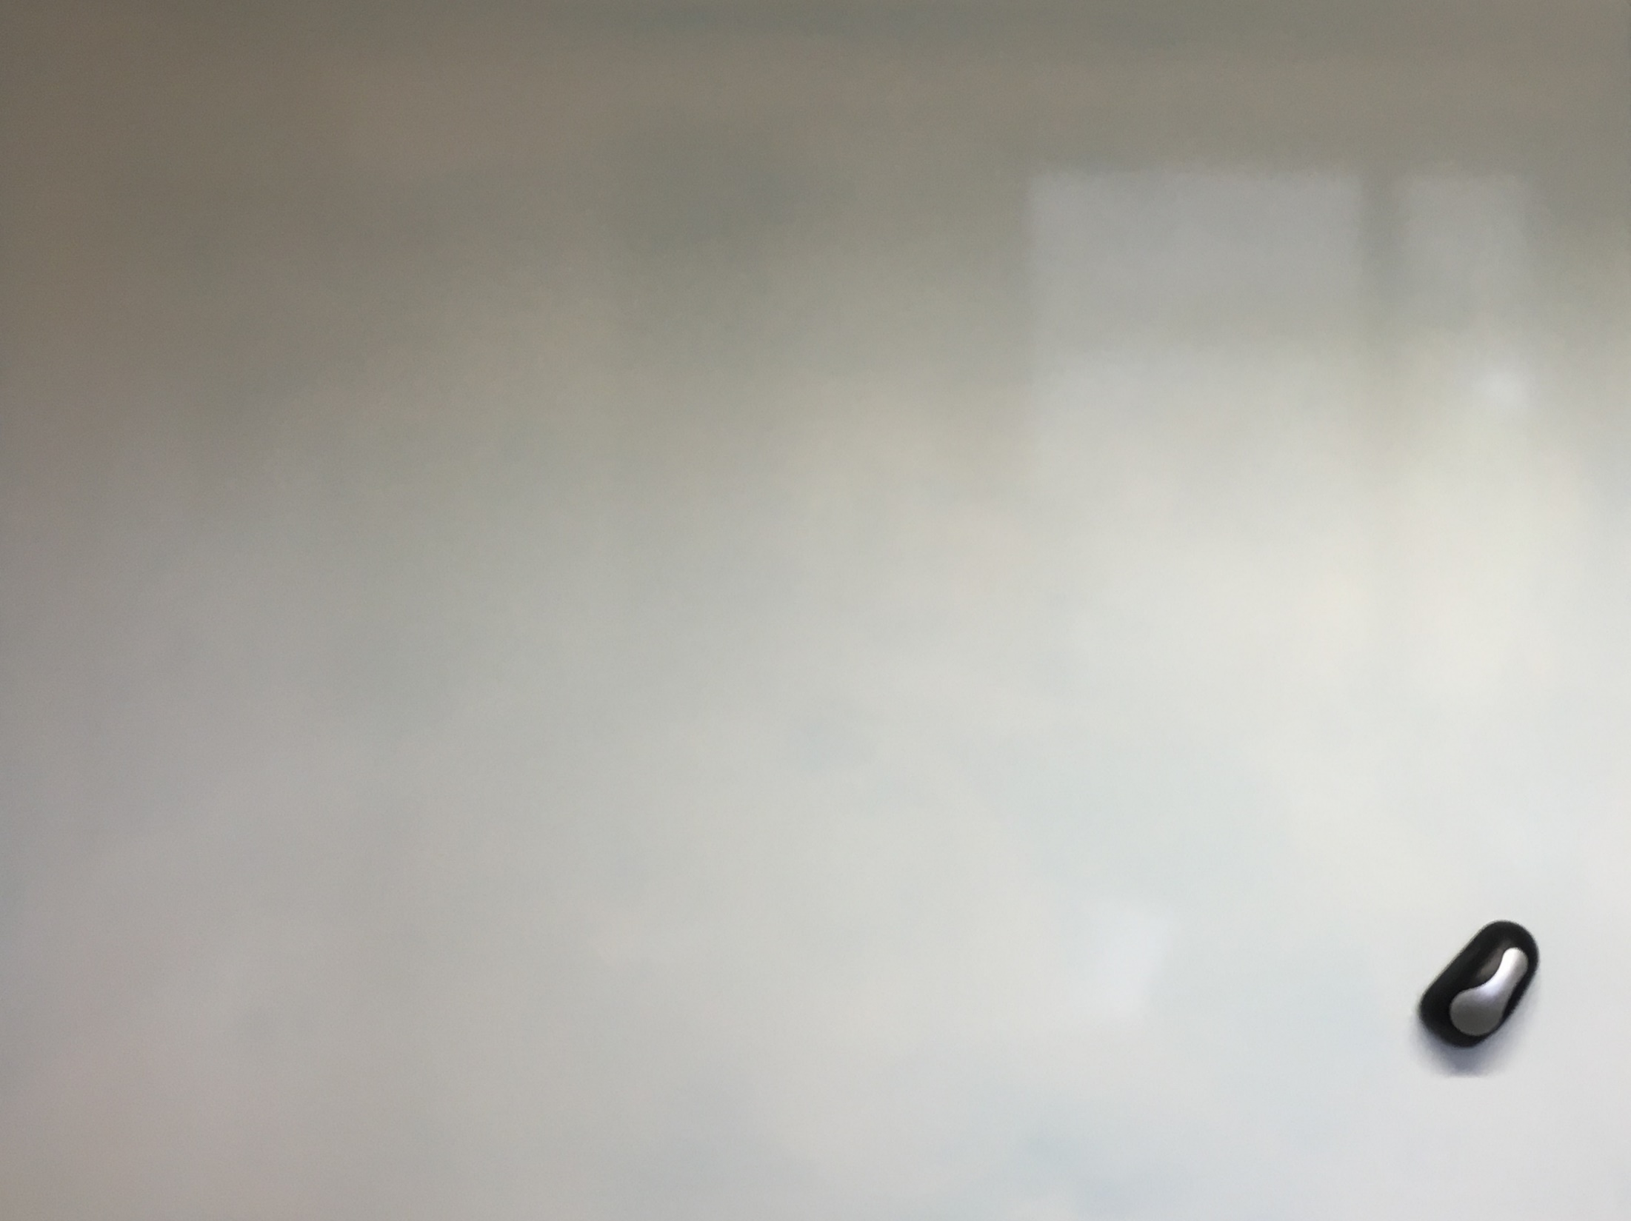

Slide 3
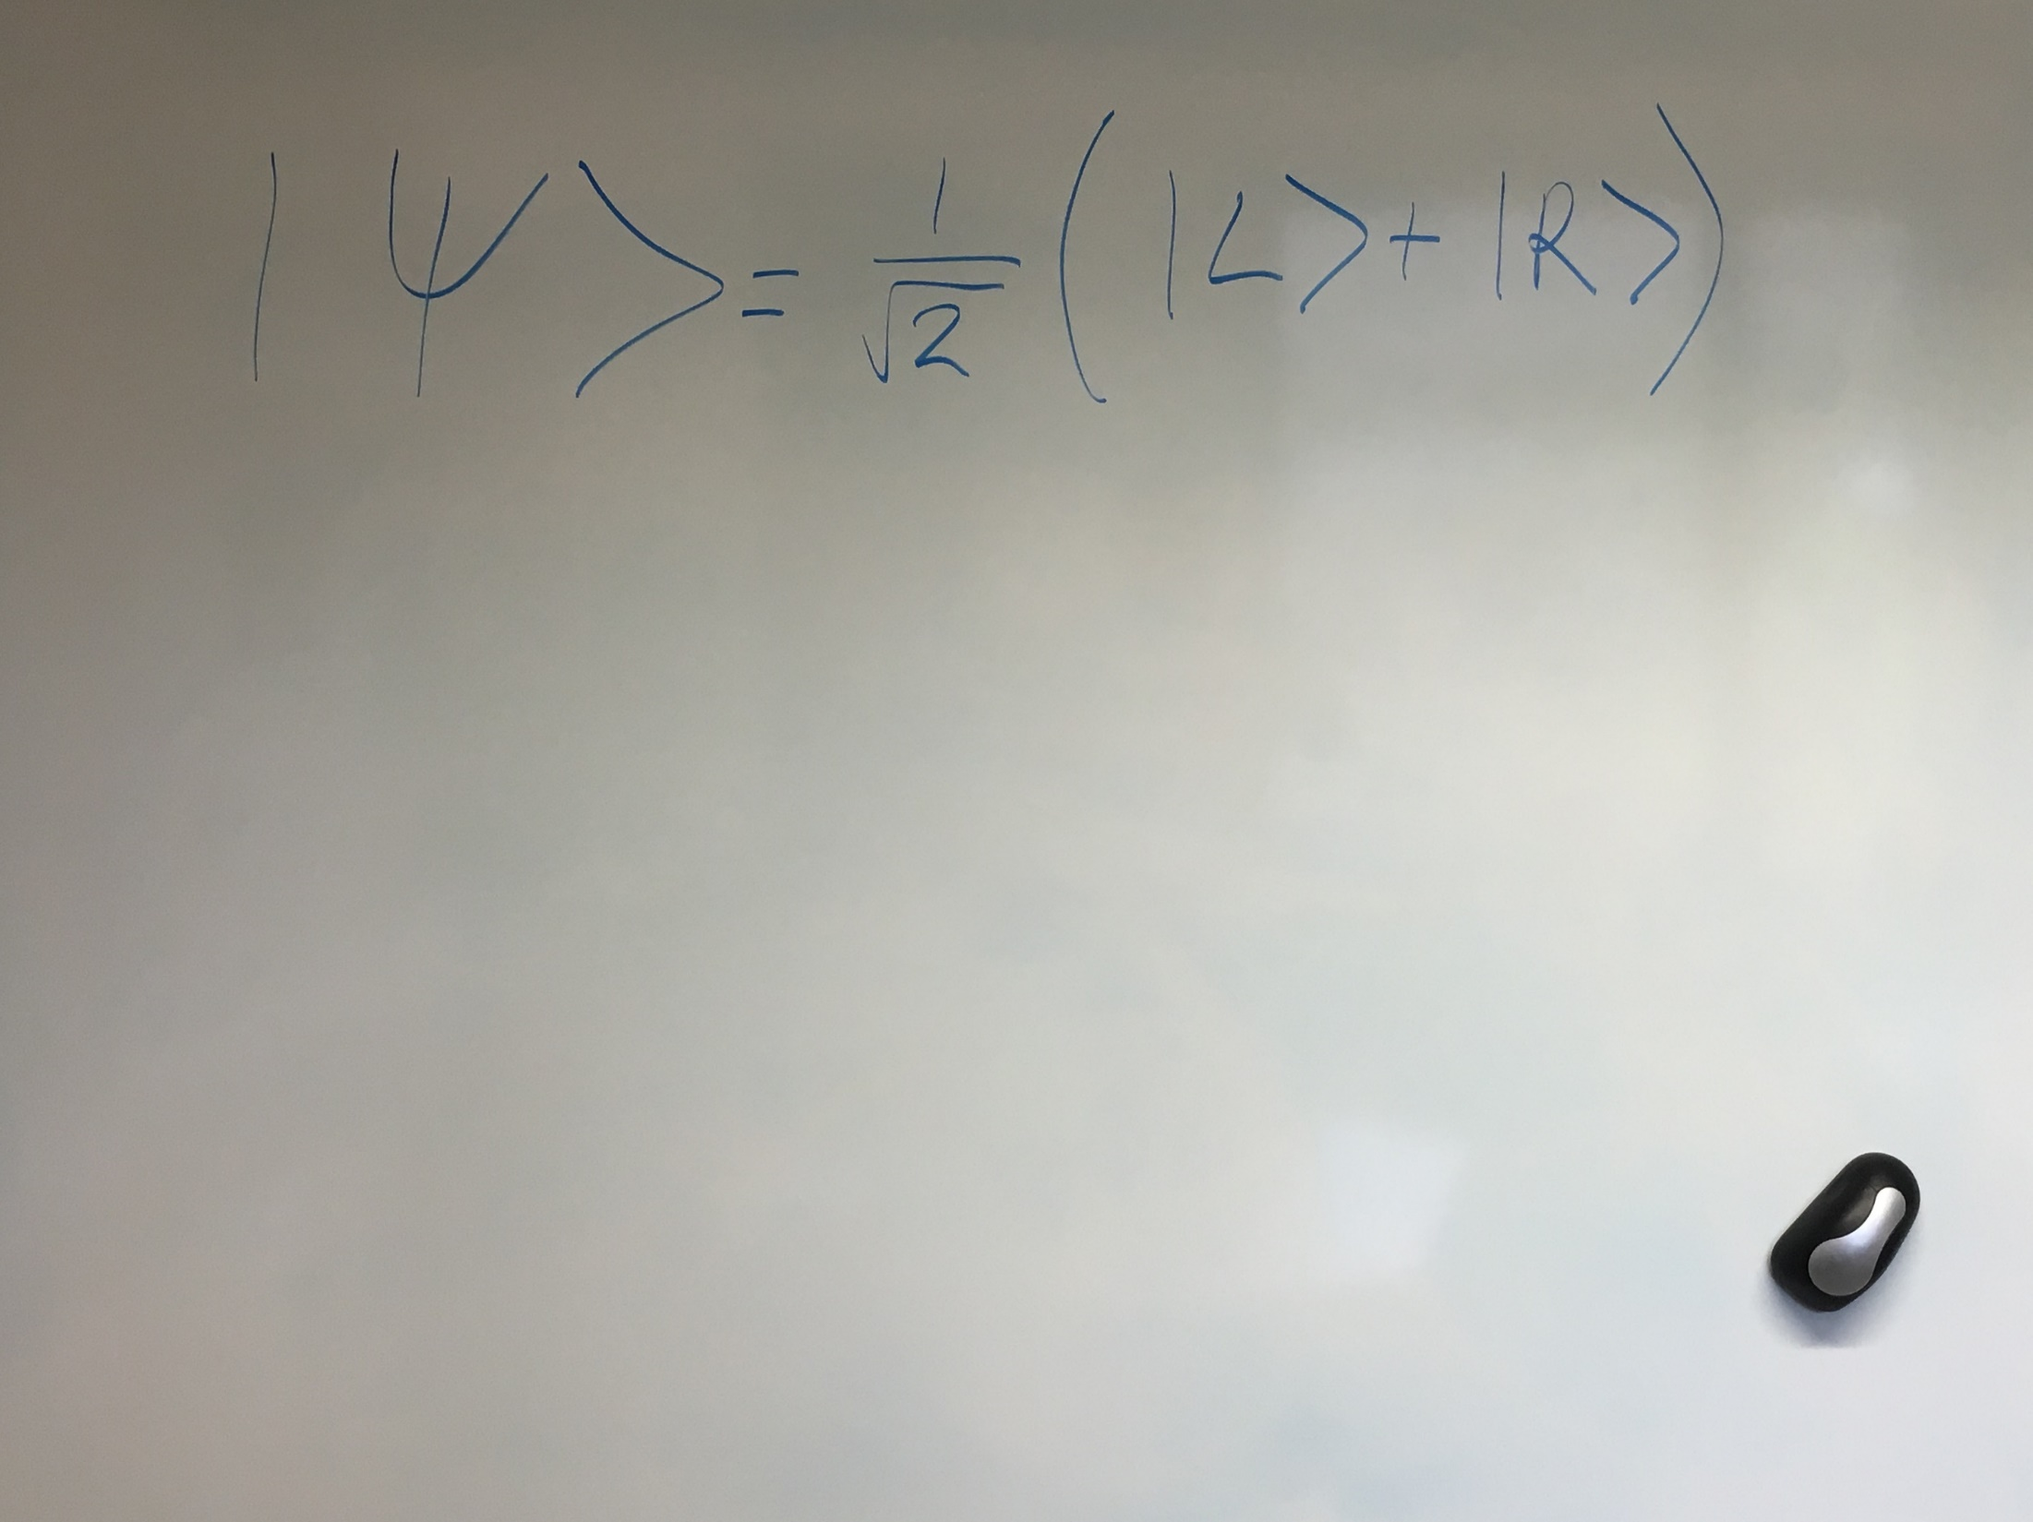

Slide 4
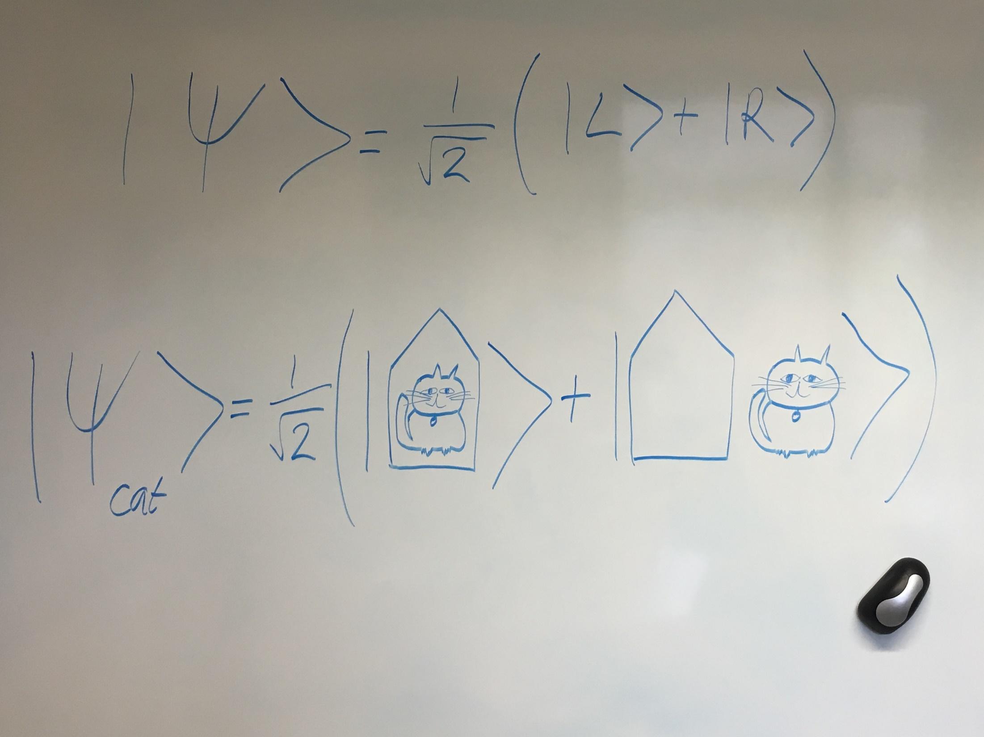

Slide 5

  Science goal:
  What is the most macroscopic spatial superposition possible?

Slide 6
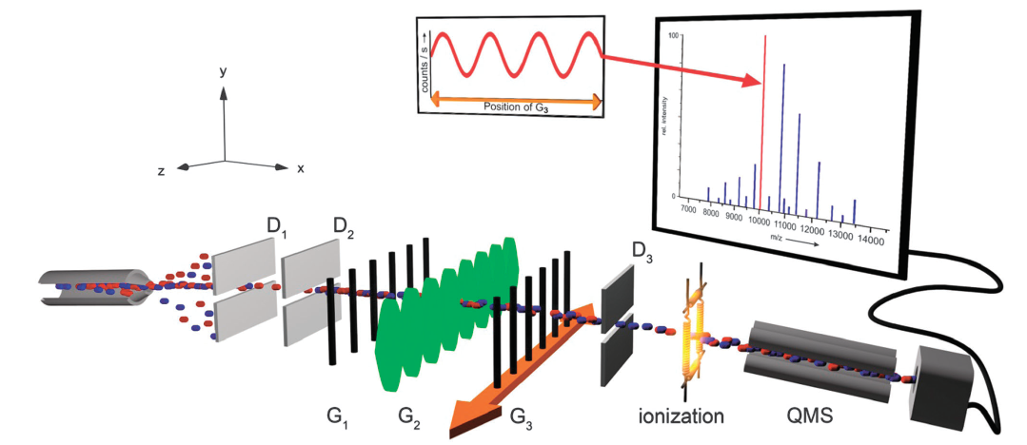
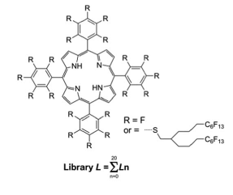
  Most macroscopic spatial superposition so far
S Gerlich et al, Nature Comms 2, 263 (2011)
T Juffmann et al, Nature Nano 7, 297 (2012) Markus Arndt’s group
P Haslinger et al, Nature Physics 9, 144 (2013)
S Eibenberger et al, PCCP 15, 14696 (2013)

Slide 7
  Outline
Science goals
Deliverables and plan of work for six years
  Where is the work happening, what internal infrastructure?
  Strengths and weaknesses
Coordinator, team and experience plus internal work package governance
Budget and potential modifications
International landscape
Dedicated work package workshop
Opportunities for new members to join
Overlaps with other WPs
Conclusion

Slide 8
  Science goals
Most macroscopic superposition?
Spontaneous wavefunction collapse?
Search for dark matter, quantum gravity, short-range forces, GUP

Slide 9
  Plan of work
Levitated 10-1000 nm particle (10⁵ – 10¹¹ atoms) put in a spatial superposition:
Subpackage 1: Silica spheres
Subpackage 2: Diamonds containing NV⁻ centres
More massive objects with smaller superposition distance
Subpackage 3: Clamped oscillators
Theory underpins everything
Subpackage 4: Theory

Slide 10
  Deliverables: SP1 Silica spheres
  Lead: Hendrik Ulbricht, Southampton. Experiments in Southampton and Oxford
Per 1 (Years 1-2):
D1: Implement low-noise electronics with high-precision timing for switching the trap
D2: Reach the lowest ever centre-of-mass (CM) temperatures for nanoparticles
D3: CM cooling followed by free-fall experiments and wavefunction expansion studies
D4: Build ion trap for non-interferometric tests of CSL heating with 1 µm silica (Oxford)
Per 2 (Year 3):
D5: CM cooling and free flight with an optical grating applied within the trap
D6: Quantum non-demolition pulsed position measurements for levitated nanoparticles
Per 3 (Years 4-6):
D7: Measure spatial superposition of 10-100 nm silica spheres with small superposition distance
D8: 30 cm free-fall with silica spheres and implementation of Talbot interferometer

Slide 11
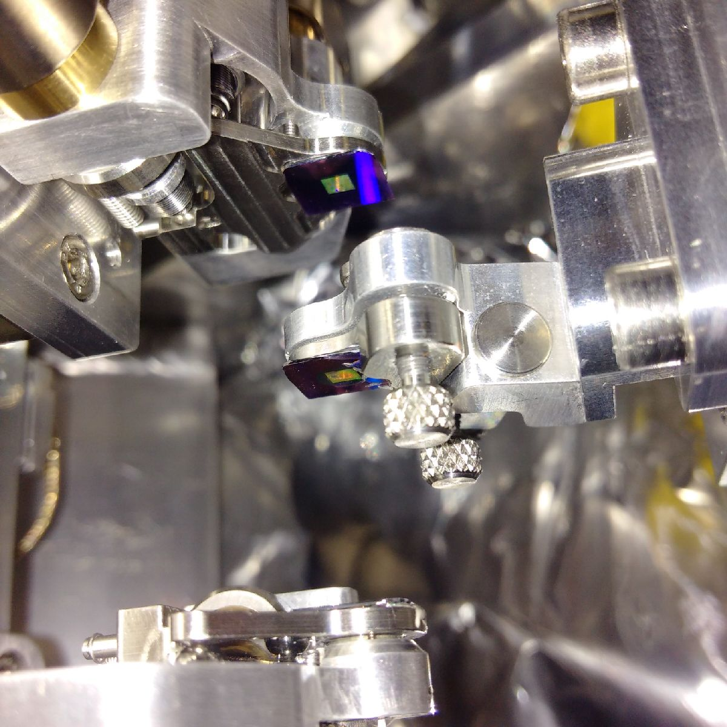
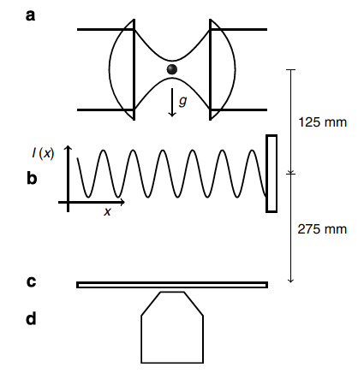
  Deliverables: SP1 Silica spheres
  Lead: Hendrik Ulbricht, Southampton. Experiments in Southampton and Oxford
James Bateman, Stefan Nimmrichter, Klaus Hornberger & Hendrik Ulbricht, Nature Communications, 5, 4788 (2014)

Slide 12
  Deliverables: SP2 Diamonds with spin Lead: Peter Barker, UCL. Experiments in UCL and Warwick
Per 1 (Years 1-2):
D9: Trapping and CM cooling in linear Paul trap of 100 nm diamonds with NV⁻ centres
D10: Build & test magnetogravitational (MG) trap for 1 µm diamonds with NV⁻ centres
Per 2 (Year 3):
D11: Install an inhomogeneous magnet into the Paul trap
D12: Cool the internal temperature of the diamonds to 8 K in the MG trap
D13: Implement active damping of vibrations and tilt following LIGO work
Per 3 (Years 4-6):
D14: In-trap Ramsey interferometry of 100 nm diamonds using linear Paul trap
D15: Charge neutralisation and free fall from the Paul trap
D16: Charge neutralisation in the MG trap
D17: Create small spatial superposition in MG trap

Slide 13
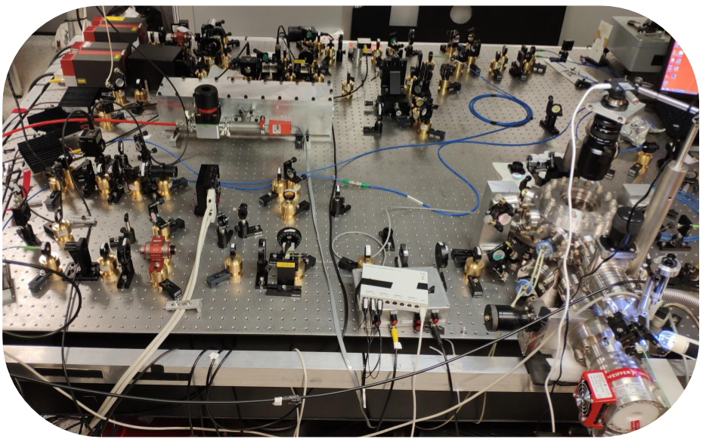
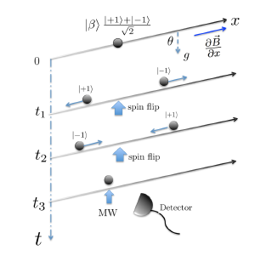
  Deliverables: SP2 Diamonds with spin Lead: Peter Barker, UCL. Experiments in UCL and Warwick
Proposals from our collaboration:
- M Scala… & S Bose, PRL 111, 180403 (2013)
- C Wan…& MS Kim, PRA 93, 043852 (2016)
- C Wan… & MS Kim, PRL 117, 143003 (2016)
- S Bose… & G Milburn, PRL 119, 240401 (2017)
- RJ Marshman… S Bose, arXiv:1807.10830 (2018)
- S Bose & GW Morley, arXiv:1810.07045 (2018)

Slide 14
  Deliverables: SP3 Clamped oscillators
  Lead: Michael Vanner, Imperial
Per 1 (Years 1-2):
D18: Generate and observe mechanical interference fringes at low thermal occupations
Per 2 (Year 3):
D19: Experimentally observe an optomechanical geometric phase / revivals
Per 3 (Years 4-6):
D20: Use the geometric phase to more strongly test GUP

Slide 15
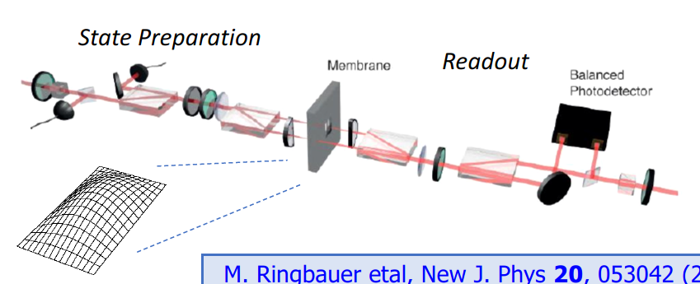
  Deliverables: SP3 Clamped oscillators
  Lead: Michael Vanner, Imperial
£2M state-of-the-art lab under construction at Imperial

Slide 16
  Deliverables: SP4 Theory
  Lead: Sougato Bose, UCL
Per 1 (Years 1-2):
D21: Theory of quantum sensing in optomechanical interferometry
D22: Identify system specs for the detection of dark matter and neutrinos D23: Design hybrid system: atomic ion coupled to ion-trapped nanoparticle
D24: Design optomechanical short-range force tests in unexplored regimes
D25: Design proposal to test relativistic effects in quantum mechanics
Per 2 (Year 3):
D26: Self-consistent description of non-eqm. mesoscopic QM including CSL
D27: Extend our gravitational wave detector proposals
D28: Improve simulations and proposals for macroscopic superpositions
Per 3 (Years 4-6):
D29: Study of models with very light scalar fields using QFT methods

Slide 17
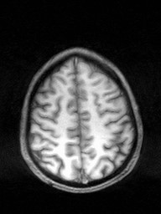
  Deliverables: SP4 Theory
  Lead: Sougato Bose, UCL
Per 1 (Years 1-2):
D21: Animesh Datta (Warwick)
D22: Paul Harrison (Warwick)
D23: Andrew Steane (Oxford)
D24: John March-Russell (Oxford)
D25: Myungshik Kim (Imperial)
Per 2 (Year 3):
D26: Mauro Paternostro
D27: Haixing Miao (Birmingham)
D28: Sougato Bose (UCL)
Per 3 (Years 4-6):
D29: Xavier Calmet (Sussex)

Slide 18
  Strengths and weaknesses
Strengths:
Results come with or without spontaneous collapse
Leverages investment in three QT Hubs
Many years of work by us to propose this work
Community already working together
Weakness:
We haven’t made a spatial superposition yet
      → Address this with multiple experimental approaches

Slide 19
  Meet the team
Management team (re-evaluates plans for years 3-6):
Gavin Morley (coordinator), Clare Burrage, Sheila Rowan, John March-Russell, Hendrik Ulbricht, Peter Barker, Michael Vanner & Sougato Bose
Full team:
Michael Vanner & Myungshik Kim (Imperial), Hendrik Ulbricht & Alexander Belyaev (Southampton) Mauro Paternostro (QUB), Peter Barker, Tania Monteiro, Chamkaur Ghag & Sougato Bose (UCL), Gary Barker, Yorck Ramachers, Paul Harrison, Animesh Datta & Gavin Morley (Warwick), Andrew Steane, Christopher Foot, Hans Kraus & John March-Russell (Oxford), James Bateman (Swansea), Xavier Calmet (Sussex), Haixing Miao (Birmingham), James Millen (KCL), Clare Burrage & Pierre Verlot (Nottingham), Oliver Williams & Sean Giblin (Cardiff), Sheila Rowan & Giles Hammond (Glasgow), Andreas Nunnenkamp (Cambridge), Kishan Dholakia (St Andrews) and Michael Hartmann (Heriot Watt)

Slide 20
  Meet the team: EPSRC people
Management team:
Gavin Morley (coordinator), Clare Burrage, Sheila Rowan, John March-Russell, Hendrik Ulbricht, Peter Barker, Michael Vanner & Sougato Bose
Full team:
Michael Vanner & Myungshik Kim (Imperial), Hendrik Ulbricht & Alexander Belyaev (Southampton) Mauro Paternostro (QUB), Peter Barker, Tania Monteiro, Chamkaur Ghag & Sougato Bose (UCL), Gary Barker, Yorck Ramachers, Paul Harrison, Animesh Datta & Gavin Morley (Warwick), Andrew Steane, Christopher Foot, Hans Kraus & John March-Russell (Oxford), James Bateman (Swansea), Xavier Calmet (Sussex), Haixing Miao (Birmingham), James Millen (KCL), Clare Burrage & Pierre Verlot (Nottingham), Oliver Williams & Sean Giblin (Cardiff), Sheila Rowan & Giles Hammond (Glasgow), Andreas Nunnenkamp (Cambridge), Kishan Dholakia (St Andrews) and Michael Hartmann (Heriot Watt)

Slide 21
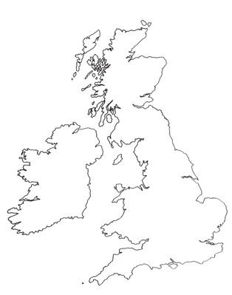
  Team experience
Review paper: A. Bassi et al., RMP 85, 471 (2013).
Proposals for macroscopic superpositions
M. R. Vanner et al., PNAS 108, 16182 (2011).
M. Scala et al., PRL 111, 180403 (2013).
M. R. Vanner et al., PRL 110, 010504 (2013).
J. Bateman et al., Nat. Commun. 5, 4788 (2014).
M. Bahrami et al., PRL 112, 210404 (2014).
C. Wan et al., PRL 117, 143003 (2016).
S. Bose et al., PRL 119, 240401 (2017).
D. Branford et al., PRL 121, 110505 (2018).
R. J. Marshman et al., arXiv:1807.10830 (2018).
Experiments towards macroscopic superpositions
M. Rashid et al., PRL 117, 273601 (2016).
P. Z. G. Fonseca et al., PRL 117, 173602 (2016).
J. Vovrosh et al., JOSAB 34, 1421 (2017).
A. C. Frangeskou et al., NJP 20, 043016 (2018).

Slide 22
  Budget
Per 1 (Years 1-2) costs £3.9M
Experimental work totalling £2.4M
eight PDRAs (£1.6M)
equipment (£600k)
consumables (£100k)
travel (£40k)
technician time (£70k)
Theory work totalling £840k
four PDRAs (£800k)
travel (£40k)
PI time for the 31 team members
£700k
Correspondingly £1.9M for Per 2 (Year 3): buy last equipment
Per 3 (Years 4-6) then costs £4.8M.
£5.8M

Slide 23
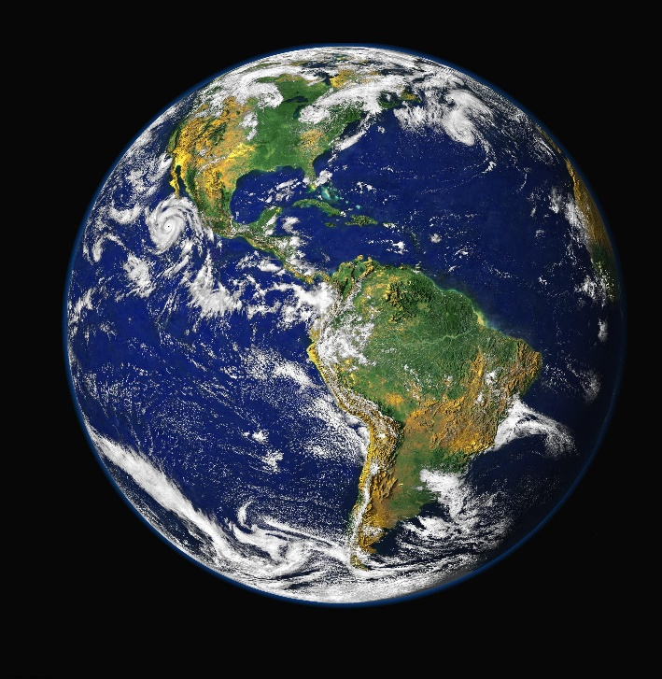
  International landscape
Molecular beams are current leaders but with limited potential: Vienna
Levitated nanoparticles: multiple groups in EU and USA but no coordinated project for creating superpositions
Clamped oscillators: multiple groups in EU and USA but we take advantage of quantum measurement tools

Slide 24
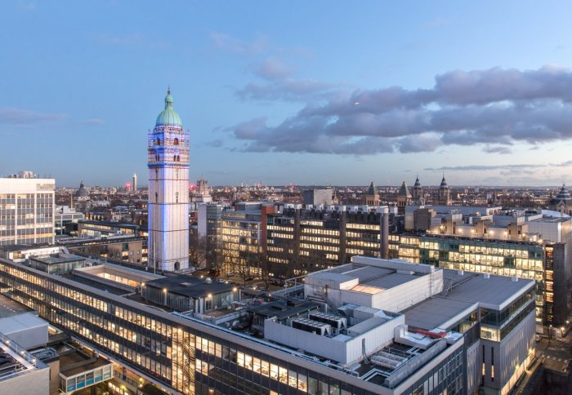
  Dedicated workpackage workshop
Informal meeting tomorrow in Oxford to discuss science and progress the 4-pager: all welcome
International conference 1st April in Imperial organised by Myungshik Kim

Slide 25

  Opportunities for new members
Please ask us!

Slide 26
  Overlap with other workpackages
WP3: AION needs low vibration and low tilt
Other dark matter searches

Slide 27
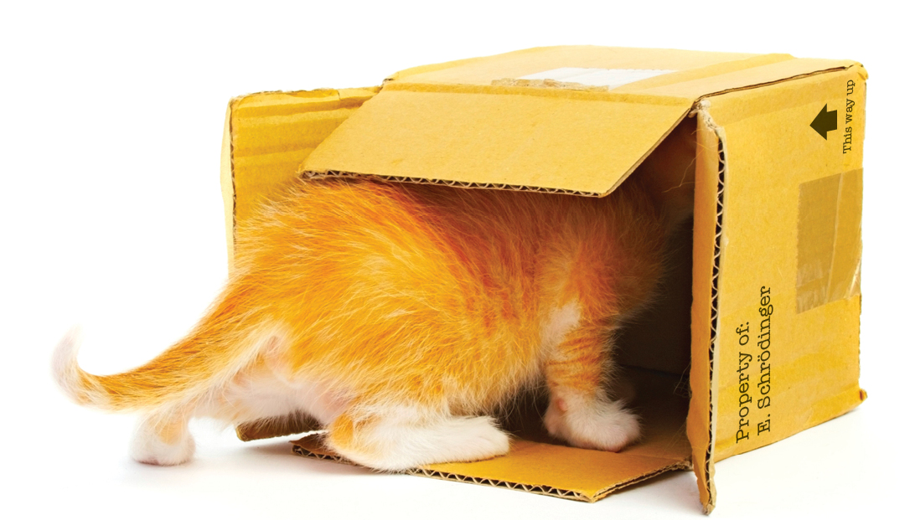
Conclusion
Let’s search for the most macroscopic spatial superposition

Slide 28
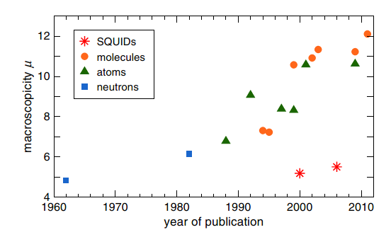
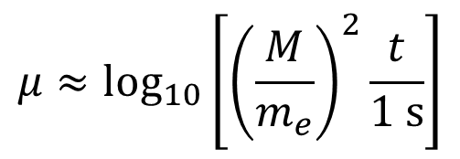
  Macroscopicity
µ ~ 28
$$μ≈{\text{log}}_{10}\left[{\left(\frac{M}{m_{e}}\right)}^{2}\frac{t}{1 \text{s}}\right]$$
Eibenberger et al, PCCP, 15, 14696 (2013)
Stefan Nimmrichter and Klaus Hornberger, PRL 110, 160403 (2013)

Slide 29
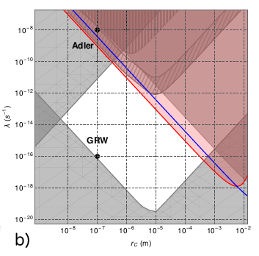
  Exclusion plot: continuous simultaneous localization
Matteo Carlesso, Mauro Paternostro, Hendrik Ulbricht, Andrea Vinante and Angelo Bassi, arXiv:1708.04812 (2018)

Slide 30
  UK groups seeking macroscopic superpositions

