Slide 1


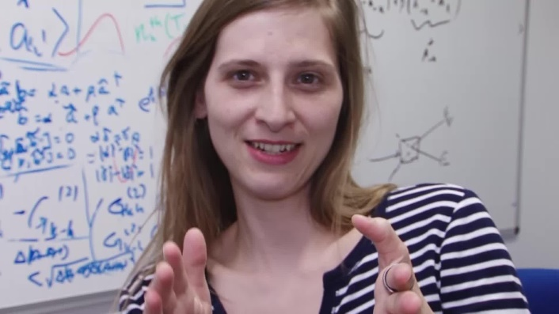

Quantum Simulators of Fundamental Physics
Silke Weinfurtner
The University of Nottingham
Sebastian Erne
The University of Nottingham
Notes:
Thank them for the opportunity to present our work and for allowing us to swap speakers.
For every following slide you should spend 1 minute. The whole talk should be 10 min, leaving 5 minutes for questions.

Slide 2

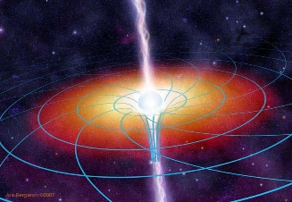
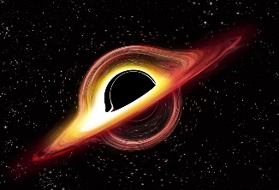

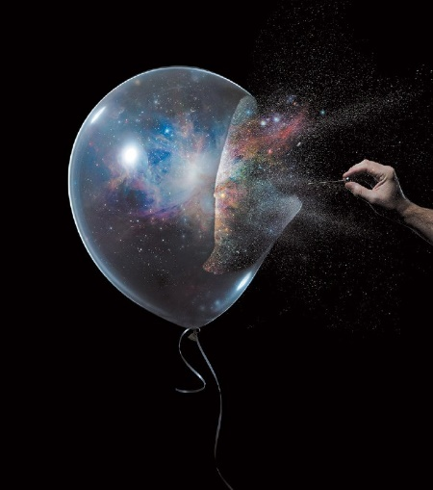
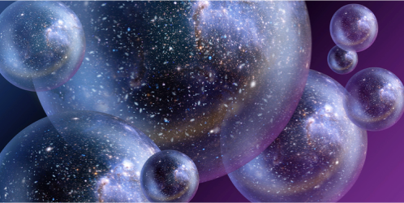
Theoretical Framework
Fundamental Physical Processes
Quantum Field Theory
In Curved-Spacetimes
Rotating Black Holes
e.g. Superradiance
spacetime
geometry
Black Holes
e.g. Hawking radiation
Gravity:
General Relativity
Cosmological spacetimes
e.g. Early Universe Processes
equivalence principle
dynamical spacetime
Quantum Vacuum
Quantum Field Theory
e.g. The False Vacuum Decay
Notes:
The whole slide should not take more than one minute.
1) Start with the left side of the slide:
Explain the theoretical framework:
- Relativistic Quantum Field Theory for flat/ Minkowski spacetimes
- Then explain in one sentence how to go from QFT in flat to QFT in Curved-spacetimes
2) Then move to the right hand side:
Explain that even for non-interacting / free-fields there are many fundamental processes expected to arise in non-trivial spacetimes geometries, such as… quickly go through list;
However, even if the spacetime geometry is the simplest one possible, namely flat spacetime geometry, the physics of the Vacuum is an interesting subject of study, e.g. the case we will discuss in more details, namely The False Vacuum Decay.

Slide 3
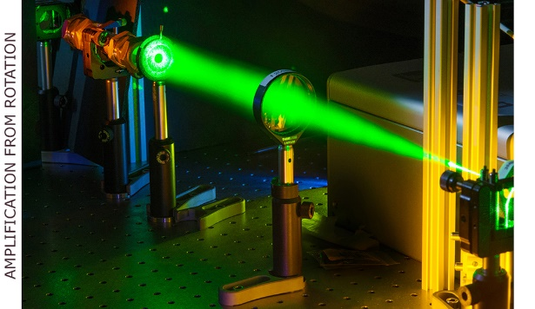
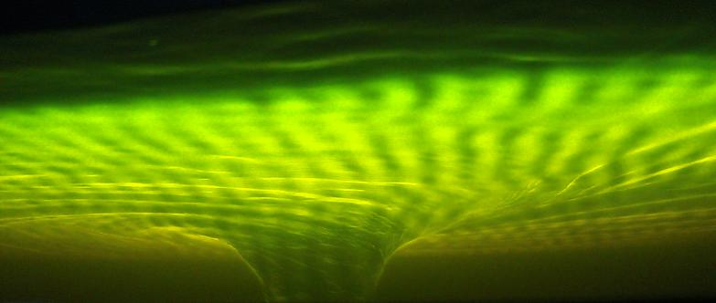

Analogue Simulators
Fundamental Physical Processes
There exists a broad class of systems
Rotating Black Holes
Black Holes
Cosmological spacetimes
Fluctuations described by an effective Relativistic Quantum Field Theory in flat or curved spacetimes.
Quantum Vacuum
Notes:
The problem with the effects listed on the right hand side are that they are hard to impossible to directly observe in our Universe. However, we suggest to study their evolution in analogue simulations, by setting up Relativistic Field Theory Simulators. The explain in one sentence what the general idea is. Then list a few of them, the first image is a fluid of light, which is Daniele Faccios system to look for superradiance and the other one is a picture taken from our setup. You could list a few more systems, but you should not take more than 1 min for the whole slide.
Please don’t forget to say at the every end that the right hand side is falling under remit of STFC, while the probe systems are falling under the remit of EPSRC, and hence this kind of research is right in between.

Slide 4
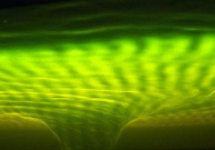
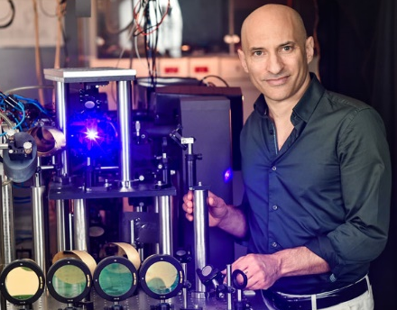
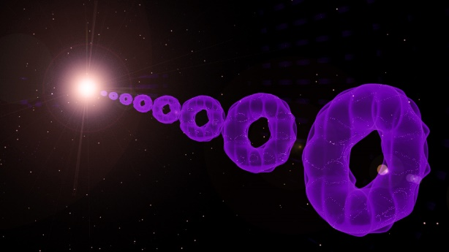
Recent successful examples of Analogue QFT Simulations
Rotating Black Holes
Superradiance
Weinfurtner 2017
Light bending
Weinfurtner 2018
Quasi-Normal Modes
Rotational superradiant scattering in a vortex flow
Theo Torres, Sam Patrick, Antonin Coutant, Mauricio Richartz, Edmund W. Tedford & Silke Weinfurtner
Nature Physics volume 13, pages833–836 (2017)
Black Holes
Hawking Radiation:
Weinfurtner/Unruh 2011
Faccio 2011
Rousseoux 2016
Black-Hole Laser:
Steinhauer 2016
Observation of quantum Hawking radiation and its entanglement in an analogue black hole
Jeff Steinhauer
Nature Physics volume 12, pages 959–965 (2016)
Cosmological spacetimes
A Rapidly Expanding Bose-Einstein Condensate: An Expanding Universe in the Lab
S. Eckel, A. Kumar, T. Jacobson, I. B. Spielman,
and G. K. Campbell
Phys. Rev. X 8, 021021 (2018)
Particle Production
Westbrook 2012
Hubble Friction
Campbell 2018
How versatile a tool are these simulators..?
How much more is there to be done..?
Notes:
This slide has only one purpose, which is to show that Relativistic Field Theory Simulators work, by listing some RECENT successes. I think you could just start by saying:
Setting up Relativistic Field Theory Simulators is still a young and rapidly growing field of research. The approach is validated through recent successes, including our own. Then use one sentence for each box.

Slide 5
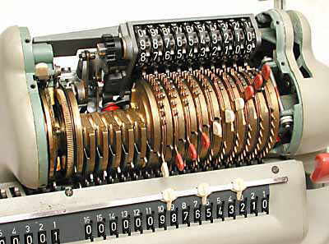
Analogue QFT Simulators have a high degree of tunability
Analogue simulators are versatile,
because it is possible to
set up and manipulate:
Signature of Spacetime
Euclidean ↔ Lorentzian
Spacetime Geometry
→ Flat spacetime
→ Black Hole Horizon
→ Cosmological scenarios
Effective Mass
Stable ↔ Unstable
Effective detectors
→ Unruh radiation
A timely and rapidly growing field of re-
search with many more successes to be
expected in the near future…
Notes:
Main point: The recent successes are by far not exhausting the capability relativistic field theory simulators.
I think you just need to stress how versatile the simulators are from both a field theoretic point of view with a high tunability and list what can be done.

Slide 6

Example: Relativistic Field Theory Simulator of The False Vacuum Decay
- Collaborators -
Hiranya Peiris
UCL / Oskar Klein
Centre Stockholm
cosmology /
early universe
phenomenology
Matthew Johnson
Perimeter Institute / York University
theoretical physics /
theoretical cosmology
Andrew Pontzen
UCL
cosmology /
numerical simulations
Jonathan Braden
Canadian Institute for
Theoretical
Astrophysics
Theoretical physics /
non-linear and
non-equilibrium
dynamics
Work to date funded by the
European Research Council
and the Royal Society
Notes:
These are the collaborators of Silke on the project, and quickly saying their names. Perhaps you should point out that Hiranya and Andrew are in the audience.
Their expertise ranging from cosmology to fundamental physics to non-equilibrium dynamics
So far this work has been funded by Hiranya’s ERC grant, and Andrew and Silke are both URF’s, hence funded by the Royal Society.

Slide 7
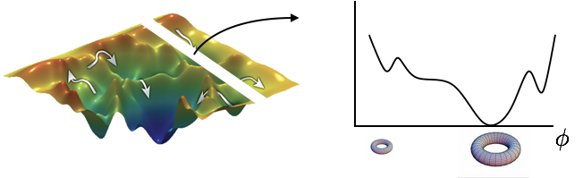
The Origin of the Universe through Vacuum Decay?
Cosmological theories inspired by particle physics exhibit vacuum decay
Vacuum Decay is quantum tunnelling out of the false vacuum via bubble nucleation
Non-equilibrium physics: relativistic first-order phase transition
→ understanding dynamics of relativistic first-order
phase transitions will shed light on the origin of
our observable universe
Notes:
As already mentioned at the beginning, the Fundamental Physical Process we will discuss in more detail is the False Vacuum Decay. The false vacuum decay is a possible candidate for the very origin of our universe.
Inspired by particle physics a Vacuum decay is present in many cosmological modes.
A vacuum decay is a quantum tunnelling from out of a false vacuum via a bubble nucleation process. (Note, not to say a quantum tunnelling from a false into a true vacuum, as this is not necessarily true, as it might just go into a lower-energy false vacuum.)
More generally such a process is a relativistic first-order phase transition, and by setting up an analogue simulation thereof, it offers the possibility to study the real-time dynamics of relativistic first order phase transitions. This in it’s own rights is a very interesting non-equilibrium system to study. At the same time it may shine light on the very origin of our observable universe.

Slide 8
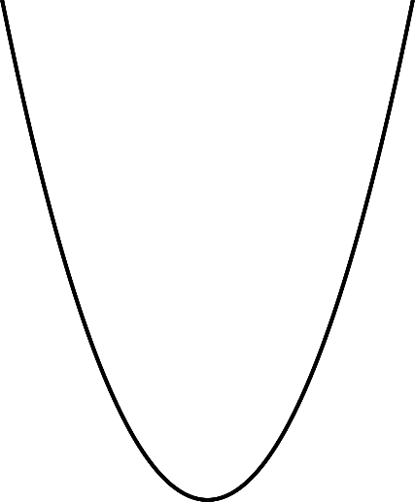
The False Vacuum Decay – Physical System
We are building upon the proposal by
O. Fialko, B. Opanchuk, A. I. Sidorov, P. D. Drummond and J. Brand, The universe on a
table top: engineering quantum decay of a relativistic scalar field from a metastable vacuum,
J. Phys. B50 (2017) 024003, [1607.01460].
2-component coupled Bose-Einstein Condensates (BECs)
ultra-cold dilute gas of N bosons, in two-single particle states
pseudo-spinor BEC (e.g. atoms in two different hyperfine states or double-well potential)
Condensation:

Slide 9
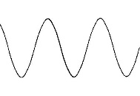
The False Vacuum Decay – Physical System & meta-stable vacua for small fluctuations
Dynamics of relative phase exhibits sine-Gordon Lagrangian
global minima and maxima
minima → stable
maxima → unstable
False Vacuum Decay
Fialko et al. suggest to add a high frequency
modulation in the transition coupling
→ maxima rendered meta-stable
Notes:
Nucleation cares about the local part of the potential, while long-term dynamics, bubble wall collations, care about global shape of the potential

Slide 10
Our Results on Investigating experimental feasibility
Feasibility study: Towards the cold atom analog false vacuum; JHEP 07 (2018) 014
Application to cosmology: A New Semiclassical Picture of Vacuum Decay, under review in PRL
Lattice simulations: work in progress
False Vacuum Decay
Floquet Instability
Notes:
Different and plausible explanation of quantum tunnelling

Slide 11
Impact
Relativistic simulations of the False Vacuum Decay give insights into:
the quantum origin of the Universe: emergence of classical bubble from
quantum fluctuations;
true quantum dynamics of first-order phase transitions, e.g. a complete
treatment of multi-bubble configurations;
The effective quantum field theory for small fluctuations in Bose-Einstein
Condensates out of equilibrium.
Notes:
Make it more general again:
- The development of Relativistic Field Theory Simulators (from theoretical framework to experimental implementation) will shine light on the real-time dynamics of otherwise illusive Fundamental Early and Late Univprocesses

Slide 12
Expression of Interest
The development of Relativistic Field Theory Simulators:
From theoretical framework to experimental implementation;
Special emphasis on Early Universe Scenarios, e.g. The False Vacuum Decay;
Notes:
Make it more general again:
- The development of Relativistic Field Theory Simulators (from theoretical framework to experimental implementation) will shine light on the real-time dynamics of otherwise illusive Fundamental Early and Late Univprocesses

