Slide 1

Beyond Standard-Model physics with ion trap methods
Andrew Steane
Oxford University

Slide 2
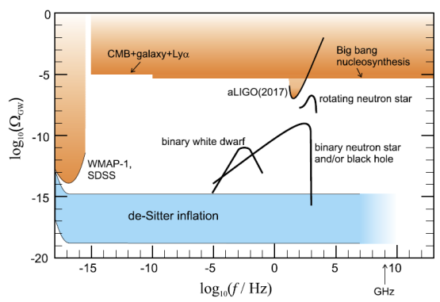
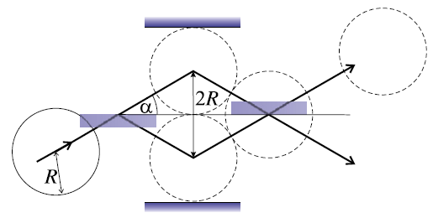
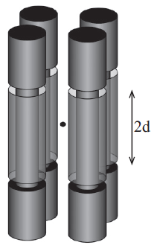
1. Physics Letters A 381 (2017) 3905–3908
Matter-wave coherence limit owing to cosmic gravitational wave background
Andrew M. Steane
2. PHYSICAL REVIEW A 95, 032112 (2017)
Detecting continuous spontaneous localization with charged bodies in a Paul trap
Ying Li, Andrew M. Steane, Daniel Bedingham, and G. Andrew D. Briggs

Slide 4
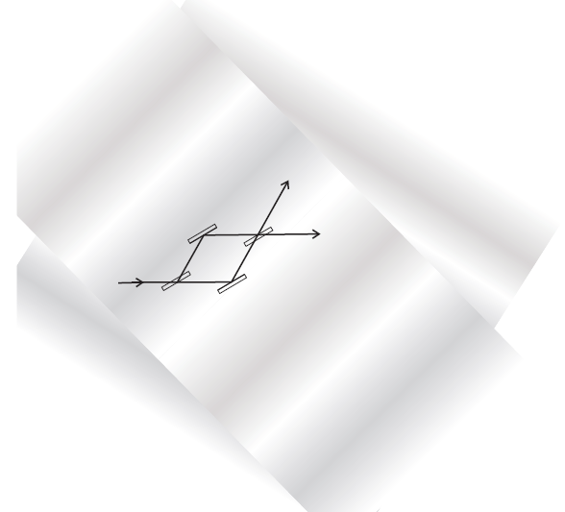
Gravitational wave background
→ wash out interference of matter waves

Slide 5
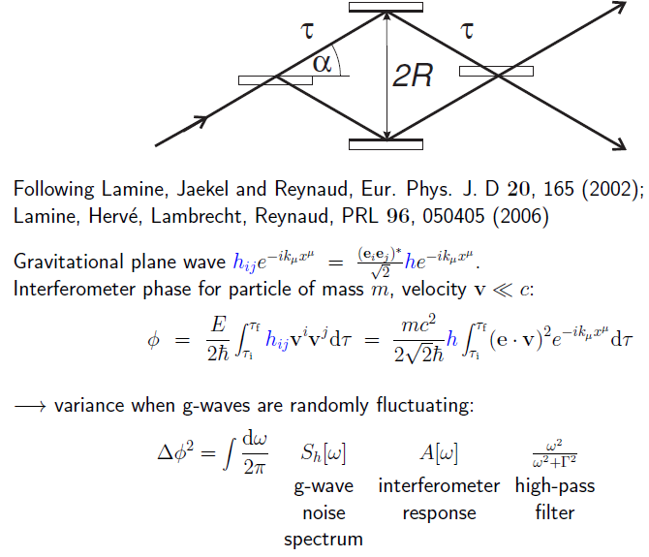

Slide 6
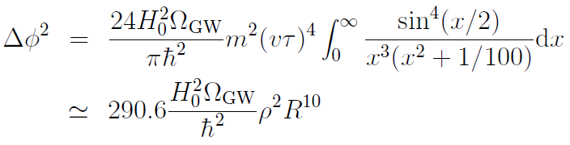

Conclusion:
You cannot observe interference of a 4 mm (0.2 gram) lump of ordinary matter, at path separation 4 mm, unless you somehow suppress or actively servo for the cosmological gravitational wave background (assuming there is one!)

Slide 7



PHYSICAL REVIEW A 95, 032112 (2017)
Detecting continuous spontaneous localization with charged bodies in a Paul trap
Ying Li, Andrew M. Steane, Daniel Bedingham, and G. Andrew D. Briggs

Slide 8
“CSL” (Continuous Spontaneous Localization)
A generalization of the idea of Ghiradi, Rimini, Weber (1986), building on Pearle (1976).
Stochastic nonlinearity in fundamental dynamics.
Ad-hoc tinkering with Schrodinger’s equation ?
--- No.
A way of capturing the phenomenological impact of various models of a more general fundamental theory (trace dynamics, gravity, …)

Slide 9
Diffractive spreading interrupted by spontaneous “collapse”

Slide 10
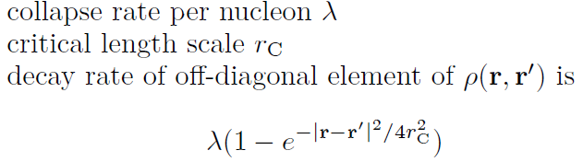
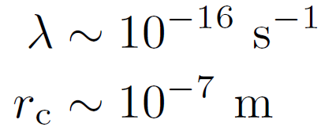
Density matrix for a blob of matter, in position basis.
Ghiradi, Rimini, Weber suggested

Slide 11
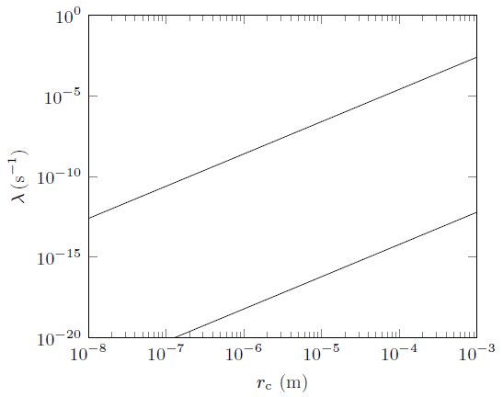
spontaneous excitation of
Ge: X rays not observed
(Curceanu 2015)
Molecule
interference
Gerlich et al 2011
mK cantilever
Vinante et al 2016
GRW values
(10 Hz, 10 m)
6
10
-16 -7
macro.
superposition
survives
Collett and Pearle, Found. Phys 33 (2003);
Bassi, Rev. Mod. Phys (2013);
Bera et al, Scientific reports (2015)

Slide 12
Various experimental approaches
Resonance of a (MEMS) cantilever
Spheres levitated by optical or magnetic forces
Sphere in a Paul trap (this work)
Just hang a sphere by a thread??
… space-based experiment …

Slide 13
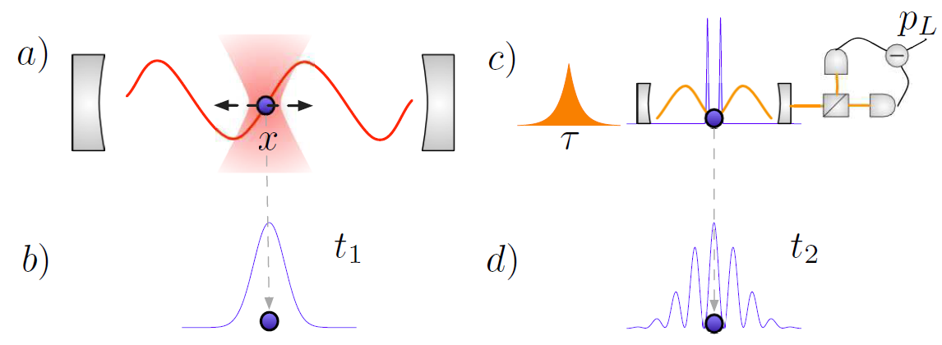
(PRL 2011)
Proposal is “two-slit” interference of 40 nm dielectric sphere;
Preparation and detection aided by
cavity quantum optomechanics

Slide 14
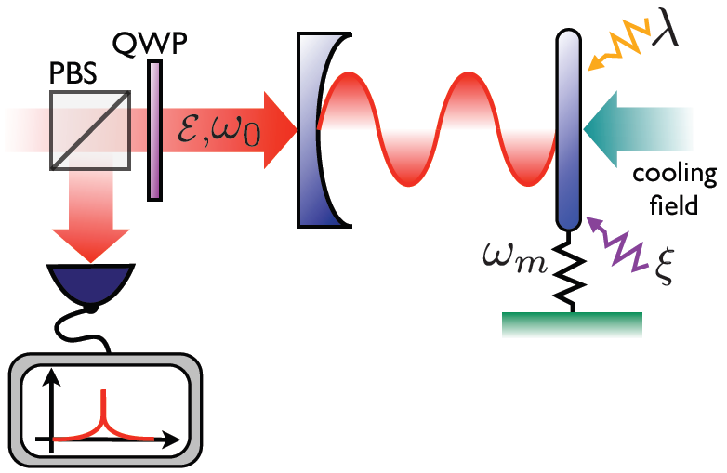
Bahrami, Paternostro, Bassi, Ulbricht (arXiv 2014)
CSL modifies the spectrum of light interacting with radiation-pressure-driven mechanical oscillator.

Slide 15
underlying physics of the method to be presented …

Slide 16
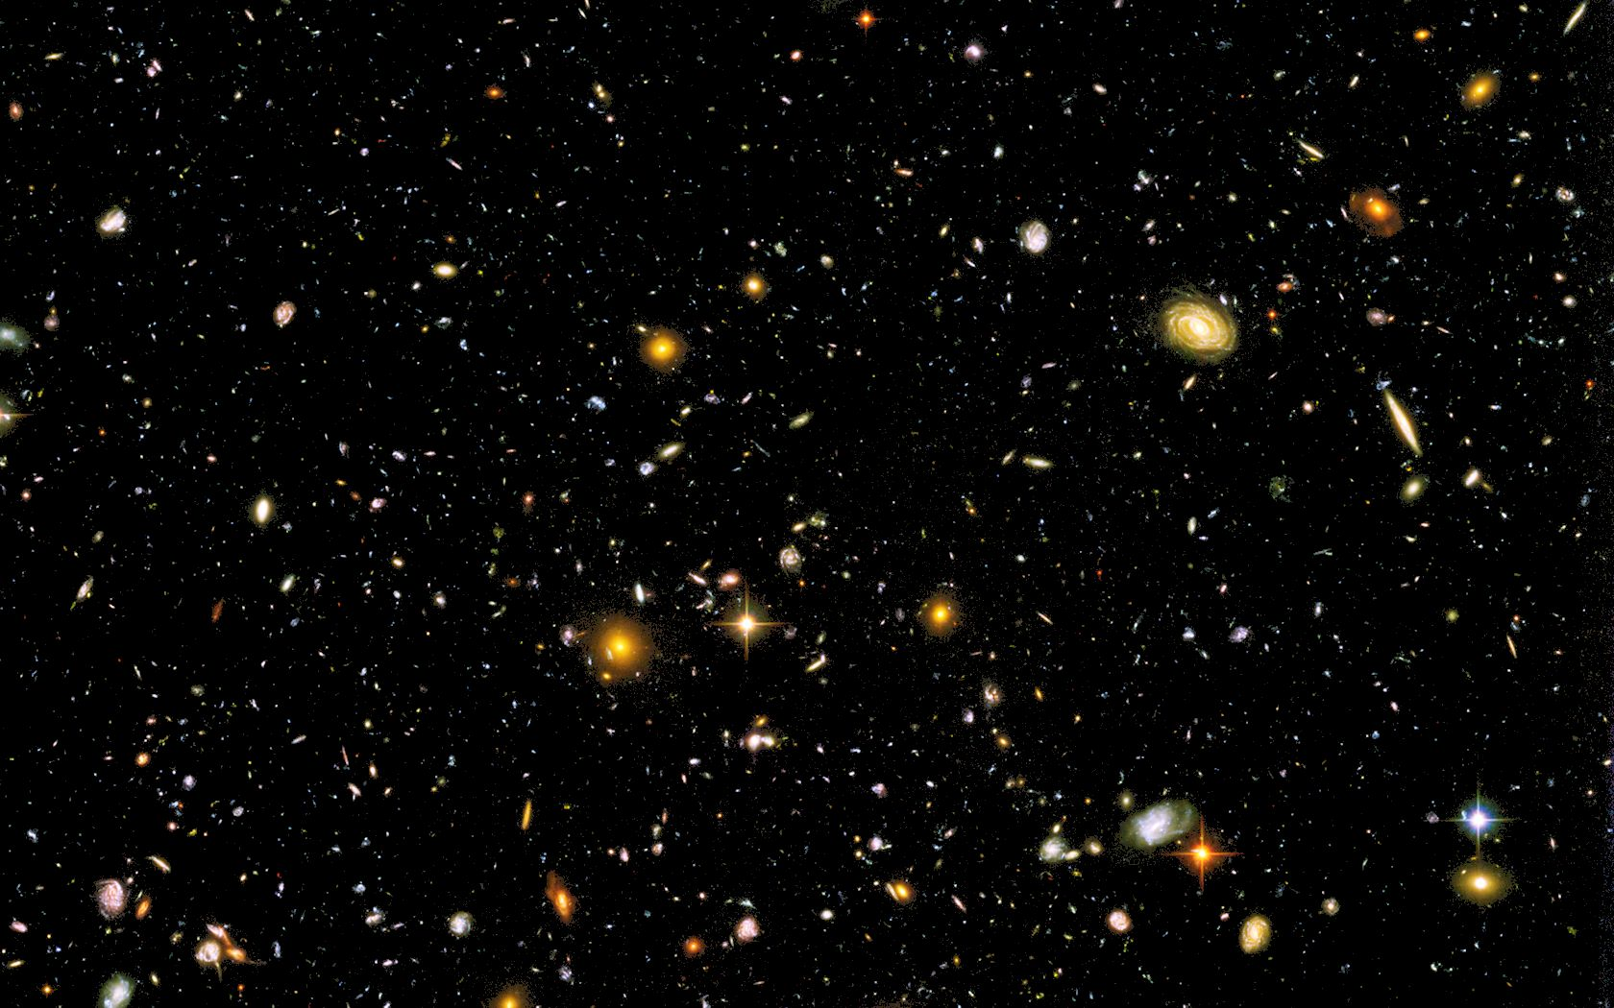

Slide 17
Our method (following suggestion of Pearle)
Cold ∼1 micron sphere in a weak trap
Watch it heat up
Requires v. low noise and v. high vacuum

Slide 18
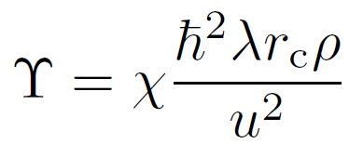

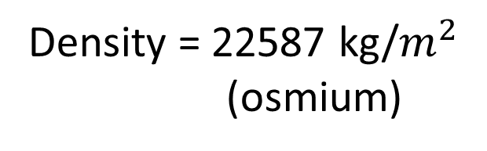
Heating effect of CSL (in some models)
Density = 22587 kg/$m^{2}$
(osmium)
Mass of 1 nucleon
Dimensionless factor
cube
At GRW parameters:
sphere
= 7 nK per minute
Existing bound ≈ 7mK per min
Radius / rc
11
(At GRW parameters, sphere radius 0.24 micron, 8x10 nucleons)

Slide 19



How to detect 10 nK?
At 10 nK,
and
We require state preparation and detection at this level.
It is comfortably above standard quantum limit
→ achievable by laser interferometric position measurements
(sphere diameter ~ 0.5 micron)

Slide 20
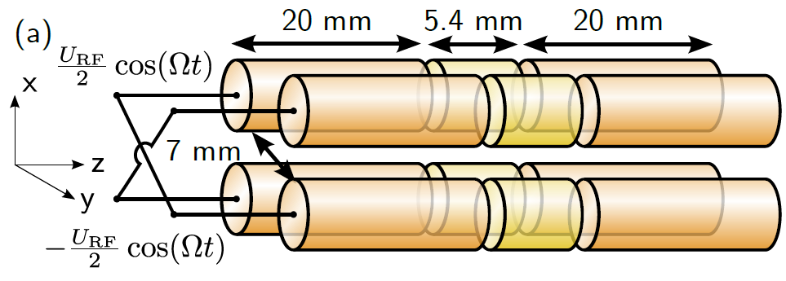
Poulsen, Miroshnychenko and Drewsen (arXiv 2012)
Sub-Hz heating rate at room temperature
+20 volt
0 volt
+20 volt
We require consider traps similar to this.
c.f. Millen et al., PRL 114, 123602 (2015) (Barker, UCL)

Slide 21
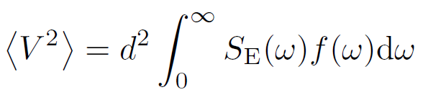
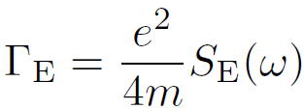

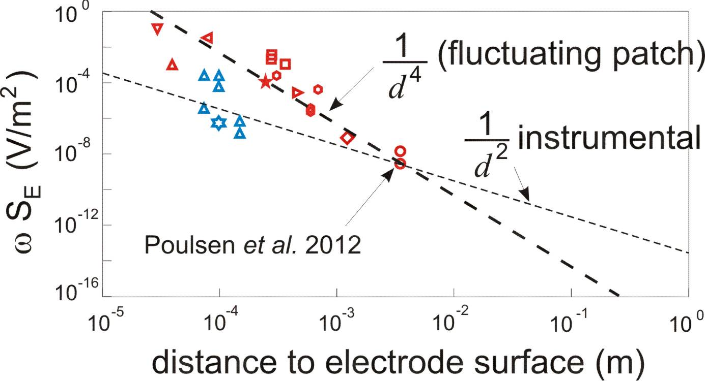
Voltage fluctuations
COM heating rate in the trap
Model:
x
Proposed
value

Slide 22
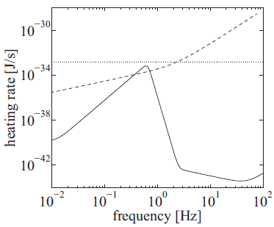
Poulsen et al. achieved Vrms ≈ 200 --700 nV
(1 electron at 3.5 mm gives 400 nV)
we are assuming the SAME noise at the electrode surface
and 1/f noise spectrum
heating rate ~ 10 nK/min
for trap vibrational frequency
of a few Hz
CSL @ GRW
Heating by electric field

Slide 23
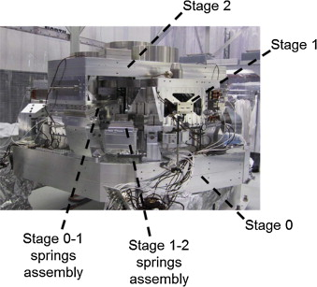

Mechanical vibrations of the trap structure
Active stabilization of optical table by laser interferometry
gives
(state of art is about 10 times better)
Mechanical filters (i.e. spring / pendulum).
Use design study for Virgo experiment:
Stabilization unit in testing at LIGO Hanford
Thermal vibrations in pendulum suspensions;
Seismic vibrations after filtering;
Thermal vibrations of electrode surfaces

Slide 24
Approx. existing
experimental
upper bound
Electric field
CSL @ GRW
Mechanical

Slide 25

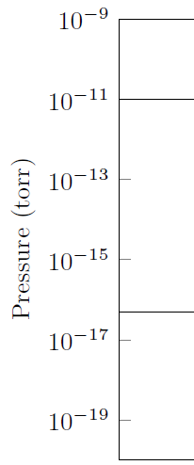

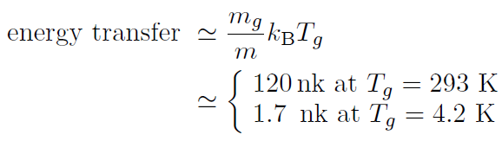
Collisions with background gas
Diffusive heating rate
Commonly observed pressure,
collision rate = 7 per second
collision rate = 3 per hour
Lowest recorded pressure,
collision rate = 1 per 7 hours

Slide 26
