Slide 1
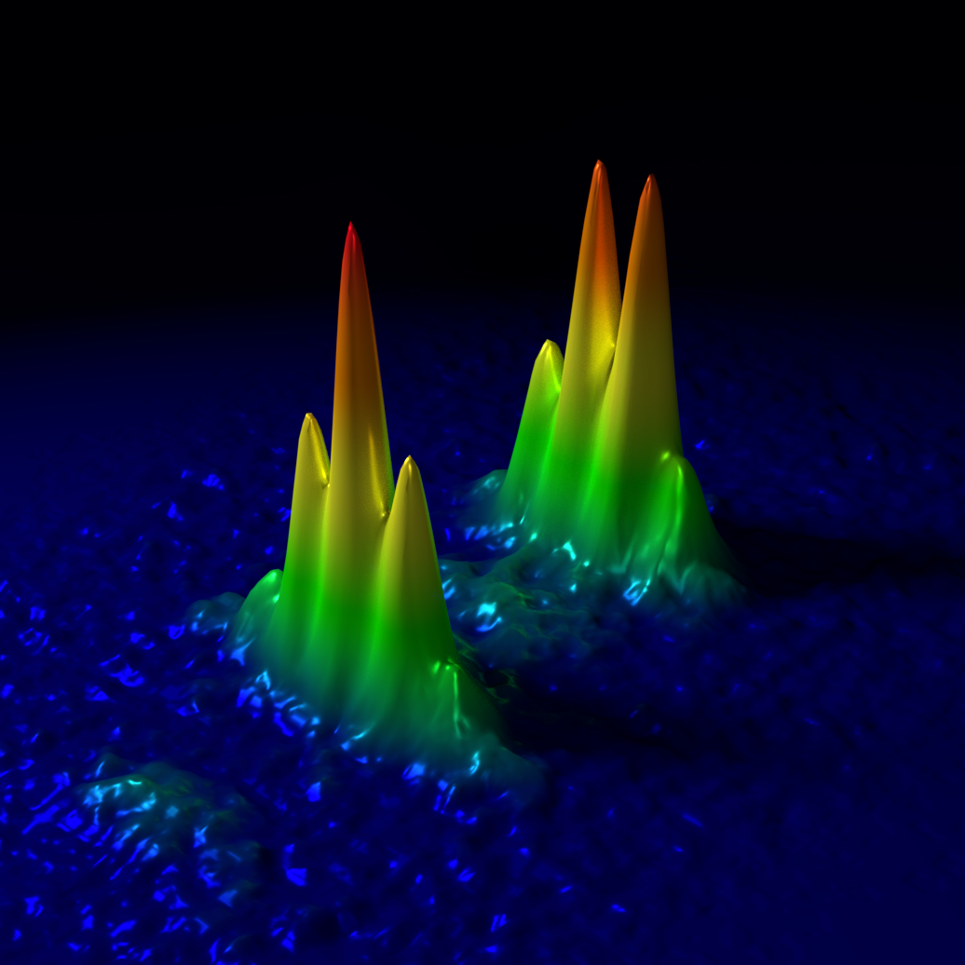
Atom interferometry and application to fundamental physics
Quantum Sensors for Fundamental Physics
Oxford, UK
Jason Hogan
Stanford University
October 16, 2018
Notes:
40 min +5 min questions

Slide 2
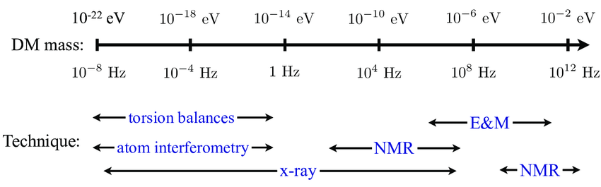
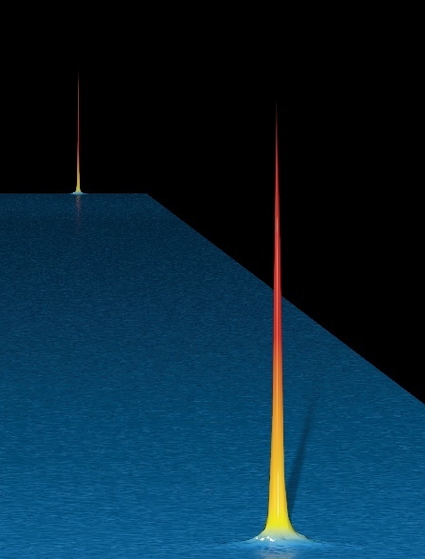
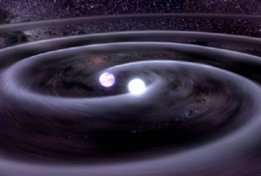
Science applications
Equivalence principle tests
Short distance gravity
Dark sector physics
QED tests (alpha measurements)
Quantum mechanics at macroscopic scales
Quantum entanglement for enhanced readout
Gravitational wave detection, sky localization

Slide 3
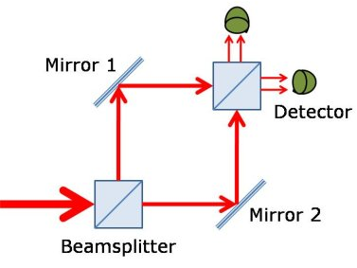
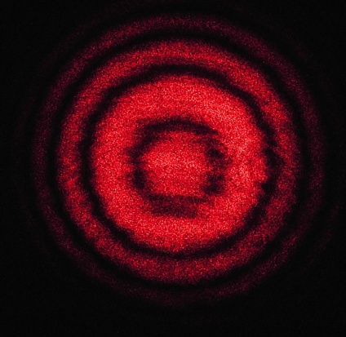
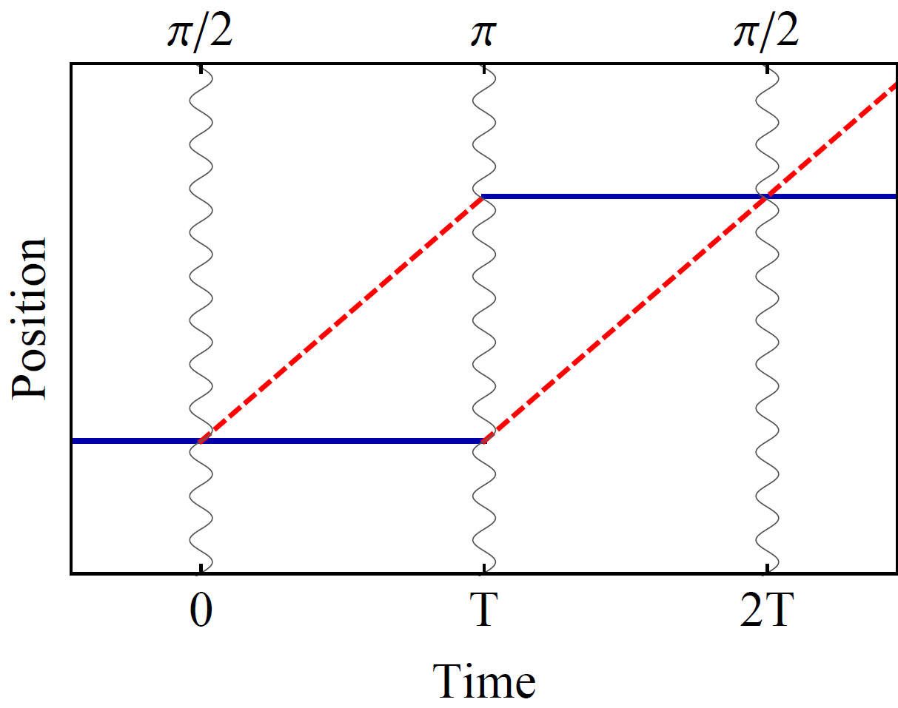
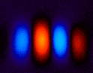
Atom interference
Light interferometer
Light
Light fringes
Atom interferometer
Beamsplitter
Atom fringes
Atom
Beamsplitter
Mirror
http://scienceblogs.com/principles/2013/10/22/quantum-erasure/
http://www.cobolt.se/interferometry.html

Slide 4

Atom optics using light
(1) Light absorption:
Rabi oscillations
ħk
v = ħk/m
(2) Stimulated emission:
ħk
Time

Slide 5
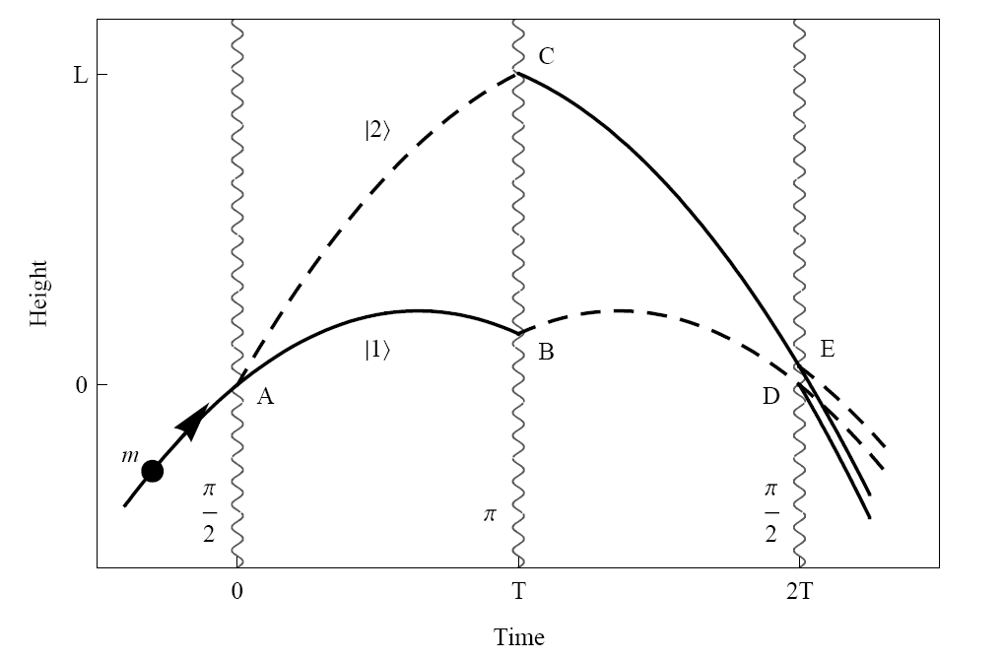
Light Pulse Atom Interferometry
Long duration
Large wavepacket separation

Slide 6
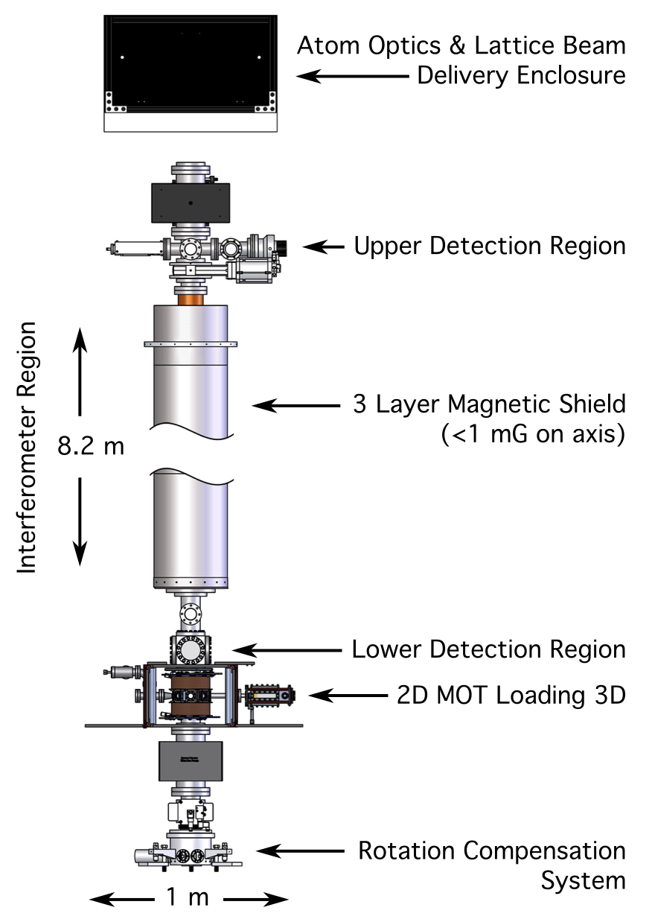
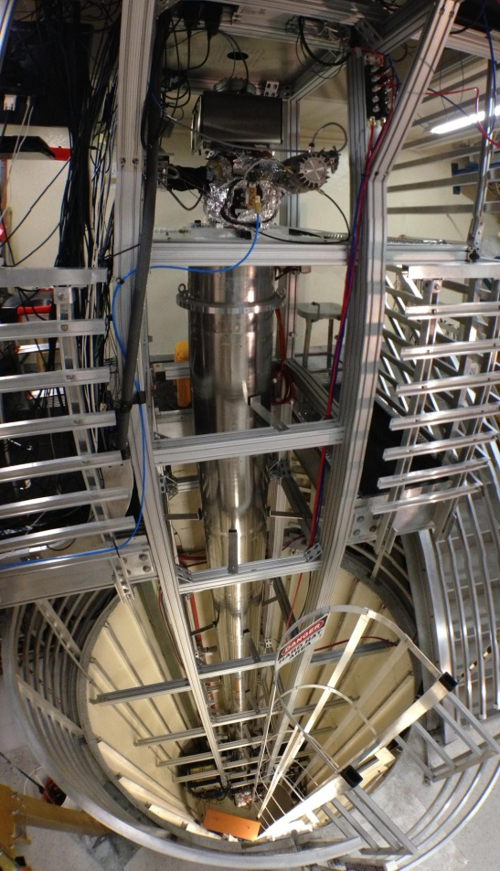
10 meter scale atomic fountain

Slide 7

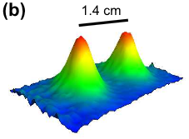
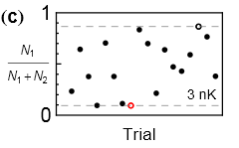
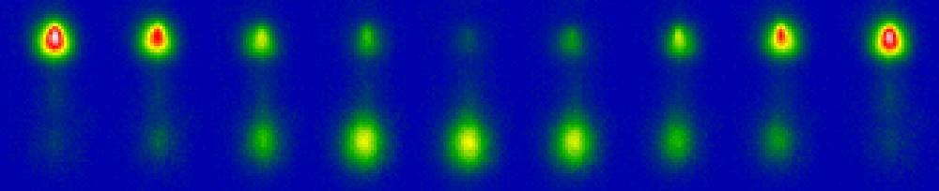

Interference at long interrogation time
Port 1
Port 2
Wavepacket separation at apex (this data 50 nK)
2T = 2.3 seconds
1.4 cm wavepacket separation
Interference (3 nK cloud)
Dickerson, et al., PRL 111, 083001 (2013).

Slide 8
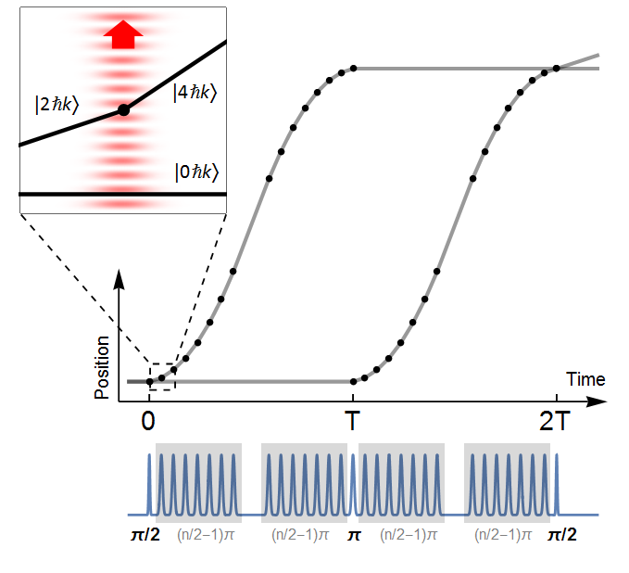
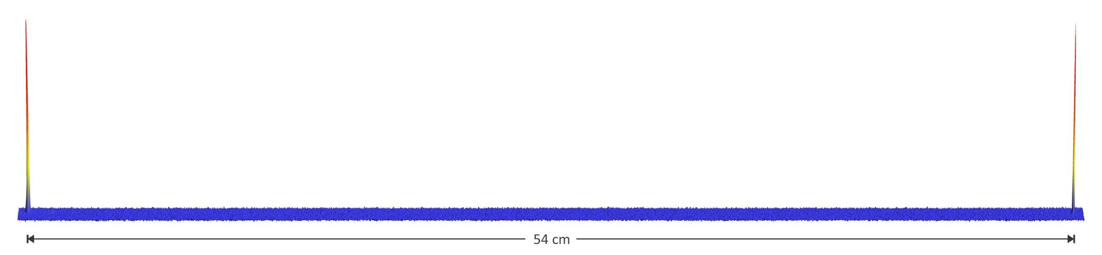
Large space-time area atom interferometry
max wavepacket separation
Long duration (2 seconds), large separation (>0.5 meter) matter wave interferometer
90 photons worth of momentum
World record wavepacket separation due to multiple laser pulses of momentum
54 cm
Kovachy et al., Nature 2015

Slide 9
Gravity Gradiometer
Gradiometer interference fringes
10 ћk
30 ћk
Asenbaum et al., PRL 118, 183602 (2017)

Slide 10
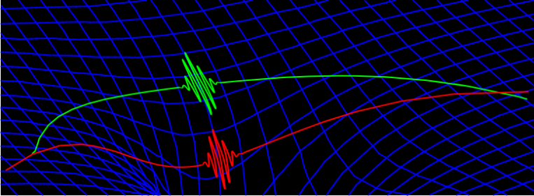
Gradiometer Demonstration
Gradiometer response to 84 kg lead test mass
Detected the gravitational tidal force (spacetime curvature) across a single particle's wavefunction
GR: gravity = curvature
→ First true manifestation of gravitation in a quantum system
Asenbaum et al., PRL 118, 183602 (2017)

Slide 11
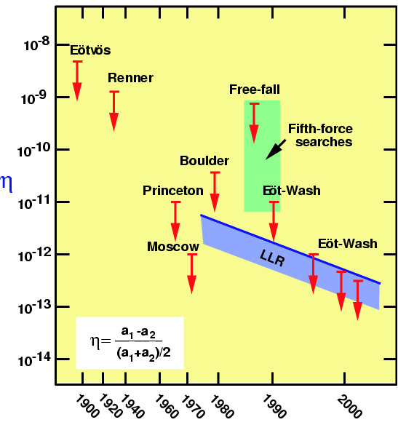

Equivalence Principle
Static EP tests
Free-fall tests, torsion balance, Lunar Ranging
Test foundation of General Relativity
Search for new forces (e.g, Yukawa potential)
C. Will, Living Reviews
Time-varying EP tests
New scalar (or vector) field that varies in space
The field could be dark matter
Force is oscillatory and EP violating:
Example: Coupling to electron mass
P. Graham et al., PRD 93, 075029 (2016)

Slide 12
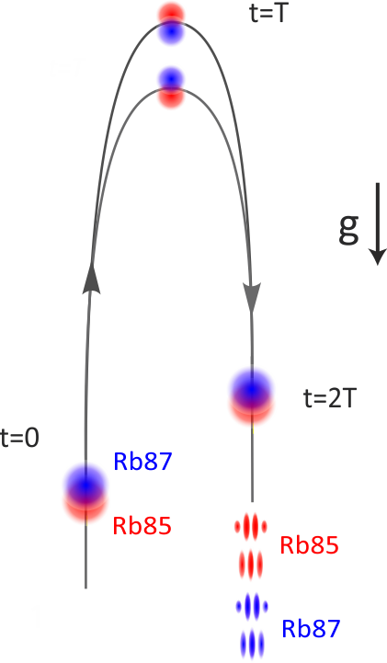
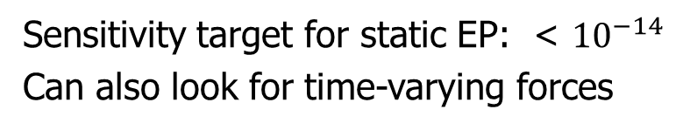
Stanford 10-meter EP test
Simultaneous Dual Interferometer
Dual interferometer fringes
Sensitivity target for static EP: < ${10}^{−14}$
Can also look for time-varying forces
Recent results: Suppressed GG sensitivity by x100
Overstreet et al., PRL 120, 183604 (2018)

Slide 13
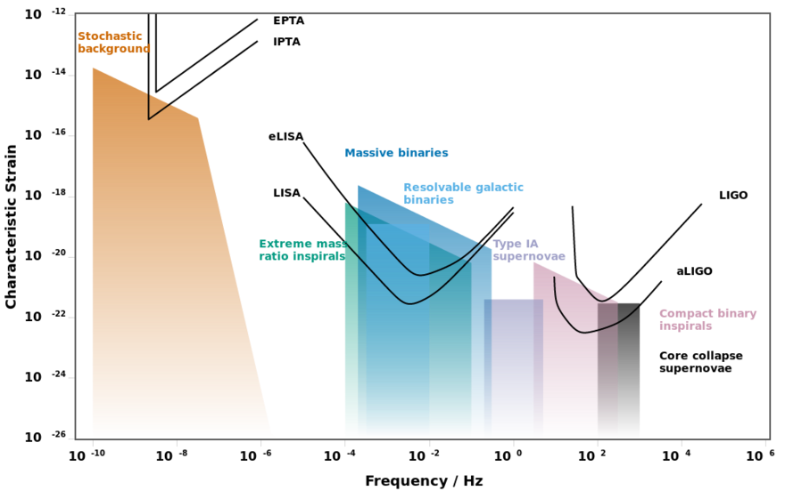
Gravitational wave frequency bands
Mid-band
There is a gap between the LIGO and LISA detectors (0.1 Hz – 10 Hz).
Moore et al., CQG 32, 015014 (2014)

Slide 14
Mid-band Science
Mid-band discovery potential
Historically every new band/modality has led to discovery
Observe LIGO sources when they are younger
Excellent sky localization
Predict when and where events will occur (before they reach LIGO)
Observe run-up using electromagnetic telescopes
Cosmology and Astrophysics
Black hole, neutron star, and white dwarf binaries
Parameter estimation (e.g., BH spin)
Ultralight scalar dark matter discovery potential
Early Universe stochastic sources (cosmic GW background)

Slide 15
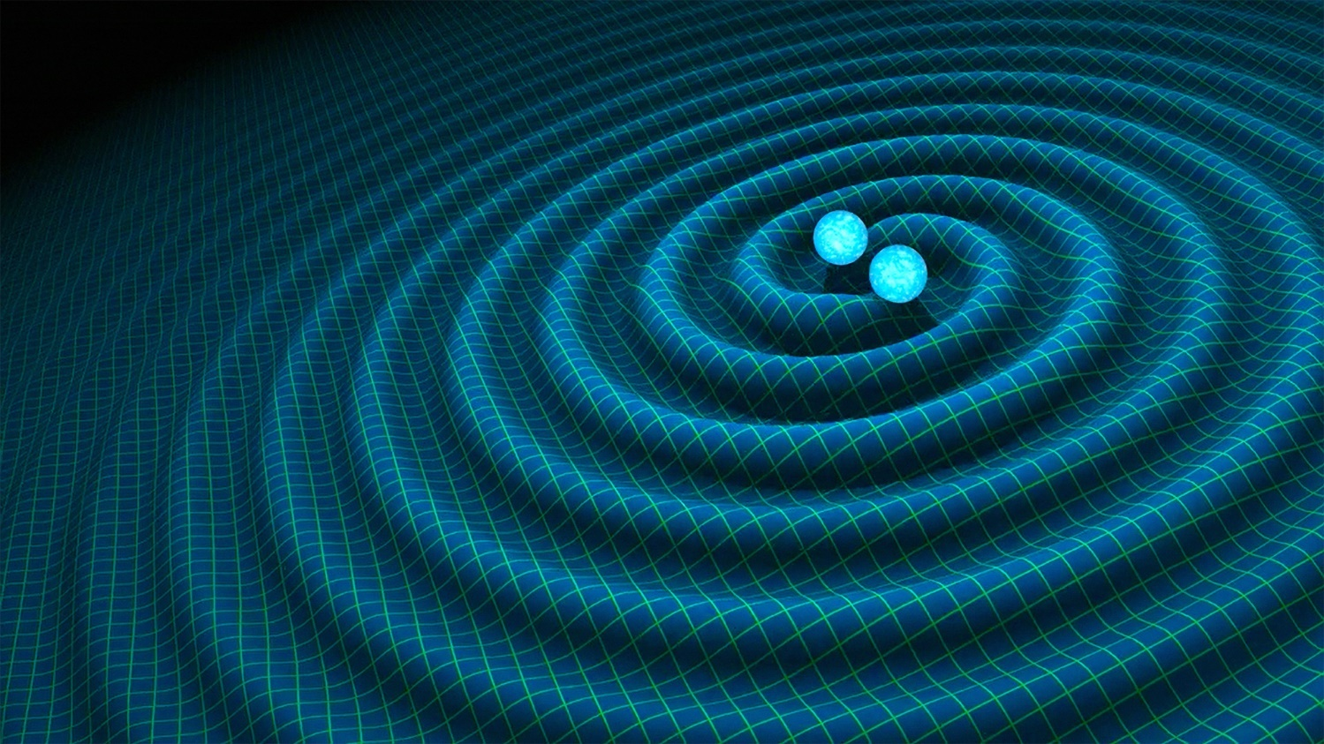
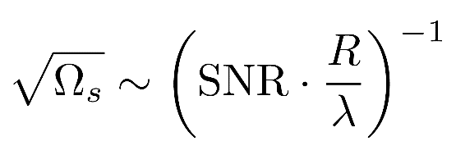
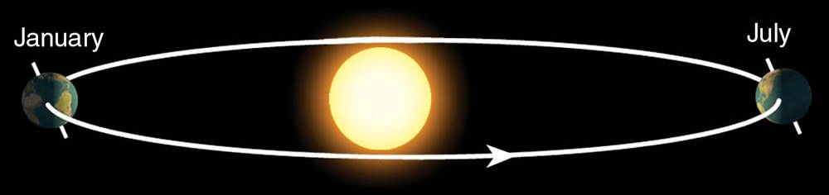
Sky position determination
Sky localization precision:
Mid-band advantages
- Small wavelength λ
- Long source lifetime (~months) maximizes effective R
λ
R
Images: R. Hurt/Caltech-JPL; 2007 Thomson Higher Education

Slide 16
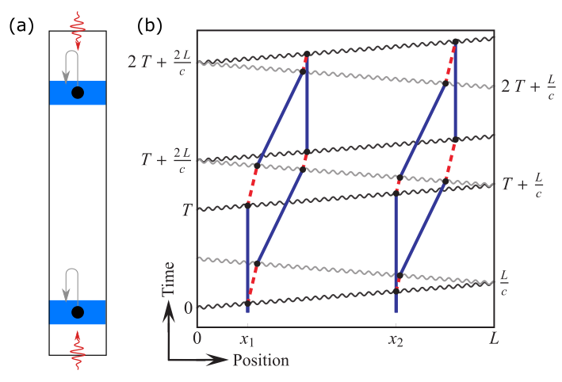
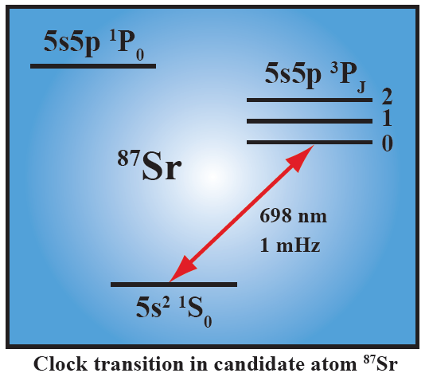
A different kind of atom interferometer
Hybrid “clock accelerometer”
Graham et al., PRL 110, 171102 (2013).
Clock: measure light travel time ➜ remove laser noise with single baseline
Accelerometer: atoms excellent inertial test masses

Slide 17


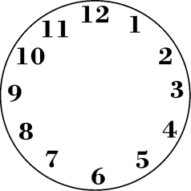
Simple Example: Two Atomic Clocks
Atom clock
Atom clock
Phase evolved by atom after time T
Time

Slide 18


Simple Example: Two Atomic Clocks
GW changes light travel time
Time
Atom clock
Atom clock

Slide 19


Phase Noise from the Laser
The phase of the laser is imprinted onto the atom.
Laser phase noise, mechanical platform noise, etc.
Laser phase is common to both atoms – rejected in a differential measurement.

Slide 20
Clock gradiometer
Excited state phase evolution:
Two ways for phase to vary:
Dark matter
Gravitational wave
Each interferometer measures the change over time T
Laser noise is common-mode suppressed in the gradiometer
Graham et al., PRL 110, 171102 (2013).
Arvanitaki et al., PRD 97, 075020 (2018).

Slide 21

Ultralight scalar dark matter
Ultralight dilaton DM acts as a background field (e.g., mass ~10⁻¹⁵ eV)
+ …
Electron
coupling
Photon
coupling
e.g., QCD
DM scalar field
DM mass density
DM coupling causes time-varying atomic energy levels:
DM induced oscillation
Dark matter coupling
Time

Slide 22
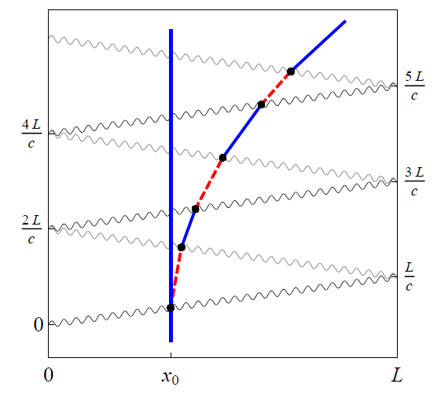
LMT and Resonant Pulse Sequences
Sequential single-photon transitions remain laser noise immune
LMT beamsplitter (N = 3)
Resonant sequence (Q = 4)
Graham, et al., PRL (2013)
Graham, et al., PRD (2016)

Slide 23
GW Sensitivity for a Satellite Detector
Satellite detector concept
Two spacecraft, MEO orbit
Atom source in each
Heterodyne laser link
Resonant/LMT sequences
L = 4 × 10⁷ meters
Dots indicate remaining lifetimes of 10 years, 1 year and 0.1 years

Slide 24
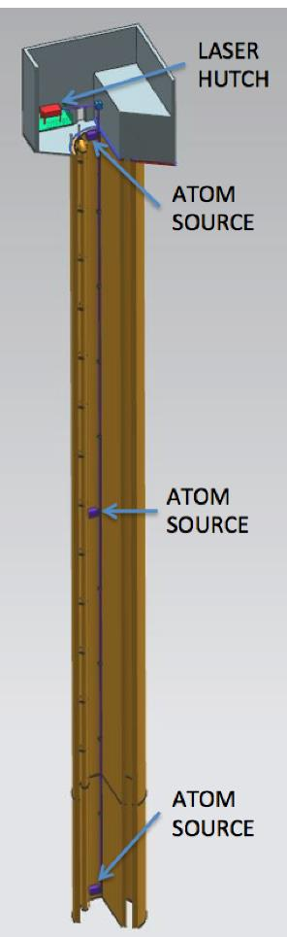
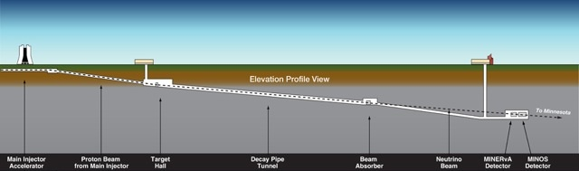






MAGIS-100: Proposed GW detector prototype at Fermilab
Matter wave Atomic Gradiometer Interferometric Sensor
100-meter baseline atom interferometry in existing shaft at Fermilab
Intermediate step to full-scale (km) detector for gravitational waves
Clock atom sources (Sr) at three positions to realize a gradiometer
Probes for ultralight scalar dark matter beyond current limits (Hz range)
Extreme quantum superposition states: >meter wavepacket separation, up to 9 seconds duration
100 meters
Notes:
MAGIS = Matter wave Atomic Gradiometer Interferometric Sensor

Slide 25
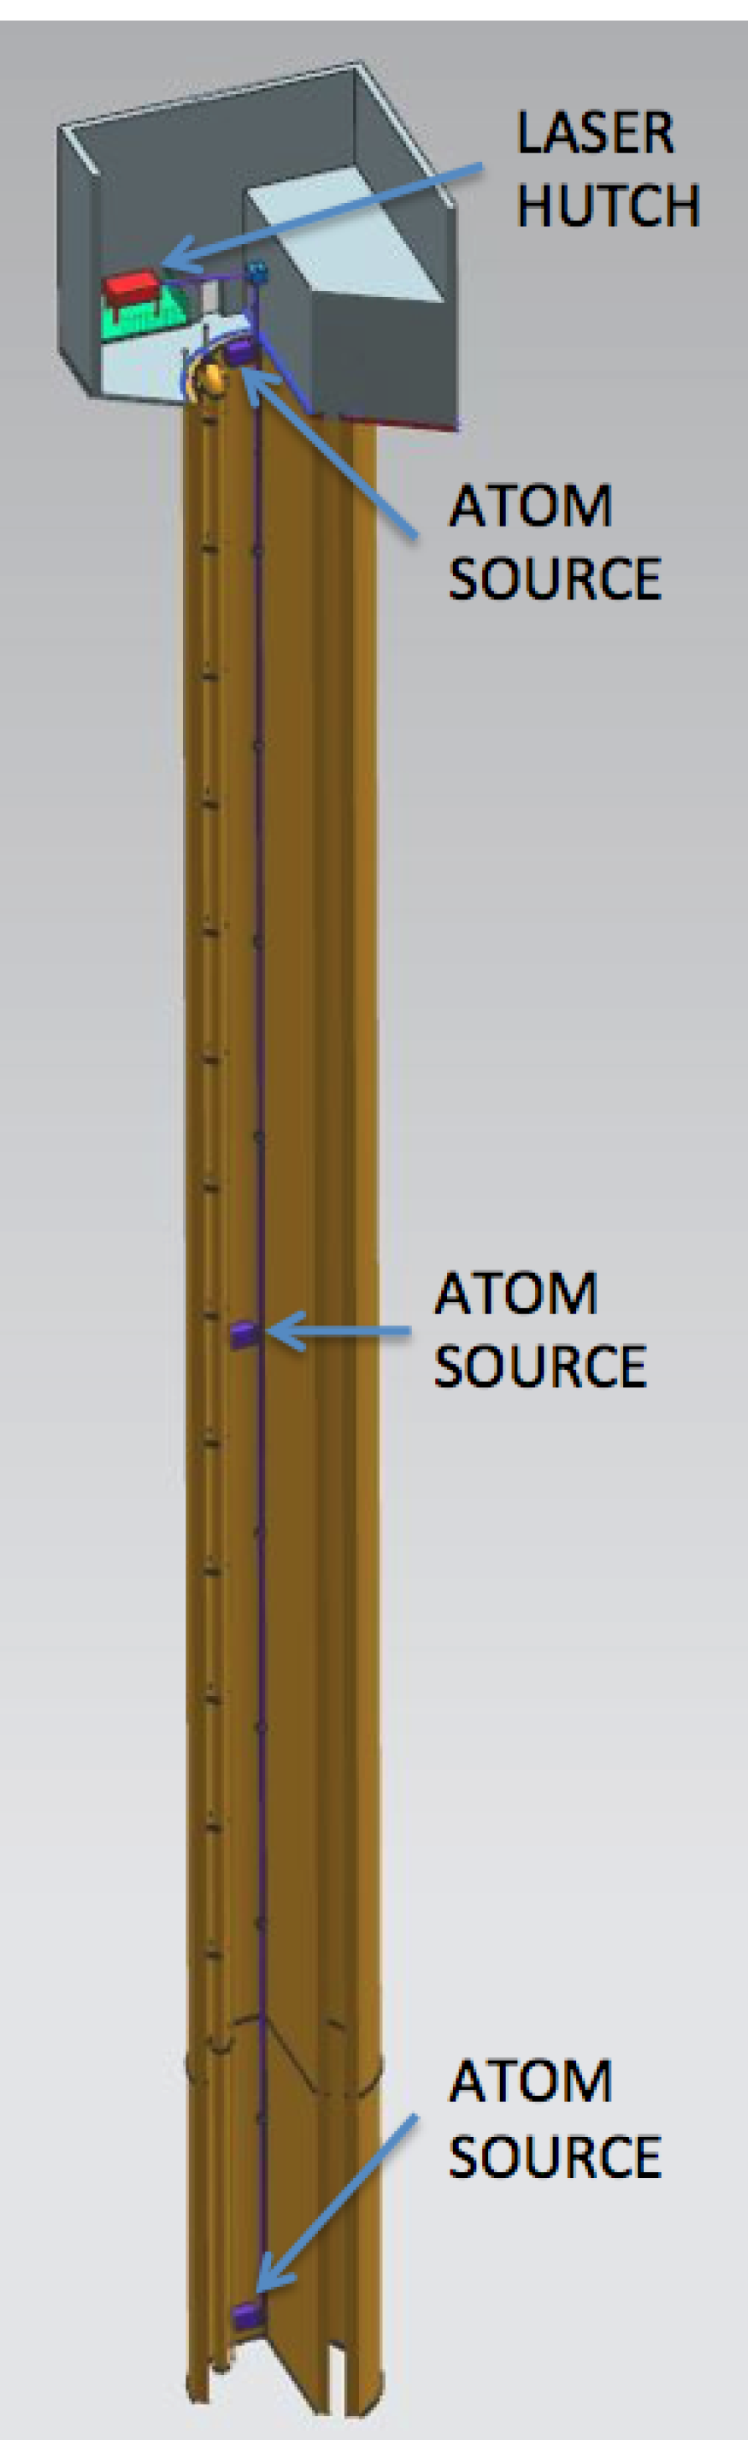
MAGIS-100 Design
System Components:
~90 meter vacuum tube (vertical)
Atoms sources (three, attached to tube)
Laser system for implementing atom interferometry (hutch at top)
Laser hutch location

Slide 26
MAGIS Estimated Sensitivity
DM sensitivity
(coupling to electron mass)
Full-scale instrument (km baseline)
Arvanitaki et al., PRD 97, 075020 (2018).
GW strain sensitivity

Slide 27
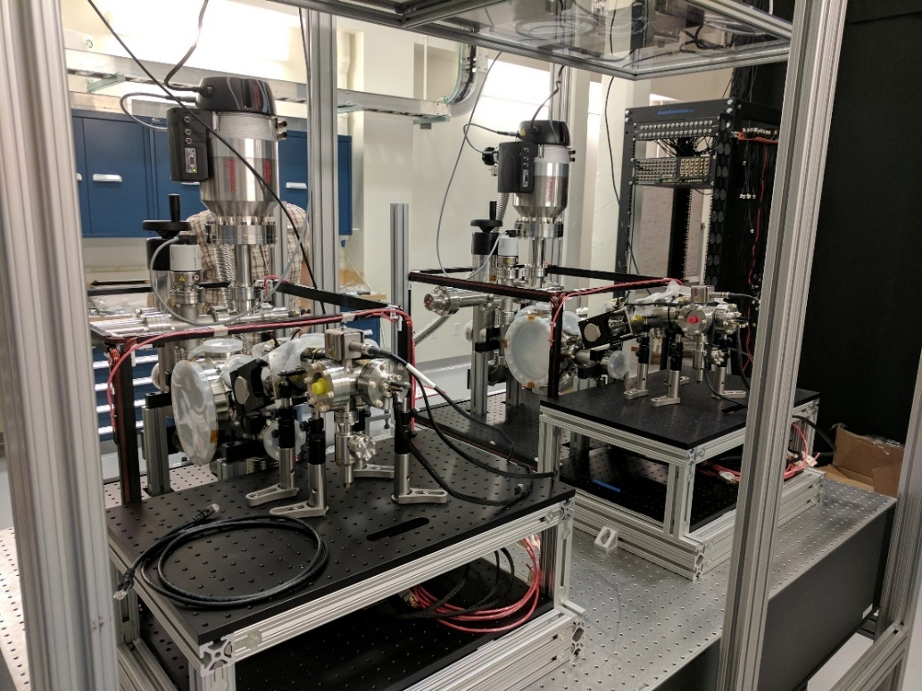
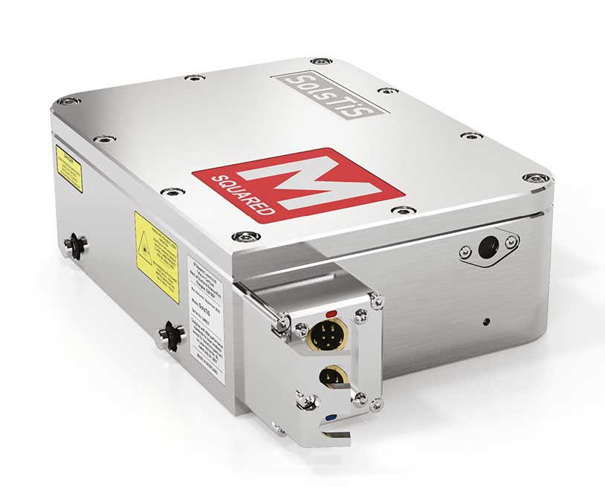
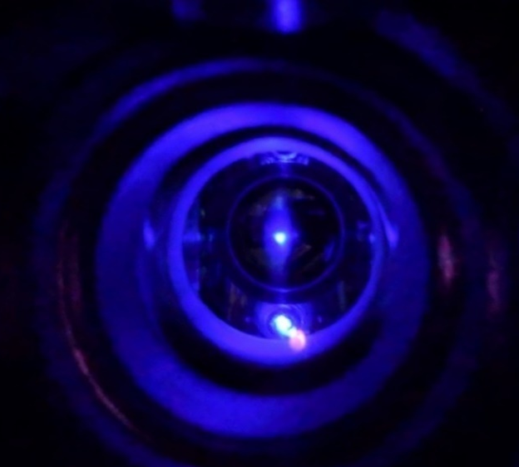
Stanford MAGIS prototype
Sr gradiometer CAD
(atom source detail)
Two assembled Sr atom sources
Trapped Sr atom cloud
(Blue MOT)
Atom optics laser
(M Squared SolsTiS)

Slide 28
Collaborators
Rb Atom Interferometry
Mark Kasevich
Tim Kovachy
Chris Overstreet
Peter Asenbaum
Remy Notermans
Sr Atom Interferometry
Jan Rudolph
TJ Wilkason
Hunter Swan
Yijun Jiang
Connor Holland
Ben Garber
NASA GSFC
John Mather
Babak Saif
Bernard D. Seery
Lee Feinberg
Ritva Keski-Kuha
MAGIS-100:
Joseph Lykken (Fermilab)
Robert Plunkett (Fermilab)
Swapan Chattopadhyay (Fermilab/NIU)
Jeremiah Mitchell (Fermilab)
Roni Harnik (Fermilab)
Phil Adamson (Fermilab)
Steve Geer (Fermilab)
Jonathon Coleman (Liverpool)
Tim Kovachy (Northwestern)
Theory
Peter Graham
Roger Romani
Savas Dimopoulos
Surjeet Rajendran
Asimina Arvanitaki
Ken Van Tilburg

Slide 30

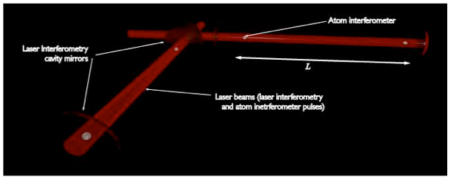
Atomic sensors for gravitational wave detection
Atomic clocks and atom interferometry offer the potential for gravitational wave detection in an unexplored frequency range (“mid-band”)
Potential for single baseline detector (use atoms as phase reference/local clock)
Mid-band
0.03 Hz to 3 Hz
Satellite proposal using optical lattice clocks + drag free inertial reference (Kolkowitz et al., PRD 2016)
MAGIS: Atom interferometry with clock atoms serving as both inertial reference + phase reference (Hogan, Kasevich)
Mid-band science
LIGO sources before they reach LIGO band
Optimal for sky localization: predict when and where inspiral events will occur (for multi-messenger astronomy)
Probe for studying cosmology
Search for dark matter (dilaton, ALP, …)
MIGA: Terrestrial detector using atom interferometer + optical cavity (Bouyer, France)
Notes:
Basic concept: atoms are good clocks (phase ref.) and good inertial references. Use clock to measure light-flight time between two inertial references traveling on their geodesics.
The mid-band is not covered by other GW detectors, would be complementary. Mid-band is very promising for sky localization and parameter estimation.
There are several large baseline proposals for GW detectors using clocks and atom interferometers (on ground and in space), each with a different approach and technical pros/cons, but based on similar basic concepts. It makes sense to study many ideas.

Slide 31
Lattice Clocks
Optical lattice atomic clocks
Resonant (dynamical decoupling)
Drag-free satellites
S. Kolkowitz, I. Pikovski, N. Langellier, M. D. Lukin, R. L. Walsworth, and J. Ye, Phys. Rev. D 94, 124043 (2016)

Slide 32
GW Detector Comparison
 | Inertial reference | Laser phase reference
LIGO | Suspended end mirrors | Second arm
LISA | Drag-free proof masses | Second baseline
MAGIS | Atom | Atom
Atomic clock | Drag-free proof mass | Atom

Slide 33
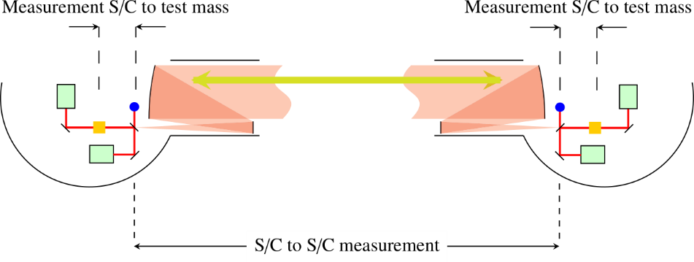
Compare to LISA
LISA:
Second baseline needed for phase reference:
Atom interferometer:
Atom test mass
- Records laser noise
- Acts as phase reference
Atoms
(Figures adapted from LISA yellow book.)

Slide 34
Bounds on stochastic GW sources
Example resonant sequence
Envelope
(cosmic strings)
(phase transition)
White dwarf
Narrow band sensitivity possible in 1 year
Graham, et al., arXiv:1606.01860 (2016)

