Slide 1
AI and Automation in Sports
Ryan Grimes
Hampton University

Slide 2
Abstract
AI and automation in sports has gone from being for broadcasting to being for player protection. These innovations provide greater fairness, accuracy, and safety while also improving performance and training.
Devices that collect biometric readings, location tracking, and injury reports are potential targets for cyberattacks. In the event of compromisation, player privacy and data integrity will be jeopardized.
Past research has examined accuracy and health benefits; however, device security, data flow, and contingency planning in the event of an attack or breach has not been acknowledged.

Slide 3
Current Implementation of AI and Automation in Sports
Since 2014, the NFL has used radio-frequency identification (RFID) tags placed in players’ shoulder pads, officials, pylons, and footballs to captures location, speed, distance traveled, and other data at a rate of 10 times per second. This process generates over 200 new data points on every play [6].
Hawk-eye technology is the most widely used and Statcast is one of the most notable subfunctions of it. Hawk-eye technology is a ball-tracking system that uses multiple fast cameras to analyze a ball’s trajectory then generates a 3D ball route model [14]. It is commonly used in baseball, football, and tennis to make split-second decisions, especially when it deals with line calling.
The NFL has adopted advanced pads and helmets, such as Riddell’s Precision-Fit helmets, to manage data on player health. This specific helmet uses personalized, 3D-printed padding contoured to an athlete’s head to manage impact energy [9].
SISU Sense concussion-sensing mouthguard uses an embedded microchip sensor to give accurate acceleration readings when an impact occurs. The mouthpiece comes with an app that allows users to instantly view data from specific days or months [11].

Slide 4
Problem Statement
This research will explore both the benefits and risks of sports technology by focusing on the intersection of AI, automation, and cybersecurity. In addition, the importance of safeguarding athlete data, maintaining system integrity, and ensuring ethical use of AI on and off the field will be emphasized.

Slide 5

Methodology
Quantitative
There are two surveys posted on various media platforms in order to collect data from a diverse audience.
Qualitative
Several research papers and articles are analyzed and synthesized to identify previous findings.

Slide 6
Findings
Research at Stanford University found that many commonly used head impact sensors produce inaccurate data. The reasoning behind this is because sensors mounted to flexible soft tissue, like a skin patch or skull cap, can move upon impact and overpredict the acceleration of the impact by up to 500 percent compared to skill motion. In addition, the researchers found that devices attached to the teeth, like the previously highlighted SISU mouthguard, or sensors inside the ear canal perform better [12].
The data collection and pre-processing phase of data collection and transmission is vulnerable to sensor spoofing and scaling attacks [1].
Computer vision faces challenges such as similarities between players and frequent occlusions, difficulty in jersey number recognition due to massive jerseys with sharp contours, false positives because of fans wearing jerseys, and lack of cross-compatibility of AI algorithms [4].
Image reconstruction uses selective median and random filters to identify altered pixel points; this process has been used to defend against attacks on modified frames without modifying the original neural network [1]

Slide 7
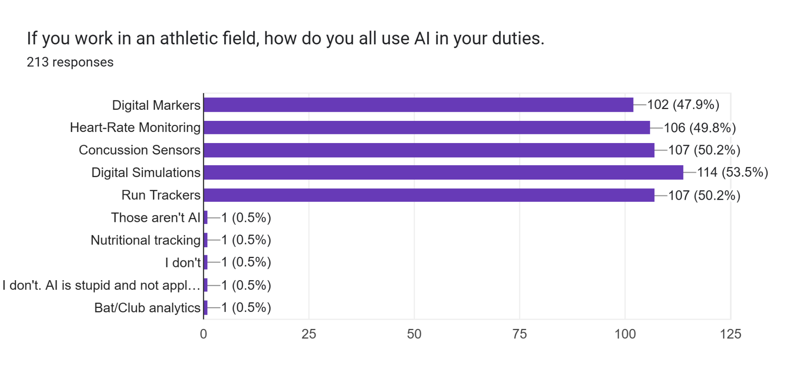
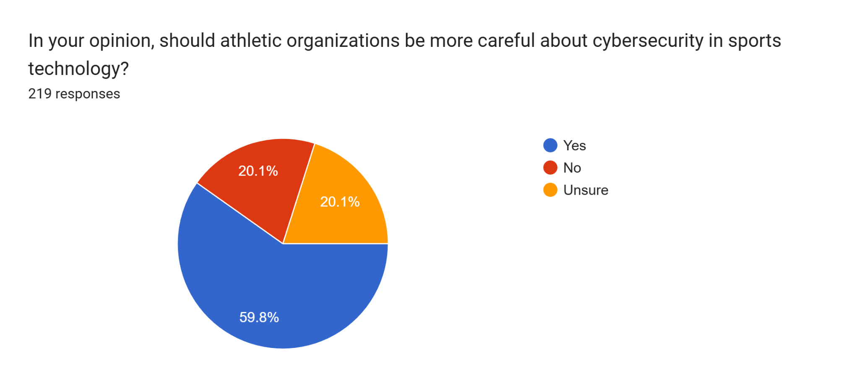
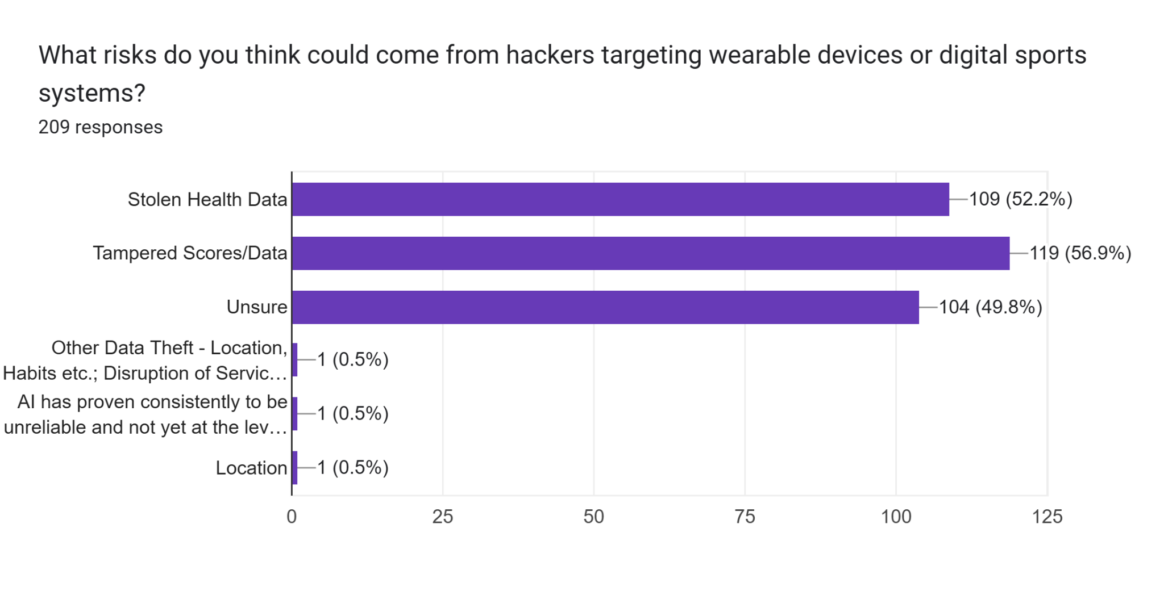
Findings

Slide 8
Analysis
In its current state, developers need to prioritize security before it AI and automation implemented
Data integrity and accuracy is paramount for the deployment of AI and automation.
Human oversight is a simple mitigation technique that improves accountability and accuracy.
Implementing detection and filtering and data provenance and authentication enhances data’s reliability.

Slide 9
Conclusion
By emphasizing security over creativity, AI and automation can safely improve fairness, efficiency, and accuracy of sports.

