Slide 1
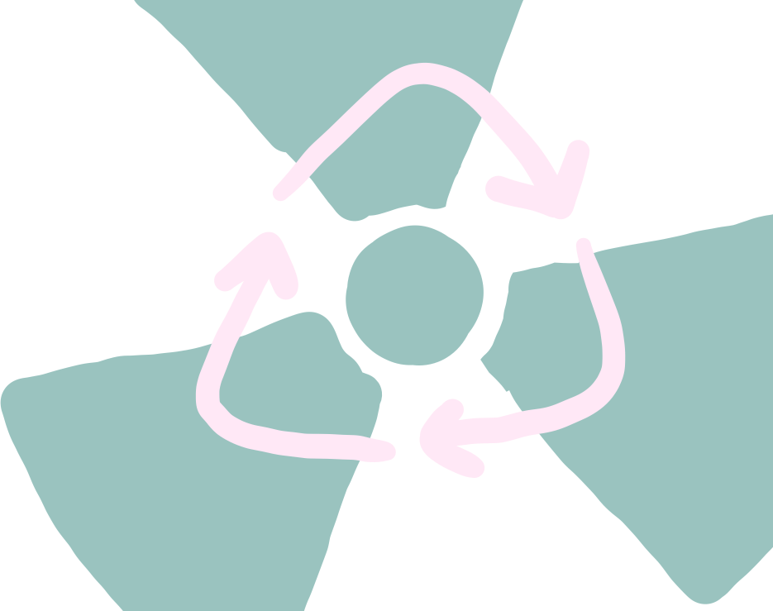


Multi-MOX: Fascilitating plutonium multi-recycling in the French PWR fleet
Gulla Louise Serville Torvund
PhD student, University of Oslo
15th Nordic meeting on Nuclear Physics

Slide 2
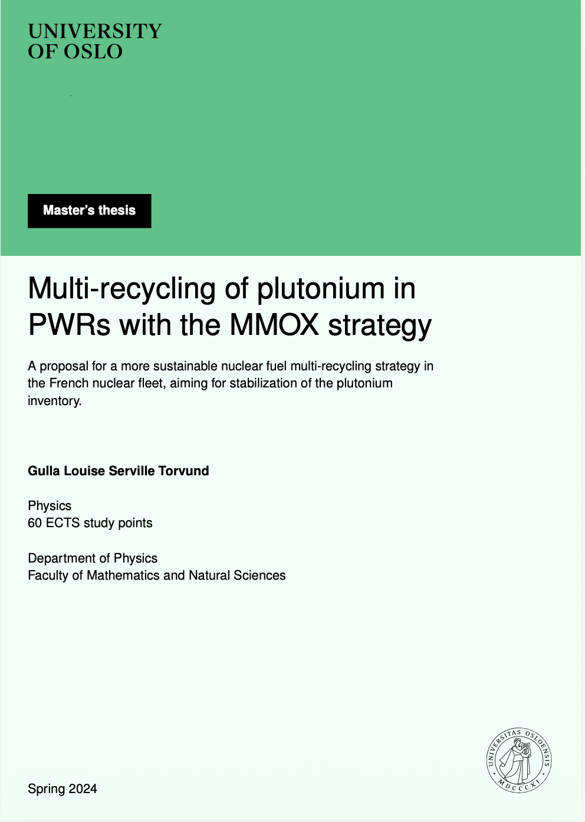

Master’s thesis (spring ‘24)

Slide 3
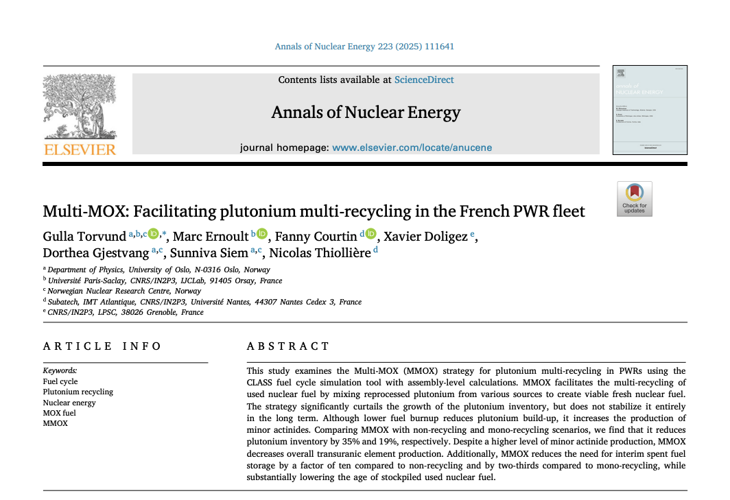
Annals of Nuclear Energy (spring ‘25)
Torvund, G., Ernoult, M., Courtin, F., Doligez, X., Gjestvang, D., Siem, S., & Thiollière, N. (2025). Multi-MOX: Facilitating plutonium multi-recycling in the French PWR fleet. Annals of Nuclear Energy, 223, 111641.

Slide 4


Slide 5
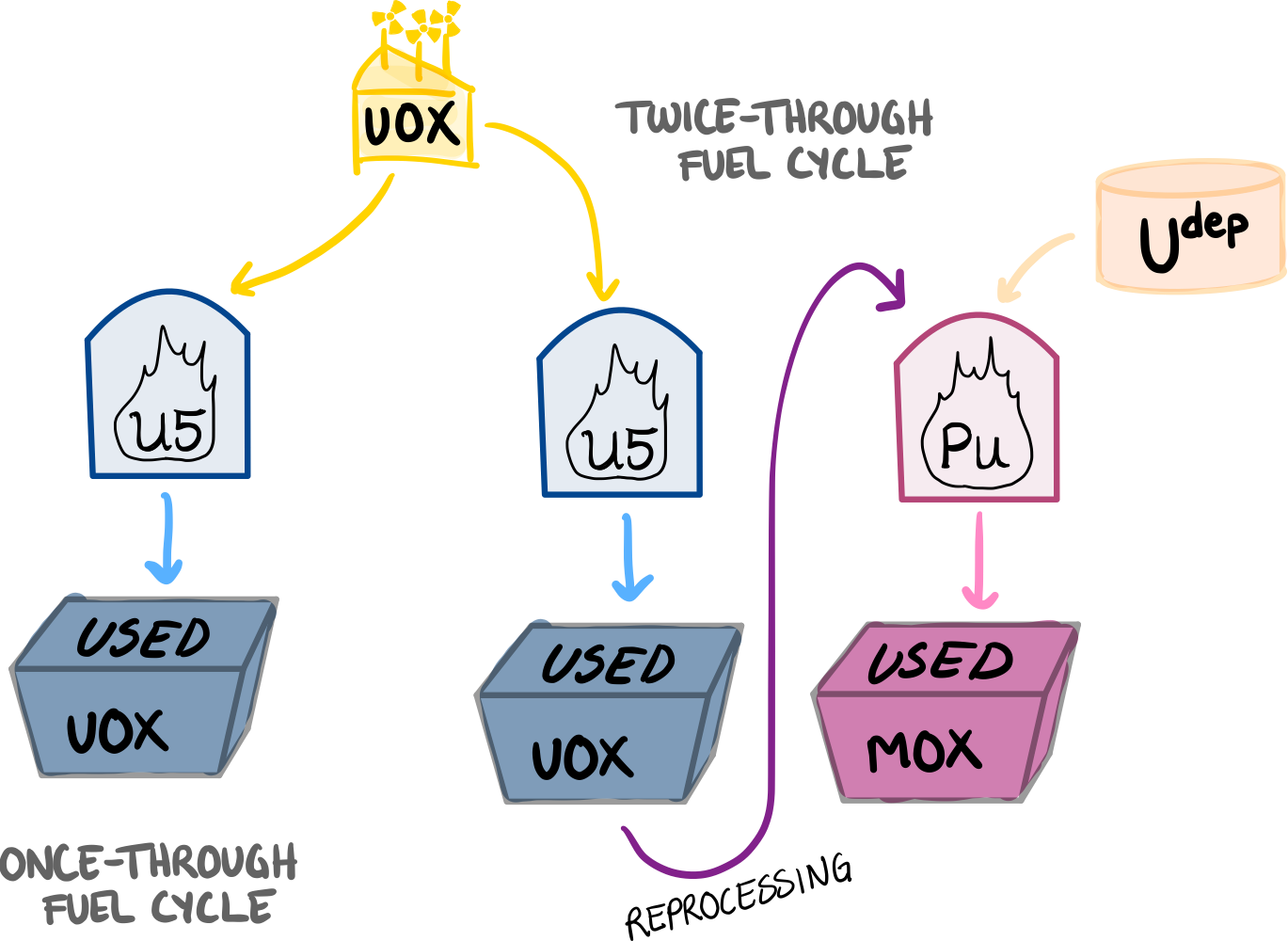

Slide 6
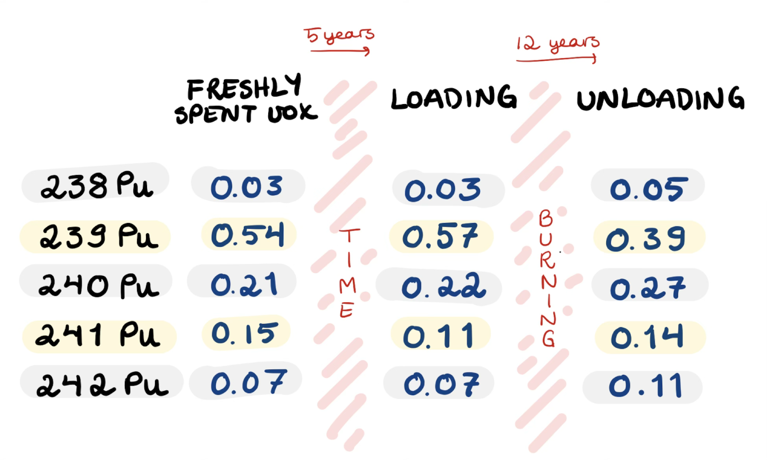

Two problems with Pu multi-recycling:
1) degrading Pu quality
¹S. Aniel, J. Bergeron and A. Puill. Evaluation of the maximum content of a MOX-fueled pressurized water reactor versus isotopic composition with respect to the void coefficient. Tech. rep. Gif-sur-Yvette: Commissariat a l’Energie Atomique (CEA), 1997, pp. 181–193.

Slide 7
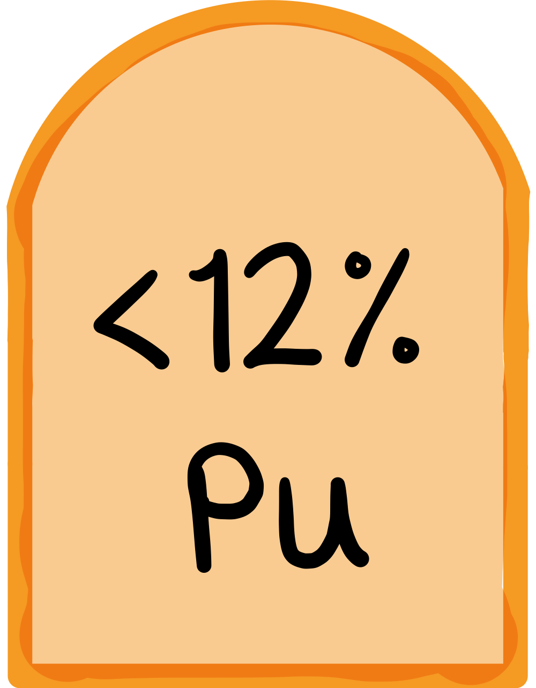
Two problems with Pu multi-recycling:
1) degrading Pu quality
2) safety limit on Pu in reactors¹
¹S. Aniel, J. Bergeron and A. Puill. Evaluation of the maximum content of a MOX-fueled pressurized water reactor versus isotopic composition with respect to the void coefficient. Tech. rep. Gif-sur-Yvette: Commissariat a l’Energie Atomique (CEA), 1997, pp. 181–193.

Slide 8
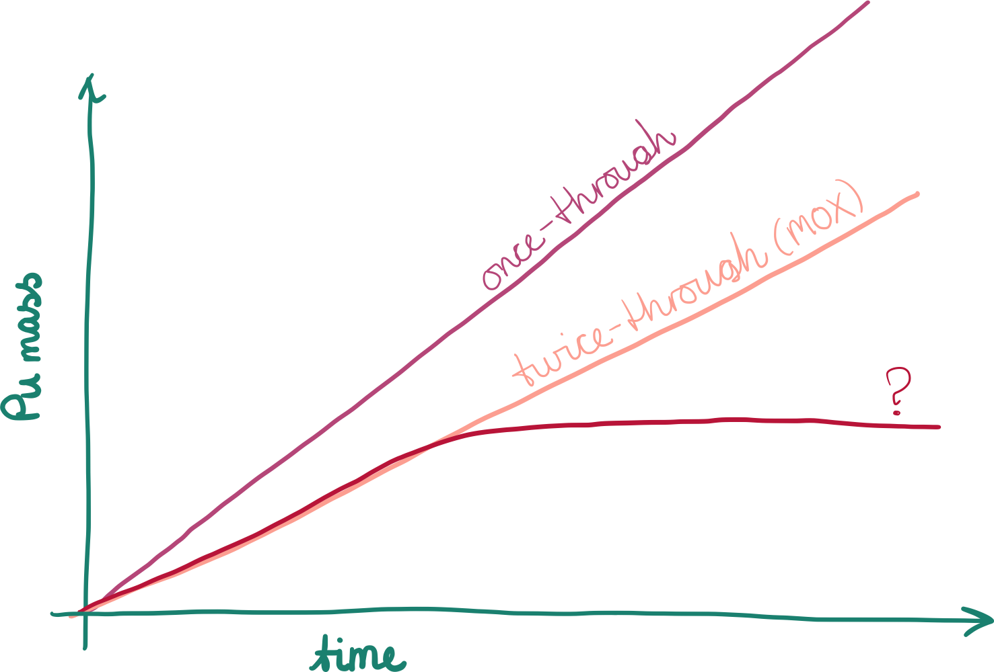

Slide 9
Fast reactors
POSTPONED

Slide 10
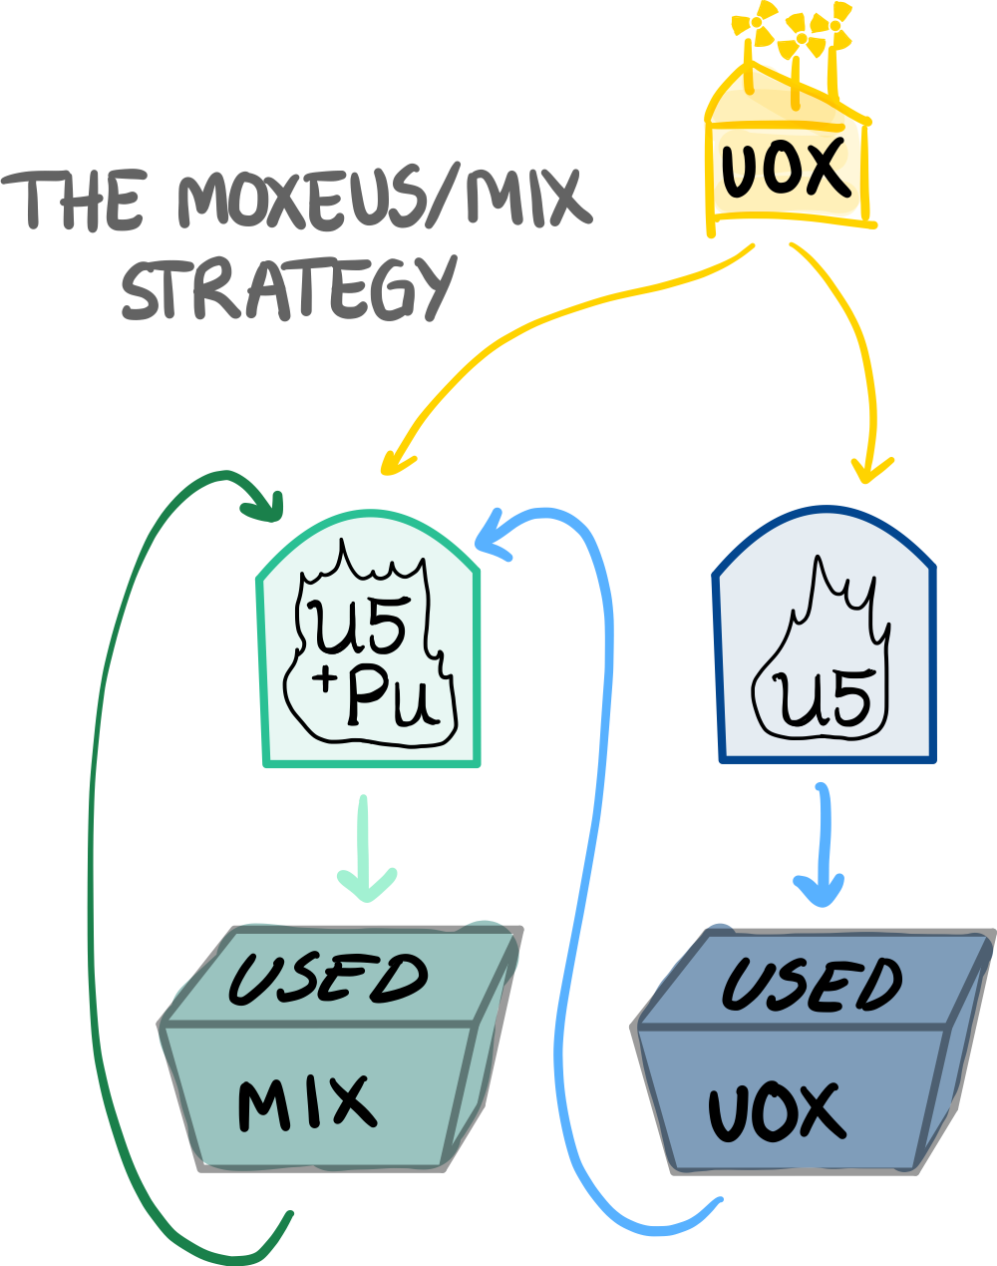
Fast reactors
POSTPONED
TOO COMPLICATED?

Slide 11
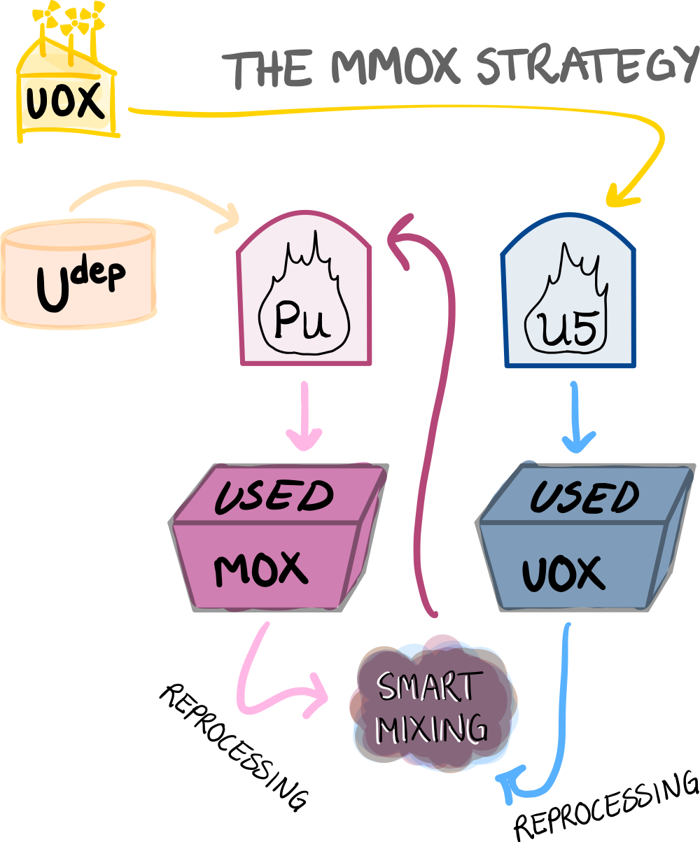

Slide 12
What will happen to the plutonium inventory (and a bunch of other stuff) if we employ the Multi-MOX method?

Slide 13

CLASS
(Core Library for Advanced Scenario Studies)
Fuel cycle (CLASS)
Depletion (SMURE)
Neutronics (Serpent)
B. Mouginot et al. ‘Core library for advanced scenario simulation, CLASS: principle & application’. In: International Conference “The Role of Reactor Physics toward a Sustainable Future”(PHYSOR 2014). 2014, 12–p.

Slide 14
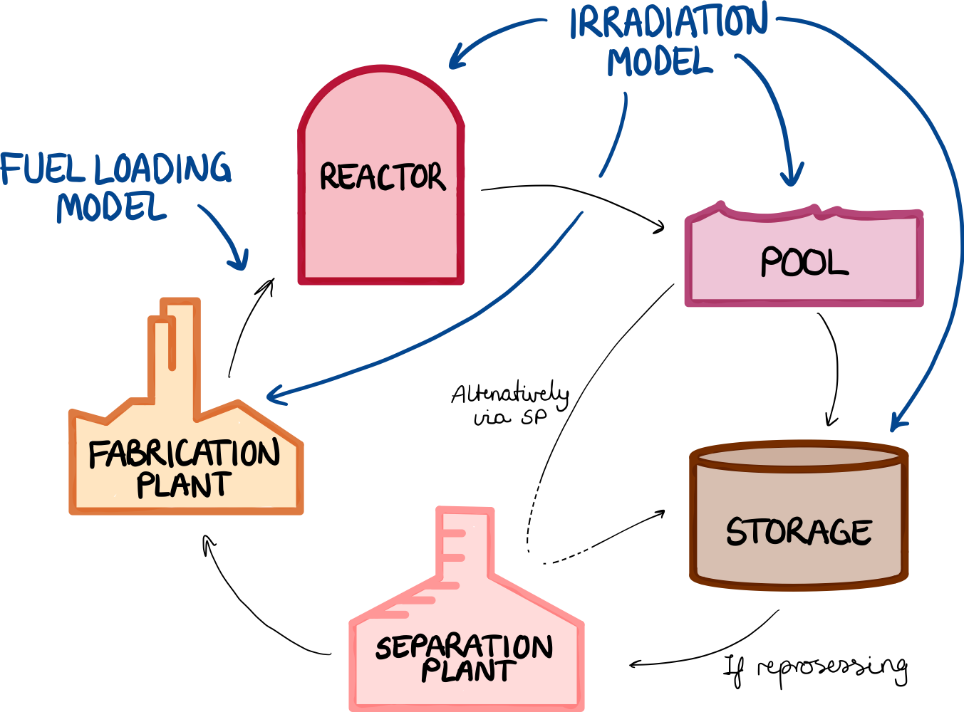
ANN trained on SMURE results predicts time-dependent cross sections. Irradiation model calculates neutron flux and depletion matrix.
ANN trained on SMURE results to predict time-dependent k_{eff} of fuel.

Slide 15
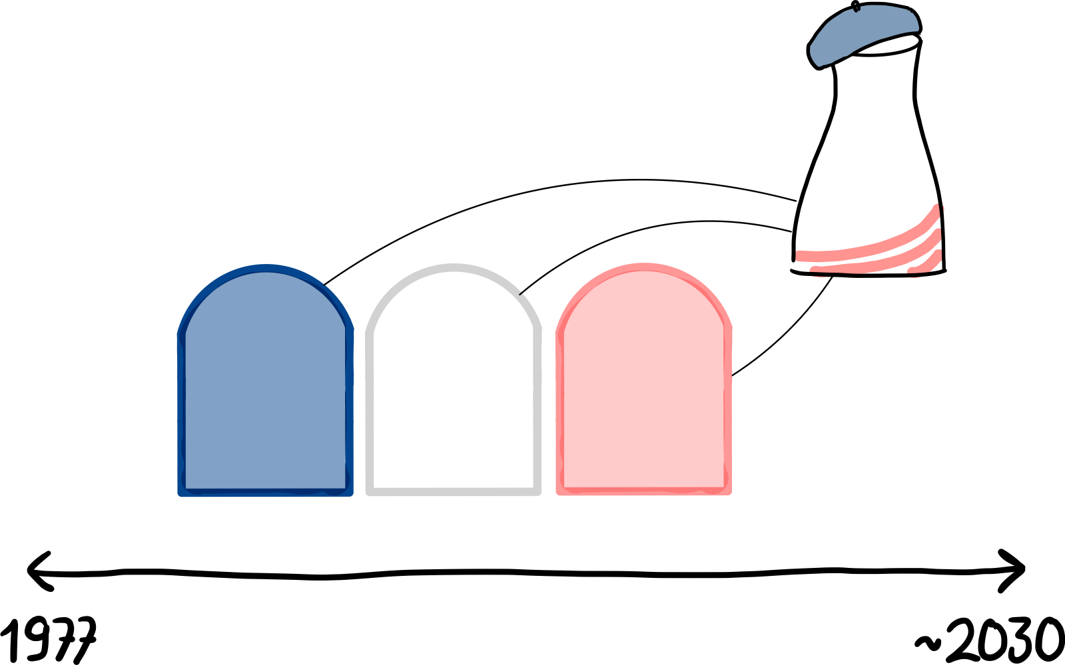

Slide 16
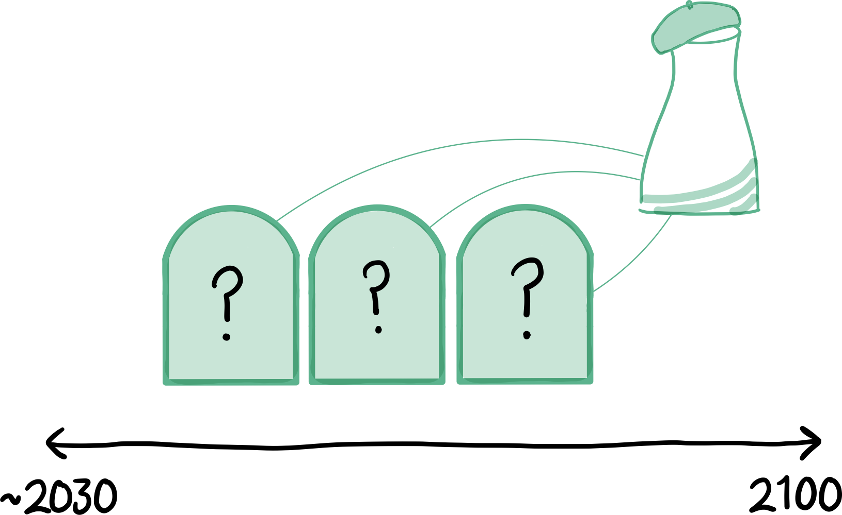

Slide 17
MMOX scenarios
MMOX Low BU (33 GWd/t)
MMOX Medium BU (40 GWd/t)
Reference scenarios
Only UOX
MOX Continued (8%)
MMOX High BU (49/47 GWd/t)
MOX Stabilized (10.2%)
MIX

Slide 18
MMOX scenarios
MMOX Low BU (33 GWd/t)
MMOX Medium BU (40 GWd/t)
Reference scenarios
Only UOX
MOX Continued (8%)
MMOX High BU (49/47 GWd/t)
MOX Stabilized (10.2%)
MIX
Using predictions for the future French fleet^{1,2}:
BU~50 GWd/t
10% SMR capacity
¹F. Courtin et al. ‘Pu multi-recycling scenarios towards a PWR fleet for a stabilization of spent fuel inventories in France’. In: EPJ N-Nuclear Sciences & Technologies 7 (2021), p. 23.
²RTE. Energy Pathways to 2050 (Key results). Tech. rep. RTE for the French government, Oct. 2021.

Slide 19
Results:
Pu inventory
20%
35%
19%

Slide 20
Results:
MA/TRUE inventory
same result regardless of BU

Slide 21
Results: Uranium consumption
250 t
50,000 t of U^{nat}
5%
8%

Slide 22
Key takeaways: Multi-MOX
Novel method of multi-recycling plutonium in PWRs
Easily implememted in a fuel cycle strategy already using MOX fuel
Significantly reduces the accumulation of plutonium in storage

Slide 23
Questions?
Gulla L. S. Torvund
gltorvun@uio.no

Slide 24
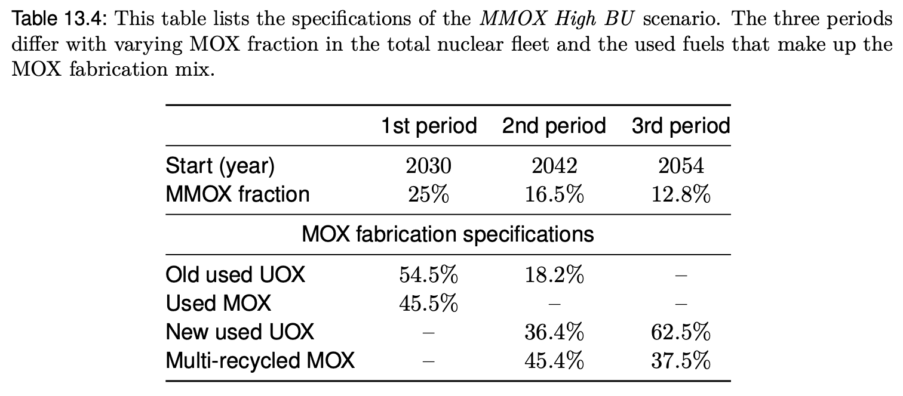
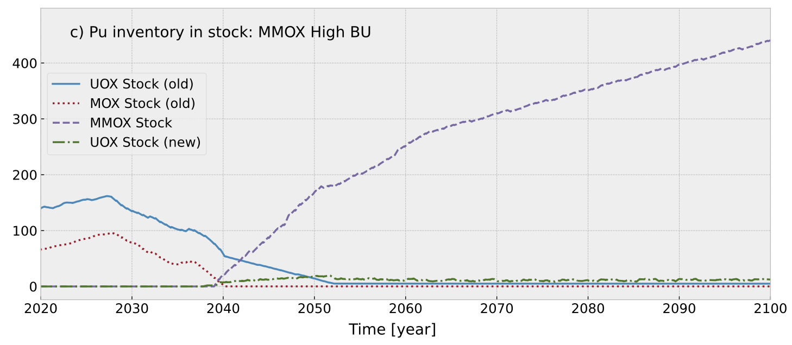
How did the MMOX mixing go?

Slide 25
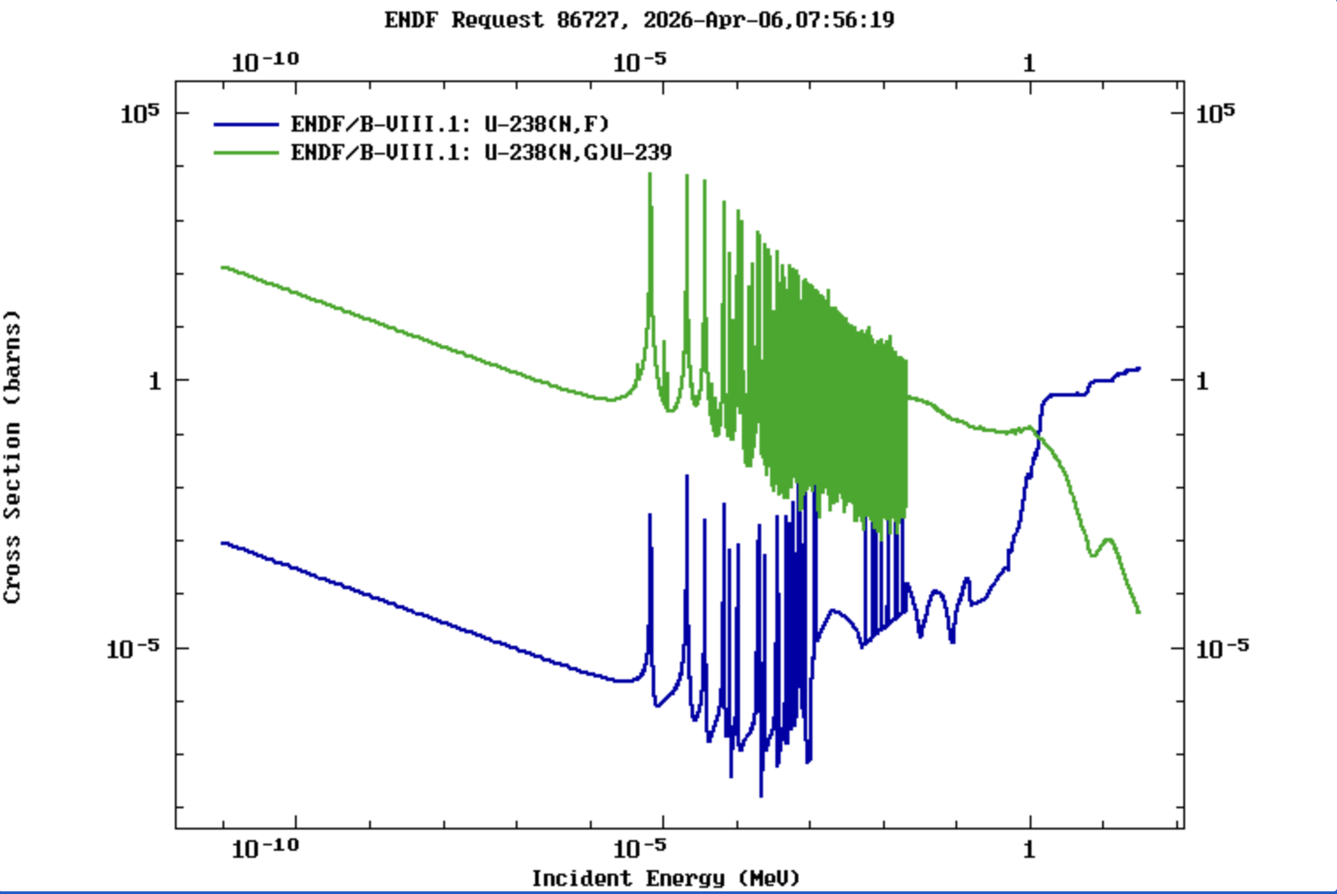
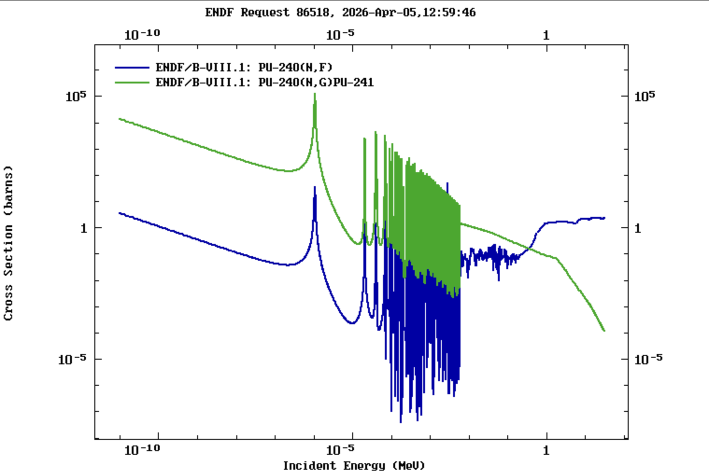
Why does Pu-240 contribute to a positive void coefficient?
238-U
240-Pu

Slide 26
Results: Pu quality

Slide 27
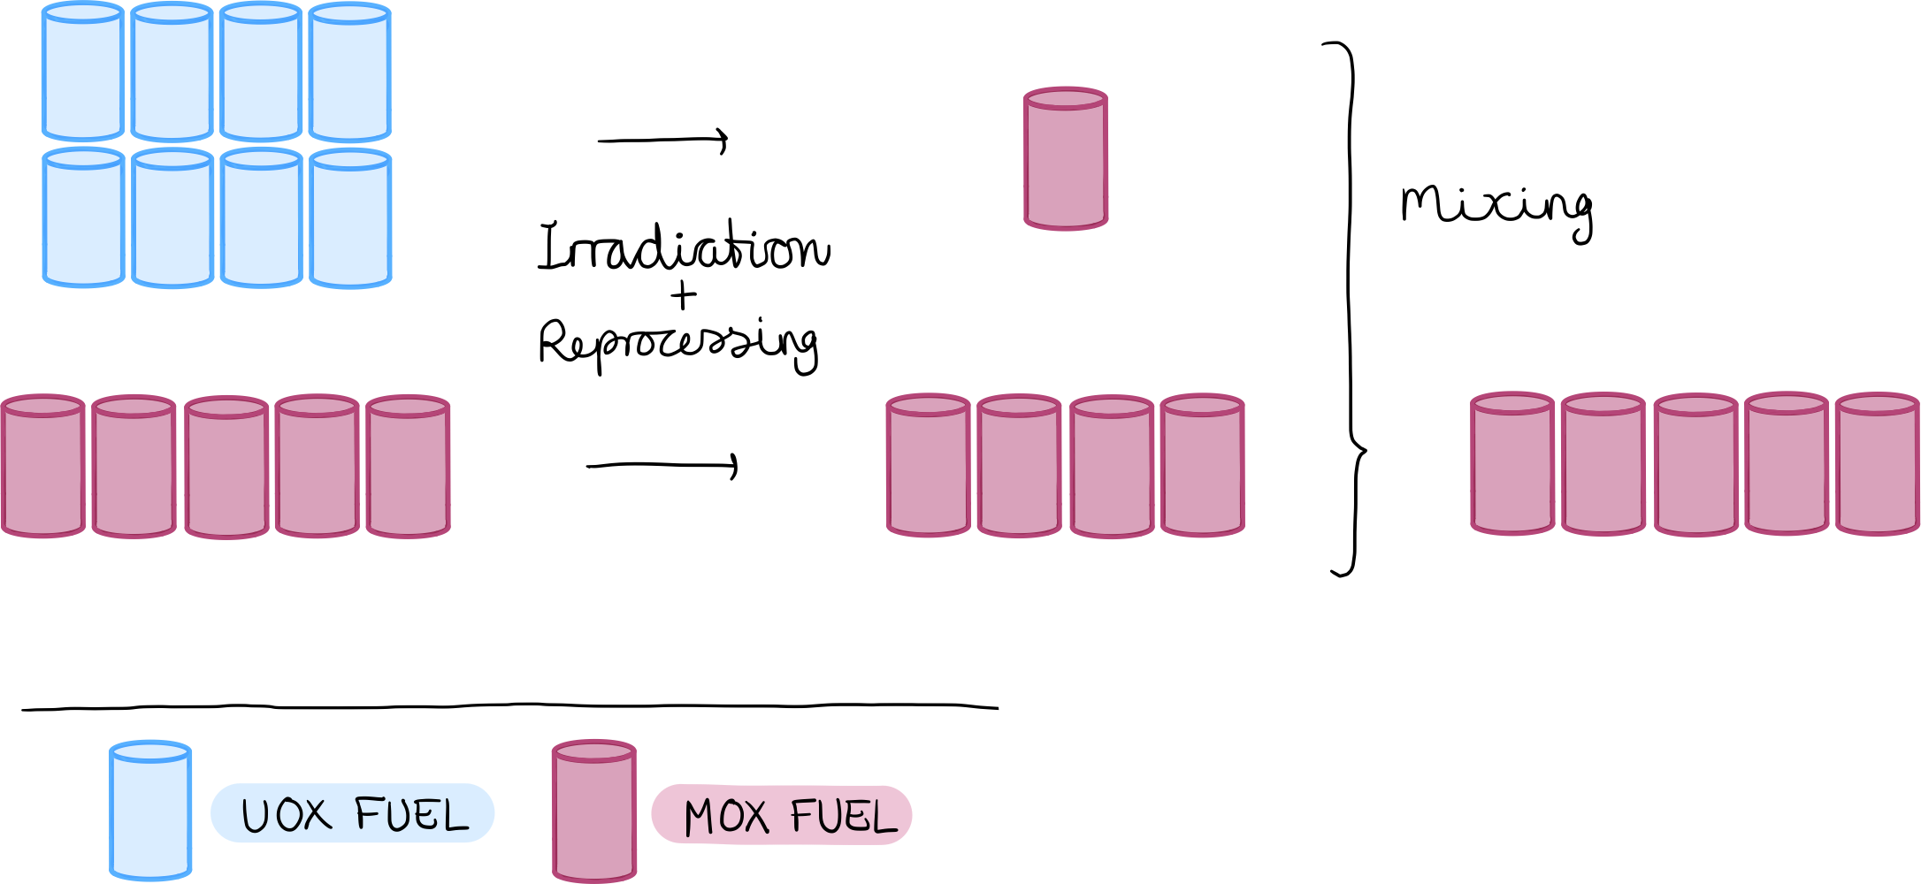
~40% need to be MOX fueled

