Slide 1
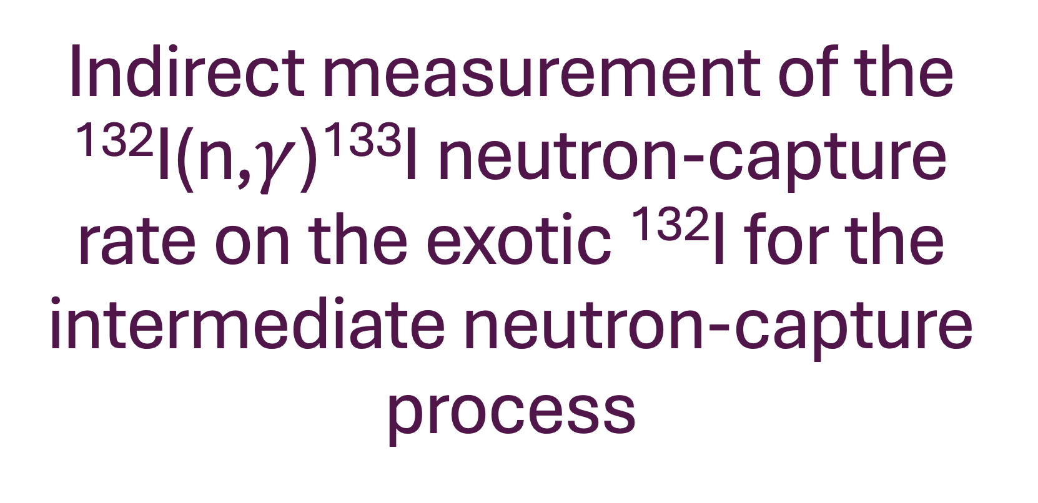
Indirect measurement of the ¹³²I(n,$γ$)¹³³I neutron-capture rate on the exotic ¹³²I for the intermediate neutron-capture process

Slide 2
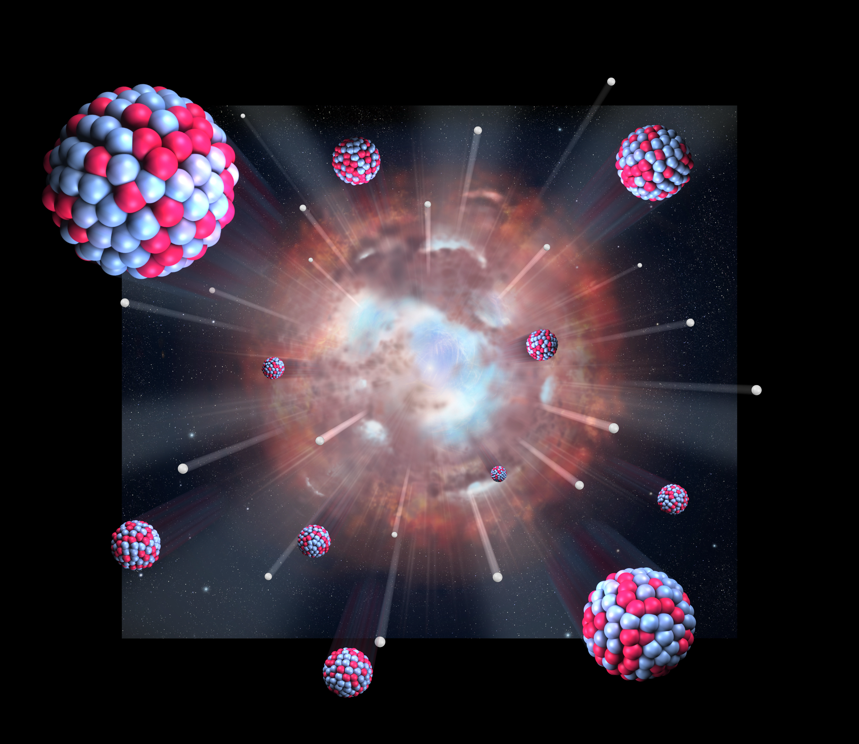
Measuring neutron-capture rates on ¹³²I relevant for the intermediate neutron-capture process

Slide 3
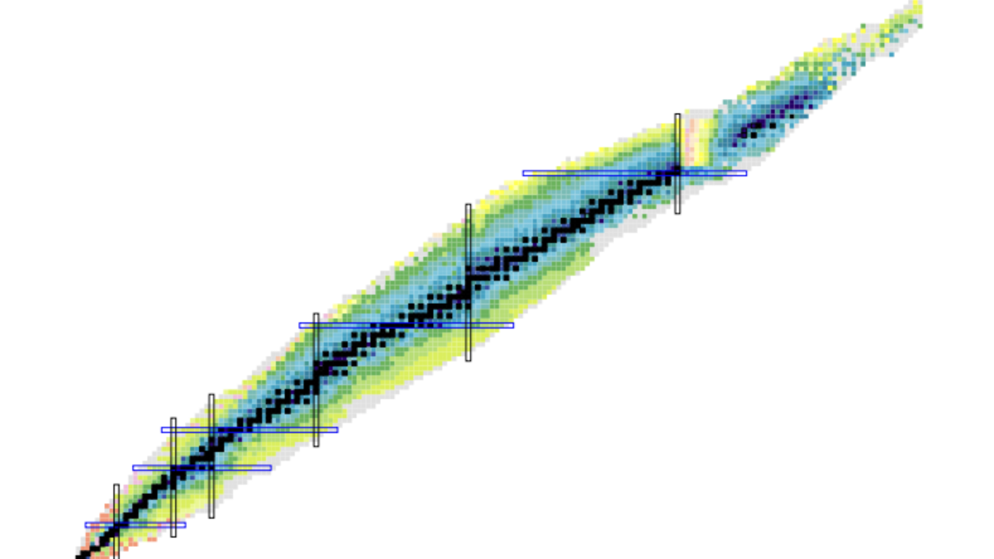
S-process
R-process
Stellar burning

Slide 4
Accurate modelling of the i-process requires input on
neutron-capture rates
for unstable, neutron-rich nuclei such as ¹³²I

Slide 5
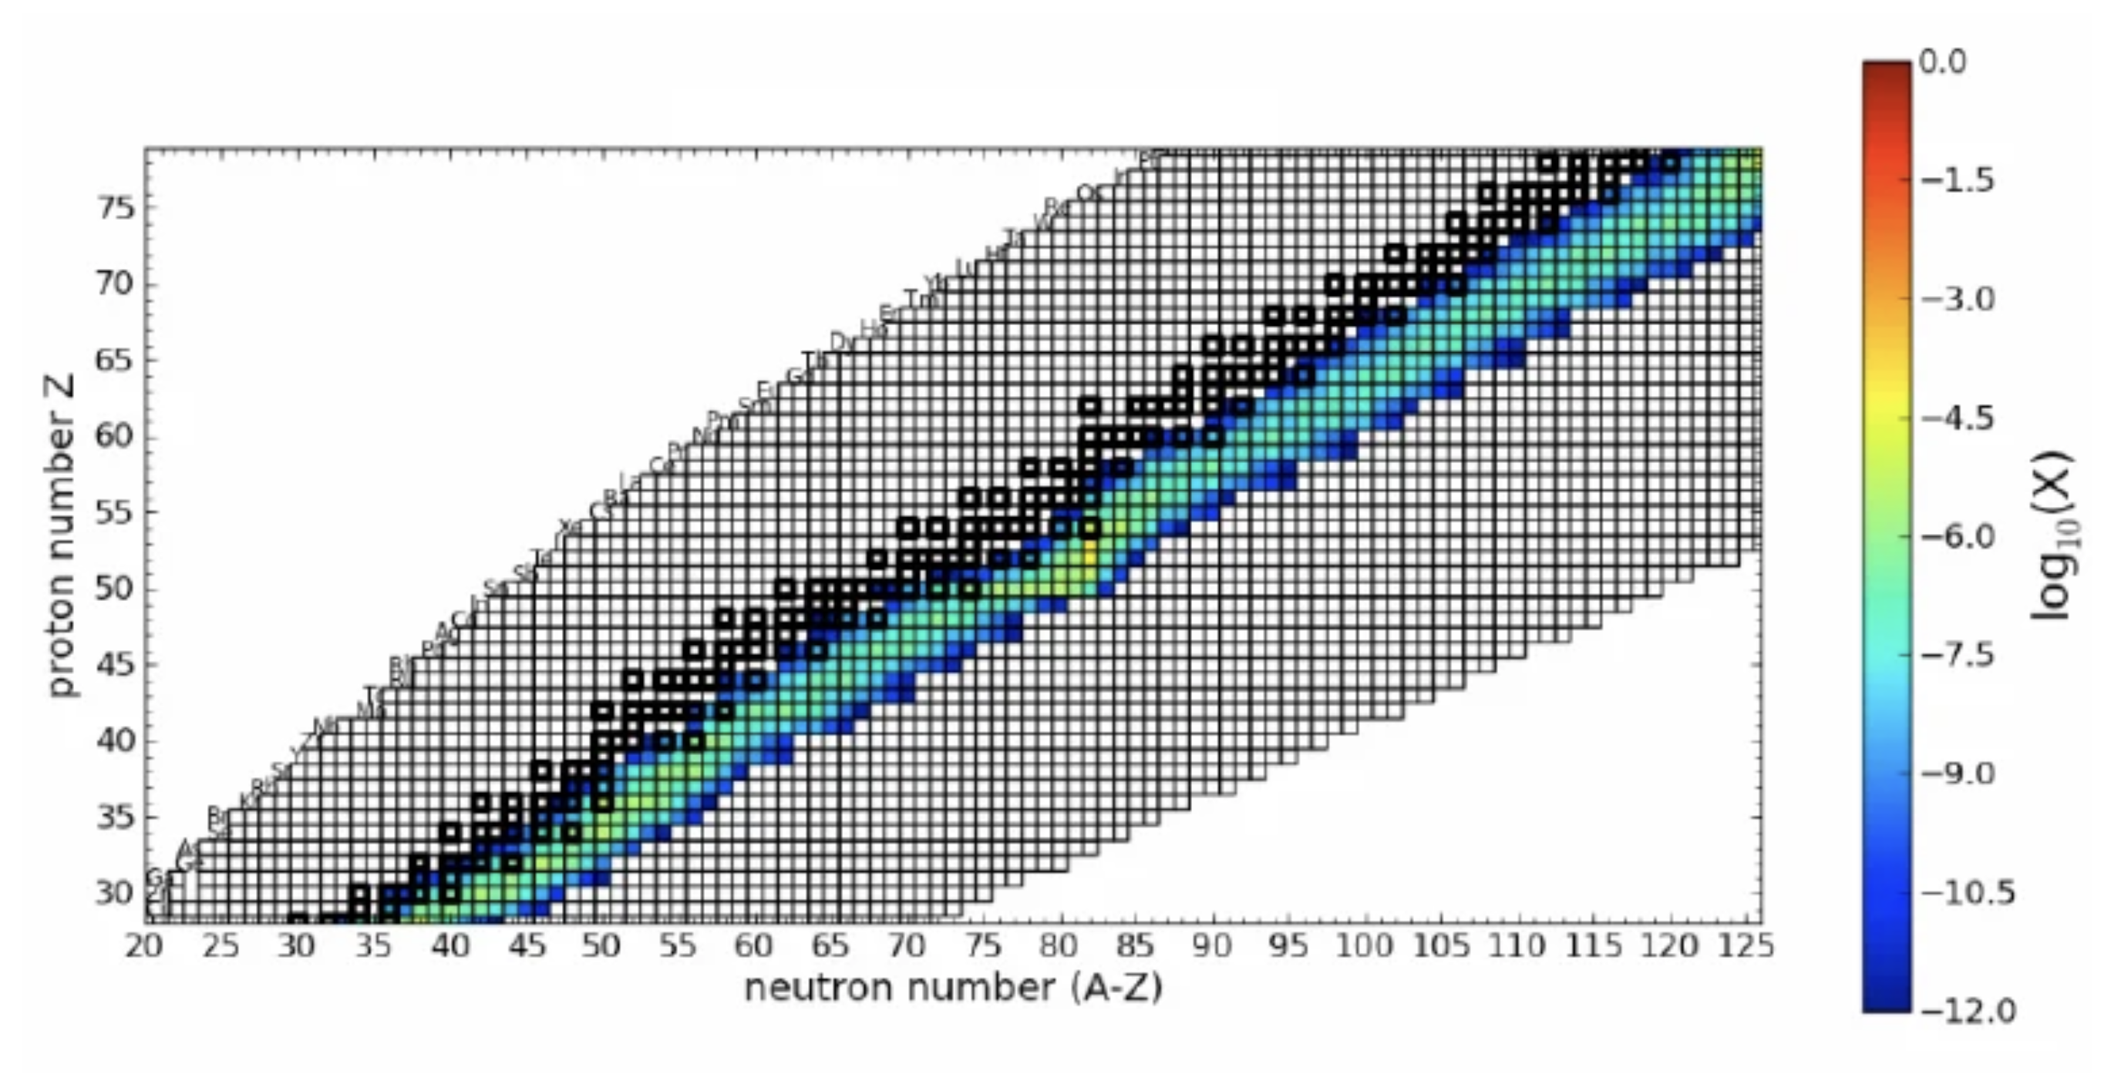
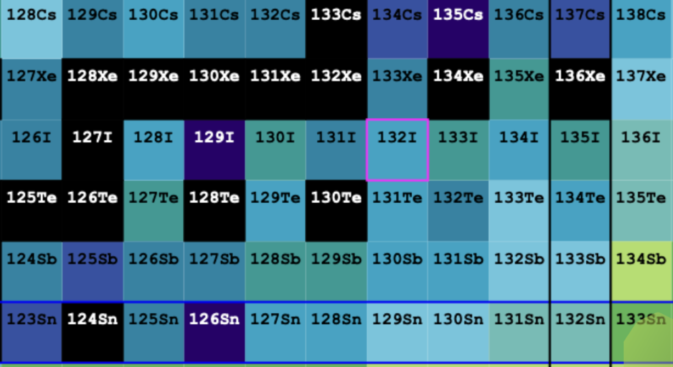
The i-process pathway

Slide 6
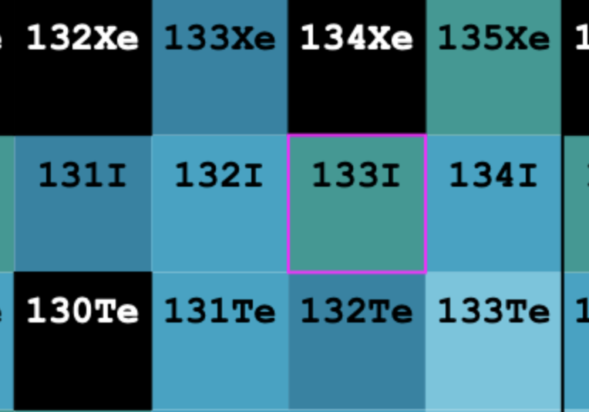
How do we obtain neutron-capture rates of ¹³²I?
Through information on ¹³³I
n

Slide 7
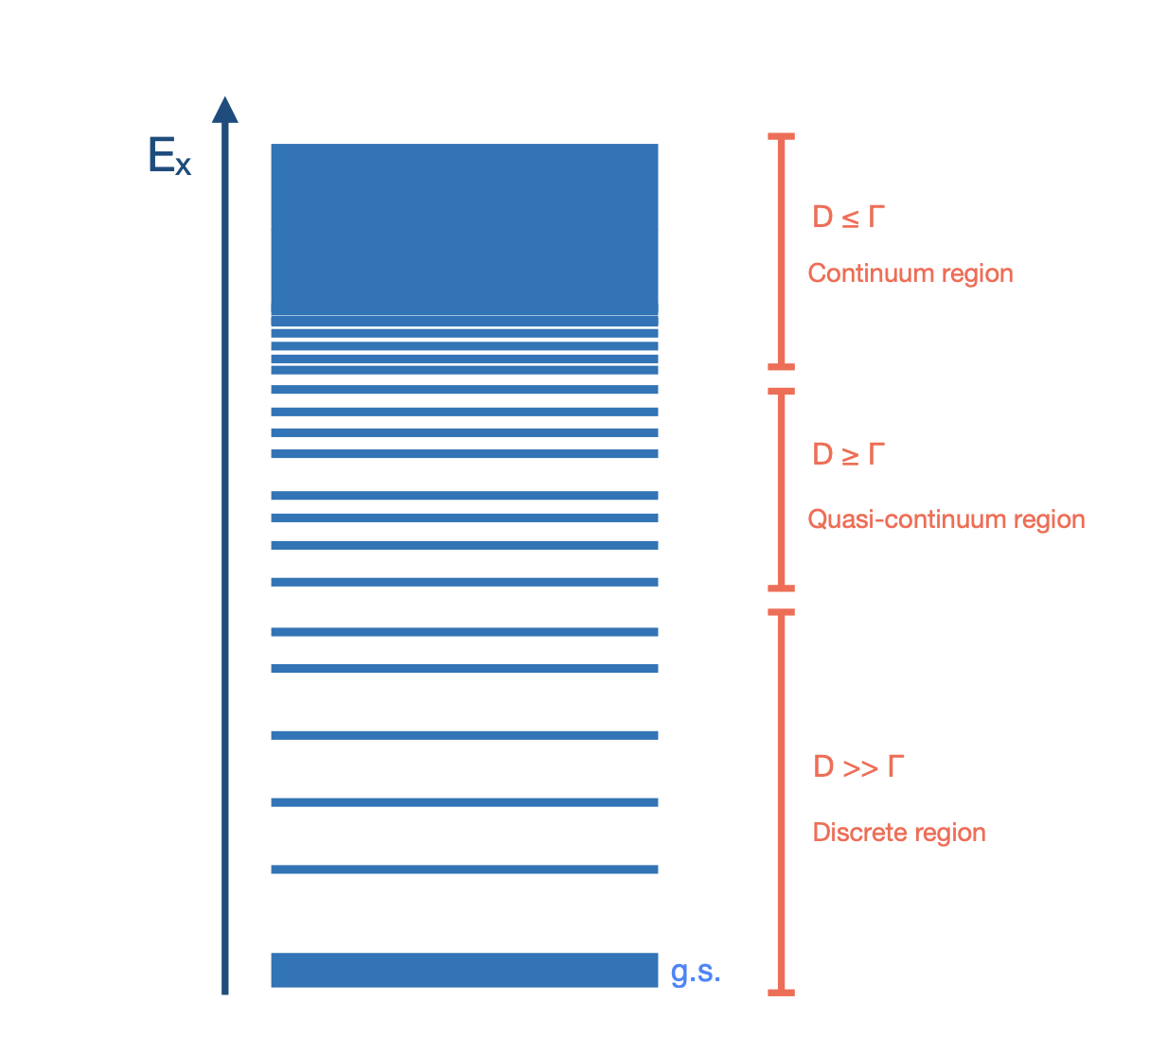
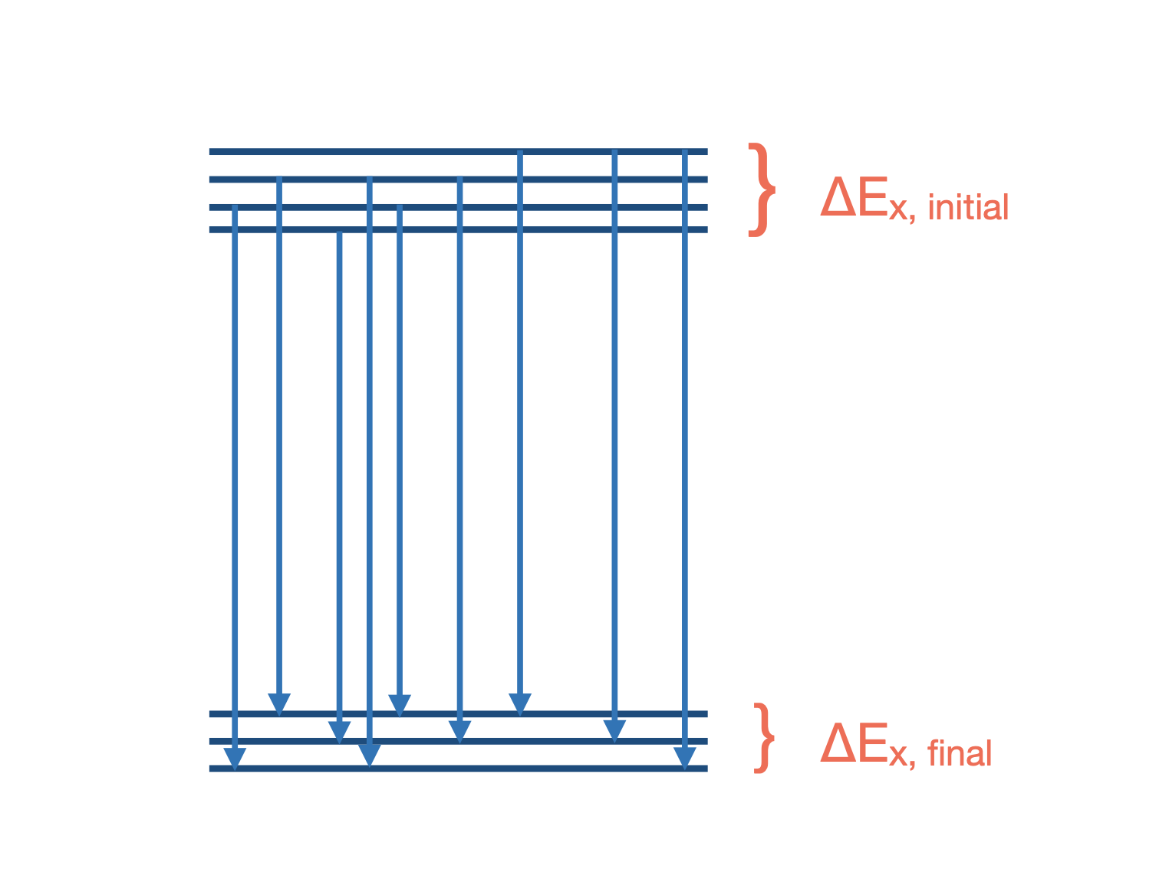
Nuclear Level Density
$γ$-ray strength function

Slide 8
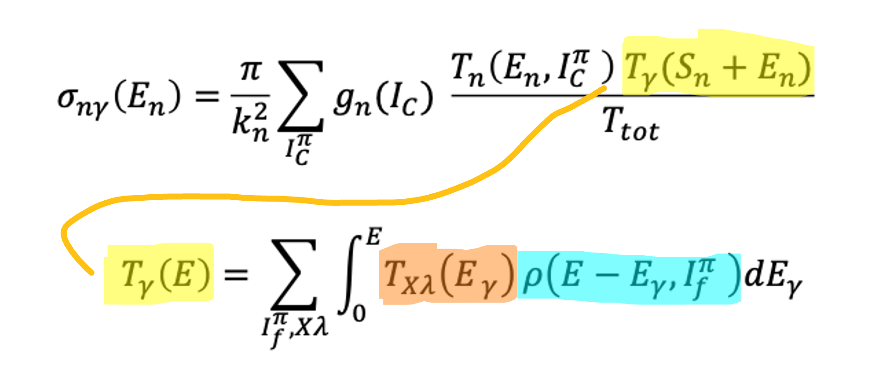
Nuclear Level Density
$γ$-ray strength function

Slide 9
Extract:
Nuclear level density
Gamma-ray strength function
The Oslo Method!

Slide 10
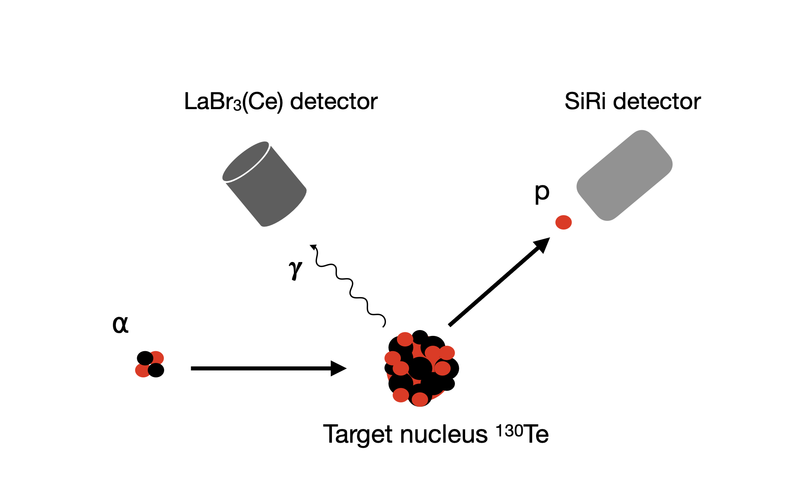

The Experiment
¹³⁰Te(α, p$γ$)¹³³I reaction

Slide 11
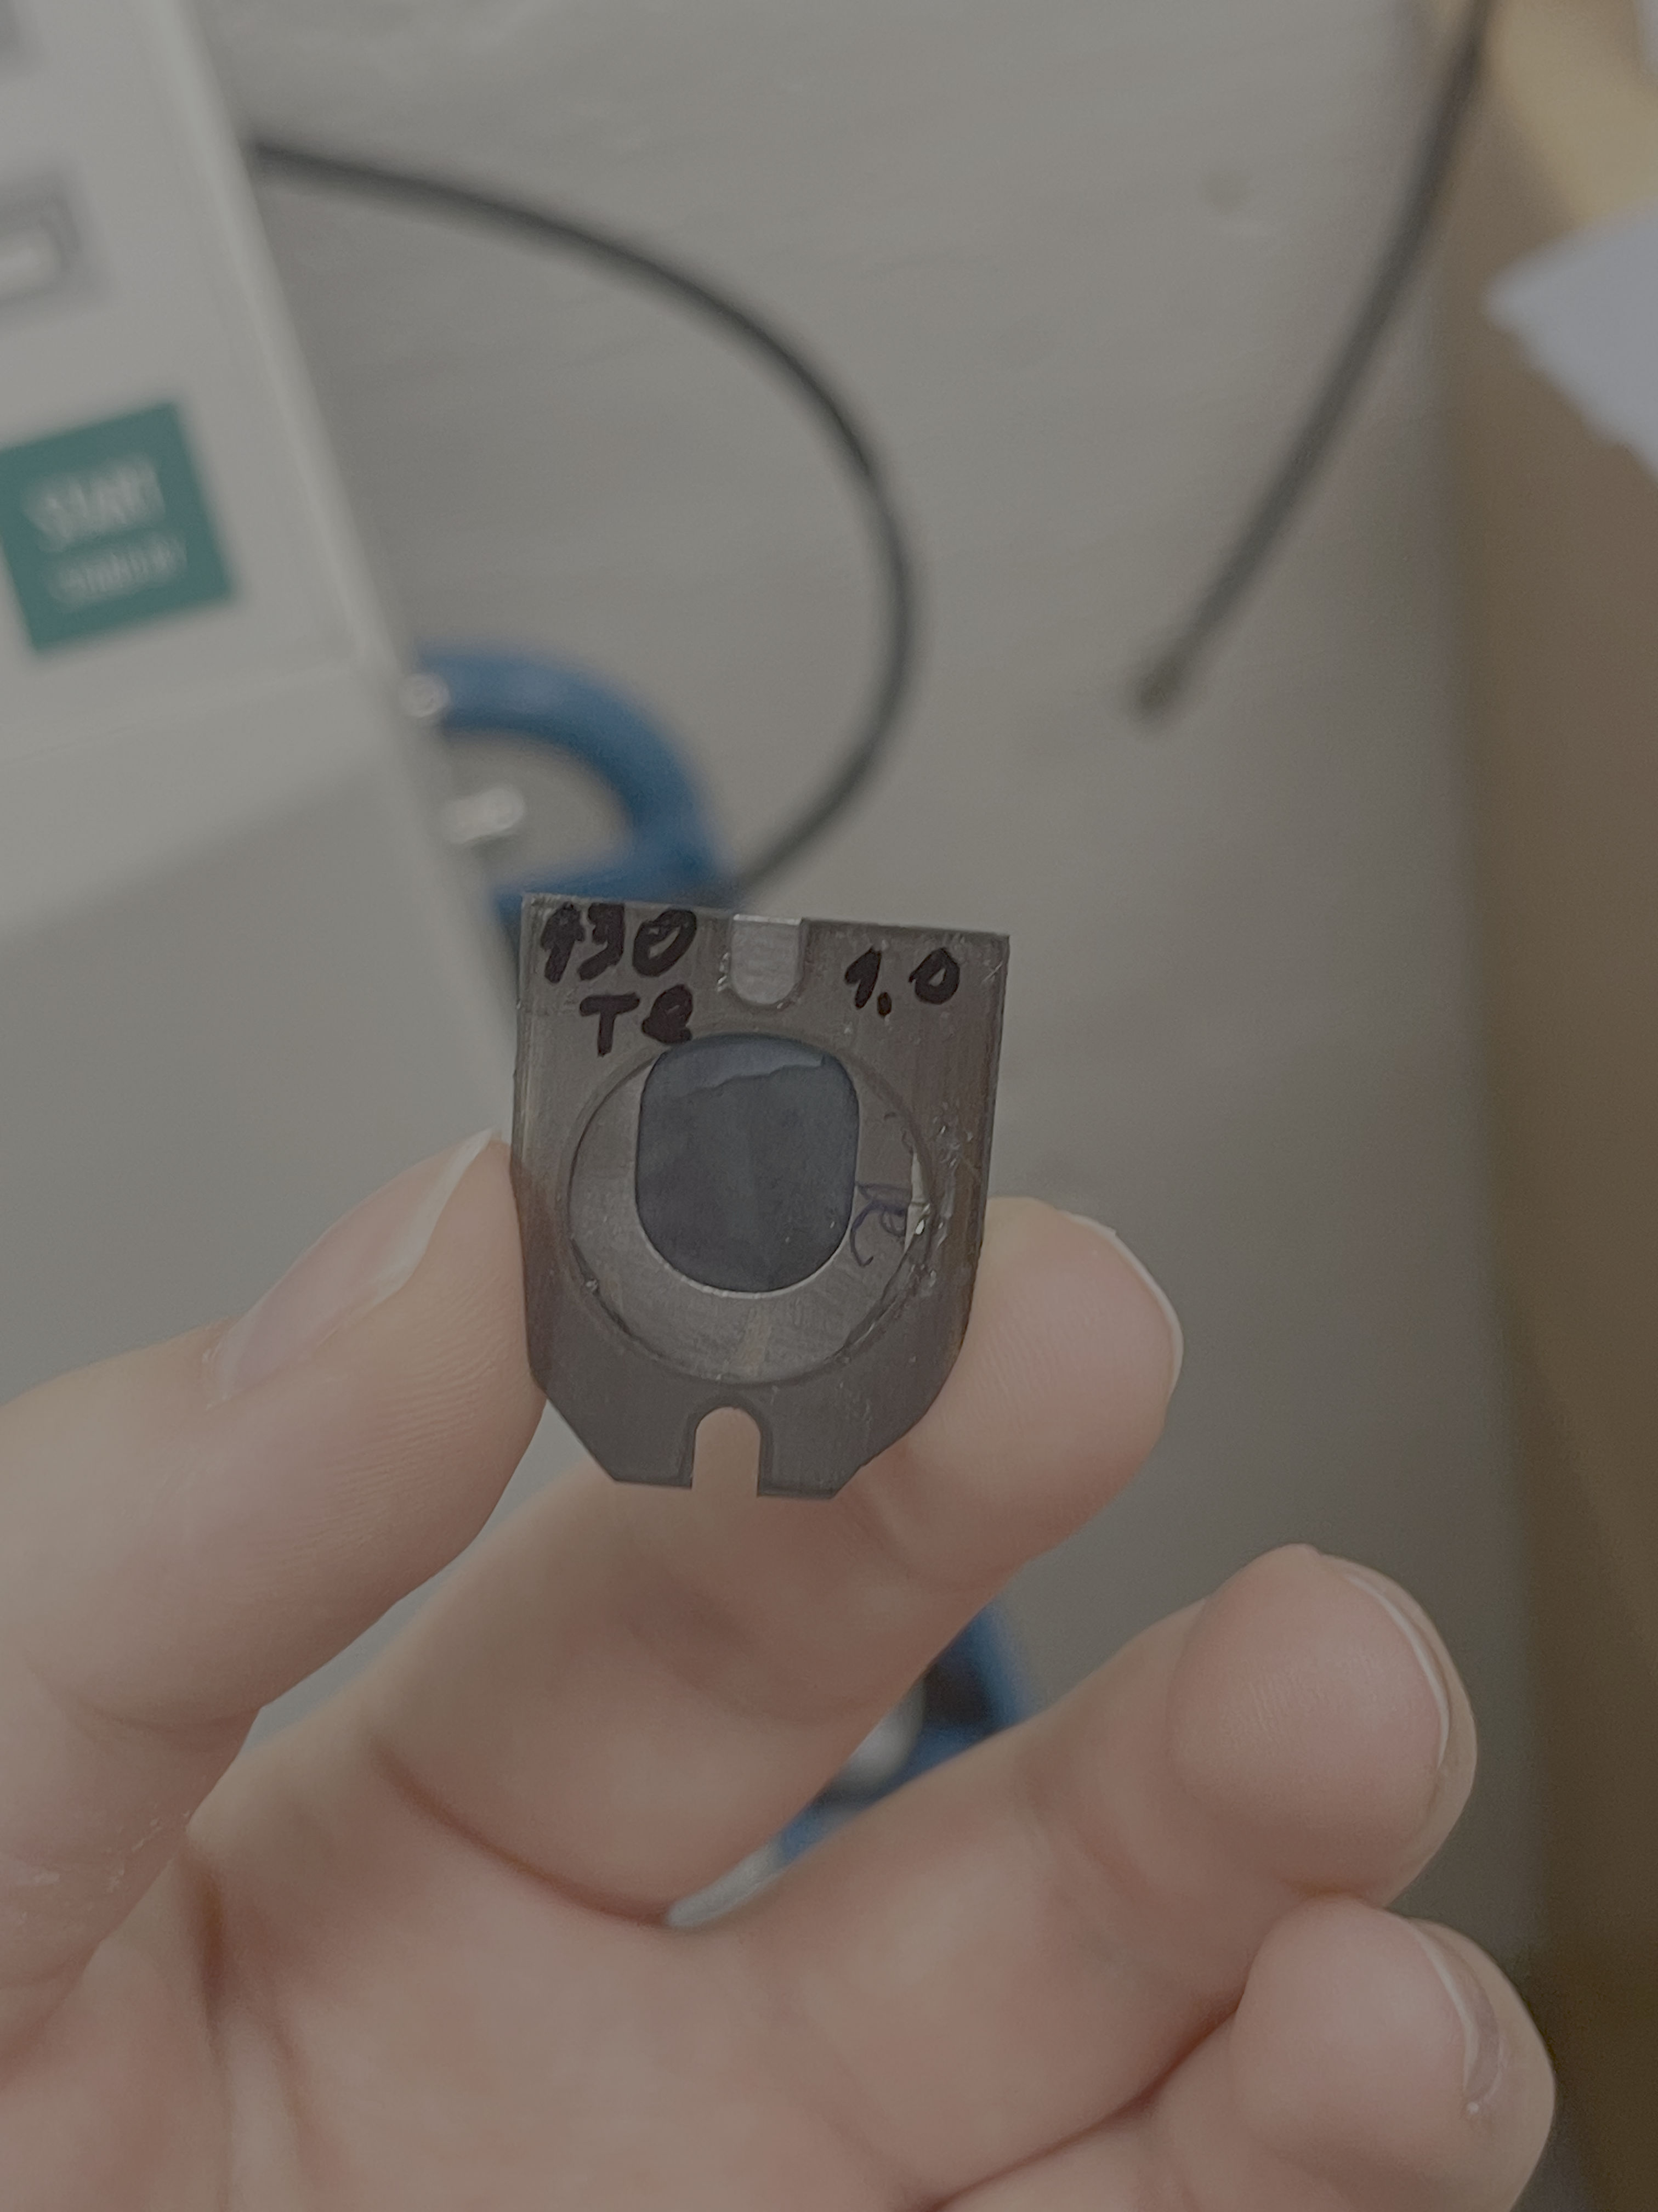
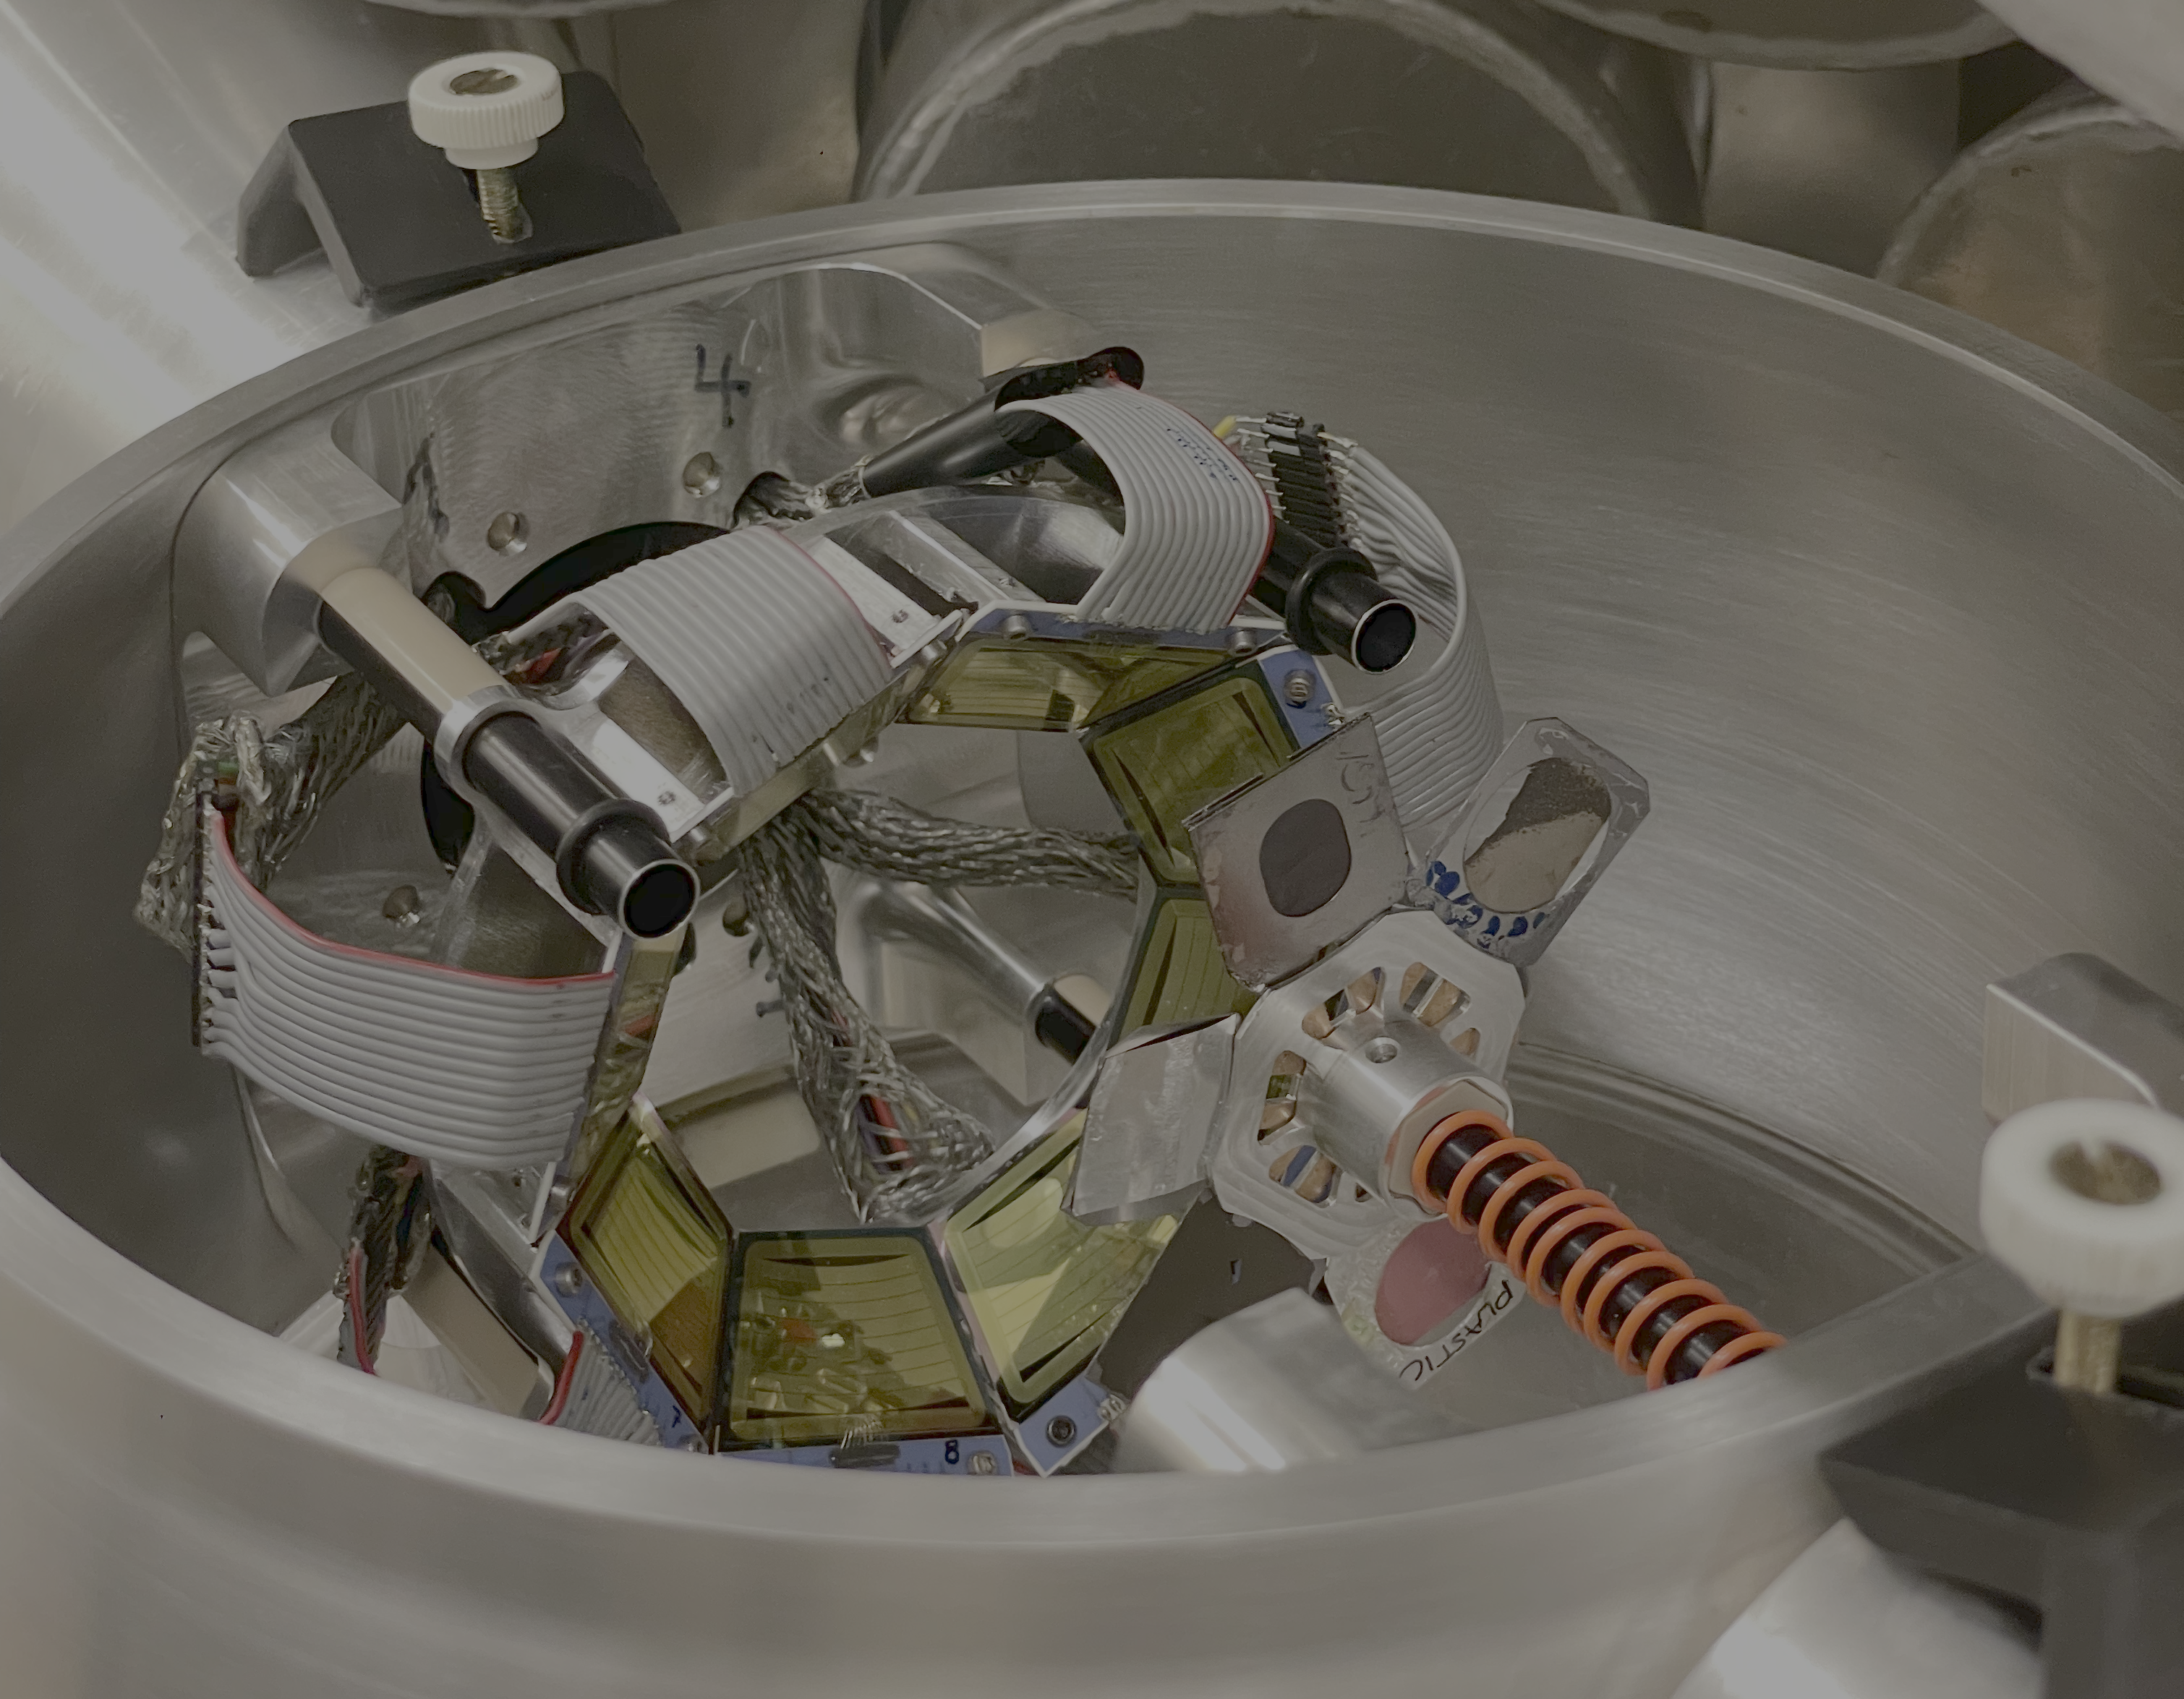
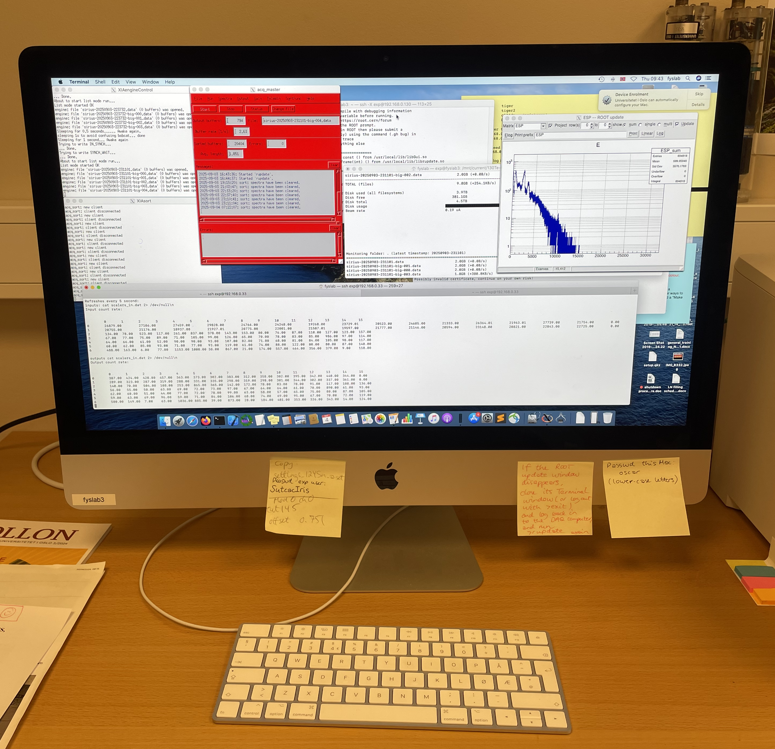
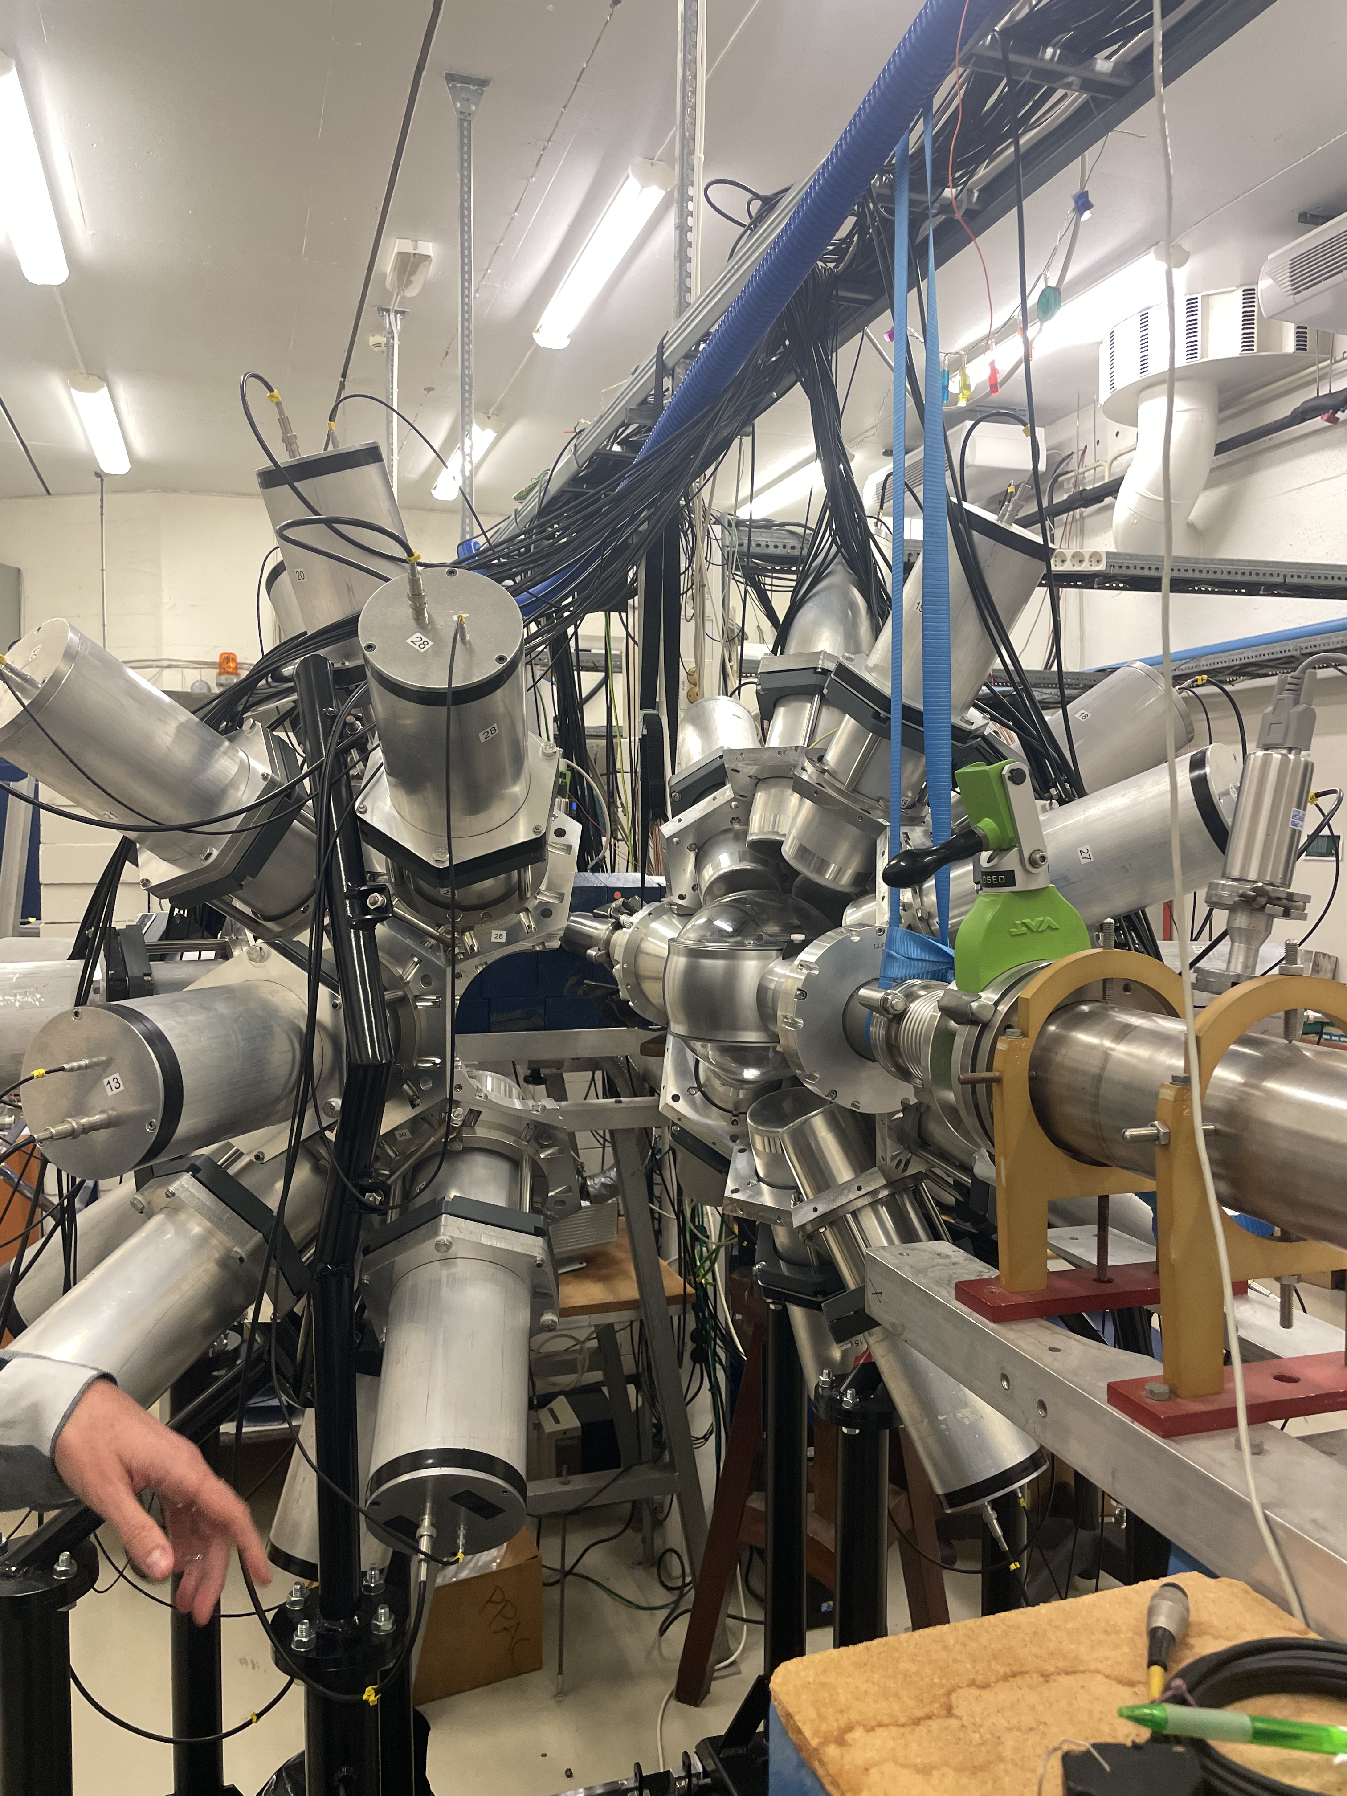
The Experiment

Slide 12
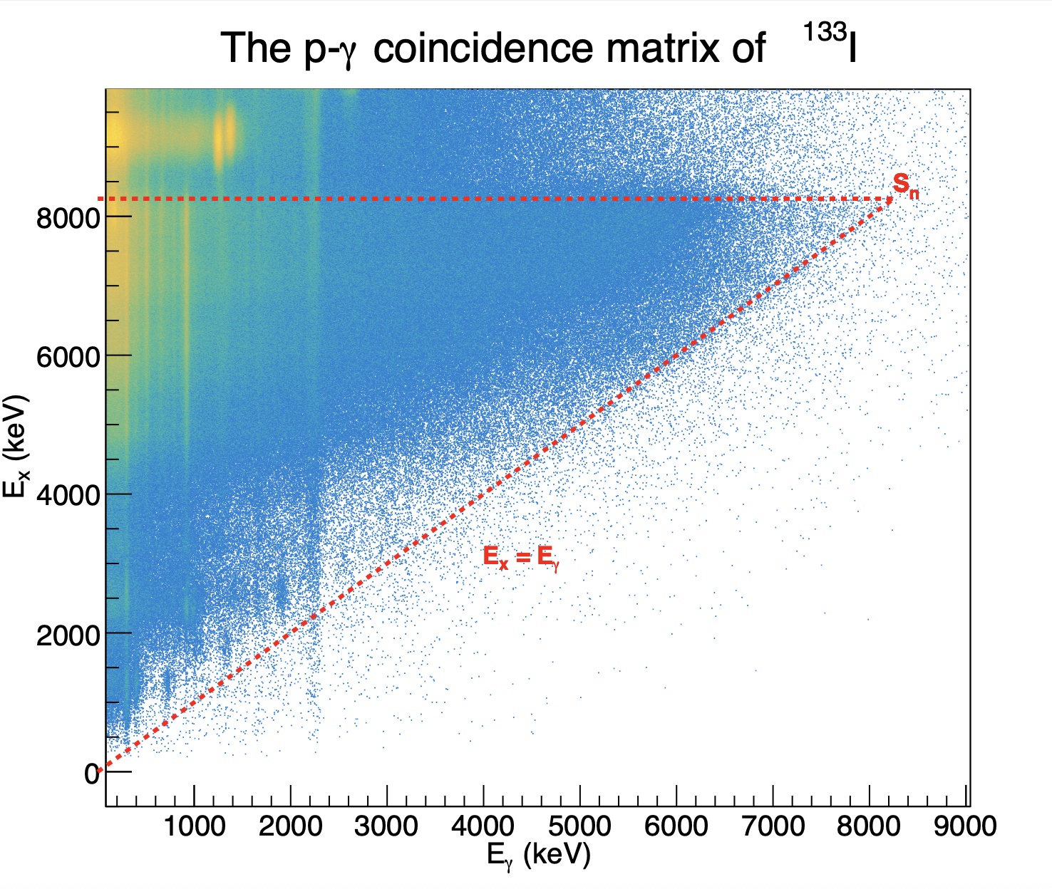

Slide 13
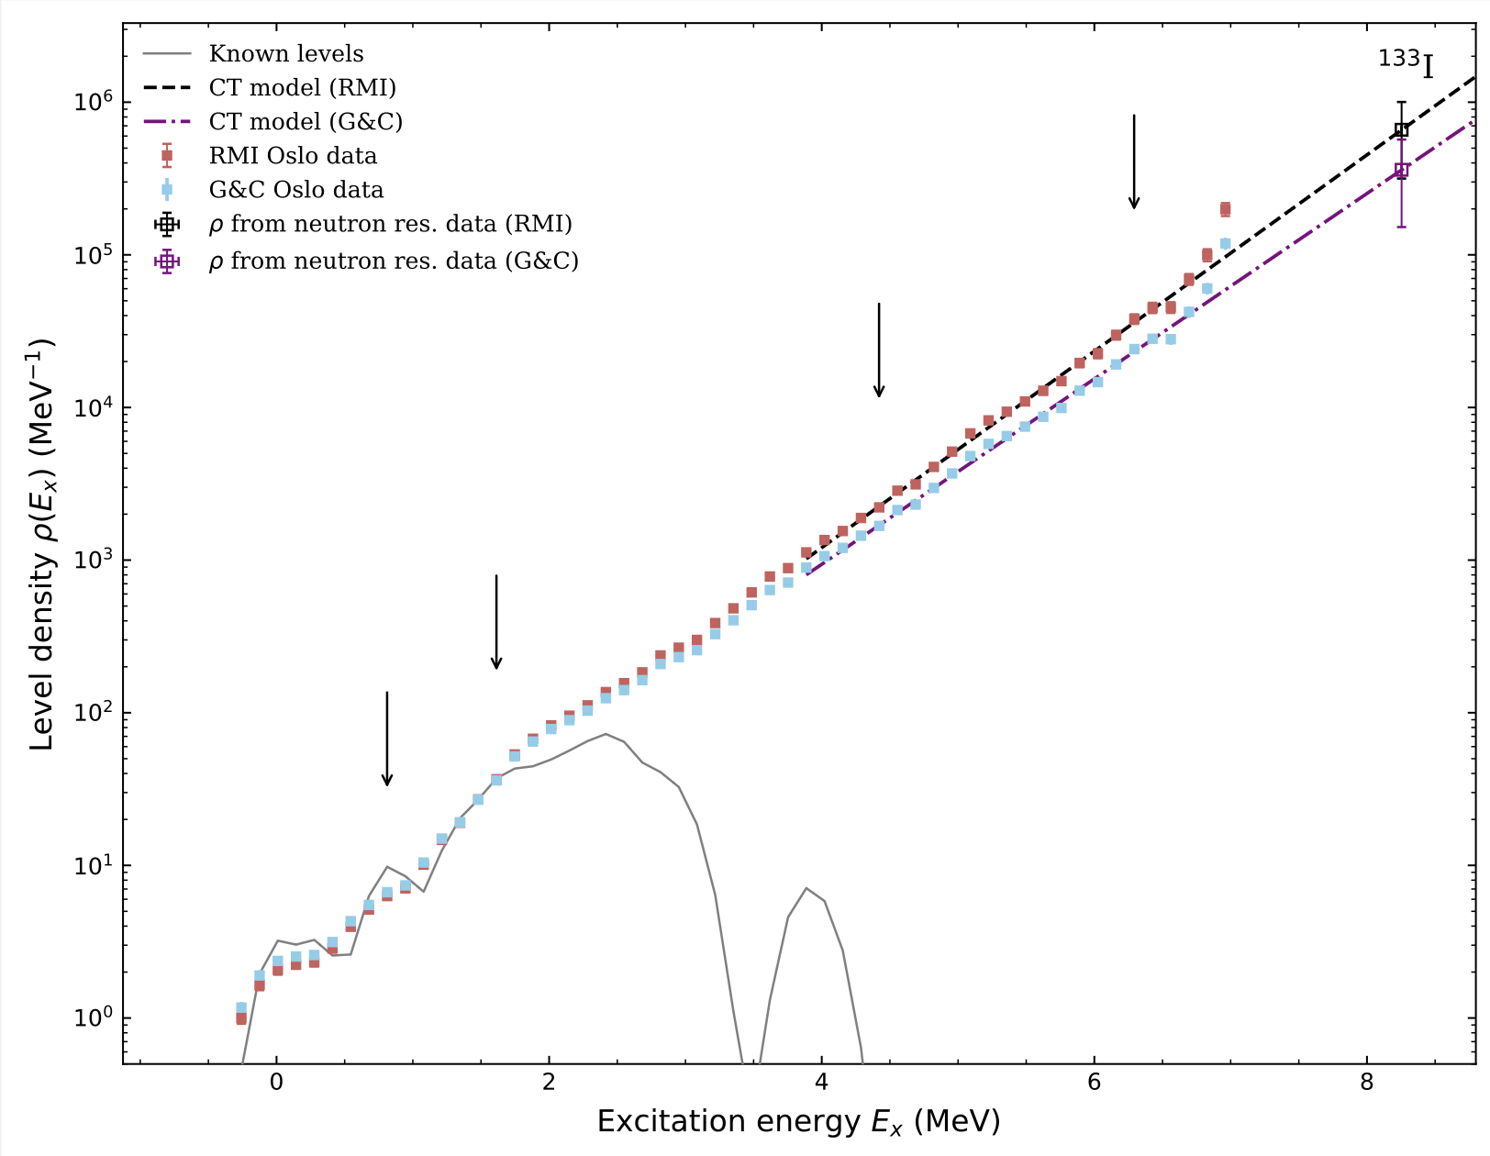
Nuclear level density

Slide 14
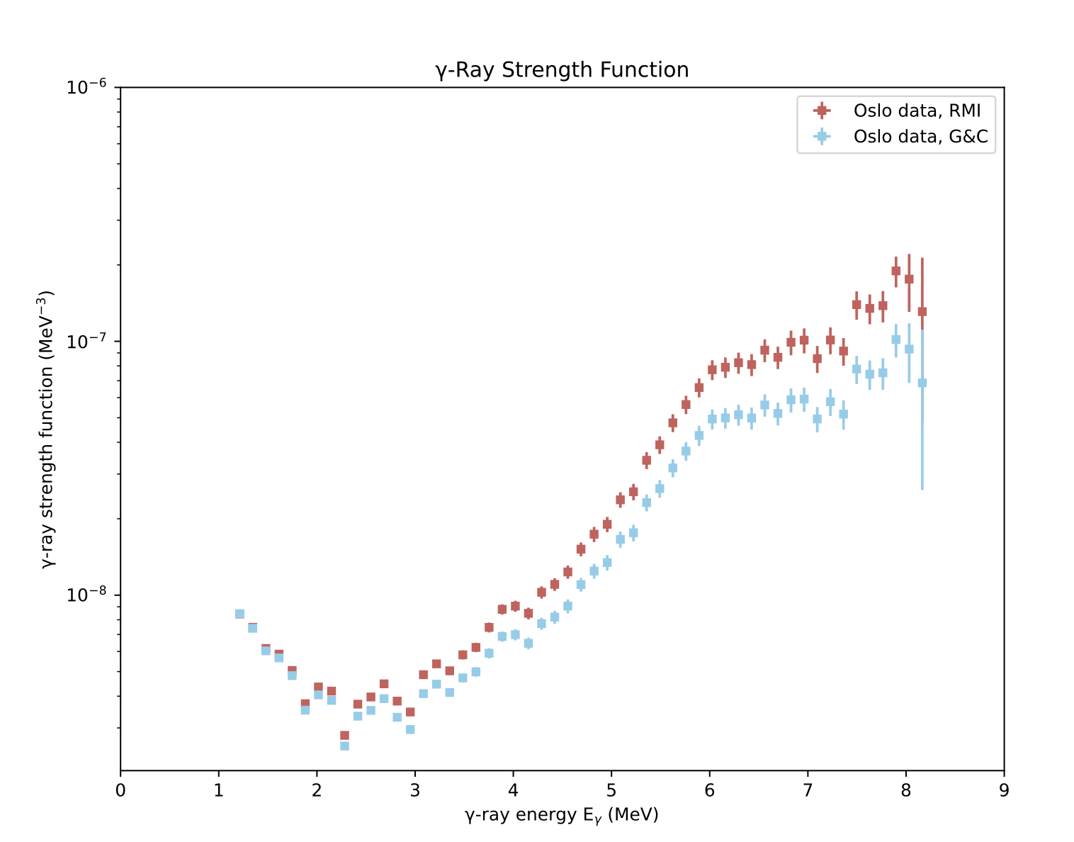
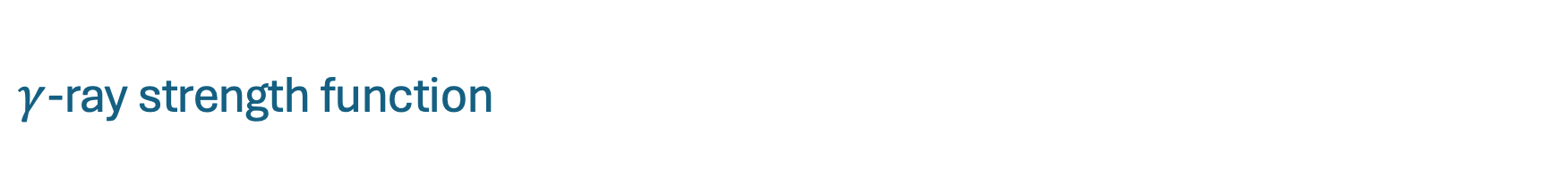
$γ$-ray strength function

Slide 15
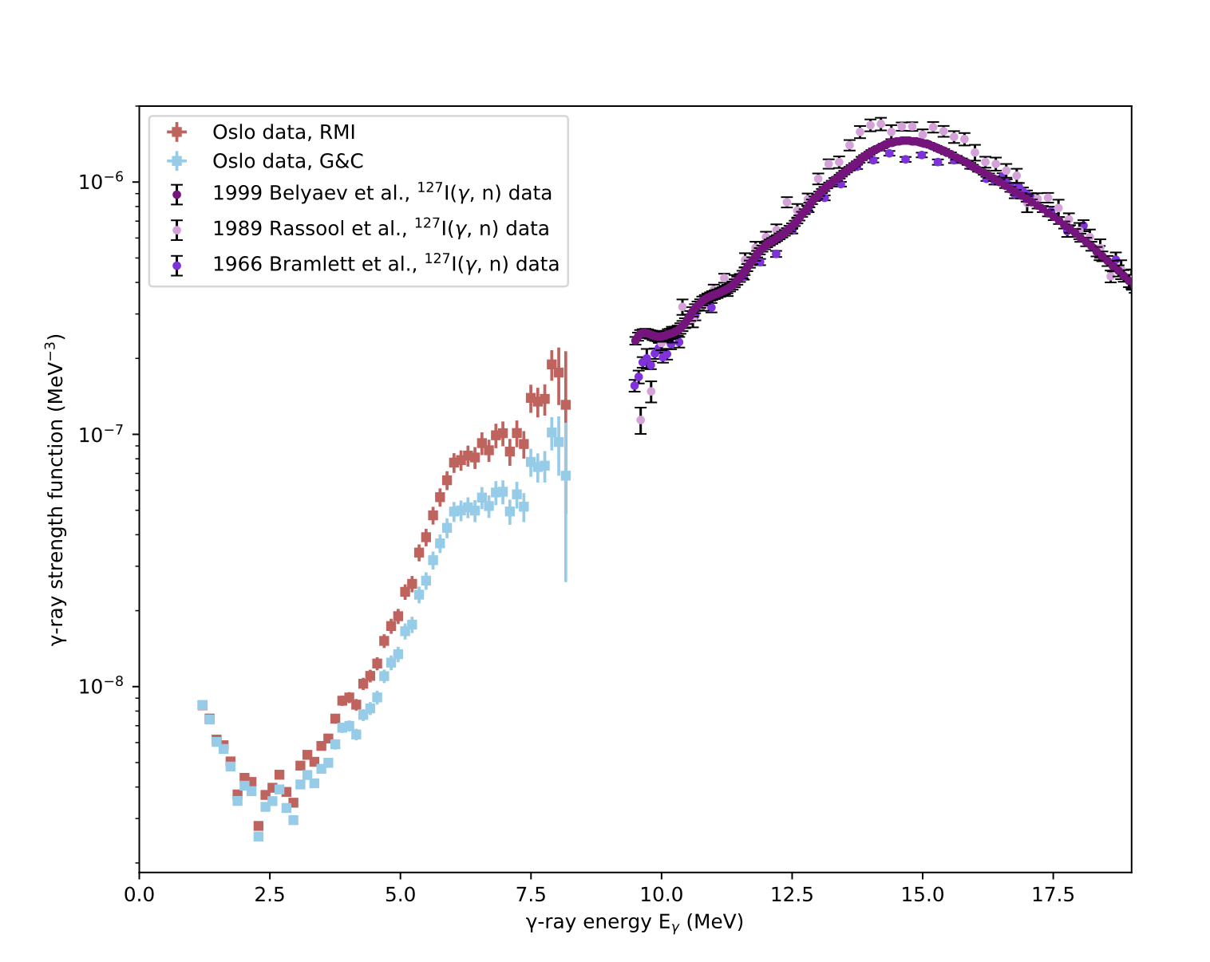
Comparison to existing exp. GDR data

Slide 16
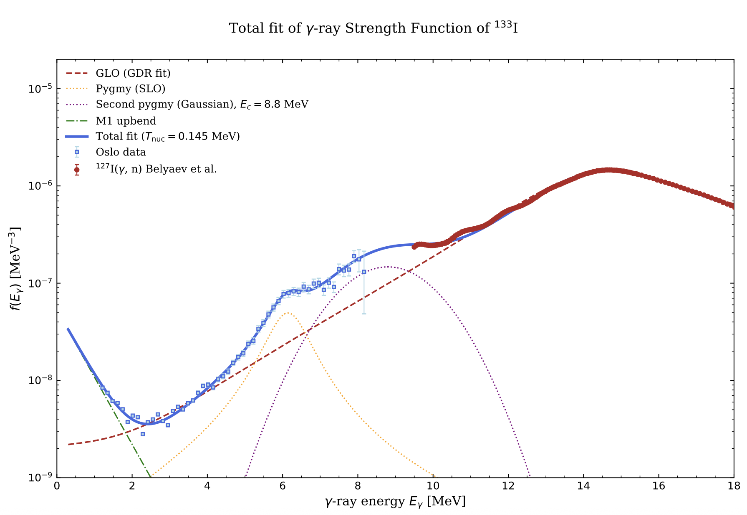
Comparison to existing exp. GDR data

Slide 17
To be continued …

