Slide 1



Field Theory for Neutronics
15th Nordic Meeting on Nuclear Physics
Jacob Persson¹, Eliel Camargo-Molina¹, Stefano Moretti¹ and Andreas Solders²
High Energy Physics¹ and Applied Nuclear Physics², Department of Physics and Astronomy, Uppsala University
Strand Hotel, Visby, Gotland, Sweden
2026-05-06
Supported by Vattenfall Nuclear Fuel (VNF) and Swedish Centre for Nuclear Technology (SKC)
In collaboration with Ringhals

Slide 2
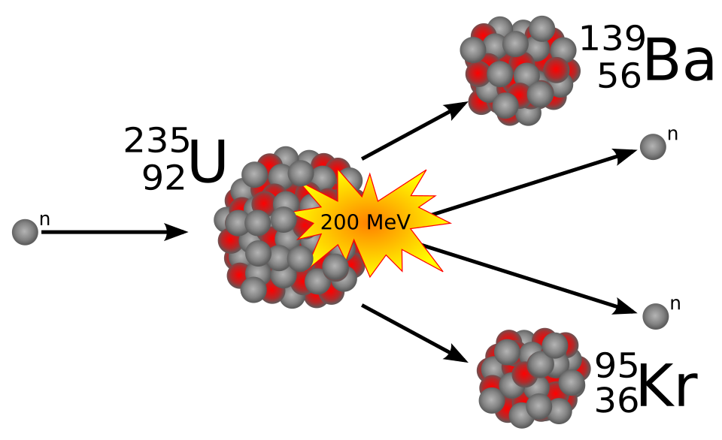
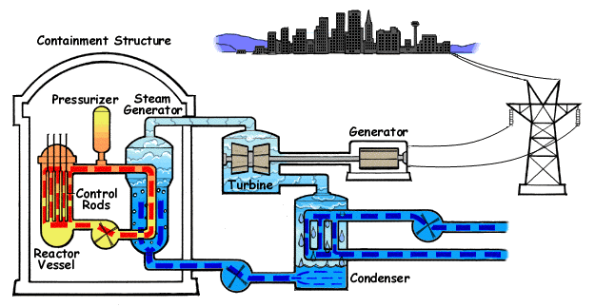
Purpose & Motivation
Stefan-Xp. “Nuclear fission of uranium 235” commons.wikipedia.org. Accessed: 29 Jan. 2026. [Online]. Available: https://commons.wikimedia.org/wiki/File:Kernspaltung.svg.
Interactions between neutrons and U-235 can cause fission which release energy
The modelling of neutron transport is important to many aspects of nuclear reactor operation
We want to improve the model of neutron transport by including fluctuations and feedback effects using methods from quantum field theory
U.S.NRC. “Pressurized Water Reactor.” commons.wikipedia.org. Accessed: 29 Oct. 2025. [Online]. Available: https://commons.wikimedia.org/wiki/File:PressurizedWaterReactor.gif.

Slide 3
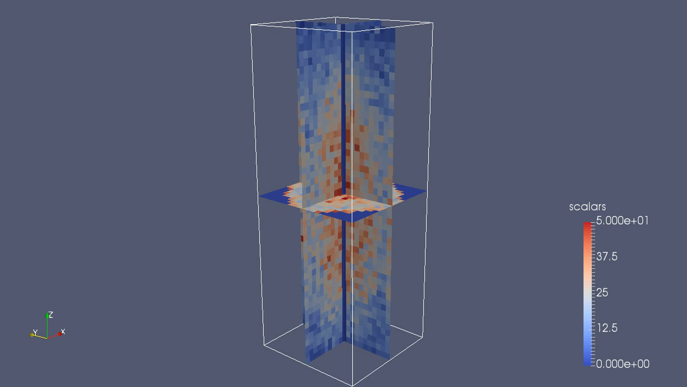
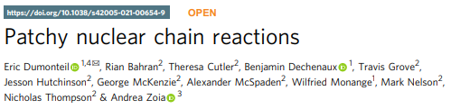
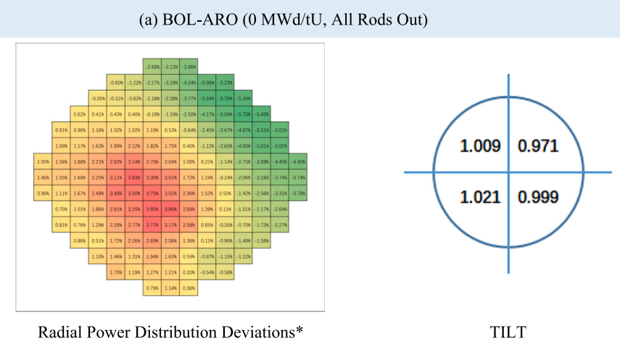
Background
Experiments have found connections between neutron fluctuations and spatial correlations of the neutron distribution
This might contribute to the asymmetry of power distribution seen in large reactors
Li, X., Cai, D., Wang, X., He, M., Li, Z., Zhao, C., & Wang, X. (2025). Neutronic analysis of PWR fuel-assembly bowing based on measurement data. Nuclear Engineering and Design, 443, 114283.

Slide 4
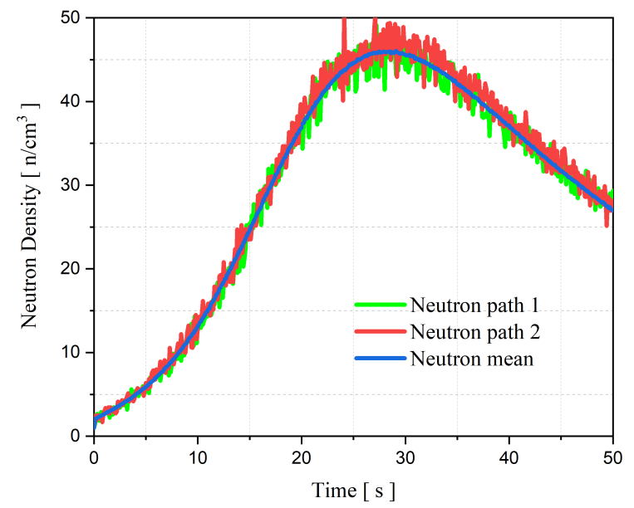
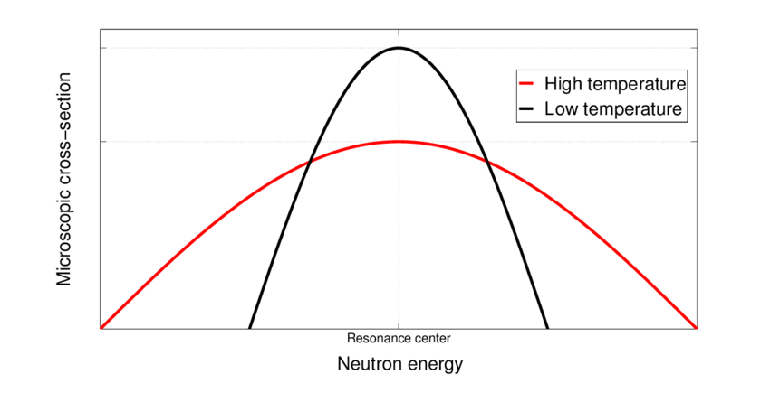
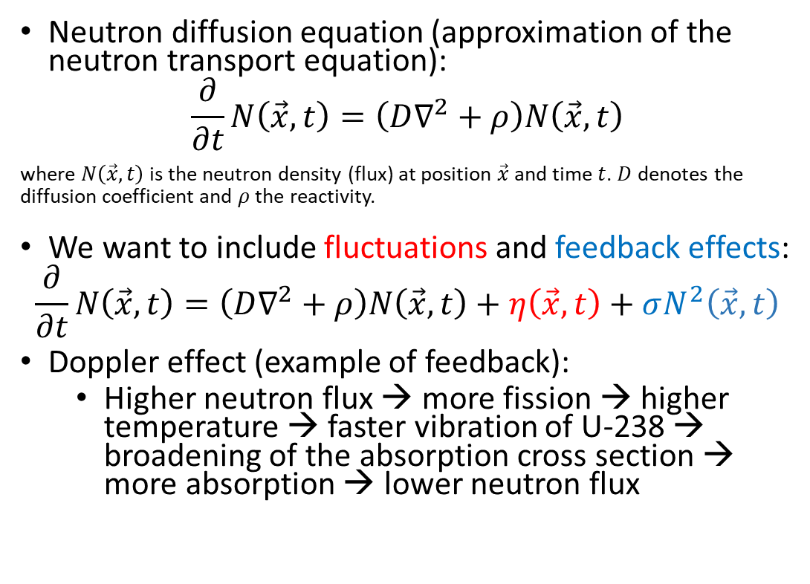
Neutron transport
Neutron diffusion equation (approximation of the neutron transport equation):
$$\frac{∂}{∂t}N\left(\vec{x},t\right)=\left(D∇^{2}+ρ\right)N\left(\vec{x},t\right)$$
where $N\left(\vec{x},t\right)$ is the neutron density (flux) at position $\vec{x}$ and time $t$. $D$ denotes the diffusion coefficient and $ρ$ the reactivity.
We want to include fluctuations and feedback effects:
$$\frac{∂}{∂t}N\left(\vec{x},t\right)=\left(D∇^{2}+ρ\right)N\left(\vec{x},t\right)+η\left(\vec{x},t\right)+σN^{2}\left(\vec{x},t\right)$$
Doppler effect (example of feedback):
  Higher neutron flux → more fission → higher temperature → faster vibration of U-238 → broadening of the absorption cross section → more absorption → lower neutron flux
Suescún-Díaz, D., “Stochastic Neutron Population With Temperature Feedback Effects Using The Implicit Runge-Kutta Scheme,” J. Appl. Sci. Eng., vol. 28, no. 8, pp. 1795-1803, Sept. 2024, doi: http://dx.doi.org/10.6180/jase.202508_28(8).0016.
Qvist, S. A. (2013). Safety and core design of large liquid-metal cooled fast breeder reactors. University of California, Berkeley.

Slide 5
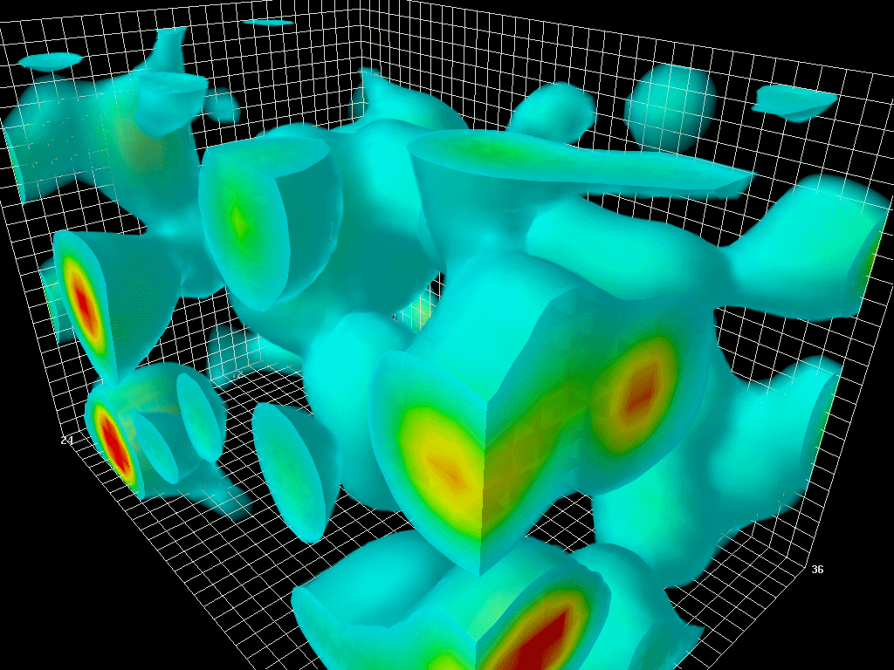
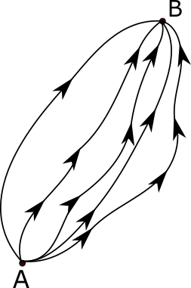
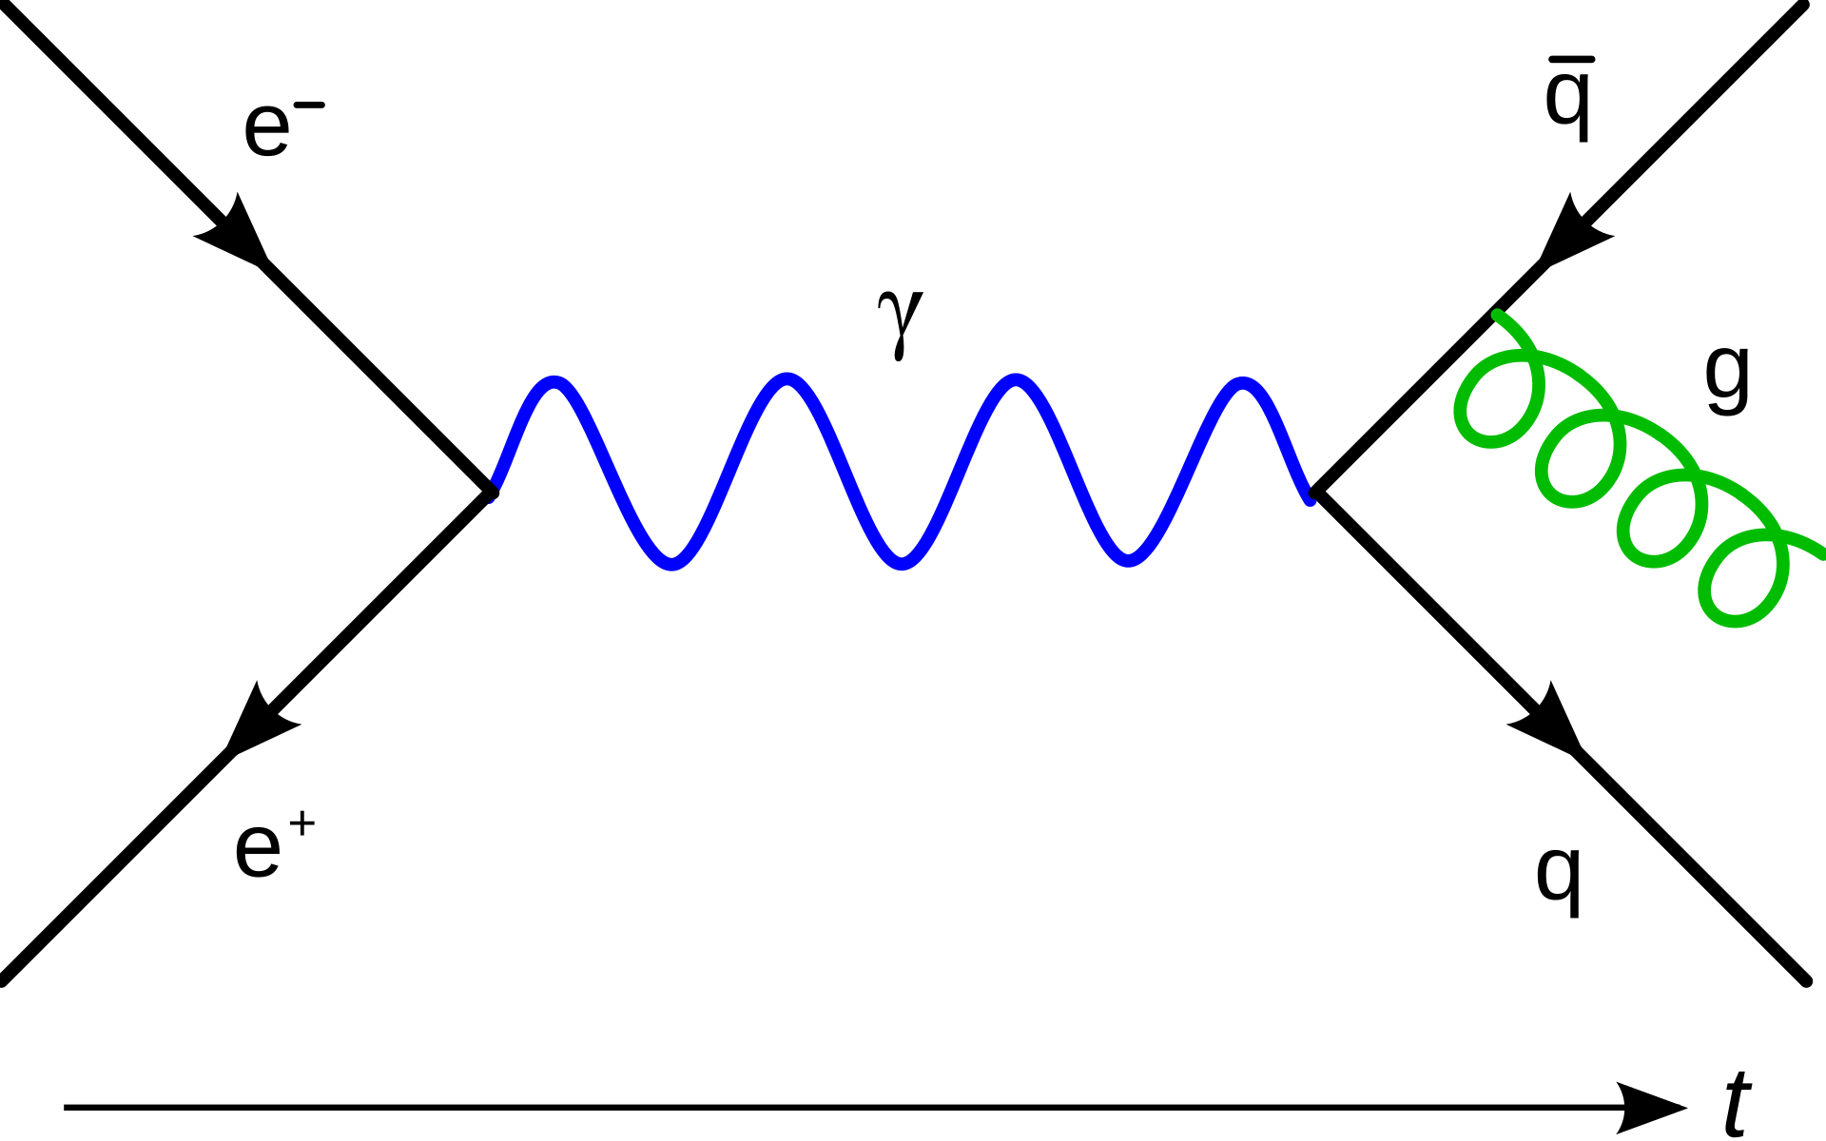
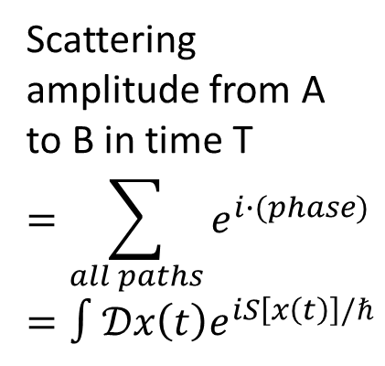
Quantum Field Theory (QFT)
QFT is a framework that models the behaviour of fundamental particles
The fields in QFT fluctuates
  Tools from QFT can be used to analyse neutron fluctuations
Scattering amplitude from A to B in time T
$$=\sum_{all paths}{e^{i∙(phase)}}=∫𝒟x\left(t\right)e^{iS\left[x\left(t\right)\right]/ℏ}$$
D. Leinweber. “Quantum Fluctuations.” commons.wikipedia.org. Accessed: 30 Oct. 2025. [Online]. Available:
https://commons.wikimedia.org/wiki/File:Quantum_Fluctuations.gif.
J. Holdsworth. “Feynman Diagram Gluon Radiation.” commons.wikipedia.org. Accessed: 3 Feb. 2026. [Online]. Available: https://commons.wikimedia.org/wiki/File:Feynman_Diagram_Gluon_Radiation.svg.
Sachin48 sps. “Feynman paths.” commons.wikipedia.org. Accessed: 30 Oct. 2025. [Online]. Available: https://commons.wikimedia.org/wiki/File:Feynman_paths.png.

Slide 6


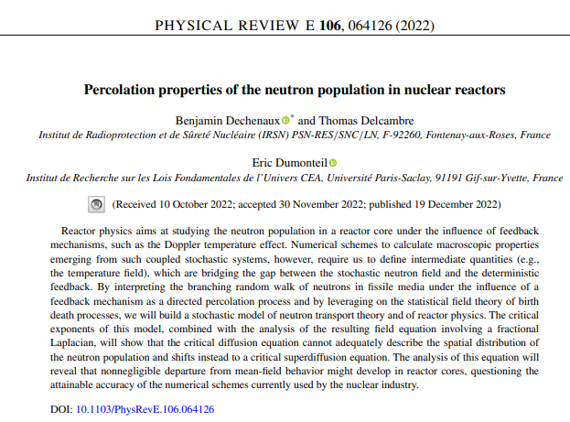

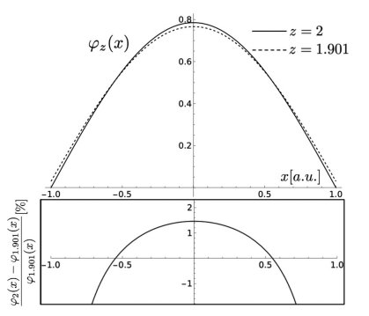
Previous work

Slide 7
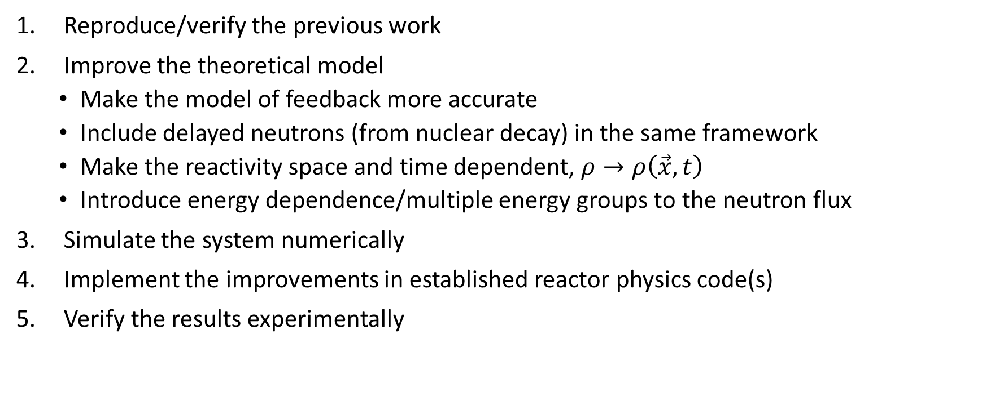
Research plan
Reproduce/verify the previous work
Improve the theoretical model
  Make the model of feedback more accurate
  Include delayed neutrons (from nuclear decay) in the same framework
  Make the reactivity space and time dependent, $ρ→ρ\left(\vec{x},t\right)$
  Introduce energy dependence/multiple energy groups to the neutron flux
Simulate the system numerically
Implement the improvements in established reactor physics code(s)
Verify the results experimentally

Slide 8
Backups

Slide 9
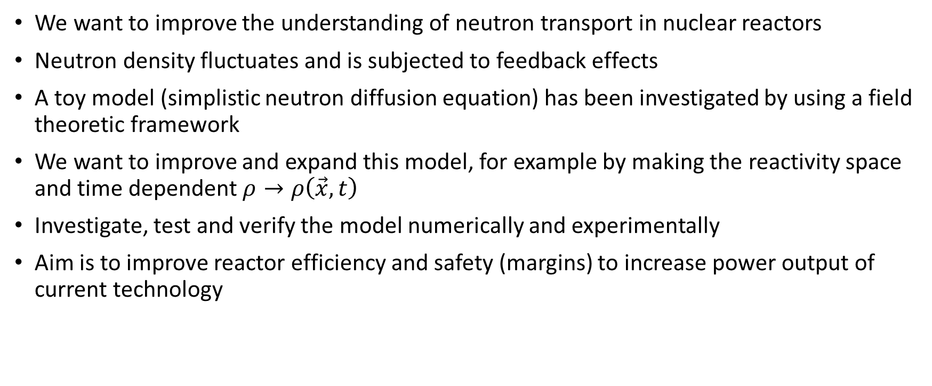
Summary
We want to improve the understanding of neutron transport in nuclear reactors
Neutron density fluctuates and is subjected to feedback effects
A toy model (simplistic neutron diffusion equation) has been investigated by using a field theoretic framework
We want to improve and expand this model, for example by making the reactivity space and time dependent $ρ→ρ\left(\vec{x},t\right)$
Investigate, test and verify the model numerically and experimentally
Aim is to improve reactor efficiency and safety (margins) to increase power output of current technology

Slide 10
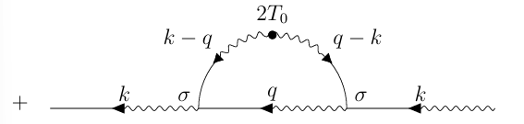


Preliminary results
Neutron diffusion equation with feedback strength σ and noise η
Assume Gaussian noise with covariance
If $T_{1}=0$, the Feynman diagrams up to second order in σ are

Slide 11

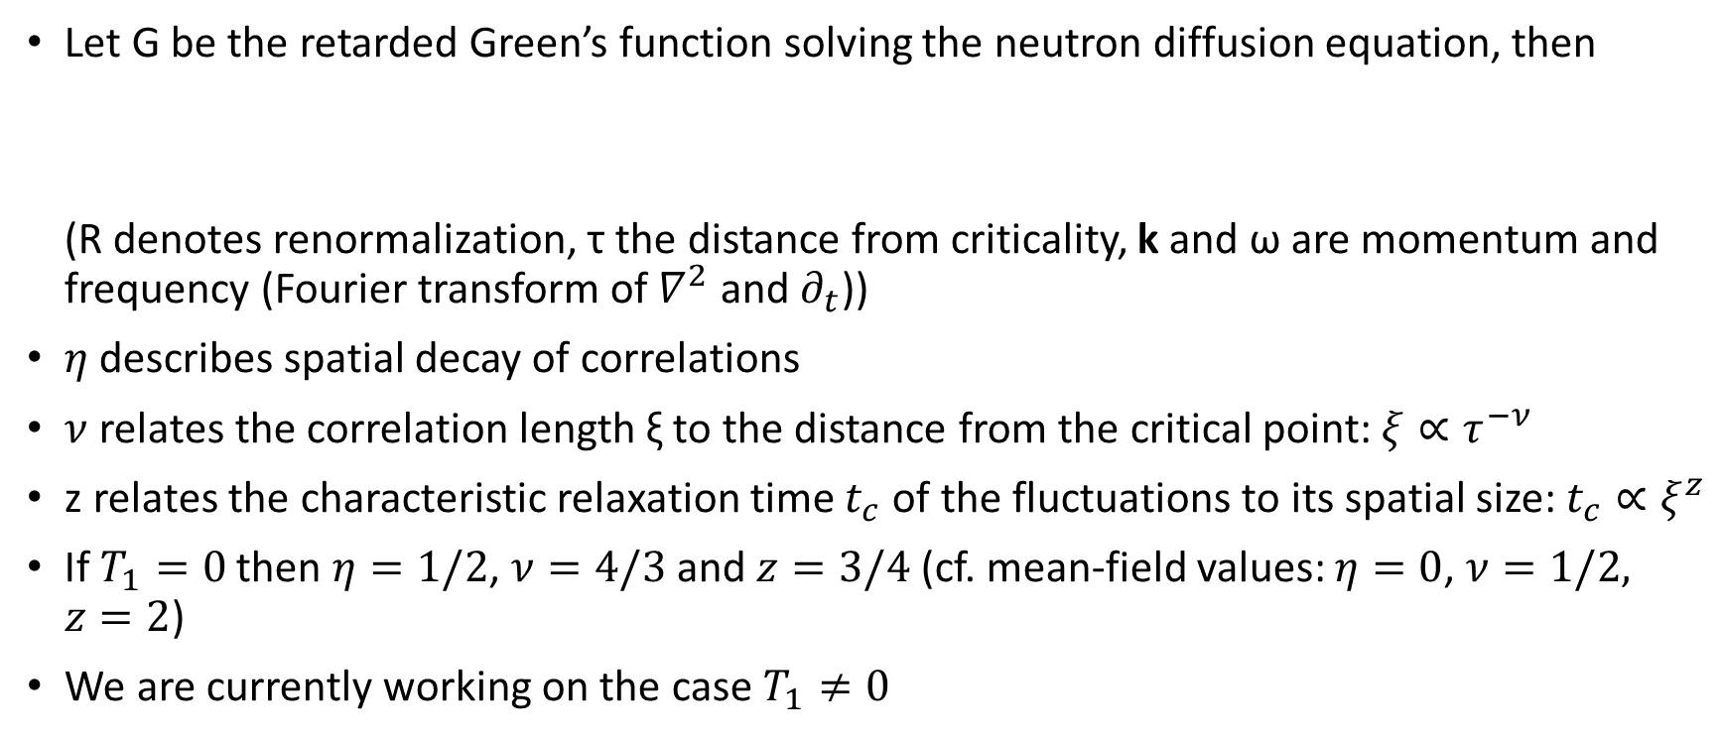
Preliminary results
Let G be the retarded Green’s function solving the neutron diffusion equation, then
(R denotes renormalization, τ the distance from criticality, k and ω are momentum and frequency (Fourier transform of $∇^{2}$ and $∂_{t}$))
$η$ describes spatial decay of correlations
$ν$ relates the correlation length ξ to the distance from the critical point: $ξ∝τ^{−ν}$
z relates the characteristic relaxation time $t_{c}$ of the fluctuations to its spatial size: $t_{c}∝ξ^{z}$
If $T_{1}=0$ then $η=1/2$, $ν=4/3$ and $z=3/4$ (cf. mean-field values: $η=0$, $ν=1/2,$ $z=2$)
We are currently working on the case $T_{1}≠0$

Slide 12
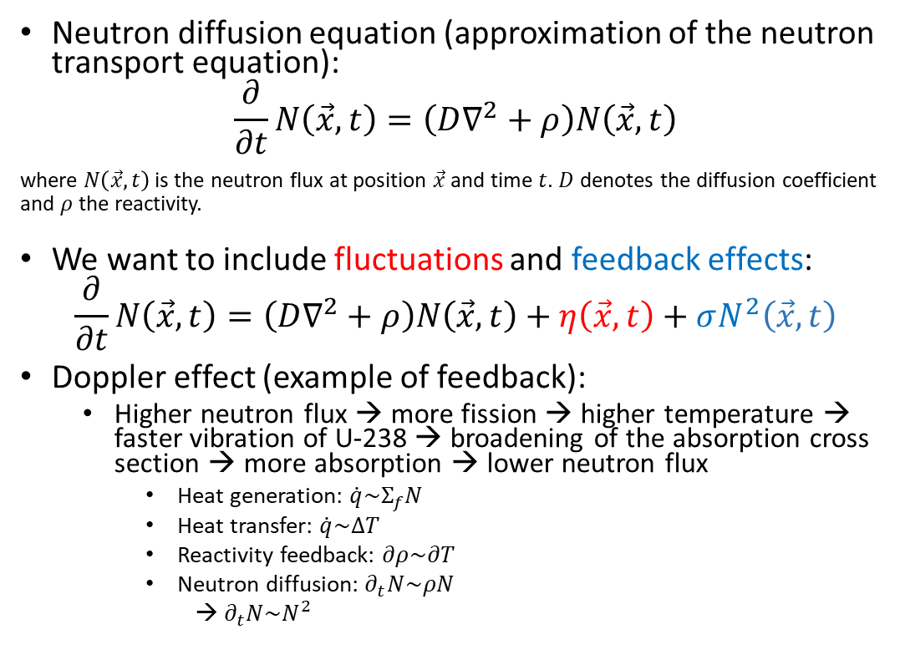
Neutron transport
Neutron diffusion equation (approximation of the neutron transport equation):
$$\frac{∂}{∂t}N\left(\vec{x},t\right)=\left(D∇^{2}+ρ\right)N\left(\vec{x},t\right)$$
where $N\left(\vec{x},t\right)$ is the neutron flux at position $\vec{x}$ and time $t$. $D$ denotes the diffusion coefficient and $ρ$ the reactivity.
We want to include fluctuations and feedback effects:
$$\frac{∂}{∂t}N\left(\vec{x},t\right)=\left(D∇^{2}+ρ\right)N\left(\vec{x},t\right)+η\left(\vec{x},t\right)+σN^{2}\left(\vec{x},t\right)$$
Doppler effect (example of feedback):
  Higher neutron flux → more fission → higher temperature → faster vibration of U-238 → broadening of the absorption cross section → more absorption → lower neutron flux
    Heat generation: $\dot{q}\sim Σ_{f}N$
    Heat transfer: $\dot{q}\sim ΔT$
    Reactivity feedback: $∂ρ\sim ∂T$
    Neutron diffusion: $∂_{t}N\sim ρN$
    → $∂_{t}N\sim N^{2}$
Suescún-Díaz, D., “Stochastic Neutron Population With Temperature Feedback Effects Using The Implicit Runge-Kutta Scheme,” J. Appl. Sci. Eng., vol. 28, no. 8, pp. 1795-1803, Sept. 2024, doi: http://dx.doi.org/10.6180/jase.202508_28(8).0016.
Qvist, S. A. (2013). Safety and core design of large liquid-metal cooled fast breeder reactors. University of California, Berkeley.

Slide 13
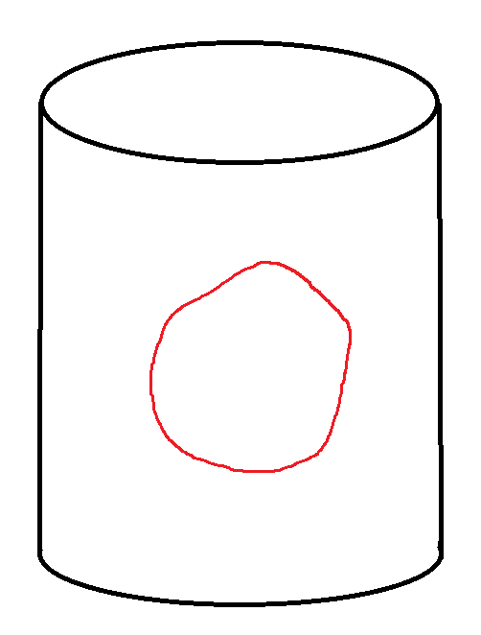
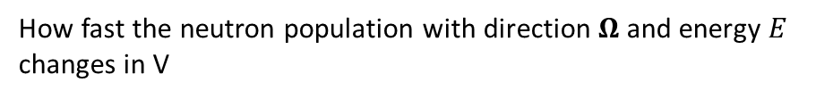
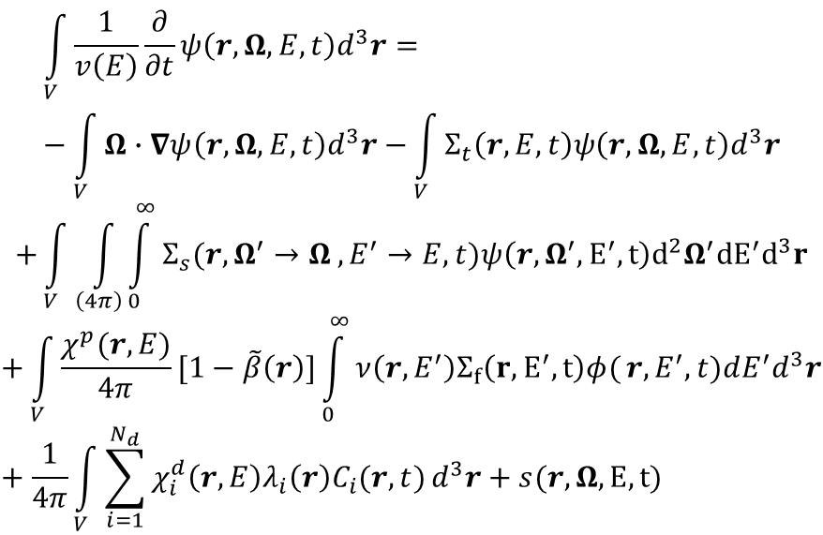
Neutron transport
How fast the neutron population with direction $Ω$ and energy $E$ changes in V
Absorption + scattering
$$\int_{V}^{ }{\frac{1}{v\left(E\right)}\frac{∂}{∂t}ψ\left(r,Ω,E,t\right)d^{3}r=}−\int_{V}^{ }{Ω∙∇ψ\left(r,Ω,E,t\right)d^{3}r−}\int_{V}^{ }{Σ_{t}\left(r,E,t\right)ψ\left(r,Ω,E,t\right)d^{3}r}$$
$$+\int_{V}^{ }{\int_{\left(4π\right)}^{ }{\int_{0}^{∞}{Σ_{s}(r,Ω^{′}→Ω}}},E^{′}→E,t)ψ\left(r,Ω^{′},E^{′},t\right)d^{2}Ω^{′}{dE}^{′}d^{3}r$$
$$+\int_{V}^{ }{\frac{χ^{p}(r,E)}{4π}[1−\tilde{β}\left(r\right)]\int_{0}^{∞}{ν\left(r,E^{′}\right)Σ_{f}\left(r,E^{′},t\right)φ(}}r,E^{′},t)dE^{′}d^{3}r+\frac{1}{4π}\int_{V}^{ }{\sum_{i=1}^{N_{d}}{χ_{i}^{d}\left(r,E\right)λ_{i}\left(r\right)C_{i}(r,t)}d^{3}r}+s(r,Ω, E, t)$$
Fissile material
Outgoing - incoming neutrons
Outgoing neutron
Volume V
Scattering
Fission
Fission
Absorption
Source
Delayed neutrons
Scattering
$$C_{i}\left(r,t\right)=\tilde{β_{i}}\left(r\right)\int_{−∞}^{∞}{\int_{0}^{∞}{ν\left(r,E\right)Σ_{f}\left(r,E,t\right)φ\left(r,E,t\right)dE−λ_{i}\left(r\right)C_{i}\left(r,t\right), }} \\ i=1,…,N_{d}$$
Incoming neutron
https://en.wikipedia.org/wiki/Neutron_transport#Neutron_transport_equation

Slide 14
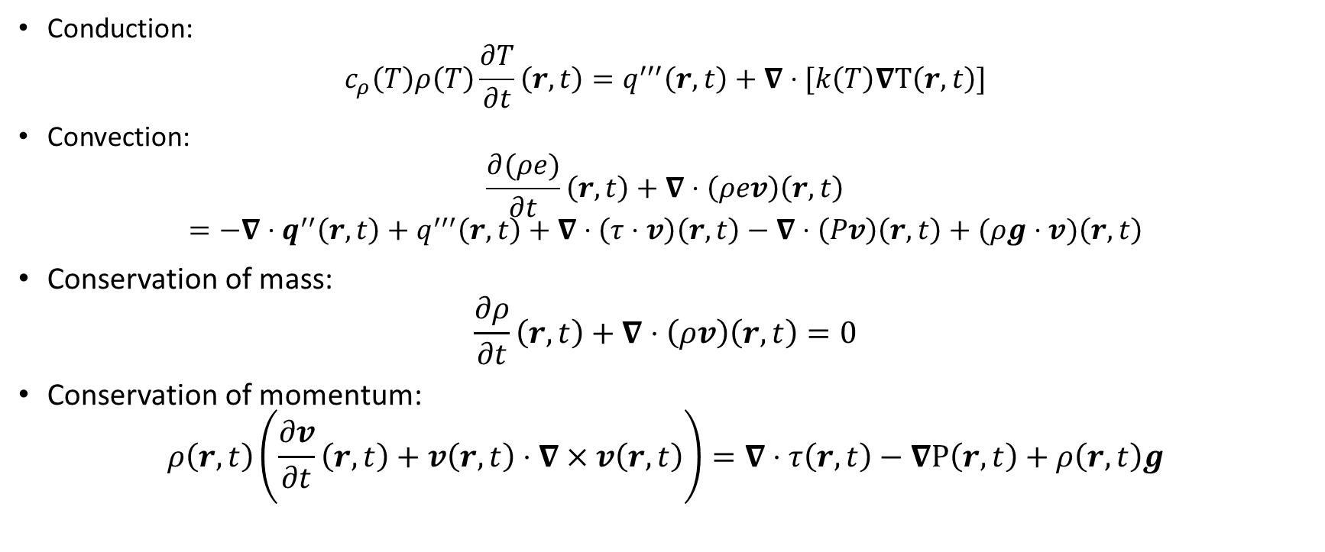
Thermal hydraulics
Conduction:
$$c_{ρ}\left(T\right)ρ\left(T\right)\frac{∂T}{∂t}\left(r,t\right)=q^{′′′}\left(r,t\right)+∇⋅[k\left(T\right)∇T\left(r,t\right)]$$
Convection:
$$\frac{∂(ρe)}{∂t}\left(r,t\right)+∇⋅\left(ρev\right)\left(r,t\right)$$
$$=−∇⋅q^{′′}\left(r,t\right)+q^{′′′}\left(r,t\right)+∇⋅\left(τ⋅v\right)\left(r,t\right)−∇⋅\left(Pv\right)\left(r,t\right)+(ρg⋅v)\left(r,t\right)$$
Conservation of mass:
$$\frac{∂ρ}{∂t}\left(r,t\right)+∇⋅\left(ρv\right)\left(r,t\right)=0$$
Conservation of momentum:
$$ρ\left(r,t\right)\left(\frac{∂v}{∂t}\left(r,t\right)+v\left(r,t\right)⋅∇×v\left(r,t\right)\right)=∇⋅τ\left(r,t\right)−∇P\left(r,t\right)+ρ\left(r,t\right)g$$

Slide 15




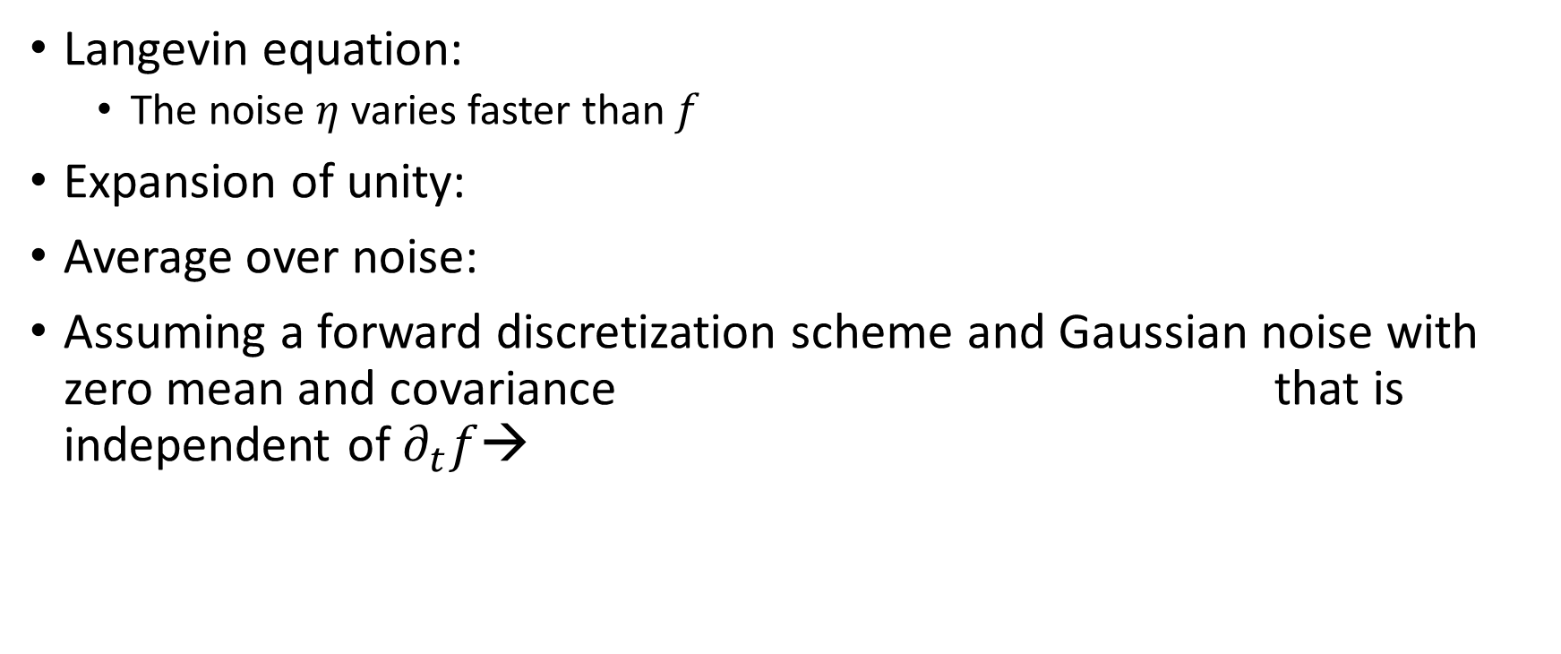
Derivation – Langevin equation
Langevin equation:
  The noise $η$ varies faster than $f$
Expansion of unity:
Average over noise:
Assuming a forward discretization scheme and Gaussian noise with zero mean and covariance that is independent of $∂_{t}f$→

Slide 16


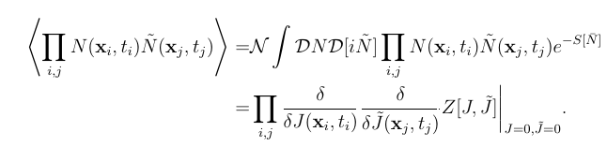


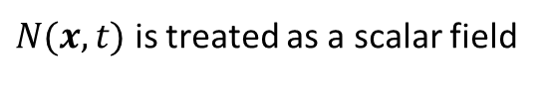
Derivation – Correlation functions
Stochastic neutron diffusion equation:
  →
Generating functional:
Correlation functions:
→
$N(x,t)$ is treated as a scalar field
(assuming that the noise is independent of $N$)

Slide 17




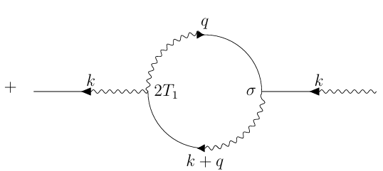
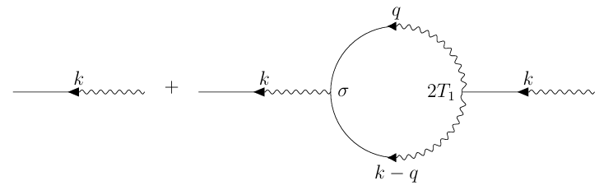
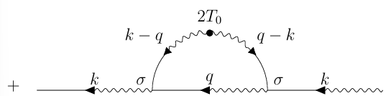
Feynman diagrams
Components:
Propagator + higher order contributions:

Slide 18
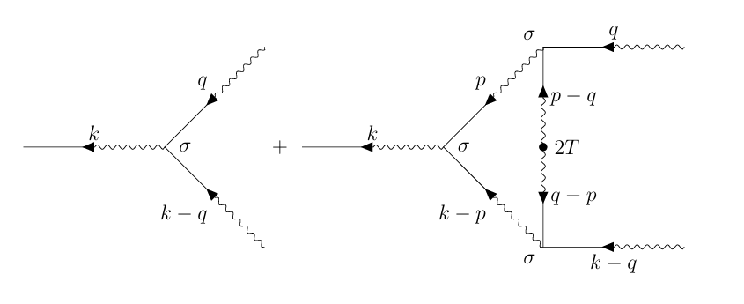
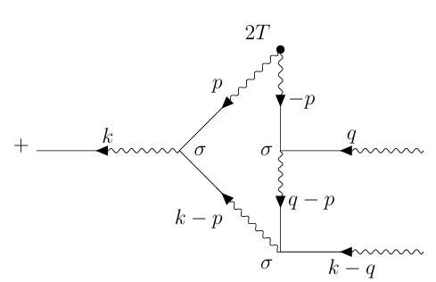

Feynman diagrams
Feedback coupling contributions (if $T_{1}=0$):

Slide 19












Renormalization
If $T_{1}=0$
Green’s function:
Renormalized parameters:
Universal scaling function:

