Slide 1
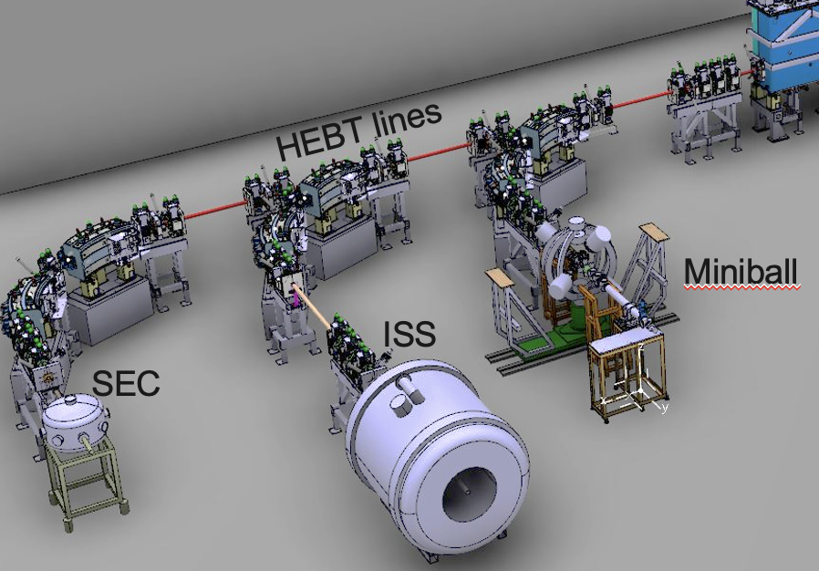
HIE-ISOLDE Scattering Experiement Chamber SEC activities at the XT03 beamline
Olof TENGBLAD
IEM - CSIC
The activity at the XT03 beamline
Scattering Experimental Chamber SEC
SEC-daq system
10 years of Experiments at SEC
Notes:
I would like to thank the organizers to let me present our work at this meeting.
Especially to be here in Visby where I as a 1st year PhD student at Chalmers was helping the organizers in the 2nd International Conference on Nucleus-Nucleus Collisions, 10 - 14 Jun 1985, Visby, Sweden
and in principle closing the circle as I will retire in a year from now. Today I will present;
The activity at the XT03 beamline of HIE-ISOLDE
Present the versatile Scattering Experimental Chamber SEC
The present stage of the SEC-daq system
10 years of Experiments at SEC

Slide 2
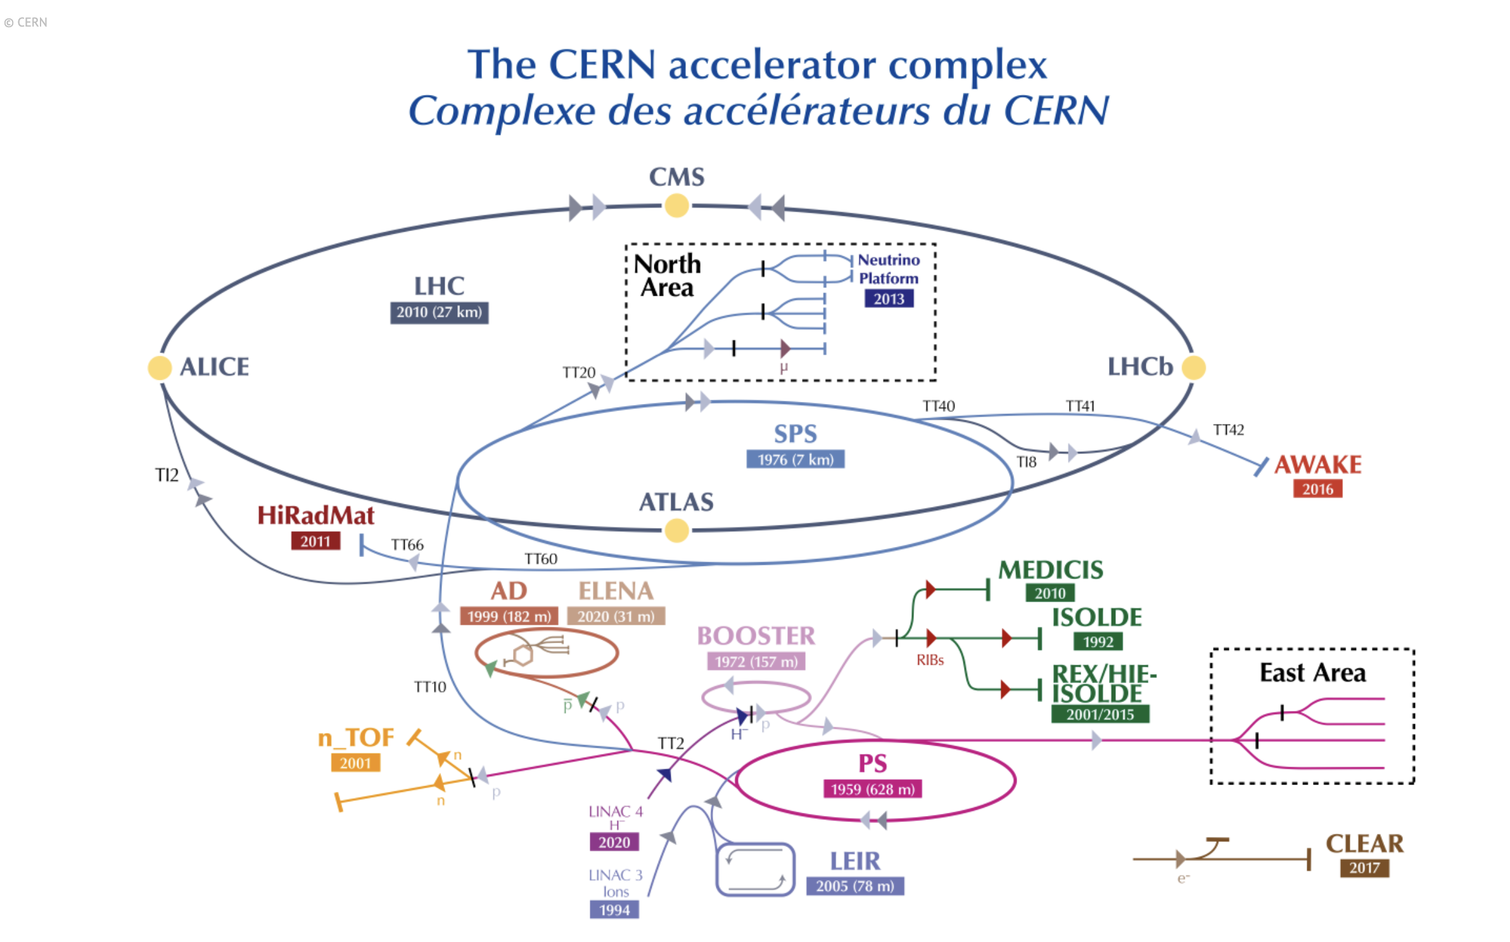

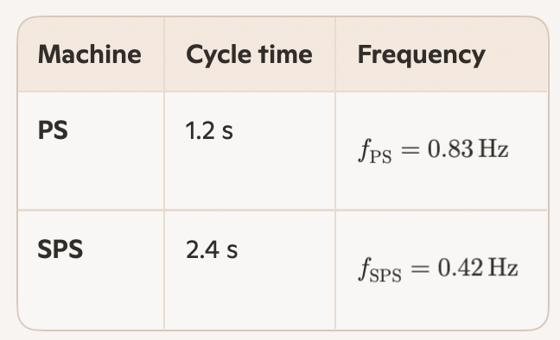
ISOLDE in the Accelerator complex of CERN
Linac4 → PSB → ISOLDE
LHC (27 km)
SPS (6.9 km)
CERN super cycle is based in PS 1.2s repetition, SPS on 2.4 s → 50% of p-pulses for pre-SPS physics, main part to ISOLDE
Notes:
Just first to situate ISOLDE in the Accelerator complex of CERN
The proton beam is produced, accelerated via LINAC4 into PS BOOSTER from here it is send to PS – SPS and into LHC
PS cycle time is 1.2s while SPS runs with 2.4s cycletime → that 50% of protons can be used in pre-SPS physics and main part of this goes to ISOLDE.

Slide 3

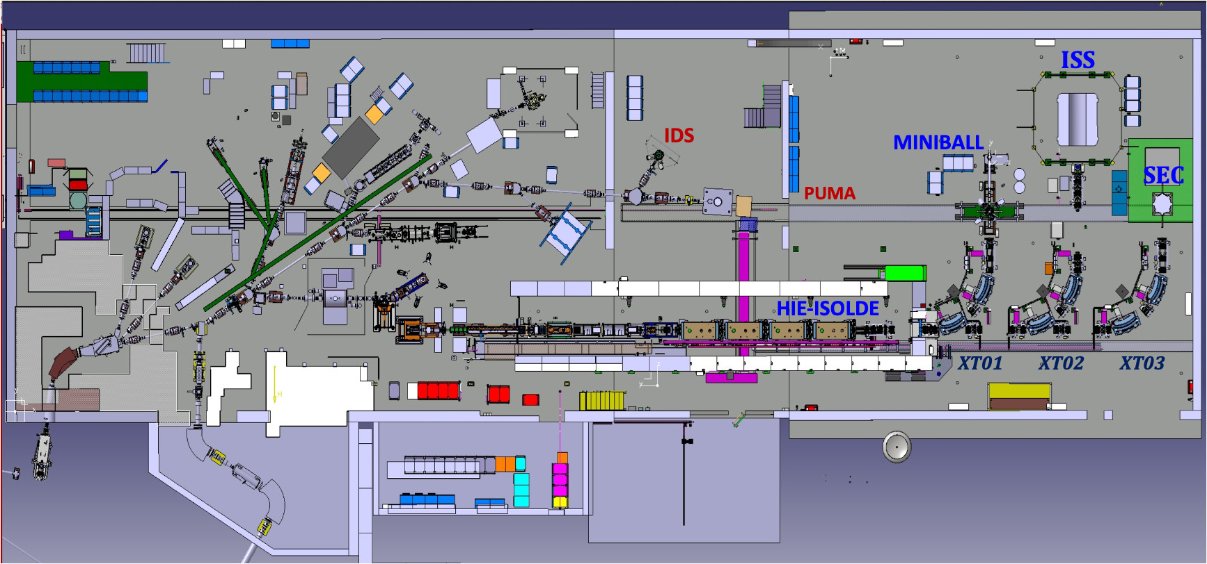
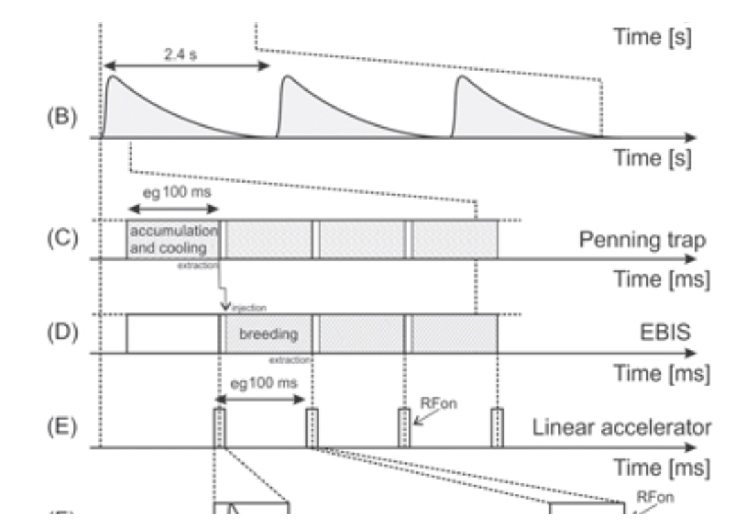
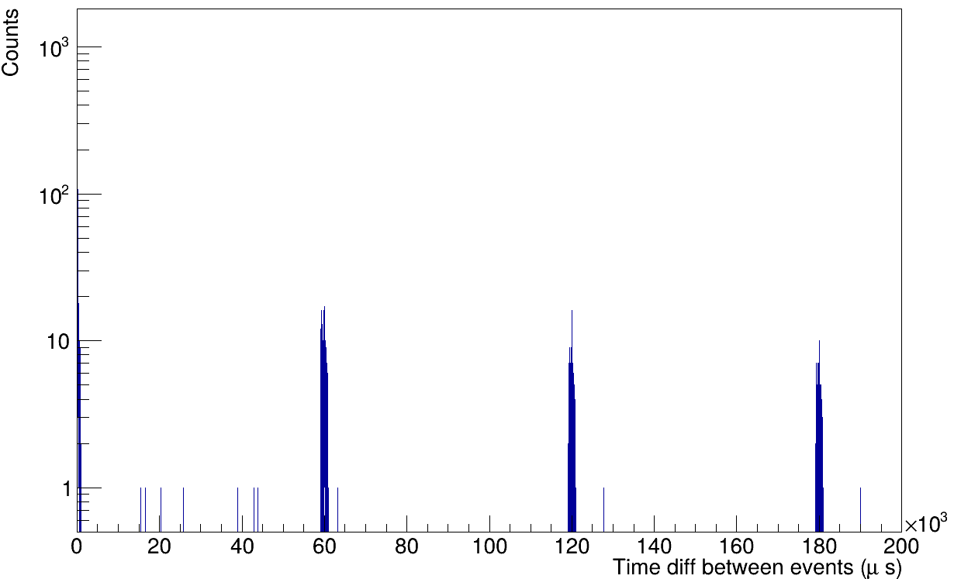
ISOLDE 60 years in 2027
Δ-Timestamp
ISOLDE target get a 3 μs long 3x10¹³ pps of 1.4 GeV from PSB (max 2 μA), extraction 100ms, EBIS breeding 20 ms (50Hz), A/Q=4,
Extraction stretched 3 ms → 10 MeV/u REX 100 MHz → HIE-ISOLDE 200 MHz → μs-structure @ SEC every 60 ms
Notes:
The ISOLDE hall, proton beam comes in onto two separated target stations GPS or HRS that are on potential of 30-60 kV
the beams are extracted into the grounded beamline system. The beam to HIE ISOLDE goes via a TRAP (that sit on the same potential to catch the beam at minimum energy) send to an EBIS ionsource for breeding and then taken into the HIE-ISOLDE with an A/Q=4 energy up to 10 MeV/u. Pulse beam structure into the experiments

Slide 4
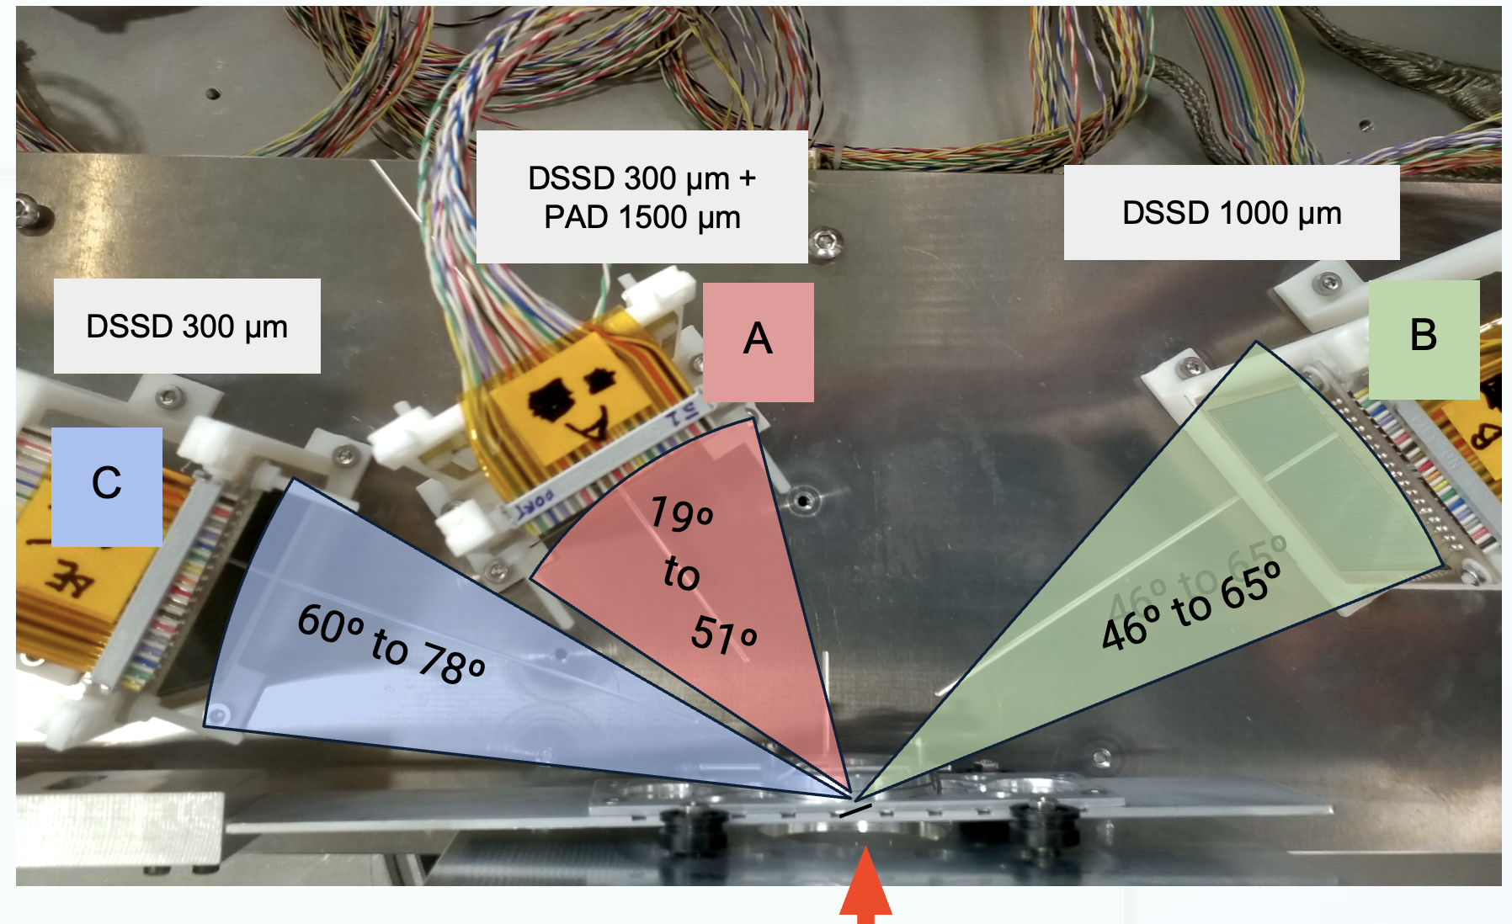
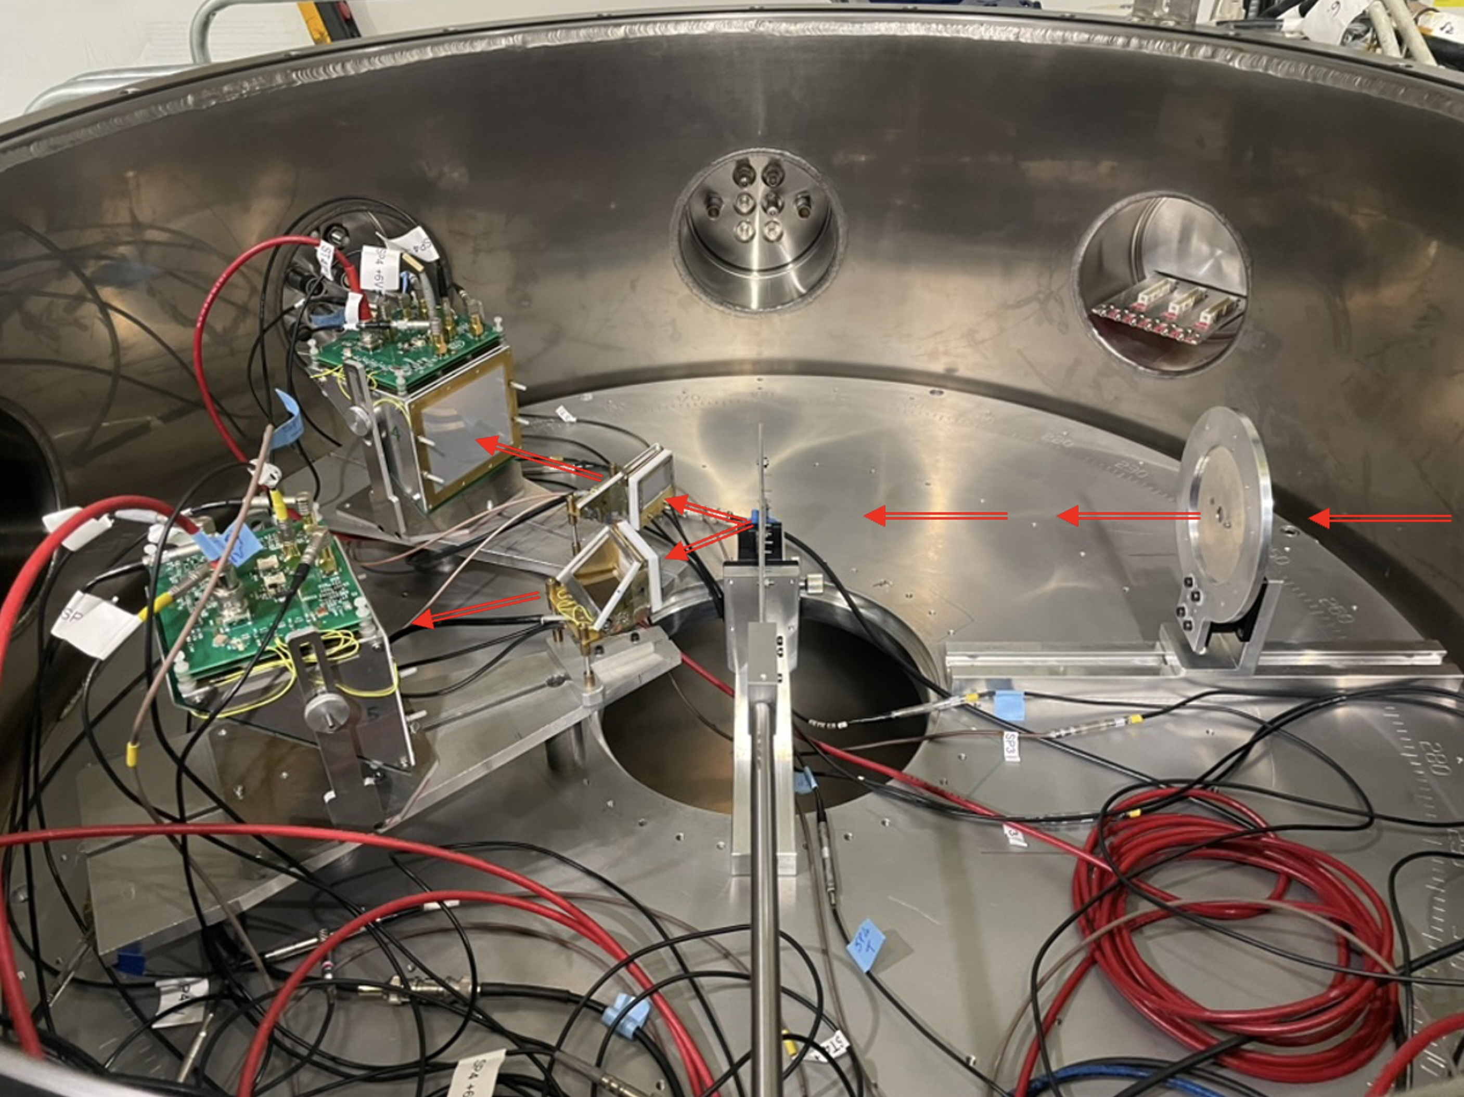
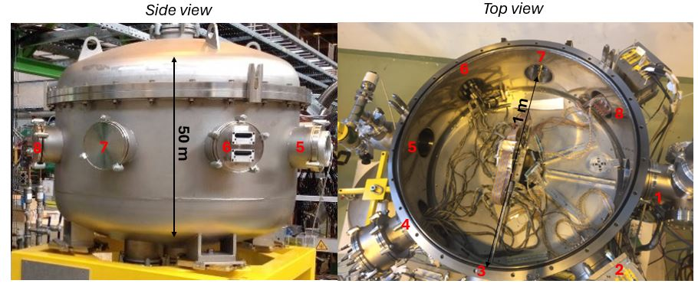

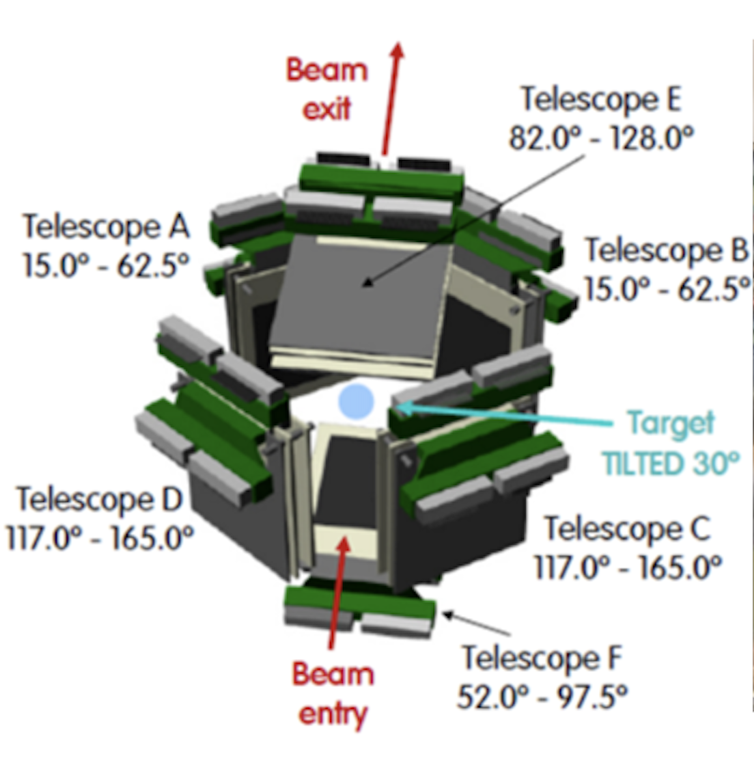
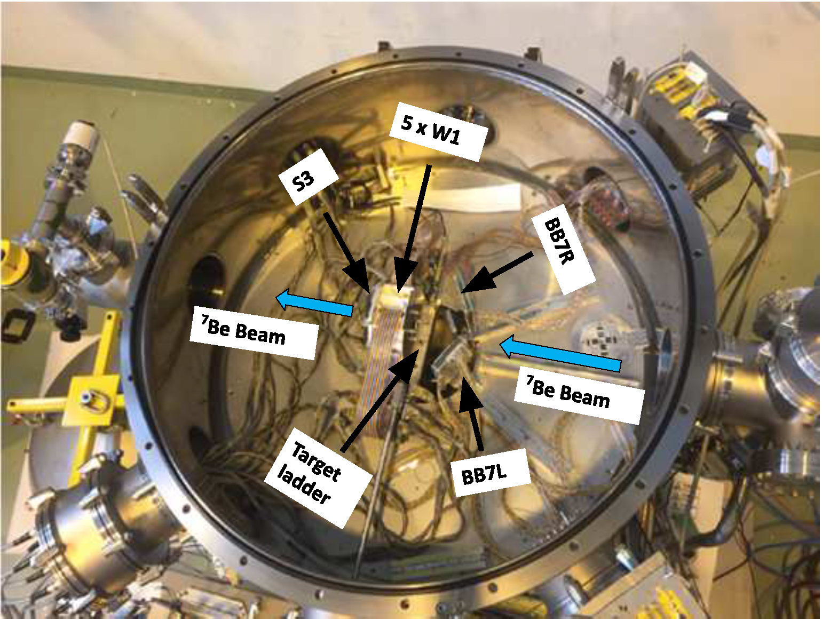
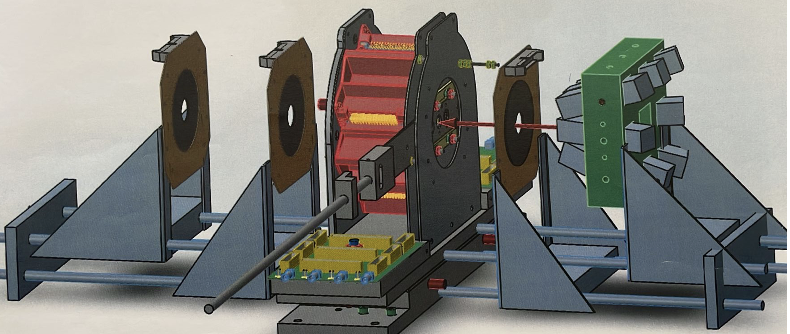
SEC experiments
2022: IS698 D. Galaviz
α-scattering of light Sn-isotopes → p-process
2025: IS550 S. Heinz & E. Vardaci
Study of the Dinuclear System Ni + 238U
GLORIA
2018 A. Di Pietro
IS616: ⁸B + ⁶⁴Zn
2017 I. Martel
IS619: ¹⁵C + ²⁰⁸Pb
2024-25: IS690 M. Borge
9Li(t,p) ; 11Be(t,p)
Joakim Cederkall
2018: IS561 9Li(t,p) K. Riisager
IS554 ⁷Be(d,p)⁸Be D. Gupta
Notes:
The XT03 beamline at the HIE-ISOLDE facility provides a flexible platform for a broad range of non-permanent reaction experiments with accelerated
radioactive beams. At its focal plane, the Scattering and Experiment Chamber (SEC) offers a large, modular volume capable of hosting diverse internal detector
setups. We present an overview of the SEC installation, mechanical layout, and integrated beam-diagnostic systems, together with a summary of the detector
configurations deployed during the first decade of operation.

Slide 5
10 years of Physics @ SEC Representative physics highlights illustrate the versatility and performance of the XT03–SEC infrastructure.
2017 IS619 Elastic Scattering of ¹⁵C on a ²⁰⁸Pb target: the 1n-halo character
2018 IS616 Elastic Scattering of the 1n-halo ¹¹Be+ ⁶⁴Zn /¹⁹⁷Au
IS561 Transfer reactions at the neutron dripline with triton target IS554 The Cosmological ⁷Li problem
2019 – 2021 Long Shutdown 2 + covid
2022 IS698: α-scattering of light tin-isotopes -- p-process
2024. IS690 ⁹Li(t,p)
2025 IS690b ¹¹Be(t,p)
2025 IS550: Probing the Island of Stability of Super Hevies with ISOLDE beams; pave the way towards SHE
Notes:
So I will give you some details on the experiments performed, starting with elastic scattering of halo-nuclei near the Coulomb barrier.

Slide 6
Elastic Scattering of halo nuclei on heavy target at Coulomb barrier energies
Key Mechanisms
Weak binding & extended matter distribution → halo wave functions extend far outside the core, enhancing breakup at large radii.
Strong coupling to the continuum → Coulomb dipole excitation + nuclear breakup reduce elastic flux.
Suppressed refractive (far‑side) scattering → breakup damping prevents rainbow formation.
Surface‑dominated interaction → scattering becomes Fresnel‑like, smooth and forward‑peaked.
Heavy targets amplify the effect → strong Coulomb field increases dipole excitation and long‑range couplings.
Takeaway
Elastic scattering becomes a sensitive probe of halo extension and continuum coupling dynamics.
Notes:
Elastic Scattering of halo nuclei on heavy target at Coulomb barrier energies
The HIE-ISOLDE energies are well suited for this kind of experiments

Slide 7

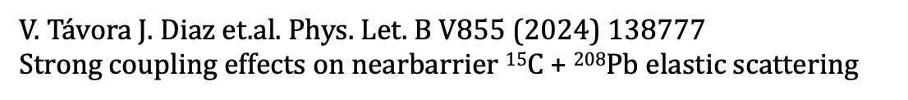
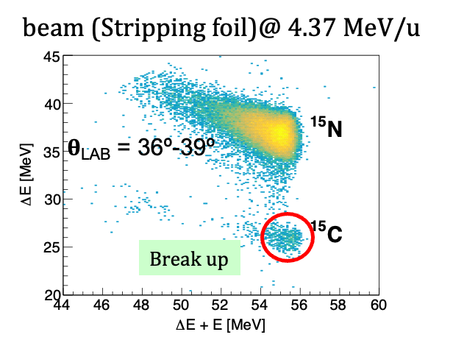
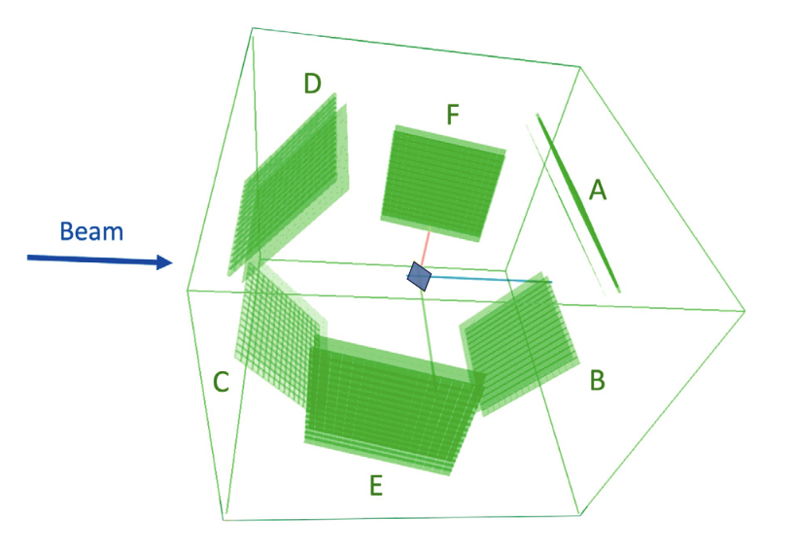
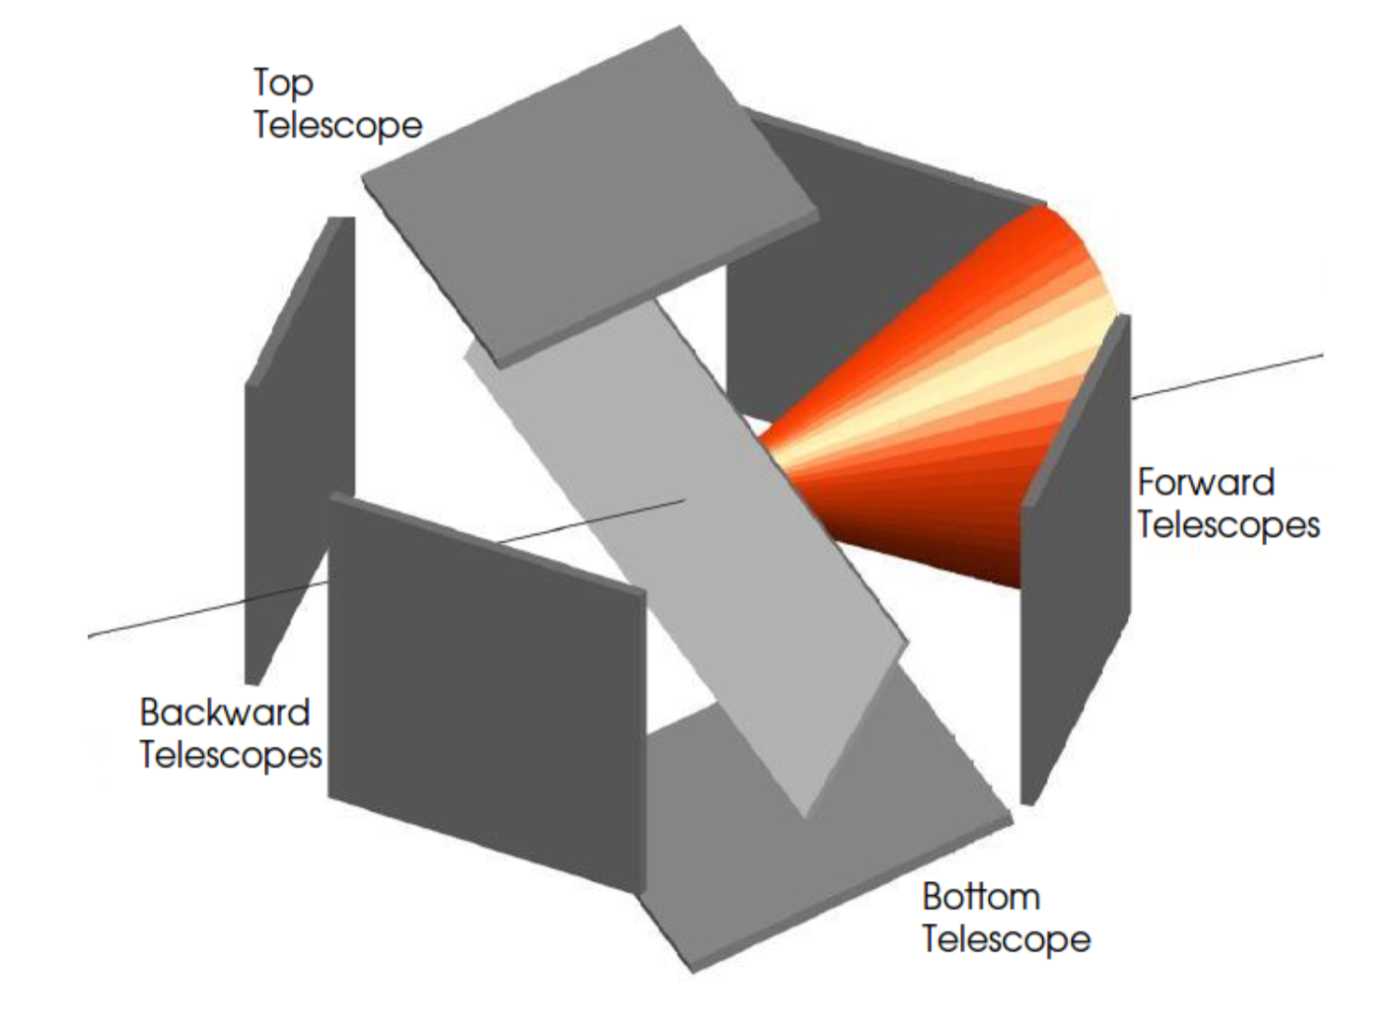
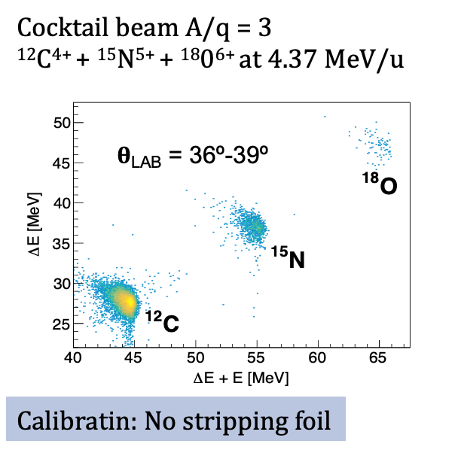
IS619: ¹⁵C+²⁰⁸Pb @4.37 MeV/u → is ¹⁵C a n-halo?
GLORIA Setup
From 2D pixel to angular sectors
F
B
A
E
The halo nature of ¹⁵C is demonstrated by
the observation of the long-range absorption effect,
the disappearance of the Coulomb rainbow,
the large reaction cross section,
effect due to the halo are clearly seen compared to ¹²C
¹⁵C + ²⁰⁸Pb @4.37 MeV/u
Notes:
IS619 aimed to prove a debated question if 15C could be seen as n-halo
And yes so it si

Slide 8
p-halo vs n-halo behaviour in Coulomb interaction dynamics
The p in the halo feels Coulomb interaction, expected dynamics different from n-halo
The proton in the halo feels the e.m. field and interacts with core and target
These additional interactions create an “effective barrier” making the halo dynamically more bound [e.g. Kucuc & Moro PRC86 (2012) 034601; A.Bonaccorso et al.: PRC69 (2004) 024615]
Possible semiclassical picture
T
T
n
C
C
p
Due to a dynamic polarization effect, the valence proton is expected to be displaced behind the nuclear core and shielded from the target; this effect causes a reduction of break-up probability compared to first-order perturbation theory predictions
Notes:
Is there a difference in the p-halo vs n-halo behaviour in Coulomb interaction dynamics ?

Slide 9
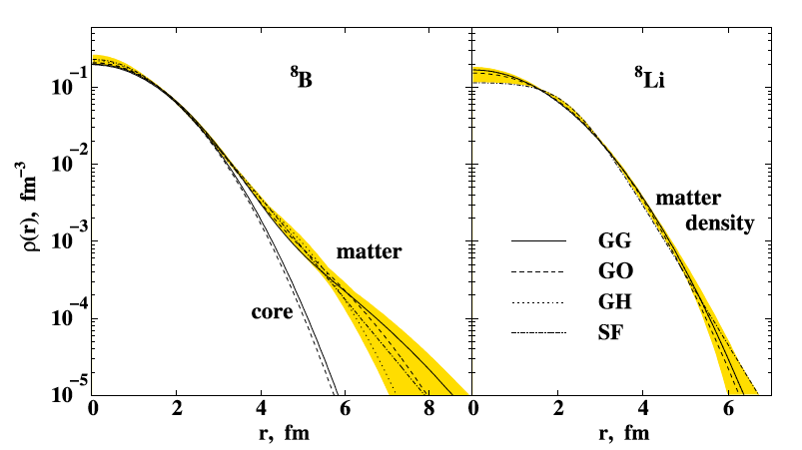
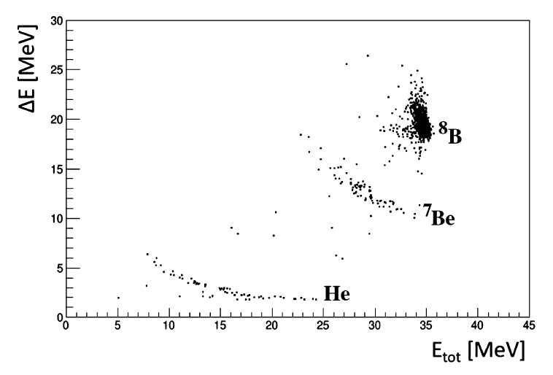


⁸B
Sp = 136,4 keV
⁸Li
IS616: Scattering of ⁸B on a ⁶⁴Zn Target → p-halo
Sp = 136,4 keV
First ⁸B beam @ HIE-ISOLDE
Primary target: Carbon Nanotube
Beam : ⁸BF₂
Yield: ∼ 400 pps
Beam energy E 4.9 MeV/u
⁶⁴Zn-target 1,05 mg/cm²
Aim to Measure
Diff Elastic Cross Section
Break-up & Transfer
Total Cross Section
Deduce the Nuclear & Coulomb Contributions
core
⁸B vs ⁸Li density distribution
G.A. Korolev et al.
Phys.Lett. B 780 (2018) 200
GLORIA detector chamber NIM A 755 (2014) 69
Large angular range - high granularity
⁸B+⁶⁴Zn @ 39,2 MeV
F
B
15$°≤ θ ≤62,5°$
A
⁸B→⁸Be*→ 2α
Breakup
E
Notes:
Proton halo effects in the 8B+64Zn reaction at an energy around 1.5 times the Coulomb barrier have been studied at HIE-ISOLDE CERN using, for the first time, the only existing postaccelerated 8B beam.
This, together with the use of a high granularity and large solid angle detection system, allowed for a careful mapping of the elastic angular distribution, especially in the Coulomb-nuclear interference region. Contrary to what is observed for the one-neutron halo nucleus 11Be on the same target in a similar energy range, the analysis of the elastic scattering angular distribution shows only a modest suppression of the Coulomb-nuclear interference peak, with no remarkable enhancement of the total reaction cross-section. Inclusive angular and energy distributions of 7Be produced in direct reaction processes have also been measured. The comparison of these data with the results of theoretical calculations for the elastic and non-elastic breakup contributions indicate that both processes are important. Overall, the experimental data suggest a 8B collision dynamics at the barrier very different from the one of neutron halo nuclei, showing only modest effects of coupling to continuum

Slide 10

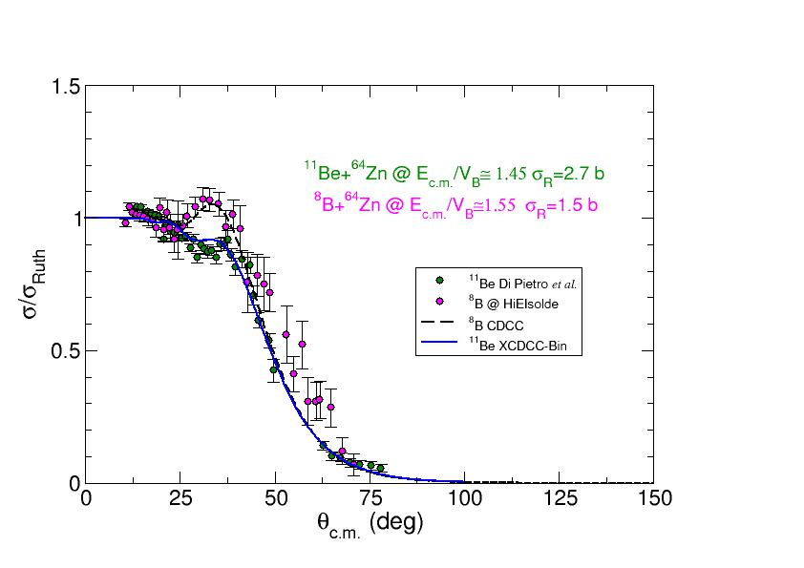
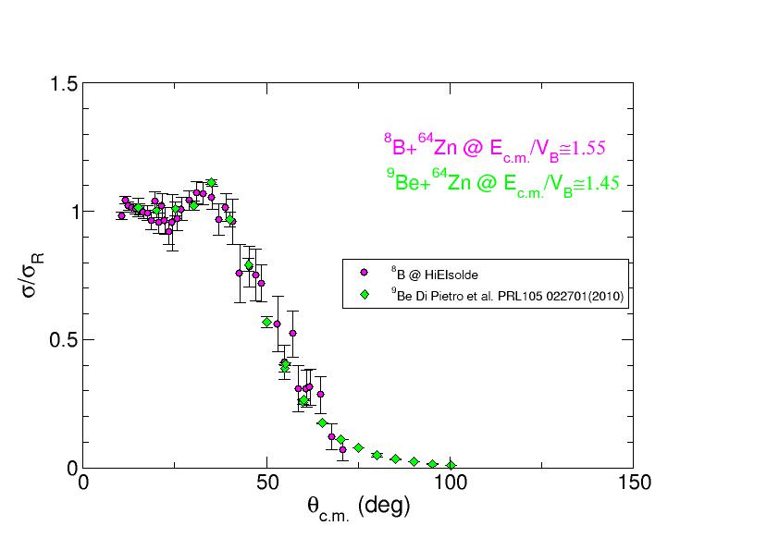
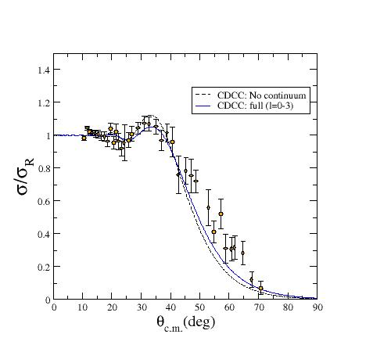
Comparison: Scattering of p-halo vs n-halo & w.bound
⁸B,¹¹Be+⁶⁴Zn: p-halo vs n-halo
⁸B, ⁹Be+⁶⁴Zn:
p-halo vs weakly bound
⁸B
⁸B
p
⁸B+⁶⁴Zn @ 39,2 MeV
⁷Be
¹¹Be
⁹Be
IS616
No suppression of rainbow
For ⁸B total σ_{R} a factor ∼ 2 lower than in n-halo ¹¹Be
Total reaction cross-section for ⁸B+⁶⁴Zn σ_{R} ⩳1.5 b
similar to ⁹Be+⁶⁴Zn at similar E_{c.m.} / V_{c}
Proton halo behaves as a more bound nucleus ⁹Be as predicted by
A. Bonaccorso et al. PRC 69, 024615 (2004)
Notes:
Here we can compare the results from the different type p or n or weakly boune nuclei
So here we can see the difference comparing p-halo, n-halo and weakly bound: clearly the n-halo nuclei like 11Be and as we saw earlier 15C show the suppression of the rainbow

Slide 11

The Cosmological ⁷Li problem
Spokesperson: D. Gupta Bose Inst. Kolkata, India
Prof. Dhruba Gupta
Phys Rev Let 128 (2022) 252701
Phys Let B 833 (2022) 137294
Phys Let B 853 (2024) 138673
Nuc. Phys. A 1065 (2026) 123249
Notes:
Moving to astrophysics

Slide 12
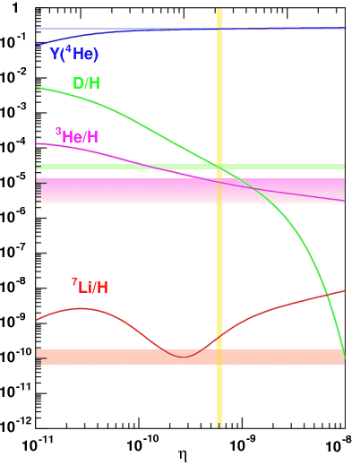


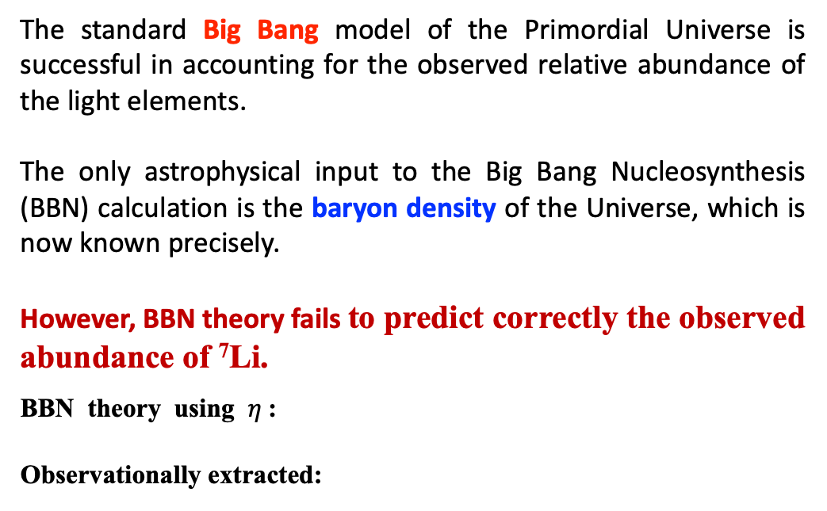
IS554 The Cosmological ⁷Li problem
BBN -- Big Bang Nucleosynthesis
The standard Big Bang model of the Primordial Universe is successful in accounting for the observed relative abundance of the light elements.
The only astrophysical input to the Big Bang Nucleosynthesis (BBN) calculation is the baryon density of the Universe, which is now known precisely.
However, BBN theory fails to predict correctly the observed abundance of ⁷Li.
BBN theory using $η$:
Observationally extracted:
D, ³He, ⁴He
Relative Abundance
Astrophysical solutions: Hidrodynamics Korn, Nature (2006);
Physics Beyond the standard BBN Model
Nunclear Physics: ⁷Li is mainly produce by EC of ⁷Be
Production of ⁷Be @ T=0.3-0.6 GK : ³He(α,γ)⁷Be Destruction: ⁷Be(n,p)⁷Li, ⁷Be(n,α)⁴He and ⁷Be(d,p)2α.
Solutions:
Observed (predicted) values: bands (lines) for H/D; ^{3,4}He; ⁷Li
Notes:
The cosmological lithium problem - a discrepancy between the observed amount of 7Li and that predicted by Big Bang nucleosynthesis models - has puzzled scientists for
decades. Such primordial 7Li originates mainly from the decay of 7Be. Using a HIE- ISOLDE beam of 7Be at the SEC station, we investigated a potential 7Be destruction
pathway, yielding new data to help to tackle the puzzle. The experiment IS554 [17] (spokesperson D. Gupta of Bose Institute, Kolkata) was performed at the start of the
Long Shutdown 2 (LS2) of CERN in December 2018. Before the PS booster stopped delivering protons a Uranium Carbide target was irradiated with 0.37 µA of 1.4 GeV
protons for 3 days. The activated target was mounted on the GPS target station and heated to release the 7Be beam, which was post-accelerated before being delivered to
the SEC station for the reaction study.
First, I explain what lithium 7 problem is.
It is a cosmological problem.
Light elements abundances synthesized at early universe are explained by Big Bang Nucleosynthesis called BBN.
Here, “early” means that the age of universe is between a few second and a few minutes.
This time region is sometimes called “The first three minutes”
Bing Bang Nucleosynthesis predicts light element abundances from a parameter, baryon to photon ratio.
This figure shows the predicted and observed abundances of the light element abundances.
In this figure the observed values are represented by these bands, and predicted values are represented by these lines.
At the observed value of baryon to photon ratio, observed values and predicted values are consistent, except for Lithium 7.
For lithium 7, predicted value is two or three times larger than observed value.
This inconsistency is called lithium 7 problem.
Since the predicted value exceed the observational value, we have to introduce a lithium 7 reducing process.
Possible solutions:
Astrophysical solutions tried to reconcile the difference on the basis of stellar processing of ⁷Li, it may be destroyed in metal-poor stars through diffusion and turbulent mixing. Improvements in observationally inferred primordial lithium abundance, found to be very difficult to justify enough destruction. Korn, Nature (2006); Ryan (1999)
Physics beyond standard BBN
Destruction of mass-7 nuclides through interaction with WIMP particles, unstable particles in the early universe that could have affected BBN. Existence of ⁸Be as a bound nuclide during BBN. Interpretations assumed nuclear reaction rates known accurately Goudelis (2016), Coc (2012), Fields (2011), Cyburt (2006)
Nuclear physics aspects of the primordial lithium problem
In the condition of BBN, ⁷Li is effectively destroyed through ⁷Li(p,α)⁴He, so that 95% of the primordial ⁷Li is the by-product of the electron capture β-decay of the primordial ⁷Be after the cessation of nucleosynthesis.
Nuclear aspects involve the reaction rates of ⁷Be production, mainly ³He(α,γ)⁷Be and its destruction through ⁷Be(n,p)⁷Li, ⁷Be(n,α)⁴He and ⁷Be(d,p)2α.

Slide 13
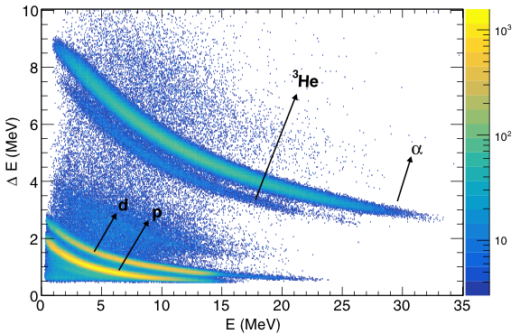
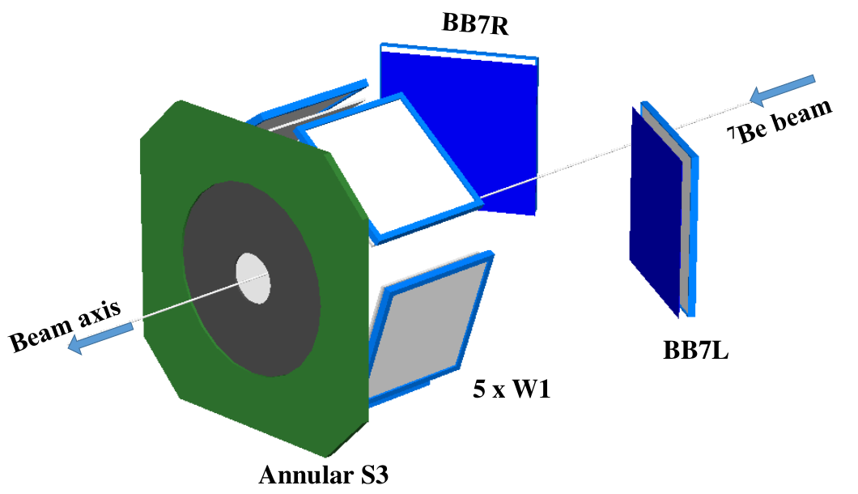
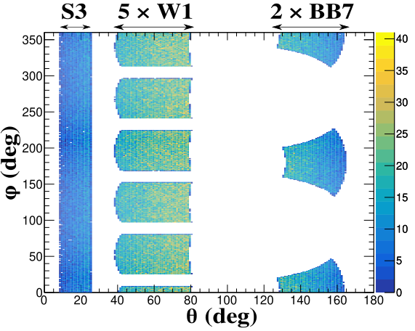
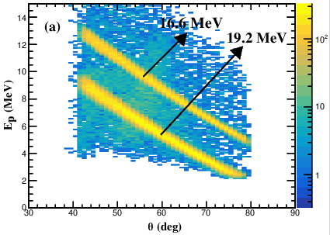
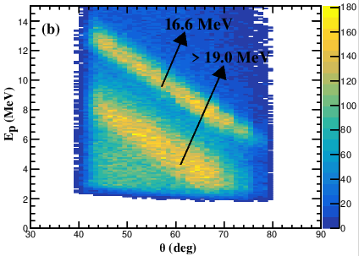
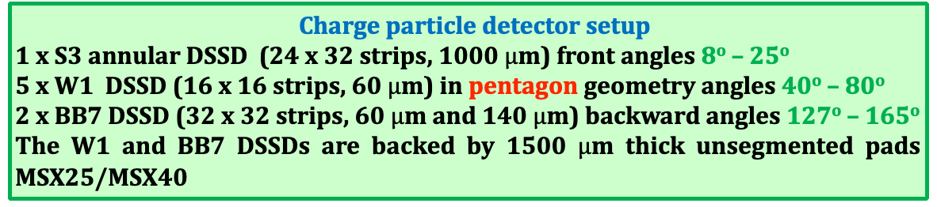
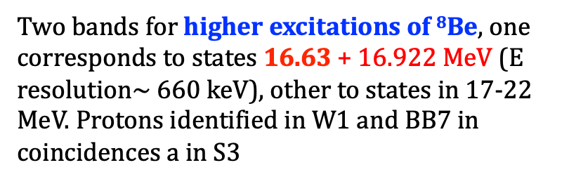
IS554: Study of ⁷Be(d,p)⁸Be* at 0-22 MeV
⁷Be⁴⁺ beam (5x10⁵pps) @ 5 MeV/u
MAGISOL Setup
ΔE-E spectrum of p, d, ³He, and α, detected at W1 + BB7 telescopes
Targets:
15μm CD₂; 15μm CH₂
The total solid angle coverage of the detectors is 32% of 4π.
Two bands for higher excitations of ⁸Be, one corresponds to states 16.63 + 16.922 MeV (E resolution$\sim$660 keV), other to states in 17-22 MeV. Protons identified in W1 and BB7 in coincidences a in S3
Notes:
We used the MAGISOL setup with Annular S3 dssd in forward angle a pentagon of W1 dssd 40-80. degrees and two BB7 telescopes in Backward
Can the higher excitations help in the 7Be production? Like in 12C the Hoyle state? The cosmological lithium problem - a discrepancy between the observed amount of
7Li and that predicted by Big Bang nucleosynthesis models - has puzzled scientists for decades. Such primordial 7Li originates mainly from the decay of 7Be. Using a HIE-
ISOLDE beam of 7Be at the SEC station, we investigated a potential 7Be destruction pathway, yielding new data to help to tackle the puzzle.
The experiment IS554 [17] (spokesperson D. Gupta of Bose Institute, Kolkata) was performed at the start of the Long Shutdown 2 (LS2) of CERN in December 2018. Before the PS booster stopped
delivering protons a Uranium Carbide target was irradiated with 0.37 µA of 1.4 GeV protons for 3 days. The activated target was mounted on the GPS target station and
heated to release the 7Be beam, which was post-accelerated before being delivered to the SEC station for the reaction study.

Slide 14
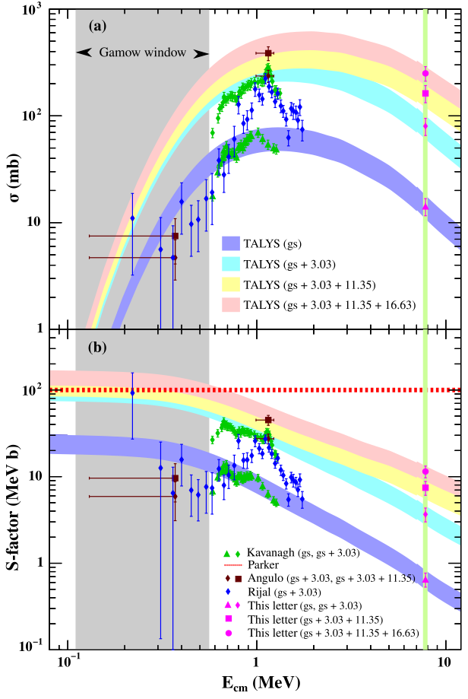
Results of the ⁷Be(d,p)⁸Be* Study
Excitation function The bands are TALYS calculations normalized to the measured cross section, giving an estimate of contributions of individual states of ⁸Be up to the 16.6 MeV state for the first time.
The existing data within Gamow window (T = 0.5–1 GK, E_{c.m.} = 0.11–0.56 MeV) has large error bars. Good agreement with data outside Gamow window. The S factor due to contribution of gs+3.03+11.35 MeV state agrees with Parker’s estimate of 100 MeV b.
Addition of the 16.63 (+ 16.922) MeV state leads to a maximum value of S factor within the Gamow window increases to 167 MeV (+60%) but it cannot solve the Lithium anomaly. → mitigation of Li abundance < 1%
Contribution of higher excited states in ⁷Be(d,p)⁸Be* do not solve the Cosmological lithium problem
Courtesy of Dhruba Gupta
Phys Rev Let 128 (2022) 252701
Phys Let B 833 (2022) 137294
Phys Let B 853 (2024) 138673
Nuc. Phys. A 1065 (2026) 123249
Notes:
The data follow the different simulation TALYS bands and the inclusion of the higher excited states do NOT help in the production of 7Be
The experimental DATA say NO it does not solve the lithium problem

Slide 15
2019 - 2021
Long Shutdown 2 + covid
2022 IS698: a-scattering of light tin-isotopes -- p-process
2024. IS690 ⁹Li(t,p)
2025 IS690b ¹¹Be(t,p)
2025 IS550: Probing the Island of Stability of Super Hevies with ISOLDE beams; pave the way towards SHE

Slide 16
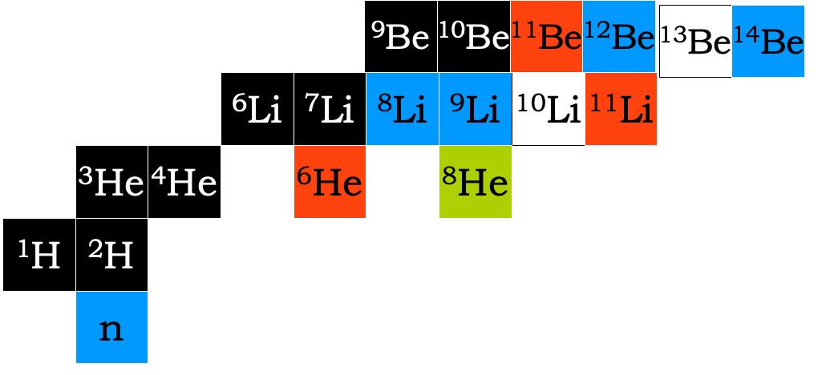
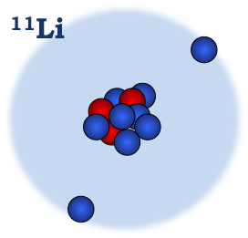
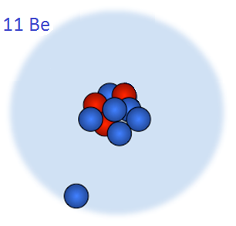
Halo nuclei in n-transfer reactions
S_{2n} = 0.369 MeV
¹¹Li
¹¹Be
Halo Nuclei: Common “Structural” properties
Rather inert core plus one or two barely unbound
extra (1-2) neutrons or protons
Extended nucleon distribution, large “radius”→ “halo”
Very few excited states – if any.
Unique exotic structure: Insight into slow degrees of freedom (Sn=0.5 MeV, t = 10⁻²¹S; For S_{n} = 8 MeV t = 10⁻²³s
S_{n} = 0.5 MeV
Interplay between Nuclear Structure & Reaction Mechanism
Notes:
As said among these are the halo nuclei like 11Li and 11Be
Using 9Li(t,p) we can produce and study the halo-nuclei 11Li and the resonances of 10Li (non-bound)
Using the halo nuclei 11Be(t,p) we can reach the 13Be 14B

Slide 17

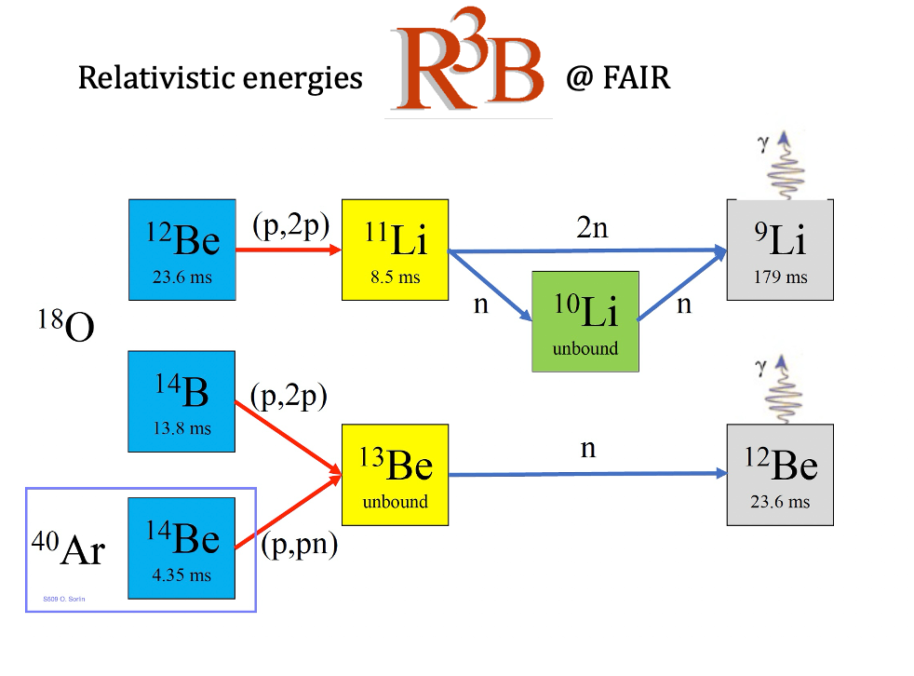
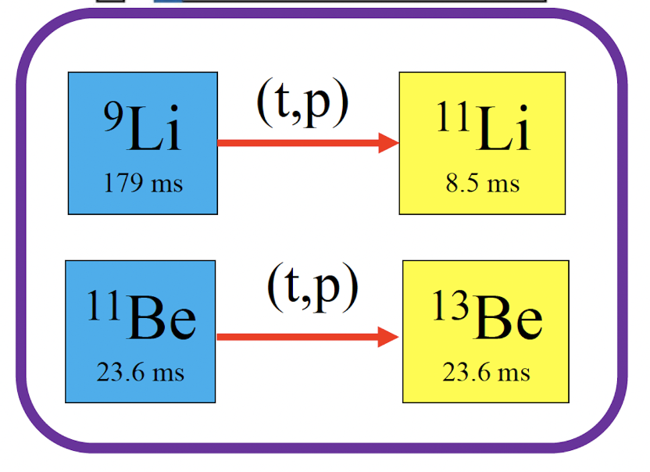
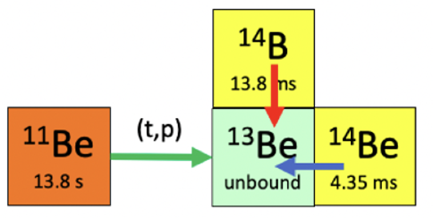

Goal: to perform the combined set of experiments
Studying the Structure of Light Exotic Nuclei in Inverse-Kinematics Reactions
Study of open quantum systems, ¹¹Li, and ¹³Be
using (p,2p) and (p,pn) reactions at R3B

Slide 18
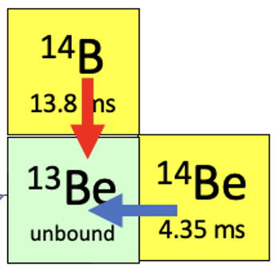
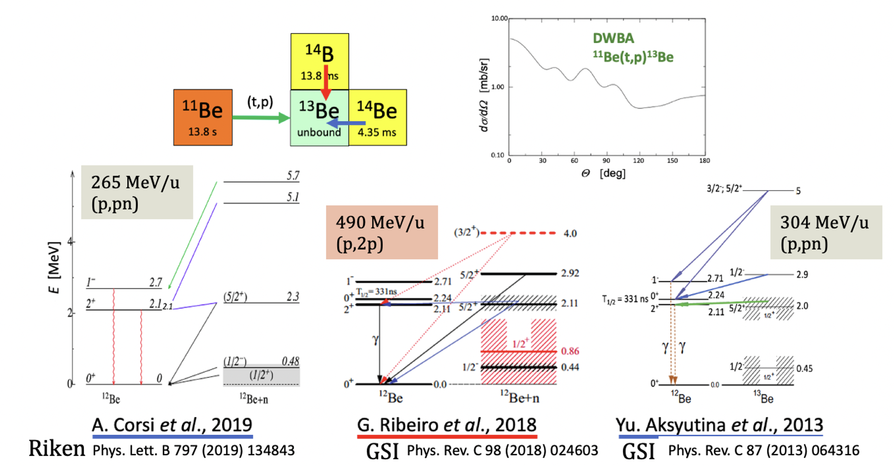
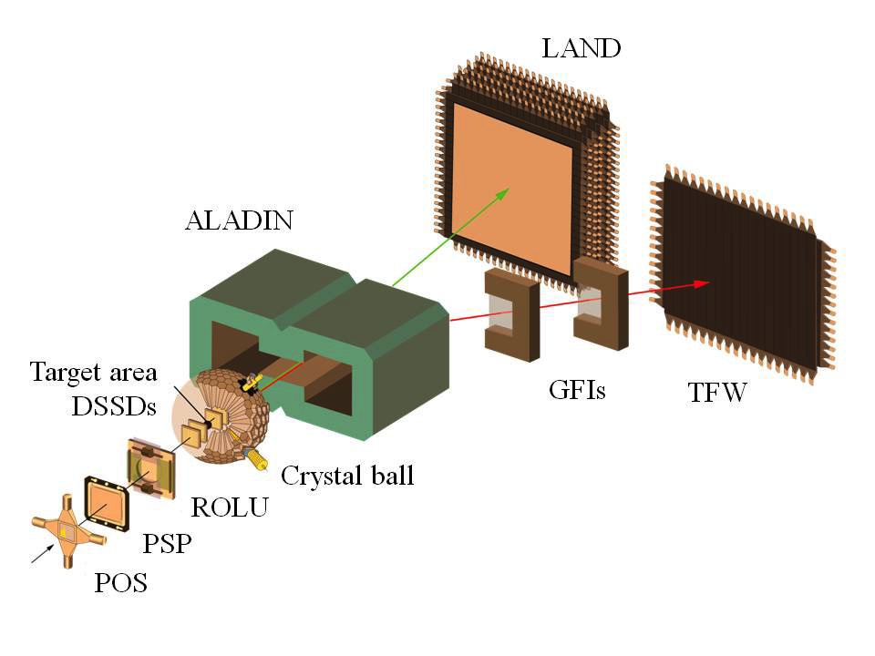
¹³Be is interesting as subsystem of the 2-neutron halo nucleus ¹⁴Be.
The relative positions of the 1/2⁺ and 1/2⁻ resonances are debated.
The 1/2⁻ state obtained from the breakup of ¹⁴Be breakup (¹³Be) appears at a surprisingly low energy compared with its analogue in ¹⁵C (¹⁴C+n).
Notes:
So yes 13Be has been studied in several experiments, but these do not agree fully in the interpretations.
The latest results (2019) results from RIKEN with much better statistics, but still the interpretation of the data differs,
As also indicated in the paper of Corsi et.al the the seed i.e. (p,2p) or (p,pn) populate differently the states.
At R3B we have the UNIQNESS of higher beam energy, the best existing experimental setup and we would like to measure the two reactions
with the same setup in the same beamtime.
Thus it is and will be important to study the two reactions with the same setup at more or les the same time.

Slide 19
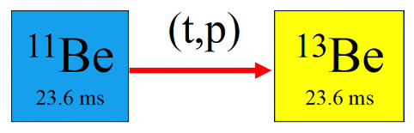
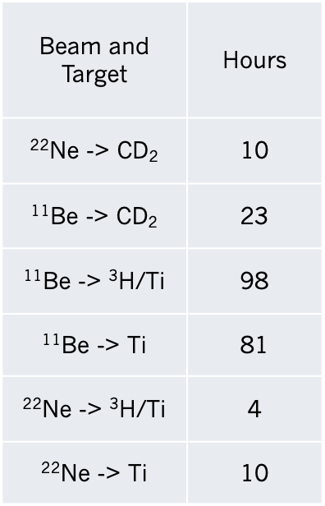
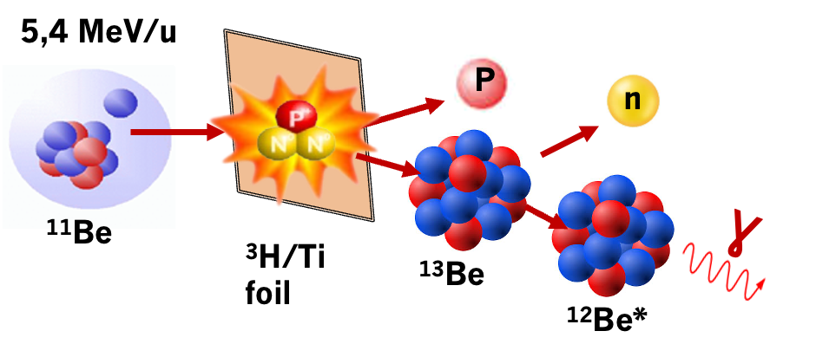
IS690: ¹¹Be(t,p) n-transfer reactions
³H-Target: 12 × 5 mm, 1 µm-thick Ti foil loaded with tritium (³H/Ti ≈ 0.4)
activity of the source is 3,38 GBq.
study the angular distribution of the protons, and the
gamma spectrum to characterize the high excited states.
beams @ 5,4 MeV/u
Contaminant in the ¹¹Be beam, of ²²Ne, reduced to about 2–10% using the C-foil stripper.
also run experiment with only ²²Ne beam
(no C-stripper foil in the bend to XT03)
Notes:
So IS690 11Be(t,p) @ 5.4 MeV/u at HIE-ISOLDE onto a solid 3H/Ti target
We have 22Ne contaminant in the beam, using the C-stripper foil we reduce this to about 1-2 % but anyhow its is quite a lot in the 11Be beam (this we monitored in our beamdump)
Anyhow we have to take several targets into account: we further used deuteron target for setting up and calibrate the system

Slide 20
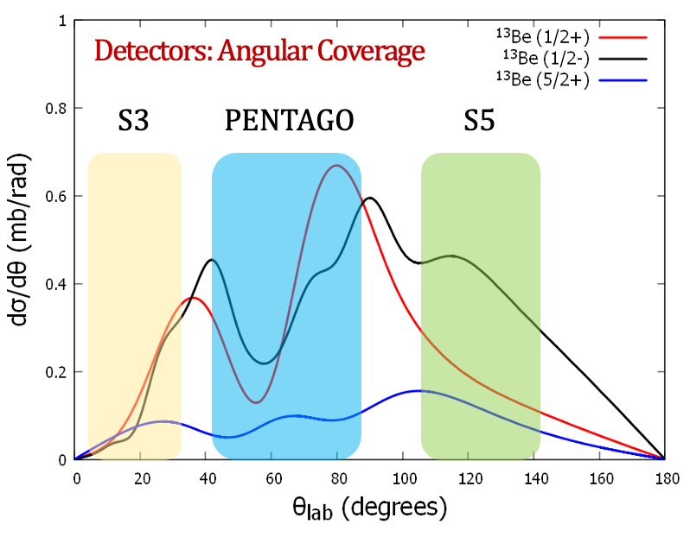

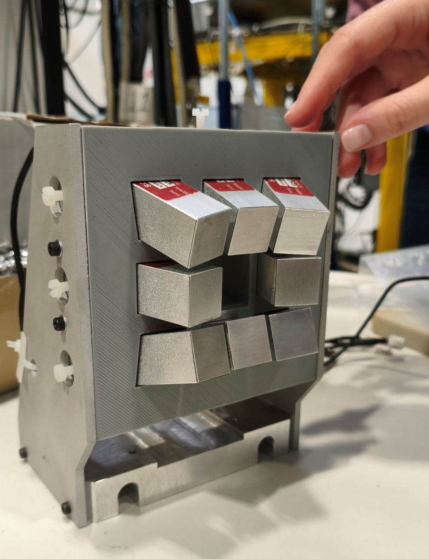
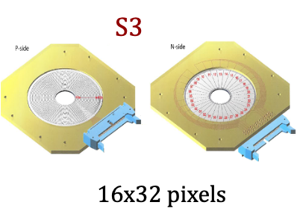
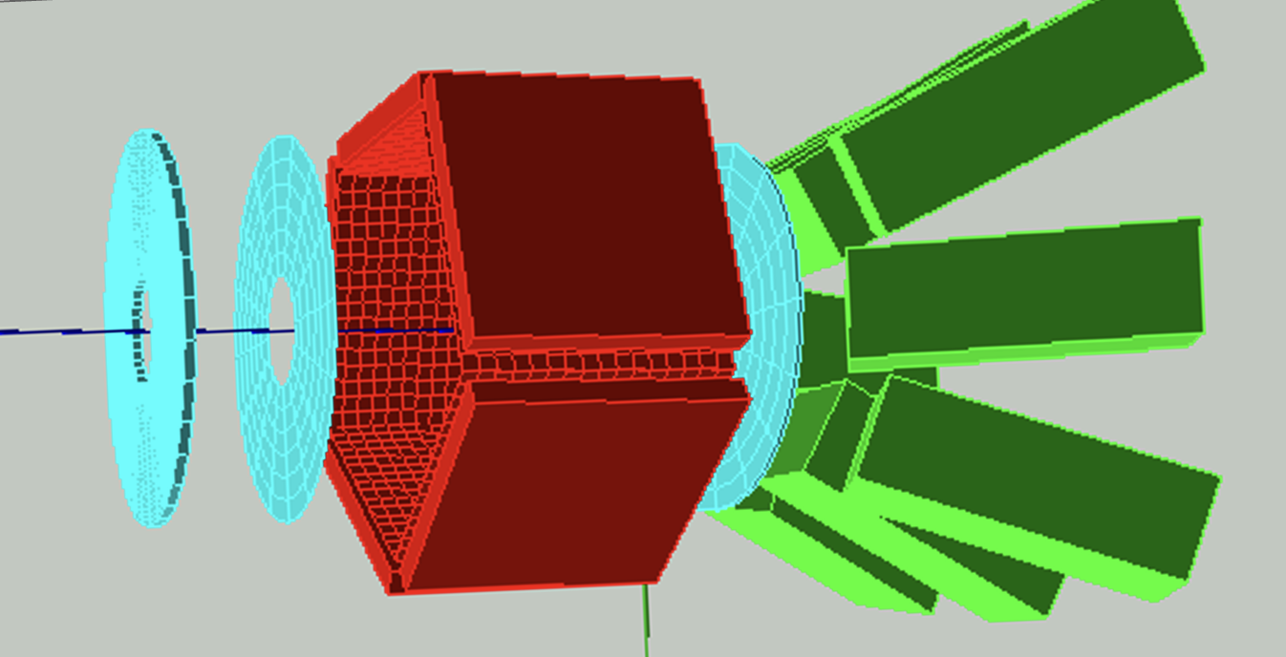
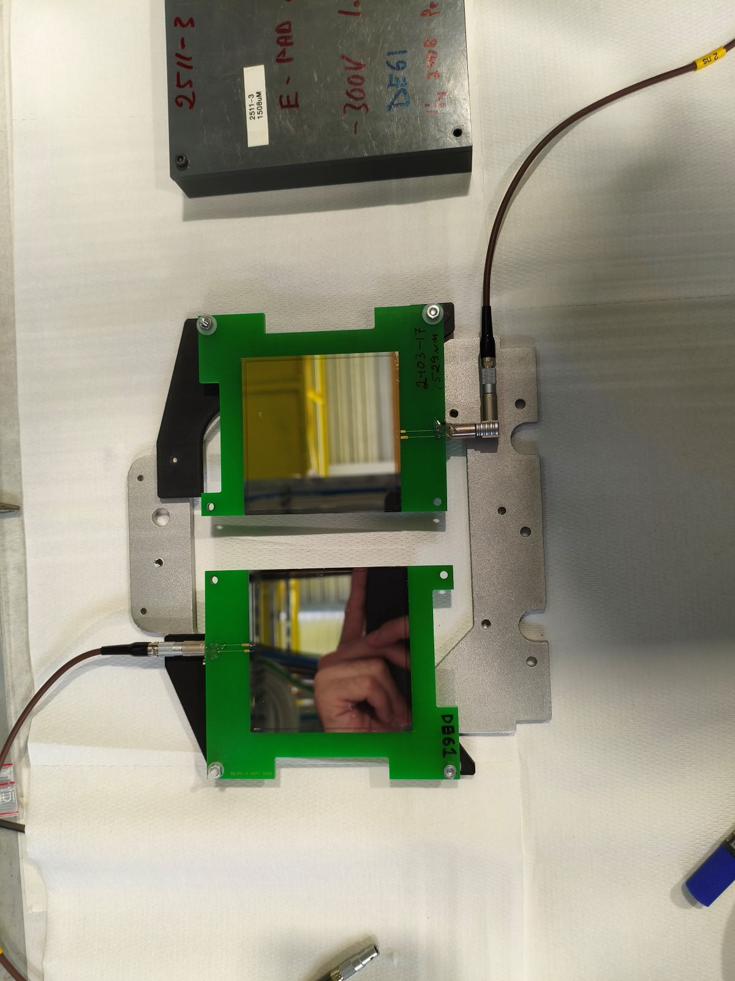
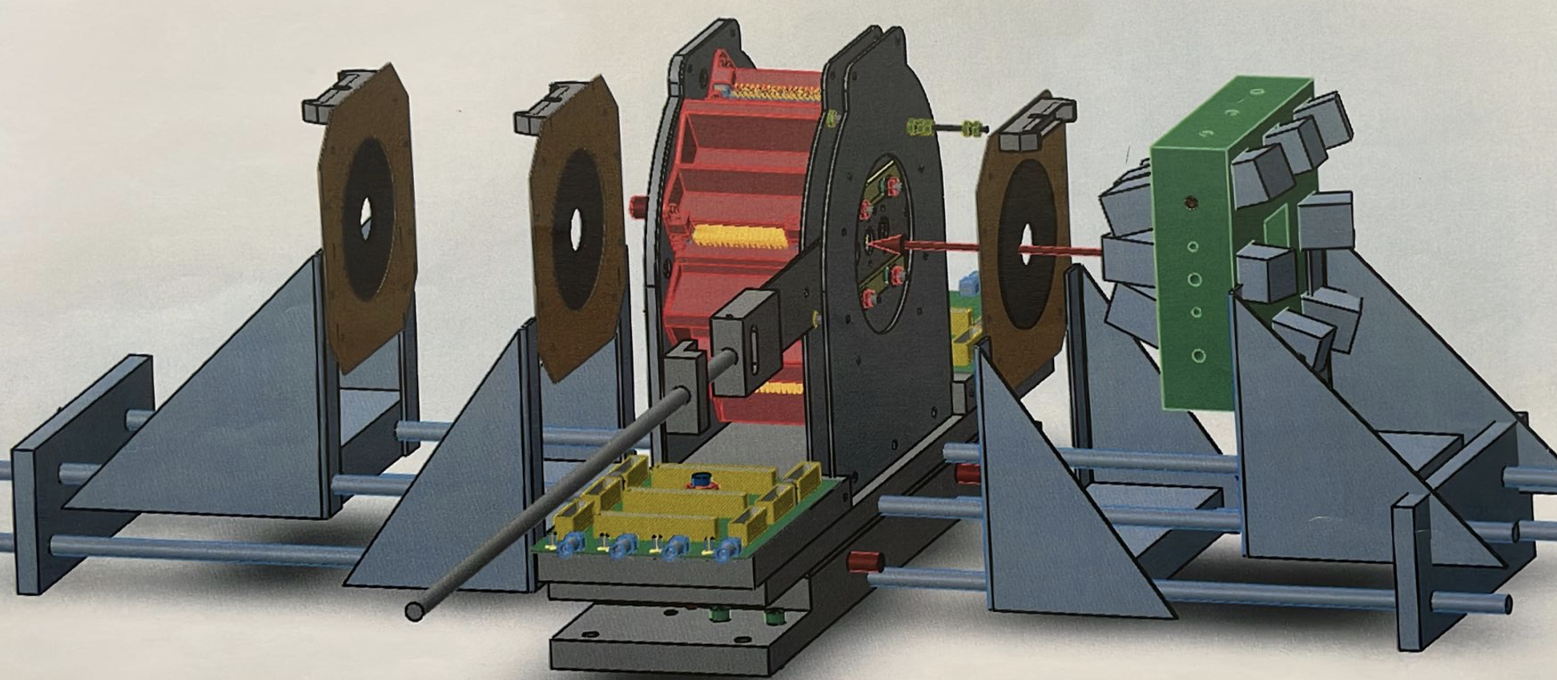


IS690b: ¹¹Be(t,p)¹³Be
SCIONIX Gd₂Al₂Ga₃O₁₂:Ce
8x GAGG + SiPM for γ detection in vacuum
MSX40
Enough Si to stop
products
Notes:
To do these studies we need more complicated setup and this means a real upgrade of the SEC capabilities
We have installed a very complete Si detector setup for detection of charge particles
A pentagon of 5x DSSD(60um) + PAD 1500um telescopes
Downstream 2x S3 DSSD telescope discs upstream a S5
Further including 8x GAGG scintillators for gamma detection
So about 2500 detector elements and 450 electronic channels

Slide 21






mvme - Mesytec VME Data Acquisition system
SEC chamber
Notes:
SEC-Daq: High-density readout electronics with custom PCB feedthroughs for large-channel particle detection and in-vacuum scintillator operation

Slide 22






Detector overview; ¹¹Be(d,x)
Pentagon
GAGGs
S3
MSX40
Beam Dump Si
22
Notes:
This to show the response in the different detectors. Beamdump we control the incoming beam, we see the incoming 11Be and the contaminat 22Ne non-interacting beam through the target)
The forwards direction triple telescope (1+1+1.5 mm) Si, The PENTAGON telescopes the GAGG scintillators

Slide 23

²²Ne (d,d) ²²Ne*
Background
23
Notes:
we use the 2Ne elastic inelastic scattering on the CD2 target (however the data are so very good and will be published soon)
Selecting the deuteron events we can place the theoretical kinematic curve ontop and identify the excitations, further introducing also the GAGG in coincidence
We clearly identify the 1274 gamma rays
So the system works excellently and we can proceed

Slide 24








Deuteron - target
¹¹Be (d,t) ¹⁰Be*
¹¹Be (d,d)¹¹Be*
GAGG
Pentagon
¹¹Be (d,p)¹²Be*
Notes:
Dispersed set of DATA depending on the channels choosen in the telescopes

Slide 25






¹¹Be (t,p) ¹³Be*
2n-transfer
Proton Kinematic curve
¹³Be Excitation Spectrum
Ti background subtracted
¹³Be* 2530 & (p,p)
¹³Be* 1610
¹³Be* 3550
¹³Be &
¹¹Be* (390)
25
Notes:
And 2-n transfer to 13Be. Here we have ofcourse to work harde to get out results but they will come

Slide 26




Summary
The SEC chamber is a versatile chamber for reaction experiments
The chamber can host different detector setups inside
Elastic scattering around then Coulomb barrier gives insight to the halo structures
Inverse kinematics is a powerful tool to study weakly-bound light nuclei, including excited and resonant states.
The results obtained for the ²²Ne and ¹¹Be on the $CD_{2}$ & T/Ti establish a basis for exploring the ¹³Be structure.
The upgrade of detectors & electronics very positive
Thank you
Acknowledge funding via EUROLABS & MCIN AEI under Project PID2019-104390GB-I00

Slide 27









Collaborators
Sweden Nuclear Physics Univ. Lund
Subatomic Physics Chalmers Göteborg
Spain FNEXP IEM CSIC Madrid,
GEM Univ. de Huelva
GFN Univ. Complutense Madrid
Denmark Physics and Astronomy Aarhus University
SEC activities performed at the XT03 beamline of HIE - ISOLDE.
Notes:
These are the institute that are collaborating with equipment to SEC

Slide 28
Publications exp. SEC : 2021 - 2025
Nuclear Physics A Volume 1065, January 2026, 123249, Samanta, S
The 7Be(d, α)5Li(p α) and 7Be(d, p)8Be*(p 7Li) reactions at 5 MeV/u
Physical Review C 110, 034328 (2024). N. Sokołowska, et.al.
Decay study of 11Be with an optical time-projection chamber
Physics Letters B Volume 855, 2024, 138770 V.T avora et.el.
Strong coupling effects on near-barrier 15C + 208Pb elastic scattering
Il Nuovo Cimento 47 C (2024) 34 R. Spartà, et.al.
8B reaction dynamics researched at HIE -ISOLDE
Physics Letters B 853 (2024) 138673 Sk M. Ali, et.al.
Study of the 7Be(d,3He)6Li* reaction at 5 MeV/u
EPJ Web of Conferences 290, 02005 (2023) V.G.Tavora, et.al.
Scattering of 15C on 208Pb at energies near the Coulomb barrier:
Study of the experimental device response via the 12C+208Pb scattering.
NIM B 541 (2023) 176–179 Martel, I.; et.al.
An innovative Superconducting Recoil Separator for HIE-ISOLDE
Phys. Rev. Lett. 128, 252701 – 2022, Ali, S.M. et.al.
Resonance Excitations in 7Be(d,p)8Be to Address the Cosmological Lithium Problem
Physics Letters B 833 (2022) 137294, Kundalia, K. et.al
Study of elastic and inelastic scattering of 7Be + 12C at 35 MeV
Physics Letters B 820 (2021) 136477, Spartà,R et.al.
Probing proton halo effects in the 8B+64Zn collision around the Coulomb barrier
Notes:
Big part of the activity has of course been to analyse and published the activity from RUN2
So here a list of publications from experiments performed in RUN2 published in the 2021-2026.

