Slide 1
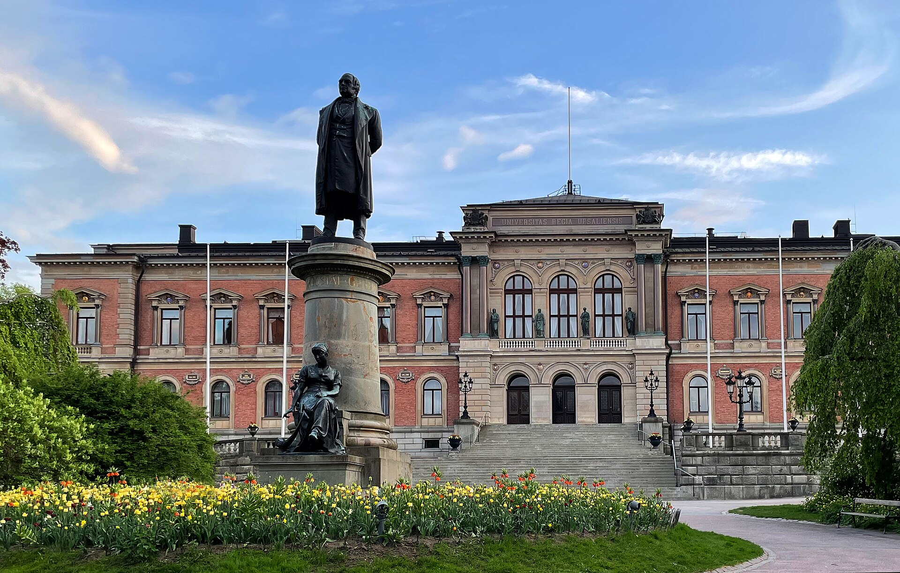


NESSA: NEutron SourceS at UppSAla A versatile neutron facility for detector physics, activation studies and SEE research
Sandipan Dawn
Sandipan.dawn@physics.uu.se
15th Nordic Meeting in Nuclear Physics

Slide 2
Presentation Outline
NESSA: Facility Overview
Present Beamlines:
14 MeV mono-energetic neutrons based on D-T reaction.
Tandem Accelerator based Neutron facility for selected ranges of neutron energies.
Associated Detector Systems.
Monte Carlo simulations.
Current Experimental Program.
Future Research Directions.
NESSA Team
S. Pomp (PI), G. Ericsson, M. Lantz, E. Arnqvist, L. Hägg, S. Jarl Holm., & S. Dawn

Slide 3
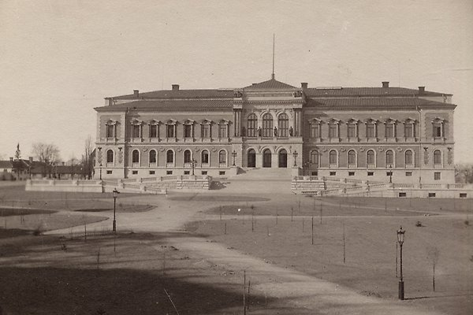
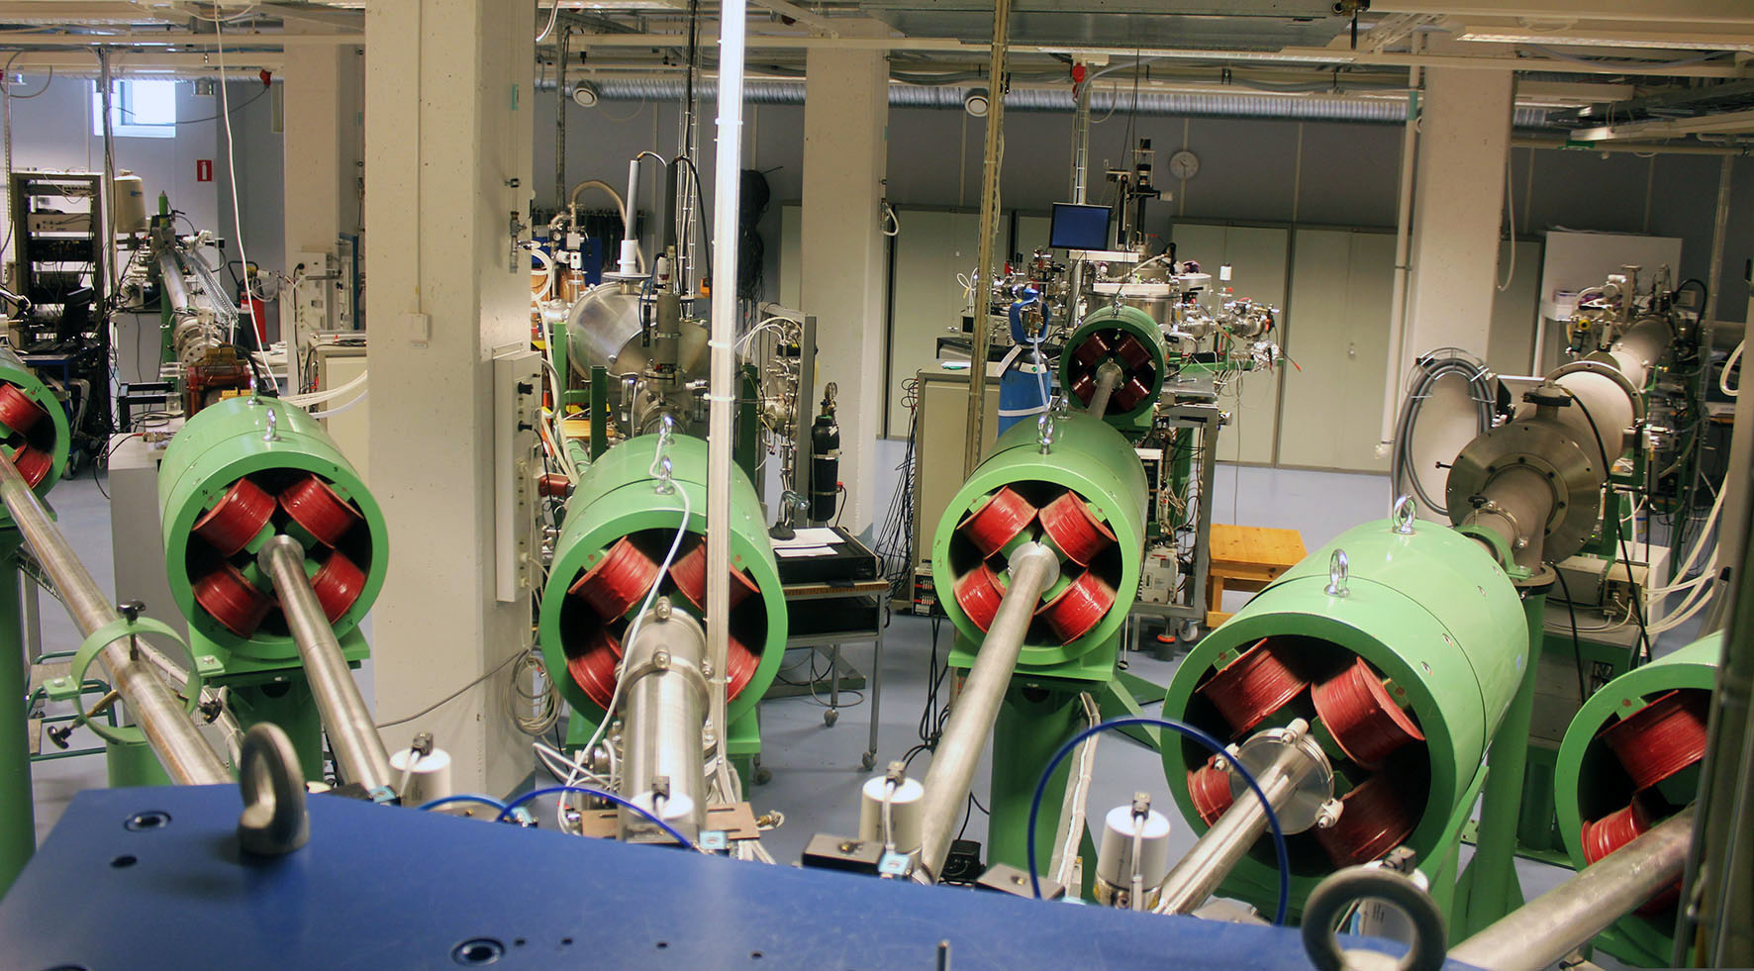
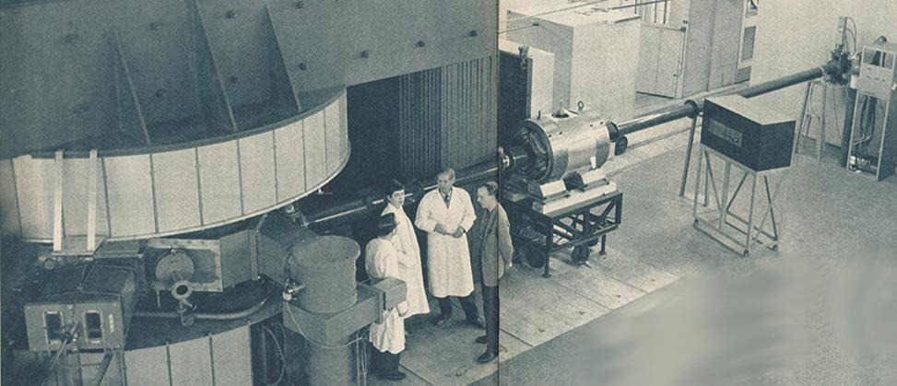
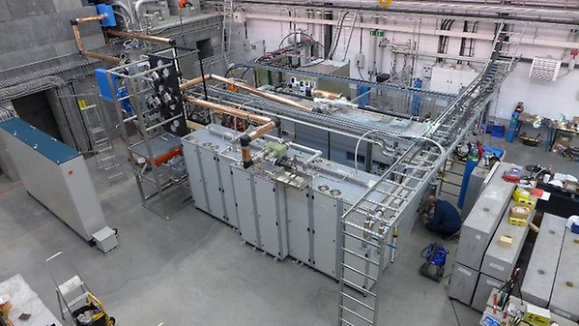
The Neutron Physics Legacy at Uppsala — and the Gap NESSA Fills
TSL : A world class high energy neutron beam for basic research: Closure in 2013 left a major gap in Swedish neutron physics infrastructure — the gap NESSA now fills
TANDEM Laboratory Ion beams for materials research.
The Fast Reflectometer for Extended Interfacial Analysis (FREIA) for the ESS facility
TANDEM
TSL
FREIA

Slide 4
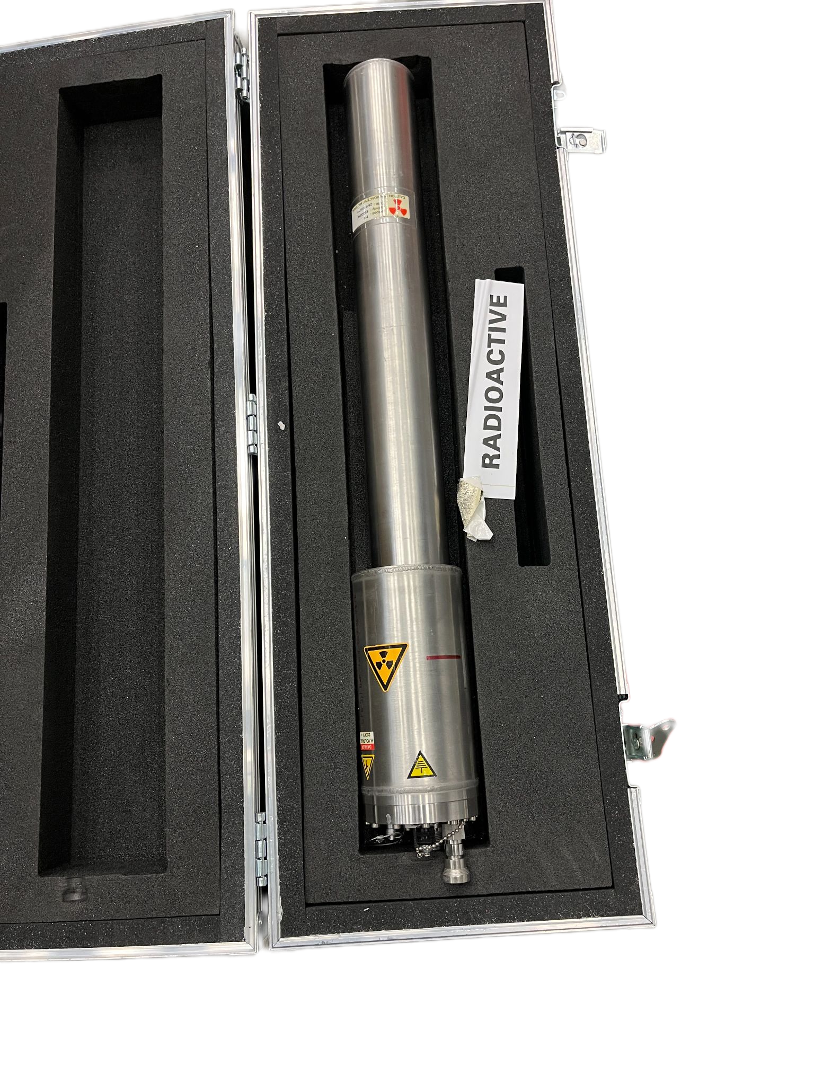
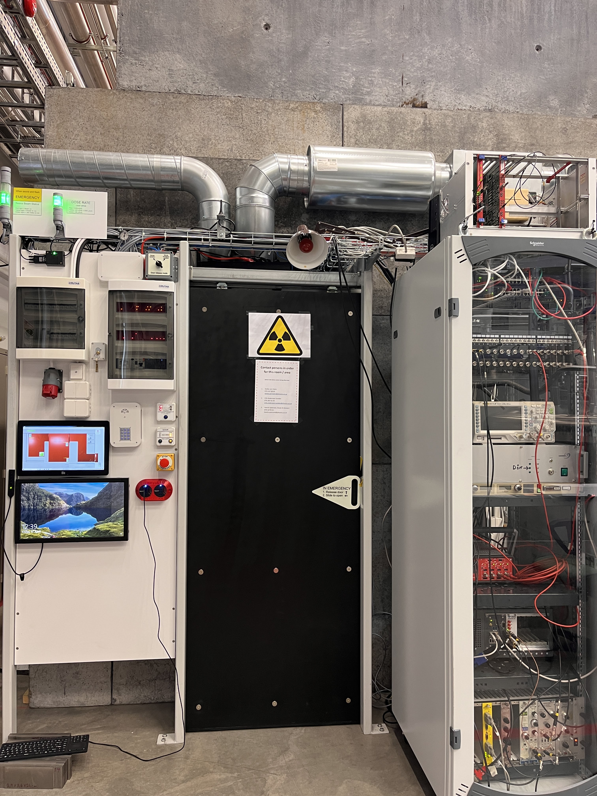
NESSA facility at Ångström Laboratory, Uppsala
Initiated in 2013*.
Commissioned in November 2025.
Sodern Genie 16™ Model.
Door, dose and ventilation interlocks for Radiation Safety.
Flux and dose rate monitoring from outside control station.
*H. Sjostrand et al.; Total Monte Carlo Evaluation for Dose Calculations, RPD, 2013

Slide 5
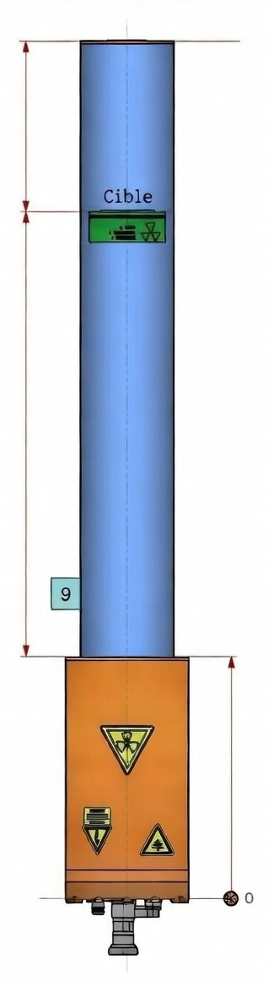
Key Technical Specifications of the Neutron Generator
70mm
Peak neutron yield: 4.7 × 10⁸ n/s/4π sr
Tritium inventory (2018): 120 GBq
Maximum achievable thermal flux at 3.5 cm from target (Closest User Position: CUP)
Operating modes: continuous (DC) and pulsed
Pulsed mode (current-limited): minimum achievable pulse: 10 µs
Pulse timing controlled via proximity box; external trigger compatible
151mm
CUP

Slide 6
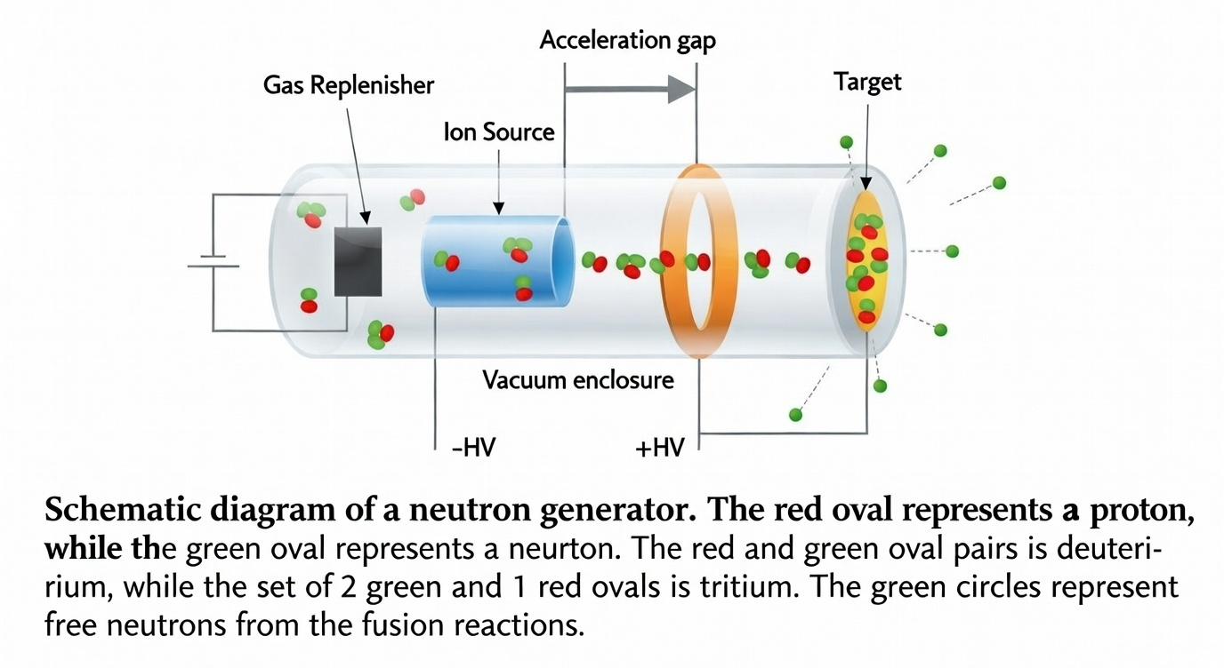
Principal Components of the D-T Neutron Generator
Gas replenisher: regulated D-T fuel supply.
RF ion source: generates D-T plasma.
HV accelerating stage: 40–120 kV.
Tritiated target (Ti-T): emits 14.1 MeV neutrons.
Both source and target use an equimolar D:T mixture (50:50).
proton
neutron

Slide 7
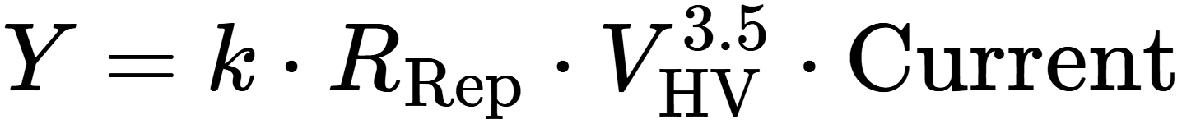
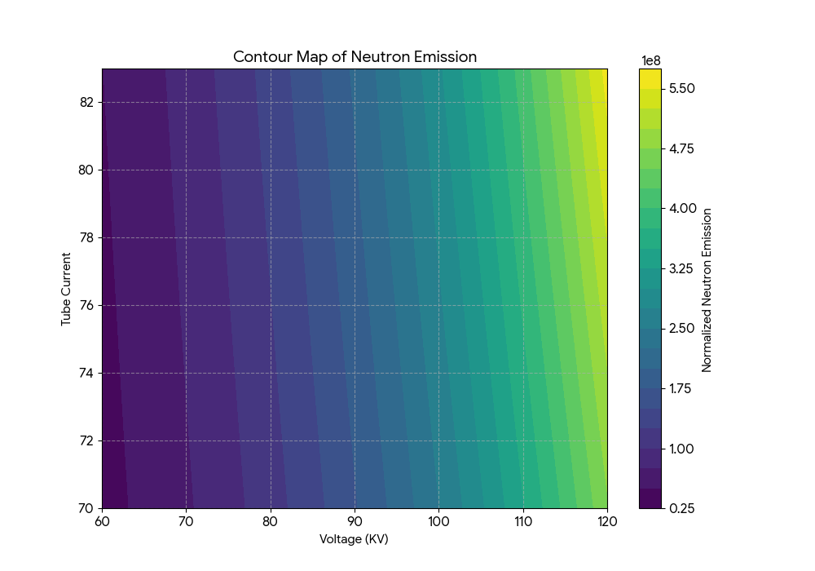
Neutron Flux: Measurement Parameters and Notation
Parameter Definitions:
R_{Rep} — Gas replenisher resistance (mΩ). controlling gas pressure and D-T fuel flow.
V_{HV} — Applied high voltage (kV). governs ion beam energy and thus neutron yield.
I_{tube} — Tube current (µA). directly proportional to the neutron production rate.
At 120 KV- V_{HV} , 80 µA- I_{tube} & 1670 mΩ- R_{rep}
Y=4.4 x 10⁸ n/s.

Slide 8
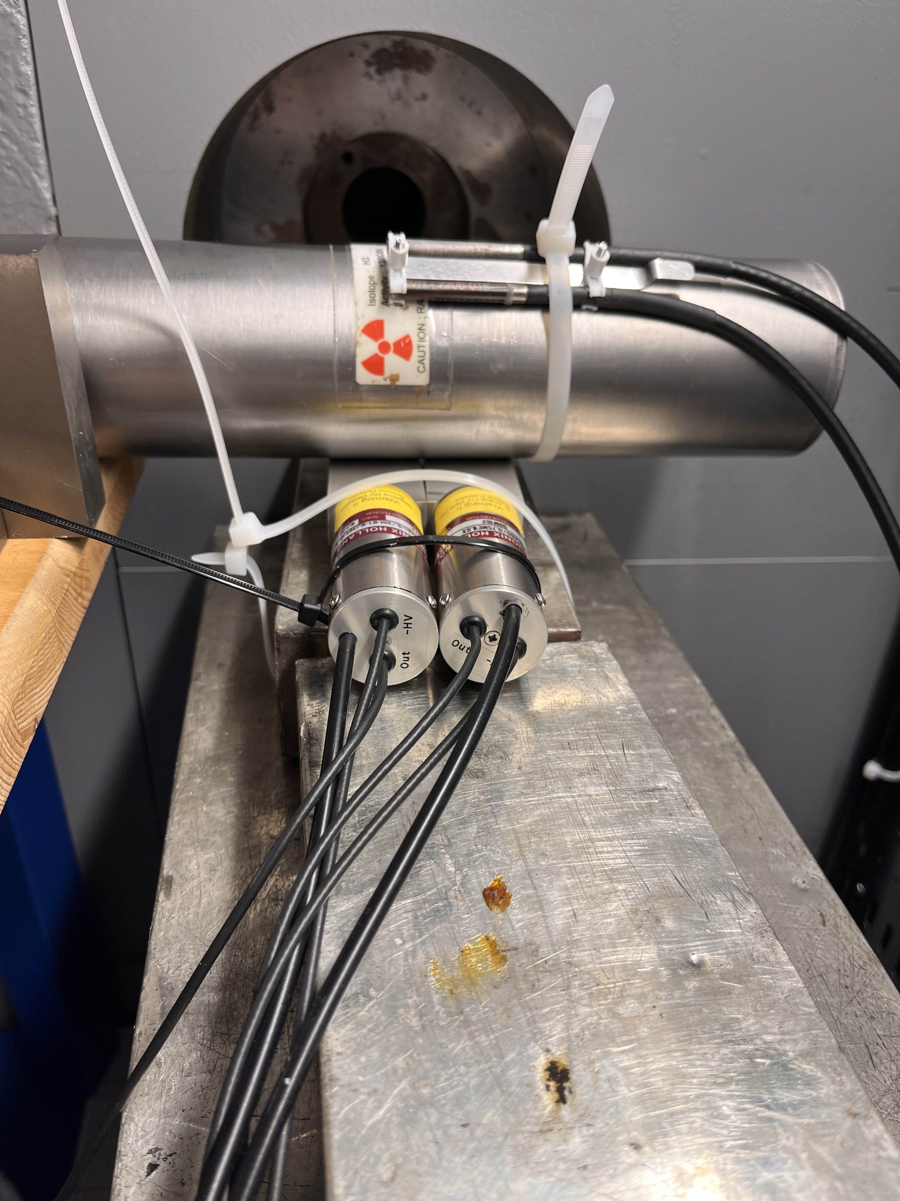
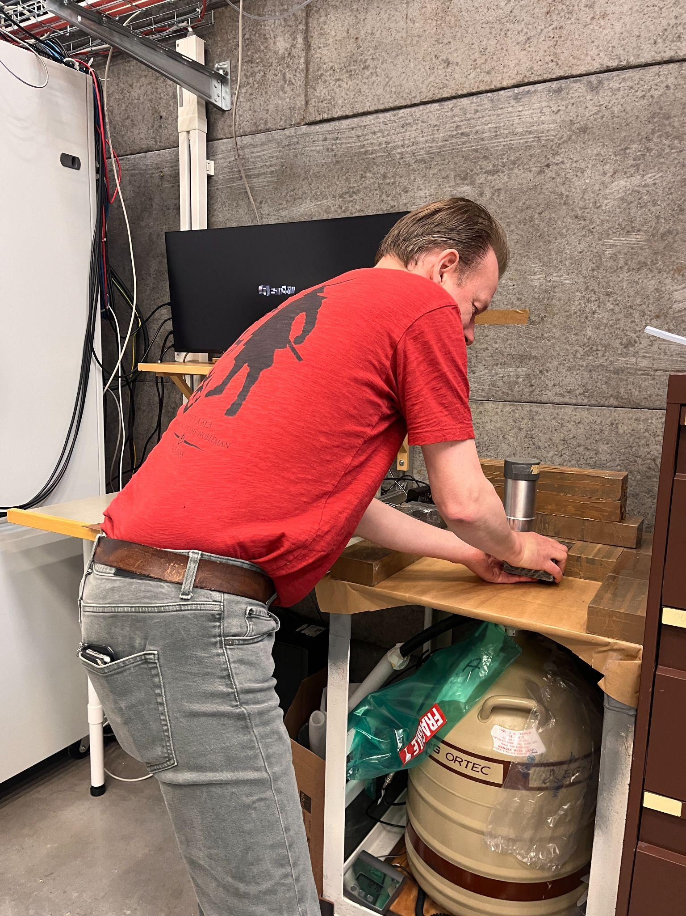
Associated Detector Systems and Instrumentation
Micro-fission chamber (µFC) for real-time beam flux monitoring — both ²³⁵U and ²³⁸U variants available.
NaI(Tl) & LaBr₃ scintillators for prompt gamma-ray spectroscopy.
EJ-301 liquid scintillator for fast-neutron detection and n/γ discrimination.
High Efficiency HPGe system for gamma spectrometry.
WENDI extended energy neutron dose-rate meter
Fission Chambers and Liquid scintillators placed in closed user position
Building up the lead castle for HPGe in NESSA

Slide 9
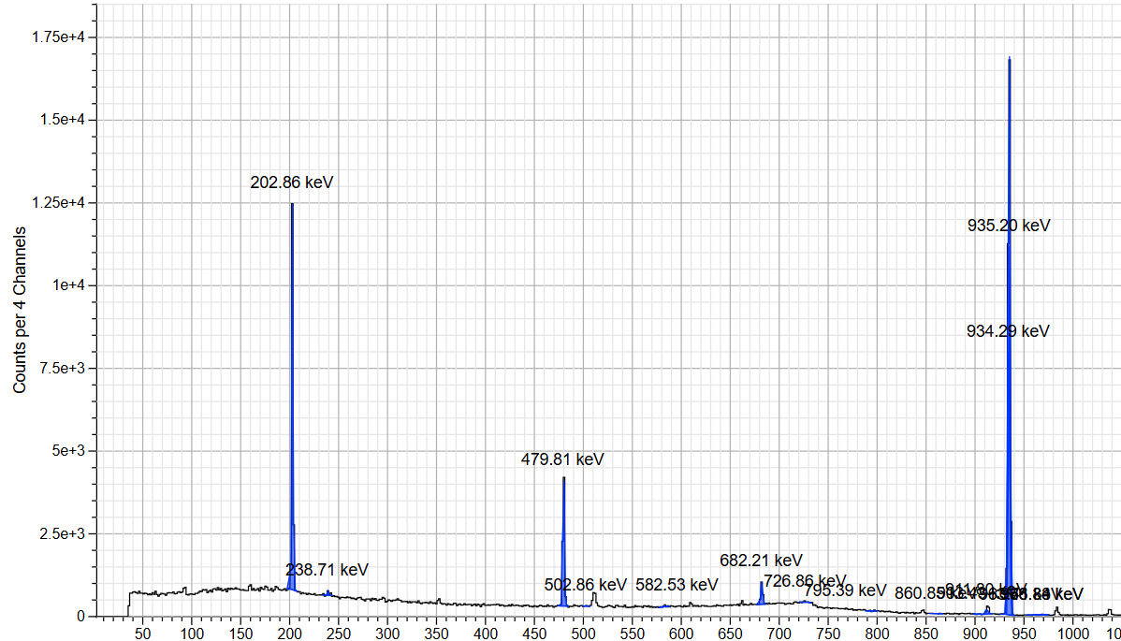
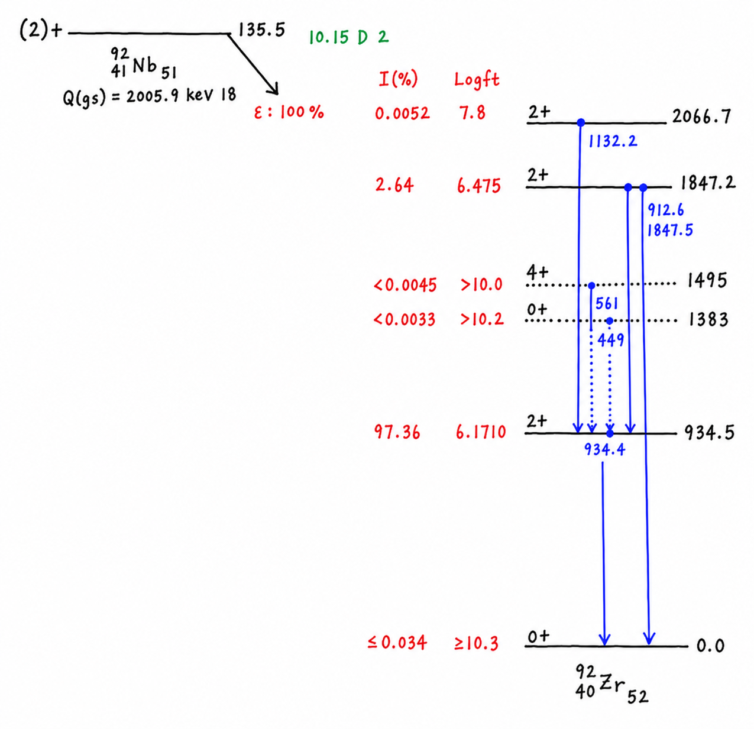
⁹³Nb Activation Foil Dosimetry and Flux Monitoring
⁹³Nb(n.2n)^{92m}Nb
⁹³Nb is one of the most suitable elements for absolute yield measurements via neutron activation.
⁹³Nb(n,2n)^{92m}Nb → 934.44 keV γ with 99.15 % branching ratios.
σ ~ 0.457 barn at 14 MeV.
100% isotopic abundance

Slide 10
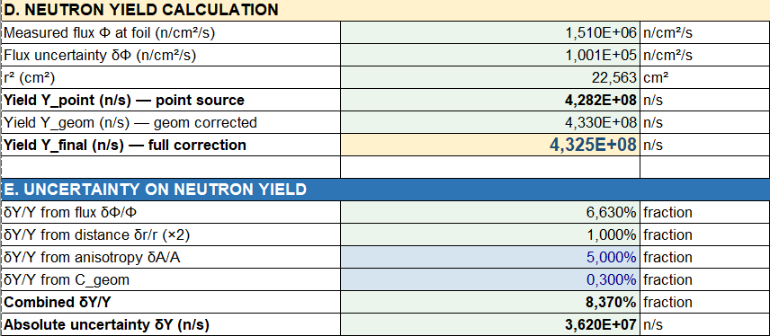
Absolute Neutron Yield from ⁹³Nb(n,2n)⁹²ᵐNb Activation Foil
Y = (4.33 ± 0.36) × 10⁸ n/s
Calibrated values during commissioning is 4.4 x 10⁸ n/s.
Source degrades over time (6 years old)
Uncertainty from HPGe counting is only statistical uncertainty.

Slide 11
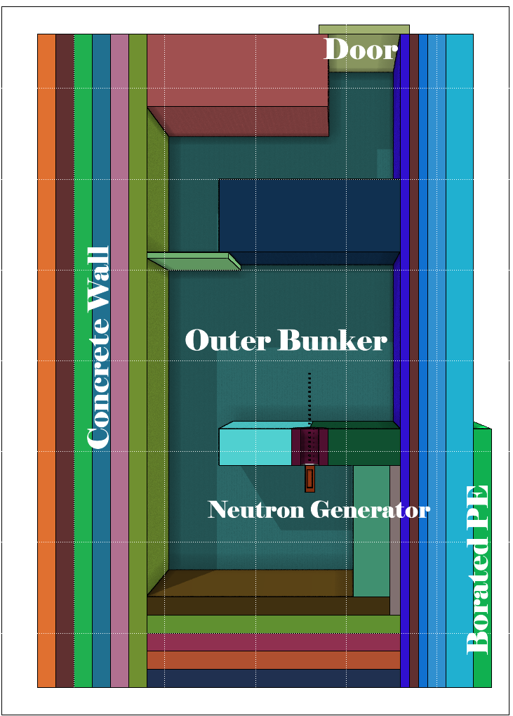
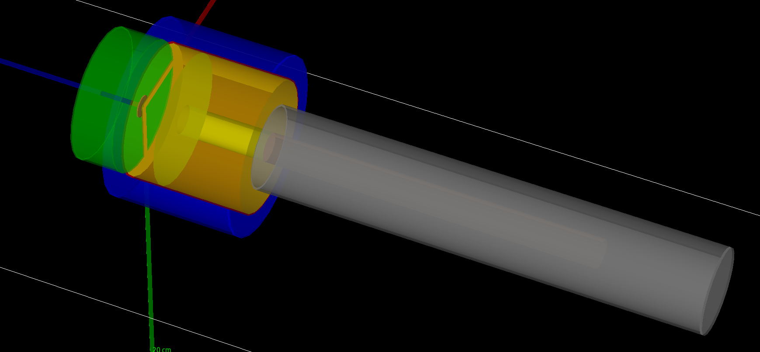
Monte Carlo Modelling of the complete beamline
Major Monte Carlo codes have been used to reconstruct complete NESSA geometry and detector responses.
Geant4. FLUKA. MCNP. PHITS & SERPENT.
Activation analysis of different structural materials, air activation.
Neutron Spectrometry and dosimetry at different irradiation positions.
Intercomparison of different physics models, cross-section libraries and Monte Carlo codes.
Reconstruction of HPGe detector
3D reconstruction of NESSA facility

Slide 12
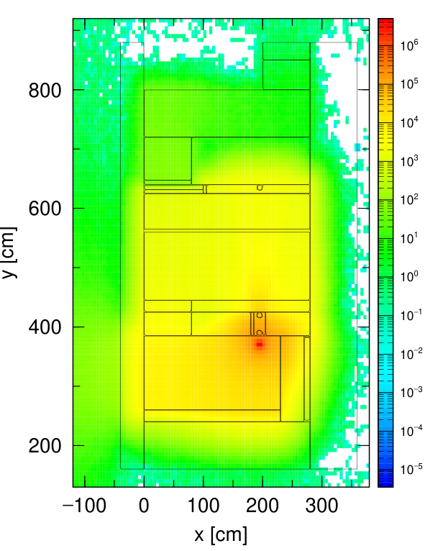
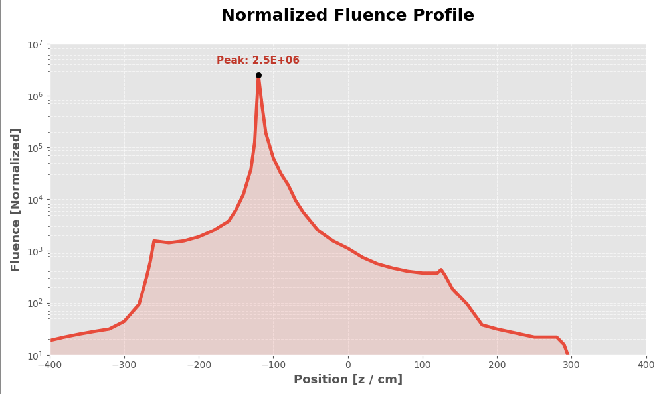
Simulated Neutron Fluence
Characterization of Neutron fluence and spectra through out the beam hall.
Maximum flux at CUP is 2.46 x 10⁶ n/cm²/sec.
Important for detector characterization. activation analysis and safety report.
Neutron Fluence Map in NESSA bunker using PHITS

Slide 13
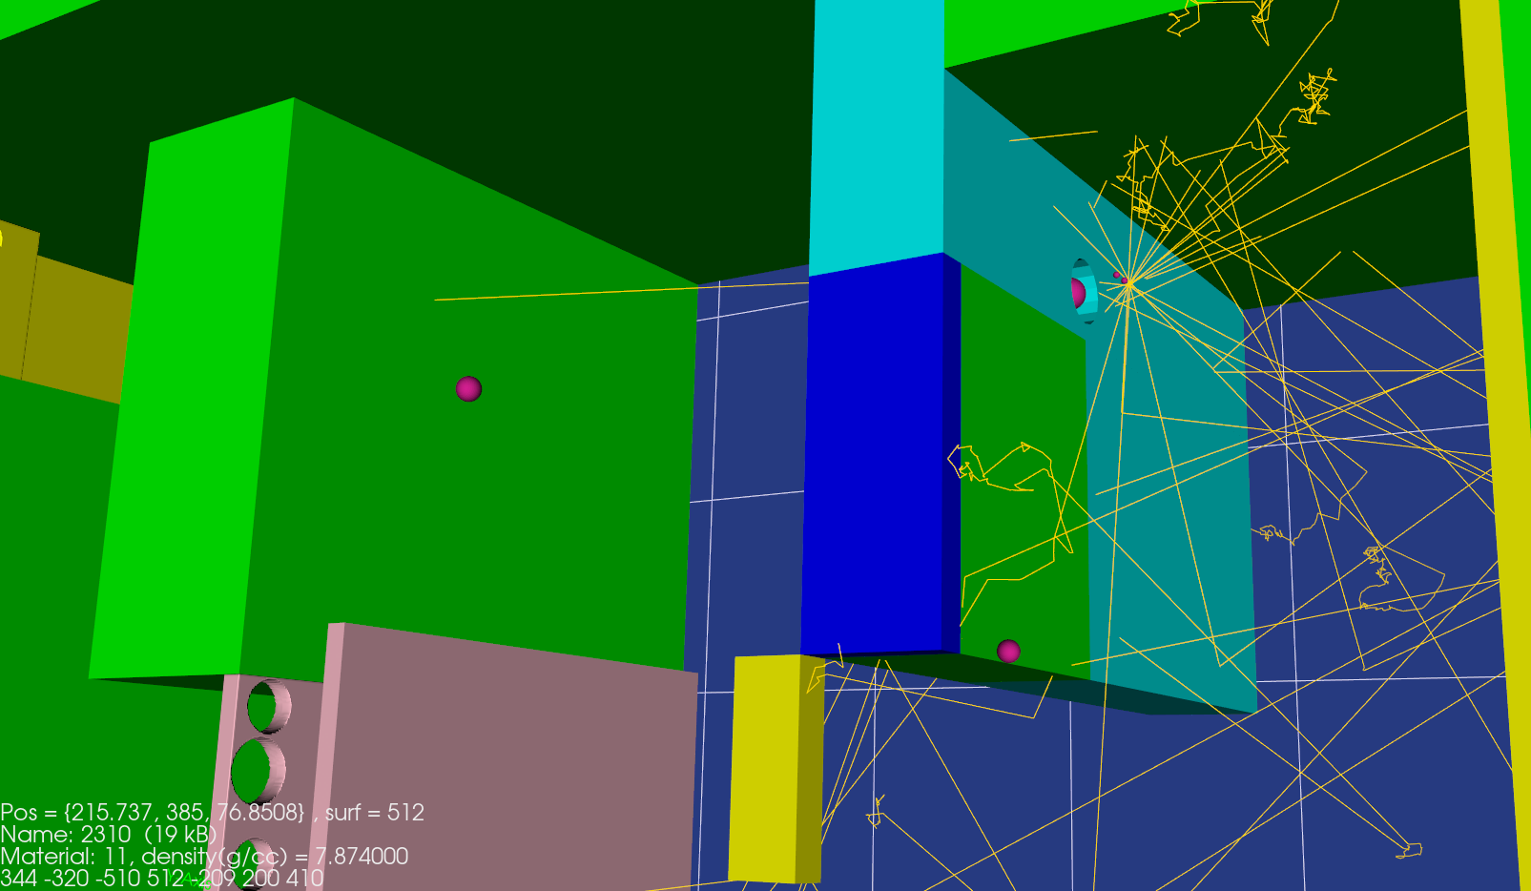
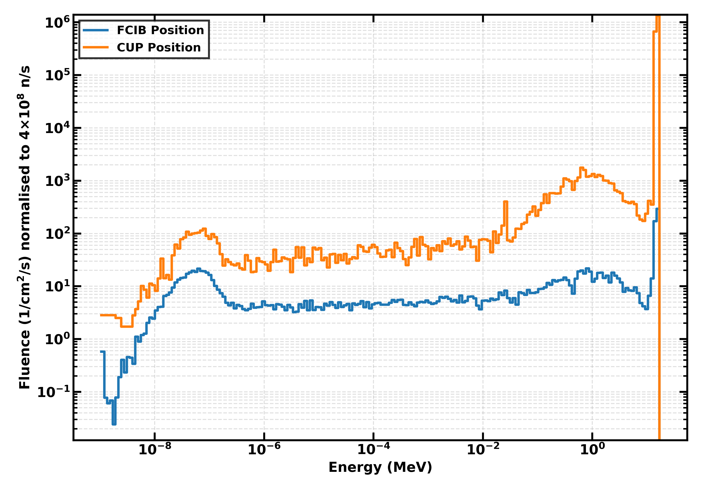
Characterization of Neutron Spectra
Location / Energy Range | Fluence (1/cm²) | % | Notes
CUP Location
Thermal (<10 eV) | 2.76E+03 | 0.14 | Room-return thermal
10 eV - 100 keV | 5.78E+03 | 0.28 | Epithermal region
Fast (≥100 keV) | 2.03E+06 | 99.58 | Primary D-T (~14.1 MeV)
FCIB Location
Thermal (<10 eV) | 2.14E+03 | 25.06 | Room-return thermal
10 eV - 100 keV | 1.91E+03 | 22.40 | Epithermal region
Fast (≥100 keV) | 4.49E+03 | 52.53 | Primary D-T (~14.1 MeV)
Room back-scattering components are significant due to relatively compact geometry.
At certain irradiation positions. it can be up to 50%.
Important for detector calibration and response studies.

Slide 14
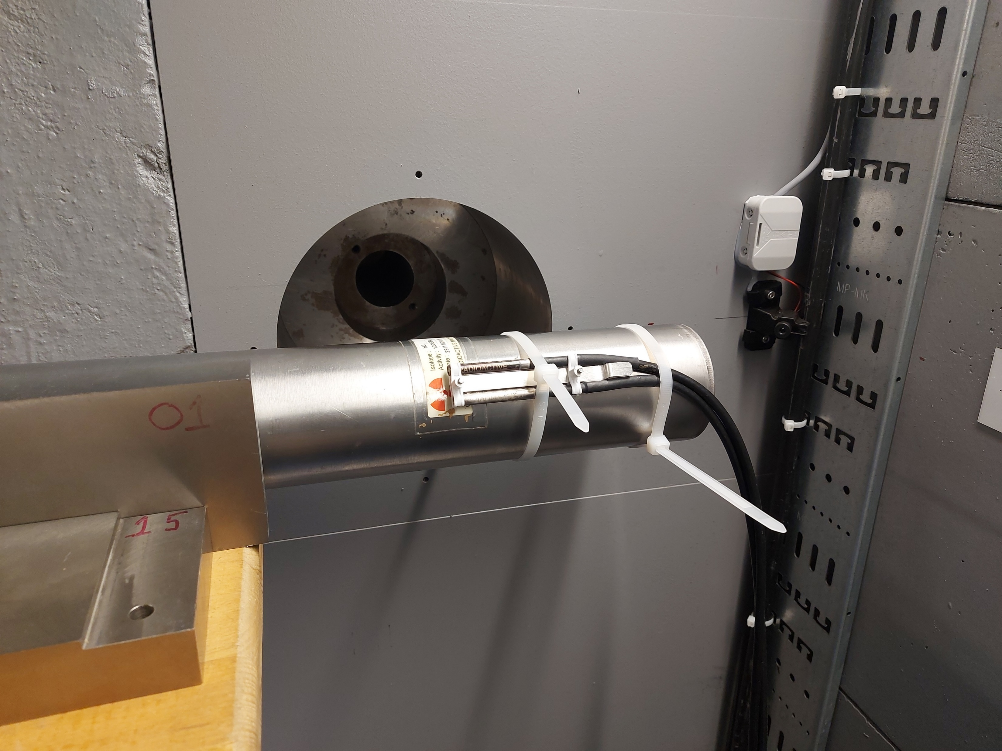
Fission Chamber response in NESSA
uFC location experiment | coating | σ_{avg}(b) | Measured count rate (cps) ⁽*⁾ | Calculated rate (MCNP) (ε = 65%) | Calculated rate (PHITS) (ε = 65%)
CUP* | ²³⁵U | 2.45 | 34.16 | 36.1 (+5.7%) | 33.10 (-3.1%)
CUP* | ²³⁸U | 1.15 | 10.20 | 15.6 (+53%) | 14.4 (+41%)
FCIB ** | ²³⁵U | 92.00 | 2.213 | 2.224 (+0.5%) | 2.060 (-6.9%)
FCIB** | ²³⁸U | 0.36 | 11.01x10⁻³ | 8.60⋅10⁻³ (-22%) | 7.69⋅10⁻³ (-30%)
R₂₃₅/R₂₃₈ is the spectral index
Fission chamber in irradiation positions
* CUP is about 4 cm from the neutron emitting target
** FCIB is about 130 cm from the neutron emitting target
Ericsson. G.. Pomp. S.. Hägg. L.. & Dawn. S. (2026). Development of a Neutron Field Monitoring System for the DT Neutron Generator Facility NESSA

Slide 15
Gamma Ray in the neutron field: Simulation Results
Type
Nuclide
Reaction
γ Energy (MeV)
T½
Source in NESSA
SHORT-LIVED minutes — hours
PROMPT
¹H
¹H(n.γ)²H
2.223
—
PE shielding. thermalised n
Isotope
T½
Reaction
γ (keV)
PROMPT
¹²C
¹²C(n.n'γ)
4.439
—
Borated PE. organic material
V-52
3.74 min
V-51(n,γ)
1434.1 keV
PROMPT
¹⁶O
¹⁶O(n.n'γ)
6.129 / 6.917
—
Concrete walls. air in hall
Al-28
2.24 min
Al-27(n,γ)
1778.9 keV
PROMPT
⁵⁶Fe
⁵⁶Fe(n.n'γ)
0.847 / 1.238
—
Iron plug. collimator wall
Mg-27
9.46 min
Al-27(n,p)
843.8 keV
DELAYED
¹⁶N
¹⁶O(n.p)¹⁶N
6.129 / 7.115
7.1 s
Concrete & air; dominates post-beam dose
C-11
20.4 min
C-12(n,2n)
511.0 keV
DELAYED
²⁴Na
²⁷Al(n.α)²⁴Na
1.369 / 2.754
14.96 h
Al in structural material
Mn-56
2.58 h
Fe-56(n,p)
846.8 keV
Prompt (during beam-on)
Delayed (post beam-off. activation)
Production of Prompt and Delayed gamma due to neutron activation.
Plays important role in radiation protection.
An important resource for activation studies, beam characteristics, gamma detector response.

Slide 16
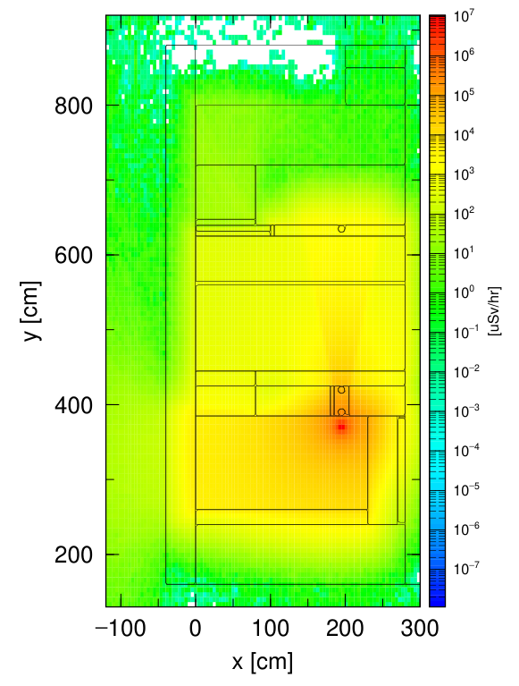
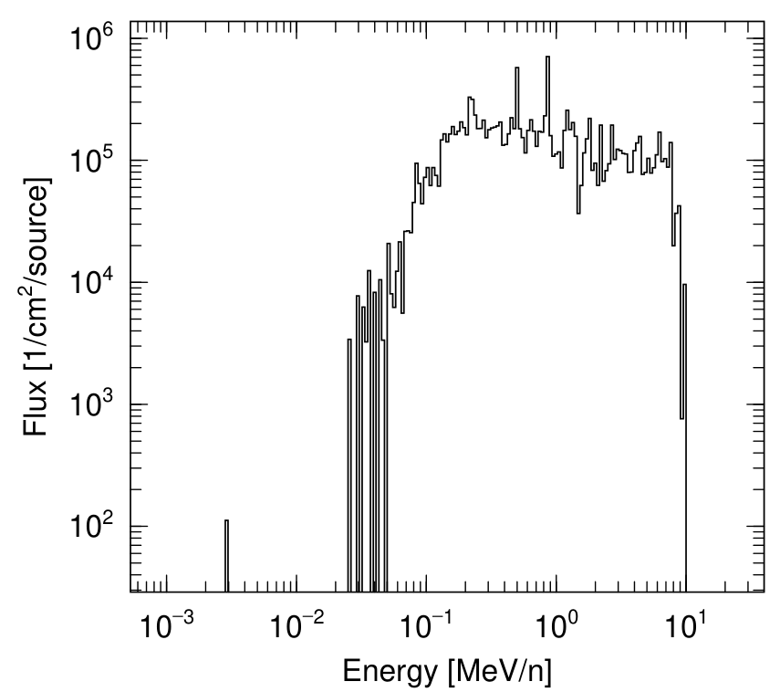
Gamma Ray in the neutron field
Dose rate near the closest user position can reach 10 Sv/h.
Wide distribution of energies. Can reach up to 10 MeV.
Dose rate out side bunker is < 1µSv/h
Distribution of gamma dose rate in source plane using PHITS
Simulated Prompt γ spectra at CUP using PHITS

Slide 17
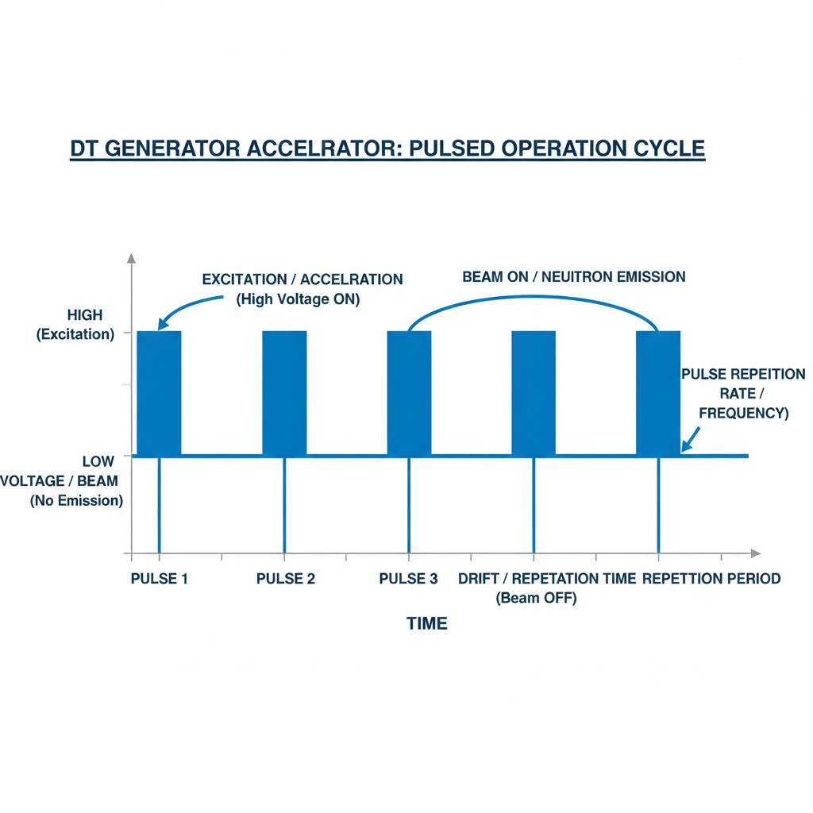
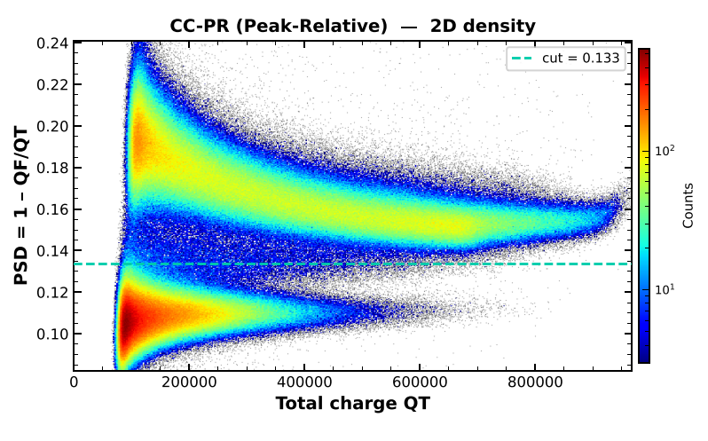
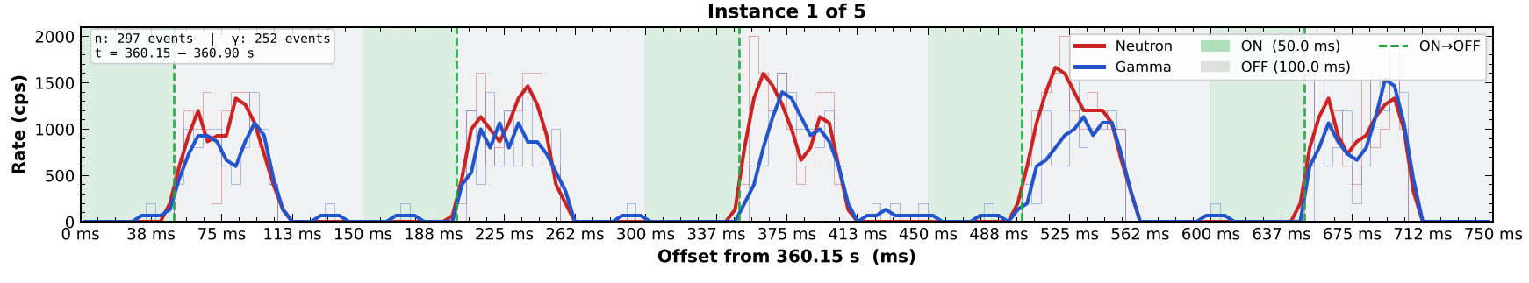
Liquid Scintillator in Pulse Mode : Die-Away Phase
neutron
gamma
Neutron Generator in Pulse Mode
n/γ discrimination
Important application in studying Die-Away phase in nuclear disarmament

Slide 18
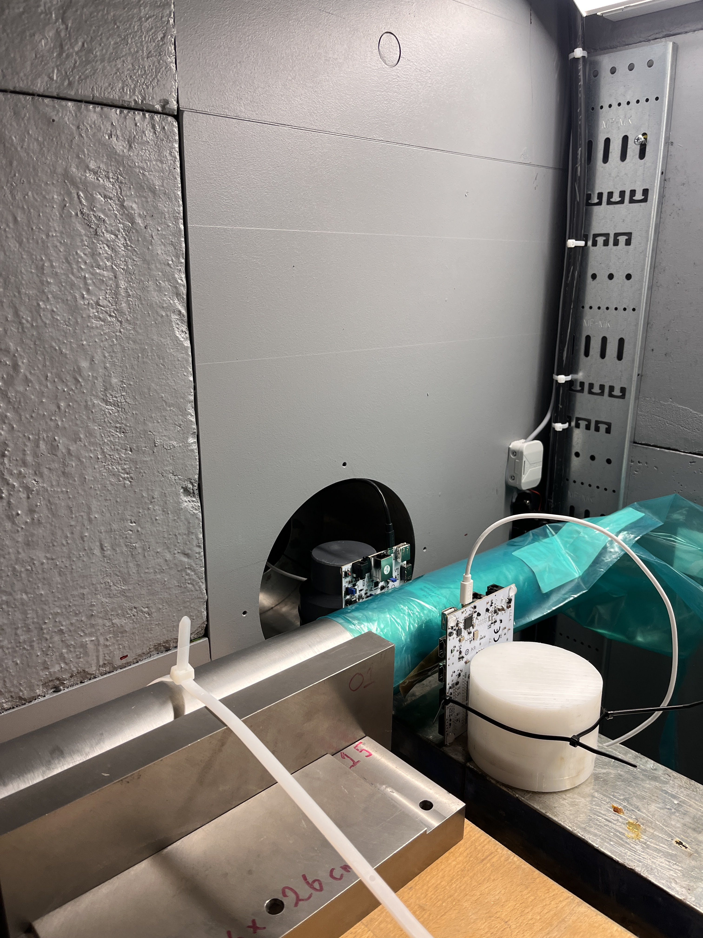
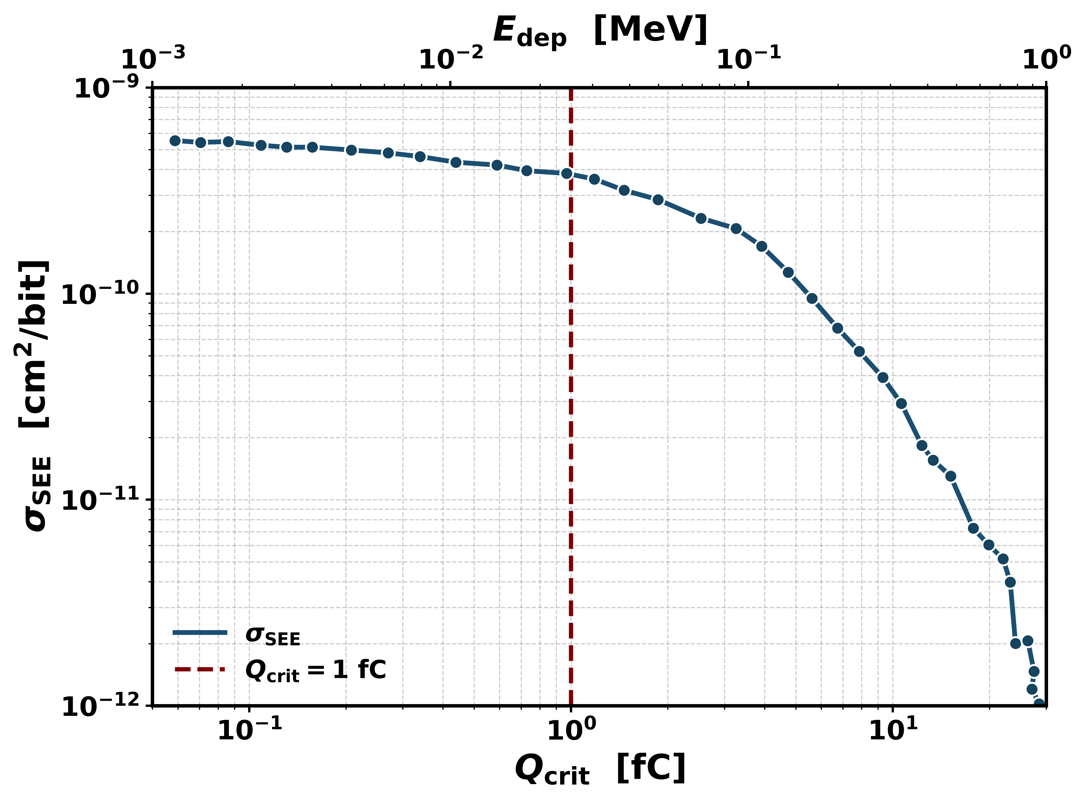
Studying SEE and Electronics Damage at NESSA
Major Goal of NESSA: studying electronics damage like Single Event Error/Upset(SEE).
Direct implication in Space Science. Reactor Electronics. Aviation Safety.
Irradiated two chip configurations (Linear Feedback Shift Register and Fast Fourier Transform)
Observed single bit-flip errors in program memory requiring automatic reconfiguration.
Error rates scaled dramatically with resource utilization: FFT (86% chip utilization) suffered ~10 x more errors in comparison to LFSR design.
Error cross-section has been studied with G4SEE Monte Carlo simulation code.
Irradiation of electronic chips at NESSA
Evaluation of SEE cross-sections as a factor of critical charge using G4SEE simulation

Slide 19
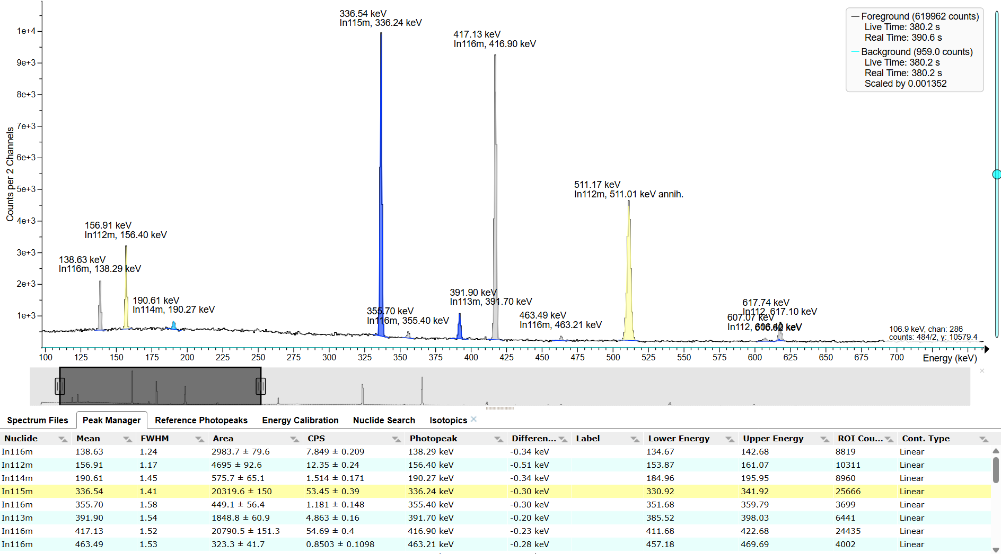
^{115/113}In +14 MeV neutron: Initial Results
¹¹⁵In reactions (95.7% abundant):
(n,2n)¹¹⁴ᵐIn — threshold 10.4 MeV, 49.51 d, 190.27 keV —absolute yield calibration reaction: 1210 ± 71 mb
(n,γ)¹¹⁶ᵐIn — thermal capture, 54.29 min, 1097/1293 keV — the room-return thermal contribution: Simulation benchmark
(n,n')¹¹⁵ᵐIn — threshold 0.34 MeV, 4.486 h, 336 keV — inelastic threshold detector : T½ = 4.353 ± 0.224 h.
¹¹³In reactions (4.3% abundant):
(n,2n)¹¹²In — threshold 9.2 MeV, dual isomers at 156.5 617.5 keV — IYR measurement

Slide 20
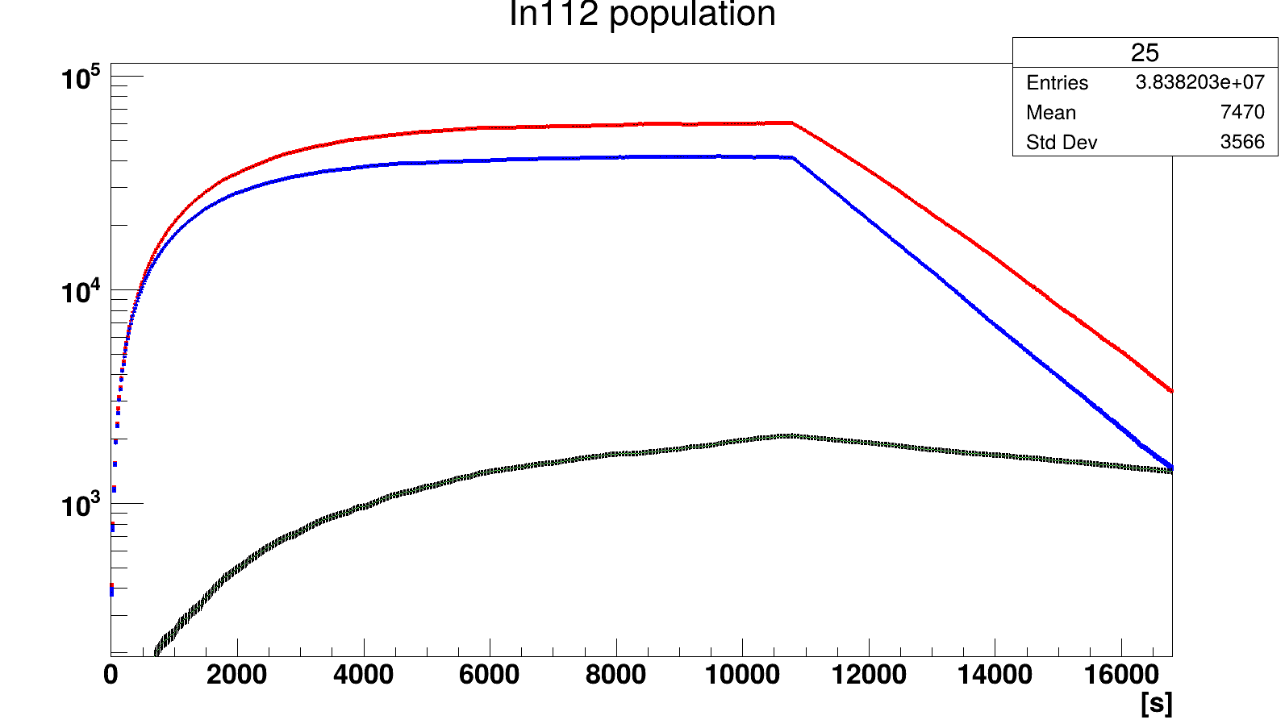
¹¹³In(n,2n) Isomeric Yield Ratio — Decay Scheme & Measurement
Decay Scheme
Measurement & Analysis Chain
¹¹³In + n (E_n ≈ 14.7 MeV)
Foil in 14.7 MeV neutron beam
Y ≈ 4.3×10⁸ n/s (⁹³Nb calibration)
1
Irradiation at NESSA D-T beam
(n,2n)
HPGe Spectroscopy
¹¹²ᵐIn
T½ = 20.67 min
¹¹²ᵍIn
T½ = 14.97 min
2
156.5 keV (¹¹²ᵐIn) + 617.5 keV (¹¹²ᵍIn + ¹¹²Ag)
Timed series: cool, count, repeat
IT (99%)
γ: 156.5 keV
γ: 617.5 keV
Bateman ODE Solver (Python)
3
Source-term equations for all phases:
irrad. → cooling → counting; Ag-112 deconvolution
⚠ ¹¹²Ag interferes
617.5 keV overlap
¹¹⁵In(n,α)
Geant4 Validation
4
Full geometry simulation of HPGe + foil;
efficiency, self-absorption, angular distribution
^{112g}In
^{112m}In
IYR = Yᵐ / Yᵍ (pure ground-state yield)
5
IYR Extraction
R = A₁₅₆ / A₆₁₇_corrected
Statistical + systematic uncertainties
¹¹²Ag

Slide 21
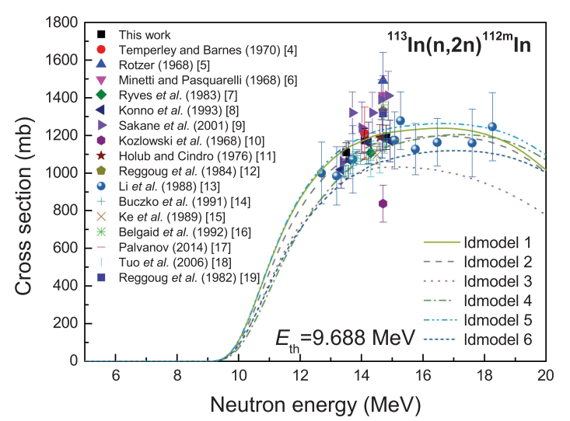
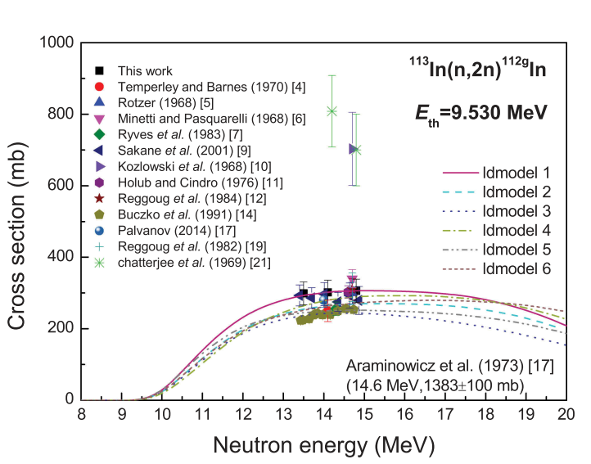
¹¹³In(n,2n) IYR — Results at 14.7 MeV & Cross-Checks
Measured IYR (Yᵐ / Yᵍ): 3.82 ± 0.47
**first measurement at NESSA
Geant4 Validation
HPGe detector geometry fully modelled.
Foil self-attenuation at 156 & 617 keV.
Simulated peak efficiencies agree with IAEA source calib.
G4Radioactivation used for cascade verification.
Intercomparison of HP, INCLXX, QGSP_BIC, FTFP_BERT physics model.
¹¹²Ag: T½ = 3.13 h, γ 617.5 keV
Produced via ¹¹⁵In(n,α) (~2.7 mb)
Bateman ODE system solved numerically
Time series fitting separates ¹¹²In from ¹¹²Ag component
Correction: ~8% on ground-state yield
Luo et al., 2017, Nuclear Science and engineering, Volume 188

Slide 22
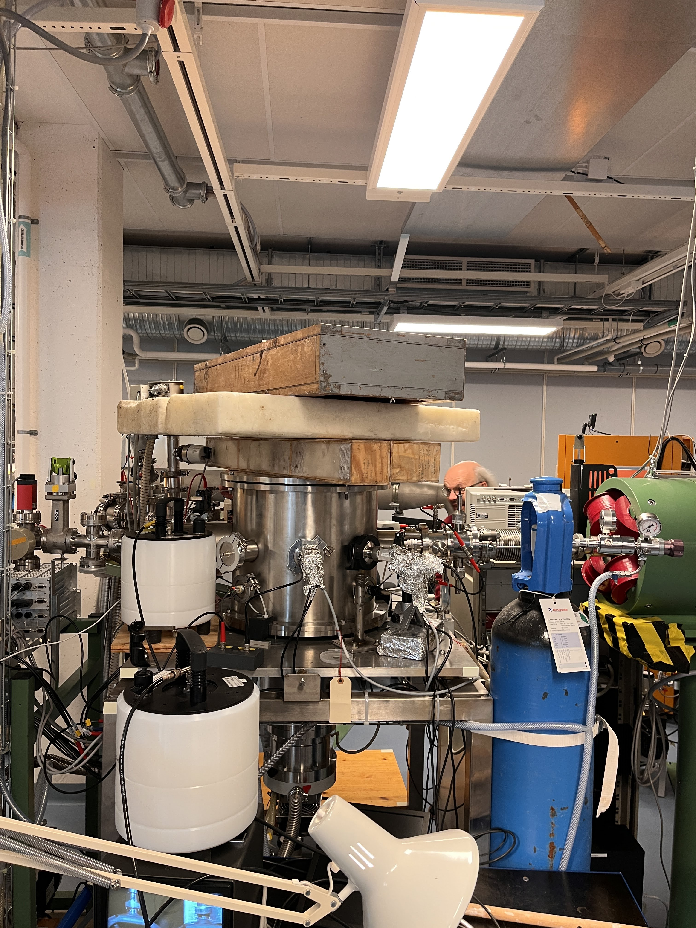
5 MV 15SDH-2 Pelletron facility for Neutron production
Target | Primary (p.n) reaction | Q (MeV) | Eth (MeV)
Be | ⁹Be(p.n)⁹B | −1.85 | 2.06
LiF | ⁷Li(p.n)⁷Be | −1.64 | 1.88
V | ⁵¹V(p.n)⁵¹Cr | −1.53 | 1.56
Mn | ⁵⁵Mn(p.n)⁵⁵Fe | −1.02 | 1.04
Mo | ⁹⁸Mo(p.n)⁹⁸Tc | −2.47 | 2.50
Zn | ⁶⁸Zn(p.n)⁶⁸Ga | −3.72 | 3.78
Fe | ⁵⁶Fe(p.n)⁵⁶Co | −5.35 | 5.44
B | ¹¹B(p.n)¹¹C | −2.76 | 3.02
C | ¹³C(p.n)¹³N | −3.00 | 3.24
Complementary Neutron Beam facility at Tandem Laboratory at Uppsala University.
Proton beam up to 10 MeV energies can be achieved.
Several targets have been tested for neutron production

Slide 23
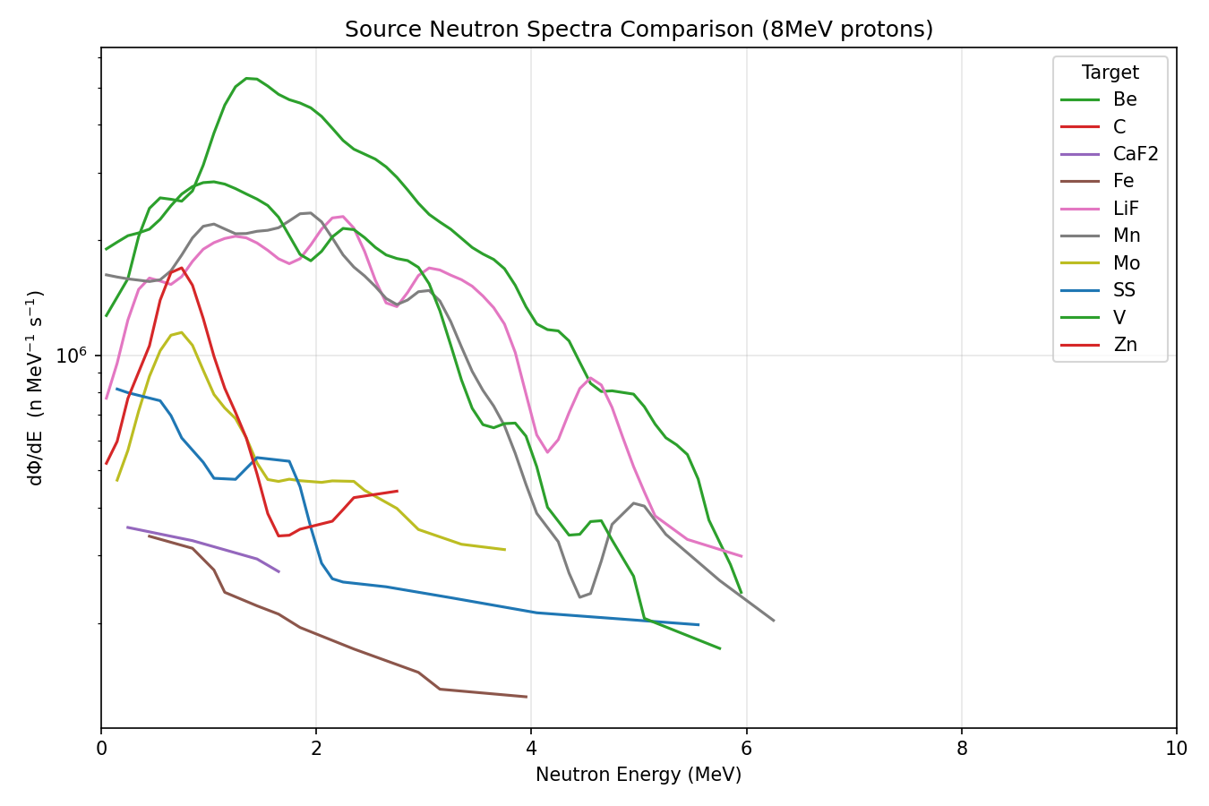
8MeV proton on different targets
Target | Measurement (n/s/nAmp) | Simulation (n/s/nAmp)
Be | 1.03 x 10⁰⁷ | 1.33x 10⁰⁷
LiF | 7.56 x 10⁰⁶ | 7.38x 10⁰⁶
V | 8.25x 10⁰⁶ | 7.83x 10⁰⁶
Mn | 1.11x 10⁰⁷ | 1.01x 10⁰⁷
Mo | 2.16x 10⁰⁶ | 1.64x 10⁰⁶
Zn | 2.16x 10⁰⁶ | 1.76x 10⁰⁶
Experimental vs Simulated Neutron yield at various proton energies.
Experimental measurements are extrapolated from Neutron Dose rate meters and activation foil measurement.
Simulations for low Z, low proton energies
Depends heavily on Physics models, cross section libraries.

Slide 24
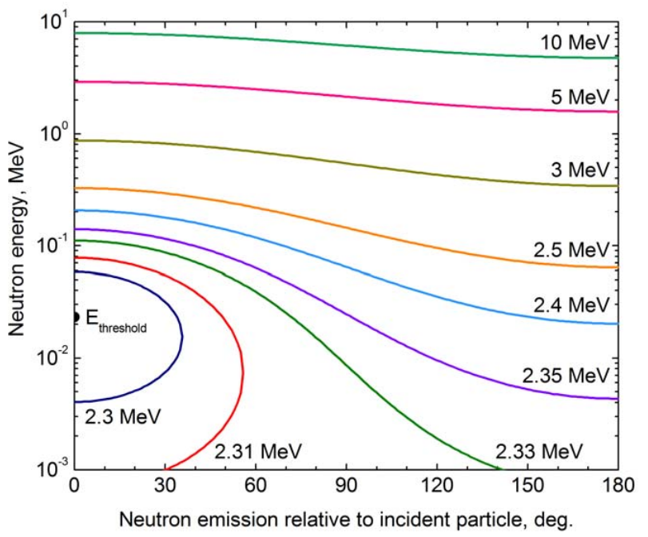
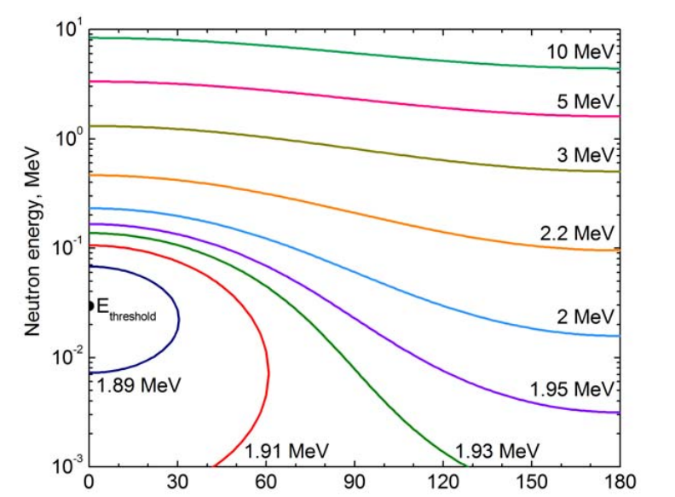
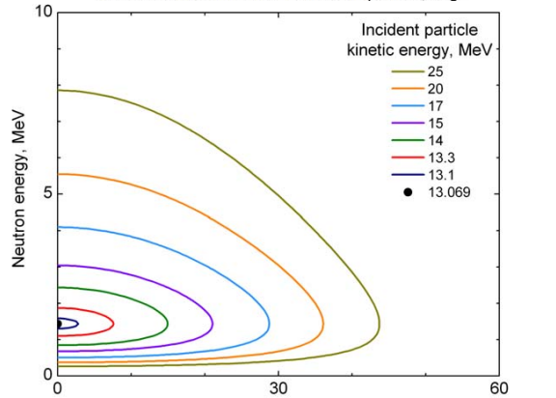
3 Major Reaction Channels with highest Neutron Yield
⁷Li(p,n)⁷Be
¹H(⁷Li,n)⁷Be
⁹Be(p,n)⁹B
3 Major Neutron producing targets.
Quasi Monoenergetic neutron of various energies are available.
Possibilities to study inverse kinematics
Chichester, David L.. "Production and applications of neutrons using particle accelerators." , Nov. 2009. https://doi.org/10.2172/1169209

Slide 25
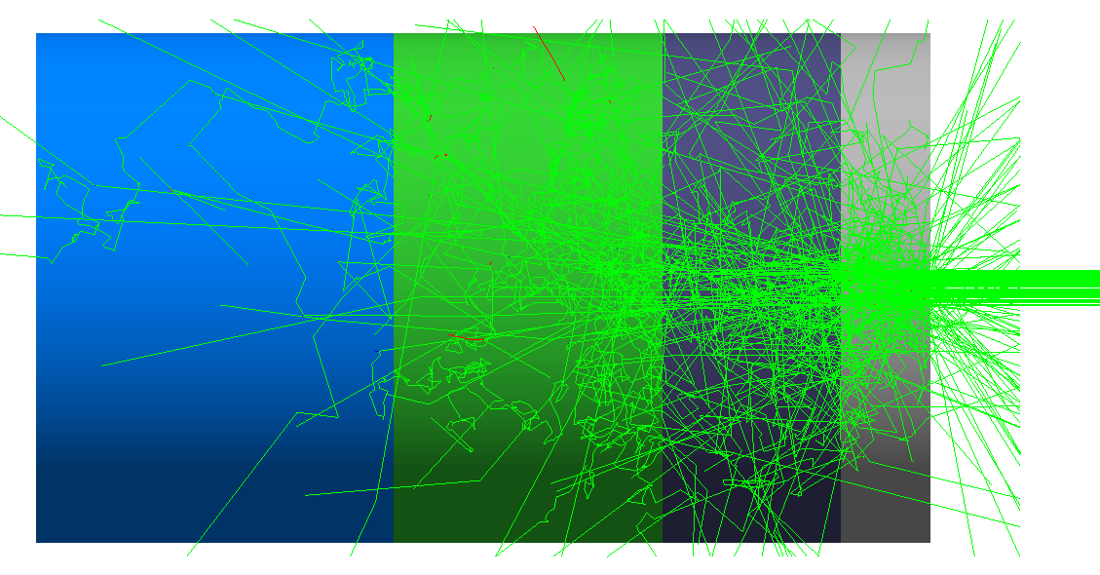
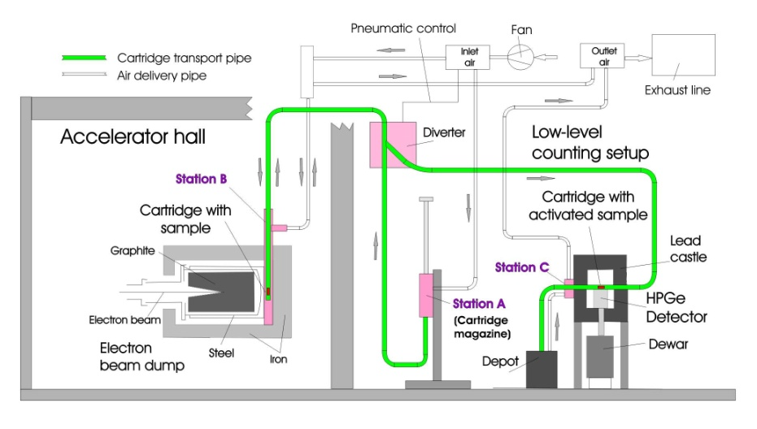
Future Developments in NESSA
Thermalized Beam line
Rabbit system for activated samples
Optimal moderator configuration under study
Goal :T_{1/2}< 10 sec.

Slide 26
NESSA in 2026-2027
Procurement of High Yield D-T Generator – 1 x 10¹⁰ n/s : 20 X increase.
Funded by Swedish Energy Agency.
Procurement under process.
Tandem Laboratory: More Standardized and dedicated neutron beam line with multiple energies and angular distribution.
Establishment of reference neutron fields and cross calibration with established facilities.

Slide 27
Summary
NESSA: being built as an intermediate-level, complete neutron beamline facility to serve the full spectrum of neutron physics research.
Absolute neutron yield calibrated: Y = (4.33 ± 0.36) × 10⁸ n/s via ⁹³Nb activation
First SEE measurement confirmed: Neutron-induced bit-flip errors observed in chips — NESSA is operational for electronics irradiation.
Fission chamber response validated: R₂₃₅/R₂₃₈ spectral index measured;
First nuclear data result from NESSA: ¹¹³In(n,2n) isomeric yield ratio measured — IYR = 3.82 ± 0.47 at 14.7 MeV, first measurement at this facility.
NESSA is open, and we would be genuinely glad to collaborate, share beam time, and do good science together.

Slide 28

Thank you & Question??

