Slide 1
Recent Developments and Measurements at the JYFLTRAP Mass Spectrometer
Simon Rausch

Slide 2
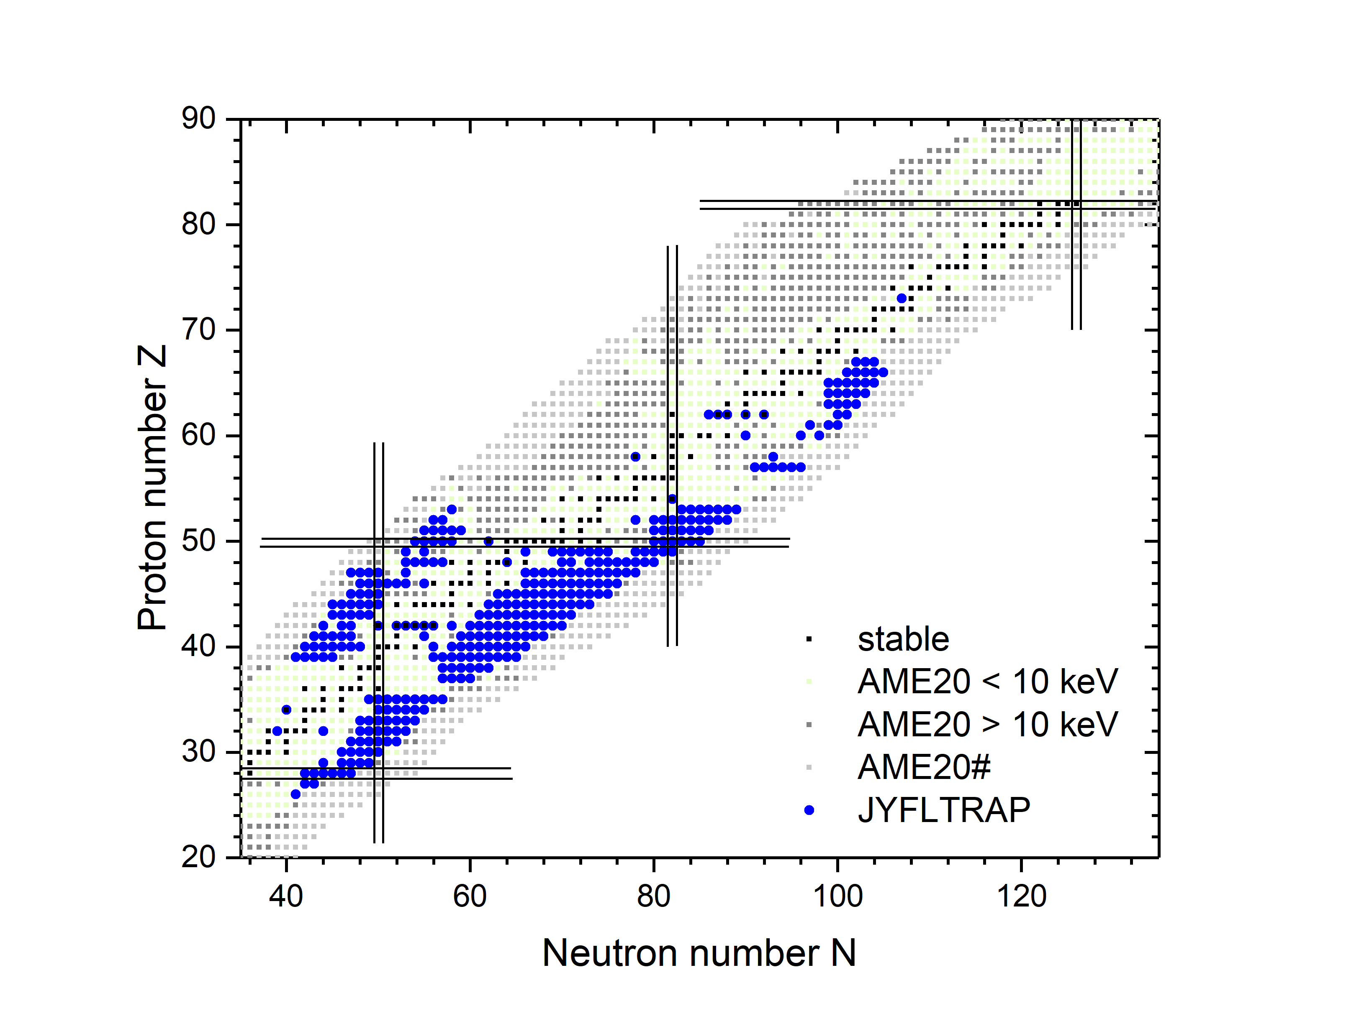
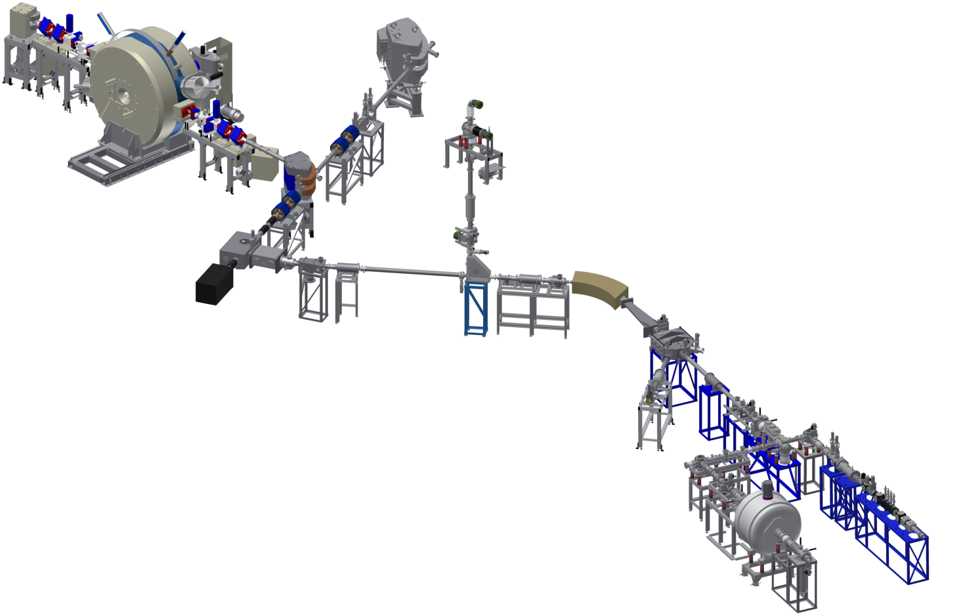
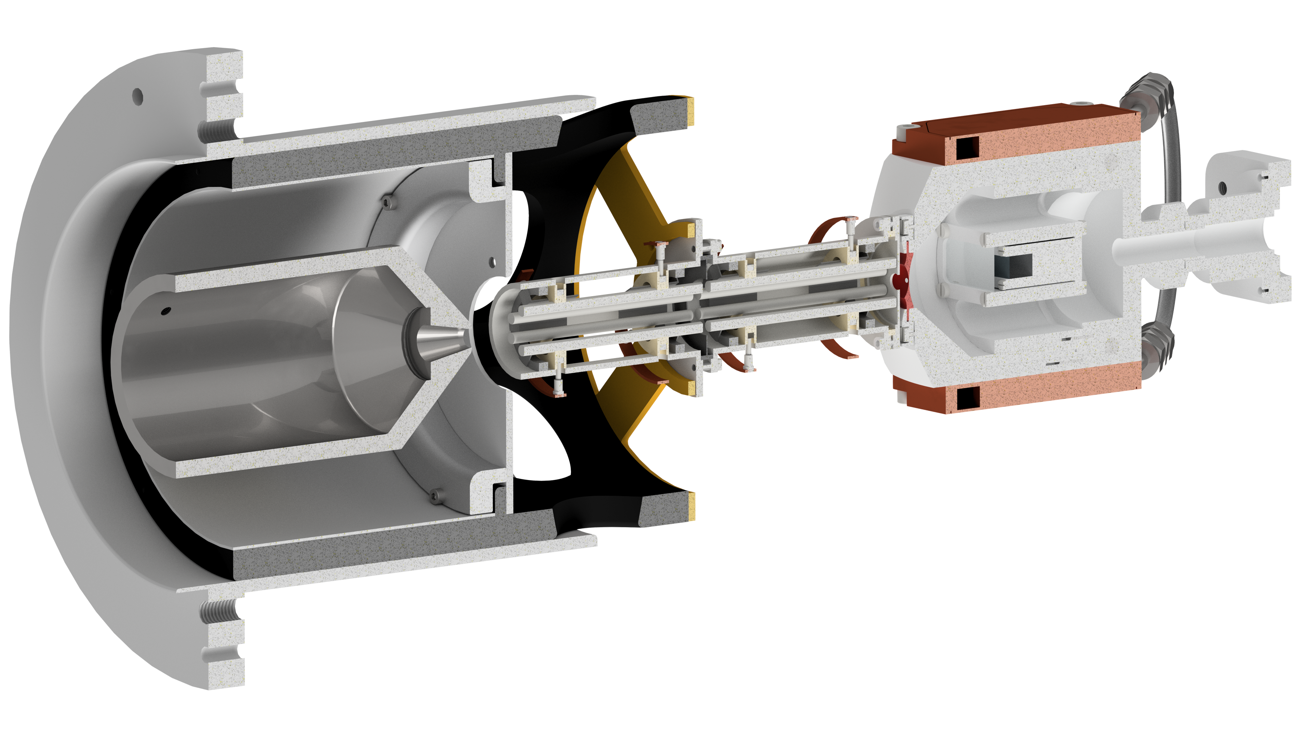
IGISOL
K130 cyclotron
Offline ion source
MCC30/15 light-ion cyclotron
Dipole magnet
𝑀/∆𝑀≈350
Target area
Beam
Atom trap
Extractor
RFQ cooler-buncher
Decay spectroscopy
Laser cooling trap
Target
Reaction products
MR-TOF-MS
SPIG
Laser spectroscopy
Paul trap
JYFLTRAP mass spectrometer
Post trap spectroscopy

Slide 3
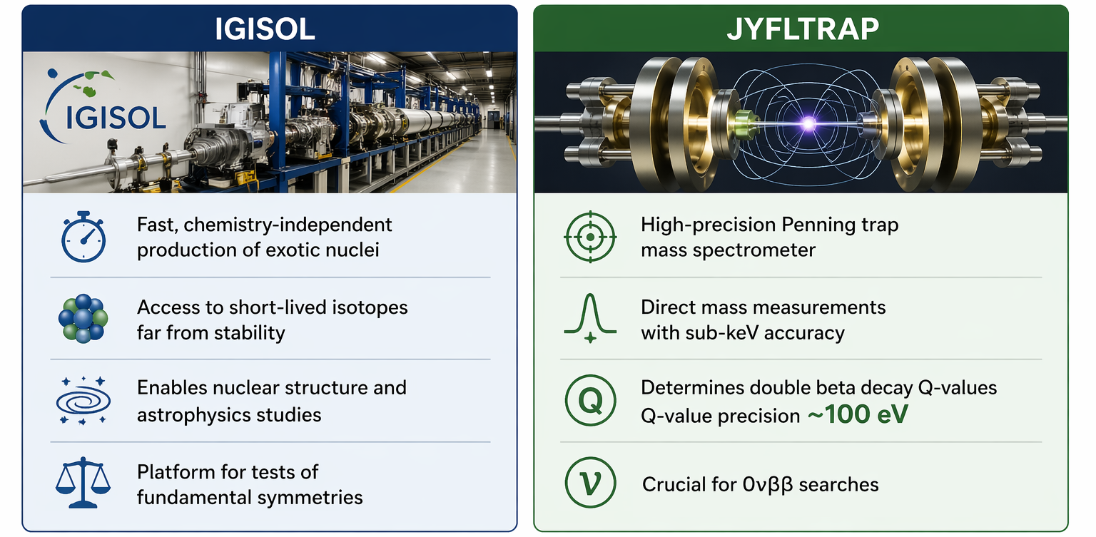
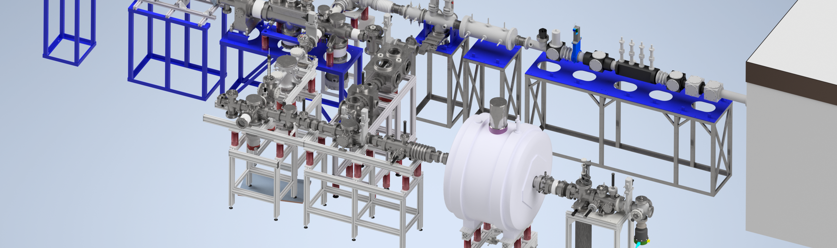
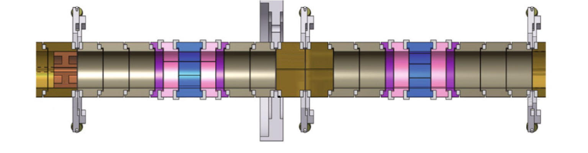
Motivation

Slide 4
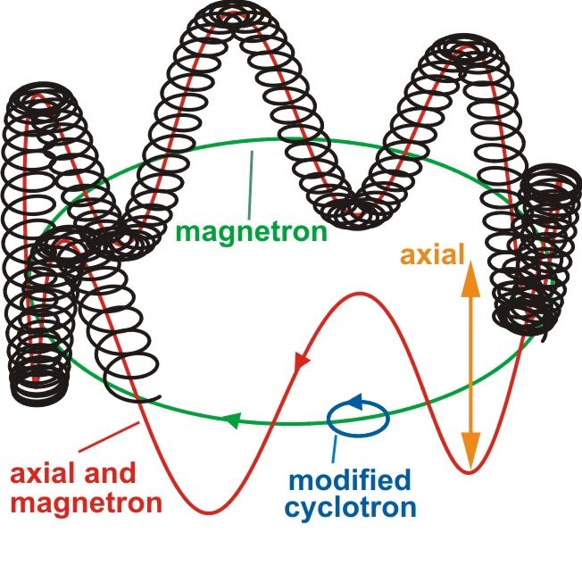
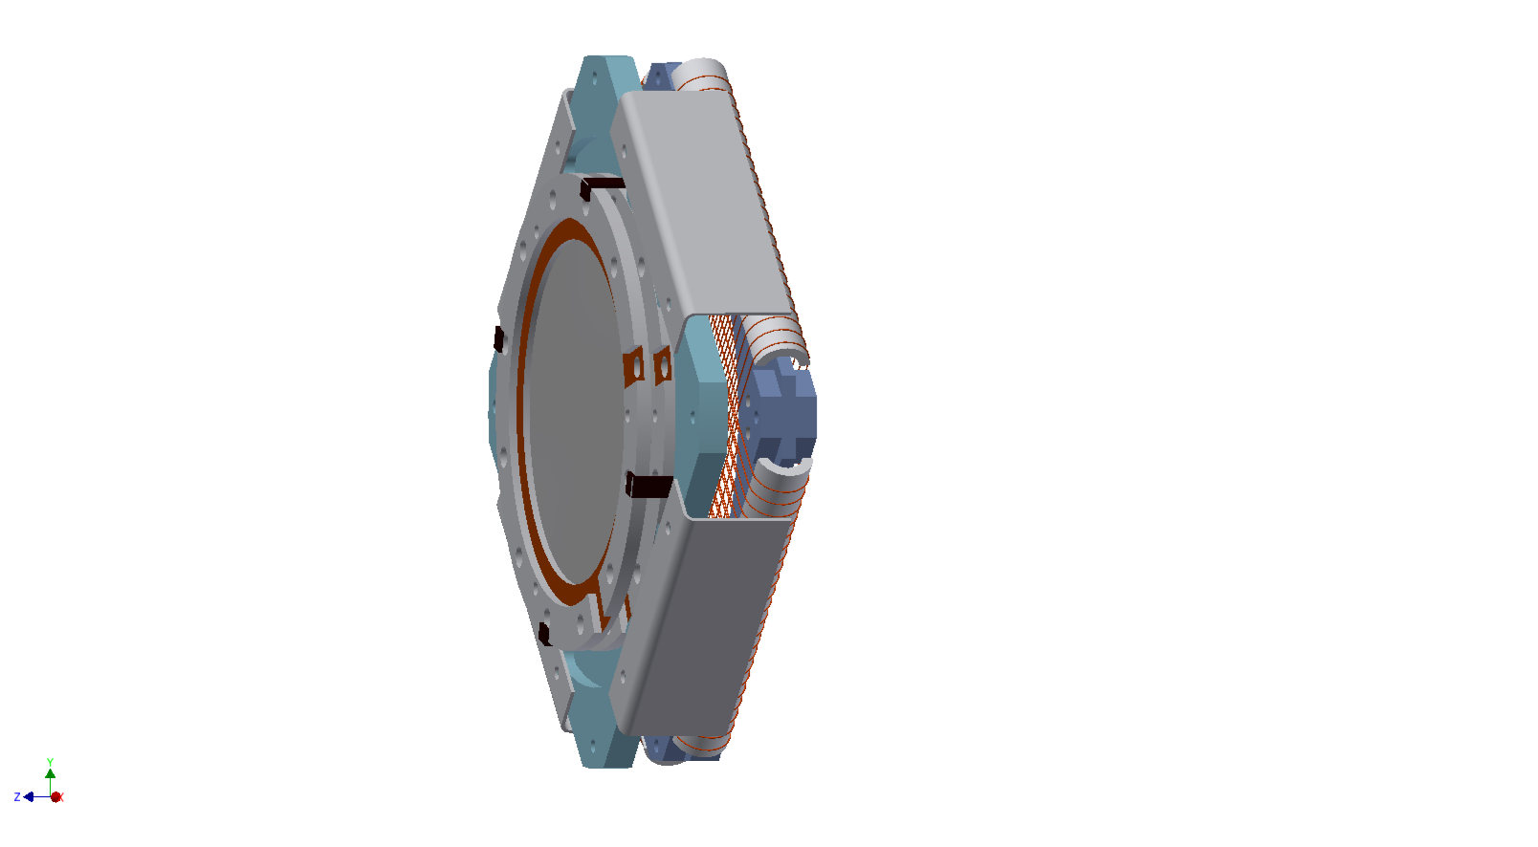
JYFLTRAP double Penning trap
Cylindrical Penning traps
7T homogeneous magnetic field
Harmonic potential
Purification trap
Measurement trap
Eronen et al., EPJA 48 (2012) 46
Segmented electrodes for multipolar excitation

Slide 5
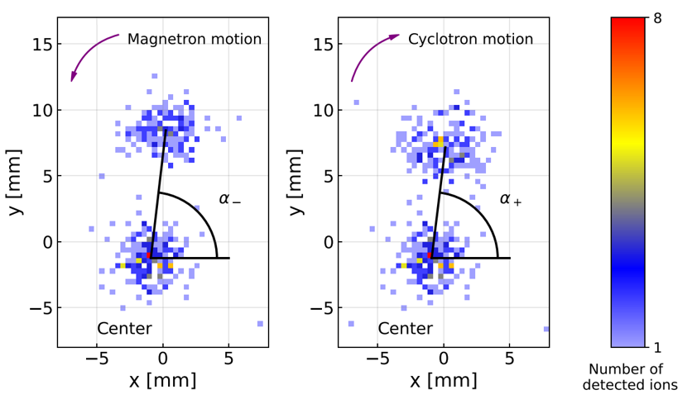
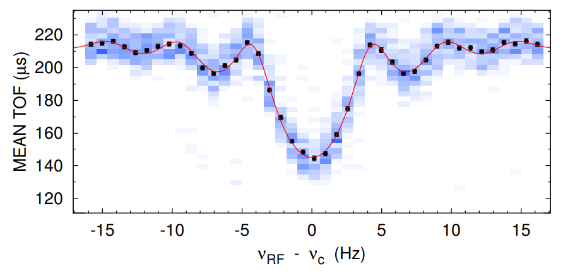


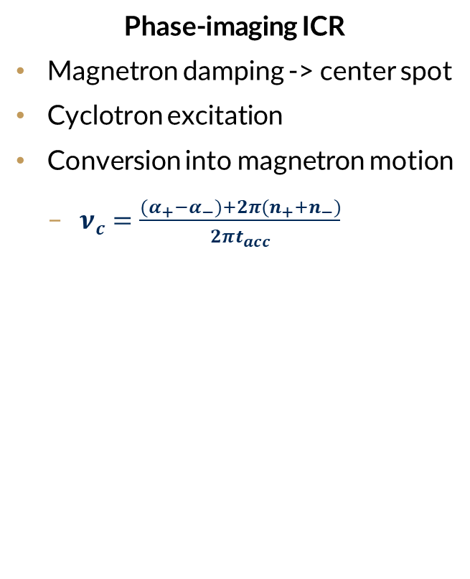

Ion cyclotron resonance (ICR) mass spectrometry
Time-of-flight ICR
Magnetron excitation
Conversion into modified cyclotron motion
$ν_{c}=ν_{+}+ν_{−}=\frac{qB}{2πm}$
More energy in radial motion
Shorter TOF during extraction
Phase-imaging ICR
Magnetron damping -> center spot
Cyclotron excitation
Conversion into magnetron motion
$ν_{c}=\frac{{(α}_{+}−α_{−})+2π(n_{+}+n_{−})}{2πt_{acc}}$
$$α_{−}$$
$$α_{+}$$

Slide 6
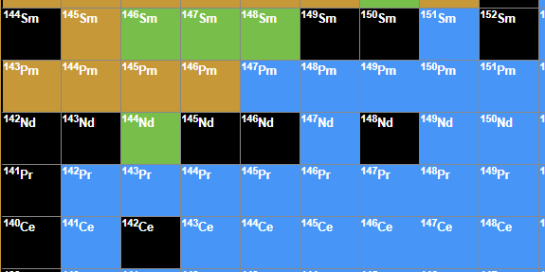
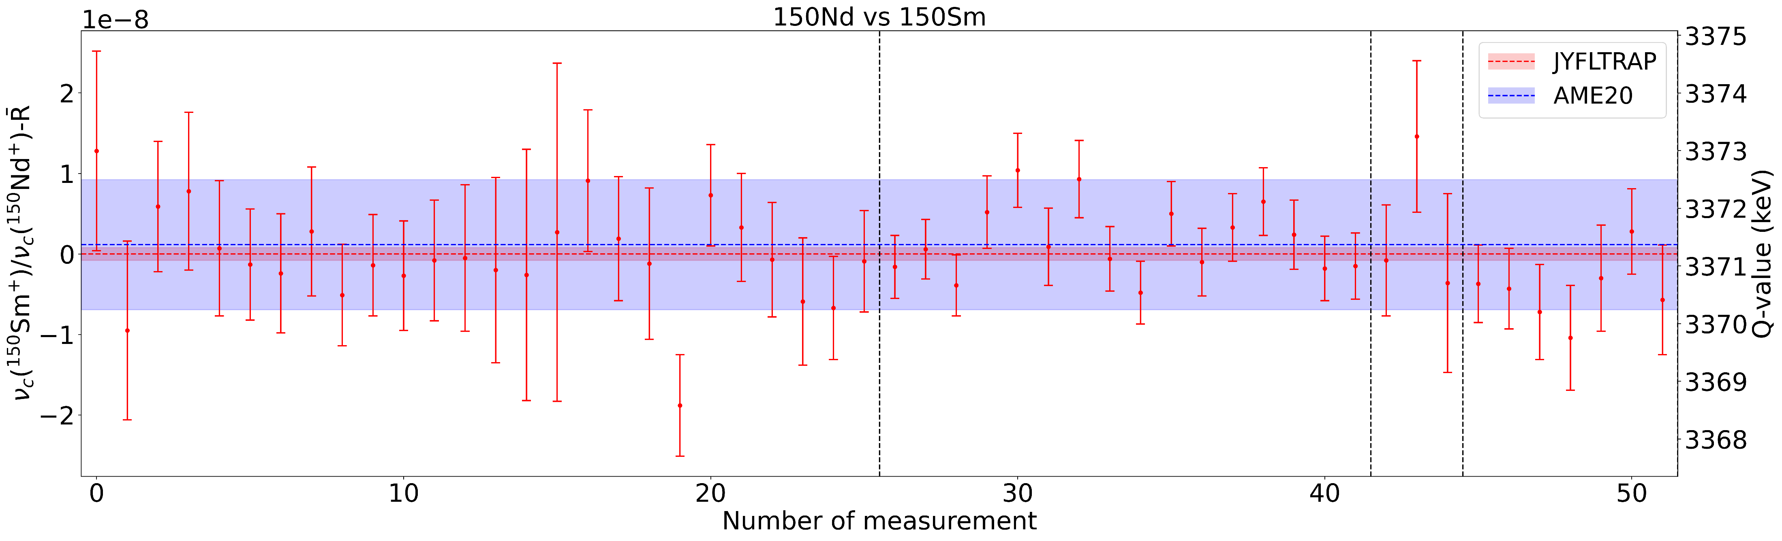
Double-beta decay Q-values
Q-value measurements
¹⁵⁰Nd -> ¹⁵⁰Sm (benchmark measurement)
¹⁴⁸Nd -> ¹⁴⁸Sm
¹⁴²Ce -> ¹⁴²Nd
Input to calculate 0νββ decay and 2νββ decay half-life
Q_{β-β-} = 3371.208(110) keV
[1] M. Wang et. al, Chinese Phys. C 45 030003 (2021)

Slide 7
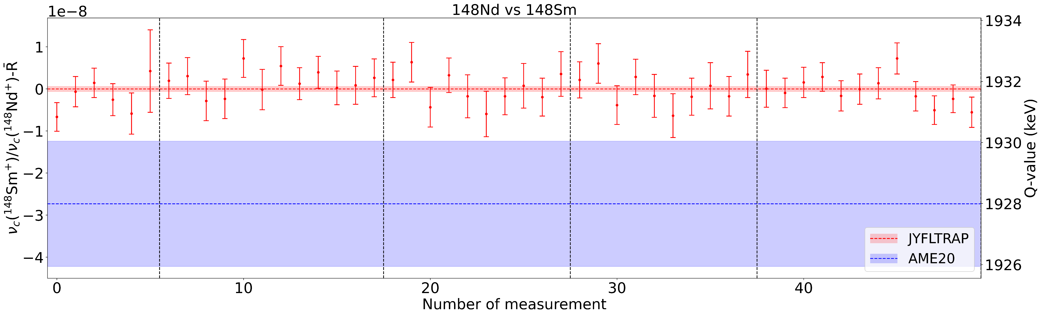
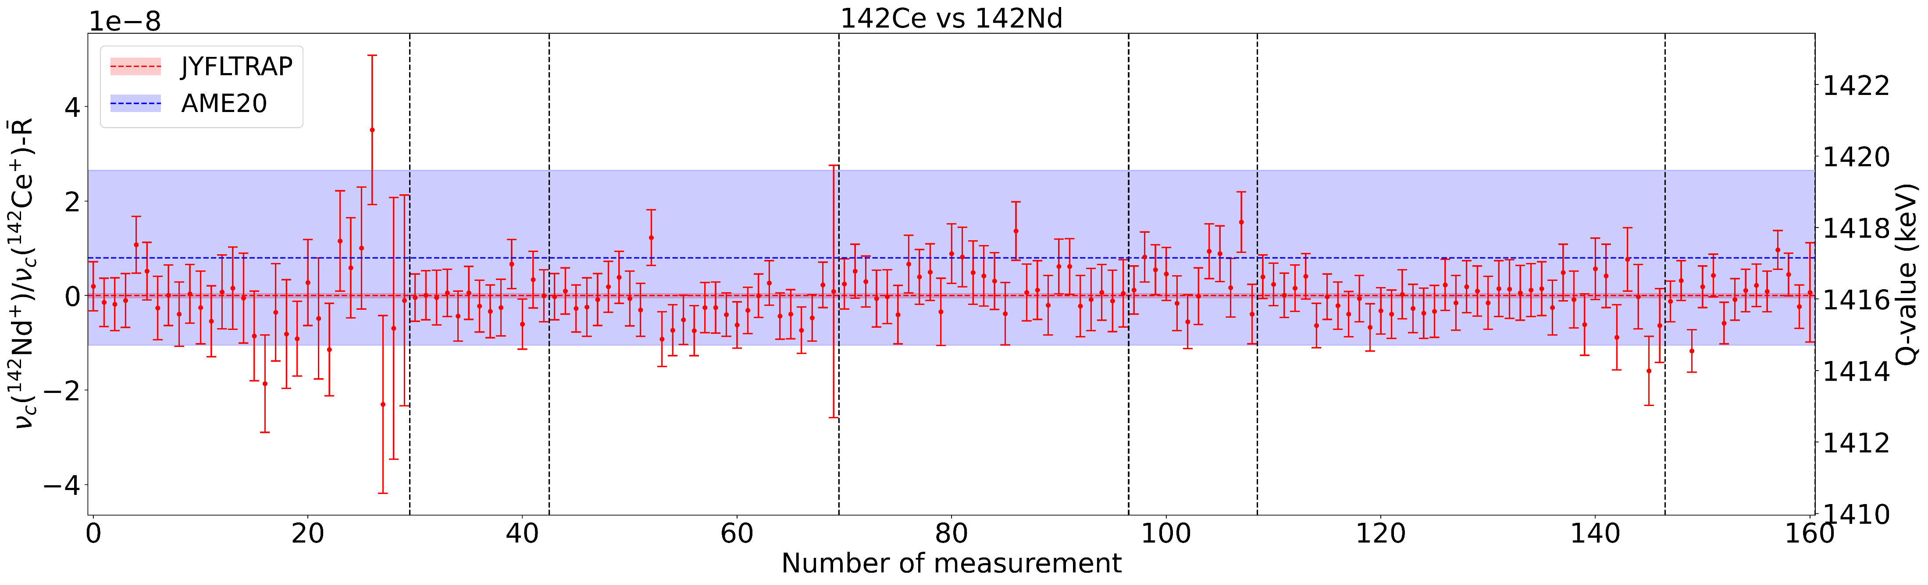
Double-beta decay measurements
Q_{β-β-} = 1931.756(82) keV
Q_{β-β-} = 1416.047(60) keV
[1] M. Wang et. al, Chinese Phys. C 45 030003 (2021)

Slide 8
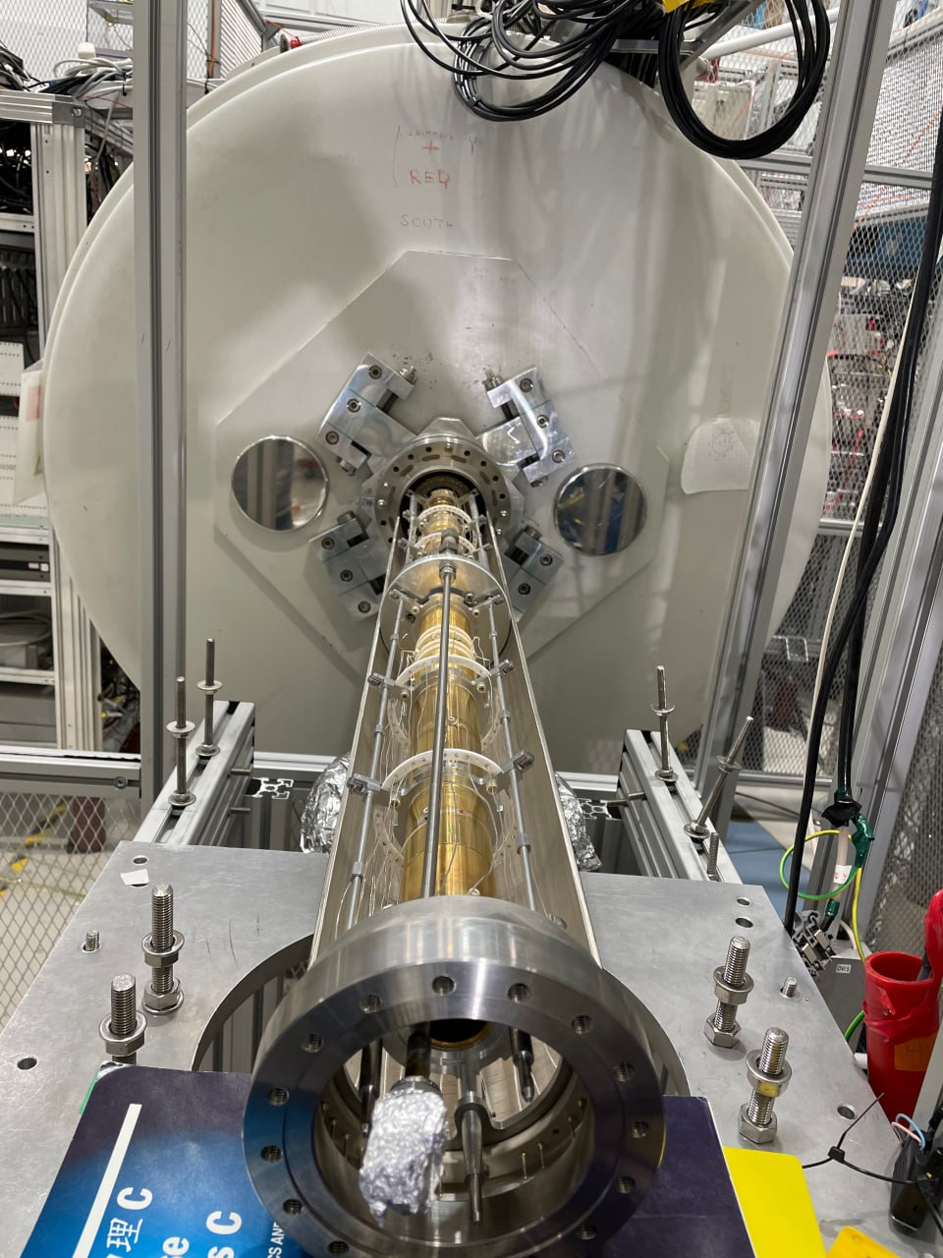
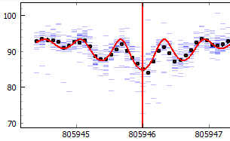
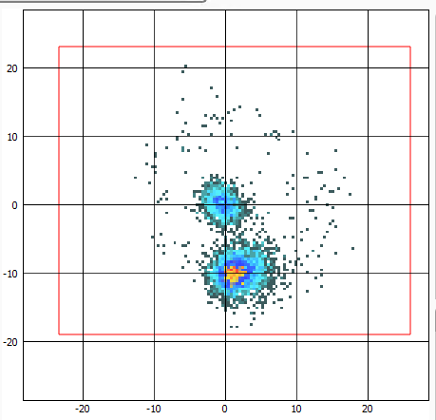
Unexpected break and a fresh start
Quench early 2024
Recommissioning until fall 2025
First TOF-ICR and PI-ICR on October 22nd
First beamtime only two days later!
Since then, 6 JYFLTRAP online beamtimes (26 days)

Slide 9
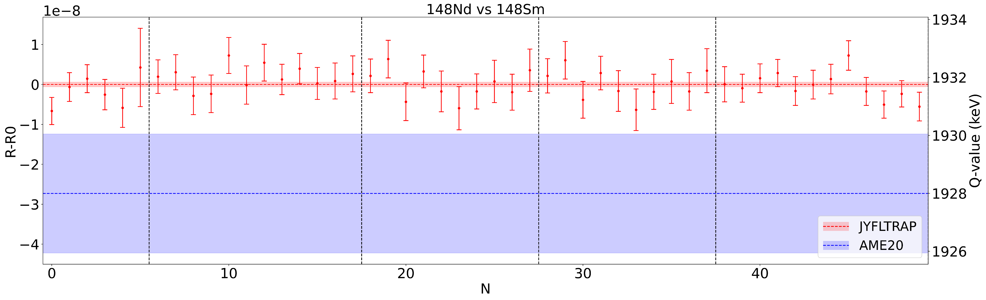

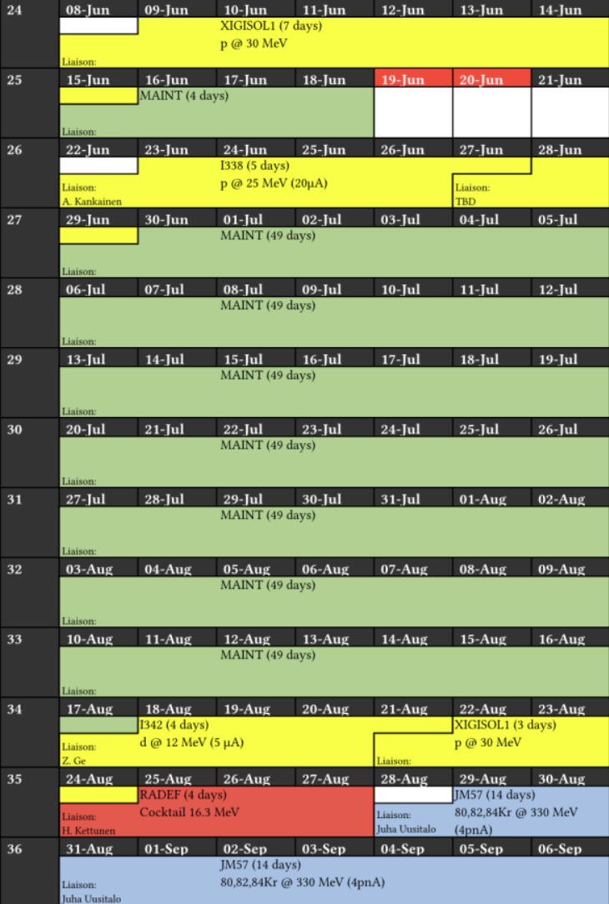
Summary
Q-value measured for
¹⁴⁸Nd -> ¹⁴⁸Sm
¹⁴²Ce -> ¹⁴²Nd
Improved precision by factor 25 - 40
Input for 0νββ decay and 2νββ decay half-life calculations
Trap recommissioned after quench
First data is already in
Analysis ongoing
Already 13 pending proposals (80 days) for trap measurement

Slide 10
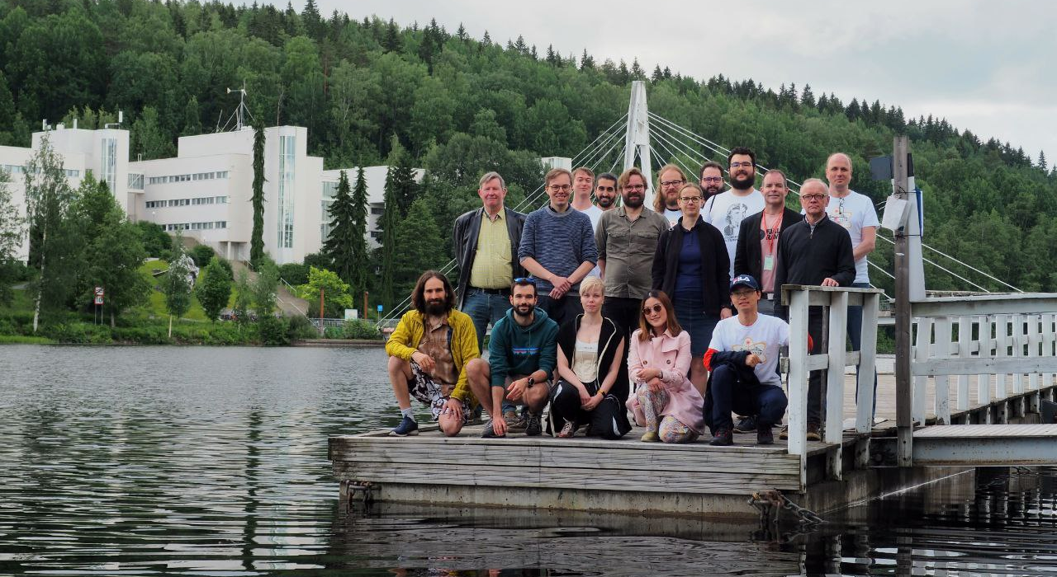


Acknowledgements

