Slide 1


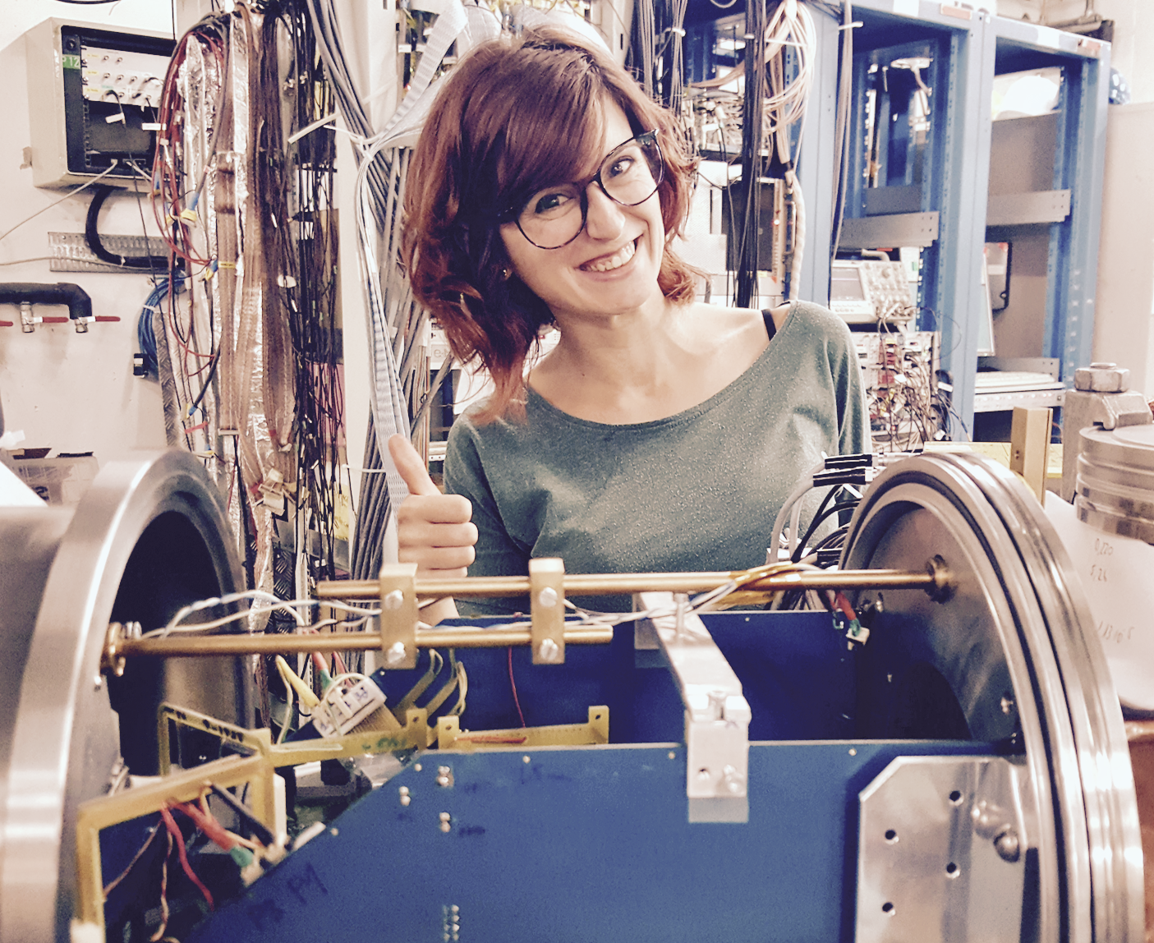

15th Nordic Meeting on Nuclear physics
Fixing the isospin mixing of the ⁸Be 2⁺ doublet populated via the ⁸B β⁺/EC decay
M J G Borge
On behalf of
Daniel Fernández Ruiz
Silvia Viñals i Onsés
Experimental Nuclear Physics Group (IEM-CSIC), Madrid, Spain

Slide 2
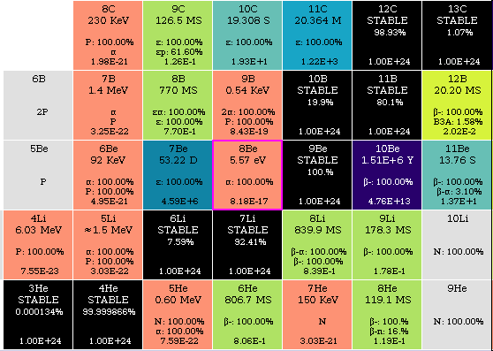
Study of excited states in ⁸Be
Amazing differences in half life between the stable ⁹Be (T > 10²⁴ s) to the resonant ⁸Be (T= 9x0⁻¹⁷s).
Excited states of ⁸Be has been study by reactions or beta-decay.
Beta-decay exclusive I^{π} reach
β-decay probes both spin,isopin
Parent?➔ ⁸Li (β⁻)[16003,14(6)] & ⁸B(β⁺/EC) [17979.8(19] MIRROR NUCLEI
E(level) 8Be | I , π, Τ | Γ | Decay mode
0.0 keV | 0, + , 0 | 5.57 eV 25 | α (100%)
3010(10) keV | 2, +, 0 | 1513 keV 15 | α (100%)
11350 (15) keV | 4, +, 0 | 3500 keV | α (100%)
16626 (3) keV | 2,+, 0/1 | 108.1 keV 5 | α (100%)
16922 (3) keV | 2, +, 0/1 | 74.0 keV 4 | α (100%)
17640 (1) keV | 1, +, 1 | 138 keV 6 | p (99.8%) + IT = 0.204
María J. Gª Borge 5th Nordic Meeting on Nuclear Physics, May 5th-8th, Visby, Sweden

Slide 3
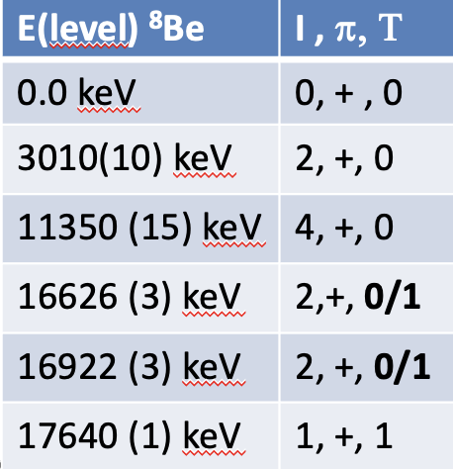
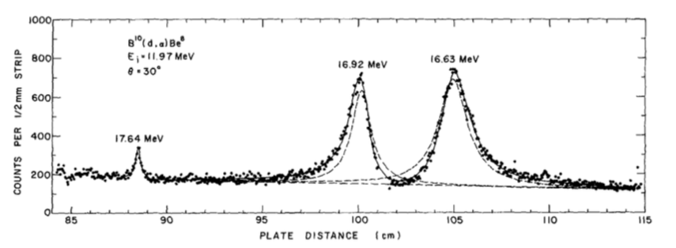
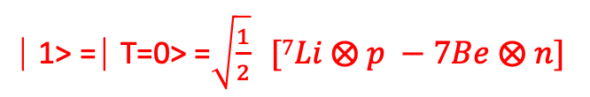
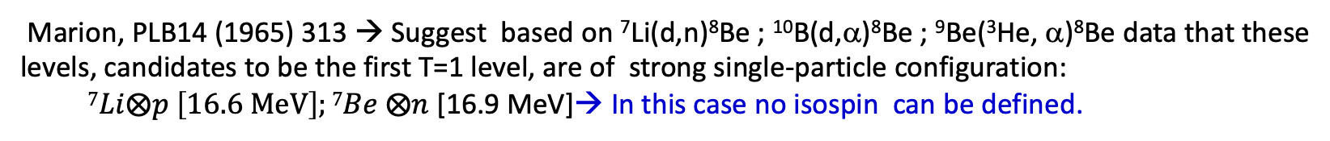
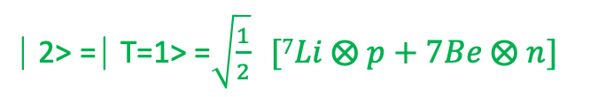
2⁺ Doublet in ⁸Be
The 16.6 and 16.9 2⁺ doublet in ⁸Be has been characterized in different reaction studies
Marion, PLB14 (1965) 313 → Suggest based on ⁷Li(d,n)⁸Be ; ¹⁰B(d,α)⁸Be ; ⁹Be(³He, α)⁸Be data that these levels, candidates to be the first T=1 level, are of strong single-particle configuration:
$7Li⨂p \left[16.6 MeV\right];7Be ⨂n$ [16.9 MeV]→ In this case no isospin can be defined.
⎸1> = ⎸T=0> =$\sqrt{\frac{1}{2}} [7Li ⨂ p −7Be ⨂ n]$
⎸2> = ⎸T=1> =$\sqrt{\frac{1}{2}} [7Li ⨂ p+7Be ⨂ n]$
Study of ¹⁰B(d,α)⁸Be @ 12 MeV → reaction occur only through the T=0 component.
→First determination of the line shapes of the 16.92 and 16.63 MeV states.
→Presence of asymmetry in the shapes that was explained by interference effect [Browne, et al Phys Lett 23 (1966) 373]
¹⁰B(d,α)⁸Be
E = 11,97 MeV
θ= 30º
Γ_{16.6} / Γ_{16.9} = 1.39(3)
ΔE = 289 keV
H_{C} = 143 keV
→ E₀ = 47 keV
E & Γ of doublet corroborated in different studies in ⁶Li(³He,p)⁸Be; ⁷Li(³He,d)⁸Be; ⁹Be(³He, α)⁸Be, for details see
F Ajzenberg-Selove ·
NPA227(1974) 1-244
α-α scattering
Γ_{16.6} / Γ_{16.9} = 1.45(1)
ΔE = 301,5 keV
H_{C} = 148,2 keV
Hinterberger et al.
NPA (1978) 397
María J. Gª Borge 5th Nordic Meeting on Nuclear Physics, May 5th-8th, Visby, Sweden
Notes:
Qualitatively the intermediate range
attraction is compensated by the short - range repulsion. Using the Sussex harmonic
osciillator matrix elements and taking higher - or der particle- hole excitat ons i nt o
account , Goldhammer obtained a Coulomb matrix element of 146 keV, i n good
agreement wi t h t he exper i ment al l y deduced value.
The Sussex harmonic oscillator matrix elements are employed to estimate the effect of cross terms between the nuclear interaction and the Coulomb potential. The 2p, 3p1h, and 4p2h corrections are calculated
Explanation of the very high
Goldhammer , PR 11(1975) 1422

Slide 4
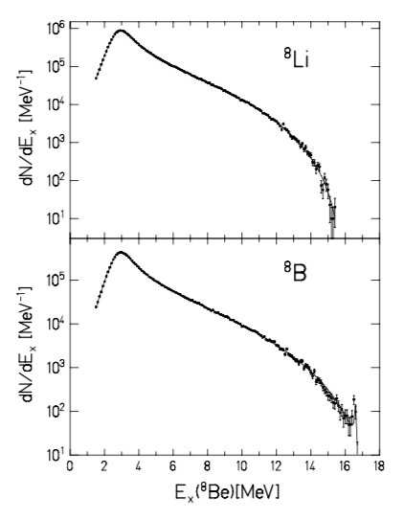
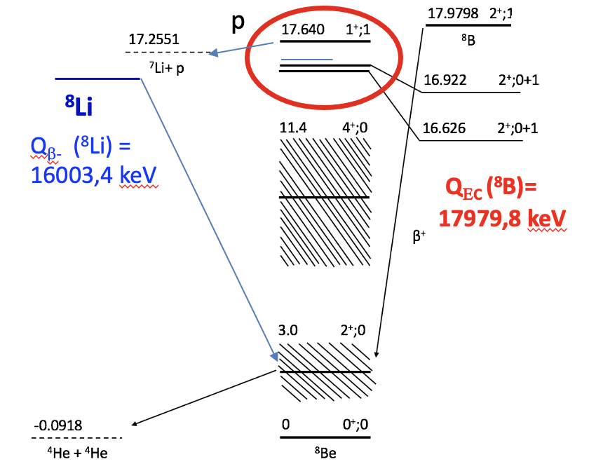

The $β^{+}$decay of ⁸B → ⁸Be
Isospin mixture can be determined through the Fermi (F) (T=1) and Gamow-Teller (GT) (T=0,1) feeding to the levels.
The β⁺ decay is sensitive to B_{F} and B_{GT} , but reaching of 2⁺ doublet has a problem: statistics.
  Phase space supresses the feeding to the double by six orders of magnitude
The 3 MeV level takes most of the β-feeding, (>88%).
16,6 MeV : observed by several groups in EC/β⁺-decay studies
(E. Matt et al., Physics Letters 9 (1964) 174)
Feeding around 10%
16,9 MeV expected to be fed 2x10⁻² of 16.6 MeV:
  first hinted at the JYFL08 experiment (O. Kirsebom et al., Phys. Rev. C 83 (2011) 065802)
Wilkinson & Alburger PRL 26 (1971)1127
5 events
attributed to 16,9 MeV
María J. Gª Borge – INPC 2025, May 25th-30th, Daejeon Korea
María J. Gª Borge 5th Nordic Meeting on Nuclear Physics, May 5th-8th, Visby, Sweden

Slide 5
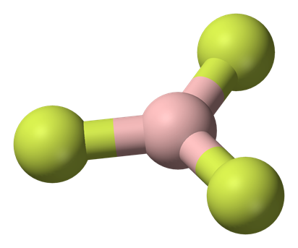
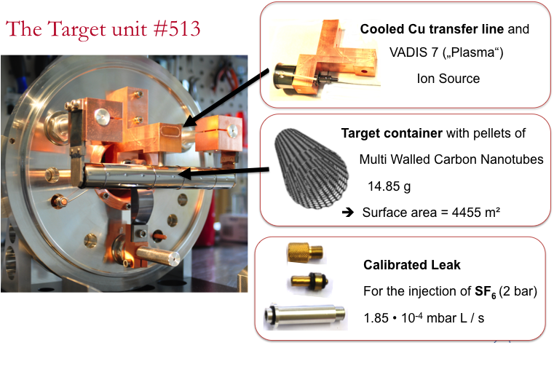
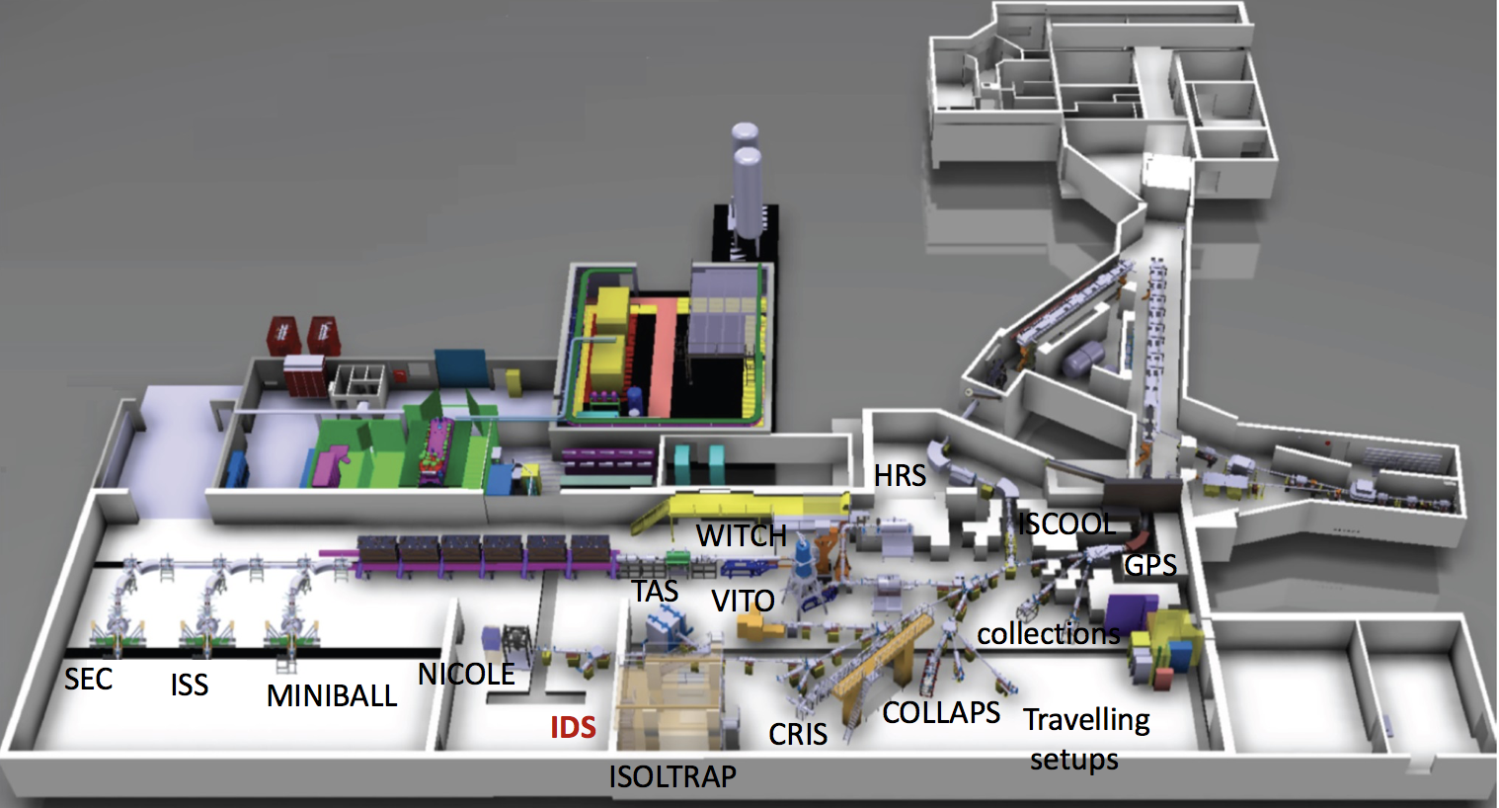
⁸B production
SF₆ (g)
⁸B
⁸BF₂⁺ (g)
MEDICIS
Ballof et al, EPJA55 (2019) 65]
1.4 GeV
Protons
3x 10¹³pps
⁸BF₂

Slide 6
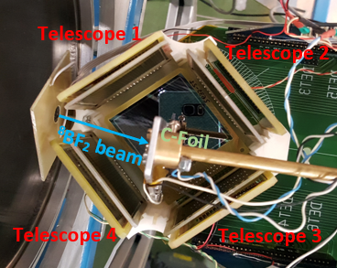

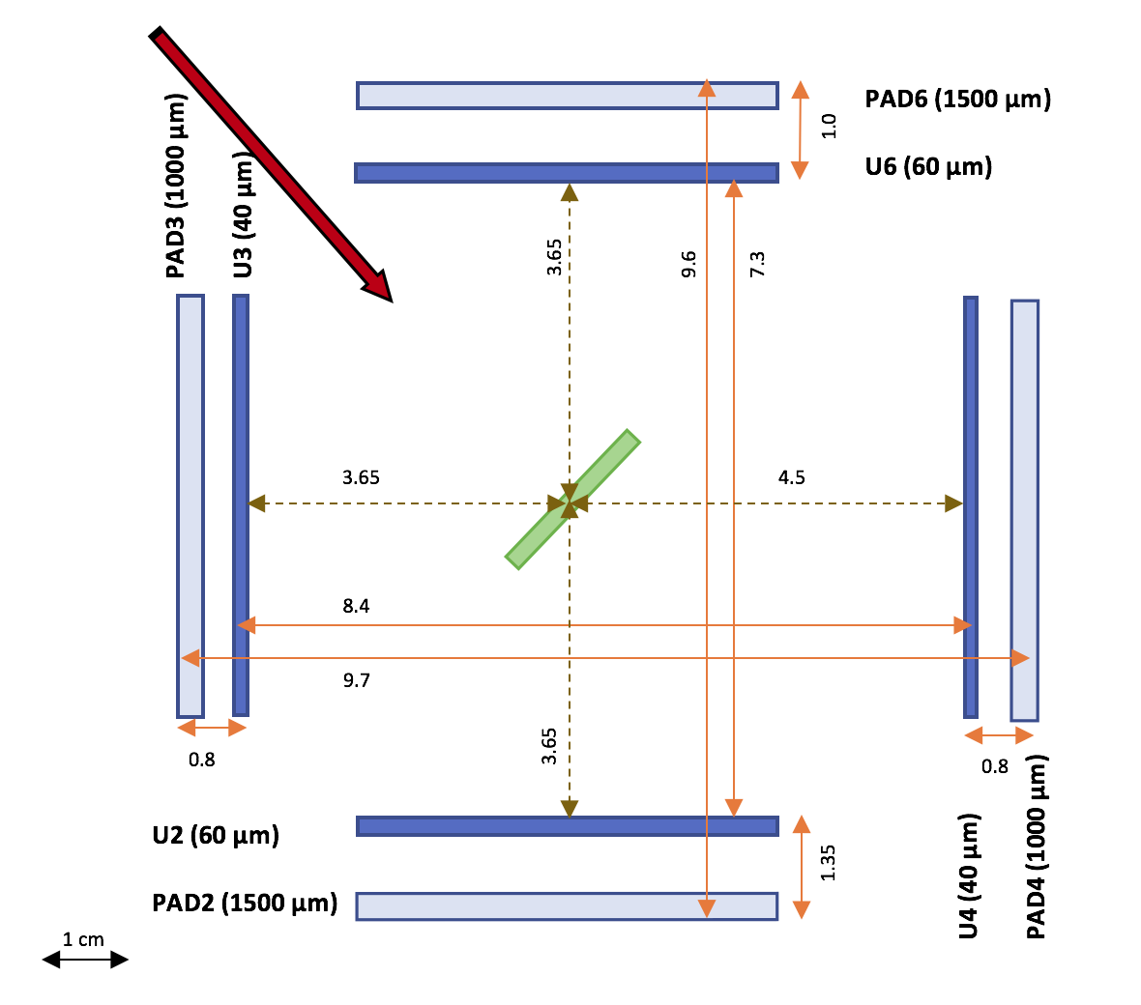
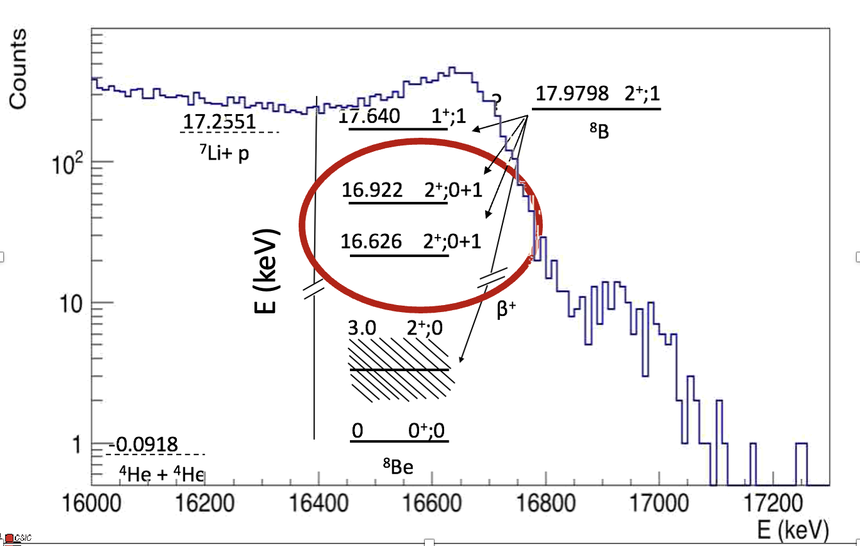



IS633 Experiment at IDS
⁸BF₂
Resolving the β-feeding to the 16,6 and 16,9 MeV level for the first time !!
(25000 counts/s)
IS633 2 orders of magnitude more statistics than ever!
$$β^{+}$$
4 Si △E-E telescopes DSSD + PAD
stop α: 1-9 MeV -- 60μm (U6 & U2)
stop α: 1-7 MeV -- 40μm-- 40μm (U3 & U4)
(low β-response)
α
α
⁸BF₂ molecular beam is implanted in a ¹²C foil
The $β^{+}$decay of ⁸B ($T_{1/2}=771.17(94)$ ms) populates states of ⁸Be. Viñals et al., Acta Polonica B 51 (2020)
⁸Be is unbound → $α$–$α$ break up
Reconstruction of the $α −α$ coincidence spectrum through a system of four telescopes
¹² C Catcher (138 nm)
DSSD
PAD
Particle Telescope
$$Ω=38\% 4π$$
María J. Gª Borge 5th Nordic Meeting on Nuclear Physics, May 5th-8th, Visby, Sweden

Slide 7
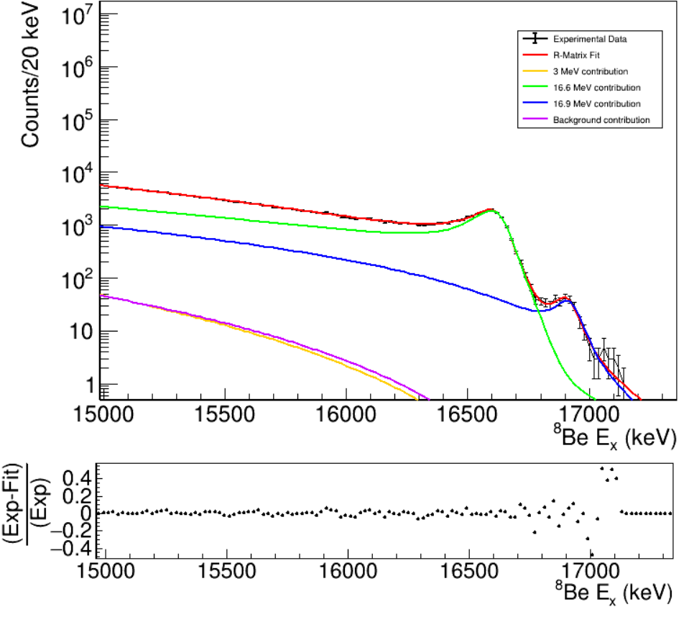
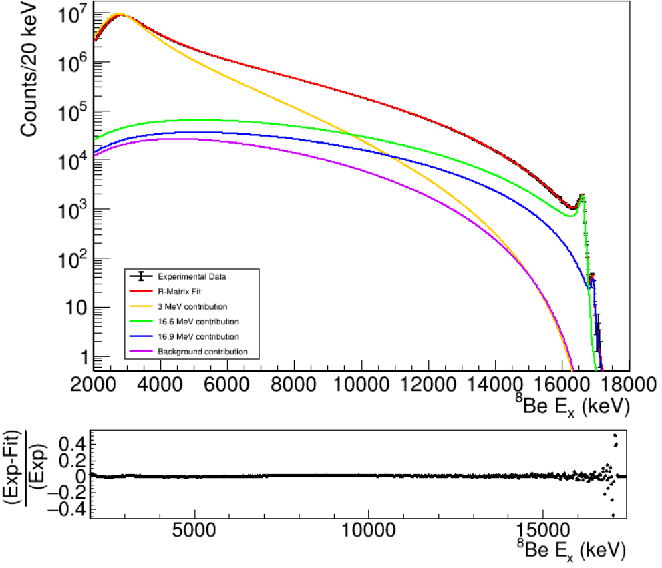
R-Matrix Fit: B_{F}, B_{GT} and Γ from the α-α spectrum
R-Matrix formalism → Nuclear resonances in reaction studies
→ β-decay followed by 2-body break up
3 MeV
16,6 MeV
16,9 MeV
BKG
A.M. Lane and et al., Rev. Mod. Phys. 30(2):257-353, 1958
F.C. Barker, Aus. Journ. Phys. 22(3):293-316, 1969
Ingredients: α-α coincidence spectrum + coincidence response matrix
Local 2⁺ doublet fit
Global fit
Total fit MeV
16,6 MeV
BKG
16,9 MeV
3 MeV
The global fit includes the contributions of the 3 MeV and Intermediate region.
The contribution of the broad 3 MeV state has not influence in the region of the 2⁺ 16 MeV doublet.
María J. Gª Borge 5th Nordic Meeting on Nuclear Physics, May 5th-8th, Visby, Sweden

Slide 8
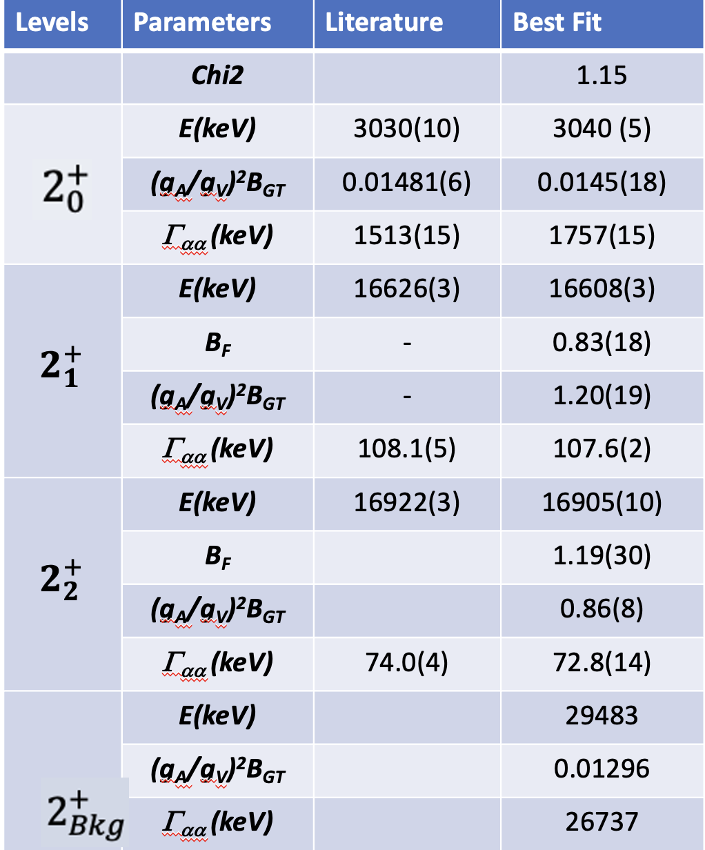
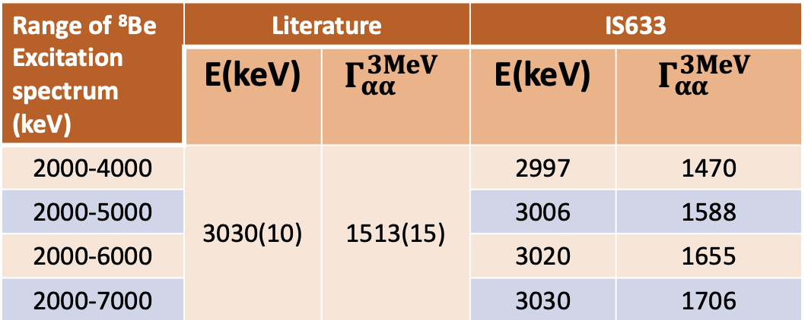

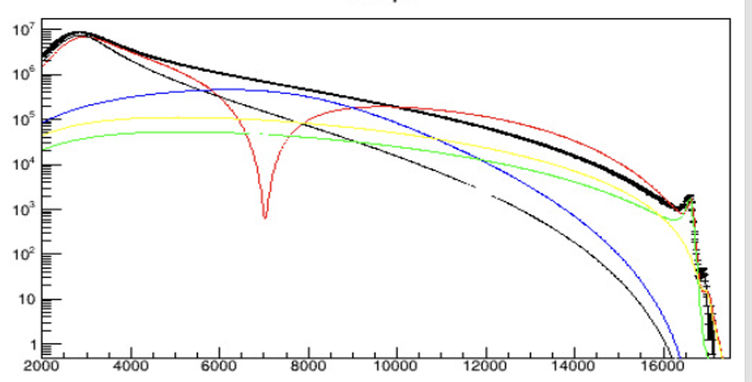
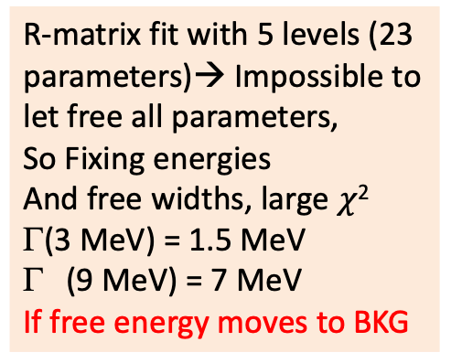
Results from R-matrix Fit
The width of the 3 MeV comes too large
Beyond the Wigner limit (1.138 MeV)
Local fits to the 3 MeV region produce results in agreement with published values.
Test of an intermediate broad 2⁺ level
Proposal [2⁺ @ 9 MeV (Γ=10 MeV) Barker 1989] [2+ @ 11 MeV (Γ=10 MeV) Sargsyan PRL128 2022]
R-matrix fit with 5 levels (23 parameters)→ Impossible to let free all parameters,
So Fixing energies
And free widths, large $χ$²
Γ(3 MeV) = 1.5 MeV
(9 MeV) = 7 MeV
If free energy moves to BKG
María J. Gª Borge 5th Nordic Meeting on Nuclear Physics, May 5th-8th, Visby, Sweden
Notes:
Sargssyan performed large scale ab-initio calculation using SA-NCMC frame work (NNLOpt chiral potential) indicate the presence of a 2+ state in the alfa-alfa- system accessible in beta decay playing an important role in precision measurements A=8 system
Cluster structure with strong correlations.

Slide 9
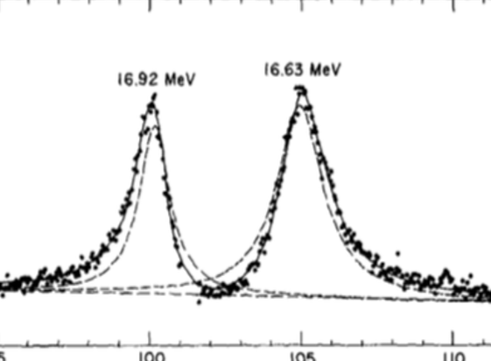
Sensitivity of the R-matrix to isospin components
The R-Matrix fit is sensitive to the Fermi and GT feeding due to the destructive and constructive interference effects of the T=1 and T=0 isospin values
The ⁸Be doublet α decay via the T=0 components
    → if fed via T=0 destructive interferences→
    → if fed via T=1 constructive
¹⁰B(d,α)⁸Be
Population via T= 0
Browne, et al Phys Lett 23 (1966)373
Best Fit
Imposing B_{F}= 0

Slide 10


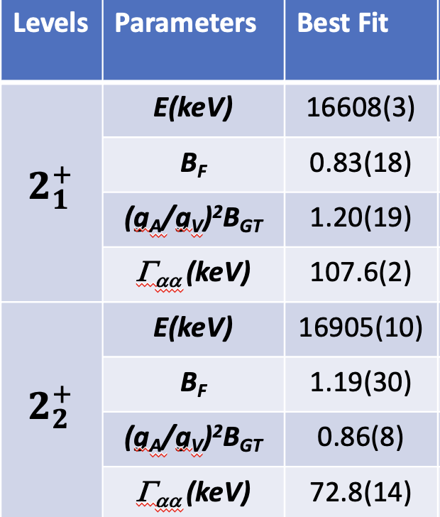
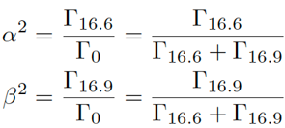
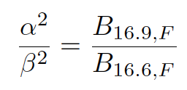
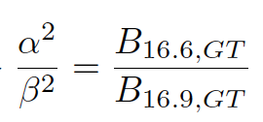
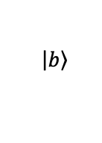
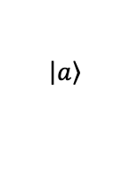
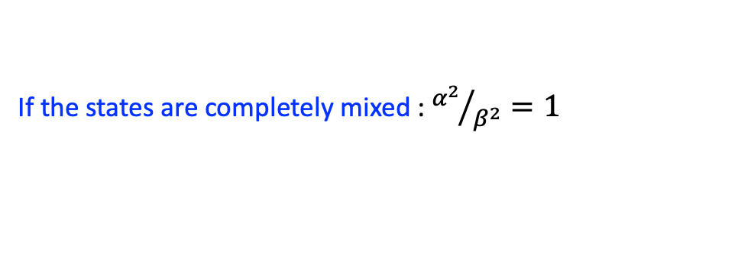

Isospin Mixing Coefficients of the 2⁺ doublets
Assuming 16,9 and 16,6 can be expressed as a mixture of two states with well defined isospin.
17.64 MeV (1⁺,1)
EC
⁸B
16.90 MeV (2⁺,0 +1 )
F.C. Barker, Phys. Rev. Lett. 35 (1975) 613
mixing coeficients
$$\left.\left|a\right.\right\rangle$$
$$β^{+}$$
If the states are completely mixed : ${α^{2}}/{β^{2}}=1$
16.60 MeV (2⁺,0 +1 )
⁸Be
$$\left.\left|b\right.\right\rangle$$
How can we find α²/β² ?
→ M_{0,GT}>>>M_{1,GT} =0 Assumed due to S.M. calculations PROVEN in our case as Σ(Τ=1)=2,02( 35) -2
Method 1
Method 3
Method 2
Method | Isospin Coefficient α² / β²
From B_{F} Ratio (1) | 1,43 (11)
From B_{GT} Ratio (2) | 1,40(8)
Widths Γ_{16.6} / Γ_{16.9} | 1,48(3)
_{α} | 0,772
_{β} | 0,636
α² /β² = 1,47(1)
ΔE = 298(75) keV
α = 0,77; β = 0,63
Hc = αβΔE = 145 keV
=1,47(3)
Hinterberger et al
NPA299(1978)397
María J. Gª Borge 5th Nordic Meeting on Nuclear Physics, May 5th-8th, Visby, Sweden

Slide 11
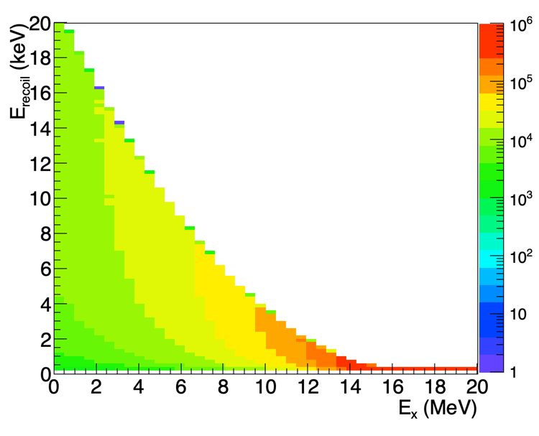
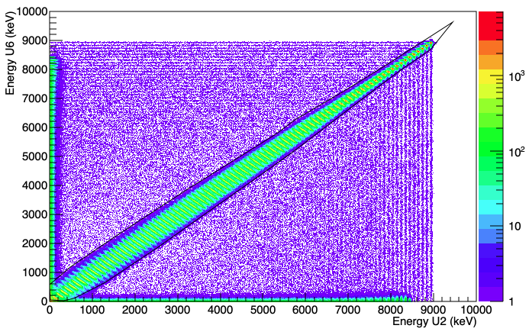
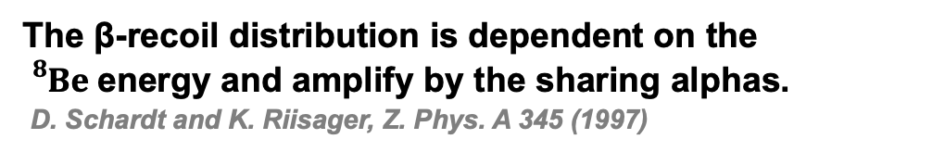
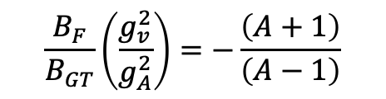
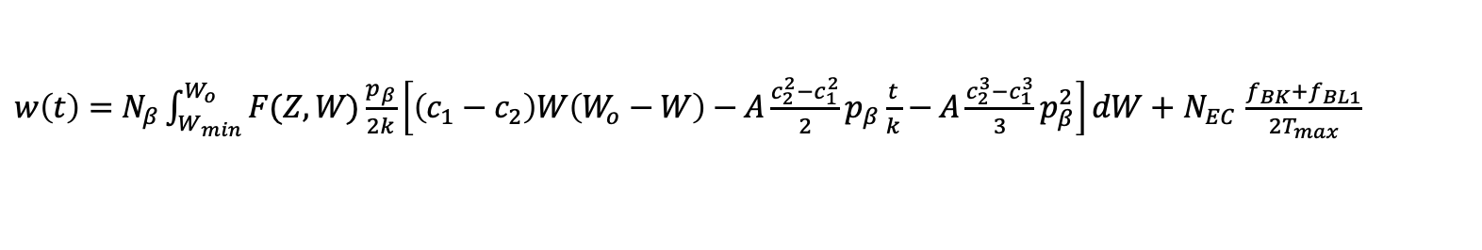
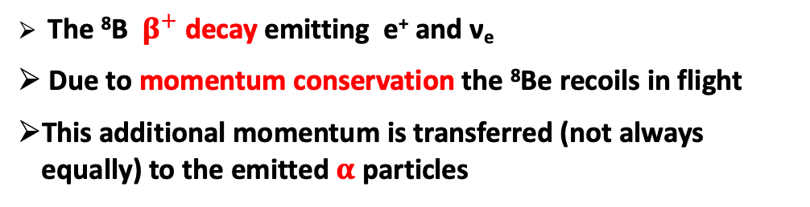
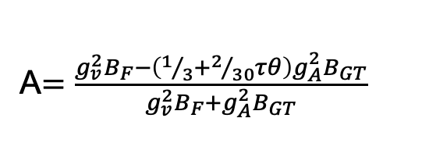
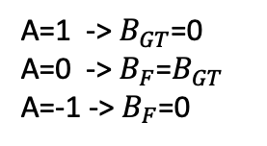
β- Recoil analysis
Use of an alternative Method: the β-recoil
The ⁸B $β^{+}$decay emitting e⁺ and ν_{e}
Due to momentum conservation the ⁸Be recoils in flight
This additional momentum is transferred (not always equally) to the emitted $α$particles
ν_{e}
⁸B
⁸Be
e⁺
Calculated ⁸Be recoil
The β-recoil distribution is dependent on the ${}_{}^{8}{Be}$energy and amplify by the sharing alphas.
D. Schardt and K. Riisager, Z. Phys. A 345 (1997)
$w\left(t\right)=N_{β}\int_{W_{min}}^{W_{o}}{F(Z,W)\frac{p_{β}}{2k}\left[\left(c_{1}−c_{2}\right)W\left(W_{o}−W\right)−A\frac{c_{2}^{2}−c_{1}^{2}}{2}p_{β}\frac{t}{k}−A\frac{c_{2}^{3}−c_{1}^{3}}{3}p_{β}^{2}\right]dW}+$ $N_{EC}$ $\frac{f_{BK}+f_{BL1}}{2T_{max}}$
α−α selected
Recoil
Distribution
Fermi function
Asymmetry parameter
β-component
EC-component
For ⁸B $→$ ⁸Be ΔJ=0 and ΔL=2 therefore $τθ$=10 and $B_{F}$ and $B_{GT}$ can be deduced from A (Schardt & Riisager, Z. Phys. A 345 (1997))
A$=\frac{g_{v}^{2}B_{F}−\left(1/3+2/{30}τθ\right)g_{A}^{2}B_{GT}}{g_{v}^{2}{B_{F}+g}_{A}^{2}B_{GT}}$
$$\frac{B_{F}}{B_{GT}}\left(\frac{g_{v}^{2}}{g_{A}^{2}}\right)=−\frac{\left(A+1\right)}{\left(A−1\right)}$$
A=1 -> $B_{GT}$=0
A=0 -> $B_{F}$=$B_{GT}$
A=-1 -> $B_{F}$=0
María J. Gª Borge 5th Nordic Meeting on Nuclear Physics, May 5th-8th, Visby, Sweden

Slide 12
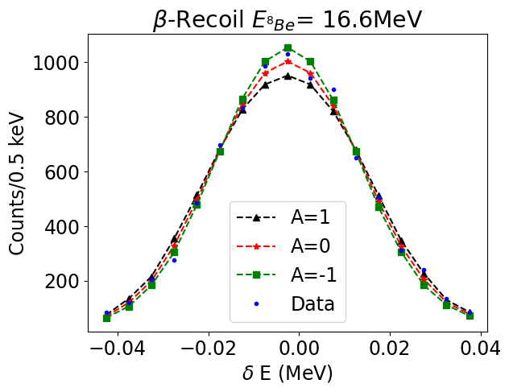
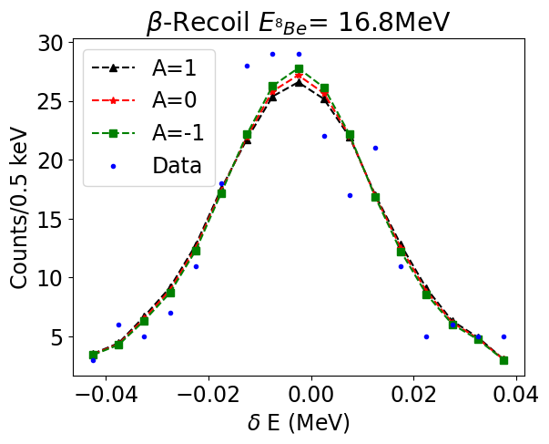
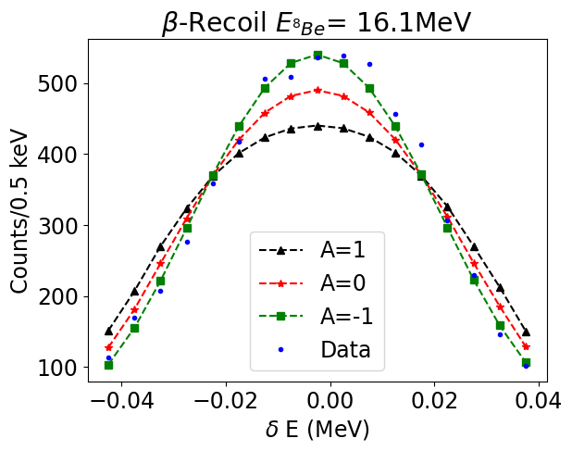
Sensitivity of the Method: Uncertainties
The α₁ – α₂ spectrum is fitted using the recoil function folded with a response function with A as a fit parameter ($N_{β}$ and $N_{EC}$ ratio is computed theoretically and fixed).
The quality of our fitting method is as good as we can resolve the Fermi and GT contribution with it.
Condition : the recoil distribution should be significantly modified by variations in A
Form 16,8 MeV onwards a combination of low stats and low dependence of A, from larger EC recoil, makes this method not sensitive.
For most of the energies variations in A are significant enough to consider our fits trustworthy.
María J. Gª Borge 5th Nordic Meeting on Nuclear Physics, May 5th-8th, Visby, Sweden

Slide 13
Evolution of Asymmetry parameter A
From 3 MeV to 16,2 MeV Gamow-Teller dominates the decay. ( A=-1,00(1)-> B_{F}=0 ; B_{GT} =1).
Reaching the doublet region, the influence of the Fermi contribution becomes noticeable.
In the 16,60 (5) MeV region A=0,10(8)-> B_{F}= B_{GT} =0.5, there is a total Fermi and GT coexistence
Between the resonances, the Fermi contribution dominates (A=1,0(4)-> B_{F} =1 ; B_{GT} =0)
In 16,90(5) MeV there is a very high uncertainty!!
María J. Gª Borge 5th Nordic Meeting on Nuclear Physics, May 5th-8th, Visby, Sweden

Slide 14
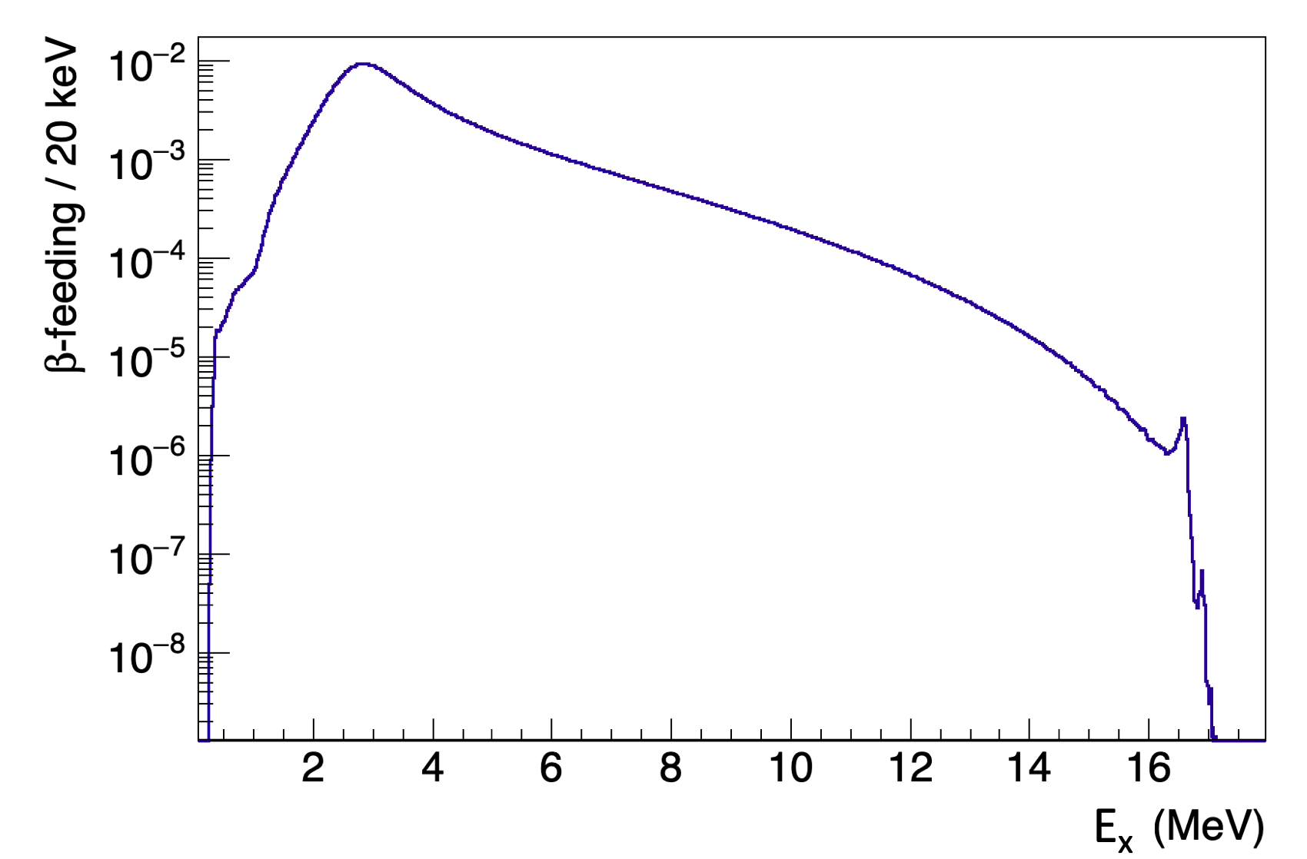
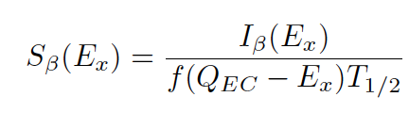
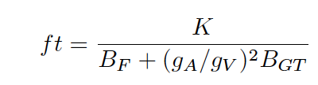
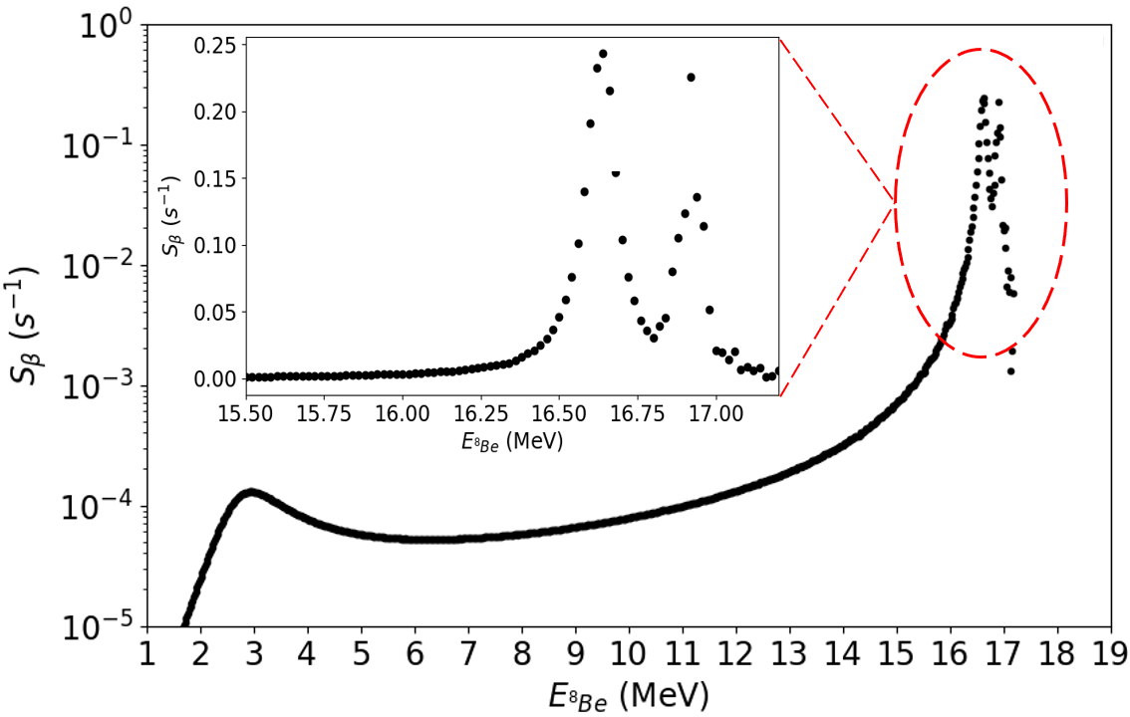



⁸Β β-Strength
I_{β}
I_{β}
K = 6144(4) s; g_{A} / g_{V} = -1.2754(13)
The fermi transition is confined in the doublet and proceed via T=1 component
M₀ >>>. M₁ according to shell model
The Model couples the beta decay and α-emission process
María J. Gª Borge 5th Nordic Meeting on Nuclear Physics, May 5th-8th, Visby, Sweden

Slide 15
Appling Barker Two-body model to the 2⁺ ⁸Be doublet
As we have proven that T=1 GT strength is so small we can apply Barker’s two-level Model to our beta strength
B_{F}= 2
(g_{A}/g_{V})²B_{GT}(T=0) = 2.6
(g_{A}/g_{V})²B_{GT}(T=1) = 0.01
α² = 0.58
E = 16600 keV; Γ = 110 keV
E = 16900 keV; Γ = 110 keV
María J. Gª Borge 5th Nordic Meeting on Nuclear Physics, May 5th-8th, Visby, Sweden

Slide 16
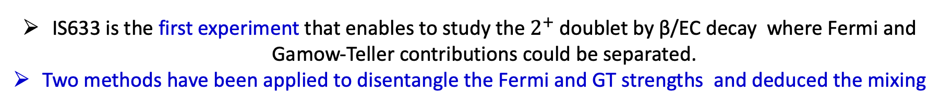
Summary & Conclusions
IS633 is the first experiment that enables to study the$2^{+}$doublet by β/EC decay where Fermi and Gamow-Teller contributions could be separated.
Two methods have been applied to disentangle the Fermi and GT strengths and deduced the mixing
A R-matrix fit to the full ⁸Be excitation spectrum is very good however it yields Γ value for the 2⁺ 3 MeV state larger than in the literature. The Γ value from local fit is good. This could be due to a very broad intermediate level or caused by coupling to the “non-resonant” continuum → No evidence for intermediate resonant state has been found in this work.
  Further the Σ of T=1 strength 2.02(11) → B_{GT} (T=1) very small ≤ 0.1, 20 times smaller than BGT(T=0) → to deduce α²/β² from the ratios of B_{F}, B_{GT} and Γ’s
The B_{F} , B_{GT} and Γ to the 2⁺ doublet gives very consistent values for the isospin mixing that differs from the often quoted value of 50%, being rather for the 16.6 MeV ⁸Be state 60% isospin T=0
The β-recoil analysis confirms that pure Gamow-Teller transitions dominates up to 16,3 MeV ⁸Be excitation energy; F and GT contributions coexist in the resonances and the Fermi component dominates between resonances (first experimental confirmation).
We find that the sum of GT and Fermi strength are similar to both states being the Fermi strength 40% larger to the 16.9 MeV state.
María J. Gª Borge 5th Nordic Meeting on Nuclear Physics, May 5th-8th, Visby, Sweden

Slide 17
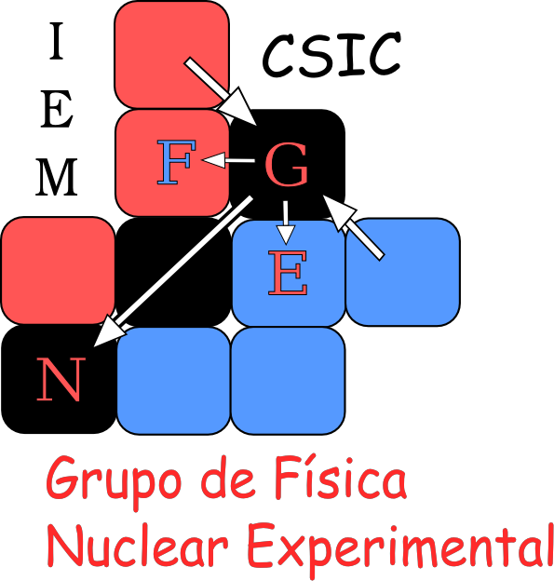
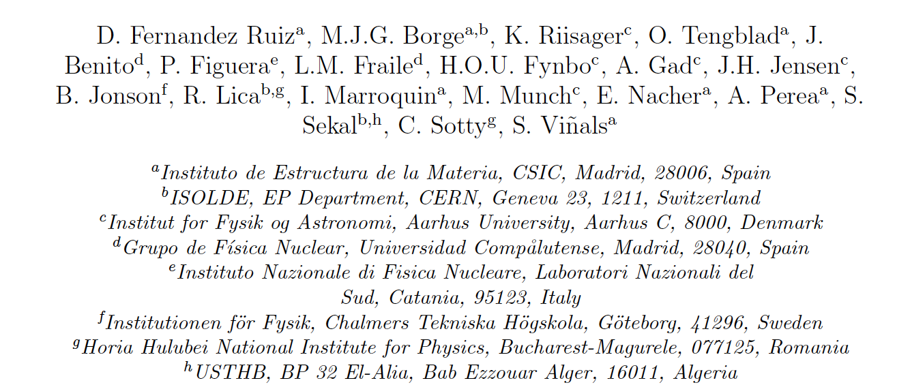



Special thanks to the members of the MAGISOL/IS633 collaboration
MAGISOL
And to you for your attention !!!
María J. Gª Borge 5th Nordic Meeting on Nuclear Physics, May 5th-8th, Visby, Sweden

Slide 18

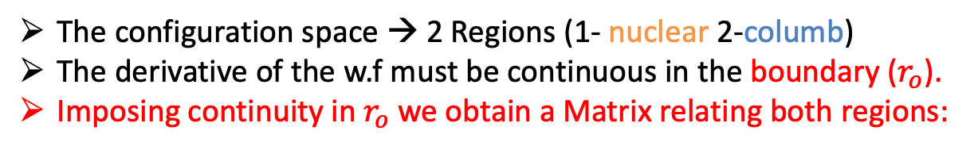

R-Matrix Fit: B_{F}, B_{GT} and Γ from the α-α spectrum
The $α$–$α$ spectrum is too complex to be fitted with a simple function (Gauss, Landau, …)
R-Matrix Method
The configuration space → 2 Regions (1- nuclear 2-columb)
The derivative of the w.f must be continuous in the boundary ($r_{o}$).
Imposing continuity in $r_{o}$ we obtain a Matrix relating both regions:
Internal Region
(Nuclear)
External Region
(Coulomb)
$$r_{o}$$
The R-Matrix is formed by individual nuclear resonances
Each with characteristics parameters (E,$B_{F}$, $B_{GT}$,$Γ$)
R-Matrix formalism → Nuclear resonances in reaction studies
→ β-decay followed by 2-body break up
A.M. Lane et al., Rev. Mod. Phys. 30(2):257-353, 1958
F.C. Barker, Aus. Journ. Phys. 22(3):293-316, 1969
María J. Gª Borge 5th Nordic Meeting on Nuclear Physics, May 5th-8th, Visby, Sweden

Slide 19
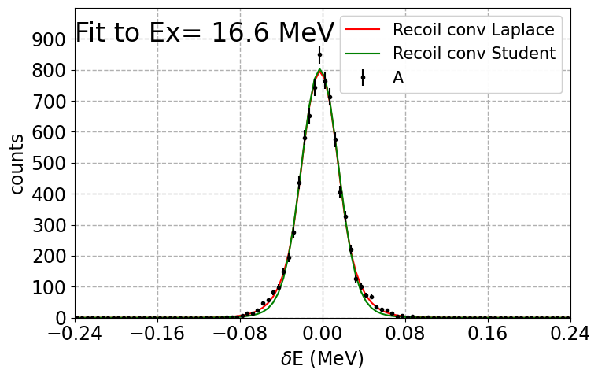

Study of the Recoil distribution: methodology
For a fixed value of Ex (i.e α₁ + α₂ - 92 keV) the β-recoil spectrum can be used to obtain $B_{F}$ and $B_{GT}$
The β-recoil spectrum is equivalent to the α₁ – α₂ spectrum
Ex=16,6 MeV
Compute α₁ - α₂
For all events with
α₁ + α₂-92 keV =16,60(5) MeV
The α₁ – α₂ spectrum is fitted using the recoil function folded with a response function with A as a fit parameter ($N_{β}$ and $N_{EC}$ ratio is computed theoretically and fixed).
The response function of the detectors at a fixed excitation energy is computed from simulated (Geant4) [Viñals et al, Eur. Phys. J. A 57, 49 (2021)]
María J. Gª Borge 5th Nordic Meeting on Nuclear Physics, May 5th-8th, Visby, Sweden

Slide 20







Why are these states interesting?
2⁺ Doublet populated by EC & β⁺ (2α) : $7Li ⨂ p ;7Be ⨂ n$
  “Total” Isospin Mixing deduced from αα-scattering [Hinterberger et al., NPA299 (1978)397]
  Assuming same matrix element →$\frac{r_{β+EC}(16.9MeV)}{r_{β+EC}(16.6MeV)}=2.4×{10}^{−2}$
⎸1> = ⎸T=0> =$\sqrt{\frac{1}{2}} [7Li ⨂ p −7Be ⨂ n]$
⎸2> = ⎸T=1> =$\sqrt{\frac{1}{2}} [7Li ⨂ p+7Be ⨂ n]$
P. von Brentano, Phys. Rep. 264 (1996) 57
The 1⁺ level @ 17.64 MeV populated by EC → decay of the core ⁷Be. Estimated branching 2.3 x 10⁻⁸ [Borge et al, j Phys. G 40(2013)035109]
$Ο$ ⎸c + h > = $Ο$ ( ⎸c > + ⎸ h > ) = ($Ο$ ⎸c> ) ⎸h> + ⎸c> ($Ο$ ⎸h > )
Nilsson Hyperfine Int. 129 (2000) 67

Slide 21











The β-recoil distribution is dependent on the ${}_{}^{8}{Be}$energy. (D. Schardt and K. Riisager, Z. Phys. A 345 (1997))
$w\left(t\right)=N_{β}\int_{W_{min}}^{W_{o}}{F(Z,W)\frac{p_{β}}{2k}\left[\left(c_{1}−c_{2}\right)W\left(W_{o}−W\right)−A\frac{c_{2}^{2}−c_{1}^{2}}{2}p_{β}\frac{t}{k}−A\frac{c_{2}^{3}−c_{1}^{3}}{3}p_{β}^{2}\right]dW}+$ $N_{EC}$ $\frac{f_{BK}+f_{BL1}}{2T_{max}}$
Recoil
Distribution
Fermi function
Asymmetry parameter
$β$-component
Ec-component
Angular Momentum
$$W_{min}=\left\{\begin{aligned} \frac{m^{2}+{\left(W_{o}+t/k\right)}^{2}}{2\left(W_{o}+t/k\right) } for\frac{t}{k}<{−(W}_{o}−m) \\ m for\left|\frac{t}{k}\right|≤{(W}_{o}−m) \\ \frac{m^{2}+{\left(W_{o}−t/k\right)}^{2}}{2\left(W_{o}−t/k\right)} for\frac{t}{k}>{(W}_{o}−m)\end{aligned}\right.$$
A$=\frac{g_{v}^{2}B_{F}−\left(1/3+2/{30}τθ\right)g_{A}^{2}B_{GT}}{g_{v}^{2}{B_{F}+g}_{A}^{2}B_{GT}}$
$$θ=\left\{\begin{aligned}&−\frac{J´+1}{2J´−1} J´=J+1 \\ &1 J´=J \\ &−\frac{J´}{2J´+3} J´=J−1 \end{aligned}\right.$$
β
$$c_{1}=min\left\{\cos{ψ_{max}},max\left[\cos{ψ_{min}},\frac{W−W_{o}−t/k}{p_{β}}\right]⁡\right\}$$
$$τ=10{\left[\frac{L\left(L+1\right)\left(2L+1\right)}{\left(2L−1\right)\left(2L+3\right)}\right]}^{1/2}$$
$$c_{2}=max\left\{\cos{ψ_{min}},min\left[\cos{ψ_{max}},\frac{W−W_{o}−t/k}{p_{β}}\right]⁡\right\}$$
⁺β
For ⁸B $→$ ⁸Be ΔJ=0 and ΔL=2 therefore $τθ$=10 and $B_{F}$ and $B_{GT}$ can be deduced from A
A$=\frac{g_{v}^{2}B_{F}−\left(1/3+2/{30}τθ\right)g_{A}^{2}B_{GT}}{g_{v}^{2}{B_{F}+g}_{A}^{2}B_{GT}}$
$$\frac{B_{F}}{B_{GT}}\left(\frac{g_{v}^{2}}{g_{A}^{2}}\right)=−\frac{\left(A+1\right)}{\left(A−1\right)}$$
A=1 -> $B_{GT}$=0
A=0 -> $B_{F}$=$B_{GT}$
A=-1 -> $B_{F}$=0

