Slide 1
Beta-delayed two-proton and alpha decay of light proton-rich nuclei
Beta-delayed two-proton and alpha decay of light proton-rich nuclei
15th Nordic Meeting on Nuclear Physics, Visby, 2026
Erik A. M. Jensen — Experimental Subatomic Physics — Chalmers
Notes:
To add text in the slide master:
Go to the top menu, choose > View > Slide Master. In the absolute first slide, change to the preferred text.
Close Master View. The new text will permeate on all slides.

Slide 2
Beta-delayed two-proton and alpha emission
Take-home message:
Beta decay is a very powerful and versatile tool in light nuclear structure studies
→ Exemplified here via β2p and βα
→ Wednesday: Riisager, Nielsen, Borge
β2p has the potential to give new insights into pp correlations
2
NMNP Visby 2026

Slide 3
2-proton emission
3
NMNP Visby 2026

Slide 4
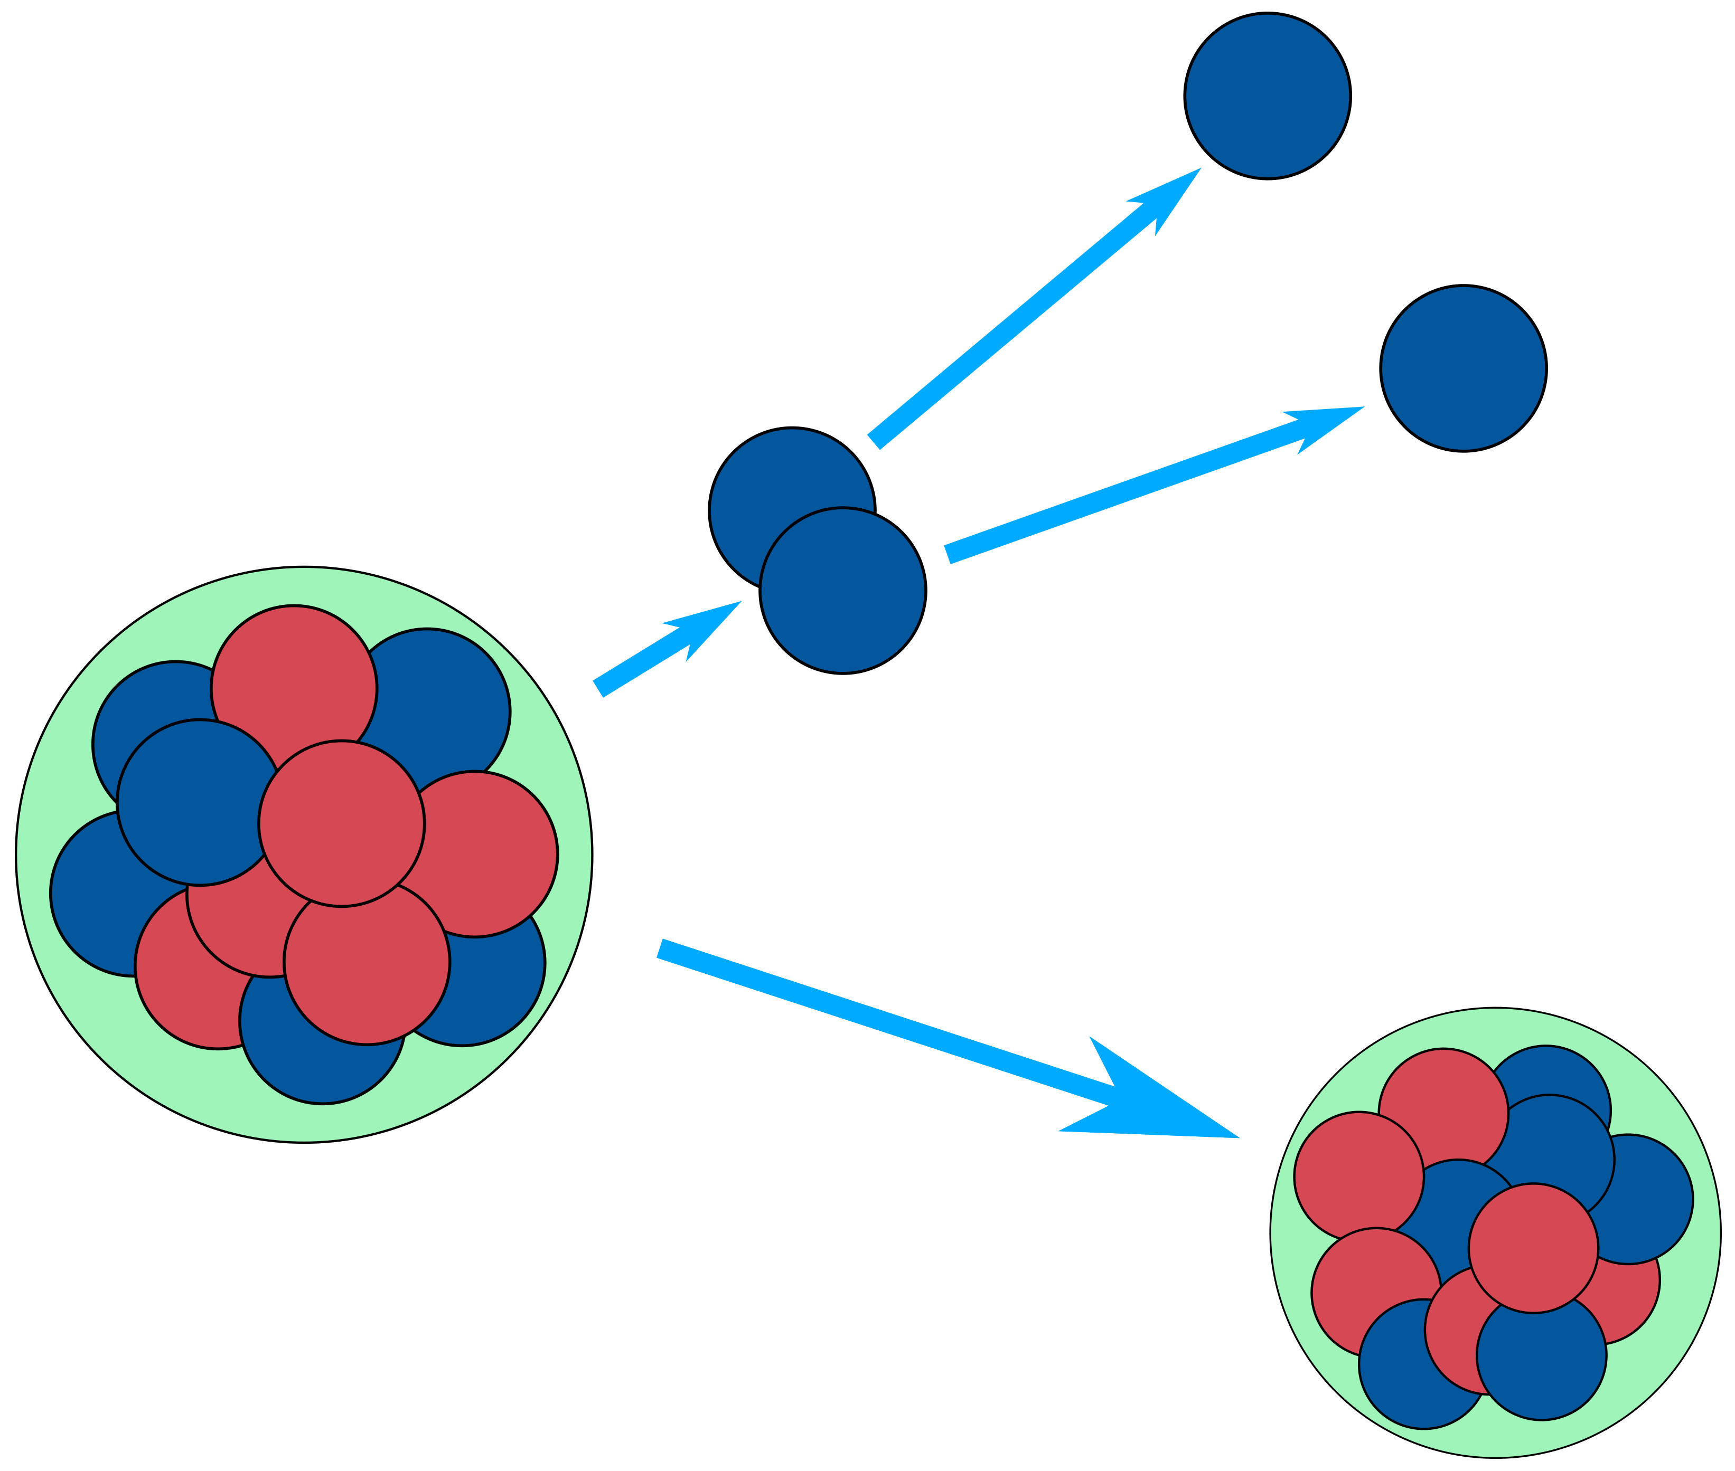
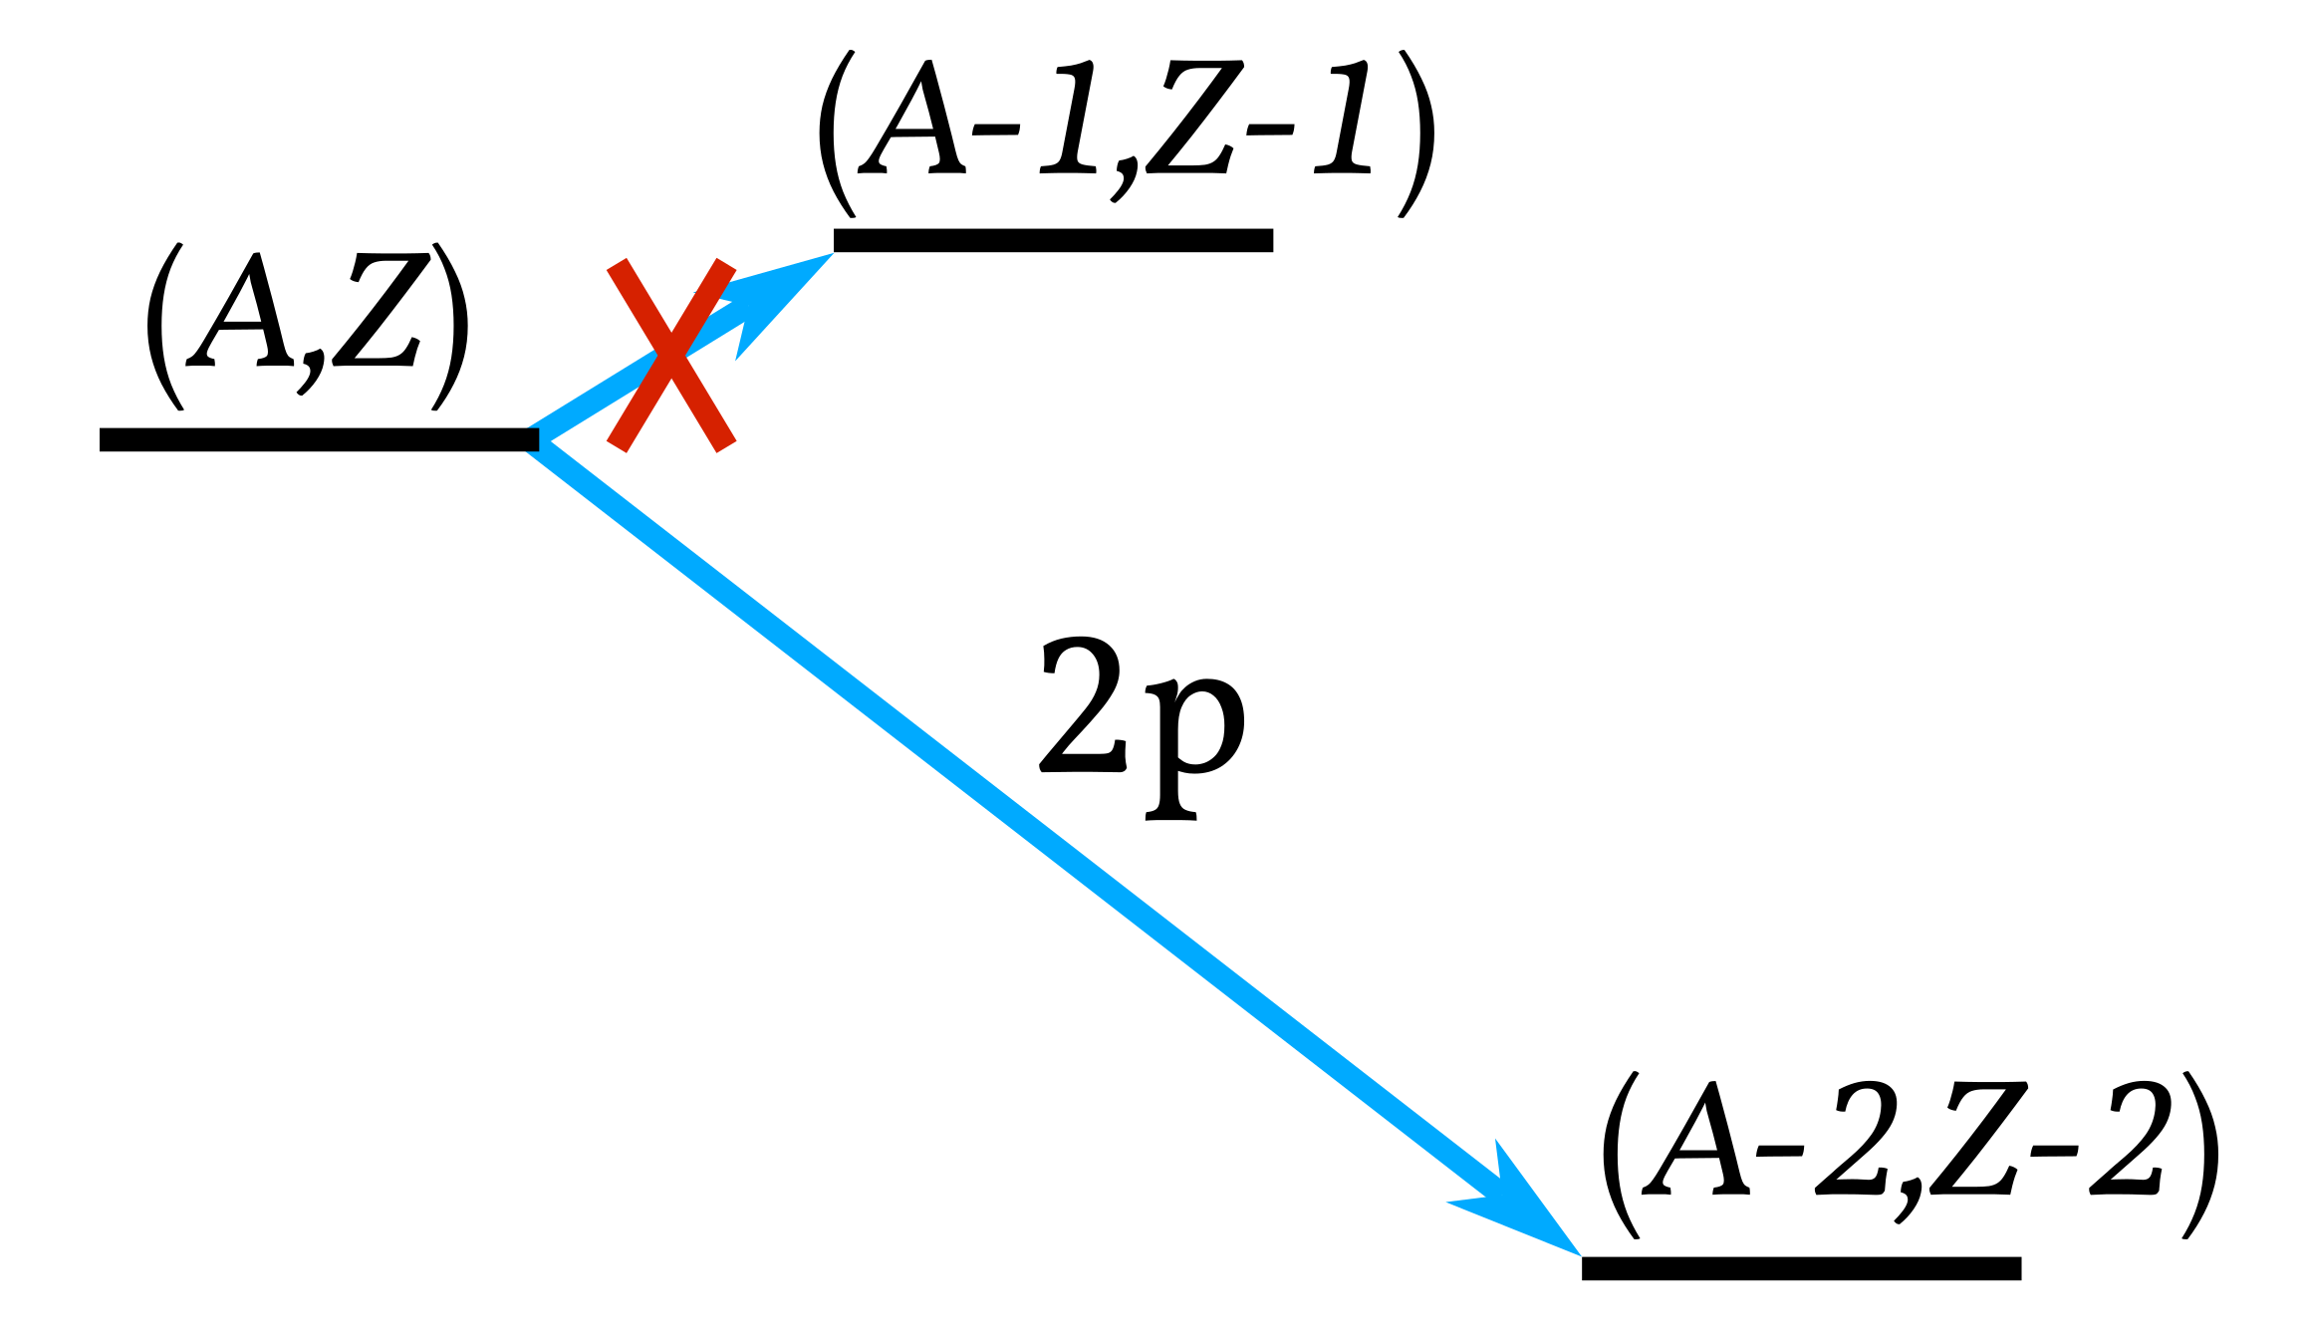
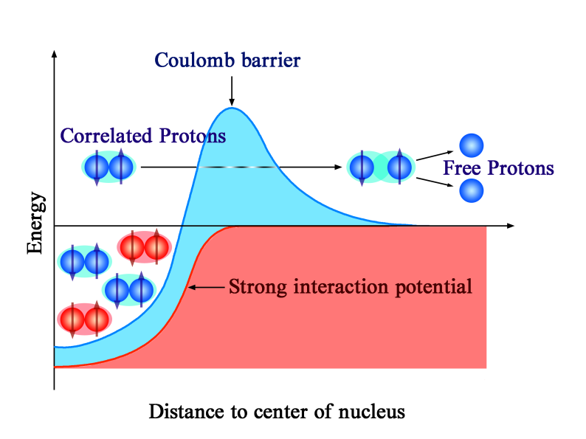
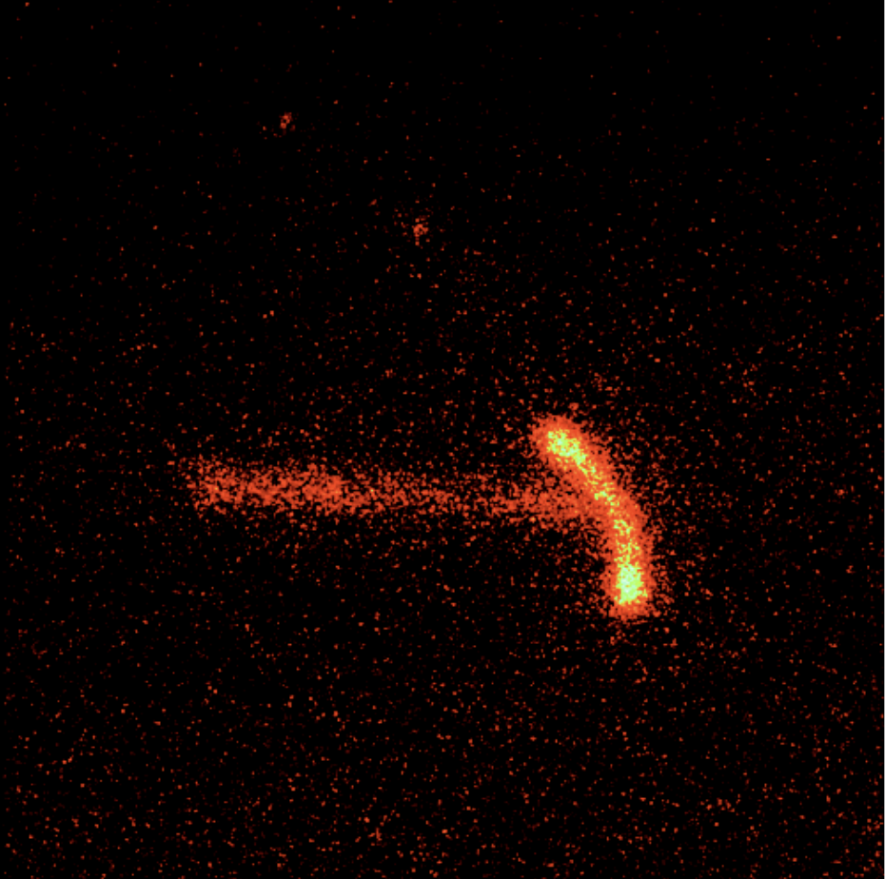
2-proton emission
Sequential: Emit one proton, and then another
Direct: Two protons, “²He”, emitted simultaneously
p
K. Miernik et al., PRL 99, 192501 (2007)
Known long-lived ground state 2p emitters:
⁴⁵Fe, ⁴⁸Ni, ⁵⁴Zn, ⁶⁷Kr
Image by Lijie Sun
⁴⁵Fe
4
NMNP Visby 2026

Slide 5
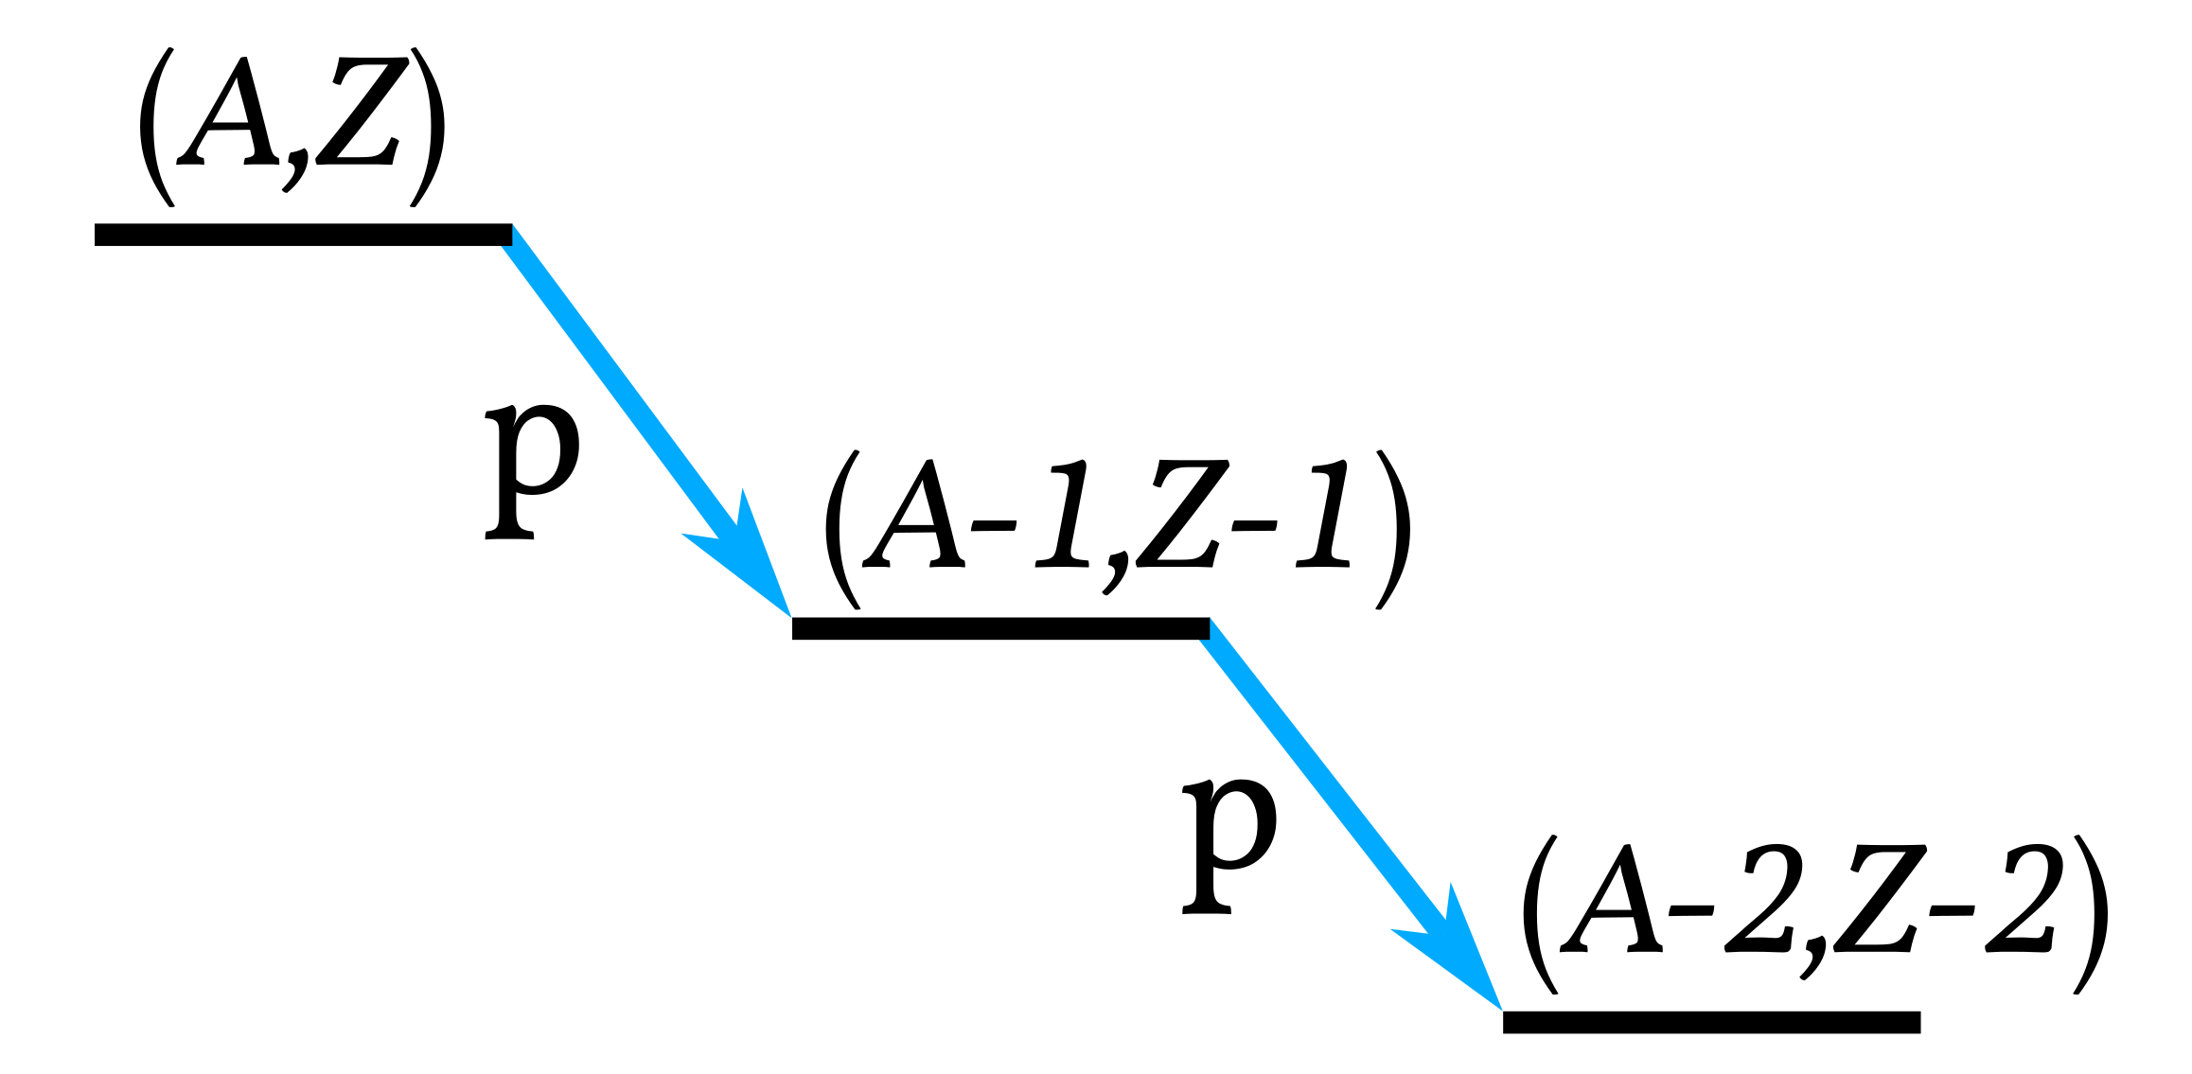
2-proton emission
2-proton emission following beta decay:
1-proton daughter is always accessible…
→ … and sequential decay mode is found to dominate
→ Direct decay mode yet to be observed
Image by Lijie Sun
5
NMNP Visby 2026

Slide 6
Beta-delayed charged particle emission
— A Primer —
6
NMNP Visby 2026

Slide 7
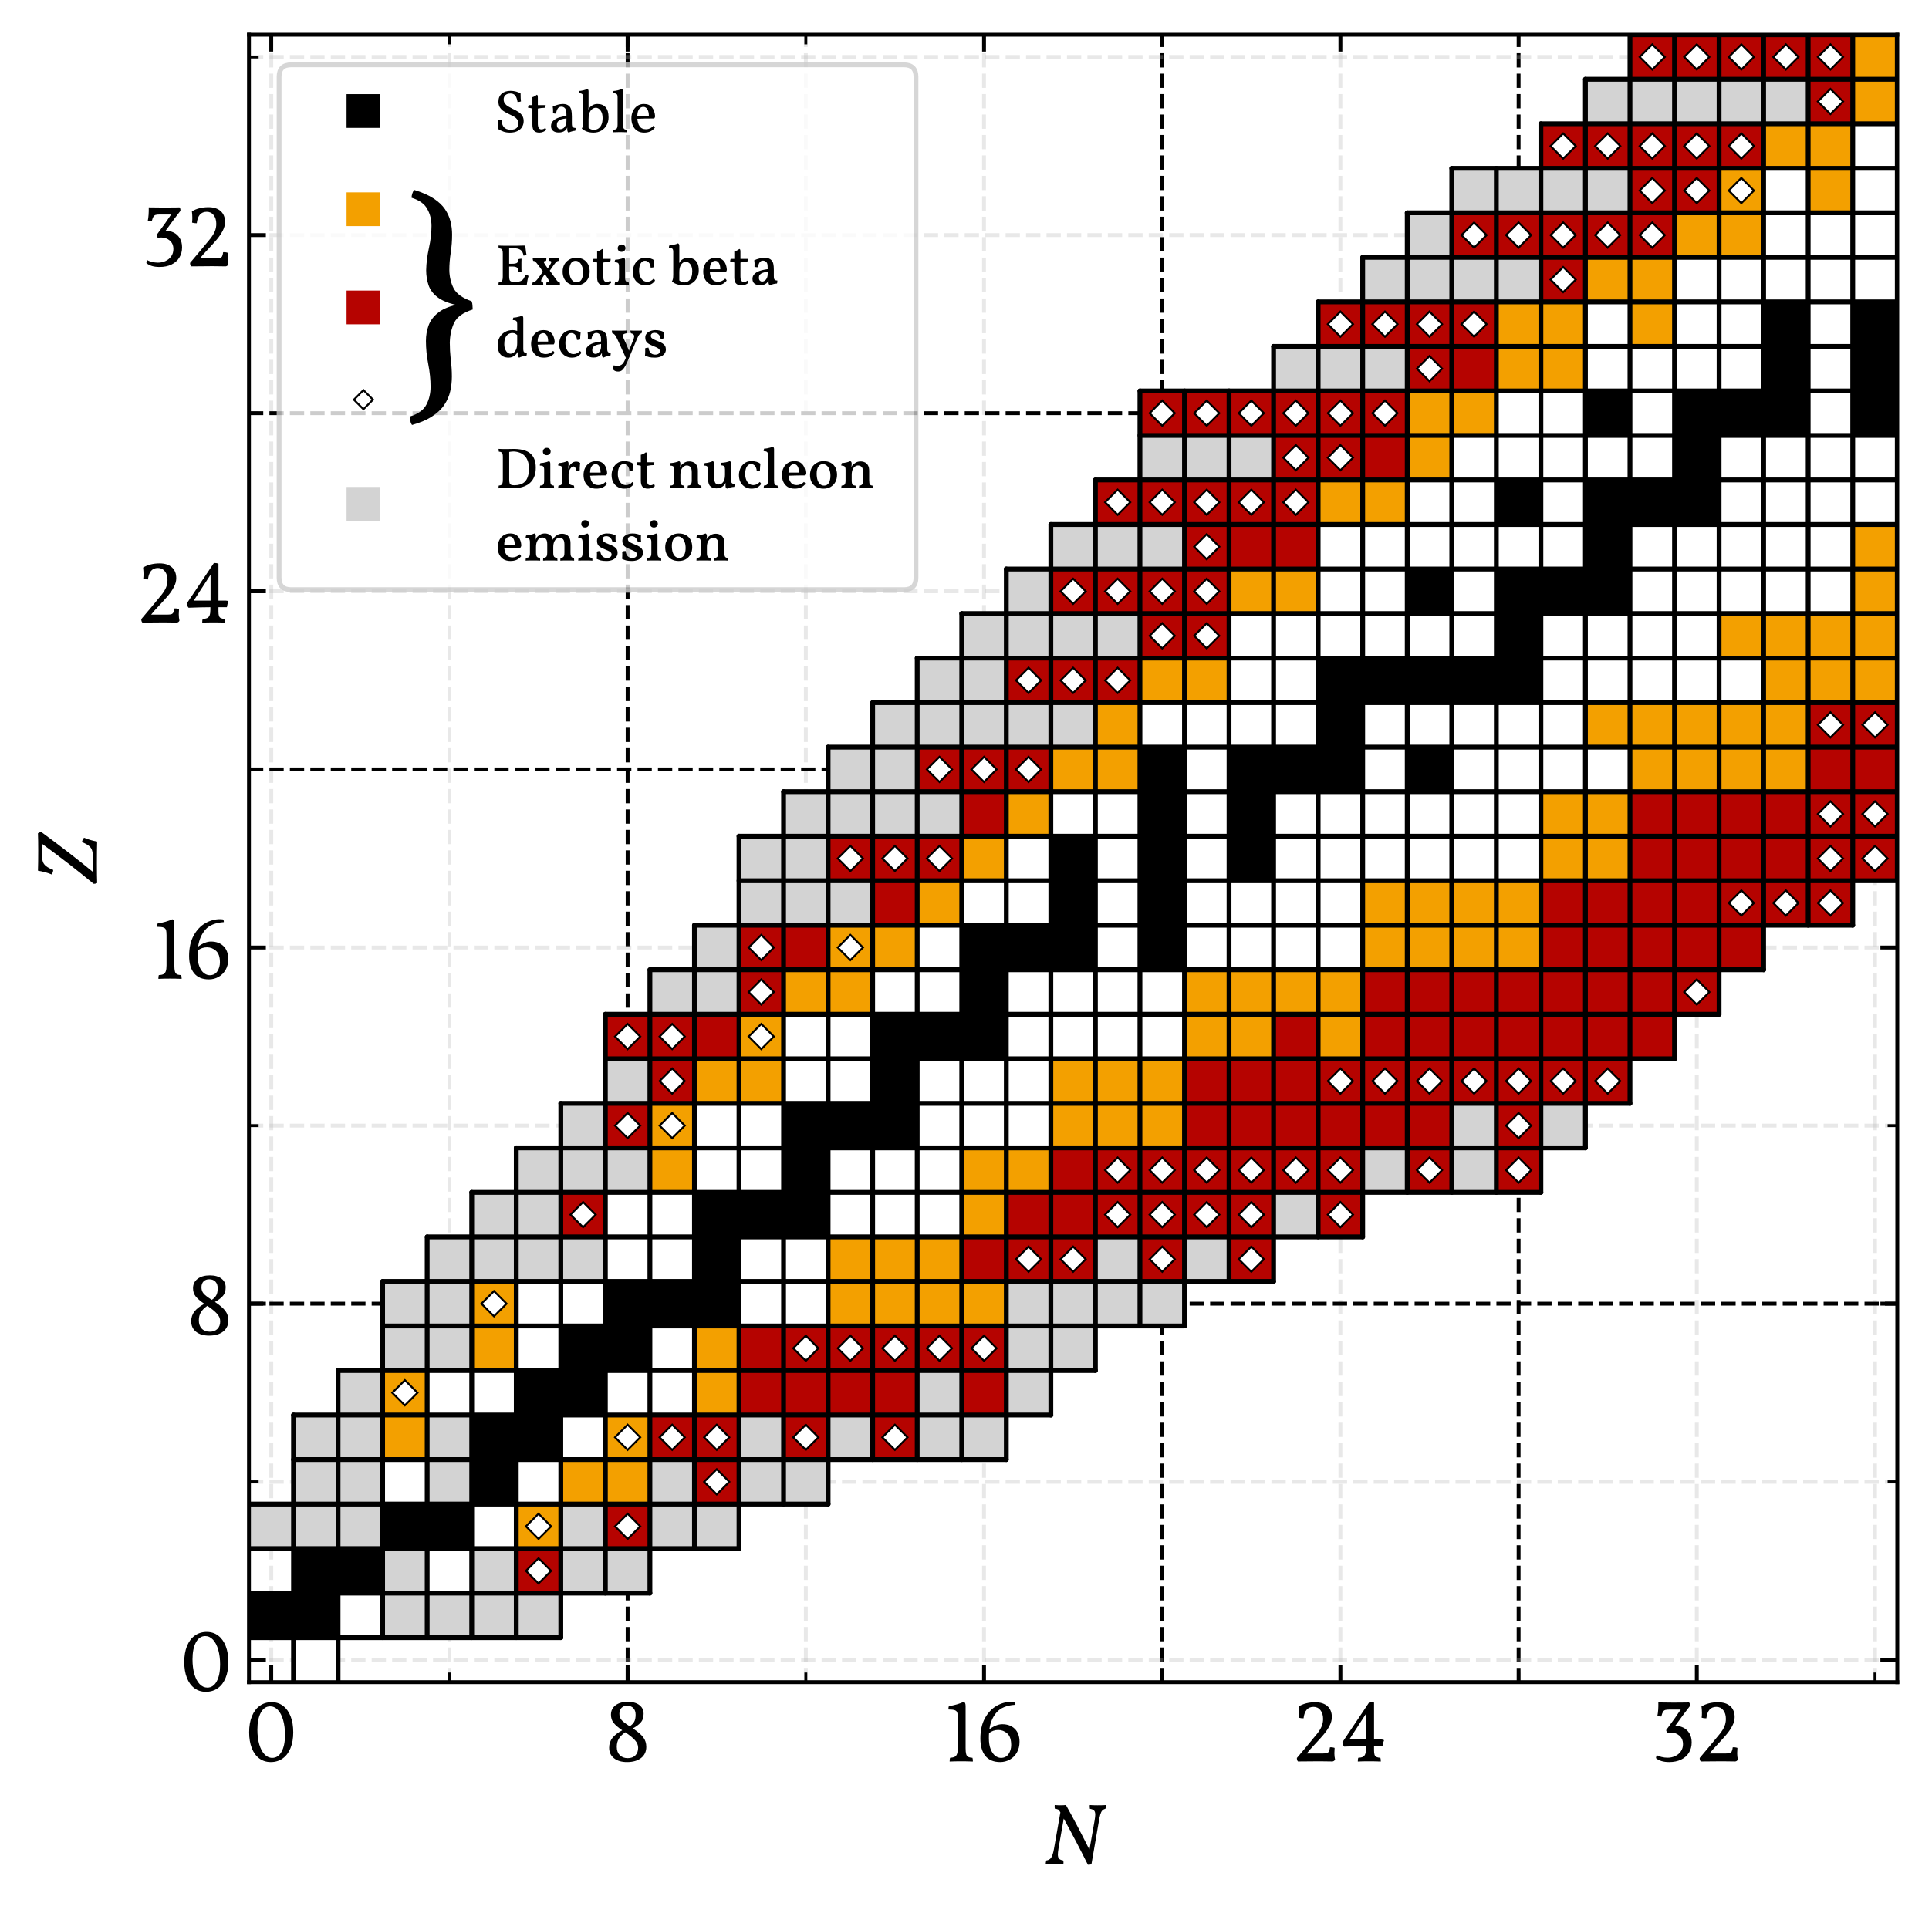
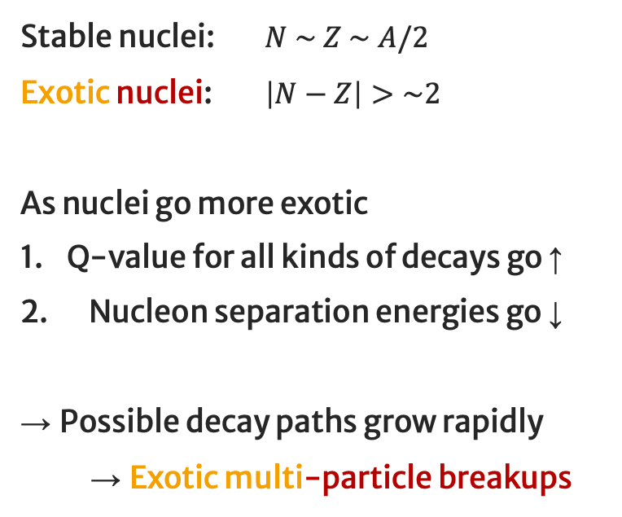
Light exotic nuclei
Stable nuclei: $N \sim Z \sim A/2$
Exotic nuclei: $\left|N−Z\right|>\sim 2$
As nuclei go more exotic
Q-value for all kinds of decays go ↑
Nucleon separation energies go ↓
→ Possible decay paths grow rapidly
→ Exotic multi-particle breakups
7
NMNP Visby 2026

Slide 8
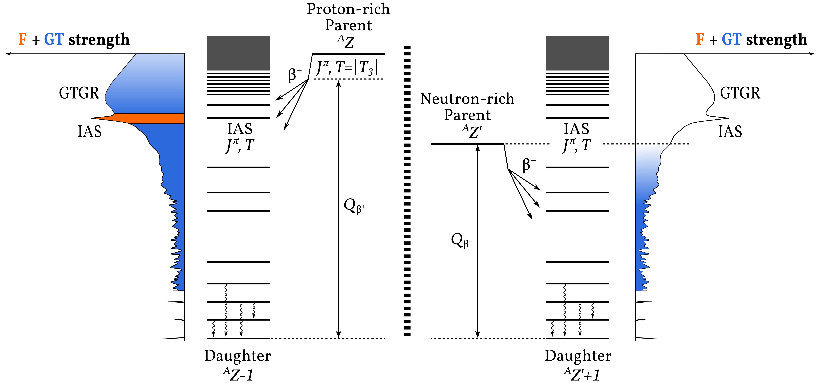






Beta decay
$$ft_{1/2}=\frac{K}{B_{F}^{}+{(g_{A}/g_{V})}^{2}B_{GT}^{}}$$
Σ$B_{F}^{}=|N−Z|$
$$\text{Σ}B_{GT}^{} ≥ 3 \text{Σ}B_{F}^{}$$
$$K=6144.48±3.70 s$$
→
Hardy and Towner PRC 102, 045501 (2020)
Mirror nuclei: Swap $N→Z$ and $Z→N$
$$f≈ε_{β,tot}^{5}/30$$
8
NMNP Visby 2026

Slide 9
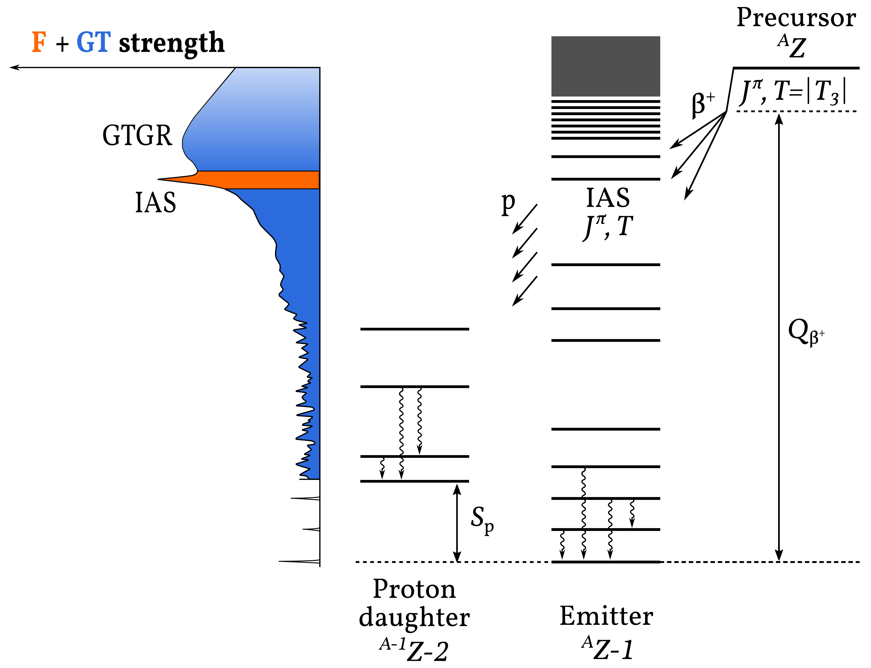
Exotic multi-particle breakups
9
NMNP Visby 2026

Slide 10
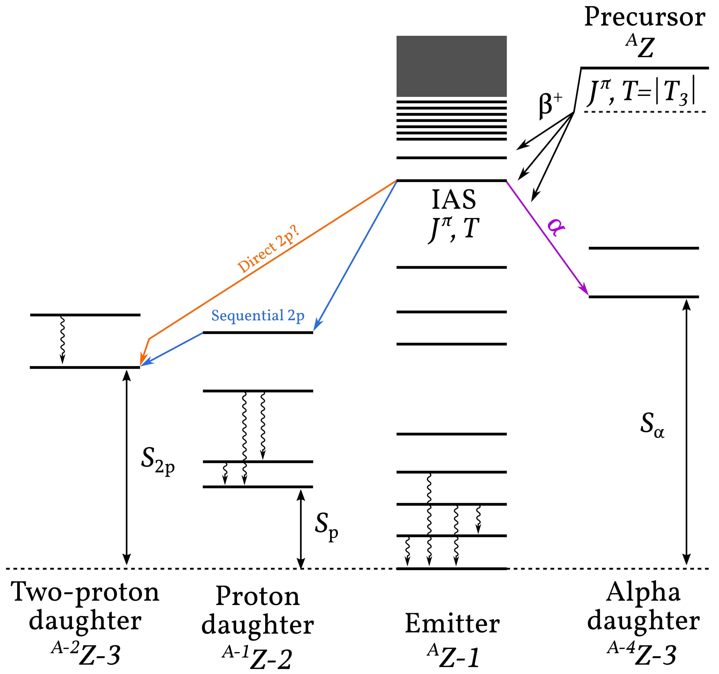
Exotic multi-particle breakups
Image by Lijie Sun
10
NMNP Visby 2026

Slide 11
Exotic multi-particle breakups
26 experimentally feasible* β2p precursors
11
NMNP Visby 2026

Slide 12
Exotic multi-particle breakups
26 experimentally feasible* β2p precursors
Image by Lijie Sun
🏅
Coulomb barrier
12
NMNP Visby 2026

Slide 13
Radioactive Ion Beam production; briefly
13
NMNP Visby 2026

Slide 14
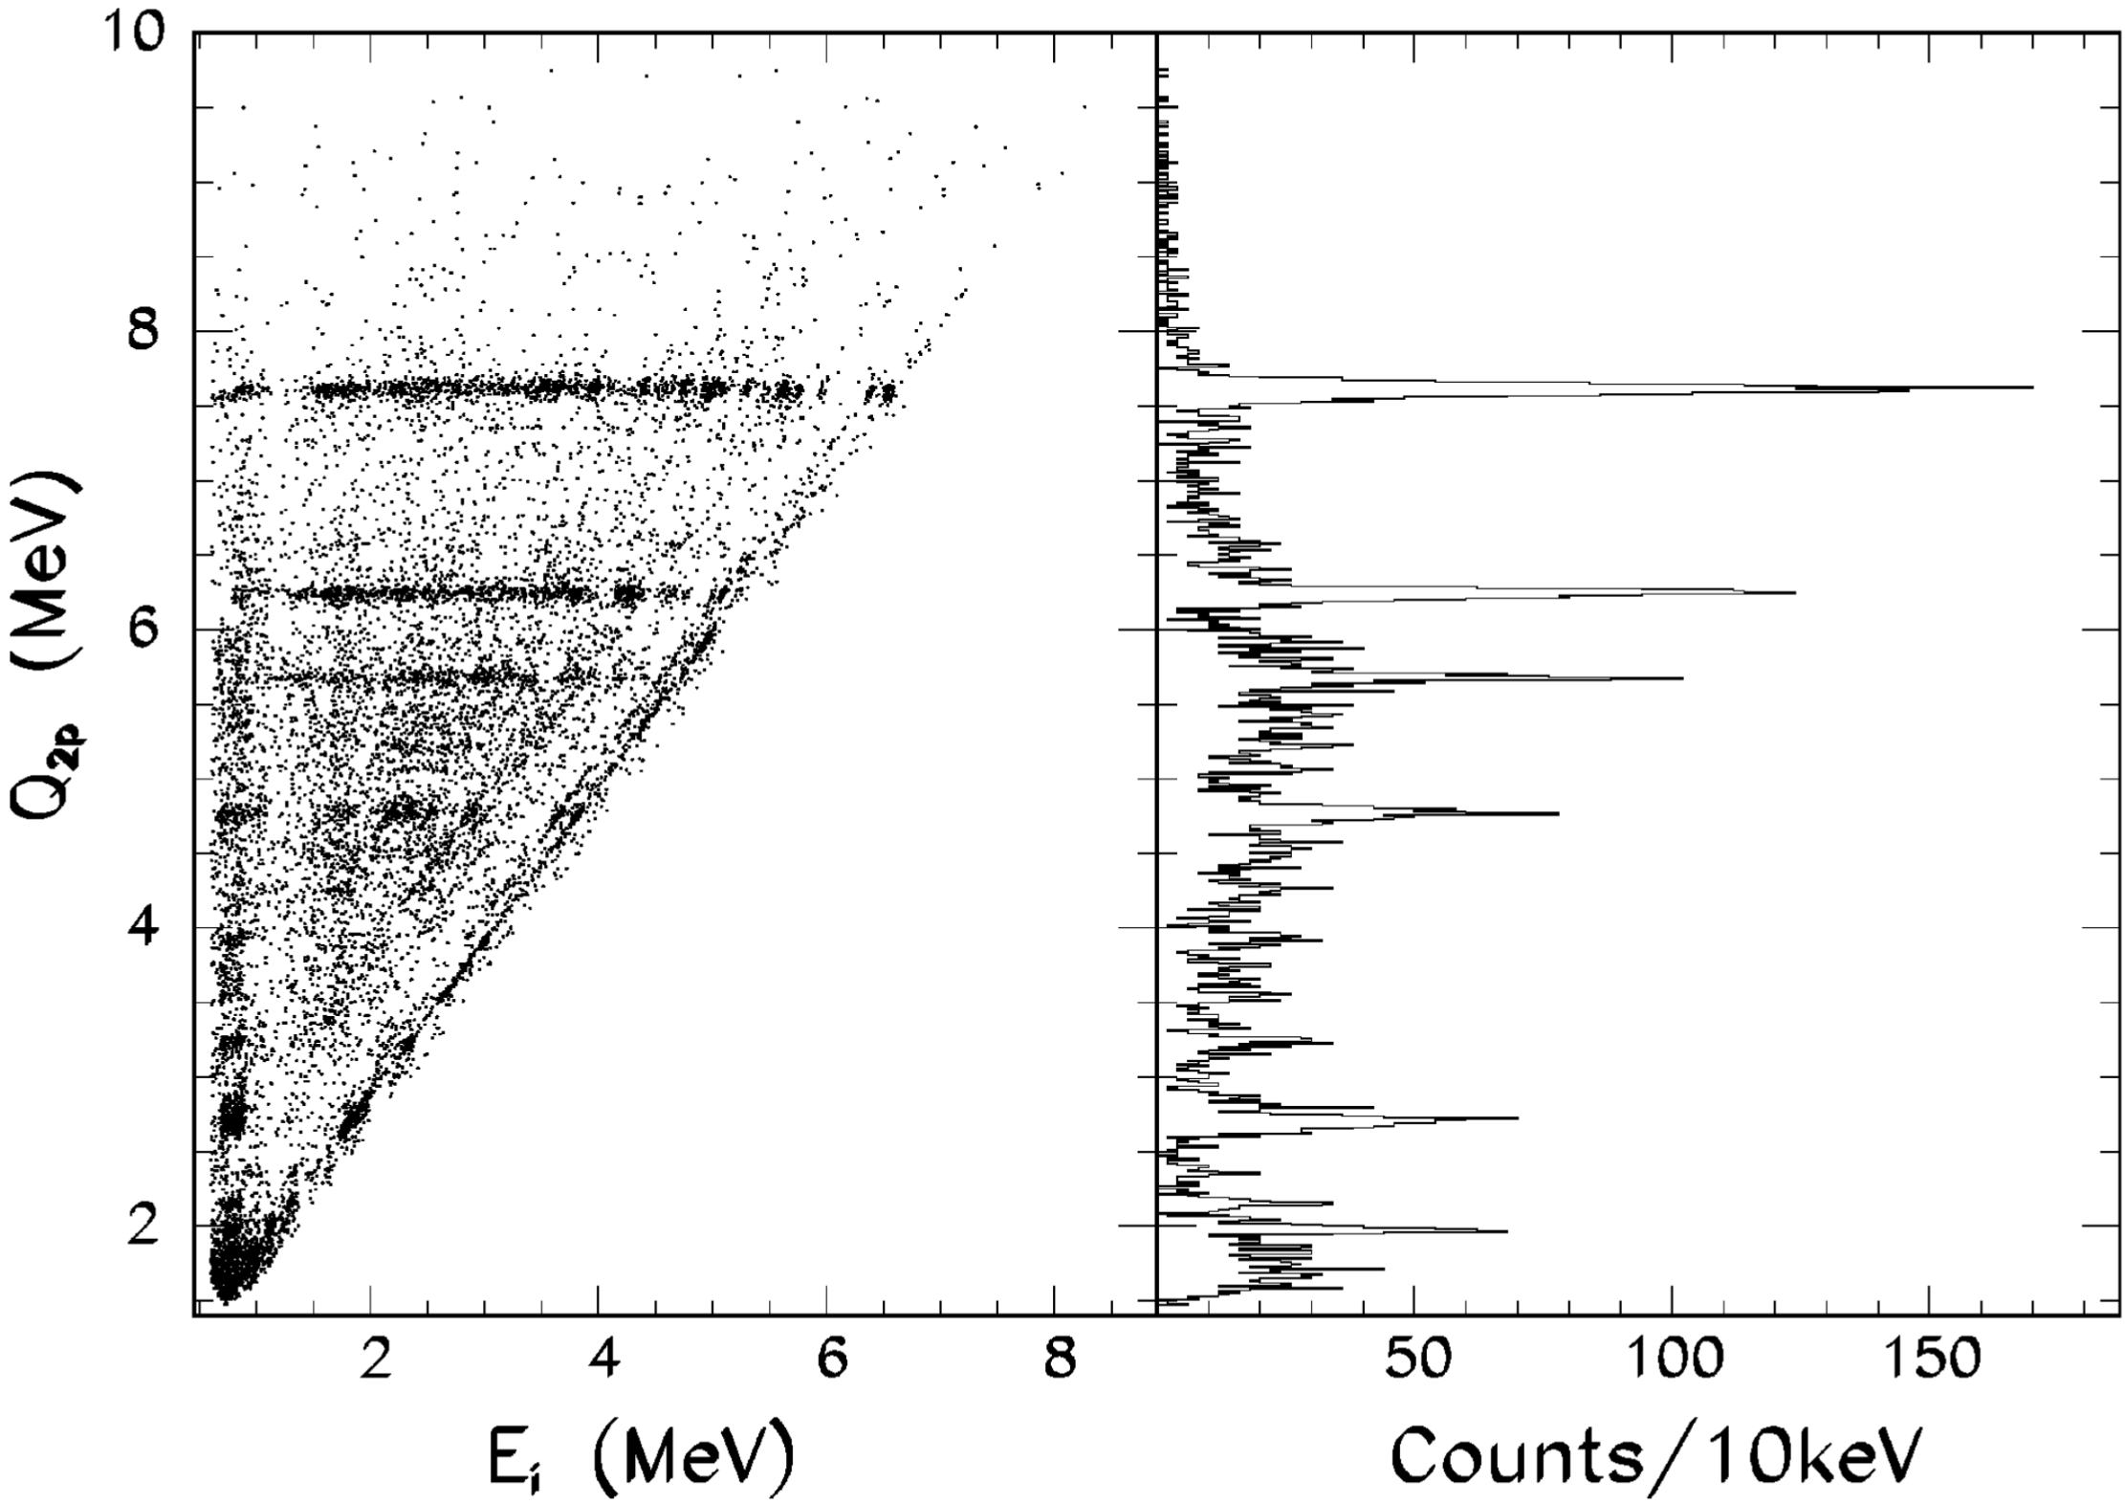
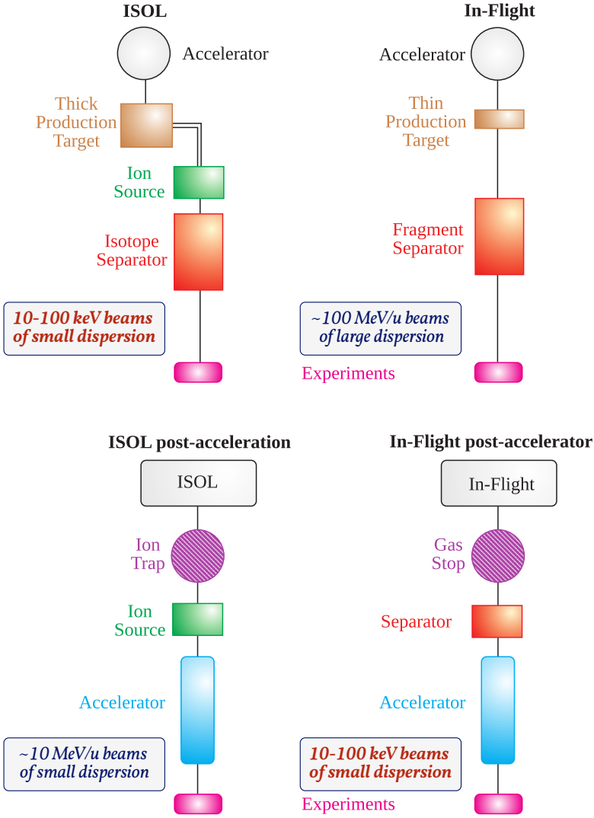
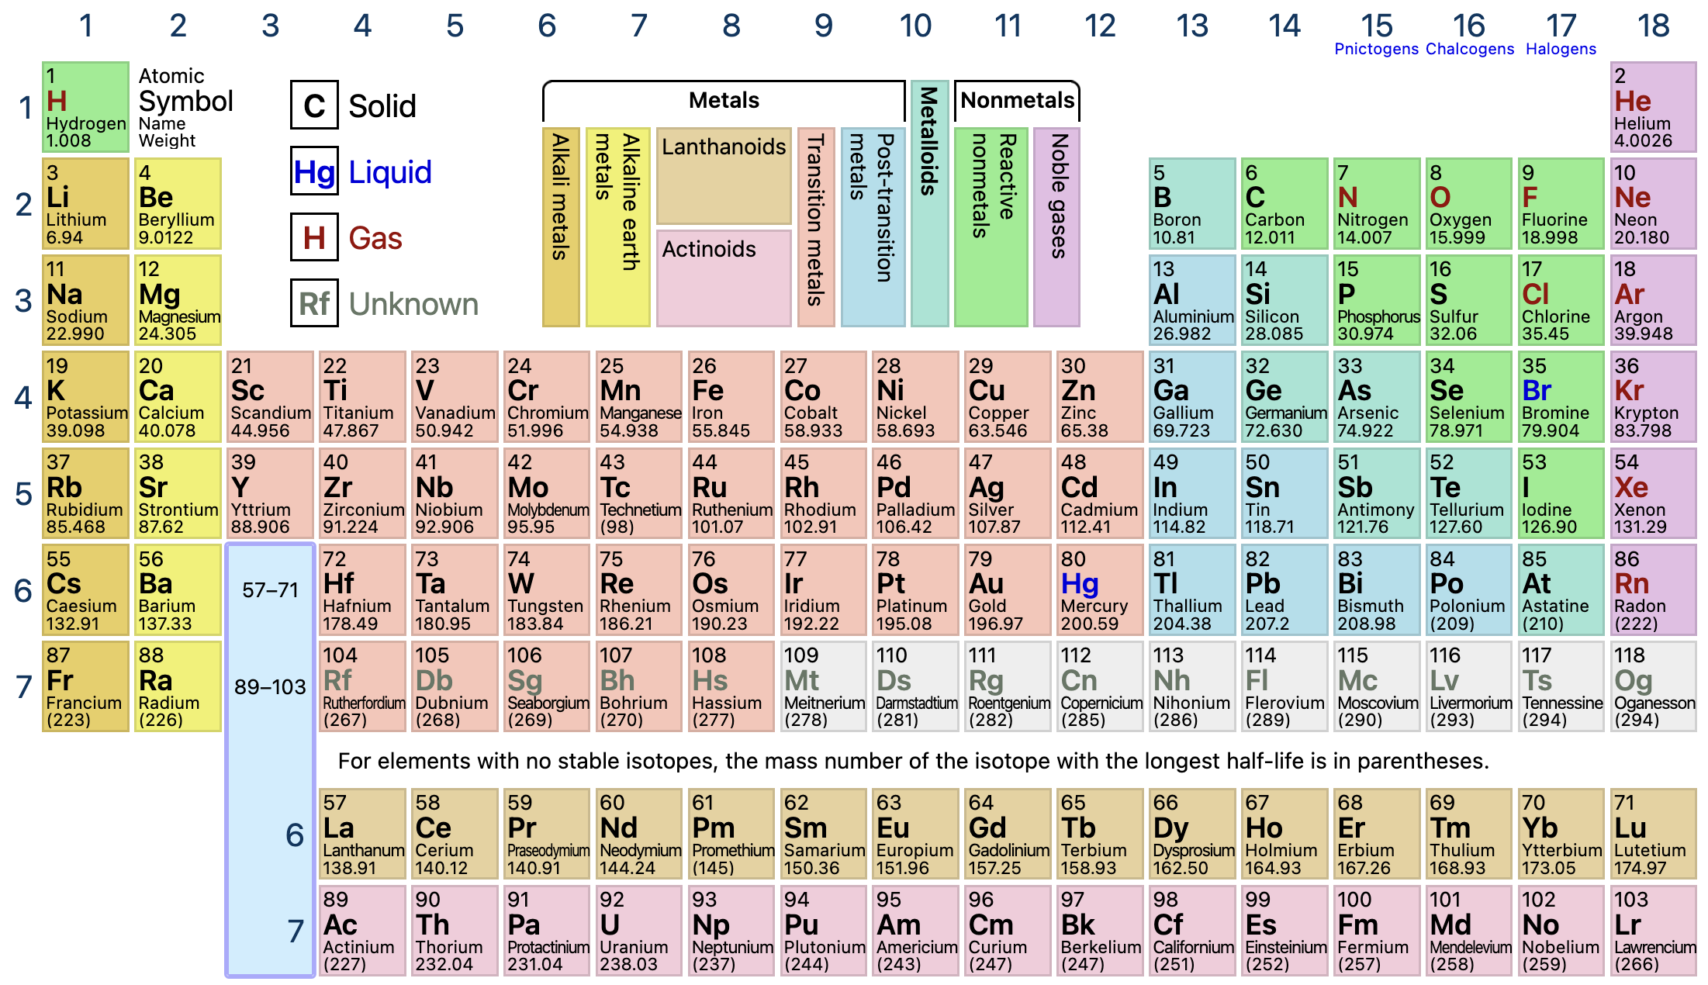
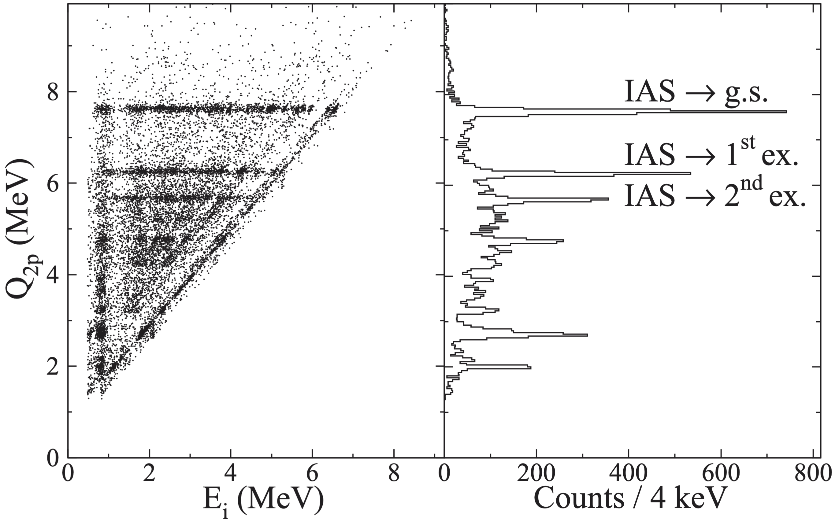
ISOL and in-flight
H. O. U. Fynbo et al., Nucl. Phys. A 677 (2000), 38
ptable.com
³¹Ar β2p
³¹Ar
🏅
ISOL and in-flight are complementary
Points at which chemistry makes life difficult
Adapted from B. Jonson, NuPECC Report (2000)
G. T. Koldste et al., Phys. Rev. C 89 (2014), 064315
²⁹P
³⁰S
³¹Cl
²⁷P
14
NMNP Visby 2026

Slide 15
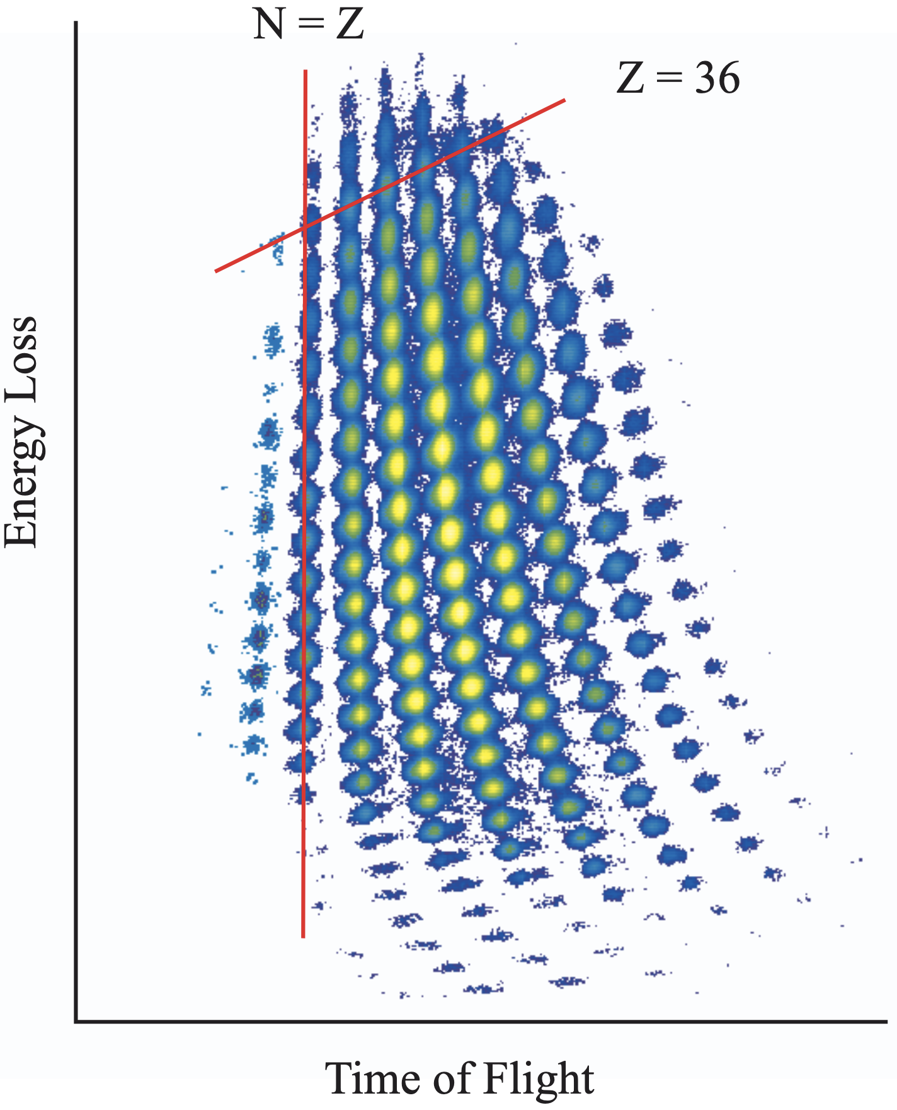
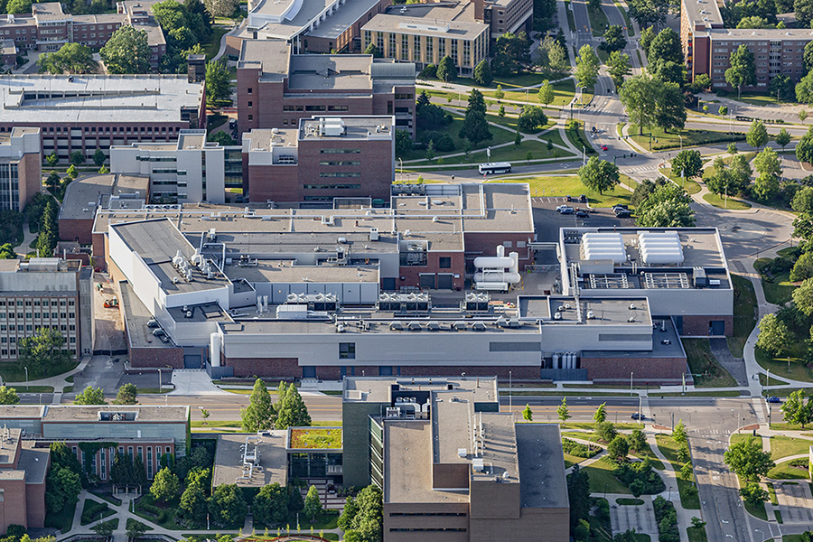
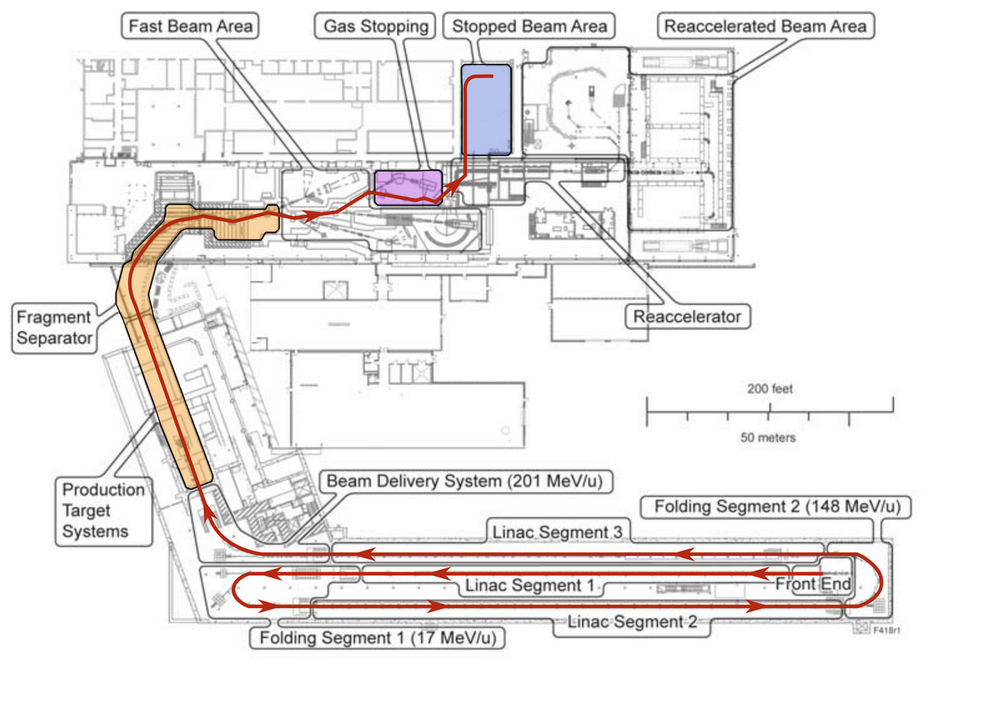
Facility for Rare Isotope Beams
Adapted from J. G. Weisend II et al., AIP Conf. Proc. 1434 (2012), 94
30 keV radioactive beam
D. J. Morrissey and B. M. Sherrill, Lect. Notes Phys. 651 (2004), 113
Courtesy of C. S. Sumithrarachchi
ISOL-like beam quality!
~ 100 MeV/u
~ 200 MeV/u
1st Beta-Decay Experiment in Gas Stopping Area at FRIB in 2023:
Primary beam ³⁶Ar @ 210 MeV/u
Production target ¹²C
Cooling of in-flight beam in Gas Stopper
1st publication accepted in PRL last week 🎉
frib.msu.edu
Adapted from R. Ringle et al., Nucl. Instrum. Meth. Phys. Res. B 496 (2021), 61
Adapted from B. Jonson, NuPECC Report (2000)
~ 100 MeV/u
30 keV
15
NMNP Visby 2026

Slide 16
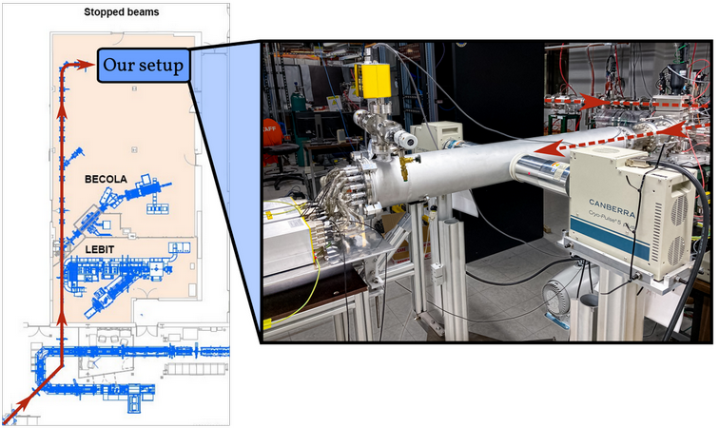
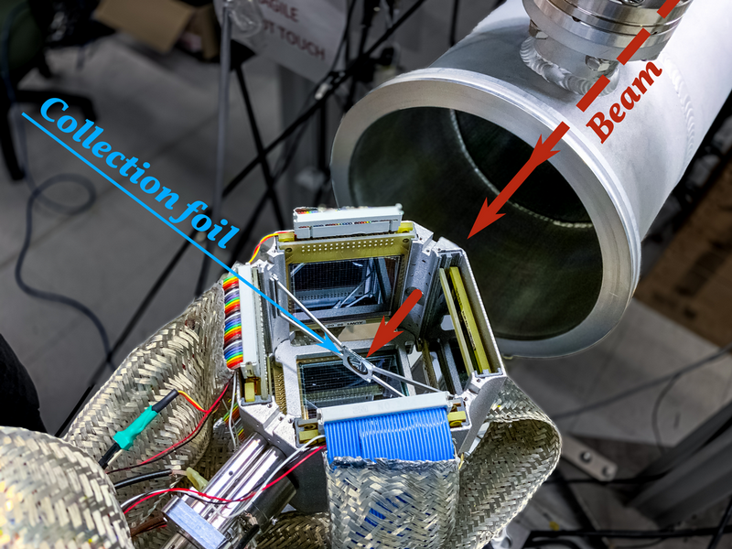
Our custom-built setup
Germanium detectors
²²Al
β1p + β2p of ²²Al
²⁰Ne
²¹Na
²²Mg
¹⁸Ne
MAGISOL Silicon Cube :
- 6 ΔE-E silicon detectors
ΔE: 16x16 DSSSDs
- 42 % of 4π for p/α
- 18 % of 4π for 2p
16
NMNP Visby 2026

Slide 17
β2p of ²²Al
17
NMNP Visby 2026

Slide 18
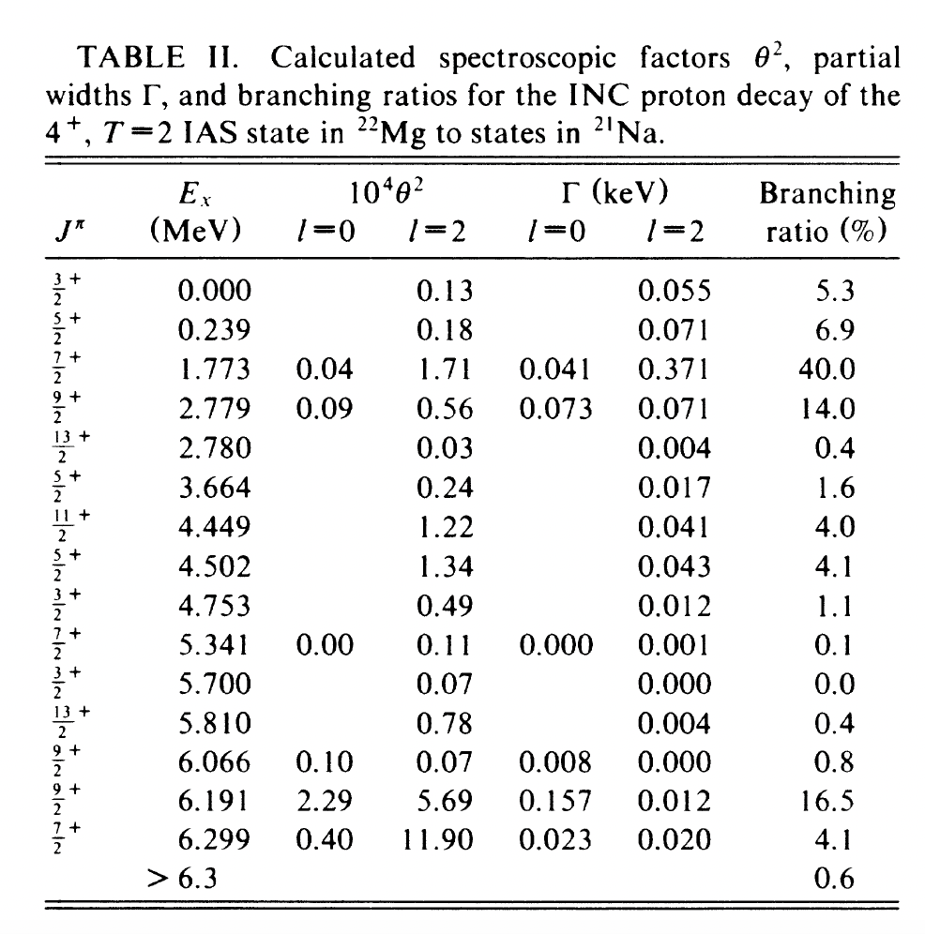
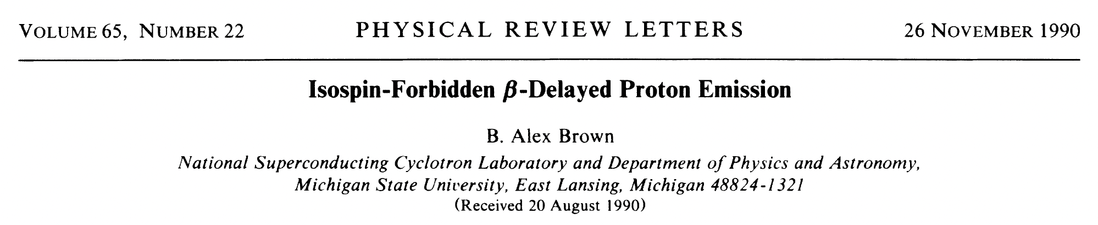
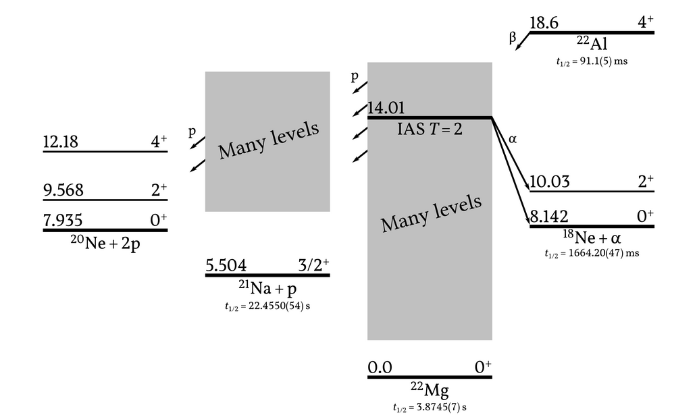
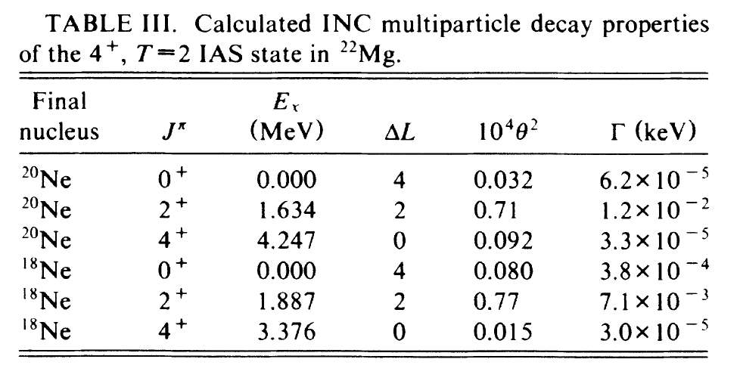
β2p of ²²Al
1p
~70%
2p
~30%
Theory
“²He”
~1.1%
}
Similar
α
~0.7%
18
NMNP Visby 2026

Slide 19
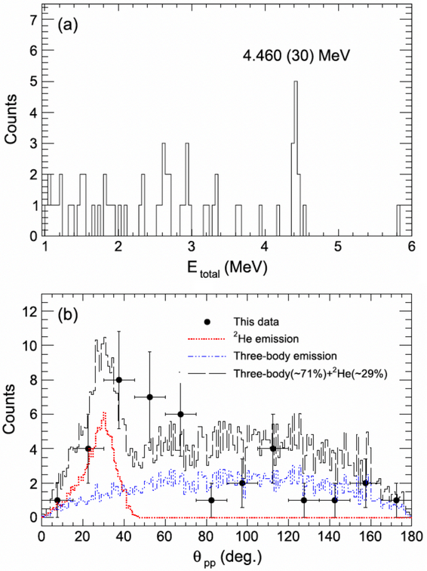
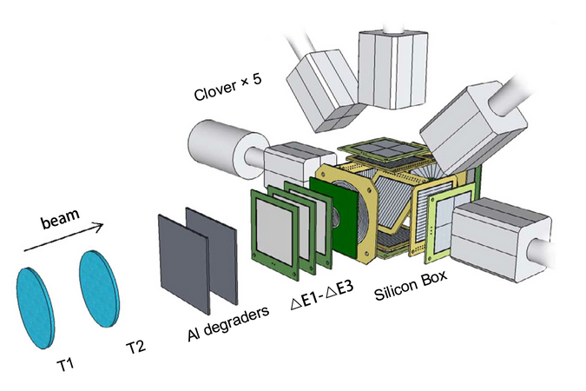
β2p of ²²Al
Y.T. Wang et al. Phys. Lett. B784 (2018) 12
“²He”
29(13)%
Experiment
Low statistics
Low resolution
Discrimination between 1p and 2p branches difficult
In-flight @ RIBLL1
19
NMNP Visby 2026

Slide 20
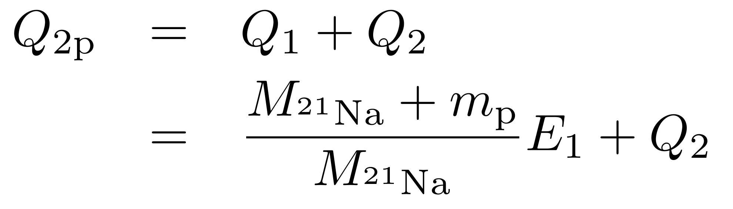
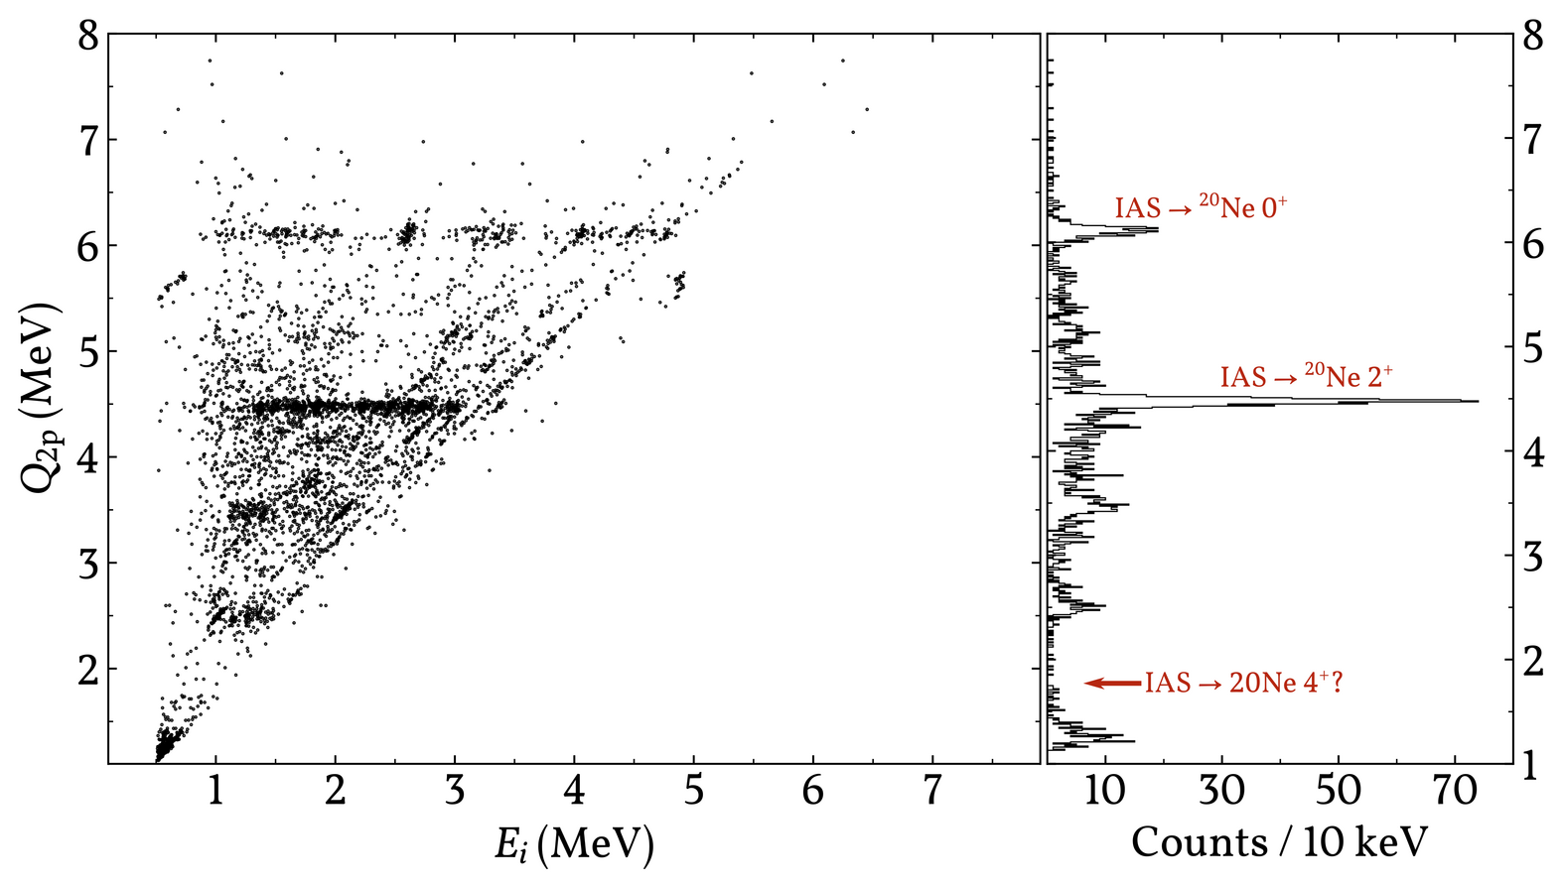
β2p of ²²Al
33 h beam time
9*10³ pps expected
7*10⁰ pps delivered
Sequential decay:
Nevertheless,
1.2*10⁵ 1p events
2.4*10³ 2p events
Order of magnitude more than ever before; with superior resolution!
20
NMNP Visby 2026

Slide 21
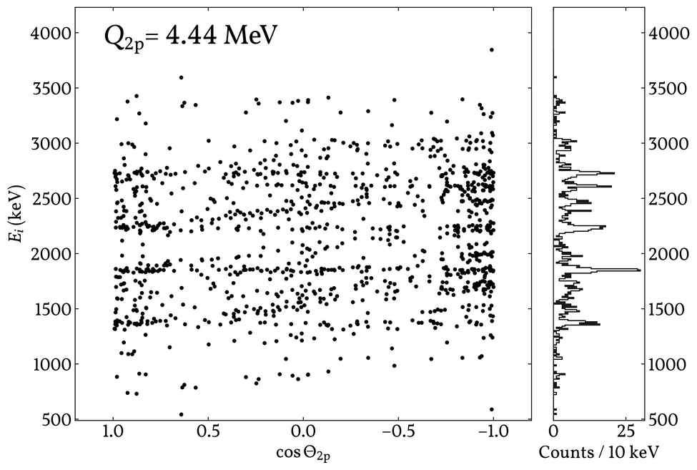
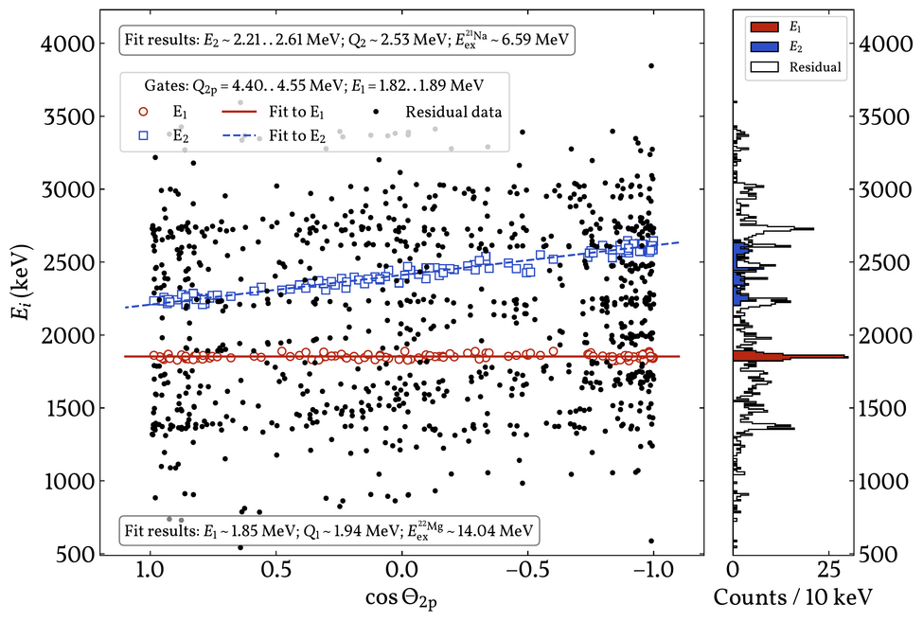




β2p of ²²Al
6.5 MeV
Never-before seen level in ²¹Na!
Hence, likely 9/2⁺ via s-wave
2 other never-before seen levels within this energy gate
Sequential decay:
$$E_{1}$$
const. w.r.t
$$Θ_{2p}$$
$$E_{2}$$
lin. in
$$cosΘ_{2p}$$
21
NMNP Visby 2026

Slide 22
β1p, β2p and βα of ²²Al via IAS in ²²Mg
Clarifications and many new 2p branches!
No indication of “²He”
However, fairly large α branch...
B.R.s (%) | Exp. FRIB ‘23 | Exp. RIBLL1 ‘21 | Exp. GANIL ‘06 | Theory SM ‘90
1p | ~70 | 51 | 40 | ~70
2p | ~25 | 43 | 58 | ~30
α | ~5 | 4 | 2 | ~1
”²He” | <1 | ~2 | - | ~1
TODO:
- Decay scheme ↔ angular correlations ↔ beta strength mapping ↔ upper limit
- More statistics would be nice...
Based on 2-3k 2p events
22
NMNP Visby 2026

Slide 23
Outlook
The search for statistically significant direct β2p is now possible!
Present yields at FRIB:
²²Al | 2.4*10³ pps
²²Si | 10~20 pps
²³Si | 4*10² pps
²⁶P | 1~2*10³ pps
²⁷S | 80 pps
✓ Measured
✓ Estimated
New theoretical evaluations welcome!
23
NMNP Visby 2026

Slide 24
βα and the halo nature of ²²Al
24
NMNP Visby 2026

Slide 25
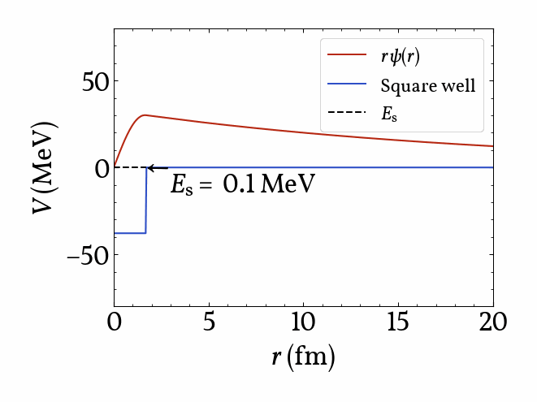
Halo nuclei
B. Jonson, Phys. Rep. 389 (2004), 1
Valence nucleon(s) very loosely bound to core nucleus
→ Tunnelling
Adapted from I. Tanihata et al., Prog. Part. Nucl. Phys. 68 (2013), 215
25
NMNP Visby 2026

Slide 26
Halo nuclei
Hallo?
²²Al
²²Mg
²²Na
I. Tanihata et al. (eds.), Handbook of Nuclear Physics, Springer Nature Singapore, 2023
→ Candidates found close to driplines
→ Proton halos more rare
26
NMNP Visby 2026

Slide 27
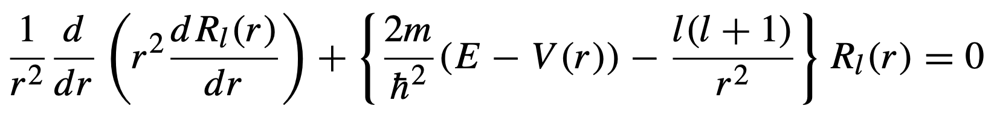
Halo formation hindrances
A ~ 20
Universal:
Angular momentum barrier
Proton-specific:
Coulomb barrier
Conclusion: Low separation energy is a necessary but not a sufficient requirement
I. Tanihata et al. (eds.), Handbook of Nuclear Physics, Springer Nature Singapore, 2023
27
NMNP Visby 2026

Slide 28
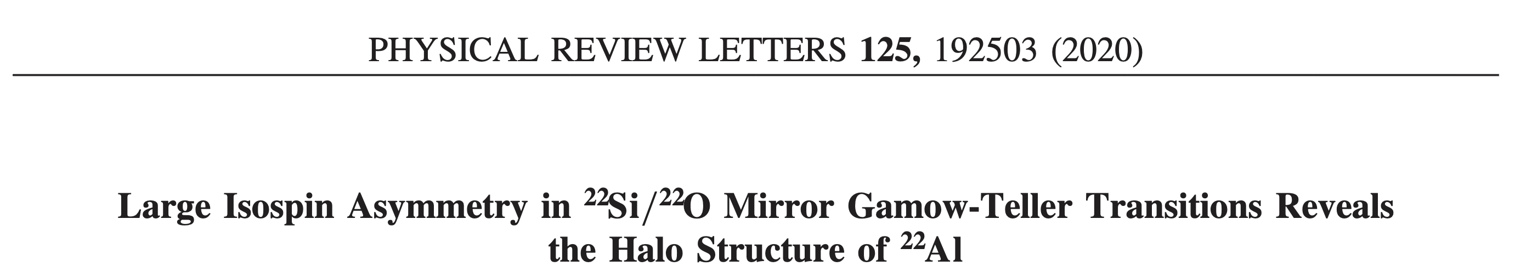
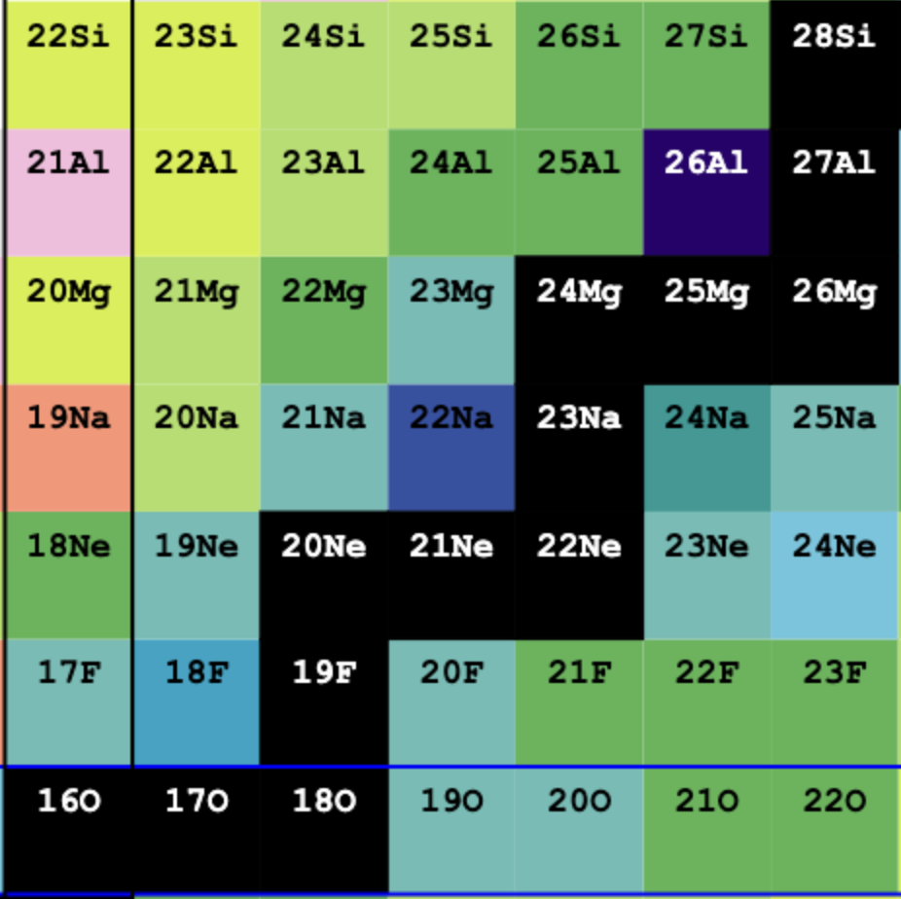

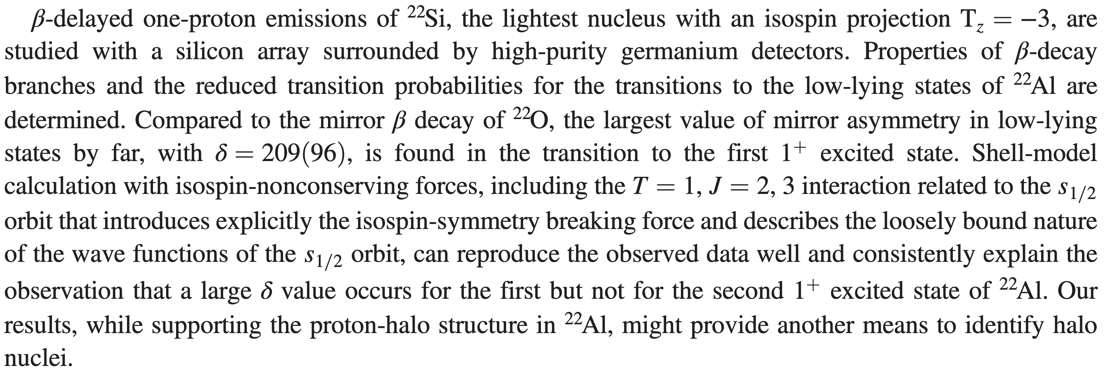
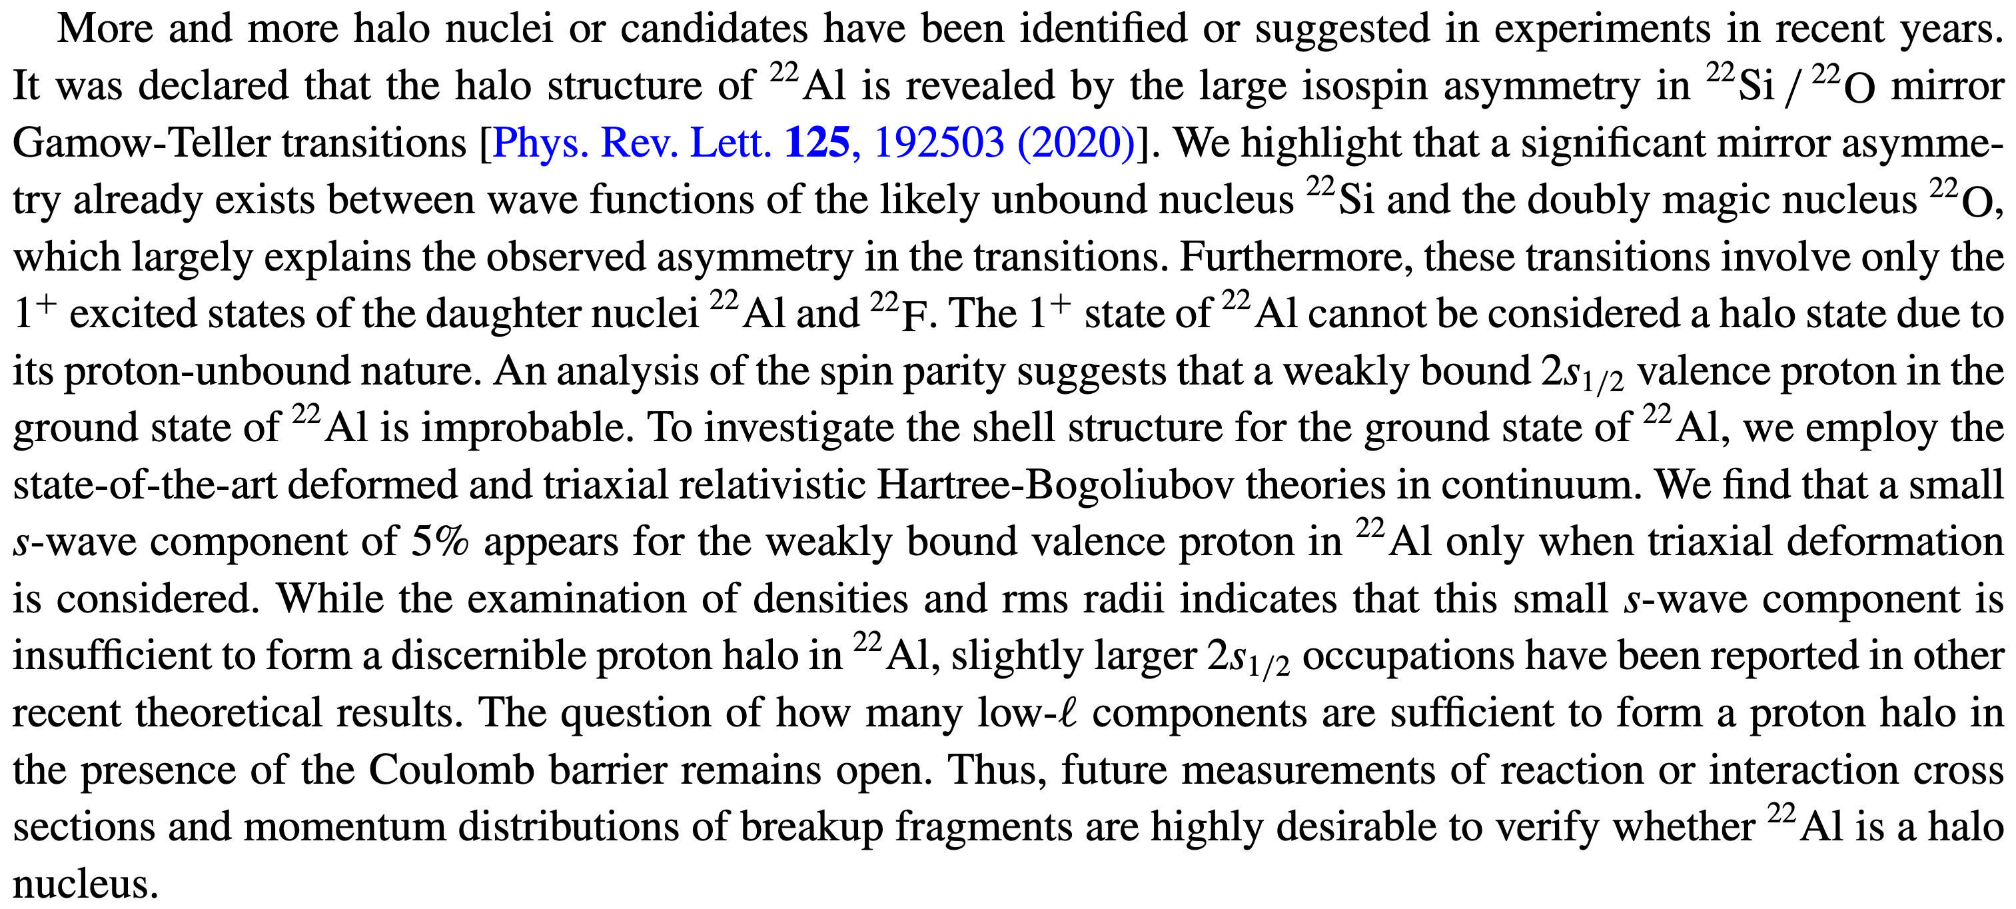


²²Al halo speculation
$$T_{3}=−3$$
Experiment
nndc.bnl.gov
Theory
See, however, Lin, Wang and Nazarewicz, PRL 136, 122501 (2026).
$$T_{3}=3$$
28
NMNP Visby 2026

Slide 29
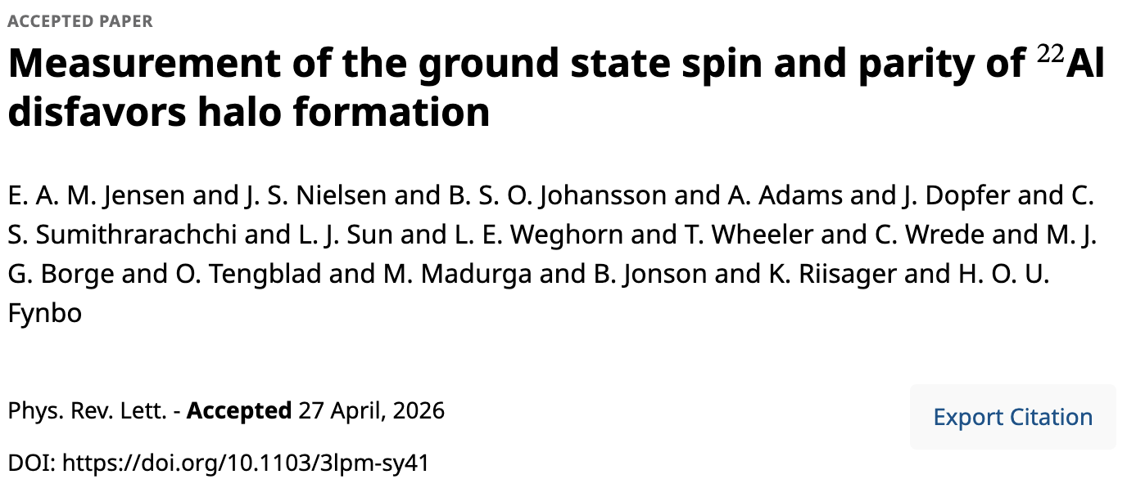

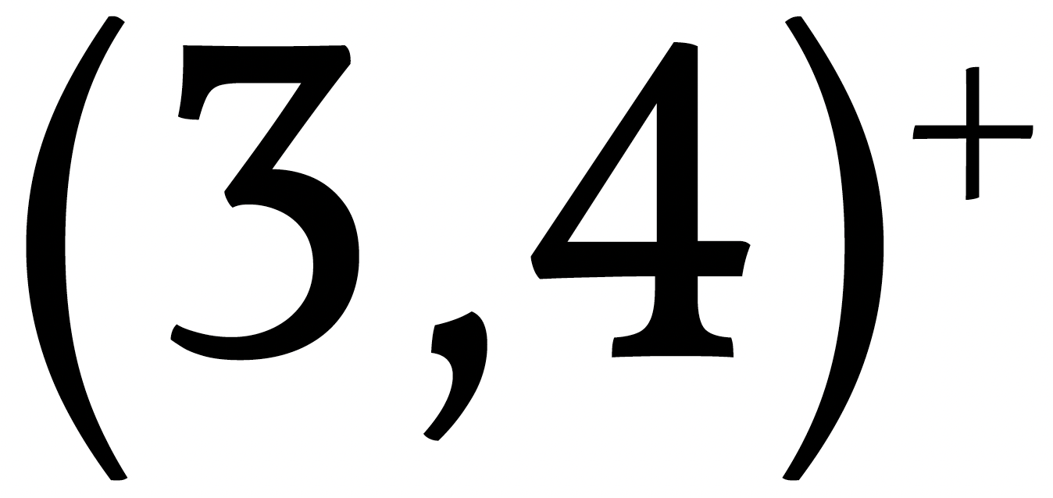


Beta-delayed alpha emission of ²²Al
A ~ 20
Low separation energy is a necessary but not a sufficient requirement
$$T_{3}=−2$$
nndc.bnl.gov
α + ¹⁸Ne
²²Al β2p
Take-home message:
Beta decay is a very powerful and versatile tool in light nuclear structure studies
$$T_{3}=2$$
78(2) %
22(2) %
Thomas-Ehrman shift could “invert” low-level ordering
?
29
NMNP Visby 2026

Slide 30




Logotype
Thanks to all collaborators
And thank you!

