Slide 1
Beta-decays in (exotic) light nuclei
K. Riisager
Dept. of Physics and Astronomy
Aarhus University / Denmark

Slide 2
Light particle-stable nuclei

Slide 3
Light nuclei, driplines
Collective dofs
Driplines estimated from
semiempirical mass formula
without pairing

Slide 4
Light nuclei, driplines
Collective dofs
Isospin important dof
Smaller symbol =
no (stable) mirror nucleus

Slide 5
Light nuclei, driplines
Single-particle dofs
Shell model orbits
p-rich: “standard” shells
n-rich: “modified” shells

Slide 6
Light nuclei
Clustering dofs
n alpha nuclei (?)
(Deformation…)
Favoured decay modes
(nuclear astro-interest)

Slide 7
Q_{EC}-value systematics
M.V. Lund et al, Phys. Lett. B 750 (2015) 356-359

Slide 8

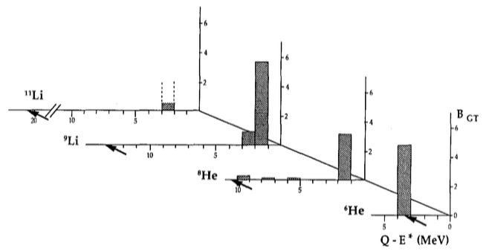
Fermi and Gamow-Teller decays
Theory: W exchange → V-A theory → F/GT transitions
F transitions: inside T-multiplets / to IAS (only for p-rich nuclei)
GT transitions: mainly to GTGR (above IAS…)
  So all “low-energy” decays are in the tail
  Visible in very proton-rich nuclei
  Visible for some very light neutron-rich nuclei
    Exp: M.J.G. Borge et al, Z. Phys. A 340 (1991) 255
    Theory: H. Sagawa, I. Hamamoto, M. Ishihara, Phys. Lett. B 303 (1993) 215
Sum rules:

Slide 9
Precision (weak interaction) studies
CVC, 0⁺ to 0⁺ (Hardy and Towner, + many groups) … now also mixed F-GT
Types of weak interaction (Vector - Scalar, Axial vector - Tensor - Pseudoscalar)
  Examples: ⁶He, ⁸Li-⁸B, ¹²B-¹²C-¹²N, ³²Ar, ³⁵Ar
Breaking of isospin symmetry
  Charge symmetry breaking strong interactions ?
  Coulomb effects
  Weak second class currents ?
  so far mainly binding energy effects

Slide 10

Mirror beta decays
My recent review (EPJA 59:35 (2023)) uses
Black circles: 0⁺ to 0⁺ - red triangle: systematic uncertainties ?
Recurrent “explanations” for the long halflife of ¹⁴C (log ft = 7.3 / 9.0)
More than 2 standard deviations (black squares: proton halos ?):

Slide 11
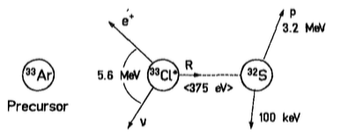
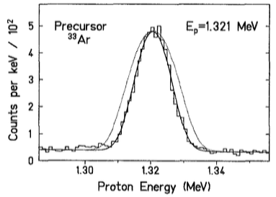
Spectroscopy interlude 1 – recoil effects etc
Developped 1958 for weak interaction studies in A=8 nuclei
Now supplement to standard selection rules / coincidences
Basic formalism e.g. D. Schardt, KR, Z. Phys. A 345 (1993) 265
Lineshape sensitive to
  F / GT etc structure
  Spin sequence (initial/intermediate)
  Particle emission to gs/excited state
  Intrinsic widths
  Interference ….
See also Maria Jose Garcia Borge, today
³¹Ar spin: PLB 467 (1999) 194

Slide 12
Spectroscopy interlude 2 - deformation
Selection rules in K for beta-delayed particle emission in deformed nuclei
Formalism, applied to ²¹Mg decay: KR, EAM Jensen, AS Jensen, EPJA 61:87 (2025)
Similar info. as in transfer reactions
Assigned both K and J values

Slide 13
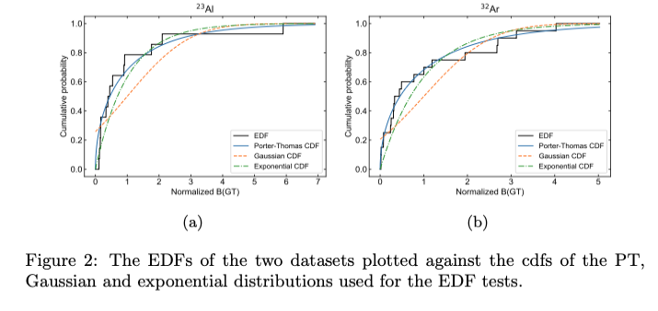
Spectroscopy interlude 3 – chaos ?
Are the strengths of GT transition described by Random Matrix Theory ?
Method and use on ²³Al data: O.S. Kirsebom et al, EPJ A47 (2011) 130
Katrine Jensen (AU): analysis of ³²Ar data in B. Blank et al, EPJ A57 (2021) 28

Slide 14
Beta-delayed multi-particle emission
Both sequential and simultaneous emission now possible
Classic example: ¹²B or ¹²N decay to 3⍺ final state
Other possibilities: beta-2N, beta-3N, beta-N⍺ (¹¹Li: beta-3n2⍺!)
2p: here ³¹Ar the best studied case for a long time (ISOLDE)
  New results from FRIB Erik Jensen, Friday
3p: TPC detectors an efficient way to move forward

Slide 15
Broad final states
²⁰Na decay, K.L. Laursen et al, EPJA 49:79 (2013)
Broad states may interfere:
Theory: R-matrix
Very broad states in
  A=8, 12; ²⁰Na decay
Heavily distorted…
⁸He Jeppe S. Nielsen, today
Use beta strength in continuum
to ensure sum rules still hold (KR, NPA 925 (2014) 112, 298)

Slide 16
Decays directly into continuum states ?
A very broad resonance becomes ”context dependent”
Radiative capture/break-up can go between bound and continuum states
So may beta decay, details in KR et al, Nucl. Phys. A 940 (2015) 119
Indications via R-matrix fits:
  Vary the channel radius parameter
  “standard resonances” should be stable
  “changing position” fits with “particle in well”…
  (pure continuum can be fitted with R-matrix levels)

Slide 17

Halo states
Several reviews in section V of Handbook of Nuclear Physics, eds. I. Tanihata et al (Springer, 2023) – my chapter on beta decay p. 1057-80
Beta-delayed particle emission prominent
Core+halo cluster structure can be reflected in final states
Large spatial extension may give decays directly to continuum
Beta decay can yield info. on detailed halo state structure
Example of 2+3: beta-delayed
deuteron emission from 2n-halo

Slide 18
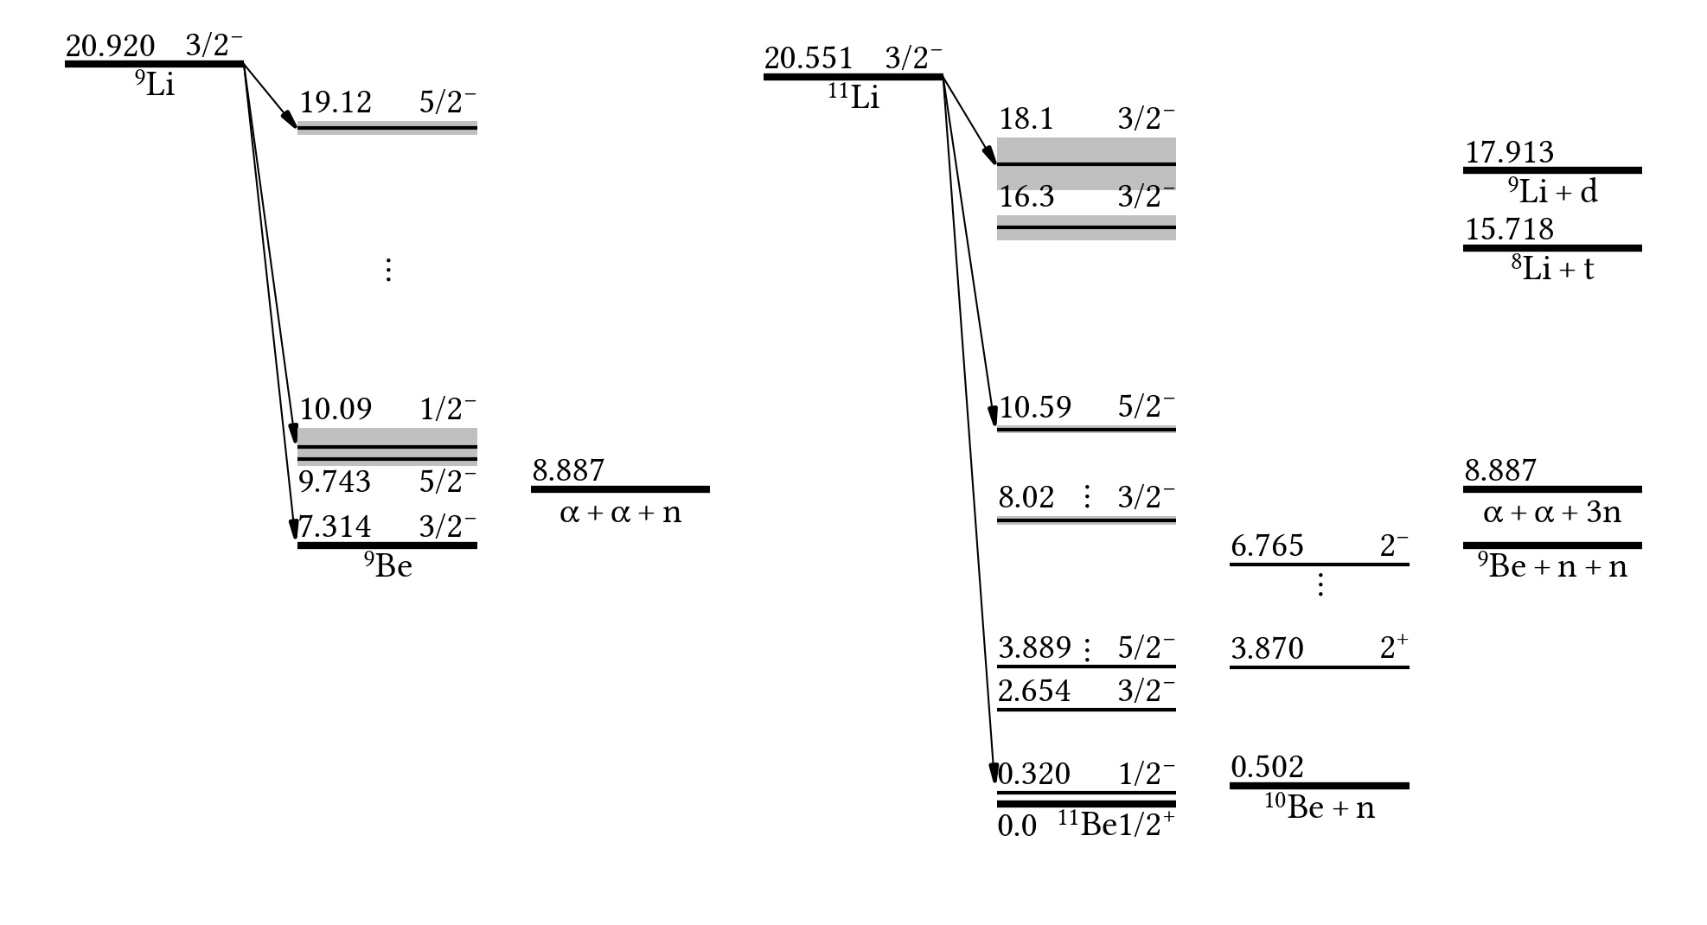
Three-body calculation of ¹¹Li beta decay
Predicted GT strength
E. Garrido et al, Phys. Rev. C 107, 014003 (2023)
Halo decay:
  IAS
  AAS
Core decay:
  g.s.

Slide 19
Outlook
Beta decays a few nucleons away from the line of beta stability provides nuclear structure information beyond the standard selection rules (for beta and gamma decays)
Beta-delayed particle emission processes:
  So far mainly probed in detail for proton-rich nuclei
  Neutron-rich nuclei will be interesting to study
  Current limitations in production yields and neutron detection capabilities

