Slide 1
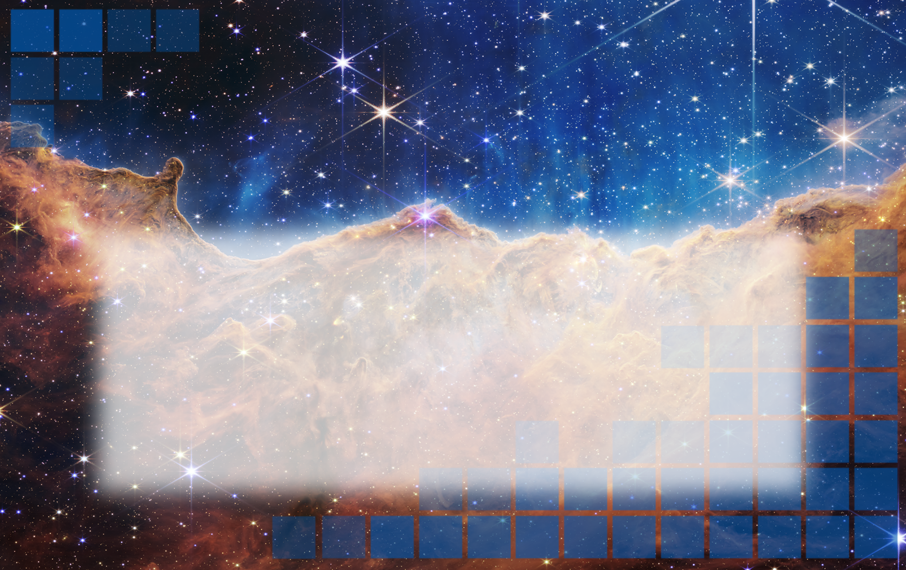
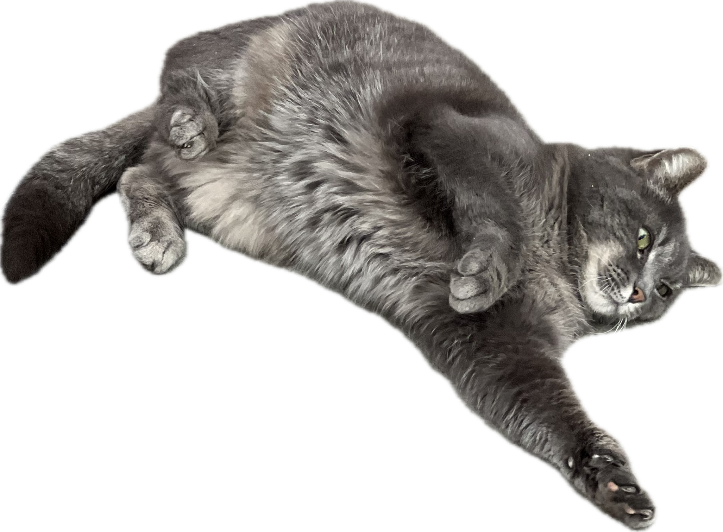

15th Nordic Meeting on Nuclear Physics
The Pygmy Dipole Resonance and its evolution
across the Sn mass region
Markova Maria
Postdoctoral researcher at the
Department of Physics, University of Oslo,
NNRC
maria.markova@fys.uio.no
7 May 2026

Slide 2
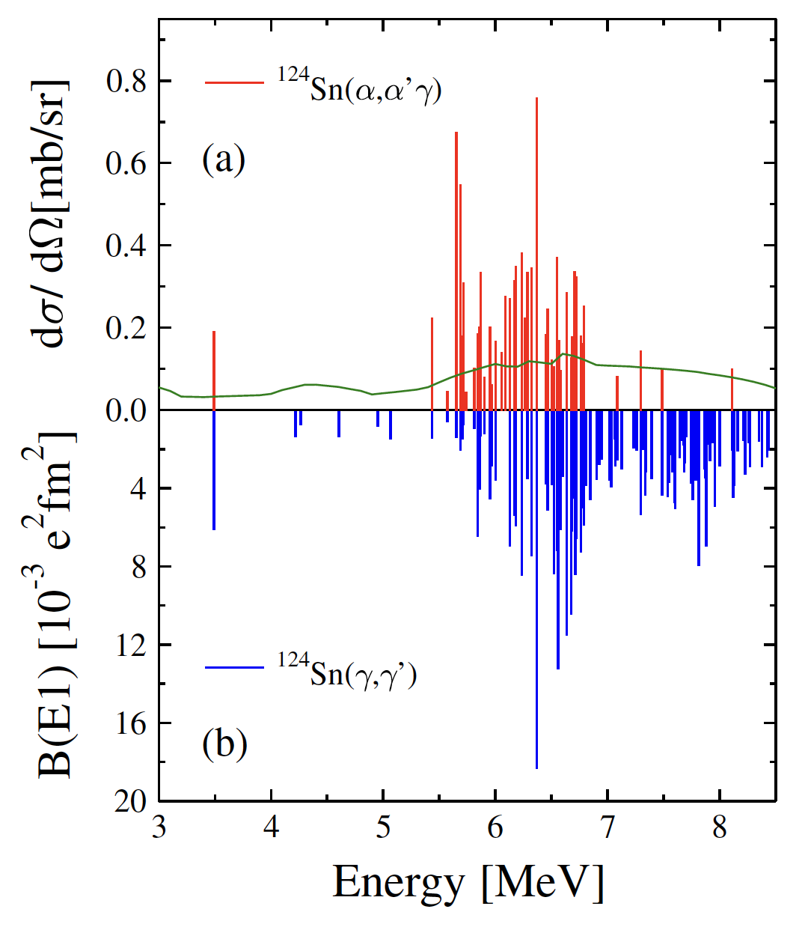
The pygmy dipole resonance in nuclei
Macroscopic picture: IVGDR originates from collective, out-of-phase oscillations of protons against neutrons.
(enhancement of ≈ 100% of the EWSR).
Isovector mode!
The PDR is associated with a low-lying E1 strength in the vicinity of the neutron
threshold (several % of the EWSR).
E. Lanza et al., Prog. Part.
Nucl. Phys. 129,104006 (2023).
J. Endres et al.,
PRL 105, 212503 (2010)
Macroscopic picture: the PDR is generated by oscillations of a neutron excess (skin) against an isospin saturated core (N = Z).
Both the isovector (out-of-phase, IV) and the isoscalar (in-phase, IS) components are present!
M. Markova (UIO)
PDR in and its properties
7 May 2026
1/18

Slide 3
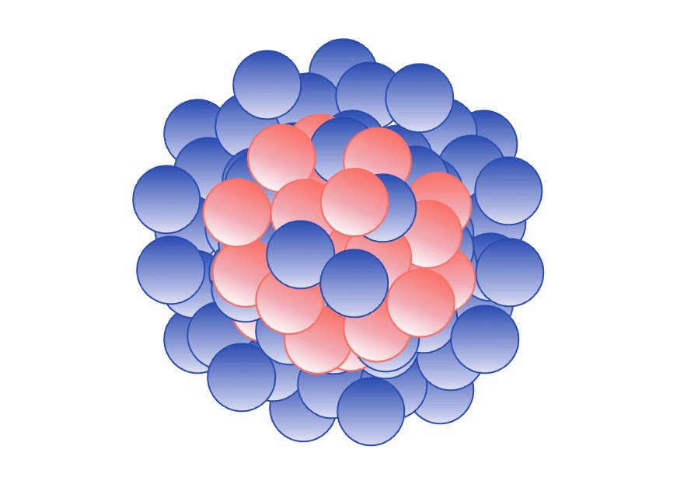
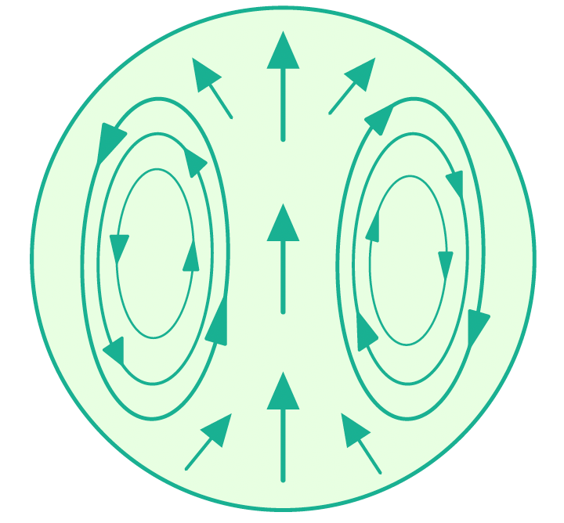
The pygmy dipole resonance in nuclei
Mixed isovector/isoscalar nature of the PDR.
How “collective” is it?
Collective IS component +
Non-collective IV component
neutron skin
picture
To make things even more complicated:
E. Lanza et al., Prog. Part.
Nucl. Phys. 129,104006 (2023).
The toroidal dipole mode?
Single-particle content
of the low-lying E1 states?
Impact of deformation?
Pygmies of other multipolarities?
and many more…
M. Markova (UIO)
PDR in and its properties
7 May 2026
2/18

Slide 4
How can the PDR be studied?
How does the PDR evolve in different isotopic chains?
1
2
3
4
Consistency
+
Completeness
5
6
7
8
9
10
Strength
“PDR”
Energy
A. Bracco et al.,
Prog. Part. Nucl. Phys. 106, 360-433 (2019).
M. Markova (UIO)
PDR in and its properties
7 May 2026
3/18

Slide 5
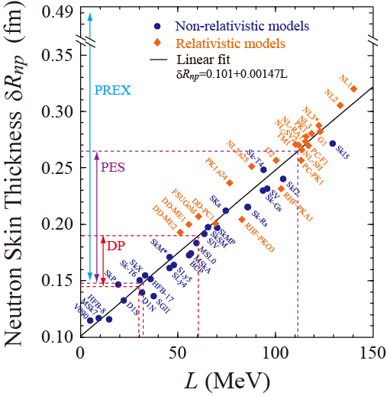
Motivation: why are we interested in the PDR?
Relation of the PDR to the neutron skin thickness
Heavy-element nucleosynthesis
Neutron skin thickness can provide useful constraints for the equation of state:
PDR strength
Neutron
star
properties
Symmetry energy term
EoS
parameters
Neutron
skin
With PDR
Without
PDR
In either case we need to know what is happening in the PDR region!
X. Roca-Maza et al.,
PRL 106 (2011) 252501
A. Carbone et al., Phys.
Rev. C 81, 041301 (2010)
S. Goriely,
PLB 436 1998 10–18
M. Markova (UIO)
PDR in and its properties
7 May 2026
4/18

Slide 6







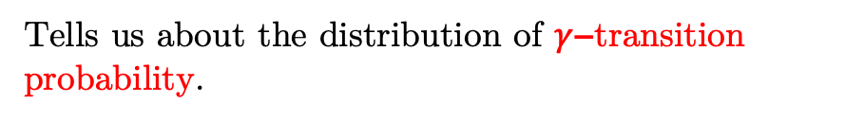



Main ingredients of our study: NLD and GSF
Gamma-ray strength function (GSF) and nuclear level density (NLD) are average properties of excited nuclei.
Averaged partial radiative width
$$E_{f}$$
$$E_{i}$$
$γ$-ray energy
Density of final states
Tells us about the distribution of $γ$−transition probability.
$$E_{γ}$$
$$E_{γ}$$
$γ$-decay: Downward strength $\overset{⃖}{f}$
$$\vec{f}$$
$$\overset{⃖}{f}$$
Excitation energy
$$E_{f}$$
Oslo method!
NLD
$$E_{i}$$
Statistical-model
calculations
($n, γ$) rates
ground state
GSF
M. Markova (UIO)
PDR in and its properties
7 May 2026
5/18

Slide 7
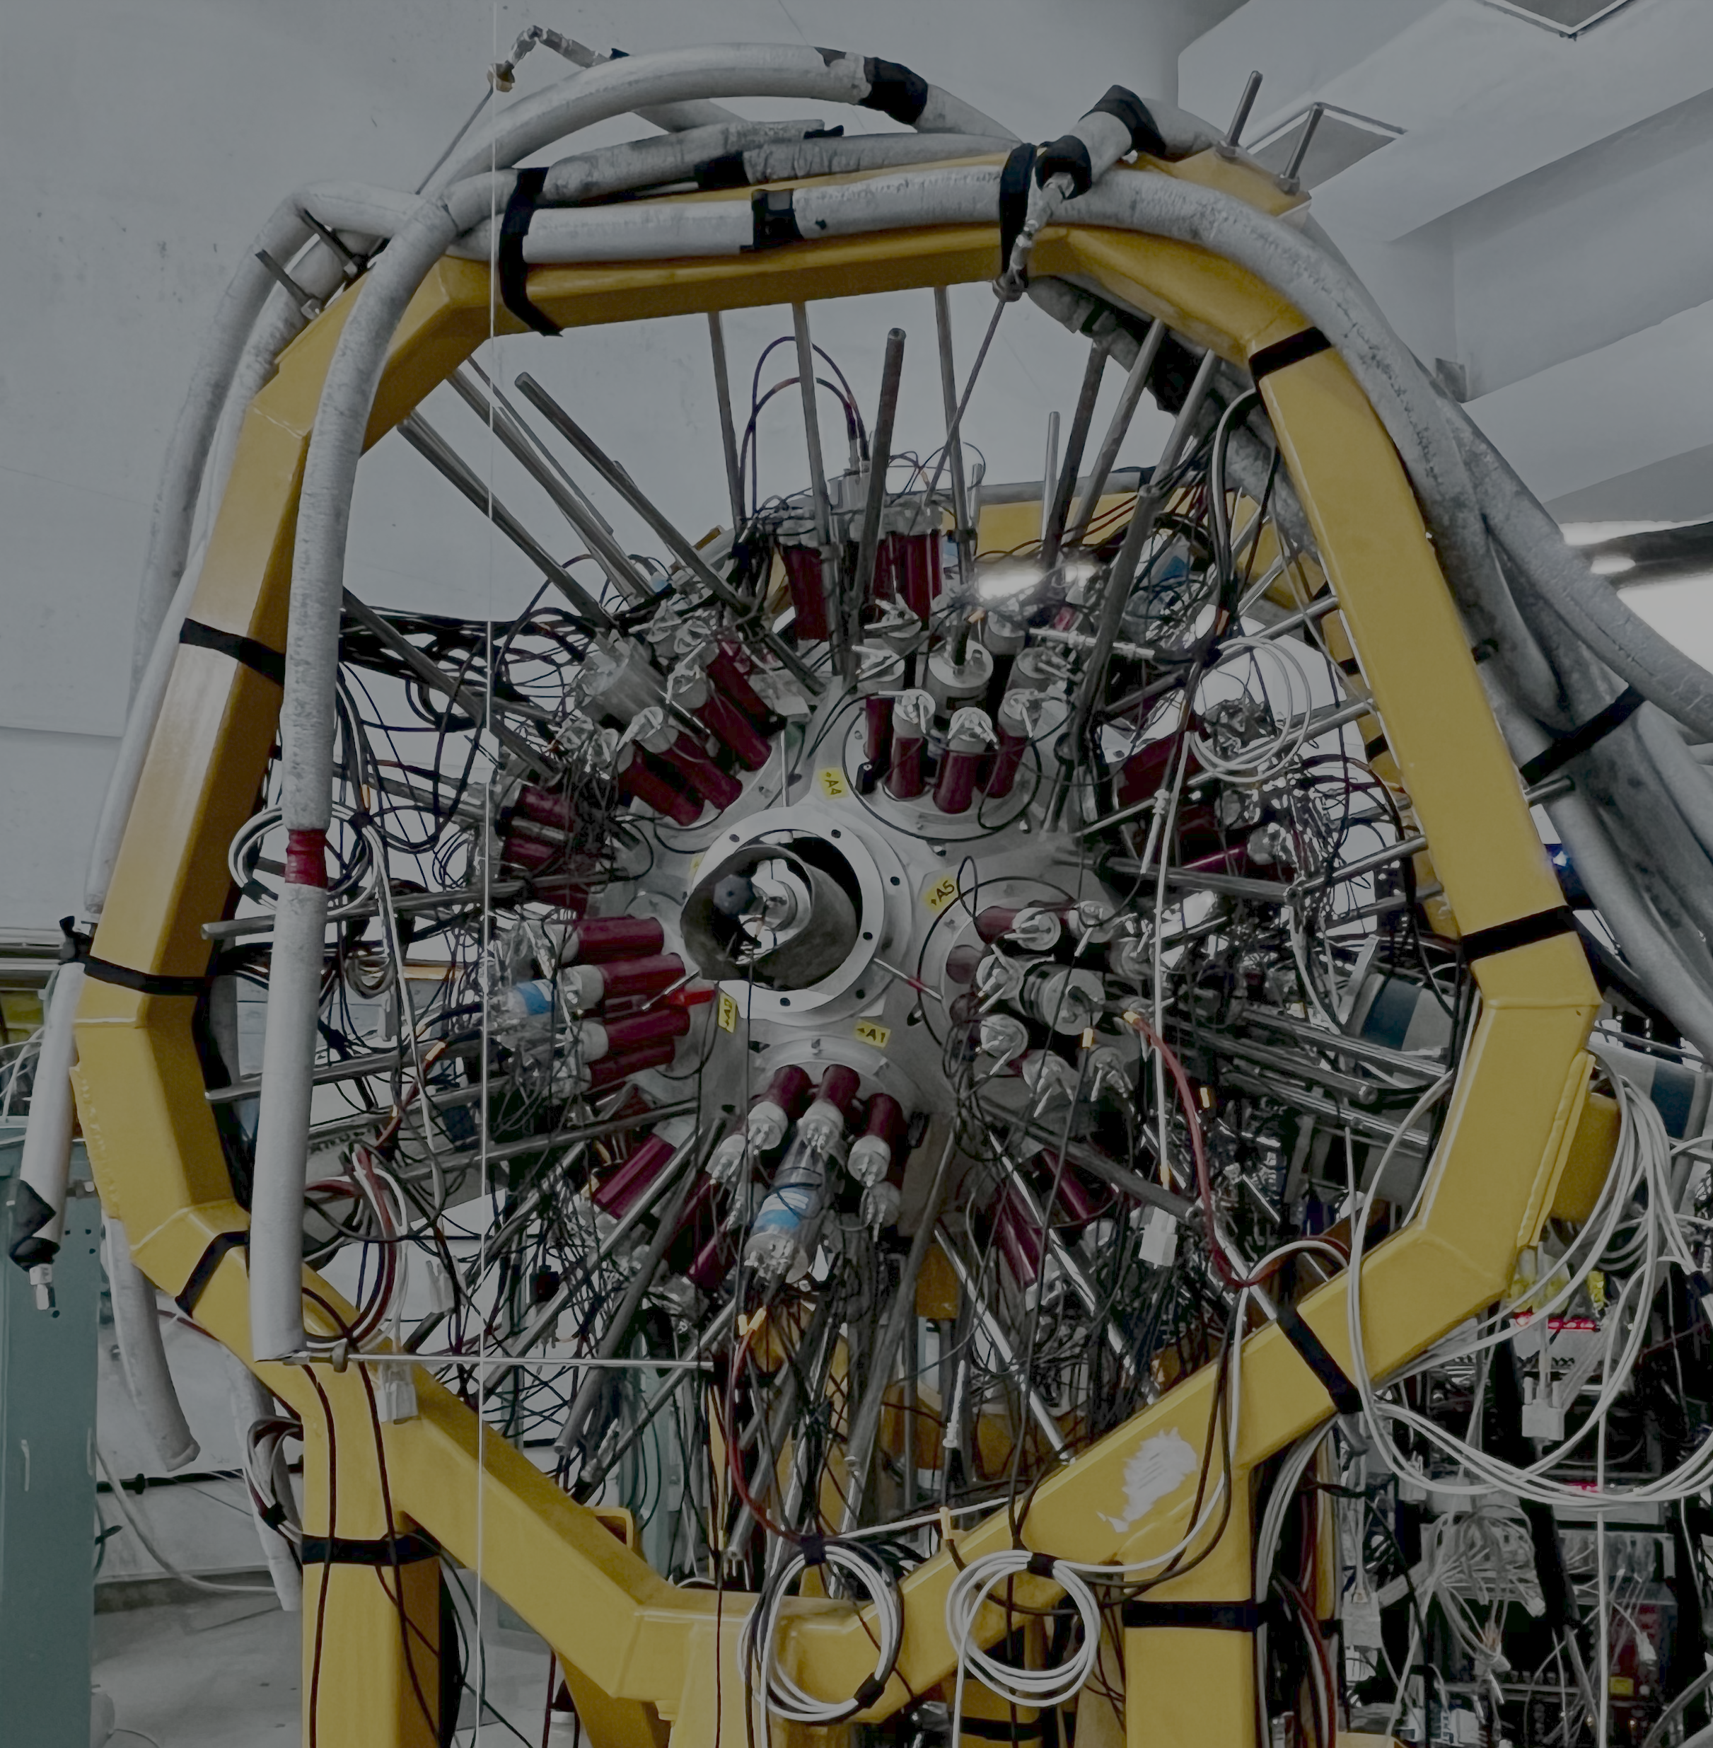
Isotopes studied at the OCL
“Old” setup CACTUS, Oslo
“New” setup OSCAR, Oslo
“New” setup, ELI-NP/IFIN-HH
M. Markova (UIO)
PDR in and its properties
7 May 2026
6/18

Slide 8
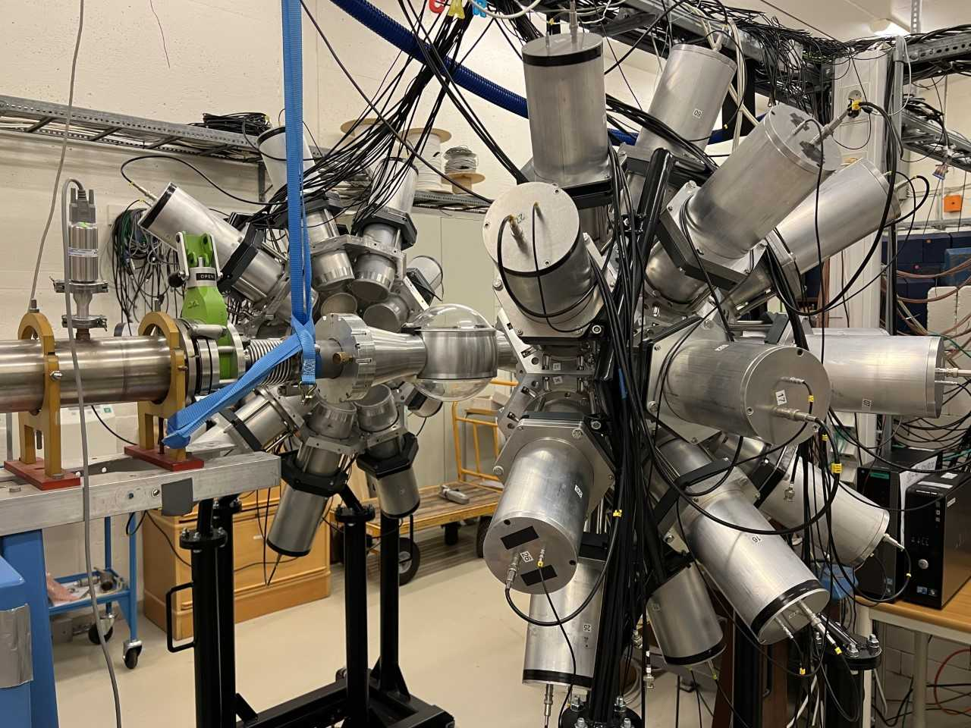
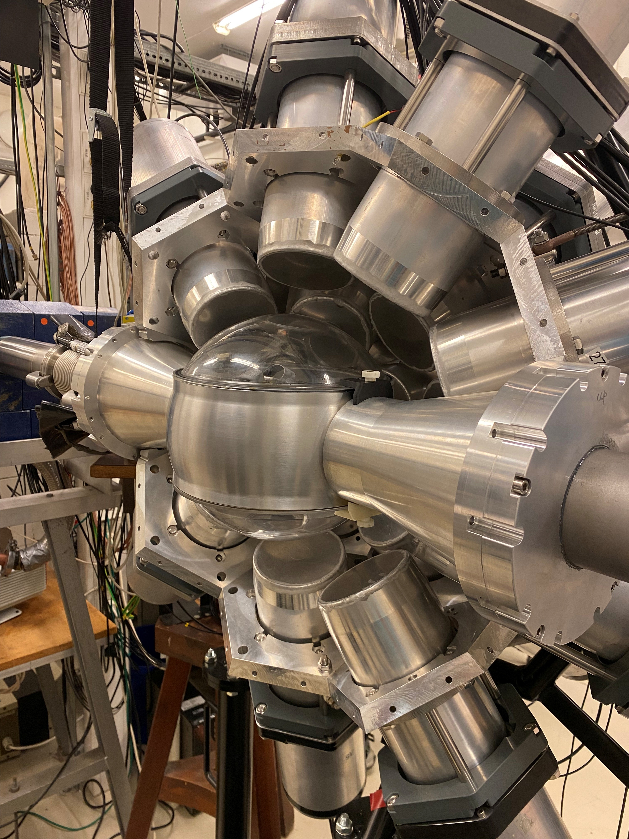
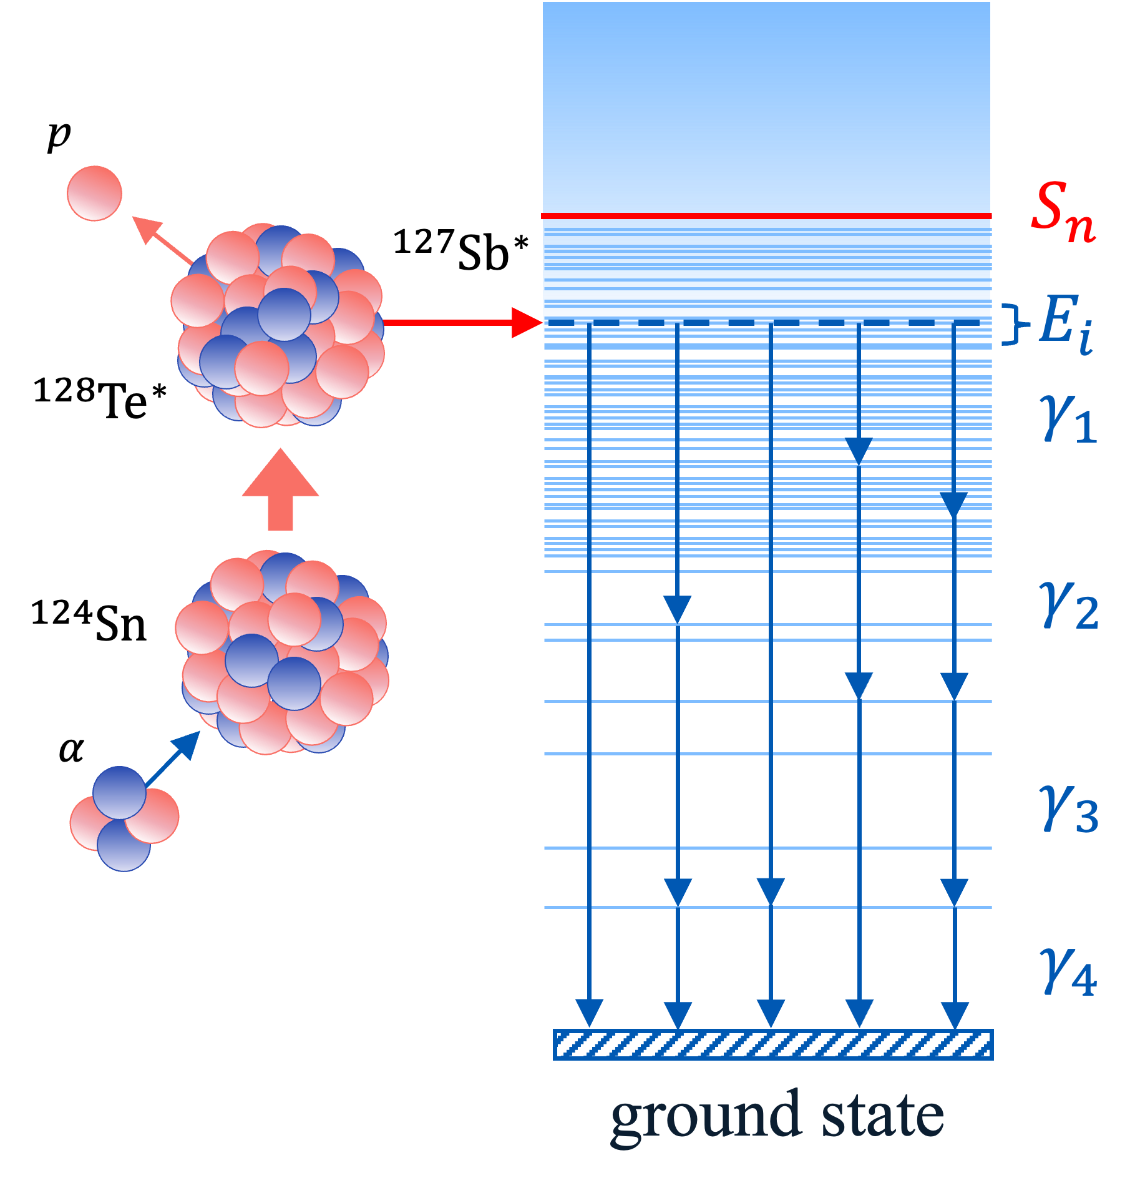
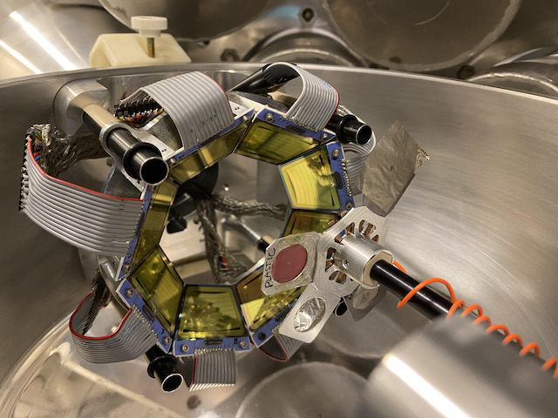
Experiments at the OCL
OSCAR
SiRi
Studied sample
with 16 and 25 MeV protons
SiRi Si particle telescope + NaI(Tl) (CACTUS, older)/ LaBr3(Ce) (OSCAR, new) detector array.
with 11.5 MeV deuterons
with 38 MeV
126°-140° or 40°-54° particle angles are covered.
with 23 and 24 MeV
M. Markova (UIO)
PDR in and its properties
7 May 2026
7/18

Slide 9
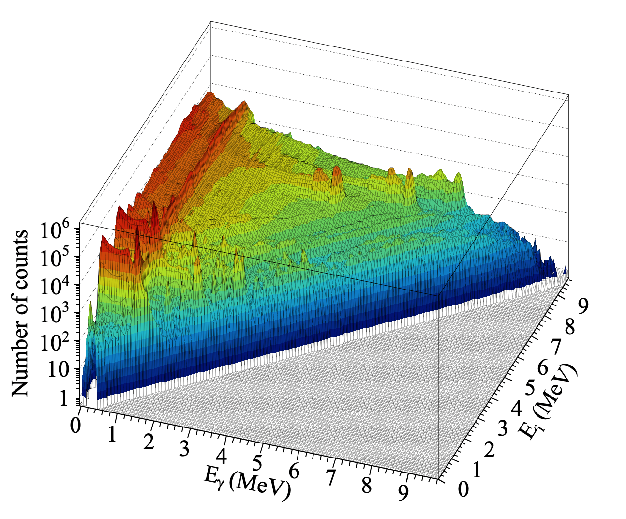
The Oslo method: step-by-step
M. Markova (UIO)
PDR in and its properties
7 May 2026
8/18

Slide 10
The Oslo method: step-by-step
(dipole transitions)
NLD
GSF
Scaling the NLD to discrete low-lying states.
Extracting the NLD and GSF slope from
neutron resonance data.
Scaling the GSF to the neutron resonance data.
M. Markova (UIO)
PDR in and its properties
7 May 2026
9/18

Slide 11
NLD and GSF in Sn isotopes
“PDR”?
M. Markova (UIO)
PDR in and its properties
7 May 2026
10/18

Slide 12
Decomposition of the dipole GSF
GDR
Gauss 1
(+Gauss 2)
GLO
SLO
M. Markova (UIO)
PDR in and its properties
7 May 2026
11/18

Slide 13

Decomposition of the dipole GSF
M. Markova (UIO)
PDR in and its properties
7 May 2026
12/18

Slide 14
Systematics of the PDR
The low-lying strength is centered at ≈ 8.4 MeV in all studied Sn
isotopes.
The low-lying component remains
at ≈ 6.5 MeV in heaviest tins.
Ranges from 2% to 3% TRK,
the largest strength is in 120Sn.
The low-lying component increases in strength with
N, the “real” PDR
(IV component)?
Purely IV strength
M. Markova (UIO)
PDR in and its properties
7 May 2026
13/18

Slide 15
Theory vs Experiment
M. Markova (UIO)
PDR in and its properties
7 May 2026
14/18

Slide 16

“PDR” in other nuclei
D. Savran et al.,
Prog. Part. Nucl. Phys. 70, 210 (2013).
M. Markova (UIO)
PDR in and its properties
7 May 2026
15/18

Slide 17

“PDR” in other nuclei
Sn
Sm
Dy
???
Cd
Pd
M. Markova (UIO)
PDR in and its properties
7 May 2026
16/18

Slide 18
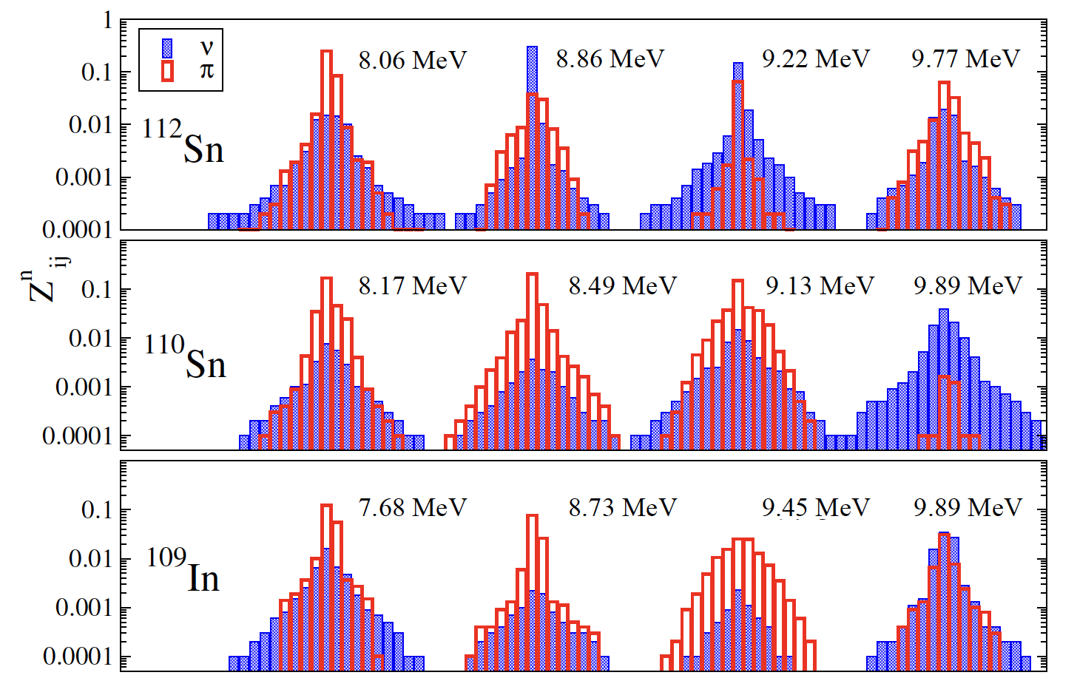

“PDR” around Sn
Decomposition?
The “odd one out”
M. Markova (UIO)
PDR in and its properties
7 May 2026
17/18

Slide 19
Summary and Outlook
An extensive study of statistical properties of nuclei in the Sn mass region has been done in Oslo from 2013 – 2026.
The GSFs and NLDs from the Oslo experiments provide new insights into the evolution of the “PDR”.
No systematic increase of the low-lying E1 strength with N was observed in Sn isotopes and other nuclei in the Sn mass region.
The presumed IV component of the PDR at 6 MeV was extracted.
Suppression of the low-lying E1 strength in the neutron-deficient 109In was observed.
M. Markova (UIO)
PDR in and its properties
7 May 2026
18/18

Slide 20
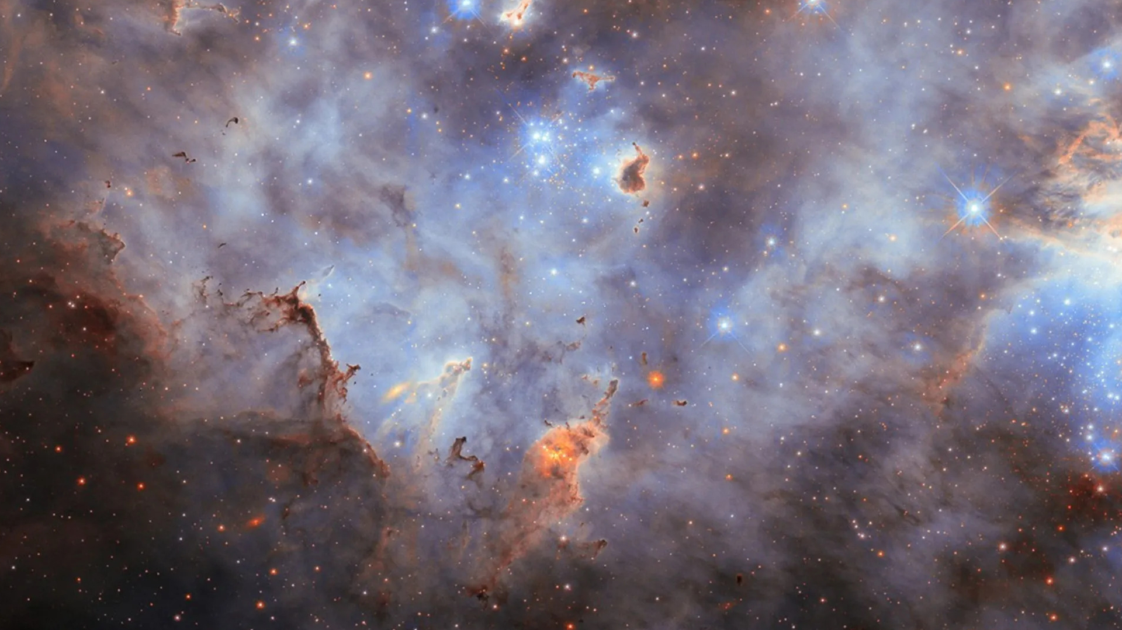







Special thanks to our collaborators!
Our most recent results
E. Litvinova
P.-A. Söderström
J. C. Müller, P. A. Sobas, J. C. Wikne, and V. Modamio.
Thank you
for your
attention!
A. C. Larsen, A. A. Görgen, M. Guttormsen, F. L. Bello Garrote,
M. M. Bjørøen, T. K. Eriksen, D.
Gjestvang, V. Ingeberg, E. Lima,
F. Pogliano, W. Paulsen, L. G. Pedersen,
N. I. J. Pettersen, E. Sahin, S. Siem,
G. M. Tveten, V. M.Valsdottir, F. Zeiser.
P. von Neumann-Cosel,
J. Isaak
S. Goriely, A. Choplin,
S. Martinet, L. Siess
Large Magellanic Cloud captured by the Hubble Space Telescope. (ESA/Hubble & NASA, C. Murray, J. Maíz Apellániz)

