Slide 1

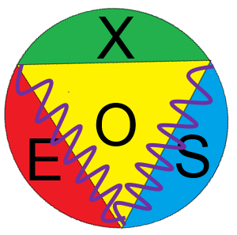
Alessandro Scordo
INFN Frascati National Laboratory, Italy
High precision X-ray measurements with the VOXES spectrometer at INFN-LNF
Advances in X-ray and Gamma RAy DEtectors and applications (XGRADE 2026)
24-26/03/2026, Palermo

Slide 2


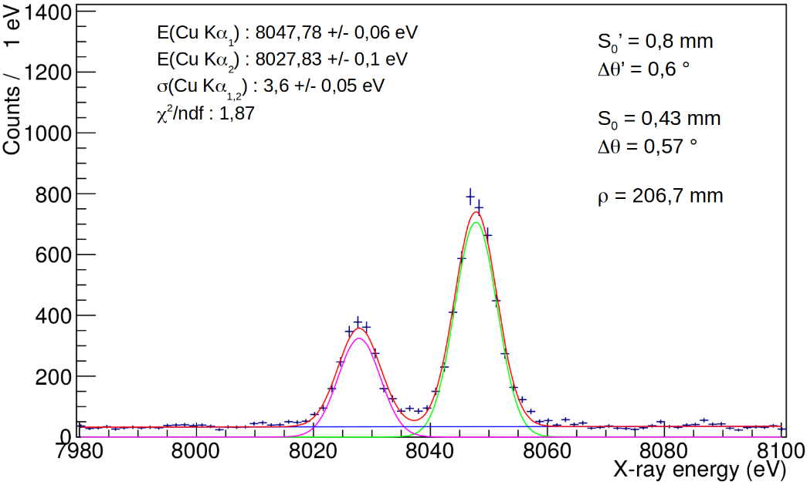
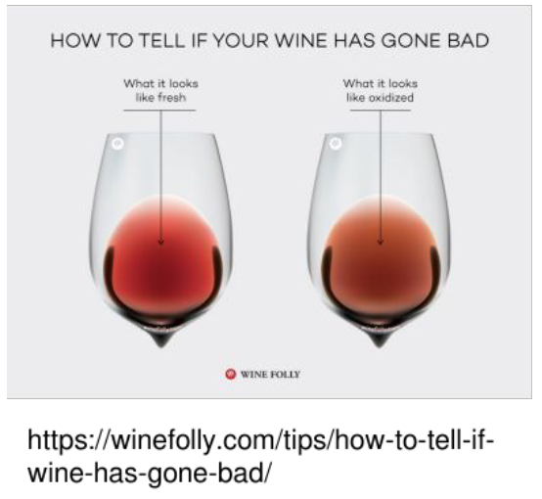
Spoil & Wake Up
In this talk you’ll hear about a X-ray detection system that:
…and wine!!!
Reaches ~ 1330 ΔE/E - 0.5% E/ΔE (7 eV FWHM) @ 8 keV
Works @ Room Temperature
Does not need to be operated in a facility
It is, actually, a facility by itself
It’s (more or less) compact and movable
A. Scordo - Advances in X-ray and Gamma RAy DEtectors and applications (XGRADE 2026) 24-26/03/2026, Palermo

Slide 3
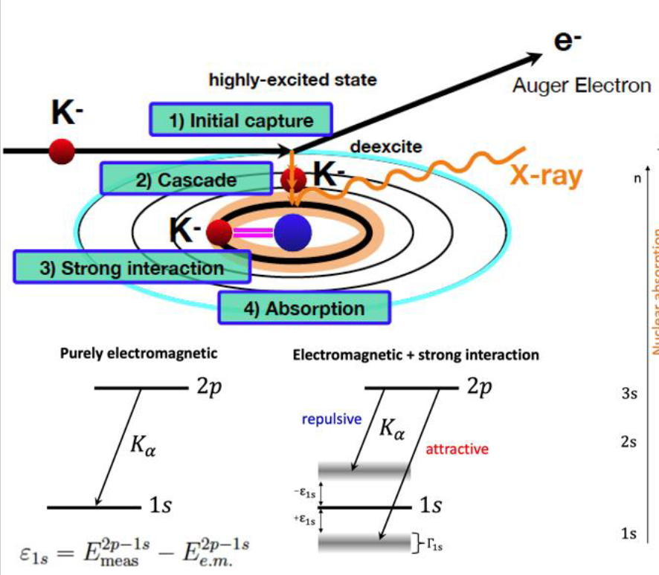
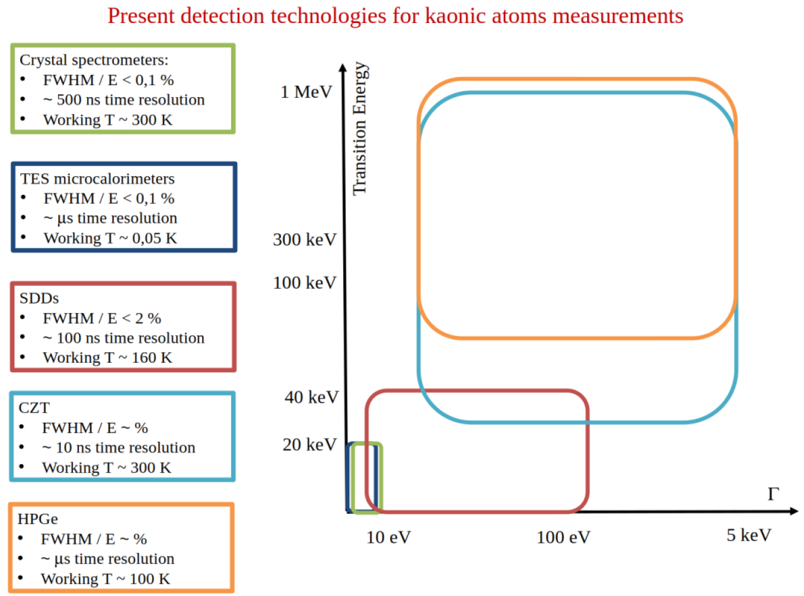
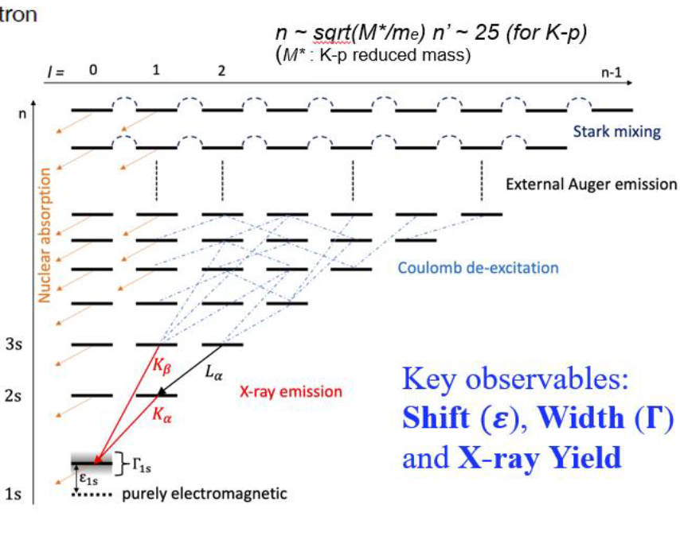
Original Motivations
Still open questions in the field require new and more precise measurements of low energy and sub-eV width transitions
Kaonic atoms allow to test strong interaction with strangeness at threshold (P_{K}- ~ 0 MeV/c)
A. Scordo - Advances in X-ray and Gamma RAy DEtectors and applications (XGRADE 2026) 24-26/03/2026, Palermo

Slide 4
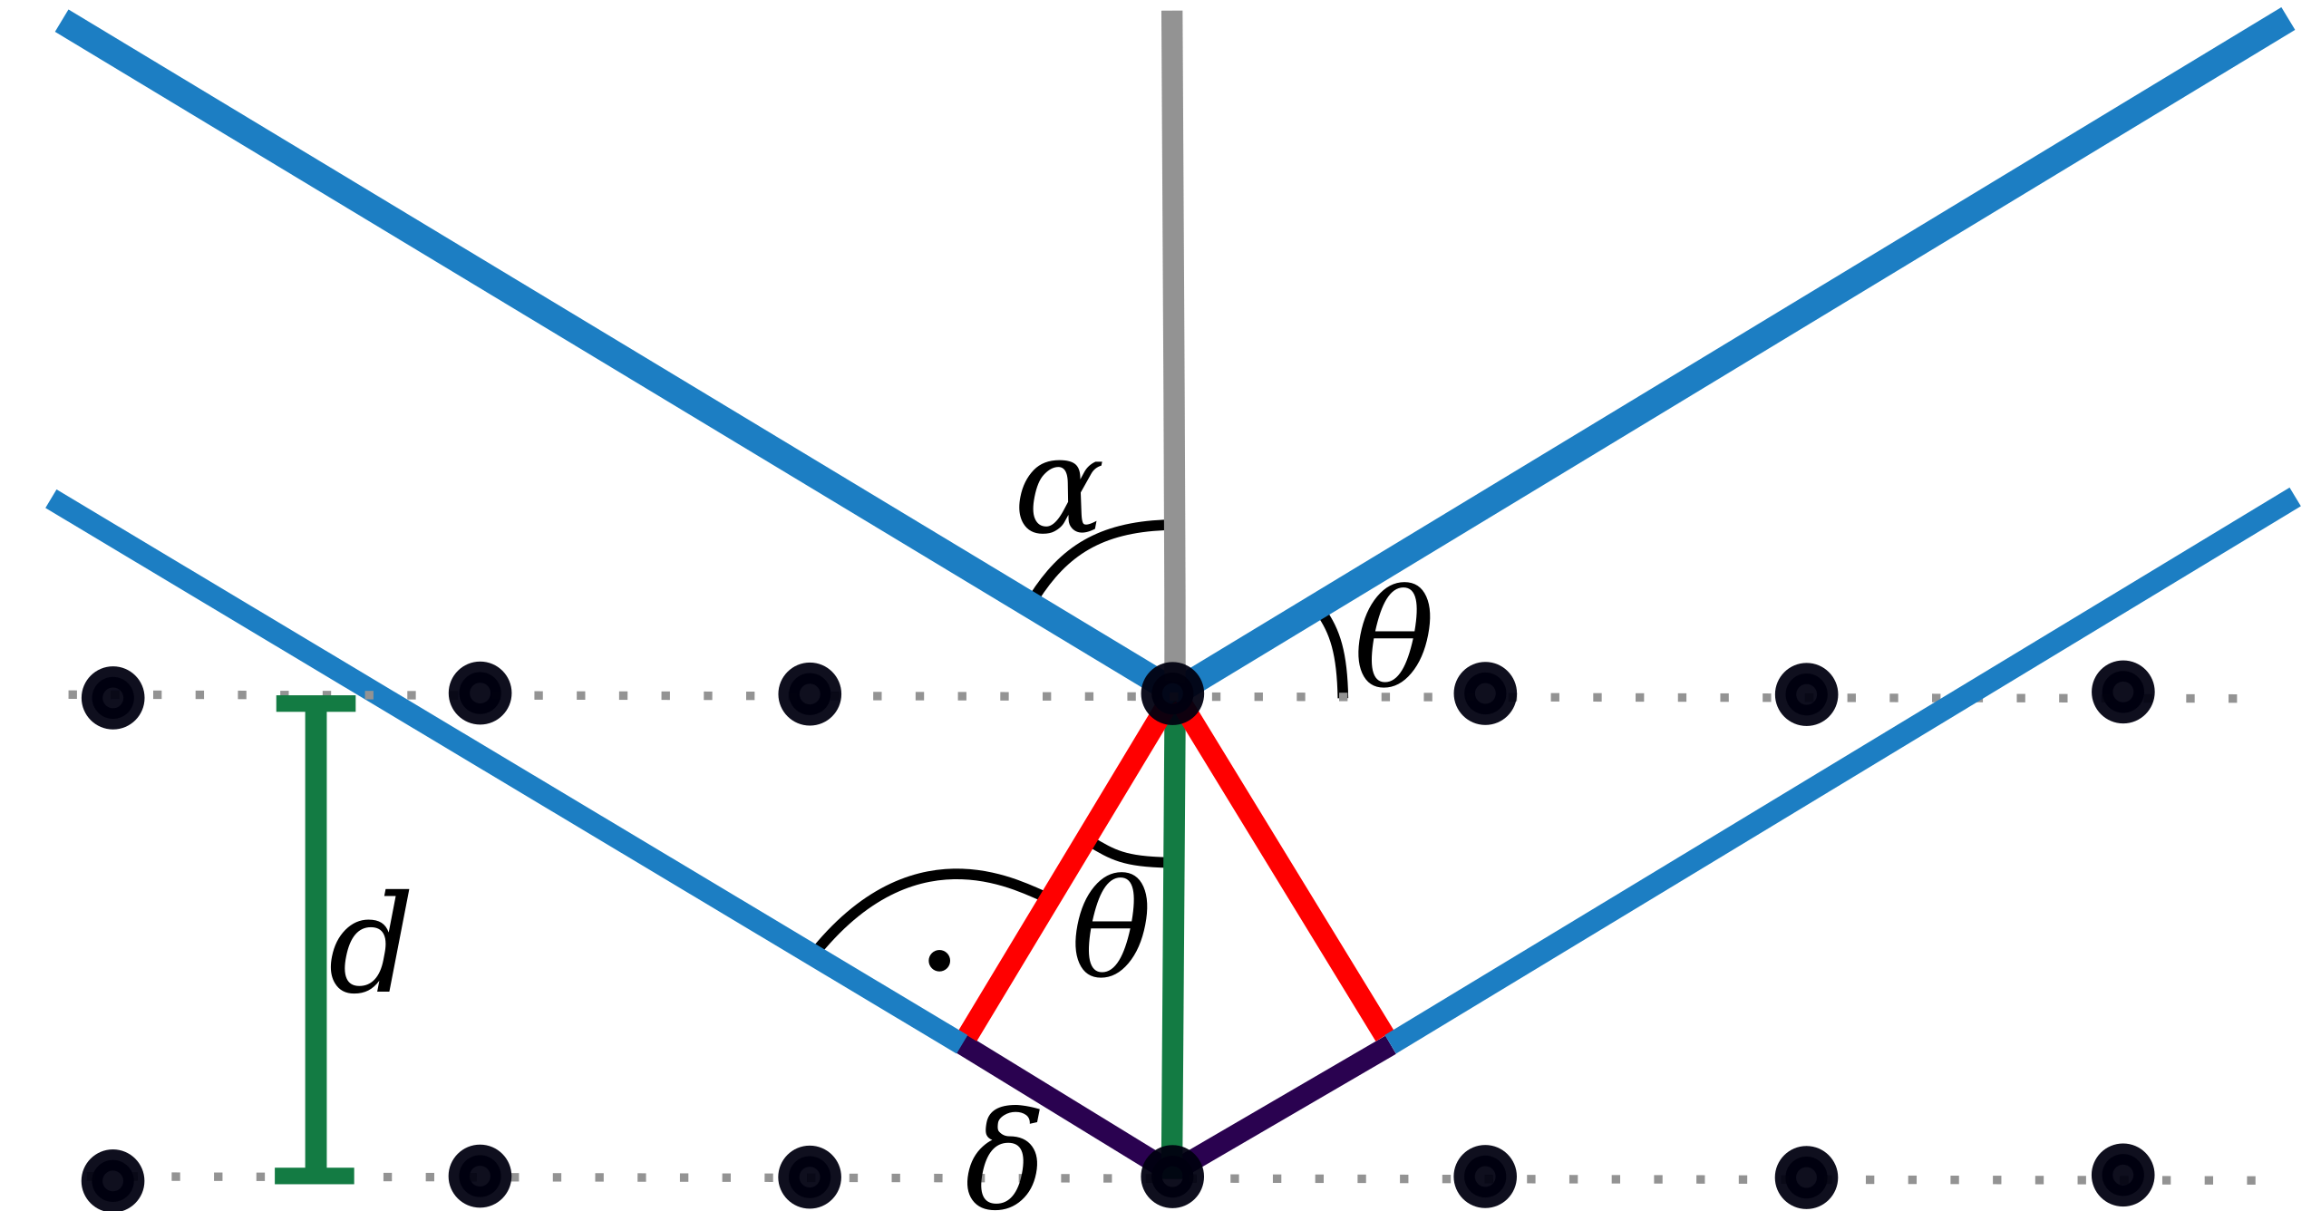
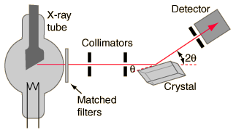
Original Motivations
nλ = 2dsinθ_{B}
FWHM ~ 1-10 eV can be achieved depending on the quality of the crystal and the dimensions of the detectors
Natural background reduction from geometry
Bragg spectroscopy is usually exploited by XAS, XES, synchrotron light users, etc…
This means:
Point-like sources
High yields (no need to increase them)
1 eV (Si, Mica, etc) or 2-3 eV (HAPG) resolution is very easily achievable
But….
- Small solid angles can be covered
- Typical efficiencies : 10⁻⁵ – 10⁻⁸
- Typical d (Si) ≈ 5.5 Å (good for E < 6 keV)
- Typical source size 10-100 mm
But what if we really need wider sources for higher statistics?
Or what if our photons come from a diffused isotropic source?
A. Scordo - Advances in X-ray and Gamma RAy DEtectors and applications (XGRADE 2026) 24-26/03/2026, Palermo

Slide 5
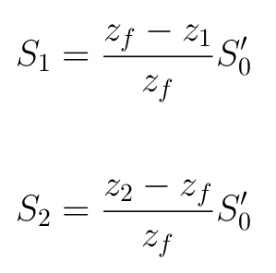
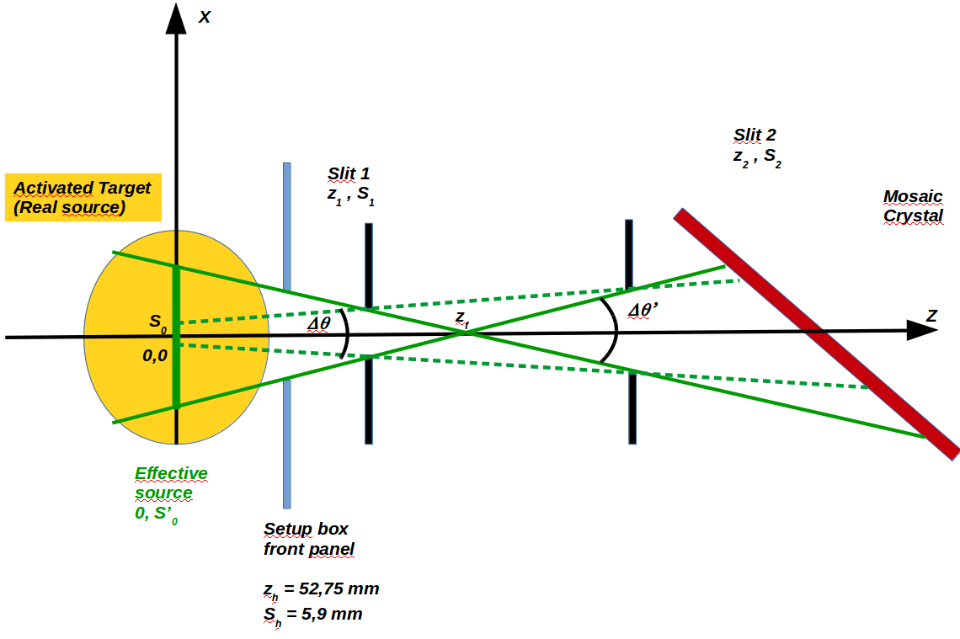


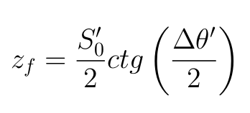
Original Motivations
S₀’ represents the effective source from which the emitted X-rays ‘’see’’ the crystal
Is it all? Are the red lines really (only) background?
How much can we increase the effective source size keeping FWHM as low as required?
S₀ is the portion of effective source with the highest number of emitted X-rays ‘’seeing’’ the crystal
A set of two slits can be used to define the geometrical parameters of the X-ray beam:
∆θ , S₀ (solid lines)
∆θ’ , S₀’ (dashed lines)
X ray source
Slits
HAPG
Signal photons
Background (?)
A. Scordo - Advances in X-ray and Gamma RAy DEtectors and applications (XGRADE 2026) 24-26/03/2026, Palermo

Slide 6
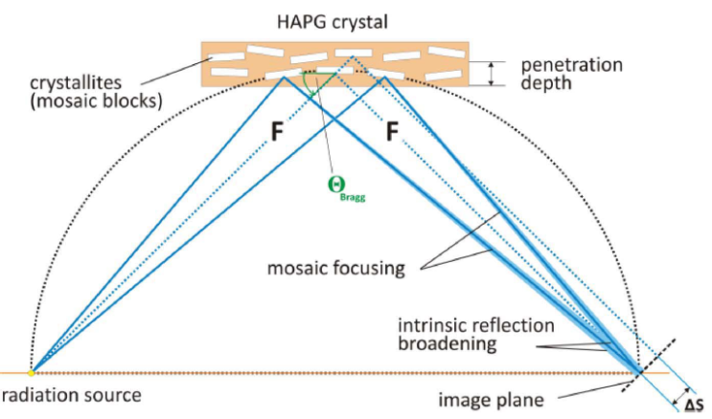
Pyrolitic Graphite Mosaic Crystals
Pyrolitic Graphite (d = 3.354 Å):
Mosaic crystal consist in a large number of nearly perfect small crystallites.
Mosaicity makes it possible that even for a fixed incidence angle on the crystal surface, an energetic distribution of photons can be reflected
Bending does not influence resolution and intensity
Mosaic spread down to 0.05 degree
Integral reflectivity ~ 10² higher than for other crystals
Variable thickness (efficiency)
Excellent thermal and radiation stability
Highly Annealed Pyrolitic Graphite (HAPG):
Lower mosaicity (Δθ≈0.07°)
Lower reflectivity
Better resolution (FWHM)
Highly Oriented Pyrolitic Graphite (HOPG):
Higher mosaicity (Δθ≈1°)
Higher reflectivity
Worse resolution (FWHM)
Increase of efficiency
(focusing) ~ 50
Loss in resolution
A. Scordo - Advances in X-ray and Gamma RAy DEtectors and applications (XGRADE 2026) 24-26/03/2026, Palermo

Slide 7
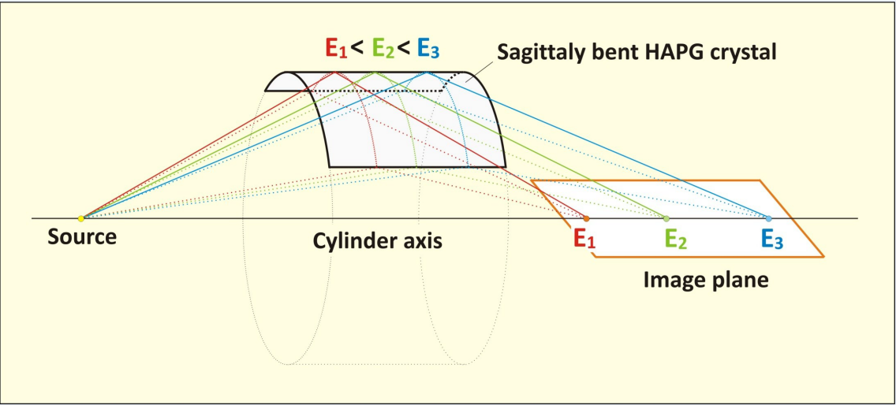
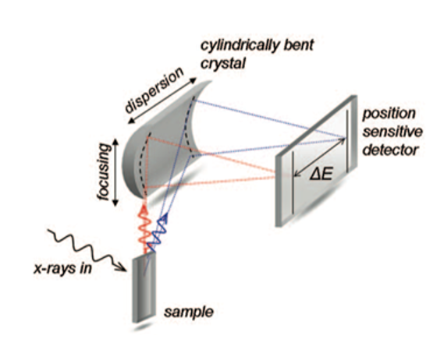
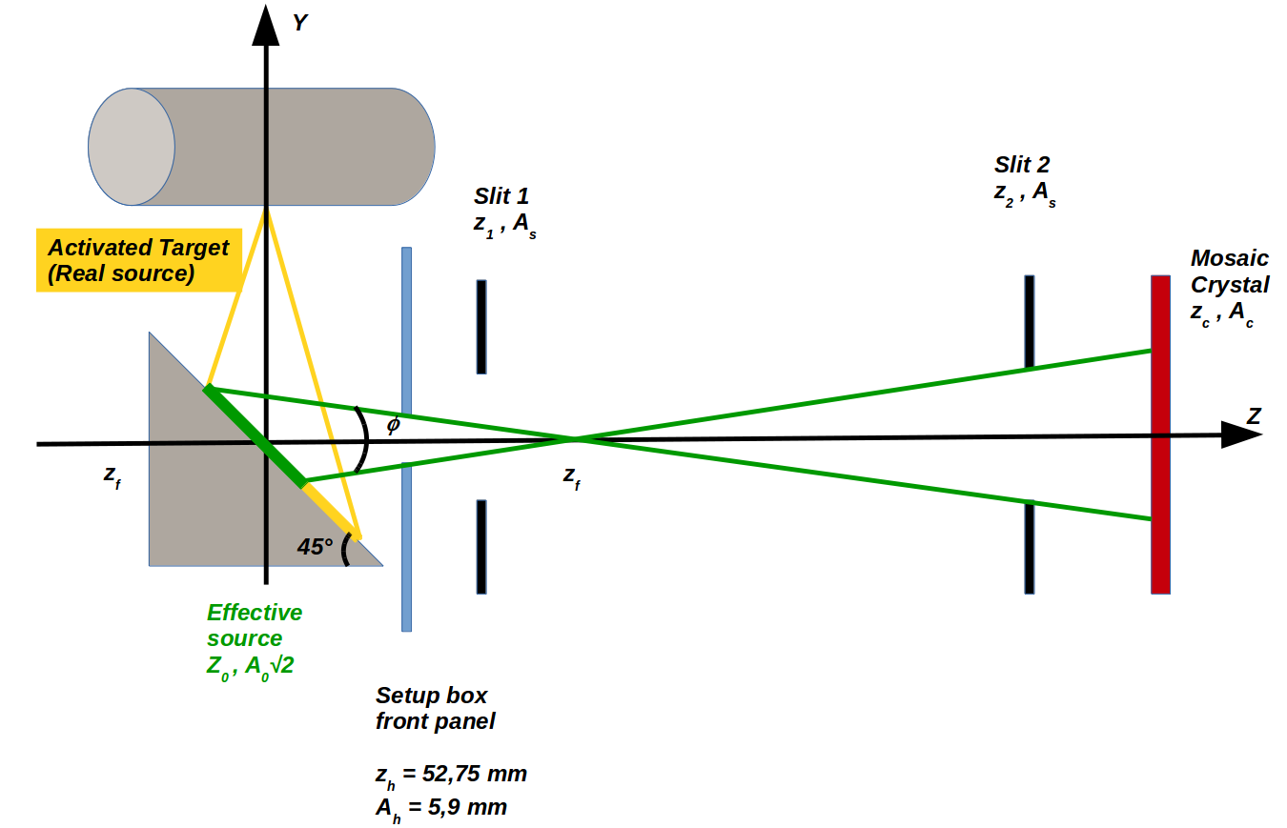
The Von Hamos configuration
VH configuration can further improve the signal collection efficiency.
In this configuration, also the vertical dimension of the X-ray source can be exploited with no (theoretical) limits
A. Scordo - Advances in X-ray and Gamma RAy DEtectors and applications (XGRADE 2026) 24-26/03/2026, Palermo

Slide 8
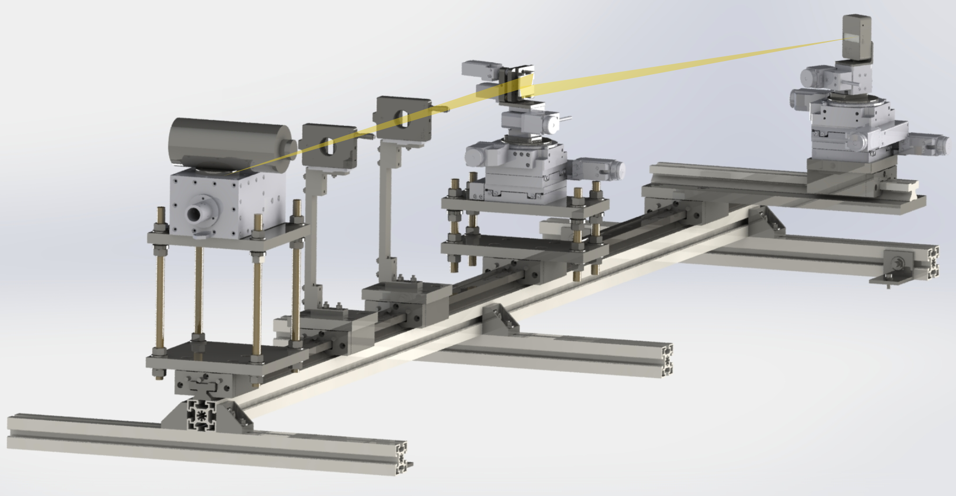
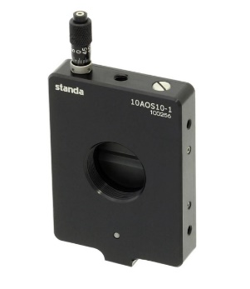
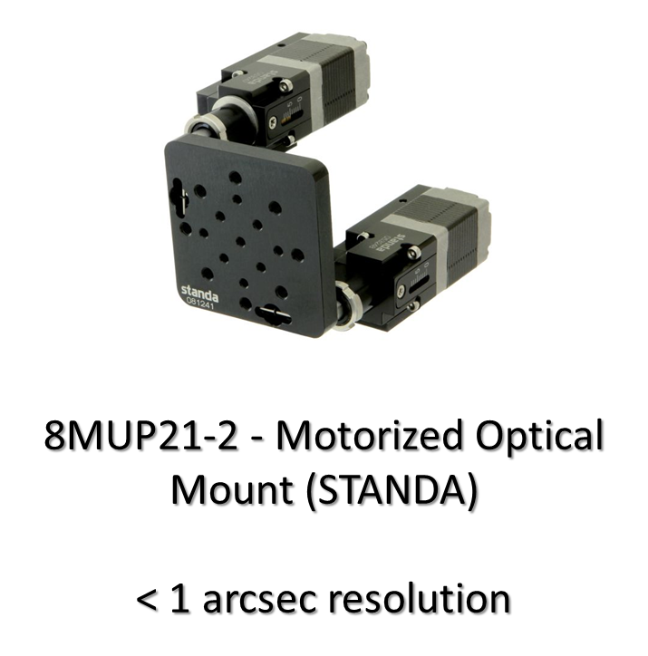
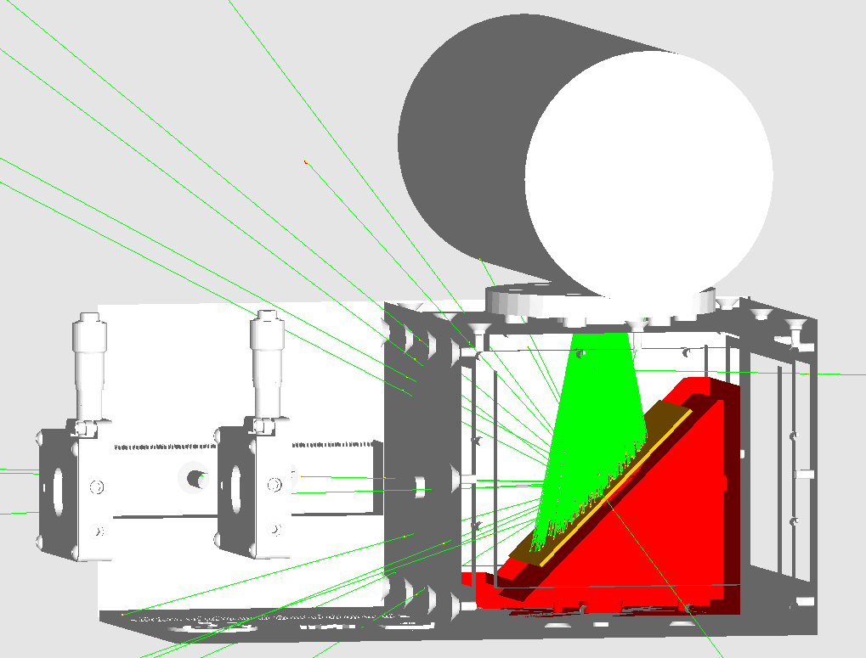
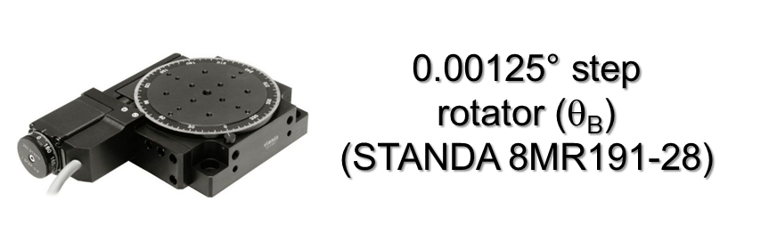
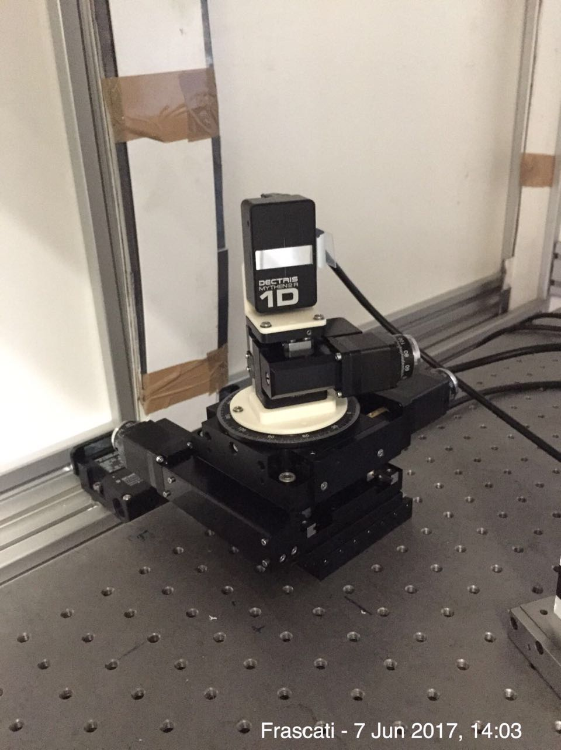
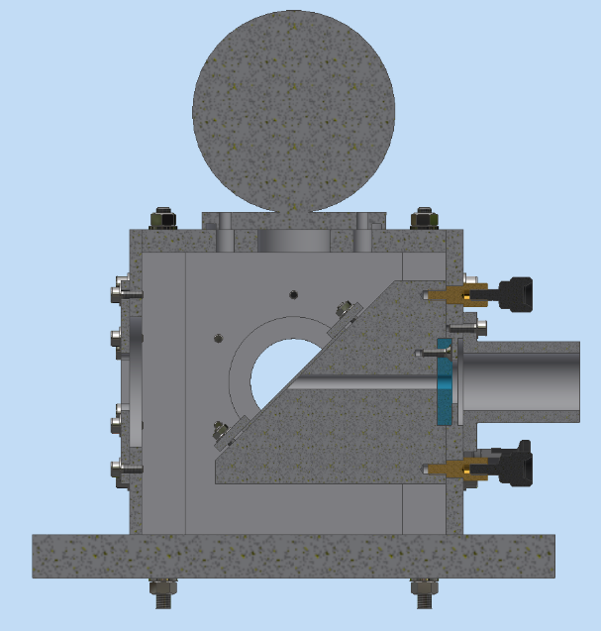
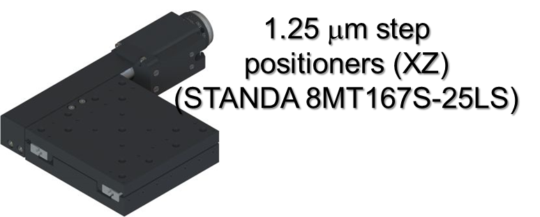
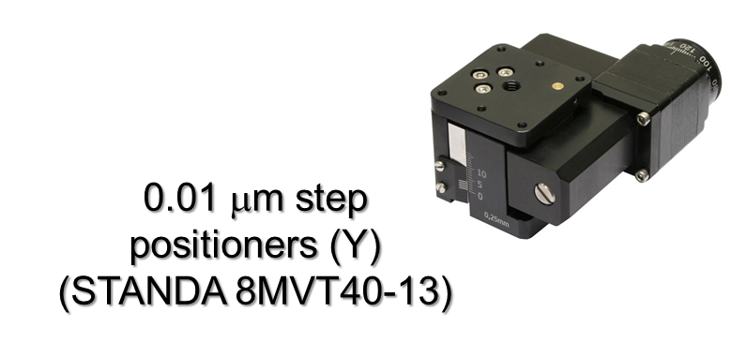
The VOXES spectrometer @ LNF
0-10 mm opening
26 mm circular frame
< 1 μm sensitivity
Slits
(STANDA 10MAOS10-1)
Dectris Ltd
MYTHEN2 detector:
32 x 8 mm surface
640 channels → 50 mm resolution
4-40 keV range
Working @ room temperature
A. Scordo - Advances in X-ray and Gamma RAy DEtectors and applications (XGRADE 2026) 24-26/03/2026, Palermo

Slide 9
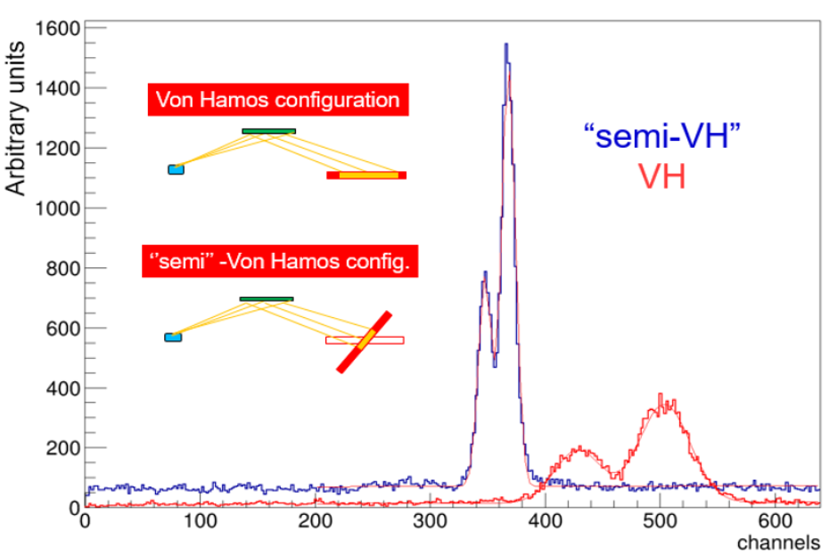
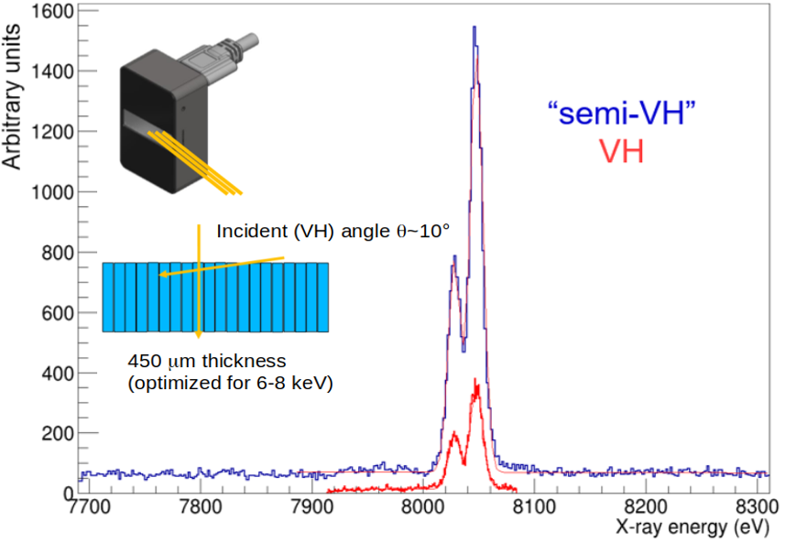
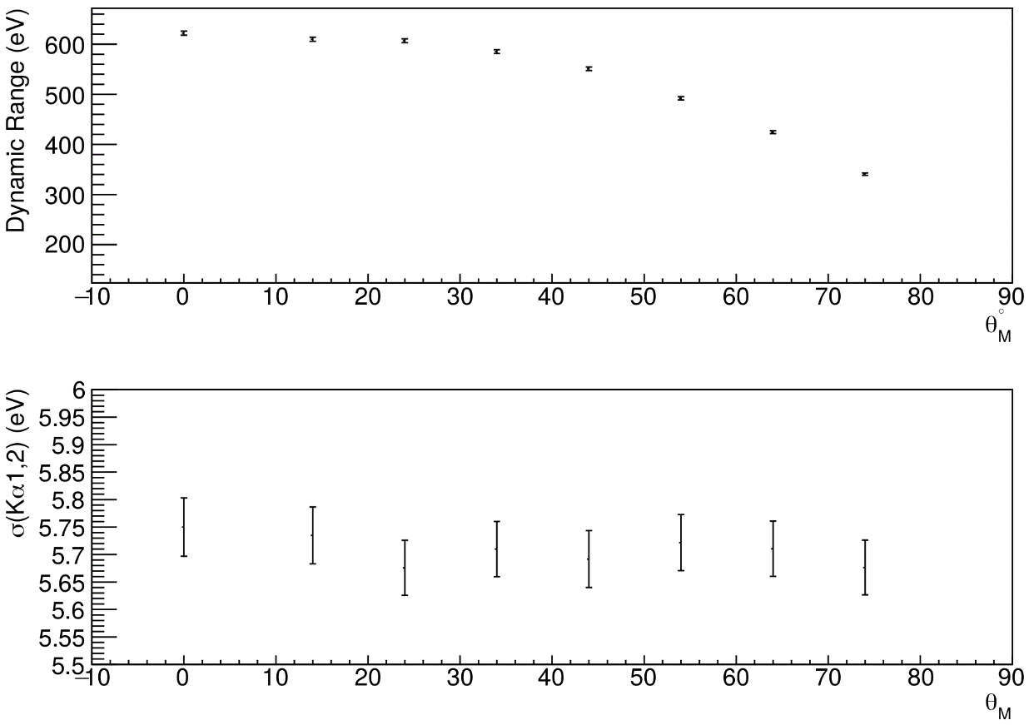
The Semi Von Hamos configuration
Position detector rotation allows for a wider dynamic range, higher detection efficiency and lower cross talk or charge sharing
Position detector rotation does not worsen energy resolution
A. Scordo - Advances in X-ray and Gamma RAy DEtectors and applications (XGRADE 2026) 24-26/03/2026, Palermo

Slide 10
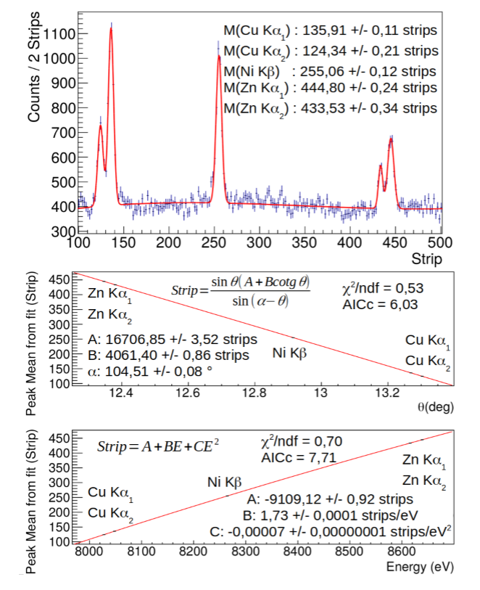
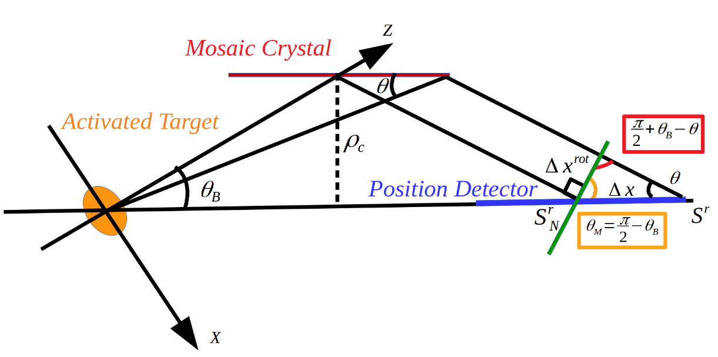
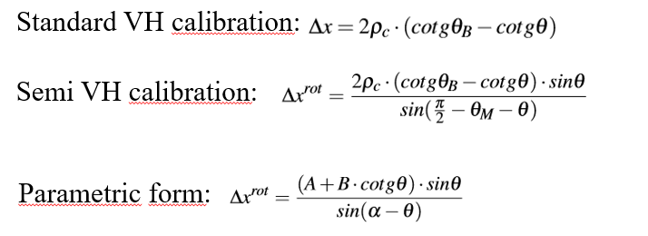
Calibration procedure and function
For small θ values (sinθ ≈ θ) or small ranges, is it also possible to calibrate with a linear function
A. Scordo - Advances in X-ray and Gamma RAy DEtectors and applications (XGRADE 2026) 24-26/03/2026, Palermo

Slide 11
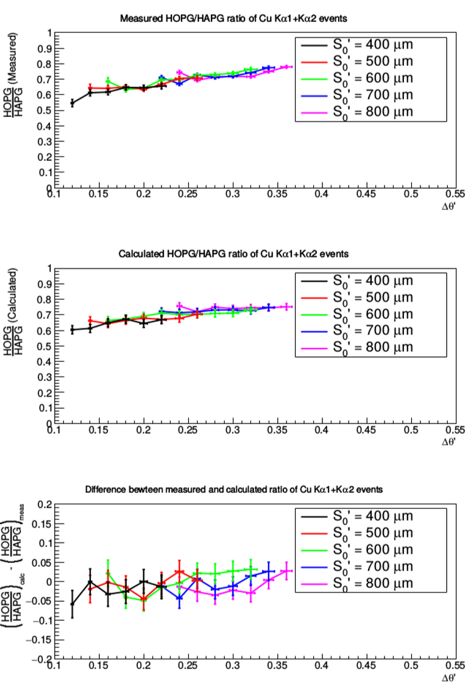
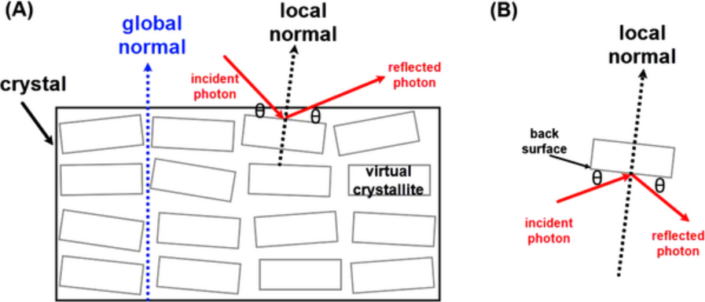
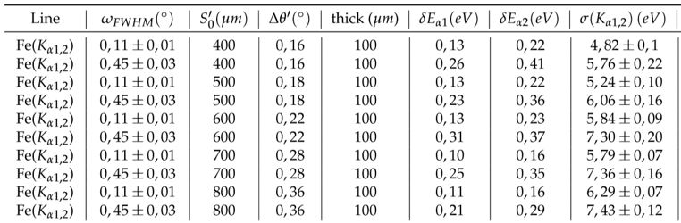
Effects of the HAPG mosaicity
Mosaic spread is worsening resolution (as expected…)
…but why not increasing the rate???
A. Scordo - Advances in X-ray and Gamma RAy DEtectors and applications (XGRADE 2026) 24-26/03/2026, Palermo

Slide 12
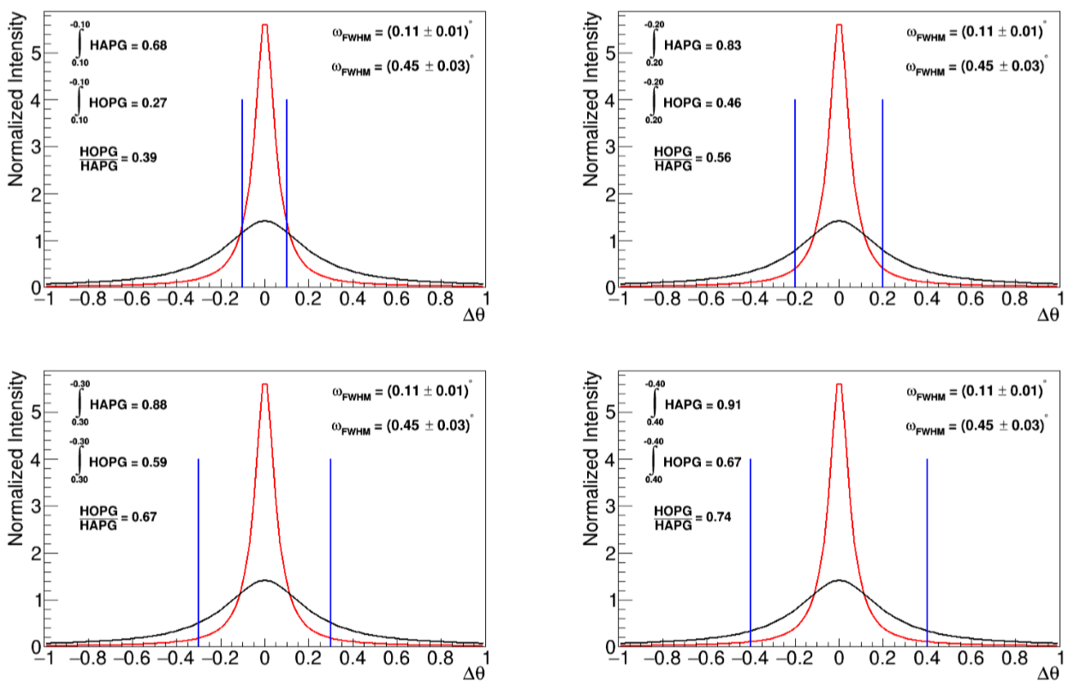
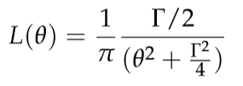
Effects of the crystal mosaicity
Number of crystallites per mm³ is of the same order of magnitude in every crystal
The number of effectively used crystallites is given by the integral of the mosaicity spread within the energy range of interest:
Mosaicity should be chosen depending on the application
A. Scordo - Advances in X-ray and Gamma RAy DEtectors and applications (XGRADE 2026) 24-26/03/2026, Palermo

Slide 13
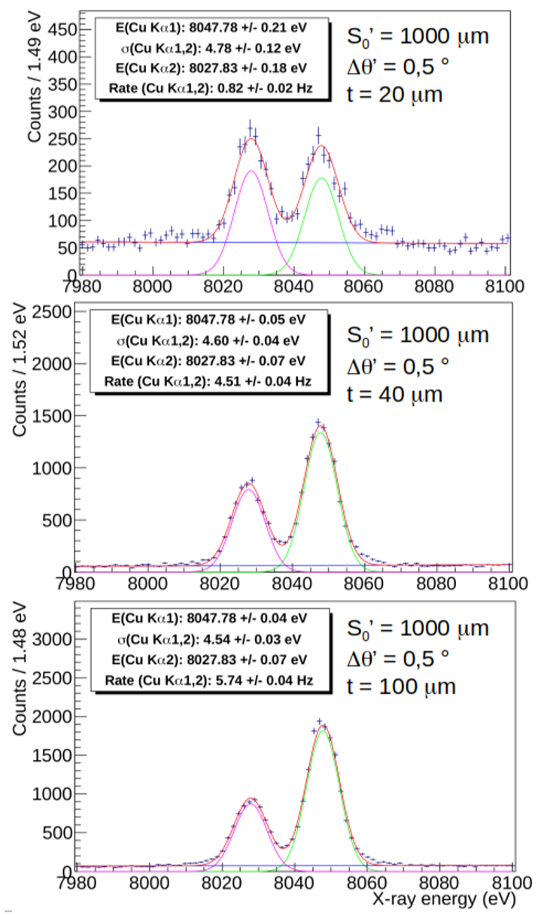
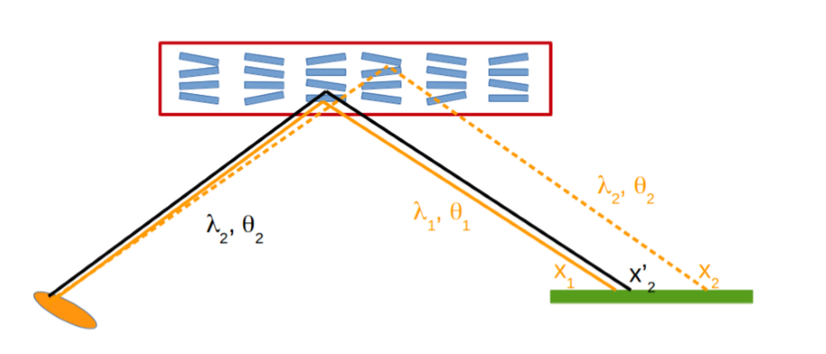
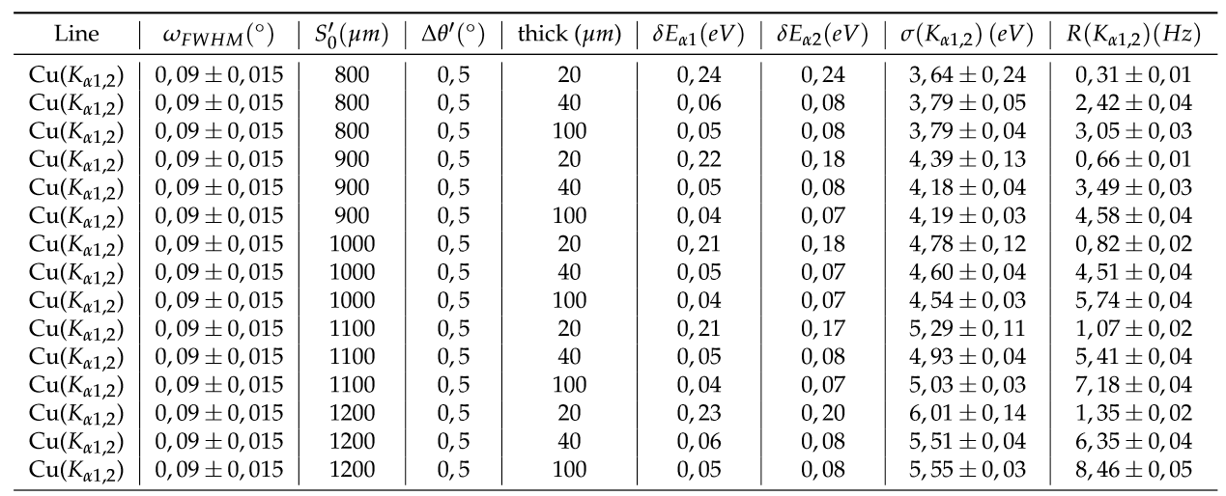
Effects of the crystal thickness
Which is the effect of HAPG thickness?
The resolution worsening effect induced by the crystal thickness is not anymore predominant; on the contrary, the resolution broadening induced by the source size is more important.
A. Scordo - Advances in X-ray and Gamma RAy DEtectors and applications (XGRADE 2026) 24-26/03/2026, Palermo

Slide 14
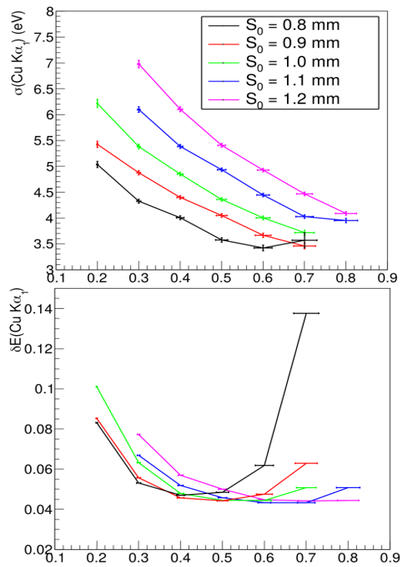

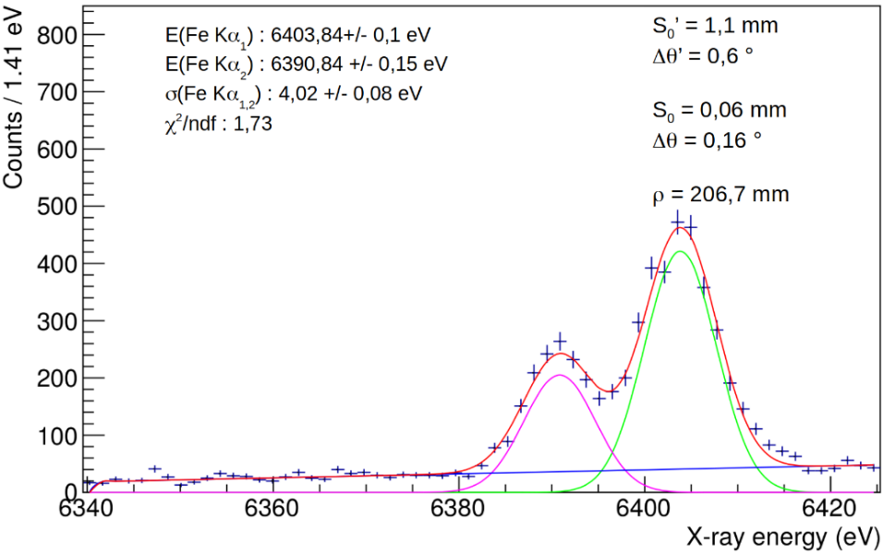
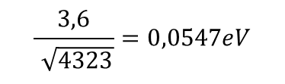
VOXES Characterization: results
In the limit of a background free pure gaussian peak, the precision is related to the resolution via:
$$\frac{3,6}{\sqrt{4323}}=0,0547eV$$
Given the energy and ρ_{c} it is alwasy possible to find the optimal configuration to obtain the best peak position precision
Valid for all energies
(tested for 6-20 keV)
Δθ (°)
A. Scordo - Advances in X-ray and Gamma RAy DEtectors and applications (XGRADE 2026) 24-26/03/2026, Palermo

Slide 15
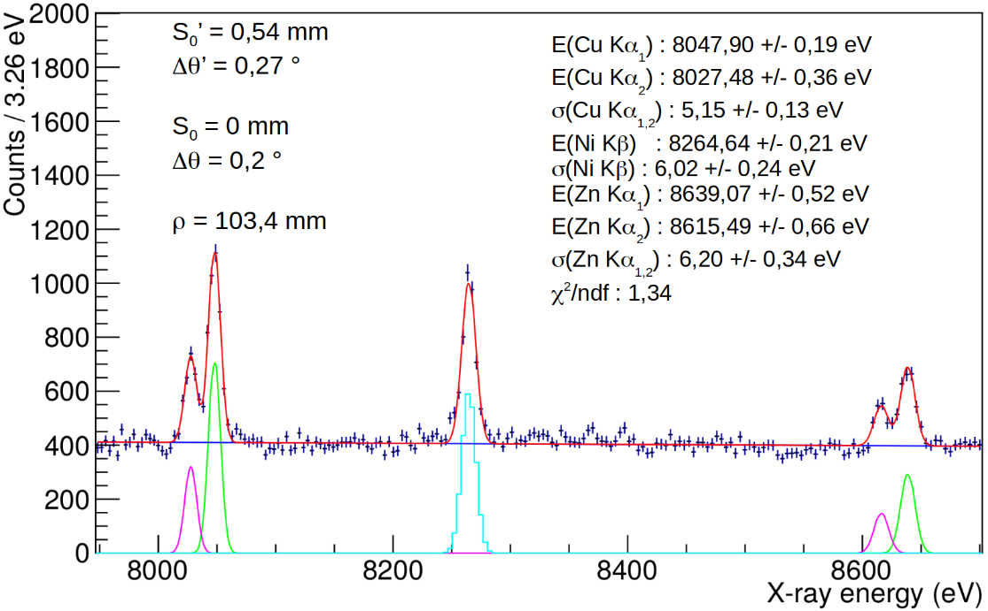
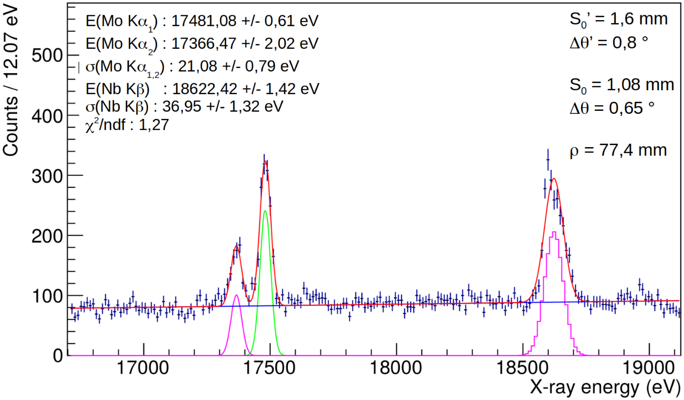
VOXES Characterization: results
700 eV dynamic range (one shot)
Resolution still at 6 eV level (s)
>1 keV dynamic range
Resolution still at 1,2 ‰
Almost 2 mm source size
Did we understand the geometry properly?
How can we test the actual source size?
Do we get what we should?
X-ray tracing simulations
A. Scordo - Advances in X-ray and Gamma RAy DEtectors and applications (XGRADE 2026) 24-26/03/2026, Palermo

Slide 16
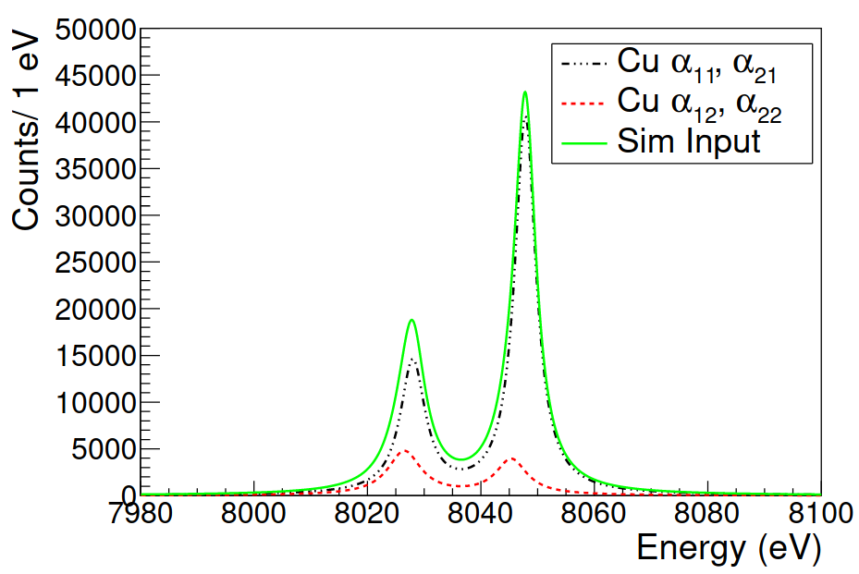
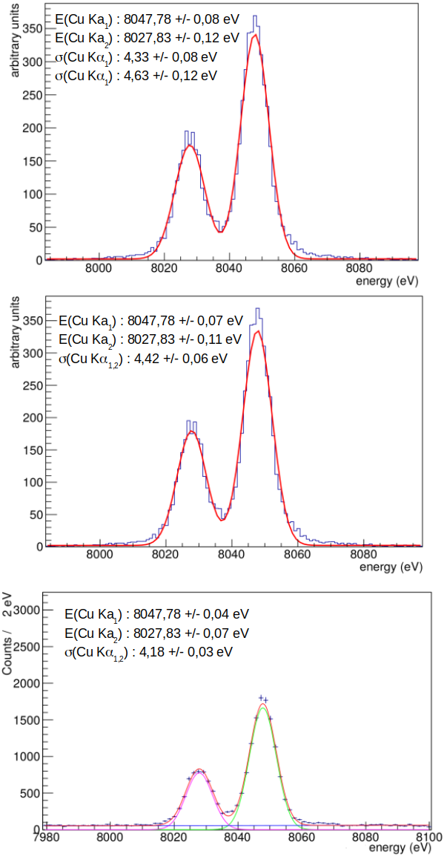

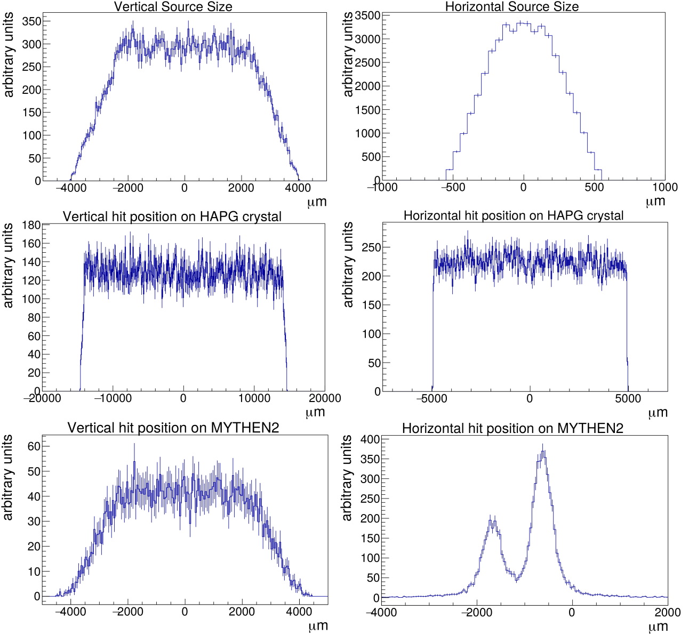
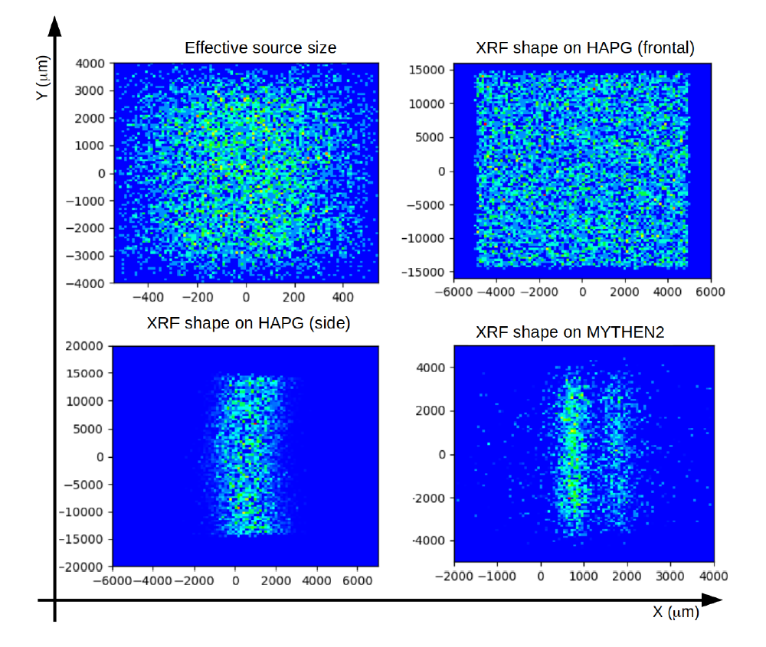
Ray Tracing Simulations: spectra reconstruction
Source dimensions in agreement with the horizontal and vertical expected values
Shadow + XOP code embedded in OASYS framework
(EOS26 school)
RT
Exp.
Peak position and σ well reproduced
A. Scordo - Advances in X-ray and Gamma RAy DEtectors and applications (XGRADE 2026) 24-26/03/2026, Palermo

Slide 17
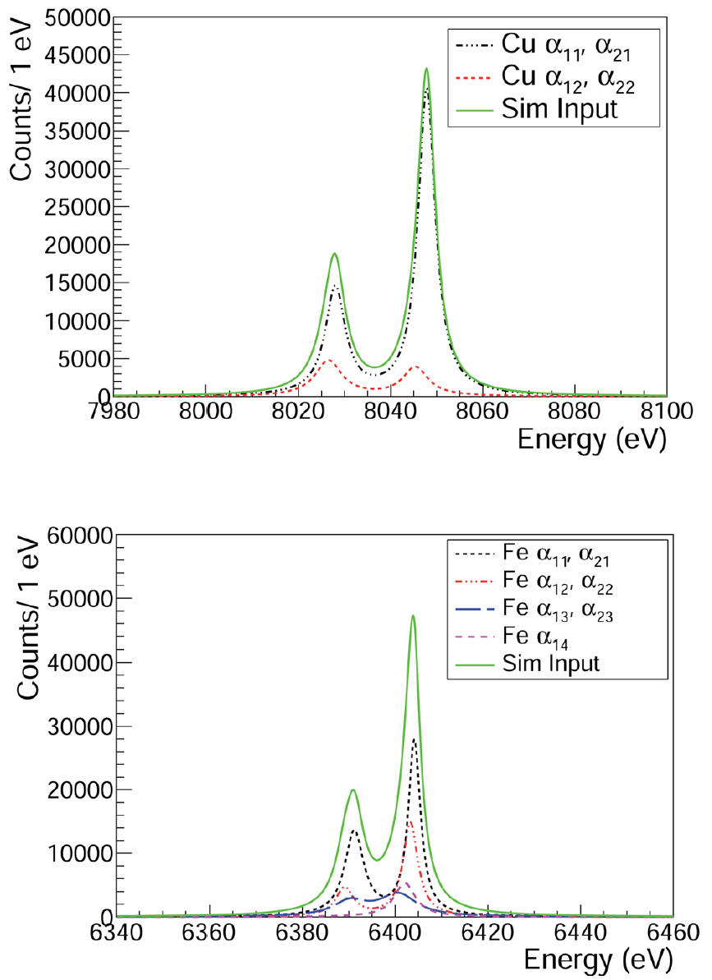
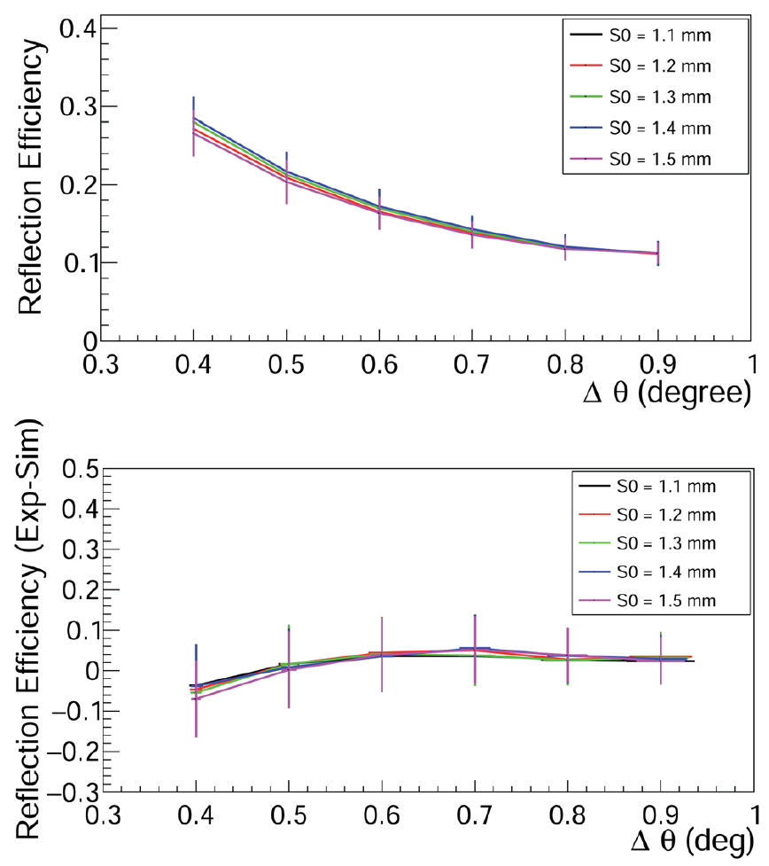
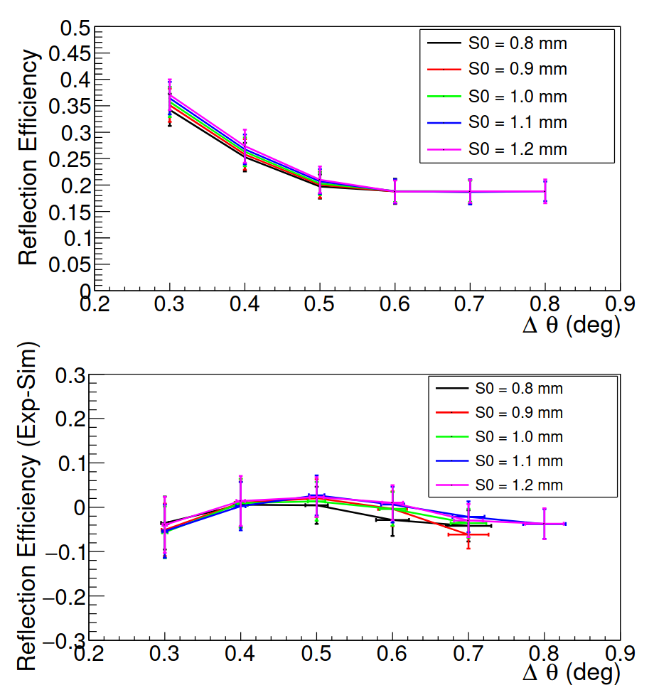

Ray Tracing Simulations: reflection efficiencies
Reflection efficiencies have been measured for Cu (up) and Fe (down) with a Silicon PinDiode as reference detector
Reflection efficiencies have been then computed with RT simulations and compared to measured ones
RT simulation have been realized with accurate Cu and Fe lineshapes
The combination of these two studies fully validates the XOP and SHADOW based ray tracing simulations for HAPG mosaic crystals.
A. Scordo - Advances in X-ray and Gamma RAy DEtectors and applications (XGRADE 2026) 24-26/03/2026, Palermo

Slide 18


The VOXES facility @ LNF
New background-free source box made of Teflon
Set of HAPG/HOPG and Si(220) crystals with various curvature radii
ANDOR DY934P-BR-DD-T2 1024x1024 pixels CCD
Pixel size: 13x13 μm
Timepix 256x256 pixels
Pixel size: 55x55 μm
Amptek X123 SiPin Detector
6 mm² active area
Mo/W X-ray tubes
High resolution (FWHM ~ 0,1%) Bragg spectroscopy line (4-20 keV)
Large acceptance and efficiency line with a PinDiode detector (2-40 keV)
A. Scordo - Advances in X-ray and Gamma RAy DEtectors and applications (XGRADE 2026) 24-26/03/2026, Palermo

Slide 19

Bayesian Auto-alignment procedure
Developed by S. Manti @ LNF
A. Scordo - Advances in X-ray and Gamma RAy DEtectors and applications (XGRADE 2026) 24-26/03/2026, Palermo

Slide 20




The VOXES facility @ LNF
FeKβ_{1,3}
CoKα₁
Fe + Co spectrum obtained with the high resolution Bragg spectrometer line
CoKα₂
FeKβ’
Multi-target spectrum obtained with the high efficiency line
A. Scordo - Advances in X-ray and Gamma RAy DEtectors and applications (XGRADE 2026) 24-26/03/2026, Palermo

Slide 21

The MITIQO project
A. Scordo - Advances in X-ray and Gamma RAy DEtectors and applications (XGRADE 2026) 24-26/03/2026, Palermo

Slide 22

The MITIQO project
Metal’s State (Oxidation) reduces the quality and it is driven by Metals
A. Scordo - Advances in X-ray and Gamma RAy DEtectors and applications (XGRADE 2026) 24-26/03/2026, Palermo

Slide 23



The MITIQO project
Goal: distinguish oxidized liquid Fe from Fe⁰
FERROFOLIN 40 mg/15 ml + 0,185 mg/15 ml
A. Scordo - Advances in X-ray and Gamma RAy DEtectors and applications (XGRADE 2026) 24-26/03/2026, Palermo

Slide 24

The MITIQO project
A. Scordo - Advances in X-ray and Gamma RAy DEtectors and applications (XGRADE 2026) 24-26/03/2026, Palermo

Slide 25

The MITIQO project
MITIQO high efficiency line detection capabilities have been calibrated with diluted samples of FERROFOLIN
According to several studies, Principal Components Analysis applied to relative metal concentrations provide hints on geographical origin of wines
A. Scordo - Advances in X-ray and Gamma RAy DEtectors and applications (XGRADE 2026) 24-26/03/2026, Palermo

Slide 26

The MITIQO project
Hints of clusterization! -> Reduce unwanted contamination in the setup
A. Scordo - Advances in X-ray and Gamma RAy DEtectors and applications (XGRADE 2026) 24-26/03/2026, Palermo

Slide 27


Conclusions
VOXES is now a well established facility at the INFN Laboratories of Frascati
We are also open to external applications/collaborations
We also welcome suggestions and ideas for possible applications
Come visit us in Frascati
A. Scordo - Advances in X-ray and Gamma RAy DEtectors and applications (XGRADE 2026) 24-26/03/2026, Palermo

Slide 28


