Slide 1
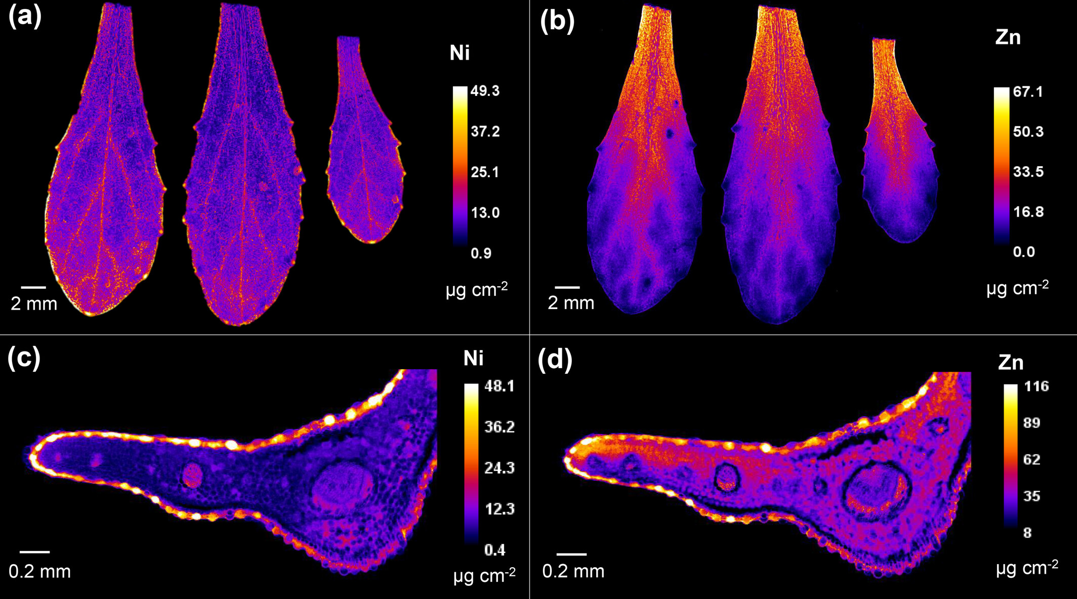
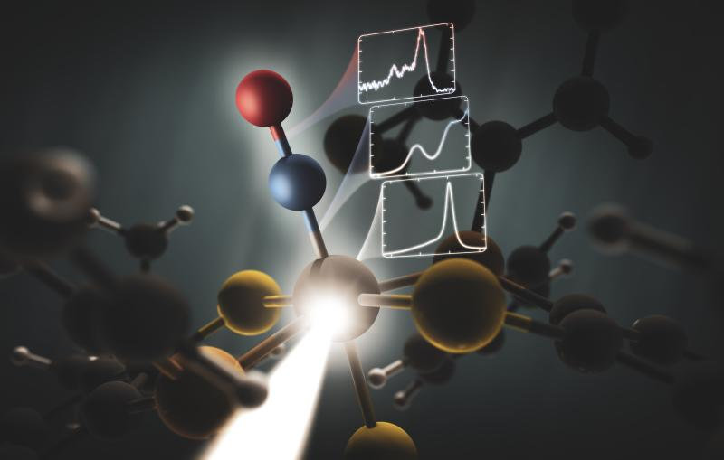



Direct pre-amplifier sampling ADC for high-count rate and high-resolution X-ray spectroscopy
A. Abba, V. Arosio, P. Barcella, F. Caponio, E. Carlotti, M. Carminati, S. Carsi, C. Fiorini, B. Pedretti, E. Proserpio, C. Tintori
Nuclear Instruments
CAEN SPA
Politecnico di Milano – DEIB
XGRADE – Palermo 2026 – 26-03-2026

Slide 2
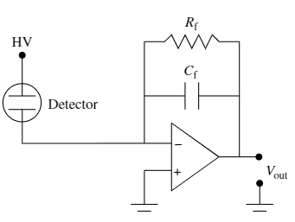
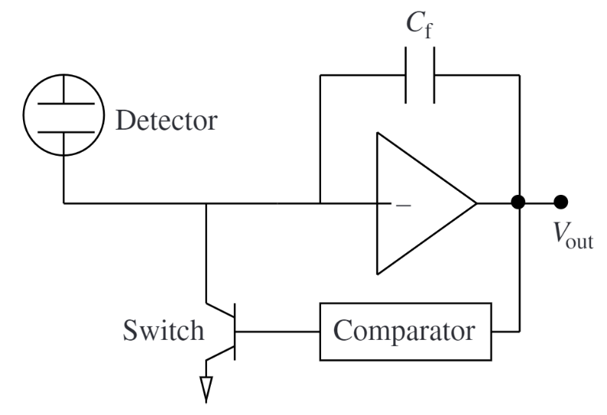
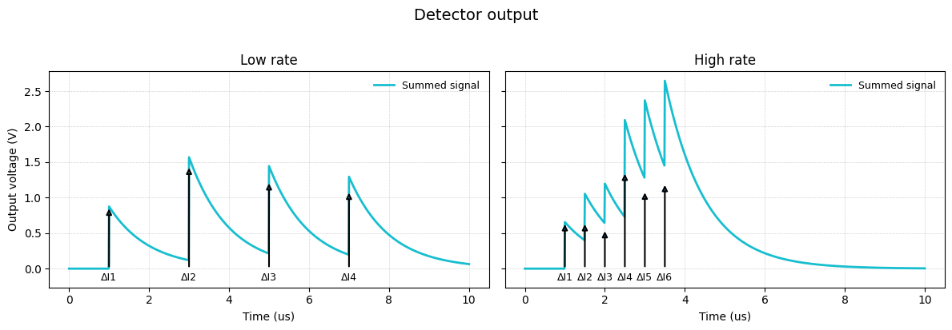
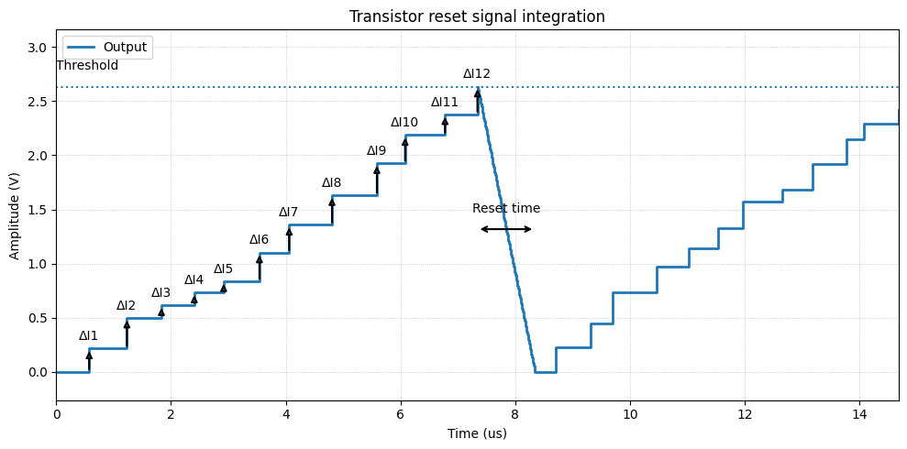
Comparison between resistive feedback and transistor reset charge amplifier
RESISTIVE FEEDBACK CHARGE PRE-AMPLIFIER
TRANSISTOR RESET CHARGE PRE-AMPLIFIER

Slide 3
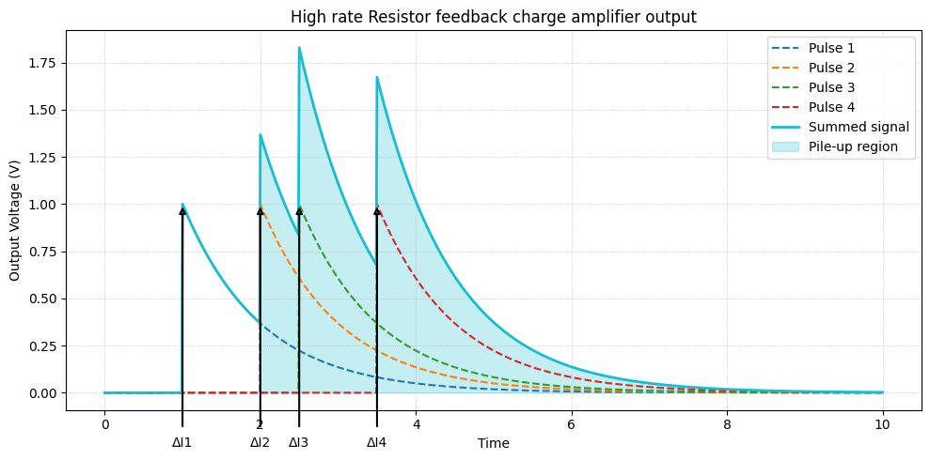
Pileup and saturation on continuous reset amplifier

Slide 4
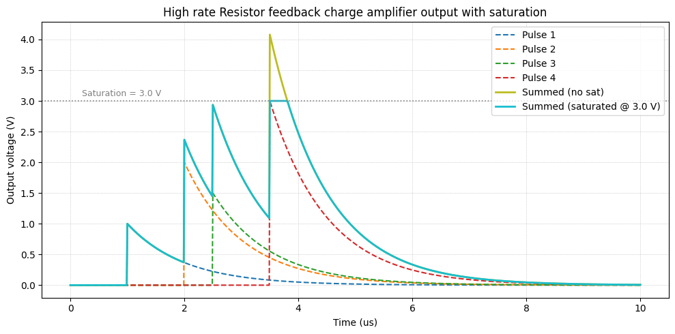
Pileup and saturation on continuous reset amplifier

Slide 5
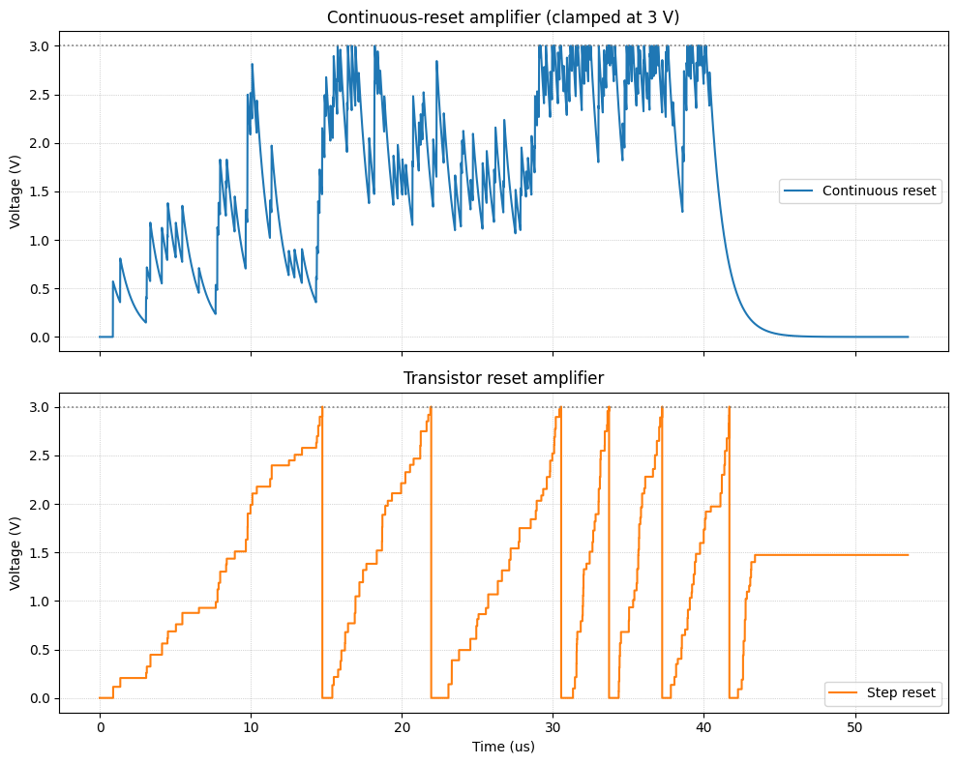
Transistor reset amplifier for high rate detector
RATE INCREASE

Slide 6
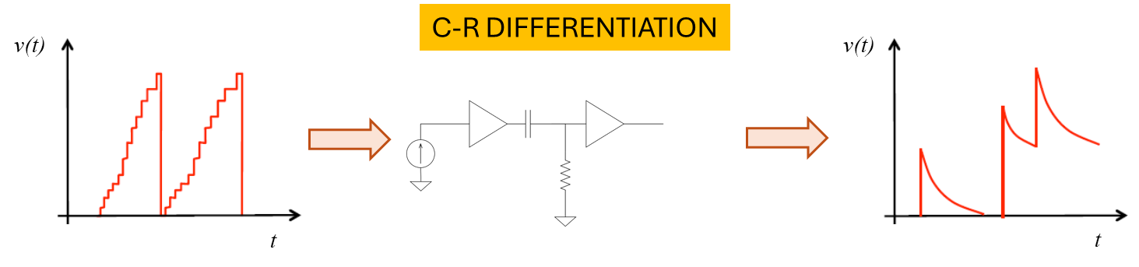
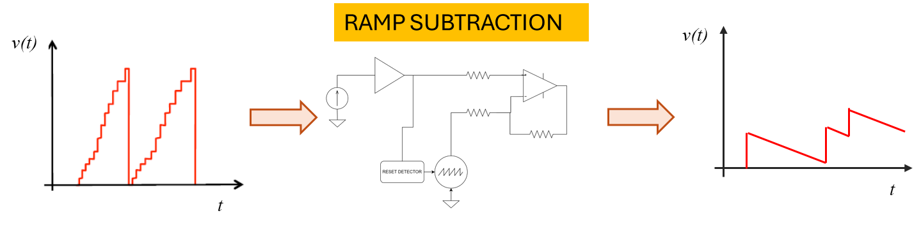
Transistor reset amplifier for high rate detector

Slide 7
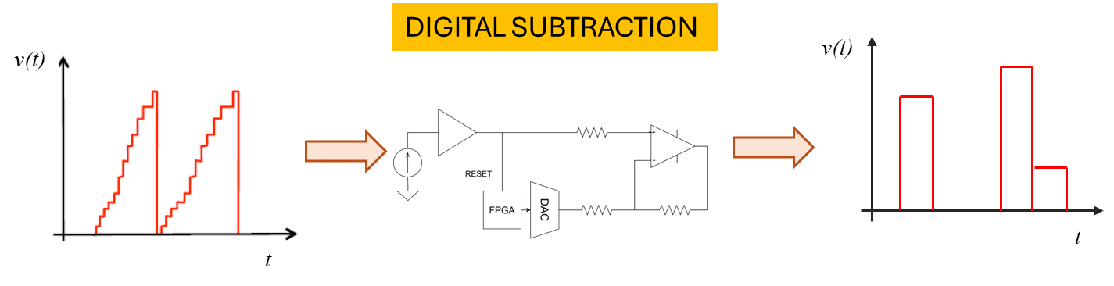
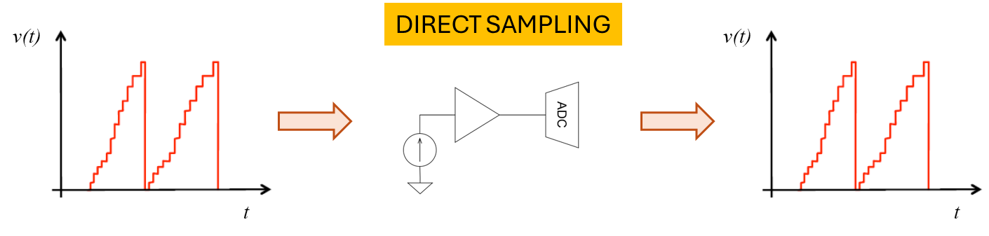
Transistor reset amplifier for high rate detector

Slide 8
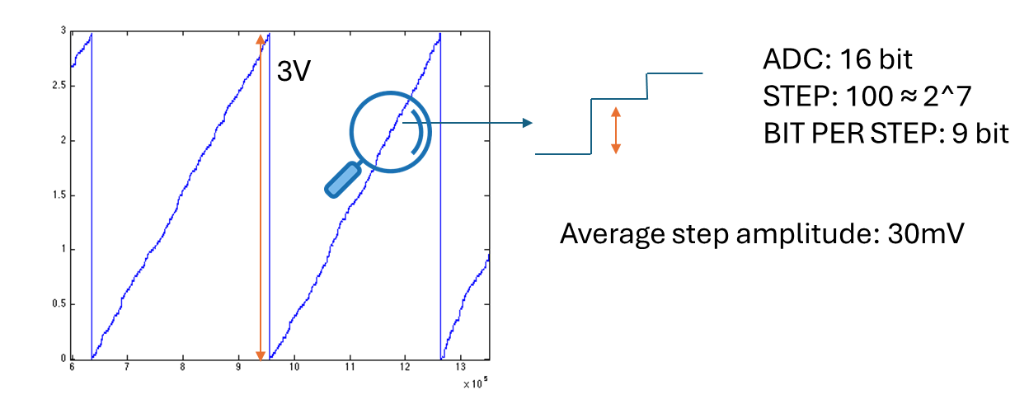
Sampling the transistor reset detector output

Slide 9
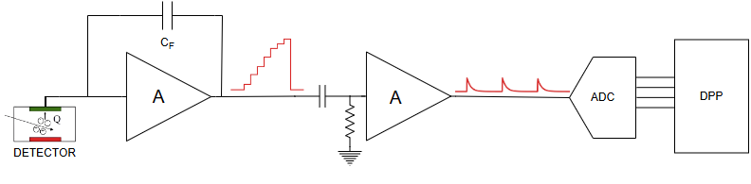
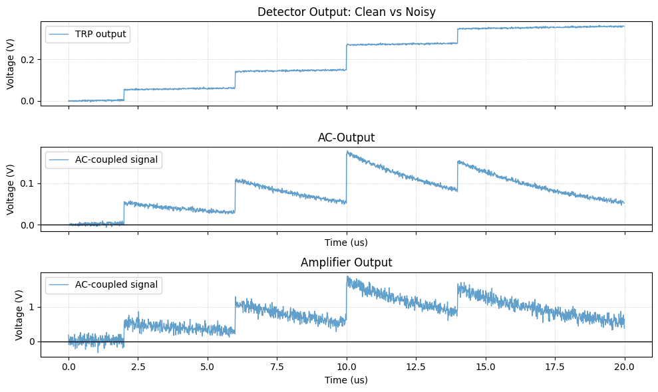
Reshape and amplify TRP output signal
Detector output
Pileup effect → trade-of between shaping time and gain
Additional noise introduced by amplifier

Slide 10
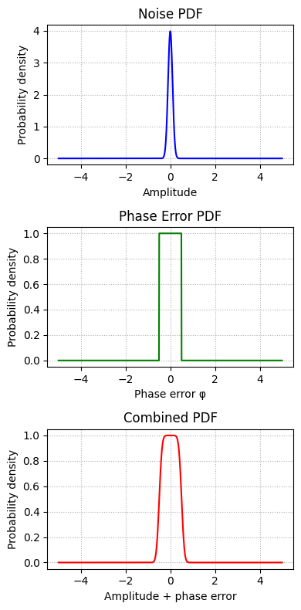
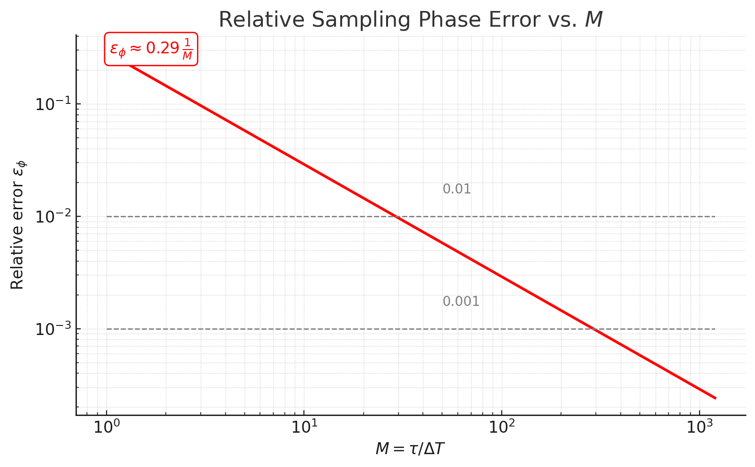
Reshape and amplify TRP output signal
Deconvolution
M=τ/ΔT

Slide 11
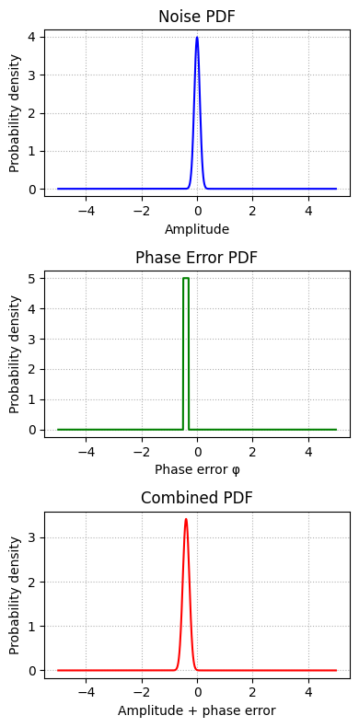



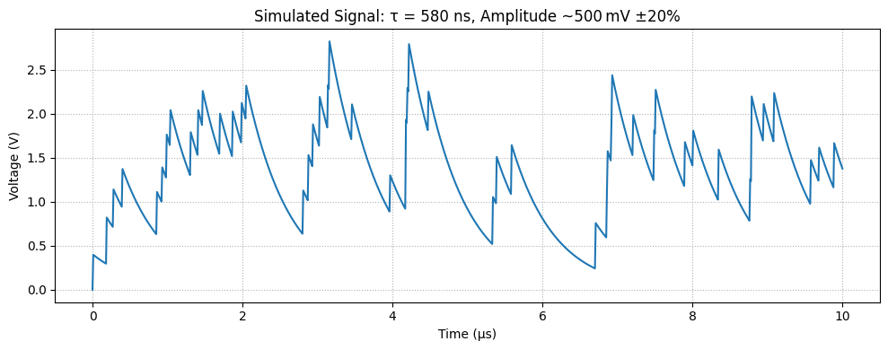
Reshape and amplify TRP output signal
To introduce Low sampling error M should be high
High M means:
High sample rate (fast ADC)
Long shaping time (pileup)
Ts = 10ns → 100Msps
(2.2% = 130eV on Fe⁵⁵ Kα)
Simulation 5 Mcps
Fe⁵⁵ Kα = 500mV
Low M=τ/ΔT ratio
High M=τ/ΔT ratio

Slide 12


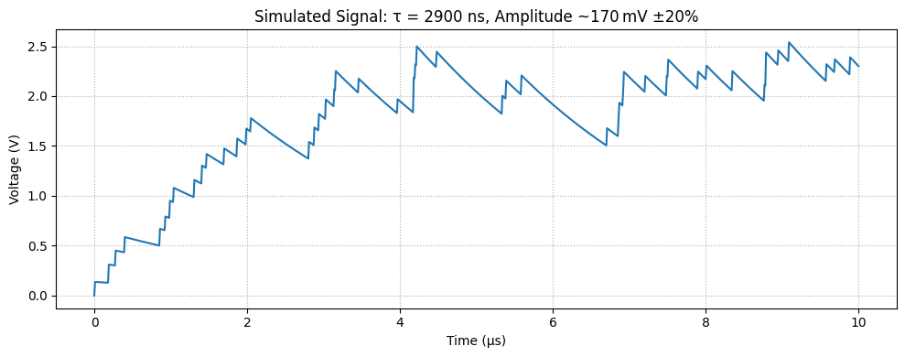
Reshape and amplify TRP output signal
To introduce Low sampling error M should be high
High M means:
High sample rate (fast ADC)
Long shaping time (pileup)
Ts = 10ns → 100Msps
(2.2% = 130eV on Fe⁵⁵ Kα)
Simulation 5 Mcps
Fe⁵⁵ Kα = 170mV
Low M=τ/ΔT ratio
High M=τ/ΔT ratio

Slide 13
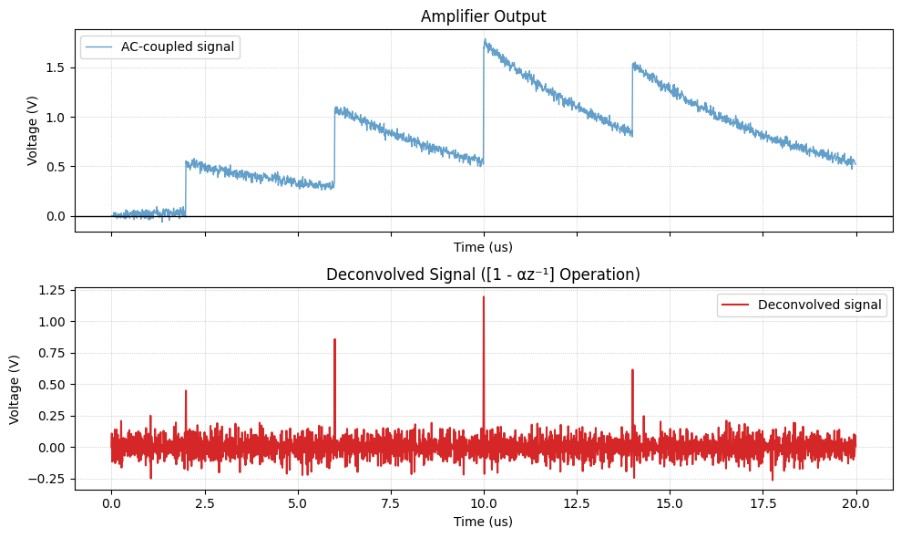
Reshape and amplify TRP output signal
Deconvolution

Slide 14
Reshape and amplify TRP output signal
Deconvolution

Slide 15

Reshape and amplify TRP output signal
Deconvolution
Signal Sharpening
Converts each exponential decay into short impulse of amplitude ΔI
Improves temporal resolution and separates overlapping events
High-Pass Action on Noise
Acts as a digital high-pass filter: attenuates low-frequency drift but amplifies mid-/high-frequency components
White noise spectrum becomes “colored,” with increased power at higher frequencies
Noise Variance Increase If input noise has variance σ², output variance ≈ (1 + α²) σ²RMS noise grows by factor √(1 + α²)
SNR Degradation
Peak amplitude remains ΔI, but noise floor rises resulting

Slide 16
Reshape and amplify TRP output signal
Deconvolution
+
Digital Shaping
Trigger (Fast Shaper)
Deconvolution
Energy Sample
Spectrum
-
Slow Shaper
Baseline Restorer

Slide 17
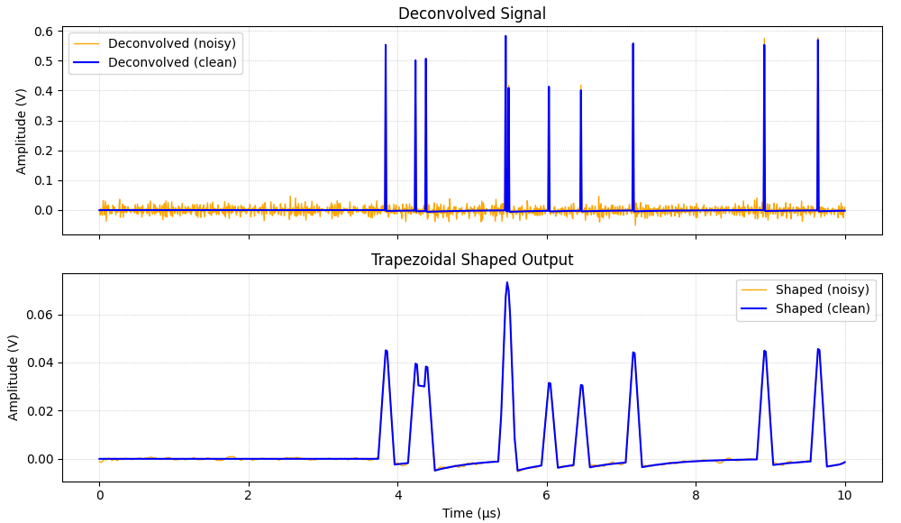
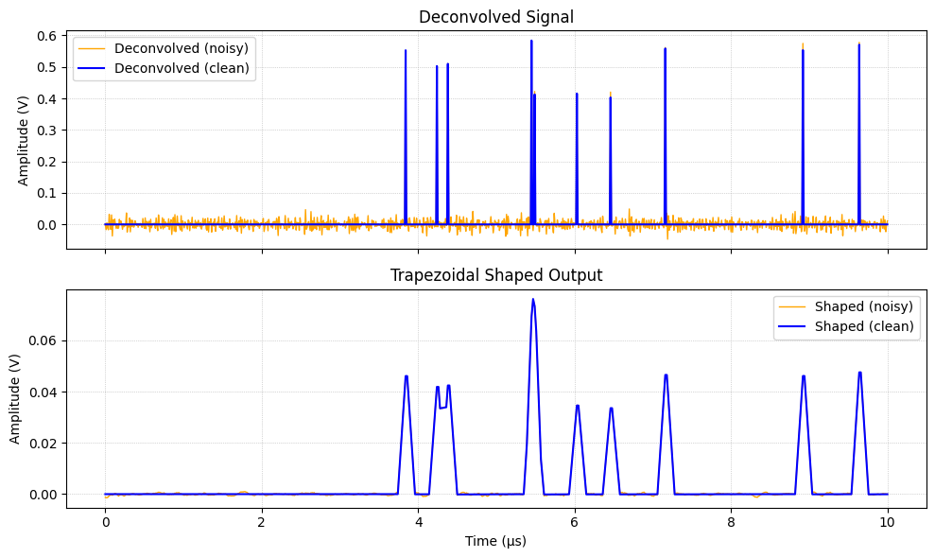

Reshape and amplify TRP output signal
Deconvolution
+
Digital Shaping
Over Compensated
Correctly Compensated
Under Compensated

Slide 18
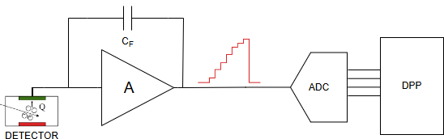
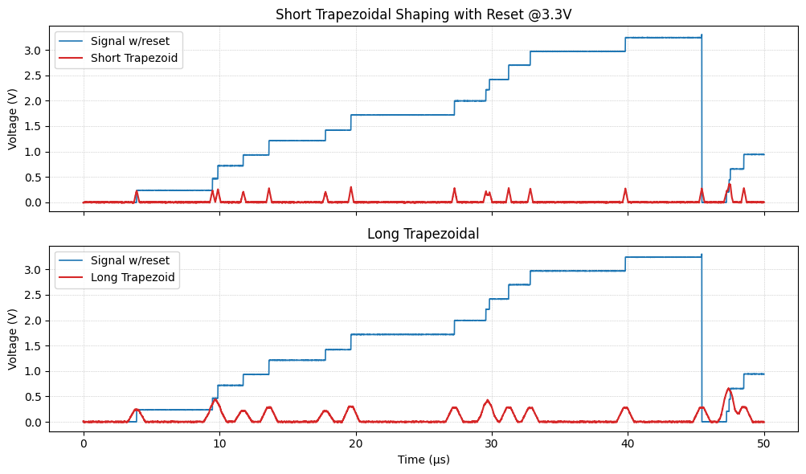
Direct sampling with 20 bit ADC
Trigger (Fast Shaper)
TRP
Output
Energy Sample
Spectrum
Slow Shaper

Slide 19
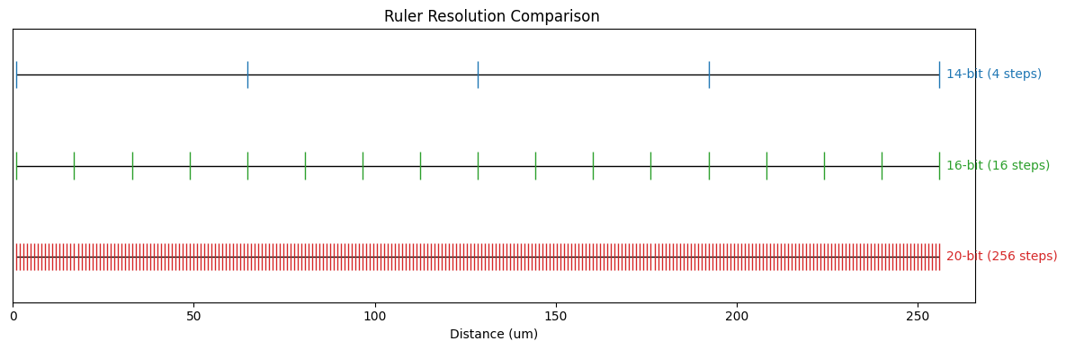
Direct sampling with 20 bit ADC

Slide 20
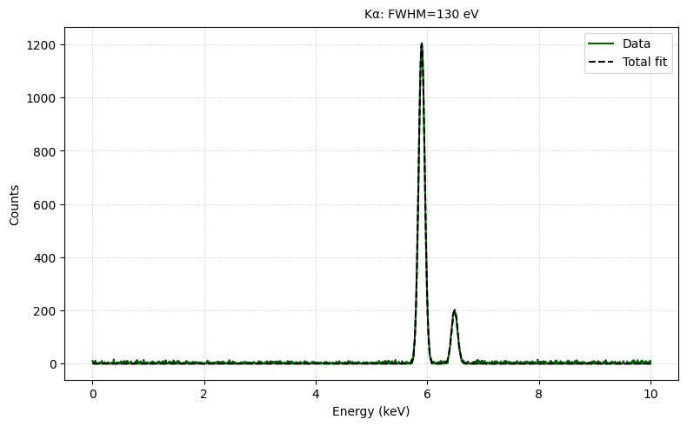
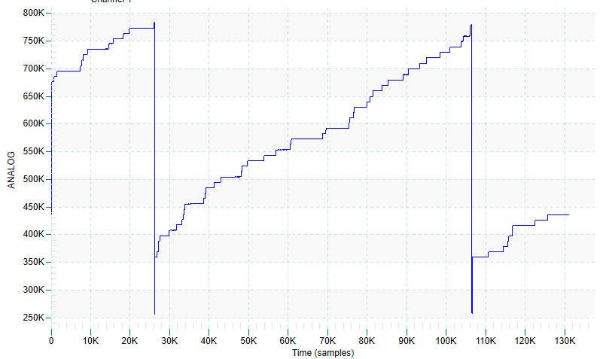
20 bit ADC effective resolution
3V
5.9KeV = 25mV
Resolution | LSB (mV) | LSB per keV
14 bit | 3 V/2¹⁴ ≃ 0.1831 | 4.237 mV/keV / 0.1831 mV/LSB ≃ 23.2 LSB/keV
16 bit | 3 V/2¹⁶ ≃ 0.04578 | 4.237 / 0.04578 ≃ 92.6 LSB/keV
20 bit | 3 V/2²⁰ ≃ 0.002861 | 4.237 / 0.002861 ≃ 1 480 LSB/keV

Slide 21
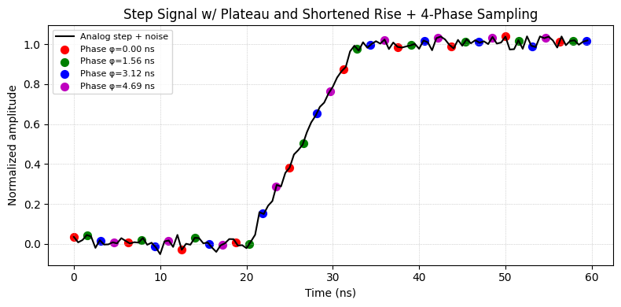
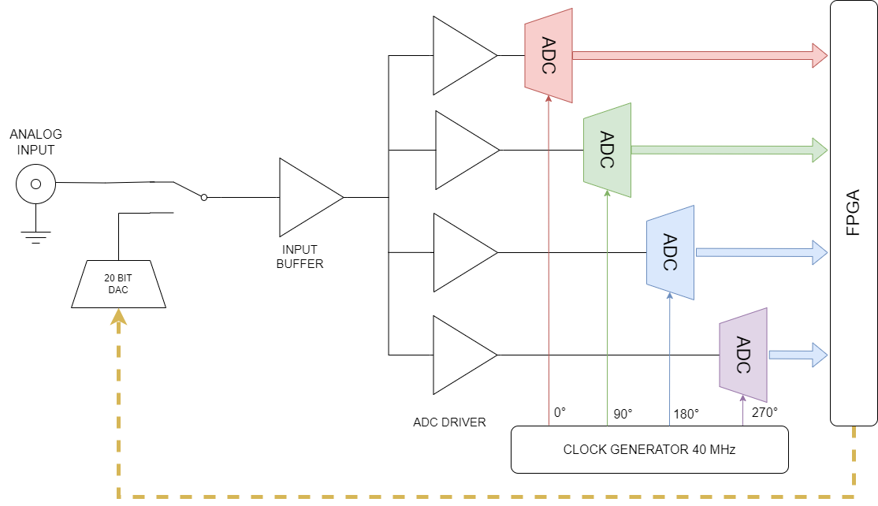
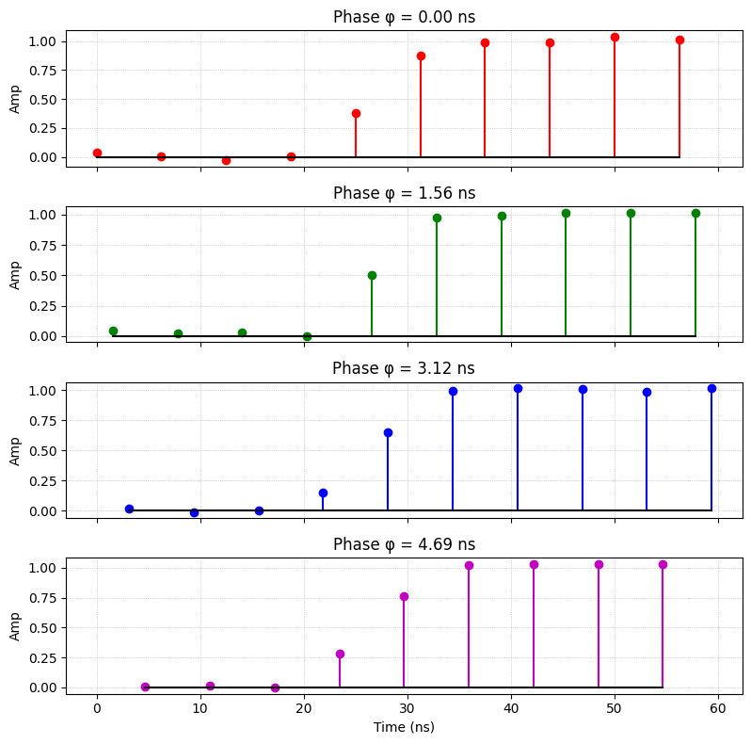
Interleaving 160 MHz 20 bit digitizer using 4x40 MHz SAR ADC
40 MHz 20 bit SAR ADC

Slide 22
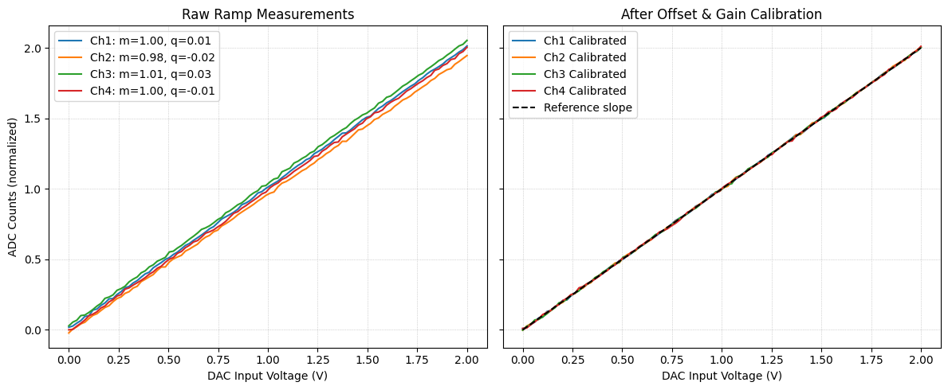



Gain and offset calibration
Acquire Calibration Ramps For each ADC channel, apply a precise linear ramp 𝑥(𝑡)x(t) (e.g. 0 → 𝑉​ over 2 µs) from a 20-bit DAC.
Fit a Straight Line
Correct Offsets Subtract each channel’s own offset so that each line passes through the origin:
Equalize Gains
Calibration Signal
-q_{i}
m_{i}
m_{ref} is channel 1

Slide 23
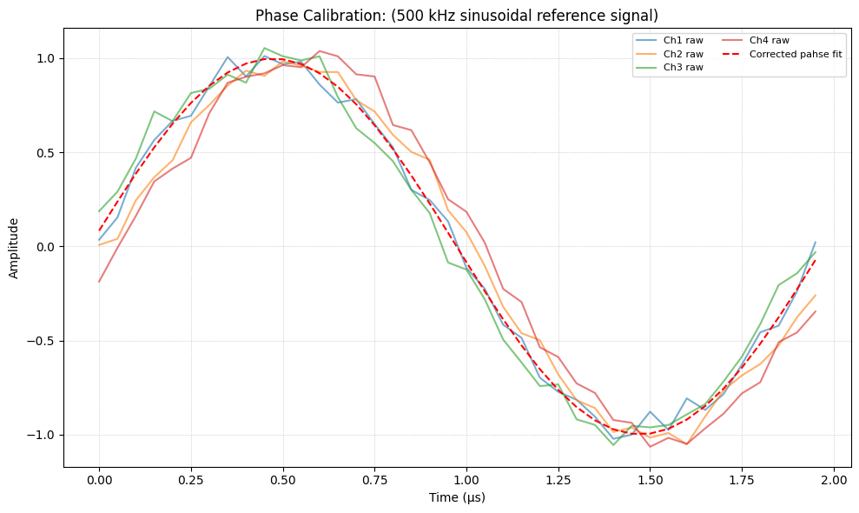
Gain and offset calibration
Calibration Signal
SAMPLE
PROGRAMMABLE PHASE SHIFT CLOCK GENERATOR
SIN FIT (LM FIT)
PHASE SHIFT EXTIMATOR
ADJUST CLOCK DELAY LINES
< 100ps
PHASE LOCKED

Slide 24
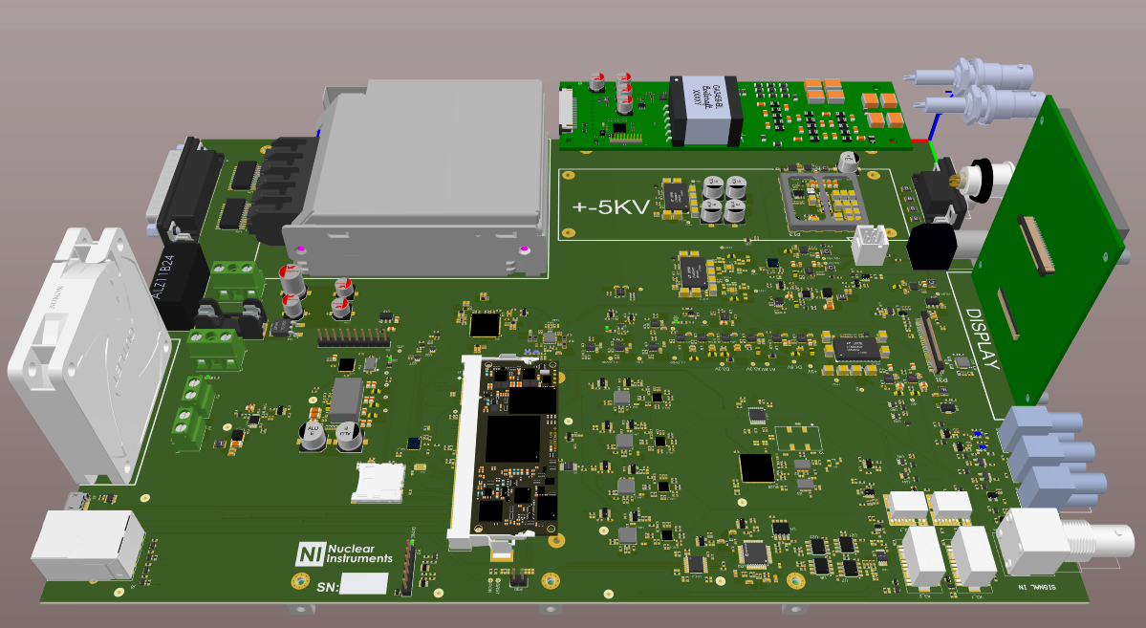
System overview
2A 2V Peltier driver
+-5KV BIAS HpGE/CZT/CdTE 0.5mA
Slow GPIO (16 in/Out TTL)
+-250V BIAS SDD/SiPIN/PIP/SiPM 1mA
Standard AMPTEK/MOXTEK connector
Fast GPIO (3 in 3 Out TTL)
Clock generator with phase shifter
Calibration DAC
Signal Input
FPGA (Zynq 7020)
ADC DRIVER
4xADC 20 bit
Low Noise Front End

Slide 25
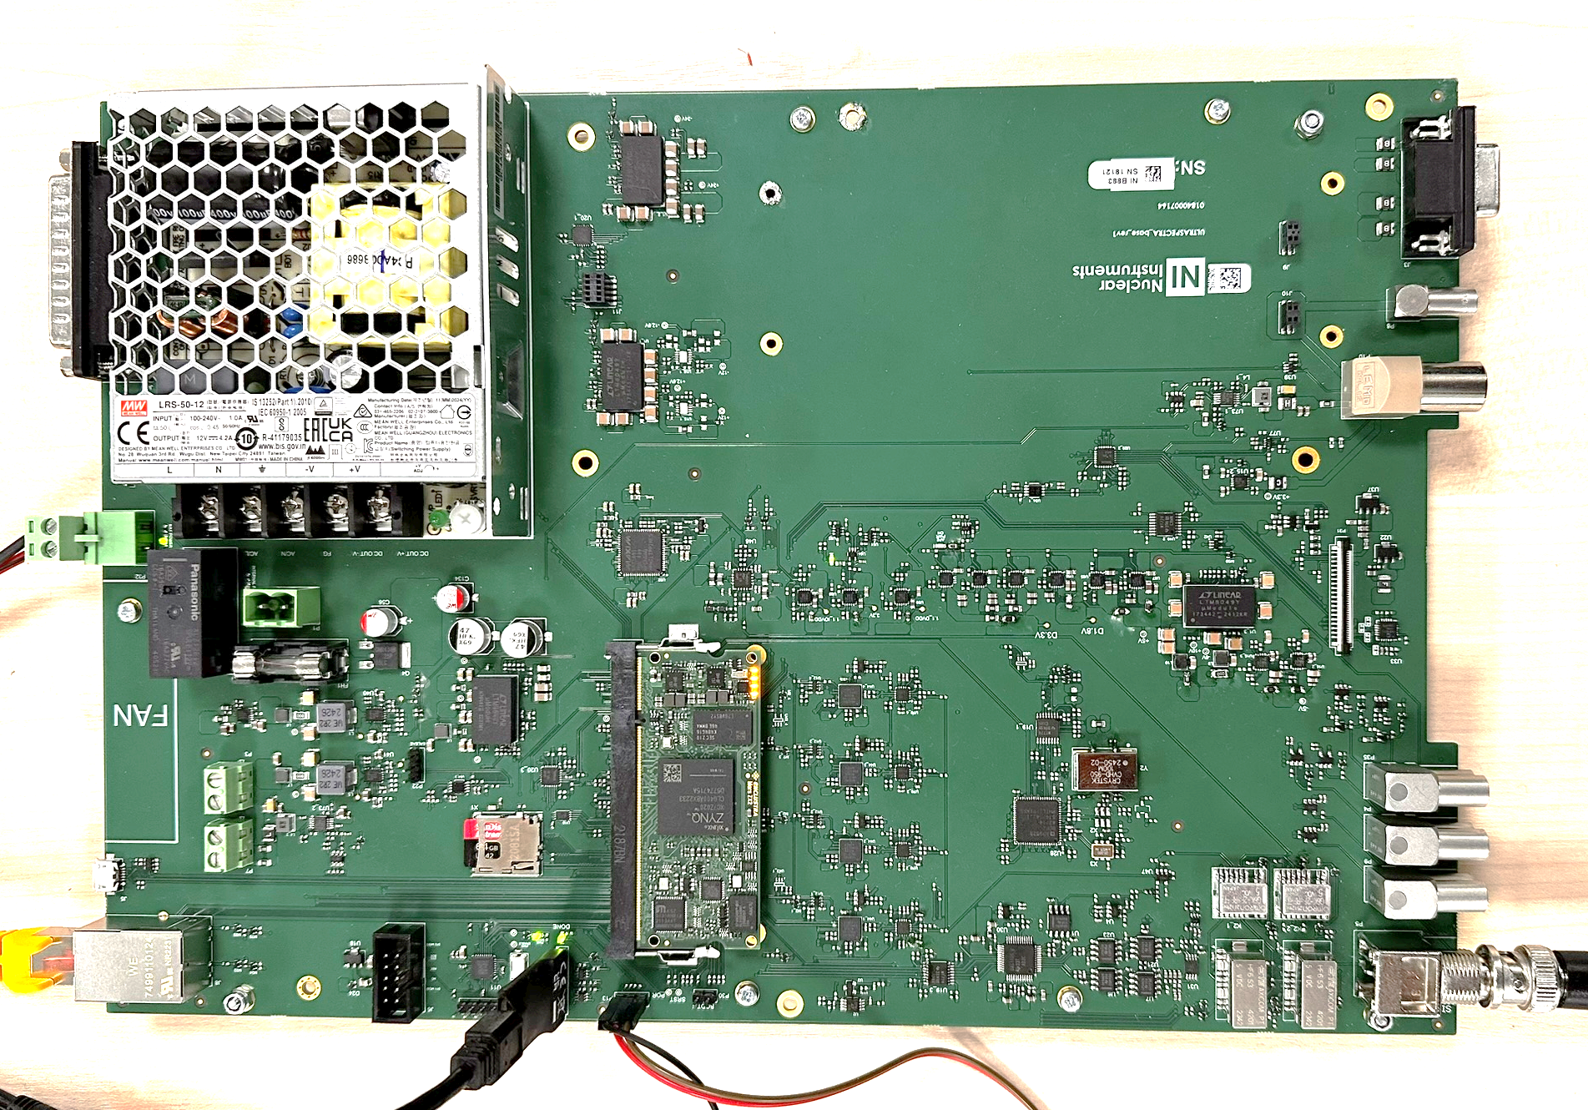
System overview

Slide 26
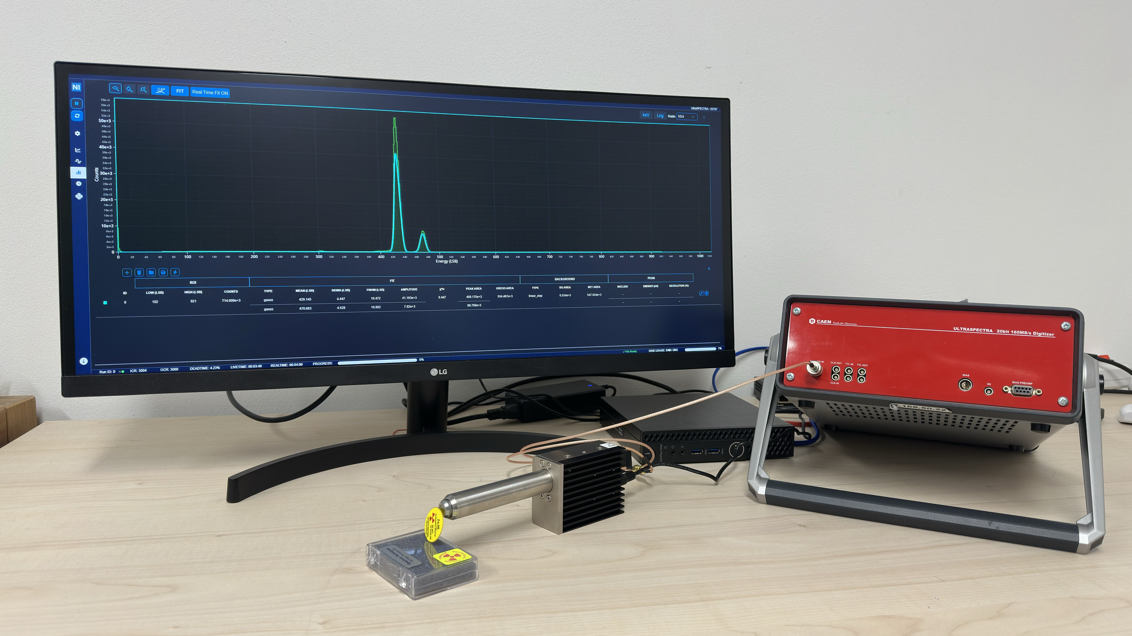

Characterization setup
Ultraspectra web interface
Analog output of the detector
Ultraspectra
Detector courtesy of KETEK
KETEK AXAS 3.0 SDD Module
V000-KTN0-H020-MA2C
⁵⁵Fe 25uCi / 10mCi

Slide 27
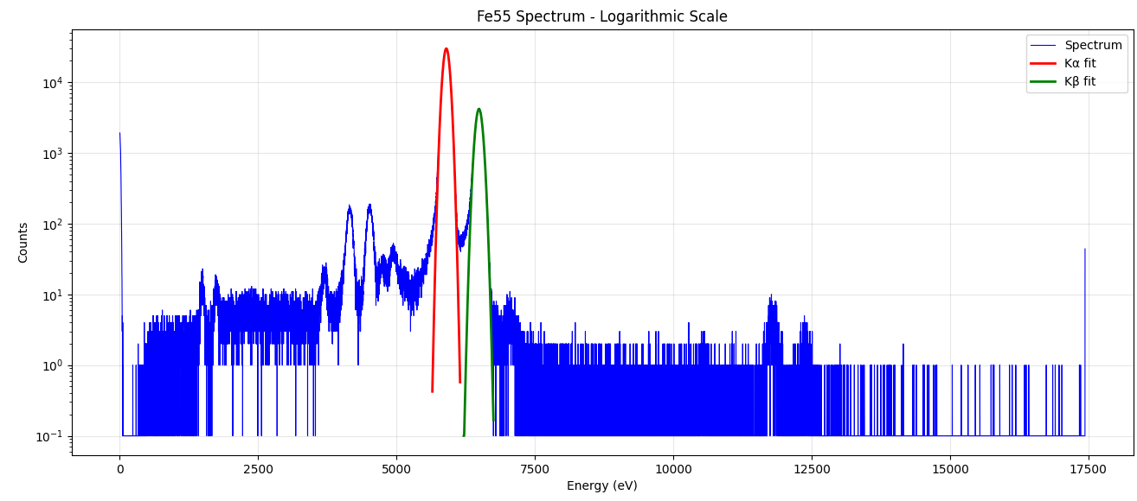
Characterization setup
Mn Kα Resolution=125 eV

Slide 28
Low rate (10 kcps OCR) resolution vs shaping time

Slide 29
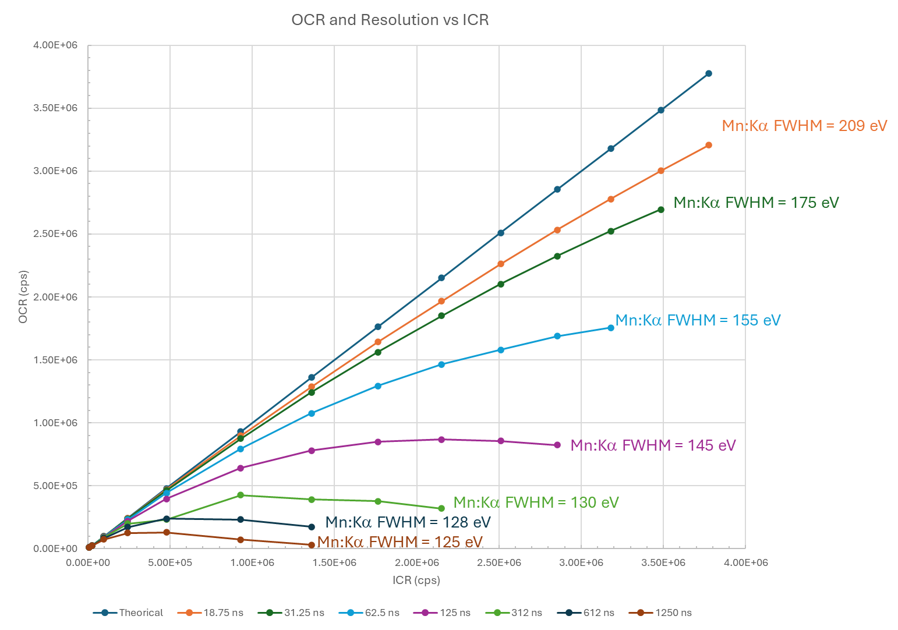
Trapezoidal filter-based throughput (OCR vs ICR)

Slide 30
High rate (> 1 Mcps OCR) resolution characterization
ICR (cps) | OCR (cps) | Resolution (eV) | Live Time (%)
507k | 358k | 141 | 71 %
510k | 409k | 144 | 80 %
1558k | 1049k | 155 | 67 %
1558k | 1236k | 162 | 79 %
1846k | 1358k | 171 | 74 %
2730k | 2018k | 200 | 74 %
Live Time (%)

Slide 31
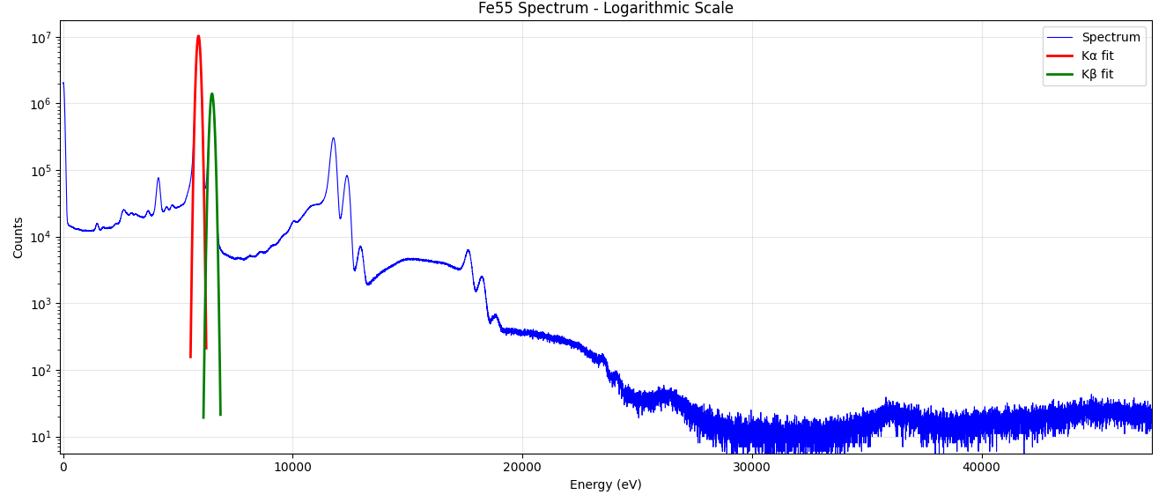
⁵⁵Fe Spectrum – ICR 1.6 Mcps – 74% Live Time 171 eV resolution
Mn Kα Resolution=171 eV

Slide 32
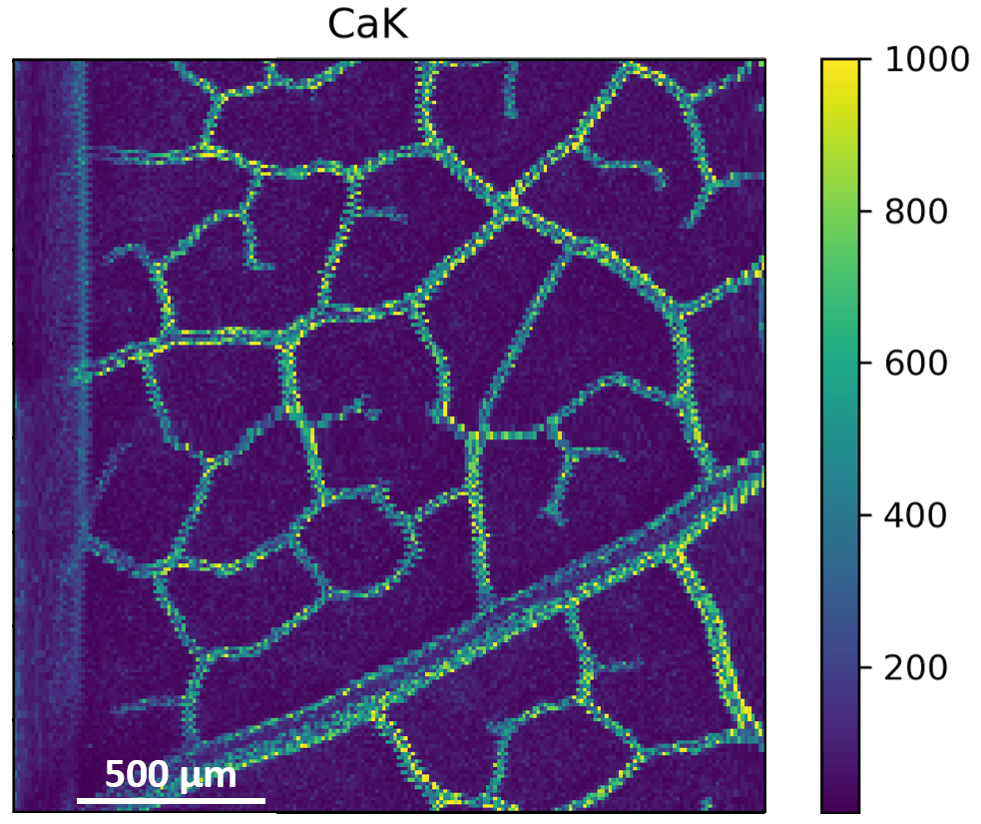

Ardesia Project ARray of DEtectors for Synchrotron radIation Applications
Motivation :
Develop a low-noise and versatile detector based on monolithic arrays of Silicon Drift Detectors for high-rate synchrotron applications
(mainly XRF, XAFS, and XFM)
Synchrotron Radiation Source
Monochromator
XRF
XAFS
Detector requirements:
X-ray energy range: 0.2 keV – 20 keV (Si detection region)
Target energy resolution (~125 eV of FHWM Mn-Kα) at optimum shaping time and low rate, good resolution (≤ 200 eV) at short shaping time and high throughput (> 1 Mcps/ch.)
Modular and scalable design, to easily increase sensitive area and adapt to different experiment configurations
Energy Dispersive
Detector
Focusing
Optic
XFM
Emitted X-ray
Fluorescence
Incident X-rays
Sample

Slide 33
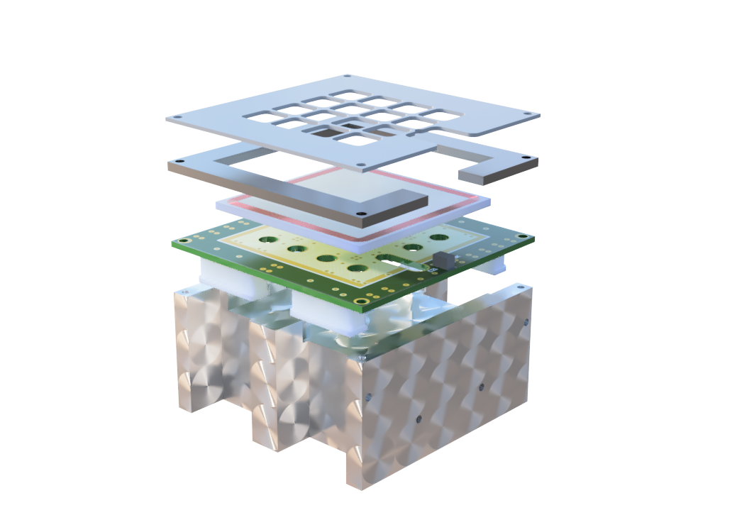
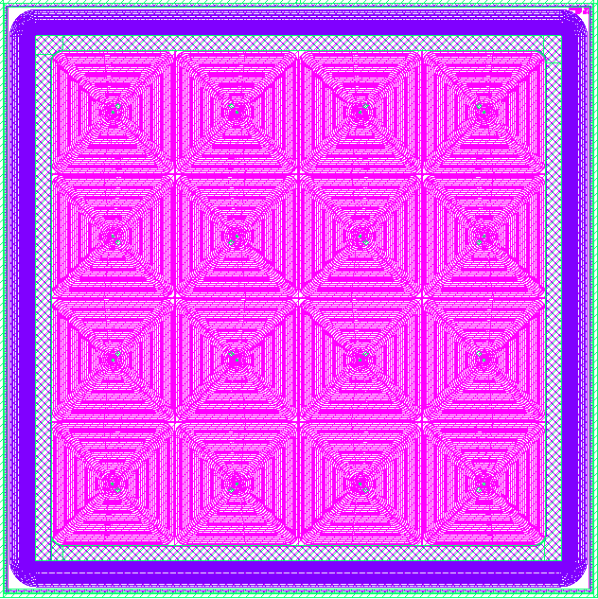
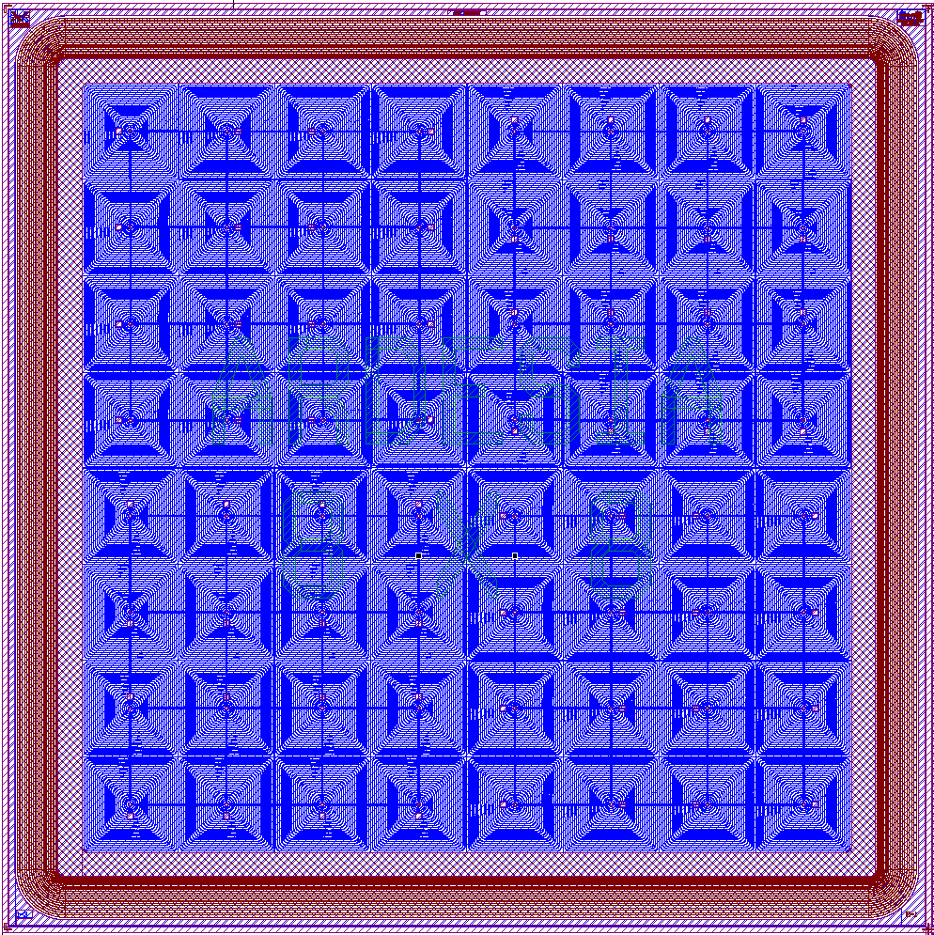

Ardesia Project ARray of DEtectors for Synchrotron radIation Applications
Increase high-rate capability of SDD-based X-ray spectrometers
SDD array
4 × 4 5-mm-side
Mo collimator
Detector Jig
4 × 4 5-mm-side
8 × 8 2.5-mm-side
Module PCB
Al Frame
24 mm
24 mm
24 mm
Hosts the 16/64 channel Monolithic SDD array (450 µs, 80 µm, or 1 mm thicknesses)
500 µm thick Molybdenum Mask to prevent charge sharing
Active area after collimation: 324 mm² (81% of window)
Four custom-designed 4-channel CUBE Preamplifiers
Preamplifiers and Detector are glued to a High-density PCB

Slide 34
Resolution vs Shaping Time (ARDESIA)
ICR:

Slide 35
High rate (> 1 Mcps OCR) resolution characterization (ARDESIA)
ICR (cps) | OCR (cps) | Resolution (eV) | (Live Time %)
19.5 | 19k | 140 | 97.0%
1230k | 740k | 163 | 60.0%
1230k | 806k | 162 | 65.0%
1230k | 985k | 176 | 80.0%
1210k | 1020k | 220 | 95.0%
Live Time (%)

Slide 36
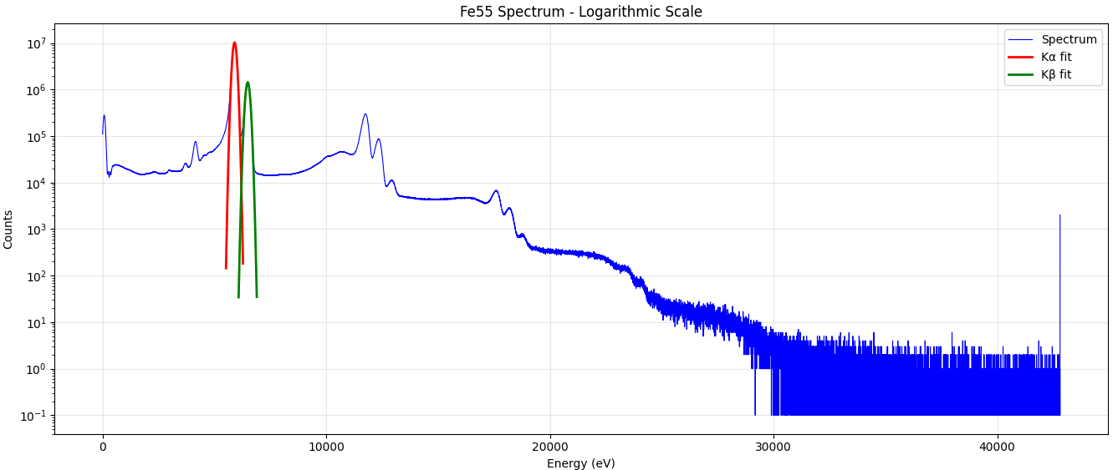
⁵⁵Fe Spectrum – ICR 1.2 Mcps – 85% Live Time 190 eV resolution (ARDESIA)
Mn Kα Resolution=190 eV

Slide 37
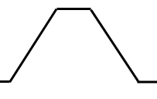
Realtime MCA processing algorithm
Z^{-k}
Z^{-m}
_
_
DETECTOR
ACC
SAMPLE
-
SPECTRUM
ENERGY FILTER
Leakage current subtraction
Z^{-k}
Z^{-m}
_
_
DERIVATE
ACC
>
THRESHOLD
TRIGGER FILTER

Slide 38
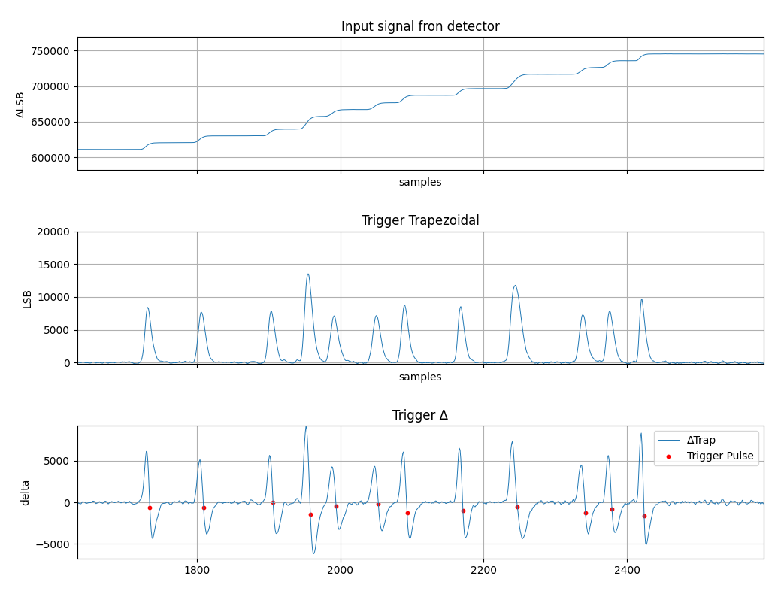
Trigger algorithm signals
Detector output

Slide 39
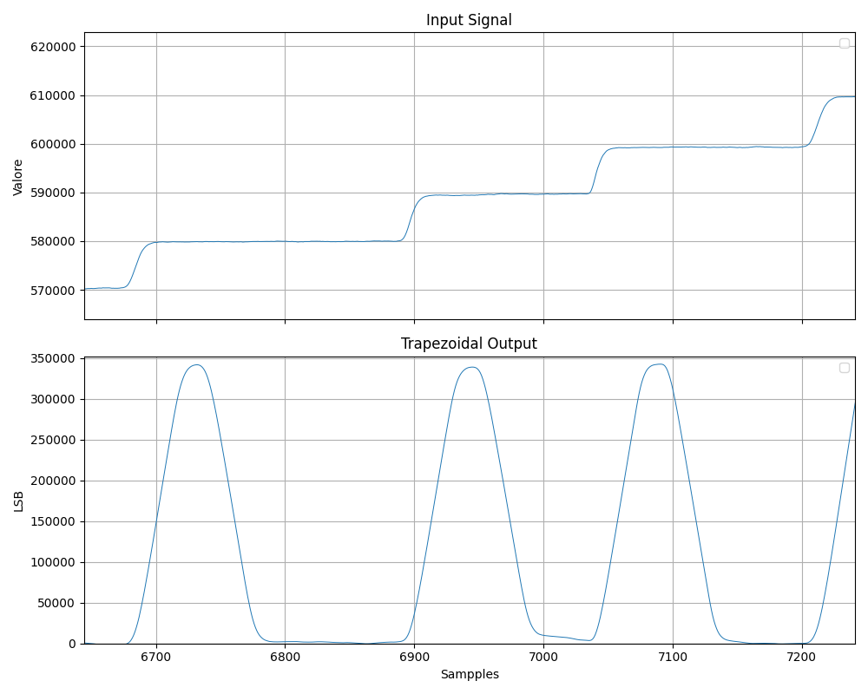
Energy Filter
Energy Sampling
samples

Slide 40
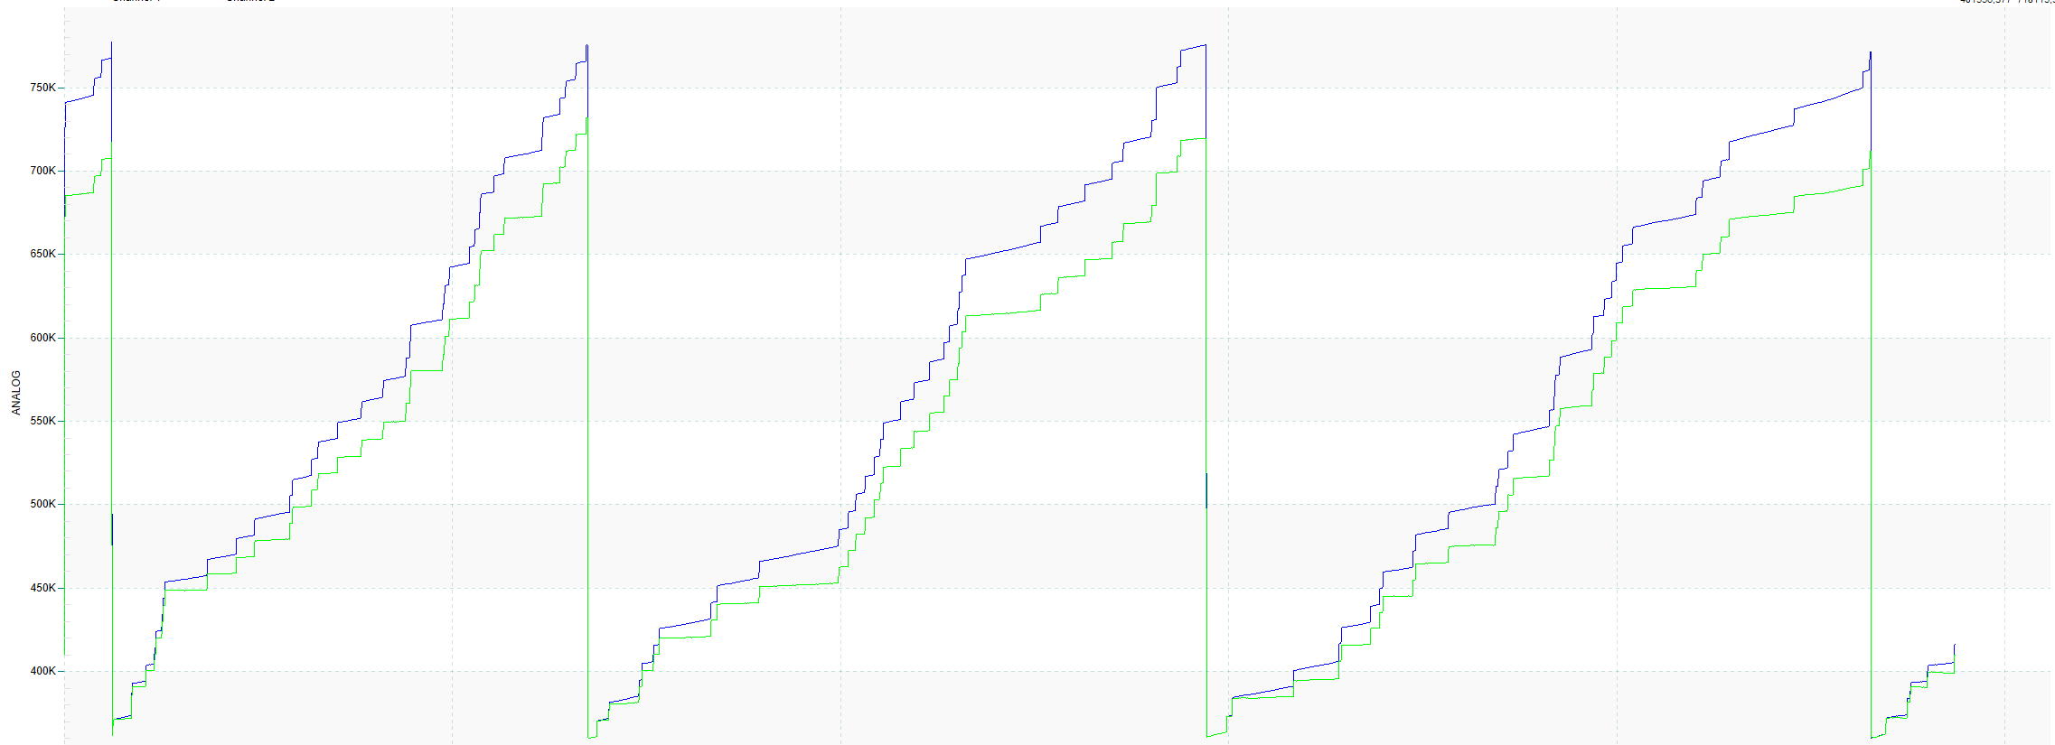
Leakage current compensation
-
Leakage free input signal
Linear leakage extimator
Leakage ramp generator
ADC
Trigger

Slide 41
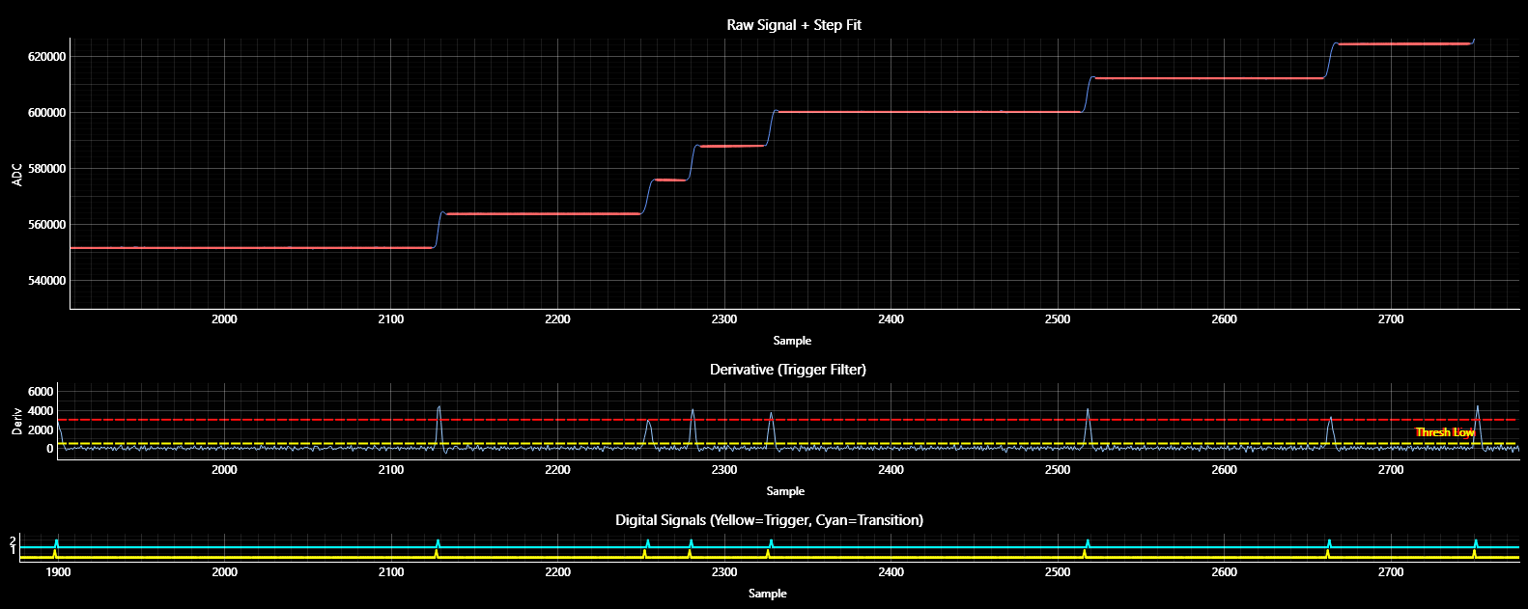
High rate model-based fitting filter

Slide 42










High rate model-based fitting filter
Linear Regression (AFTER)
Linear Regression (BEFORE)
$$𝒜=\{\left(n_{i},x\left[n_{i}\right]\right)∣n_{i}>T+t_{\text{rise}}\}$$
$$ℬ=\{\left(n_{i},x\left[n_{i}\right]\right)∣n_{i}<T\}$$
$$x\left[n\right]=b_{k}+A_{k}⋅u\left(n−T_{k}\right)+\text{noise}$$
$$y_{A,B}\left(n\right)=a_{A,B}n+b_{A,B}$$
CFD:
$$\left(a_{B},b_{B}\right)=\arg{\min{\sum_{n_{i}∈ℬ}{{\left(x\left[n_{i}\right]−\left(a_{B}n_{i}+b_{B}\right)\right)}^{2}}}}$$
$$c\left[n\right]=x\left[n−d\right]−f x\left[n\right]$$
$$c\left[n_{0}\right] c\left[n_{0}+1\right]<0$$
$$y_{B}\left(T\right)=a_{B}T+b_{B}$$
$$T=n_{0}−\frac{c\left[n_{0}\right]}{c\left[n_{0}+1\right]−c\left[n_{0}\right]}$$
Digital CFD with sub-sample regression
$$E=y_{A}\left(T\right)−y_{B}\left(T\right)$$

Slide 43

High rate model-based fitting filter
ACCEPTED
REJECTED
Minimum acceptable distance between events

Slide 44
High rate model-based fitting filter

Slide 45
Comparison between trapezoidal shaper and regression
At constant ICR, the trapezoidal and fit methods are compared in terms of resolution using the same dead time

Slide 46



Ultraspectra & Web Interface
1 channels 160 Msps, 20 bit digitizer
Realtime TRP optimized trapezoidal filter and model-based regression for high rate operation
Up to 32 million point memory for waveform digitalization
SmartMCA web based software with realtime fitting and calibration
C/C++/C#/Python/Java/NodeJS/Labview … SDK and REST API for slow control and readout
Onboard ARM CPU with Ubuntu Linux
Easy integration in SCADA system (TANGO and EPICS integration is ongoing). Onboard Grafana connector.
Fully supported in Sci-Compiler

Slide 47

Future Development: 16 channels Ultraspectra
16 channels, 160 Msps
±6, ±4, ±2 input dynamic range
Trapezoidal and real-time fitting
1 Gbps + 10 Gbps readout interfaces
Tango and Epics support
Web Interface
Rack 2U format

Slide 48


Firmware customization
Allows for customizing the firmware of digitizers and logic units.
Simple and intuitive graphical programming language to learn.
Nearly 200 IP cores designed for nuclear physics applications.
Enables any researcher to develop their own acquisition and processing setup without FPGA knowledge.
Firmware portability across different hardware.
Extends the system's lifecycle by maintaining firmware compatibility with future hardware.

Slide 49









Firmware customization
DT5571
DT5560
DT1260
V2495
DAQ121 – 1 Gsps 32 channels differential – 12 bit
DAQ141 – 1 Gsps 32 channels differential – 14 bit
SCICOMPILER
OPENFPGA
HARDWARE PLATFORMS
V2730 V2740/5
(COMPATIBLE WITH ESS & ISIS READOUT)
DT550W
20 bit !!
R5560

Slide 50







Firmware customization
READOUT GUI
SIMULATE
WINDOWS AND LINUX SDK
FIRMWARE

Slide 51














Open source SDK compatible with all Nuclear Instruments and CAEN OpenFPGA Digitizer
Available open source on GitHUB
https://github.com/NuclearInstruments/SCISDK
Works on: Windows, Linux
Compatible with Raspberry PI
Available on: PIP, NPM, and APT (for Ubuntu) and ANT (java)
Works inside Jupyter Lab, pre installed on new instruments
Documentation and examples available here:
https://nuclearinstruments.github.io/SCISDK/

