Slide 1

Giacomo Secci
INFN Milano, Italy
Design, Fabrication and Qualification of Cryogenic High-Vacuum Enclosures for HPGe Detectors
Advances in X-ray and Gamma RAy DEtectors and applications (XGRADE 2026)
24-26/03/2026, Palermo

Slide 2

Content
State-of-the-Art HPGe Detectors
The N3G Projects (Next Generation Germanium Gamma detectors)
Mechanical Solutions for HPGe Detectors: Vacuum-Tight Capsules Design and Validation
Inside the Capsule: Innovative Detector Support Architecture and Mounting Strategies
G. Secci - Advances in X-ray and Gamma RAy DEtectors and applications (XGRADE 2026) 24-26/03/2026, Palermo

Slide 3
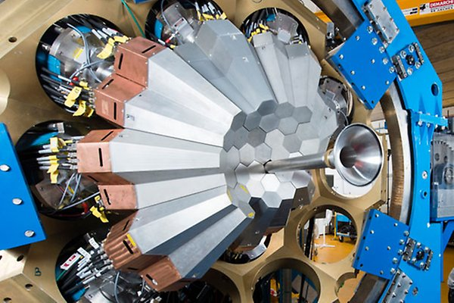
State-of-the-Art HPGe Detectors
High Purity Germanium (HPGe) detectors: impurity concentration of 10¹⁰ cm⁻³
Remarkable energy resolution: ≈ 2 keV @ 1.33 MeV
Interaction points identification through detector segmentation and Pulse Shape Anaysis (PSA)
γ trajectories reconstruction: tracking algorithms
AGATA (Avanced GAmma Tracking Array)
GRETA (Gamma-Ray Energy Tracking Array)
G. Secci - Advances in X-ray and Gamma RAy DEtectors and applications (XGRADE 2026) 24-26/03/2026, Palermo

Slide 4
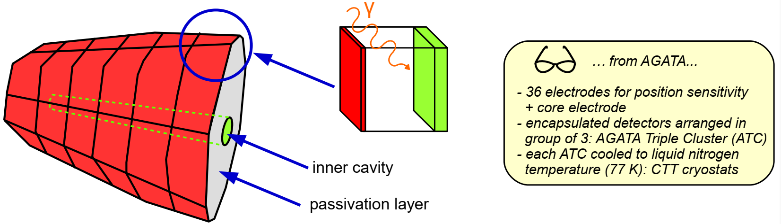
State-of-the-Art HPGe Detectors
n-type HPGe germanium crystals, featuring an external p-type boron implantation
Heavily n-doped cavity realized by lithium evaporation and diffusion
Passivation layer to prevent electrical discharges
Tapered hexagonal geometry with asymmetric shape: 4π configuration
G. Secci - Advances in X-ray and Gamma RAy DEtectors and applications (XGRADE 2026) 24-26/03/2026, Palermo

Slide 5

Next Generation HPGe Detectors
State-of-the-art HPGe detectors are supplied to scientific collaborations by industry, and their technical and manufacturing specifications are not known.
N3G Project: Next Generation Germanium Gamma Detector (INFN)
GOAL: developing new HPGe detectors while acquiring the know-how about their management and maintenance
Mechanical Advances: vacuum technology enclosures
Physics of Semiconductors: doping technologies photolithography
Electronics: detector connection charge sensitive preamplifiers
G. Secci - Advances in X-ray and Gamma RAy DEtectors and applications (XGRADE 2026) 24-26/03/2026, Palermo

Slide 6
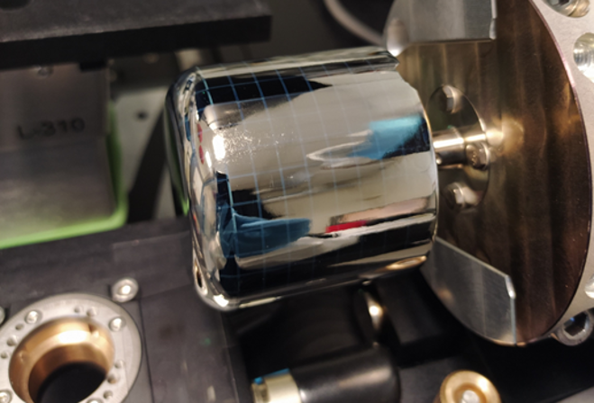
Detectors Fabrication
...once upon a time, in a faraway factory, a hyper-pure germanium crystal was born...
cleaning and polishing
RFMS Radio Frequency Magnetron Sputtering: dopant precursor film deposition (e.g. aluminum, antimony...)
PLM process: the laser pulse is directed onto the surface of the rotating sample
UV laser makes the dopant diffuse in germanium
rapid regrowth rebuilds the crystalline structure that tightly incorporates the dopant
layer thickness: 100 nm-300 nm
G. Secci - Advances in X-ray and Gamma RAy DEtectors and applications (XGRADE 2026) 24-26/03/2026, Palermo

Slide 7
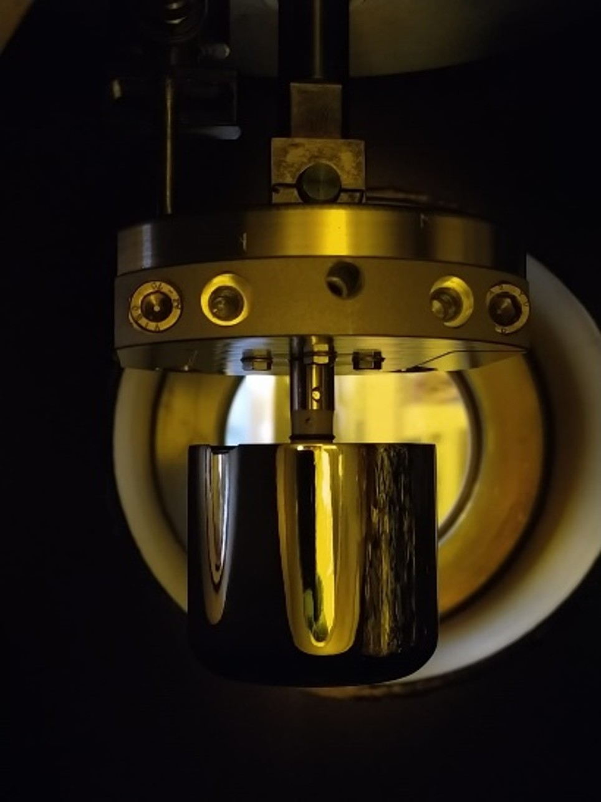
Detectors Fabrication
100 nm gold deposition through RF sputtering: lower contact resistance and junction protection
Photolithography
(positive) photo-resist deposition and soft bake
light exposure and photo-resist development
baking and drying
etching: electrodes isolation
cleaning: photo-resist stripping with acetone
trench passivation in methanol baths
G. Secci - Advances in X-ray and Gamma RAy DEtectors and applications (XGRADE 2026) 24-26/03/2026, Palermo

Slide 8
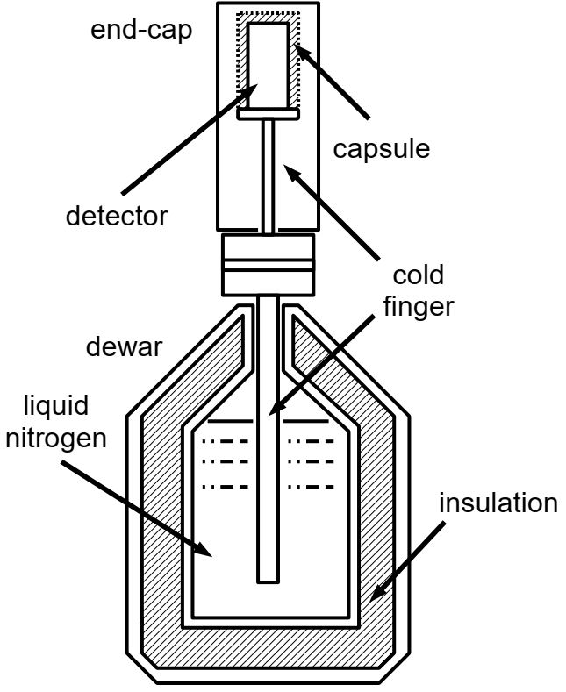
Detectors Operation Conditions
HPGe detectors require operation in:
High-vacuum environment
Cryogenic environment
Moisture and oxygen can react with the detector surface and degrade its electrical properties
Germanium narrow band-gap (0.66 eV)
Cryostat: vacuum-insulated structure designed to provide both mechanical support and efficient thermal coupling to a cryogenic reservoir of liquid nitrogen (77 K)
G. Secci - Advances in X-ray and Gamma RAy DEtectors and applications (XGRADE 2026) 24-26/03/2026, Palermo

Slide 9
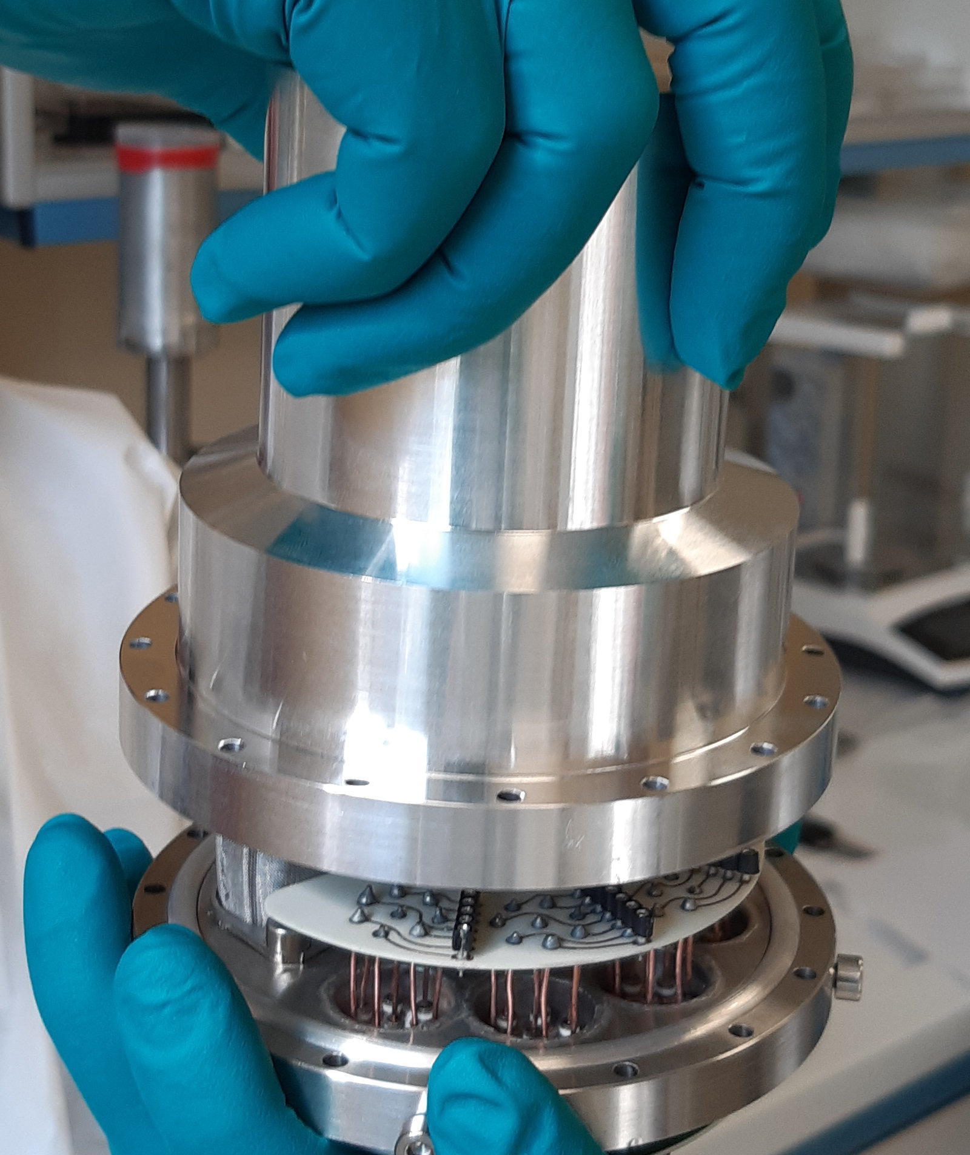
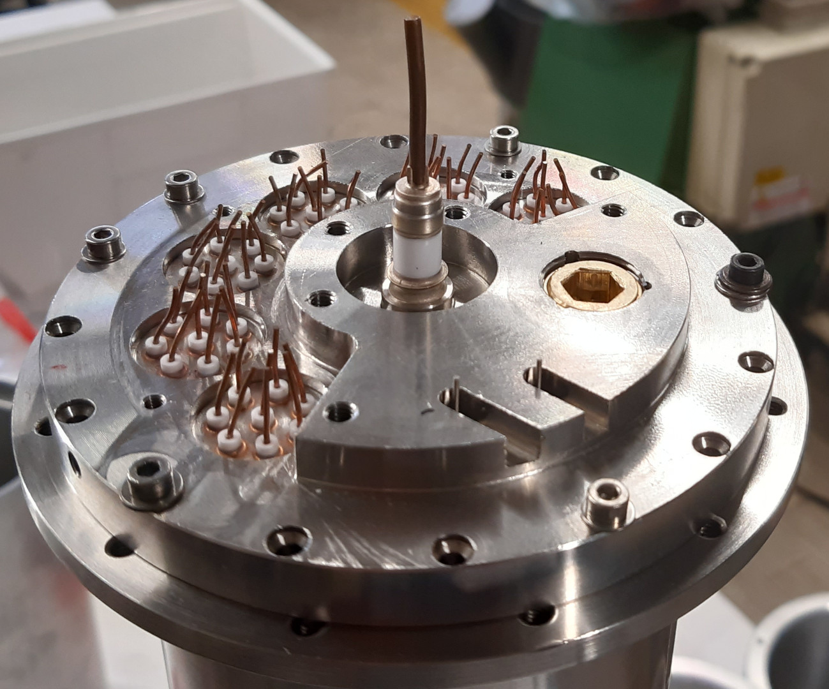
Detector Capsule: Design
The vacuum-tight capsule contains and protects the HPGe crystal:
cylindrical aluminum case
stainless steel flange
Electrical feed-trough connectors
Vacuum port
Helicoflex Gasket
Porous Getter
G. Secci - Advances in X-ray and Gamma RAy DEtectors and applications (XGRADE 2026) 24-26/03/2026, Palermo

Slide 10
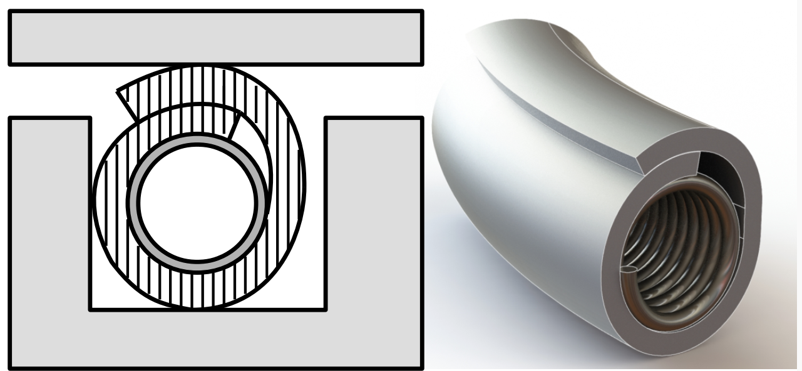
Detector Capsule: Helicoflex Gaskets
High-performance metal seal designed for extreme environments (aerospace, vacuum, nuclear)
Soft outer metallic layer: intentionally softer than flange material to ensure tight sealing
Viscoplastic deformation: material flows into surface micro-asperities
Internal helical spring: provides elasticity and maintains consistent contact pressure
Long-term reliability: accommodates tolerances, surface imperfections, and operational variations
G. Secci - Advances in X-ray and Gamma RAy DEtectors and applications (XGRADE 2026) 24-26/03/2026, Palermo

Slide 11
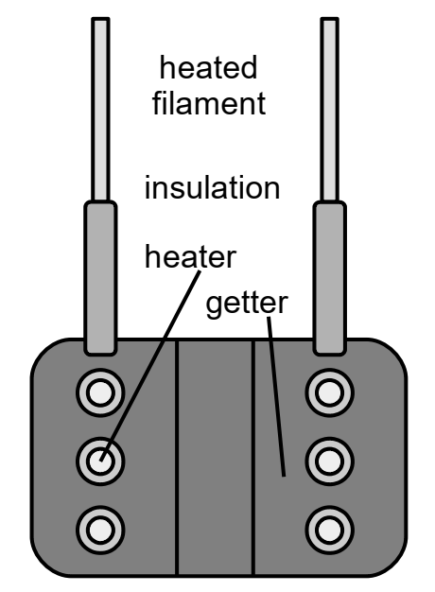
Detector Capsule: Porous Getter
Non-evaporable getters: reactive metallic materials (Zr, Ti, V) that remove gases via chemisorption
Thermal activation required (≈450–900 °C): removes oxide layer and exposes reactive surface
Selective gas sorption: effective for O₂, N₂, H₂, CO, CO₂ , ineffective for noble gases and light hydrocarbons
ST 172 porous getters: high surface area, enhanced pum-ping efficiency and low-temperature activation (~450–500 °C)
Regenerable performance: pumping speed decreases with use but can be restored through thermal reactivation
G. Secci - Advances in X-ray and Gamma RAy DEtectors and applications (XGRADE 2026) 24-26/03/2026, Palermo

Slide 12
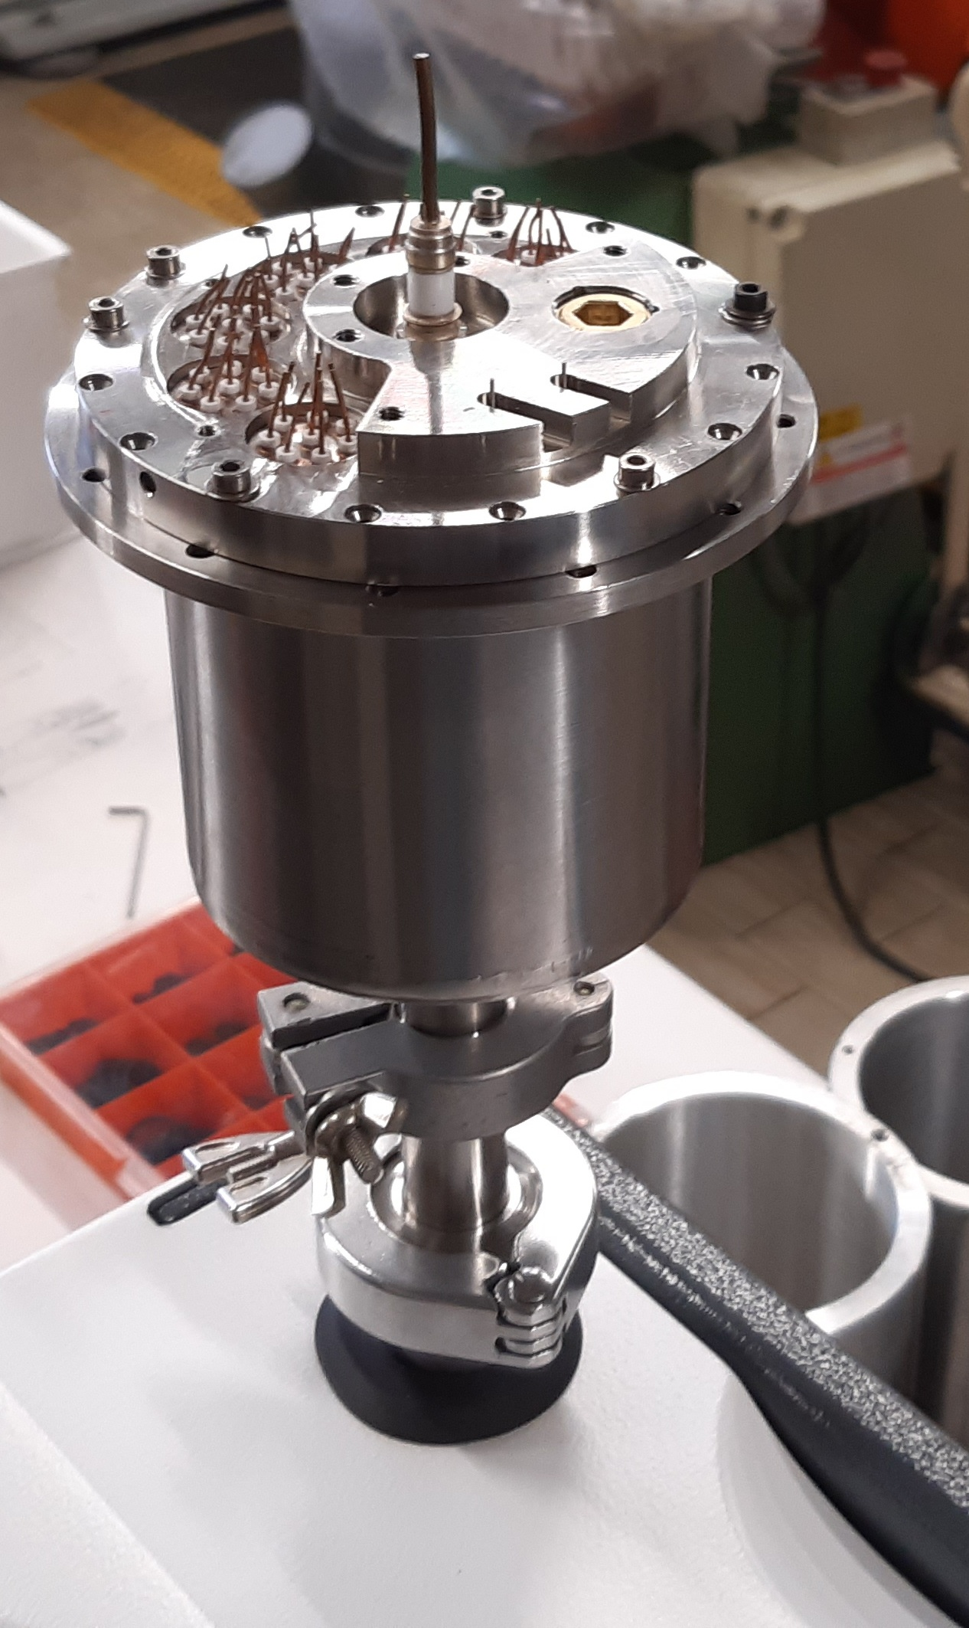
Detector Capsule: Leak Detection
Tracer gas leak detection (mass spectrometry): high sensitivity and fast respons; independent, self-contained system
Helium as tracer gas: sensitivity down to ~10⁻¹¹ mbar·L/s; limitations include memory effects and material permeation
G. Secci - Advances in X-ray and Gamma RAy DEtectors and applications (XGRADE 2026) 24-26/03/2026, Palermo

Slide 13
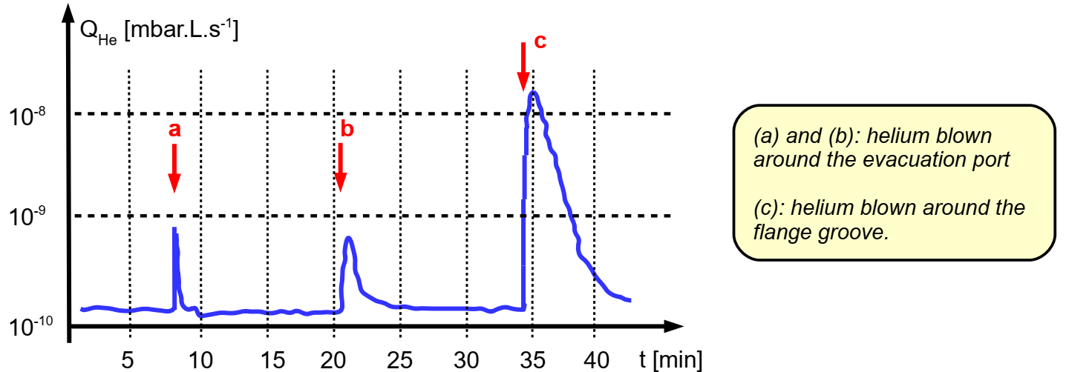
Detector Capsule: Leak Test
Components cleaned with isopropyl alcohol before sealing
Leak-test configuration optimized to minimize parasitic leaks
Helicoflex® gaskets installed according to datasheet specifications: analytical tightening torque calculation
G. Secci - Advances in X-ray and Gamma RAy DEtectors and applications (XGRADE 2026) 24-26/03/2026, Palermo

Slide 14
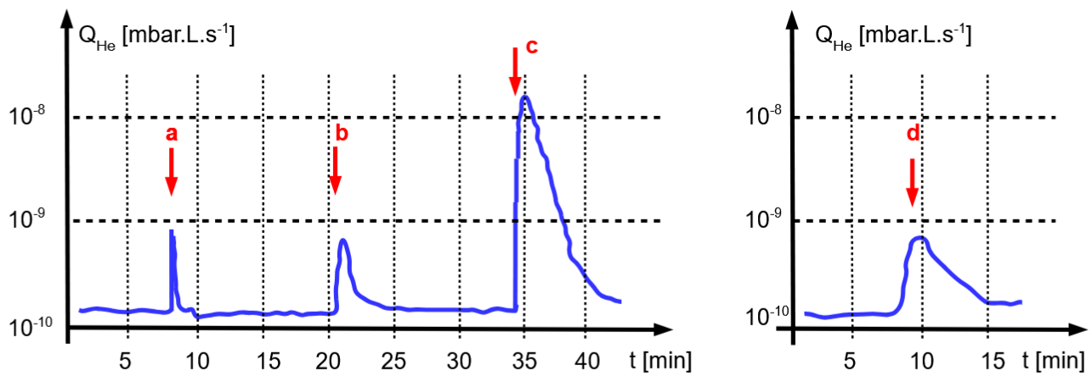

Detector Capsule: Leak Test
Components cleaned with isopropyl alcohol before sealing
Leak-test configuration optimized to minimize parasitic leaks
$$Q_{L}=8×{10}^{−10}mbar∙L∙s^{−1}$$
+10% tightening torque applied to flange screws:
$$∆t=3h→∆P=1×{10}^{−5}mbar$$
G. Secci - Advances in X-ray and Gamma RAy DEtectors and applications (XGRADE 2026) 24-26/03/2026, Palermo

Slide 15
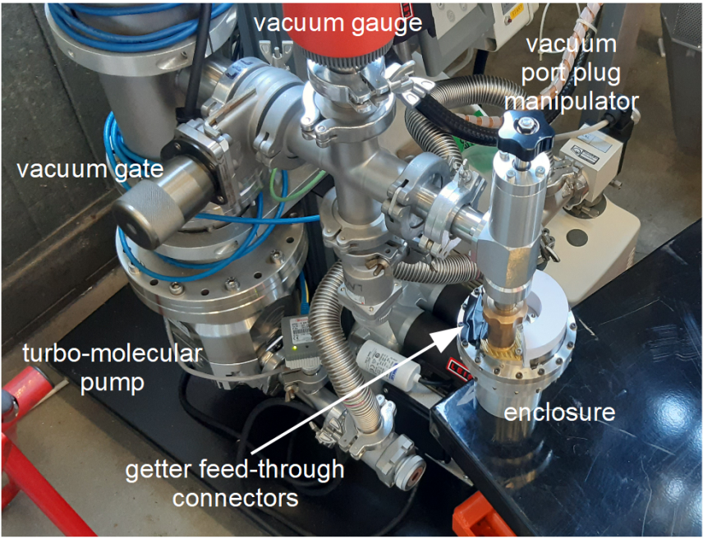
Detector Capsule: Getter Activation
Getter activation is essential
Dedicated manipulator: capsule evacuation and sealing plug opening/closing
PT100 temperature sensor installation
Getter activation: 6 A current over ∆t = 10 min
G. Secci - Advances in X-ray and Gamma RAy DEtectors and applications (XGRADE 2026) 24-26/03/2026, Palermo

Slide 16
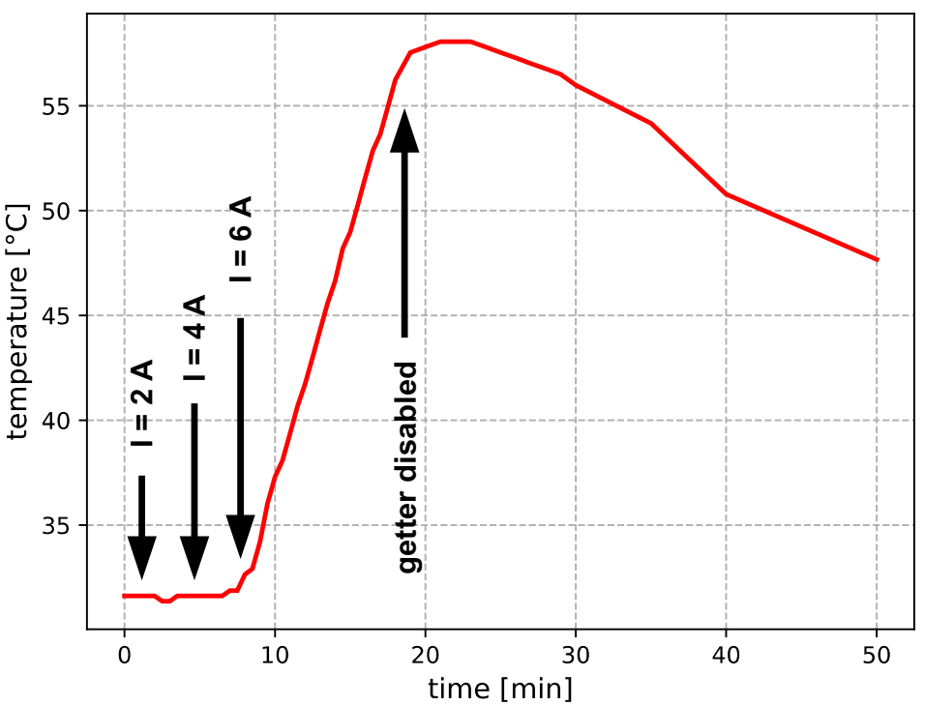
Detector Capsule: Getter Activation
Getter activation is essential
Dedicated manipulator: capsule evacuation and sealing plug opening/closing
PT100 temperature sensor installation
Getter activation: 6 A current over ∆t = 10 min
Temperature monitoring
G. Secci - Advances in X-ray and Gamma RAy DEtectors and applications (XGRADE 2026) 24-26/03/2026, Palermo

Slide 17
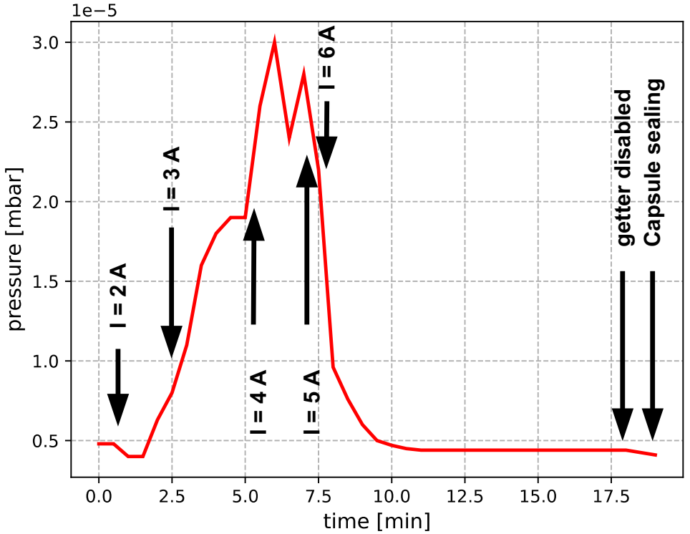
Detector Capsule: Getter Activation
Getter activation is essential
Dedicated manipulator: capsule evacuation and sealing plug opening/closing
PT100 temperature sensor installation
Getter activation: 6 A current over ∆t = 10 min
Pressure monitoring
G. Secci - Advances in X-ray and Gamma RAy DEtectors and applications (XGRADE 2026) 24-26/03/2026, Palermo

Slide 18
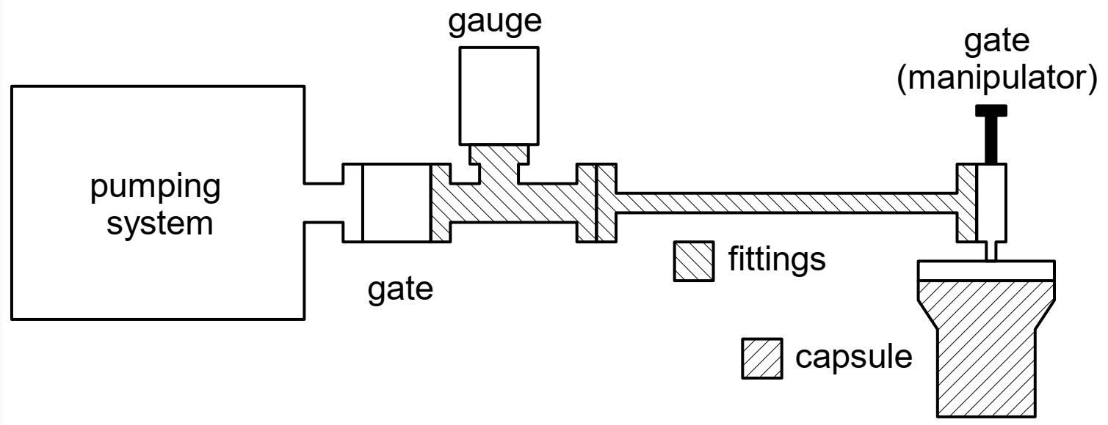





Detector Capsule: Validation
Pressure measured at the cap tightening:
$$P_{i}=1.2×{10}^{−5}mbar$$
Pressure measured at the cap reopening (∆t = 5d):
$$P_{f}=2.2×{10}^{−5}mbar$$
Effective capsule pressure:
$$P_{tot}V_{tot}=P_{fitt}V_{fitt}+P_{caps}V_{caps} →$$
$$P_{caps}=3.4×{10}^{−5}mbar$$
Over 5 days: (from 10⁻⁶ mbar to 10⁻⁴ mbar in one month)
$${∆P}_{caps}=2.2×{10}^{−5}mbar$$
Cryogenic vacuum operation improves long-term vacuum stability (capsule in cryostat)
G. Secci - Advances in X-ray and Gamma RAy DEtectors and applications (XGRADE 2026) 24-26/03/2026, Palermo

Slide 19
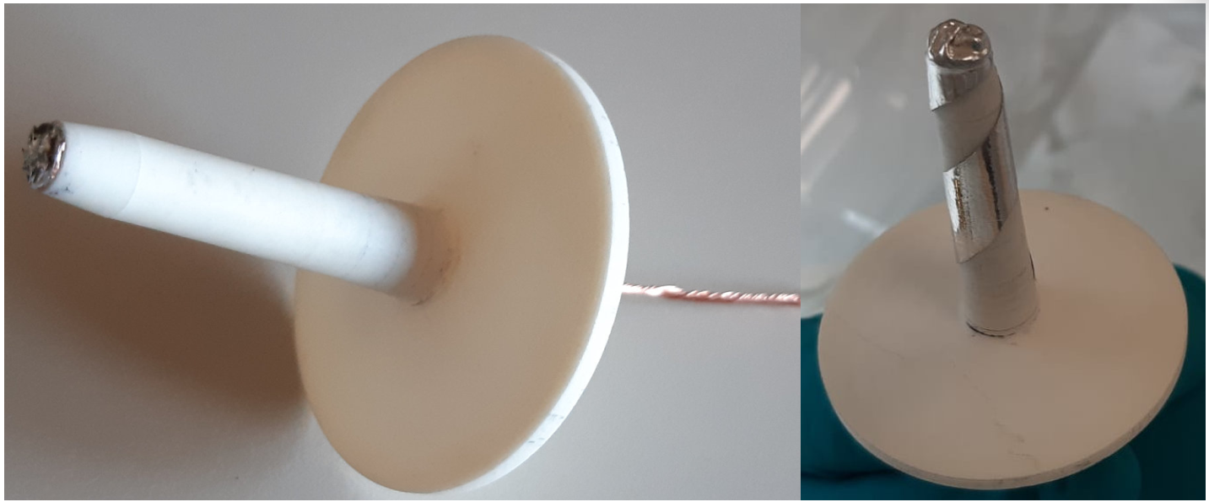
Inside the Capsule: Support Structure
Coaxial HPGe detector mounted within enclosure using a dedicated mechanical support system
Alumina hollow conical support: provides structural stability and precise alignment of the crystal
Indium: conductive contact while preventing mechanical stress and friction
Central electrical rod: high negative bias voltage (3–5 kV) for detector polarization
G. Secci - Advances in X-ray and Gamma RAy DEtectors and applications (XGRADE 2026) 24-26/03/2026, Palermo

Slide 20
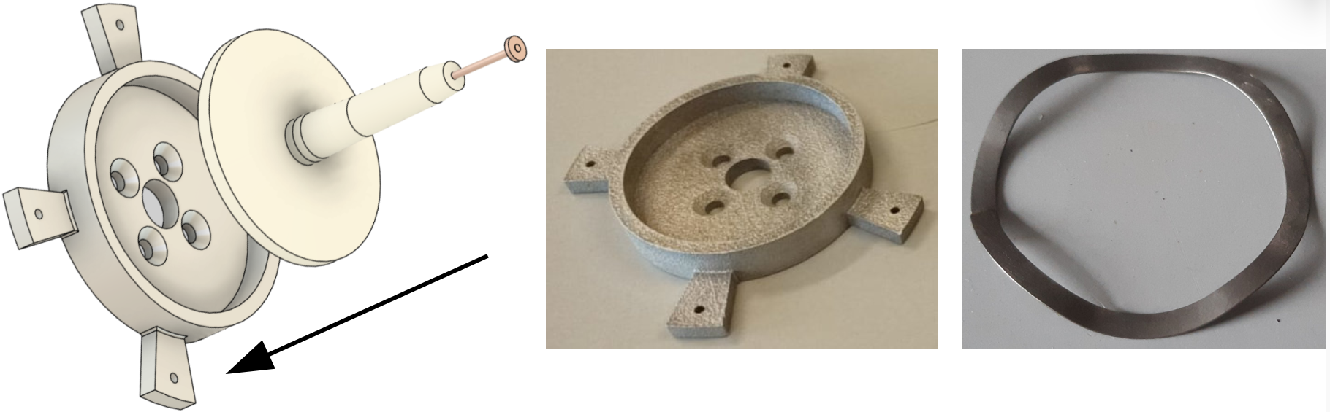
Inside the Capsule: Support Structure
Spring-supported base: alumina cone rests on a single-wave annular spring (Inconel) housed in an aluminum holder fixed to the flange
Cryogenic compatibility: Inconel spring ensures elasticity and mechanical stability at liquid-nitrogen temperatures
G. Secci - Advances in X-ray and Gamma RAy DEtectors and applications (XGRADE 2026) 24-26/03/2026, Palermo

Slide 21
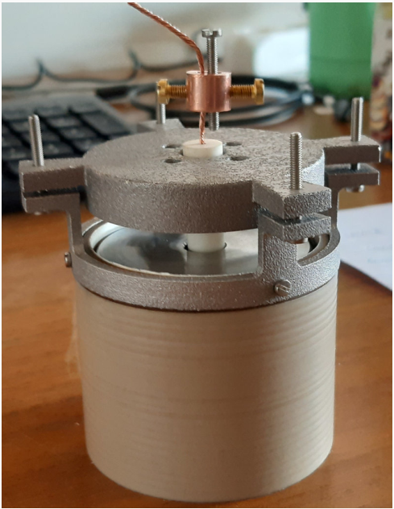
Inside the Capsule: Support Structure
Detector, cone, spring and spring-holder closed by a PEEK cylindrical case
Clamping system: aluminum ring + M2.5 steel screws fix the PEEK case to the spring-holder
Controlled tightening force: 4.4 N mm tightening torque (half the torque to unwrap a candy!)
Crystal position independent from the container absolute orientation
G. Secci - Advances in X-ray and Gamma RAy DEtectors and applications (XGRADE 2026) 24-26/03/2026, Palermo

Slide 22
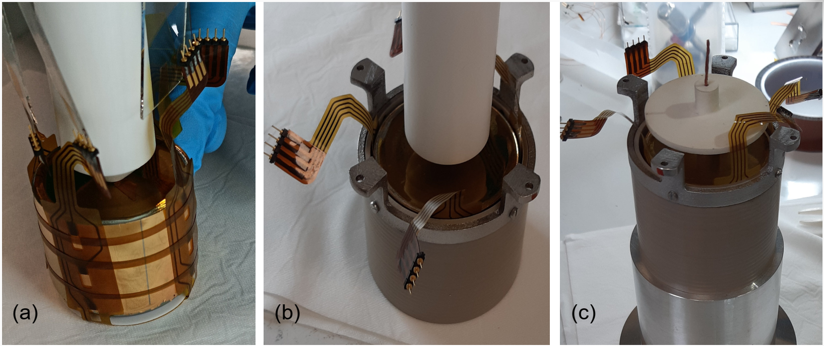
Detector Assembly
G. Secci - Advances in X-ray and Gamma RAy DEtectors and applications (XGRADE 2026) 24-26/03/2026, Palermo

Slide 23
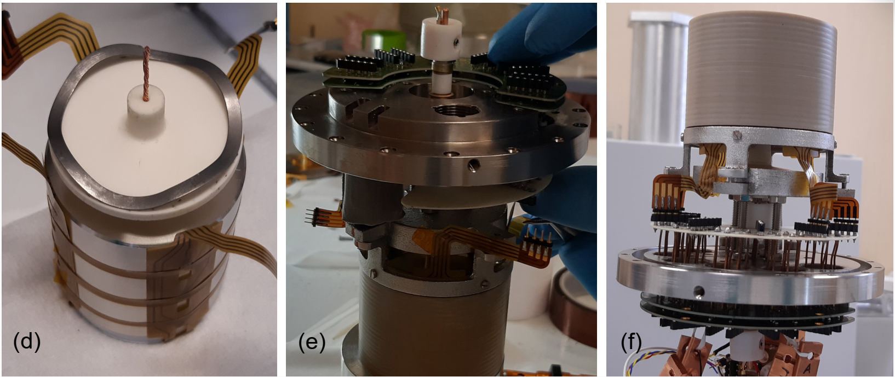
Detector Assembly
G. Secci - Advances in X-ray and Gamma RAy DEtectors and applications (XGRADE 2026) 24-26/03/2026, Palermo

Slide 24
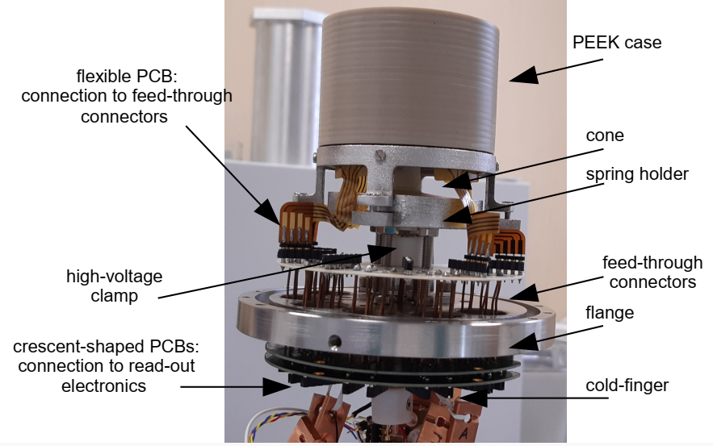
Detector Assembly
G. Secci - Advances in X-ray and Gamma RAy DEtectors and applications (XGRADE 2026) 24-26/03/2026, Palermo

Slide 25
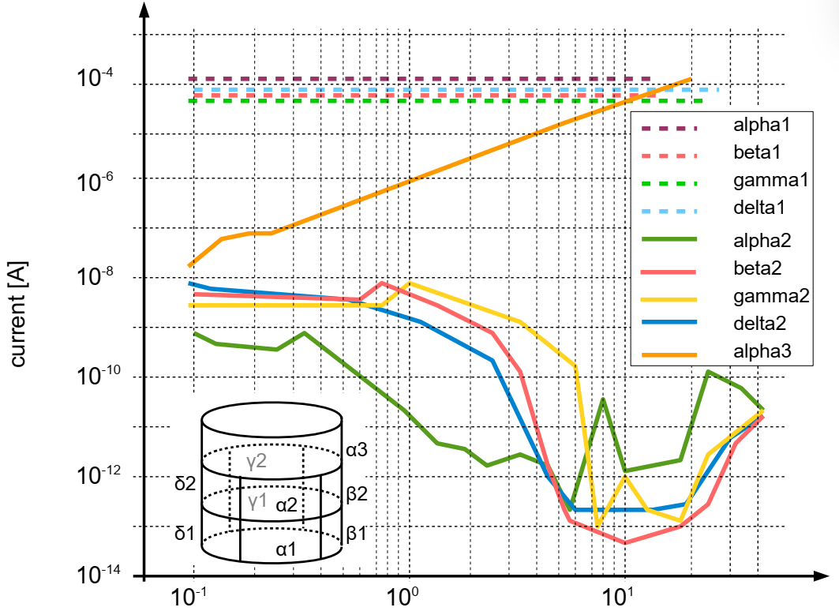
Detector Assembly and Test
Liquid nitrogen cooling down and test
I-V characterization: leakage current measured with a precision ammeter
Upper segment: high leakage current … issues during etching
Bottom segments: high leakage current … gold on passivation
Middle segments: leakage current in the picoampere range
G. Secci - Advances in X-ray and Gamma RAy DEtectors and applications (XGRADE 2026) 24-26/03/2026, Palermo

Slide 26
Detector Assembly and Test
Resistance measurements between adjacent segments
Measurements performed in the middle region to minimize leakage current
10 TΩ between adjacent lateral segments
Few TΩ between middle and top/bottom segments
High resistance confirms effective electrical isolation from trenching
Low breakdown voltage and surface damage prevented charge collection measurements
Connection system and mechanical support proved reliable and efficient
G. Secci - Advances in X-ray and Gamma RAy DEtectors and applications (XGRADE 2026) 24-26/03/2026, Palermo

Slide 27
Conclusion
A reliable design for cryogenic vacuum enclosures has been developed and validated for operation at liquid nitrogen temperatures
Sealing and vacuum stability are effectively ensured through HelicoFlex technology and NEG-based chemical pumping
Leak detection methodologies based on mass spectrometry and helium tracing proved essential for system validation
Experimental results confirm excellent performance, with minimal pressure increase
Mechanical integration of the detector guarantees stable operation, proper biasing and reproducible assembly
G. Secci - Advances in X-ray and Gamma RAy DEtectors and applications (XGRADE 2026) 24-26/03/2026, Palermo

Slide 28

Thank You for
Your Attention !
giacomo.secci@mi.infn.it

