Slide 1

Ezio Caroli
INAF/OAS – Bologna, Italy
Scattering polarimetry with CdTe/CZT segmented spectrometers: an overview
Advances in X-ray and Gamma RAy DEtectors and applications (XGRADE 2026)
24-26/03/2026, Palermo

Slide 2







Teams and people behind the story
INAF/OAS of Bologna (Italy): N. Auricchio, John B. Stephen, E. Virgilli, ….
INAF/IASF of Palermo, S. Del Sordo, A. Segreto, C. Gargano, …..
IMEM/CNR of Parma (Italy), A. Zappettini, M. Bettelli, ……
DiFC/Palermo University (Italy): L. Abbene, F. Principato, A. Buttacavoli, …..
LIP of Coimbra (Portugal): R. M. Curado da Silva, J. Maja, …….
DTU (Denmark): I. Kuvvetli, C. Jorgensen, ……..
CEA-Paris Saclay (France): O. Limousin, A. Meuris, P. Laurent, ……
DFT/Ferrara University (Italy): L. Ferro, M. Moita, …..
Ezio Caroli -- Advances in X-ray and Gamma RAy DEtectors and applications (XGRADE 2026) 24-26/03/2026, Palermo

Slide 3

I take the opportunity to be here, in Palermo, to dedicate this presentation to the memory of my dear friend and colleague Stefano Del Sordo Milano – 12/9/1961 – Palermo 16/05/2024
E. Caroli - Advances in X-ray and Gamma RAy DEtectors and applications (XGRADE 2026) 24-26/03/2026, Palermo

Slide 4
Why high energy polarimetry matter
Outline
Why high‑energy polarimetry in Astrophysics
The physical principle: the Compton modulation
CdTe/CZT spectrometers as scattering polarimeters
The 3D CZT drift strip spectrometers
3D CZT as focal plane unit for spectro-polarimetry
Conclusion
E. Caroli - Advances in X-ray and Gamma RAy DEtectors and applications (XGRADE 2026) 24-26/03/2026, Palermo

Slide 5
1.1 Why high energy polarimetry matter
Polarimetry in the hard X- and soft-γ ray open a new window for understanding the nature of the nonthermal emission mechanisms responsible for some of the most energetic phenomena in the universe.
Still many open questions, regarding the discrimination between different emission mechanisms for several classes of cosmic sources (GRB, Pulsars, AGN/Blazars, ….)
Linear polarization carries information that is not accessible through spectroscopy alone. In fact, polarimetry can be considered as a fourth observational mode to be added to imaging, spectroscopy, timing.
E. Caroli - Advances in X-ray and Gamma RAy DEtectors and applications (XGRADE 2026) 24-26/03/2026, Palermo

Slide 6
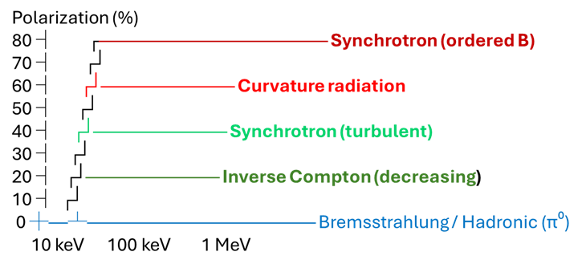
1.2 What polarization tells us
Polarimetry provide two more observables: the polarisation degree and the phase of polarization. By this two parameter we gain access to the geometry, composition, and emission physics of the source.
The polarization degree quantifies how ordered the electromagnetic field is in the emitting region. It is a direct probe of the emission mechanism and the magnetic‑field structure.
The polarization phase encodes the orientation of the electric‑field vector projected on the sky. This observable is sensitive to the magnetic‑field geometry, the source geometry and the viewing angle
A. Scordo - Advances in X-ray and Gamma RAy DEtectors and applications (XGRADE 2026) 24-26/03/2026, Palermo

Slide 7
1.3 A long standing scientific priority
Current Landscape of X‑ray and Gamma‑ray Polarimetry Instruments
Soft X‑ray (2–10 keV): IXPE — Imaging X‑ray polarimetry
Hard X-ray (30-300 keV): AstroSat/CZTI; INTEGRAL (IBIS, SPI); POLAR — GRB polarimeter
Soft Gamma ray (0.2–10 MeV): INTEGRAL/SPI
Sensitivity in the hard X‑ray / soft gamma‑ray regime remains limited. Only IXPE is really optimized for polarimetry
Yet the science case (GRBs, pulsars, AGN) is strong and well‑established
To fully exploit the diagnostic power of high‑energy astrophysics, future hard‑X and soft‑gamma missions must treat polarimetry not as an optional add‑on, but as a core, optimized, and standard operational capability built into the detector design from the start.
E. Caroli - Advances in X-ray and Gamma RAy DEtectors and applications (XGRADE 2026) 24-26/03/2026, Palermo

Slide 8
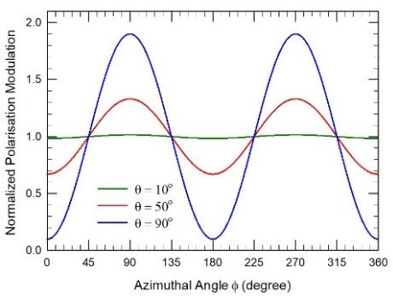
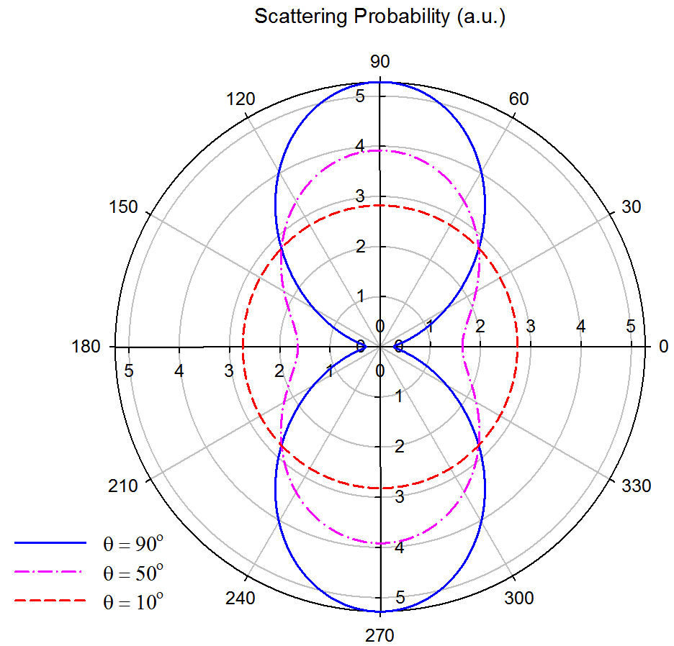
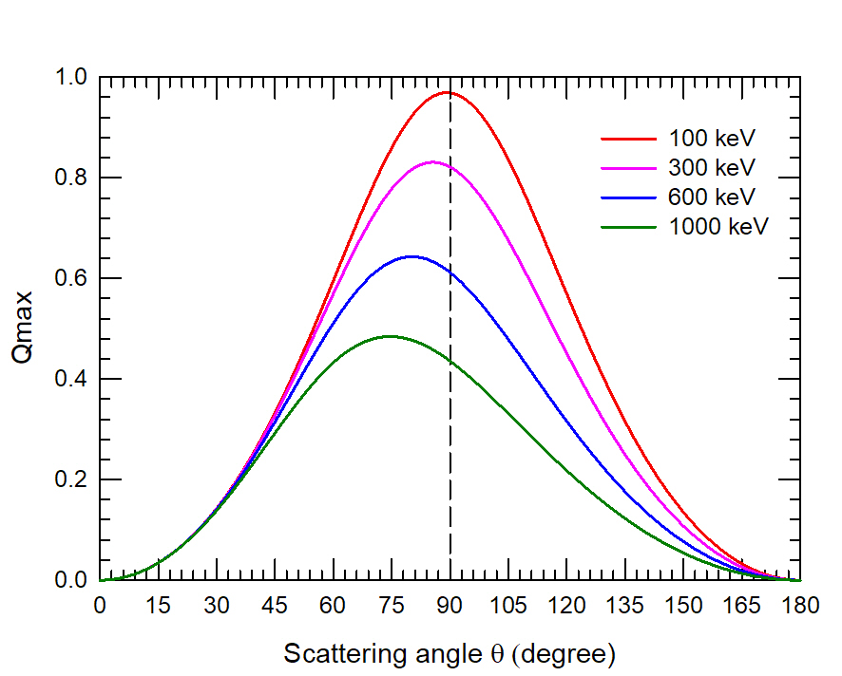
2.1 The Compton modulation principle
Klein-Nishina differential cross-section for linearly polarized photons: the probability distribution of the scattering angle will present a maximum along the direction orthogonal to the polarization plane and a minimum in the parallel one
E. Caroli - Advances in X-ray and Gamma RAy DEtectors and applications (XGRADE 2026) 24-26/03/2026, Palermo

Slide 9
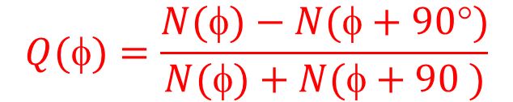
2.2 Requirements for a Compton polarimeter
The Quality of a scattering polarimeter is quantified by the Modulation Factor (Q). This parameter derived directly from the modulation curve using the scattered events distribution. N(φ) and N(φ+90°) are the scattered counts integrated over two orthogonal directions for which the ratio is the maximum.
$$Q()=\frac{N()−N(+90°)}{N()+N(+90 )}$$
The modulation factor can be optimized when scattered events are properly selected.
Selection efficacy depends on accuracy of the reconstructed scattering‑direction distribution (scattergram). Two core requirements for an efficient Compton polarimeter:
High spectroscopic resolution
High spatial resolution
Spectrometers with 2D/3D spatial resolution are an efficient method to measure the linear polarisation using Compton scattering:
Each element/pixel can act at the same time both as a Scattering and as a Detection unit.
E. Caroli - Advances in X-ray and Gamma RAy DEtectors and applications (XGRADE 2026) 24-26/03/2026, Palermo

Slide 10
3.1 Why segmented CdTe/CZT as Compton polarimeter
A bit of history. In the early 1990s, room‑temperature semiconductor technology was still emerging. From only those years came the very first proposed applications for X‑ray and gamma‑ray detectors in high‑energy astrophysics.
Main advantages for astrophysics instrumentations
High stopping power with good energy resolution
Natural compatibility with fine segmentation
Room temperature operation (no cryogenic system needed)
The figure shows the first design proposed by our group for a detector to be used on a coded‑mask telescope operating in the 50–1000 keV band. The detector was based on an array of linear modules containing small CdTe sensors (Eurorad, Strasbourg) of 2 × 2 × 20 mm (“allumette”).
From this configuration, we first envisioned these detectors as spectro-polarimeters for hard X‑ and soft gamma rays.
E. Caroli - Advances in X-ray and Gamma RAy DEtectors and applications (XGRADE 2026) 24-26/03/2026, Palermo

Slide 11
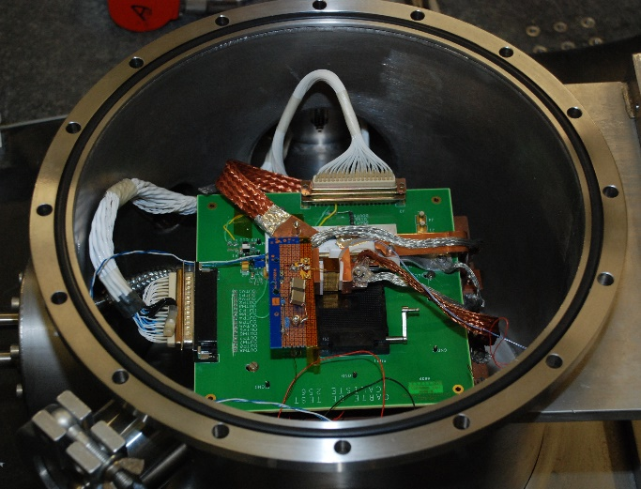
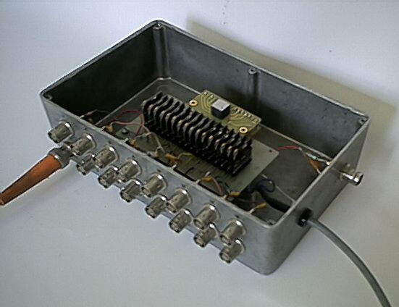
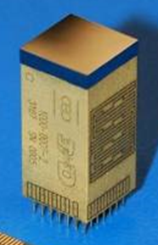

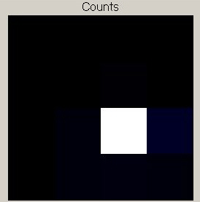
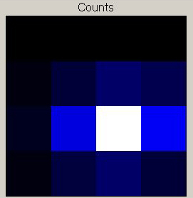
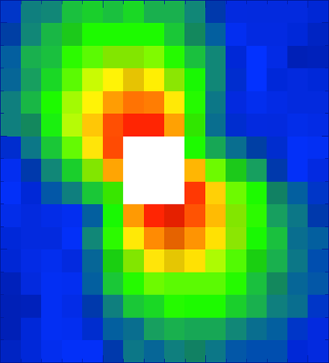
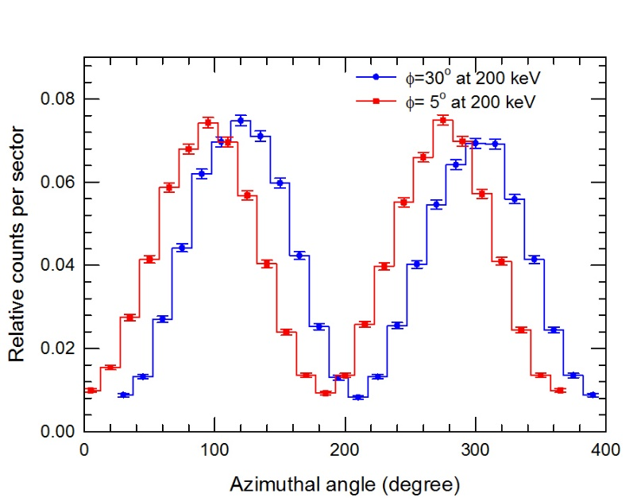
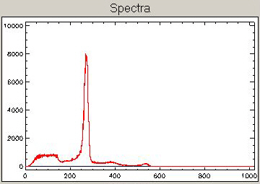
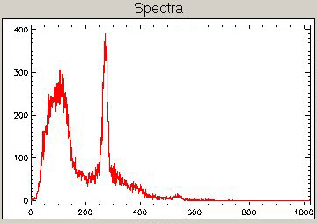
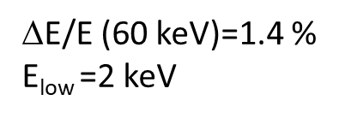
3.2 Validation of 2D CZT/CZT as Compton polarimeters
2002 – 2018: at ESRF using pixelated (2D) CZT/CdTe spectrometers with linearly polarized beam ranging from 100 to 700 keV.
5th Experiment (2011)
1st Experiment (2002)
Caliste Module: 1 mm thick Schottky CdTe, 2 mm thick CZT
16x16 pixels (650 µm pitch)
CdTe (3.4, 5, 7.5 mm thick
Eurorad 4x4 pixel (2.5 mm pitch)
Q=0.85
$$E/E (60 keV)=1.4 %
E_{low} =2 keV
7.5 mm thick CdTe (bias=750 V):
@ 300 keV, Q=0.41 (MC Q=0.35-0.45)
@ 400 keV, Q=0.3 (MC Q=0.28-0.4)
E=200 keV,
30° inclination with respect to polarisation direction.
Single events
Double events
E. Caroli - Advances in X-ray and Gamma RAy DEtectors and applications (XGRADE 2026) 24-26/03/2026, Palermo

Slide 12
12
3.3 From 2D to 3D segmented spectrometer
Requirements for next decades hard X and soft gamma ray space instruments (2040-2050).
At about 100× improvement in sensitivity up to 600–700 keV is required to address key outstanding scientific questions.
With spectroscopy, imaging, and timing, polarimetry should become a standard mode for studying cosmic‑ray sources in the hard X/soft γ regime
Promising yet challenging approach to meet the above requirements:
High‑energy optics (e.g. Laue lenses) for future telescopes
New strong requirement on the detector
High detection efficiency, achievable with increased thickness (80% at 500 keV);
Fine spectroscopy (1% FWHM at 511 keV) achievable with small volume charge collection;
Fine spatial resolution (<<0.5 mm) achievable with high segmentation.
3D CZT spectro-imager
E. Caroli - Advances in X-ray and Gamma RAy DEtectors and applications (XGRADE 2026) 24-26/03/2026, Palermo

Slide 13
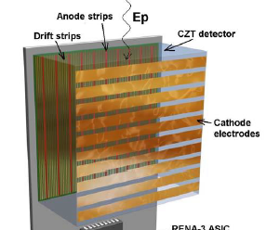
3.4 3D CZT spectrometer architectures
Thin stacked layers (crossed strip or pixel)
Concept: depth from hit‑layer address
Drawbacks: complex assembly/electronics; significant passive material → unwanted scattering (Japan, USA)
Thick CZT (10–20 mm) with pixels
Concept: pixel effect enables depth reconstruction
Drawbacks: high low‑energy threshold; charge sharing degrades low‑energy spatial resolution (USA)
Our alternative solution: a configuration based on CZT spectrometers unit combining three key concepts:
PTF irradiation configuration decouples photon absorption thickness from charge‑collection distance.
Crossed strips: the cathode and anode are sets of orthogonal microstrip
Anode drift strip configuration makes the device effectively a single‑charge‑carrier detector.
E. Caroli - Advances in X-ray and Gamma RAy DEtectors and applications (XGRADE 2026) 24-26/03/2026, Palermo

Slide 14
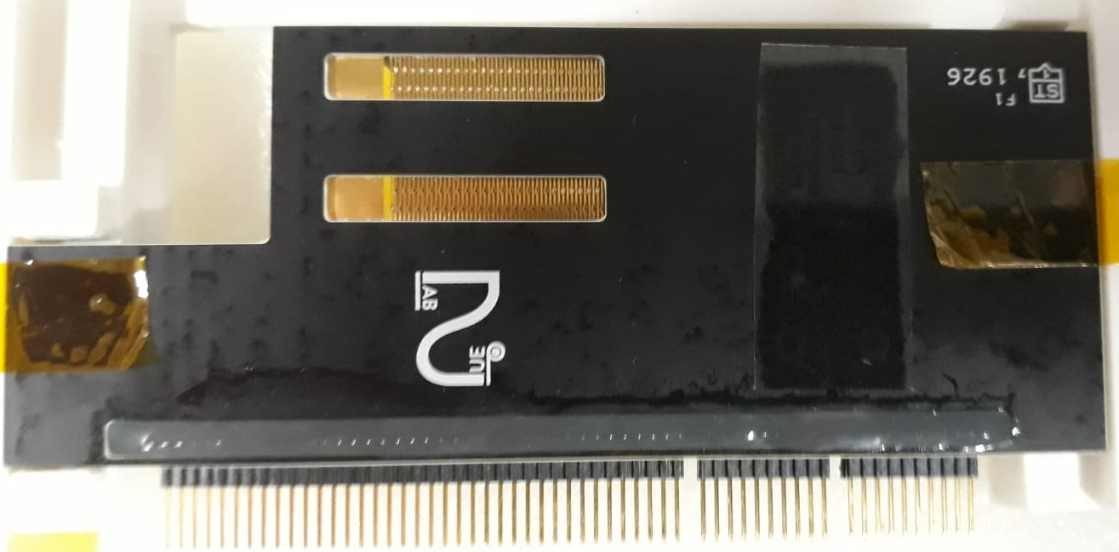
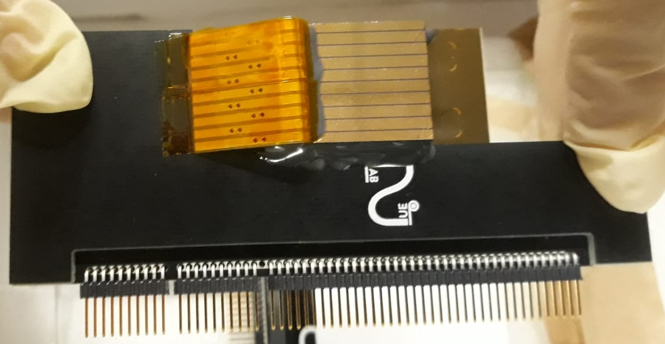
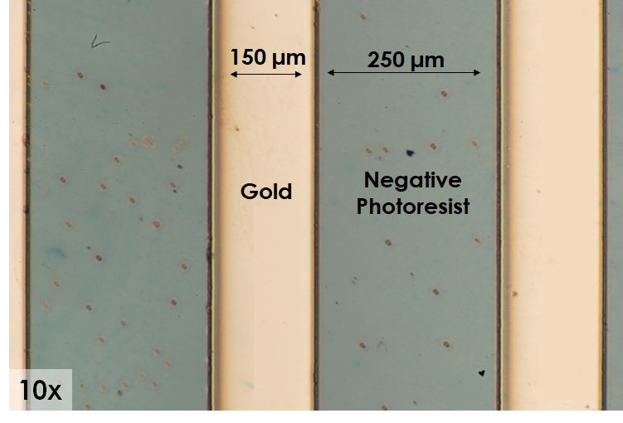
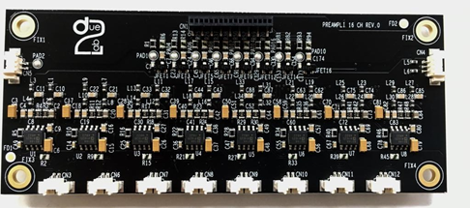
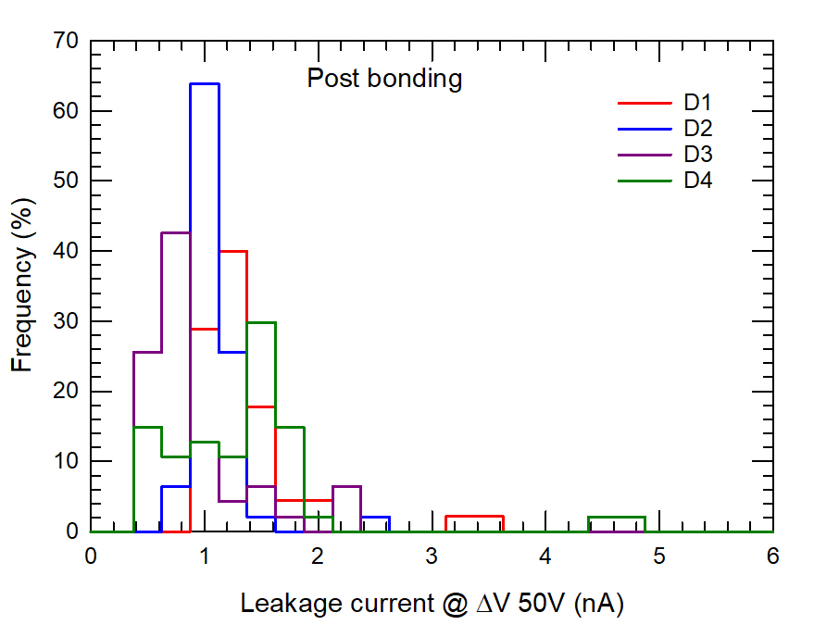
4.2 Key feature of the 3D drift Strip detector /1
New passivation method to limit the surface leakage currents between anodes strips.
N. 4 3DCZT sensors realized and tested in laboratory
Spectroscopic graded CZT crystal: 19.6x19.6x6 mm³
ANODE: 48 Au strips (0.15 mm strip width, 0.25 mm gap). (12 collecting strips, 3 drift strips between each collecting ones)
CATHODE: 10 Au strip (1.9 mm width, 0.1 mm gap).
16 channels low noise CSP (∼100 e⁻ RMS) hybrid boards developed and realized.
E. Caroli - Advances in X-ray and Gamma RAy DEtectors and applications (XGRADE 2026) 24-26/03/2026, Palermo

Slide 15
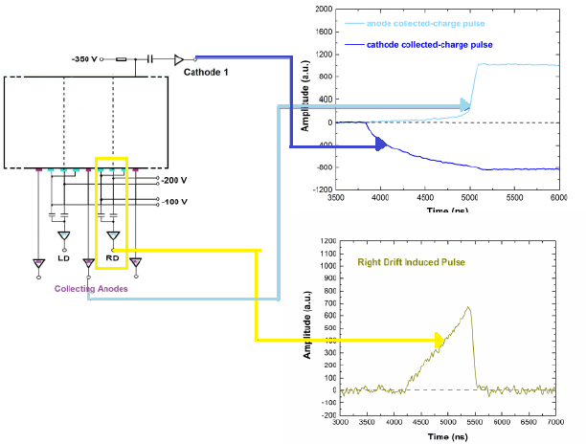
4.2 Key feature of the 3D drift Strip detector /2
For each 3D CZT sensor: (1) readout of collecting anode and cathode strips signal + (2) readout of grouped drift strip induced signals;
The drift strips are grouped by connecting the strips that occupy the same relative position with respect to two collecting anodes (anode cell). The resulting signals are used to enhance both spatial and energy resolution.
Digital pulse processing of CSP readout signals.
PTF configuration allows increasing the detector thickness (i.e. the photon‑absorption efficiency) up to 40 mm, compared to the current standard of 20 mm.
A limited number of readout channels (25/35) enables a highly segmented sensor (~30,000 “virtual” voxels, for a spatial resolution of ~0.4 mm in xyz): this is fundamental for scattering polarimetry
The digital processing approach provides high flexibility, allowing the detection system to adapt to different operating conditions without requiring any hardware modifications
E. Caroli - Advances in X-ray and Gamma RAy DEtectors and applications (XGRADE 2026) 24-26/03/2026, Palermo

Slide 16
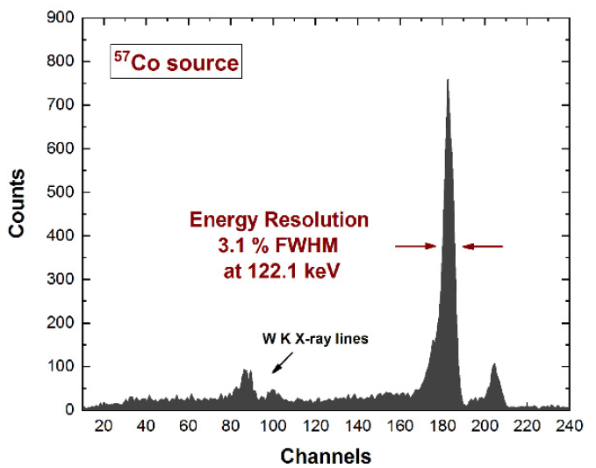
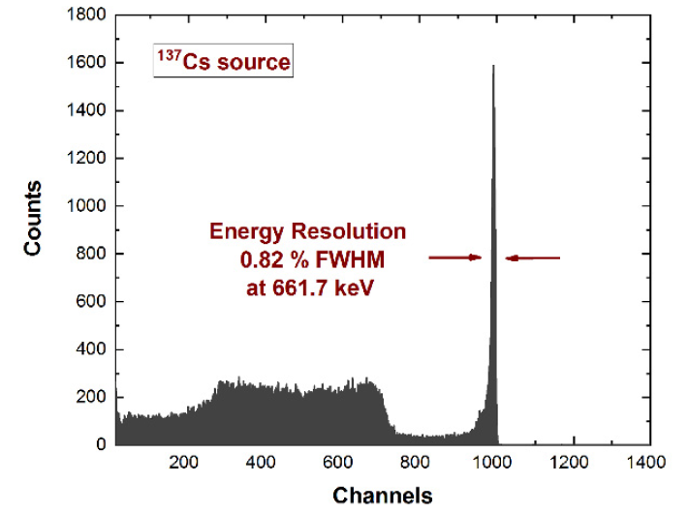
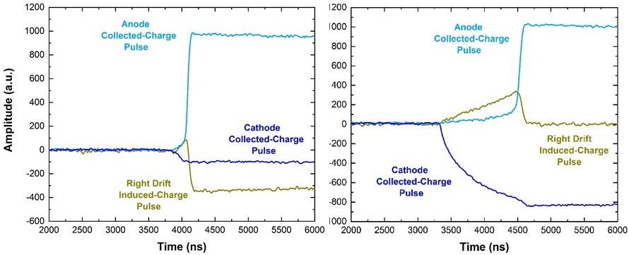
4.1 3D CZT drift sensor spectroscopic performance
Digital Readout Approach Key Advantage
The simultaneous readout of drift-strip, anode, and cathode signals enables different compensations and corrections.
These processing significantly improves the spectroscopic resolution and the spatial resolution in 3D
Spectra with uncollimated source (all events).
Excellent room temperature energy resolution after full spectral correction with induced pulses from drift strips
Example of Anode, Catode e induced drift strip signals
E. Caroli - Advances in X-ray and Gamma RAy DEtectors and applications (XGRADE 2026) 24-26/03/2026, Palermo

Slide 17
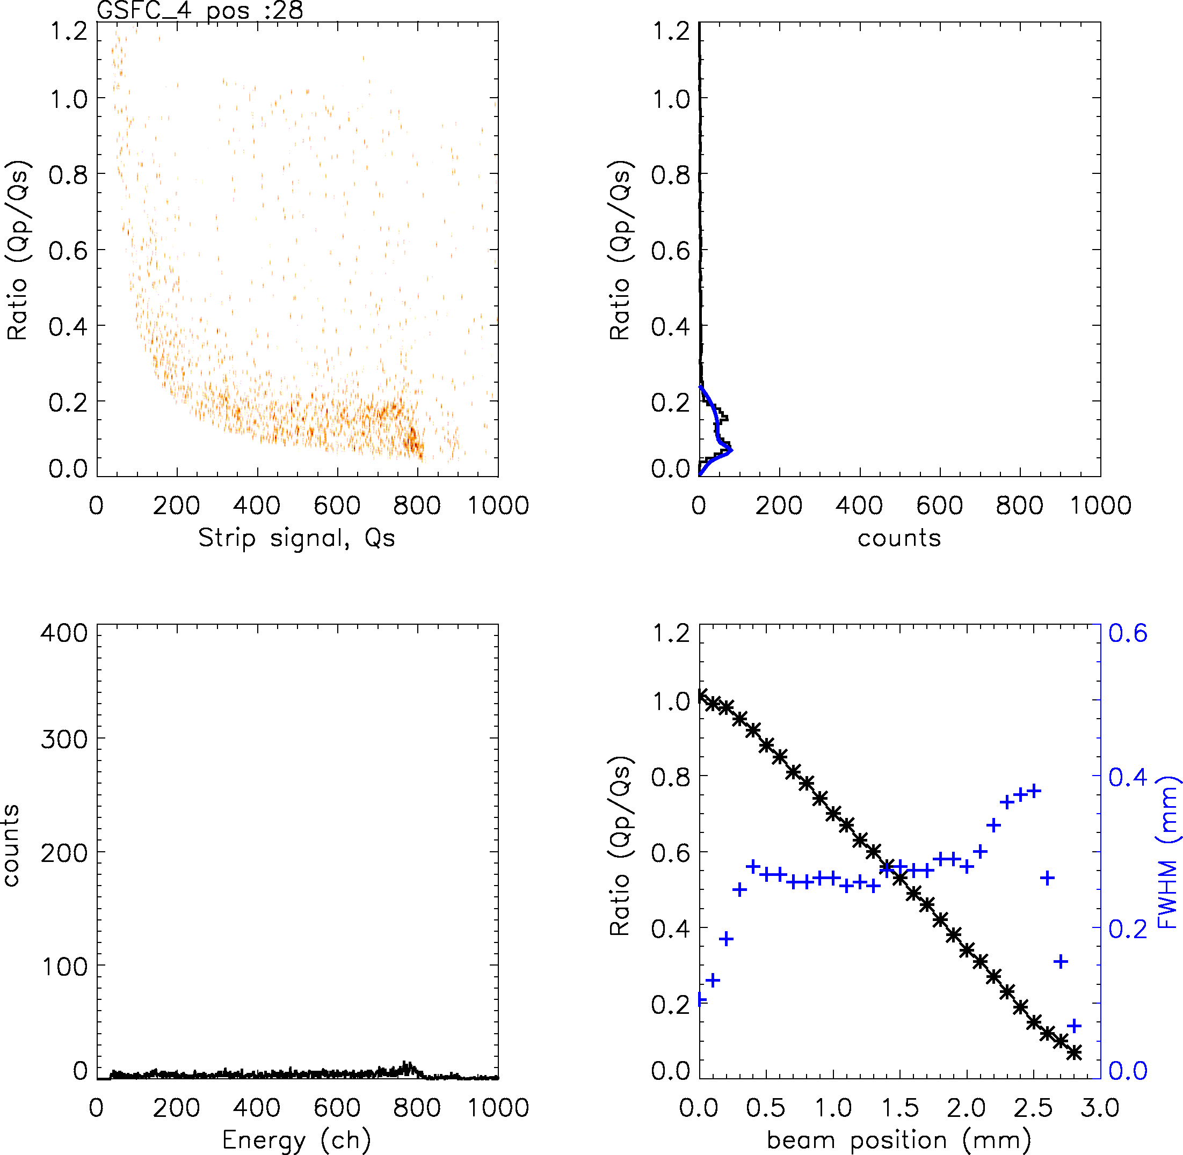
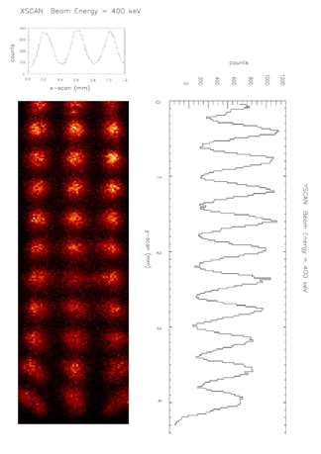
4.2 3DCZT drift sensor spatial resolution performance
ESRF Beam Test (2023)
3DCZT new version (6 mm thick)
Beam size 20 µm
Energy from 60 to 300 keV
3 anodic cells + 10 cathode and 3 drift strip group.
Δx = 0.35 mm at 300 keV
ESRF Beam Test (2010)
3DCZT first version (3 mm thick)
Beam size 50 µm
Performances at 400 keV:
Δx = 0.25 mm
Δy = 0.15 mm
Δz = 0.65 mm
ΔE (FWHM): 1.4%
X (mm)
Cathode/Anode (C/A) Ratio vs beam position used to detemine the photon incident position along the collecting electric field direction (x)
Y (mm)
E. Caroli - Advances in X-ray and Gamma RAy DEtectors and applications (XGRADE 2026) 24-26/03/2026, Palermo

Slide 18
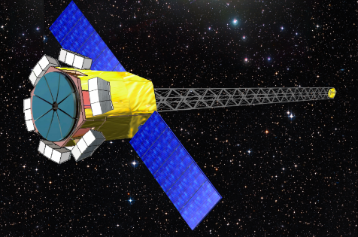
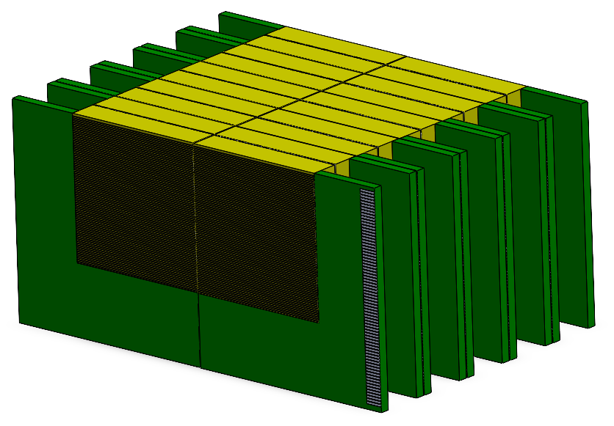
5.1 3D CZT spectrometers as focal plane units
Intrinsically well‑suited for Laue lens telescopes operating in the 50–600/700 keV energy band.
These narrow field of view telescopes require focal plane detectors that are compact, high‑efficiency with fine 3D spatial and spectroscopic resolution.
Properly tiled 3DCZT sensors can form detection planes up to 6–8 cm per side with 2–4 cm thickness (thickness limited by noise induced by the length of the anode strips).
Stacked detection planes can be assembled to reach the desired detection efficiency (e.g., ≈80% at 700 keV).
This detector underpins the Laue Lens telescope design studied for the a new high‑energy astrophysics mission concept: ASTENA: Advanced Surveyor of Transient Events and Nuclear Astrophysics
E. Caroli - Advances in X-ray and Gamma RAy DEtectors and applications (XGRADE 2026) 24-26/03/2026, Palermo

Slide 19
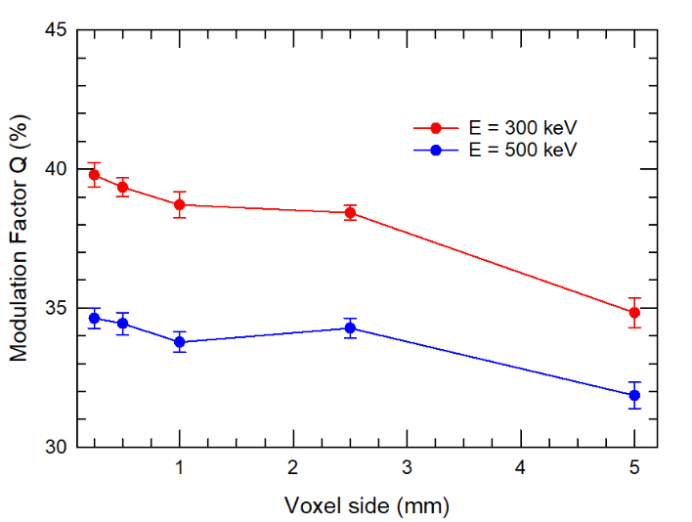
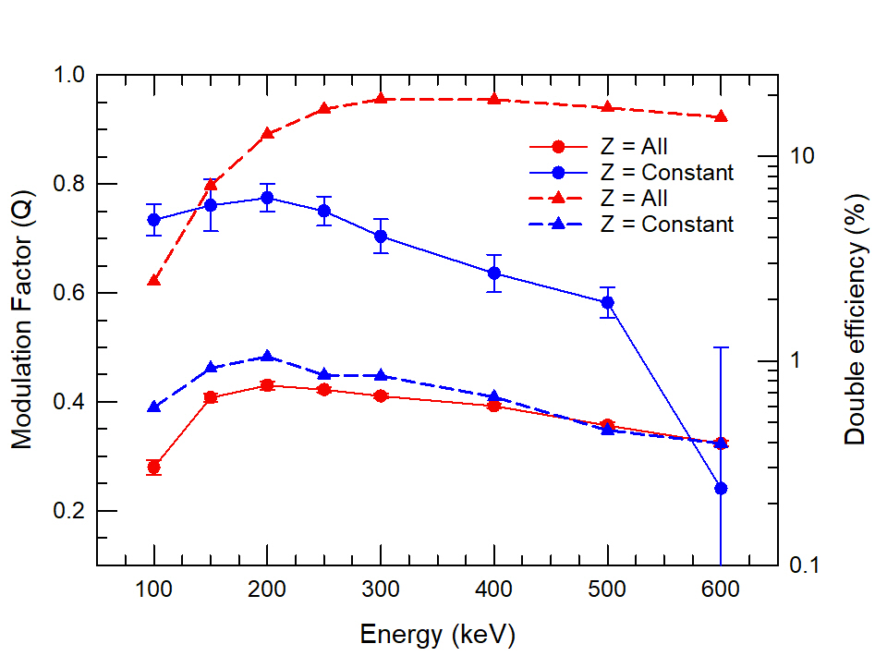
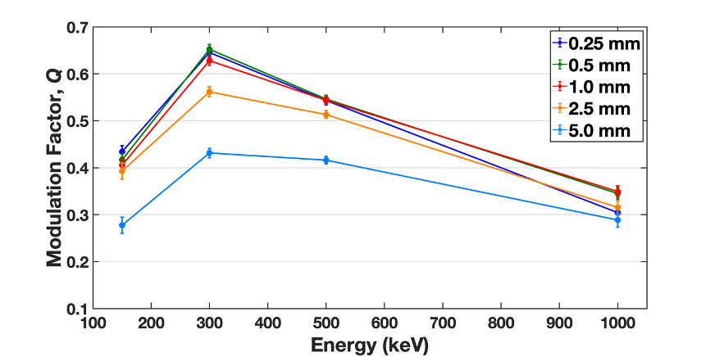
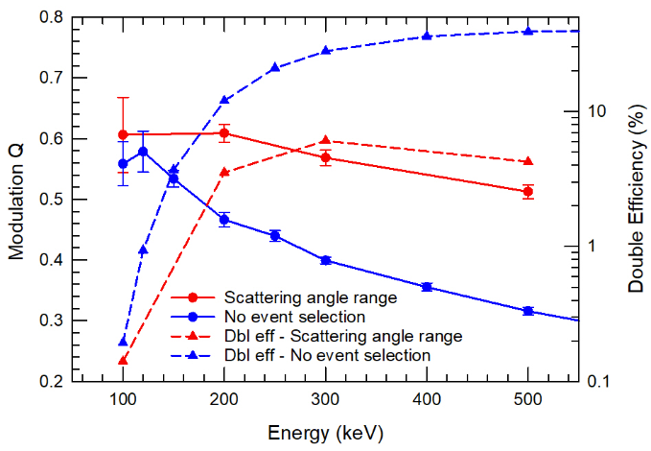
5.2 Simulation results: Q optimisation
MonteCarlo simulation with MEGALIB (GEANT4 environment).
Detector plane model based on the 3D‑CZT sensor architecture
Characteristics of the beam: Homogeneous & Monochromatic Radius (FWHM): 1.5 mm (∅ Laue PSF) On-axis, 100% polarized
Target: Study of the modulation factor variations as function of:
Incident photon energy
3D spatial resolution (voxel size)
Event‑selection criteria
All double event
Voxel 0.5 mm
Geometric selection
Angle selection
Voxel 0.5 mm
scattering angle selection
80° - 100°
E. Caroli - Advances in X-ray and Gamma RAy DEtectors and applications (XGRADE 2026) 24-26/03/2026, Palermo

Slide 20
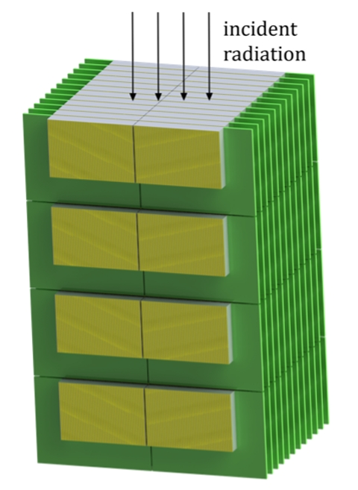
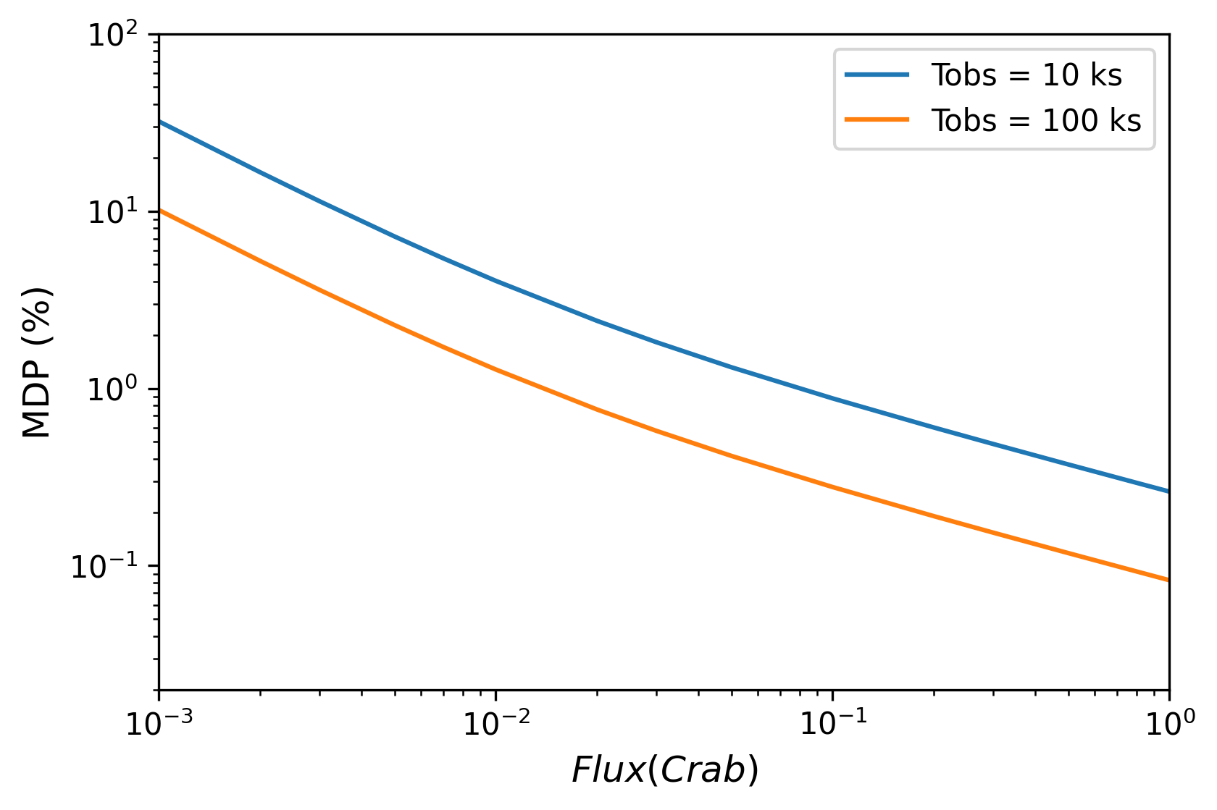
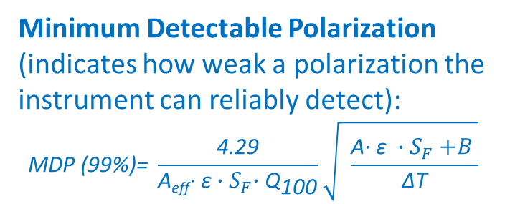
5.3 Simulation results: MDP evaluation
Source with a Crab like spectrum
𝑁(𝐸)=𝑁₀ 𝐸^{−2.1}, 𝑁₀ ≈ 9.7 ph⋅cm⁻²⋅s⁻¹⋅keV⁻¹ (in 60-600 keV N ≈ 0.1 ph⋅cm⁻²⋅s⁻¹)
Minimum Detectable Polarization (indicates how weak a polarization the instrument can reliably detect):
$$\text{MDP}\text{ (99\%)}\text{= }\frac{\text{4.29}}{\text{A}\text{eff}\text{∙ }\text{ε}{∙S}_{F}∙{\text{Q}}_{\text{100}}}\sqrt{ \frac{\text{A}\text{∙ }\text{ε} {∙S}_{F}+B }{\text{ΔT}}}$$
Cen A
Carb Pulsar
Cyg X-1
MEGALIB GEOMETRIC MODEL:
3DCZT of 4 (L) x 2 (H) x 0.5 (T) cm³
The layer: 8 x 8 x 2 cm³ (32 3DCZT)
Stack of 4 layers
Voxel size: 0.25x0.25x0.25 mm³
MDP=1%
Expected MDP values — especially for short exposures (<10⁵ s) — exceed those of all current instruments by a wide margin. Combined with a ~100× sensitivity gain, this enables polarization measurements even for faint, weakly polarized, or rapidly variable sources. Hard X‑ray and soft gamma‑ray polarimetry finally becomes a full observational dimension, on par with spectroscopy, imaging, and timing.
E. Caroli - Advances in X-ray and Gamma RAy DEtectors and applications (XGRADE 2026) 24-26/03/2026, Palermo

Slide 21
6.3 Conclusions
This work has been a collective adventure: a long-term effort that combined physics, technology, and collaboration across institutions and countries.
Today, with the renewed interest in high energy polarimetry and with detector technologies more mature, we are in a position to contribute meaningfully to the next generation of missions in the hard X- and soft γ-ray domain.
As polarimetry can be indeed considered the ‘ultimate dimension’ in Astrophysics, then CdTe/CZT Compton polarimeters remains one of the most promising instrument to explore it, and the results obtained up to now show that this approach is ready for the challenges of the coming decades
Thank you for your attention and your patience — two precious resources in science
E. Caroli - Advances in X-ray and Gamma RAy DEtectors and applications (XGRADE 2026) 24-26/03/2026, Palermo

