Slide 1

Dr. Murat Aydemir
Erzurum Technical University, Turkey
Machine Learning-Driven Design of High-Performance X-Ray and Gamma-Ray Detectors
Advances in X-ray and Gamma RAy DEtectors and applications (XGRADE 2026)
24-26/03/2026, Palermo

Slide 2

Our Research Activities
Functional Materials
Organic emitters
Inorganic scintillators
Hybrid systems
Radiation & Detector Materials
X-ray / gamma-ray response
Scintillation efficiency
Stability and hardness
Integrated Detector
Materials Research
Synthesis • Characterization • Device • Data
Characterization & Photophysics
Time-resolved spectroscopy
Energy-transfer analysis
Structure-property links
Machine Learning & Data Science
Descriptor engineering
Predictive modelling
Data-guided screening
Integrated workflow: materials design, photophysical understanding, detector relevance, and ML-guided decision-making
M. Aydemir - Advances in X-ray and Gamma RAy DEtectors and applications (XGRADE 2026) 24-26/03/2026, Palermo

Slide 3
Collaborating with CERN-DRD5
Our Strengths
CERN DRD5 Focus
Materials synthesis
Natural
bridge
Quantum sensing R&D
advanced detector concepts for high-energy physics
Natural
bridge
Natural
bridge
Natural
bridge
Photophysics & spectroscopy
WP2: QDs & chromatic calorimetry
wavelength-engineered materials and layered detector ideas
Detector materials
Our contribution
materials selection, characterization, and ML-guided design insight
Machine learning
Interdisciplinary expertise ranging chemistry, physics, engineering, and data-driven analysis
Objective: to contribute materials expertise and data-driven design guidance for next-generation radiation detectors
M. Aydemir - Advances in X-ray and Gamma RAy DEtectors and applications (XGRADE 2026) 24-26/03/2026, Palermo

Slide 4



What Materials Are We Working On?
Inorganic scintillators
Organic scintillators and polymers
high-density stopping power and mature detector use
Materials
portfolio
lightweight systems with fast response and design flexibility
- GAGG, LYSO, BGO, PbWO4 and PbF2
- light yield, fast timing, and radiation robustness
- plastic scintillators and molecular emitters
- rapid response and scalable processing routes
organic - inorganic - nanoscale - hybrid
Quantum dots and nanocrystals
Hybrid and multilayer architectures
spectral tunability for wavelength-engineered detector concepts
materials integration instead of single-phase optimization
- perovskite and semiconductor nanocrystals
- emission tuning and chromatic readout potential
- crystal + polymer + quantum-dot combinations
- optical coupling and layered detector design
Key message: we are exploring a heterogeneous detector-materials space where performance depends on both material class and device architecture.
M. Aydemir - Advances in X-ray and Gamma RAy DEtectors and applications (XGRADE 2026) 24-26/03/2026, Palermo

Slide 5
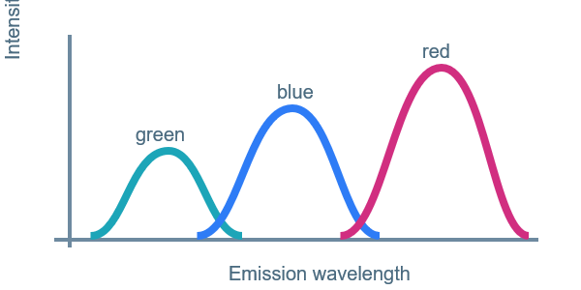
Quantum Dots as Tunable Detector Materials for HEP
Size-Dependent Emission
Detector-Relevant Advantages
Quantum confinement tunes emission across the visible range.
Electronic Structure
Key QD properties relevant to detector design.
Discrete energy levels emerge as QD size decreases.
Tunable λ
Narrow FWHM
Emission can be matched to SiPM/PMT response.
~20 nm bandwidth supports chromatic separation.
Large
Small
QD diameter
Energy
Eg
Emission λ
Eg
Fast τ
Radiation robust
larger QD -> red-shifted
smaller QD -> blue-shifted
Eg
Sub-ns response supports fast timing concepts.
Robustness supports detector use.
Why They Matter for DRD5
Large QD
Medium
Small QD
wavelength-shifting layers for chromatic Calorimeter (CCAL)
hybrid integration with crystals and polymers
spectral separation in single-readout schemes
Smaller QDs exhibit a larger effective band gap, enabling tunable optical response.
For detector applications, this gives several advantages: tunable emission that can be matched to SiPM or PMT sensitivity windows, narrow emission bandwidth that can support chromatic separation, and fast optical response that is relevant for timing.
M. Aydemir - Advances in X-ray and Gamma RAy DEtectors and applications (XGRADE 2026) 24-26/03/2026, Palermo

Slide 6
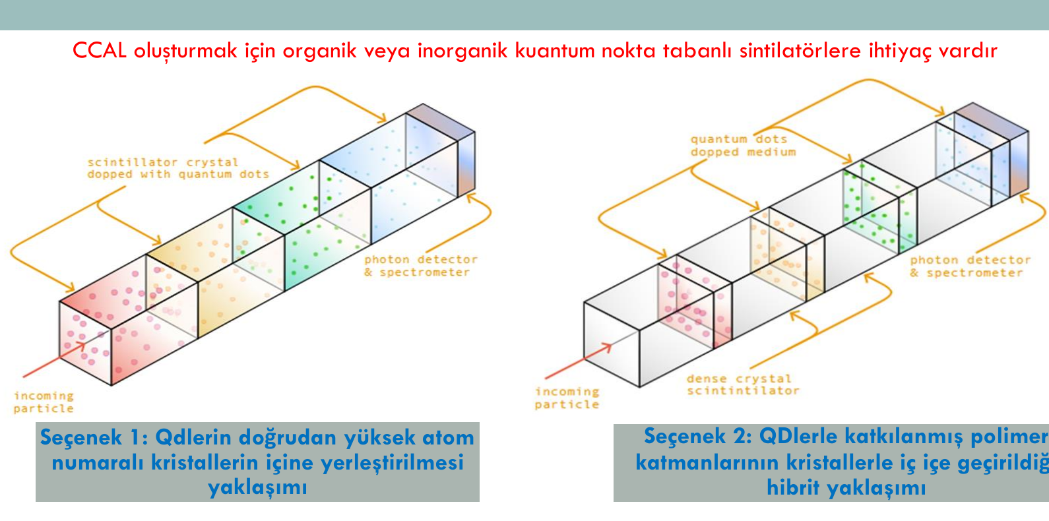
QD Structures and Integration Pathways
Detector integration architectures
For CCAL-like concepts, QDs can be integrated directly into absorbers or through QD-doped polymer layers.
The development of CCAL relies on organic or inorganic quantum dot–based scintillator materials
Direct incorporation of QDs into scintillating host
Hybrid approach: QD-doped polymer layers interleaved with other detector materials
These architectures can give the QDs different roles: direct emission, wavelength shifting, or participation in a chromatic calorimeter stack.
Option 1
Direct QD incorporation into dense crystals
Option 2
QD-doped polymer layers interleaved with crystals
Scientific meaning
architecture matters as much as chemistry
QD performance cannot be discussed in isolation from the host matrix, interface quality, and optical coupling. This is exactly the kind of coupled design problem where descriptor-based analysis becomes useful
M. Aydemir - Advances in X-ray and Gamma RAy DEtectors and applications (XGRADE 2026) 24-26/03/2026, Palermo
7

Slide 7
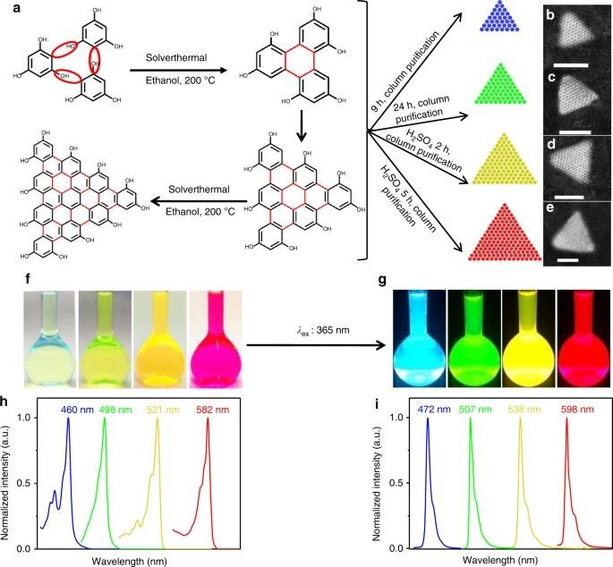
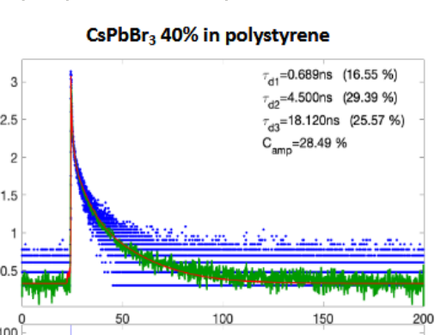
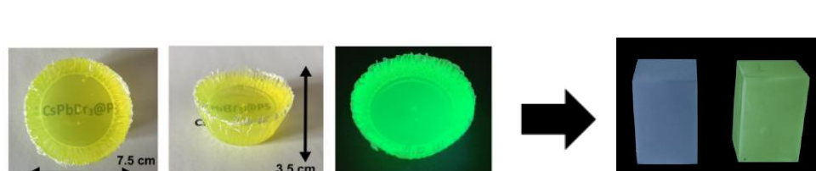
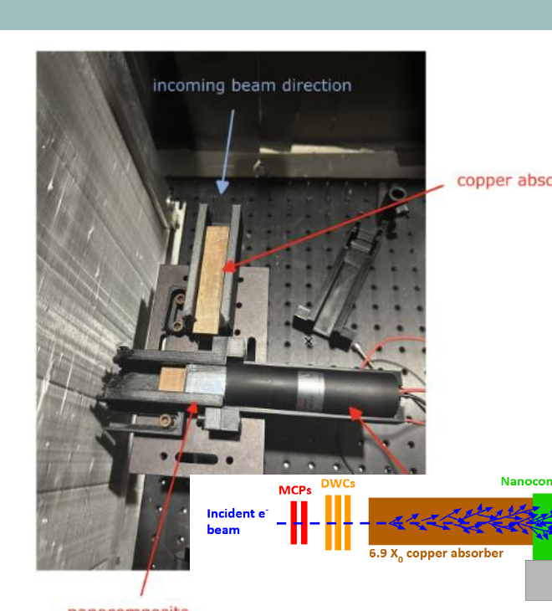
Polymer Nanocomposite Scintillators
Why polymer
Emission tunability
Fast scintillation kinetics
CsPbBr3 40% in polystyrene shows a sub-ns fast component.
nanocomposites?
Tunable narrow-band emission
Scalable PS/PU host matrices
Fast timing under X-ray excitation
Representative materials path
Observed: narrow-band emission • bright X-ray response • ultrafast decay channel
QD
PS / PU
Fabrication and macroscopic samples
Beam-test relevance
CCAL
layer
QD-loaded polymer bodies and representative scintillating blocks.
Nanocomposite module placement in CERN-oriented hardware tests.
Key detector message
Processable polymer hosts enable wavelength-engineered scintillator slabs for detector integration.
The example shown here highlights that QD-loaded polymer systems can produce bright X-ray response and sub-nanosecond fast components, which makes them promising for spectrally selective and timing-sensitive detector concepts.
M. Aydemir - Advances in X-ray and Gamma RAy DEtectors and applications (XGRADE 2026) 24-26/03/2026, Palermo
7

Slide 8
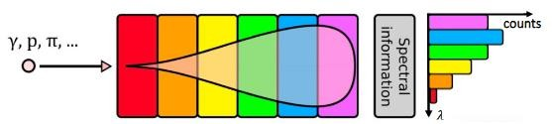
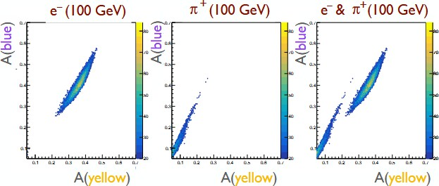
CCAL systems
Key advantages (beyond classical calorimetry):
Nanocomposites can primarily be used as tunable wavelength shifters (WLS).
86% “chromatic” electron - pion discrimination
Longitudinal shower profiling
Particle identification
Chromatic energy measurement
The structure is longitudinally segmented; each layer has a specific emission wavelength and absorption band.
Single readout with spectral information.
Unidirectional spectral transparency.
Longitudinal segmentation can be as thin as the material itself; 20 nm QDs with narrow-band emission enable many layers.
Target: longitudinal tomography of the shower profile.
M. Aydemir - Advances in X-ray and Gamma RAy DEtectors and applications (XGRADE 2026) 24-26/03/2026, Palermo
7

Slide 9
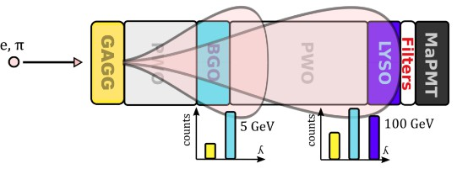
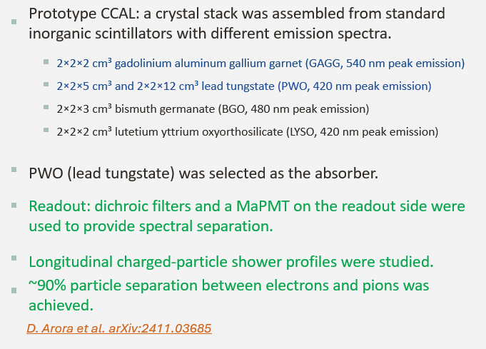
CERN Beam Tests 2023-baseline prototype / proof that CCAL is experimentally real
M. Aydemir - Advances in X-ray and Gamma RAy DEtectors and applications (XGRADE 2026) 24-26/03/2026, Palermo
7

Slide 10
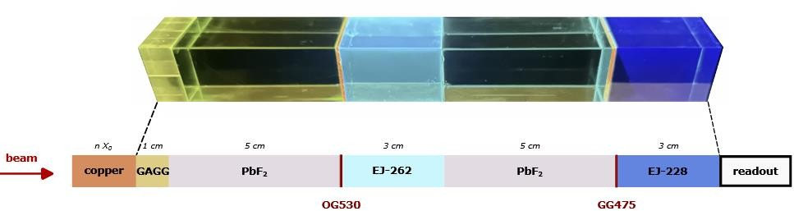
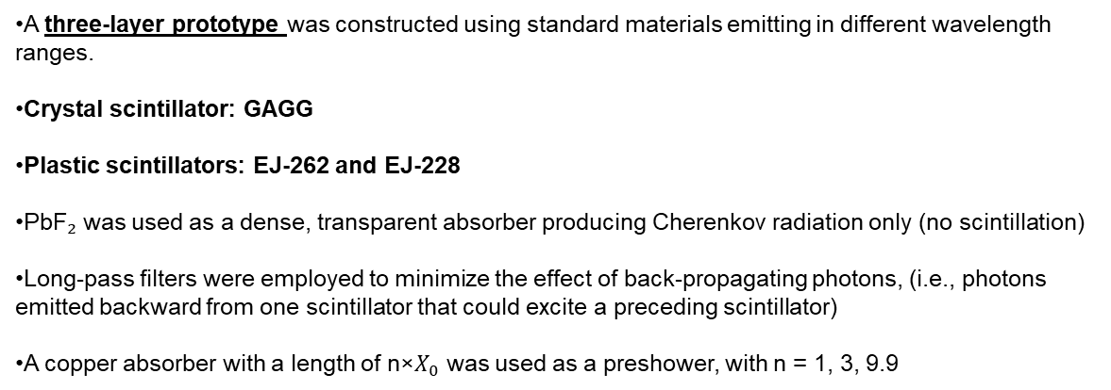
CERN Beam Tests 2025-Multilayer / filtered / improved architecture
A three-layer prototype was constructed using standard materials emitting in different wavelength ranges.
Crystal scintillator: GAGG
Plastic scintillators: EJ-262 and EJ-228
PbF₂ was used as a dense, transparent absorber producing Cherenkov radiation only (no scintillation)
Long-pass filters were employed to minimize the effect of back-propagating photons, (i.e., photons emitted backward from one scintillator that could excite a preceding scintillator)
A copper absorber with a length of n×$X_{0}$​ was used as a preshower, with n = 1, 3, 9.9
The final detector response depends simultaneously on emission wavelength, filtering strategy, absorber role, optical transport, and stack order. So even before introducing ML, the physics already tells us that this is a high-dimensional design space
M. Aydemir - Advances in X-ray and Gamma RAy DEtectors and applications (XGRADE 2026) 24-26/03/2026, Palermo
7

Slide 11
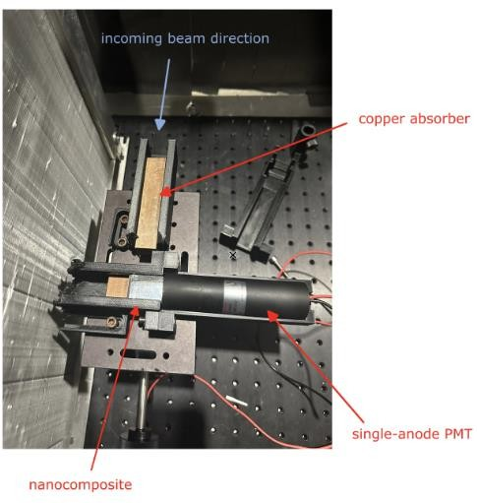
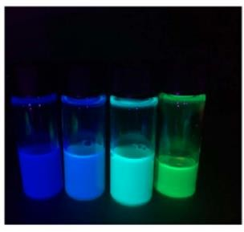
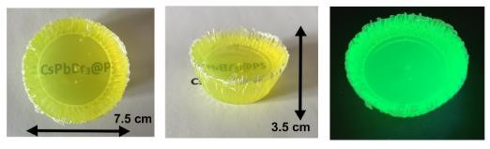
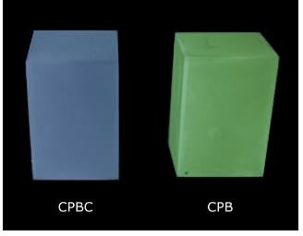
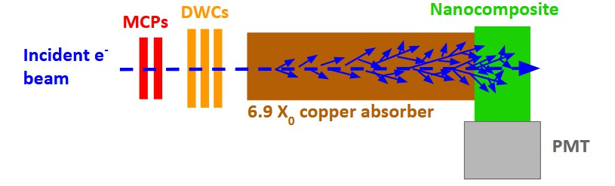

CERN Beam Tests 2025-QD/polymer nanocomposites
Nanocomposites were prepared by embedding quantum dots (semiconductor nanocrystals) into a transparent host matrix.
They exhibit:
narrow-band emission
tunable emission wavelengths
fast timing response
Two cesium lead halide nanocrystal systems were investigated:
CsPbBr₃ (CPB)
CsPbBrCl-based nanocrystals (CPBC)
For sample fabrication, the nanocrystals were dispersed in two organic polymer matrices:
polystyrene (PS) and polyurethane (PU)
Final sample size: 2 × 2 × 3 cm³
J. Králet al 2025 J. Phys. Mater. 8 015007
M. Aydemir - Advances in X-ray and Gamma RAy DEtectors and applications (XGRADE 2026) 24-26/03/2026, Palermo
7

Slide 12
Open Design Problem
Material
variables
composition - density - defects
Architecture
variables
multilayers - interfaces - thickness
Detector
performance
Optical / timing
variables
emission - timing - readout matching
Irradiation / test-condition
variables
beam energy - dose - filtering - stability
Detector performance emerges from coupled material-architecture interactions, making one-variable-at-a-time optimization insufficient.
M. Aydemir - Advances in X-ray and Gamma RAy DEtectors and applications (XGRADE 2026) 24-26/03/2026, Palermo
7

Slide 13
Why Machine Learning Now?
Experimental design space
What ML can do for us
Many variables must be chosen simultaneously:
Machine learning does not replace detector physics; it reveals structure in a high-dimensional materials dataset.
Material family
QD composition
Host polymer
Need for
ML guidance
Pattern discovery
Ranking & selection
Interpretability
Crystal absorber
Layer thickness
Optical coupling
Identify clusters, correlations, and hidden structure across material classes.
Prioritize promising material–architecture combinations before exhaustive testing.
Estimate which descriptors drive timing, emission, and detector response.
Readout type
Filter choice
Beam condition
Result: the search space grows combinatorially, while experiments remain slow and expensive.
Planned ML workflow
Experiments
Descriptors
Models
Insights
Next
experiments
too many
combinations
How can we reduce the experimental search space without losing physical meaning?
M. Aydemir - Advances in X-ray and Gamma RAy DEtectors and applications (XGRADE 2026) 24-26/03/2026, Palermo
7

Slide 14
Machine Learning Workflow
Experiments
Descriptor
space
Unsupervised
mapping
Candidate
ranking
Design
insight
materials, devices,
beam-test observations
composition, host,
optical and device variables
PCA, clustering,
latent structure
promising material–
architecture combinations
physically meaningful
selection rules
Experimental design space
Core logic
What the ML stage delivers
• Material family
• QD composition and size
• Host polymer / crystal absorber
• Layer thickness and coupling
• Filter and readout configuration
High-dimensional detector materials data
→ structured descriptor space
→ interpretable screening and prioritization
• cluster structure across material classes
• descriptor-level interpretation
• reduced search space for experiments
• ranked candidates for detector testing
Challenge: the number of possible experiments grows combinatorially.
Machine learning supports selection; it does not replace physical interpretation.
The key point is that the output is not a black-box score alone. The output is a physically interpretable reduction of the detector design space, which can then guide the next experimental campaign.
M. Aydemir - Advances in X-ray and Gamma RAy DEtectors and applications (XGRADE 2026) 24-26/03/2026, Palermo
7

Slide 15
Descriptor Space Used for ML
Optical / Scintillation
ML Tasks and Scientific Outputs
Emission peak (λem) and spectral width (FWHM)
Light yield / photon output
Absorption–emission overlap and WLS compatibility
Curated Descriptor Matrix
Dimensionality reduction
PCA / UMAP mapping of the material landscape
Materials
×
Descriptors
Timing / Kinetics
Grouping / similarity
Rise time, decay time, fast/slow components
Prompt fraction and timing response
Energy-transfer and recombination dynamics
Clustering of scintillator families and architectures
Standardized, comparable, physics-aware inputs
Prediction
Materials / Architecture
Response ranking, discrimination potential, candidate prioritization
Density, Zeff, refractive-index contrast
Layer sequence, thickness, loading fraction
Host matrix, crystal/QD/polymer integration route
Interpretation
Feature importance and physically meaningful design rules
Experimental / Detector Context
Key message: the descriptor space must encode both intrinsic material physics and detector-level integration variables to enable interpretable ML-guided screening.
Beam energy • particle type • readout channel • filter set • geometry • irradiation conditions
M. Aydemir - Advances in X-ray and Gamma RAy DEtectors and applications (XGRADE 2026) 24-26/03/2026, Palermo
7

Slide 16
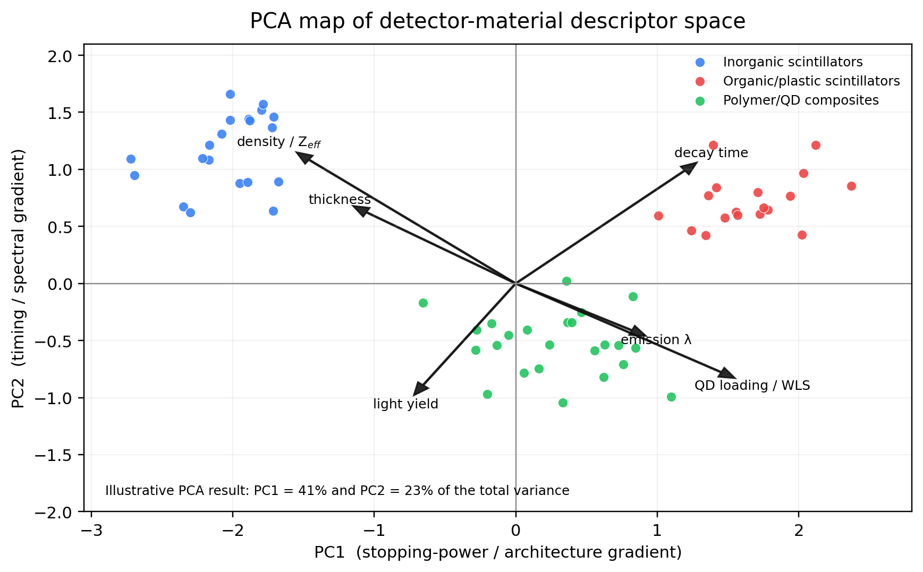
PCA Mapping of the Materials Space
Physical interpretation of PCA axes
PC1: captures a stopping-power / architecture gradient driven by density, thickness and high-Z content.
PC2: captures a timing / spectral gradient governed by decay time, emission wavelength and QD/WLS loading.
Cluster-level meaning
high-Z inorganic scintillators separate toward the density / thickness quadrant
organic/plastic scintillators occupy a timing-dominated region
polymer/QD composites populate an intermediate, tunable design regime
Illustrative scientific takeaway
The first two principal components recover a physically interpretable separation between inorganic scintillators, organic/plastic scintillators, and polymer/QD composites, suggesting that descriptor compression can preserve meaningful materials-domain structure before supervised ML.
M. Aydemir - Advances in X-ray and Gamma RAy DEtectors and applications (XGRADE 2026) 24-26/03/2026, Palermo
7

Slide 17
Cluster Signatures and Physical Regimes
Standardized
descriptor matrix
PCA-reduced
latent space
Cluster
assignment
Centroid /
signature analysis
Physical
interpretation
Methodological strength
Cluster-centroid heatmap (illustrative z-scored descriptor levels)
Scientific interpretation
Clustering is scientifically useful only if the resulting groups are:
Cluster A is absorber-driven: density and stopping descriptors dominate.
Cluster B is QD/polymer-driven: timing, emission tuning, and loading are enriched.
Cluster C reflects fast but simpler organic/plastic systems.
Cluster D is a transition regime with high architecture complexity.
Density /
Zeff
Emission
window
Timing
response
QD / WLS
loading
Architecture
complexity
internally coherent
externally separated
physically interpretable
stable under descriptor selection
A
High-Z
high
low
low
low
low
B
Polymer-QD
low
high
high
high
mid
Illustrative validation result
C
Organic/plastic
low
mid
high
low
low
D
Transition
low
mid
mid
mid
high
Result
k = 4 clusters gives a robust separation between high-Z, polymer/QD, organic/plastic, and transition regimes.
Descriptor enrichment across cluster centroids
Clustering suggests that physically interpretable groups exist before supervised ML, supporting downstream candidate ranking.
low
high
M. Aydemir - Advances in X-ray and Gamma RAy DEtectors and applications (XGRADE 2026) 24-26/03/2026, Palermo

Slide 18
Multi-objective Candidate Selection for Next-Generation Detector Materials
Physics-guided ranking framework
Decision map: Pareto-efficient detector candidates
Design implications
Input descriptor groups
High-ranking candidates are not defined by a single best property; they arise from balanced timing, spectral separation, and detector-stack compatibility.
Timing / kinetics
Preferred design region
rise time, decay, prompt fraction
Spectral separability
QD-polymer WLS
Dense absorber-linked materials may improve shower containment, but wavelength-selective layers become essential for information-rich readout.
Spectral behavior
Hybrid QD/crystal
emission band, overlap, WLS compatibility
Dense crystal stack
Absorber relevance
QD-polymer nanocomposites are attractive because emission can be tuned toward peak SiPM/PMT quantum-efficiency windows while preserving fast response.
density, high-Z compatibility, stack role
Fast plastic stack
Stability metrics
Conventional reference
The ML step therefore becomes a prioritization tool for experimental beam-test campaigns, not a replacement for detector physics.
radiation hardness, processability, robustness
Illustrative score
Bubble size ~ multi-objective score
Fast timing response
Score = w₁·Timing + w₂·Spectral separation + w₃·Architecture compatibility + w₄·Stability
Illustrative result
Multi-objective ML ranking helps identify which material classes should move first into prototype fabrication and beam validation.
Goal: identify candidates that sit on the best trade-off frontier rather than maximizing a single descriptor.
M. Aydemir - Advances in X-ray and Gamma RAy DEtectors and applications (XGRADE 2026) 24-26/03/2026, Palermo
7

Slide 19
From ML Ranking to Experimental Validation
1. Ranked candidate pool
2. Validation workflow
3. Prototype roadmap
Illustrative multi-objective ranking
Physics-guided closed loop
Decision logic for the next experimental campaign
Candidate
Light
yield
Timing
Stability
Score
Ranked
materials
Prototype
fabrication
Tier 1
Fabricate 2–3 top Pareto candidates covering distinct spectral/timing regimes
QD/PS-1
0.88
0.82
0.67
0.84
GAGG-QD
0.79
0.71
0.91
0.81
Optical / timing
validation
Beam-test / detector
benchmarking
Tier 2
Benchmark against current reference scintillators and hybrid stacks
QD/PU-2
0.75
0.89
0.56
0.77
PbF2-QD
0.61
0.93
0.70
0.75
Hybrid-L
0.84
0.64
0.73
0.74
Feedback into
descriptor model
Select architecture-specific winners for CCAL-oriented beam testing
Tier 3
Scientific result: top-ranked candidates occupy a balanced regime rather than an extreme single-metric regime.
Closed-loop strategy: ML is not the endpoint; it is the decision layer that prioritizes experiments and learns from validation outcomes.
Scientific result / expected gain
Key implication
Operational metrics
A descriptor-guided workflow can reduce the experimental search burden while preserving coverage of chemically and functionally distinct detector candidates.
Candidates showing simultaneous intermediate-to-high performance in yield, timing, and stability are more promising for prototype transfer.
Δλ selectivity • rise/decay time • light output • attenuation • radiation tolerance
M. Aydemir - Advances in X-ray and Gamma RAy DEtectors and applications (XGRADE 2026) 24-26/03/2026, Palermo
7

Slide 20


Conclusions and Challenges
Conclusions
Challenges
Interdisciplinary integration of synthesis, detector physics, and machine learning provides a rational framework for scintillator discovery.
Limited and heterogeneous datasets: material classes, detector geometries, and test conditions are not yet standardized across studies.
QDs, polymers, crystals, and hybrid CCAL architectures define a high-dimensional but physically interpretable detector design space.
Strong performance trade-offs remain between light yield, timing, radiation hardness, thickness, and manufacturability.
Beam-test experience confirms that spectral separation and architecture-aware selection can improve particle discrimination and prototype relevance.
Descriptor uncertainty is still significant for hybrid systems, especially when interfacial effects and architecture variables dominate performance.
ML transforms experimental observations into prioritizable candidate maps and physics-guided design rules. (instead of conventional trial and error methods)
Experimental validation throughput remains the main bottleneck for closing the loop between model predictions and prototype optimization.
M. Aydemir - Advances in X-ray and Gamma RAy DEtectors and applications (XGRADE 2026) 24-26/03/2026, Palermo
7

Slide 21


