Slide 1

Giacomo Secci
INFN Milano, Italy
Integrated Front-End Electronics and Flexible Interconnection Systems for Segmented High-Purity Germanium Detectors
Advances in X-ray and Gamma RAy DEtectors and applications (XGRADE 2026)
24-26/03/2026, Palermo

Slide 2

Content
State-of-the-Art HPGe Detectors
The N3G Projects (Next Generation Germanium Gamma detectors)
Innovative Electrical Connections
Integrated Charge Sensitive Preamplifiers for HPGe Detectors: Design and Experimental Validation
G. Secci - Advances in X-ray and Gamma RAy DEtectors and applications (XGRADE 2026) 24-26/03/2026, Palermo

Slide 3
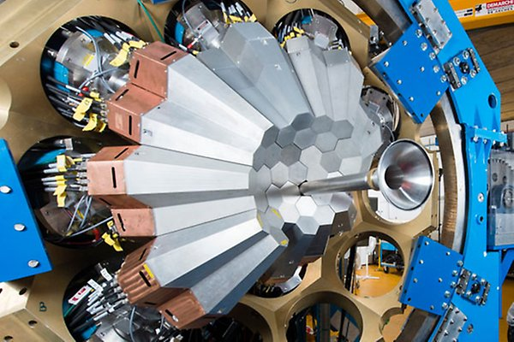
State-of-the-Art HPGe Detectors
High Purity Germanium (HPGe) detectors: impurity concentration of 10¹⁰ cm⁻³
Remarkable energy resolution: ≈ 2 keV @ 1.33 MeV
Interaction points identification through detector segmentation and Pulse Shape Anaysis (PSA)
γ trajectories reconstruction: tracking algorithms
AGATA (Avanced GAmma Tracking Array)
GRETA (Gamma-Ray Energy Tracking Array)
G. Secci - Advances in X-ray and Gamma RAy DEtectors and applications (XGRADE 2026) 24-26/03/2026, Palermo

Slide 4
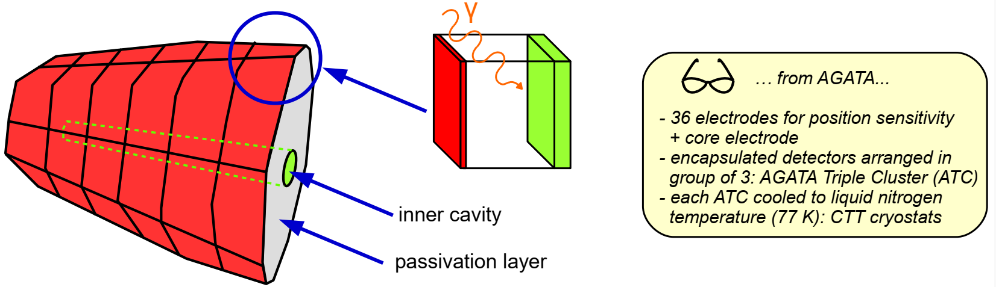
State-of-the-Art HPGe Detectors
n-type HPGe germanium crystals, featuring an external p-type boron implantation
Heavily n-doped cavity realized by lithium evaporation and diffusion
Passivation layer to prevent electrical discharges
Tapered hexagonal geometry with asymmetric shape: 4π configuration
G. Secci - Advances in X-ray and Gamma RAy DEtectors and applications (XGRADE 2026) 24-26/03/2026, Palermo

Slide 5
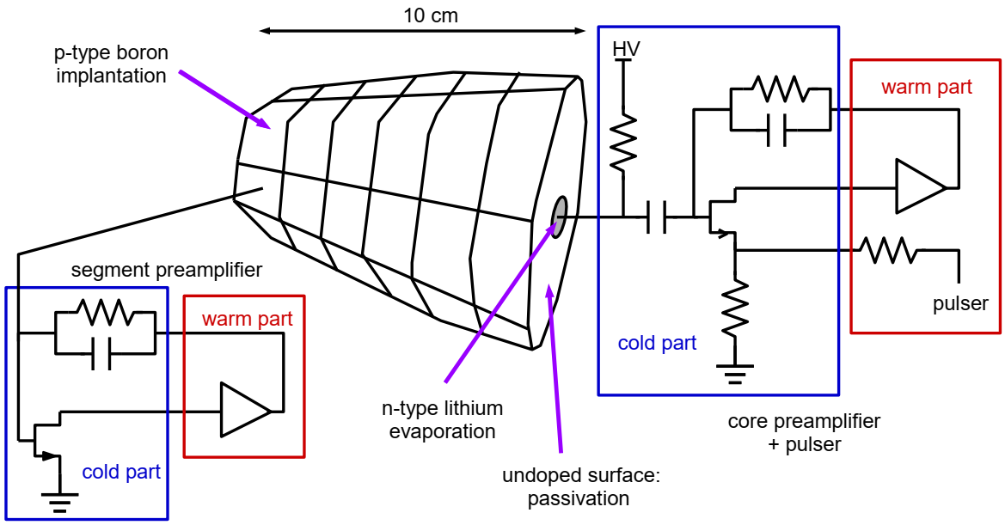
State-of-the-Art HPGe Detectors
Cold stage: input FET (BF862-20 mW power consumption), feedback capacitor (1 pF) and feedback resistor (1 GΩ) → "block-fet" Faraday cage
Warm stage: trans-impedance preamplifier with fast reset circuit
G. Secci - Advances in X-ray and Gamma RAy DEtectors and applications (XGRADE 2026) 24-26/03/2026, Palermo

Slide 6
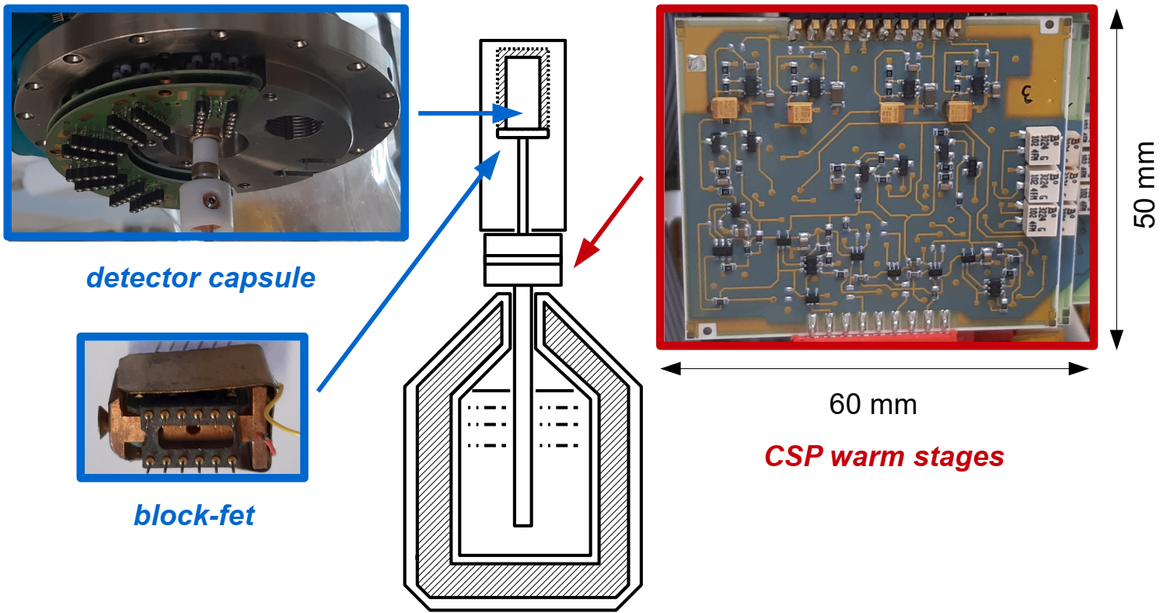
State-of-the-Art HPGe Detectors
Each block-fet includes the input FET and the feedback components of three preamplifier channels
Each warm PCB implements three preamplifier channels
G. Secci - Advances in X-ray and Gamma RAy DEtectors and applications (XGRADE 2026) 24-26/03/2026, Palermo

Slide 7

Next Generation HPGe Detectors
State-of-the-art HPGe detectors are supplied to scientific collaborations by industry, and their technical and manufacturing specifications are not known.
N3G Project: Next Generation Germanium Gamma Detector (INFN)
GOAL: developing new HPGe detectors while acquiring the know-how about their management and maintenance
Mechanical Advances: vacuum technology enclosures
Physics of Semiconductors: doping technologies photolithography
Electronics: detector connection charge sensitive preamplifiers
G. Secci - Advances in X-ray and Gamma RAy DEtectors and applications (XGRADE 2026) 24-26/03/2026, Palermo

Slide 8
Next Generation HPGe Detectors
Innovative doping technique: Pulsed Laser Melting (PLM)
Junction depth on the order of 100 nm – 300 nm: easier segmentation and dead-layer minimization, BUT…
difficult to be connected to the front-end electronics
Surface scratches and excessive pressure may cause irreversible damage to the junction
G. Secci - Advances in X-ray and Gamma RAy DEtectors and applications (XGRADE 2026) 24-26/03/2026, Palermo

Slide 9
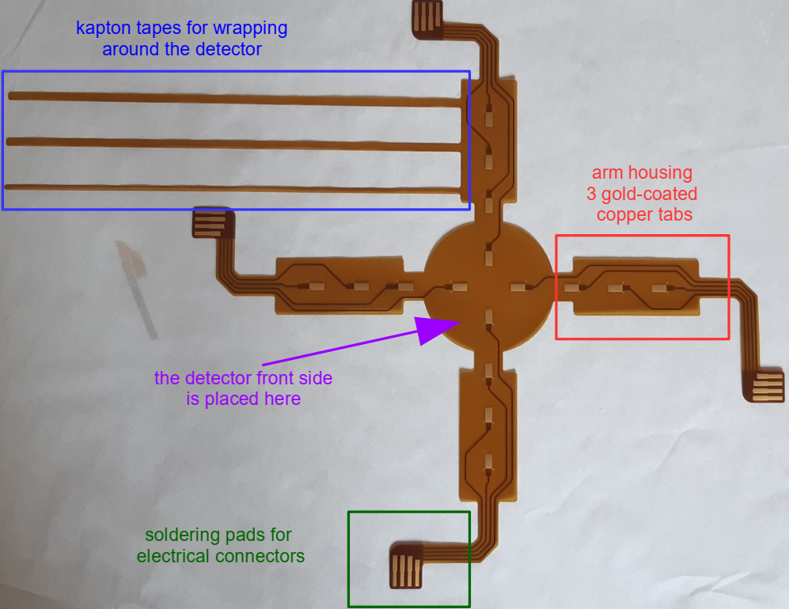
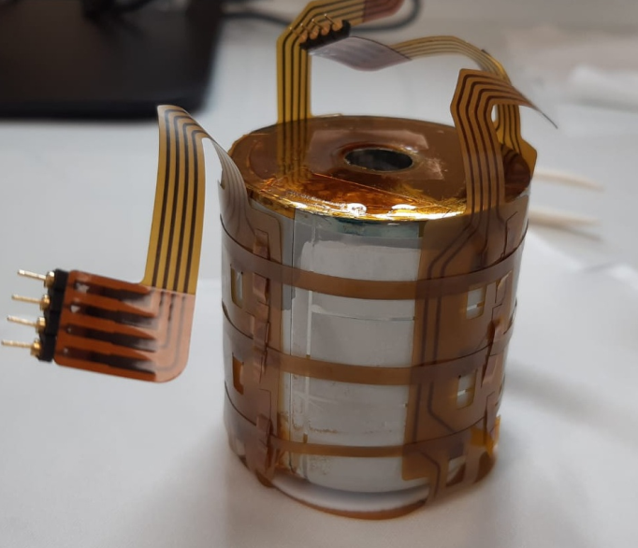
Detector Electrical Connections
GOAL: reliable electrical interface for signals transmission
Mechanical and thermal integrity without any structural or functional damage
Flexible PCBs to be wrapped around the detector
G. Secci - Advances in X-ray and Gamma RAy DEtectors and applications (XGRADE 2026) 24-26/03/2026, Palermo

Slide 10
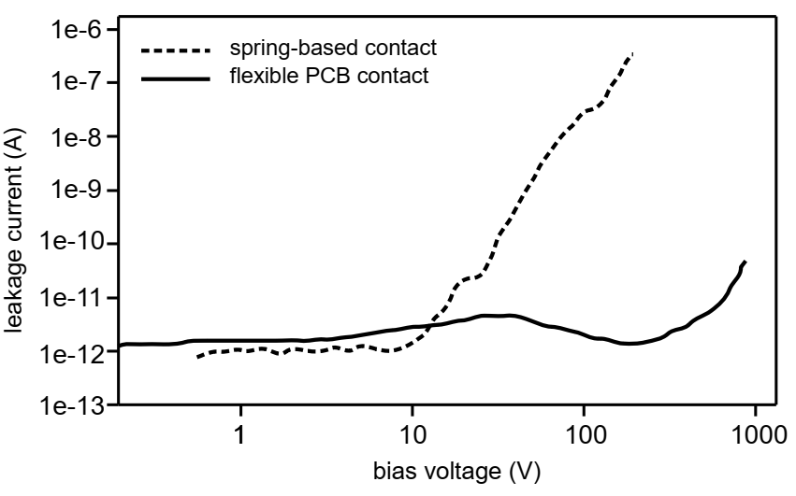
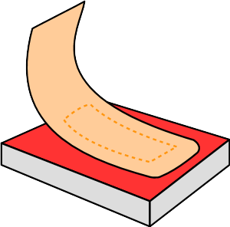
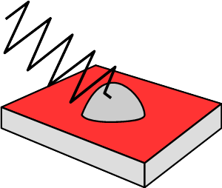
Detector Electrical Connections
Three models developed: one meets the stringent project requirements
Digital microscope inspection: no visible damage
Test with a planar HPGe detector: significant reduction of leakage current compared to standard contact methodologies
flexible-PCB
connection
micro-spring
connection
G. Secci - Advances in X-ray and Gamma RAy DEtectors and applications (XGRADE 2026) 24-26/03/2026, Palermo

Slide 11
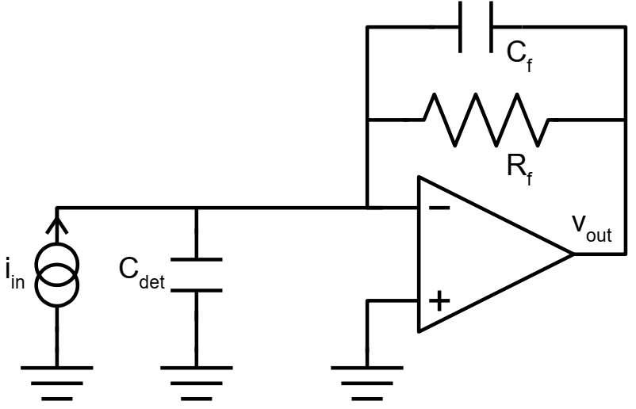
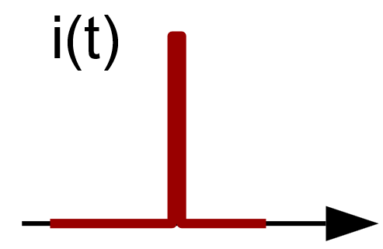
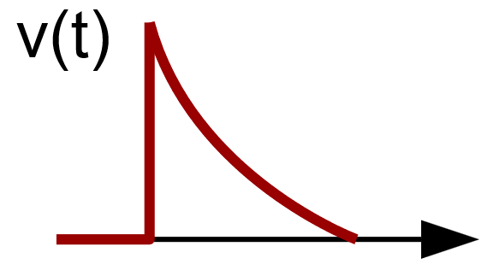
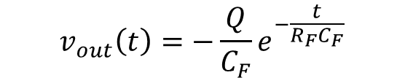

Detector Read-Out: Charge Sensitive Preamplifiers
We consider any electrode as a current generator with a parallel capacitance
We can describe the induced current with a delta-like pulse:
$$i\left(t\right)=Qδ(t)$$
The CSP is the active circuit that integrates the current pulse into a voltage signal:
$$v_{out}\left(t\right)=−\frac{Q}{C_{F}}e^{−\frac{t}{R_{F}C_{F}}}$$
The amplitude of the signal is proportional to the charge released by the studied interaction
G. Secci - Advances in X-ray and Gamma RAy DEtectors and applications (XGRADE 2026) 24-26/03/2026, Palermo

Slide 12
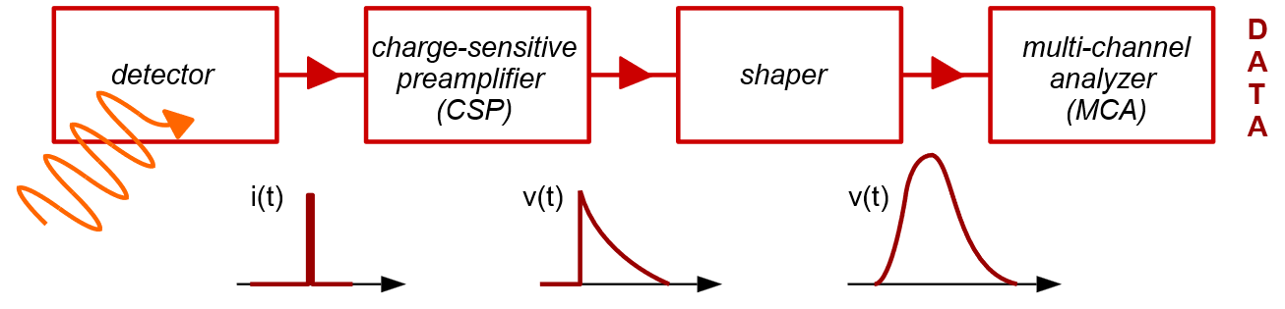
Detector Read-Out: Charge Sensitive Preamplifiers
We consider any electrode as a current generator with a parallel capacitance
We can describe the induced current with a delta-like pulse:
$$i\left(t\right)=Qδ(t)$$
The CSP is the active circuit that integrates the current pulse into a voltage signal:
$$v_{out}\left(t\right)=−\frac{Q}{C_{F}}e^{−\frac{t}{R_{F}C_{F}}}$$
The signal can then be sent to a shaping amplifier or directly digitized
G. Secci - Advances in X-ray and Gamma RAy DEtectors and applications (XGRADE 2026) 24-26/03/2026, Palermo

Slide 13
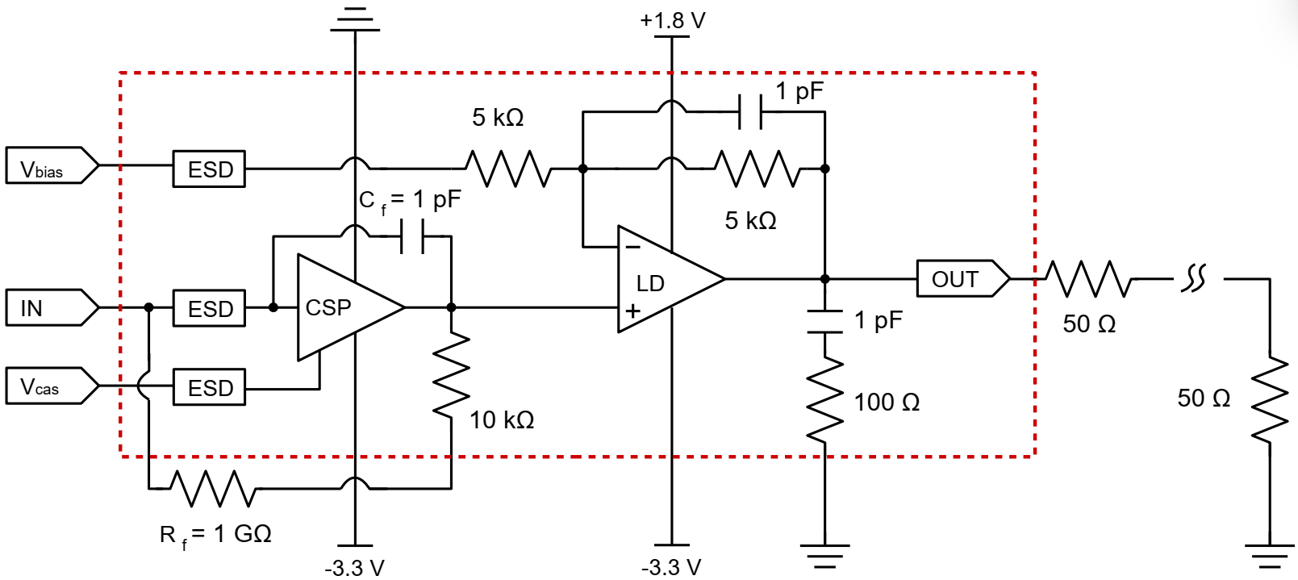
Detector Read-Out: Charge Sensitive Preamplifiers
Integrated charge sensitive preamplifiers for holes-collecting electrodes: developed using the AMSC35B4C3 350 nm process
G. Secci - Advances in X-ray and Gamma RAy DEtectors and applications (XGRADE 2026) 24-26/03/2026, Palermo

Slide 14
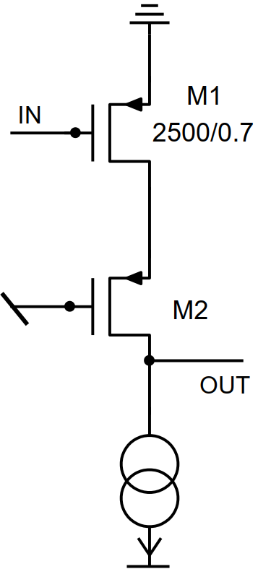




The Integrated CSP
The CSP architecture employs a four-stage configuration, comprising three common-source gain stages followed by a source follower buffer
input transistor optimization: W and L influence noise in opposing ways:
$$S_{in}\left(f\right)=a+bf+cf^{2}$$
$$a=4kT/R_{f}$$
$$b={(2πC_{tot})}^{2}A_{f}$$
$$c=4kTγ/g_{m}$$
Larger area = larger capacitance = more white series noise
Larger area = lower A_{f}= lower flicker noise
A trade-off is necessary: W/L = 2500 µm / 0.7 µm
The gate must be folded multiple times!
G. Secci - Advances in X-ray and Gamma RAy DEtectors and applications (XGRADE 2026) 24-26/03/2026, Palermo

Slide 15
The Integrated CSP
The CSP architecture employs a four-stage configuration, comprising three common-source gain stages followed by a source follower buffer
input transistor optimization: W and L influence noise in opposing ways: W = 2500 µm and L = 0.7 µm optimized values
RC Miller Compensation
2-stages line-driver configured as non-inverting amplifier: operating point externally adjustable
Line-driver architecture based on Operational Transcionductance Amplifier
50 Ω terminated line driving capability
G. Secci - Advances in X-ray and Gamma RAy DEtectors and applications (XGRADE 2026) 24-26/03/2026, Palermo

Slide 16
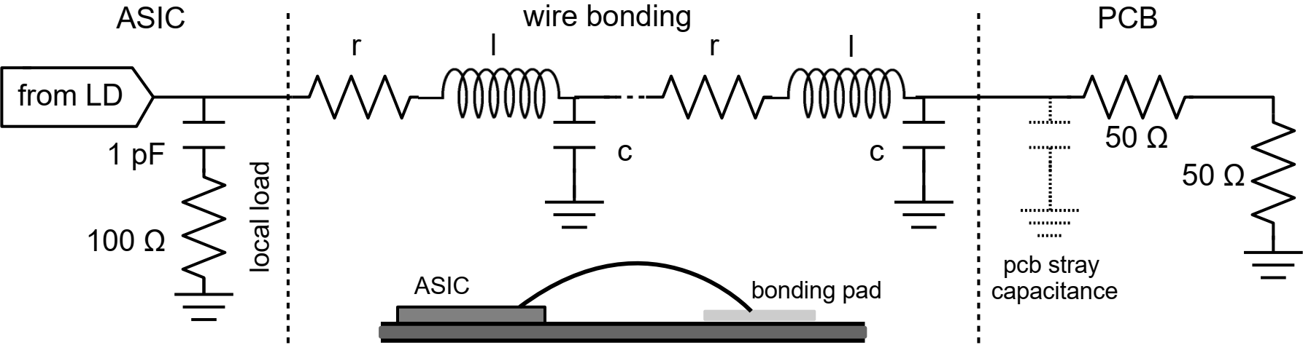
The Integrated CSP
Wire bond are transmission lines (r = 0.1 Ω mm⁻¹, l = 1 nH mm⁻¹, c = 0.1 pF mm⁻¹): they introduce high-frequency resonance on the line-driver loop gain
Local RC load reduce this high-frequency resonance
Decoupling capacitors near power pads prevent resonance on supply lines
G. Secci - Advances in X-ray and Gamma RAy DEtectors and applications (XGRADE 2026) 24-26/03/2026, Palermo

Slide 17
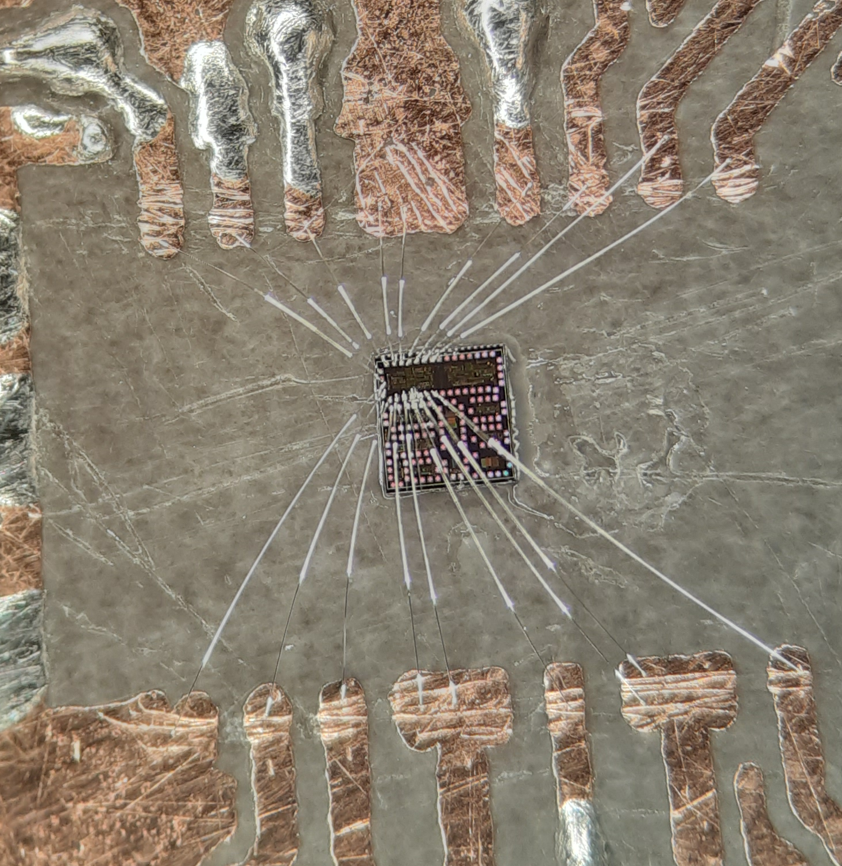
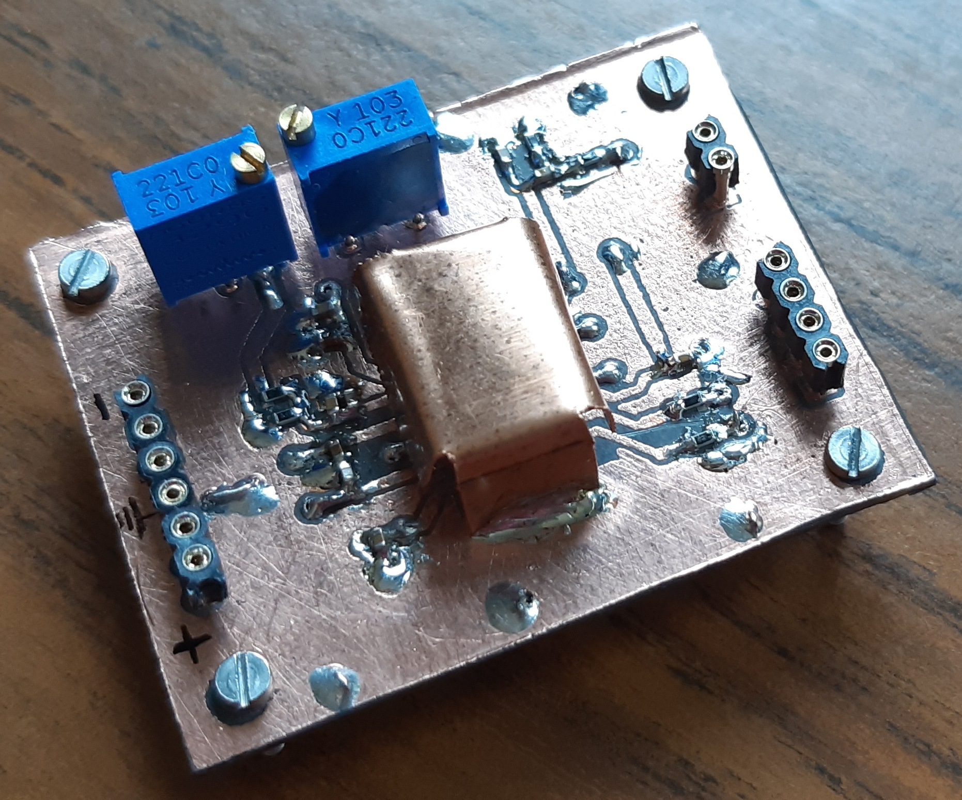
The Integrated CSP: Results
ASIC directly bonded on a test PCB featuring a PTFE substrate
900 µm x 475 µm area consumption
25.2 mW power consumption
21 MeV equivalent dynamic range
The detector capacitance was emulated by connecting a capacitor between the input-node and ground
Unfortunately, we do not yet have a fully operational detector available and disassembling one would be too risky.
G. Secci - Advances in X-ray and Gamma RAy DEtectors and applications (XGRADE 2026) 24-26/03/2026, Palermo

Slide 18
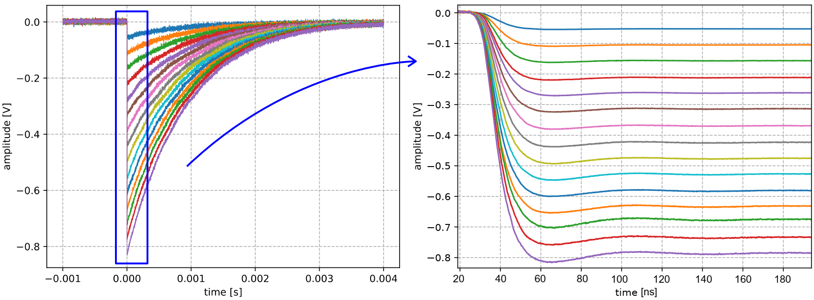
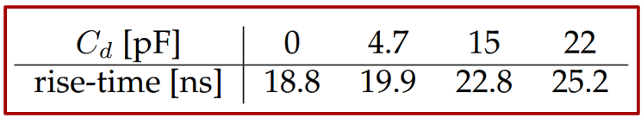
The Integrated CSP: Results
1 MeV-15 MeV range of interest for gamma spectroscopy experiments
22.8 ns rise time @ C_{d} = 15 pF
G. Secci - Advances in X-ray and Gamma RAy DEtectors and applications (XGRADE 2026) 24-26/03/2026, Palermo

Slide 19
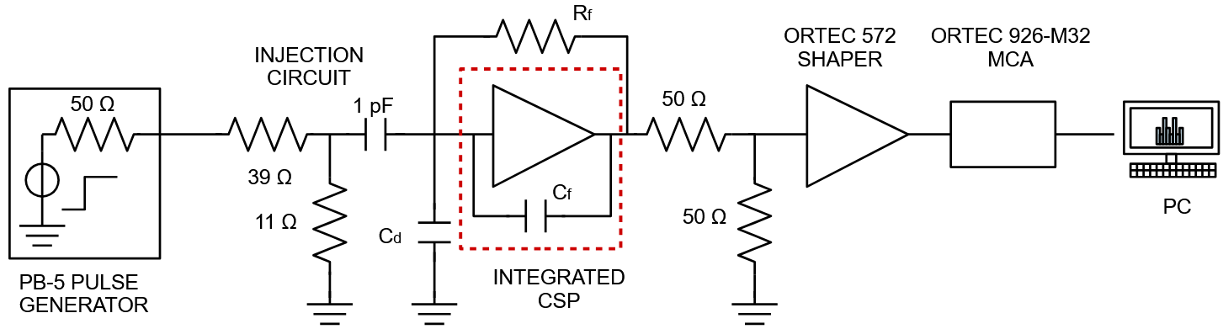
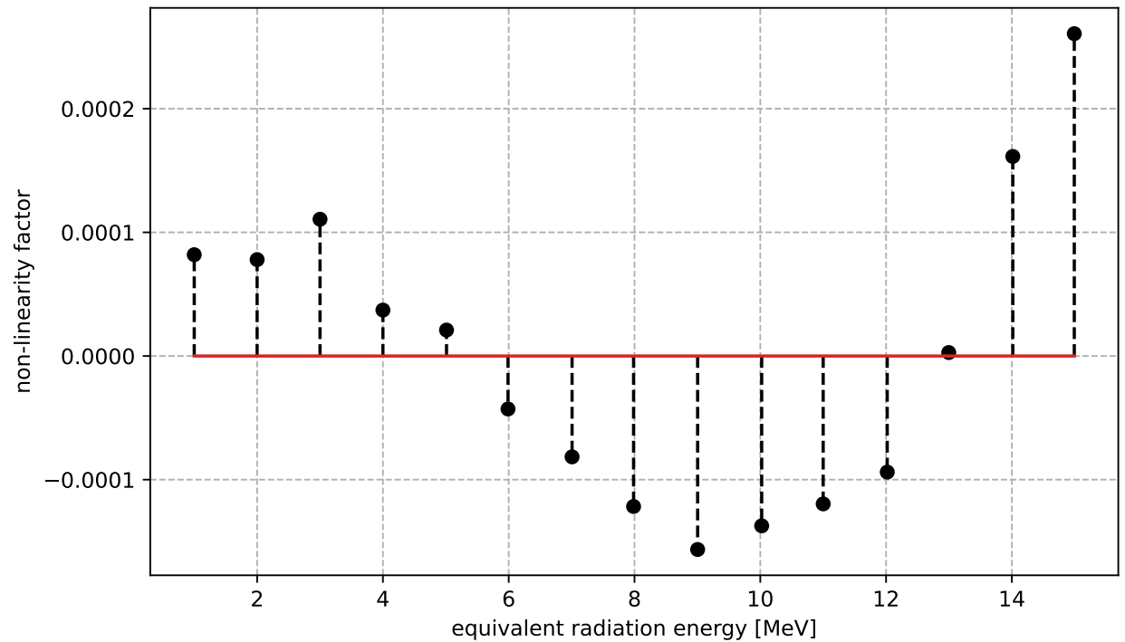
The Integrated CSP: Results
Non-linearity analysis: CSP + shaping amplifier (ORTEC 572) + multi-channel analyzer
Integral non-linearity factor < 0.3‰ on the 15 MeV equivalent dynamic range
G. Secci - Advances in X-ray and Gamma RAy DEtectors and applications (XGRADE 2026) 24-26/03/2026, Palermo

Slide 20
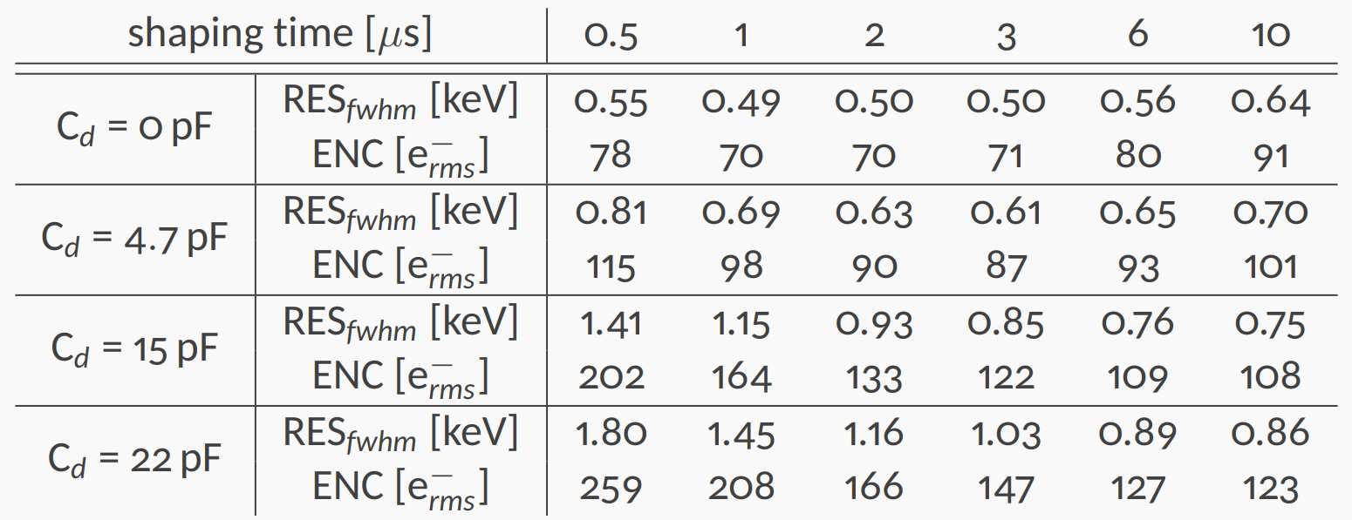


The Integrated CSP: Results
Noise analysis: pulser + CSP + shaping amplifier (ORTEC 572)
Equivalent Noise Charge (ENC):
$$V_{signal}/V_{noise\left(rms\right)}=Q_{injected}/ENC$$
FWHM Resolution:
${RES}_{FWHM}={2.355∙(E}_{injected}/Q_{injected}$) $∙ENC$
Fano statistic limit: 209 e−_{rms} (@ 1 MeV)
G. Secci - Advances in X-ray and Gamma RAy DEtectors and applications (XGRADE 2026) 24-26/03/2026, Palermo

Slide 21
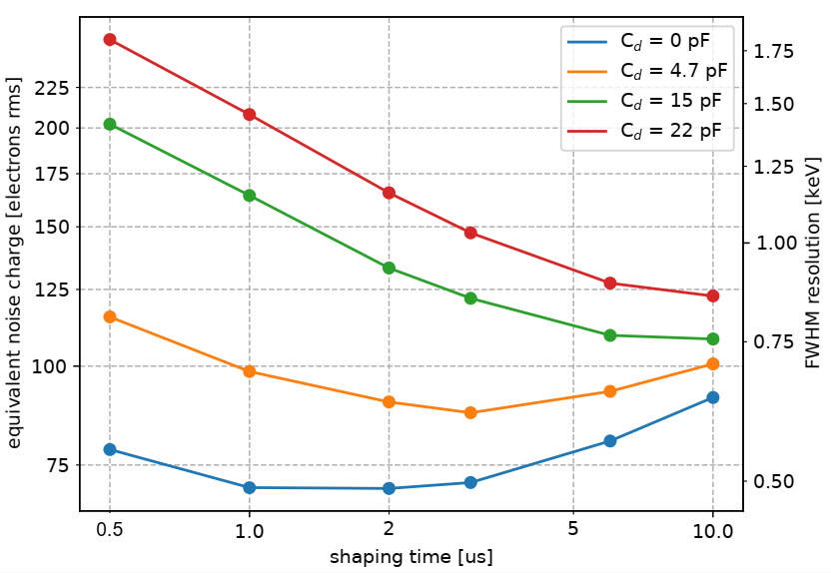
The Integrated CSP: Results
Noise analysis: pulser + CSP + shaping amplifier (ORTEC 572)
Fano statistic limit: 209 e−_{rms} (@ 1 MeV)
G. Secci - Advances in X-ray and Gamma RAy DEtectors and applications (XGRADE 2026) 24-26/03/2026, Palermo

Slide 22
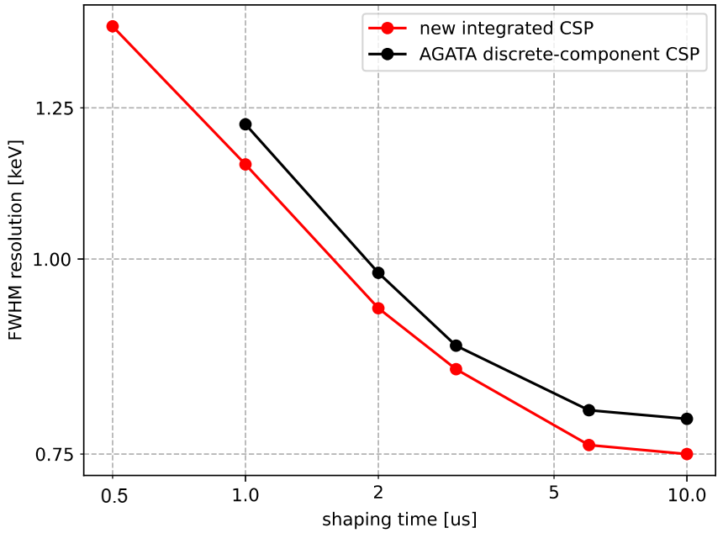
The Integrated CSP: Results
Noise analysis: comparison with state-of-the art discrete-component CSPs
Fano statistic limit: 1.46 keV FWHM @ 1 MeV
G. Secci - Advances in X-ray and Gamma RAy DEtectors and applications (XGRADE 2026) 24-26/03/2026, Palermo

Slide 23
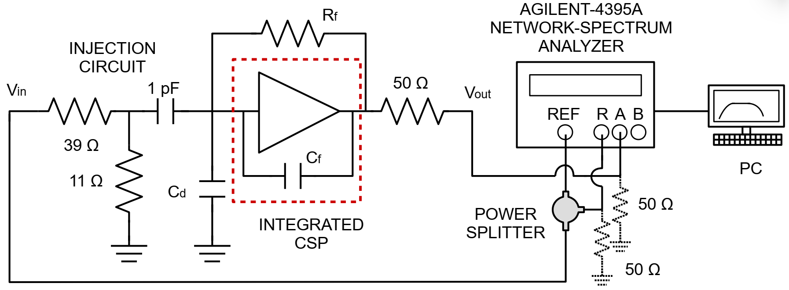
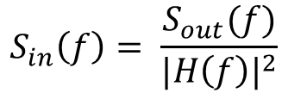
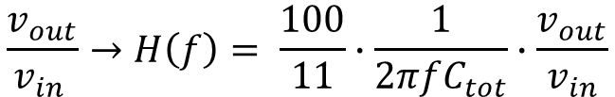
The Integrated CSP: Results
Noise power spectral density analysis
$$\frac{v_{out}}{v_{in }}→H\left(f\right)= \frac{100}{11}∙\frac{1}{2πfC_{tot}}∙\frac{v_{out}}{v_{in}}$$
Frequency by frequency measurement of
Frequency by frequency measurement of the output spectral density of noise: S_{out}(f)
$$S_{in}\left(f\right)= \frac{S_{out}(f)}{{|H\left(f\right)|}^{2}}$$
Input-referred power spectral density of noise:
G. Secci - Advances in X-ray and Gamma RAy DEtectors and applications (XGRADE 2026) 24-26/03/2026, Palermo

Slide 24
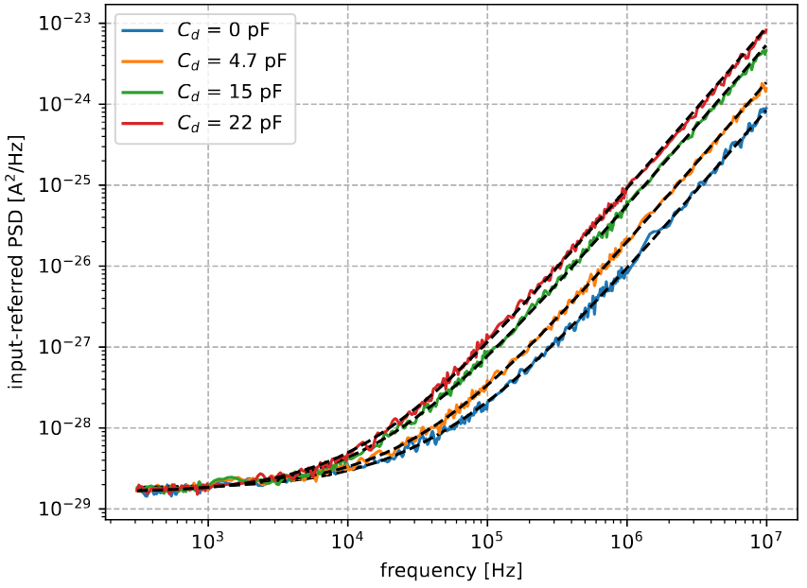




The Integrated CSP: Results
Noise power spectral density analysis for C_{d} = 0 pF, 4.7 pF, 15 pF, 22 pF
… from theory:
$$S_{in}\left(f\right)=a+bf+cf^{2}$$
$$a=4kT/R_{f}$$
$$b={(2πC_{tot})}^{2}A_{f}$$
$$c=4kTγ/g_{m}$$
… to reality:
G. Secci - Advances in X-ray and Gamma RAy DEtectors and applications (XGRADE 2026) 24-26/03/2026, Palermo

Slide 25
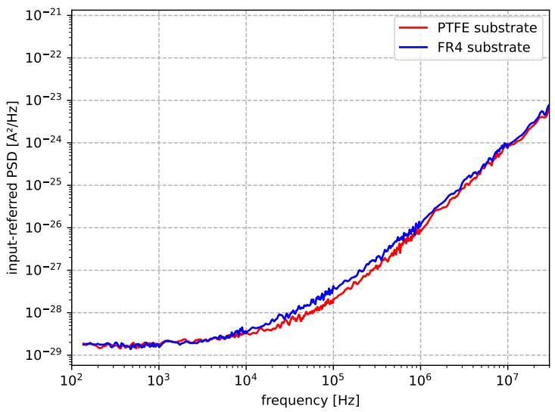
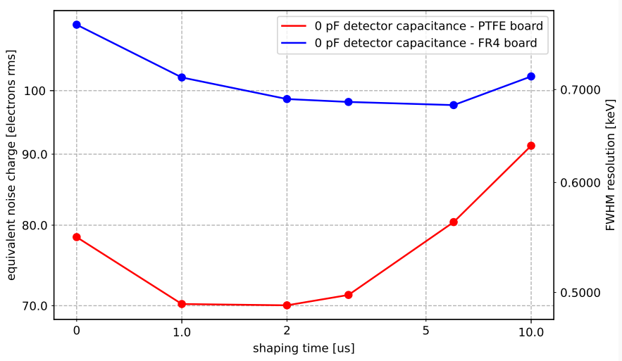
The Integrated CSP: Results
PCB substrate study: FR4 and PTFE boards compared under identical conditions at zero detector capacitance to isolate substrate noise
G. Secci - Advances in X-ray and Gamma RAy DEtectors and applications (XGRADE 2026) 24-26/03/2026, Palermo

Slide 26
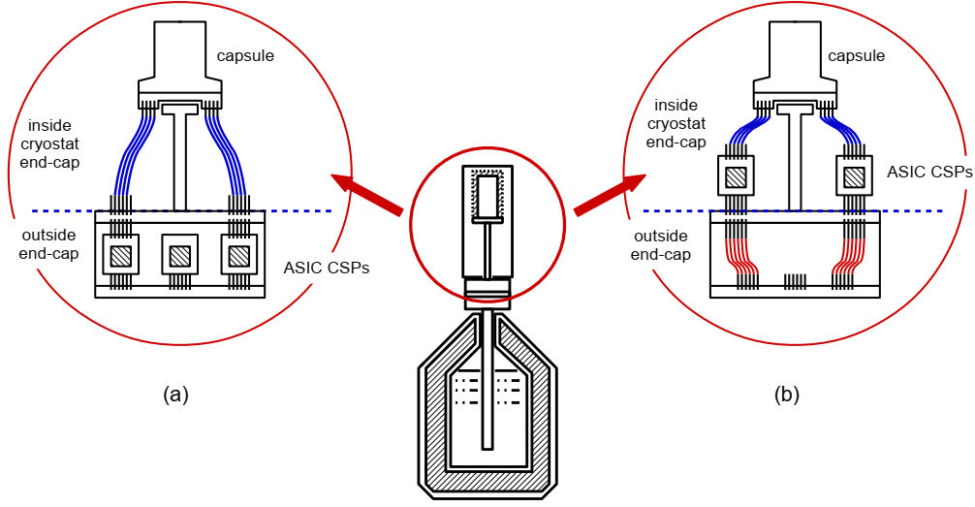
The Integrated CSP: Mounting Strategies
ASIC advantages: low power consumption and compact area enable alternative mounting strategies inside the cryostat
G. Secci - Advances in X-ray and Gamma RAy DEtectors and applications (XGRADE 2026) 24-26/03/2026, Palermo

Slide 27
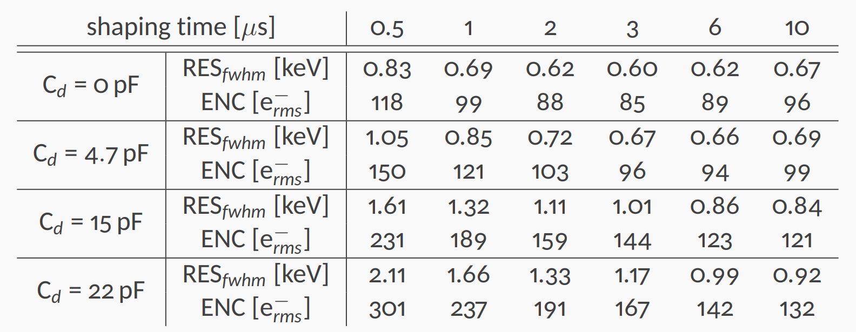
Read-Out of Electrons-Collecting Electrodes
Integrated charge sensitive preamplifiers for electrons-collecting electrodes
Experimental validation:
35 mW power consumption
21 MeV dynamic range
30 ns rise-time with Cd = 15 pF (stronger compensation)
0.3 ‰ integral non-linearity factor (15 MeV dynamic range)
G. Secci - Advances in X-ray and Gamma RAy DEtectors and applications (XGRADE 2026) 24-26/03/2026, Palermo

Slide 28
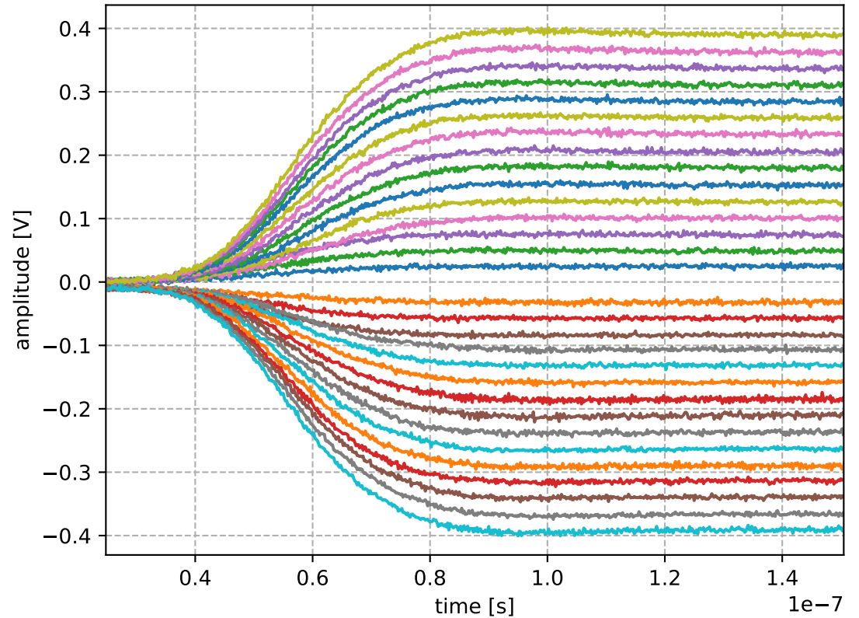
CSP with differential output
All preamplifiers are also available with differential output
G. Secci - Advances in X-ray and Gamma RAy DEtectors and applications (XGRADE 2026) 24-26/03/2026, Palermo

Slide 29
Conclusion
Next generation HPGe detectors introduce new challenges
New flexible PCBs were engineered to realize a robust connection while ensuring mechanical and thermal integrity
New ASIC CSPs were designed and successfully tested
The new circuit architecture has demonstrated high reliability, excellent linearity and very low noise.
G. Secci - Advances in X-ray and Gamma RAy DEtectors and applications (XGRADE 2026) 24-26/03/2026, Palermo

Slide 30

Thank You for
Your Attention !
giacomo.secci@mi.infn.it

