Slide 1

Walter Raniero
INFN Legnaro National Laboratory, Italy
walter.raniero@lnl.infn.it
Advances in HPGe detector tecnologies for next generation high resolution gamma spectroscopy
Advances in X-ray and Gamma RAy DEtectors and applications (XGRADE 2026)
24-26/03/2026, Palermo

Slide 2

Outline
HPGe gamma detectors
PLM (Pulse Laser Melting): Next generation of contact on HPGe detectors
PLM and Photolitography on Planar and Coxial HPGe segmented detectors
Neutron damage in PLM planar HPGe segmented detectors
HPGe Double-Sided Strip Detector (DSSD)
W. Raniero - Advances in X-ray and Gamma RAy DEtectors and applications (XGRADE 2026) 24-26/03/2026, Palermo

Slide 3
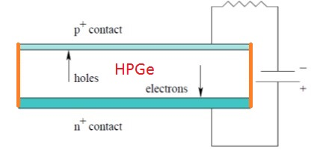
HPGe detector
B doped = 0.3 µm (implantation)
HPGe
Charge carrier density: 10¹⁰ cm⁻³
Surface passivation:
HPGe planar detector
Li doped = 0.9 mm (diffusion)
Diameter: 40mm
Height: 20mm
W. Raniero - Advances in X-ray and Gamma RAy DEtectors and applications (XGRADE 2026) 24-26/03/2026, Palermo

Slide 4
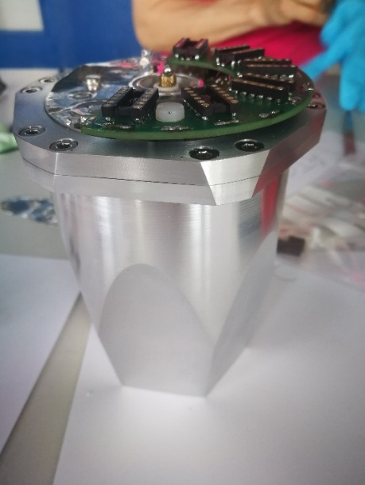
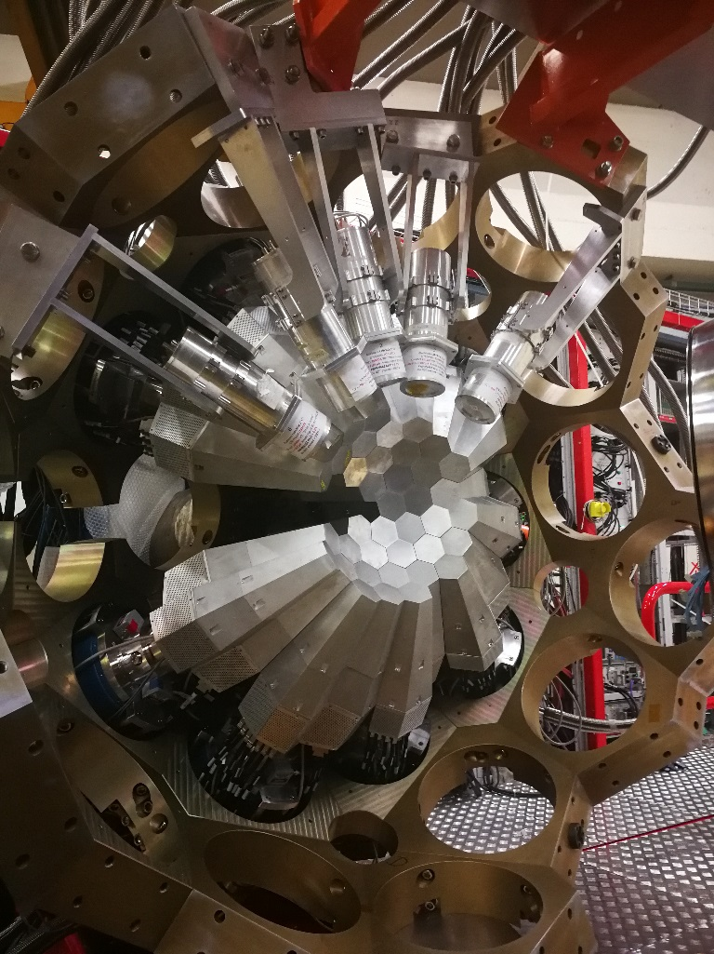
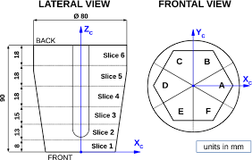
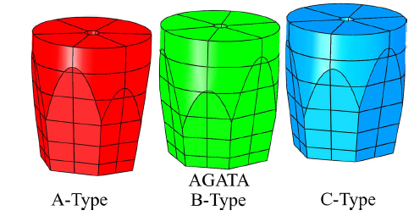
HPGe detector state of the art: AGATA
ATC (AGATA triple cluster detector)
Installation at LNL-INFN
2Kg weight
80 mm diameter
90mm long
1 core inner contact
36 segments
3 asymmetrical HPGe detector
J.J Valiente al. NIM Phys. Res. A (2023) 1049
J. Eberth et al. Eur. Phys. J. A (2023) 59: 179
W. Raniero - Advances in X-ray and Gamma RAy DEtectors and applications (XGRADE 2026) 24-26/03/2026, Palermo

Slide 5

n-type detector «AGATA»
The boron junction is thin, and easily segmentable
n⁺(Li) [V-]
n-type HPGe bulk
E
e
h
ϒ
Passivation
W. Raniero - Advances in X-ray and Gamma RAy DEtectors and applications (XGRADE 2026) 24-26/03/2026, Palermo

Slide 6
p-type detector « future AGATA»
n⁺(Sb)
n⁺ (Li)
Polarity inversion demanded to test higher damage resistivity (hole trapping by neutron damage)
p⁺(B) [V+]
The lithium junction is thick and not stable under annealing
treatments
E
p-HPGe
bulk
h
e
Thin and thermally stable n-type dopants (Pulsed Laser Melting).
ϒ
p-HPGe with segmentable n+ junction collecting electrons.
Passivation
W. Raniero - Advances in X-ray and Gamma RAy DEtectors and applications (XGRADE 2026) 24-26/03/2026, Palermo

Slide 7
Outline
HPGe gamma detectors
PLM (Pulse Laser Melting): Next generation of contact on HPGe detectors
PLM and Photolitography on Planar and Coxial HPGe segmented detectors
Neutron damage in PLM planar HPGe segmented detectors
HPGe Double-Sides Strip Detector (DSSD)
W. Raniero - Advances in X-ray and Gamma RAy DEtectors and applications (XGRADE 2026) 24-26/03/2026, Palermo

Slide 8
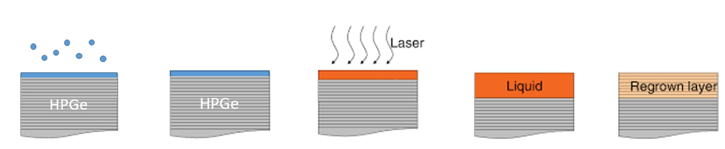
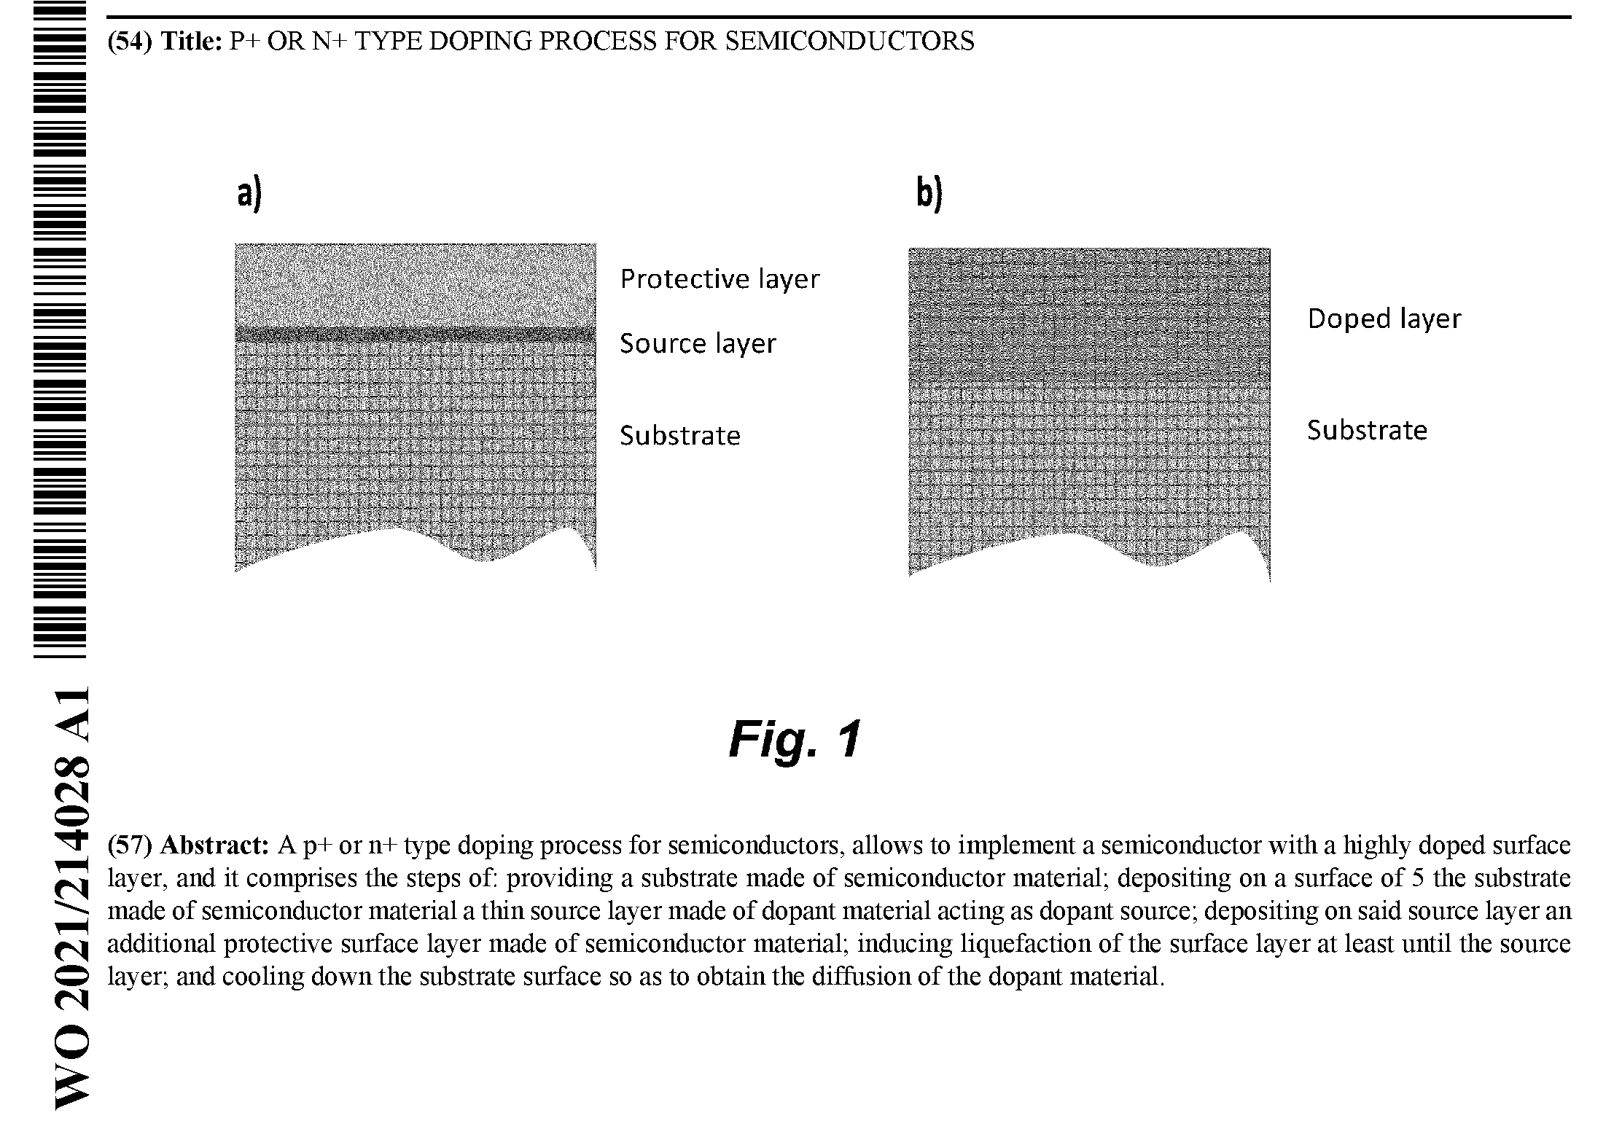
PLM (Pulse Laser Melting)
Deposition
Doping layer
pulse < 100ns
Doped layer
Melting temperature is reached - short time (<100 ns)
Only the surface (< 200 nm) is melted, the bulk is at Tamb
High dopant concentrations with very sharp dopant profile
Very clean process suitable for preserving the Ge hyperpurity
Suitable for complex contact geometries (segmentation)
Autors:
D. De Salvador, G. Maggioni, D. Napoli, E. Napolitani
W. Raniero - Advances in X-ray and Gamma RAy DEtectors and applications (XGRADE 2026) 24-26/03/2026, Palermo

Slide 9
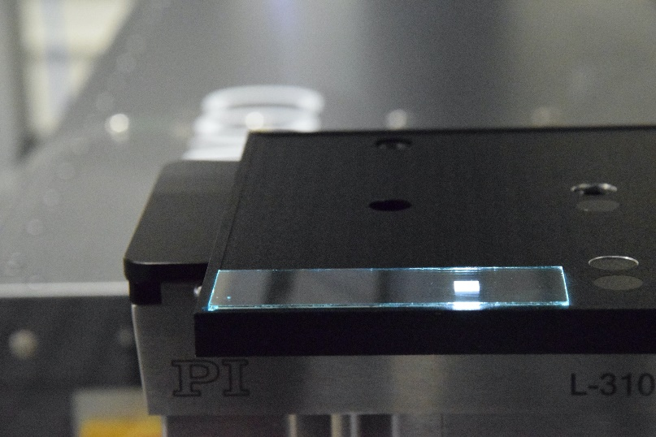
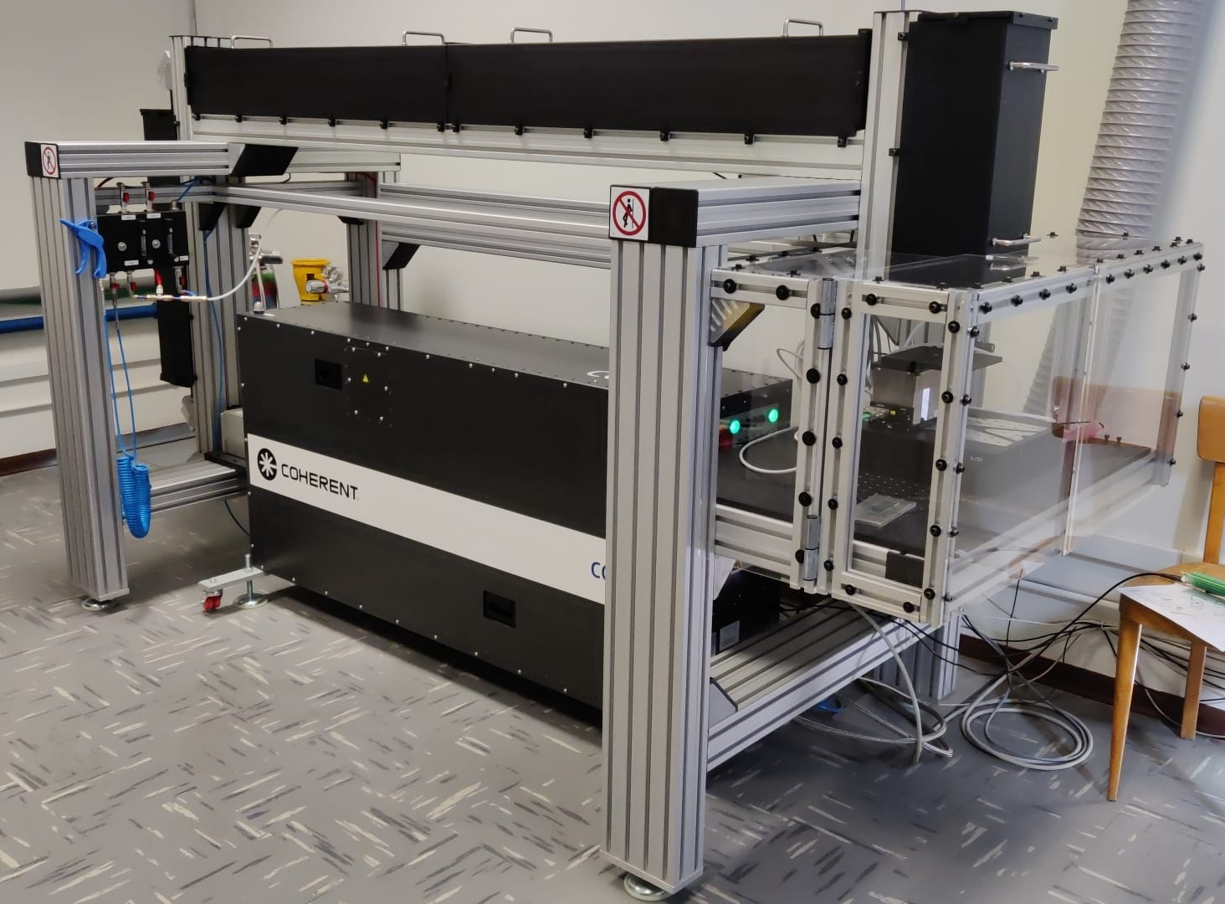

PLM laser Technology
Excimer KrF laser
𝜆=248 nm, 22 ns
Frequency: 1-10 Hz
ED= 50-1300 mJ/cm²
Square 5x5mm² spot
Homogeneity: < 2%
lateral resolution <30 µm
Motorized XYZ stage
5 mm
W. Raniero - Advances in X-ray and Gamma RAy DEtectors and applications (XGRADE 2026) 24-26/03/2026, Palermo
Notes:
KrF (Krypton Fluoride)

Slide 10
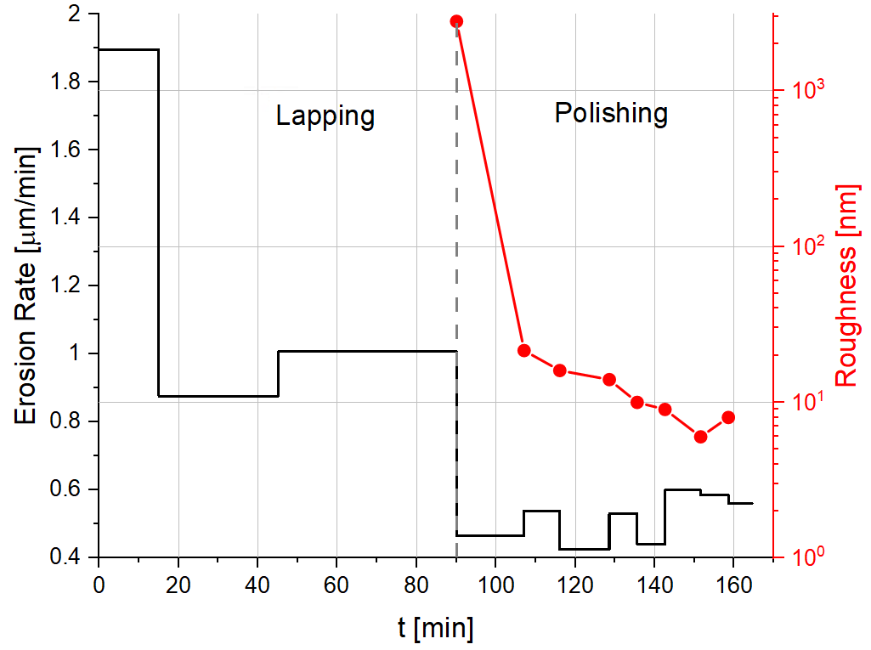
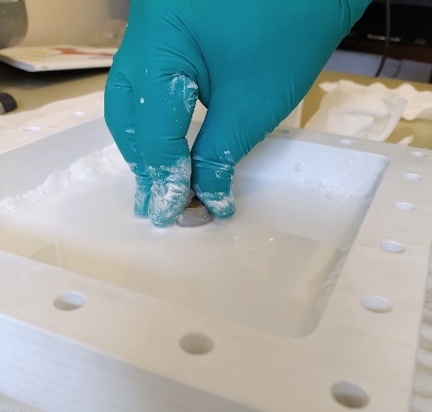
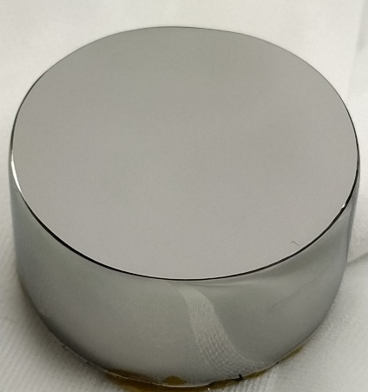
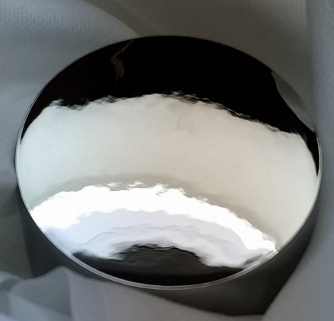
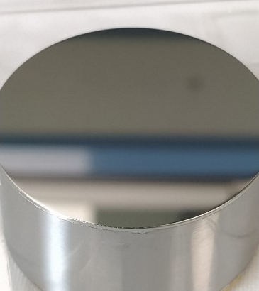
PLM on HPGe: Crystal preparation
Grinded surface
Grinding
Polishing
3 µm Al₂O₃ slurry
3 µm Al₂O₃ slurry
Etched surface
(High waviness,
low roughness)
Polished surface (CMP)
(Low waviness,
low roughness)
2025
rotating disc rinsed with H₂O₂ 1%
(pH 12 with KOH)
Rate: ≈200 nm/min
… + Colloidal Silica (30nm size)
Rate: ≈ 400 nm/min
W. Raniero - Advances in X-ray and Gamma RAy DEtectors and applications (XGRADE 2026) 24-26/03/2026, Palermo

Slide 11
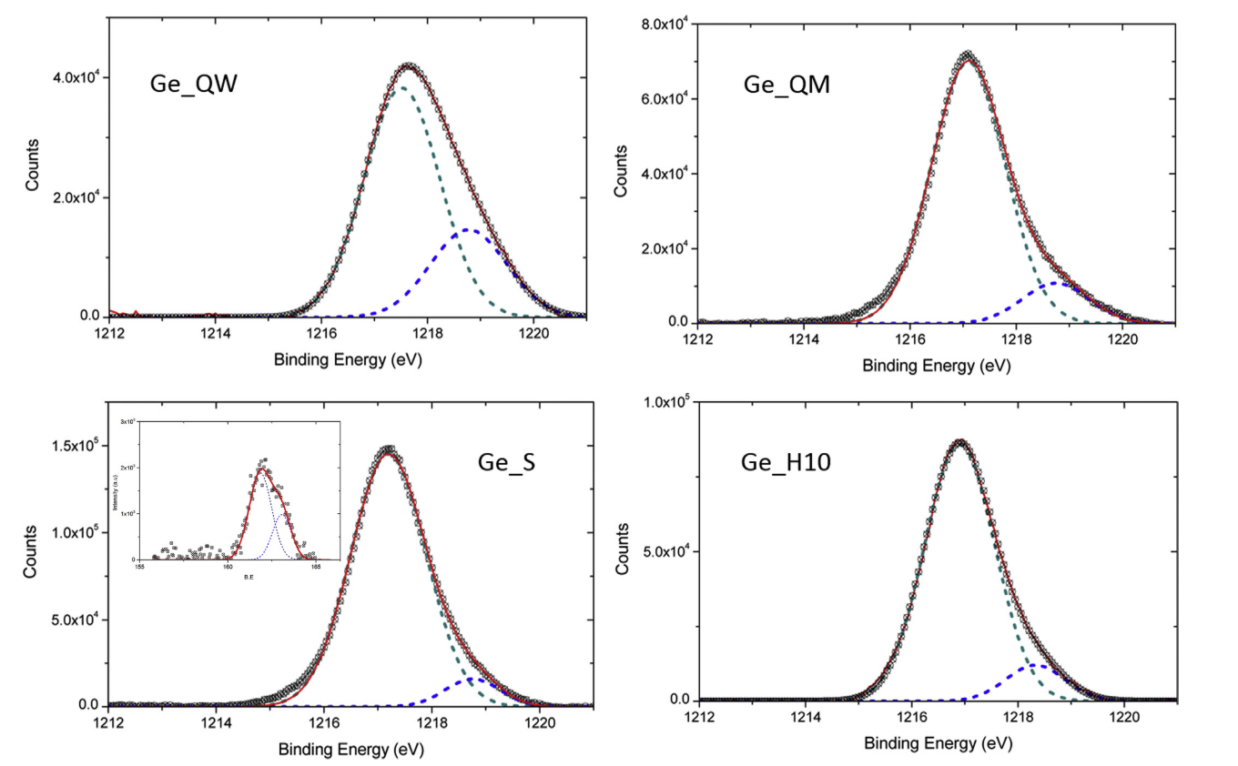
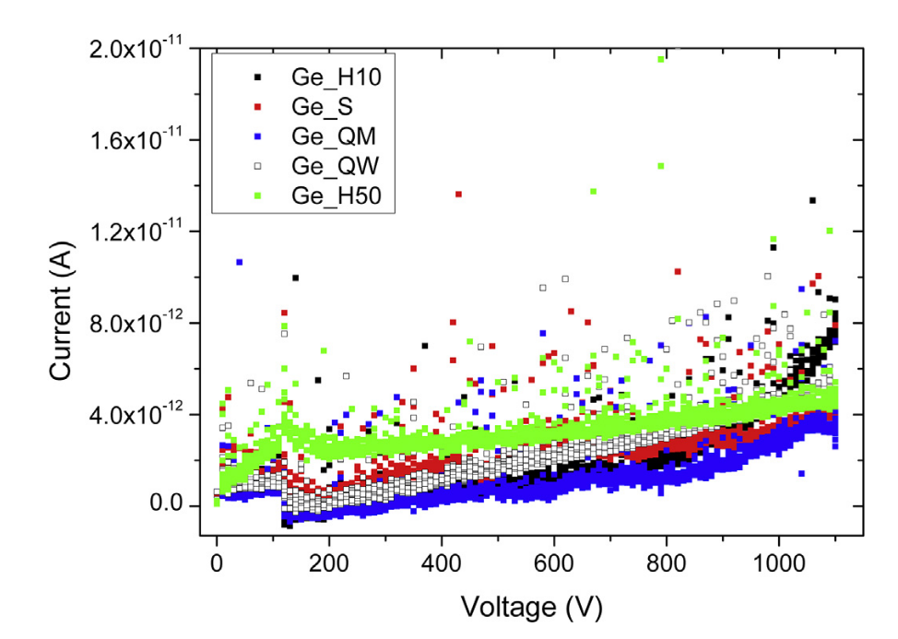
HPGe gamma detector (Passivation)
X-ray Photoelectron Spectroscopy (XPS)
Passivation techniques: study the evolution of Ge – GeO – GeO₂
I-V Curve (leakage current)
Crystal is depleted (reverse bias) Crystal at 80 ÷ 90K
Ge (2p)
GeO
HNO₃/HF (3:1) etching and quenching bath:
Water (Ge_W)
Methanol (Ge_QM)
Sulfide termination (Ge_S)
Hydride termination (Ge_H10)
National Laboratories of Legnaro (LNL)
University of Padua (UNIPD) & IKP Cologne
S. Carturan et al., Mater. Chem. Phys. 2015
W. Raniero - Advances in X-ray and Gamma RAy DEtectors and applications (XGRADE 2026) 24-26/03/2026, Palermo

Slide 12
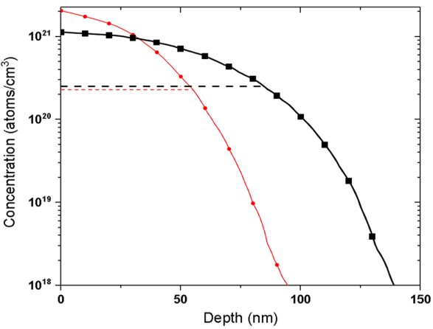
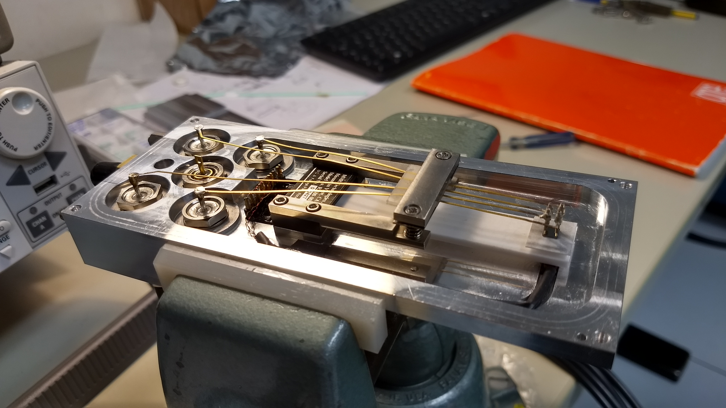
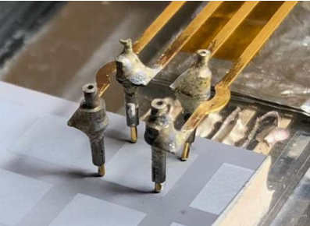
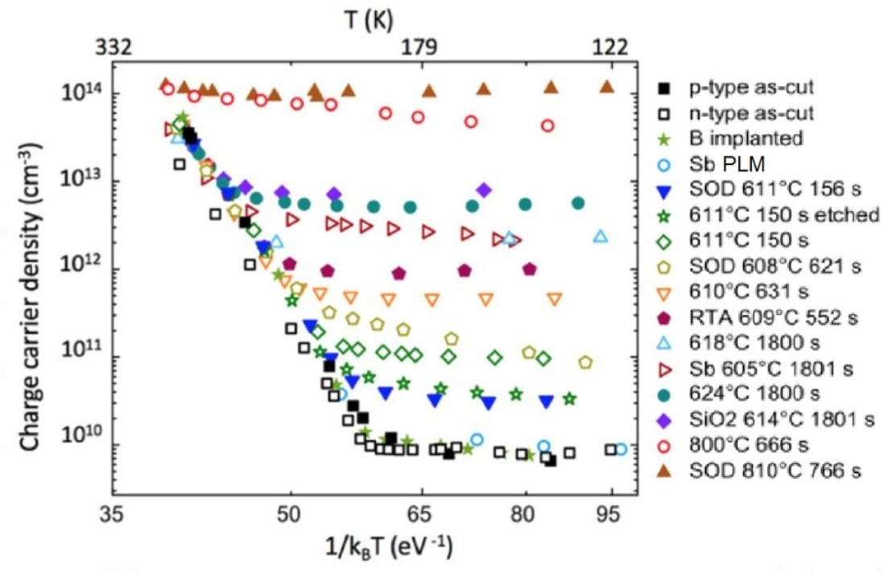
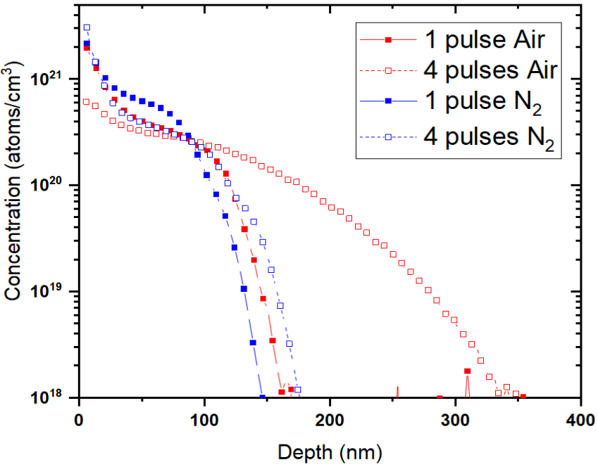
PLM on HPGe: material characterization
1 pulse
- - - 1 pls activation
4 pulses
- - - 4 pls activation
SIMS (Secondary
Ions Mass Spectrometry)
Van Der Pauw Hall
Sb
Impurities concentration in Ge bulk
Al
Narrow Contact
V. Boldrini et al., Journal of Physics D: Applied Physics (2018) volume 52, 3
W. Raniero - Advances in X-ray and Gamma RAy DEtectors and applications (XGRADE 2026) 24-26/03/2026, Palermo

Slide 13
Outline
HPGe gamma detectors
PLM (Pulse Laser Melting): Next generation of contact on HPGe detectors
PLM and Photolitography on Planar and Coxial HPGe segmented detectors
Neutron damage in PLM planar HPGe segmented detectors
HPGe Double-Sided Strip Detector (DSSD)
W. Raniero - Advances in X-ray and Gamma RAy DEtectors and applications (XGRADE 2026) 24-26/03/2026, Palermo

Slide 14
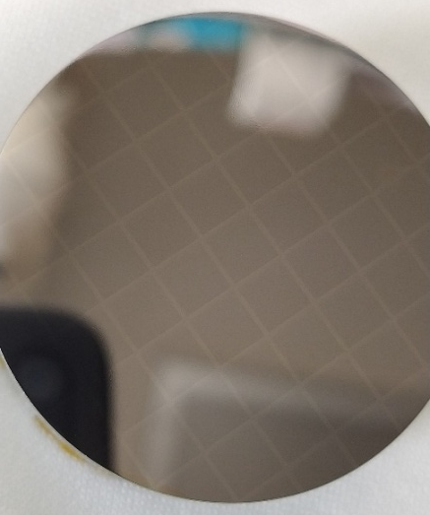
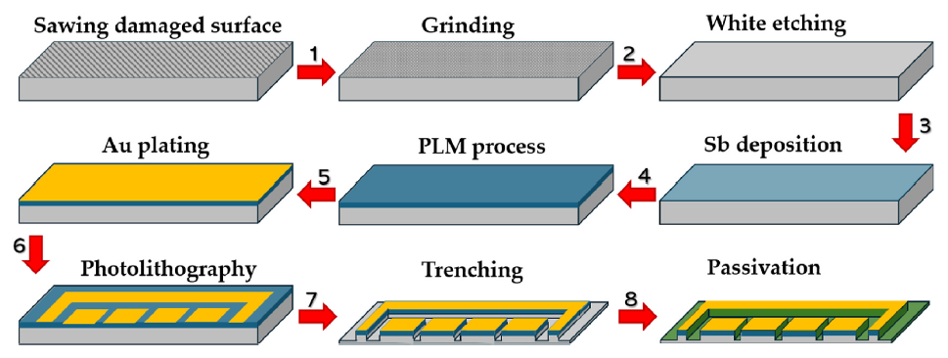
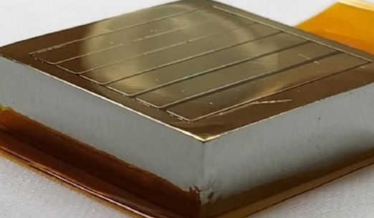
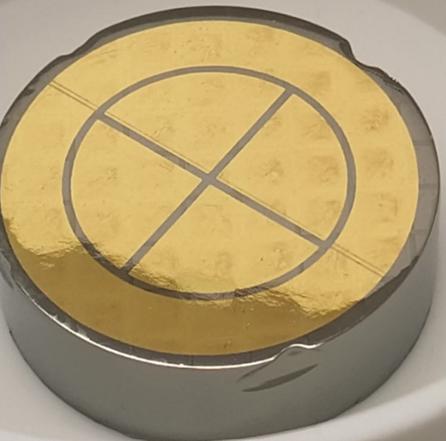
Photolitograpgy on 2D - PLM: 1° type Segmentation
Full area PLM
Au deposition
100 nm PVD deposition of Au in Ar plasma with ultrapure target in vacuum (10⁻⁶ mbar)
Photolithography
Photoresist deposition, baking, exposure and development, followed by Au stripping and resist removal.
Intercontact gaps passivation
(3:1) HNO₃ : HF etching followed by chemical quenching passivation.
W. Raniero - Advances in X-ray and Gamma RAy DEtectors and applications (XGRADE 2026) 24-26/03/2026, Palermo

Slide 15
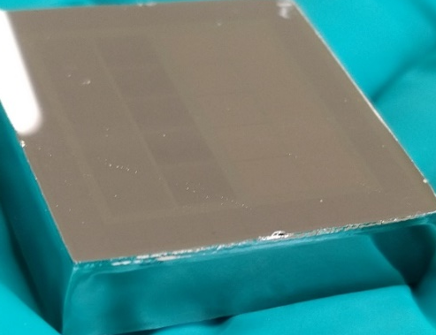
PLM contact: 2° type Segmentation
Lithographic process using selective etching solutions:
Hot pure H₂SO₄ for Sb deposition (preserve Sb junction)
H₂O₂ for GeP deposition (slowly etches everywhere)
Kern solutions (H₂O₂, H₃PO₄, Ethanol) for Al-Ge deposition (preserve Al junction)
Chemical passivation
Passivation of undoped surfaces with suitable solutions.
Selective etching
Removal of untreated dopant using selective etchants to protect the near junction.
W. Raniero - Advances in X-ray and Gamma RAy DEtectors and applications (XGRADE 2026) 24-26/03/2026, Palermo

Slide 16
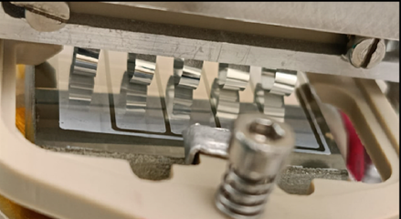
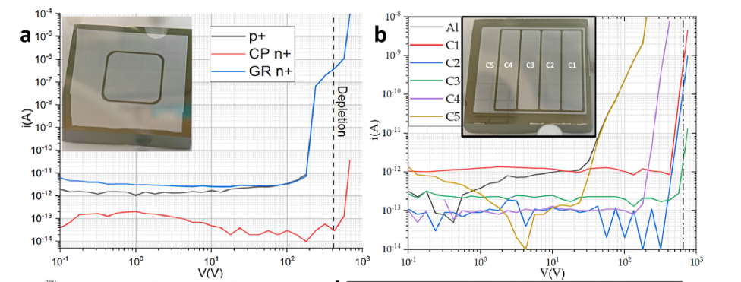
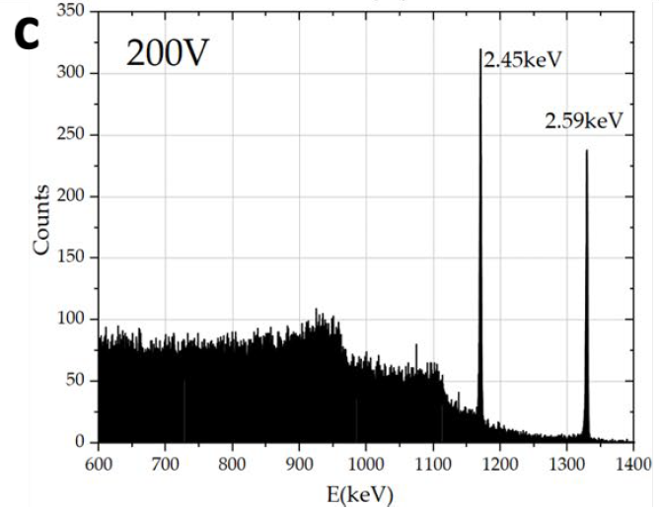
2D – Planar p-type PLM segmented detector
Soft contact + Al plated (segmented)
Sb/p-HPGE/Al,
N=6x10⁹ cm⁻³
L=28mm, t=10mm
Sb/p-HPGE/Al,
N=1.6x10¹⁰ cm⁻³ L=33mm, t=8.5mm
S. Bertoldo et al., MSSP(2025) volume 200
W. Raniero - Advances in X-ray and Gamma RAy DEtectors and applications (XGRADE 2026) 24-26/03/2026, Palermo

Slide 17
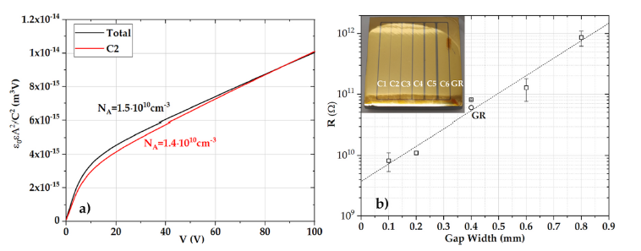
2D – Planar p-type PLM segmented detector
C-V test to estrapolate HPGe purity
R(Ω) segmentation gap (0.1 ÷ 0.8mm gap)
Sb/p-HPGE/Al, L=35mm, t=10mm
This confirms that the PLM process is highly safe against bulk contamination of HPGe material
W. Raniero - Advances in X-ray and Gamma RAy DEtectors and applications (XGRADE 2026) 24-26/03/2026, Palermo

Slide 18
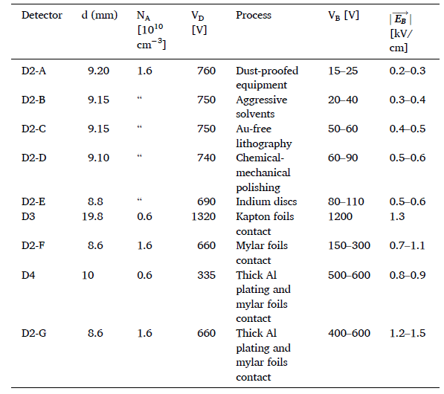
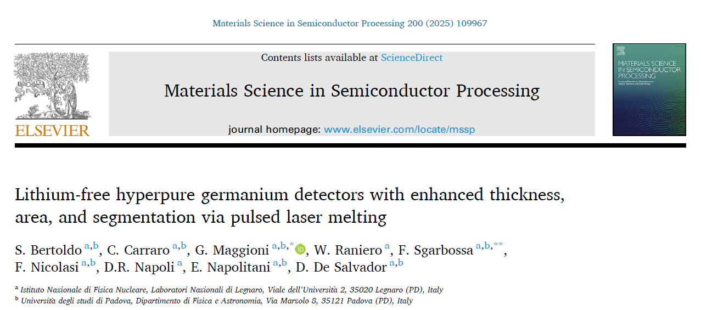
2D – Planar p-type PLM segmented detector
S. Bertoldo et al., MSSP(2025) volume 200
https://doi.org/10.1016/j.mssp.2025.109967
W. Raniero - Advances in X-ray and Gamma RAy DEtectors and applications (XGRADE 2026) 24-26/03/2026, Palermo

Slide 19
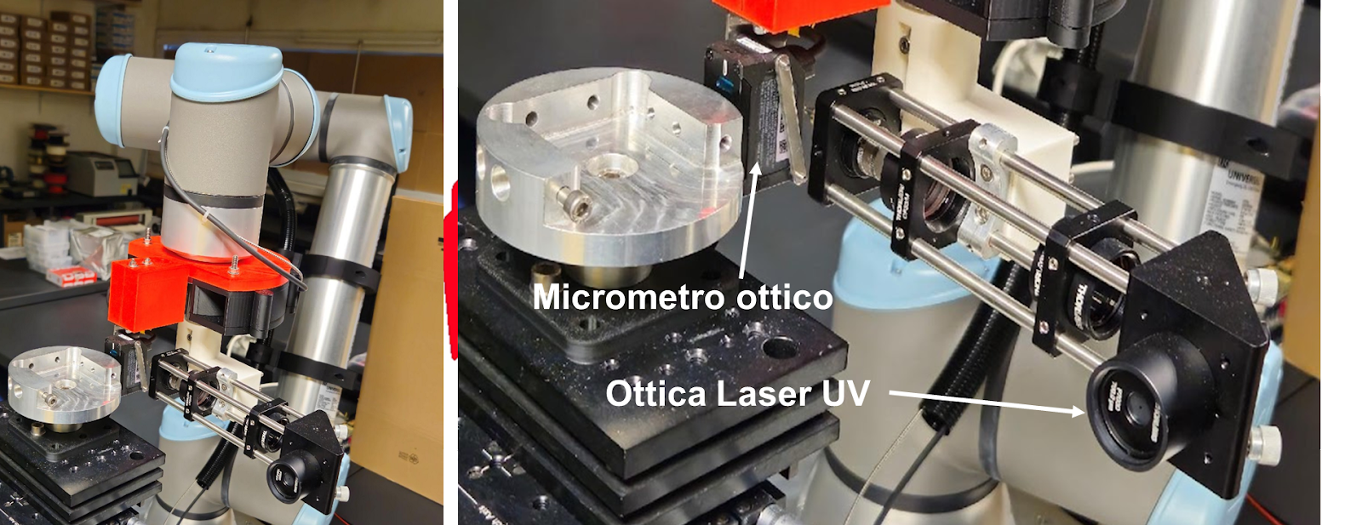
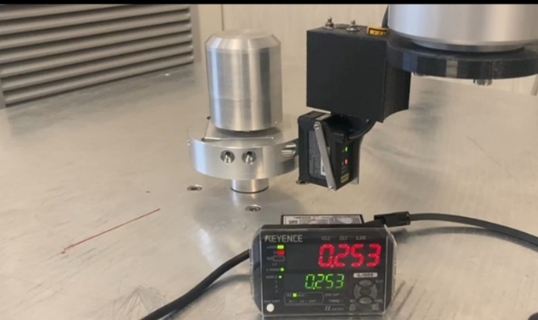

Photolitography on 3D – PLM detector
Scanning, reconstruction, and pattern
W. Raniero - Advances in X-ray and Gamma RAy DEtectors and applications (XGRADE 2026) 24-26/03/2026, Palermo

Slide 20
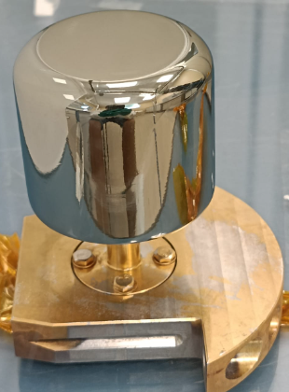
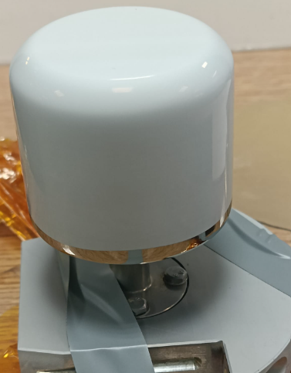
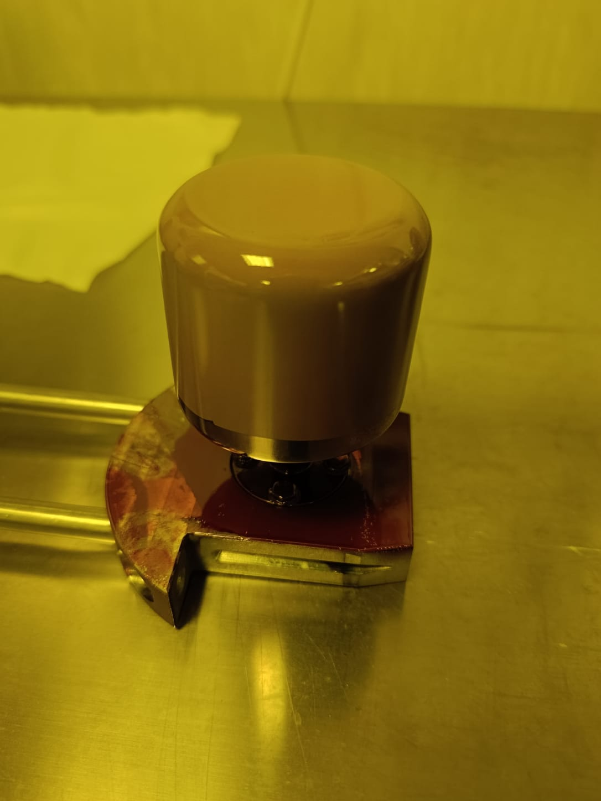
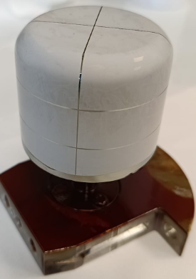
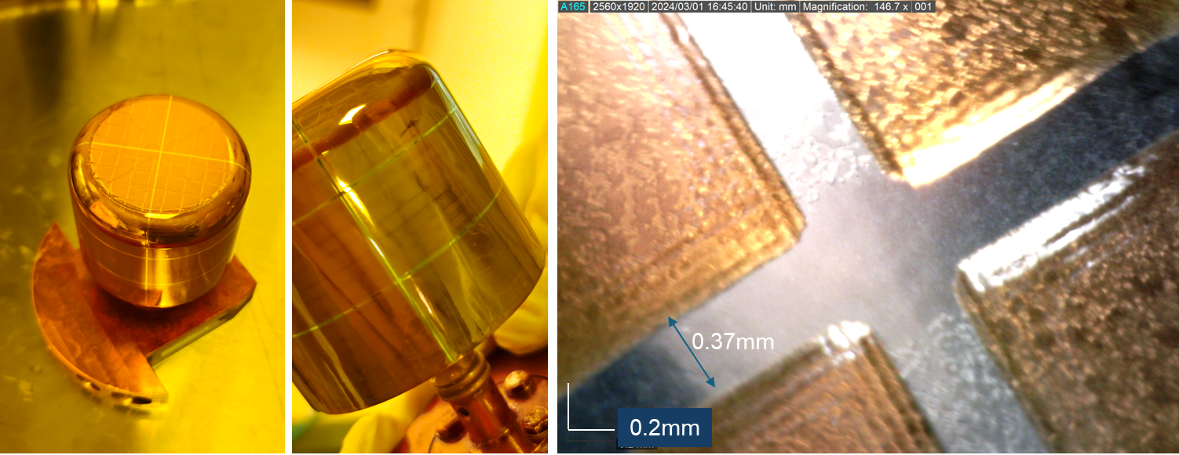
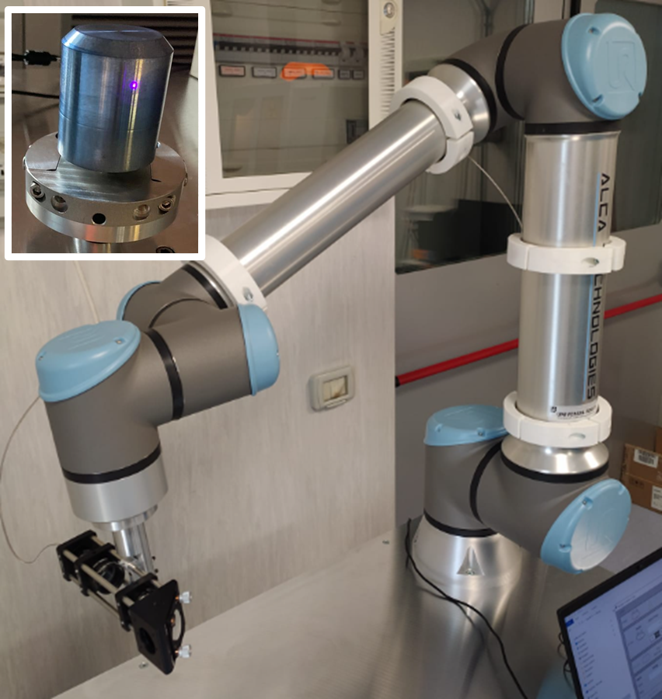
Photolitography on 3D – PLM detector
50mm d, 50mm h,
n-type crystal,
AlGe PLM junction, Li core
Al plated + photoresist spry coating
After photolithography
Al plated
W. Raniero - Advances in X-ray and Gamma RAy DEtectors and applications (XGRADE 2026) 24-26/03/2026, Palermo

Slide 21
Outline
HPGe gamma detectors
PLM (Pulse Laser Melting): Next generation of contact on HPGe detectors
PLM and Photolitography on Planar and Coxial HPGe segmented detectors
Neutron damage in PLM planar HPGe segmented detectors
HPGe Double-Sided Strip Detector (DSSD)
W. Raniero - Advances in X-ray and Gamma RAy DEtectors and applications (XGRADE 2026) 24-26/03/2026, Palermo

Slide 22
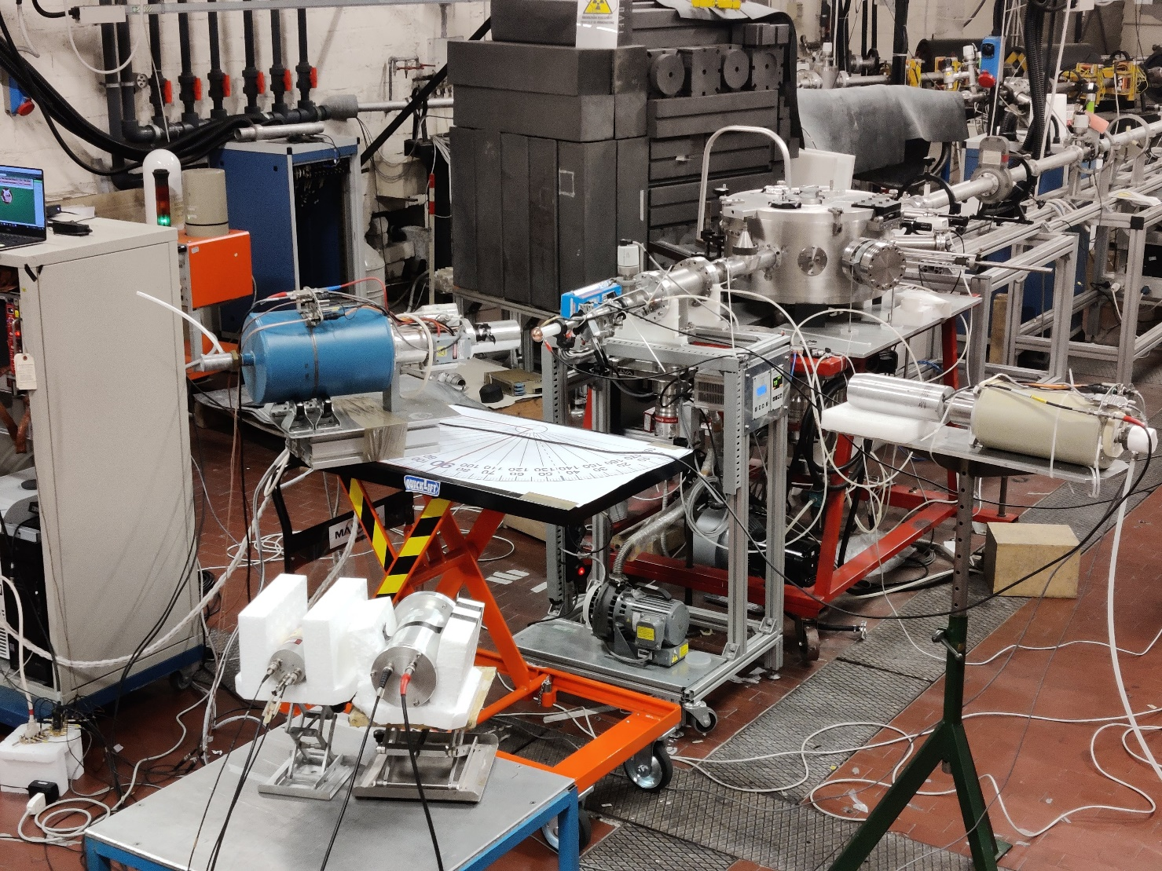
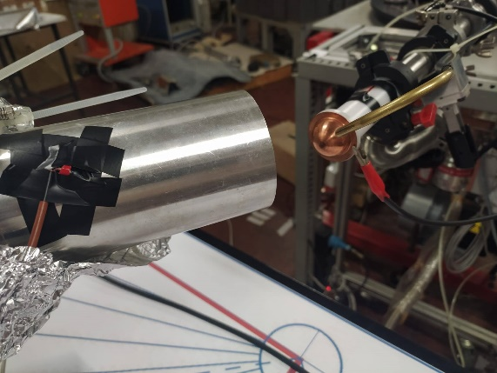

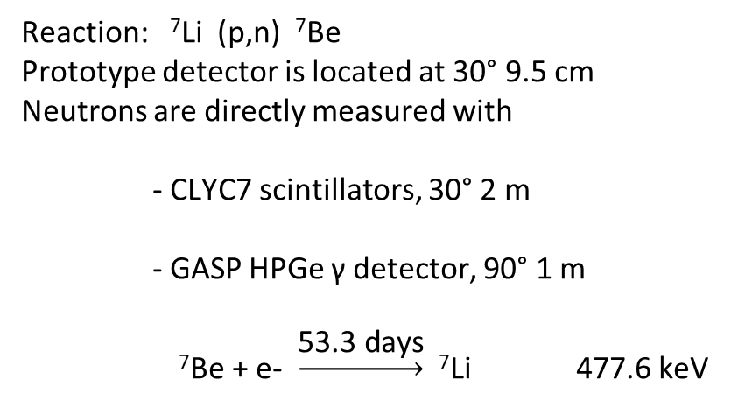
Neutrons damage on planar PLM segmented detector
380nA 4MeV proton beam
⁷Li target, 100µm
N3G Planar HPGe
Beam
Target
Reaction: ⁷Li (p,n) ⁷Be
Prototype detector is located at 30° 9.5 cm
Neutrons are directly measured with
- CLYC7 scintillators, 30° 2 m
- GASP HPGe γ detector, 90° 1 m
⁷Be + e- $\underset{→}{\text{5}\text{3.3 }\text{days}}$ ⁷Li 477.6 keV
HPGe GASP
CLYC7
R. Escudeiro at all. “Neutron radiation damage on a planar segmented germanium detector” proceeding Presented at the XXXVII Mazurian Lakes Conference on Physics, Piaski, Poland, September 3-9, 2023
W. Raniero - Advances in X-ray and Gamma RAy DEtectors and applications (XGRADE 2026) 24-26/03/2026, Palermo

Slide 23
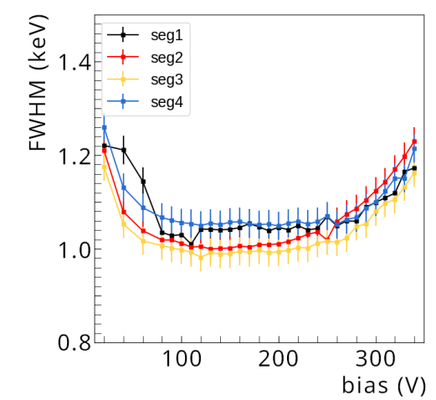
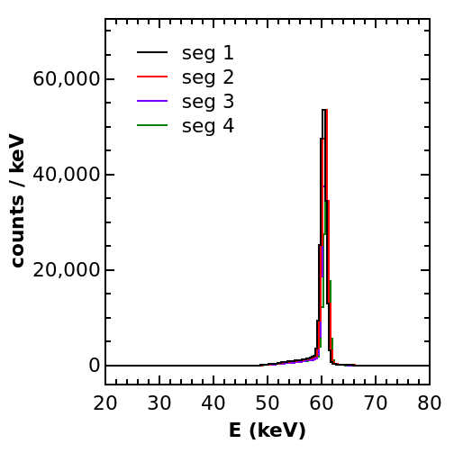
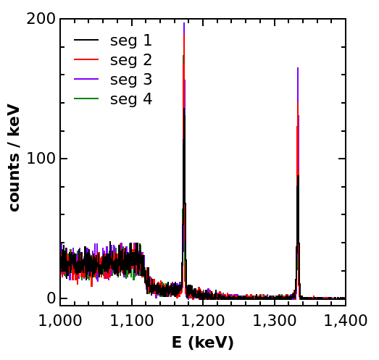
Neutrons damage on planar PLM segmented detector
Resolution at 80V operational bias before the neutron damage run
Detector prototype:
Sb/p-HPGE/Al, L= 32mm, t= 8.6mm
4 contacts + guard ring
²⁴¹Am
E = 59,5 keV
FWHM < 1,1 keV
⁶⁰Co
E = 1332 keV
FWHM < 1,8 keV
Energy resolution in the lab
²⁴¹Am
W. Raniero - Advances in X-ray and Gamma RAy DEtectors and applications (XGRADE 2026) 24-26/03/2026, Palermo

Slide 24
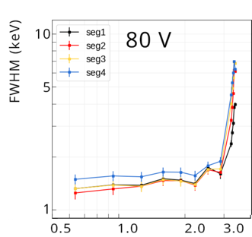
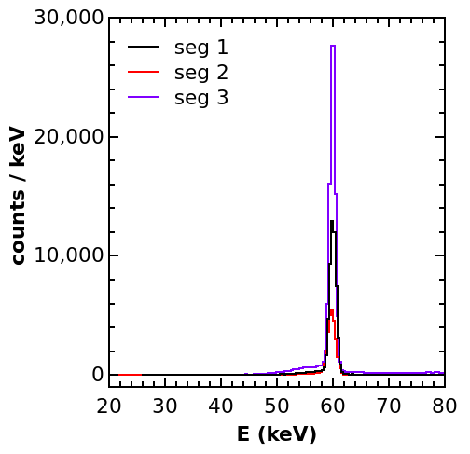
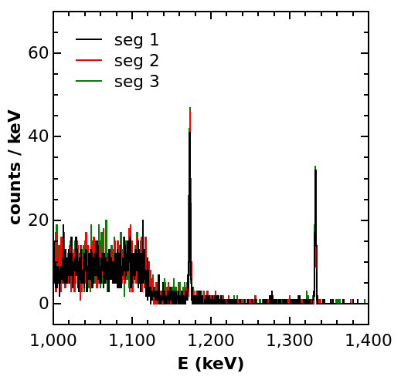
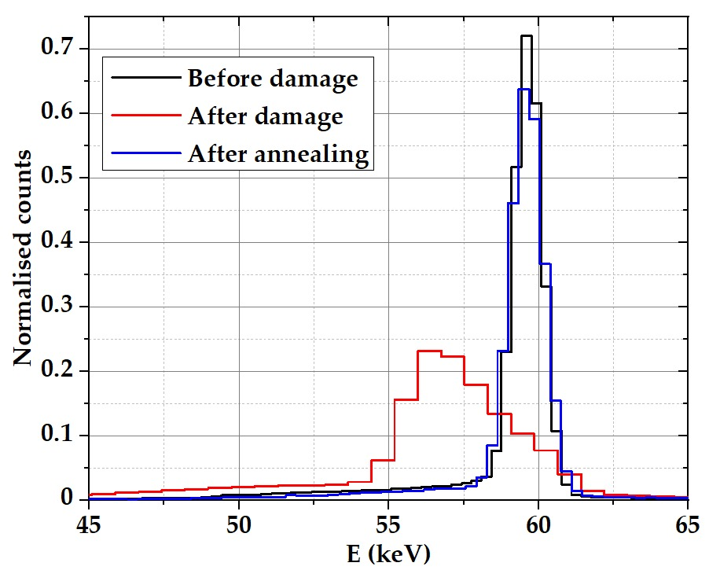
Neutrons damage on planar PLM segmented detector
Drastic drop in resolution after
≈ 3∙10⁹ neutrons/cm² irradiation fluence
Annealing procedure: 7 days at 105°C continuously pumped inside the cryostat
²⁴¹Am
E = 59,5 keV
FWHM < 1,6 keV
⁶⁰Co
E = 1332 keV
FWHM < 2 keV
²⁴¹Am
E = 59,5 keV
FWHM = 3,2 – 4,2 keV
W. Raniero - Advances in X-ray and Gamma RAy DEtectors and applications (XGRADE 2026) 24-26/03/2026, Palermo

Slide 25
Outline
HPGe gamma detectors
PLM (Pulse Laser Melting): Next generation of contact on HPGe detectors
PLM and Photolitography on Planar and Coxial HPGe segmented detectors
Neutron damage in PLM planar HPGe segmented detectors
HPGe Double-Sided Strip Detector (DSSD)
W. Raniero - Advances in X-ray and Gamma RAy DEtectors and applications (XGRADE 2026) 24-26/03/2026, Palermo

Slide 26





HPGe Double-Sided Strip detector (DSSD)
HRIS (high resolution imager and spectrometer for space astronomy)
PI: N. Auricchio
LAUE lens telescope
Radioactive ion beams (RIB) enable exploration of nuclei far from stability, with high‑energy ions implanted into an active stopper in in‑flight decay‑spectroscopy experiments. Use HPGe as an active stopper in decay-spectroscopy
PI: S. Capra
Cadmium Zinc Telluride (CZT)
HPGe n-type: high resolution, position sensitive detector
Silicon DSSSD detector
HPGe n-type DSSD detector:
Rad-hard detector,
efficiency for detecting beta-decay electrons
W. Raniero - Advances in X-ray and Gamma RAy DEtectors and applications (XGRADE 2026) 24-26/03/2026, Palermo

Slide 27



HPGe p-type Double-Sided Strip detector (DSSD)
6 top Al/Ge PLM P+
2026
Thin 2mm prototype detector
Cross-section:
Al
Sb-n+ junction
p-type HPGe
Al/Ge p+
Al
6 bottom Sb PLM N+
W. Raniero - Advances in X-ray and Gamma RAy DEtectors and applications (XGRADE 2026) 24-26/03/2026, Palermo

Slide 28




HPGe p-type Double-Sided Strip detector (DSSD)
2026
Single diode with continuous junctions and metalization
Photoresit and bake on both sides
Exposure and development
Trenching and resist removal
W. Raniero - Advances in X-ray and Gamma RAy DEtectors and applications (XGRADE 2026) 24-26/03/2026, Palermo

Slide 29



HPGe p-type Double-Sided Strip detector (DSSD)
2026
C-V Test
I-V Test (Al side)
I-V Test (Sb side)
W. Raniero - Advances in X-ray and Gamma RAy DEtectors and applications (XGRADE 2026) 24-26/03/2026, Palermo

Slide 30
Summury
The research carried out on PLM contacts has produced promising results:
PLM n+/p+ contacts technology preserve hyperpurity of HPGe crystal
PLM n+/p+ contacts are rad-hard on neutron damage (annealing recovery)
PLM n+/p+ contacts are thermally stable, narrow with high dopant concentration profile
PLM n+/p+ contacts are thinner (150÷250nm) enabling for segmented HPGe detectors; this technology could be valuable for developing new types of detectors, such as DSSD planar devices for nuclear or astrophysics application.
ò
W. Raniero - Advances in X-ray and Gamma RAy DEtectors and applications (XGRADE 2026) 24-26/03/2026, Palermo

Slide 31






















R&D Gamma ray detector Team
Davide De Salvador
Stefano Bertoldo
Enrico Napolitani
Francesco Sgarbossa
Chiara Carraro
Sara Carturan
Gianluigi Maggioni
Francesco Recchia
Dino Bazzacco
Filippo Nicolasi
Walter Raniero
Daniel Napoli
Stefano Capra
Giacomo Secci
Alberto Pullia
Bénédicte Million
Luciano Manara
Andrea Mazzolari
Lorenzo Malagutti
Andres Gadea
W. Raniero - Advances in X-ray and Gamma RAy DEtectors and applications (XGRADE 2026) 24-26/03/2026, Palermo

Slide 32

Thanks for
your Attention !
walter.raniero@lnl.infn.it

Slide 34




2D – Planar PLM segmented detector : I-V test
n+ junction
(spring contact)
V_{depl.} : 1300V
Sb/p-HPGE/Al,
N=1.6x10¹⁰ cm⁻³ L=35mm, t=10mm
n+ junction (!) / (!)(!)
(indium pad)
Contact force
Breakdown Voltage
n+ junction (!)(!)(!)
(elastic tabs)
Sb/p-HPGE/Al,
N=6x10⁹ cm⁻³ D=40mm, t=20mm
W. Raniero - Advances in X-ray and Gamma RAy DEtectors and applications (XGRADE 2026) 24-26/03/2026, Palermo

Slide 35

Neutrons damage on planar PLM segmented detector
Operational Voltage 80-120-160V
Neutron irradiation for 20 and 2 min to 5 min runs with ²⁴¹Am to better characterize resolution worsening
Drastic drop in resolution after
≈ 3∙10⁹ neutrons/cm² irradiation fluence
²⁴¹Am
E = 59,5 keV
FWHM = < 2 keV until threshold
W. Raniero - Advances in X-ray and Gamma RAy DEtectors and applications (XGRADE 2026) 24-26/03/2026, Palermo

Slide 36

PLM laser Technology
Laser beam
Rotor
2D - Planar detector
Rotor
3D - Coaxial detector
Z-axis
Z-axis
XY-axes
W. Raniero - Advances in X-ray and Gamma RAy DEtectors and applications (XGRADE 2026) 24-26/03/2026, Palermo

