Slide 1

Edoardo Borciani
INAF-OAS Bologna
SWIPE :​
SOFT-X AND GAMMA-RAY WIDE-FIELD POLARIMETER EXPLORER
Advances in X-ray and Gamma RAy DEtectors and applications (XGRADE 2026)
24-26/03/2026, Palermo

Slide 2

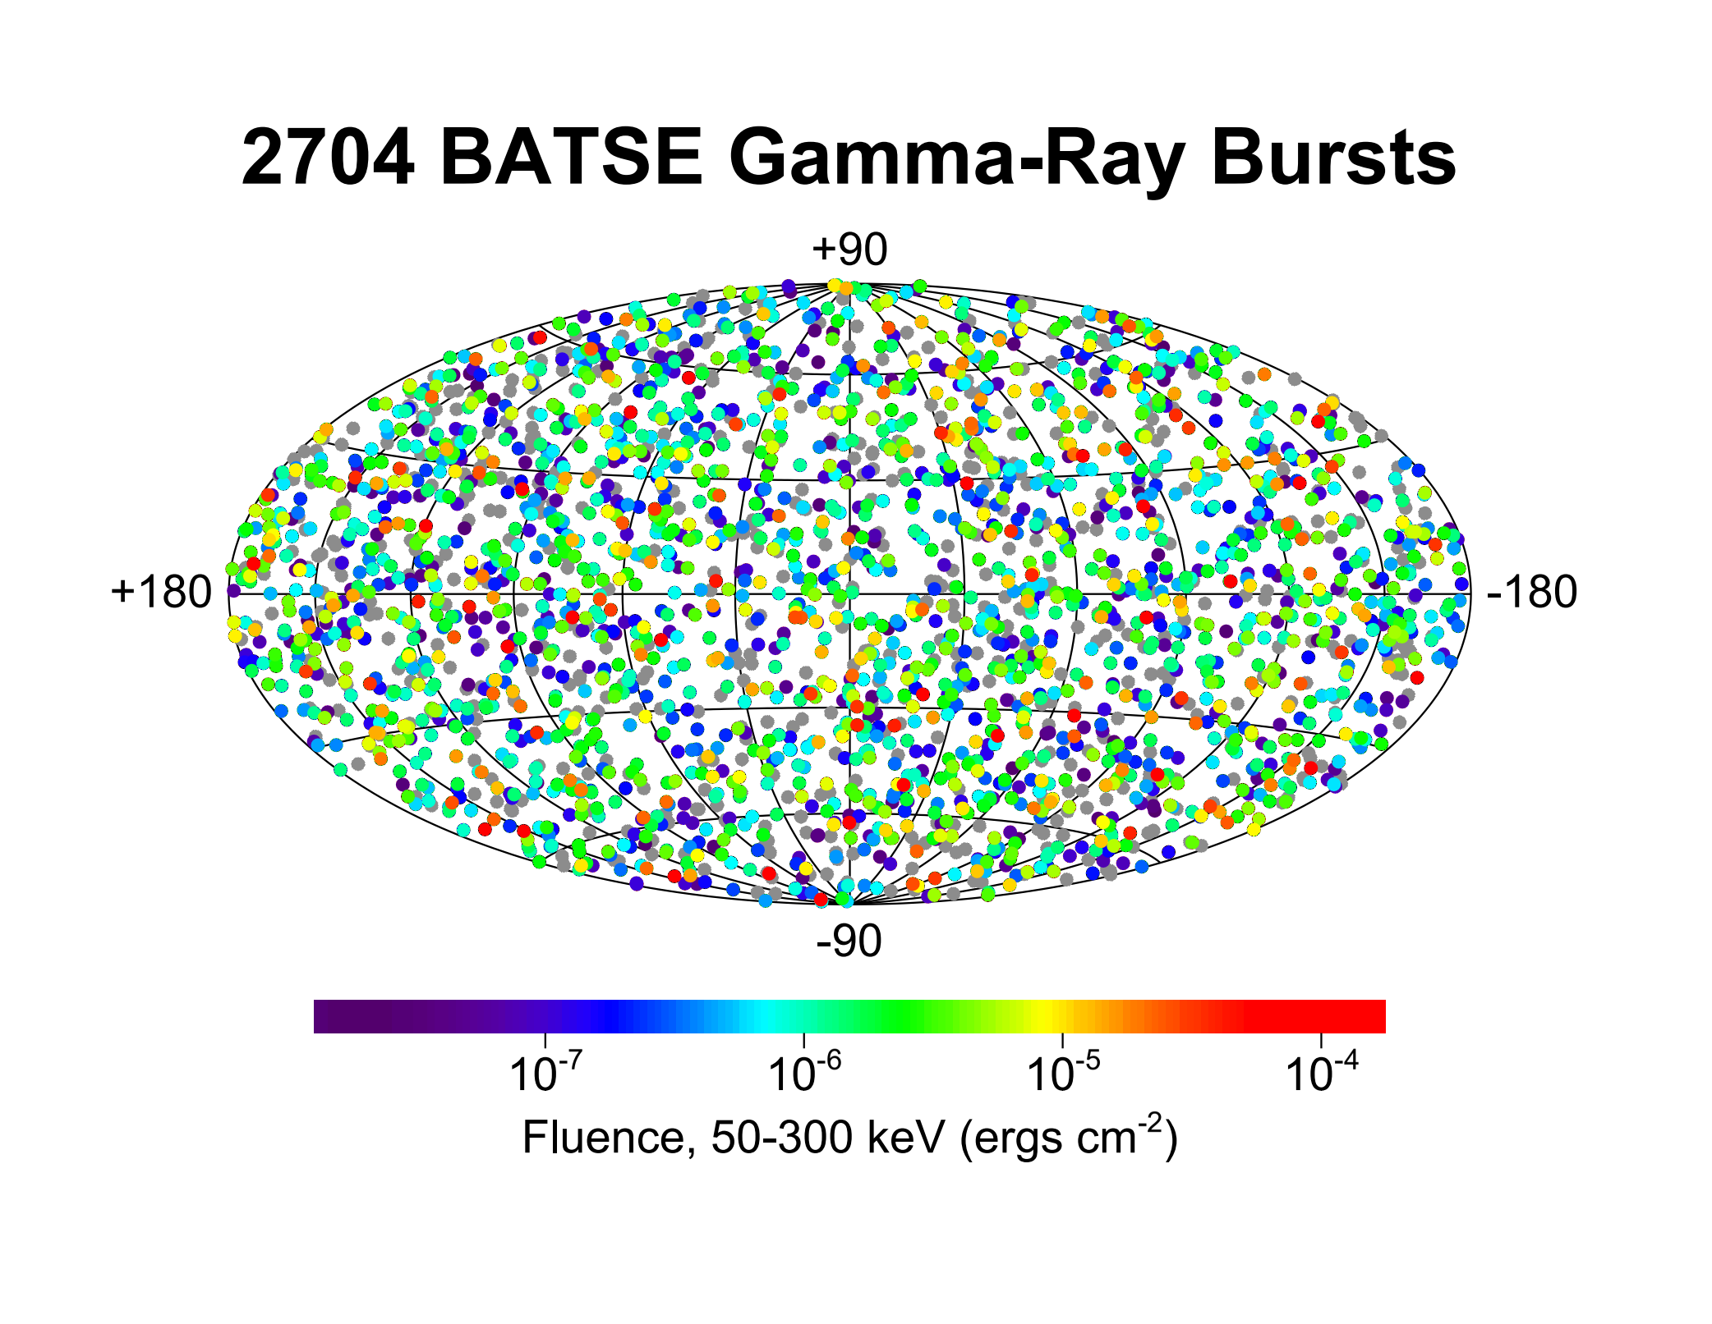
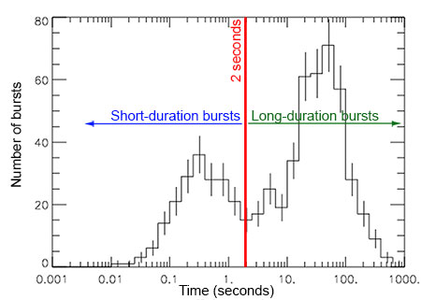
GRB in a nutshell
Sudden high-energy emission up to 10⁻³ erg/cm²/s.​
Two categories:​
Long (1–1000 s):​
      supernovae​
Short (0.1–1 s): ​
      BH-NS/ NS-NS merger​
E. Borciani - Advances in X-ray and Gamma RAy DEtectors and applications (XGRADE 2026) 24-26/03/2026, Palermo

Slide 3
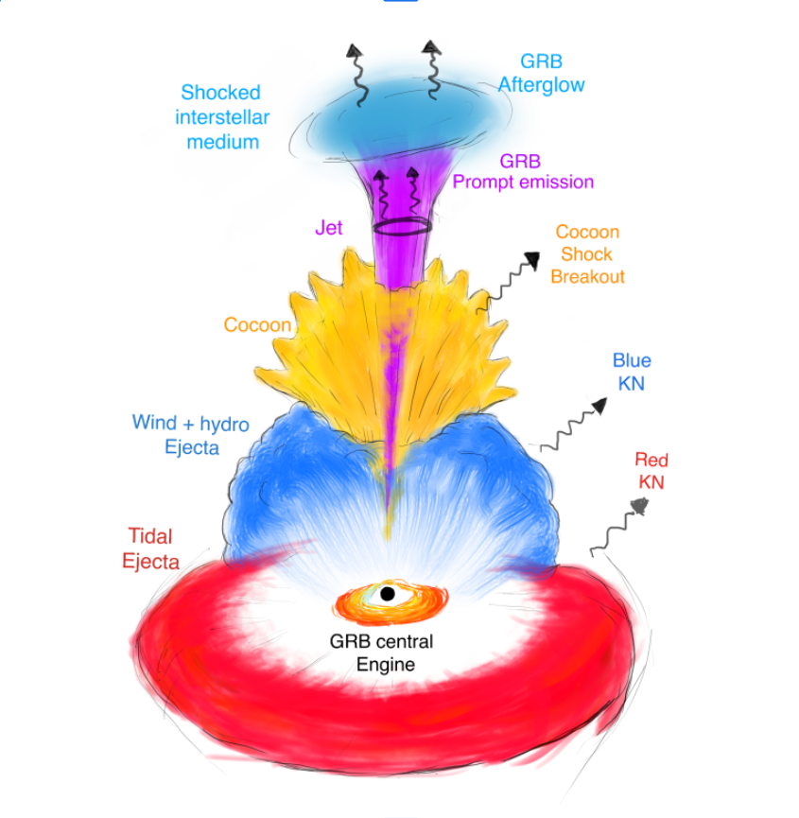
Polarimetry
Why polarimetry?
“Complete picture of GRB” ​
understanding the physical origin of the prompt emission;​
probing the magnetic field in the jet and during the afterglow;​
polarimetry of prompt γ-ray for the theoretical modeling (intrinsic vs geometric models).​
E. Borciani - Advances in X-ray and Gamma RAy DEtectors and applications (XGRADE 2026) 24-26/03/2026, Palermo

Slide 4

Polarimetry
Why Polarimetry?​
GRBs yes... but not only:​
Transient Binaries​
Magnetar bursts (AXP, SGR, Fast Radio Bursts) ​
X-ray Flashes​
Terrestrial Gamma-ray Flashes;​
E. Borciani - Advances in X-ray and Gamma RAy DEtectors and applications (XGRADE 2026) 24-26/03/2026, Palermo

Slide 5

But most importantly...
Unexplored!
Launched in 2021!
E. Borciani - Advances in X-ray and Gamma RAy DEtectors and applications (XGRADE 2026) 24-26/03/2026, Palermo

Slide 6
Science Objectives
Science Objectives​
Polarimetry of prompt emission of GRB
But also ...
Magnetar burst (AXP, SGR, Fast Radio Burst)
Solar Flares
Transient Binaries
E. Borciani - Advances in X-ray and Gamma RAy DEtectors and applications (XGRADE 2026) 24-26/03/2026, Palermo

Slide 7
SWIPE Design
SOFT-X AND GAMMA-RAY WIDE-FIELD POLARIMETER EXPLORER
Design
E. Borciani - Advances in X-ray and Gamma RAy DEtectors and applications (XGRADE 2026) 24-26/03/2026, Palermo

Slide 8
SWIPE Design
Large Area Photo-electric Polarimeter
Compton Polarimeter
E. Borciani - Advances in X-ray and Gamma RAy DEtectors and applications (XGRADE 2026) 24-26/03/2026, Palermo

Slide 9
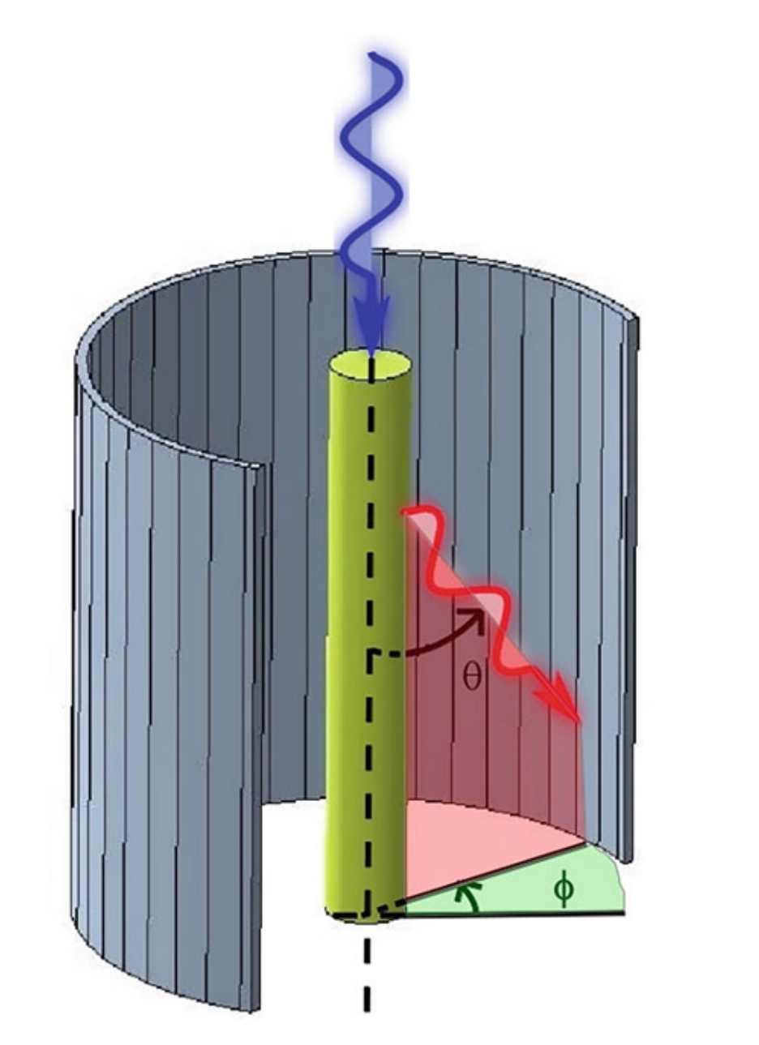
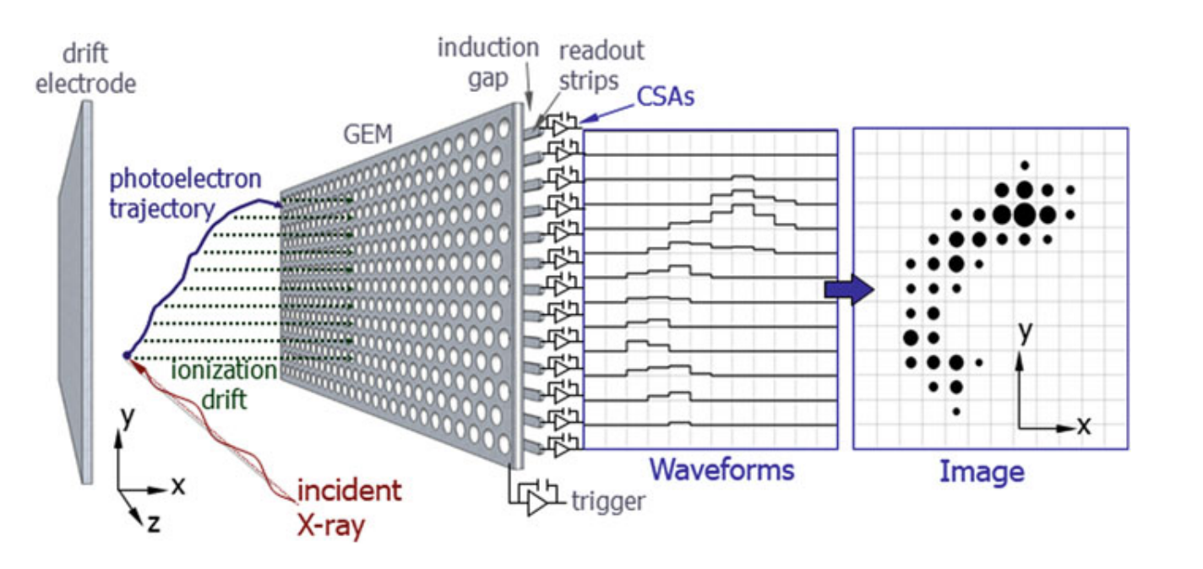
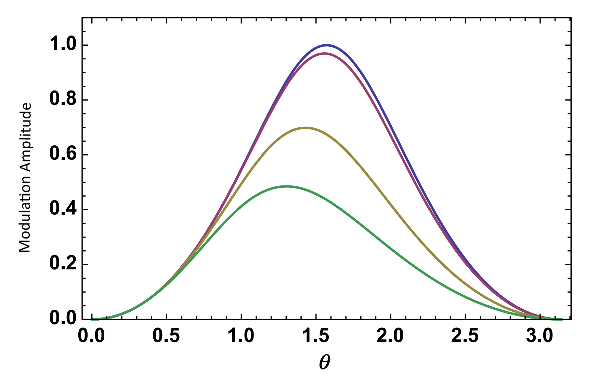
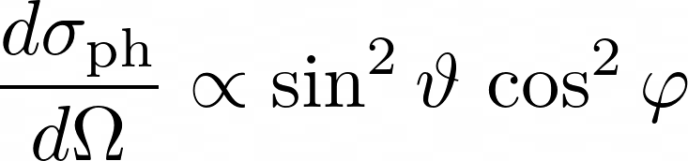
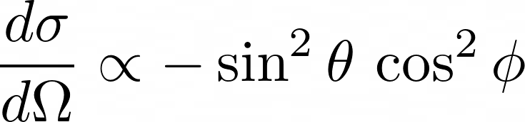
SWIPE Design
E. Borciani - Advances in X-ray and Gamma RAy DEtectors and applications (XGRADE 2026) 24-26/03/2026, Palermo

Slide 10
Large area Photoelectric Polarimeter
Large area Photoelectric Polarimeter
E. Borciani - Advances in X-ray and Gamma RAy DEtectors and applications (XGRADE 2026) 24-26/03/2026, Palermo

Slide 11
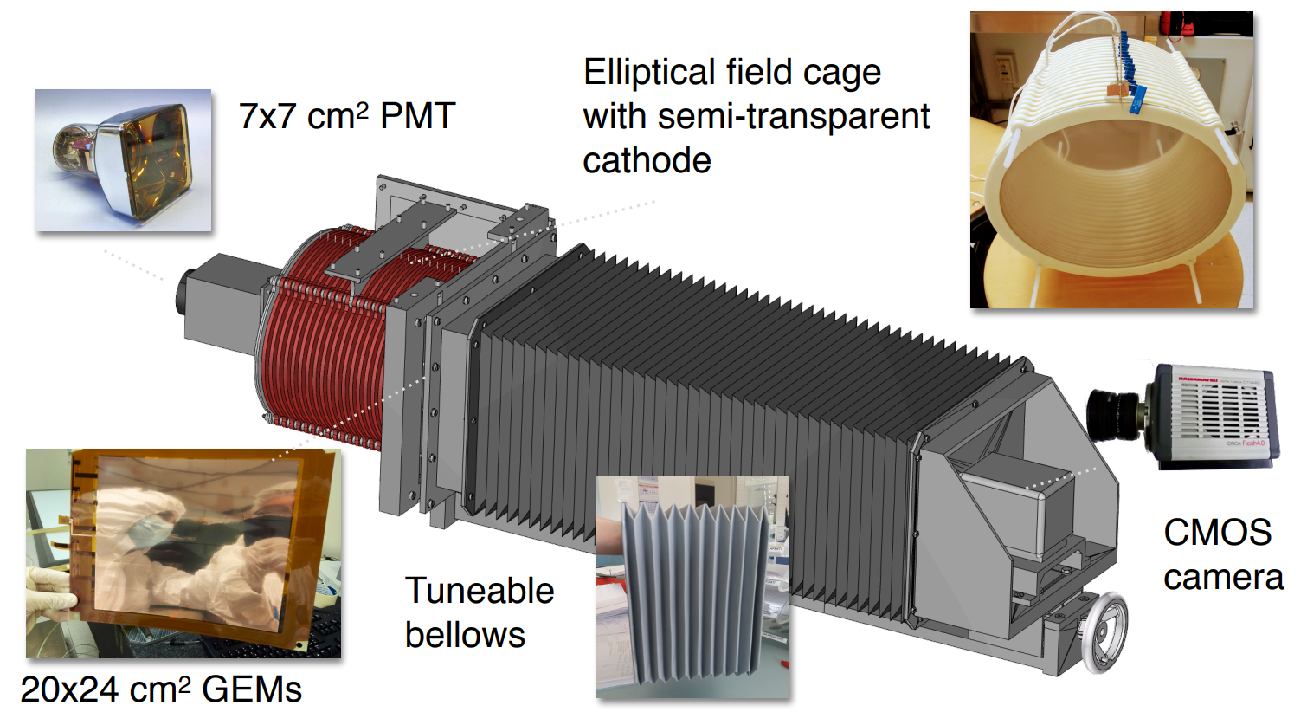
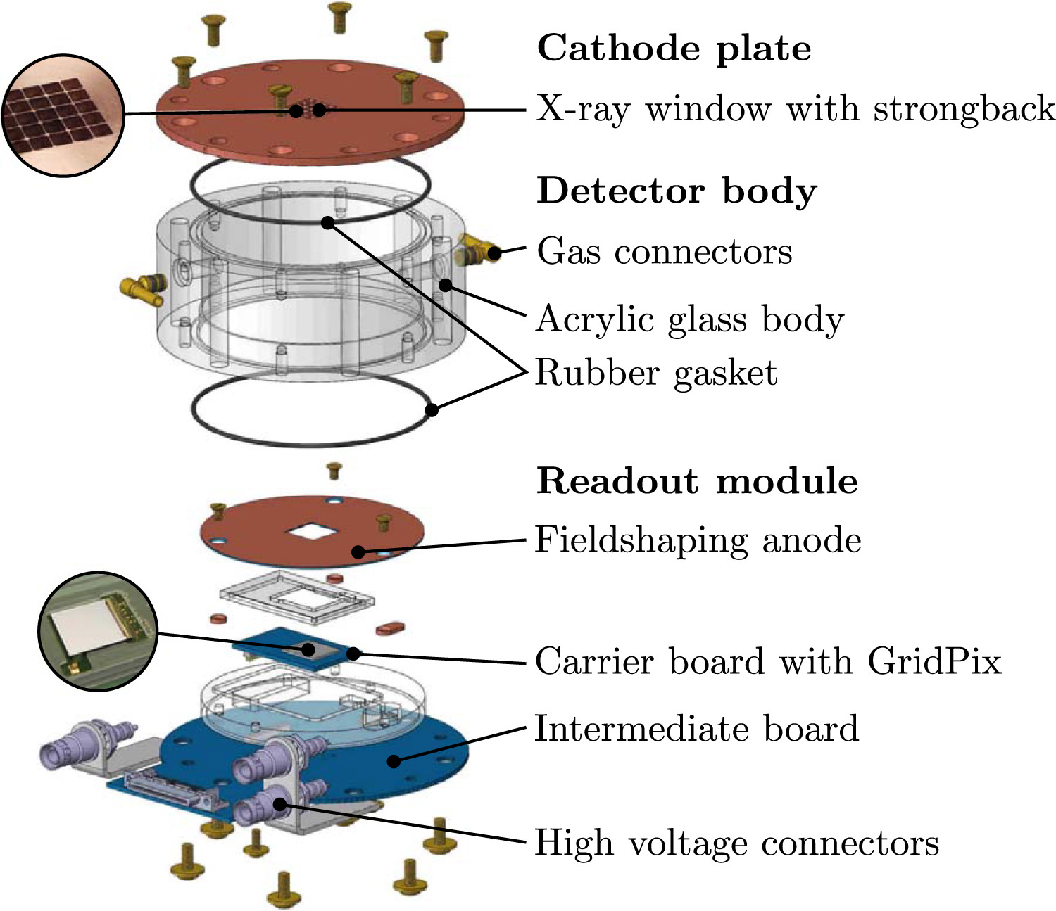
Large area Photoelectric Polarimeter
GridPix = Improves speed and 3D track reconstruction, with the improvement of Timepix3 (tested by University of Bonn) https://doi.org/10.1016/j.nima.2025.170397
TPC approach = photoelectron track imaging for background discrimination (CYGNO collaboration); https://arxiv.org/abs/2601.01435
E. Borciani - Advances in X-ray and Gamma RAy DEtectors and applications (XGRADE 2026) 24-26/03/2026, Palermo

Slide 12
Compton Polarimeter
Compton Polarimeter
E. Borciani - Advances in X-ray and Gamma RAy DEtectors and applications (XGRADE 2026) 24-26/03/2026, Palermo

Slide 13
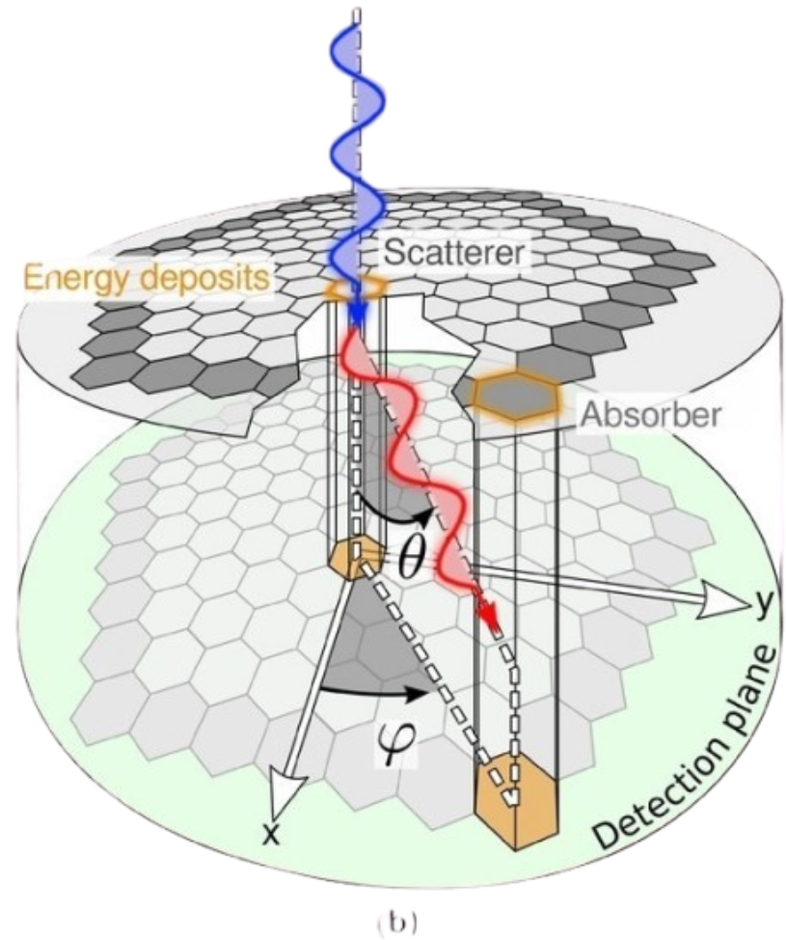
Compton Polarimeter
Double Phase
Photon first scatters on a low-Z material (plastic scintillators EJ-200 or EJ-208)…​
​
… and then it is absorbed in a high-Z material (CsI:Tl/GAGG:Ce)​
​
​
E. Borciani - Advances in X-ray and Gamma RAy DEtectors and applications (XGRADE 2026) 24-26/03/2026, Palermo

Slide 14
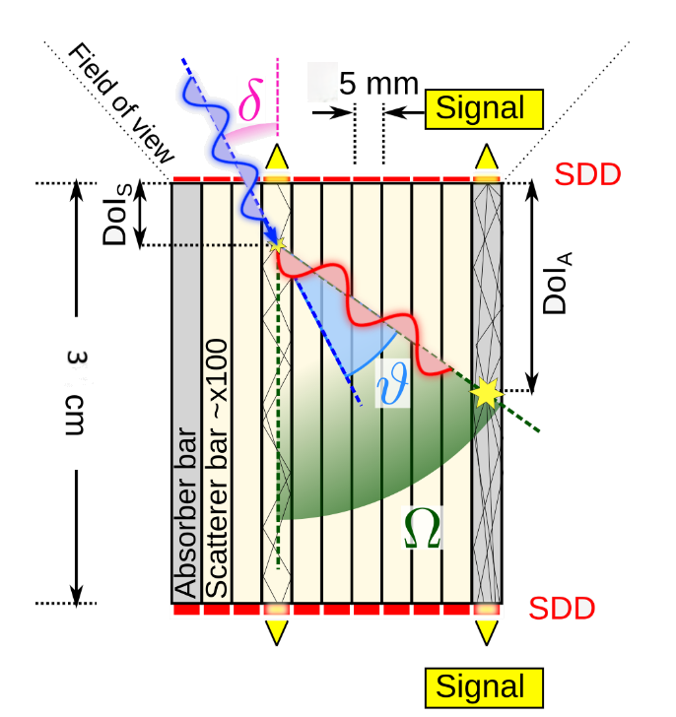
Compton Polarimeter
Compton Polarimeter
Study the trigger efficiency as a function of the distance in the bar;​
Derive the Depth-Of-Interaction and hence scattering angle.
θ constraint → 21% improvement in MDP
compared to unconstrained case (ideal limit)
https://doi.org/10.48550/arXiv.1102.1228
E. Borciani - Advances in X-ray and Gamma RAy DEtectors and applications (XGRADE 2026) 24-26/03/2026, Palermo

Slide 15
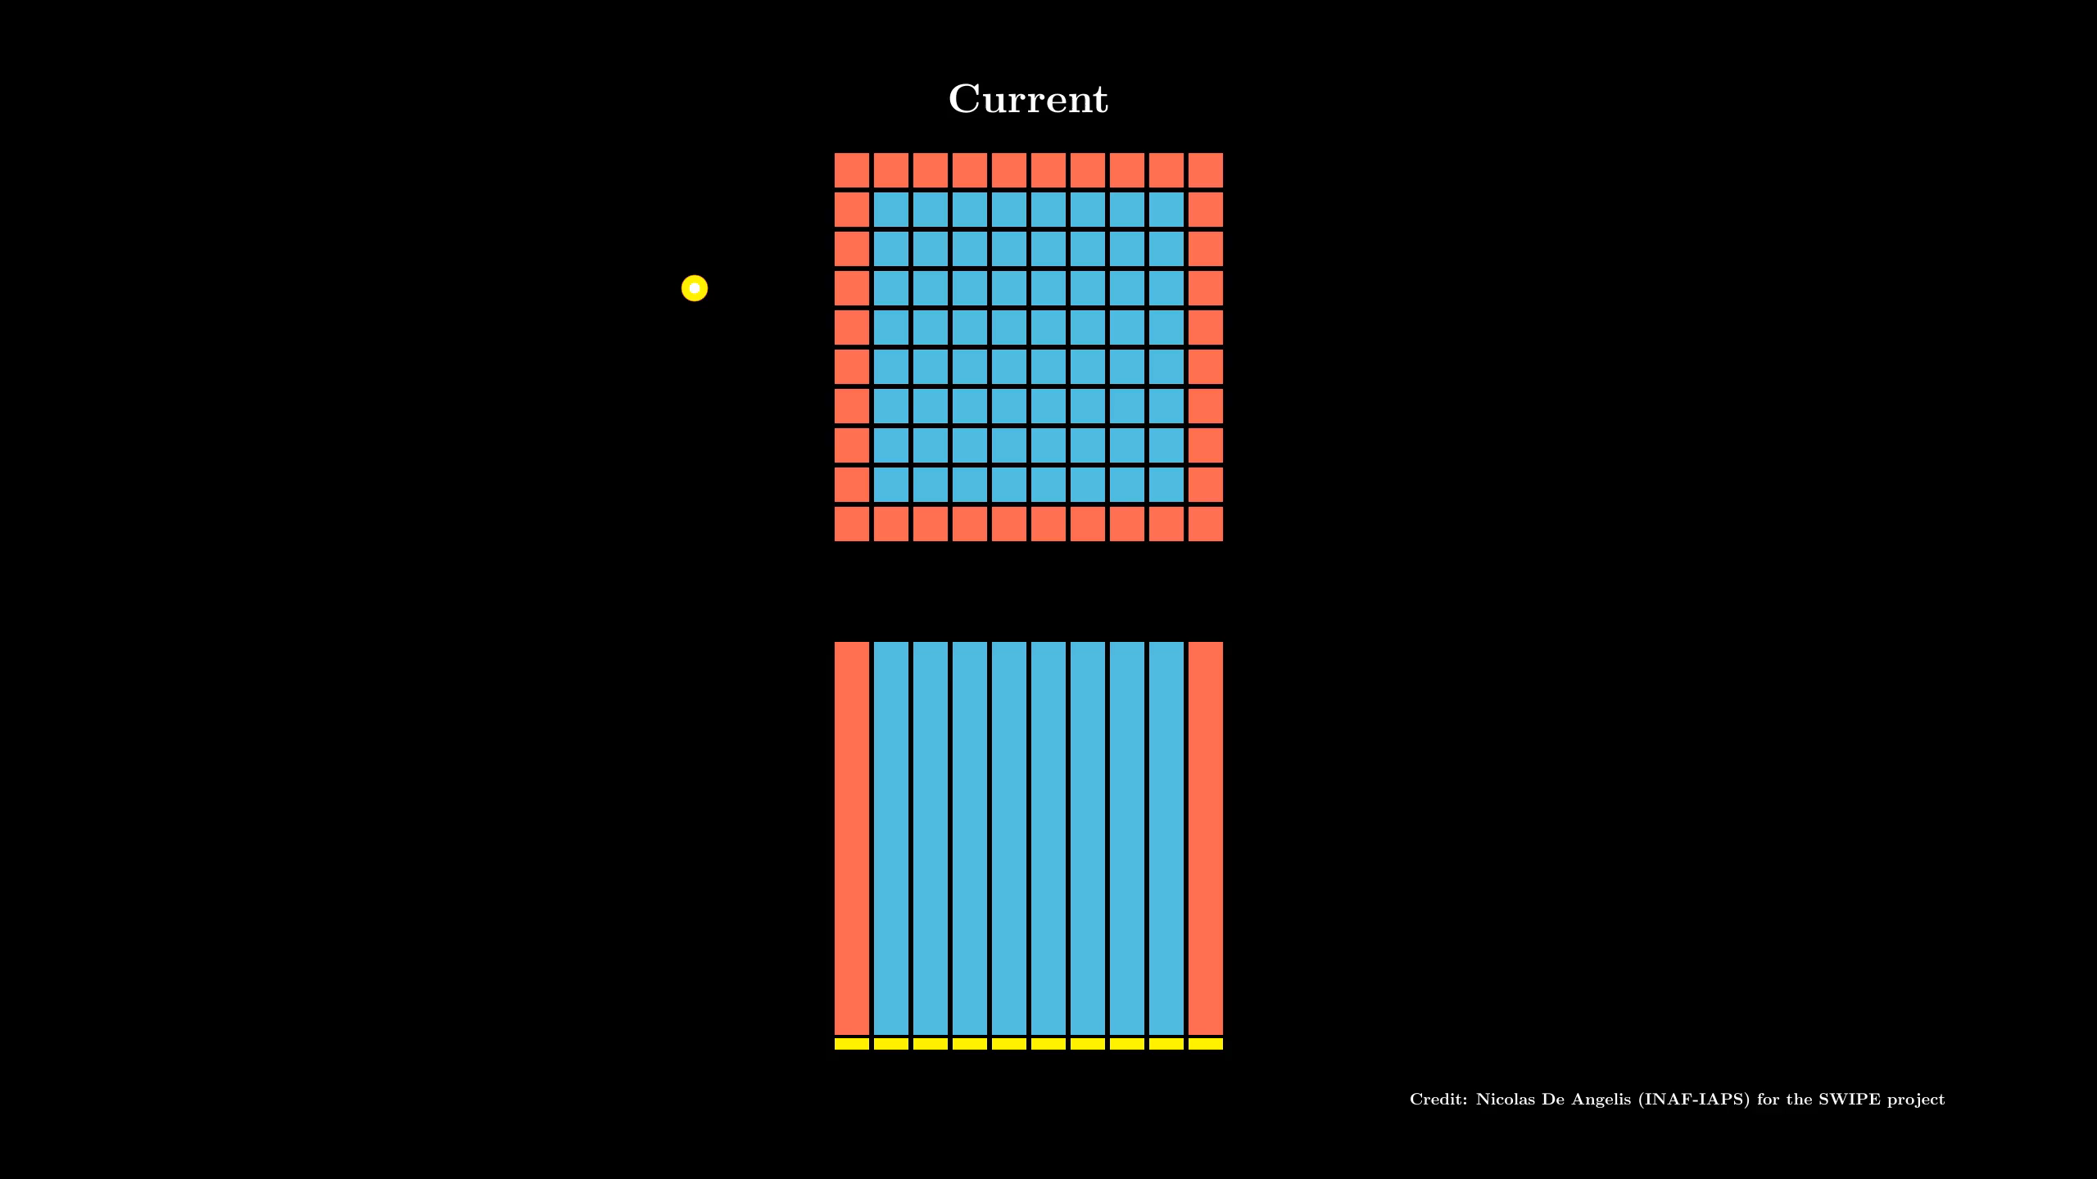
Improvement in the polarization detection
E. Borciani - Advances in X-ray and Gamma RAy DEtectors and applications (XGRADE 2026) 24-26/03/2026, Palermo

Slide 16
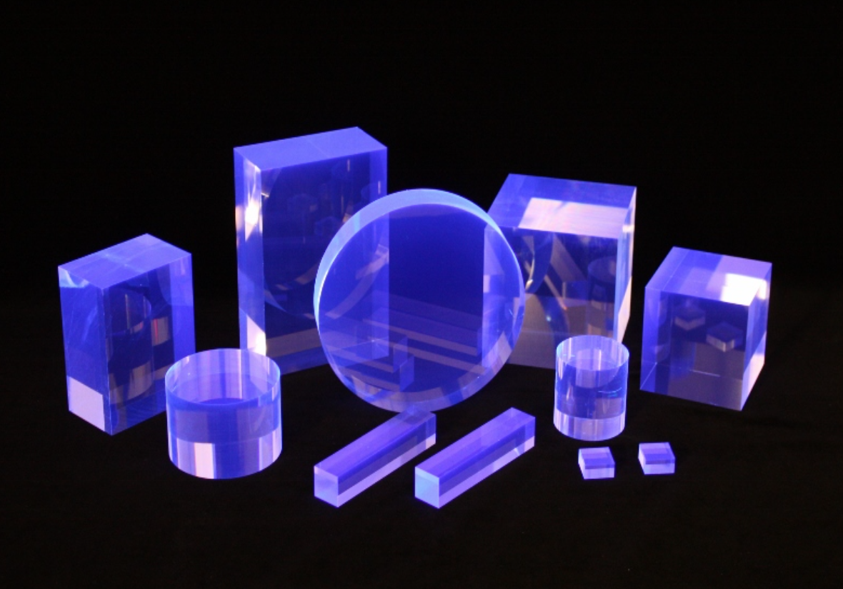
Plastic Scintillator
Scatterer
Low-Z plastic scintillators:​
favorable ratio between Compton scattering and photoelectric absorption probabilities;​
Light yield ∼ 10k photons/MeV;​
pulse shape ∼ ns;​
​
Problem: we want to collect the few photons coming from the scintillation. ​
​
E. Borciani - Advances in X-ray and Gamma RAy DEtectors and applications (XGRADE 2026) 24-26/03/2026, Palermo

Slide 17
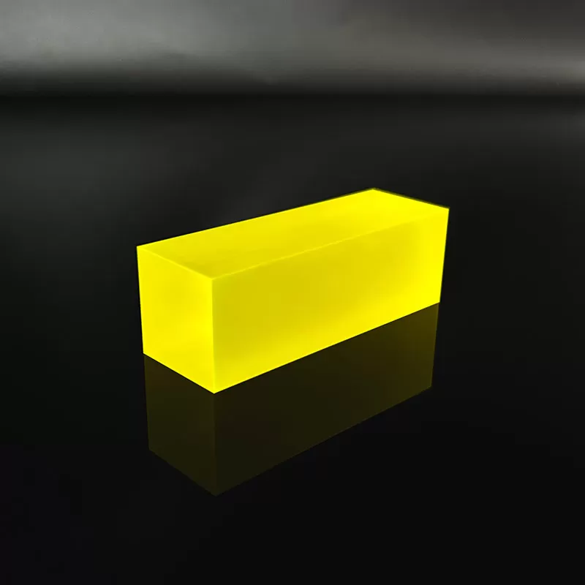
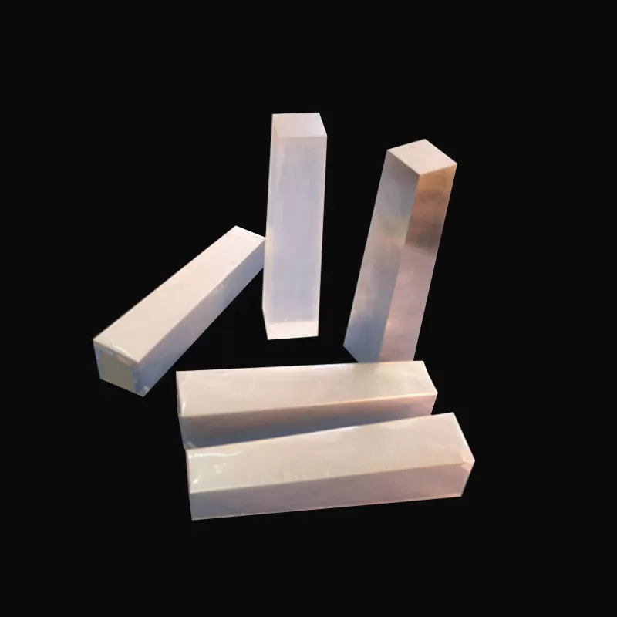
SDD + Absorber Prototype
SDDs:
Compact system;​
Large-area scalings;​
Large heritage in SDD design and production in the framework of the ReDSoX collaboration (INFN, FBK, INAF, PoliMI, UniPV, and several other institutions);
Needs low noise FEE;
Currently tested in INAF OAS - Bologna​
CsI:Tl
GAGG:Ce
E. Borciani - Advances in X-ray and Gamma RAy DEtectors and applications (XGRADE 2026) 24-26/03/2026, Palermo

Slide 18
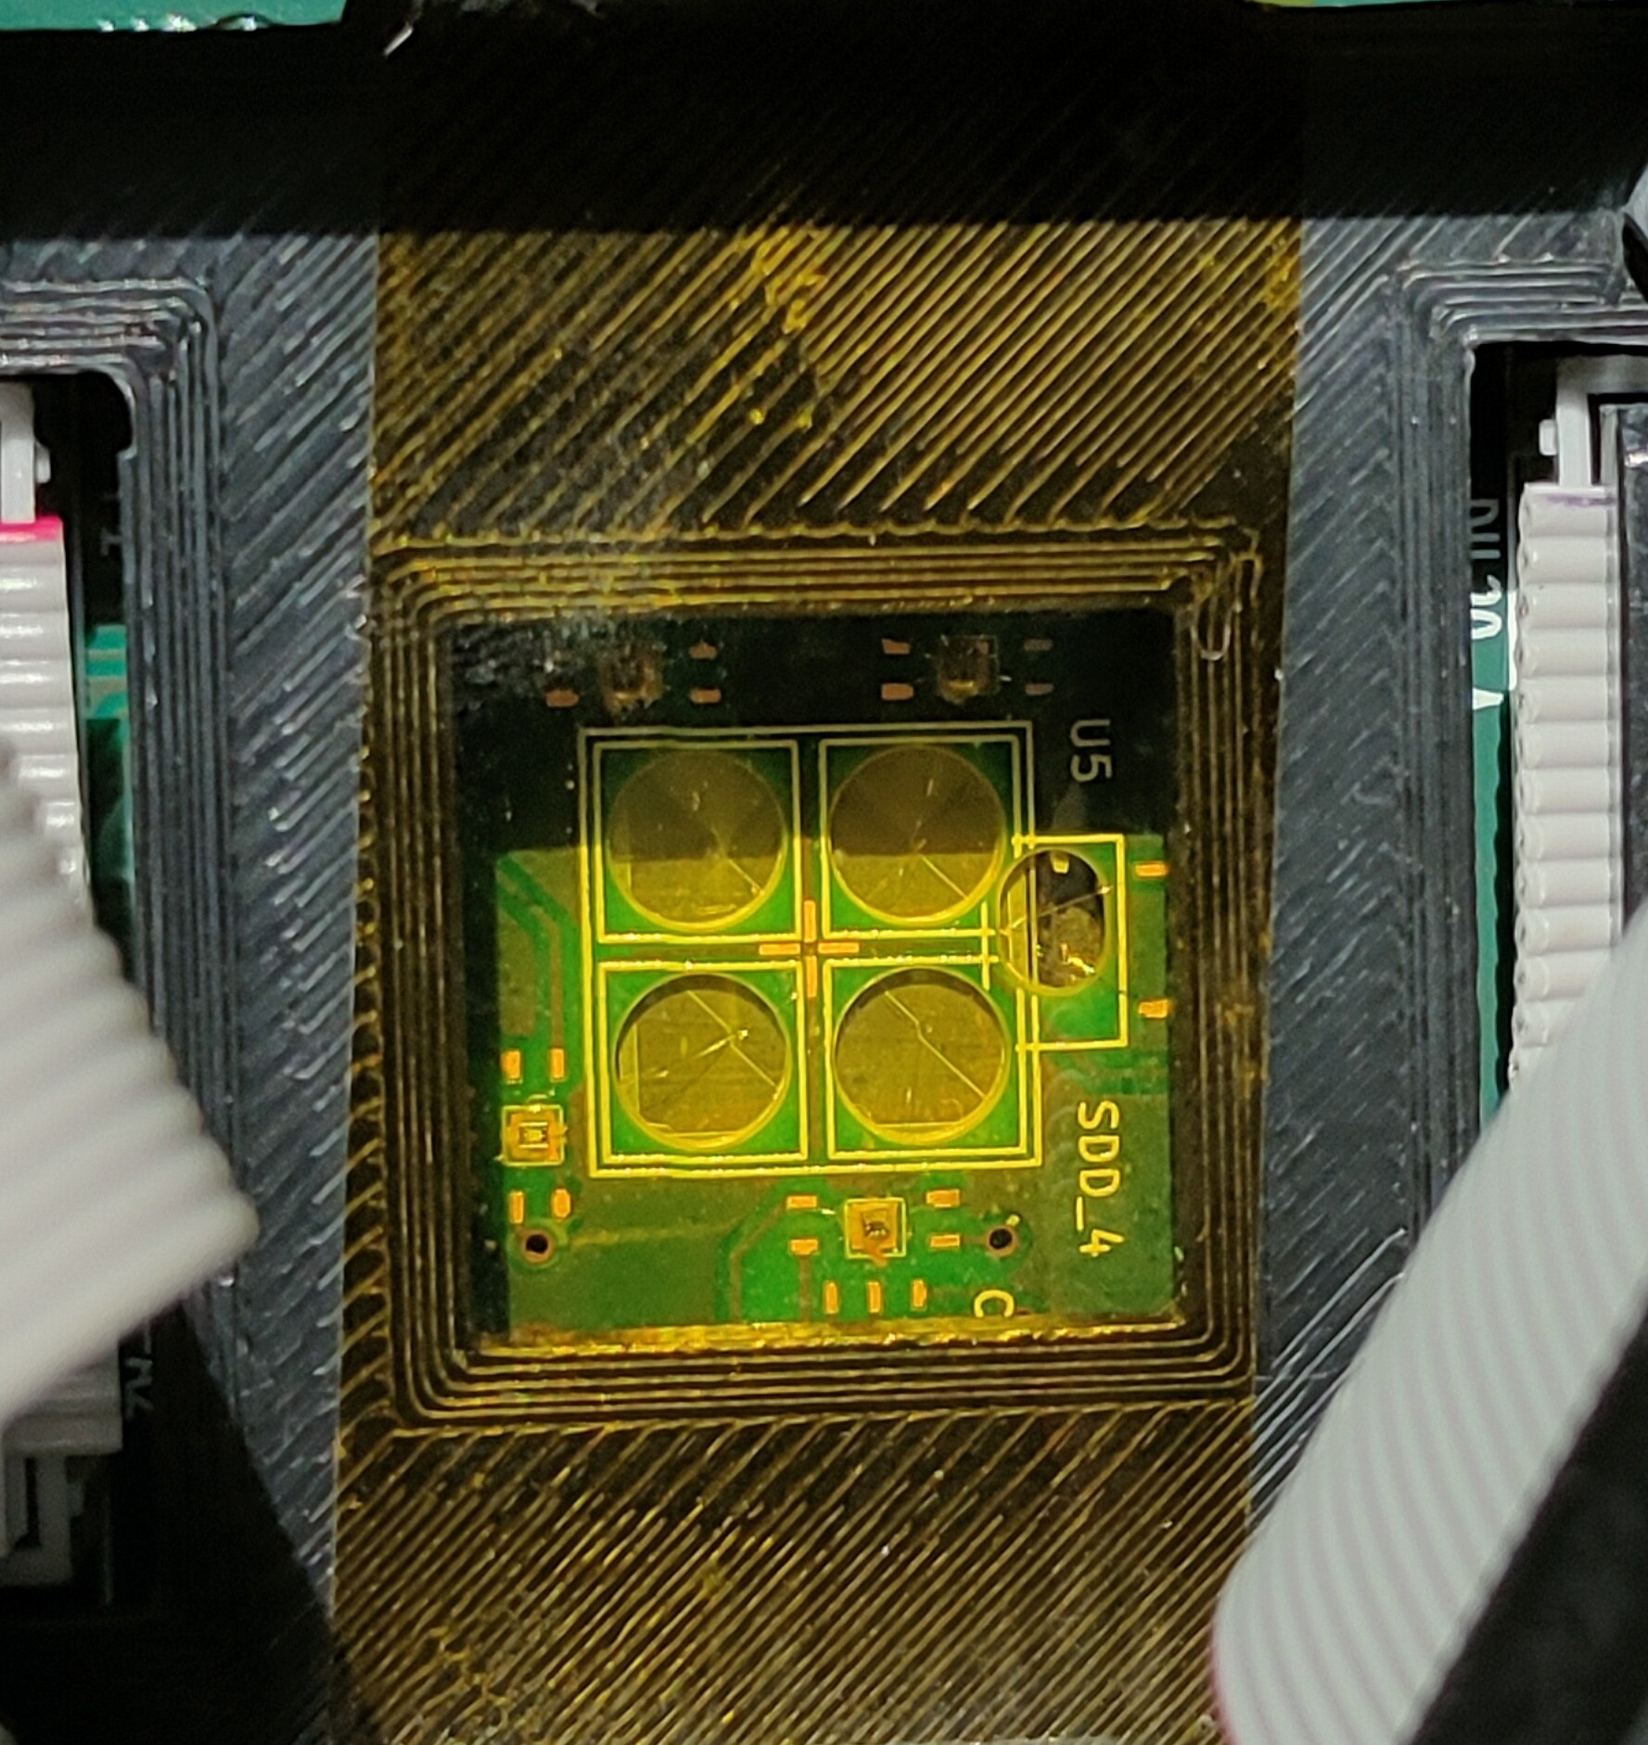
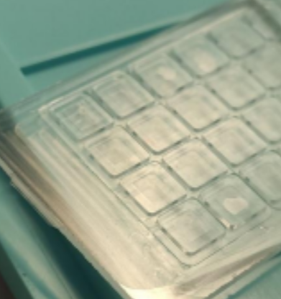
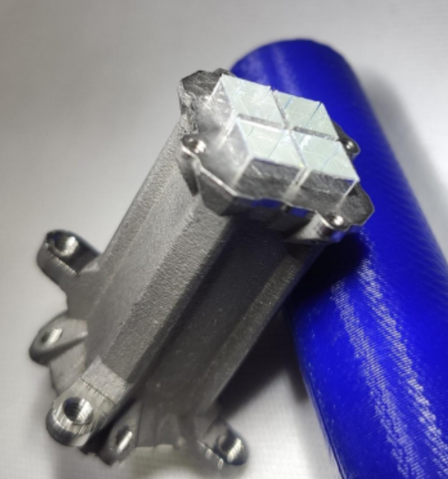
Instrumental Setup
2x2 SDDs Array
(5x5x0.45 mm)
+
Commercial ASIC
Preamplifier
(CUBE)
4.5×4.5x0.6 mm Silicon
optical pad
(curtesy of FBK Trento)
Four 4.5×4.5x30 mm CsI scintillator bar inside titanium housing with VD2000
(courtesy of FBK Trento)
E. Borciani - Advances in X-ray and Gamma RAy DEtectors and applications (XGRADE 2026) 24-26/03/2026, Palermo

Slide 19
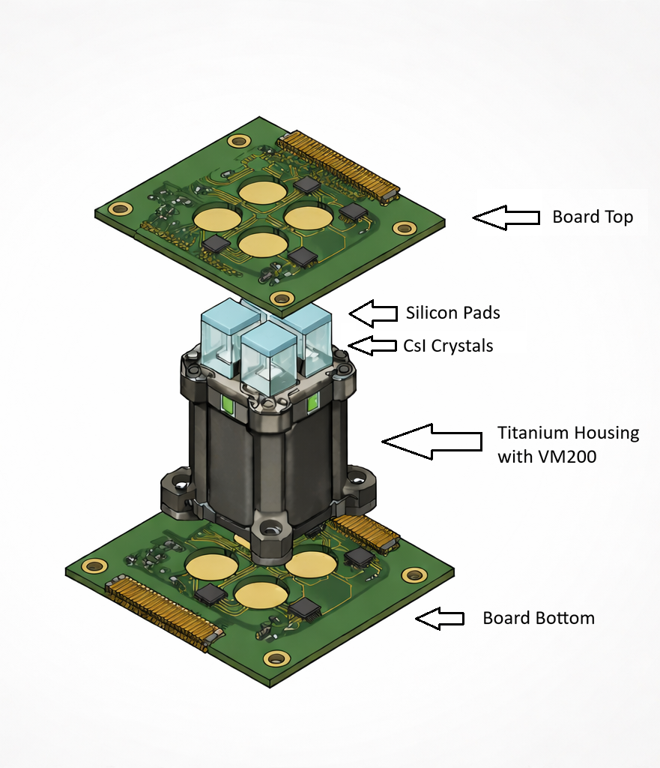
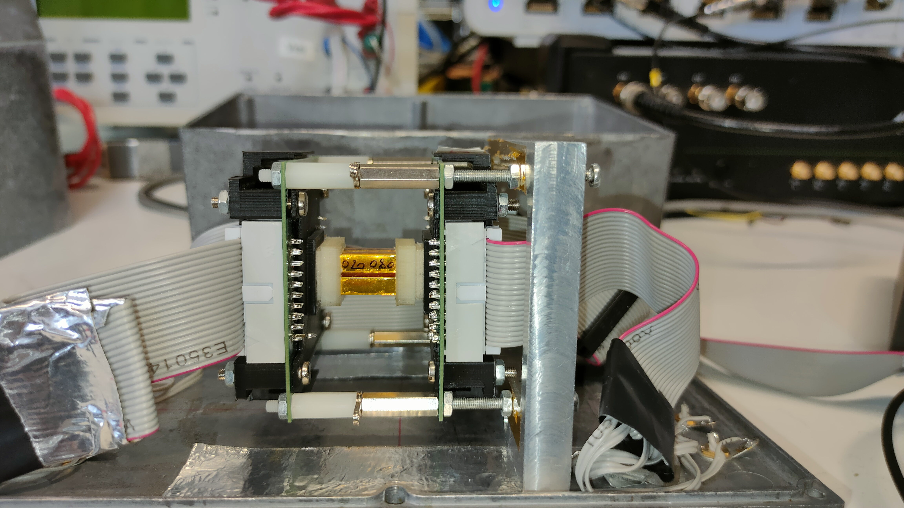
Instrumental Setup
E. Borciani - Advances in X-ray and Gamma RAy DEtectors and applications (XGRADE 2026) 24-26/03/2026, Palermo

Slide 20
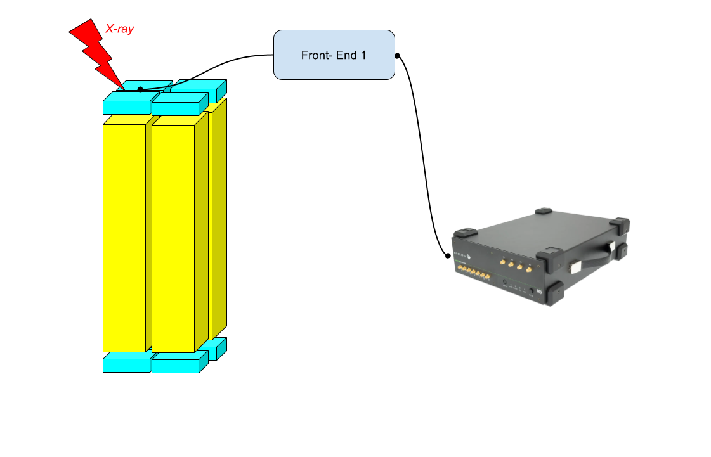
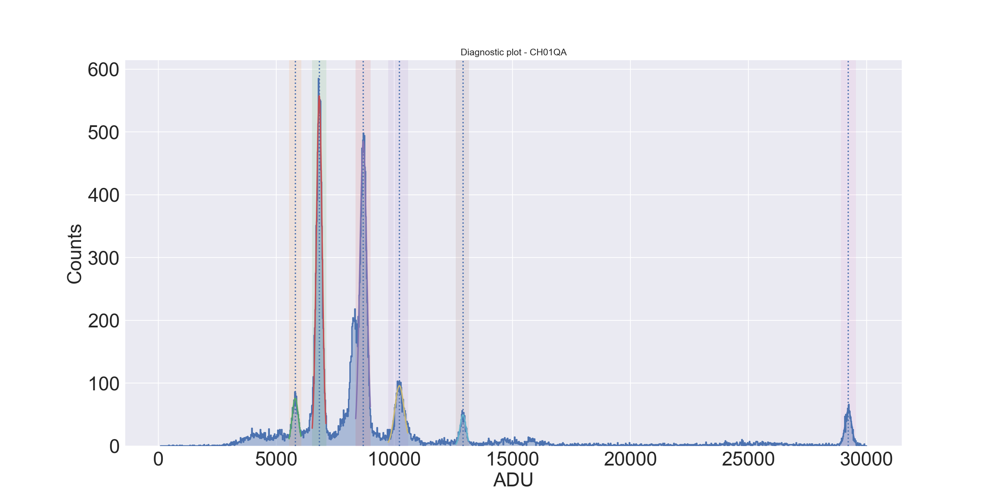
Siswich principle and hodoscopic architecture
https://spectrum-instrumentation.com/products/details/DN2445-04.php
E. Borciani - Advances in X-ray and Gamma RAy DEtectors and applications (XGRADE 2026) 24-26/03/2026, Palermo

Slide 21
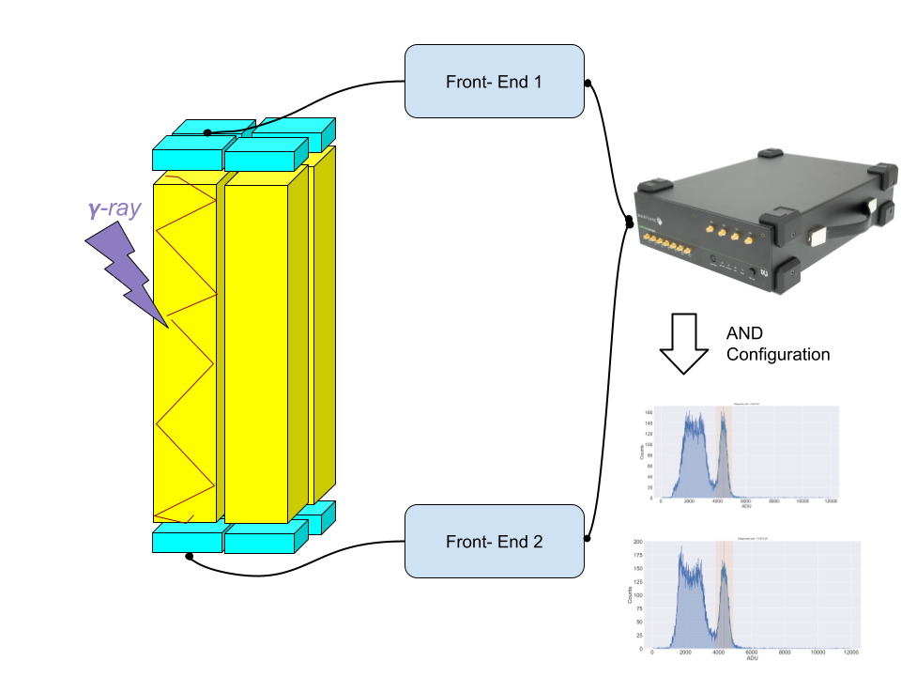
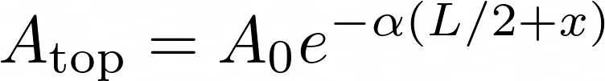


Siswich principle and hodoscopic architecture
E. Borciani - Advances in X-ray and Gamma RAy DEtectors and applications (XGRADE 2026) 24-26/03/2026, Palermo

Slide 22
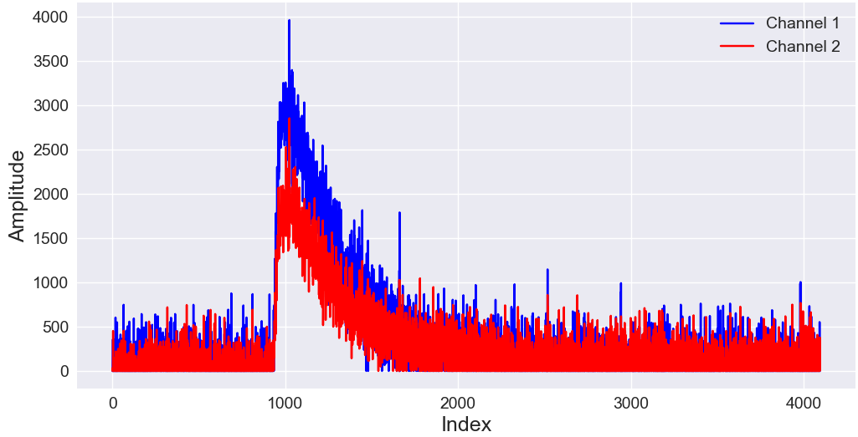
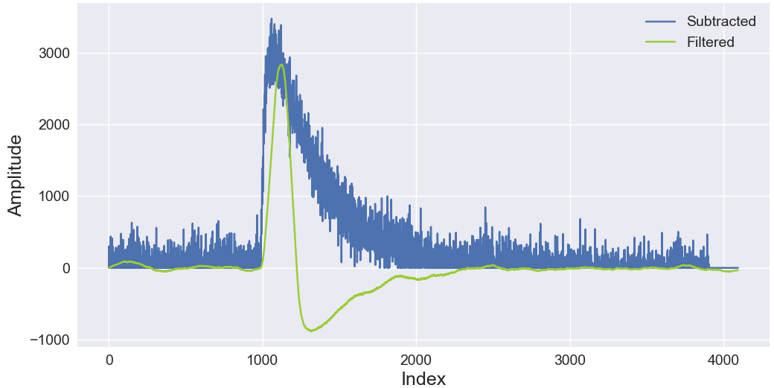
Digital Filter
Raw Digitized Waveforms
Single Waveform with Filtered Signal
https://bibliotekanauki.pl/articles/147770
E. Borciani - Advances in X-ray and Gamma RAy DEtectors and applications (XGRADE 2026) 24-26/03/2026, Palermo

Slide 23
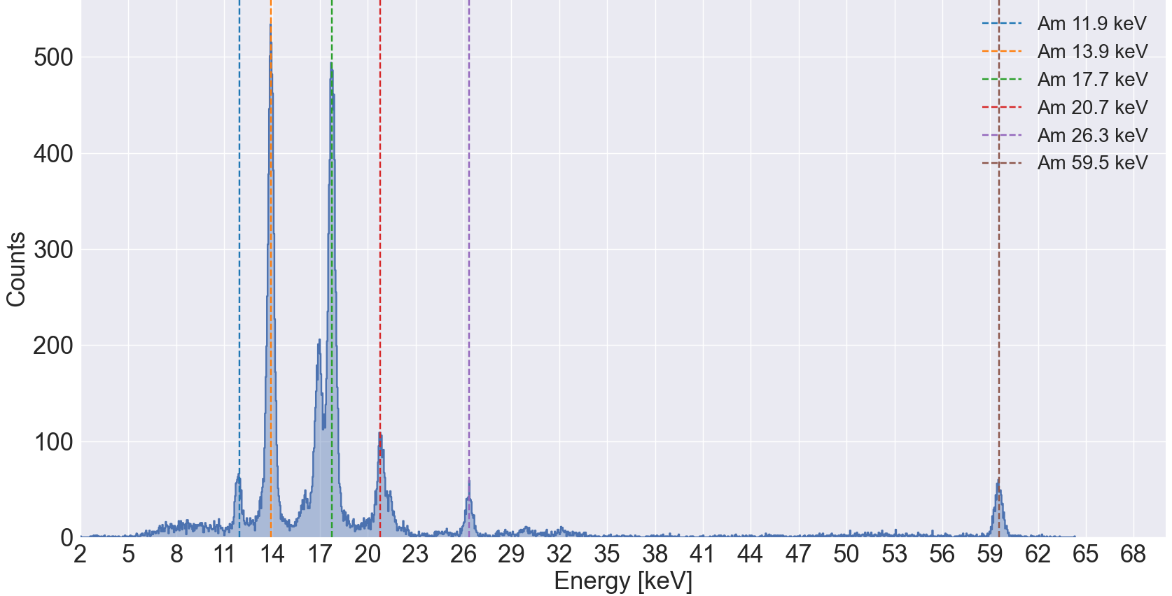
X-ray Calibration
Channel | El. noise (e-)
E1P1 | 55 ± 1
E1P2 | 45 ± 1
E1P3 | 48 ± 1
E1P4 | 48 ± 1
E2P1 | 56 ± 1
E2P2 | 47 ± 1
E2P3 | 50 ± 1
E2P4 | 57 ± 1
E. Borciani - Advances in X-ray and Gamma RAy DEtectors and applications (XGRADE 2026) 24-26/03/2026, Palermo

Slide 24
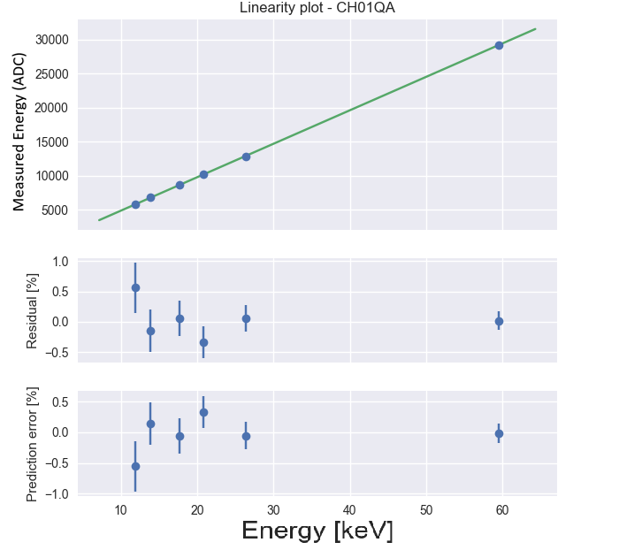
Linearity
Channel | Linear Correlation
E1P1 | 0.9998
E1P2 | 0.9999
E1P3 | 0.9999
E1P4 | 0.9999
E2P1 | 0.9999
E2P2 | 0.9999
E2P3 | 0.9999
E2P4 | 0.9997
E. Borciani - Advances in X-ray and Gamma RAy DEtectors and applications (XGRADE 2026) 24-26/03/2026, Palermo

Slide 25
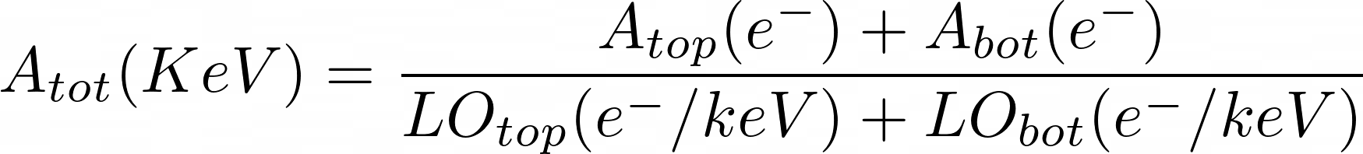
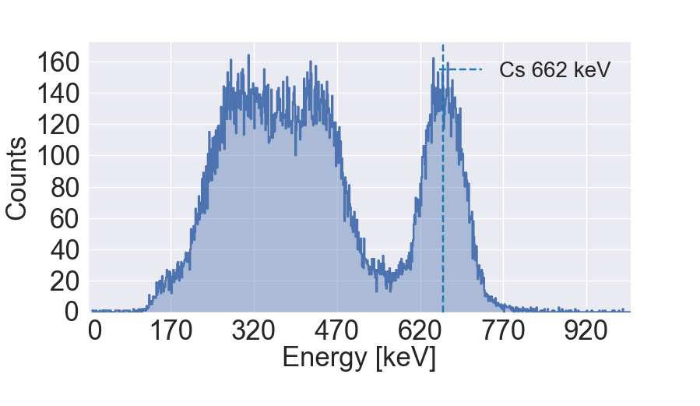
Gamma calibration & Light Output
Channel | FWHM (ADU) | El. Noise (e-) | Light Output (e-/keV)
E1P4 | 457 ± 8 | 48 ± 1 | 10.6 ± 0.1
E2P3 | 445 ± 11 | 50 ± 1 | 9.1 ± 0.1
E. Borciani - Advances in X-ray and Gamma RAy DEtectors and applications (XGRADE 2026) 24-26/03/2026, Palermo

Slide 26
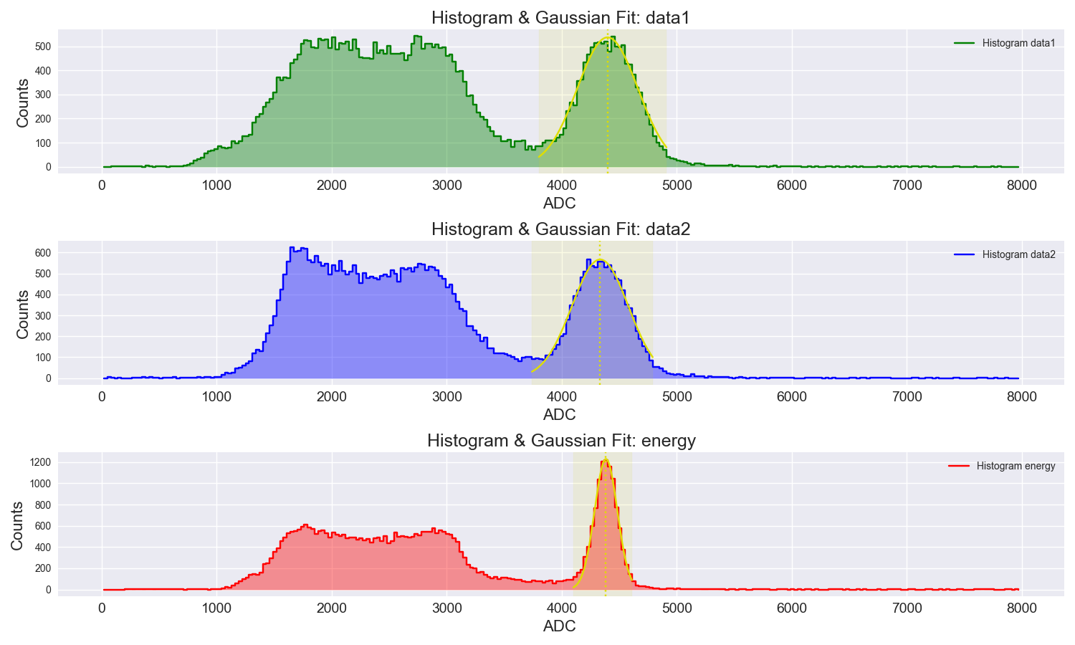
Double-reaout Energy Resolution
Channel | Energy resol. (@662 keV)
E1P4 | 14.1 ± 0.3
E2P3 | 13.2 ± 0.2
Total | 5.3 ± 0.3
E. Borciani - Advances in X-ray and Gamma RAy DEtectors and applications (XGRADE 2026) 24-26/03/2026, Palermo

Slide 27
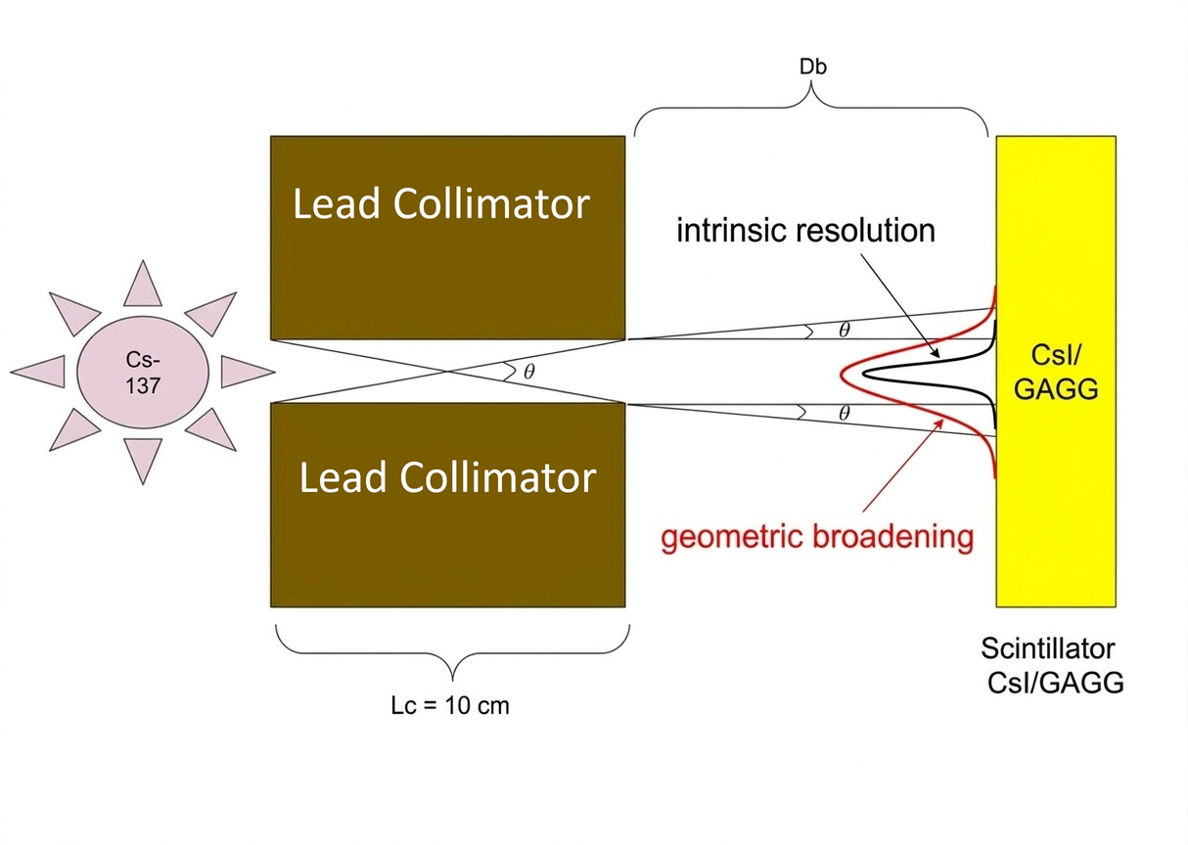
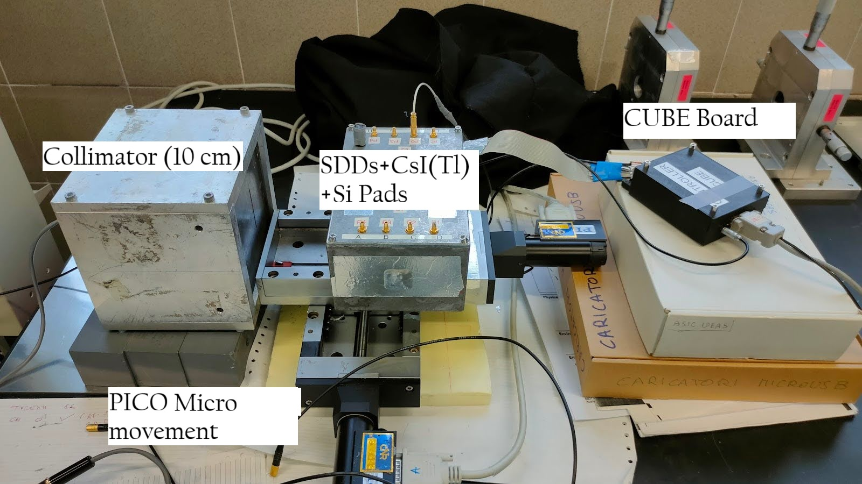
Spatial Resolution
Slit = 2 mm
E. Borciani - Advances in X-ray and Gamma RAy DEtectors and applications (XGRADE 2026) 24-26/03/2026, Palermo

Slide 28
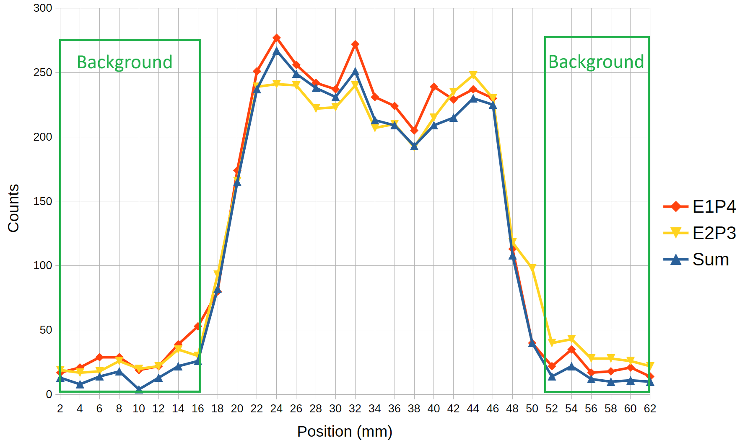
Bar Recostruction
E. Borciani - Advances in X-ray and Gamma RAy DEtectors and applications (XGRADE 2026) 24-26/03/2026, Palermo

Slide 29
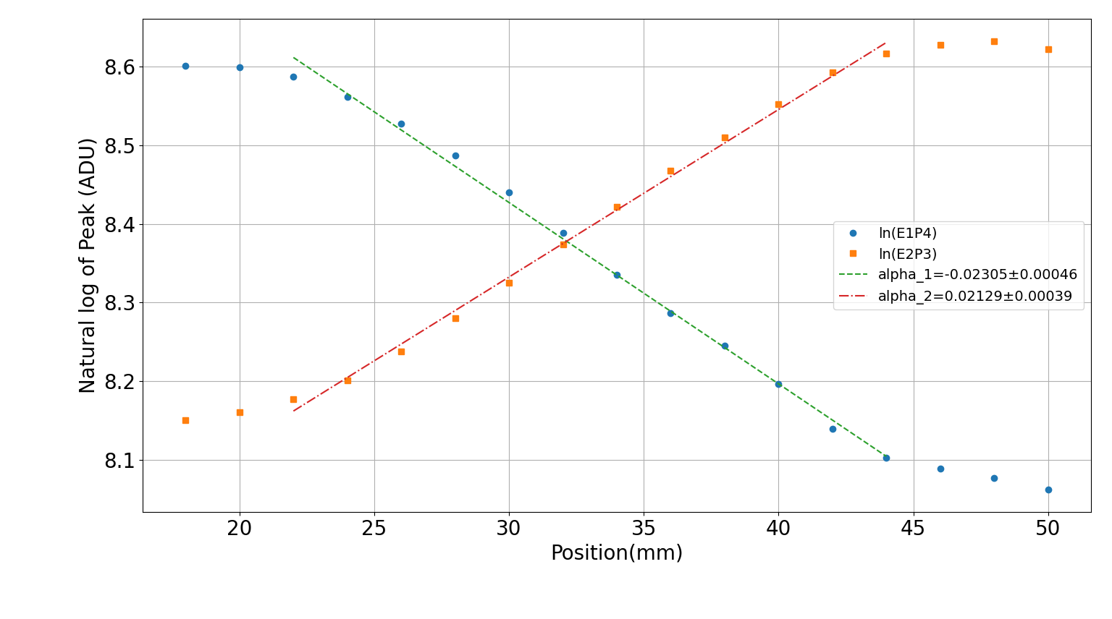
Attenuation coefficient
Channel | α (mm⁻¹)
E1P4 | -0.0231
E2P3 | 0.0212
Average | 0.022
E. Borciani - Advances in X-ray and Gamma RAy DEtectors and applications (XGRADE 2026) 24-26/03/2026, Palermo

Slide 30
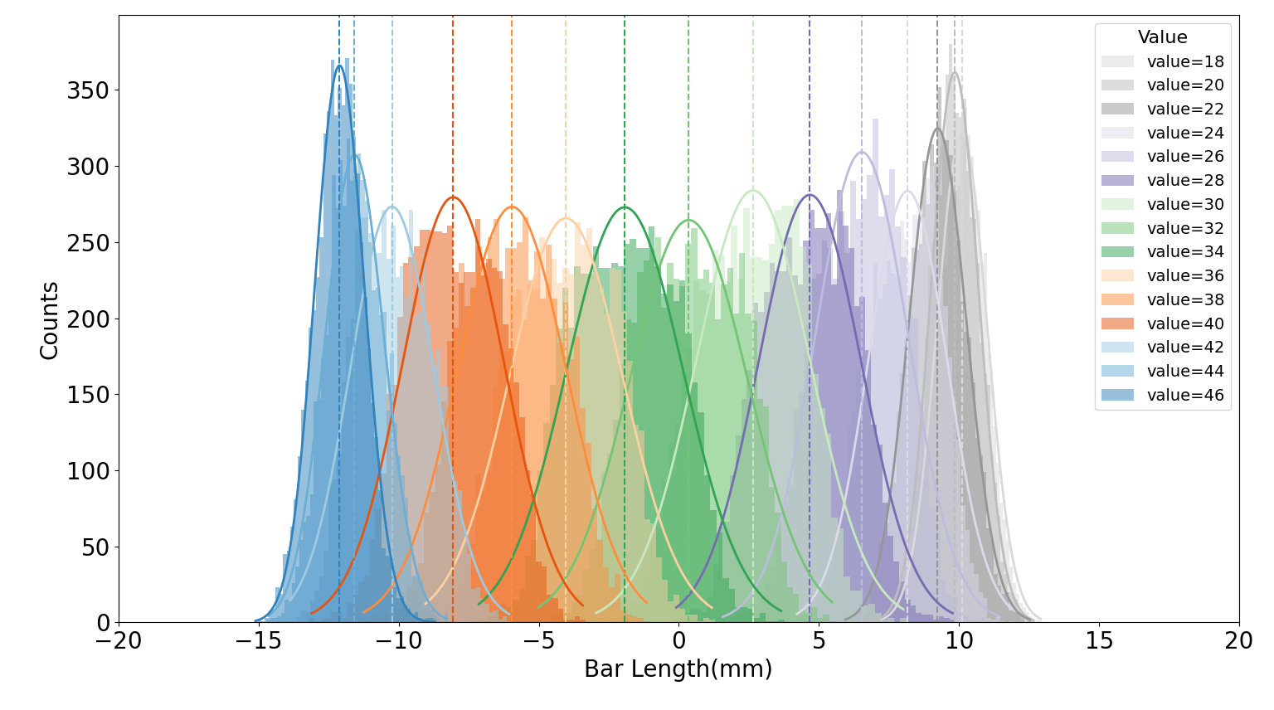


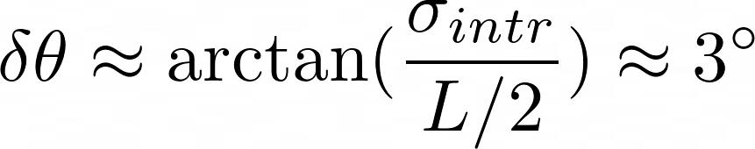
Spatial Resolution
mm
Equivalent angular uncertainty for a 10 cm
scintillator bar
E. Borciani - Advances in X-ray and Gamma RAy DEtectors and applications (XGRADE 2026) 24-26/03/2026, Palermo

Slide 31
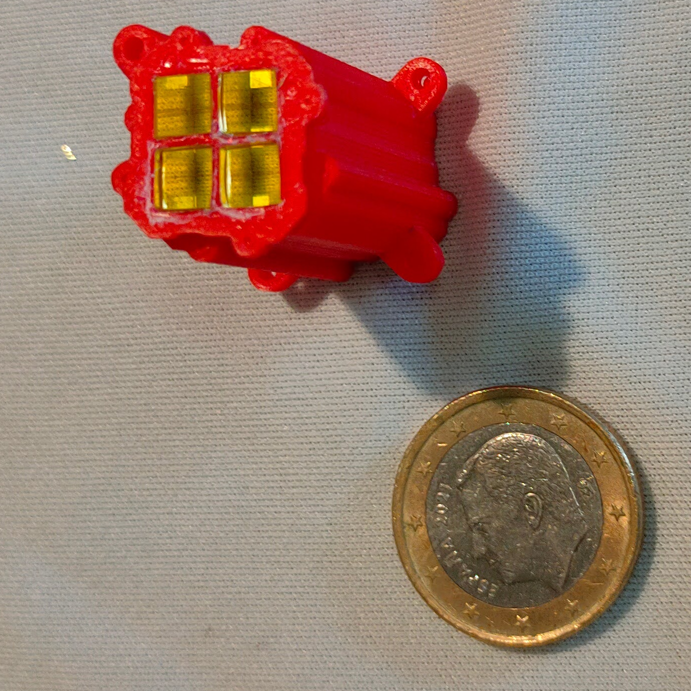
Next Steps
GAGG Characterizations & Spatial Resolution
GAGG + Plastic Scintillator & event discrimination
Simulation to improve detector design
E. Borciani - Advances in X-ray and Gamma RAy DEtectors and applications (XGRADE 2026) 24-26/03/2026, Palermo

Slide 32

Long Term Science Goal
Detect polarization of tens of GRBs per years with a Minimum Detectable Polarization < 5%
E. Borciani - Advances in X-ray and Gamma RAy DEtectors and applications (XGRADE 2026) 24-26/03/2026, Palermo

Slide 33
Science Requirements
Deadtime < 1 μs
Field of view > 1 sr
Collecting area >> 1000 cm²
Response to modulation > 0.3
E. Borciani - Advances in X-ray and Gamma RAy DEtectors and applications (XGRADE 2026) 24-26/03/2026, Palermo

Slide 34
KEY IMPROVEMENTS​
1. Pushing down the energy threshold to X-ray energy range ( goal 20 keV)​
2. 3-D event reconstruction (S/N and sensitivity improvement)​
3. Scintillators optimized for either scattering or​ absorption of scattering photons​
E. Borciani - Advances in X-ray and Gamma RAy DEtectors and applications (XGRADE 2026) 24-26/03/2026, Palermo

Slide 35
Conclusion
Large heritage
R&D activity
Future proposals
Thanks to REDSOX and THESEUS collaboration;
Collaboration between GSSI/ INAF/ INFN-LNF/ Univ. Bonn
Identification of possible improvements;
SDD vs Si-PM
Other applications of large area polarimeters possible
Clear astrophysical application
Polarimetry is the baseline, but others will be evaluated
E. Borciani - Advances in X-ray and Gamma RAy DEtectors and applications (XGRADE 2026) 24-26/03/2026, Palermo

Slide 36
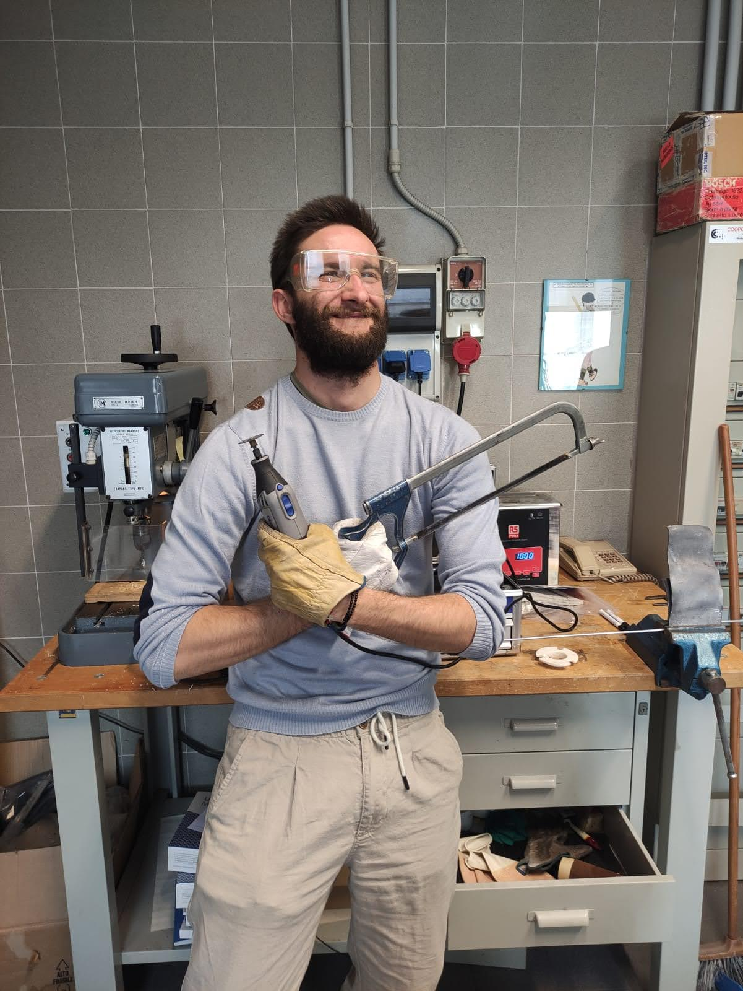
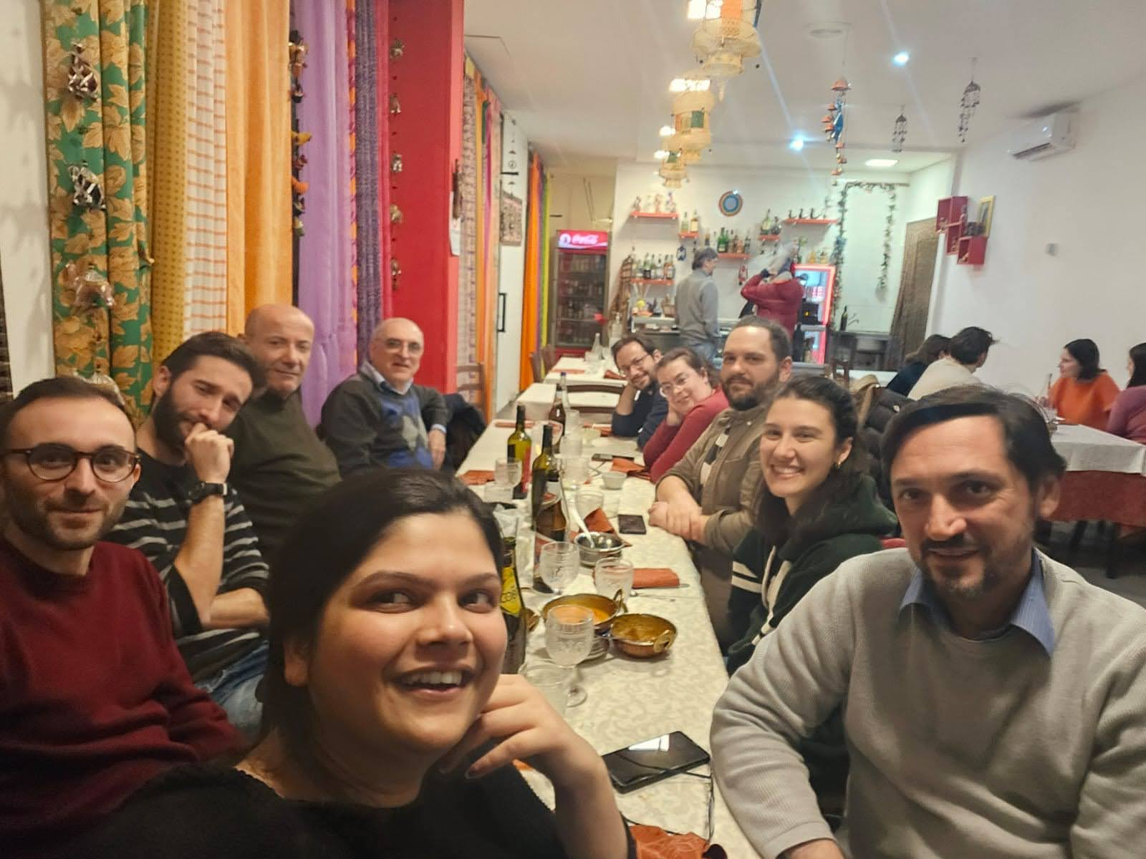
Thank You!
Contacts:
edoardo.borciani@inaf.it
riccardo.campana@inaf.it
fabio.muleri@inaf.it
E. Borciani - Advances in X-ray and Gamma RAy DEtectors and applications (XGRADE 2026) 24-26/03/2026, Palermo

Slide 37


Slide 38
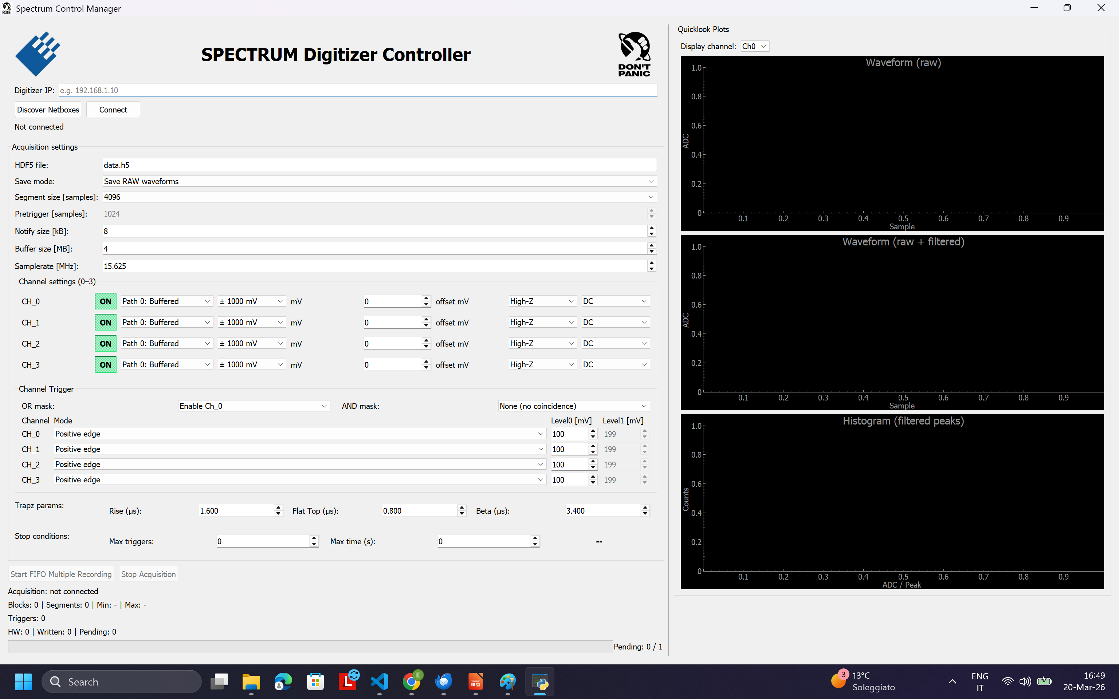
Software Spectrum
E. Borciani - Advances in X-ray and Gamma RAy DEtectors and applications (XGRADE 2026) 24-26/03/2026, Palermo

Slide 39
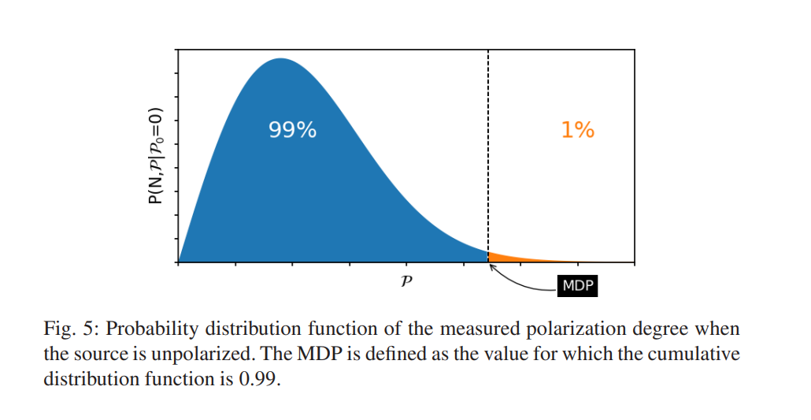

E. Borciani - Advances in X-ray and Gamma RAy DEtectors and applications (XGRADE 2026) 24-26/03/2026, Palermo

Slide 40
Software Spectrum
E. Borciani - Advances in X-ray and Gamma RAy DEtectors and applications (XGRADE 2026) 24-26/03/2026, Palermo

Slide 41
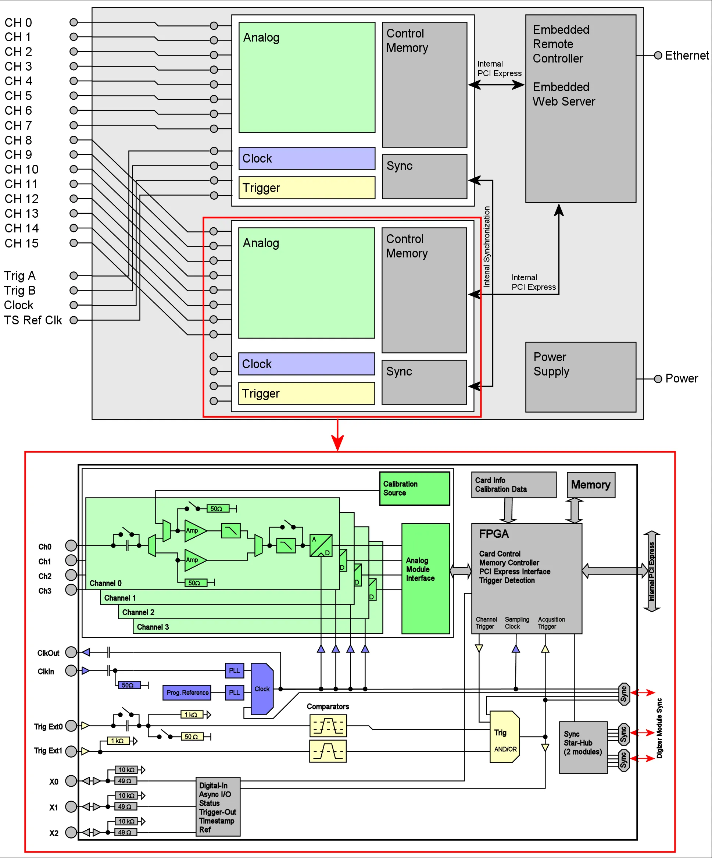
Software Spectrum
Spectrum Digitizer Characteristics:
250 MS/s on 4 channels
14 bit ADC
4 single-ended inputs
6 input ranges: ±200 mV up to ±10 V
Window, re-arm, OR/AND trigger (2-4 channels)
GBit Ethernet/LXI compatible instrument
Separate ADC and amplifier per channel
Simultaneous sampling on all channels
Datasheet
E. Borciani - Advances in X-ray and Gamma RAy DEtectors and applications (XGRADE 2026) 24-26/03/2026, Palermo

Slide 42
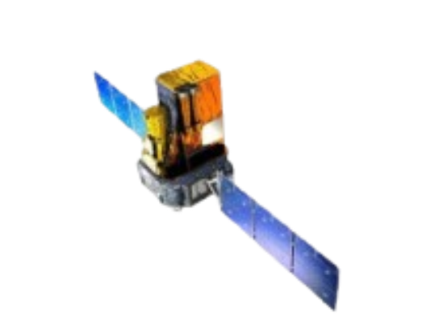
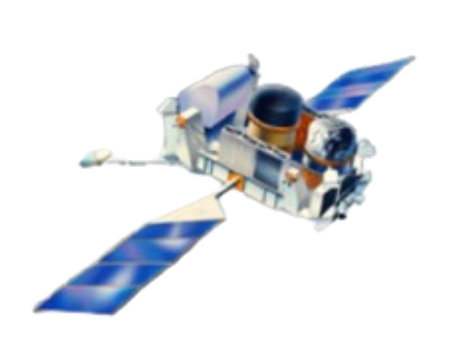
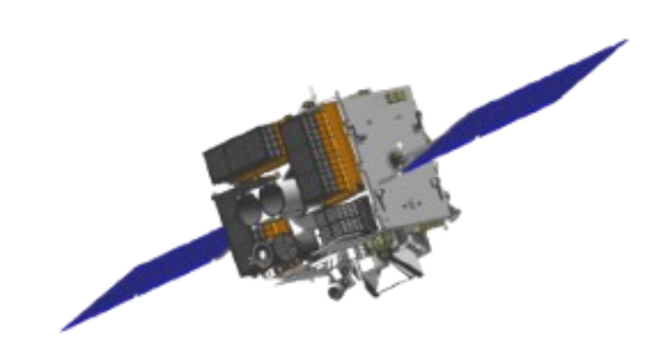
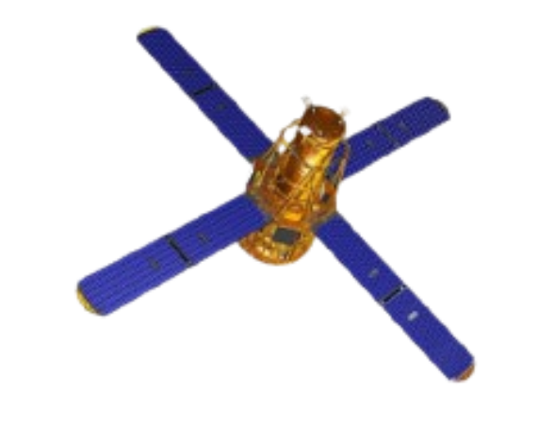
International Context
Small dedicated instruments:​
  IKAROS/GAP​
  POLAR​
POLAR : <68% (99%confidence)​
<41% (99%confidence)​
<31% (99%confidence)
COSI : <46% (90%confidence)​
IKAROS: 70 ± 22​
27 ± 11​
IBIS : >28% (90%confidence)​
>33% (90%confidence)​
< 4/43 ± 25 ​
Not-dedicated instrument:​
  CGRO-BATSE​
  INTEGRAL- IBIS/SPI​
  ASTROSAT-CZTI​
  RHESSI​
[Zhang et al., 2019]​
E. Borciani - Advances in X-ray and Gamma RAy DEtectors and applications (XGRADE 2026) 24-26/03/2026, Palermo

