Slide 1

Muhammed Emin Bedir, Ph.D
Assistant Professor Karamanoglu Mehmetbey University – Dept. of Electrical & Energy Engineering
Honorary Fellow, Medical Physics, University of Wisconsin-Madison
Co-authors: A. Yilmaz| B. R. Thomadsen
Sharpening the Surgeon’s Eye:
A Reconfigurable Dual-Mode Gamma Probe Architecture
Optimized for Radio-Guided Surgery
Advances in X-ray and Gamma RAy DEtectors and applications (XGRADE 2026)
24–26/03/2026, Palermo

Slide 2
Table of Contents
Section Category | Slide Title / Topic
Background & Intro | The Clinical Challenge in Radio-Guided Surgery
Background & Intro | Conventional Methods, Current Innovations & Their Limitations
Background & Intro | Motivation and Targets
Background & Intro | Proposed Solution and Challenges
Background & Intro | Prototype and Detector Architecture
Methods & Results | Baseline Characterization of the Detector
Methods & Results | The Limitations of Static Geometry in a Dynamic OR
Methods & Results | Overcoming the Computational Bottleneck: Mathematical Modeling
Methods & Results | Overcoming the Computational Bottleneck: Validating the Models
Methods & Results | Multi-Objective AI Optimization
Methods & Results | The Universal Design: One Probe, Two Modes
Methods & Results | Comparison with Current Commercial Probes
Conclusion | Conclusion and Future Work
Conclusion | Contributing to the ENRICH Mission
End Matter | References
End Matter | Acknowledgments
M.E.Bedir - Sharpening the Surgeon’s Eye: A Reconfigurable Dual-Mode Gamma Probe Architecture Optimized for Radio Guided Surgery (XGRADE 2026) 24-26/03/2026, Palermo

Slide 3
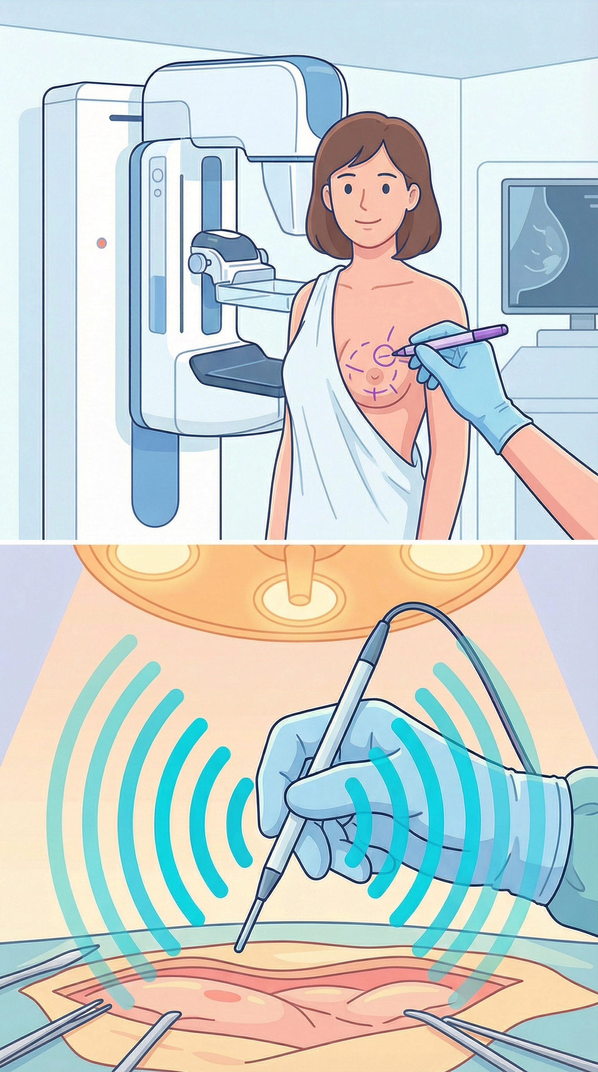
Research Problem: The Clinical Challenge in Radio-Guided Surgery
Surgical Modalities & The Ultimate Goal: Treatment ranges from lumpectomy to partial or total mastectomy. The primary objective in breast-conserving surgery is complete tumor resection with negative margins to avoid tumor recurrence (McCahill et al., 2012).
Resolving Clustered Nodes: Precise spatial resolution is crucial to distinguish deep-seated, closely spaced Sentinel Lymph Nodes (SLNs).
Limitations of Conventional Localization: Current techniques, such as Wire-Guided Localization (WGL) and Radioactive Seed Localization (RSL), rely heavily on preoperative imaging. These methods only identify the tumor's center, failing to provide real-time information about the tumor's margins or extent (Gray et al., 2004; Pouw et al., 2016).
The Clinical Reality: Because surgeons lack a real-time map of the true tumor borders, intraoperative margin delineation, re-excision rates remain unacceptably high (up to 23%), necessitating repeated surgeries to clear positive margins.
M.E.Bedir - Sharpening the Surgeon’s Eye: A Reconfigurable Dual-Mode Gamma Probe Architecture Optimized for Radio Guided Surgery (XGRADE 2026) 24-26/03/2026, Palermo

Slide 4
Conventional Methods, Current Innovations & Their Limitations
WGL
No information about the margins of the tumor.
No real time visual guidance.
RSL
No information about the margins of the tumor.
Freehand SPECT
An optical 3D tracking system combined with a gamma probe provides intraoperative 3D images. However, it requires a static surgical field; it is not truly "real-time" if the patient or target moves. (Bluemel et al, 2016)
No Margin Information is provided.
No real time visual guidance.
Difficulty to resolve clustered nodes at depth. (Engelen et al, 2015)
The 3D Image from the camera does not freely follow the surgeon’s vantage.
M.E.Bedir - Sharpening the Surgeon’s Eye: A Reconfigurable Dual-Mode Gamma Probe Architecture Optimized for Radio Guided Surgery (XGRADE 2026) 24-26/03/2026, Palermo

Slide 5
Motivation and Targets
To image the whole tumor with margin information by using a breast tumor-seeking imaging agent such as CLR1404 that labelled with ¹²³I source, and a ^{99m}Tc source to image the clustered nodes at depth.
CLR1404 is found to be taken up by almost all types of the tumor including breast tumor cells, but not by healthy cells. (Weichert, 2014)
By having information about the extent of the tumor and separated nodes at depth, improving the success rate at the first attempt of the surgery.
The other cancer patients can benefit from this approach since CLR1404 is taken up not only by breast tumor cells but also by other types of cancer cells. (Weichert, 2014)
It aims to offer improvements in workflow: Patient wait time and staff time.
5
M.E.Bedir - Sharpening the Surgeon’s Eye: A Reconfigurable Dual-Mode Gamma Probe Architecture Optimized for Radio Guided Surgery (XGRADE 2026) 24-26/03/2026, Palermo

Slide 6
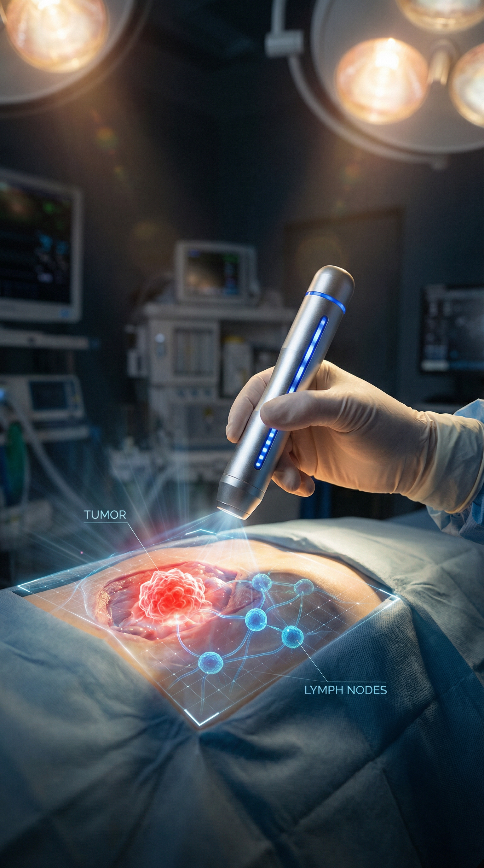
Proposed Solution and Challenges
An Advanced Intraoperative Tool: A handheld, robotic-adaptable, AI-supported gamma detection system designed to actively guide the surgeon in real-time.
Dual-Isotope Discrimination: Utilizing ¹²³I-CLR1404 (159 keV) to illuminate the entire tumor margin, concurrently with ⁹⁹ᵐTc (140.5 keV) nanoparticles to map Sentinel Lymph Nodes (SLNs) (Weichert et al., 2014).
The Instrumentation Bottleneck: This requires a detector with superior energy resolution to distinguish between 140.5 keV and 159 keV. Furthermore, it must overcome the static trade-off in physics that:
    High Sensitivity to rapidly detect signals, but simultaneously demands
    High Spatial Resolution to resolve clustered SLNs separated by as little as 10 mm at depth (Engelen et al., 2015).
M.E.Bedir - Sharpening the Surgeon’s Eye: A Reconfigurable Dual-Mode Gamma Probe Architecture Optimized for Radio Guided Surgery (XGRADE 2026) 24-26/03/2026, Palermo

Slide 7
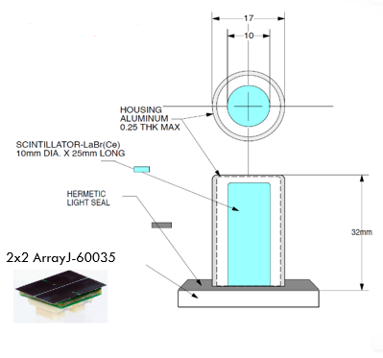
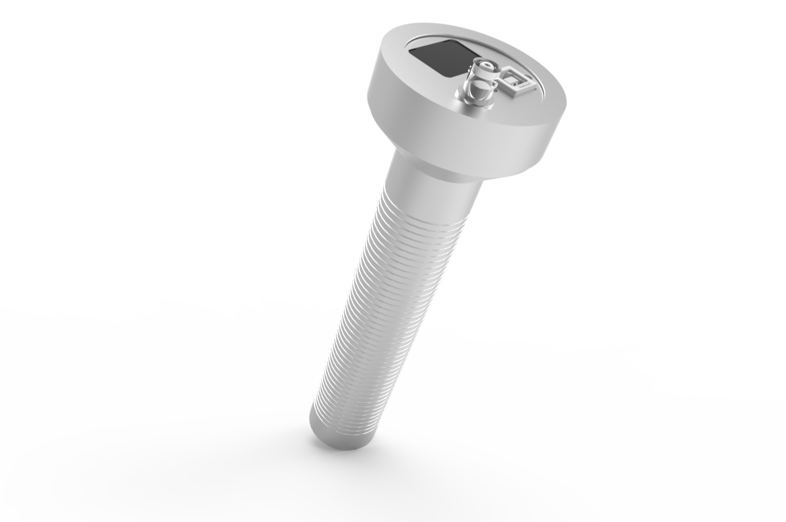
The Bare Proto-type of the detector
Charger Jack
Silk screen: Battery Charge level
BNC Connector
Built in: Li-ion battery and front-end electronics including Pre-Amplifier
7
M.E.Bedir - Sharpening the Surgeon’s Eye: A Reconfigurable Dual-Mode Gamma Probe Architecture Optimized for Radio Guided Surgery (XGRADE 2026) 24-26/03/2026, Palermo

Slide 8
Research Problem: The Clinical Challenge in Radio-Guided Surgery
Surgical Modalities & The Ultimate Goal: Treatment ranges from lumpectomy to partial or total mastectomy. The primary objective in breast-conserving surgery is complete tumor resection with negative margins to avoid tumor recurrence (McCahill et al., 2012).
Resolving Clustered Nodes: Precise spatial resolution is crucial to distinguish deep-seated, closely spaced Sentinel Lymph Nodes (SLNs).
Limitations of Conventional Localization: Current techniques, such as Wire-Guided Localization (WGL) and Radioactive Seed Localization (RSL), rely heavily on preoperative imaging. These methods only identify the tumor's center, failing to provide real-time information about the tumor's margins or extent (Gray et al., 2004; Pouw et al., 2016).
The Clinical Reality: Because surgeons lack a real-time map of the true tumor borders, intraoperative margin delineation, re-excision rates remain unacceptably high (up to 23%), necessitating repeated surgeries to clear positive margins.
M.E.Bedir - Sharpening the Surgeon’s Eye: A Reconfigurable Dual-Mode Gamma Probe Architecture Optimized for Radio Guided Surgery (XGRADE 2026) 24-26/03/2026, Palermo

Slide 9
Research Problem: The Clinical Challenge in Radio-Guided Surgery
Surgical Modalities & The Ultimate Goal: Treatment ranges from lumpectomy to partial or total mastectomy. The primary objective in breast-conserving surgery is complete tumor resection with negative margins to avoid tumor recurrence (McCahill et al., 2012).
Resolving Clustered Nodes: Precise spatial resolution is crucial to distinguish deep-seated, closely spaced Sentinel Lymph Nodes (SLNs).
Limitations of Conventional Localization: Current techniques, such as Wire-Guided Localization (WGL) and Radioactive Seed Localization (RSL), rely heavily on preoperative imaging. These methods only identify the tumor's center, failing to provide real-time information about the tumor's margins or extent (Gray et al., 2004; Pouw et al., 2016).
The Clinical Reality: Because surgeons lack a real-time map of the true tumor borders, intraoperative margin delineation, re-excision rates remain unacceptably high (up to 23%), necessitating repeated surgeries to clear positive margins.
M.E.Bedir - Sharpening the Surgeon’s Eye: A Reconfigurable Dual-Mode Gamma Probe Architecture Optimized for Radio Guided Surgery (XGRADE 2026) 24-26/03/2026, Palermo

Slide 10
Conventional Methods, Current Innovations & Their Limitations
WGL
No information about the margins of the tumor.
No real time visual guidance.
RSL
No information about the margins of the tumor.
Freehand SPECT
An optical 3D tracking system combined with a gamma probe provides intraoperative 3D images. However, it requires a static surgical field; it is not truly "real-time" if the patient or target moves. (Bluemel et al, 2016)
No Margin Information is provided.
No real time visual guidance.
Difficulty to resolve clustered nodes at depth. (Engelen et al, 2015)
The 3D Image from the camera does not freely follow the surgeon’s vantage.
M.E.Bedir - Sharpening the Surgeon’s Eye: A Reconfigurable Dual-Mode Gamma Probe Architecture Optimized for Radio Guided Surgery (XGRADE 2026) 24-26/03/2026, Palermo

Slide 11
Motivation and Targets
To image the whole tumor with margin information by using a breast tumor-seeking imaging agent such as CLR1404 that labelled with ¹²³I source, and a ^{99m}Tc source to image the clustered nodes at depth.
CLR1404 is found to be taken up by almost all types of the tumor including breast tumor cells, but not by healthy cells. (Weichert, 2014)
By having information about the extent of the tumor and separated nodes at depth, improving the success rate at the first attempt of the surgery.
The other cancer patients can benefit from this approach since CLR1404 is taken up not only by breast tumor cells but also by other types of cancer cells. (Weichert, 2014)
It aims to offer improvements in workflow: Patient wait time and staff time.
11
M.E.Bedir - Sharpening the Surgeon’s Eye: A Reconfigurable Dual-Mode Gamma Probe Architecture Optimized for Radio Guided Surgery (XGRADE 2026) 24-26/03/2026, Palermo

Slide 12
Proposed Solution and Challenges
An Advanced Intraoperative Tool: A handheld, robotic-adaptable, AI-supported gamma detection system designed to actively guide the surgeon in real-time.
Dual-Isotope Discrimination: Utilizing ¹²³I-CLR1404 (159 keV) to illuminate the entire tumor margin, concurrently with ⁹⁹ᵐTc (140.5 keV) nanoparticles to map Sentinel Lymph Nodes (SLNs) (Weichert et al., 2014).
The Instrumentation Bottleneck: This requires a detector with superior energy resolution to distinguish between 140.5 keV and 159 keV. Furthermore, it must overcome the static trade-off in physics that:
    High Sensitivity to rapidly detect signals, but simultaneously demands
    High Spatial Resolution to resolve clustered SLNs separated by as little as 10 mm at depth (Engelen et al., 2015).
M.E.Bedir - Sharpening the Surgeon’s Eye: A Reconfigurable Dual-Mode Gamma Probe Architecture Optimized for Radio Guided Surgery (XGRADE 2026) 24-26/03/2026, Palermo

Slide 13
The Bare Proto-type of the detector
Charger Jack
Silk screen: Battery Charge level
BNC Connector
Built in: Li-ion battery and front-end electronics including Pre-Amplifier
13
M.E.Bedir - Sharpening the Surgeon’s Eye: A Reconfigurable Dual-Mode Gamma Probe Architecture Optimized for Radio Guided Surgery (XGRADE 2026) 24-26/03/2026, Palermo

Slide 14
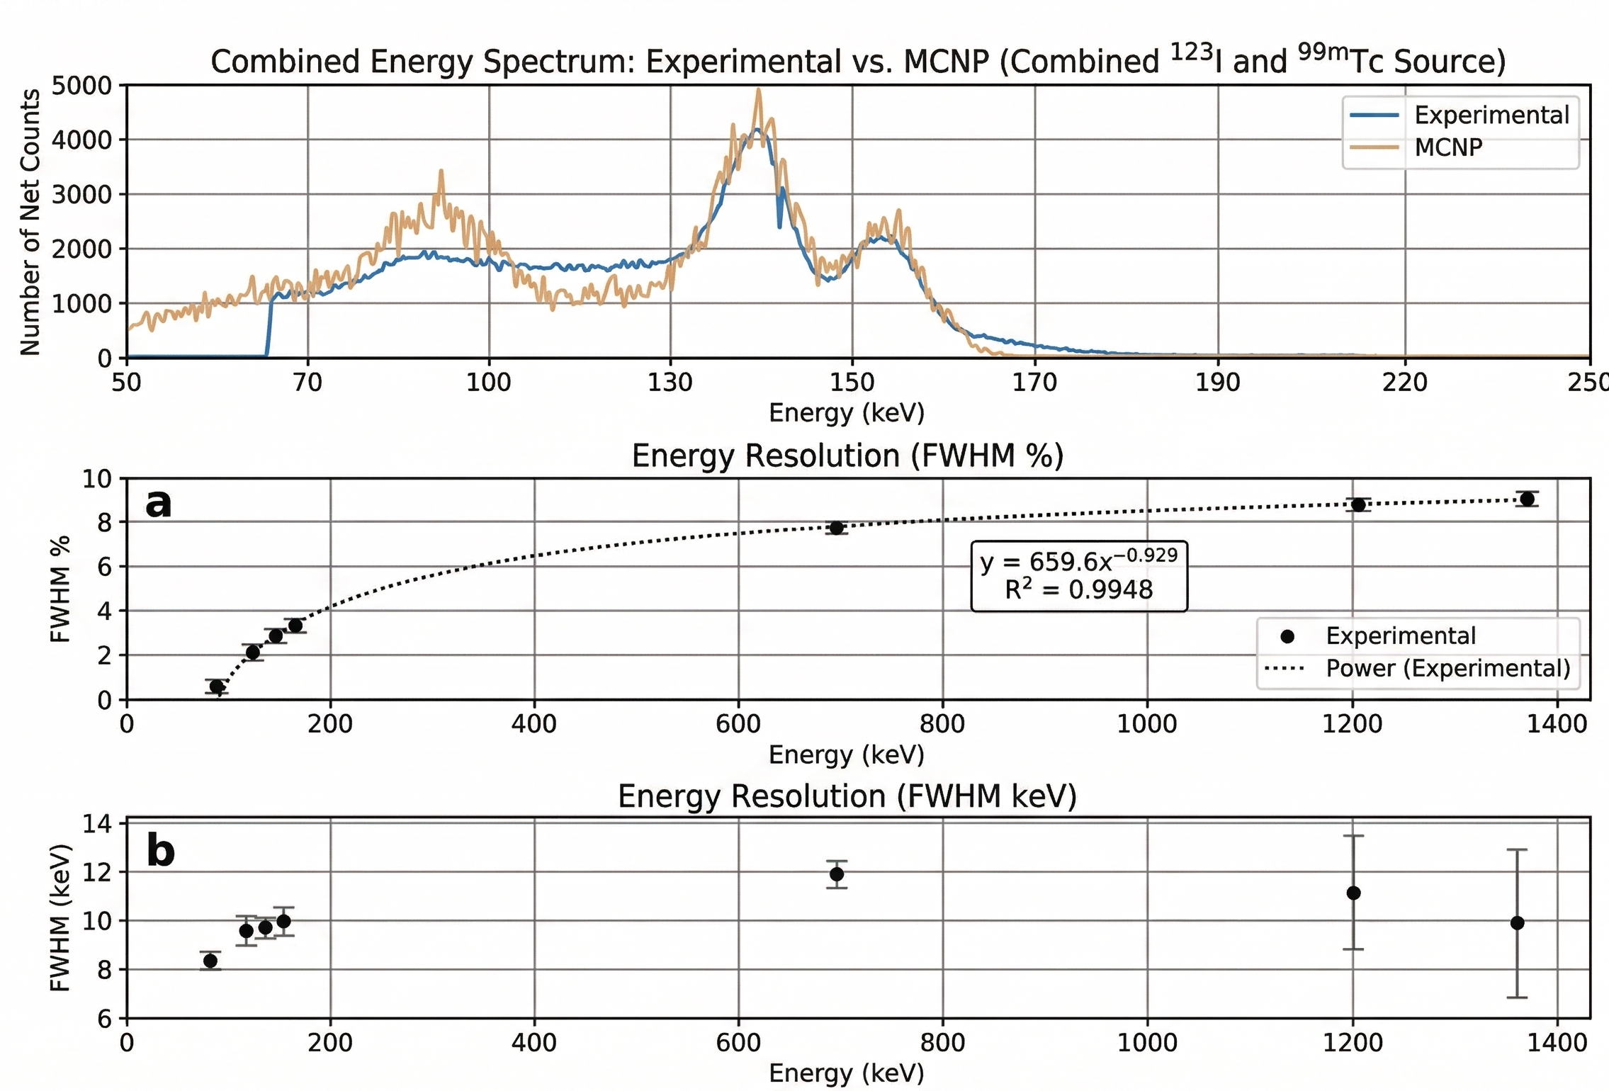
Baseline Characterization of the Detector (Bedir et al, 2020)
Very good Energy Resolution: Achieved < 10 keV FWHM at energies below 159 keV, providing excellent spectral discrimination.
Dual-Isotope Separation: Successfully and clearly resolved the 141 keV (⁹⁹ᵐTc) and 159 keV (¹²³I) photopeaks simultaneously.
Computational Validation: Experimental efficiency and spectra strongly aligned with high-fidelity MCNPX Monte Carlo simulations, establishing a rock-solid foundation.
14
M.E.Bedir - Sharpening the Surgeon’s Eye: A Reconfigurable Dual-Mode Gamma Probe Architecture Optimized for Radio Guided Surgery (XGRADE 2026) 24-26/03/2026, Palermo

Slide 15
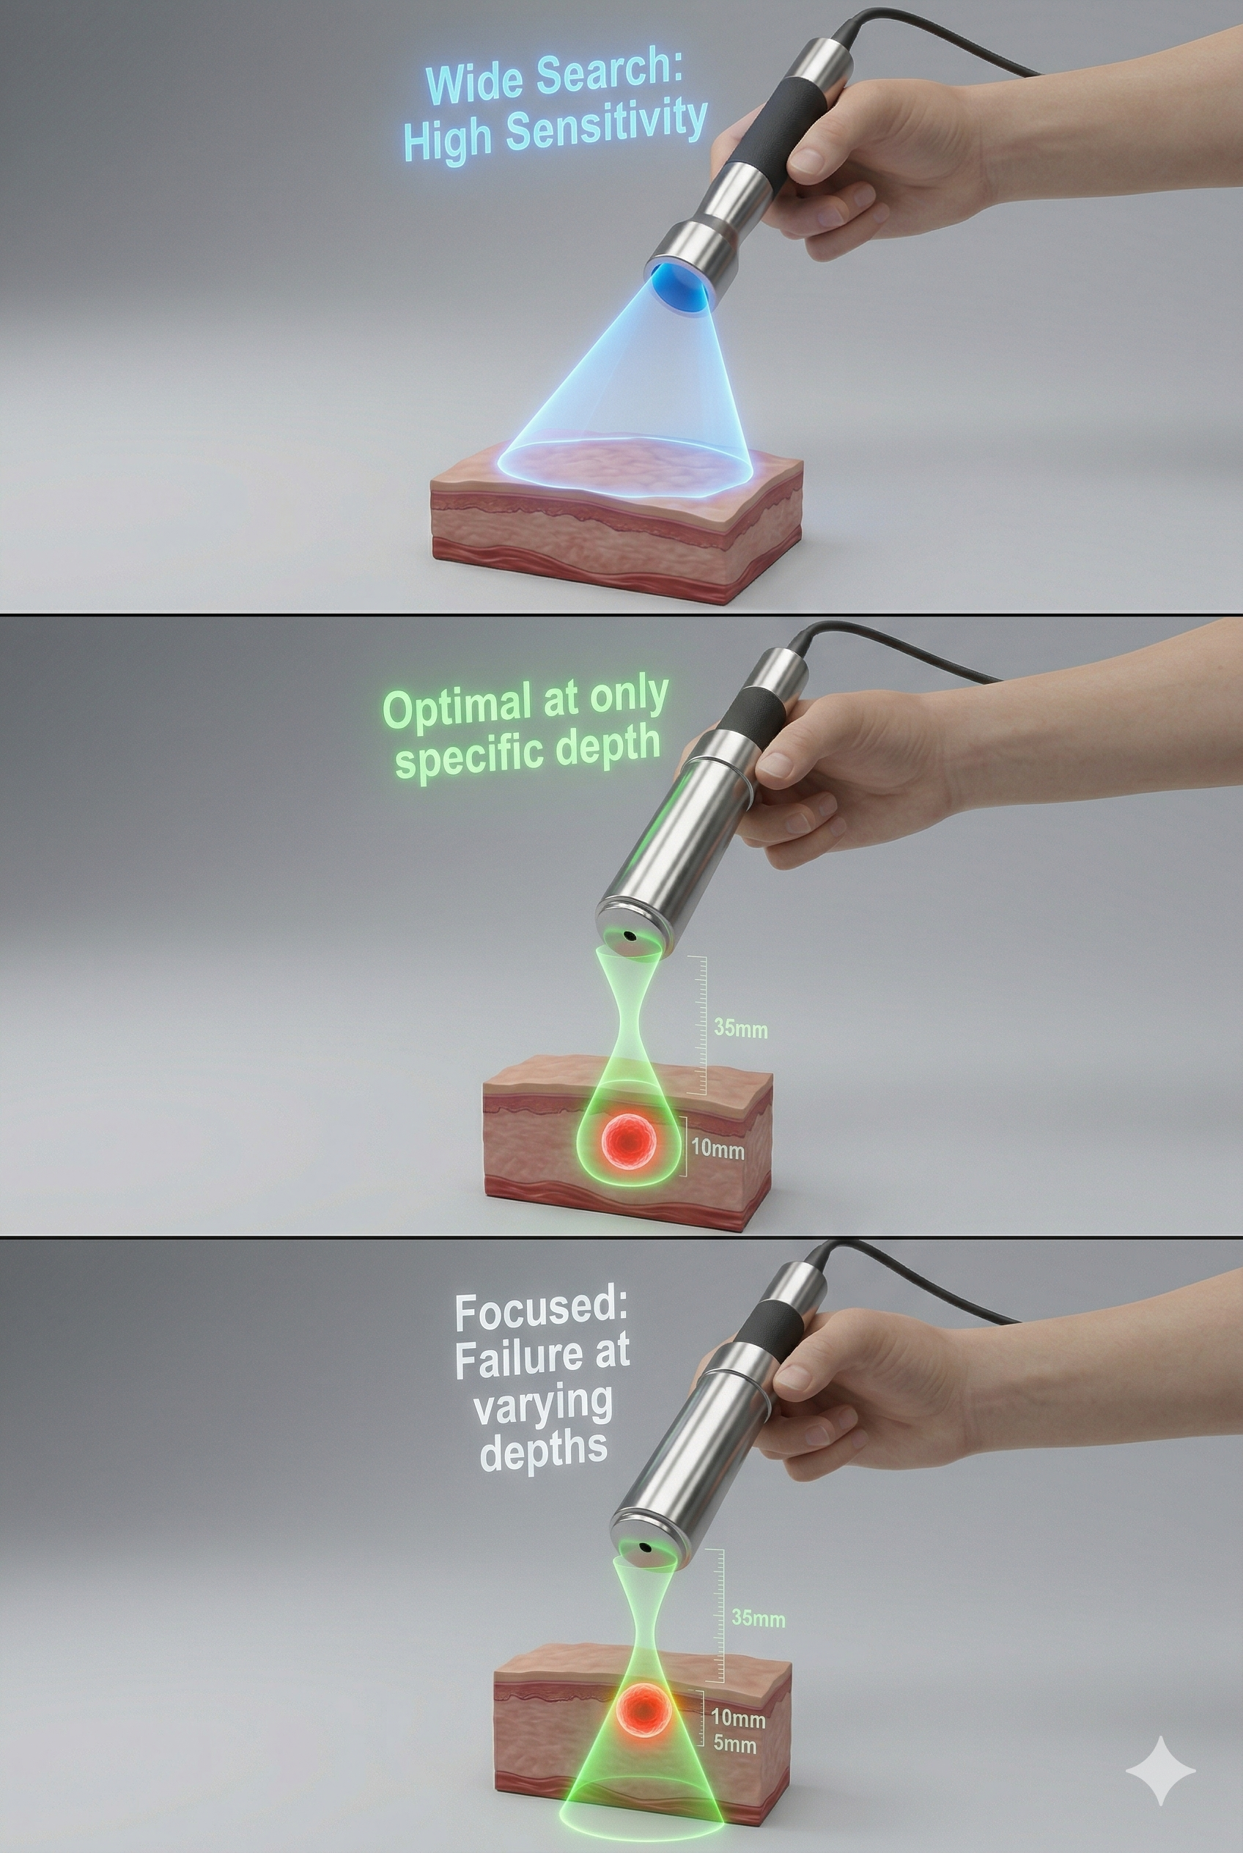
The Limitations of Static Geometry in a Dynamic OR
The Adaptability Problem: Advanced static probes (e.g., focused collimators) can achieve high resolution and sensitivity, but only at a single, specific focal depth. Their performance degrades rapidly as the source-to-detector distance changes in a dynamic surgical field (Wilson et al., 2024).
The Field of View (FOV) Dilemma: The surgical workflow consists of two distinct phases. Rapidly surveying the surgical bed requires a broad FOV (acting as a "wide-beam flashlight"). Pinpointing precise margins requires a highly restricted FOV (acting as a "focused laser").
The Unmet Need: Surgeons currently lack a single instrument capable of dynamically shifting its optics to adapt to the immediate clinical task at varying depths.
15
M.E.Bedir - Sharpening the Surgeon’s Eye: A Reconfigurable Dual-Mode Gamma Probe Architecture Optimized for Radio Guided Surgery (XGRADE 2026) 24-26/03/2026, Palermo
Notes:
"

Slide 16
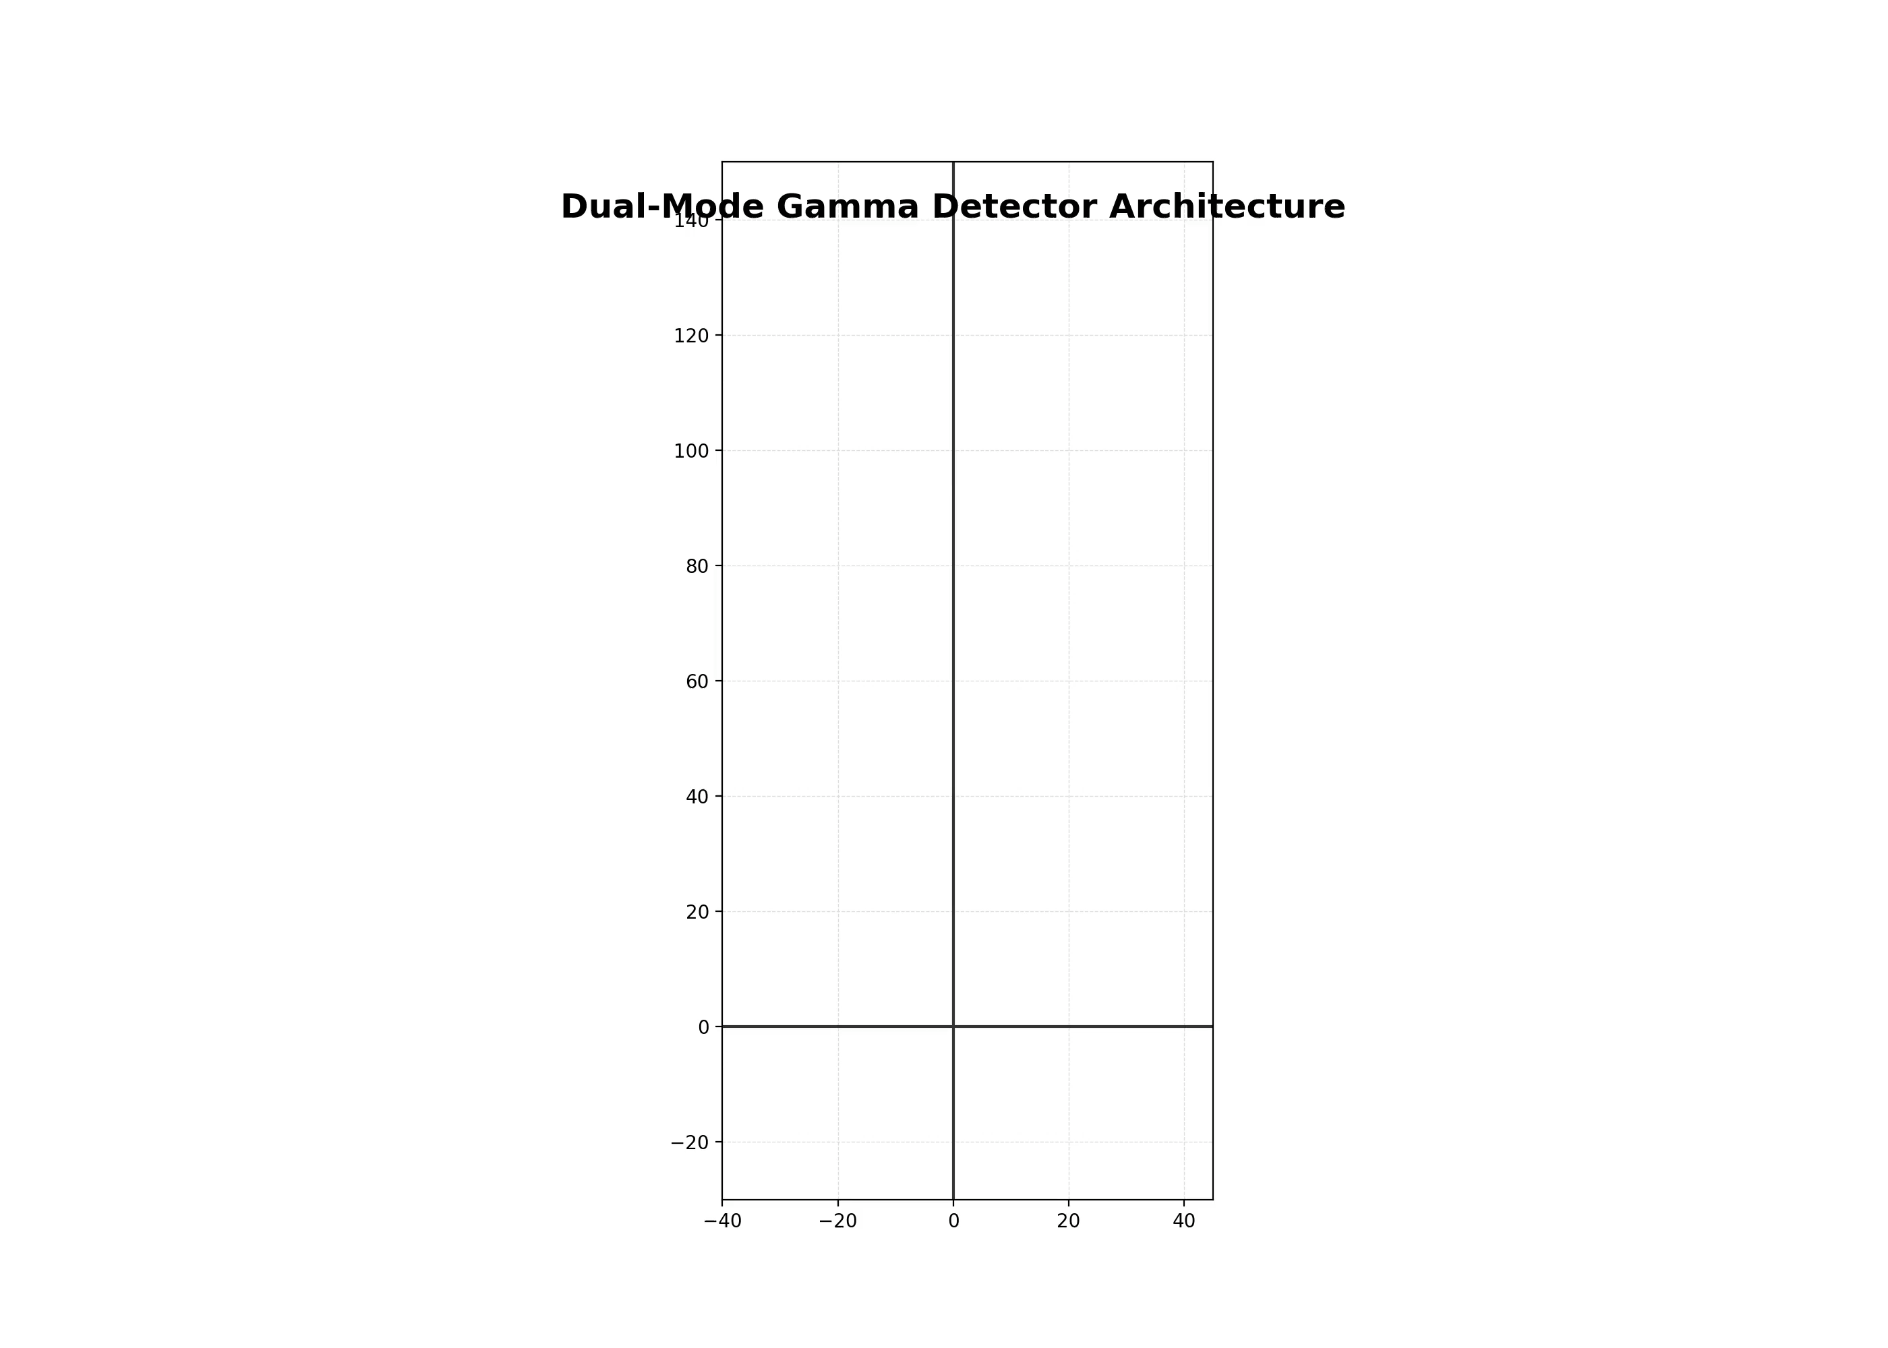
Slide title
Use Cocomat Pro as font
M.E.Bedir - Sharpening the Surgeon’s Eye: A Reconfigurable Dual-Mode Gamma Probe Architecture Optimized for Radio Guided Surgery (XGRADE 2026) 24-26/03/2026, Palermo

Slide 17
Overcoming the Computational Bottleneck: Mathematical Modeling
Millions of Combinations: Optimizing six independent variables creates millions of possible geometries. Simulating each in MCNP6 is computationally impossible.
The Search for a Solution: To feed our AI optimization algorithm, we needed a mathematical model that delivers results in seconds while maintaining the high accuracy of MCNP and physical experiments.
Two Developed Models: Simplified Analytical Model: An ultra-fast model based on solid-angle geometry. Monte Carlo Ray-Tracing: A more complex approach modeling septal penetration. Bedir, M. E., Yilmaz, A., & Thomadsen, B. R. (2026). Physics in Medicine & Biology, 71(5), 055009.
17
M.E.Bedir - Sharpening the Surgeon’s Eye: A Reconfigurable Dual-Mode Gamma Probe Architecture Optimized for Radio Guided Surgery (XGRADE 2026) 24-26/03/2026, Palermo

Slide 18
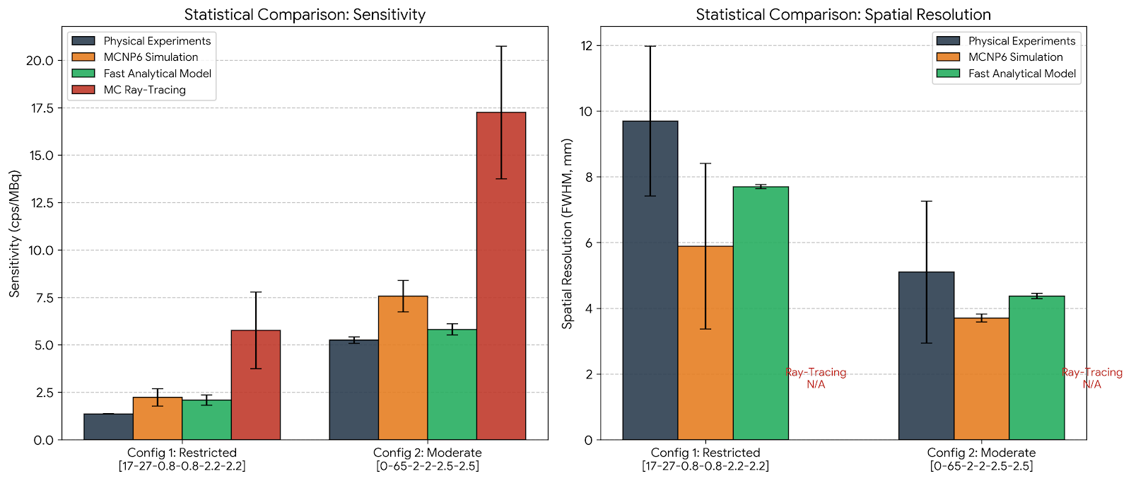
Overcoming the Computational Bottleneck: Validating the Models
Bedir, M. E., Yilmaz, A., & Thomadsen, B. R. (2026). Physics in Medicine & Biology, 71(5), 055009.
18
M.E.Bedir - Sharpening the Surgeon’s Eye: A Reconfigurable Dual-Mode Gamma Probe Architecture Optimized for Radio Guided Surgery (XGRADE 2026) 24-26/03/2026, Palermo

Slide 19
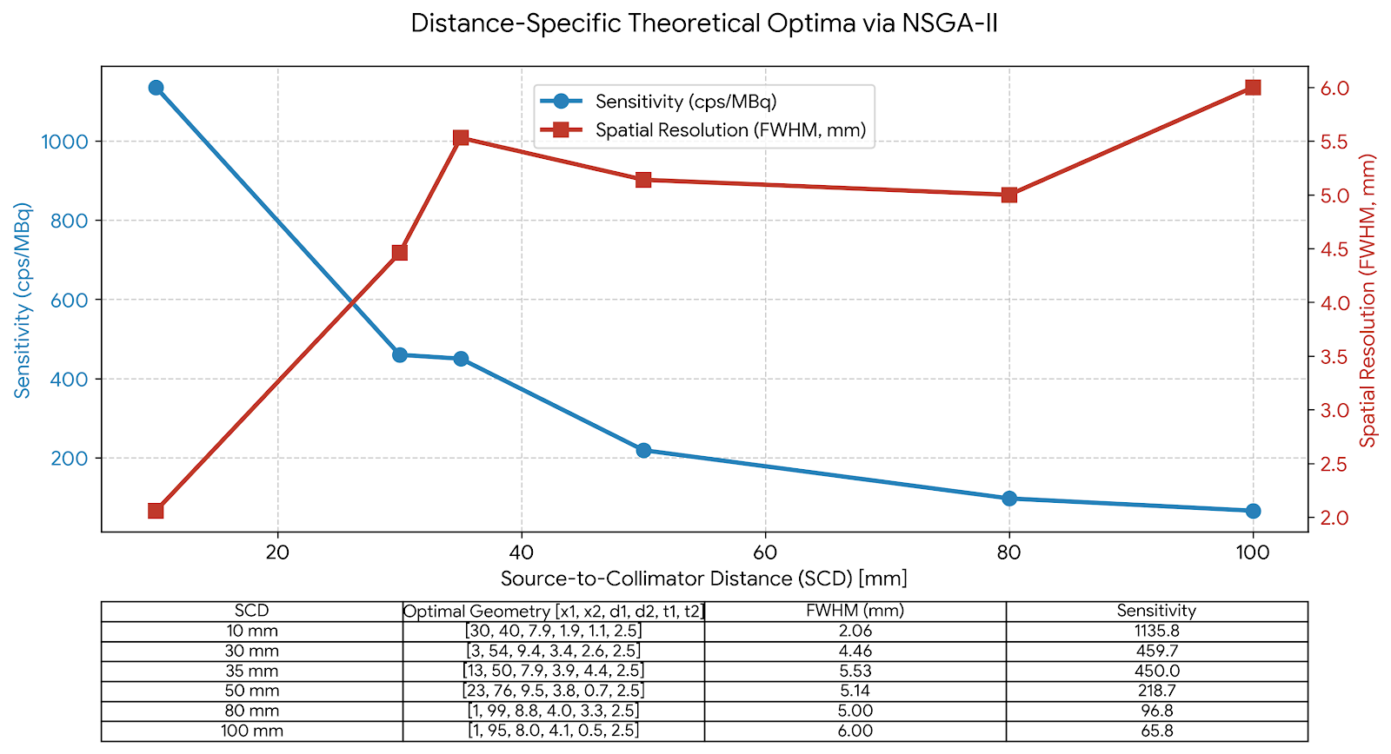
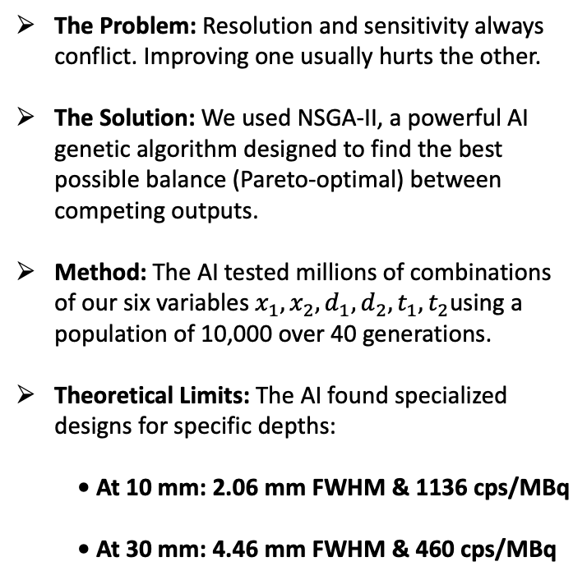
Multi-Objective AI Optimization
The Problem: Resolution and sensitivity always conflict. Improving one usually hurts the other.
The Solution: We used NSGA-II, a powerful AI genetic algorithm designed to find the best possible balance (Pareto-optimal) between competing outputs.
Method: The AI tested millions of combinations of our six variables $x_{1}, x_{2}, d_{1}, d_{2}, t_{1}, t_{2}$using a population of 10,000 over 40 generations.
Theoretical Limits: The AI found specialized designs for specific depths:
  • At 10 mm: 2.06 mm FWHM & 1136 cps/MBq
  • At 30 mm: 4.46 mm FWHM & 460 cps/MBq
Bedir, M. E., Yilmaz, A., & Thomadsen, B. R. (2026). Physics in Medicine & Biology, 71(5), 055009.
19
M.E.Bedir - Sharpening the Surgeon’s Eye: A Reconfigurable Dual-Mode Gamma Probe Architecture Optimized for Radio Guided Surgery (XGRADE 2026) 24-26/03/2026, Palermo

Slide 20
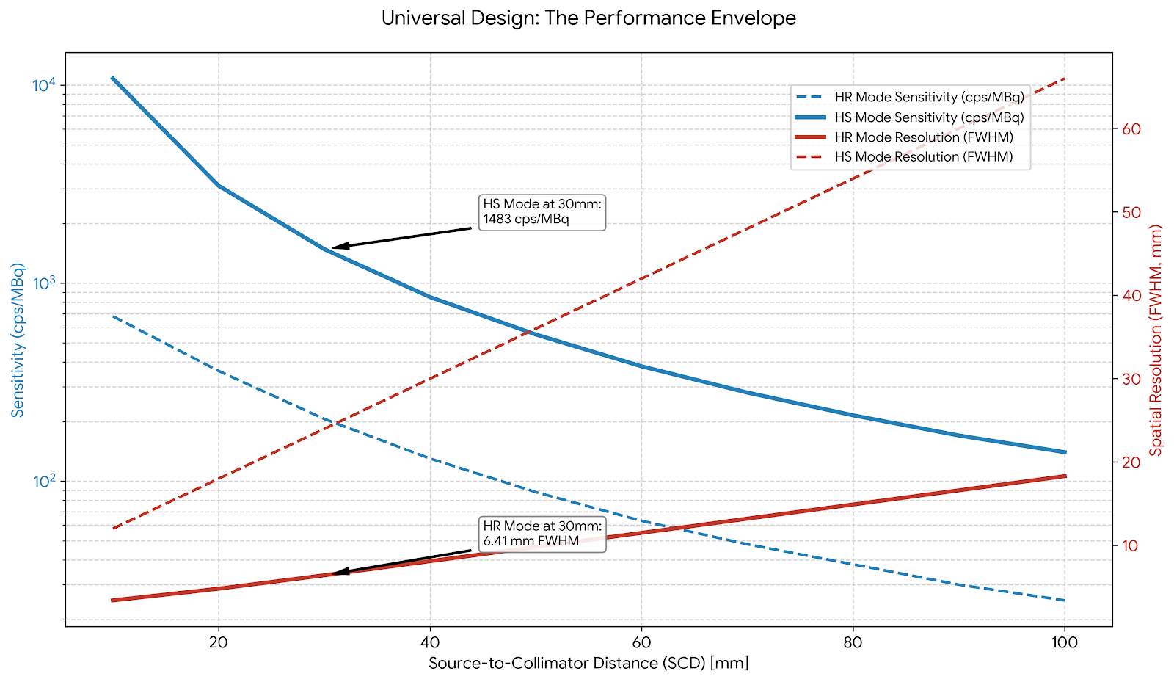
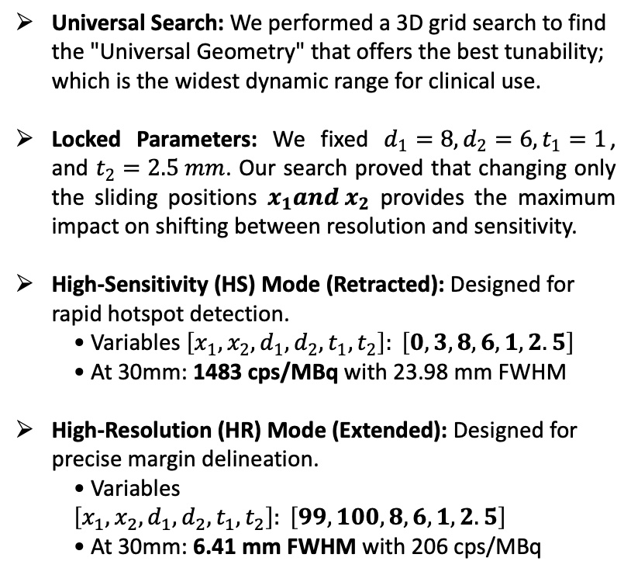
The Universal Design: One Probe, Two Modes
Universal Search: We performed a 3D grid search to find the "Universal Geometry" that offers the best tunability; which is the widest dynamic range for clinical use.
Locked Parameters: We fixed $d_{1}=8, d_{2}=6, t_{1}=1$, and $t_{2}=2.5 mm$. Our search proved that changing only the sliding positions $x_{1}and x_{2}$ provides the maximum impact on shifting between resolution and sensitivity.
High-Sensitivity (HS) Mode (Retracted): Designed for rapid hotspot detection.
  • Variables $\left[x_{1}, x_{2}, d_{1}, d_{2}, t_{1}, t_{2}\right]: \left[0, 3, 8, 6, 1, 2.5\right]$
  • At 30mm: 1483 cps/MBq with 23.98 mm FWHM
High-Resolution (HR) Mode (Extended): Designed for precise margin delineation.
  • Variables $\left[x_{1}, x_{2}, d_{1}, d_{2}, t_{1}, t_{2}\right]: \left[99, 100, 8, 6, 1, 2.5\right]$
  • At 30mm: 6.41 mm FWHM with 206 cps/MBq
Bedir, M. E., Yilmaz, A., & Thomadsen, B. R. (2026). Physics in Medicine & Biology, 71(5), 055009.
20
M.E.Bedir - Sharpening the Surgeon’s Eye: A Reconfigurable Dual-Mode Gamma Probe Architecture Optimized for Radio Guided Surgery (XGRADE 2026) 24-26/03/2026, Palermo

Slide 21
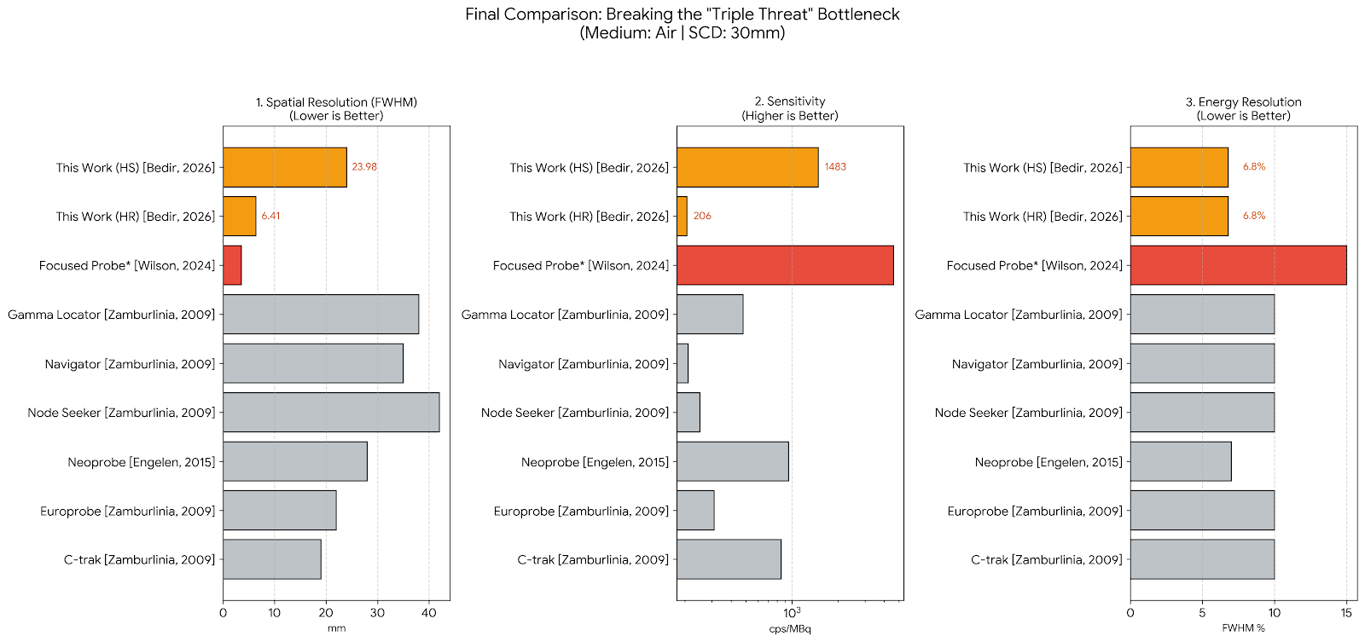
Comparison with Current Commercial Probes
The Three Clinical Targets: Effective surgery requires (1) High Sensitivity for searching, (2) Sharp Resolution for margins, and (3) High Energy Resolution for multi-tracer discrimination.
The Industry Gap: Existing probes are locked. High-sensitivity probes have poor resolution (e.g., Neoprobe), and high-resolution probes have low sensitivity or poor energy discrimination (Wilson et al., 2024; Zamburlinia et al., 2009).
This Work : Our single, reconfigurable instrument is the only one to hit all three targets at a standard 30mm depth:
  Best Search: 1483 cps/MBq in HS Mode.
  Best Margins: 6.41 mm resolution in HR Mode.
  Best Discrimination: 6.8% Energy Resolution for dual-isotope (Tc-99m/I-123) surgery.
Bedir, M. E., Yilmaz, A., & Thomadsen, B. R. (2026). Physics in Medicine & Biology, 71(5), 055009.
21
M.E.Bedir - Sharpening the Surgeon’s Eye: A Reconfigurable Dual-Mode Gamma Probe Architecture Optimized for Radio Guided Surgery (XGRADE 2026) 24-26/03/2026, Palermo

Slide 22
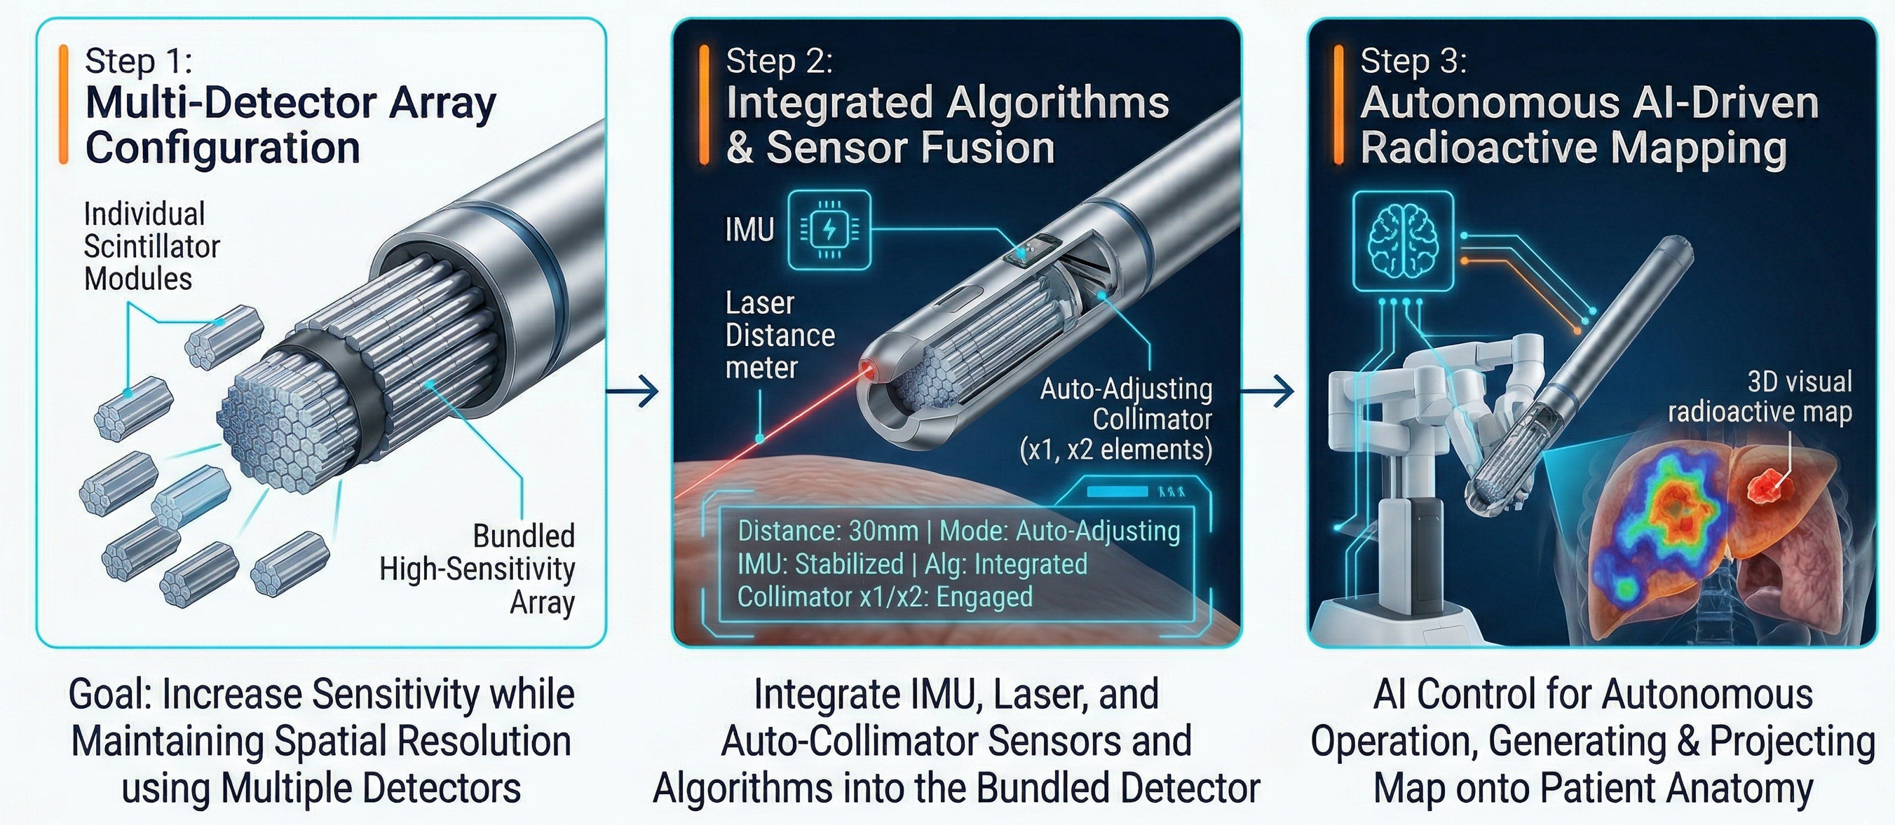
Conclusion and Future Work
Achieved Targets: Successfully met all clinical targets: 6.41 mm resolution for margins, 1483 cps/MBq for SLN search, and high-purity dual-isotope discrimination.
Step 1 Multi-Detector Bundling: Leveraging the single-unit success to create arrays that multiply sensitivity while preserving high spatial resolution.
Step 2 Sensor Fusion: Integrating laser distance meters and IMUs to automate the reconfigurable collimators (x₁, x₂) for "Resolution-on-Demand.
Step 3: Autonomous AI & Robotics: Full integration with robotic platforms to generate 3D radioactive maps projected directly onto patient anatomy.
Bedir, M. E., Yilmaz, A., & Thomadsen, B. R. (2026). Physics in Medicine & Biology, 71(5), 055009.
22
M.E.Bedir - Sharpening the Surgeon’s Eye: A Reconfigurable Dual-Mode Gamma Probe Architecture Optimized for Radio Guided Surgery (XGRADE 2026) 24-26/03/2026, Palermo

Slide 23
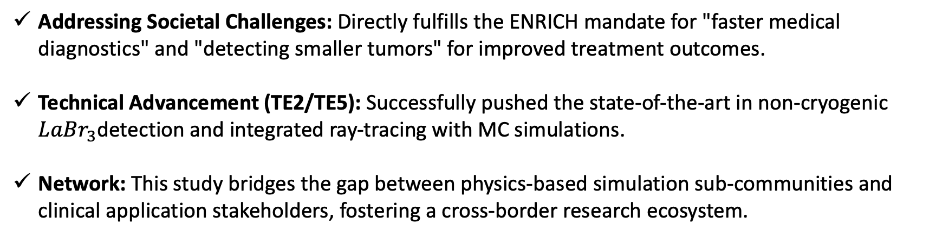
Contributing to the ENRICH Mission
Addressing Societal Challenges: Directly fulfills the ENRICH mandate for "faster medical diagnostics" and "detecting smaller tumors" for improved treatment outcomes.
Technical Advancement (TE2/TE5): Successfully pushed the state-of-the-art in non-cryogenic $LaBr_{3}$detection and integrated ray-tracing with MC simulations.
Network: This study bridges the gap between physics-based simulation sub-communities and clinical application stakeholders, fostering a cross-border research ecosystem.
23
M.E.Bedir - Sharpening the Surgeon’s Eye: A Reconfigurable Dual-Mode Gamma Probe Architecture Optimized for Radio Guided Surgery (XGRADE 2026) 24-26/03/2026, Palermo

Slide 24
References
Bedir, M. E. (2020). Design, development and characterization of a handheld radiation detector for radioguided surgery. [Doctoral dissertation, University of Wisconsin-Madison].
Bedir, M. E., Thomadsen, B. R., & Bednarz, B. P. (2020). Development and characterization of a handheld radiation detector for radio-guided surgery. Radiation Measurements, 135, 106362.
Bedir, M. E., Yilmaz, A., & Thomadsen, B. R. (2026). Sharpening the surgeon’s eye: An adaptable dual-mode gamma probe architecture optimized for high-resolution and high-sensitivity radio-guided surgery. Physics in Medicine & Biology, 71(5), 055009.
Engelen, T., Winkel, B. M., Rietbergen, D. D., KleinJan, G. H., Vidal-Sicart, S., Olmos, R. A., van den Berg, N. S., & van Leeuwen, F. W. (2015). The next evolution in radioguided surgery: Breast cancer related sentinel node localization using a freehandSPECT-mobile gamma camera combination. American Journal of Nuclear Medicine and Molecular Imaging, 5(3), 233.
Gray, R. J., Salud, C., Nguyen, K., Dauway, E., Friedland, J., Berman, C., Peltz, S., Cox, C. E., & Reintgen, D. S. (2004). Randomized prospective evaluation of a novel technique for biopsy or lumpectomy of nonpalpable breast lesions: Radioactive seed localization versus wire localization. Annals of Surgical Oncology, 11(7), 678–687.
McCahill, L. E., Single, R. M., Aiello Bowles, E. J., Feigelson, H. S., James, T. A., Barney, T., Engel, J. M., & Onitilo, A. A. (2012). Variability in reexcision following breast conservation surgery. JAMA, 307(5), 467–475.
Pouw, B., de Wit-van der Veen, L. J., Stokkel, M. P., Loo, C. E., Vrancken Peeters, M. J., & Valdés Olmos, R. A. (2016). Magnetic tracer guidance for resection of non-palpable breast cancer: A systematic review. European Journal of Surgical Oncology, 42(7), 927–937.
Weichert, J. P., Clark, P. A., Kandela, I. K., Vaccaro, A. M., Longino, M. A., Titz, B., Neuman, A. M., Keles, S., Hall, L. T., & Kuo, J. S. (2014). Alkylphosphocholine analogs for broad-spectrum cancer imaging and therapy. Science Translational Medicine, 6(240), 240ra75.
Wilson, S., Nikolov, H., & Holdsworth, D. (2024). Design and evaluation of a focused gamma probe with custom scintillation detector. Journal of Nuclear Medicine, 65(supplement_2), 241545.
Zamburlinia, M., Keymeulen, K., Bemelmans, M., Brans, B., & Kemerinka, G. J. (2009). Comparison of sentinel gamma probes for 99mTc breast cancer surgery based on NEMA NU3-2004 standard. Nuclear Medicine Communications, 30(11), 854–861.
24
M.E.Bedir - Sharpening the Surgeon’s Eye: A Reconfigurable Dual-Mode Gamma Probe Architecture Optimized for Radio Guided Surgery (XGRADE 2026) 24-26/03/2026, Palermo

Slide 25
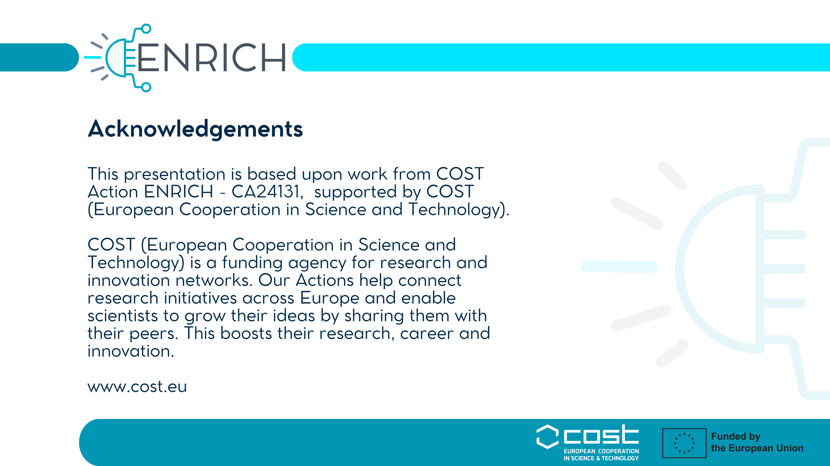
24

