Slide 1

Karima Elmasri
University of Tripoli, Libya
Radiological Monitoring of Environmental and Occupational Exposure in Libya:
The Role of Gamma and Radon Detectors
Advances in X-ray and Gamma RAy DEtectors and applications (XGRADE 2026)
24-26/03/2026, Palermo

Slide 2


University of Tripoli – Libya
one of the oldest and leading universities in Libya
Established in 1957, located in Tripoli, the capital city
The university includes a wide range of:
Engineering
  Nuclear Engineering Department
Medical
Science faculties
Research centers
K Elmasri - Advances in X-ray and Gamma RAy DEtectors and applications (XGRADE 2026) 24-26/03/2026, Palermo

Slide 3
Radiation Detection Laboratories in Libya
Libyan Atomic Energy Establishment (LAEE): responsible for radiation monitoring and safety
Conducts surveys of:
  Food
  Water
  Soil
  building materials
K.Elmasri - Advances in X-ray and Gamma RAy DEtectors and applications (XGRADE 2026) 24-26/03/2026, Palermo

Slide 4
Radiation Detection Laboratories in Libya
Tajoura Nuclear Research Centre (TNRC)
Equipped with:
    Research reactor (10 MW)
    Radiochemistry and nuclear physics laboratories
    Radiation protection and monitoring labs
K.Elmasri - Advances in X-ray and Gamma RAy DEtectors and applications (XGRADE 2026) 24-26/03/2026, Palermo

Slide 5
Radiation Detection Laboratories in Libya
Center of Radiation Measurements and Training (Tripoli)
Established to support:
  Environmental radiation monitoring
  Food and industrial product analysis
  Training in radiation protection
K.Elmasri - Advances in X-ray and Gamma RAy DEtectors and applications (XGRADE 2026) 24-26/03/2026, Palermo

Slide 6
Additional Applications
Additional Applications
Radiation laboratories are also present in:
Hospitals (radiology & nuclear medicine units)
Industrial facilities (oil & gas sector)
Environmental monitoring projects
K.Elmasri - Advances in X-ray and Gamma RAy DEtectors and applications (XGRADE 2026) 24-26/03/2026, Palermo

Slide 7
Natural Radiation and NORM
Natural radiation is present in all environments
Main sources:-
  Cosmic radiation
  Terrestrial radionuclides
  Building materials
  Radon gas
Naturally Occurring Radioactive Materials (NORM) are found in:
    Soil
    Rocks
    Water
    Construction materials
Key radionuclides: Ra-226 ,Th-232(Ra-228), K-40
Radon gas is a major contributor to indoor radiation exposure
K.Elmasri - Advances in X-ray and Gamma RAy DEtectors and applications (XGRADE 2026) 24-26/03/2026, Palermo

Slide 8
Radiological Challenges in Libya
Libya is facing increasing radiological and environmental challenges:-
Import of granite and marble building materials
Presence of aging buildings
Poor ventilation conditions
Rising groundwater levels
Concerns about water contamination
Limited radiological monitoring programs
Lack of national database for environmental radiation
K.Elmasri - Advances in X-ray and Gamma RAy DEtectors and applications (XGRADE 2026) 24-26/03/2026, Palermo

Slide 9
Research Objectives
Measure activity concentrations of: Ra-226Th-232 and K-40
Evaluate radiological hazard indices:
Radium Equivalent Activity (Raeq) External Hazard Index (Hex) Assess gamma radiation dose levels
Investigate indoor radon distribution in buildings
Study the effect of:
  Ventilation
  Building age
  Occupancy
  Construction materials
K.Elmasri - Advances in X-ray and Gamma RAy DEtectors and applications (XGRADE 2026) 24-26/03/2026, Palermo

Slide 10
Study 1: Building Materials Analysis
Study 2: Indoor Radon Monitoring
Assessment of granite and marble used in Libya
Measurement of NORM concentrations
Evaluation of radiological hazard indices
Analysis using HPGe gamma spectrometry
Measurement of radon gas concentration in buildings. Study conducted in:
Offices, Schools and Universities
Evaluation of factors affecting radon levels:-
  Ventilation
  Building age
  Occupancy
K.Elmasri - Advances in X-ray and Gamma RAy DEtectors and applications (XGRADE 2026) 24-26/03/2026, Palermo

Slide 11
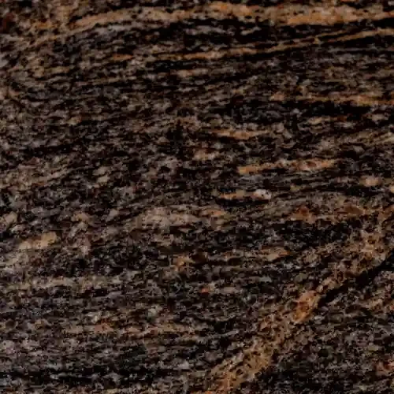
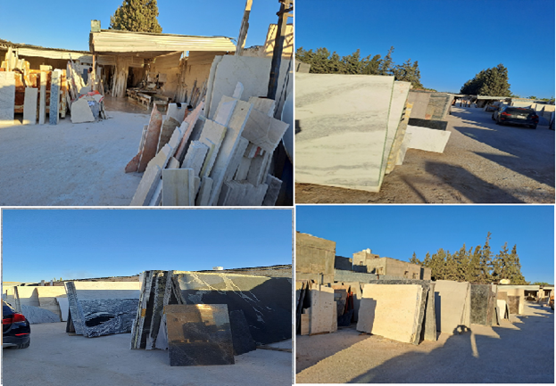
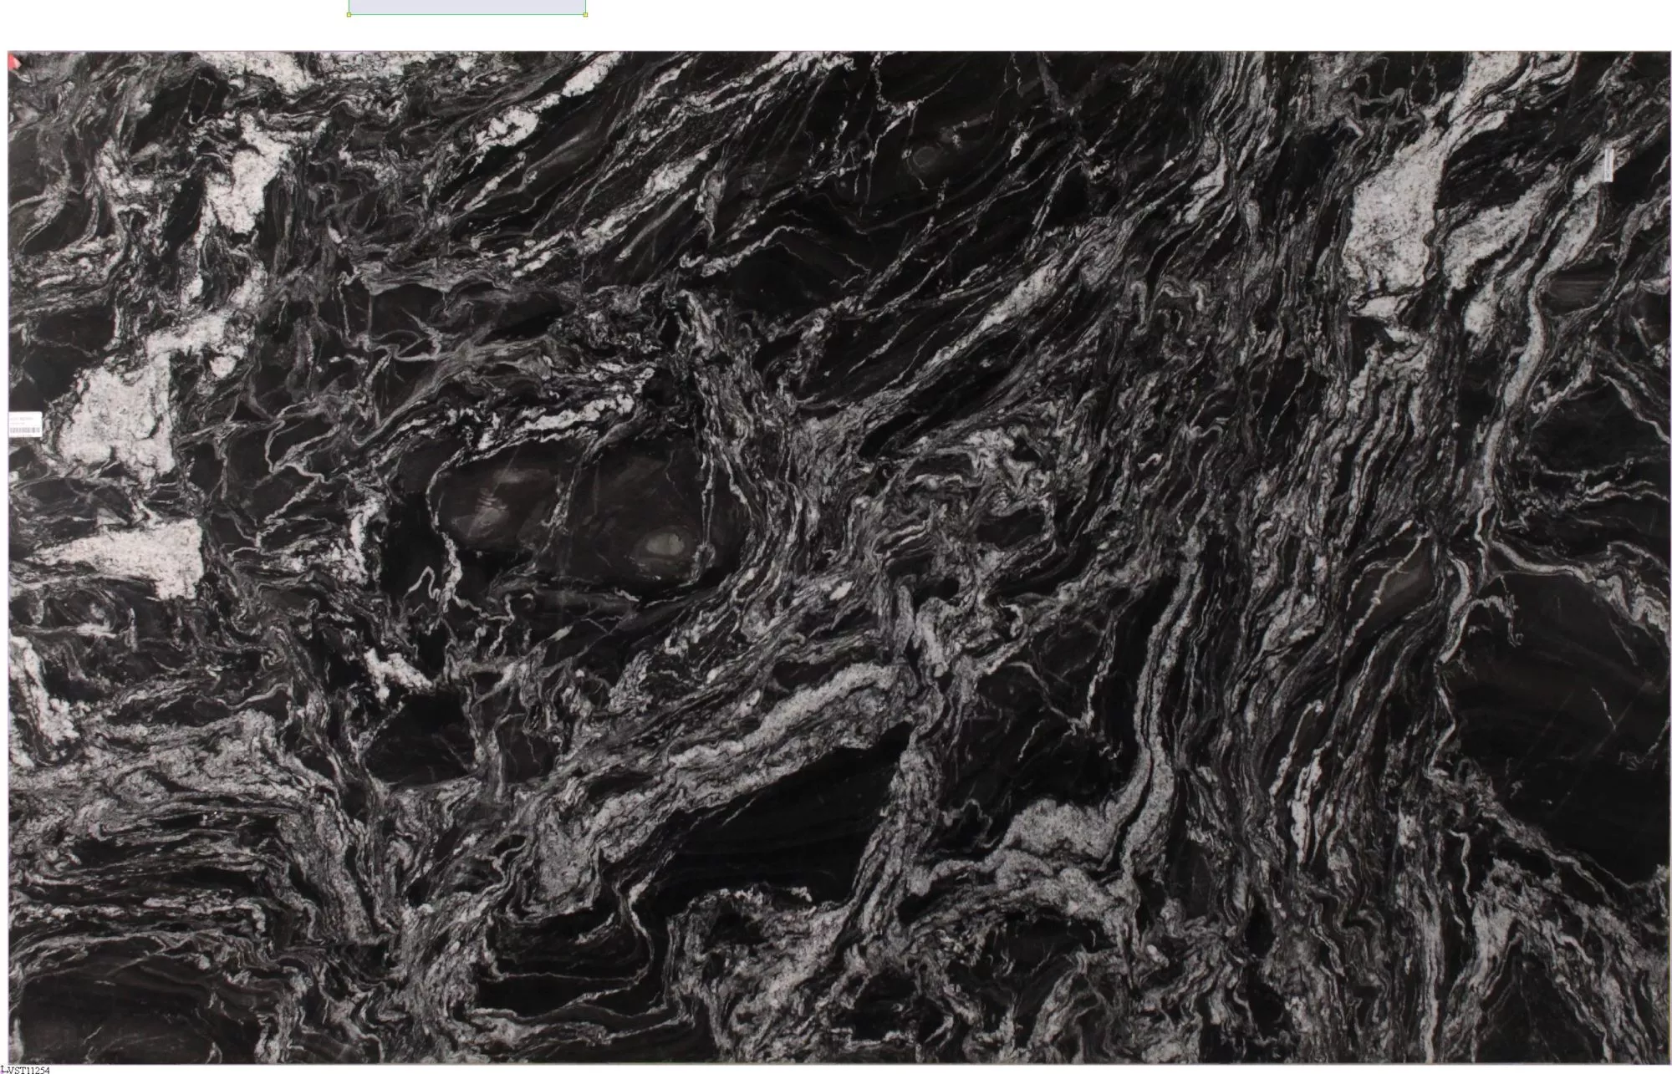
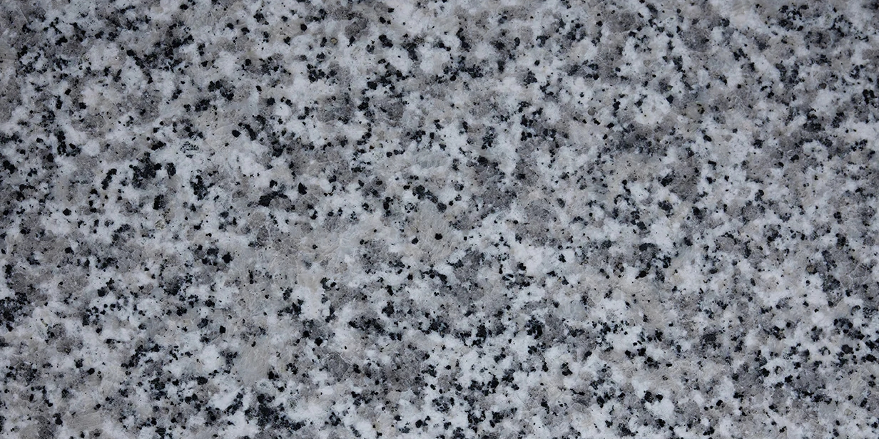
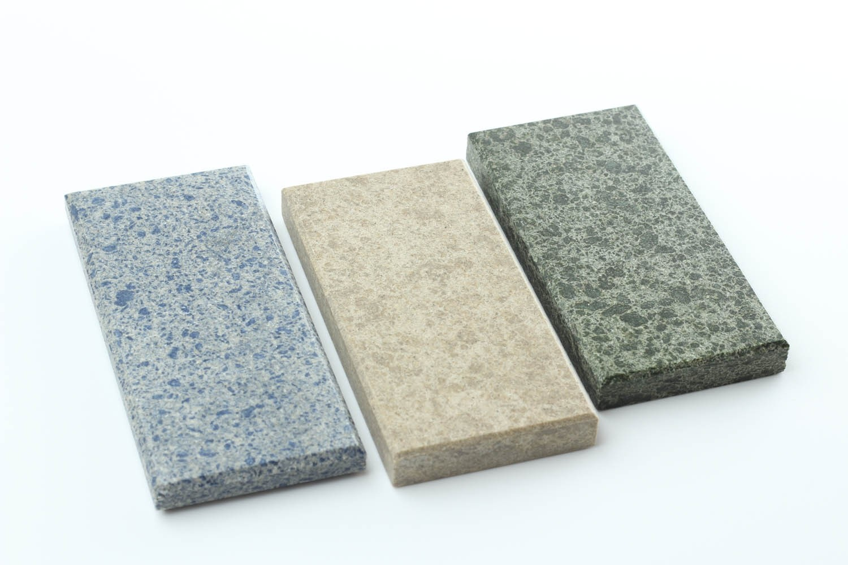
Study 1: Materials and Sample Collection
A total of granite and marble samples were collected from the Libyan market
Granite samples:11 samples imported from Asian countries
Origins include:
India- Pakistan-Uzbekistan
Marble samples: 11 samples imported from Mediterranean countries- Origin include:Turkey Italy and Spain
K.Elmasri - Advances in X-ray and Gamma RAy DEtectors and applications (XGRADE 2026) 24-26/03/2026, Palermo

Slide 12
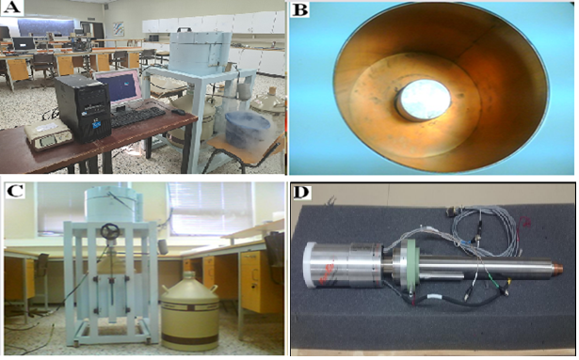
Study 1: Methodology
Activity concentrations were measured using HPGe gamma-ray spectrometry.
Radiological hazard indices, including Ra_{eq}, Activity Concentration Index, and annual effective dose, were calculated.
Results were compared with IAEA, UNSCEAR, and European Commission recommended limits.
K.Elmasri - Advances in X-ray and Gamma RAy DEtectors and applications (XGRADE 2026) 24-26/03/2026, Palermo

Slide 13
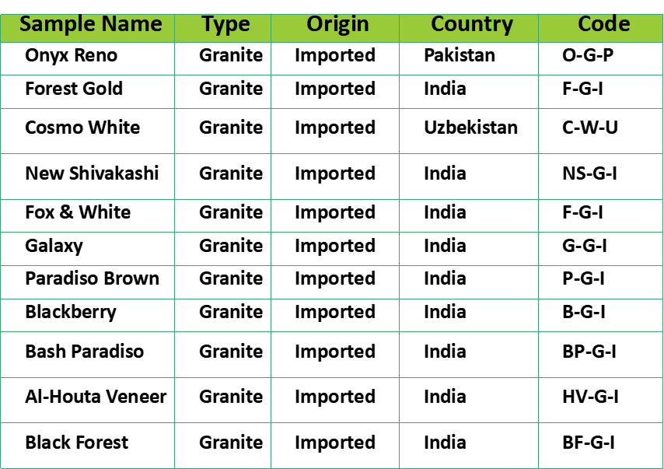
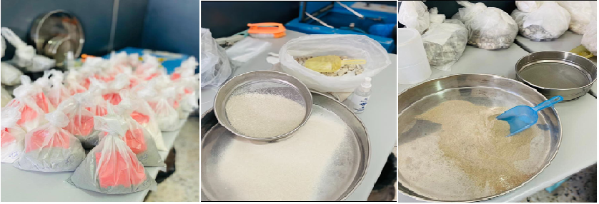
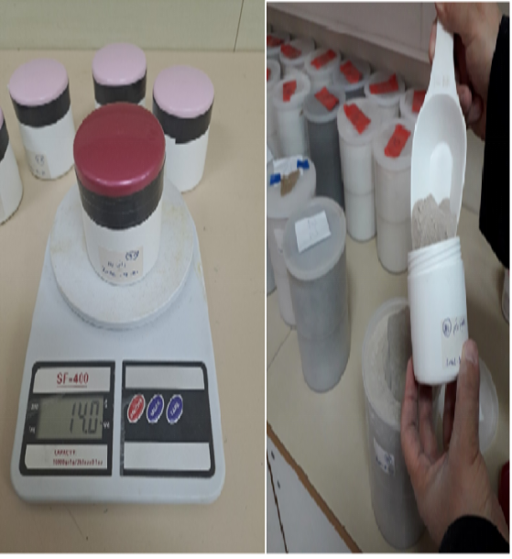
Study 1: Methodology
K.Elmasri - Advances in X-ray and Gamma RAy DEtectors and applications (XGRADE 2026) 24-26/03/2026, Palermo

Slide 14
Study 1: Samples Analyisis
HPGe detector with measured relative efficiency of 76% at an energy of 1.33 MeV(Co-60 source), and energy resolution ranging from 1.9 keV to 2.1 keV.
Several characteristic gamma lines were used for activity analysis,
  For the ²³⁸U (²²⁶Ra) series: 609.32 keV (45.4%) and 1120.29 keV (14.8%) from ²¹⁴Bi.
  For the ²³²Th series: 911.20 keV (25.8%) and 968.97 keV (15.8%) from ²²⁸Ac.
  For ⁴⁰K: 1460.82 keV (10.66%).
Measured activity concentrations were compared to international safety limits reported by UNSCEAR (2008): 33 Bq/kg for ²³⁸U, 45 Bq/kg for ²³²Th, and 420 Bq/kg for ⁴⁰K.
Use Cocomat Pro as font
K.Elmasri - Advances in X-ray and Gamma RAy DEtectors and applications (XGRADE 2026) 24-26/03/2026, Palermo

Slide 15
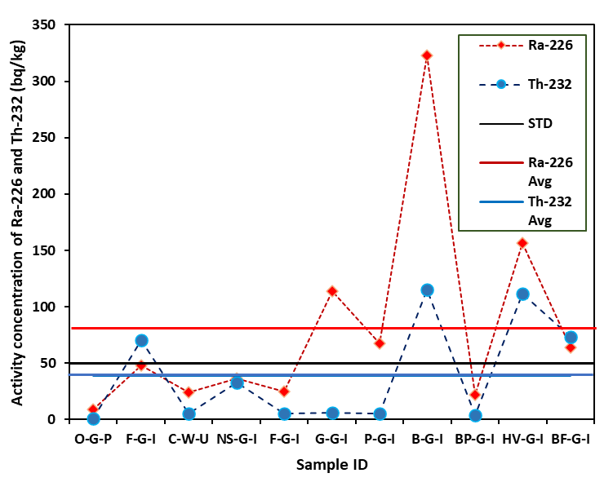
Study 1: Results
Figure 1. Activity concentration of Ra-226 and Th-232
K.Elmasri - Advances in X-ray and Gamma RAy DEtectors and applications (XGRADE 2026) 24-26/03/2026, Palermo

Slide 16
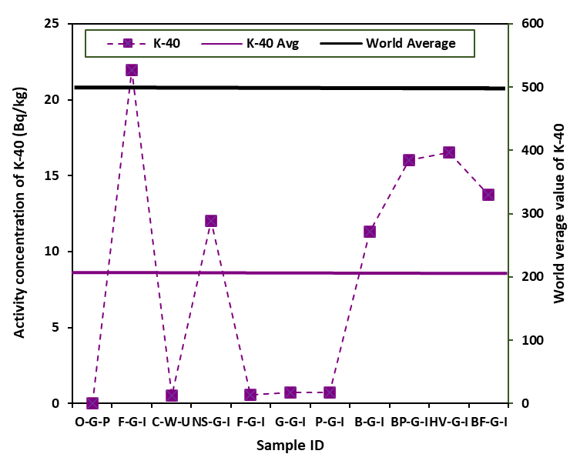
Study 1: Results
Figure 2 Activity concentration of Ra-226 and Th-232
K.Elmasri - Advances in X-ray and Gamma RAy DEtectors and applications (XGRADE 2026) 24-26/03/2026, Palermo

Slide 17
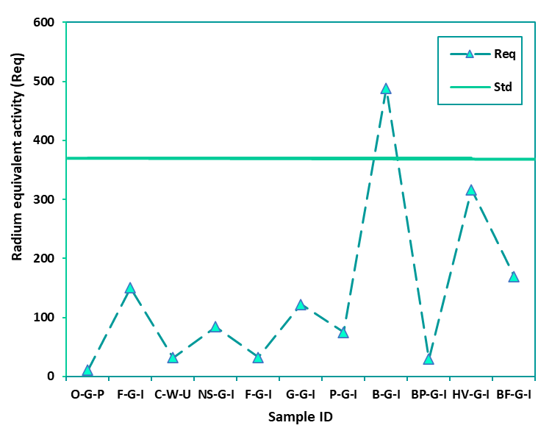
Study 1: Results
Figure 3: Radium equivalent activity levels for the granite samples
K.Elmasri - Advances in X-ray and Gamma RAy DEtectors and applications (XGRADE 2026) 24-26/03/2026, Palermo

Slide 18
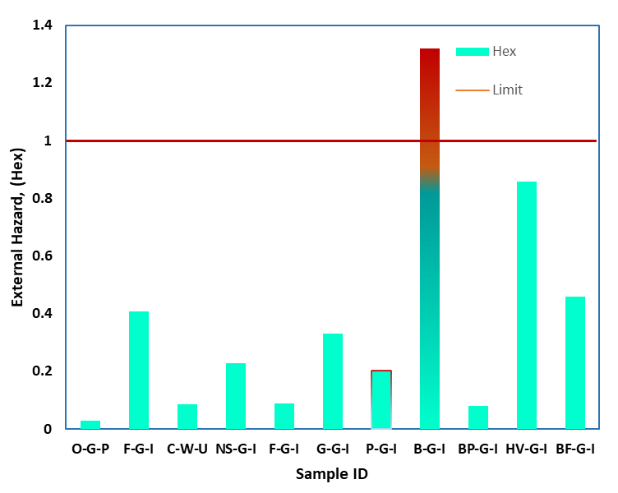
Study 1: Results
K.Elmasri - Advances in X-ray and Gamma RAy DEtectors and applications (XGRADE 2026) 24-26/03/2026, Palermo

Slide 19
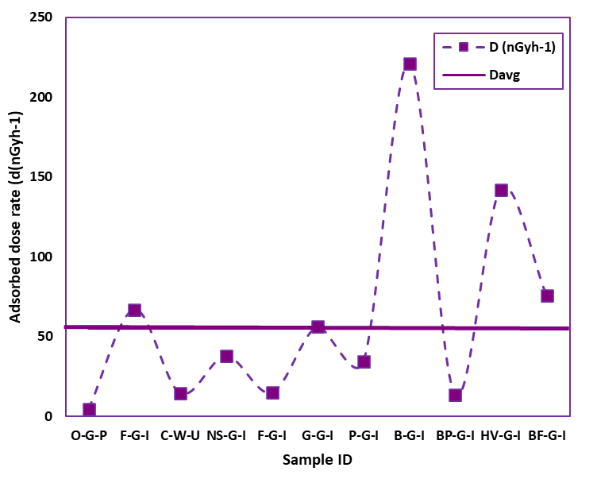
Study 1: Results
K.Elmasri - Advances in X-ray and Gamma RAy DEtectors and applications (XGRADE 2026) 24-26/03/2026, Palermo

Slide 20
Study 1: Conclusion
Several granite samples from India showed ²²⁶Ra activity concentrations exceeding 80 Bq·kg⁻¹.
Two granite samples from India exceeded the recommended limit for ²³²Th activity concentration.
Only one granite sample, originating from India, exhibited radium equivalent activity (Ra_{eq}) above the recommended limit of 370 Bq·kg⁻¹.
Granite samples imported from Pakistan and Uzbekistan showed lower radiological hazard levels and complied with international safety limits.
The Indian granite sample B-G-I exhibited elevated values across multiple hazard indices, including Raeq, annual effective dose, and ELCR, raising concerns regarding its indoor use.
K.Elmasri - Advances in X-ray and Gamma RAy DEtectors and applications (XGRADE 2026) 24-26/03/2026, Palermo

Slide 21
Study 2: Radon Gas Distribution in Closed and Aged Buildings in Tripoli
Objectives
Measure radon levels in schools, and university offices, Libraries and labs.
Compare results with WHO and EPA safety limits.
Assess effect of ventilation, building age, and materials.
Raise awareness on radon risks in public buildings.
K.Elmasri - Advances in X-ray and Gamma RAy DEtectors and applications (XGRADE 2026) 24-26/03/2026, Palermo

Slide 22
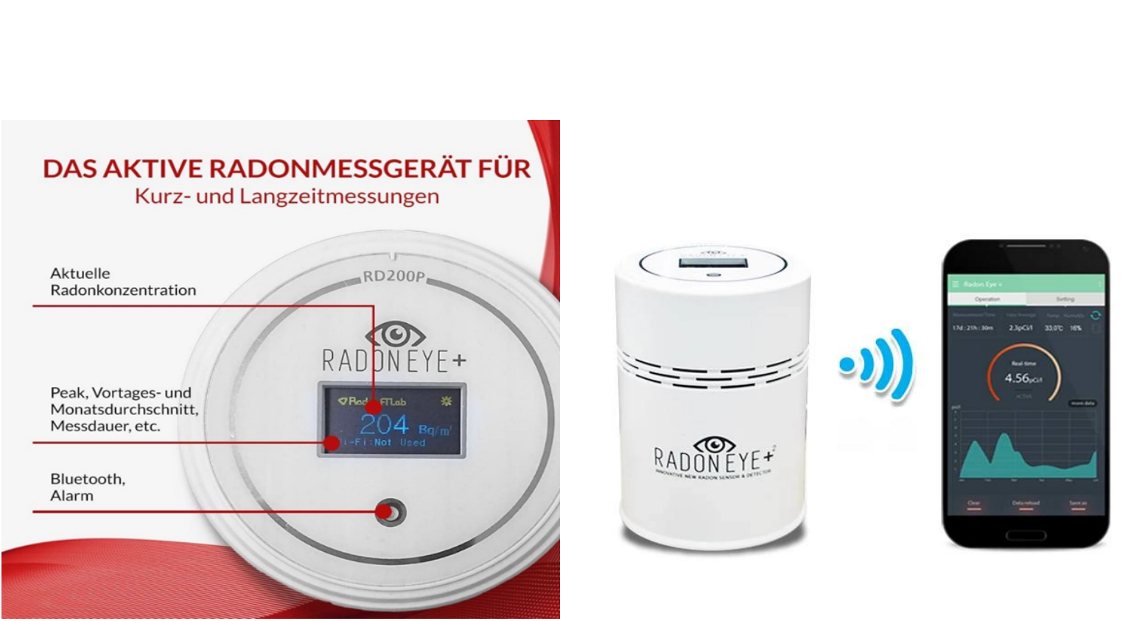
Study 2: Materials and Methods
Radon Eye Plus 2 Smart Radon Detector
K.Elmasri - Advances in X-ray and Gamma RAy DEtectors and applications (XGRADE 2026) 24-26/03/2026, Palermo

Slide 23
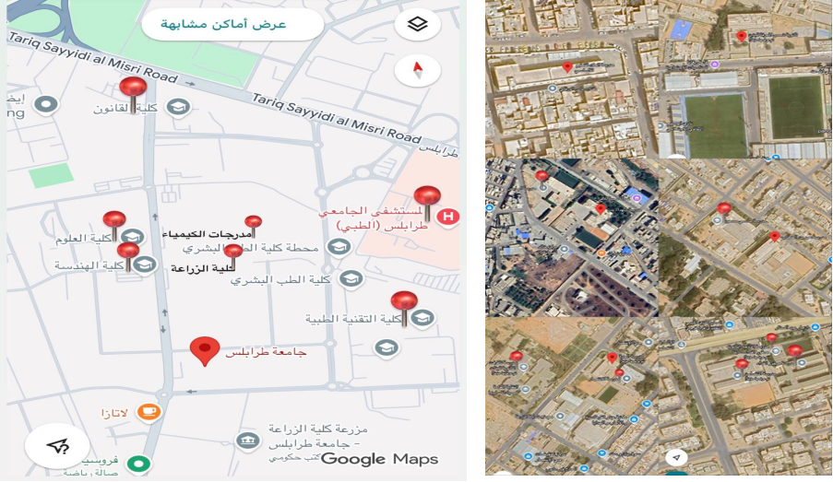
Study2: Area Description
Study location: Tripoli, Libya.
Selected building types: schools, universities Labs and offices.
The results were compared with the World Health Organization (WHO) and the International Commission on Radiological Protection (ICRP).
K.Elmasri - Advances in X-ray and Gamma RAy DEtectors and applications (XGRADE 2026) 24-26/03/2026, Palermo

Slide 24
Study 2: Results
The measured radon concentrations ranged from a minimum value of 2 Bq/m³ to a maximum value of 140 Bq/m³, with a mean concentration of 21.5 Bq/m³ and a standard deviation of 27.8 Bq/m³.
A relatively high standard deviation indicates variability in radon levels; however, all values remained below the 300 Bq/m³
K.Elmasri - Advances in X-ray and Gamma RAy DEtectors and applications (XGRADE 2026) 24-26/03/2026, Palermo

Slide 25
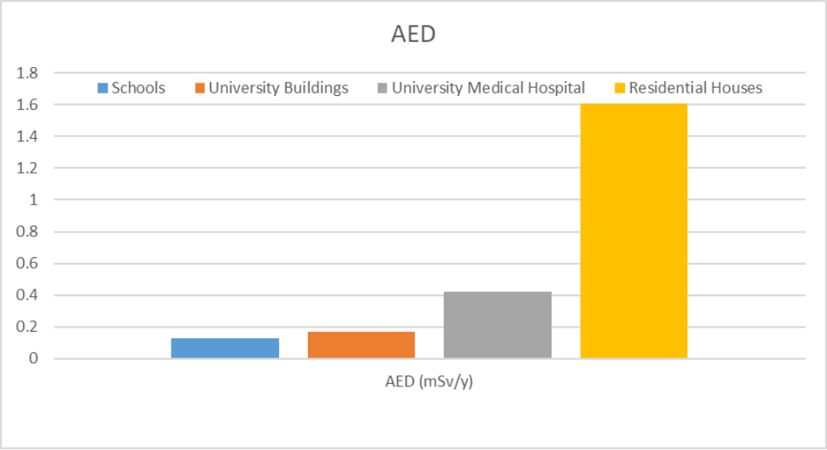
Annual Effective Dose (AED) Due to Indoor Radon
K.Elmasri - Advances in X-ray and Gamma RAy DEtectors and applications (XGRADE 2026) 24-26/03/2026, Palermo

Slide 26
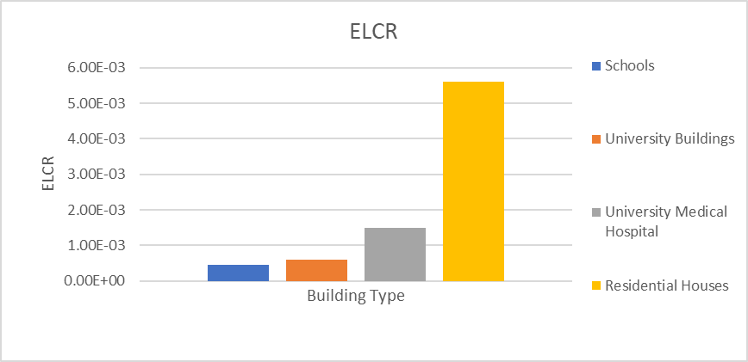
Excess Lifetime Cancer Risk (ELCR) Due to Indoor Radon
K.Elmasri - Advances in X-ray and Gamma RAy DEtectors and applications (XGRADE 2026) 24-26/03/2026, Palermo

Slide 27
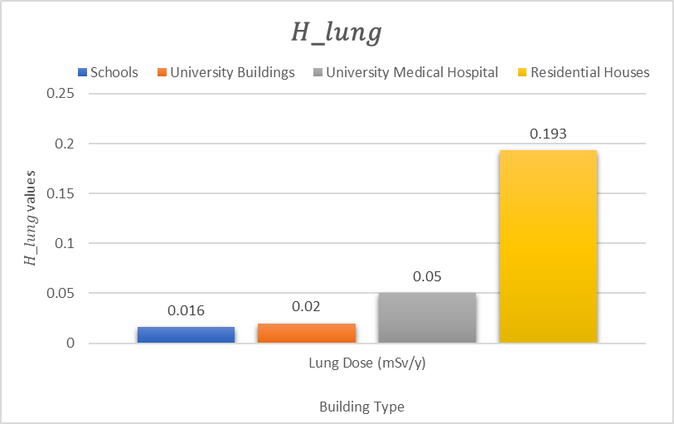
Annual Equivalent Dose to the Lung.
K.Elmasri - Advances in X-ray and Gamma RAy DEtectors and applications (XGRADE 2026) 24-26/03/2026, Palermo

Slide 28
Percentage Exceedance of WHO Reference Level for Indoor Radon
Building Type | Total Samples | Samples > 100 Bq/m³ | Percentage Exceedance (%)
Schools | 23 | 0 | 0
University Buildings | 22 | 1 | 4.5
University Medical Hospital | 4 | 0 | 0
Residential Houses | 11 | 2 | 18.2
K.Elmasri - Advances in X-ray and Gamma RAy DEtectors and applications (XGRADE 2026) 24-26/03/2026, Palermo

Slide 29
Study 2: Conclusion
The study examined indoor radon concentrations in Tripoli and the Western Mountains (schools, university buildings, a hospital, and residential houses).
Radon levels varied by building type and location: schools had the lowest, university buildings and the hospital were moderate, and residential houses were the highest, especially in the Western Mountains.
Radiological risk indicators (AED, ELCR, WLM, lung dose, WHO exceedance) showed that most buildings were within safe limits.
Residential houses recorded the highest values due to longer occupancy and higher radon levels.
AED for all buildings was below 3–10 mSv/year, indicating no immediate radiological hazard, but long-term exposure requires monitoring, especially in areas with high radon levels.
K.Elmasri - Advances in X-ray and Gamma RAy DEtectors and applications (XGRADE 2026) 24-26/03/2026, Palermo

Slide 30


