Slide 1



CadTool - a end-to-end x-ray/gamma-ray solid state detector simulation framework
J.F. Sousa¹, A. Meuris², D. Baudin³, H. Allaire^{2, 4}, O. Limousin², R. Le Breton³
¹ Université Paris-Saclay, CEA IRFU, AIM
² Université Paris-Saclay, Université Paris Cité, CEA, CNRS, AIM
³ CEA IRFU, Université Paris Saclay
⁴ Kavli IPMU (WPI), UTIAS, The University of Tokyo

Slide 2


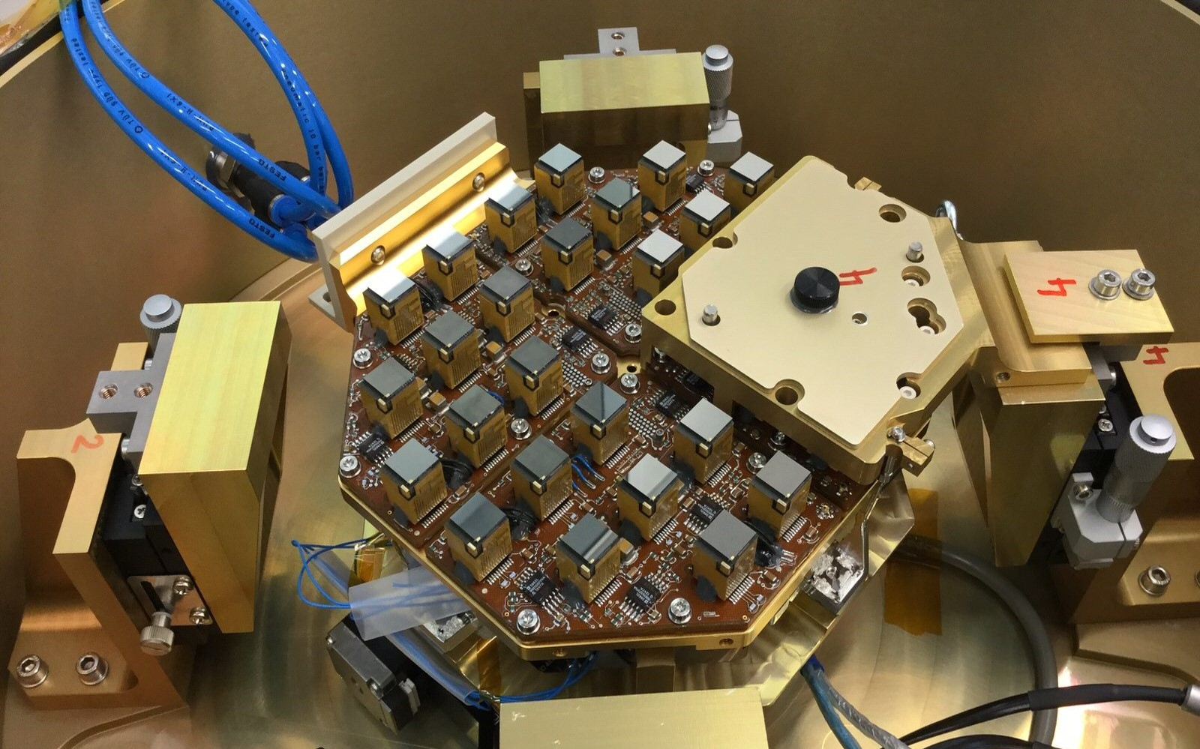
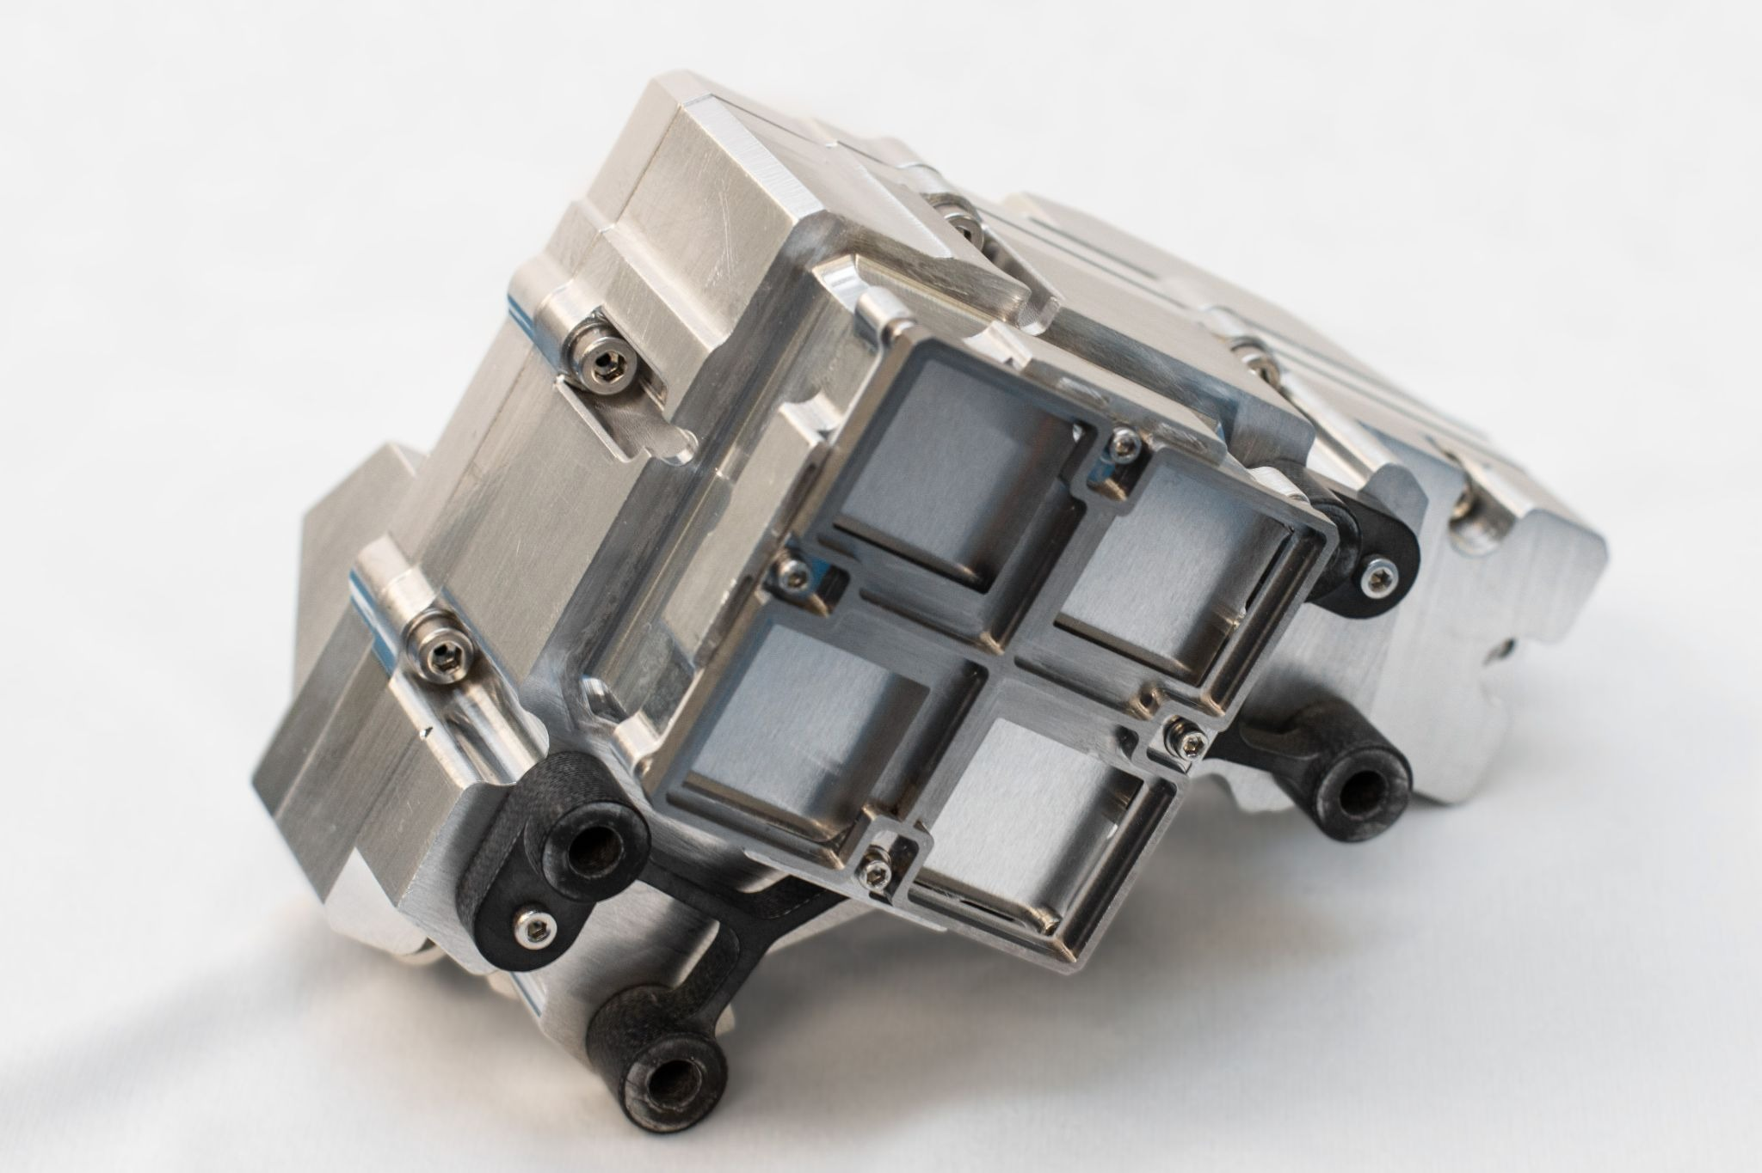
Context
The need of a Simulation Tool
Solar Orbiter / STIX
PADRE Nanosat
Simulation Tool helps with
1) Understanding detector effects
2) Evaluating detector configuration (pixel pattern)
3) Design new readout techniques
4) Modeling detector response (science)
Present
2026
M8 Proposals
SPARK
Solar Physics
~150 keV
CdTe 1 mm
250 µm x 250 µm
PHEMTO
High-Energy Astrophysics
~600 keV
Thick CZT (10 mm)
<300 μm Δxy (Laue Lenses imaging)
Future
2030’s
26/03/2026
2

Slide 3
Context
The need of a Simulation Tool
Solar Orbiter / STIX
PADRE Nanosat
Simulation Tool helps with
1) Understanding detector effects
2) Evaluating detector configuration (pixel pattern)
3) Design new readout techniques
4) Modeling detector response (science)
Present
2026
M8 Proposals
SPARK
Solar Physics
~150 keV
CdTe 1 mm
250 µm x 250 µm
PHEMTO
High-Energy Astrophysics
~600 keV
Thick CZT (10 mm)
<300 μm Δxy (Laue Lenses imaging)
Future
2030’s
PhD
26/03/2026
3

Slide 4
Outline
1. Simulation Tool Requirements
Inputs
Physics
Outputs
2. Detector Physics
Geometry and Fields
Charge cloud dynamics
Electrode induced charge
4. Tool Validation
Low Energy
High Energy
3. Events List Generator
Monte-Carlo events
Detector Spectra
5. Examples
3D
Transient signals
26/03/2026
4

Slide 5
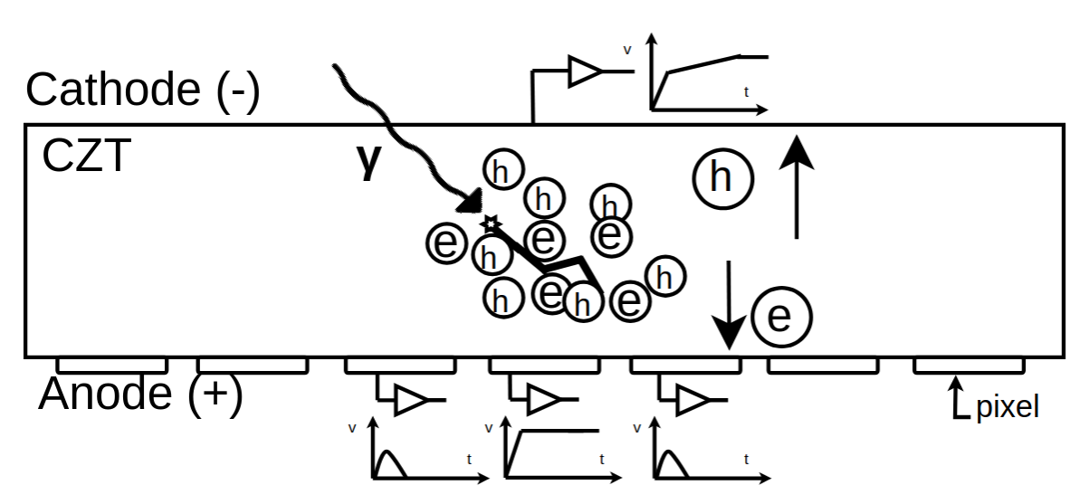
Context
Simulation Tool Requirements
Inputs
Detector Physics
Outputs
Detector Parameters
Material, Pixel/Strip, Bias, Mobility, Lifetime, Fano
Charge Drift
- Trapping
- Diffusion
- Repulsion
Transient Signals
- Charge profile
- Current profile
Electric Field and Potential
Weighting Potential
Enviroment Geometry
Box, Passive material, collimator, etc
Event list generation
Source Configuration
Geometry, Energy, Intensity
Data analysis
- images
- spectrum
- lightcurve
- response matrix
Photon-matter interaction
Front-end & Back-end electronics
Electrode charge induced
Electronics
ENC, ADC range, Threshold
26/03/2026
5

Slide 6
Context
Simulation Tool Requirements
Inputs
Detector Physics
Outputs
Detector Parameters
Material, Pixel/Strip, Bias, Mobility, Lifetime, Fano
Charge Drift
- Trapping
- Diffusion
- Repulsion
Transient Signals
- Charge profile
- Current profile
Electric Field and Potential
Weighting Potential
Enviroment Geometry
Box, Passive material, collimator, etc
Event list generation
Source Configuration
Geometry, Energy, Intensity
Data analysis
- images
- spectrum
- lightcurve
- response matrix
Photon-matter interaction
Front-end & Back-end electronics
Electrode charge induced
Electronics
ENC, ADC range, Threshold
26/03/2026
6

Slide 7
Context
Simulation Tool Requirements
Inputs
Detector Physics
Outputs
Detector Parameters
Material, Pixel/Strip, Bias, Mobility, Lifetime, Fano
Charge Drift
- Trapping
- Diffusion
- Repulsion
Transient Signals
- Charge profile
- Current profile
Electric Field and Potential
Weighting Potential
Enviroment Geometry
Box, Passive material, collimator, etc
Event list generation
Source Configuration
Geometry, Energy, Intensity
Data analysis
- images
- spectrum
- lightcurve
- response matrix
Photon-matter interaction
Front-end & Back-end electronics
Electrode charge induced
Electronics
ENC, ADC range, Threshold
26/03/2026
7

Slide 8

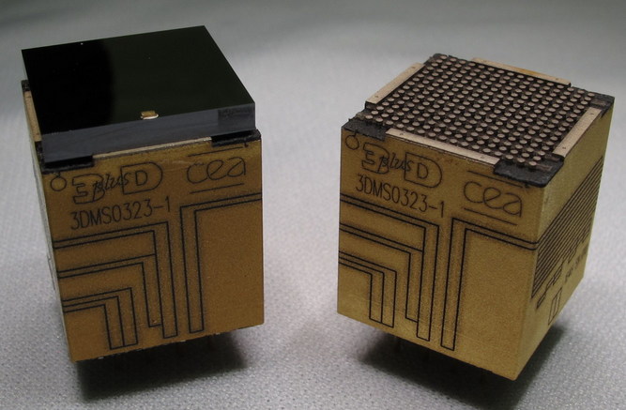
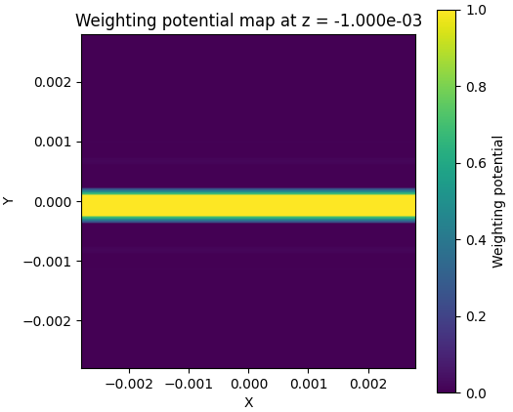
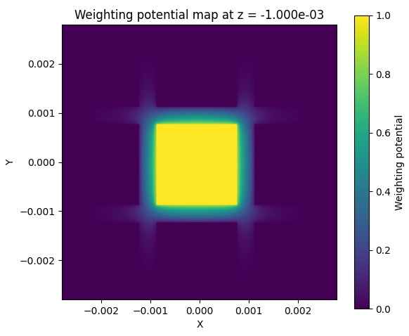
Caliste-O
Cadtool
Geometry and Fields
solidstatedetectors.jl library
Geometry definition: planar, pixel, strip
2mm CdTe pixel 800µm
26/03/2026
8

Slide 9
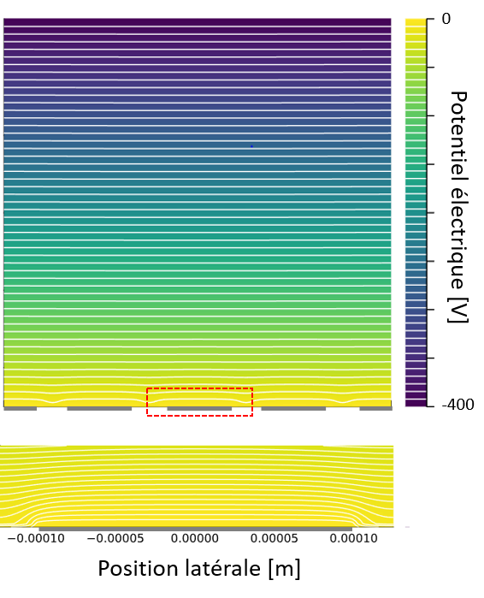
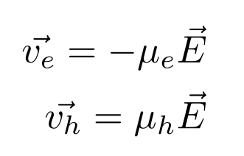
Caliste-O
Cadtool
Geometry and Fields
solidstatedetectors.jl library
Geometry definition: planar, pixel, strip
Electric field (Poisson FEM)
2mm CdTe pixel 800µm
Input for charge dynamics
26/03/2026
9

Slide 10
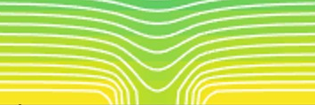
Caliste-O
Cadtool
Geometry and Fields
solidstatedetectors.jl library
Geometry definition: planar, pixel, strip
Electric field (Poisson FEM)
2mm CdTe pixel 800µm
Input for charge dynamics
26/03/2026
10

Slide 11
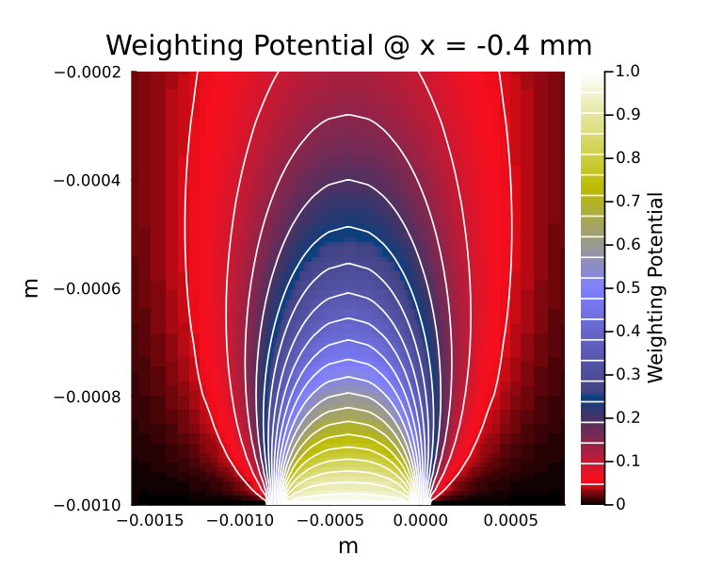

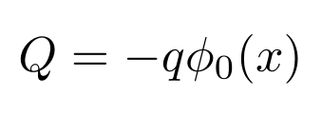
Caliste-O
Cadtool
Geometry and Fields
solidstatedetectors.jl library
Geometry definition: planar, pixel, strip
Electric field (Poisson FEM)
Weighting Potential
2mm CdTe pixel 800µm
Shockley-Ramo Theorem
Z(mm)
Charge at electrode
Electrode Weighting Potentiel
Y(mm)
Moving charge
26/03/2026
11

Slide 12
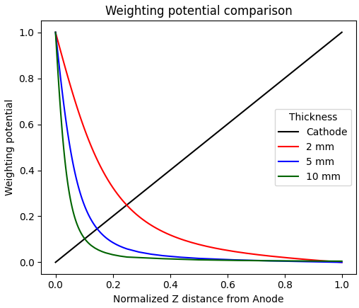
Caliste-O
Cadtool
Geometry and Fields
solidstatedetectors.jl library
Geometry definition: planar, pixel, strip
Electric field (Poisson FEM)
Weighting field
2mm CdTe pixel 800µm
Shockley-Ramo Theorem
Charge at electrode
Electrode Weighting field
Moving charge
26/03/2026
12

Slide 13
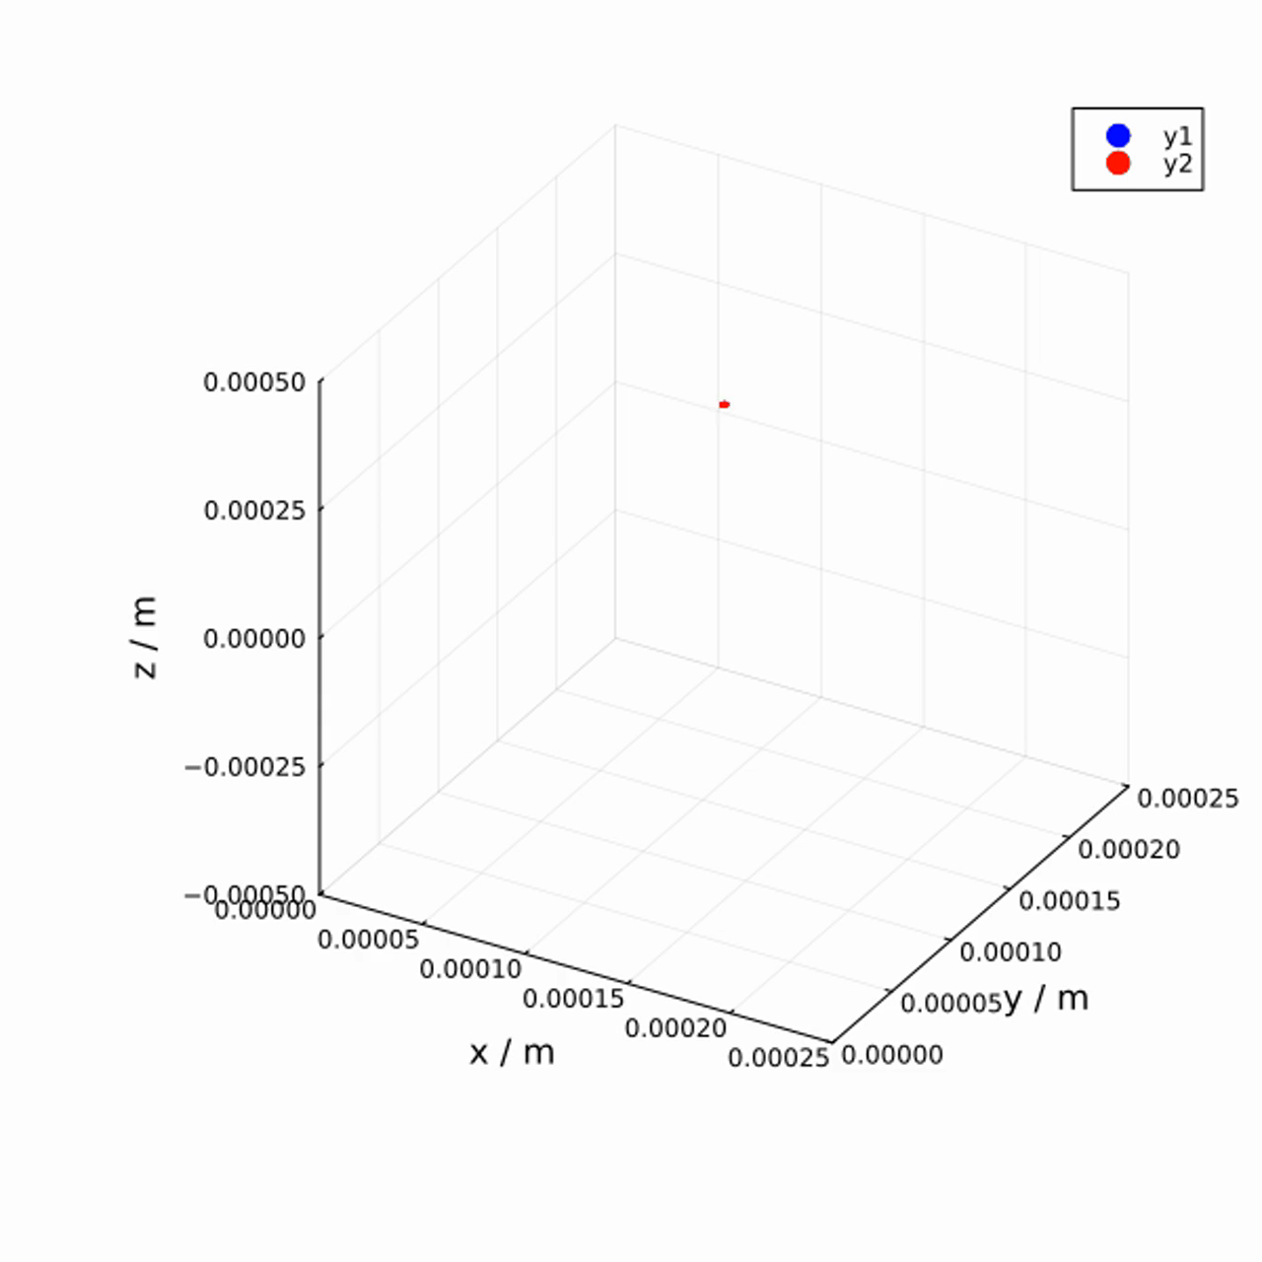
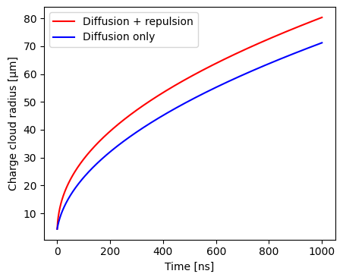
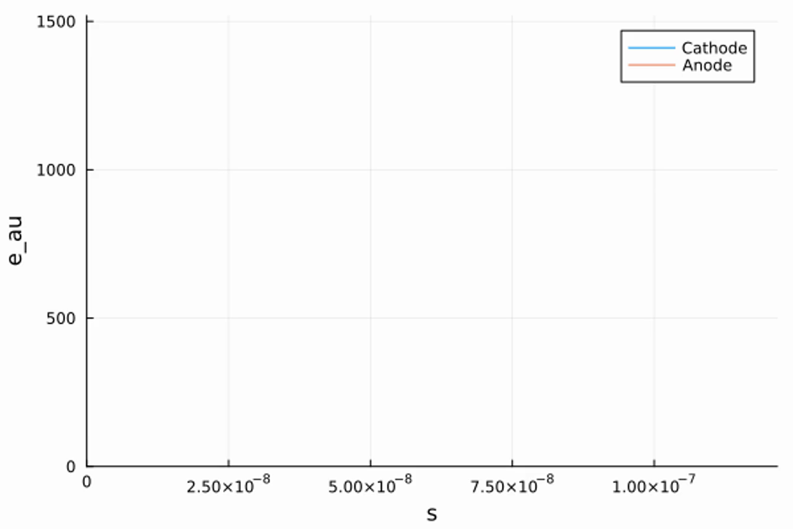

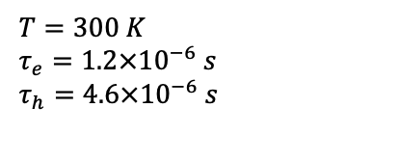
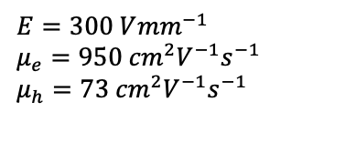
Caliste-O
Cadtool
Charge Cloud Dynamics
Charge Drift Model:
  [Benoit & Hamel, 2009] diffusion and repulsion spherical model
2mm CdTe pixel 800µm
e⁻
Induced charge on electrodes
h⁺
122 keV
$$E=300 V{mm}^{−1}$$
$$μ_{e}=950{ cm}^{2}V^{−1}s^{−1}$$
$$μ_{h}=73{ cm}^{2}V^{−1}s^{−1}$$
$$ε_{CdTe}=4.42 eV$$
$$T=300 K$$
$$τ_{e}=1.2×{10}^{−6} s$$
$$τ_{h}=4.6×{10}^{−6} s$$
12b

Slide 14
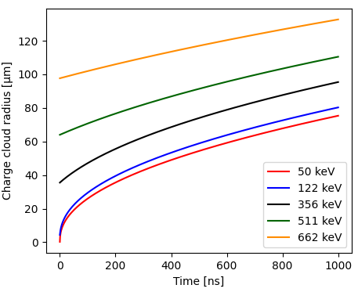
Caliste-O
Cadtool
Charge Cloud Dynamics
Charge Drift Model:
  [Benoit & Hamel, 2009] diffusion and repulsion spherical model
2mm CdTe pixel 800µm
e⁻
Induced charge on electrodes
h⁺
$$E=300 V{mm}^{−1}$$
$$μ_{e}=950{ cm}^{2}V^{−1}s^{−1}$$
$$μ_{h}=73{ cm}^{2}V^{−1}s^{−1}$$
$$ε_{CdTe}=4.42 eV$$
$$T=300 K$$
$$τ_{e}=1.2×{10}^{−6} s$$
$$τ_{h}=4.6×{10}^{−6} s$$
14

Slide 15
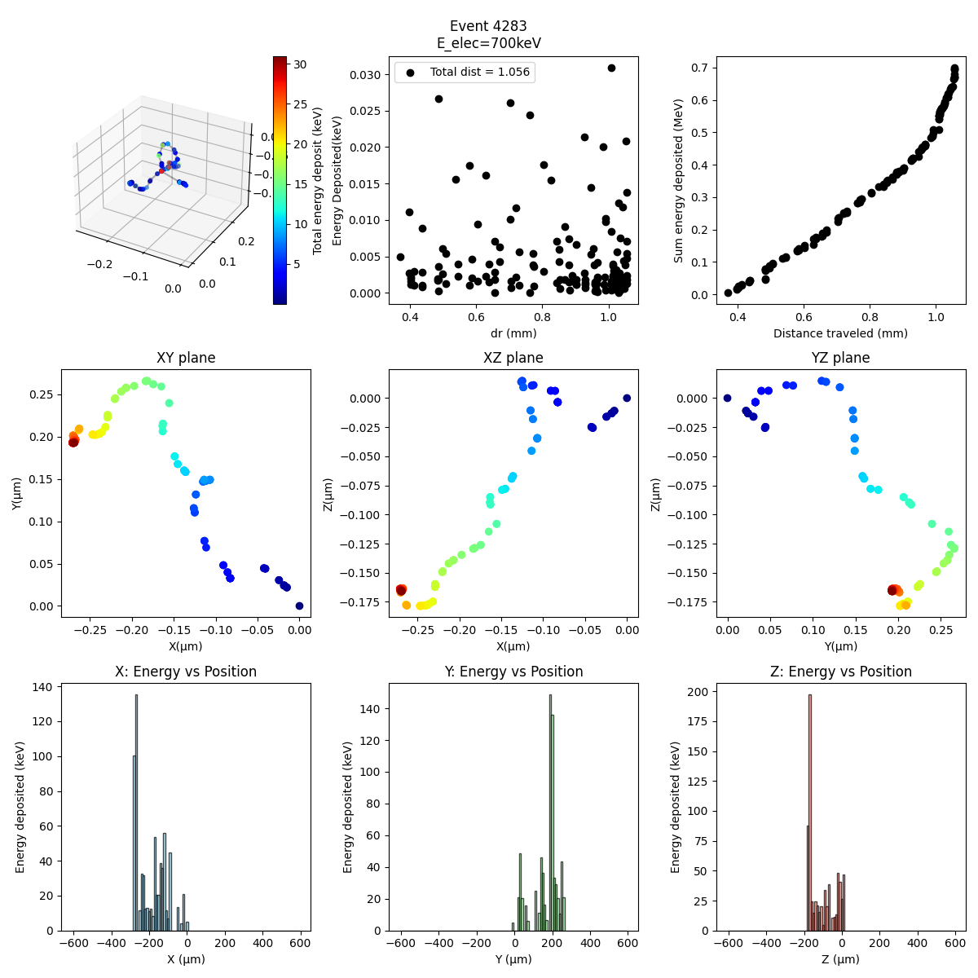

Caliste-O
Cadtool
Charge Cloud Dynamics
Charge Drift Model:
  [Benoit & Hamel, 2009] diffusion and repulsion spherical model
  Initial Radius:
  GATE photoelectron path simulation
2mm CdTe pixel 800µm
700 keV
Y(mm)
Z(mm)
Z(mm)
X(mm)
X(mm)
X(mm)
26/03/2026
15

Slide 16
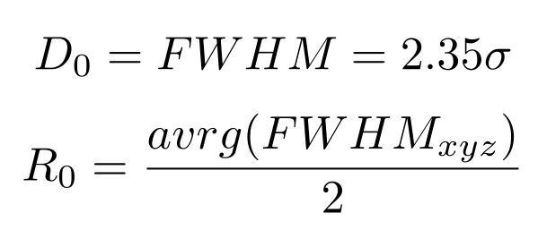
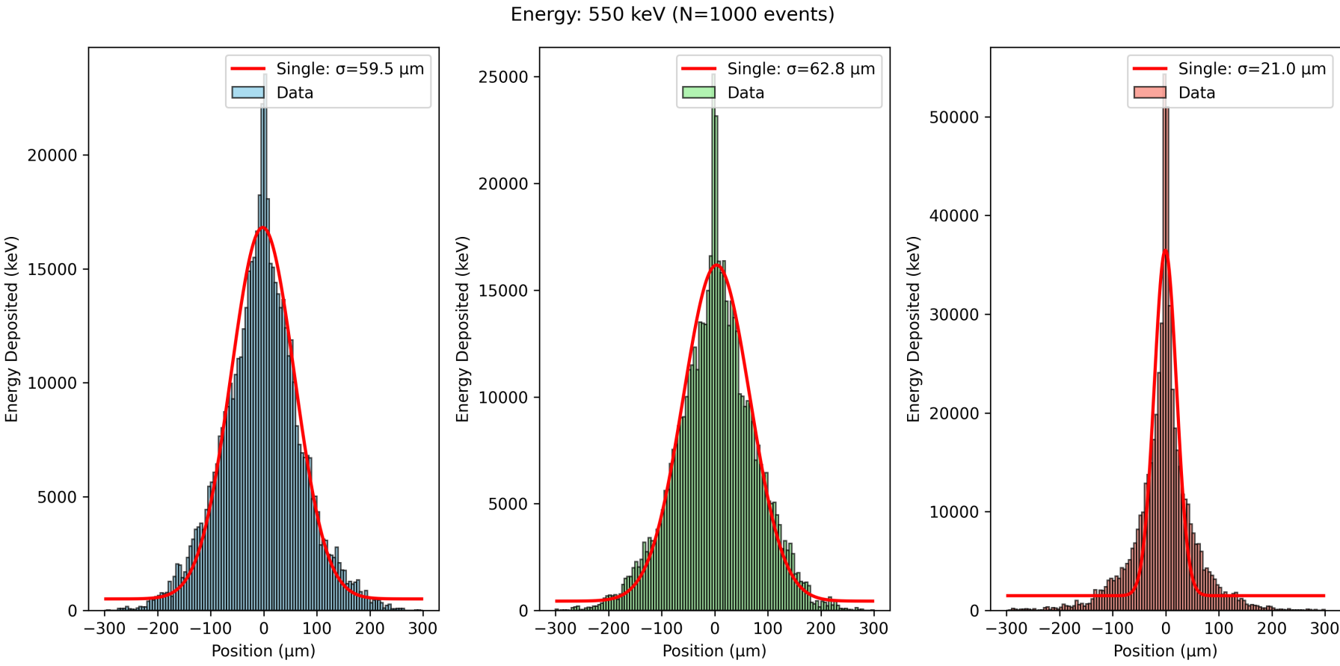
Caliste-O
Cadtool
Charge Cloud Dynamics
Charge Drift Model:
  [Benoit & Hamel, 2009] diffusion and repulsion spherical model
  Initial Radius:
  GATE photoelectron path simulation
2mm CdTe pixel 800µm
x
y
z
26/03/2026
16

Slide 17
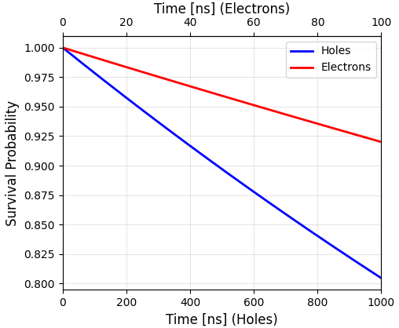
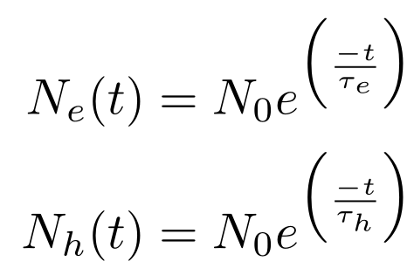
Caliste-O
Cadtool
Charge Cloud Dynamics
Charge Drift Model:
  [Benoit & Hamel, 2009] diffusion and repulsion spherical model
  Initial Radius:
  GATE photoelectron path simulation
  Trapping:
  0-1 random probability by time-step
2mm CdTe pixel 800µm
$$E=300 V{mm}^{−1}$$
$$μ_{e}=950{ cm}^{2}V^{−1}s^{−1}$$
$$μ_{h}=73{ cm}^{2}V^{−1}s^{−1}$$
$$ε_{CdTe}=4.42 eV$$
$$T=300 K$$
$$τ_{e}=1.2×{10}^{−6} s$$
$$τ_{h}=4.6×{10}^{−6} s$$
17

Slide 18
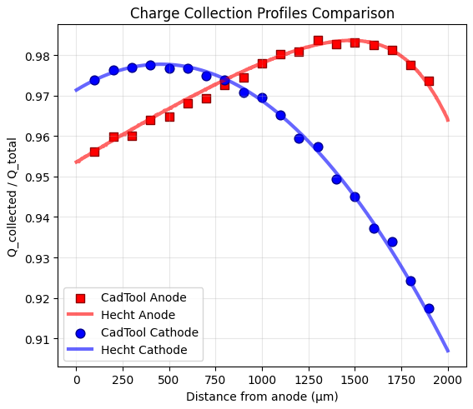
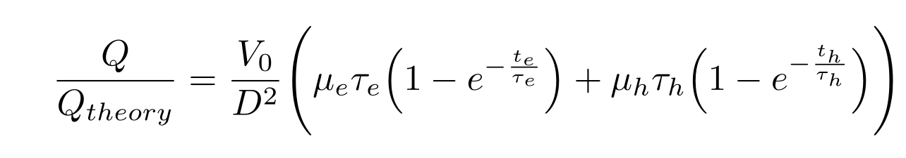
Caliste-O
Cadtool
Charge Cloud Dynamics
Charge Drift Model:
  [Benoit & Hamel, 2009] diffusion and repulsion spherical model
  Initial Radius:
  GATE photoelectron path simulation
  Trapping:
  0-1 random probability by time-step
2mm CdTe pixel 800µm
Sanity Check : Hecht relations
$$E=300 V{mm}^{−1}$$
$$μ_{e}=950{ cm}^{2}V^{−1}s^{−1}$$
$$μ_{h}=73{ cm}^{2}V^{−1}s^{−1}$$
$$ε_{CdTe}=4.42 eV$$
$$T=300 K$$
$$τ_{e}=1.2×{10}^{−6} s$$
$$τ_{h}=4.6×{10}^{−6} s$$
18

Slide 19
Cadtool
Simulation Tool
Inputs
Detector Physics
Outputs
Detector Parameters
Material, Pixel/Strip, Bias, Mobility, Lifetime, Fano
Charge Drift
- Trapping
- Diffusion
- Repulsion
Transient Signals
- Charge profile
- Current profile
Electric Field and Potential
Weighting Potential
Enviroment Geometry
Box, Passive material, collimator, etc
Event list generation
Source Configuration
Geometry, Energy, Intensity
Data analysis
- images
- spectrum
- lightcurve
- response matrix
Photon-matter interaction
Front-end & Back-end electronics
Electrode charge induced
Electronics
ENC, ADC range, Threshold
26/03/2026
19

Slide 20
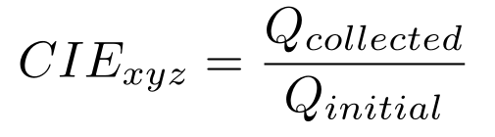
Caliste-O
Cadtool
Charge Induced Efficiency
Main pixel
Main pixel
Main pixel
Charge Induced Efficiency (CIE):
  Create 3D mesh of section of detector
  Drift charges for each point
2mm CdTe pixel 800µm
$$E=300 V{mm}^{−1}$$
$$μ_{e}=950{ cm}^{2}V^{−1}s^{−1}$$
$$μ_{h}=73{ cm}^{2}V^{−1}s^{−1}$$
$$ε_{CdTe}=4.42 eV$$
$$T=300 K$$
$$τ_{e}=1.2×{10}^{−6} s$$
$$τ_{h}=4.6×{10}^{−6} s$$
Event location
20

Slide 21
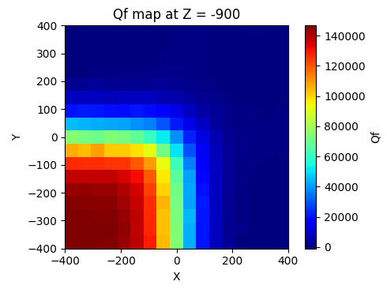
Caliste-O
Cadtool
Charge Induced Efficiency
Main pixel
Main pixel
Main pixel
Charge Induced Efficiency (CIE):
  Create 3D mesh of section of detector
  Drift charges for each point
2mm CdTe pixel 800μm
pixel
$$E=300 V{mm}^{−1}$$
$$μ_{e}=950{ cm}^{2}V^{−1}s^{−1}$$
$$μ_{h}=73{ cm}^{2}V^{−1}s^{−1}$$
$$ε_{CdTe}=4.42 eV$$
$$T=300 K$$
$$τ_{e}=1.2×{10}^{−6} s$$
$$τ_{h}=4.6×{10}^{−6} s$$
21

Slide 22

Cadtool
Simulation Tool Requirements
Inputs
Detector Physics
Outputs
Detector Parameters
Material, Pixel/Strip, Bias, Mobility, Lifetime, Fano
Charge Drift
- Trapping
- Diffusion
- Repulsion
✅
Electric Field and Potential
Transient Signals
- Charge profile
- Current profile
Weighting Potential
Enviroment Geometry
Box, Passive material, collimator, etc
Event list generation
Source Configuration
Geometry, Energy, Intensity
Data analysis
- images
- spectrum
- lightcurve
- response matrix
Photon-matter interaction
Front-end & Back-end electronics
Electrode charge induced
Electronics
ENC, ADC range, Threshold
26/03/2026
22

Slide 23
Cadtool
Simulation Tool Requirements
Inputs
Detector Physics
Outputs
Detector Parameters
Material, Pixel/Strip, Bias, Mobility, Lifetime, Fano
Charge Drift
- Trapping
- Diffusion
- Repulsion
Transient Signals
- Charge profile
- Current profile
Electric Field and Potential
Weighting Potential
Enviroment Geometry
Box, Passive material, collimator, etc
Event list generation
Source Configuration
Geometry, Energy, Intensity
Data analysis
- images
- spectrum
- lightcurve
- response matrix
Photon-matter interaction
Front-end & Back-end electronics
Electrode charge induced
Electronics
ENC, ADC range, Threshold
26/03/2026
23

Slide 24
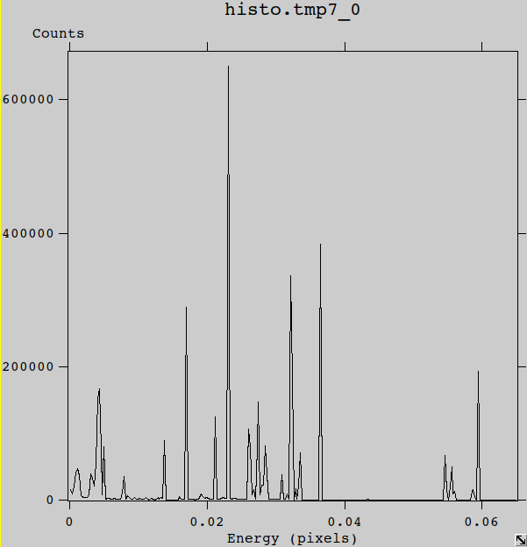
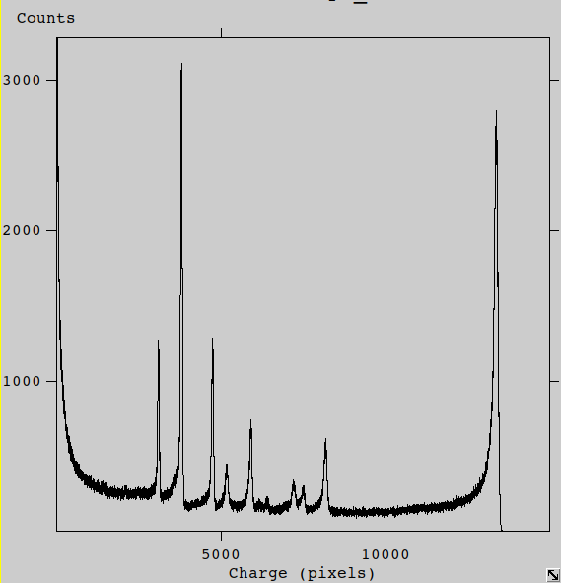
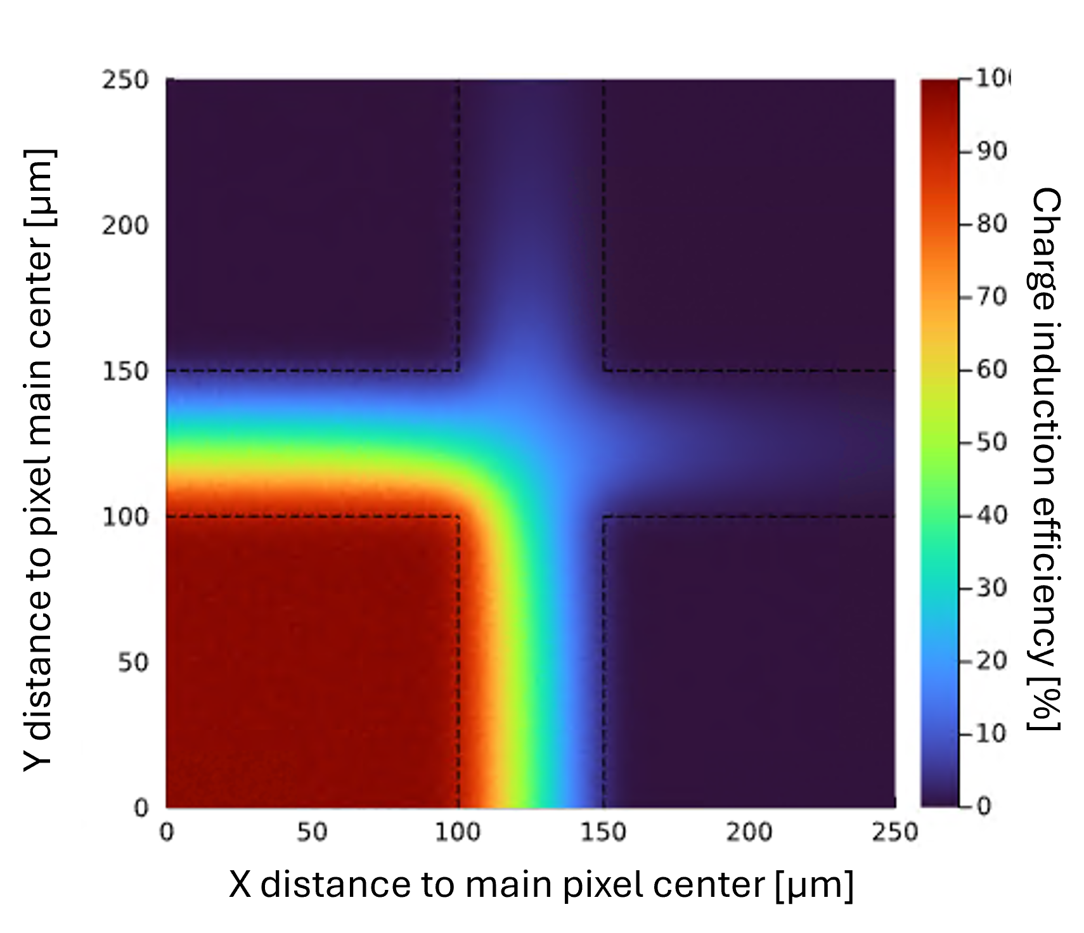
Cadtool
Event List Generation
Main pixel
Main pixel
Main pixel
Source Configuration
²⁴¹Am
Symmetric CIEs
²⁴¹Am + CIE
4 Multiplicity limit
26/03/2026
24

Slide 25
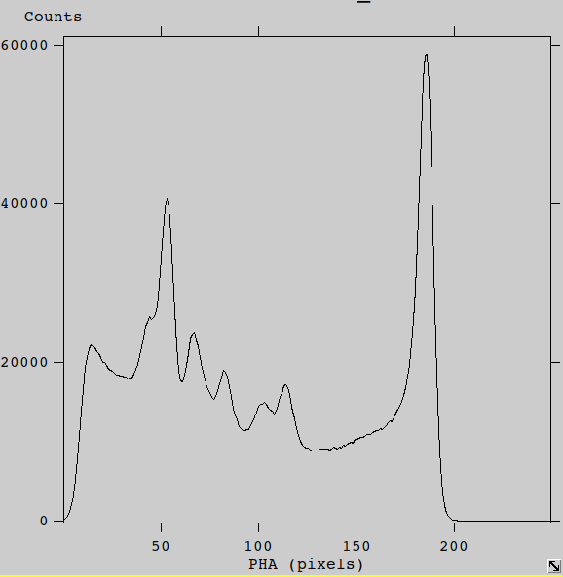
Cadtool
Event List Generation
Output a readout list
Time
List of electrode index
List of PHA (in ADU)
Main pixel
Main pixel
Electronic readout
²⁴¹Am + CIE
²⁴¹Am, readout list
*Modular Configuration*
Our use case
Front-end characteristics:
ADC, Threshold, filter
ENC, timing, deadtime
Back-end characteristics:
File format
26/03/2026
25

Slide 26
Cadtool
Simulation Tool Requirements
Inputs
Detector Physics
Outputs
Detector Parameters
Material, Pixel/Strip, Bias, Mobility, Lifetime, Fano
Charge Drift
- Trapping
- Diffusion
- Repulsion
Transient Signals
- Charge profile
- Current profile
Electric Field and Potential
Weighting Potential
Enviroment Geometry
Box, Passive material, collimator, etc
Event list generation
Source Configuration
Geometry, Energy, Intensity
Data analysis
- images
- spectrum
- lightcurve
- response matrix
✅
Photon-matter interaction
Front-end & Back-end electronics
Electrode charge induced
Electronics
ENC, ADC range, Threshold
26/03/2026
26

Slide 27
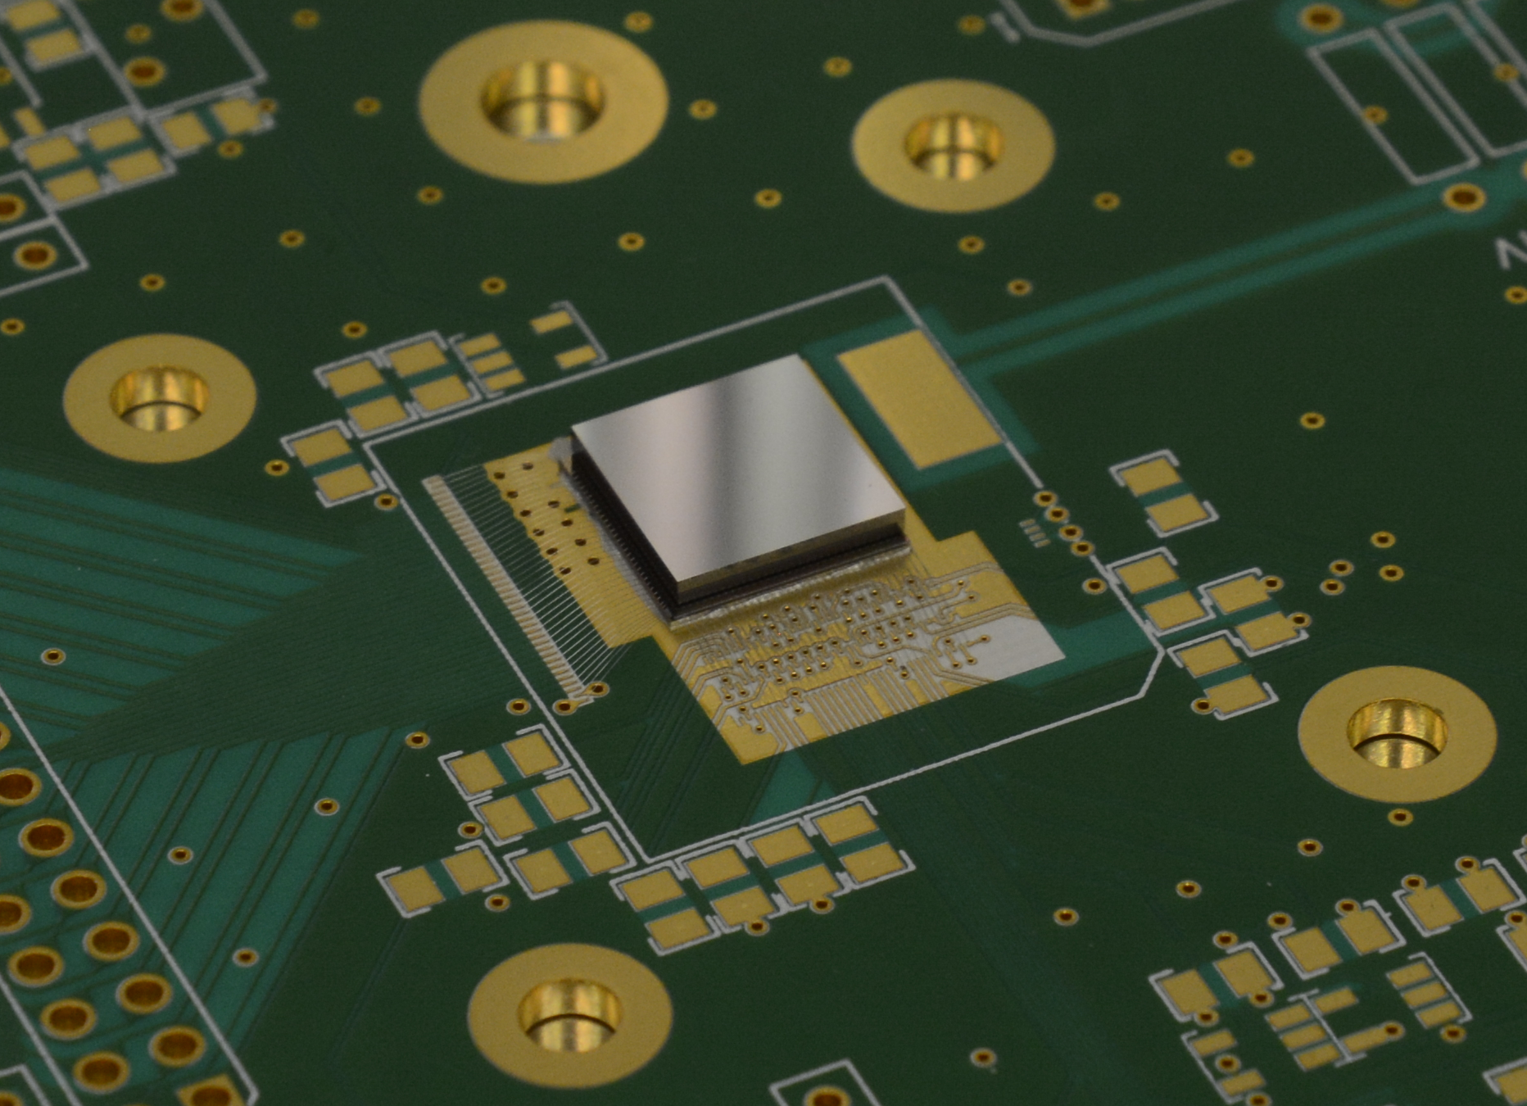
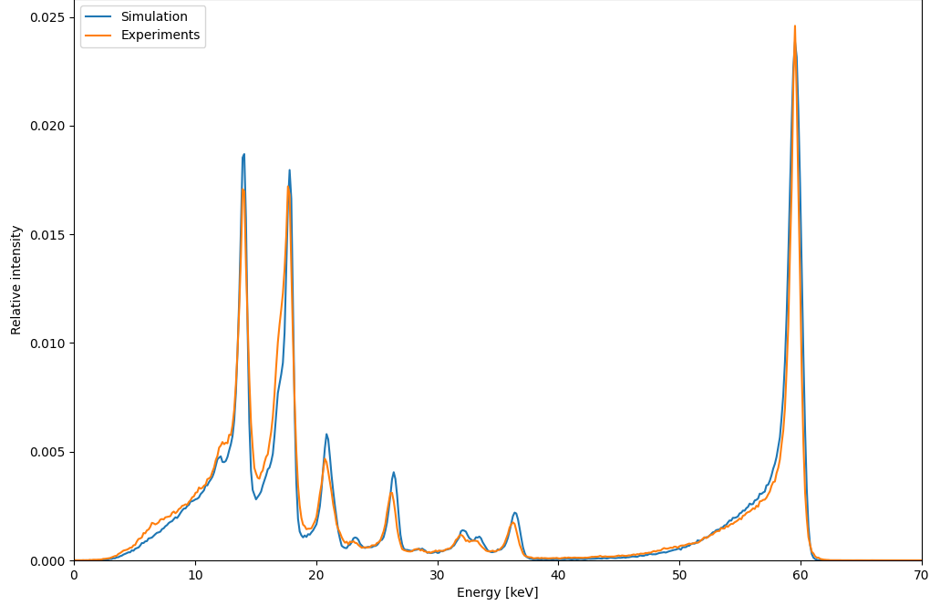
Cadtool
Low Energy Validation
< 100 keV
Main pixel
Main pixel
²⁴¹Am Single Events Spectra
HV: -400 V, Temperature: + 4°C, Peaking time: 3.6 μs
Mini-CdTe on Chip (MC²)-1K
32 x 32 pixels,
8 x 8 mm² sensitive area
1 mm-thick
Schottky-diode type CdTe
250 μm pixel pitch
FWHM @ 60 keV: 910 ± 15 eV
26/03/2026
27

Slide 28
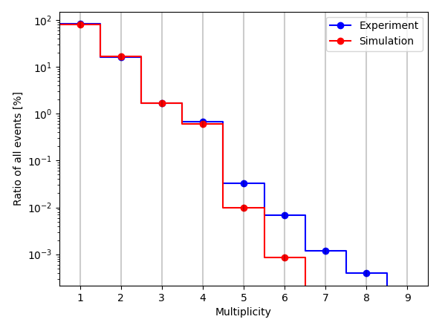
Cadtool
Low Energy Validation
< 100 keV
Main pixel
Main pixel
²⁴¹Am Single Events Spectra
²⁴¹Am Single Events Spectra
HV: -400 V, Temperature: + 4°C, Peaking time: 3.6 μs
Mini-CdTe on Chip (MC²)-1K
32 x 32 pixels,
8 x 8 mm² sensitive area
1 mm-thick
Schottky-diode type CdTe
250 μm pixel pitch
CIE limit
4 Multiplicity limit
FWHM @ 60 keV: 910 ± 15 eV
26/03/2026
28

Slide 29
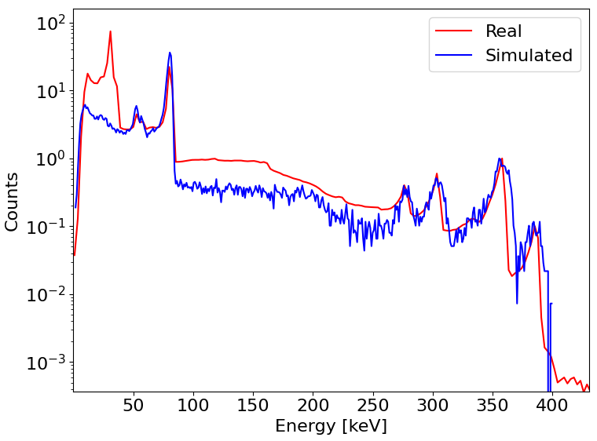
Caliste-O
Cadtool
High Energy Validation
< 1 MeV
Main pixel
Didn't put Cs daughter fluorescence on Simulation source
2mm CdTe pixel 800µm
¹³³Ba
ENC badly modeled / Bad calibration
(user problem)
Charge loss tail looks good
$$E=300 V{mm}^{−1}$$
$$μ_{e}=950{ cm}^{2}V^{−1}s^{−1}$$
$$μ_{h}=73{ cm}^{2}V^{−1}s^{−1}$$
$$ε_{CdTe}=4.42 eV$$
$$T=300 K$$
$$τ_{e}=1.2×{10}^{−6} s$$
$$τ_{h}=4.6×{10}^{−6} s$$
29

Slide 30
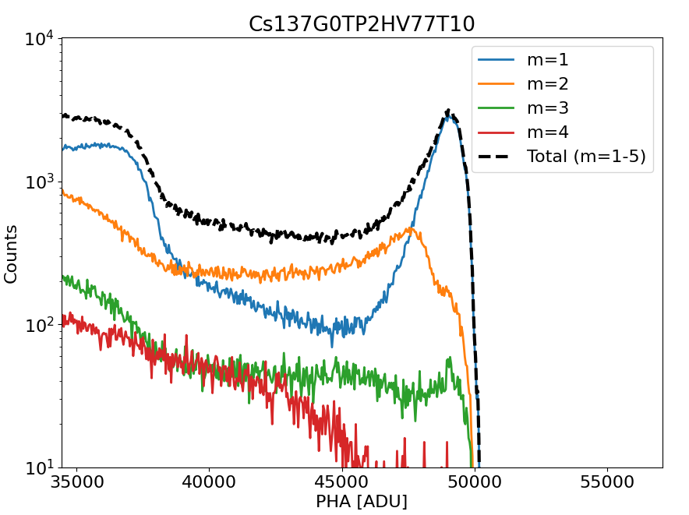
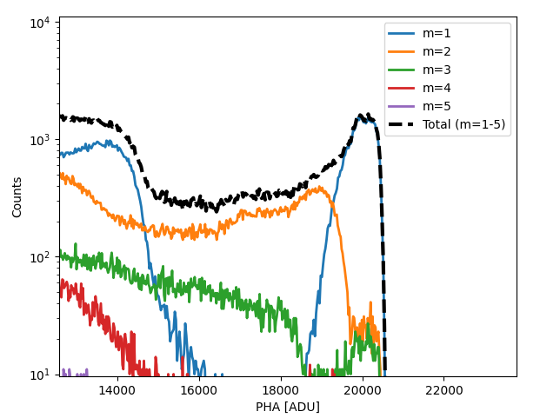
Caliste-O
Cadtool
High Energy Validation
Main pixel
Main pixel
*Work in progress*
2mm CdTe pixel 800µm
Real Caliste-O data
Simulated Caliste-O data
¹³⁷Cs
¹³⁷Cs
26/03/2026
30

Slide 31
Cadtool
Simulation Tool Requirements
Examples
Inputs
Detector Physics
Outputs
Detector Parameters
Material, Pixel/Strip, Bias, Mobility, Lifetime, Fano
Charge Drift
- Trapping
- Diffusion
- Repulsion
Transient Signals
- Charge profile
- Current profile
Electric Field and Potential
Weighting Potential
Enviroment Geometry
Box, Passive material, collimator, etc
Event list generation
Source Configuration
Geometry, Energy, Intensity
Data analysis
- images
- spectrum
- lightcurve
- response matrix
Photon-matter interaction
Front-end & Back-end electronics
Electrode charge induced
Electronics
ENC, ADC range, Threshold
26/03/2026
31

Slide 32
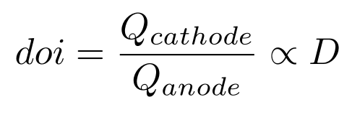
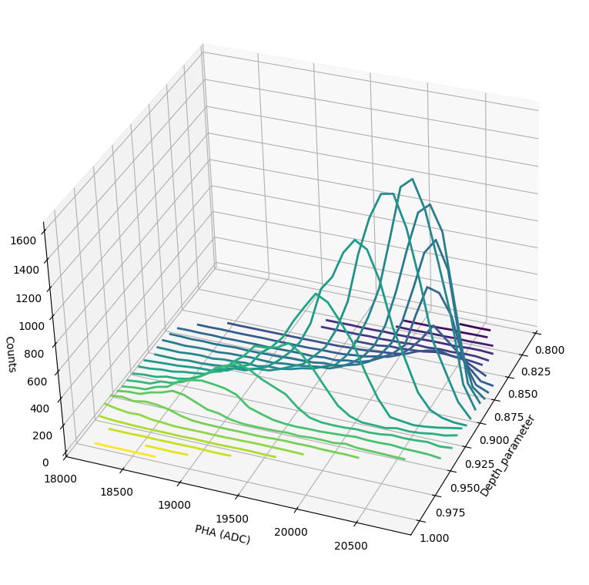
Caliste-O
Cadtool
Possible use case, 3D compensation
Main pixel
Main pixel
*Specially when there is small pixel effect*
2mm CdTe pixel 800µm
26/03/2026
32

Slide 33
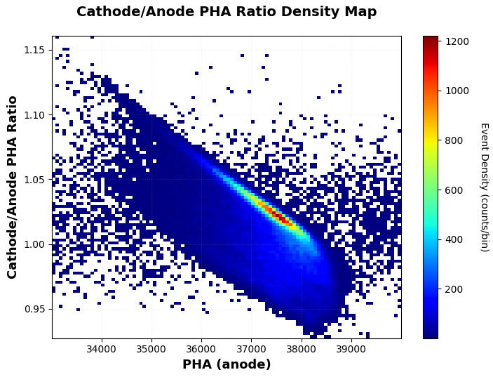
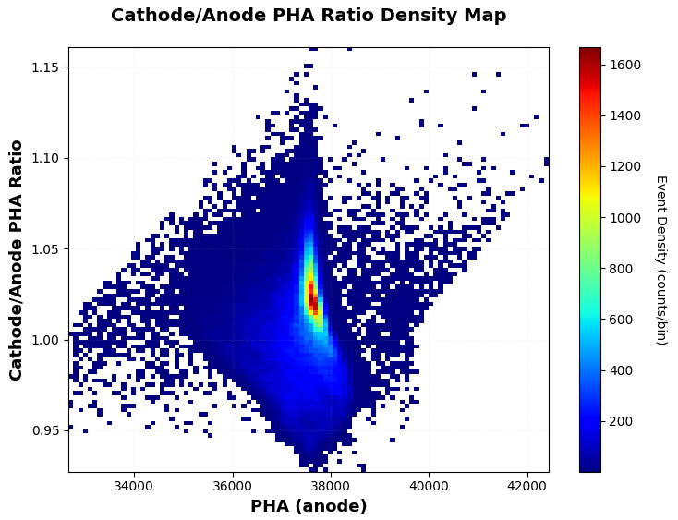
Caliste-O
Cadtool
Possible use case, 3D compensation
Main pixel
Main pixel
*Specially when there is small pixel effect*
2mm CdTe pixel 800µm
Pre-Correction
After Correction
Simulation data
Simulation data
¹³⁷Cs
662 keV
¹³⁷Cs
662 keV
28/10/2022
26/03/2026
33

Slide 34
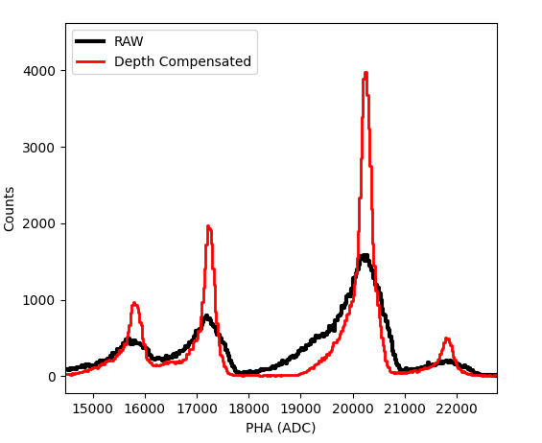
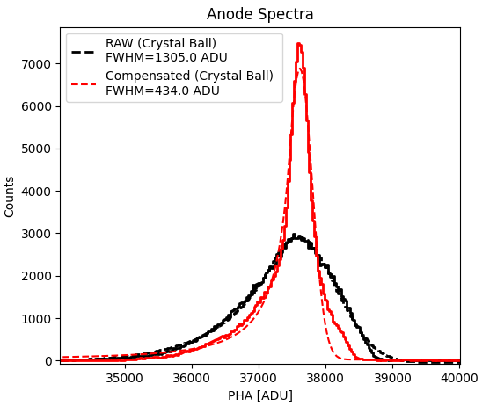
Caliste-O
Cadtool
Possible use case, 3D compensation
Main pixel
Main pixel
*Specially when there is small pixel effect*
2mm CdTe pixel 800µm
Simulation data
Simulation data
¹³³Ba
¹³⁷Cs
How much can we improve spectral response with cathode readout?
~66% improvement
26/03/2026
34

Slide 35
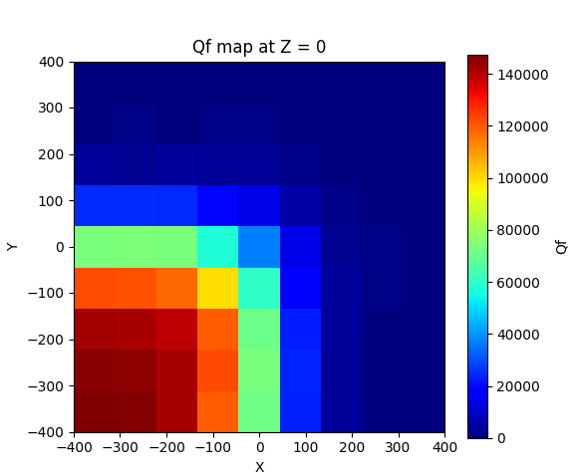
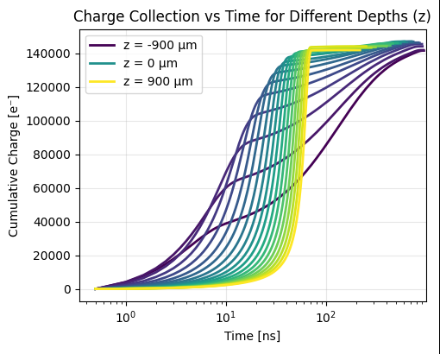
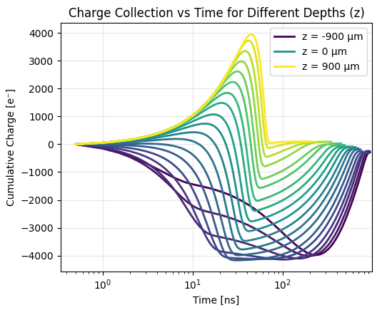
Caliste-O
Cadtool
Transient Curves
Input for electronics simulator
Cadence, SPICE
Main pixel
Main pixel
2mm CdTe pixel 800µm
Main Pixel Charge Curve
Side Neighbour Curve
Simulation data
Simulation data
Can we use side neighbor Max/Min for 3D?
26/03/2026
35

Slide 36
Caliste-O
Cadtool
Transient Curves
Input for electronics simulator
Cadence, SPICE
Main pixel
Main pixel
2mm CdTe pixel 800µm
Main Pixel Charge Curve
Side Neighbour Curve
Simulation data
Simulation data
Can we use side neighbour Max/Min for 3D?
Which gives best performance, cathode or side neighbour?
26/03/2026
36

Slide 37
Future Work
Main pixel
Main pixel
Development
Validation
Larger CIE area
Implement Elipsoidal Charge Cloud
High Energy multiplicity with Caliste-O CdTe
(ongoing)
Cathode side spectra with readout on Caliste-O (ongoing)
Validate charge cloud model ESRF (LIP Coimbra - Timepix3) and SPRING8 data (IPMU Tokyo - Strip)
Transient curves with real 5mm CZT integrated with TIA – anode and cathode
26/03/2026
37

Slide 38
Future Work
Main pixel
Main pixel
Development
Validation
Larger CIE area
Implement Elipsoidal Charge Cloud
High Energy multiplicity with Caliste-O CdTe
(ongoing)
Cathode side spectra with readout on Caliste-O (ongoing)
Validate charge cloud model ESRF (LIP Coimbra - Timepix3) and SPRING8 data (IPMU Tokyo - Strip)
Transient curves with real 5mm CZT integrated with TIA – anode and cathode
4 Multiplicity limit
26/03/2026
38

Slide 39
Future Work
Main pixel
Main pixel
Development
Validation
Larger CIE area
Implement Elipsoidal Charge Cloud
High Energy multiplicity with Caliste-O CdTe
(ongoing)
Cathode side spectra with readout on Caliste-O (ongoing)
Validate charge cloud model ESRF (LIP Coimbra - Timepix3) and SPRING8 data (IPMU Tokyo - Strip)
Transient curves with real 5mm CZT integrated with TIA – anode and cathode
26/03/2026
39

Slide 40
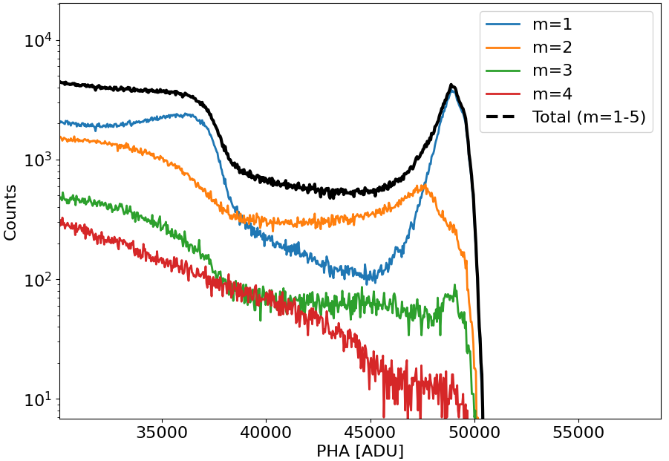
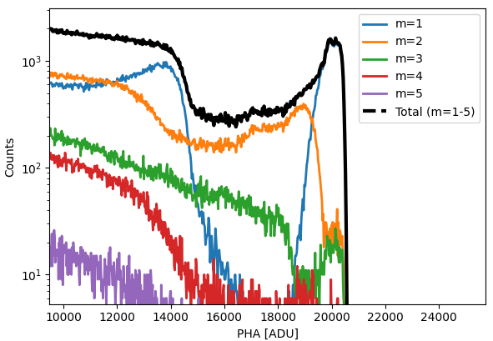
Future Work
Main pixel
Main pixel
Development
Validation
Larger CIE area
Implement Elipsoidal Charge Cloud
High Energy multiplicity with Caliste-O CdTe
(ongoing)
Cathode side spectra with readout on Caliste-O (ongoing)
Validate charge cloud model ESRF (LIP Coimbra - Timepix3) and SPRING8 data (IPMU Tokyo - Strip)
Transient curves with real 5mm CZT integrated with TIA – anode and cathode
Real Caliste-O data
Simulated Caliste-O data
26/03/2026
40

Slide 41
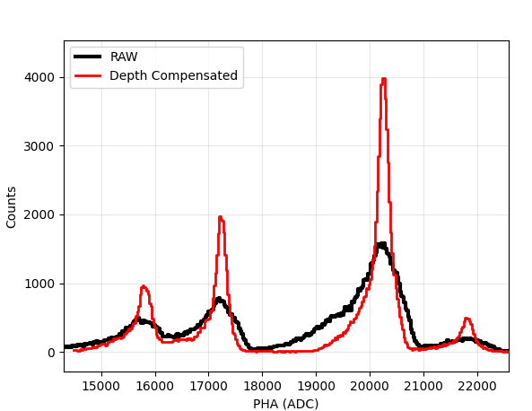
Future Work
Main pixel
Main pixel
Development
Validation
Larger CIE area
Implement Elipsoidal Charge Cloud
High Energy multiplicity with Caliste-O CdTe
(ongoing)
Cathode side spectra with readout on Caliste-O (ongoing)
Validate charge cloud model ESRF (LIP Coimbra
- Timepix3) and SPRING8 data (IPMU Tokyo -
Strip)
Transient curves with real 5mm CZT integrated with TIA – anode and cathode
¹³³Ba
26/03/2026
41

Slide 42
Future Work
Main pixel
Main pixel
Development
Validation
Larger CIE area
Implement Elipsoidal Charge Cloud
High Energy multiplicity with Caliste-O CdTe
(ongoing)
Cathode side spectra with readout on Caliste-O (ongoing)
Validate charge cloud model ESRF (LIP Coimbra - Timepix3) and SPRING8 data (IPMU Tokyo - Strip)
Transient curves with real 5mm CZT integrated with TIA – anode and cathode
ESRF Beam
(scan)
26/03/2026
42

Slide 43

Future Work
Main pixel
Main pixel
Development
Validation
Larger CIE area
Implement Elipsoidal Charge Cloud
High Energy multiplicity with Caliste-O CdTe
(ongoing)
Cathode side spectra with readout on Caliste-O (ongoing)
Validate charge cloud model ESRF (LIP Coimbra - Timepix3) and SPRING8 data (IPMU Tokyo - Strip)
Transient curves with real 5mm CZT integrated with TIA – anode and cathode
CZT 5/10mm
26/03/2026
43

Slide 44
Future use of CadTool
Main pixel
Main pixel
My PhD
Thick CZT (10mm)
Cathode readout
3D sensing
Subpixel with transient signals
Detector Community
Public Release
3Q 2026
https://github.com/hallaire/CadTool
26/03/2026
44

Slide 45
CadTool - a end-to-end x-ray/gamma-ray solid state detector simulation framework
J.F. Sousa¹, A. Meuris², D. Baudin³, H. Allaire^{2, 4}, O. Limousin², R. Le Breton³
¹ Université Paris-Saclay, CEA IRFU, AIM
² Université Paris-Saclay, Université Paris Cité, CEA, CNRS, AIM
³ CEA IRFU, Université Paris Saclay
⁴ Kavli IPMU (WPI), UTIAS, The University of Tokyo

Slide 46
references
Benoit, M., & Hamel, L. A. (2009). Simulation of charge collection processes in semiconductor CdZnTe γ-ray detectors. Nuclear Instruments & Methods in Physics Research. Section A, Accelerators, Spectrometers, Detectors and Associated Equipment, 606(3), 508–516. doi:10.1016/j.nima.2009.04.019
I. Abt et al., ‘Simulation of semiconductor detectors in 3D with SolidStateDetectors.jl’, J. Instrum., vol. 16, no. 08, p. P08007, Aug. 2021.
H. Allaire, PhD thesis, Université de Paris, 2023
26/03/2026
46

